Slide 1

Test-Beam @ DESY
Satoshi YANO

Slide 2
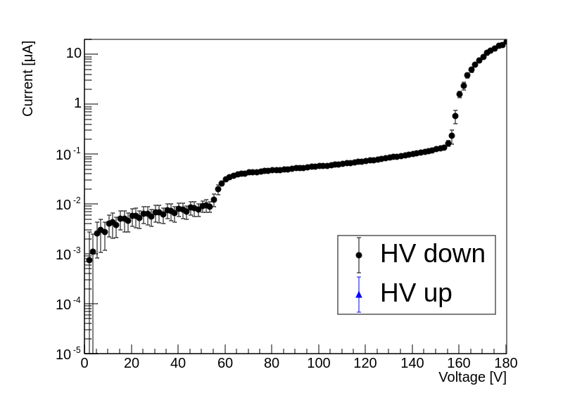
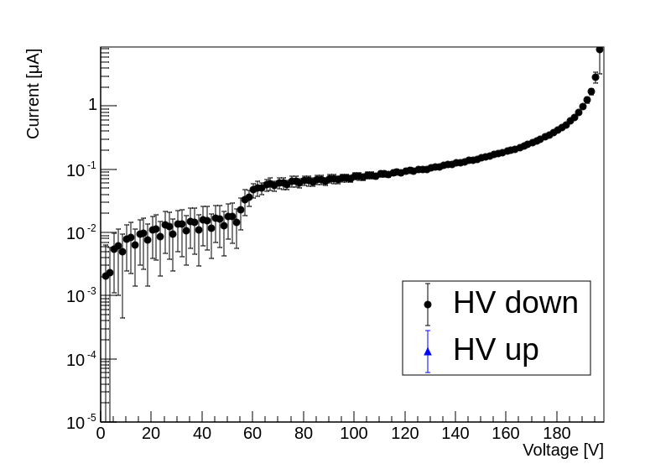
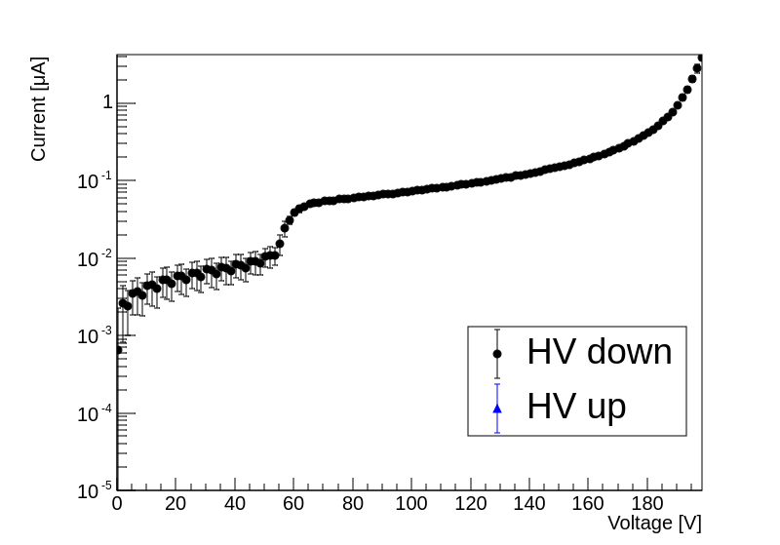
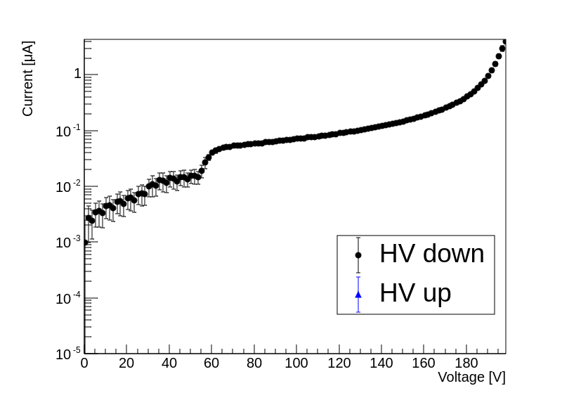
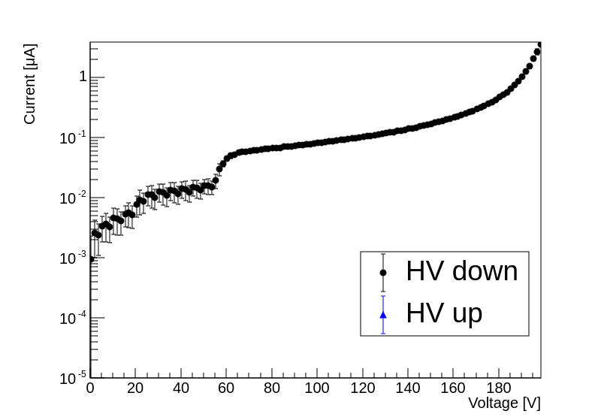
Baseline Strip Sensors
Five sensors have been bonded
Classified by voltage value at which leak current reaches 1μA
4 Class-S (1μA @ BV>=190V)
1 Class-C (1μA @ 160<BV<170V)
Class-C
Class-S
Class-S
Class-S
Class-S

Slide 3
Measurement Subject
Baseline strip-type sensor
Timing & Positioning resolution of best sensor setup @ Best Bias-Voltage
Hit position along strip direction (ΔL = 1 mm)
1M events per ΔL (10 M events in total)
Timing & Positioning resolution of best sensors @ Several Bias-Voltage (HV-Scan)
5 different HVs (ΔV = 10 V)
Hit position along strip direction (ΔL = 2 mm)
1M events per configuration (25 M events in total)
Timing & Positioning resolution of worse sensor (Class-C) @ Best Bias-Voltage
Hit position along strip direction (ΔL = 1 mm)
1M events per ΔL (10 M events in total)
Prototype pixel-type sensor (eRD112 FY24)
Timing & Positioning resolution @ Best Bias-Voltage
4 different pad geometries at the sensor
2-types (500um pitch but different electrode size) is enough?

Slide 4
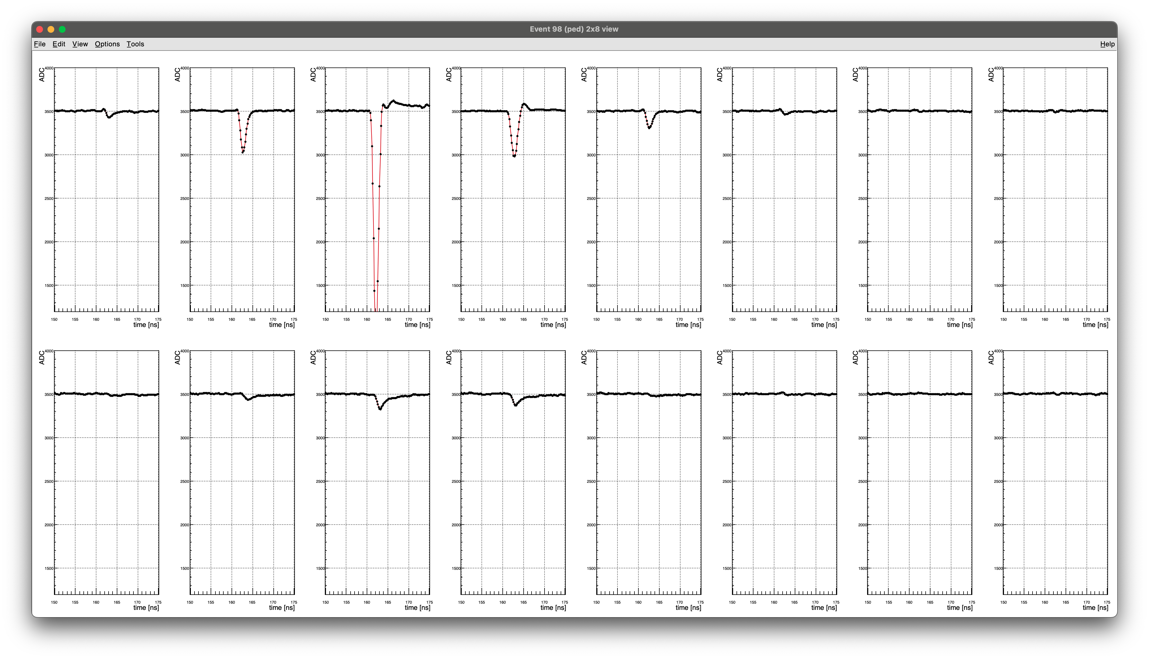
AC-LGAD Signal (Sr90)
CH1
CH3
CH5
CH7
CH15
CH13
CH11
CH9
CH0
CH2
CH4
CH6
CH14
CH12
CH10
CH8
CH7
CH15
CH6
CH14
CH5
CH13
CH4
CH12
CH3
CH11
CH2
CH10
CH1
CH9
CH0
CH8
Class-S sensor

Slide 5
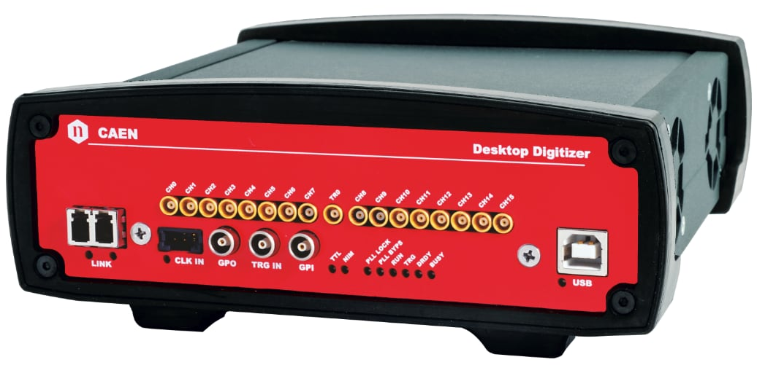
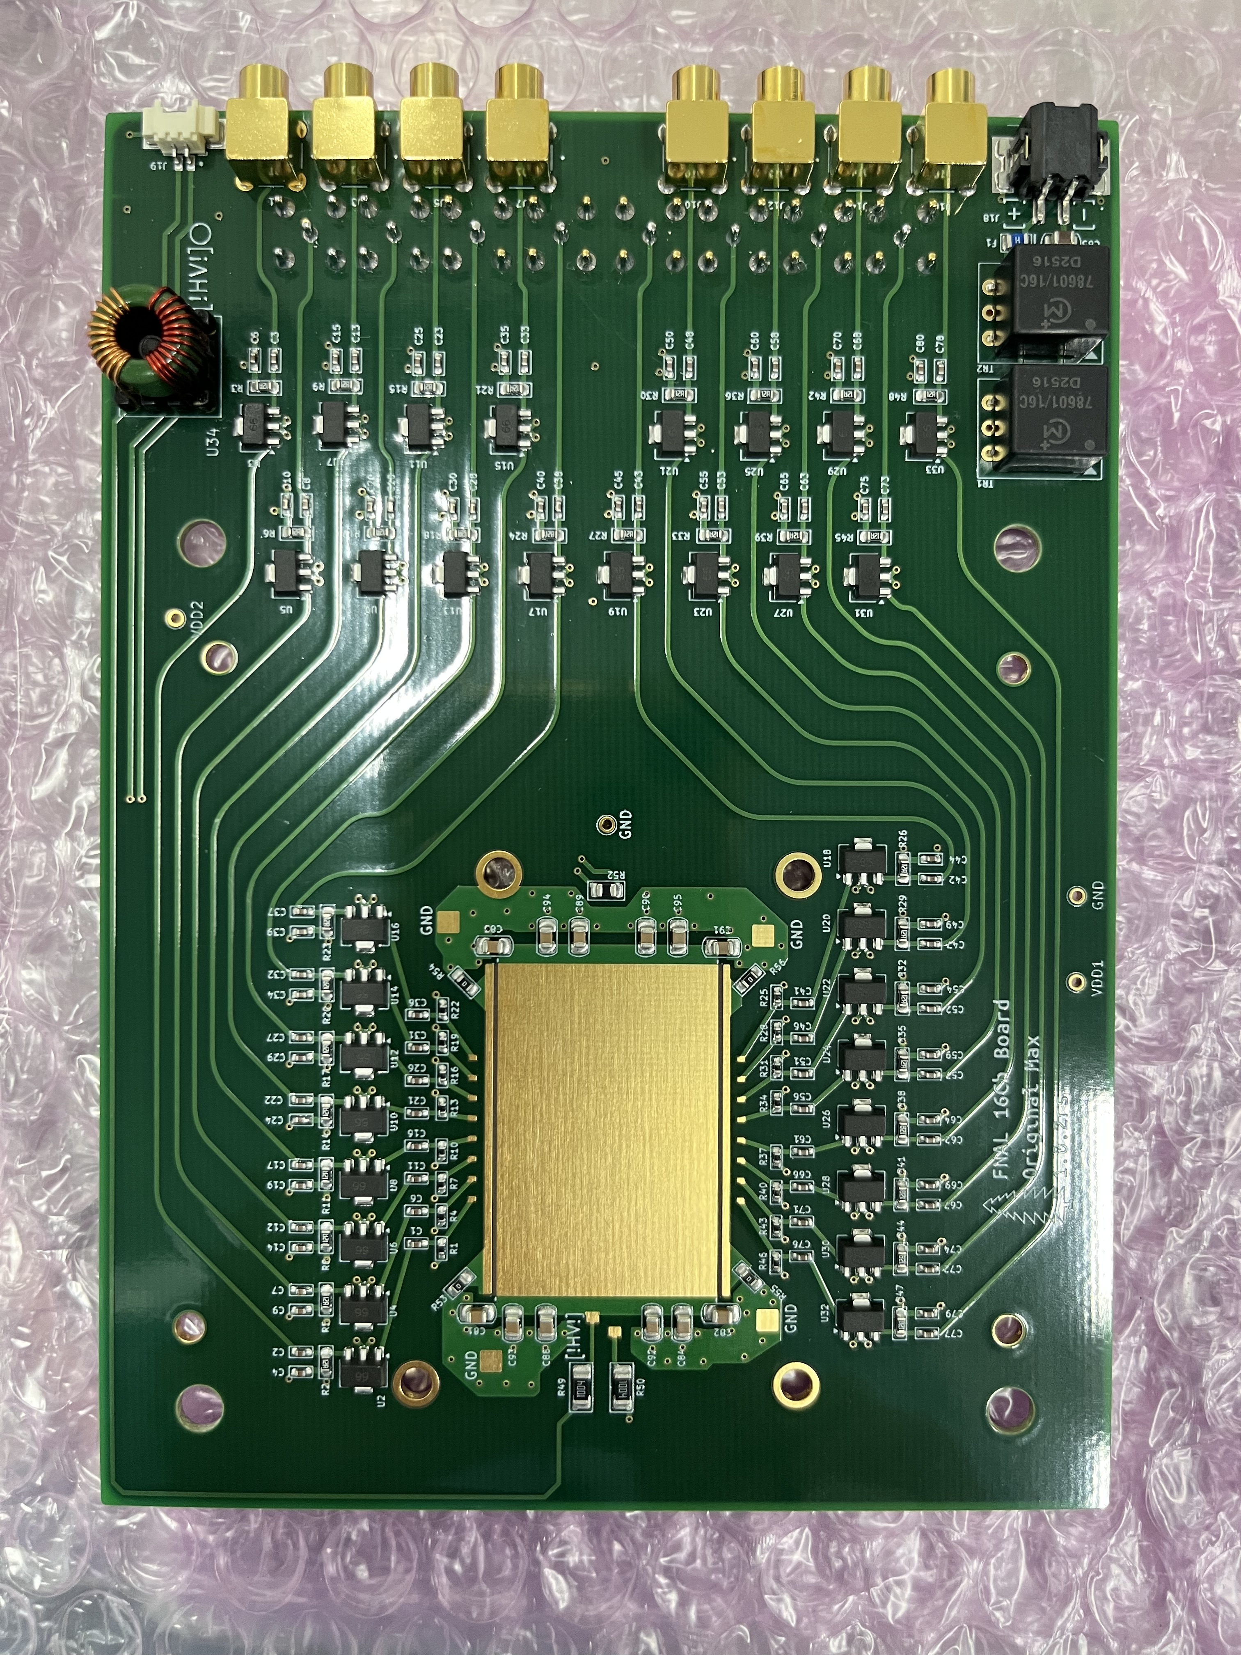
Digitizer and Board Channel mapping
CH0
CH7
TR0
CH8
CH15
2xDT5742
16+14 = 30ch
CH1
CH3
CH5
CH7
CH15
CH13
CH11
CH9
CH0
CH2
CH4
CH6
CH14
CH12
CH10
CH8
CH7
CH15
CH6
CH14
CH5
CH13
CH4
CH12
CH3
CH11
CH2
CH10
CH1
CH9
CH0
CH8

Slide 6
Setup for Resolution Measurement
EUDRBs
Telescope DAQ PC
20 mm
32 mm
10 mm
Sci.1
DUT DAQ PC
DIGITIZER
~11 mm
DIGITIZER
~4 mm
10 mm
Sci.1&2
DUT
10 mm
Sci.2
Scintillator
AC-LGAD
Wire-Bonded Area
AC-LGAD
AC-LGAD
Scintillator
MIMOSA Area
Telescops1
Telescope2
COINCIDENCE
3 AC-LGAD sensors are installed to calculate σ₁, σ₂ and σ₃
TLU
TRIGGER
TRIGGER

Slide 7
Setup for Resolution Measurement Channel Mapping (Option-1)
CH0
CH7
TR0
CH8
CH15
CH0
CH7
TR0
CH8
CH15
CH1
CH3
CH5
CH7
CH15
CH13
CH11
CH9
CH1
CH3
CH5
CH7
CH15
CH13
CH11
CH9
CH1
CH3
CH5
CH7
CH15
CH13
CH11
CH9
CH0
CH2
CH4
CH6
CH14
CH12
CH10
CH8
CH0
CH2
CH4
CH6
CH14
CH12
CH10
CH8
CH0
CH2
CH4
CH6
CH14
CH12
CH10
CH8
CH7
CH15
CH7
CH15
CH7
CH15
CH6
CH14
CH6
CH14
CH6
CH14
CH5
CH13
CH5
CH13
CH5
CH13
CH4
CH12
CH4
CH12
CH4
CH12
CH3
CH11
CH3
CH11
CH3
CH11
CH2
CH10
CH2
CH10
CH2
CH10
CH1
CH9
CH1
CH9
CH1
CH9
CH0
CH8
CH0
CH8
CH0
CH8

Slide 8
Setup for Resolution Measurement Channel Mapping (Option-2)
CH0
CH7
TR0
CH8
CH15
CH0
CH7
TR0
CH8
CH15
CH1
CH3
CH5
CH7
CH15
CH13
CH11
CH9
CH1
CH3
CH5
CH7
CH15
CH13
CH11
CH9
CH1
CH3
CH5
CH7
CH15
CH13
CH11
CH9
CH0
CH2
CH4
CH6
CH14
CH12
CH10
CH8
CH0
CH2
CH4
CH6
CH14
CH12
CH10
CH8
CH0
CH2
CH4
CH6
CH14
CH12
CH10
CH8
CH7
CH15
CH7
CH15
CH7
CH15
CH6
CH14
CH6
CH14
CH6
CH14
CH5
CH13
CH5
CH13
CH5
CH13
CH4
CH12
CH4
CH12
CH4
CH12
CH3
CH11
CH3
CH11
CH3
CH11
CH2
CH10
CH2
CH10
CH2
CH10
CH1
CH9
CH1
CH9
CH1
CH9
CH0
CH8
CH0
CH8
CH0
CH8

Slide 9
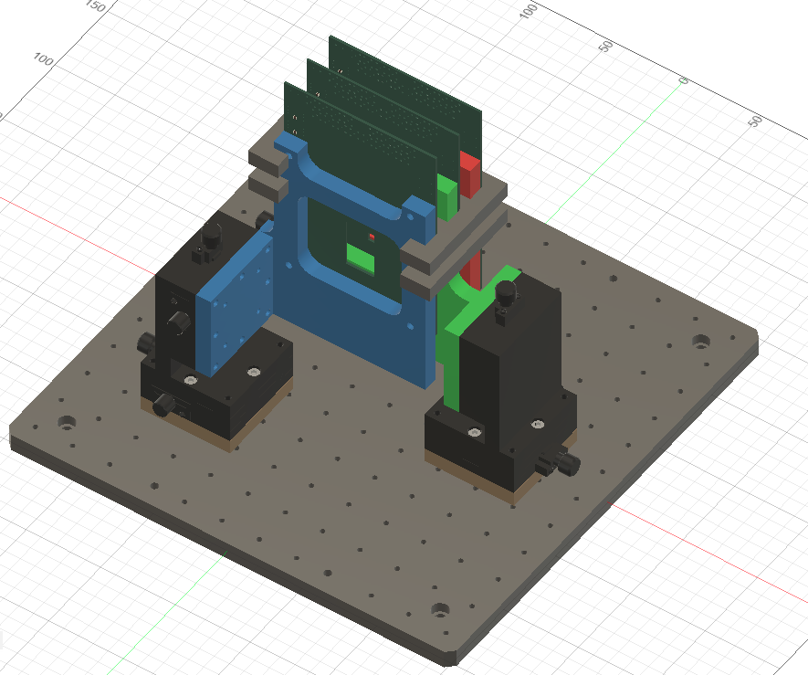
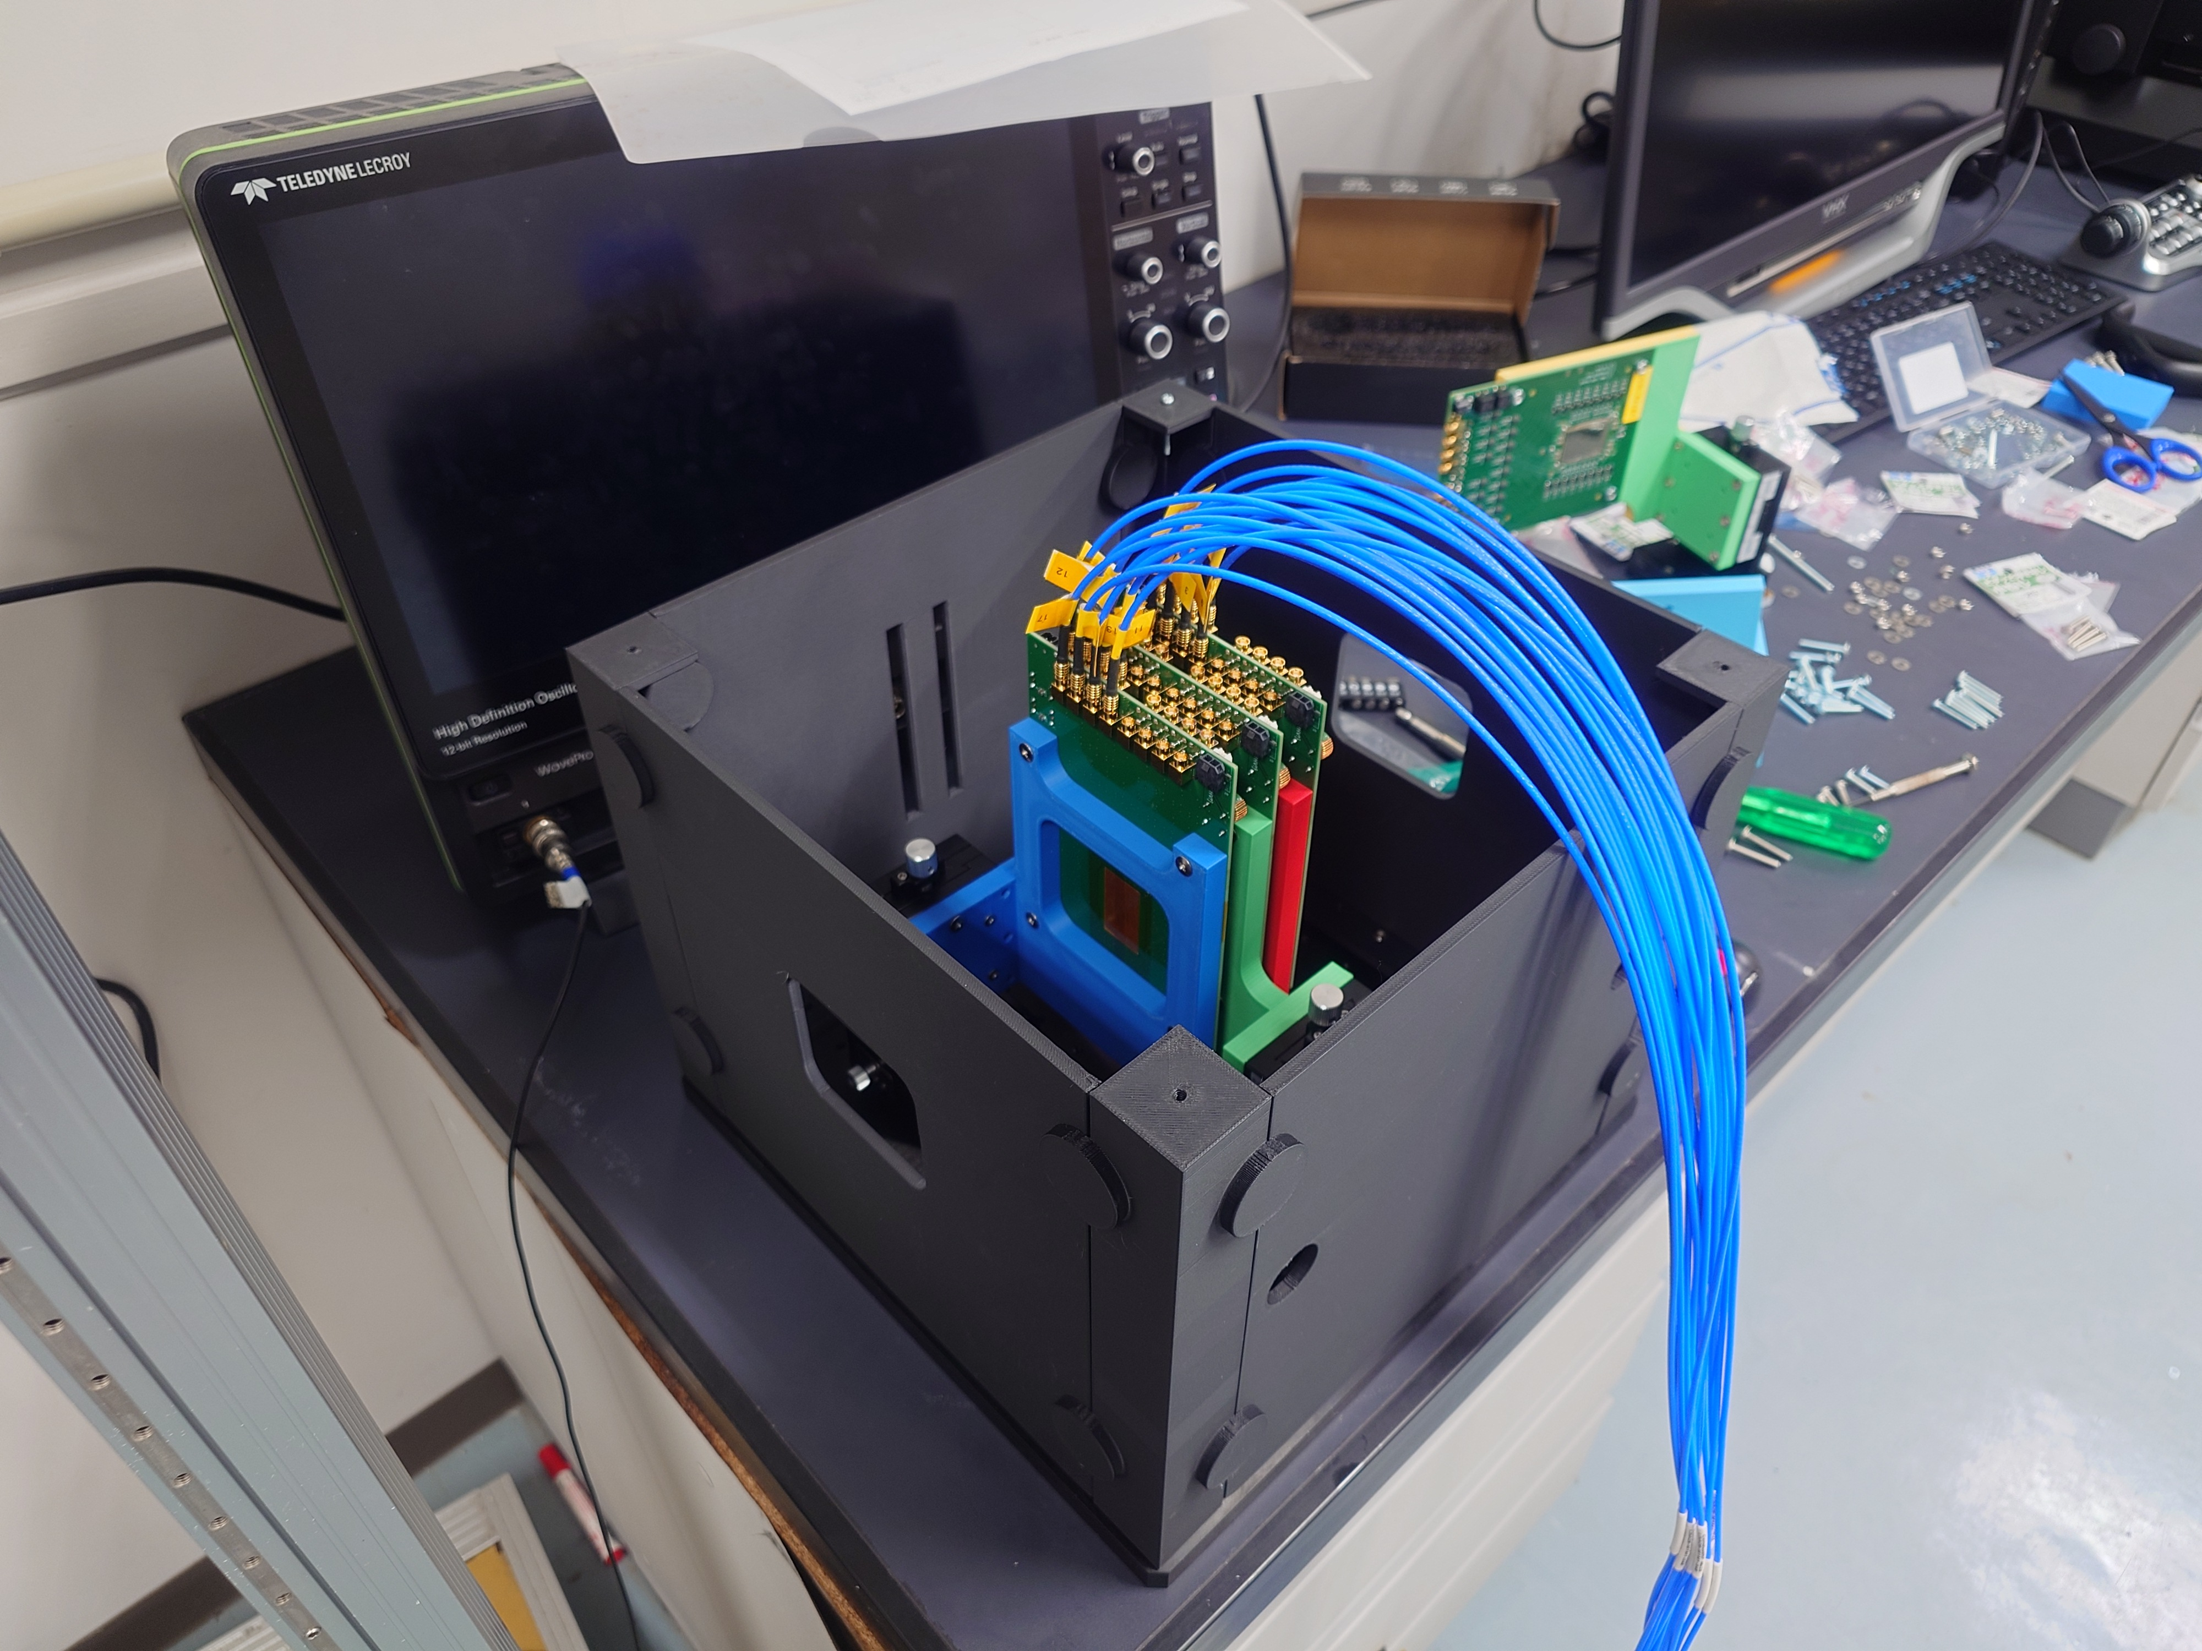
Preparation of Jig (3-Sensor Version)

Slide 10
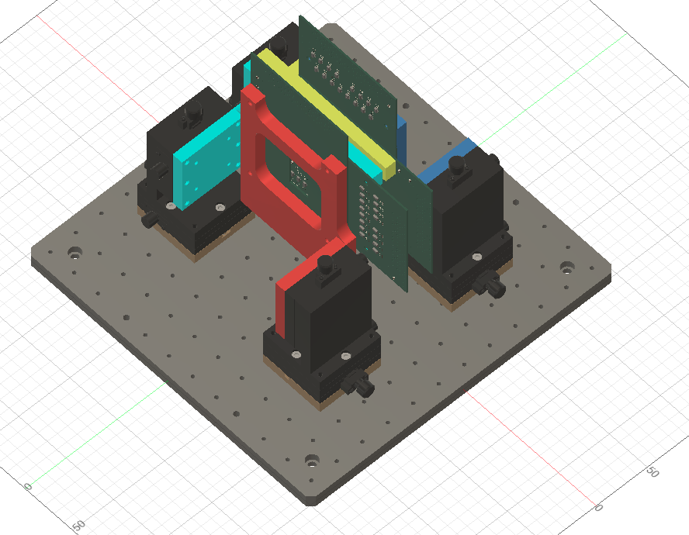
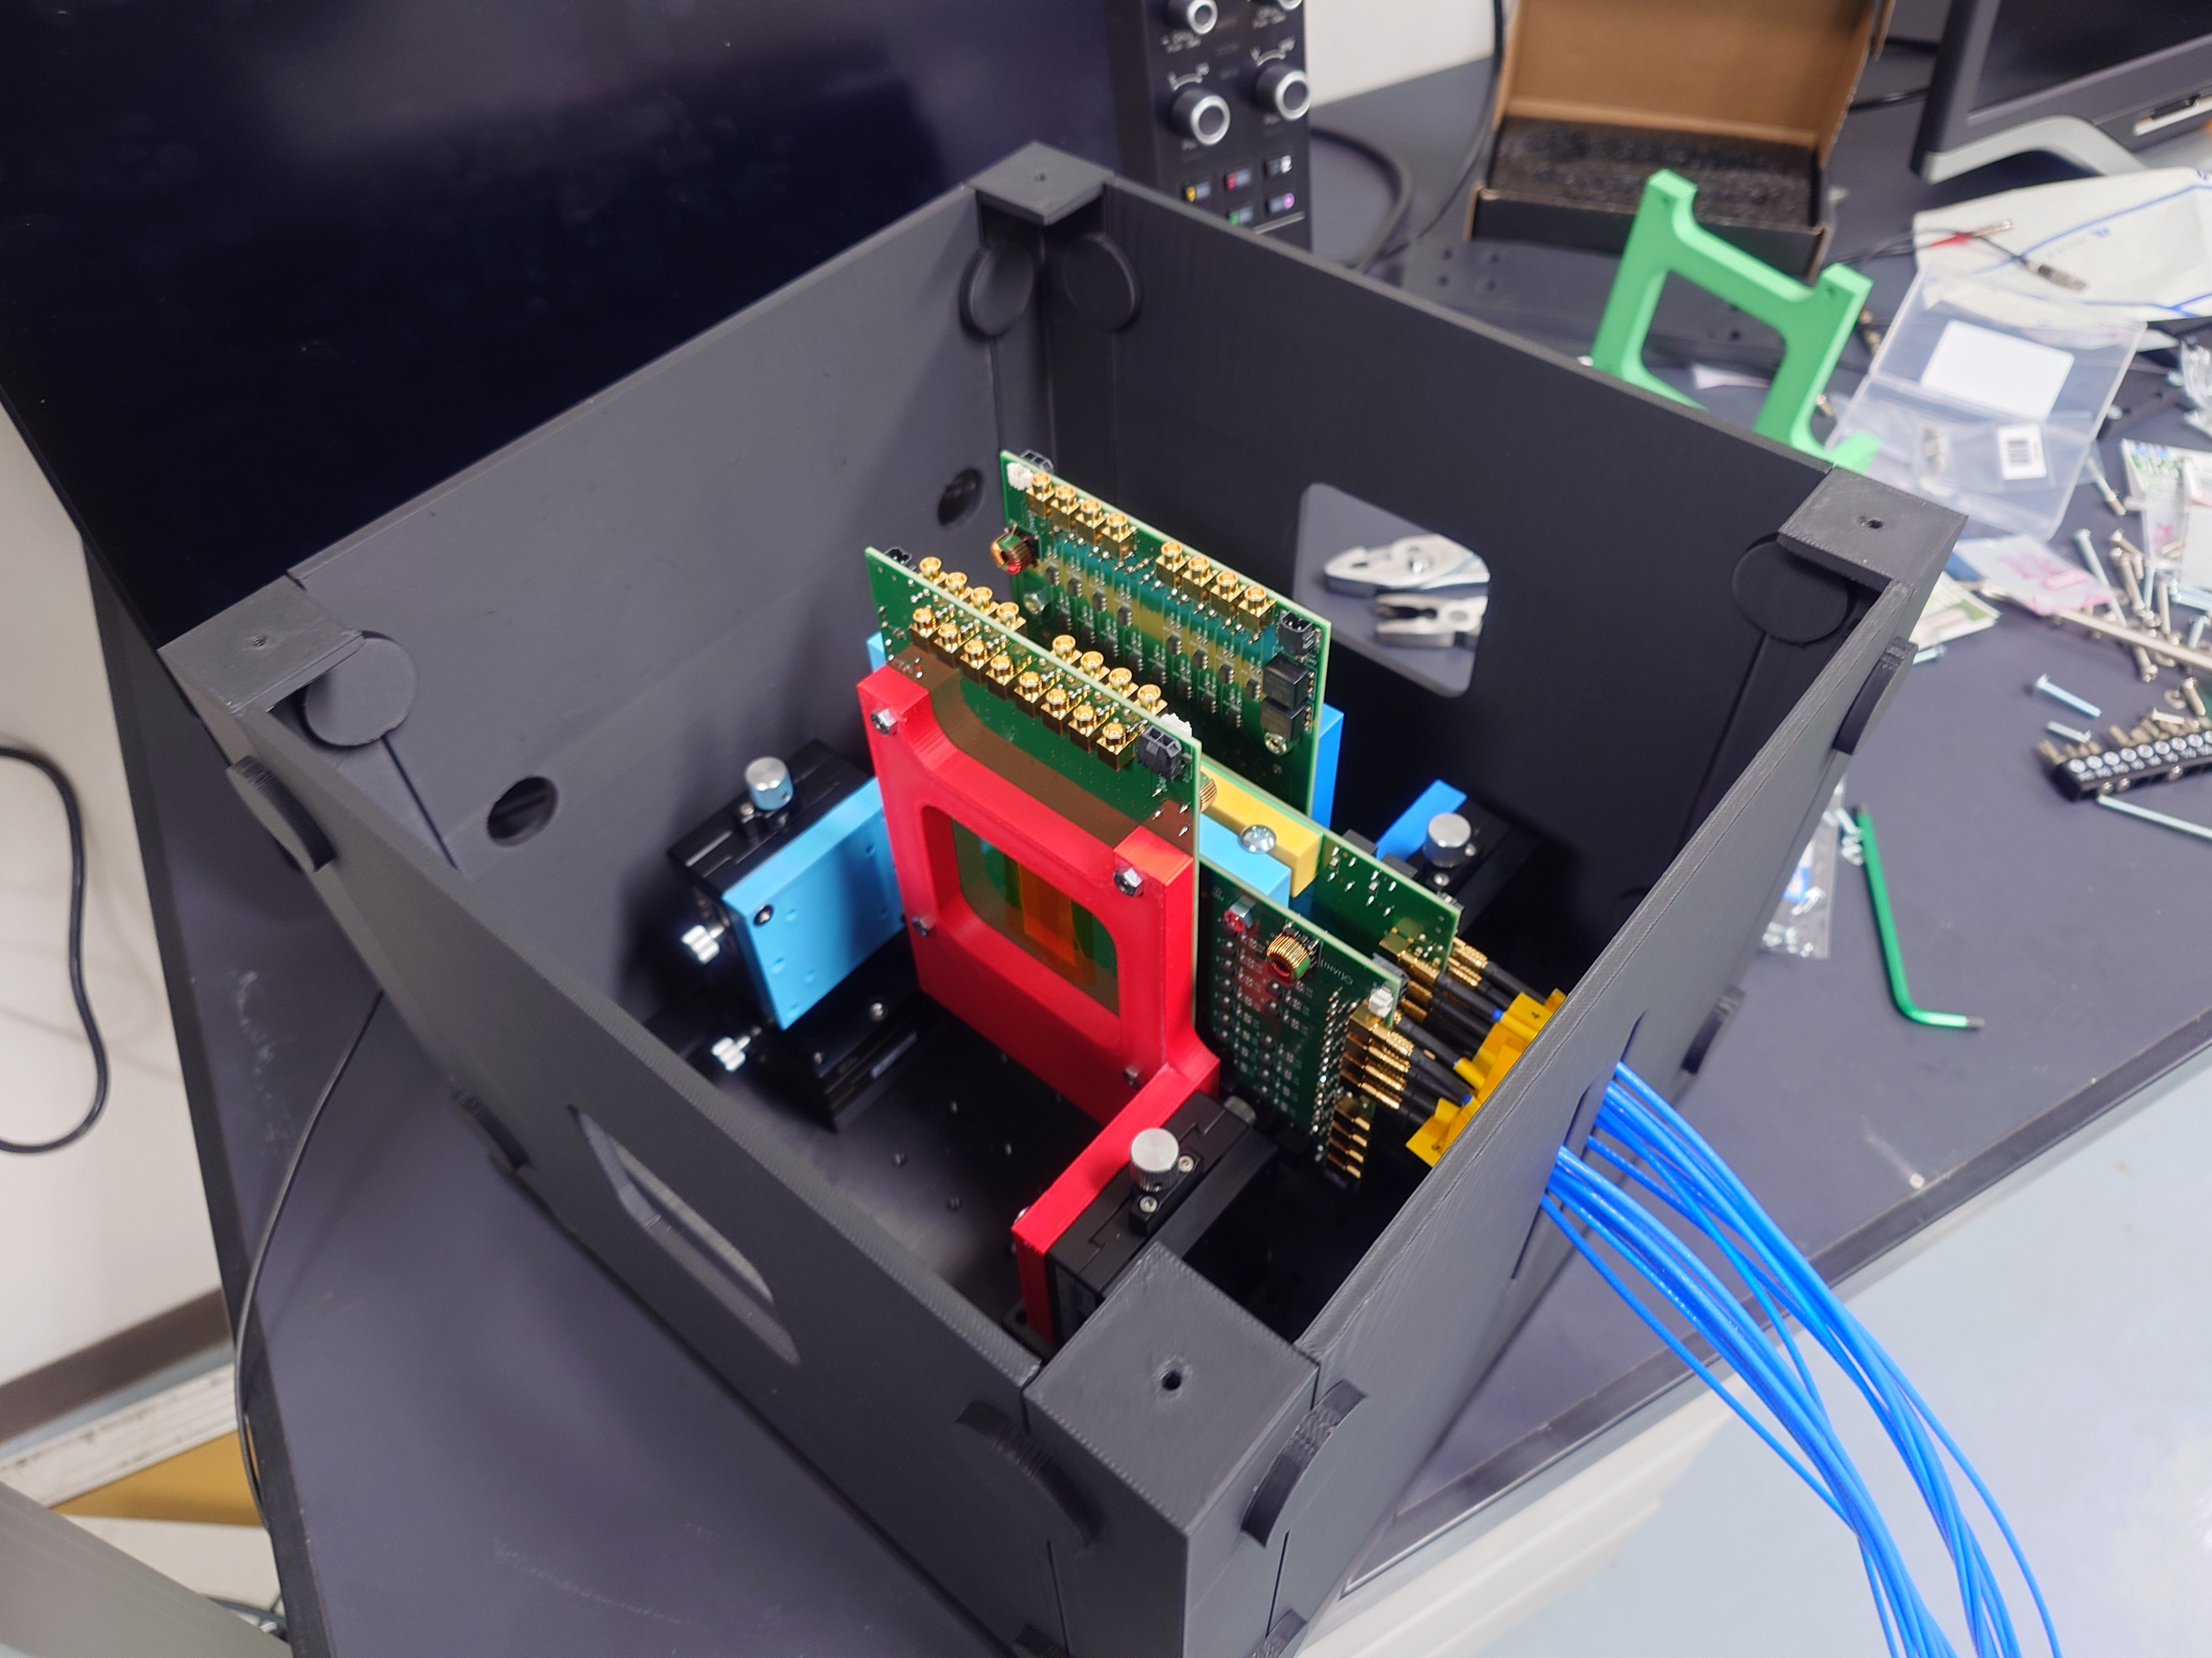
Preparation of Jig (4-Sensor Version)

Slide 11
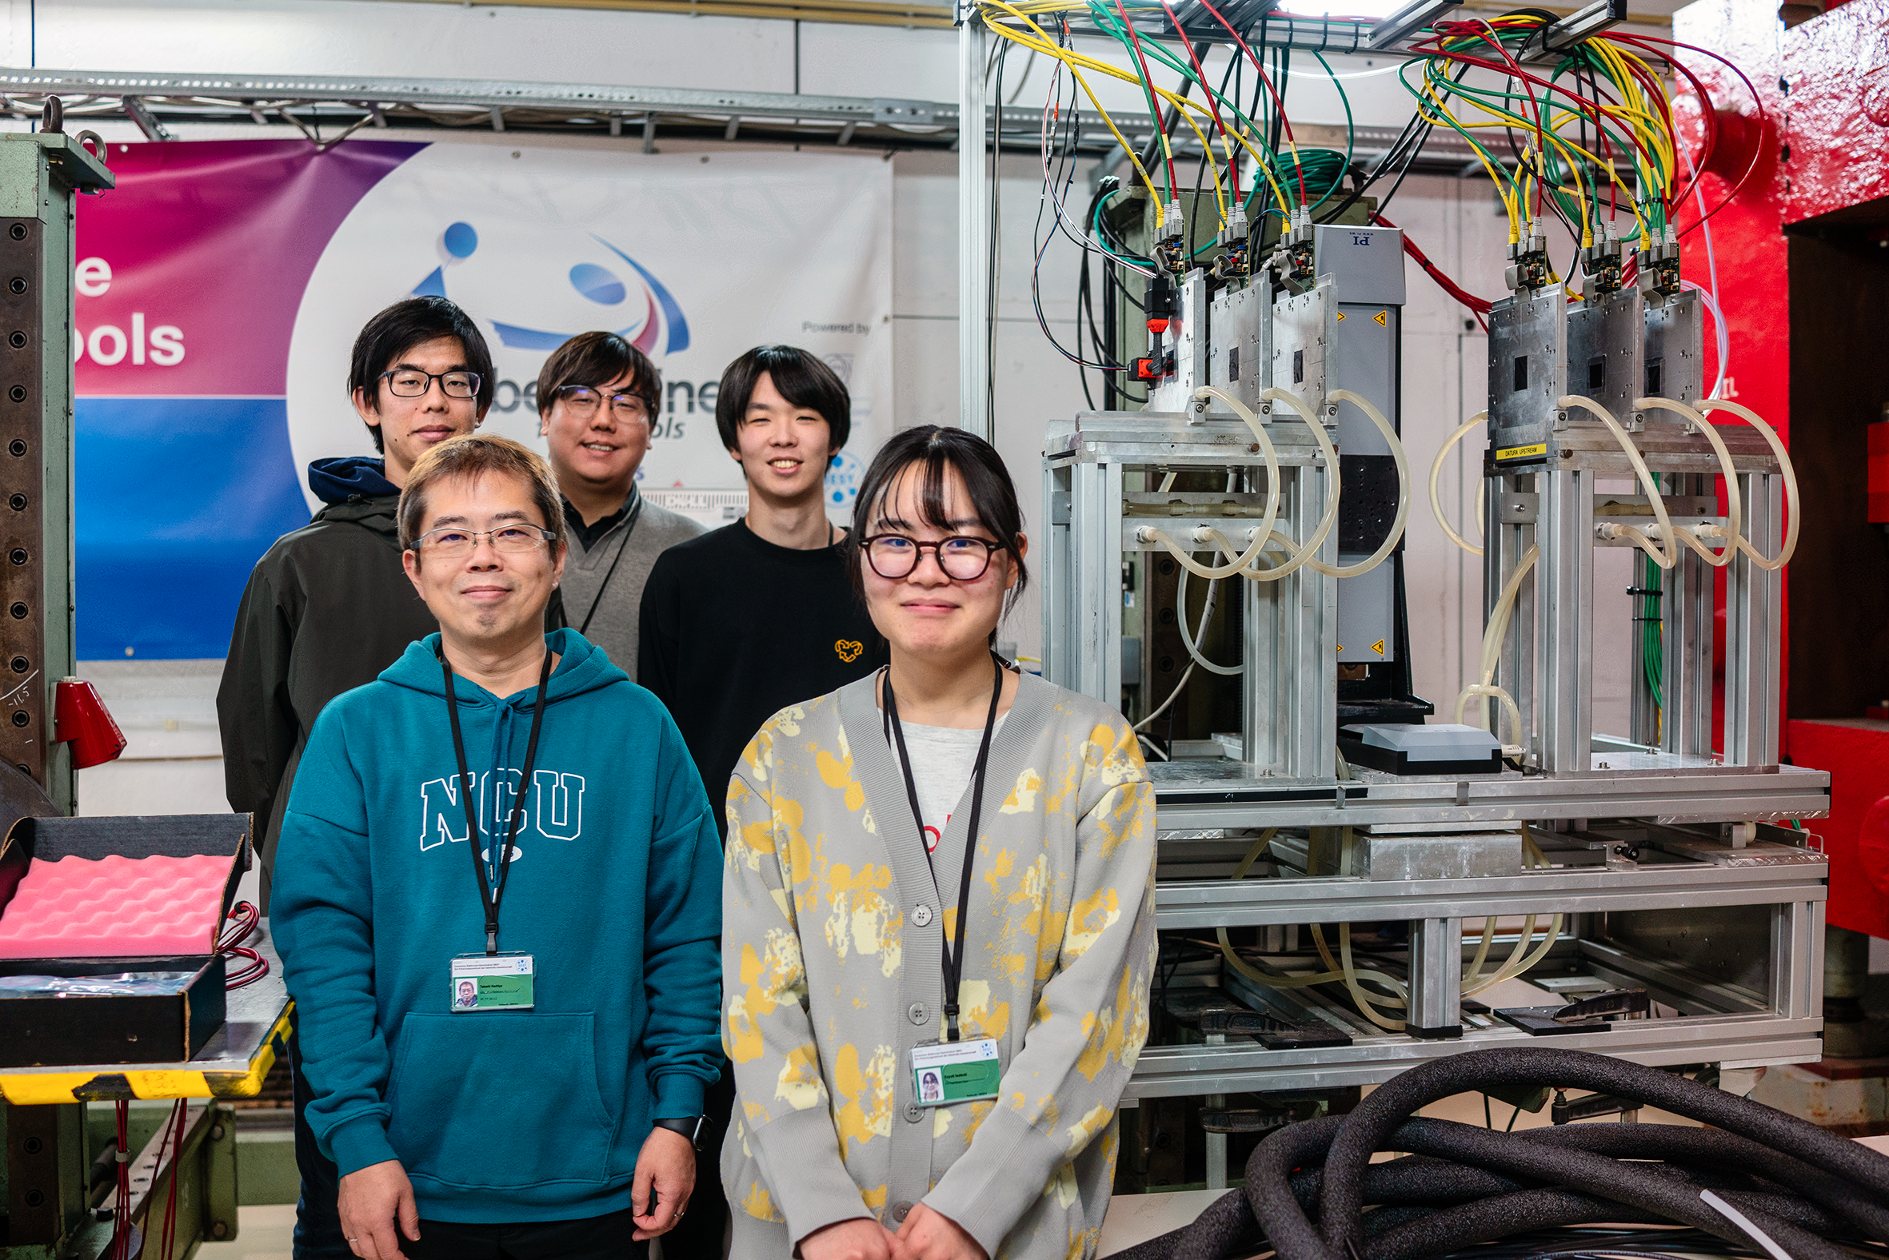
Commissioning @ DESY
5 colleagues are working hard @ DESY (12/1~)
Bong-Hwi Lim (Tokyo)
Takashi Hachiya (Nara)
Taiichi Egami (Tokyo)
Hiroki Iizuka (Tokyo)
Koyuki Iwatsuki (Nara)
They already understood how to use EUDAQ

Slide 12
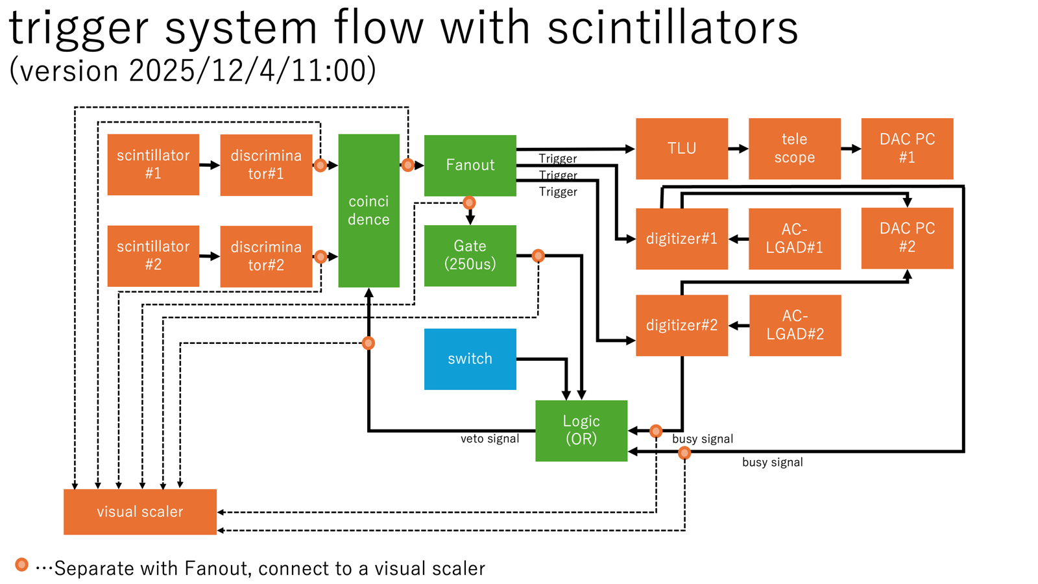
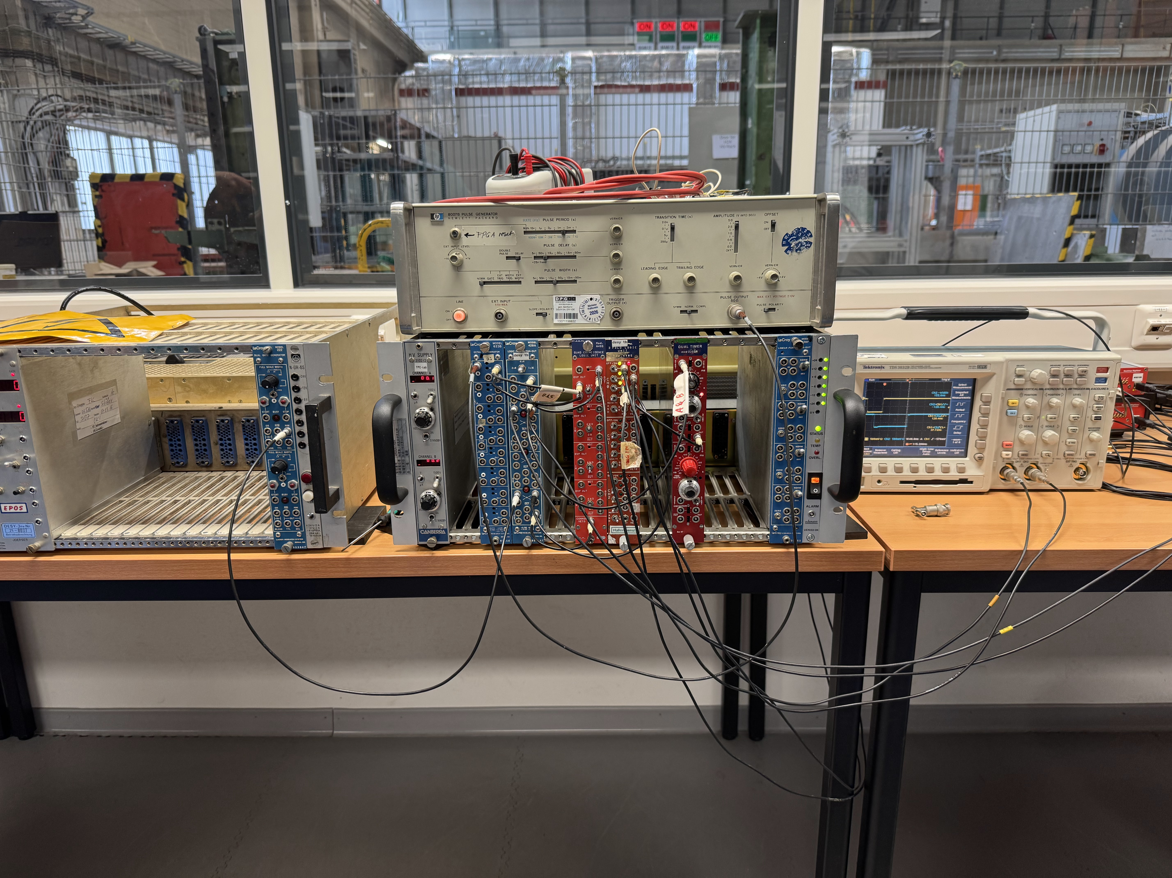
Logic Circuit

Slide 13
Backup

Slide 14
Expected Data Size (Baseline Sensor)
~26kB (0.026MB) per event (Measured Value)
16Ch + TR0, 1024 sample, 5 GHz
Example: Reading at 0.31 MB/s (Trg Rate: 11.93 Hz)
Data Size Estimation
Scenario: 200 Hz trigger rate
1M events per 16ch = 1.4 hours data-taking = 26 GB
45M events per 30ch = 26 GB/1M x 45M x 30/16 ~ 2.2 TB

Slide 15
Setup for DUT Standalone Run
DUT DAQ PC
DIGITIZER
DIGITIZER
DUT
Scintillator
AC-LGAD
AC-LGAD
AC-LGAD
AC-LGAD
Scintillator
COINCIDENCE
TRIGGER

Slide 16
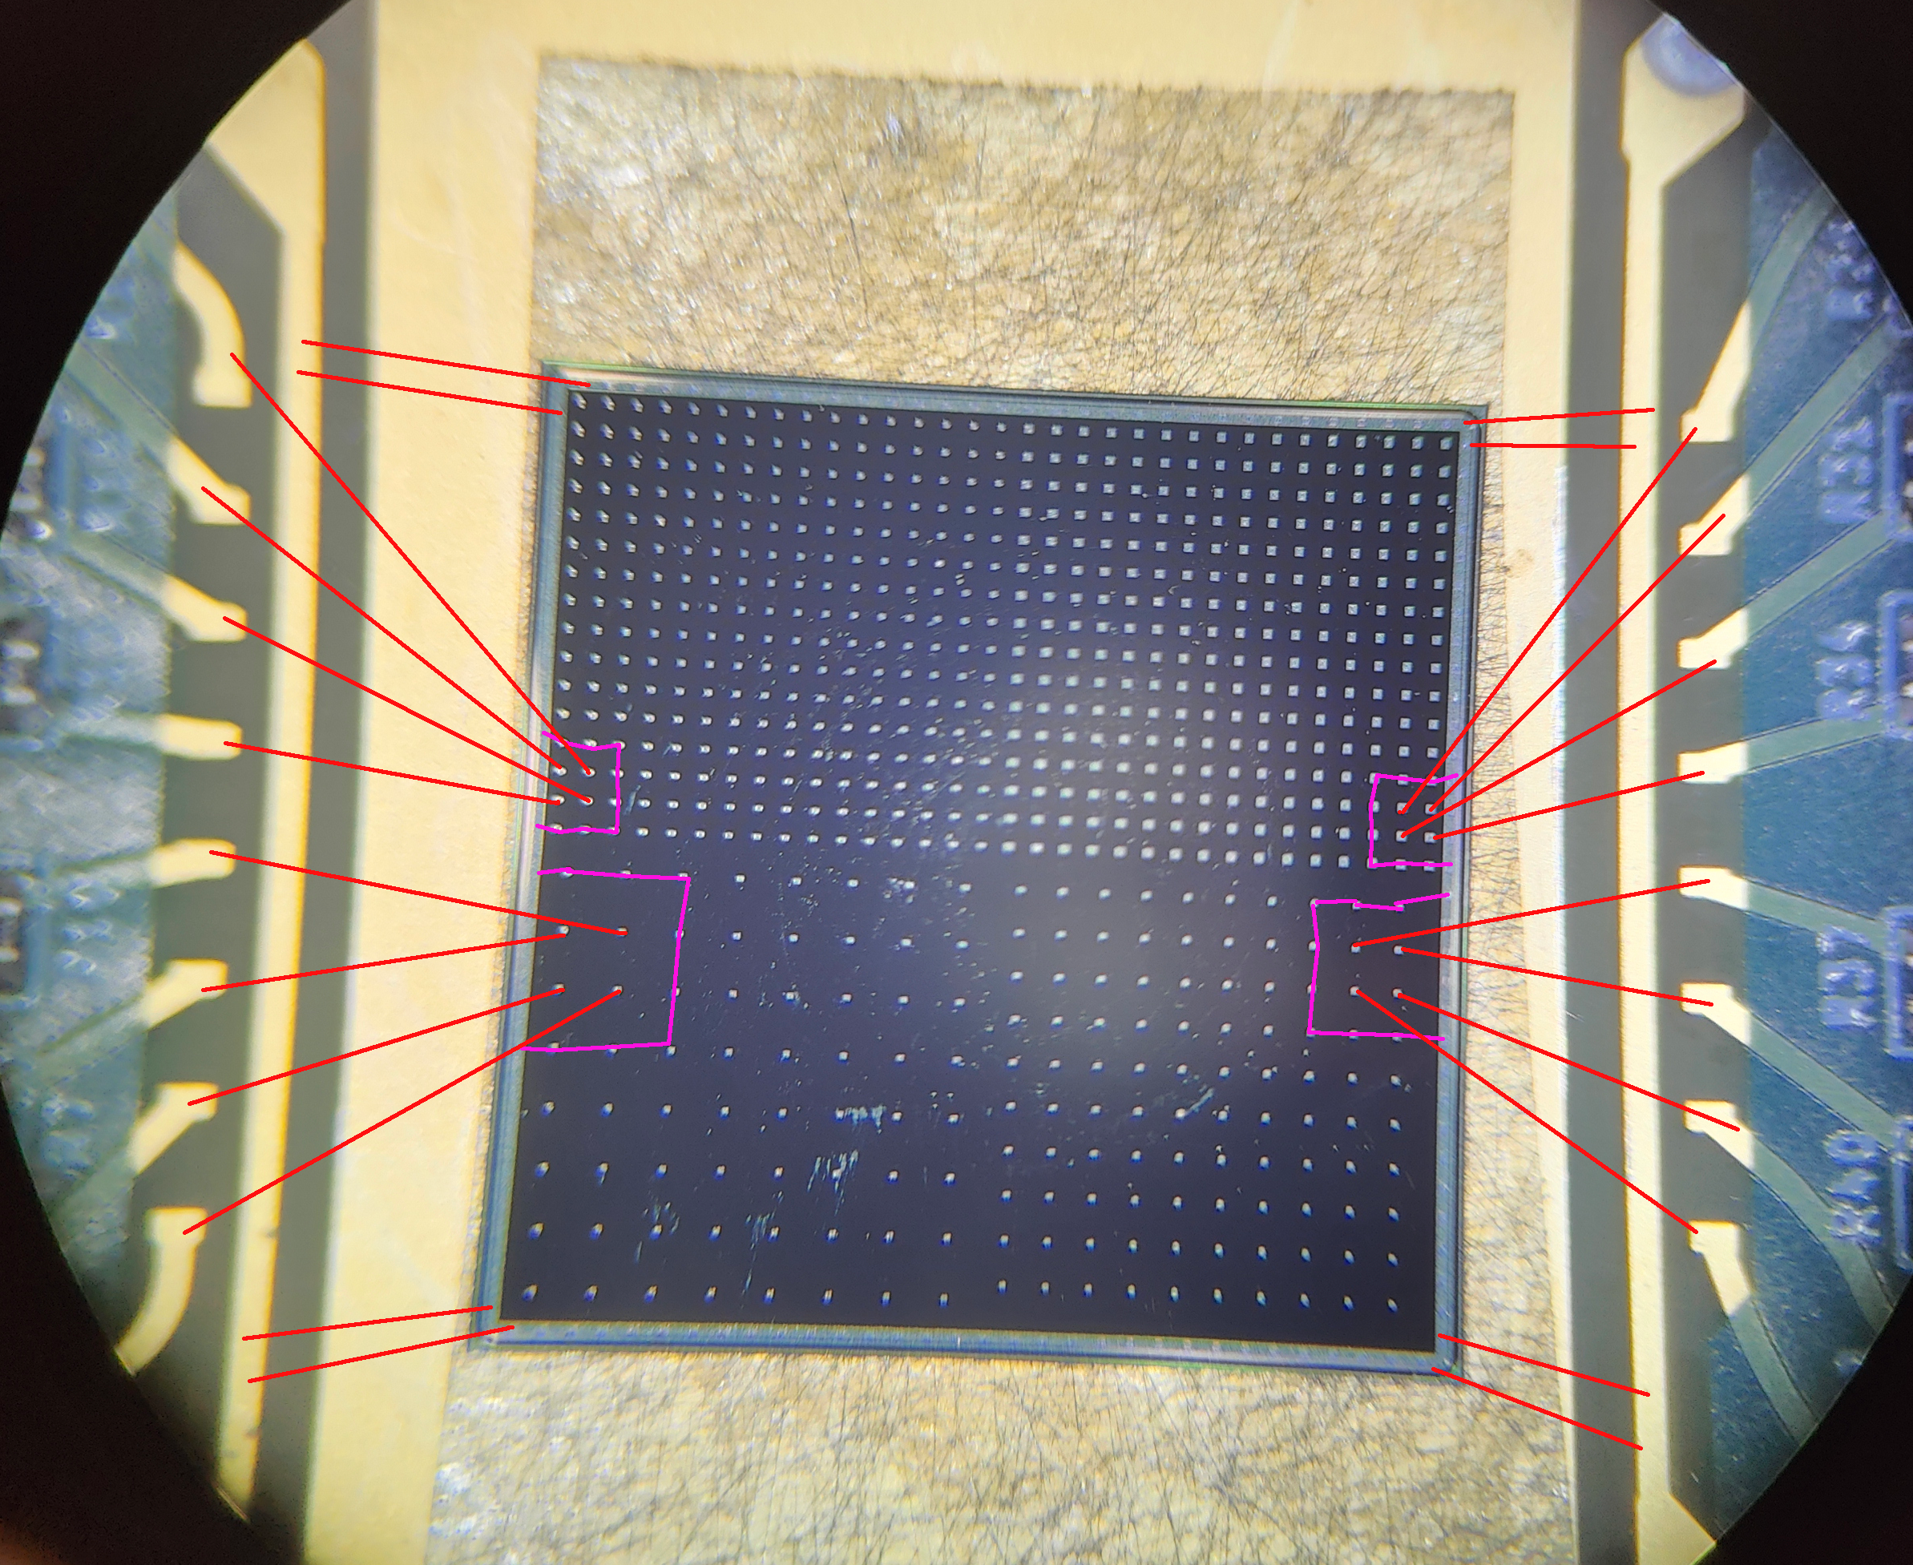
2 cm
25 strip
Bonding on GND Pad
3 strip
3.2 cm
Bonding on RDO Pad
8 strip
Bonding on GND Pad
3 strip
25 strip

