Slide 1
DAP ChatBot Developments
Mohammad Atif, Vincent Garonne, Eric Lancon,
Jérôme Lauret, Alexandr Prozorov, Michal Vranovsky

Slide 2
Impact & Opportunities of AI in Data Preservation
•For researchers: rapid onboarding, reproducible analyses, and accessible context
•For the field: preserves DOE investment and extends RHIC’s scientific legacy
•For education: AI-enabled training on real experimental data
•RHIC DAPP serves as a model for future large-scale data preservation efforts

Slide 3
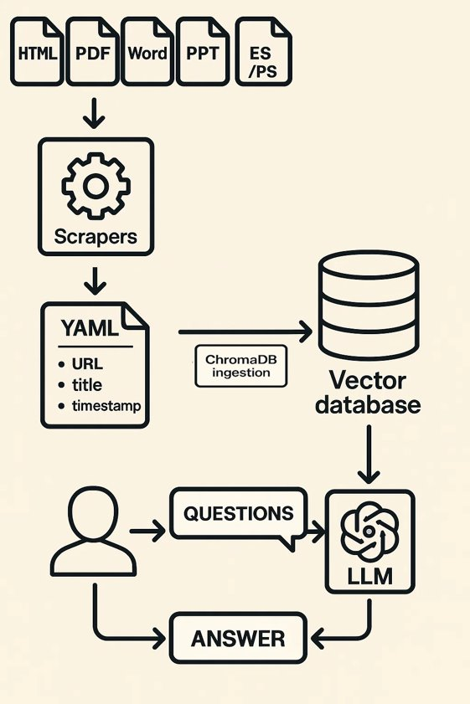
Recap...
Designing Modular Architecture with Standards
- Local LLM + RHIC knowledge base + Authentication
- Key benefits: secure, tailored, domain-aware
To keep pace with rapid domain evolution while maintaining stability
Model Context Protocol (MCP): Ensure interoperability across (local/remote) LLM providers, AI tools, and public/restricted knowledge
Retrieval-Augmented Generation (RAG)
Vector Storage - Semantic search

Slide 4
Updates
Publicly accessible link [no need to connect to BNL network]
Database migration from Chroma to Qdrant
SPHENIX data in database and separation of databases for privacy
Benchmarking
Off-campus endpoints: Azure, ALCF
Get support at scibot-support@lists.bnl.gov

Slide 5
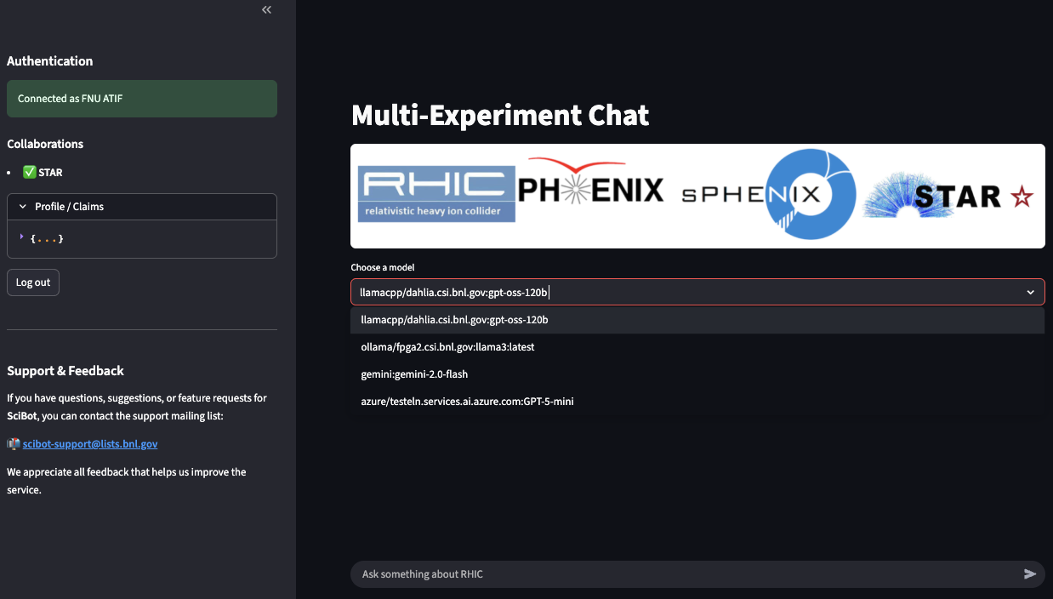
Interface
scibot.csi.bnl.gov can be accessed outside of BNL network
But requires authentication with CILogon to ask questions
can instantiate dedicated chatbot with segregated DB

Slide 6
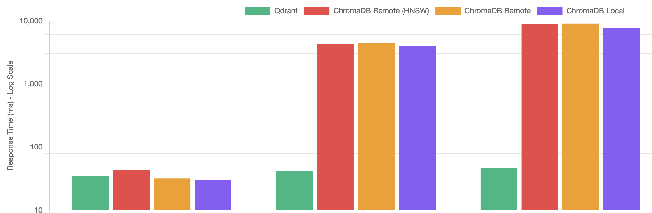
Migration from ChromaDB to Qdrant
Segregation of information requires filters
Currently: public/internal/restricted, Potentially: via metadata
Vector database: two popular choices are ChromaDB and Qdrant
Needed to migrate to Qdrant
Thanks to Vincent Garonne!
No Filter
Public Data Only
Public + STAR

Slide 7
Data Sources
 | STAR | sPHENIX | PHENIX
__.bnl.gov | Y* | Y | Y
Arxiv | Y
Mattermost | Y | In Progress
Theses | Y
Analysis notes | Y
Hypernews | Y
Code repository
Sympa
Invenio |  | Y
online.__.bnl.gov
drupal.__.bnl.gov
Indico | In Progress | In Progress
 | Internal/Restricted

Slide 8
Why Authentication Matters in SciBot (and why experiments cannot see each other’s internal data)
1. You must be identified to access internal information
Internal documents of STAR, sPHENIX, and ePIC are not public.
2. Each experiment is isolated
Members of STAR cannot see sPHENIX documents.
Members of sPHENIX cannot see STAR documents.
This separation is enforced automatically by SciBot.
3. How SciBot decides what you can see
Your login token tells SciBot which collaboration(s) you belong to.
Every document in the knowledge base is tagged with:
its visibility (public / internal)
its experiment (STAR, sPHENIX, ePIC)
SciBot only retrieves documents that match your experiment.

Slide 9
Technicalities: Access Control & Collaboration Segregation
Why identification is required
Access is granted only after validating a user’s identity through OIDC authentication (CILogon + COManage).
The server extracts group membership from the user’s token (isMemberOf) and Authorization is derived from the experiment’s Phonebook
How access control is enforced
Each indexed document in the vector database carries metadata:
visibility = public | internal
collaboration = STAR | sPHENIX | ePIC | ...
During retrieval:
Authenticated users → public + their own experiment’s collaboration
Code-level enforcement with filters:
{ "$or": [ {"visibility": "public"}, {"collaboration": {"$in": user.collaborations}} ]}

Slide 10
Validation & Reliability: Building Trust in AI
Several LLMs (and parameters)
Produce slightly different answers with different levels of detail and accuracy
Need reliable metrics for accuracy; progress from anecdotal evidence to quantifiable benchmarks
We are building a multi-layer validation and benchmarking pipeline:
Expert review for correctness and clarity
Lexical & semantic metrics
LLM-as-Judge ensemble comparisons
To make this effective, we need a large set of domain-specific Q&A pairs, focused on Nuclear Physics and RHIC, provided by experts to benchmark and validate models as they become available.

Slide 11
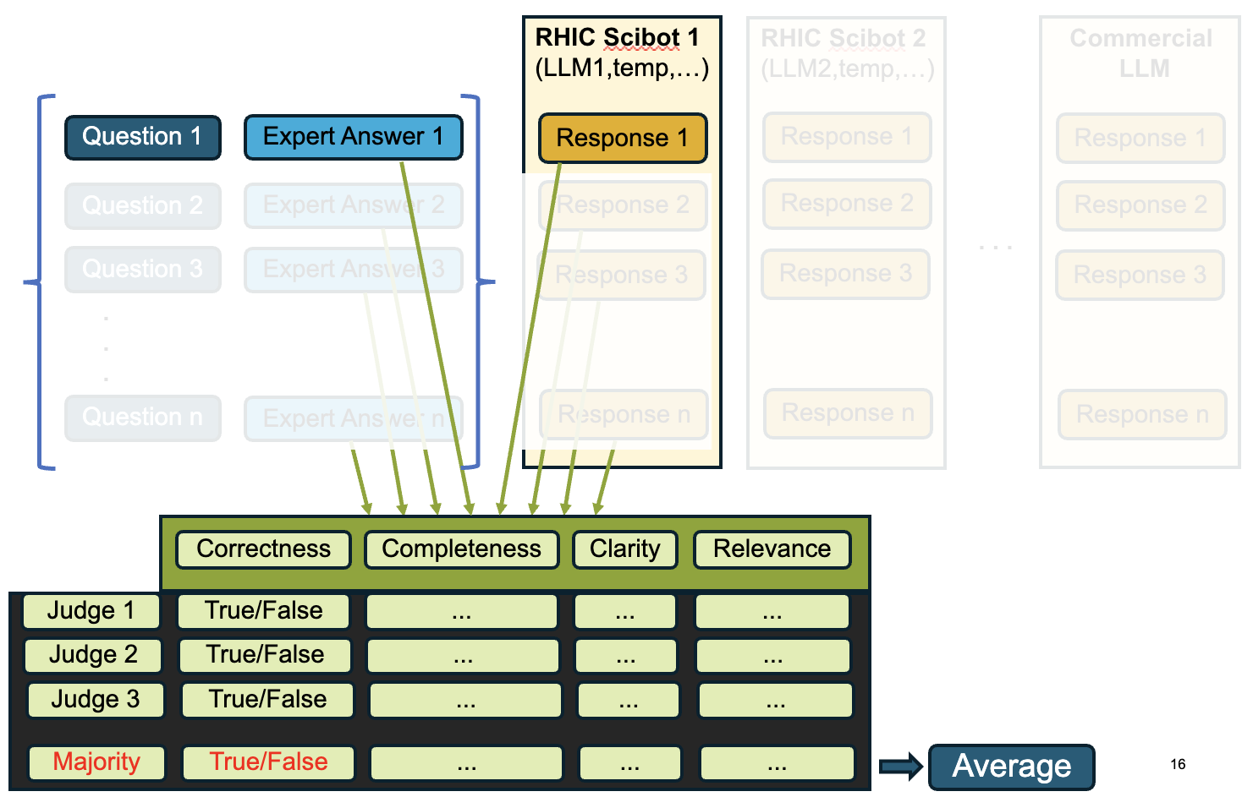
Benchmarking
Goal: To be able to select an LLM (and its params) that provides high-quality consistent answers
Semantic Similarity: cosine of vector representations of LLM answer and expert answer
LLM-as-a-judge
Curated list of question/answer pairs
~50 General Knowledge related to RHIC
~30 STAR questions (thanks to Michal Vranovsky)

Slide 12
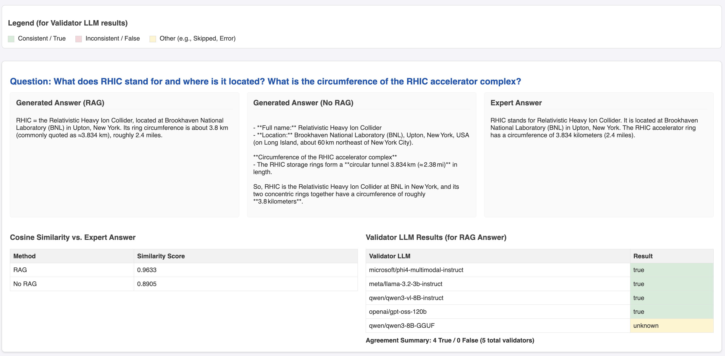
Benchmarking

Slide 13
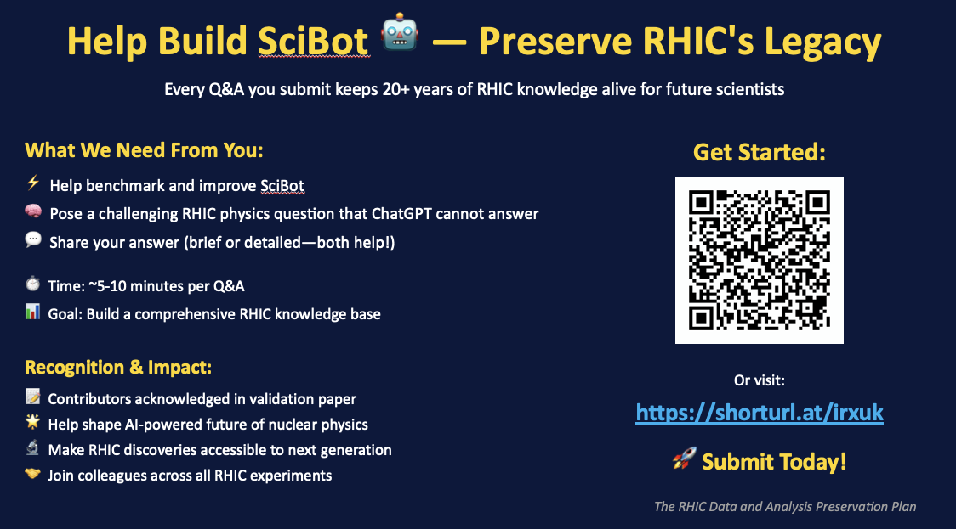

Slide 14
What do we need?
From experts:
Cross-checking and improving question/answers
Providing more question/answers for benchmarks (experiment specific)
From DAP
How to engage experts for benchmarking Q/As
Question for experiments: Which tests will convince you of data privacy/segregation?
Future work
Scrape a lot more data
Mattermost/Indico for sPHENIX, zenodo from Phenix
Drupal for STAR
Integrate real-time web search
You tell us...

