Slide 1

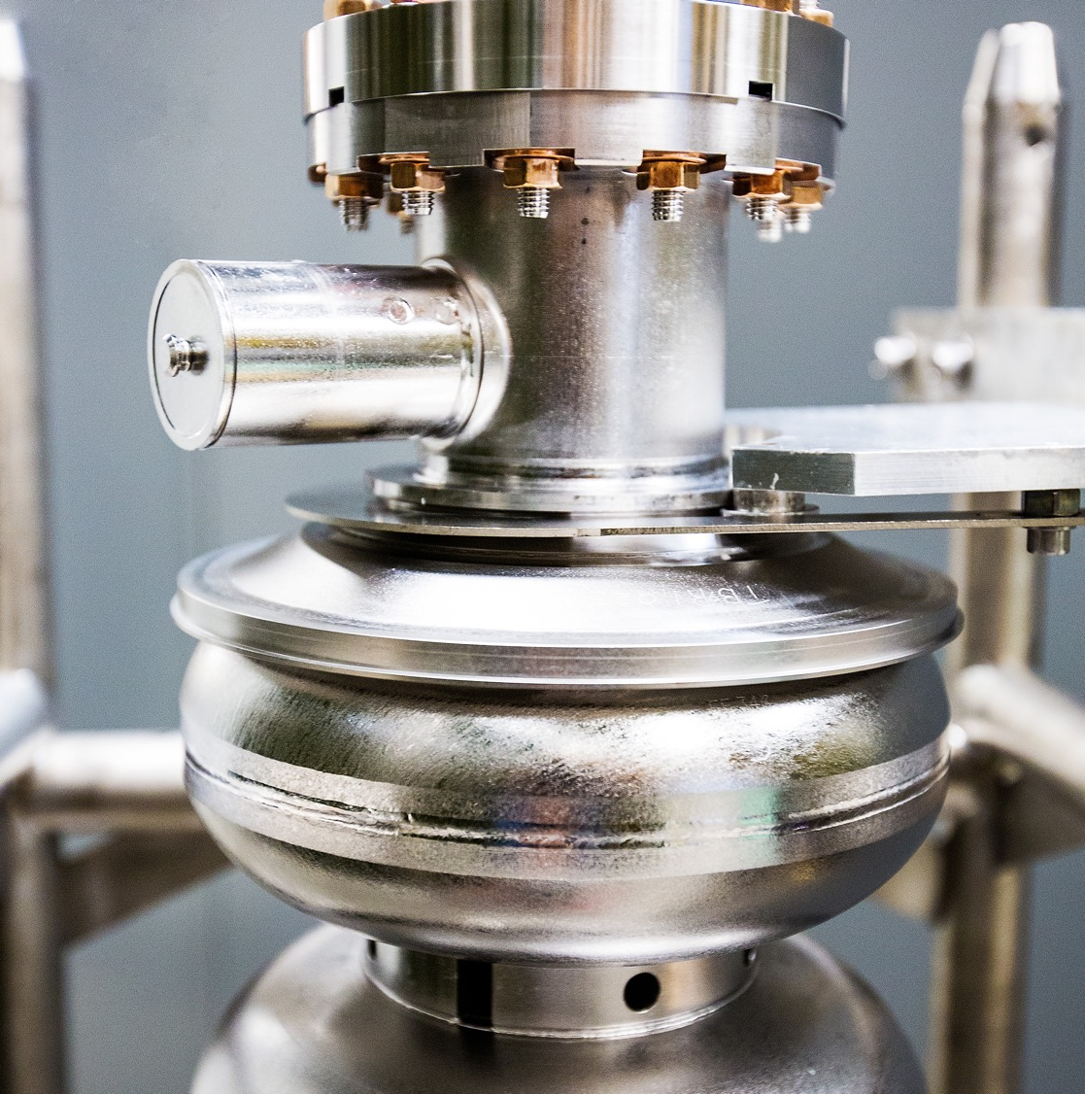
HRPPD Electrical Status
2025-12-09
Raymond Dawson
Notes:
Tip: Keep titles under 60 characters for readability
To change the photo: Right-click on photo and select change photo

Slide 2
Current Status
HRPPD Tasks: Due by 01/12/2026
Simulations
Complete - stitching vias, air side interposer pad reduction, GND planes
TBD
Vacuum side pad size selection?
Interposer downselection
High Voltage (HV) Design
Complete - preliminary pogo pins selected, HV spacing determined
TBD
Location of ground and power connections to MCPs
Optimization of number of vias
Mechanical Changes
TBD
Interposer positional tolerance
Pogo pin placement
Plastic connectors for HV connections
Check backplane fit for pogo pins and connectors
Match outline to mechanical changes
Other
Break in ground ring placed
TBD
Test file import with Kyocera
Update HRPPD with final design changes
Non-HRPPD Tasks: Due after
Backplane Changes
Cables
Safety resistors
Bypass capacitors + ringing resistors
FCFD Test Board
Board design complete
Final quote received, ETA 20 days ARO
Notes:
Add due date

Slide 3
Simulations

Slide 4
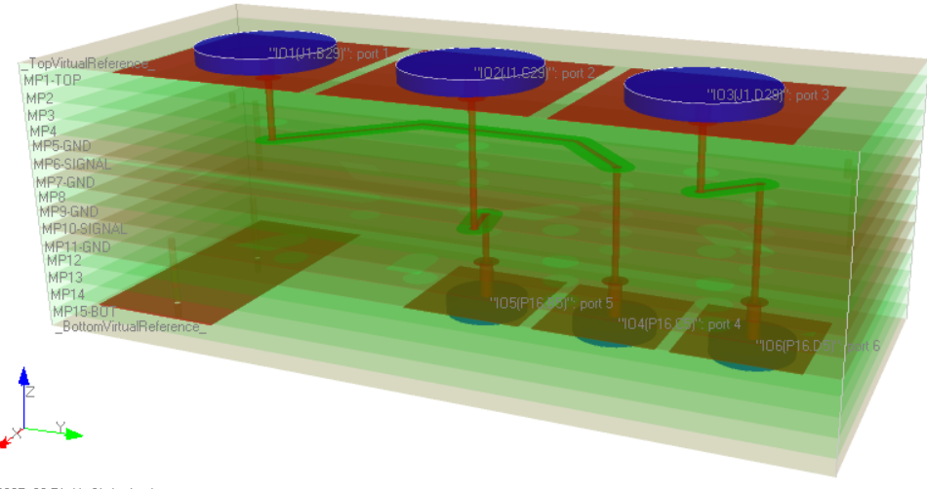
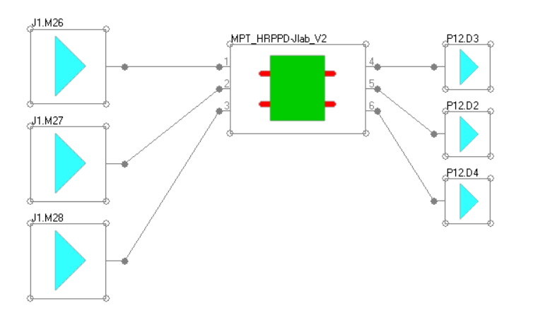
Simulation Setup
Target frequency: 1 GHz
Frequency sweep range: 2 GHz
FEXT, no NEXT
Matched TX and Rx (50Ω)
Assumes no reflections
Pad selection for max crosstalk interaction

Slide 5
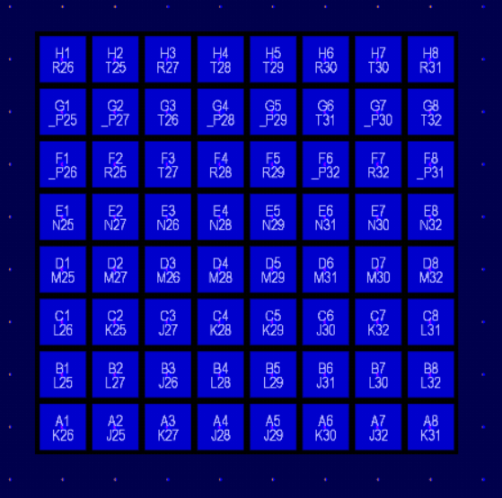
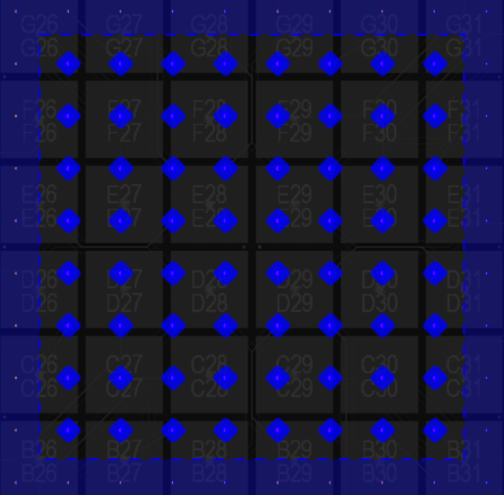
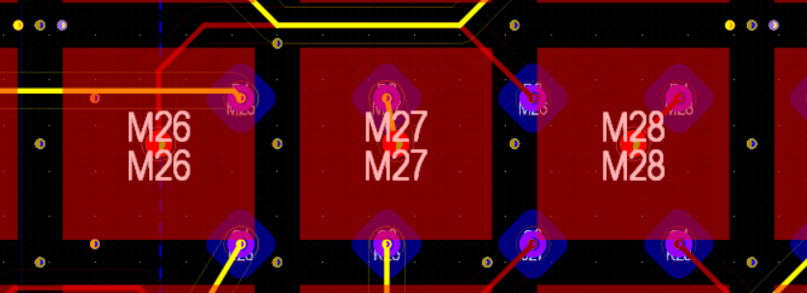
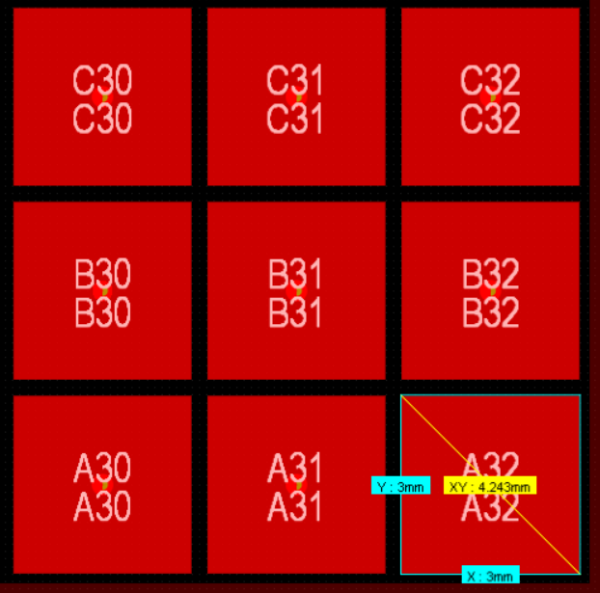
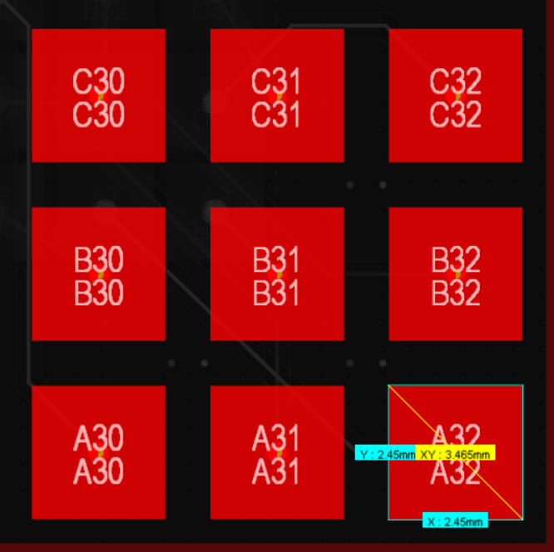
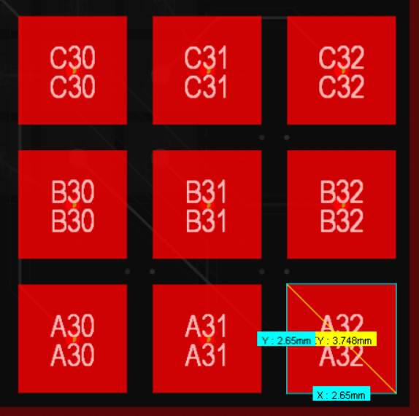
SI Improvements
Test case | Description
Original | Original imported HRPPD design, no changes
Reduced air side interposer pad size | Replaced interposer pads with Samtec recommended pads From 71x71mil (1.8x1.8mm) to 31.5x31.5mil (0.8x0.8mm) Pads are rotated 90°, so corner adjacent instead of edge (less coupling) * Neoconix pads ignored for now due to ground influence
Ground planes adjacent to top/bottom signal layers | Ground planes added to layers 2 and 14, adjacent to pads Ground planes added to layers 3 and 13, adjacent to pads
Reduced vacuum side anode pad size | Original: 118x118mil (3x3mm) Option 1: 0.6mm between pads (104mil / 2.65mm pad size) Option 2: 0.8mm between pads (96.5mil / 2.45mm pad size) Option 3: 1.5mm between pads (59mil / 1.5mm pad size)
Increased stitching vias (SV) density | 1+ stitching vias adjacent to every signal via - Via span is layers 2-15
Air Side Interposer Pad Size
Left = original, right = reduced
Vacuum Side Anode Pad Size
Left = original, center = 2.45mm, right = 2.65mm
Increased Via Density
Top = original, Bottom = Increased density

Slide 6
ICR Explained
ICR is insertion loss (IL) to power sum crosstalk ratio (PSXT)
Ideally, IL is 0 dB and PSXT is -∞ dB
Thus, ideal ICR = +∞
Realistically:
IL < -1dB (20 % power loss / 10% voltage loss)
PSXT << -40 dB (1% voltage crosstalk)
Overall crosstalk goal from HRPPD to ASIC is ~1%, so HRPPD contribution must be less than that
ICR
A larger, more positive number is better performance

Slide 7
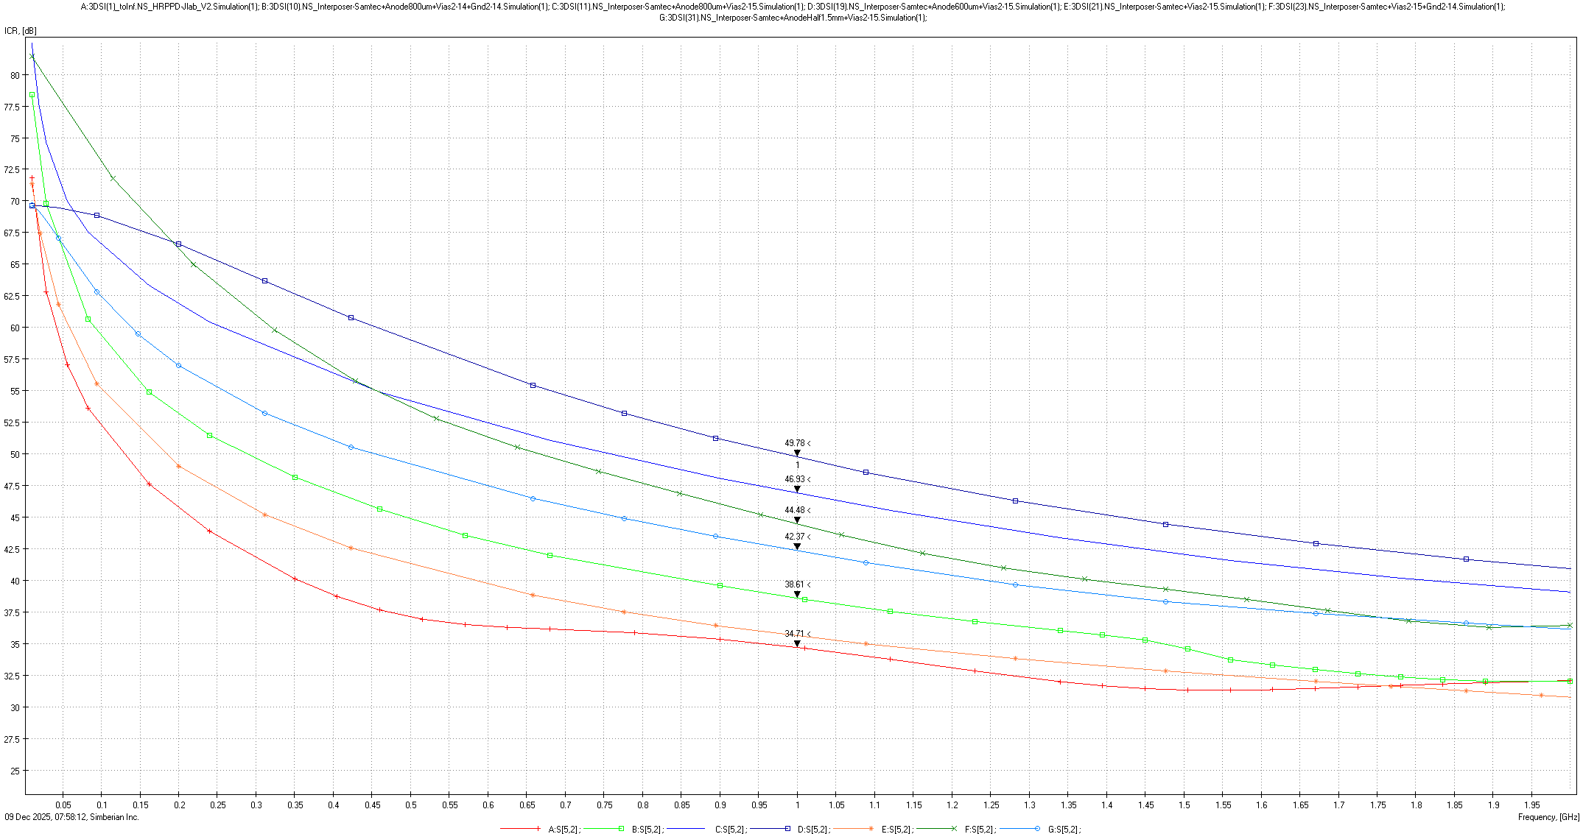
Overall ICR
Higher is better
Target >40dB (1% voltage xtalk)
Takeaways:
Interposer reduction beneficial when combined with other changes
SVs are beneficial when combined with other changes
Adding ground worsens performance
A slight reduction in pad size performs best
Further reducing pad size has opposite effect (unexpected)
0.32%: Smaller air side pads + SV 2-15 + Vacuum Pads 2.65mm
0.44%: Smaller air side pads + SV 2-15 + Vacuum Pads 2.45mm
0.51%: Smaller air side pads + SV 2-15 + GND Ly 2/14
0.76%: Smaller air side pads + SV 2-15 + Vacuum Pads 1.5mm
1.08%: Smaller air side pads + SV 2-15 + Vacuum Pads 2.65mm + GND2/14
1.59%: Smaller air side pads + SV 2-15 + Vacuum Pads 3mm
1.75%: Original

Slide 8
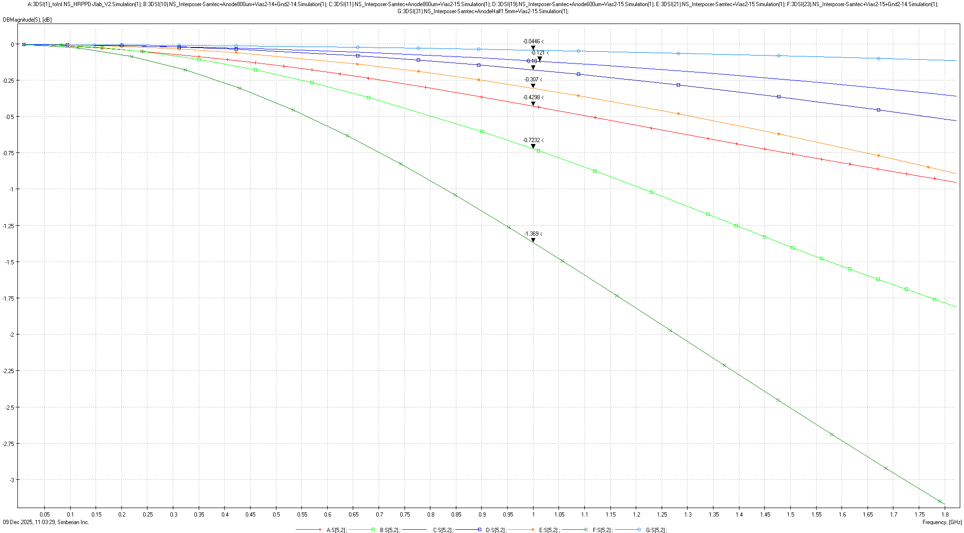
Overall Insertion Loss
0.51%: Smaller air side pads + SV 2-15 + Vacuum Pads 1.5mm
1.38%: Smaller air side pads + SV 2-15 + Vacuum Pads 2.45mm
2.05%: Smaller air side pads + SV 2-15 + Vacuum Pads 2.65mm
3.47%: Smaller air side pads + SV 2-15
4.83%: Original
8%: Smaller air side pads + SV 2-15 + Vacuum Pads 2.65mm + GND2/14
14.6%: Smaller air side pads + SV 2-15 + GND Ly 2/14
Higher is better
Target >-1dB (10% voltage loss)
Takeaways:
IL not much different amongst best performers
Smaller pad sizes perform better (as expected)
Ground planes make signals perform much worse
Notes:
Follows trend of ICR except GND planes have WORSE insertion loss due to capacitive coupling
Smaller pad sizes perform better

Slide 9
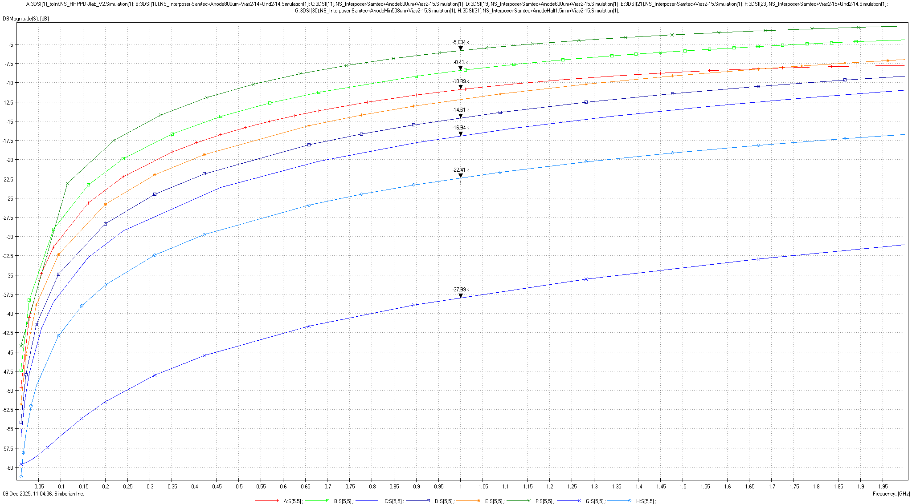
Overall Return Loss (Reflected Power)
26.1%: Smaller air side pads + SV 2-15 + GND Ly 2/14
14.42%: Smaller air side pads + SV 2-15 + Vacuum Pads 2.65mm + GND2/14
8.15%: Original
6.04%: Smaller air side pads + SV 2-15
3.46%: Smaller air side pads + SV 2-15 + Vacuum Pads 2.65mm
2.02%: Smaller air side pads + SV 2-15 + Vacuum Pads 2.45mm
0.57%: Smaller air side pads + SV 2-15 + Vacuum Pads 1.5mm
Lower is better
Target <-13dB (5% power reflected)
Takeaways:
Reducing pad size decreases return loss greatly, which in turn increases amount of power seen at RX, but also increases amount of power available to lose to crosstalk
0.02%: Smaller air side pads + SV 2-15 + Vacuum Pads 1.5mm“No pad”
Notes:
How to reduce xtalk but preserve signal integrity?

Slide 10
Simulation Summary
Changes to implement
Reduced air side interposer pad sizes
Increased stitching via density
Slightly reduced vacuum side anode pad size to 2.65mm?
Changes NOT to implement
Adding ground planes
TBD changes
Air side interposer and amount of grounds per signal
Test Case | ICR | IL | RL
Smaller air side pads + SV 2-15 + Vacuum Pads 2.65mm | 0.32% | 2.05% | 3.46%
Smaller air side pads + SV 2-15 + Vacuum Pads 2.45mm | 0.44% | 1.38% | 2.02%
Smaller air side pads + SV 2-15 + GND Ly 2/14 | 0.51% | 14.6% | 26.1%
Smaller air side pads + SV 2-15 + Vacuum Pads 1.5mm | 0.76% | 0.51% | 0.57%
Smaller air side pads + SV 2-15 + Vacuum Pads 2.65mm + GND2/14 | 1.08% | 8%: | 14.42%
Smaller air side pads + SV 2-15 | 1.59% | 3.47% | 6.04%
Original | 1.75% | 4.83% | 8.15%
ICR = Insertion to Crosstalk Ratio
- Smaller is better
IL = Insertion loss
- Smaller is better
RL = Return loss
- Larger is better
Notes:
Add % to graphs
Add IL graph? w/ %
Add return loss graph w/ %
Simbeor ? - How to reduce xtalk when return loss increased, why does shrinking pad slightly have such a dramatic effect?
Summary:
Interposer reduction good
SV good when combined with other changes
Gnd planes bad – increased IL and RL
Anode pad reduction potentially good, need to follow-up

Slide 11
High Voltage Layout

Slide 12
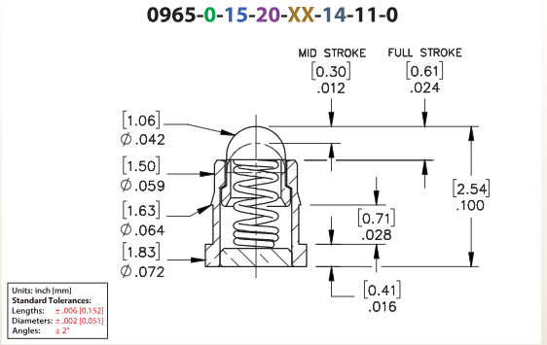
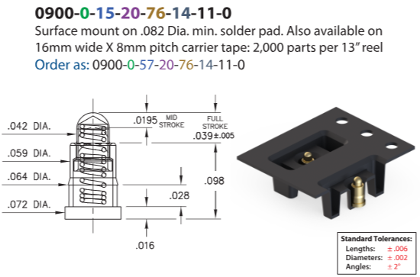
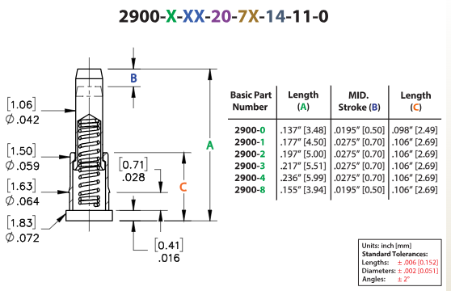
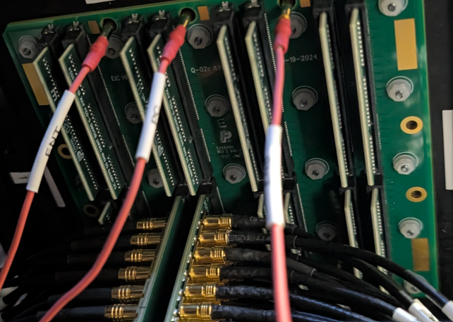
Potential Pogo Pins
Air side interposers have a maximum thickness of 3.3mm (0.130”) excluding pins. Pins on top and bottom are ~0.254mm each with target compression of 50% (0.127mm) per side
Per pin characteristics: >6A derated, 20mΩ, ~2.3mm pitch, force 60 – 80g ±20
Pogo pin placement depends on mounting hole locations and HV connectors
Will mounting holes in backplane match current layout?
What is tolerance on board-HRPPD alignment?

Slide 13
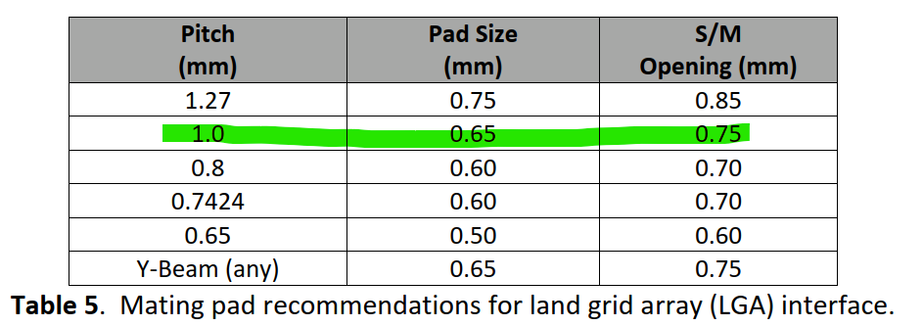
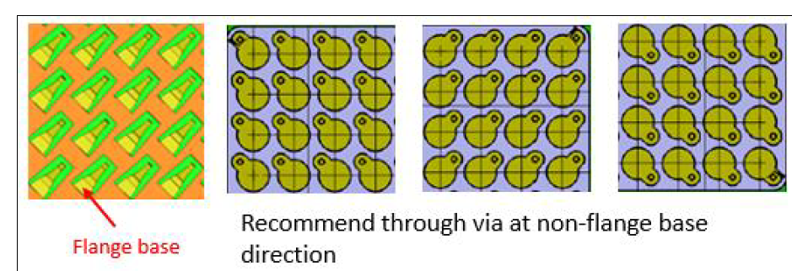
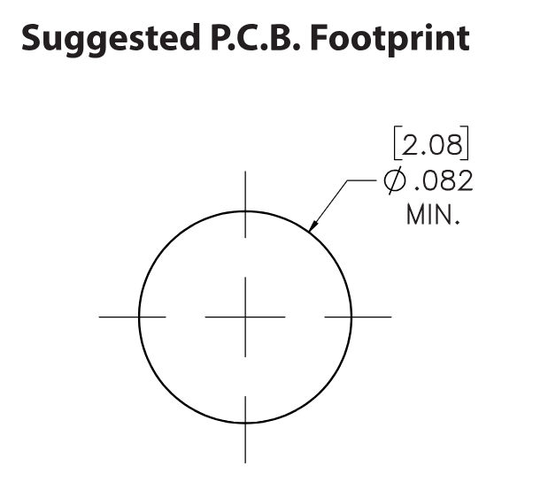
Interposer/Pogo Pin Positional Tolerance
Interposer target pad = 0.65 mm diameter
Pogo pin target pad = 2.08 mm diameter

Slide 14
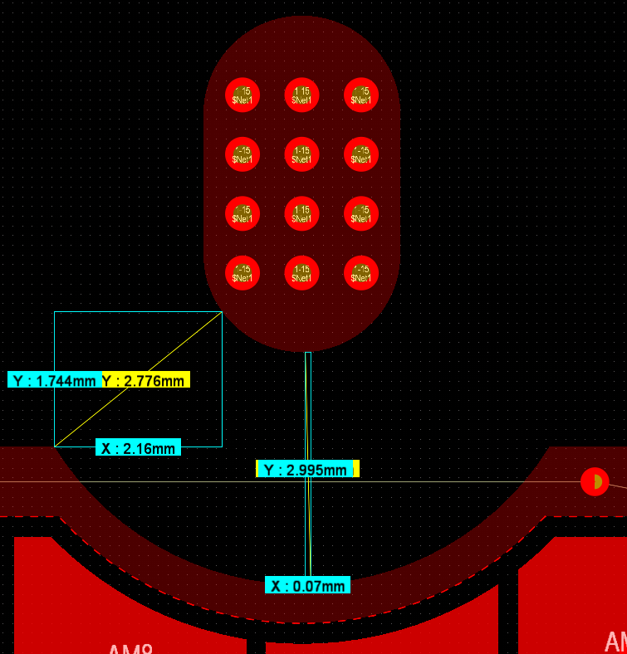
HV Spacing
Gerard has performed creepage testing
4.5kV @ 1.792mm spacing and 4kV @ 2.7mm
HRPPD target will be 3mm for 2.5kV for bare metal-metal surfaces
This is approximately current spacing on HRPPD
Does this impact sidewall?

Slide 15
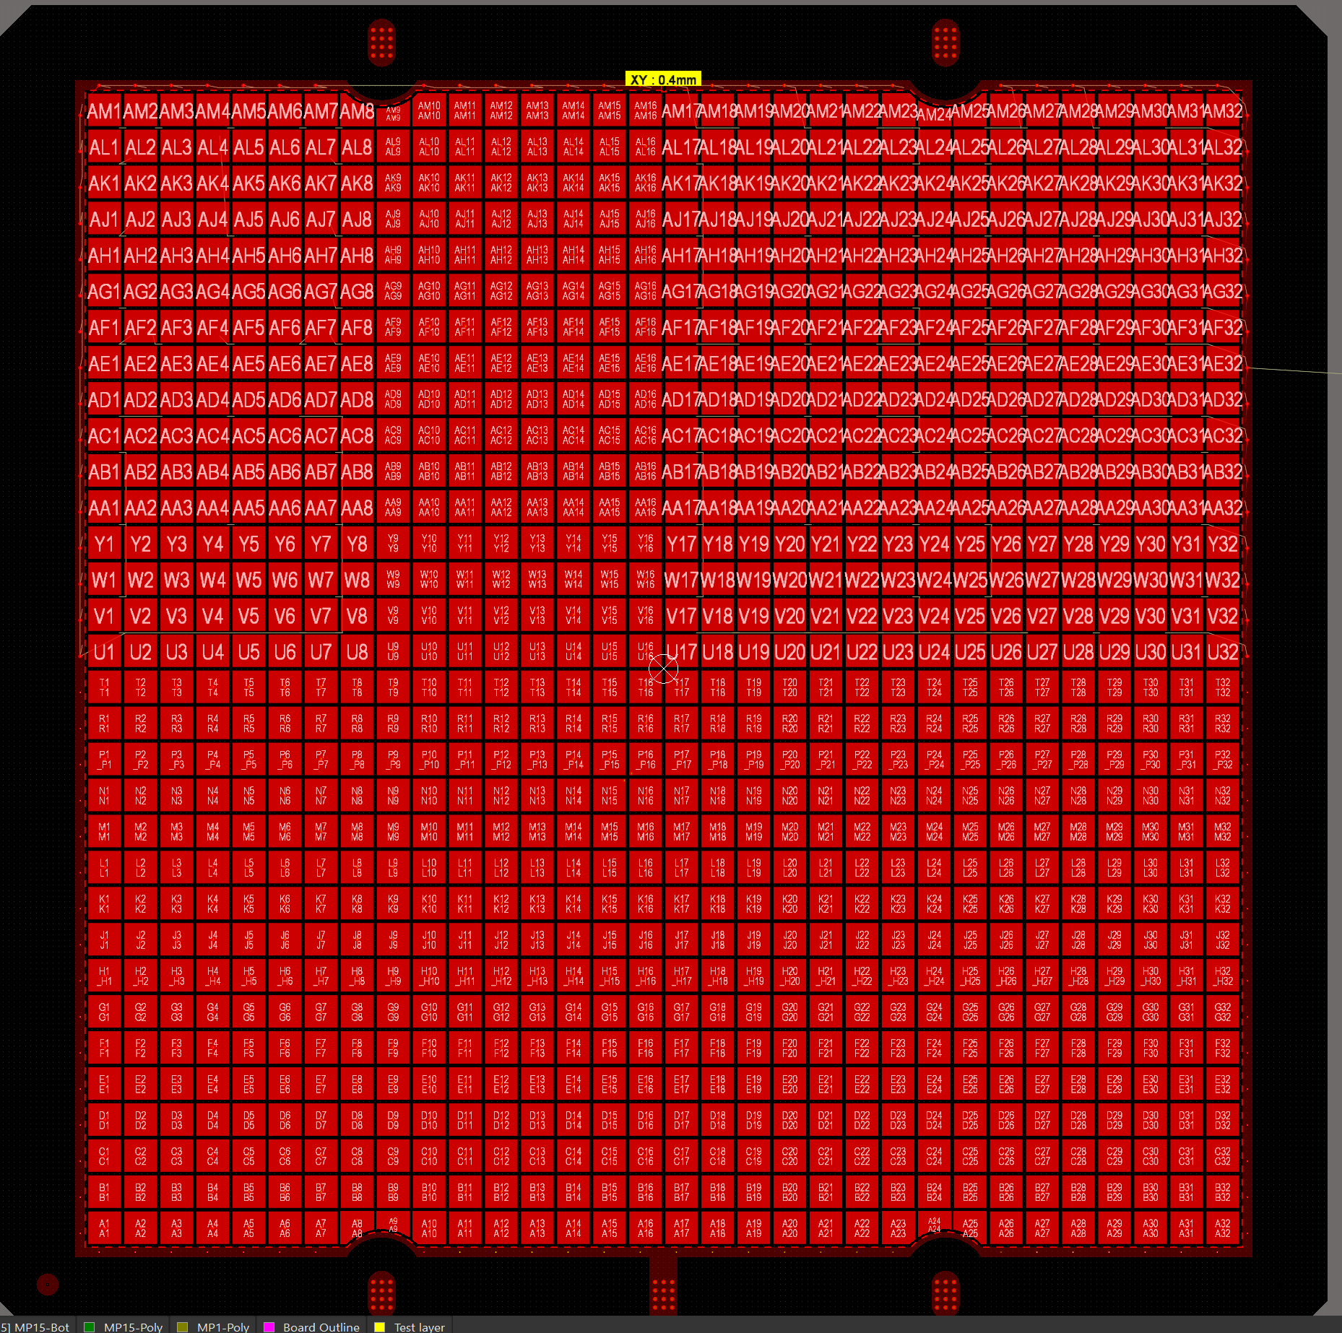
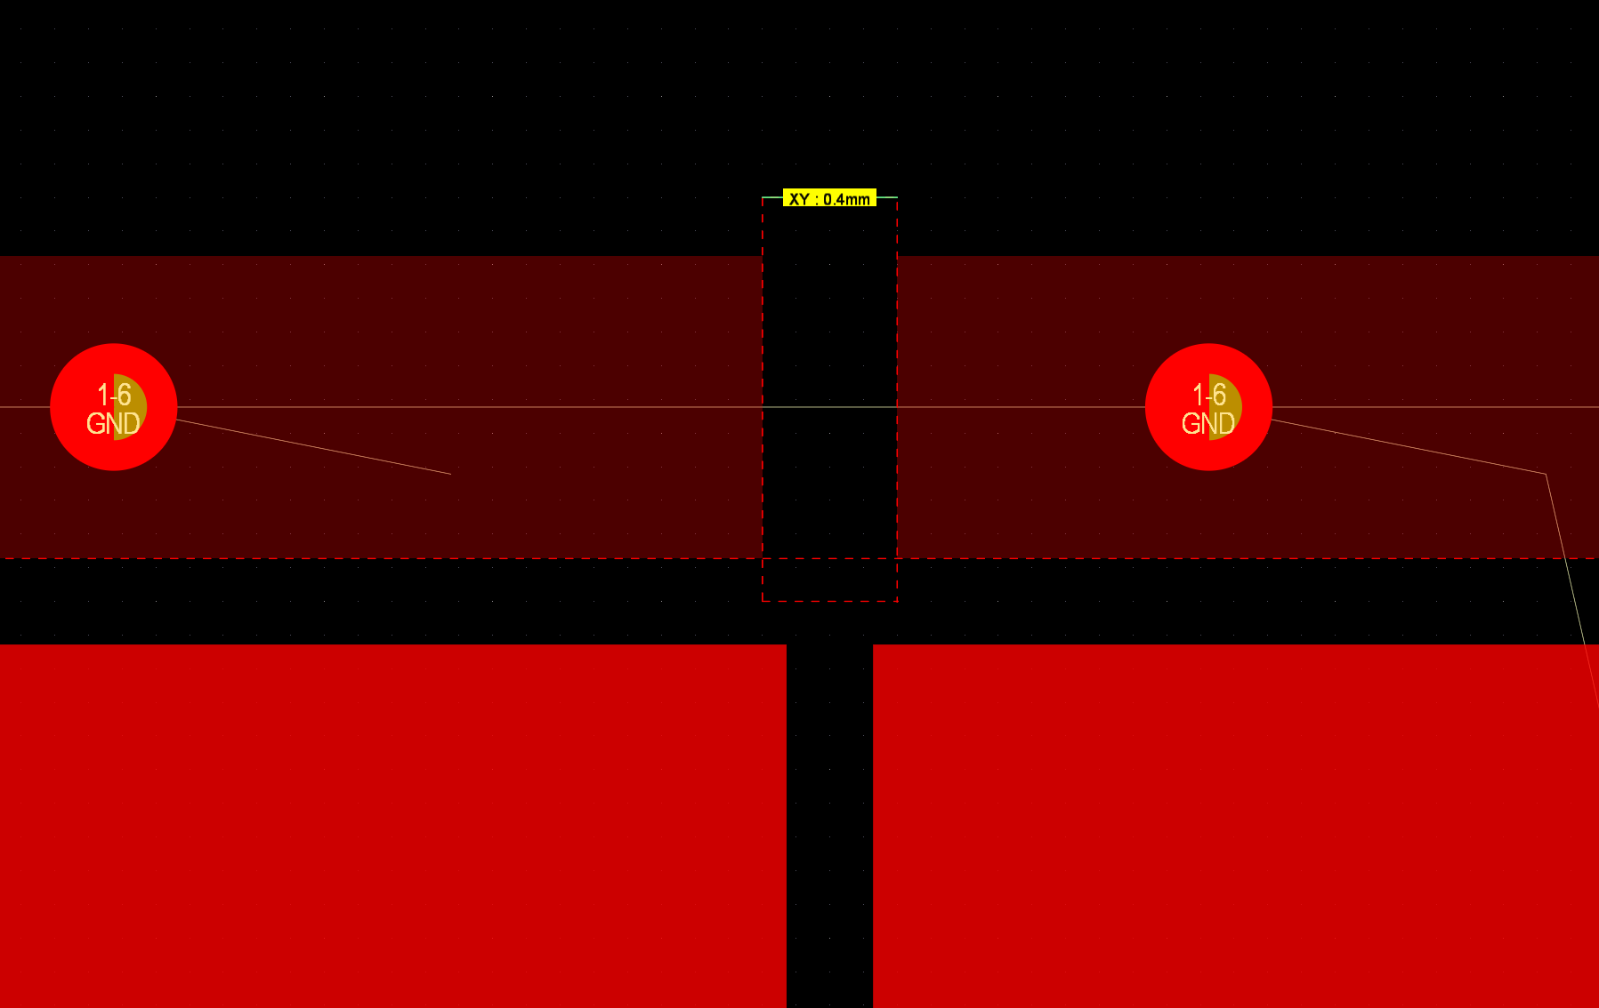
Break in Ground Ring
Incom concerned for induced currents in ground ring when solenoid fires
Does this same concern apply to ground rings of interposers?

