Slide 1
RHIC Run 25 Report
Part Deux
T Shrey for C-AD
RHIC/AGS Users Meeting
May 12, 2026

Slide 2

Think of your favorite trilogy…

Slide 3
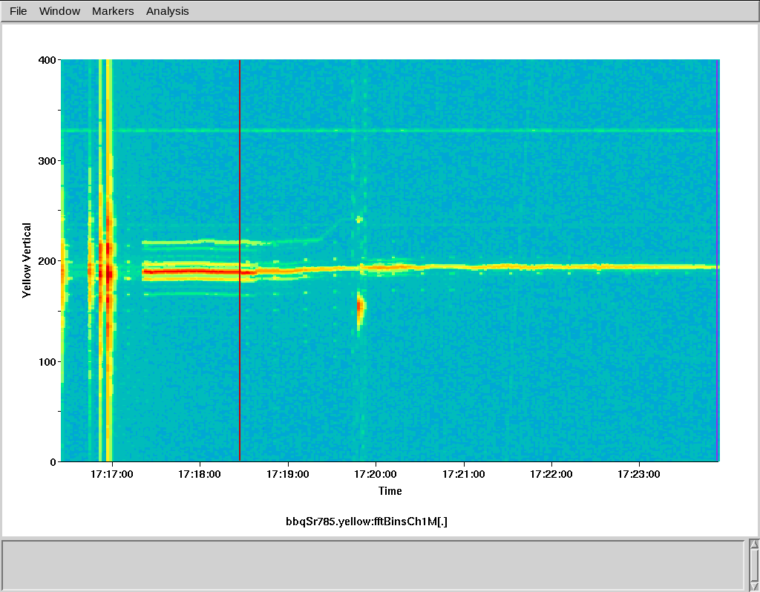

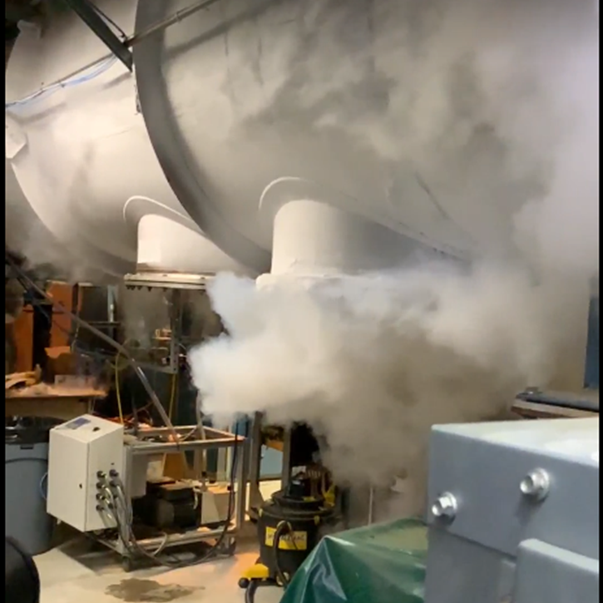
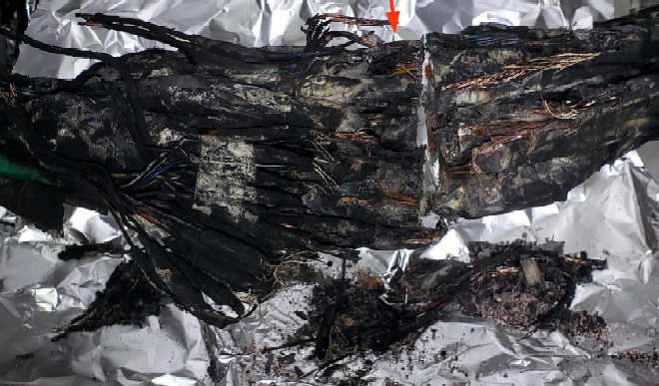
The Tale of Run25
It begins in Run 23
  Intensity limitation (aka ‘the blob’)
    Showed up at transition
    (beam is shortest here)
    Compensated with tunes
  Run ending failure
  (foreshadowing)

Slide 4
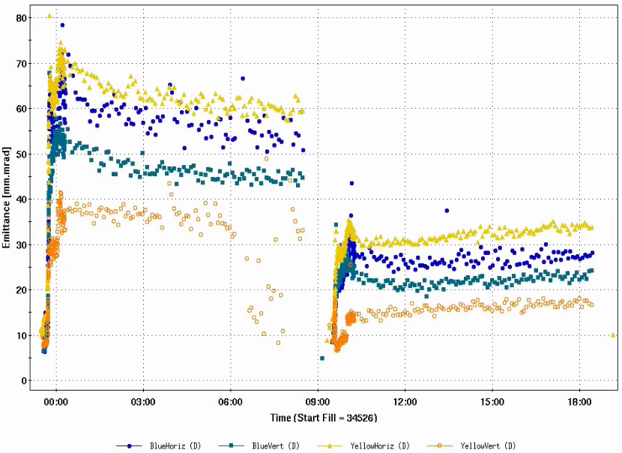

The Two Towers
Run24 taught us several things
  The 56 MHz cavity was never fully damped in Run23, hence the blob. The beginning of the pp run suffered from pretty severe emittance growth; inserting both dampers in the 56 cleaned that up.
“I have an idea, let’s stick a superconducting electromagnetic drum of death in the ring” - Vincent

Slide 5


The Two Towers II
mVTX background exploration was an exhaustive 3-week experience
  Beam (or secondaries) were hitting some aperture right upstream of the IR8 triplet and sending particles down parallel to the beam but at high offset. Three particles per minute hitting the same stave effectively disabled it.
  Tracking & backtracking. Diode-murder bump, steering, octupoles, all of it together
  Our best efforts made it maybe ok, but doing all that would severely limit our intensity
  Yellow mask was still in the ring, a result of the ambiguity of the English language.
  Remove:
  So we took it out…

Slide 6
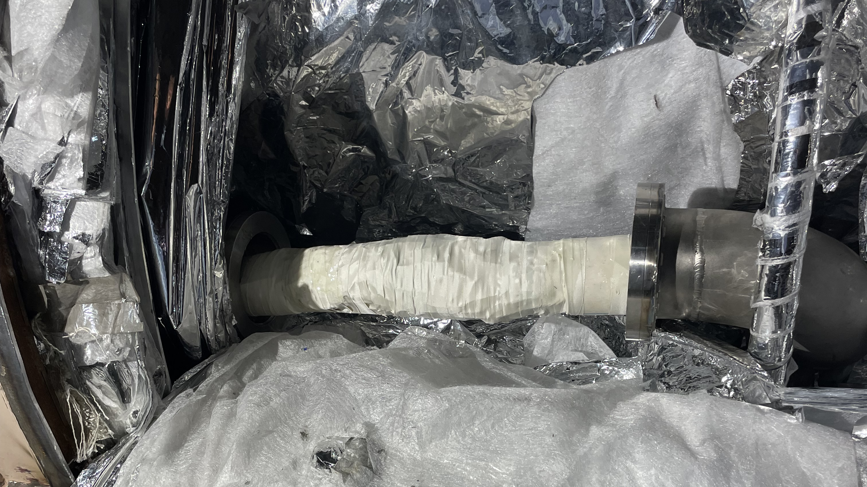
Return of the King
Run25 started with a failure to pass the hi-pot test when cold. It was eventually tracked down to a burr poking through the insulated wrap on a DX splice from Run23.
The burr was ground down and the wire bundle was sleeved in NOMEX and the process of welding everything closed began.
We started 2 months behind schedule, with a projected end date of 12/22/25.

Slide 7

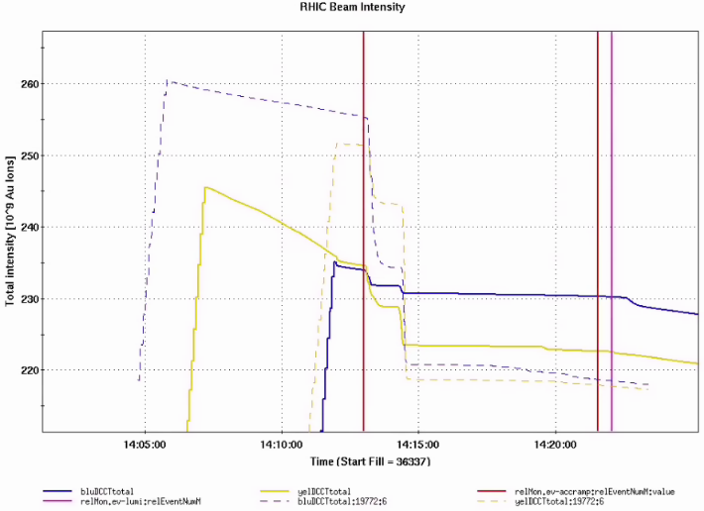
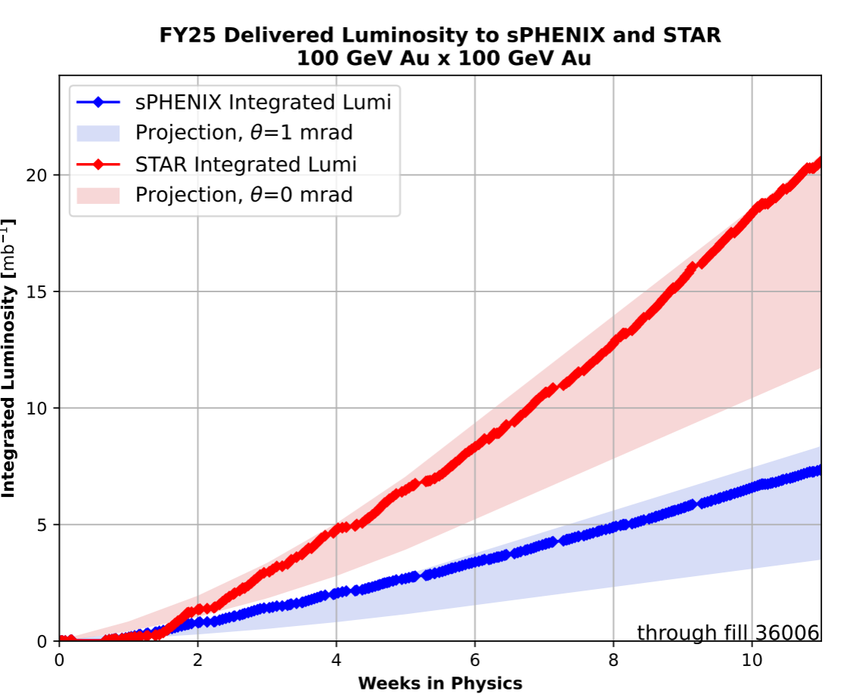
Gold Ramp Up
Sisyphean slog up Mount Doom
  Constantly hitting limits on loss monitors in very specific places and points on the ramp.
Eventually I wondered how we did this in Run 16 and found that we couldn’t – we selectively masked off problem loss monitors.
End result was spectacularly clean ramp efficiency.

Slide 8

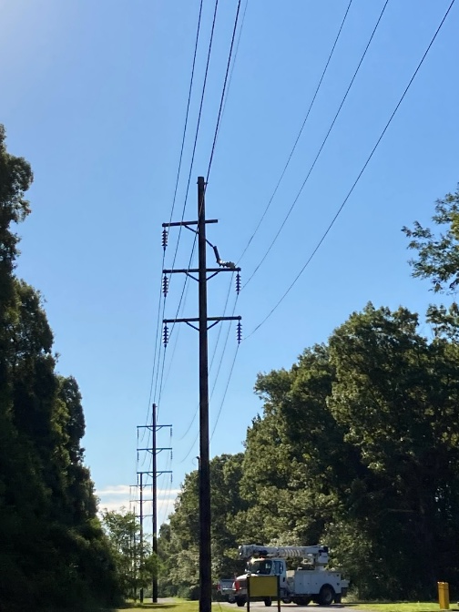
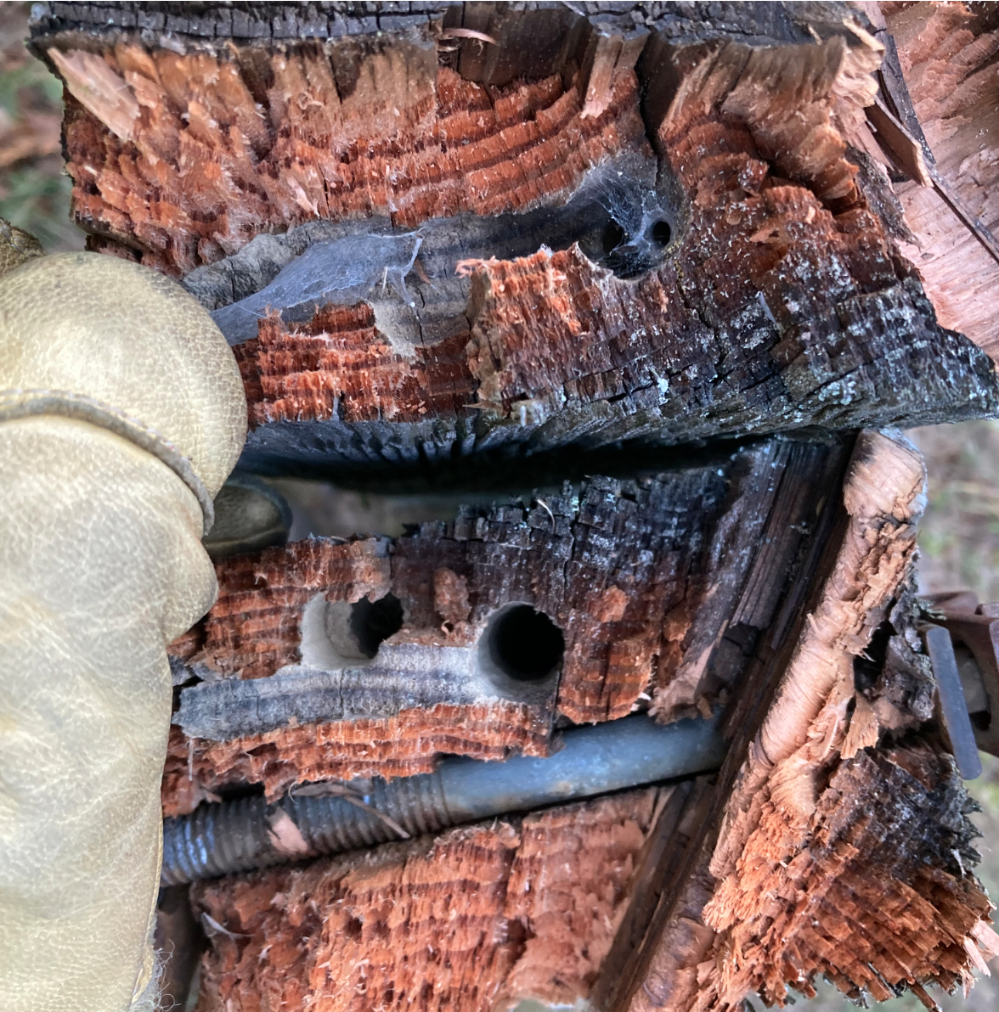
Attack of Shelob’s Cousin
11 weeks into the run one arm of a power pole was found hanging, the work of carpenter bees
The primary and backup 69kV feed for RHIC lives on either side of the same poles (oops). Each side lives inside the zero approach boundary of the other; had to kill all power to RHIC for the repair.
Cryo worked around the clock to offload as much helium as they could during the outage.
PSEG made the repair in 90 minutes and cryo immediately began moving inventory. Two weeks of downtime.

Slide 9
An Unexpected Journey
In order to prevent an abort kicker prefire, in 2020 the abort system was modified to bring mechanical relays into series with the thyratrons during the ramp. Each of the five modules can only fire when the relays are closed and the thyratron conducts.
For ramp 36108 there was a beam abort and the vacuum valves closed in the warm section around the yellow abort.
Several unfortunate things occurred:
  One thyratron became continuously conducting (??) and tripped the protection circuit, initiating a dump
  The relay on that module was also the fastest to close so the module ramped up during the bunch train
  The backup trigger, designed to fire all the remaining modules in the event of a prefire sent a second module ramping (its relay also was on the short end of the response curve).
  The two added in a spectacularly bad way to make an almost flat kick across 2/3 of the bunch train.

Slide 10
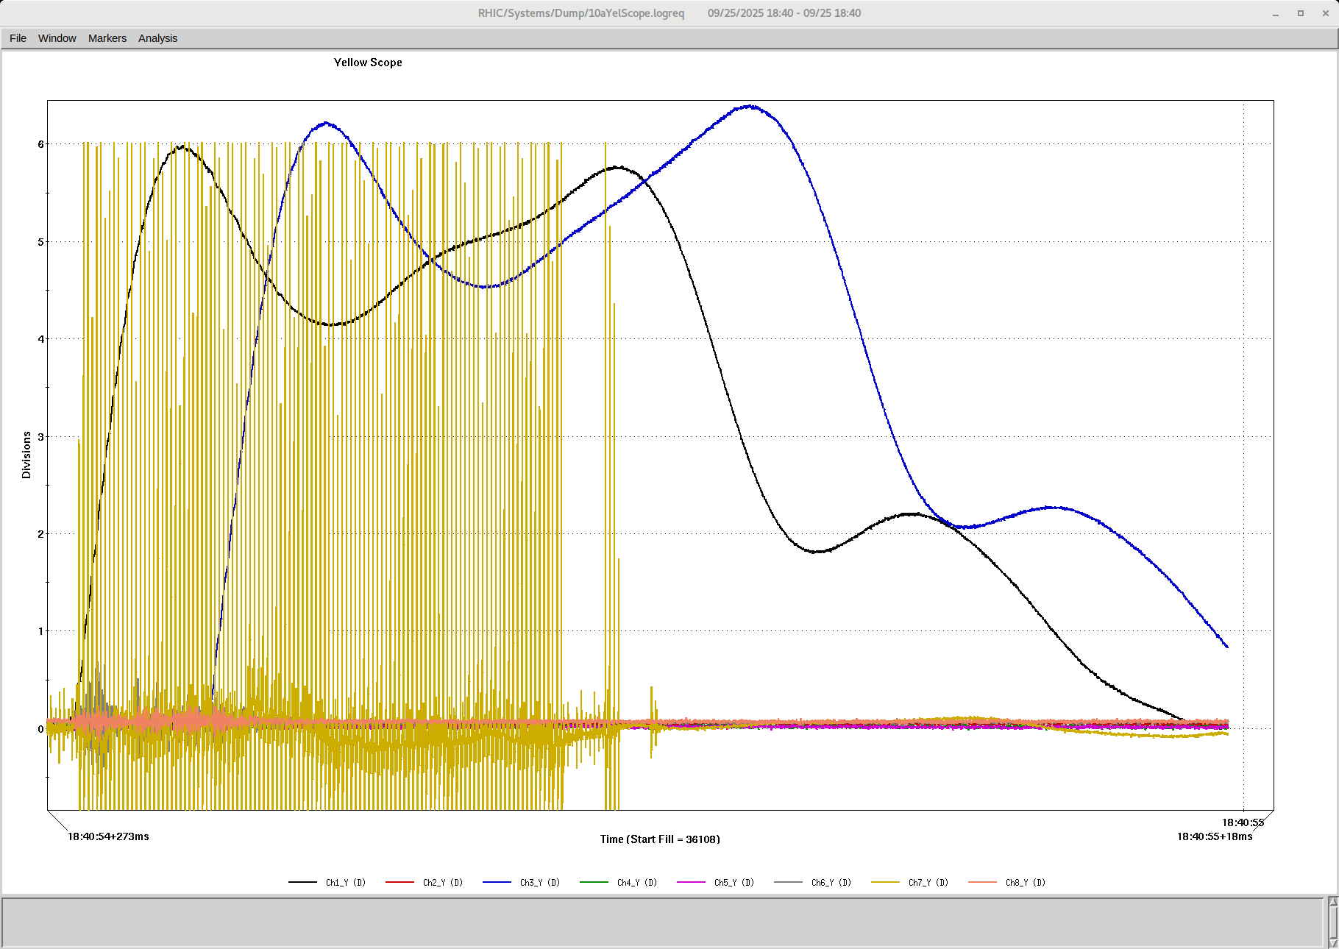
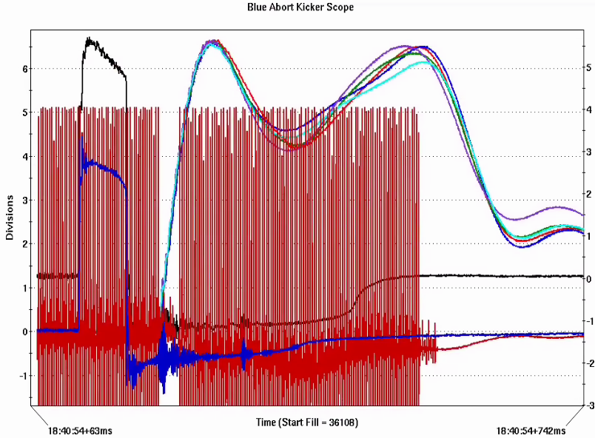
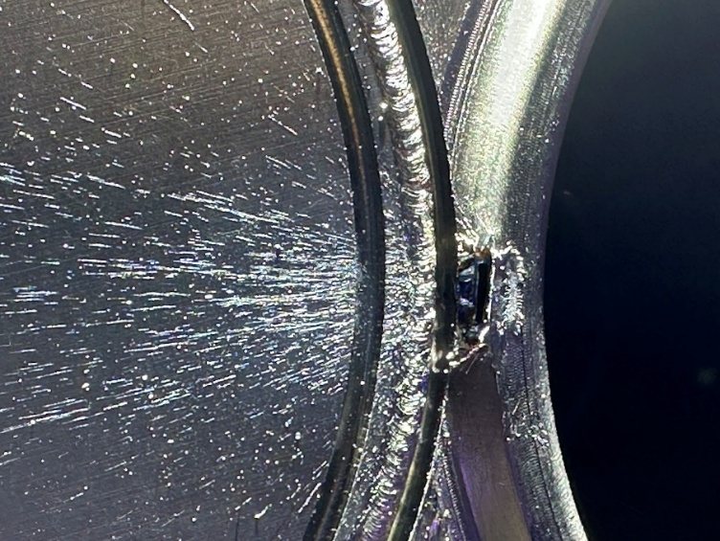
Journey II
When the abort was disassembled a 1mm hole was found punched in the vacuum flange between the circulating pipe and the dump window
An incredibly precise weld repair was performed and the warm section was baked and pumped down. 12 days of downtime.

Slide 11
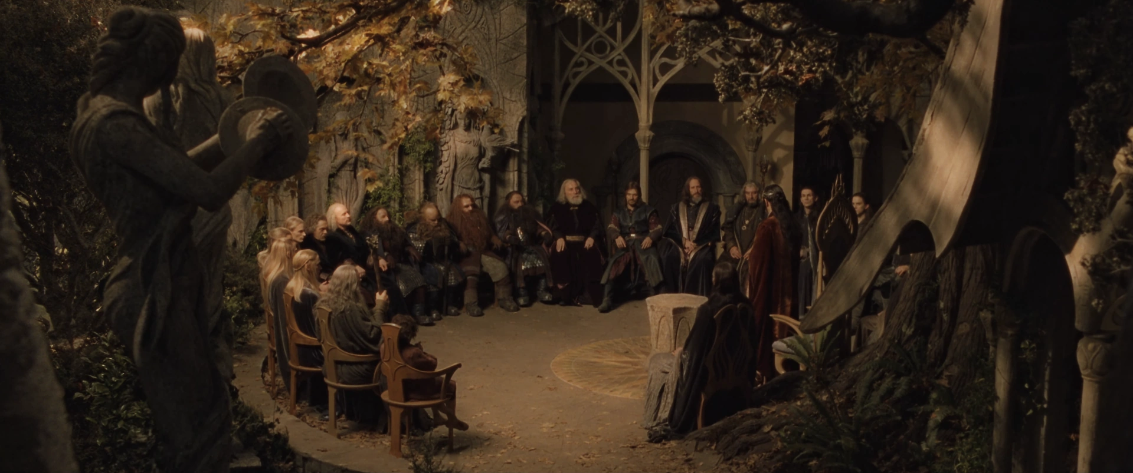
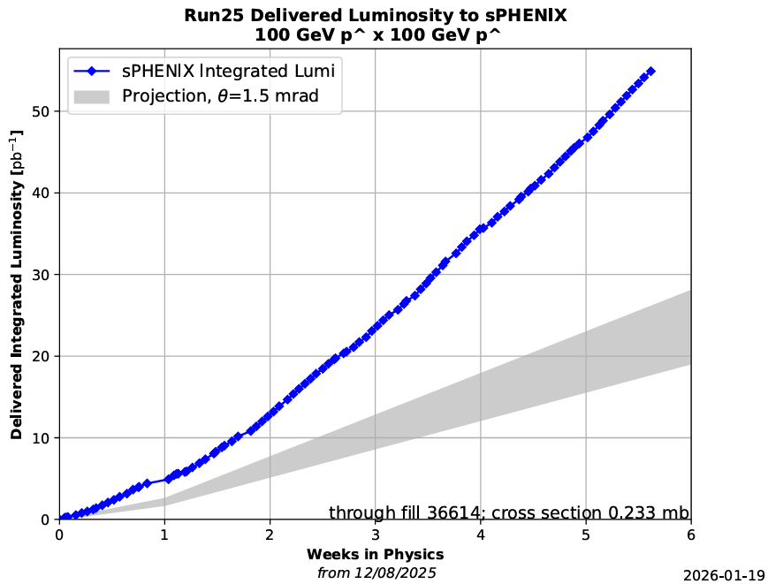
Council of Elrond
Mid-run PAC meeting convened in October to plan out the rest of the run
  Experimenter desires had minimal overlap
  PAC recommended pp run to complete sPHENIX data set
  STAR decided to sit out the pp run and advocated for a week of fixed target running since a single collision point would allow for much higher beam intensities (lower beam beam parameter) and faster data collection for sPHENIX
  Complex switched to protons on 12/10, physics running on 12/12
  With a single collision point and a desire for max lumi rather than a figure of merit typical of pp runs, intensities reached 2.4e11/bunch
  It went well…

Slide 12
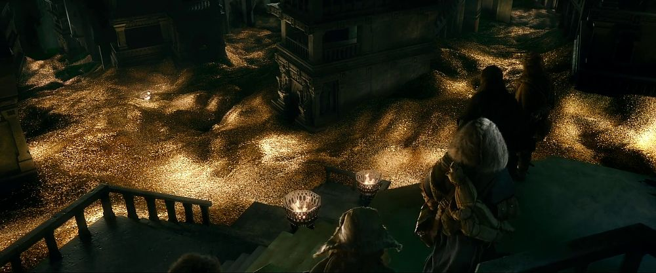
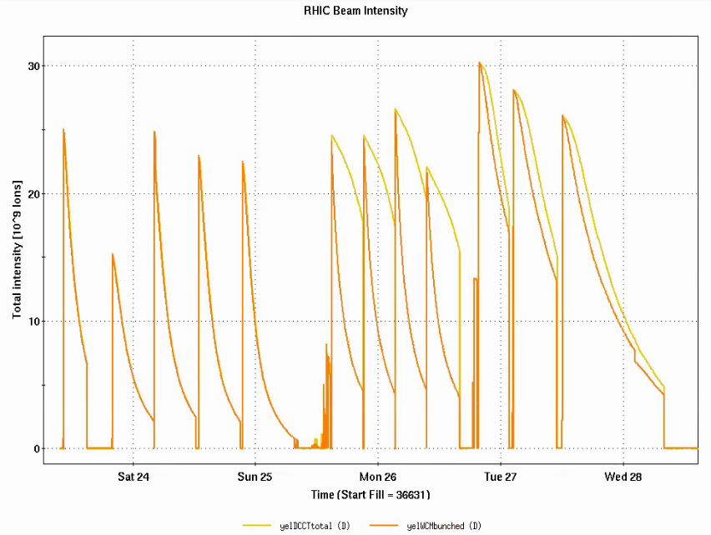

Yellow Gold
Yellow beam fixed target operation for STAR at 9.8 GeV (nominal injection energy), 8.6 GeV and 13.5 GeV
“how about a 13.5 GeV ramp setup”?
9.8
8.6
What the hobbits wanted to do that weekend…
13.5
BLIZZARD

Slide 13

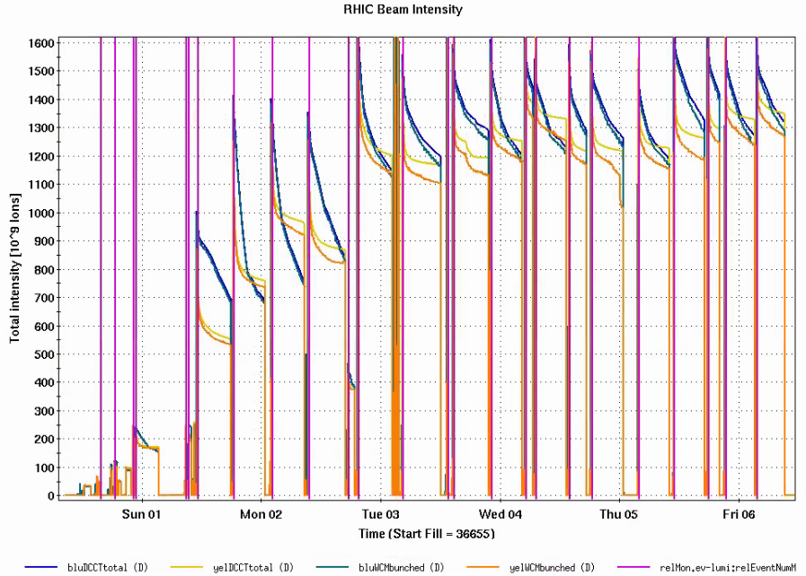
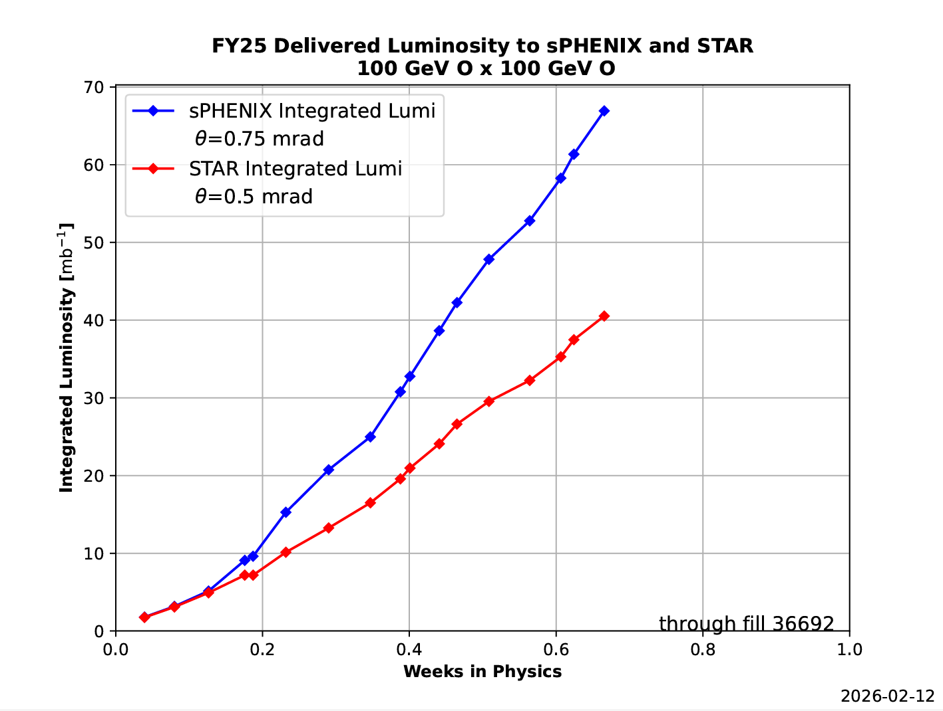
Oxygen
“You want what?”
New species, new ramp, new configuration, lowest z ever attempted for stochastic cooling
  Setup to physics in 24 hours.

Slide 14






The End
Literally – 27 calendar years, 50 fold increase in luminosity from design. Final beam dump quenched the machine
Special thanks…
Thank you for your time
Brendan
Kevin
Vincent & Kiel
Angelika
Guillaume
Keith Zeno

