Slide 1
Sam Aronson – in Memoriam
presented at the
2026 RHIC/AGS Annual Users’ Meeting Brookhaven National Laboratory
May 15th, 2026 W.A. Zajc Columbia University
Profound thanks to Joe and Rachel Aronson, Yasuyuki Akiba, Tamas Csörgő, Hideto Enyo, Yuji Goto, Wlodek Guryn, John Haggerty, Edward Kistenev, Shoji Nagamiya, Ed O’Brien, Jeanette Russo, Keiko Suzuki and Itzhak Tserruya
See also: AIP Oral History Interview with Sam: https://repository.aip.org/node/129568
This work was supported by the United States Department of Energy Grant DOE-FG02-86ER-40281
Notes:
Thanks to Joe and Rachel Aronson, Tamas Csorgo, Wlodek Guryn, John Haggerty, Edward Kistenev, Shoji Nagamiya, Ed O’Brien, Jeanette Russo, Itzhak Tserruya
Colleague, friend, mentor
College life lessons
Wit and wisdom → wisdom thru wit
Rueful
All’s well that . . .
“(At the end I told T.D. et al. that I felt like I was going out of a Mafia meeting with instructions to set up a meet with the other Family.)” Sam, 12-Feb-04 to Tim and me , in “More on the RHIC Science Retreat”
On sabbatical 1/30/05 “PHENIX and me”
Town and Gown:
“I think your concerns are valid and collaboration-based; your independence from BNL and from me should be sufficient protection against some sort of backlash. Give 'em hell.” Email 6/5/98 “Re: Many things”
“Losing a person of Sam’s caliber is a tragedy for everyone whose life he touched. I am humbled, saddened, and trying to gather and preserve these memories.
. . I pray that he may rest in peace.” Edward Kistenev

Slide 2
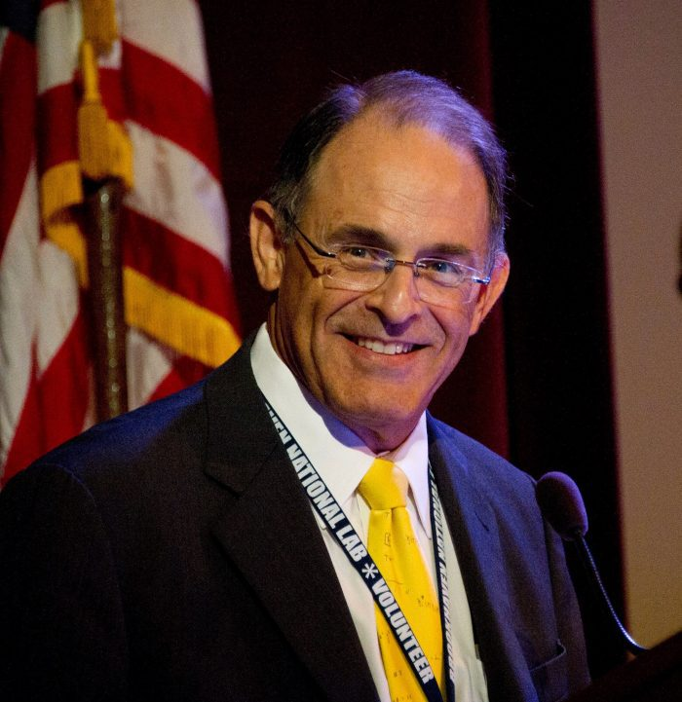
I worked very closely with Sam for nearly a decade as we were building and then operating the PHENIX experiment at RHIC. For much of that time, I was Spokesperson and Sam was the Project Director. I could not have asked for a better colleague, mentor, and friend. These are not just my sentiments, they are shared by all who knew this extraordinary man.

Slide 3
Sam’s word-line
1942: Born, Huntington, NY
1964: A.B., Columbia
1968: Ph.D., Princeton
1968: Postdoc, Chicago
1972: Faculty, Wisconsin
1978: BNL
1988: Deputy Chair, Physics
1991: RE2/PHENIX Director
2001: Chair, Physics
2005: ALD for NPP
2006: Director
2012: Stepped down as Director
2013: RBRC Director
2015: APS President

Slide 4
Sam’s word-line
1942: Born, Huntington, NY
1964: A.B., Columbia
1968: Ph.D., Princeton
1968: Postdoc, Chicago
1972: Faculty, Wisconsin
1978: BNL
1988: Deputy Chair, Physics
1991: RE2/PHENIX Director
2001: Chair, Physics
2005: ALD for NPP
2006: Director
2012: Stepped down as Director
2013: RBRC Director
2015: APS President

Slide 5
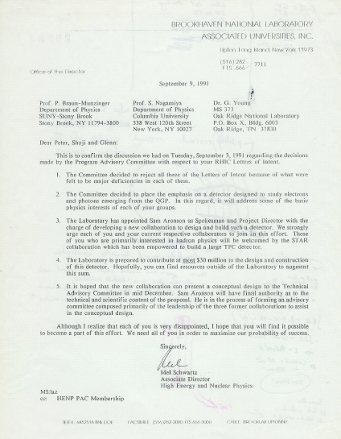

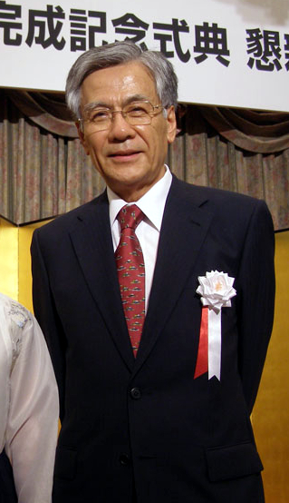
September 1991:
RE2 = RHIC Experiment #2 was created/mandated
Sam made hundreds of wise decisions in leading this budget-constrained, time-constrained project to spectacular success as the PHENIX experiment.
The wisest of these: Appointing Shoji Nagamiya as spokesperson.
“reject all three Letters of Intent because of what were felt to be major deficiencies in each of them.”
“The Laboratory has appointed Sam Aronson as Spokesman and Project Director.”
“The Laboratory is prepared to contribute at most $30 million to the design and construction of this detector.

Slide 6
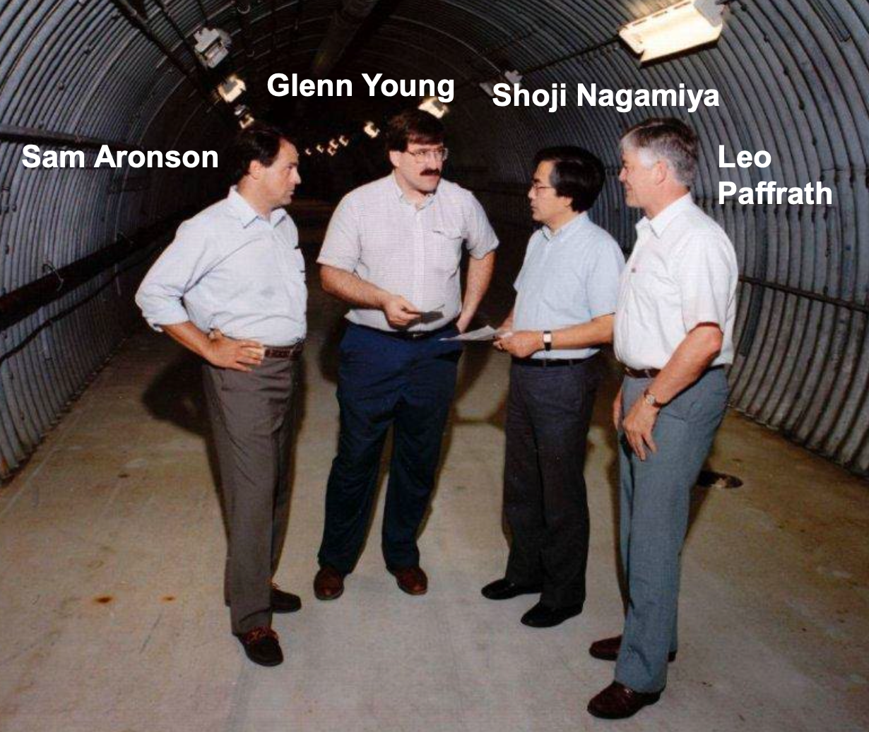
Sam played a central role in shaping and supporting this joint effort.
I recall many occasions when I discussed physics and plans with him—at BNL, on boat outings, over meals at restaurants, and at his home during those days. His insight, leadership, and warm personality left a lasting impression on me.
Preparing (a recent) lecture
brought back many fond memories from the time of the collaboration’s birth.
These memories remain very vivid.
Please accept my heartfelt condolences. I pray that he may rest in peace.
Shoji Nagamiya

Slide 7
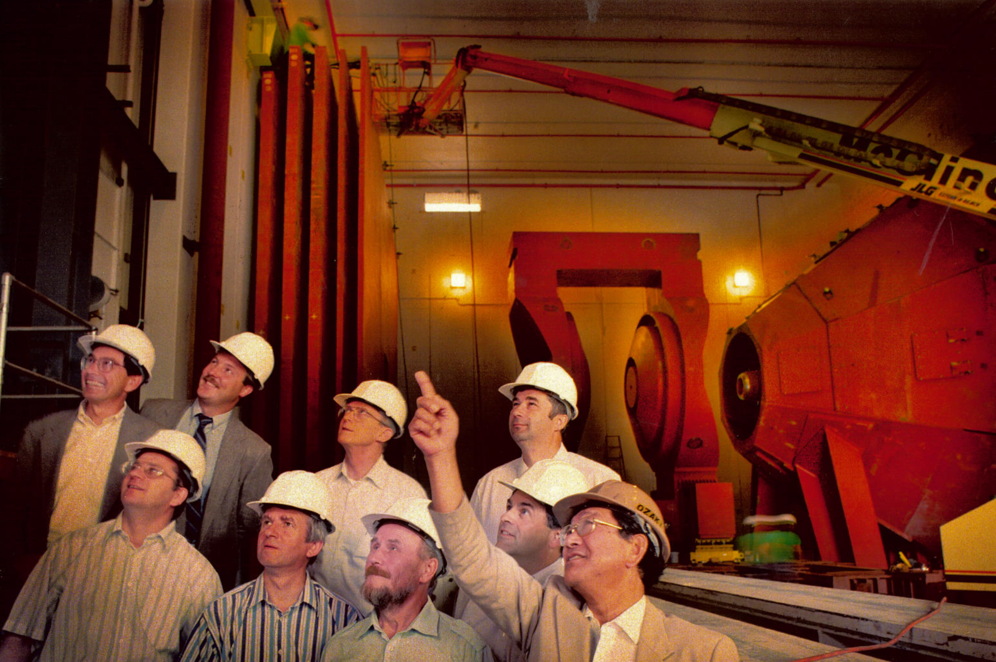
1997: A very fraught process transforming this . . .

Slide 8
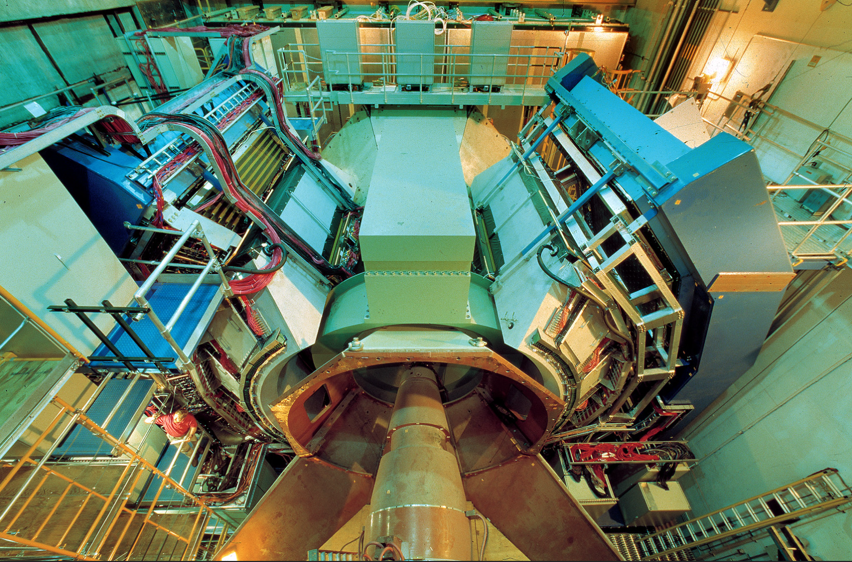
2002 . . . to this
Notes:
She (Rachel) dearly hoped that green was a peaceful choice because she knew everyone would be collaborating for long hours indoors.

Slide 9
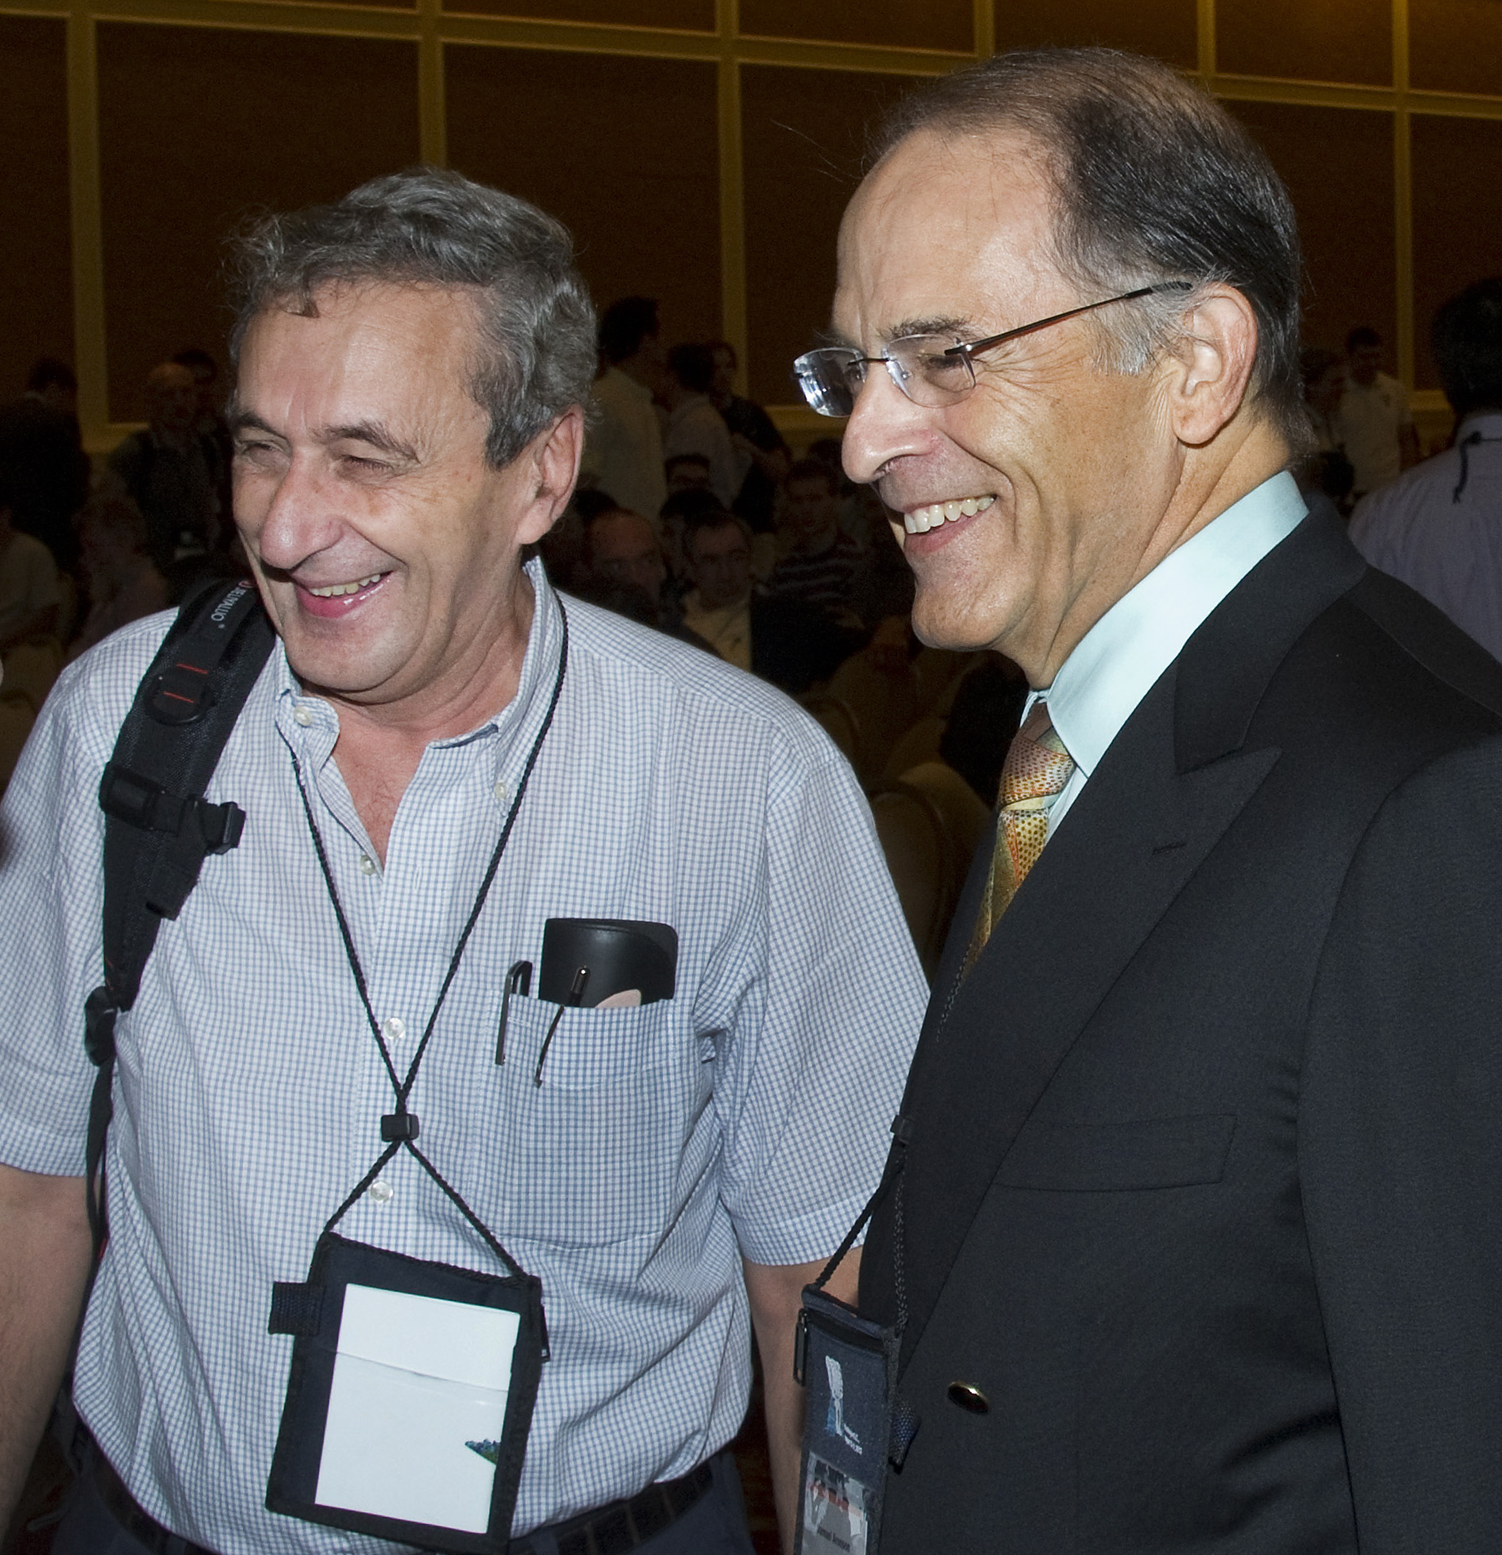
Some Hints of the Challenges PHENIX Faced
I am deeply saddened by the passing of Sam Aronson.
I met Sam almost 30 years ago when I joined PHENIX and was immediately impressed by his unique personality. . . I admired the way he managed the numerous long-day meetings, with exceptional calm, taking notes and going deeply into every detail, always demonstrating excellent judgment. I think we owe him special thanks for the fact that PHENIX was ready to take data on day 1 of RHIC. Sam was unassuming, a good man, and a superb science manager. I always enjoyed meeting him and discussing science and much more with him. . ..
Sam will be sorely missed.
Itzhak Tserruya

Slide 10
Some Hints of the Challenges PHENIX Faced
I am deeply saddened by the passing of Sam Aronson.
I met Sam almost 30 years ago when I joined PHENIX and was immediately impressed by his unique personality. . . I admired the way he managed the numerous long-day meetings, with exceptional calm, taking notes and going deeply into every detail, always demonstrating excellent judgment. I think we owe him special thanks for the fact that PHENIX was ready to take data on day 1 of RHIC. Sam was unassuming, a good man, and a superb science manager. I always enjoyed meeting him and discussing science and much more with him. . ..
Sam will be sorely missed.
Itzhak Tserruya

Slide 11
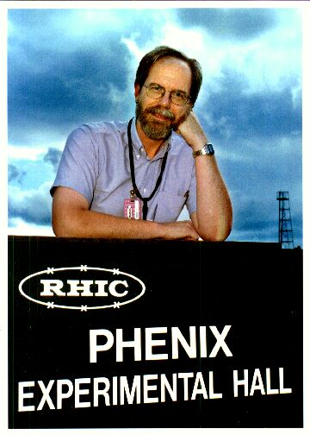
Some Hints of the Challenges PHENIX Faced
My most vivid memories of Sam are of a man who without fail treated people with respect and dignity, even in the most trying of circumstances. And circumstances were often pretty trying.
My happy years on PHENIX were in many ways due to Sam, and I think he was able to get the best work from people partly by his ability to overlook their faults and foibles.
Possibly the most valuable lesson he taught me was to admit challenges and problems and your own uncertainty. . . In this way, he extracted from the collective consciousness the best (or least bad) alternative. I hope I adopted that same approach to working with people, but Sam was the master.
Rest in peace, Sam.
John Haggerty

Slide 12
Some Hints of the Challenges PHENIX Faced
My most vivid memories of Sam are of a man who without fail treated people with respect and dignity, even in the most trying of circumstances. And circumstances were often pretty trying.
My happy years on PHENIX were in many ways due to Sam, and I think he was able to get the best work from people partly by his ability to overlook their faults and foibles.
Possibly the most valuable lesson he taught me was to admit challenges and problems and your own uncertainty. . . In this way, he extracted from the collective consciousness the best (or least bad) alternative. I hope I adopted that same approach to working with people, but Sam was the master.
Rest in peace, Sam.
John Haggerty

Slide 13
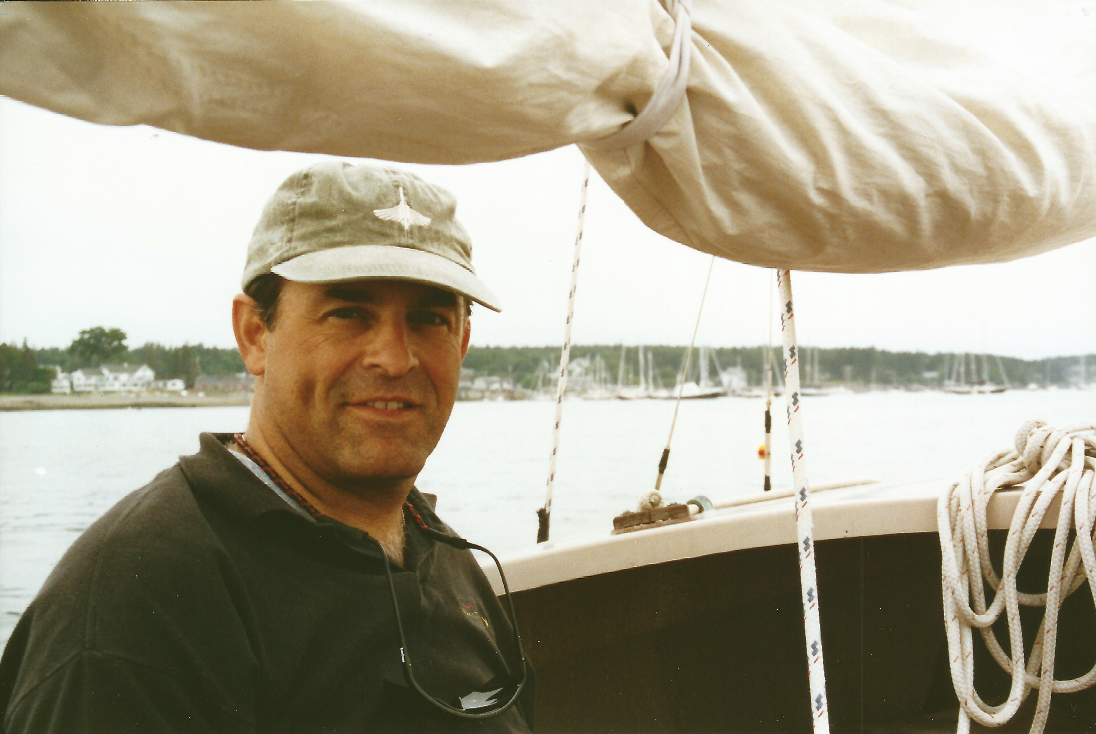
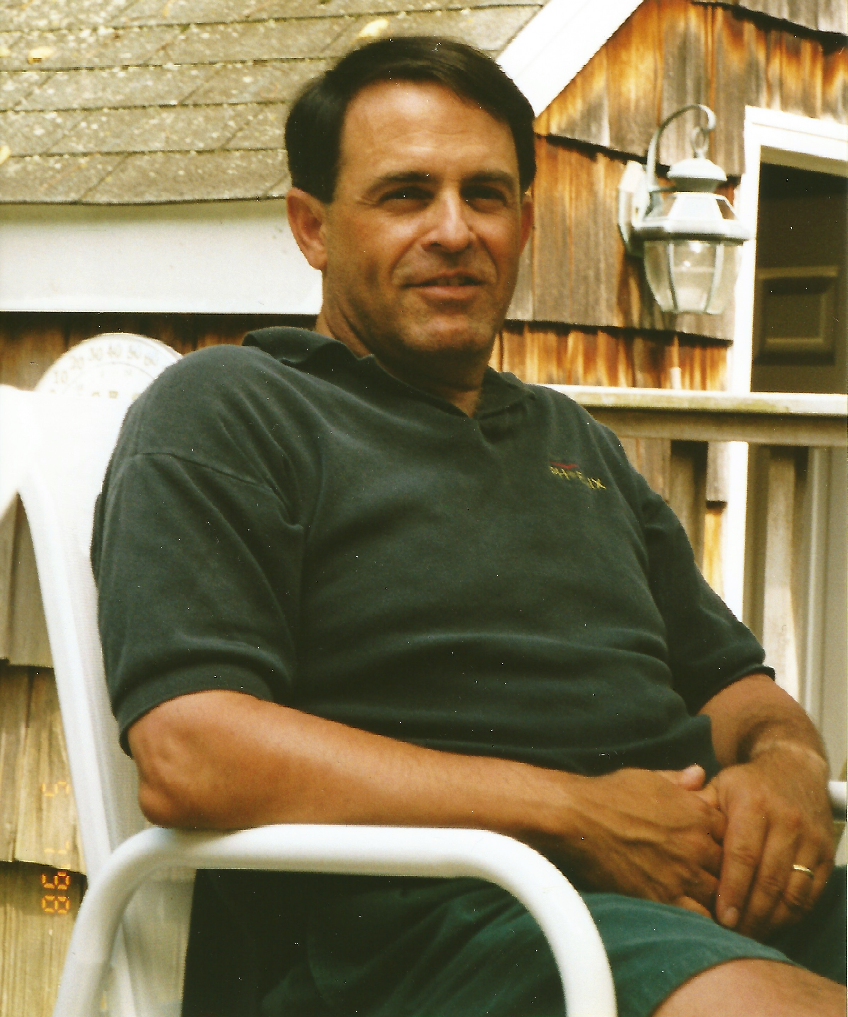
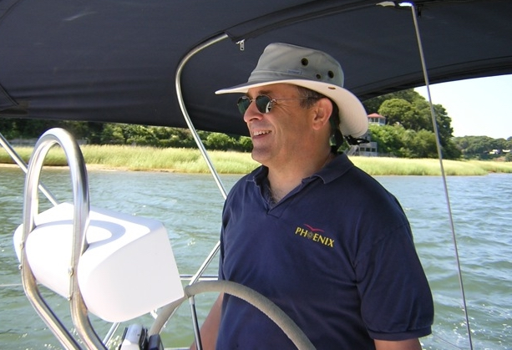
Sam’s favorite forms of stress management

Slide 14
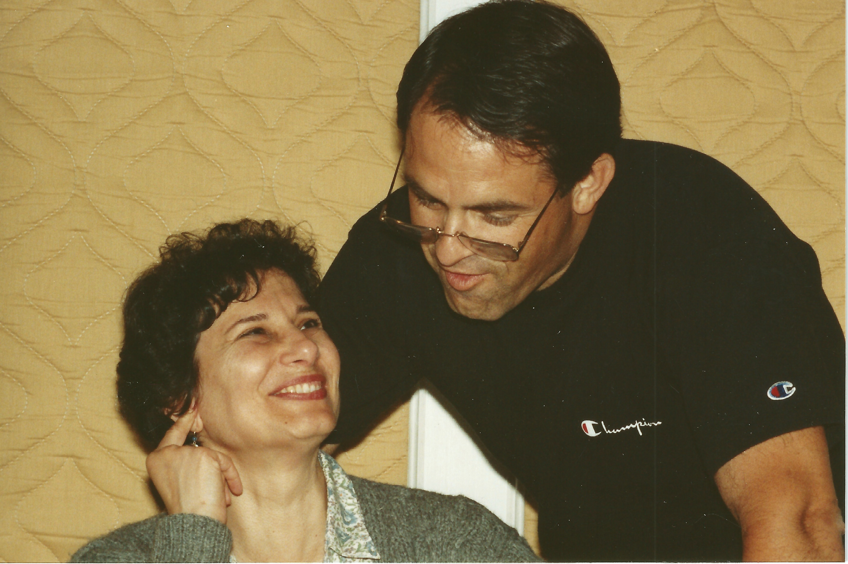
Sam’s true source of strength

Slide 15
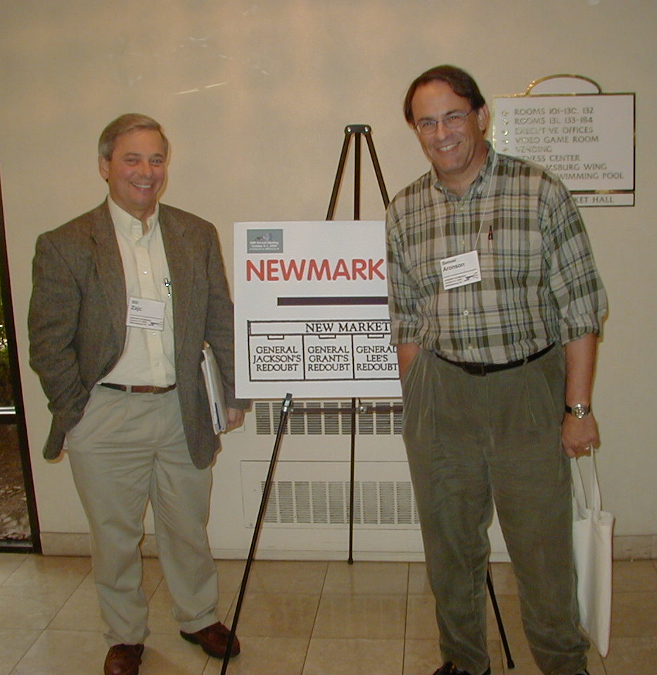
October 2000
Division of Nuclear Physics Meeting, Williamsburg, VA
We are smiling because we knew that PHENIX had taken quality and important data in the first RHIC run!

Slide 16
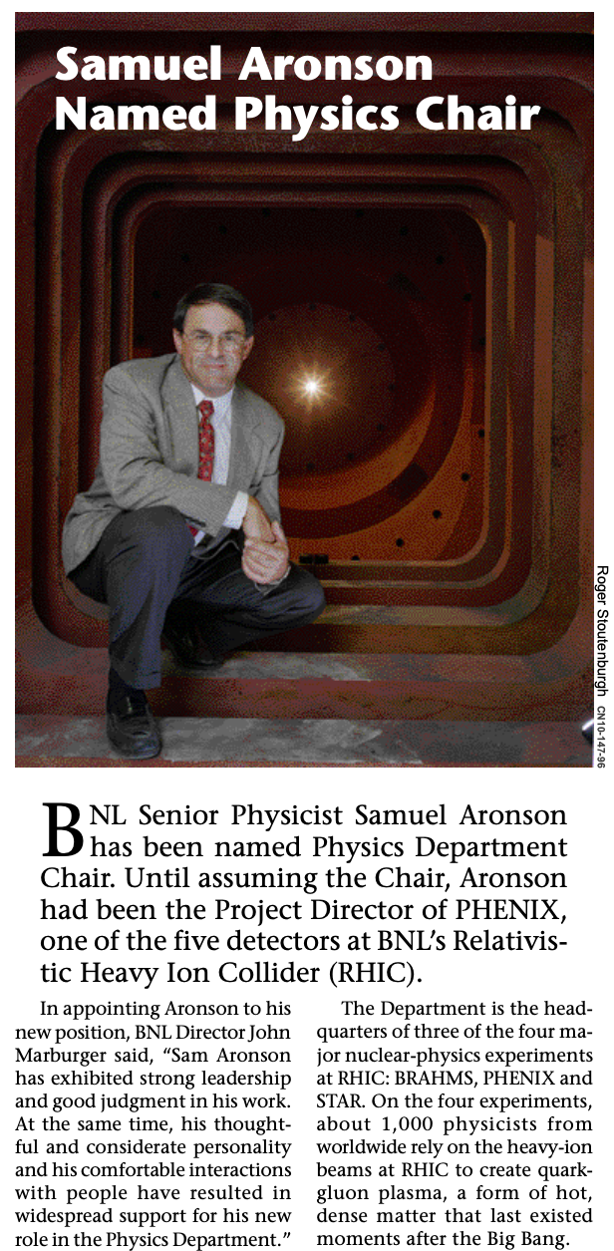
September 2001
In this role as Physics Chair, Sam would play an outsized role in developing the RHIC physics program and its results.
My message to him as he was attempting to decouple from PHENIX:
“From a legal standpoint, you are the person most vested in PHENIX. That this is also true technically and scientifically is a tribute to your dedication and leadership over the past 15 years. That you managed to prop up a new and inexperienced spokesperson during some significant fraction of that time only adds to the luster of your accomplishments.”
Notes:
https://www.bnl.gov/bnlweb/pubaf/bulletin/files/2001/20011005.pdf
(Officially 25-Sep-01)

Slide 17
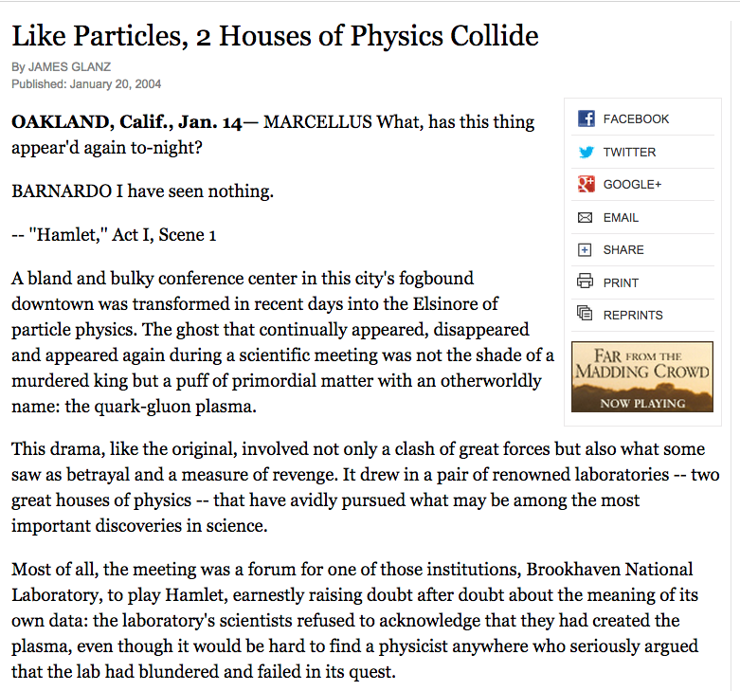
Quark Matter 2004
In handling this issue Sam played an essential role as the “diplomatic envoy” between senior lab personnel and the 4 RHIC experiments:
12-Feb-04 email message
“More on the RHIC Science Retreat”
from Sam to Tim Hallman and WAZ: I told XX et al. that I felt like I was going out of a Mafia meeting with instructions to set up a meet with the other Family.

Slide 18
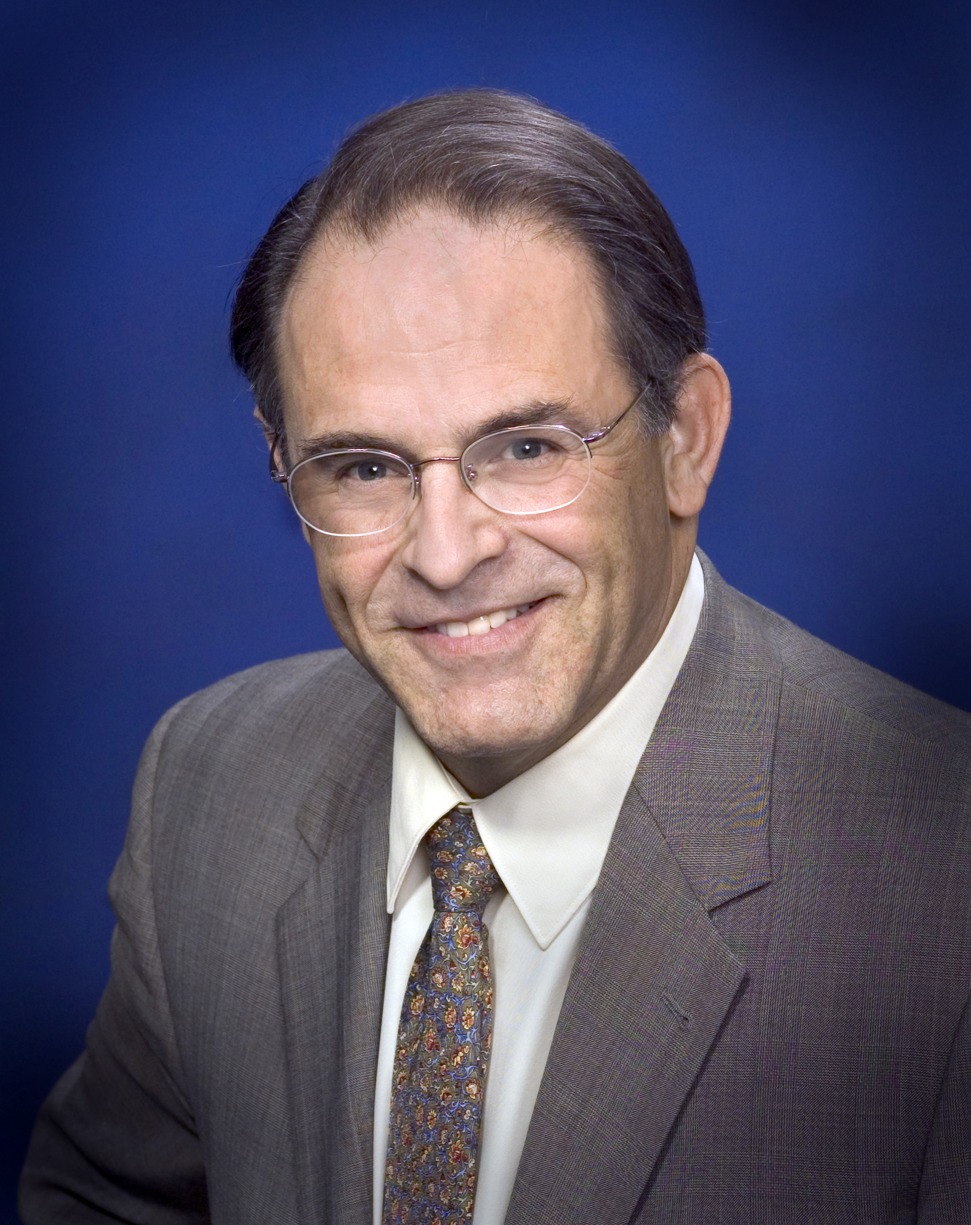
April 13, 2005:
Sam was appointed as Associate Laboratory Director (ALD) for Nuclear and Particle Physics:
"We're seeing some of the worst budgets and budget forecasts in a very long time. The challenge is to maintain and advance a compelling science program at Brookhaven Lab in the face of these decreased budgets.”
Sam Aronson
Notes:
https://www.bnl.gov/newsroom/news.php?a=110305 This too shall pass

Slide 19
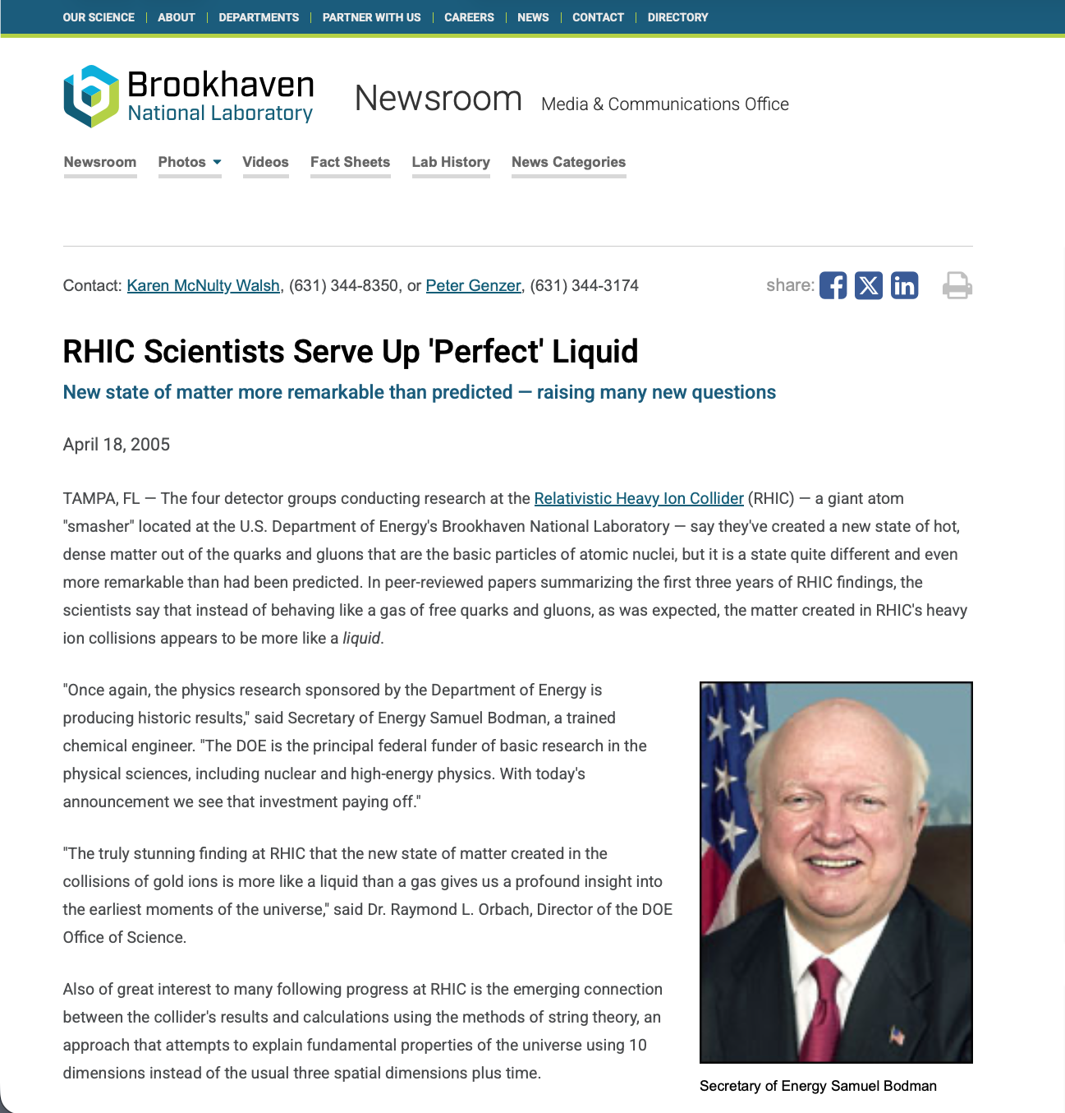
April 18, 2005: Announcement of the “perfect liquid” discovery:

Slide 20
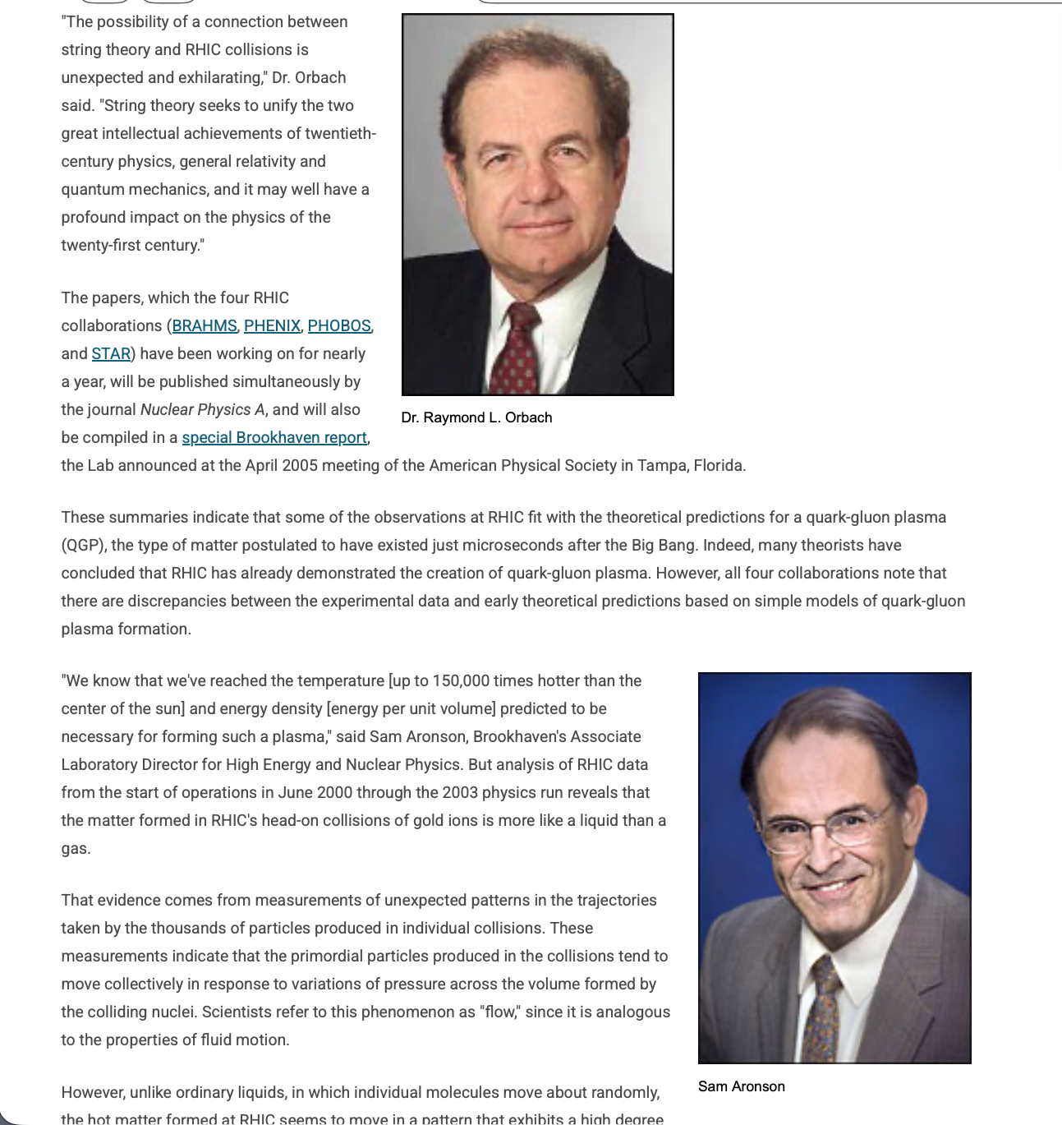
April 18, 2005: Announcement of the “perfect liquid” discovery:
We know that we've reached the temperature (up to 150,000 times hotter than the center of the sun) and energy density (energy per unit volume) predicted to be necessary for forming such a plasma. This is fluid motion that is nearly perfect. In fact, the degree of collective interaction, rapid thermalization, and extremely low viscosity of the matter being formed at RHIC make this the most nearly perfect liquid ever observed.
- Sam Aronson

Slide 21
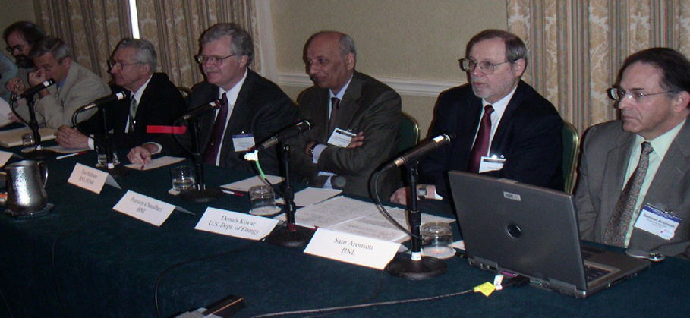
Press Event at April 2005 APS Meeting

Slide 22
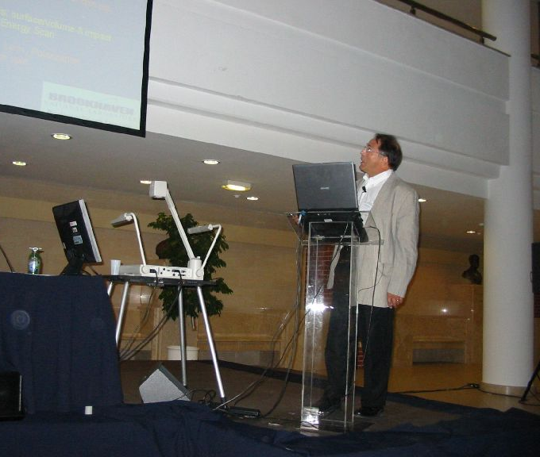
August 8th, 2005
Sam as ALD presenting his talk The Future of RHIC
at Quark Matter 2005
“long term” - eRHIC

Slide 23
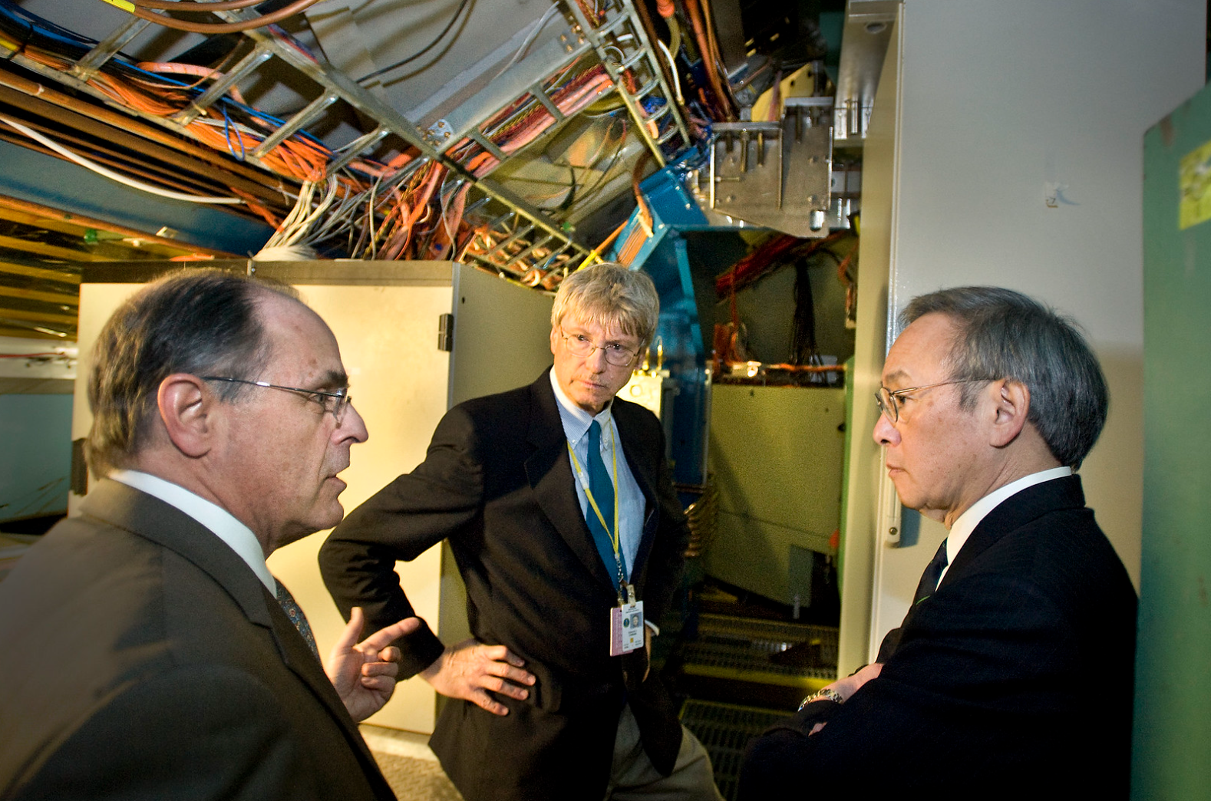
2009 – Sam returns to PHENIX
PHENIX Project Director Ed O’Brien
Secretary of Energy Steven Chu
Notes:
https://www.flickr.com/photos/brookhavenlab/5660802169/

Slide 24
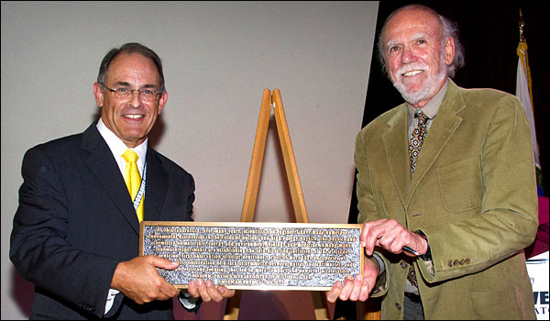
2011 – BNL as Physics Historic Site
APS 2011 President Barry Barish
Notes:
https://www.bnl.gov/newsroom/news.php?a=22596

Slide 25
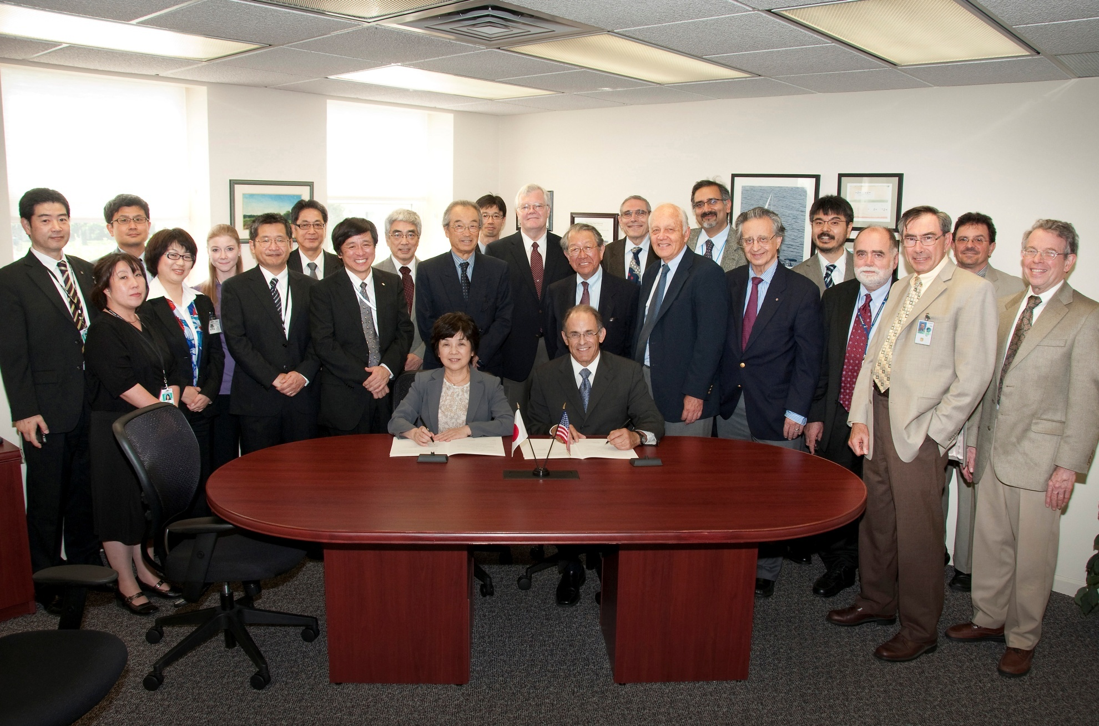
2012 – Signing Updated RBRC Agreement

Slide 26
2015 President of American Physical Society
I was so sorry to hear of Sam's passing.
I met him on several occasions through the Panel on Public Affairs in the DC office, and he was always pleasant to work with.
He . . . was on the Presidential Line from 2013–2016. That was right around the time of Corporate Reform . . . Sam led during the years immediately following those governance changes, navigating a new structure that I think has served APS very well over the past decade. Jeanette Russo APS Corporate Secretary

Slide 27
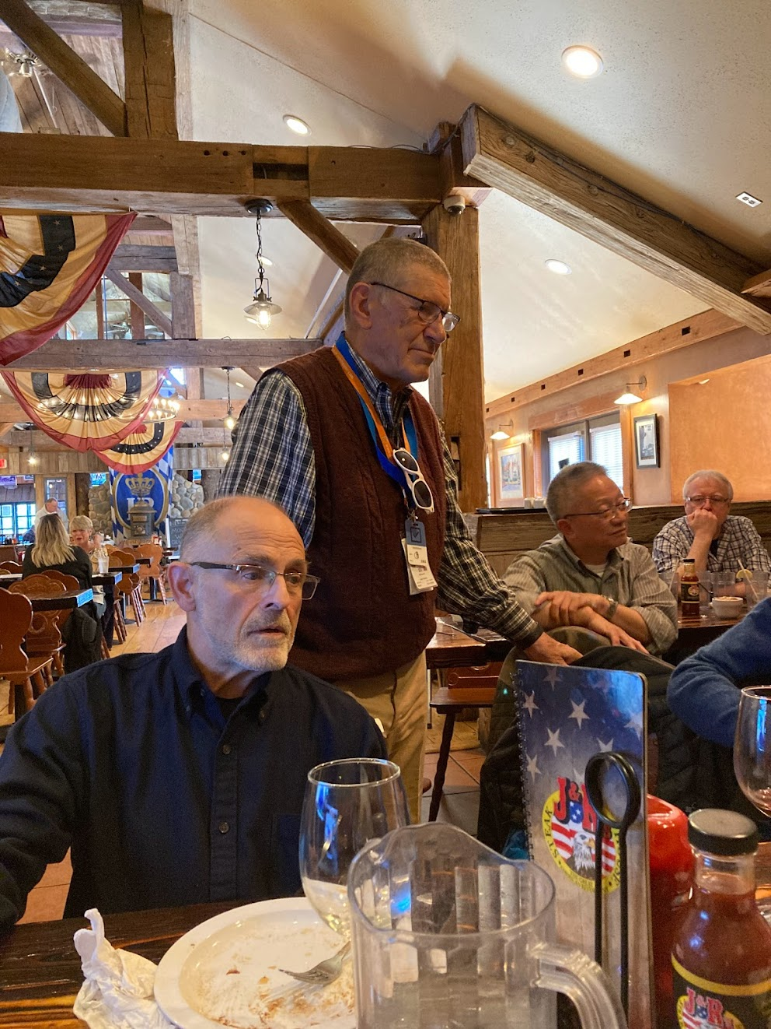
March 25, 2022 Sam and Edward Kistenev
Losing a person of Sam’s caliber is a tragedy for everyone whose life he touched. I am humbled, saddened, and trying to gather and preserve these memories. . .
I pray that he may rest in peace.
Edward Kistenev
Notes:
https://photos.google.com/share/AF1QipMKeDmMs8pwJm_o0sNtFNIxX1j31W051PDbtvT5S1ELhBnWQMVn7DG6YGLY7sEEfg/photo/AF1QipMB1B3c5Sb2kzueoW2kLqb28YNYw2EXVVujXrGU?key=NVR6eEs5ZWxOb3c2SGJpU2pycXpQTE1lZDItVlNR
From
Mike and Edward’s retirement lunch, March 25, 2022
https://photos.google.com/share/AF1QipMKeDmMs8pwJm_o0sNtFNIxX1j31W051PDbtvT5S1ELhBnWQMVn7DG6YGLY7sEEfg?key=NVR6eEs5ZWxOb3c2SGJpU2pycXpQTE1lZDItVlNR

Slide 28
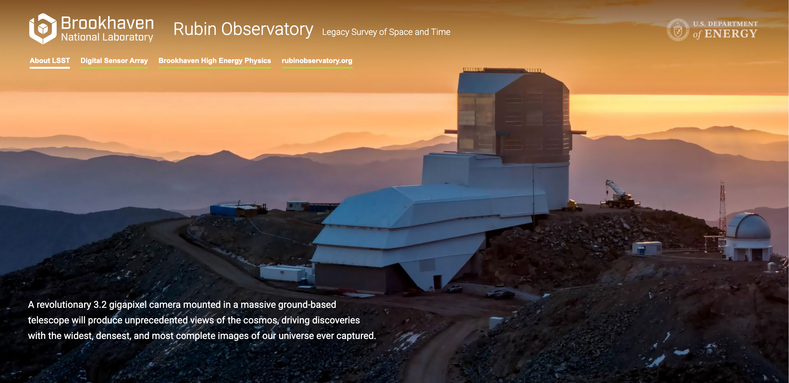
One of Sam’s Many Legacies
Notes:
https://www.bnl.gov/lsst/

Slide 29
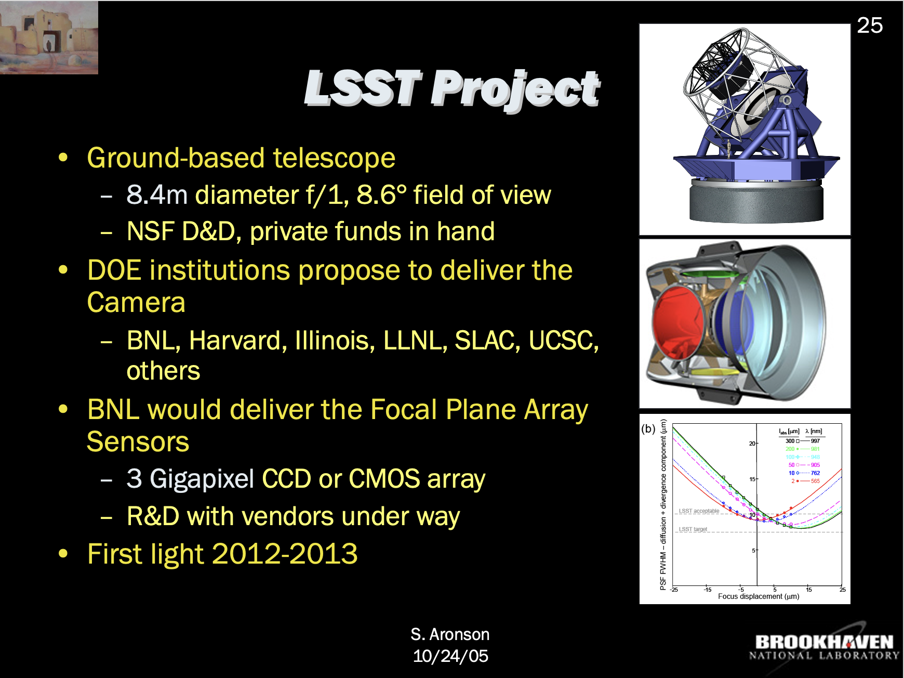
One of Sam’s Many Legacies
Notes:
https://www.bnl.gov/lsst/

Slide 30
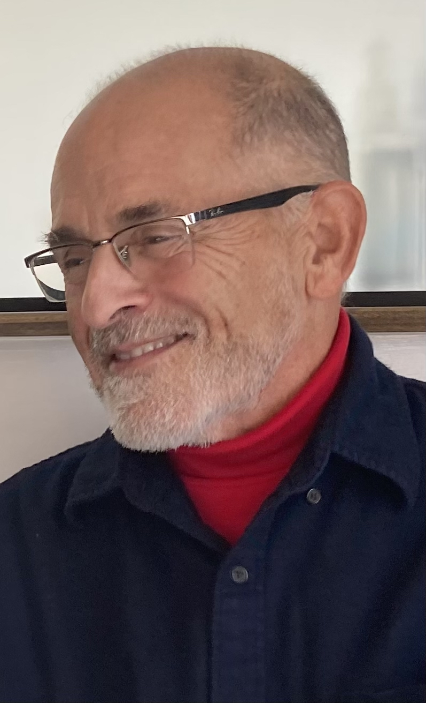
One of Sam’s Many Legacies
Notes:
https://www.bnl.gov/lsst/

Slide 31

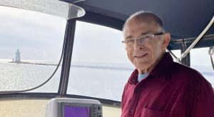

Slide 32


Slide 33
Rest in Peace, Sam
presented at the
2026 RHIC/AGS Annual Users’ Meeting Brookhaven National Laboratory
May 15th, 2026 W.A. Zajc Columbia University
Profound thanks to Joe and Rachel Aronson, Yasuyuki Akiba, Tamas Csorgo, Hideto Enyo, Yuji Goto, Wlodek Guryn, John Haggerty, Edward Kistenev, Shoji Nagamiya, Ed O’Brien, Jeanette Russo, Keiko Suzuki and Itzhak Tserruya
This work was supported by the United States Department of Energy Grant DOE-FG02-86ER-40281
Notes:
Thanks to Joe and Rachel Aronson, Tamas Csorgo, Wlodek Guryn, John Haggerty, Edward Kistenev, Shoji Nagamiya, Ed O’Brien, Jeanette Russo, Itzhak Tserruya
Colleague, friend, mentor
College life lessons
Wit and wisdom → wisdom thru wit
Rueful
All’s well that . . .
“(At the end I told T.D. et al. that I felt like I was going out of a Mafia meeting with instructions to set up a meet with the other Family.)” Sam, 12-Feb-04 to Tim and me , in “More on the RHIC Science Retreat”
On sabbatical 1/30/05 “PHENIX and me”
Town and Gown:
“I think your concerns are valid and collaboration-based; your independence from BNL and from me should be sufficient protection against some sort of backlash. Give 'em hell.” Email 6/5/98 “Re: Many things”
“Losing a person of Sam’s caliber is a tragedy for everyone whose life he touched. I am humbled, saddened, and trying to gather and preserve these memories.
. . I pray that he may rest in peace.” Edward Kistenev

