Slide 1
PHENIX in 10 Minutes
presented at the
2026 RHIC/AGS Annual Users’ Meeting Brookhaven National Laboratory
May 14th, 2026 W.A. Zajc Columbia University
Profound thanks to all my PHENIX Collaborators!
This work was supported by the United States Department of Energy Grant DOE-FG02-86ER-40281
Notes:
Thanks to Joe and Rachel Aronson, Tamas Csorgo, Wlodek Guryn, John Haggerty, Edward Kistenev, Shoji Nagamiya, Ed O’Brien, Jeanette Russo, Itzhak Tserruya
Colleague, friend, mentor
College life lessons
Wit and wisdom → wisdom thru wit
Rueful
All’s well that . . .
“(At the end I told T.D. et al. that I felt like I was going out of a Mafia meeting with instructions to set up a meet with the other Family.)” Sam, 12-Feb-04 to Tim and me , in “More on the RHIC Science Retreat”
On sabbatical 1/30/05 “PHENIX and me”
Town and Gown:
“I think your concerns are valid and collaboration-based; your independence from BNL and from me should be sufficient protection against some sort of backlash. Give 'em hell.” Email 6/5/98 “Re: Many things”
“Losing a person of Sam’s caliber is a tragedy for everyone whose life he touched. I am humbled, saddened, and trying to gather and preserve these memories.
. . I pray that he may rest in peace.” Edward Kistenev

Slide 2
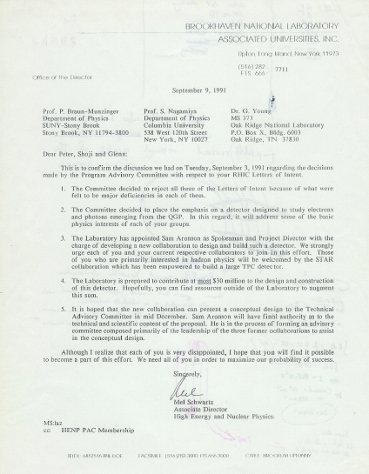
The Birth of “PHENIX”
RIP:
Dimuon
TALES/SPARC
OASIS
Née
RE2
“RHIC Experiment 2”

Slide 3

The Birth of PHENIX
“reject all three Letters of Intent because of what were felt to be major deficiencies in each of them.”
“The Committee decided to place the emphasis on a detector designed to measure electrons and photons emerging from the QGP.”
“The Laboratory has appointed Sam Aronson as Spokesman and Project Director.”
“Those of you who are primarily interested in hadron physics will be welcomed by the STAR Collaboration which has been empowered to build a large TPC detector.”
“The Laboratory is prepared to contribute at most $30 million to the design and construction of this detector.

Slide 4
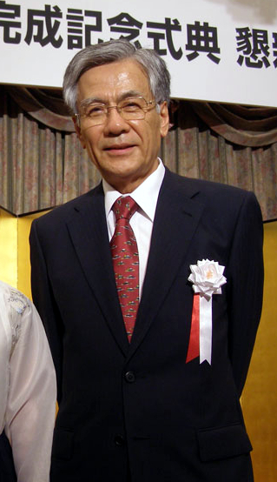
A Long Interregnum…
Dominated by the struggles you can easily imagine that follow from forced marriage of three major experiments…
Most significant event: Profoundly wise decision by Sam Aronson to separate Project Director and Spokesperson ➔ Shoji Nagamiya
先生
大
Notes:
大先生

Slide 5
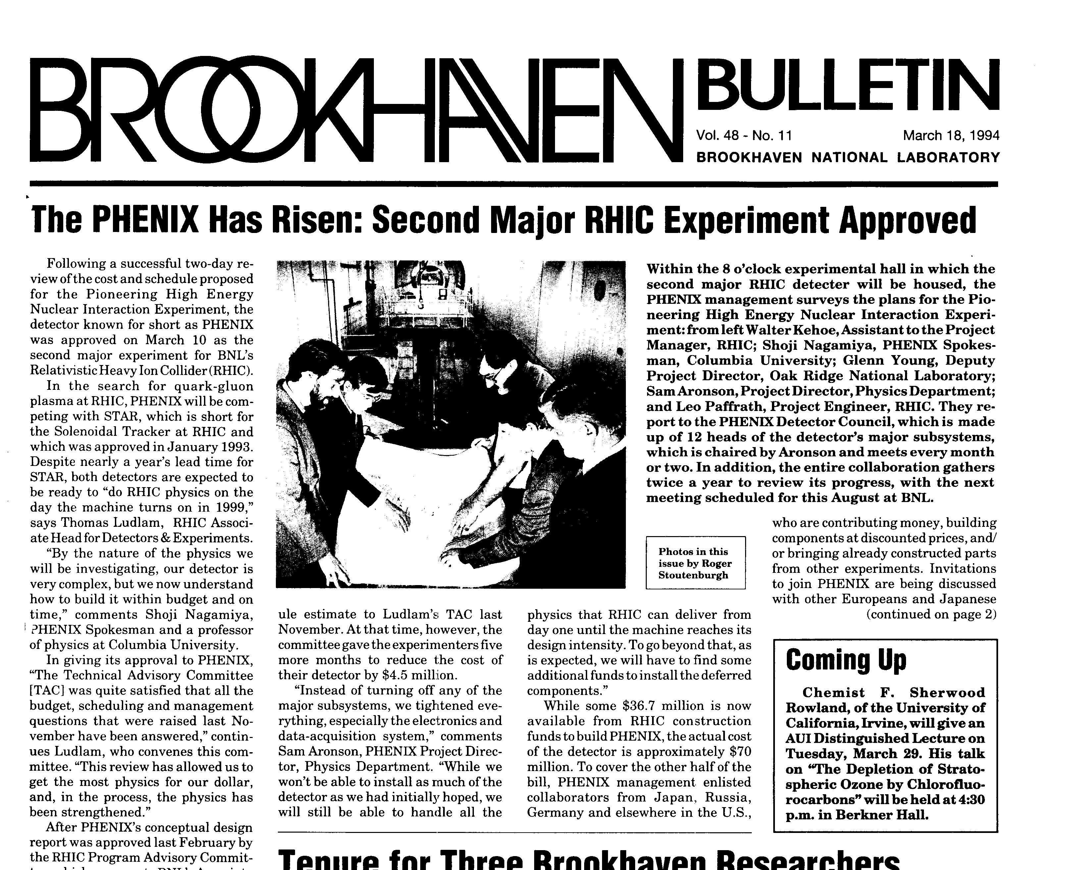
PHENIX Is Born
PHENIX: 10-Mar-94 (STAR: Jan-93)
Despite nearly (sic) a year’s lead time for STAR, both detectors are expected to be ready to “do RHIC physics on the day the machine turns on in 1999”.
(To reduce costs) “Instead of turning off any of the major subsystems, we tightened everything, especially the electronics and data acquisition system”.

Slide 6
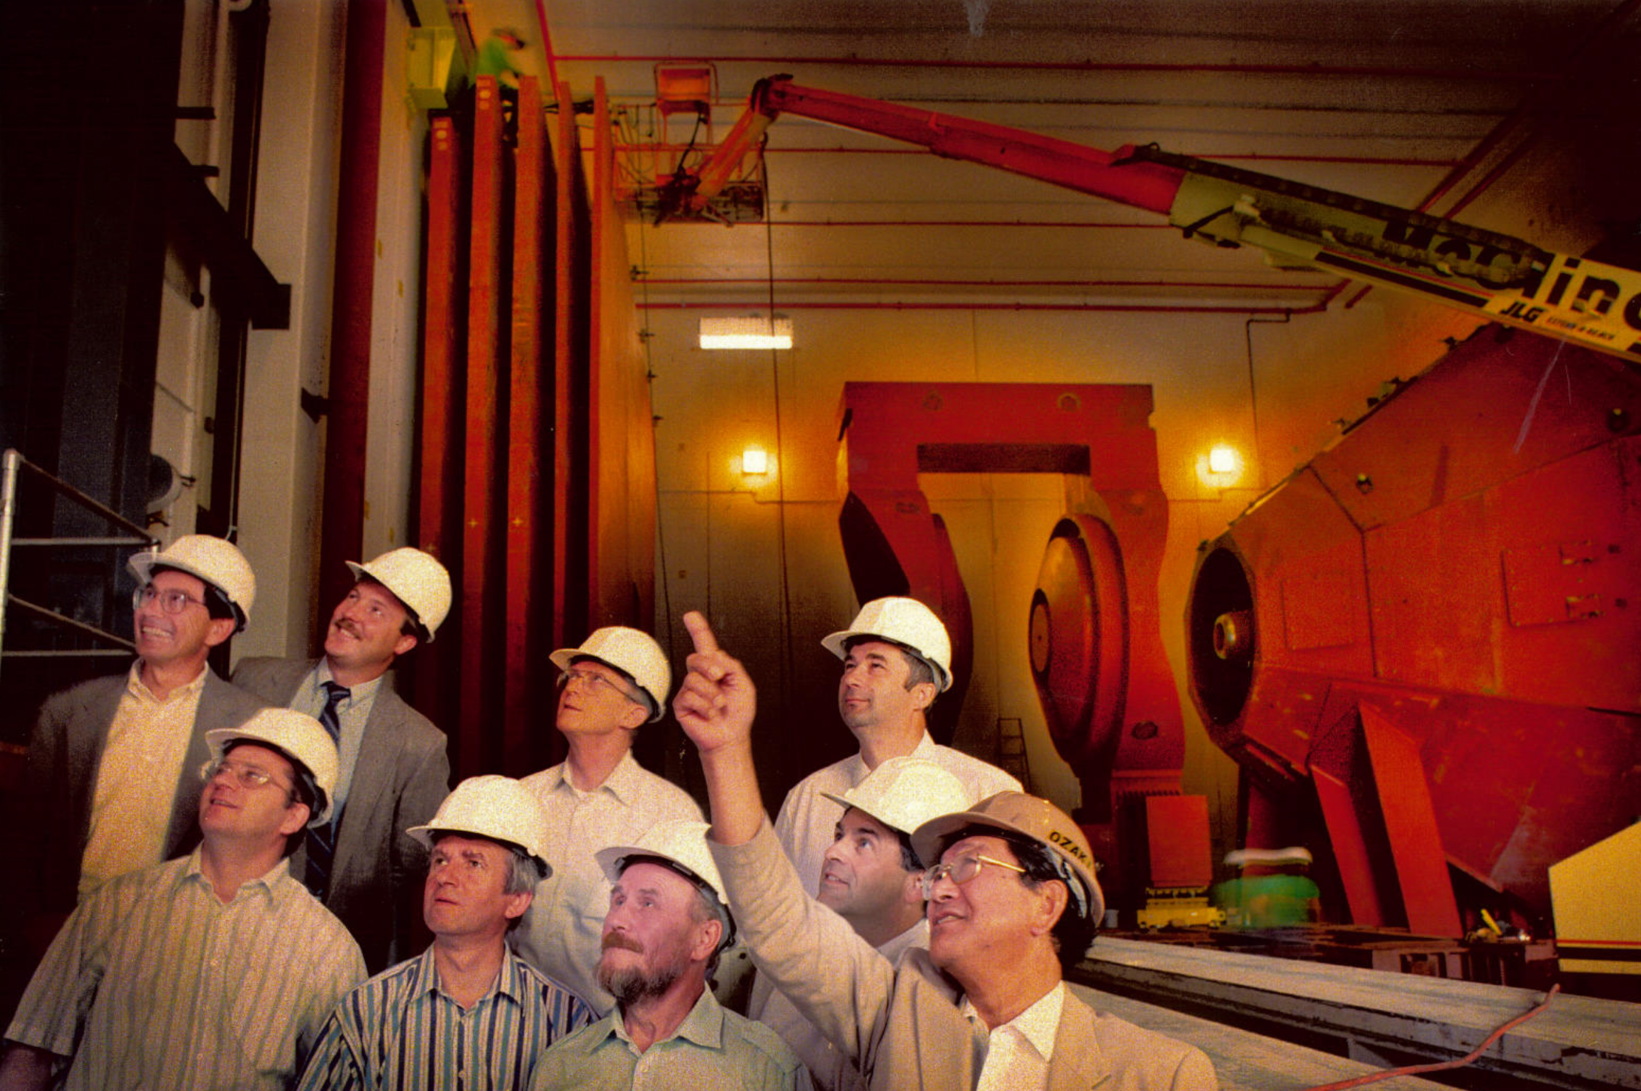
A very fraught process transforming this . . .

Slide 7
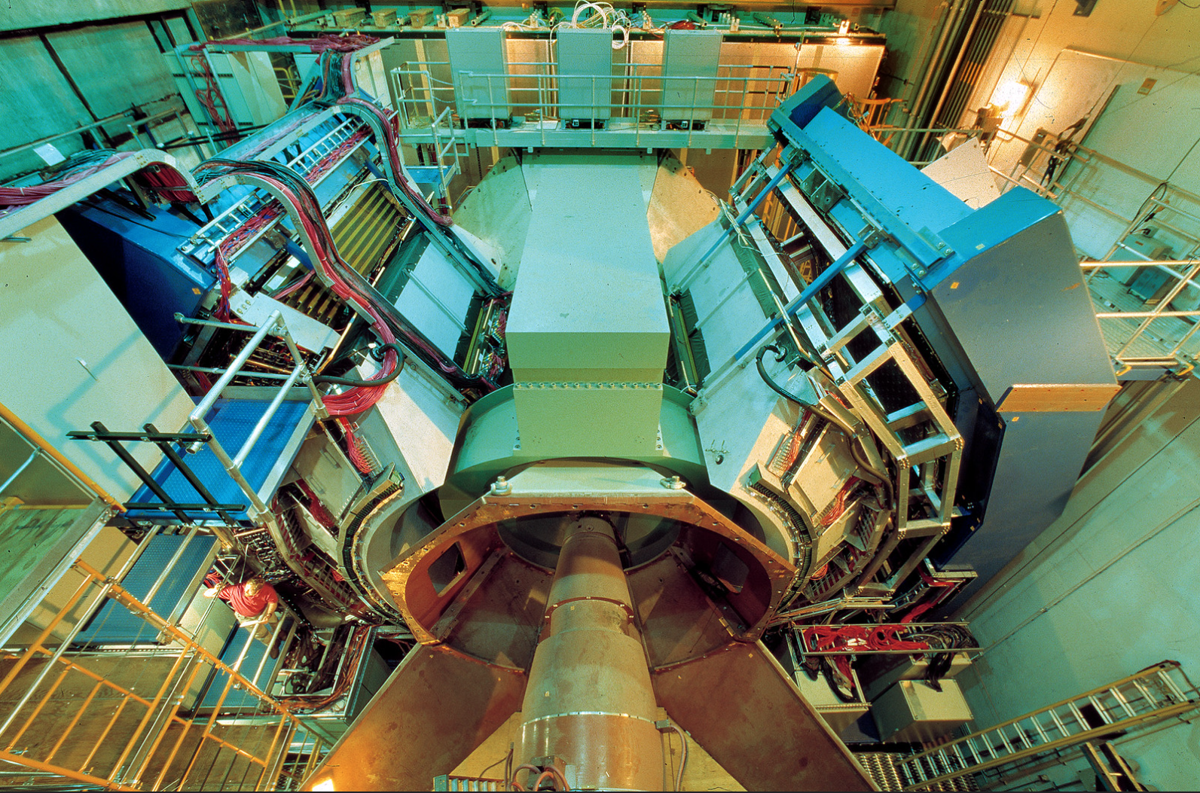
. . . to this

Slide 8
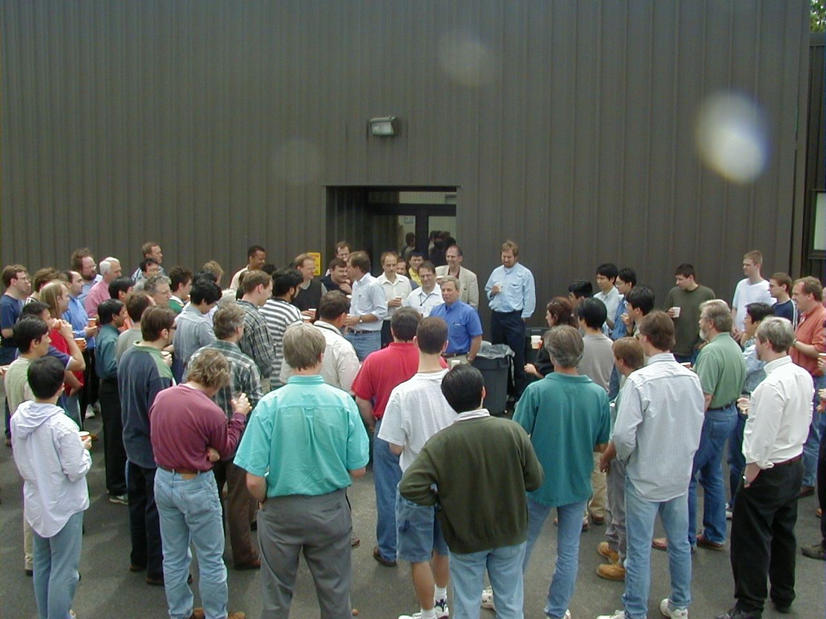
First Event, June 15th, 2000 !

Slide 9
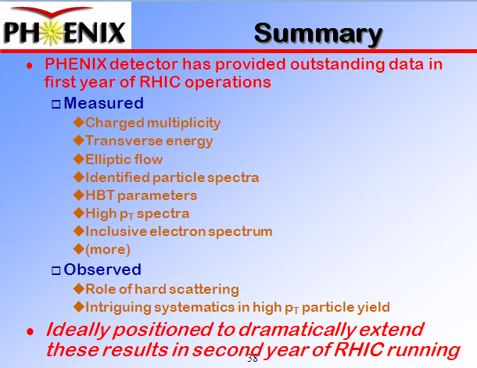
PHENIX Data Debut at QM01

Slide 10
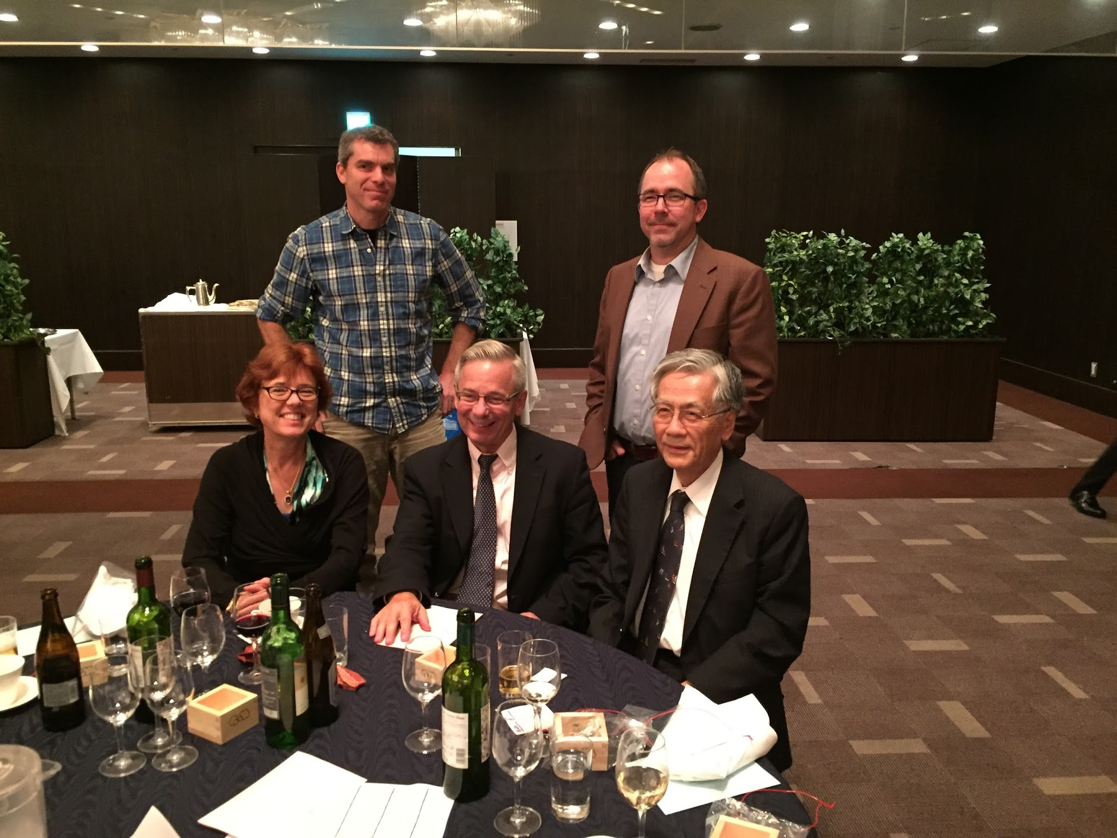
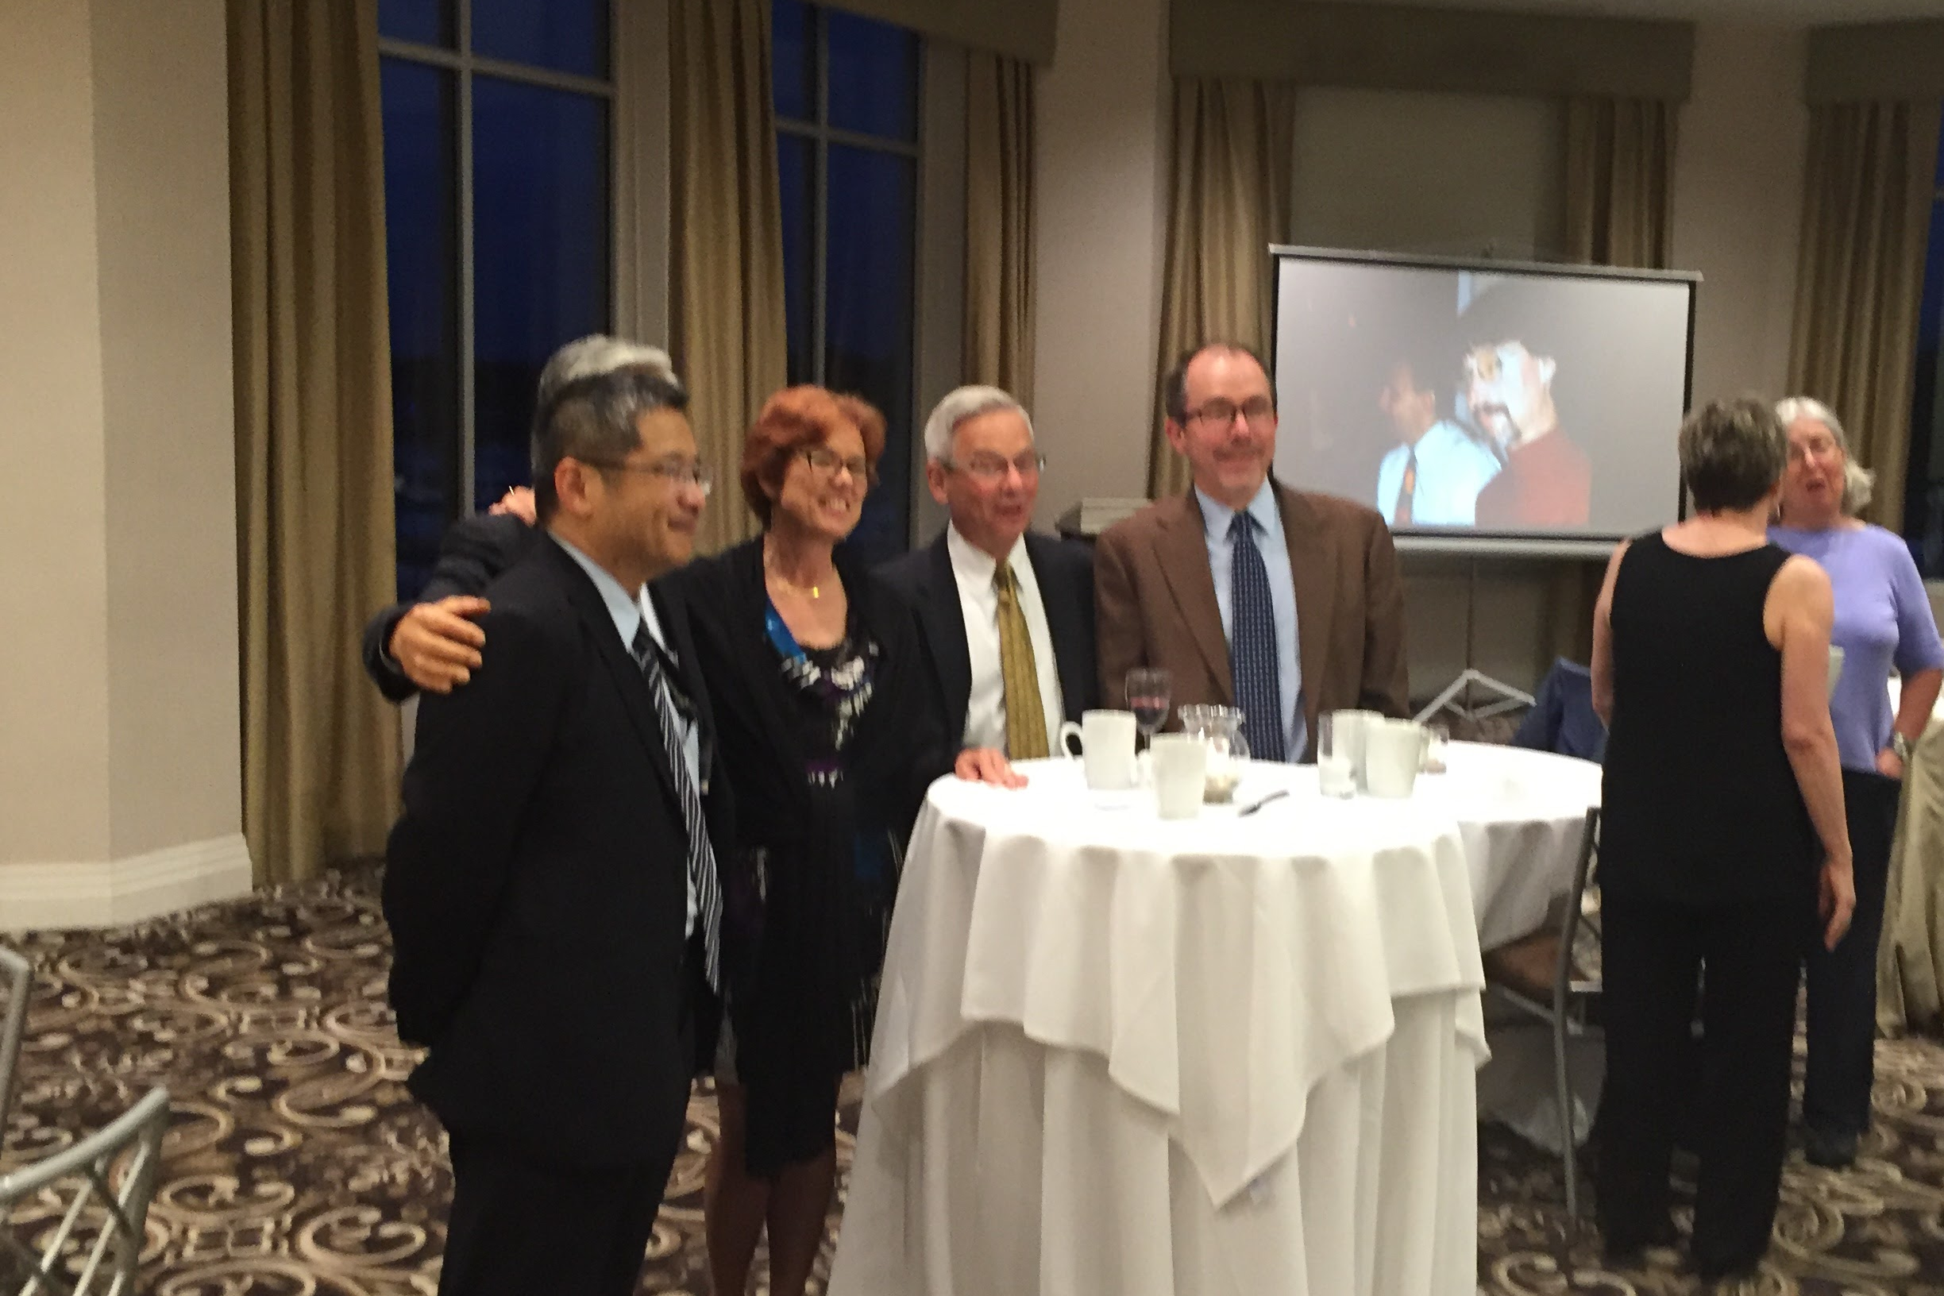
Result from Various PHENIX Generations

Slide 11
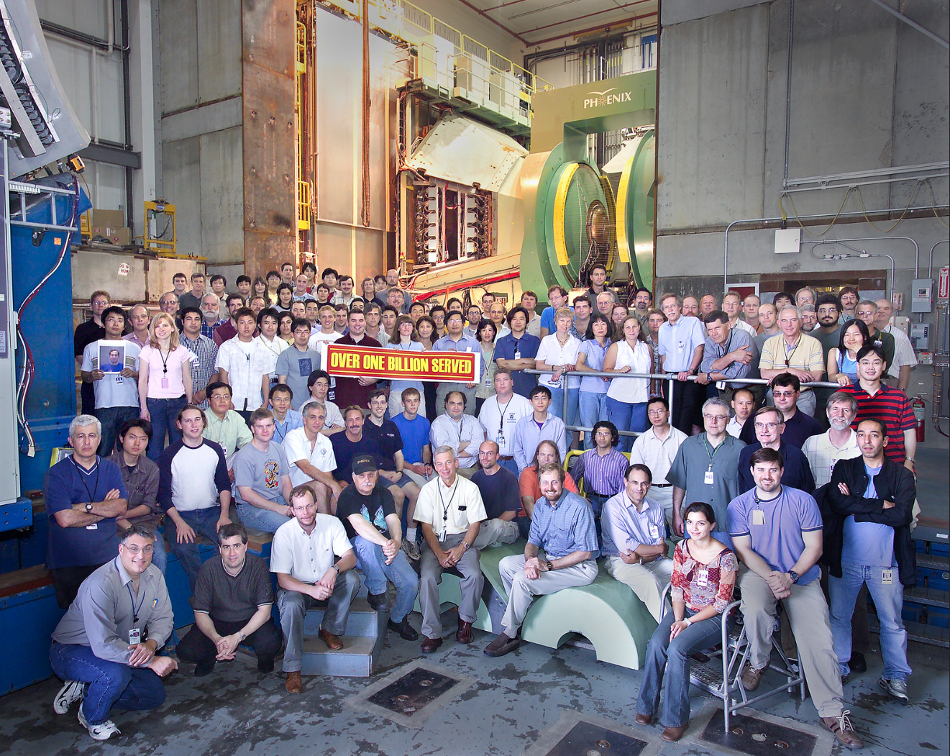
Notes:
https://www.flickr.com/photos/brookhavenlab/3311734728/

Slide 12
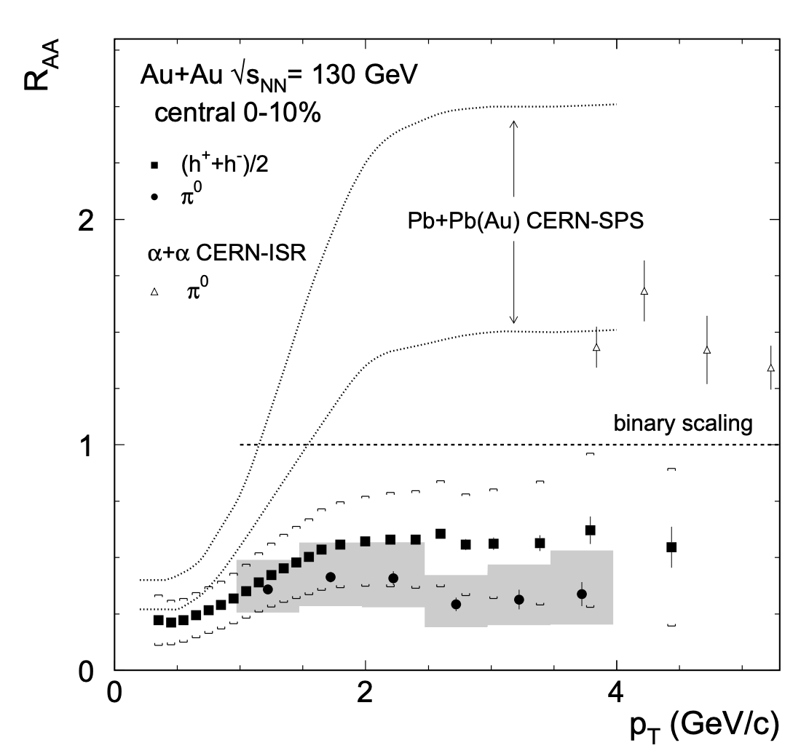
2002: First Result on “Jet” Suppression
Suppression of hadrons with large transverse momentum in central Au+Au collisions at √s_{NN} = 130 GeV, PHENIX Collaboration K. Adcox et al., Phys.Rev.Lett. 88 (2002) 022301 e-Print: nucl-ex/0109003 [nucl-ex]

Slide 13
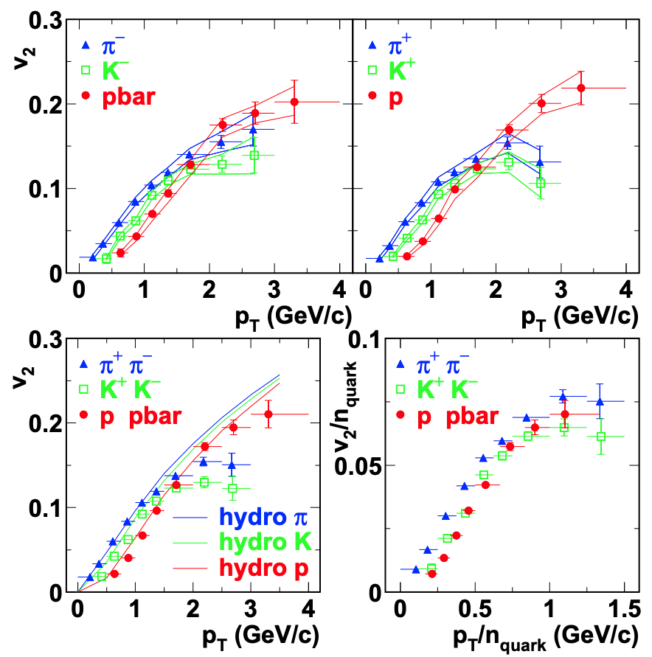
2003: First Look at Quark Recombination Effects
Elliptic flow of identified hadrons in Au+Au collisions at √s_{NN} = 200 GeV, PHENIX Collaboration S.S. Adler et al., Phys.Rev.Lett. 81 (2003) 182301 e-Print: nucl-ex/0305013 [nucl-ex]
“Finally, our scenario requires the assumption of a thermalized partonic phase characterized by an exponential momentum spectrum. Such a phase may be appropriately called a quark-gluon plasma.” Hadronization in heavy ion collisions: Recombination and fragmentation of partons, R. Fries et al., Phys.Rev.Lett. 90 (2003) 202303 e-Print: nucl-th/0301087 [nucl-th]

Slide 14
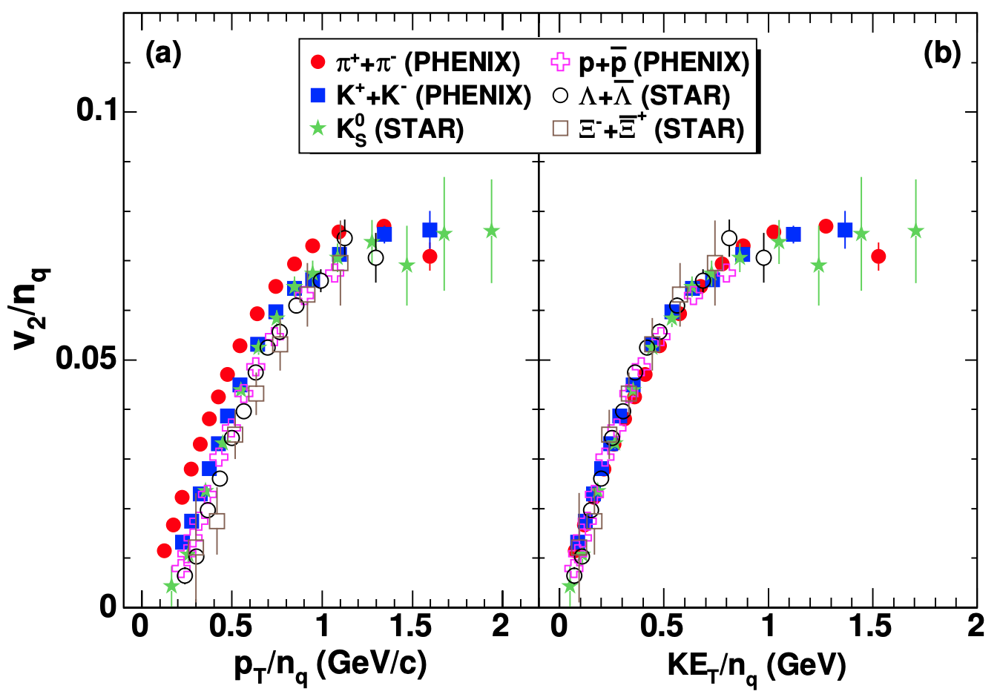
2007: Second Look at Quark Recombination Effects
Scaling properties of azimuthal anisotropy in Au+Au and Cu+Cu collisions at √s_{NN} = 200 GeV, PHENIX Collaboration S.S. Adler et al., Phys.Rev.Lett. 98 (2007) 162301 e-Print: nucl-ex/0608033 [nucl-ex]

Slide 15
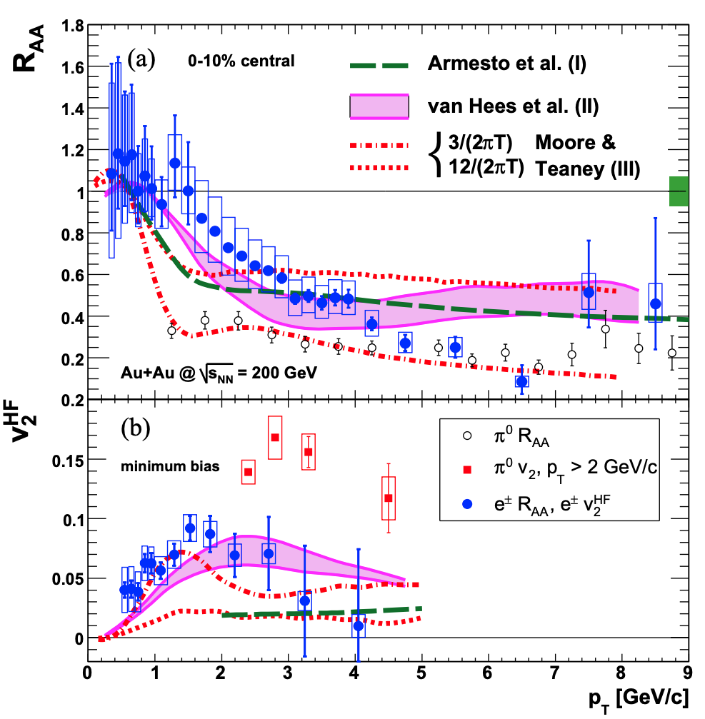
2007: First Look at Heavy Quarks and η/s
“ . . . provides an estimate for the viscosity to entropy ratio η/s ≈ (4/3 − 2)/4π, intriguingly close to the conjectured quantum lower bound 1/4π.”
Energy Loss and Flow of Heavy Quarks in Au+Au Collisions at √s_{NN} = 200 GeV, PHENIX Collaboration S.S. Adler et al., Phys.Rev.Lett. 98 (2007) 172301 e-Print: nucl-ex/0611018 [nucl-ex]

Slide 16
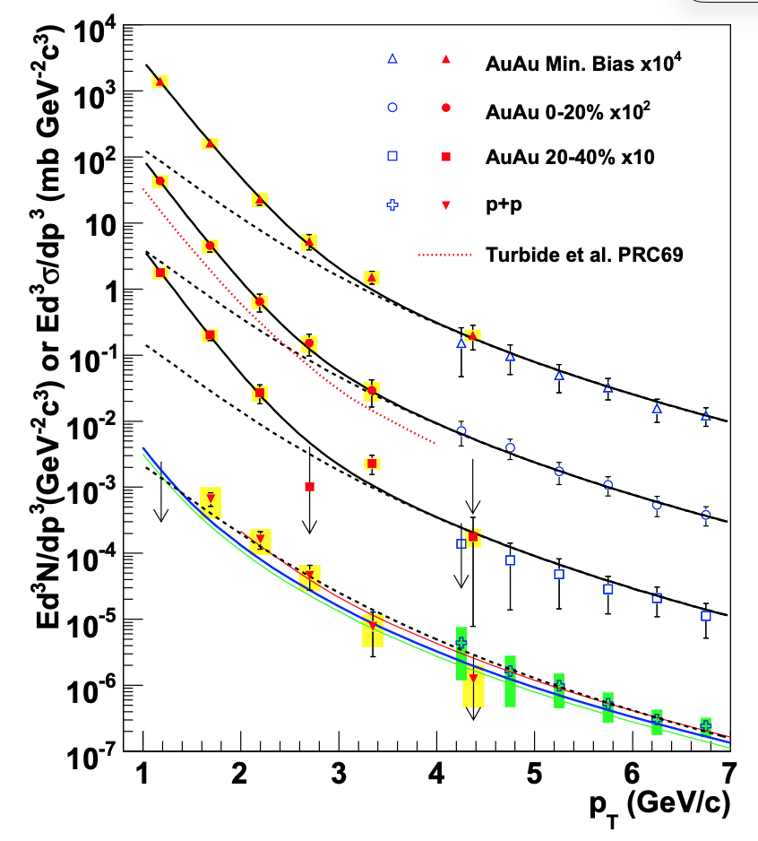
2010: First Measurement of QGP Temperature via Photons
“Hydrodynamical models with T_{init} ∼300–600 MeV at τ₀ ∼0.6–0.15 fm/c are in qualitative agreement with the data. Lattice
QCD predicts a phase transition from hadronic phase to quark gluon plasma at ∼170 MeV.”
Enhanced production of direct photons in Au+Au collisions at √s_{NN} = 200 GeV, and implications for initial temperature, PHENIX Collaboration S.S. Adler et al., Phys.Rev.Lett. 104 (2010) 132301 e-Print: e-Print: 0804.4168 [nucl-ex]

Slide 17
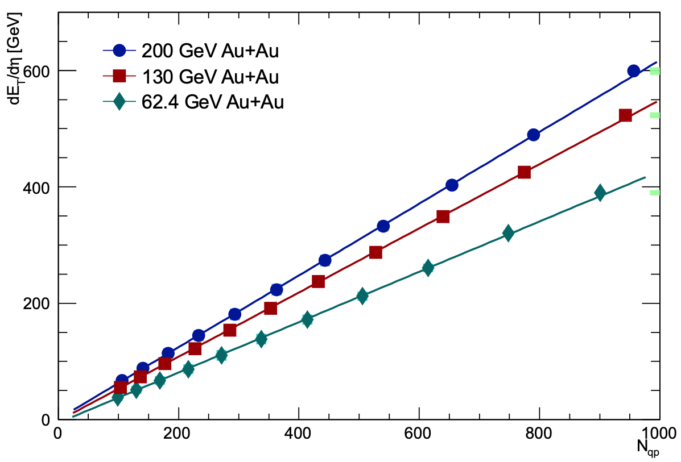
2014: A Hidden Discovery – Quark-Participant Scaling
“This result demonstrates that rather than implying a hard scattering component in N_{ch} and E_{T} distributions, Eq. 6
is instead a proxy for the number of constituent-quark participants Nqp as a function of centrality"
Transverse-energy distributions at midrapidity in p+p, d+Au, and Au+Au collisions at√s_{NN} = 62.4-200 GeV and implications for particle production models, PHENIX Collaboration S.S. Adler et al., Phys. Rev. C89 (2014) 044905 e-Print: e-Print: 1312.6676 [nucl-ex]

Slide 18
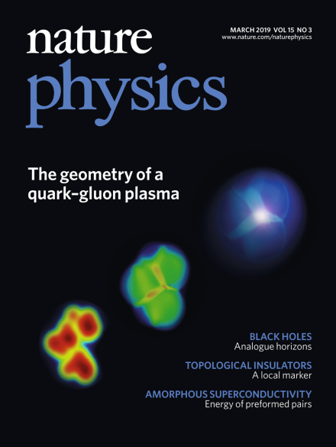
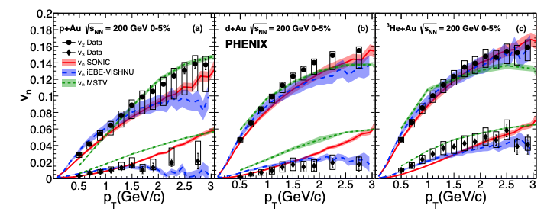
2019: First Examination of Initial Collision Shapes
Creation of quark–gluon plasma droplets with three distinct geometries, PHENIX Collaboration C. Aidala et al., Nature Phys. 15 (2019) 214, e-Print: e-Print: 1805.02973 [nucl-ex]

Slide 19
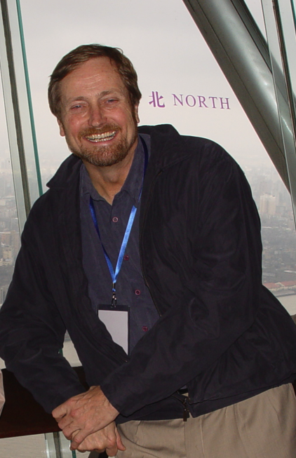
A Unique Bit of PHENIX History
Every one of PHENIX’s nearly 300 publications has been handled by one person:
Brant Johnson, PHENIX Scientific Correspondent to the journals
I am very overdue in publicly acknowledging Brant’s untiring and impeccable work on behalf of PHENIX.

Slide 20
RHIC Discoveries in Perspective
From QCD Made Simple (F. Wilczek, August, 2000 Physics Today ):
. . . we invoke a procedure that is often useful in theoretical physics. . .The stratagem tells you to make clear-cut simplifying assumptions, work out their consequences, and check to see that you don't run into contradictions. In this spirit we tentatively assume that we can describe high-temperature QCD starting with free quarks and gluons.
But there is a second, more rigorous level that remains a challenge for the future. Using fundamental aspects of QCD theory, similar to those I discussed in connection with jets, one can make quantitative predictions for the emission of various kinds of "hard" radiation from a quark-­gluon plasma. We will not have done justice to the concept of a weakly interacting plasma of quarks and gluons until some of these predictions are confirmed by experiment.

Slide 21
RHIC Discoveries in Perspective
RHIC’s data produced a paradigm shift in our understanding of the quark-gluon plasma.
Nothing could be further from the truth than the old model of QGP as a state where quarks “are liberated to roam freely”.
Rather, for thermal QCD, asymptotic freedom is relevant only asymptotically (!)
Instead – the quark-gluon plasma is the most strongly-coupled liquid ever produced, quantified in the very low value of η/s .
This will be (is) the textbook legacy of RHIC.

Slide 22
Back-up Material
W.A. Zajc Physics Department
Columbia University, New York, NY
Thanks to all my PHENIX Collaborators and other colleagues at RHIC
This work was supported by the United States Department of Energy Grant DOE-FG02-86ER-40281
Notes:
Mar-99 Private Hulk
Time to physics
Youngest
Pub history from vigdor
QGP cites
Praveen?
T-shirt plot
Luminosity from Roser
Chair?

Slide 23
RHIC Discoveries in Perspective
From QCD Made Simple (F. Wilczek, August, 2000 Physics Today ):
. . . we invoke a procedure that is often useful in theoretical physics. I call it the Jesuit Stratagem, inspired by what I'm told is a credal tenet of the Order: "It is more blessed to ask forgiveness than permission.'' The stratagem tells you to make clear-cut simplifying assumptions, work out their consequences, and check to see that you don't run into contradictions. In this spirit we tentatively assume that we can describe high-temperature QCD starting with free quarks and gluons.
But there is a second, more rigorous level that remains a challenge for the future. Using fundamental aspects of QCD theory, similar to those I discussed in connection with jets, one can make quantitative predictions for the emission of various kinds of "hard" radiation from a quark-­gluon plasma. We will not have done justice to the concept of a weakly interacting plasma of quarks and gluons until some of these predictions are confirmed by experiment.

Slide 24
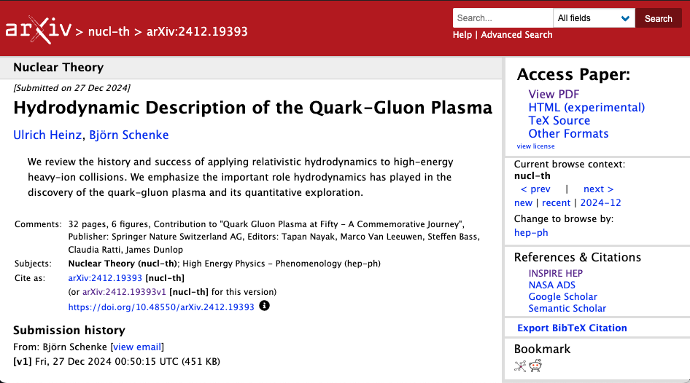
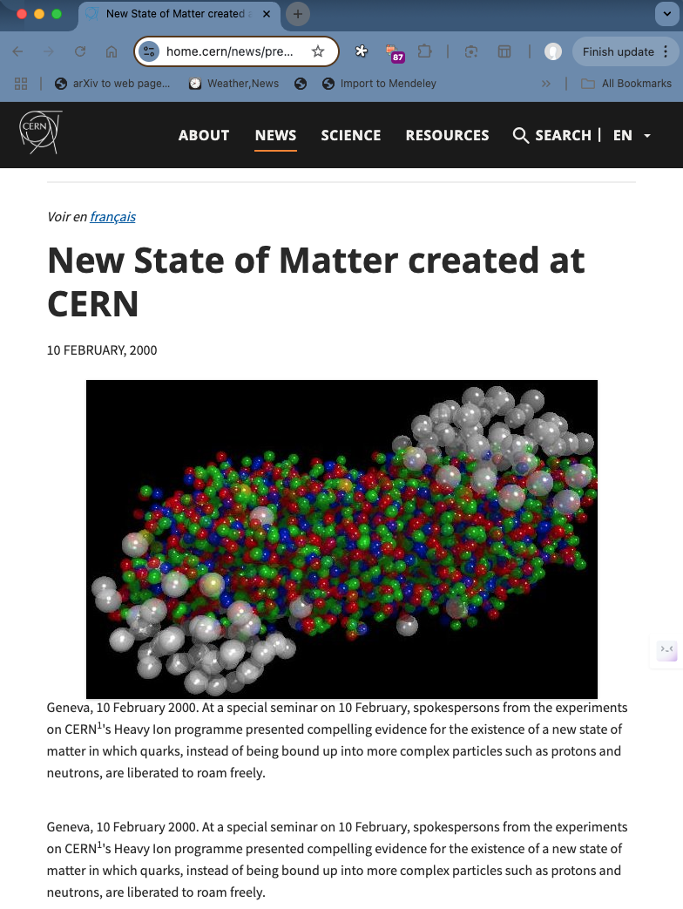
Current Perspective
“Good” news (from the RHIC perspective): It did not directly claim discovery of the quark-gluon plasma.
Bad news:
Was not linked to publication of peer-reviewed findings.
Nonetheless stated
“the experiments on CERN's Heavy Ion programme presented compelling evidence for the existence of a new state of matter in which quarks, instead of being bound up into more complex particles such as protons and neutrons, are liberated to roam freely.”
“Good” news (from the RHIC perspective): It did not directly claim discovery of the quark-gluon plasma.
Bad news:
Was not linked to publication of peer-reviewed findings.
Nonetheless stated
“the experiments on CERN's Heavy Ion programme presented compelling evidence for the existence of a new state of matter in which quarks, instead of being bound up into more complex particles such as protons and neutrons, are liberated to roam freely.”
An assessment of the insights gained from the heavy-ion program at the CERN SPS during the 1980s and 1990s [48] concluded that compelling evidence for the creation of “a new form of matter” had been found but stopped short of claiming unambiguous discovery of the quark-gluon plasma, nor did it comment on its perfectly liquid collective dynamical properties. The latter became only obvious after theory had progressed to a quantitative understanding of the bulk of the very comprehensive and precise experimental data collected at RHIC.

Slide 25
Causality in the White Paper Process
12-Feb-04: Discussion Sam Aronson, Tim Hallman, WZ “RHIC Science Retreat”
20-Feb-04: Tim Hallman, WZ discuss possible “white papers”
25-Feb-04: Spokesperson’s meeting, WZ charged to draft a process
27-Feb-04: Experiments invited to contribute ~15-page paper to RBRC Series
29-Feb-04: Draft process for White Papers’s distributed to other spokespersons + Sam Aronson
02-Mar-04: Spokespersons discuss politely declining publication in RBRC Series
Unrealistic time scale (April 5)
Interference with existing White Paper process
Would replicate rather than address CERN announcement
04-Mar-04: Draft response circulated (7 AM); revised draft (3 PM)
(Extraordinary period of work, writing, negotiations)
04-Oct-04: PHENIX WP posted to archive, other experiments to follow
( Another extraordinary period consolidating understanding strong coupling ←→ η / s…)
18-Apr-05: Perfect liquid announcement

Slide 26
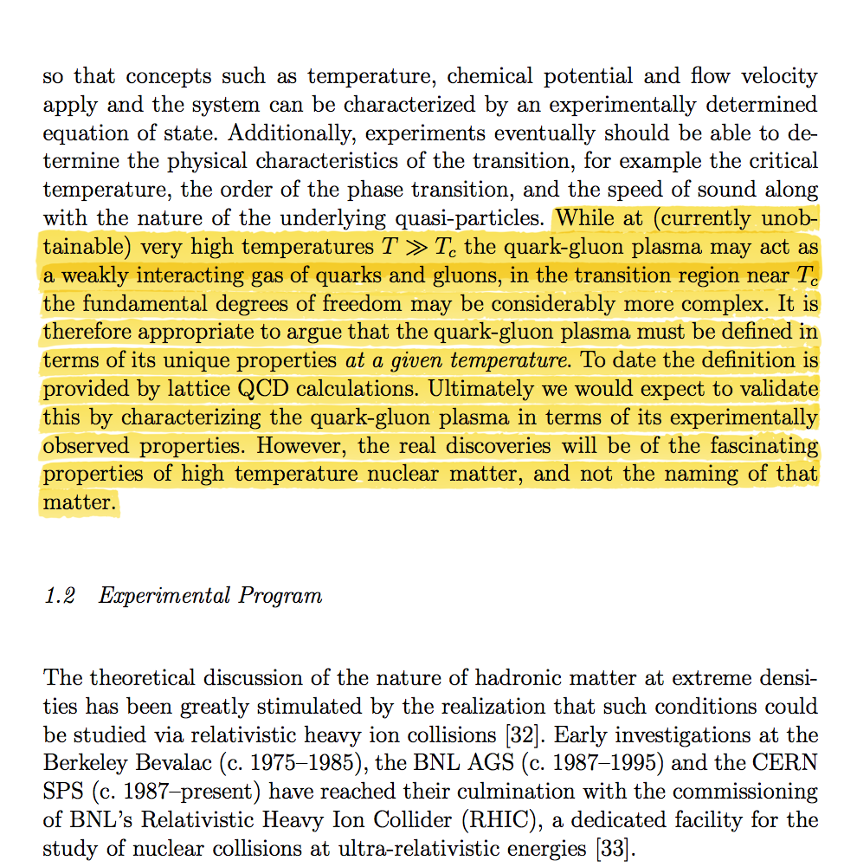
Addressing the nature of QGP discovery
From the PHENIX “White Paper”
nucl-ex/0410003
(1958 citations)
Q: What is the most relevant “experimentally observed property”?
A. Viscosity (suitably normalized)

Slide 27
PHENIX (well, me) Bragging at QM01

Slide 28
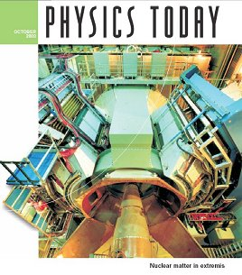
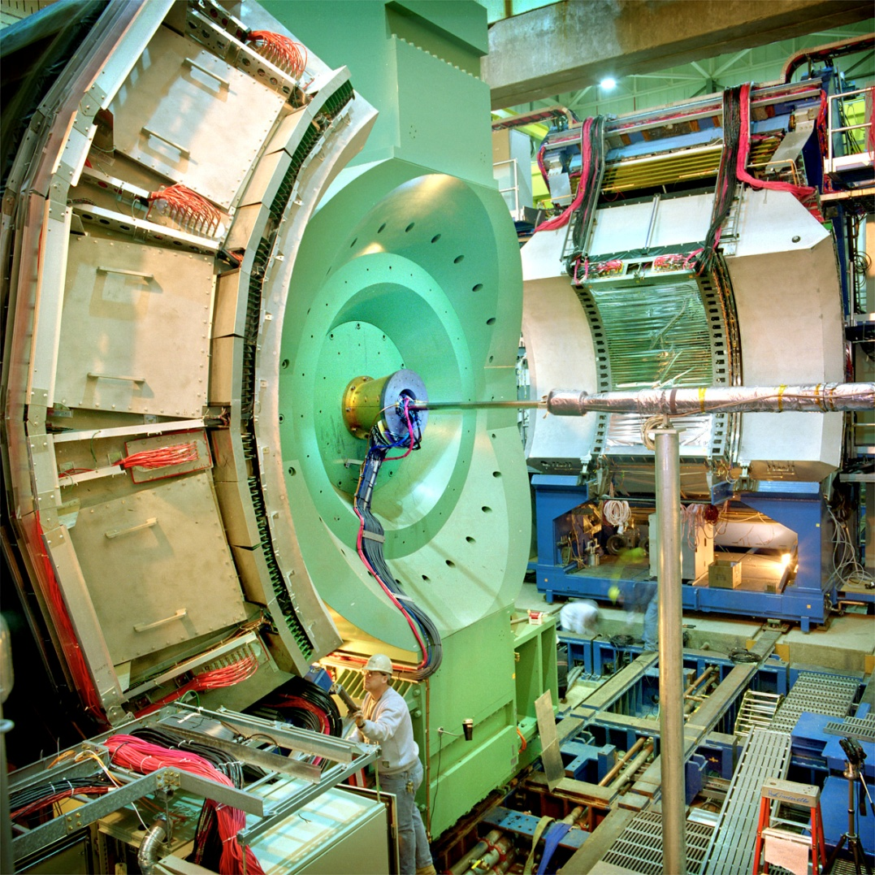

Slide 29
26-Jul-02: BNL Institutional Plan site visit: Undersecretary, Director of Office of Science unconvinced RHIC had done anything interesting
RHIC Program Review by the Nuclear Physics Division of the U.S. Department of Energy
Brookhaven National Laboratory, July 31 – August 2, 2002
Will you guarantee RHIC-I will discover QGP ?

Slide 30
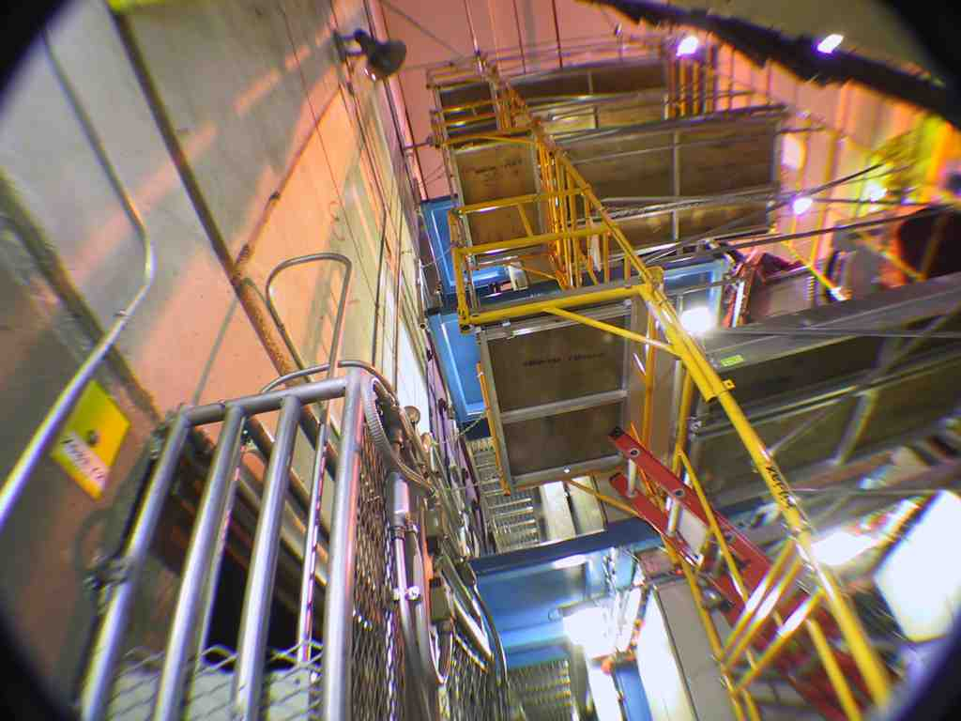
PHENIX (Mandated) Minimalism

