Slide 1


Spokesperson talks BRAHMS retro perspective
Flemming Videbæk
RHIC symposium

Slide 2
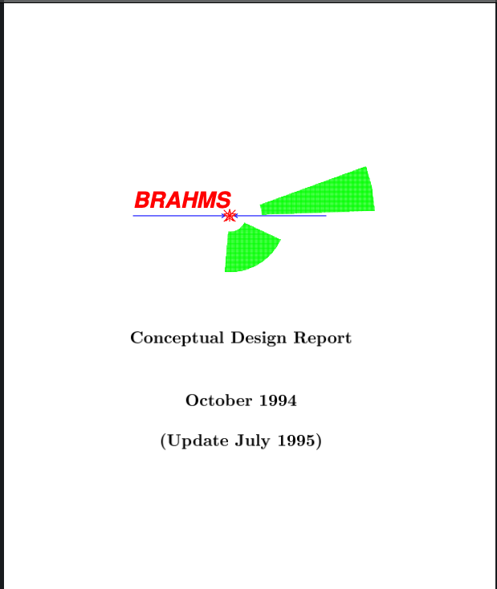
Brief History
Proposed in 1990
CDR in 1994
Approved 1995, Funding 1997-2001
Phased construction due to Funding levels . Forward spectrometer completed for 2001 run with full field.
RHIC/DOE contribution 5.5M$ Foreign contributions ~ 1.5 M$
Collaboration- people from AGS, SPS experience
Key measurements methods
Wide rapidity coverage
Particle identification
Charge particle distributions
Particle production.
Stopping
Notes:
In backup slide

Slide 3
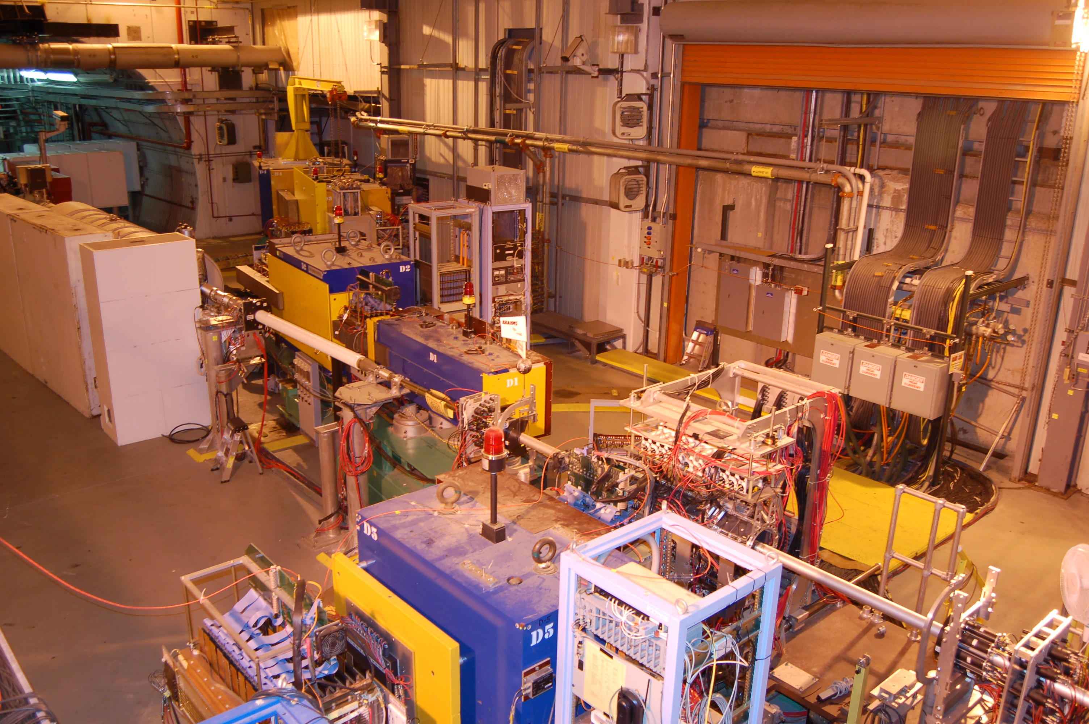
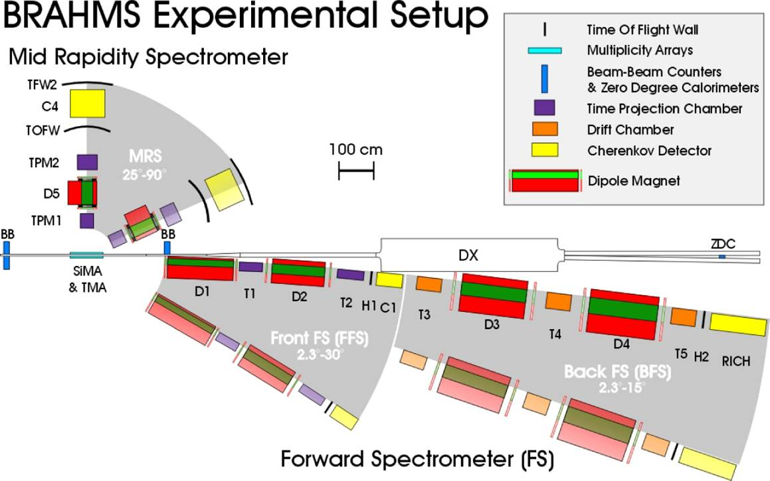
BRAHMS was initially posed to be situated at 4 o’clock region
The RF systems made this un -feasible . Swapped to 2 o’clock interaction region
Significant contributions from
NBI- TOF systems, D2 magnet, TPC
Krakow- Drift chambers
IRES Strasbourg TPC

Slide 4
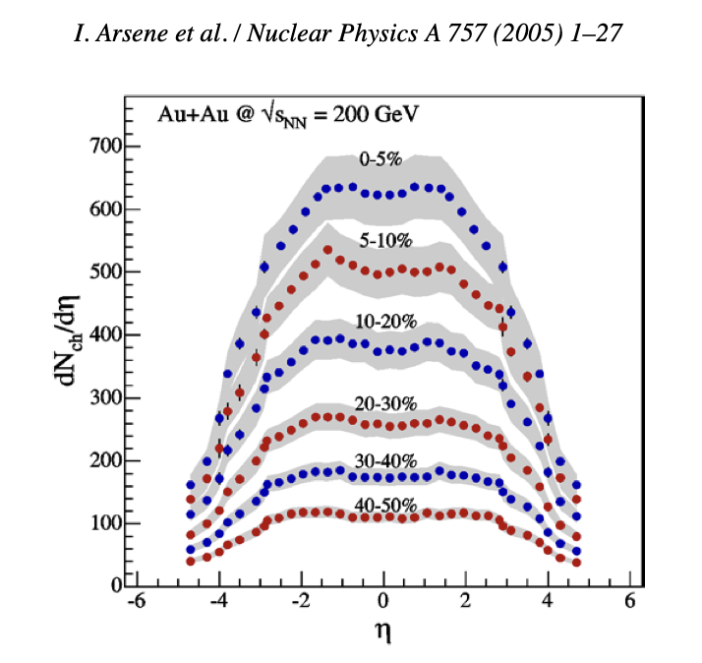
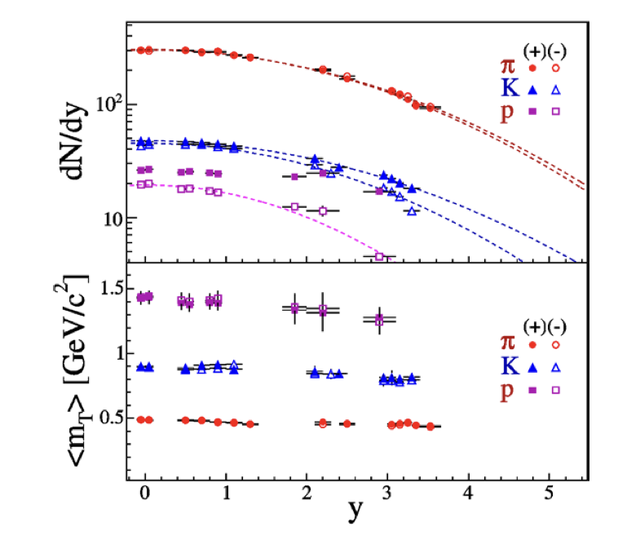
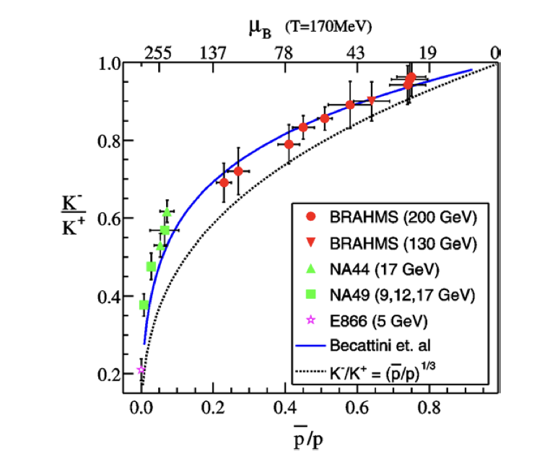
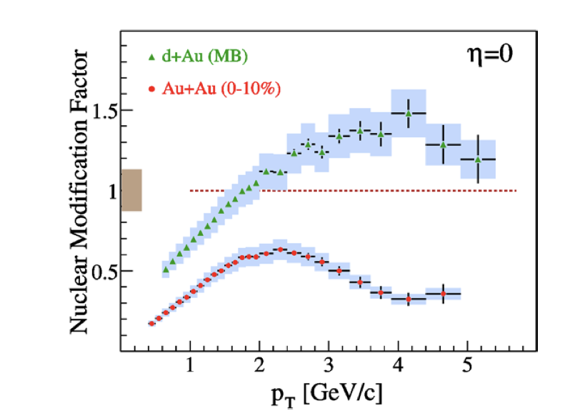
White paper
The WP process was a very successful endeavor.
It started with premise that conclusions should be in refereed publication.
Lead to 4 independent assessments from the experiments and opened at a meeting at Danford.
Lead to similar conclusion of having found new state of matter.

Slide 5
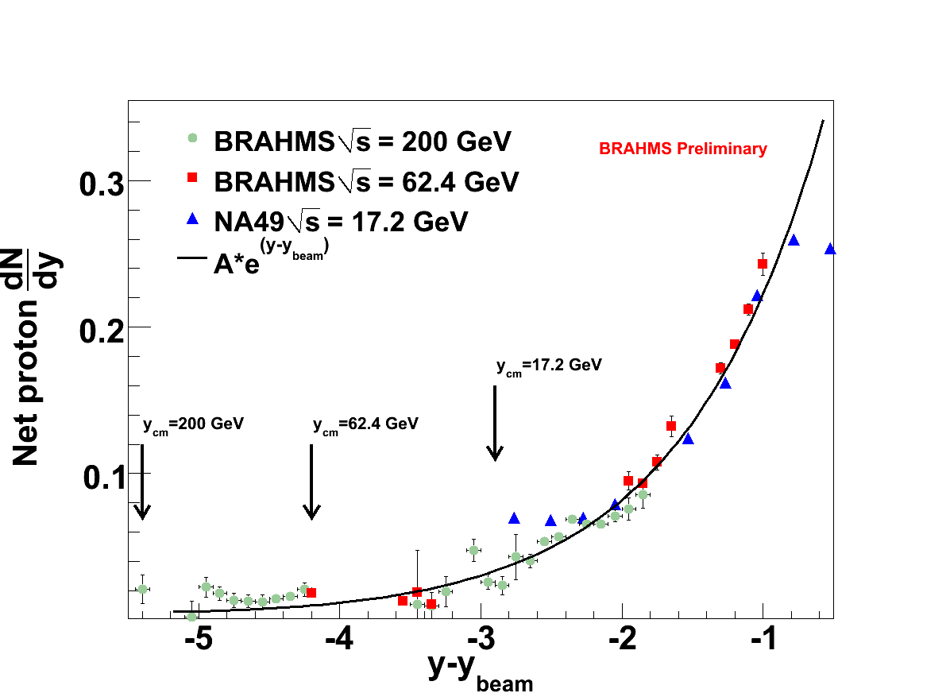
Baryon Transport Key measurement
Au-Au 0-10% central coll.
Development of net-proton poor region at RHIC
δy ~ 2.1 for central Au-Au collisions vs. ~0.9 in pp.
pp distribution is consistent with the baryon junction picture apart from the smallest y-y_{beam}> -2
Notes:
This is for central collisions

Slide 6
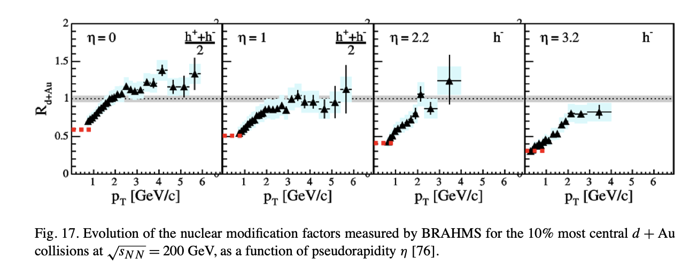
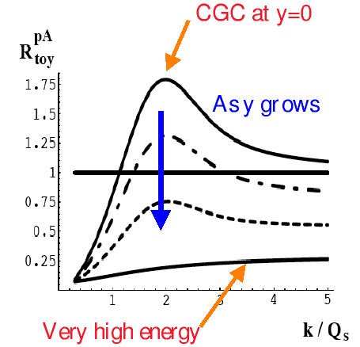
d-Au running
D. Kharzeev hep-ph/030737
R_{dAu} for identified particle consistent with charged hadrons and all exhibiting R_{dA} <=1 for p_{T}<3 GeV/c
π+ the dominant meson exhibits clear suppression
These BRAHMS data did spur interest in gluon saturation being within reach at RHIC energies.
Notes:
Figure from publication

Slide 7
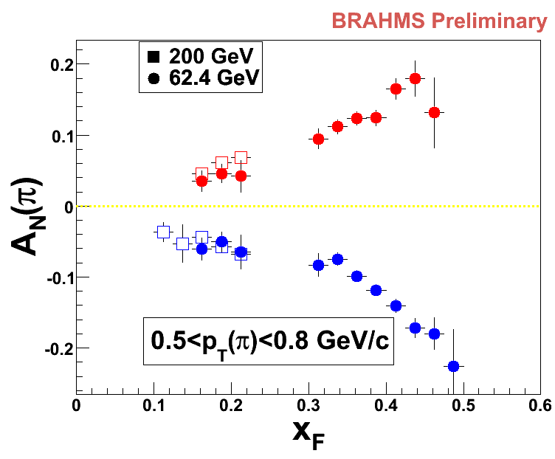
RHIC spin program
The BRAHMS program did not originally include pp spin physics, but discussion with the RHIC spin group lead us to be involved in this program and be ready to be part of it.
At the first pp run BRAHMS would not take spin data , as it was deemed you could not have 3 experiments taking spin data at the same time.
Later as machine performance was improved Brahms took extensive pp data in 2005 (200 GeV) and 2006 (62.4GeV)
Observed Large A_{N}(π): 0.3 at x_{F}~0.5
Strong x_{F} -p_{T} dependence. |A_{N}(π⁺)| ~ !A_{N}(π⁻)|
Also measured K+-
Notes:
As yesuf will tell us more about

Slide 8
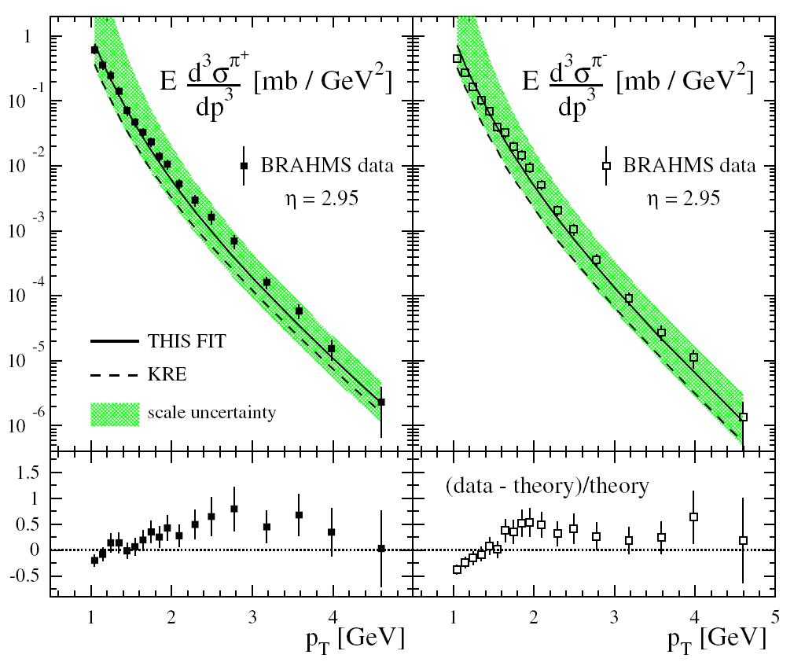
Global fits to data including BRAHMS large rapidity data
DSS, PRD 75, 114010 (2007)
Brahms data: PRL 98, 252001 (2007)
π⁺
K⁺
K⁻
π⁻
deFlorian, Sassot and Stratman performed a global fit including new data from Brahms at high rapidity. PRD 75, 114010 (2007)
Charged separated fragmentation functions
Fragmentation functions significantly constrained compared to previous “state of the art” when adding RHIC data into fits.

Slide 9
Scientific output and contributions
Collaboration 10 institutions from 6 countries
23 Refereed publications
Whitepaper with 2031 citations
4 papers, not WP, with over 250 citations
15 Ph.D. Theses
After conclusion of Brahms many collaborator went on to be important collaborators at RHIC, LHC, and SPS program

Slide 10
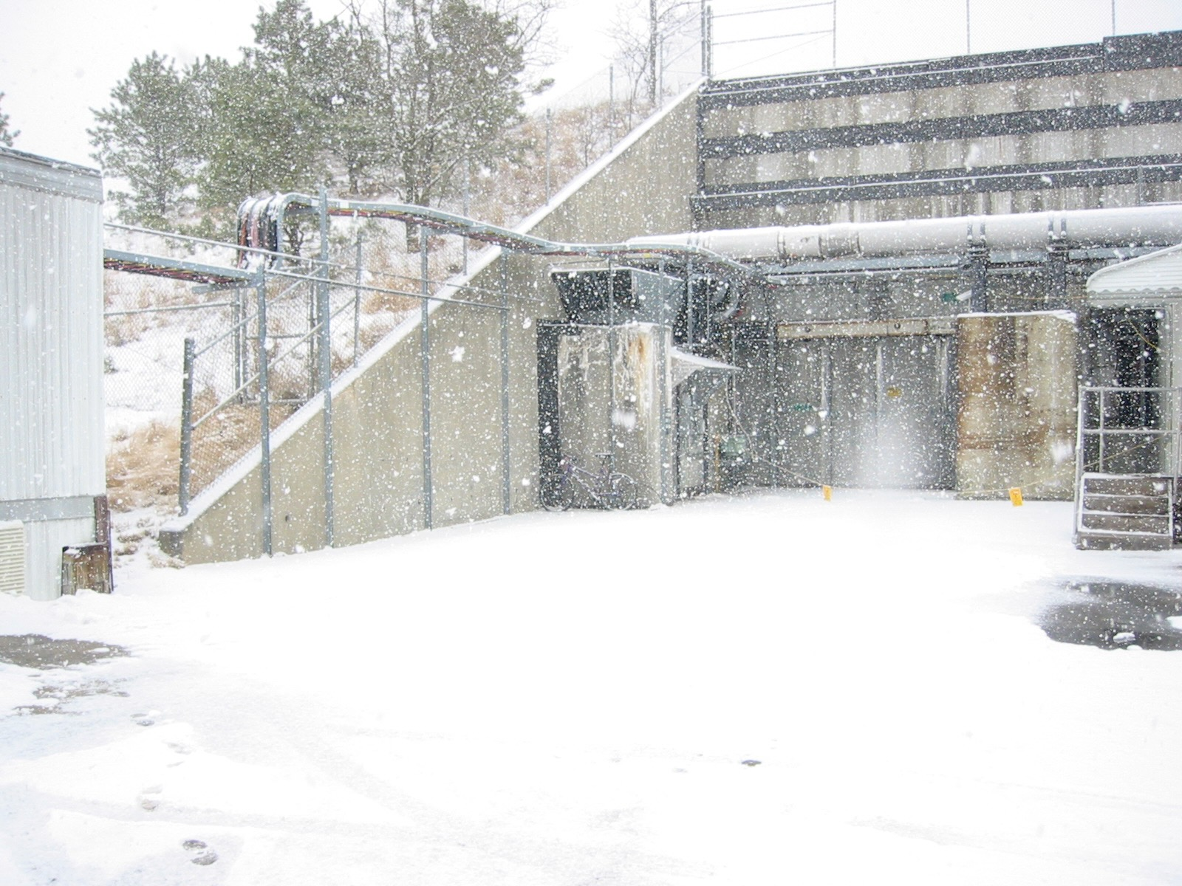
Summary
The BRAHMS experiment have provided unique physics results in the forward region, providing insight into several key questions,
It has been most rewarding to be part of the RHIC program , that really gave rise to new understanding of the state of high energy density nuclear matter, and cold QCD physics.
I am sure that the new experiment(s) coming at EIC will be equally fruitful

Slide 11
Collaboration
I.Arsene⁷, I.G. Bearden⁶, D. Beavis¹, S. Bekele⁶ , C. Besliu⁹, B. Budick⁵,
H. Bøggild⁶ , C. Chasman¹, C. H. Christensen⁶, P. Christiansen⁶, H.Dalsgaard, R.Debbe¹,
J. J. Gaardhøje⁶, K. Hagel⁷, H. Ito¹⁰, A. Jipa⁹, J. I. Jordre⁹, E.B. Johnson¹⁰,
C.E.Jørgensen⁶, R. Karabowicz³, N. Katryńska³, E. J. Kim⁴, T.M.Larsen¹¹, J. H. Lee¹,
Y. K. Lee⁴, S.Lindal¹¹, G. Løvhøjden², Z. Majka³, M. Murray¹⁰, J. Natowitz⁷, B.S.Nielsen⁶,
C.Nygaard, D. Ouerdane⁶,
D.Pald, R.Planeta³, F. Rami², C. Ristea⁶, O. Ristea⁹, D. Röhrich⁸,
S. J. Sanders¹⁰, R.A.Sheetz¹, P. Staszel³,
T.S. Tveter¹¹, F.Videbæk¹, R. Wada⁷, H. Yang⁶, Z. Yin⁸, I. S. Zgura⁹ ,V.Zhukova
¹Brookhaven National Laboratory, USA,
²Institut Pluridisciplinaire Hubert Curien , Strasbourg, France
³Jagiellonian University, Cracow, Poland,
⁶Niels Bohr Institute, University of Copenhagen, Denmark
⁷Texas A&M University, College Station. USA, ⁸University of Bergen, Norway
⁹University of Bucharest, Romania, ¹⁰University of Kansas, Lawrence,USA
¹¹ University of Oslo Norway

