Slide 1


DOE Office of High Energy & Nuclear Physics Report
Sharon Stephenson
Physics Research Director, HENP
May 15, 2026

Slide 2
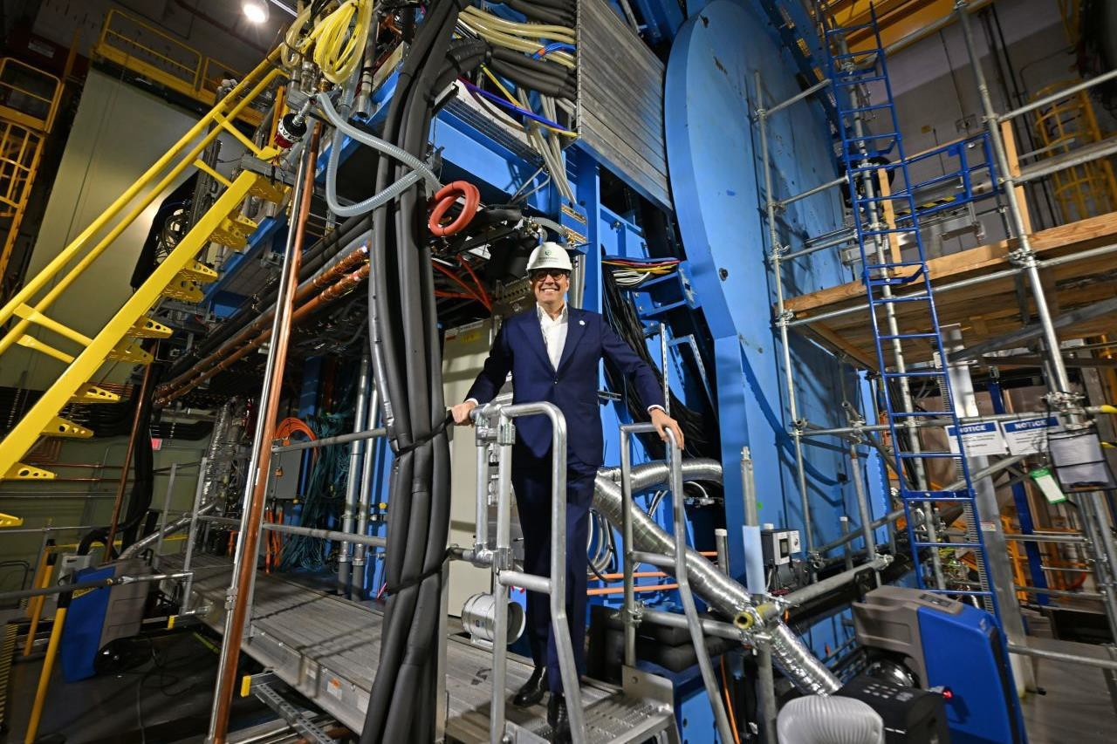
The Honorable Darío Gil, Under Secretary for Science

Slide 3
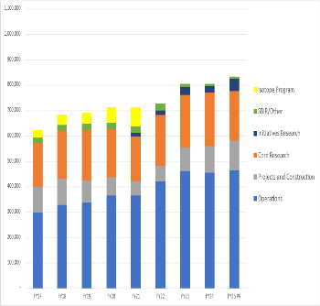
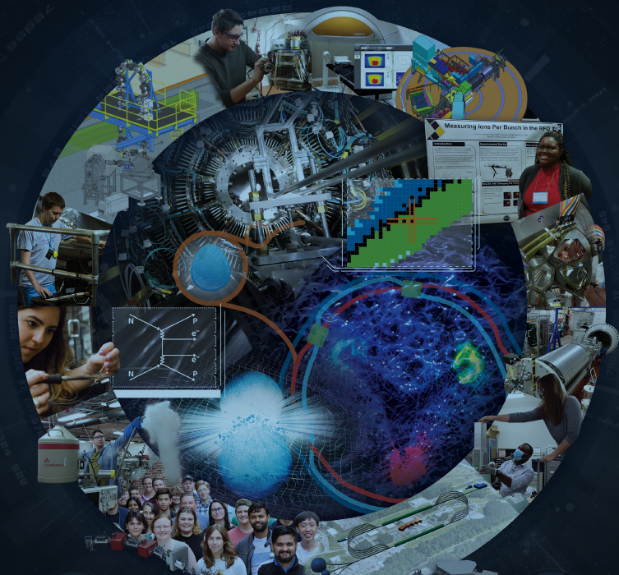
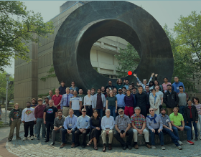
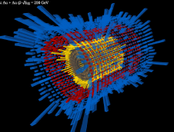
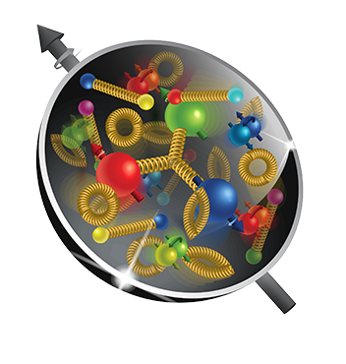
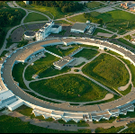
Largest supporter (>95%) of U. S. nuclear physics research FY 2026 Enacted $866.141M
Office of Nuclear Physics at a Glance
Mission: Discover, explore, and understand all forms of nuclear matter. Seeks to understand subatomic matter, including exotic matter inside neutron stars and in the early days of the universe, and how that knowledge can benefit society (critical technologies, medicine, and national security).
Supports over 1,400 Ph.D. staff and 720 graduate students FY 2026 Research: 23%
Facilities: ATLAS, CEBAF, and FRIB, and RHIC FY 2026 Operations: 57%
>4,000 users annually
In construction: Electron-Ion Collider will probe the inside of the proton FY 2026 Construction: 20%

Slide 4
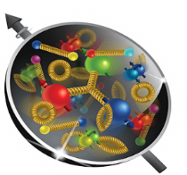
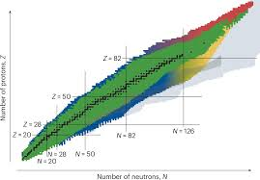
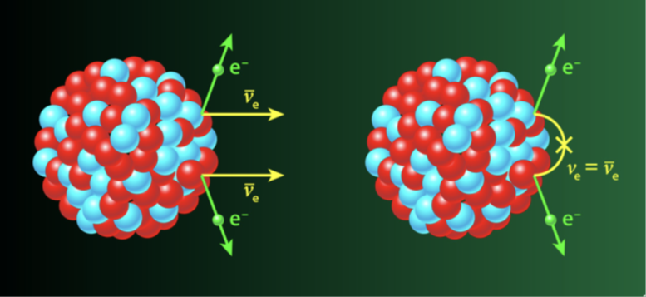
NP Avenues for Discovery
Probing Proton Substructure
Exploring the Isotope Landscape
Studying Rare Decays
Reveals dynamics, structure, and spin for protons and neutrons
Heavy ion collisions and electron scattering informs our understanding of nuclear phenomena and the formation of the universe
U.S. provides the world’s highest intensity, polarized electron beams for this science
Enables element and isotope discovery
Reaction rates and structure data for national priorities
Superheavy elements provide a fertile ground for tests of theory
Nuclear data and capabilities for characterization of electronics (e.g., defects, radiation-induced failures)
Targets natural processes that break conservation laws and symmetries
Data-driven science to explain the matter-antimatter balance
Extreme high-precision detectors translate to other applications
Nuclear-science-based innovation for Quantum Information Science
Crosscutting: Theory, AI, Advanced Computing, Accelerator & Detector R&D

Slide 5
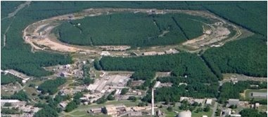
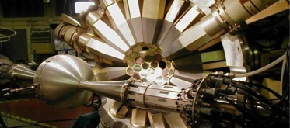
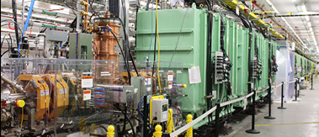
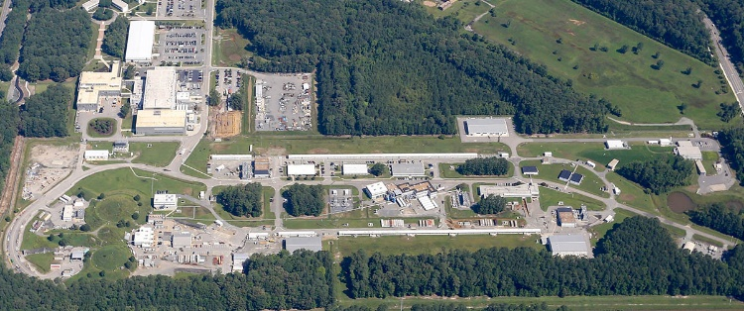
NP user facilities provide critical capabilities to maintain U.S. scientific leadership
Access to three accelerator-based facilities for exploring nuclear matter in all forms
Facility for Rare Isotope Beams and Argonne Tandem Linac Accelerator System study how protons and neutrons combine to form the atomic nucleus.
Continuous Electron Beam Accelerator Facility seeks to understand quarks and gluons, the elementary building blocks of protons and neutrons.
Open to all scientists, this suite of facilities forms the backbone of the nation’s nuclear physics research infrastructure.
Over 4,000 users from the scientific community access these facilities annually.
Relativistic Heavy Ion Collider ended operation in FY 2026 – support continues for users to analyze data and for hadron injector operations for isotopes and microelectronics testing missions.
RHIC@BNL
ATLAS@ANL
FRIB@MSU
CEBAF@TJNAF

Slide 6
NP Projects Status
Project | Location | Status | Cost | CD-4
Construction Projects
Electron-Ion Collider (EIC) | BNL | CD-3B | $1.7B to $2.8B (Est) | Q1 FY36 (Est)
Major Items of Equipment
Gamma Ray Energy Tracking Array (GRETA) ^{Fully Funded, Delegated} | LBNL | CD-4A | $58.3M (TPC) | Q2 FY28
Measurement of a Lepton-Lepton Electroweak Reaction (MOLLER) ^{Fully Funded} | TJNAF | CD-2/3 | $48.66M (TPC) | Q4 FY28
High Rigidity Spectrometer (HRS) High Transmission Beam Line (HTBL) SPectrometer Section (SPS) | MSU | CD-2/3 CD-1 | $49.7M (TPC) $65.5M - $87.3M (Est) | Q3 FY30 Q2 FY32 (Est)
Ton Scale Neutrinoless Double Beta Decay (TS-NLDBD) Near-term LEGEND-1000 | ORNL | CD-0 | $409M to $665M (Est) | TBD

Slide 7
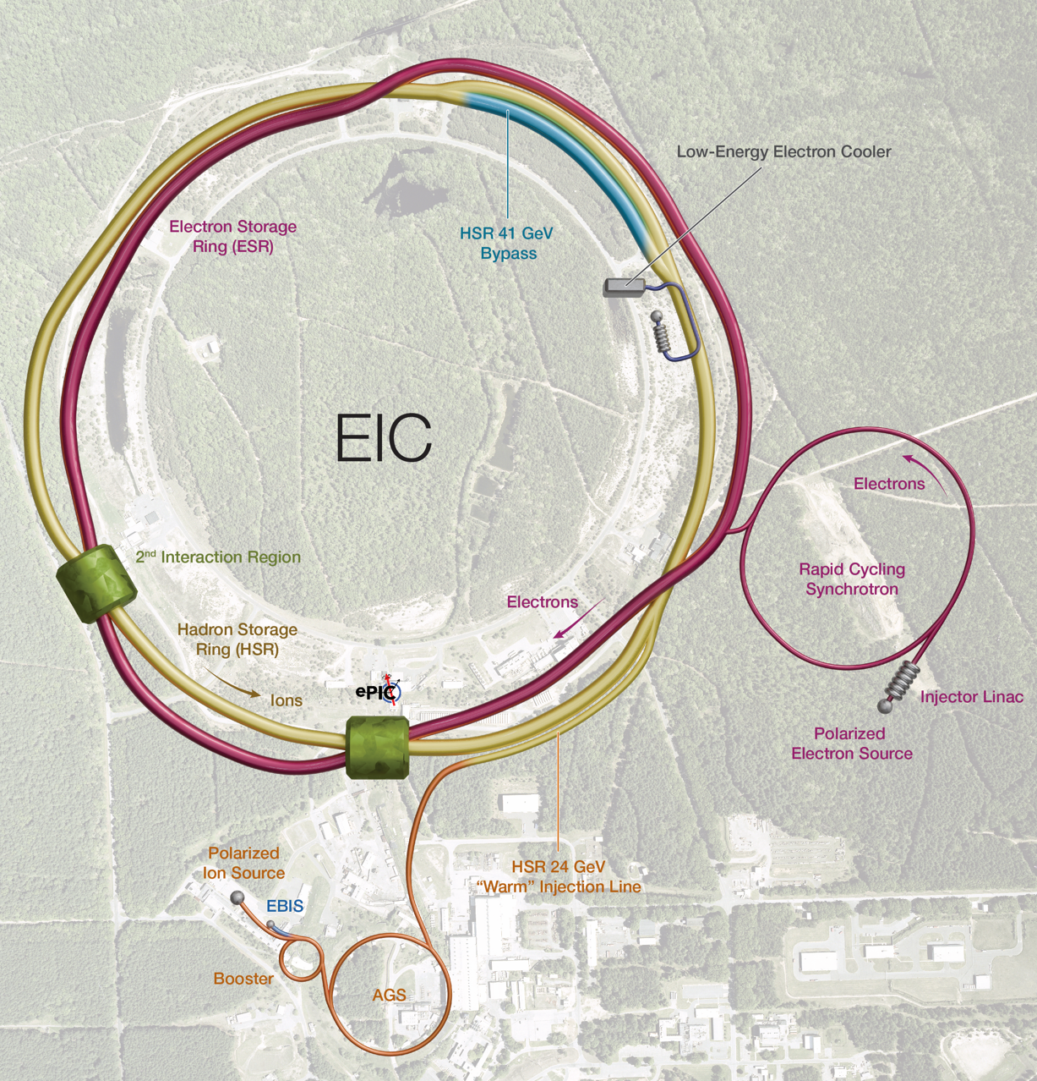
Electron-Ion Collider: Top Priority for New Facility Construction in the Nuclear Science Long Range Plan
Located at BNL, using existing RHIC assets, with TJNAF as a major partner.
Estimated cost range of $1.7 billion to $2.8 billion.
In-kind contributions: New York State and International partners
$100M grant from New York supports civil construction
~$90M anticipated for the detector ePIC (~30%)
~$50M anticipated accelerator scope (~5%)
Critical Decision-3A (long lead procurement): March 2024
Critical Decision CD-3B (second long lead procurement request) approved January 2026.
Project elaborating its subproject strategy.
Notes:
NASEM: A US-based EIC will uniquely answer: How does the mass of the nucleon arise? How does the spin of the nucleon arise? What are the emergent properties of dense systems of gluons?

Slide 8




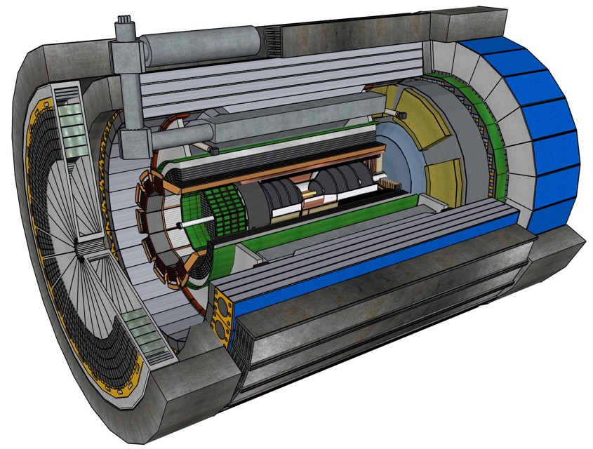





NP International Engagement Continues to Grow
Topics of mutual interest:
Alignment with NP mission and scope.
Alignment with mission and scope of international partners.
Capabilities of the participating international partners.
EIC User Group: 1,562 members from 310 Institutions in 41 countries (March 2026)
Barrel
Electromagnetic
Calorimeter
Dual-radiator
RICH
MAPS Tracking
Detectors
Superconducting
Solenoid
MPGD Tracking
Detectors
Backward
Electromagnetic
Calorimeter
Forward Time-of-Flight
Barrel Time-of-Flight
Data-Acquisition
Electronics
Expressed interests in the ePIC central detector subsystems labeled by country

Slide 9
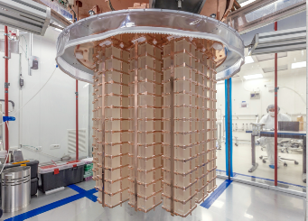
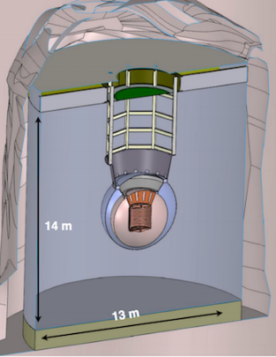
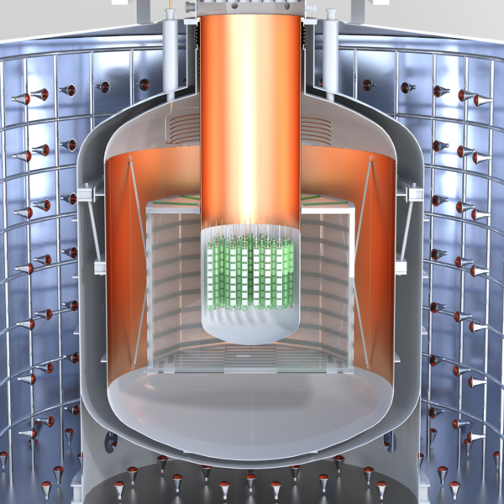
Neutrinoless Double Beta Decay: Top Priority for New Experiment Construction in the Nuclear Science Long Range Plan
Roughly $20.0M has been allocated since 2020 to explore three technologies: CUPID, LEGEND-1000, nEXO, and; supporting conceptual design and R&D.
In December 2024, LEGEND-1000 selected as the first priority for NP investment. (est. cost $500 M)
A multi-pronged campaign to detect neutrionless double beta decay is an international enterprise.
Funding agencies representatives from Canada, France, Germany, Spain, United Kingdom, and the U.S. (DOE and NSF) are working to establish a framework for continued coordination.
Three proposed technologies:
Scintillating bolometry (CUPID, ¹⁰⁰Mo enriched Li₂Mo₄ crystals)
Enriched ⁷⁶Ge crystals (LEGEND-1000, drifted charge, point contact detectors) – 1st priority for NP support
Liquid Xenon TPC (nEXO, light via SiPM, drifted ionization)
TeO₂ Crystals from CUORE
9

Slide 10
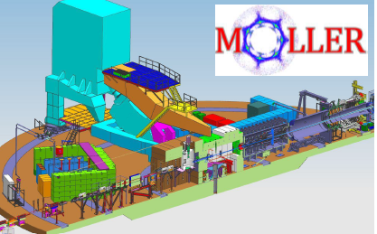
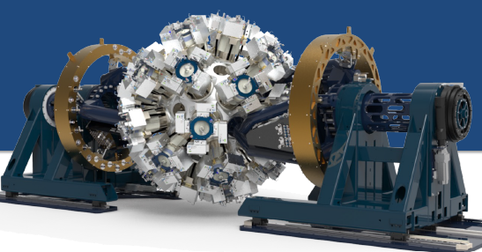
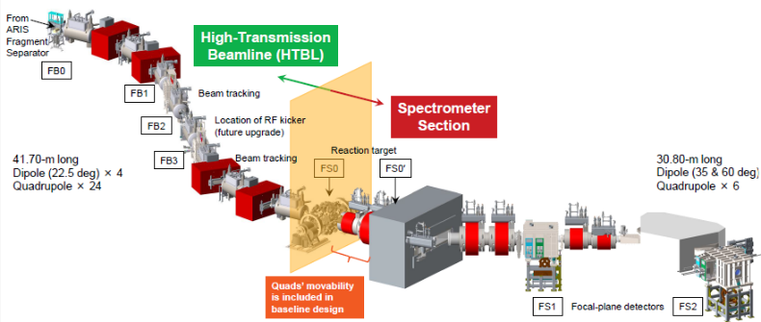
Status of other MIE projects
Measurement of a Lepton-Lepton Electroweak Reaction (MOLLER) for CEBAF
Gamma Ray Energy Tracking Array (GRETA)
for FRIB, ATLAS (LBNL)
Fully funded and delegated: Approved for early science
Fully funded: CD-2/3 achieved May 2024
2 subprojects – Spectrometer plus
High-Transmission Beamline (HTBL)
HTBL CD-2/3 achieved Feb 2025
High Rigidity Spectrometer (HRS) for FRIB (Michigan State University)

Slide 11
Deputy Director for Science Programs
Advanced Scientific Computing Research
Basic Energy
Sciences
Biological & Environmental Research
Fusion Energy
Sciences
High Energy and
Nuclear Physics
Workforce Development for Teachers & Scientists
Computational Science and Research Partnerships
Chemical Sciences, Geosciences, and Biosciences
Integrated Program
Management
Research
Fusion Energy Research
Physics Research
Communications & Public Affairs
Facilities
Materials Sciences and Engineering
Facilities and Enabling Technologies
Enabling Technologies and Partnerships
Accelerator and Technology
Office of Scientific & Technical Information
Advanced Computing Technology
Scientific User
Facilities
Facilities and
Projects

Slide 12
NP FY 2026 Allocation Distribution (Est.)
FY26 SBIR and SC program support included, ~$10,000k

Slide 13
Trends in DOE-NP Appropriations
FY 2027 PR $791.4M: Facility operations at ~90%, EIC support at $200.0M. Research down $62.1M compared to FY 2026 Enacted.

Slide 14
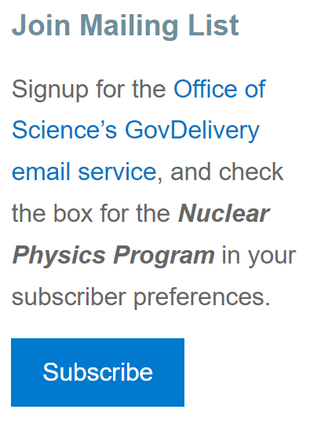
FY 2026 Notices of Funding Opportunities (NOFOs)
Title | Release Date
FY 2026 Continuation of Solicitation for the Office of Science Financial Assistance Program | 9/30/2025
Early Career Research Program | 3/3/2026
Building EPSCoR-State/National Laboratory Partnerships | 2/18/2026
The Genesis Mission: Transforming Science and Energy with AI | 3/17/2026

Slide 15
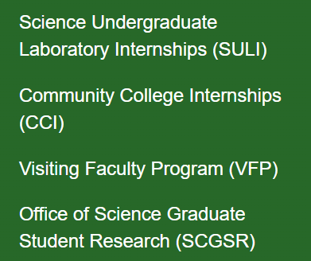
DOE Office of Science WDTS programs
Funded through DOE SC’s Workforce Development for Teachers and Scientists (WDTS) program. Other programs complement the SCGSR for workforce development.
All areas of NP are supported by this program.
DOE Office of Science Graduate S... | U.S. DOE Office of Science (SC)

Slide 16

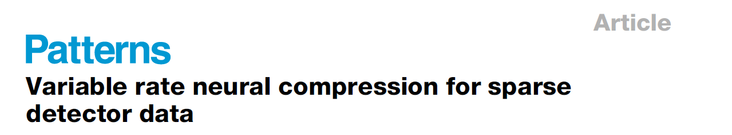
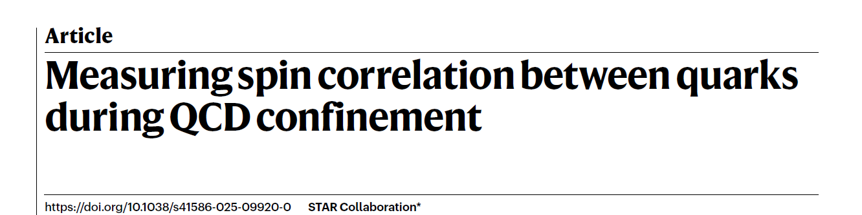
Relevant NP priorities
2025: Successful completion of the Au+Au sPHENIX campaign to measure “jet and heavy flavor observables with unprecedented statistical precision and accuracy”
2025: Continued timely and impactful science results from STAR and PHENIX to fully realize the RHIC scientific mission
2025: Crucial data and analysis preservation to usher in the ‘multimessenger’ era
Notes:
Special for this group, this year.

Slide 17
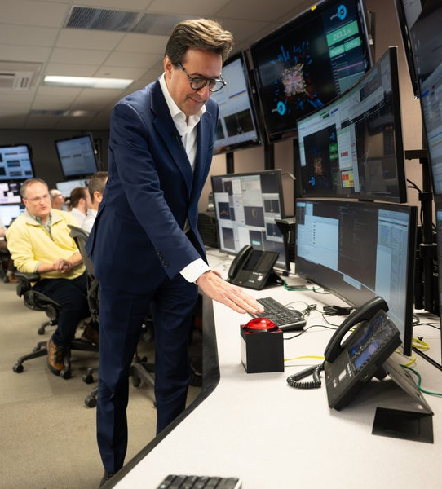
End of an Era at RHIC
At approx. 9:00 am ET on February 6, 2026, the DOE Undersecretary for Science brought operations of the RHIC collider to a close.
RHIC’s Greatest Hits
2005 Discovery of a hot, dense “perfect liquid”
2010 The liquid’s temperature, at 4 trillion degrees Celsius, confirms it is a quark-gluon plasma
2014 Gluons are found to contribute to the spin of the proton
Discovery that antiprotons attract each other like regular protons
2017 The quark-gluon plasma is deemed to be the “swirliest” fluid ever
2021 Discovery that colliding photons may make matter and antimatter
2023 Spins of gluons are found to align with the spin of the proton they’re inside, further evidence that gluons make up proton spin
2024 Discovery of the heaviest antimatter nucleus, antihyperhydrogen-4
Notes:
ADD ABHAY’s Leadership Live

Slide 18
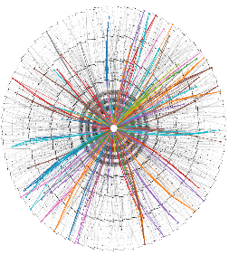
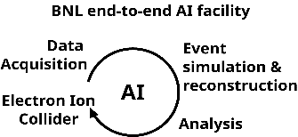
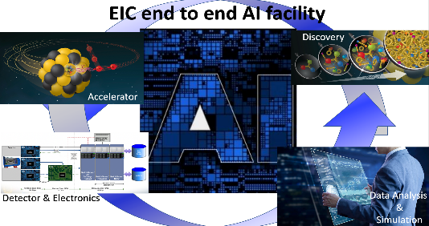
Genesis Mission and Nuclear Physics
Coordinating with ASCR, HEP, and other SC programs, NP is advancing its mission through the development of AI-ready datasets and AI models that can take advantage of them.
Two discovery science national challenges targeted:
Unifying Physics from Quarks to the Cosmos
Enhancing Particle Accelerators for Discovery
While the NP community has actively employed AI methods, the Genesis Mission offers a unique opportunity to overcome workflow pinch points and synthesize data from disparate domains.
The development of domain-specific data standards and metadata for multi-modal data, including expert knowledge documentation, will feed the American Science Cloud (AmSC), using the power of AI to accelerate discovery of new physics and progress on the fundamental questions on the nature of nuclear matter.
Event Reconstruction with
Geometric Deep Learning
Notes:
Pull?

Slide 19

The Genesis Mission: Transforming Science and Energy with AI
DOE Funding Opportunity DE-FOA-0003612 Announced: March 17, 2026. DOE anticipates a total of $293.76 million in prior and current fiscal year funds will be used to support awards under this RFA.
RFA is a collaboration between Office of Science (SC), Office of Critical Minerals and Energy Innovation (CMEI), Office of Environmental Management (EM), Office of Electricity (OE), Hydrocarbons and Geothermal Energy Office (HGEO), and Office of Nuclear Energy (NE) covering many focus areas within 21 distinct topics.
The RFA is open to interdisciplinary teams from DOE National Laboratories, U.S. industry, and academia. Phase I awards will range from $500,000 to $750,000 and will support a nine-month project period. Phase II awards are expected to be significantly larger for a three-year project period. Teams may apply directly to either phase in FY 2026, and successful Phase I teams will be eligible to compete for larger Phase II awards in future cycles.
The Phase I applications and Phase II letters of intent are under review. Phase II applications are due May 19, 2026.
Note: The Genesis Mission Consortium will offer a partnership service to facilitate finding partners for this RFA. Use of the service is optional and membership in the consortium is not required to use the partnership service.
Notes:
PLAN TO REMOVE

Slide 20
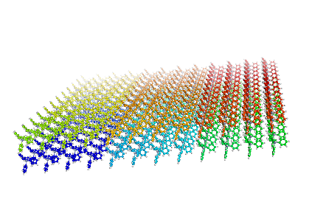
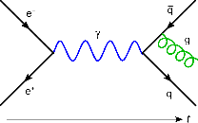
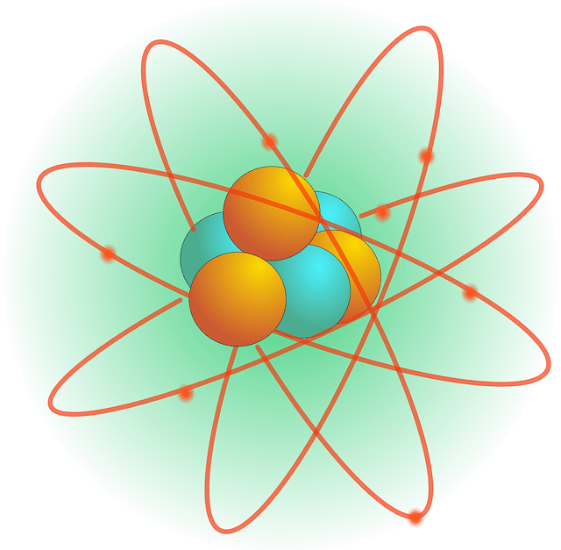
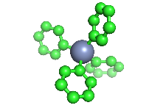
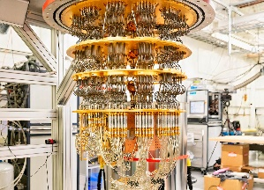
SC’s QIS Portfolio Spans its Technical Breadth
Subatomic
Nuclear
Molecular
Material
Quantum Device
Length
Scale:
SC’s portfolio of fundamental science and enabling capabilities and infrastructure for QIS spans its six core science programs and the Isotope Program.
ASCR
BES
FES
BER
HEP
NP
IP
Quantum Algorithms; Computer Science; Networking; Testbeds and HPC
New Quantum Phenomena; Quantum Computing for Materials and Chemistry; Infrastructure
Qubit Synthesis; Quantum Computing and Sensing for Fusion and Plasma Science
New Quantum-Enabled Methods for Bioimaging and Biosensing
Quantum Theory, Sensing, and Computing for Physics;
Technology Development
Spin Qubits; Quantum Computing, Simulators and Sensors; Nuclear Clocks
Isotope Research, Production, and Distribution for QIS
National QIS Research Centers | Q-NEXT, C²QA, SQMS, QSA, QSC
Enabling Infrastructure | X-ray light and neutron sources, NSRCs, Foundries, Quantum Testbeds, QC User Program, …
https://science.osti.gov/Initiatives/QIS

Slide 21
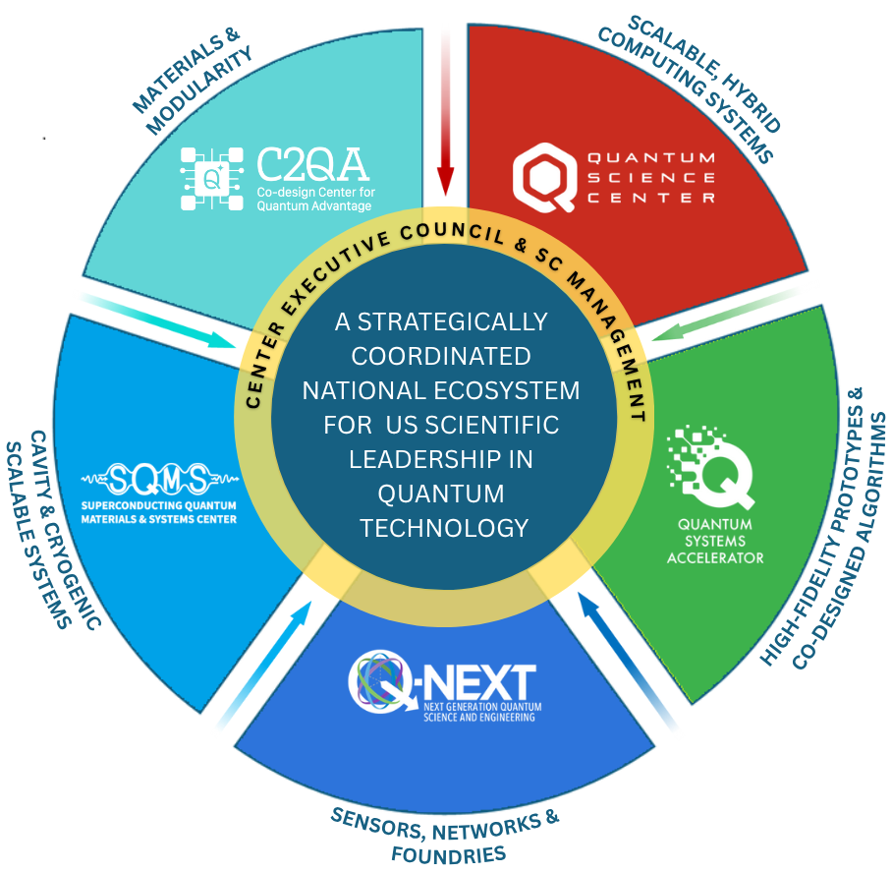
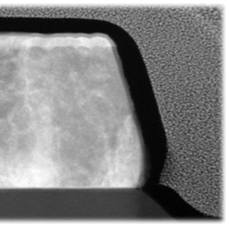
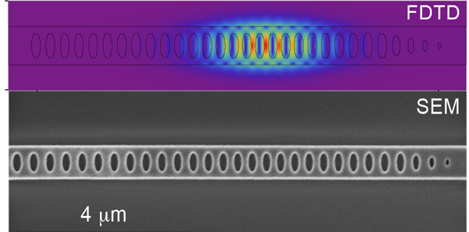
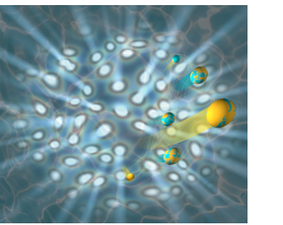
FIVE CENTERS, ONE MISSION – Achieve Critical Breakthroughs in Quantum Science, Technology and Engineering for Scientific Discovery
Addressing key roadblocks to quantum utility with unique solutions
Overcoming errors
Eliminating material decoherence
Resource-efficient error correction
Advanced cryogenics
Unlocking scaling
Distributed entanglement
Cross-platform architectures
Hybrid quantum-accelerated HPC
Enabling impact
Quantum simulations of materials
Interconnected quantum sensors
New algorithms for scientific research

Slide 22
Office of Science Advisory Committee Charges
Facilities of the Future Charge
Review proposed facilities and upgrades, identify any gaps, and prioritize the facilities that are most crucial to the needs of the nation for the next ten years (2026-2036) Consider how proposed facilities integrate with and support the Genesis Mission for AI and QIS, as well as other Administration priorities in fusion, microelectronics, biotechnology, and discovery science
AI for Transformative Science Charge
Identify how to prioritize SC resources to accelerate the application of AI for transformative scientific and engineering discovery focused on pressing national science and technology challenges Create a decadal roadmap articulating near, mid, and long-term priorities for SC to achieve the Genesis Mission
Quantum Computing Roadmap Charge
Create a roadmap to identify near-term steps to a concrete 2028 goal of an error-corrected quantum computer capable of revolutionary science Assess current landscape, noting technical opportunities, gaps, and public-private partnerships to leverage impact

Slide 23
HENP Summary
The HEP and NP programs focus on answering the most fundamental questions about matter, energy, space and time.
We do this by building and operating state-of-the-art facilities and instruments, collecting and analyzing large, complex data sets and publishing scientific results. Facility operations and data processing continue to be enhanced by the application of AI tools.
Both programs have been guided by planning processes that evaluate the science and sets priorities such that the focus remains centered on answering the most pressing and compelling questions.
-- Budget realities have not matched outyear scenarios, making it challenging to execute the vision set out in the plans.
-- HEP and NP are executing a portfolio of projects launched this decade and should have construction completed within the coming decade, setting us up for producing record breaking quantities of data and world leading results for decades to come.
The synergies between HEP and NP will enable a smooth transition in support of the SC realignment.
Notes:
Could go back to our standard summary, but given this year’s unique place through realigning, I’m considering this one for all the user group slide decks.

Slide 24
Thank you

