Slide 1
AI/ML Workshop Summary
Cameron Dean Massachusetts Institute of Technology
RHIC/AGS Annual Users Meeting
May 13th 2026

Slide 2
What is AI/ML?
Artificial Intelligence is the top-level concept enabling decision making
Machine Learning is a subset of AI concerned with training and applications
The public often confuses AI with “Artificial General Intelligence”
This is when machines exhibit behavior we would describe as indistinguishable from humans
Most ML algorithms use “supervised learning” (we pass the data and answer)
“Unsupervised learning” is becoming more apparent (the input data is unlabeled)
AI
ML
NNs
BDTs
LLMs
GANs
FMs

Slide 3
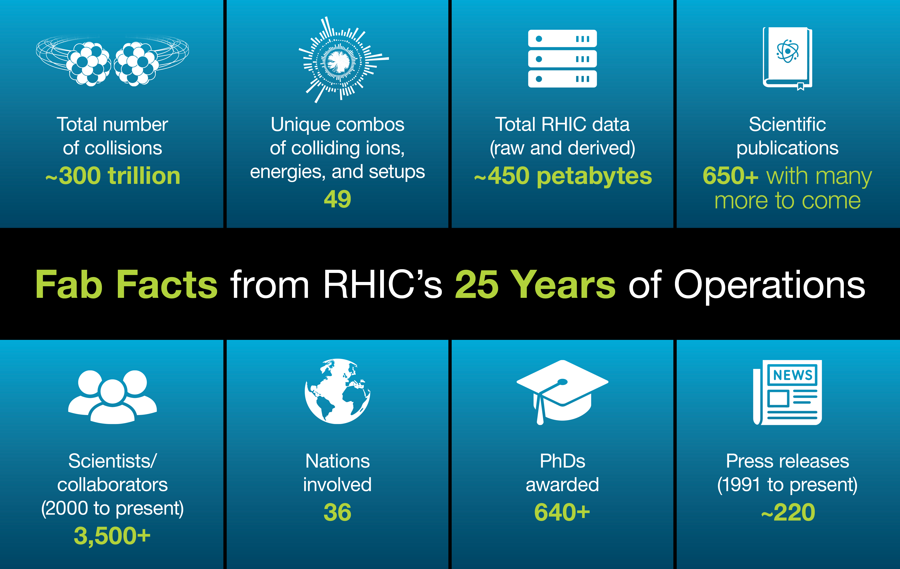
Why do we want it for RHIC/EIC science?
Our data samples are huge!
Costly and time consuming to process
Can this be optimized?
RHIC is 26 years old
Lots of knowledge accumulated over the years
Original analysts/experts may no longer be in the field
Researchers can spend lots of time searching documents for relevant information
RHIC science has not ended (there is the RHIC Analysis Group at BNL)
We need to preserve knowledge to complete the RHIC science mission
The EIC is coming
How do we best optimize design/operation/analysis? This is the time to implement
https://www.bnl.gov/newsroom/news.php?a=122794

Slide 4
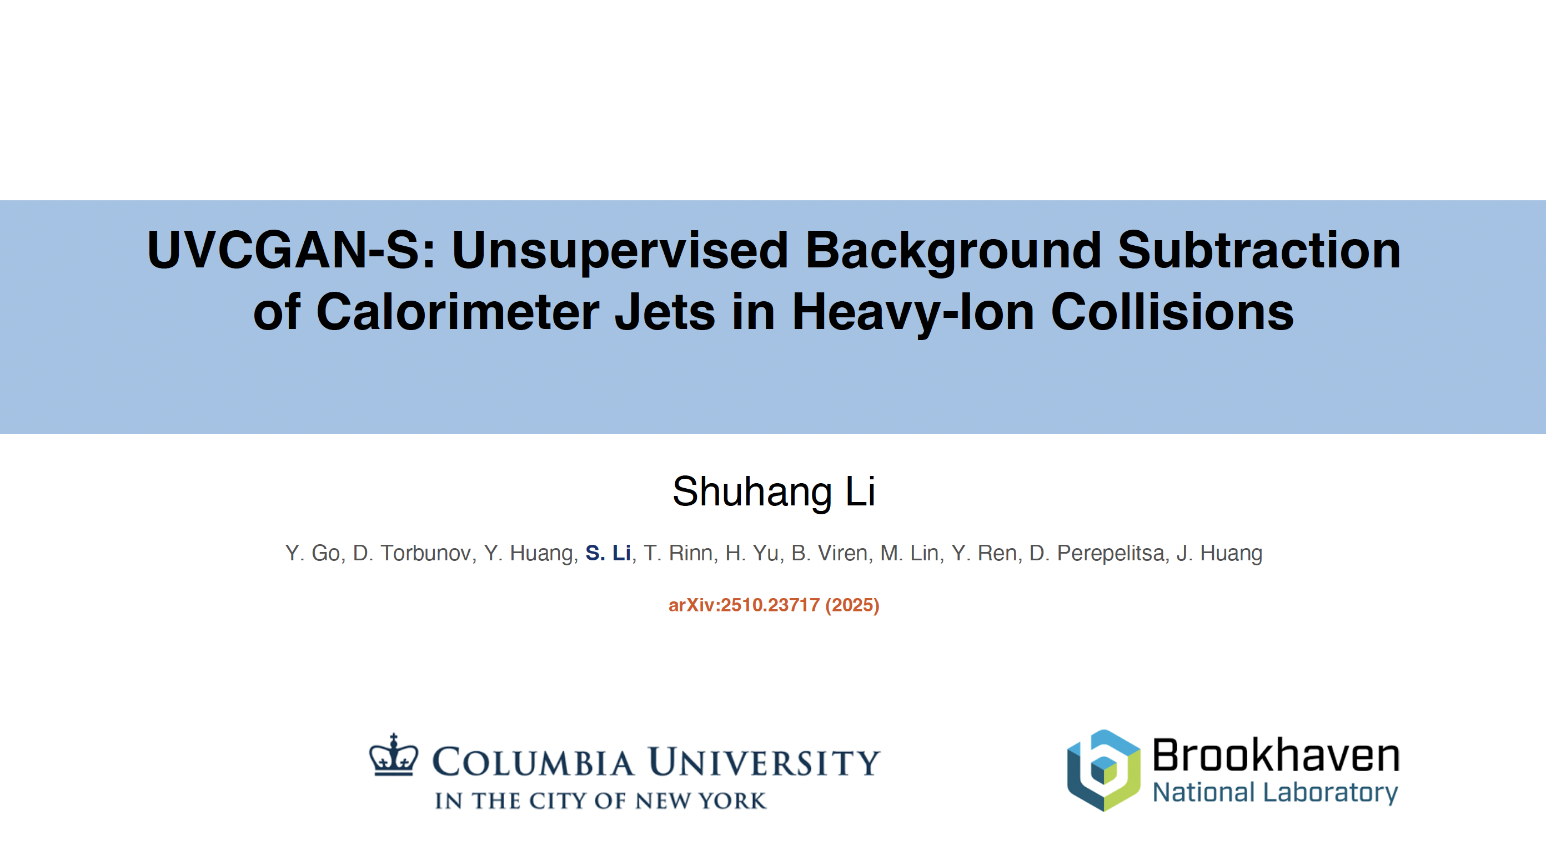

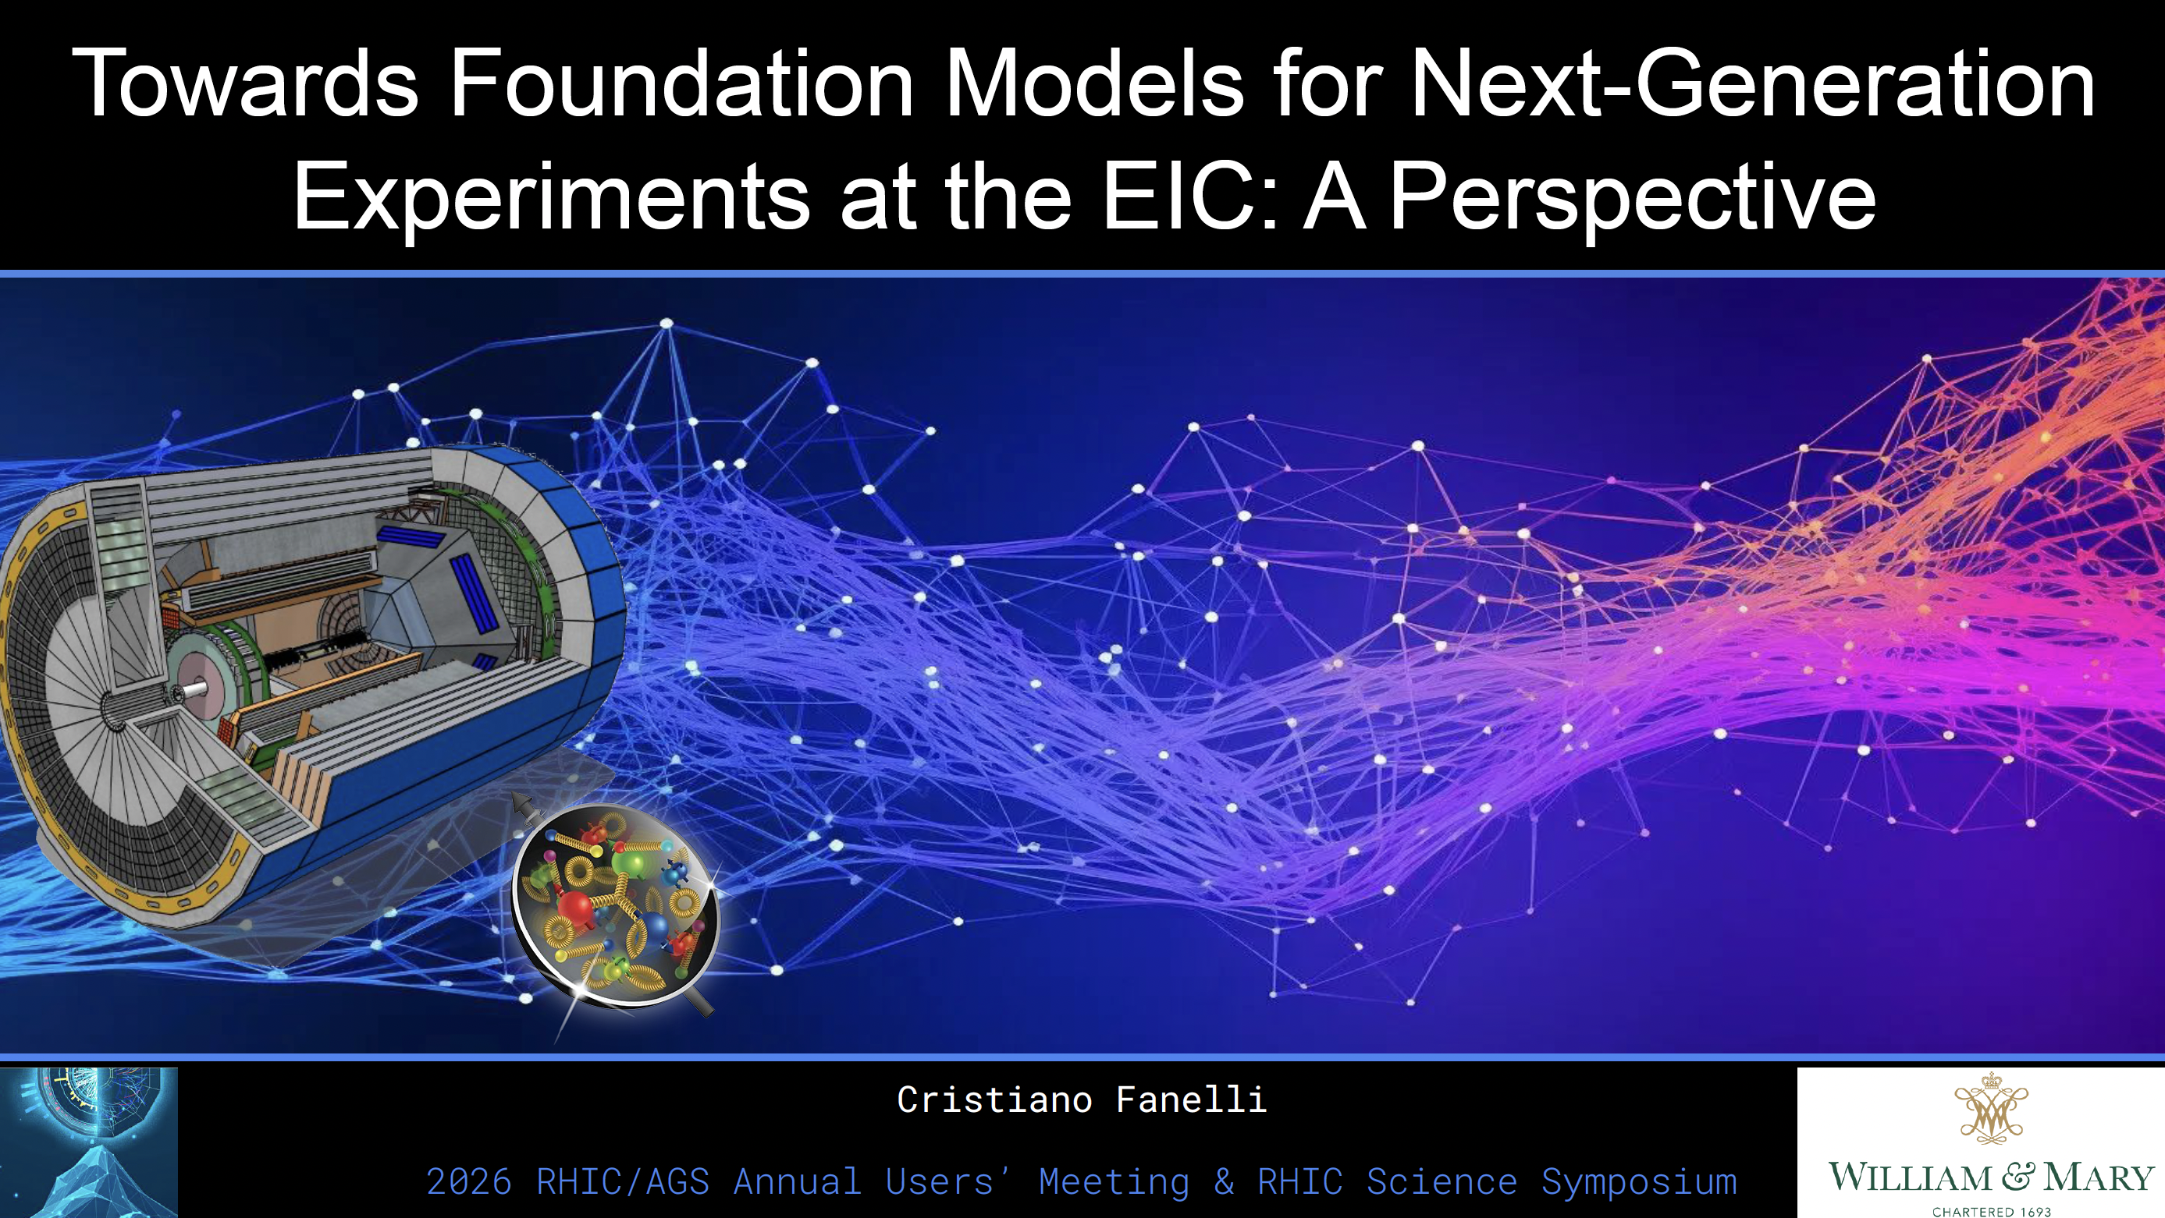
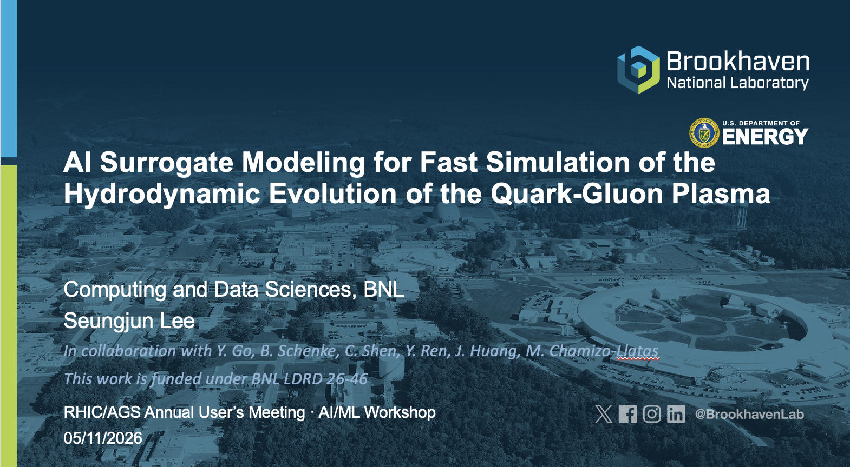
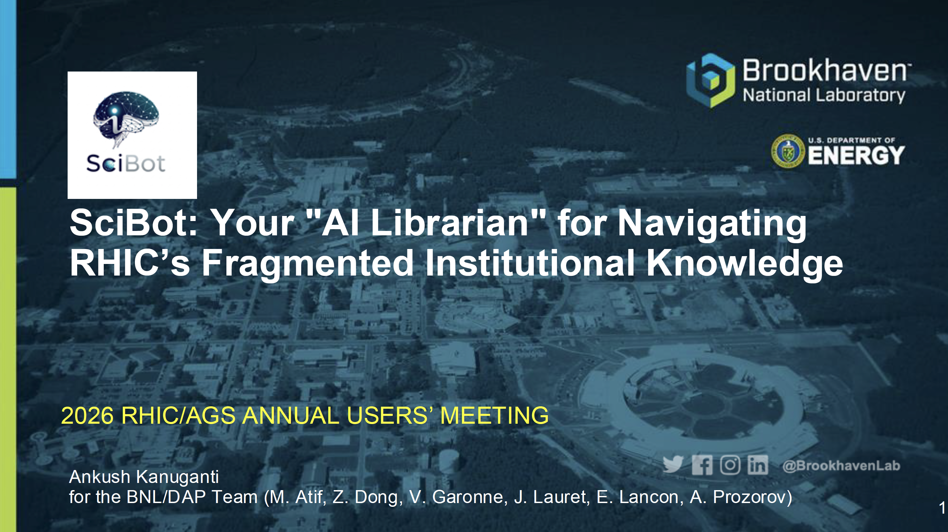
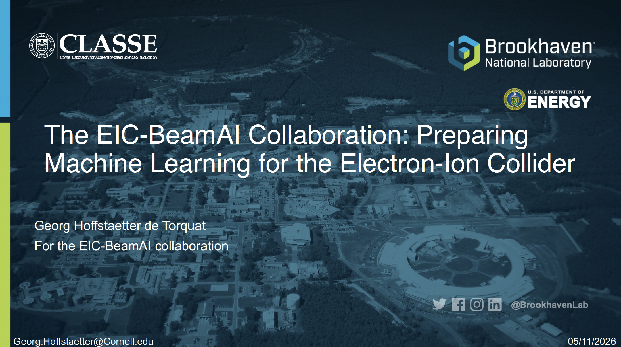
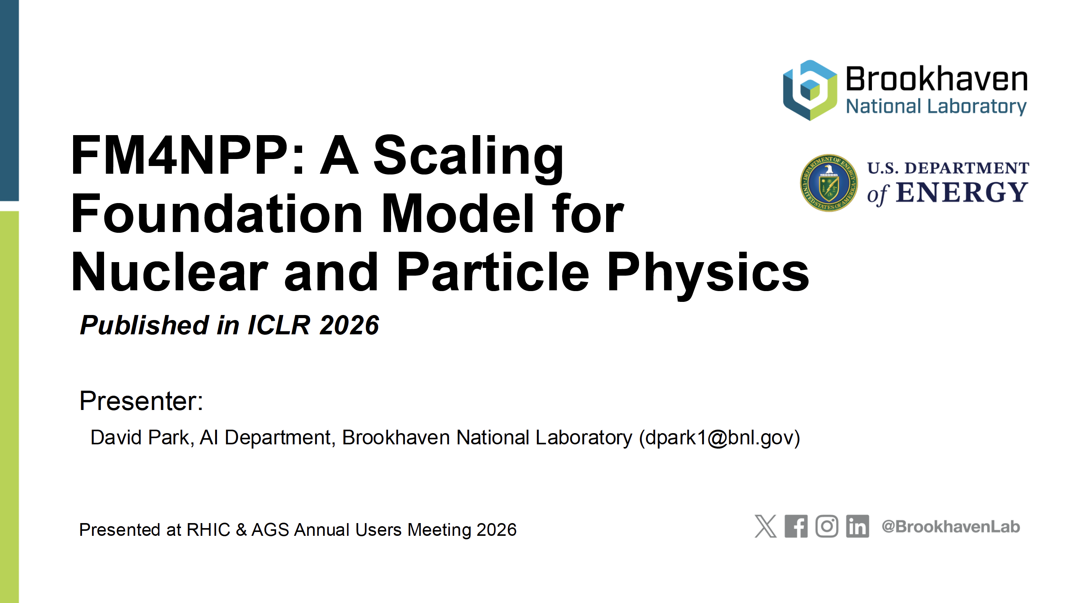
Workshop overview
Held yesterday from 9am to 3pm
We had 7 contributions
Unfortunately, an 8th contributor, Alexandr Prozorov, had to withdraw last week due to visa requirements
Wide variety of topics, from EIC accelerator optimization to chat bots
Good representation from labs and universities

Slide 5
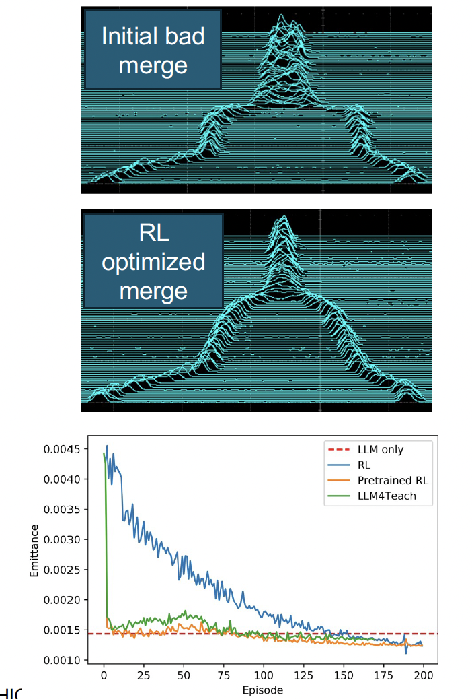
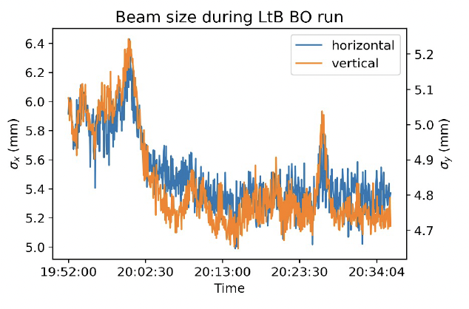
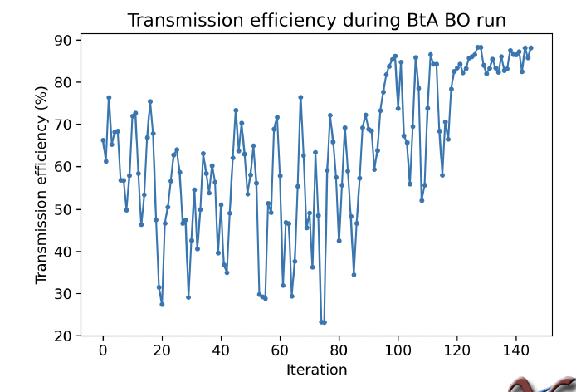
Accelerator optimization – G. Hoffstaetter
Aim: improve brightness, polarization and efficiency
Uses BNL accelerator complex as testbench
AI can be used to boost transfer efficiency
Large Language Models can improve beam merging within a few iterations
Digital Twins (simulated accelerators) can provide real-time feedback for EIC operations
LLMs for bunch merging
Bayesian Optimization of beams
Linac-to-booster beam width decreases
Booster-to-AGS efficiency increases ~20%

Slide 6
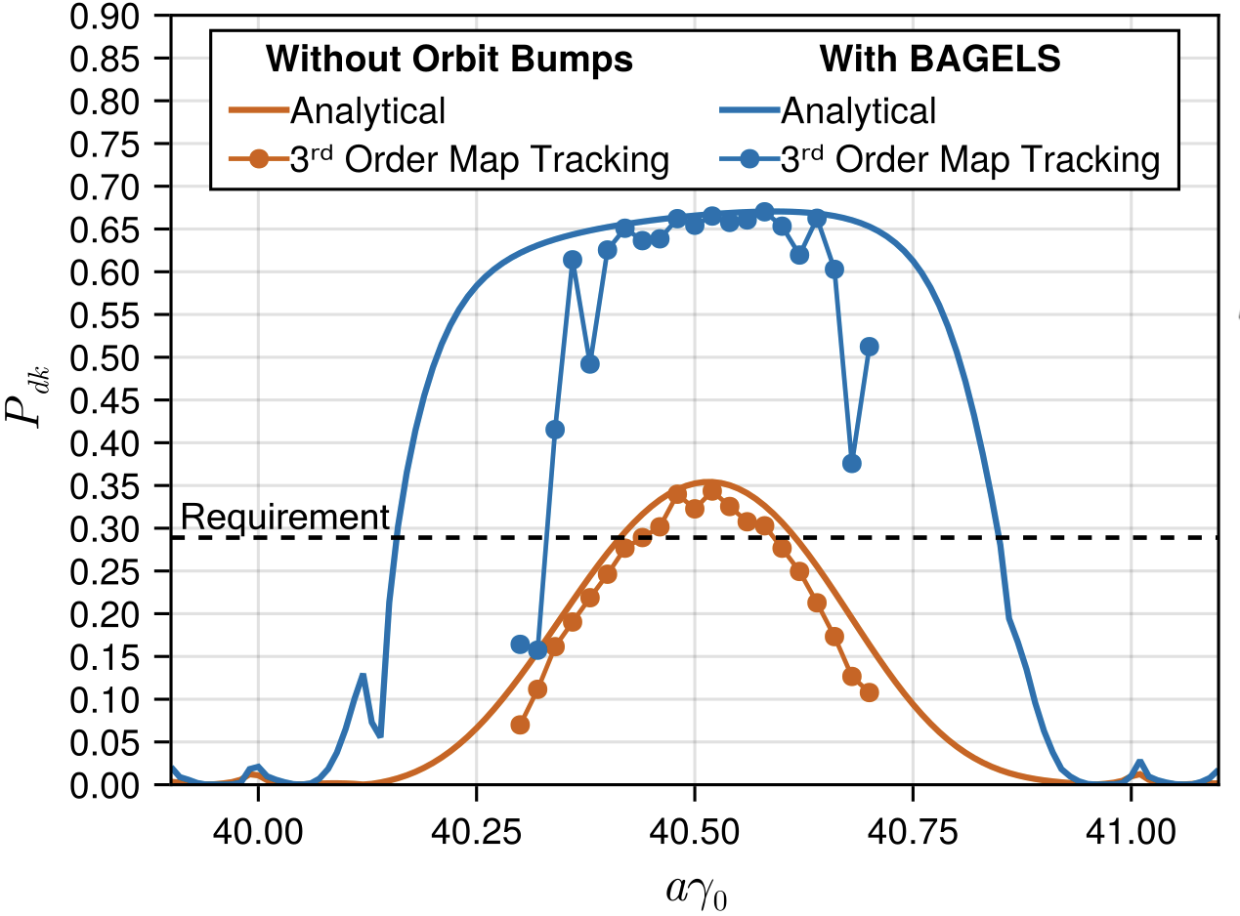
Beam optimization for the EIC – G. Hoffstaetter
BAGELS = Best Adjustment Groups for ELectron Spin
Used in the design of the EIC Electron Storage Ring
For e⁻ polarization it “nearly double[s] the asymptotic polarization” for single IP config.
Details how to introduce beam bumps to minimize radiative depolarization
Can also be used to obtain bumps that alter other parameters but minimise polarization impact
Asymptotic Polarization
Phys. Rec. Acc. (2025) 28, 031002

Slide 7
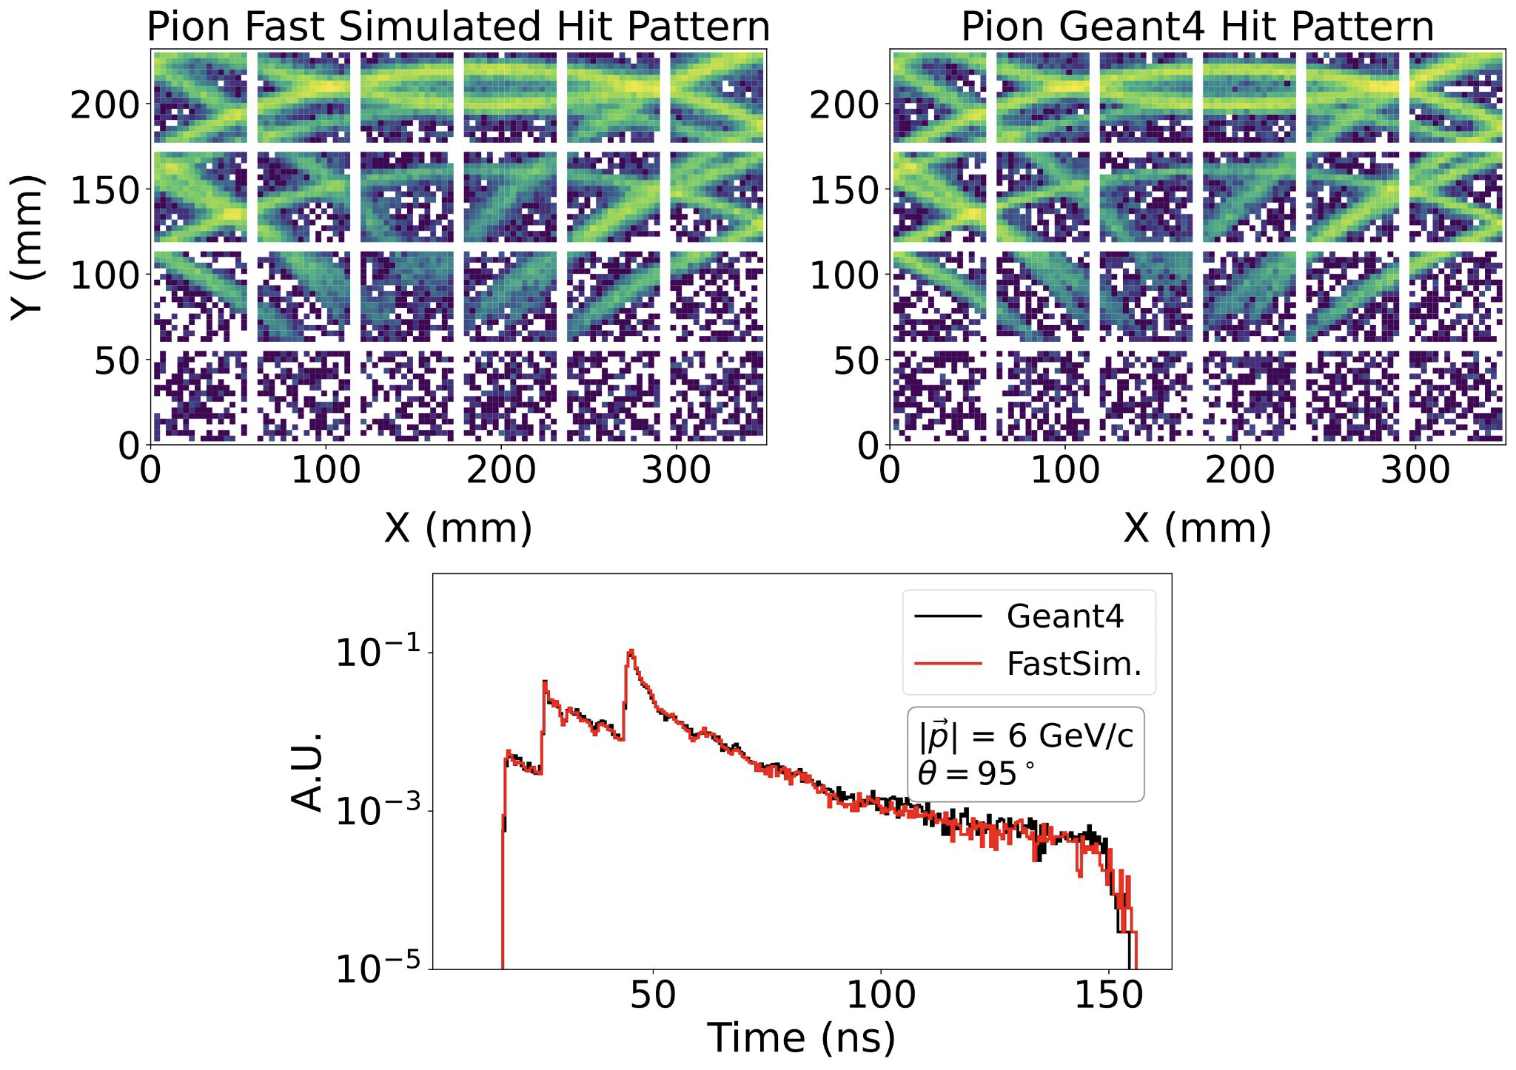
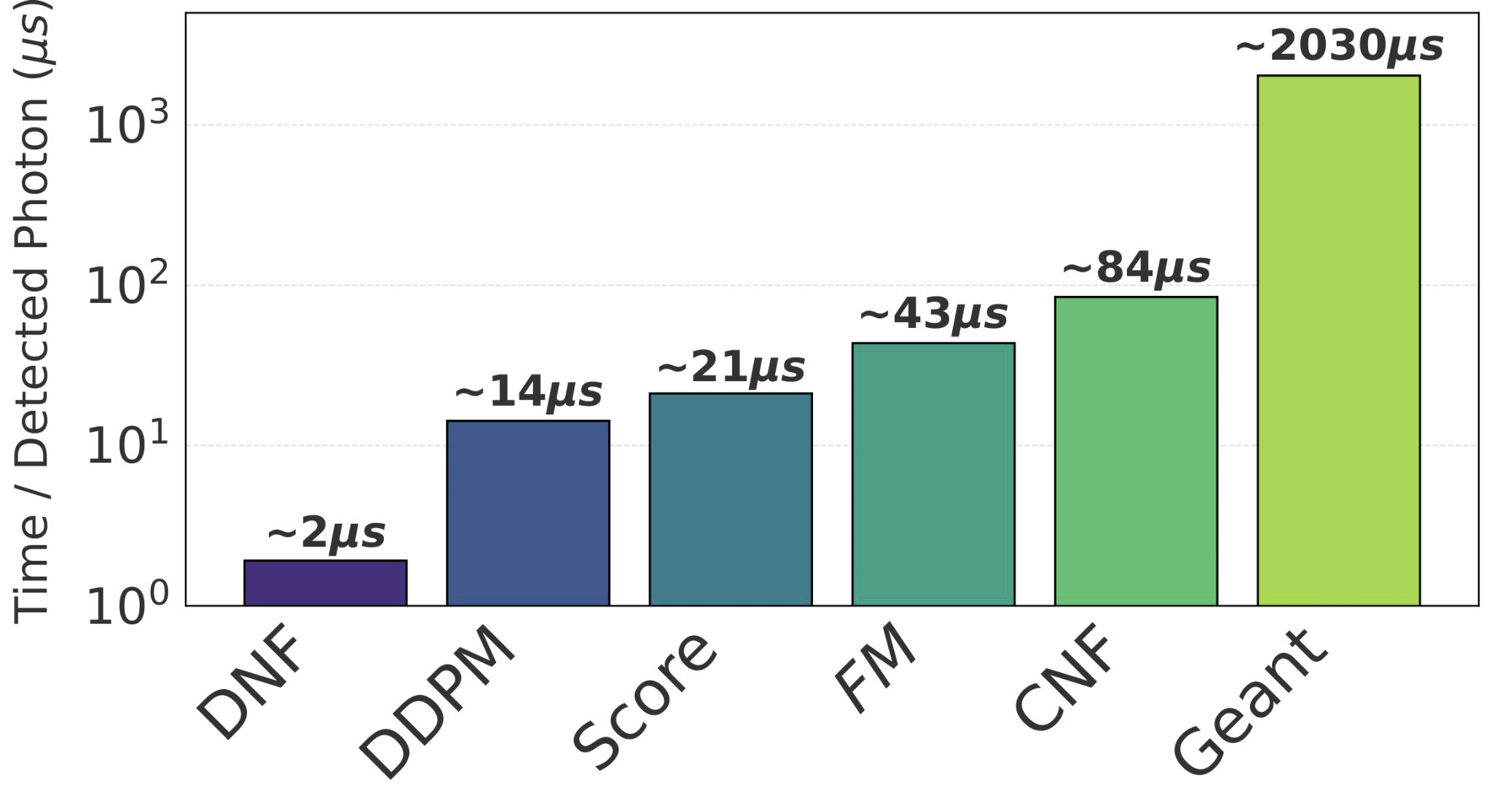
Fast-sim for the PID detectors - C. Fanelli
Several architectures developed and tested for fast simulation of photons:
Normalizing Flows, Continuous Normalizing Flows, Conditional Flow Matching, Denoising Diffusion Probabilistic Models, Score Based Generative Models
Demonstrate similar hit patterns but much faster generations
arXiv:2504.19042

Slide 8
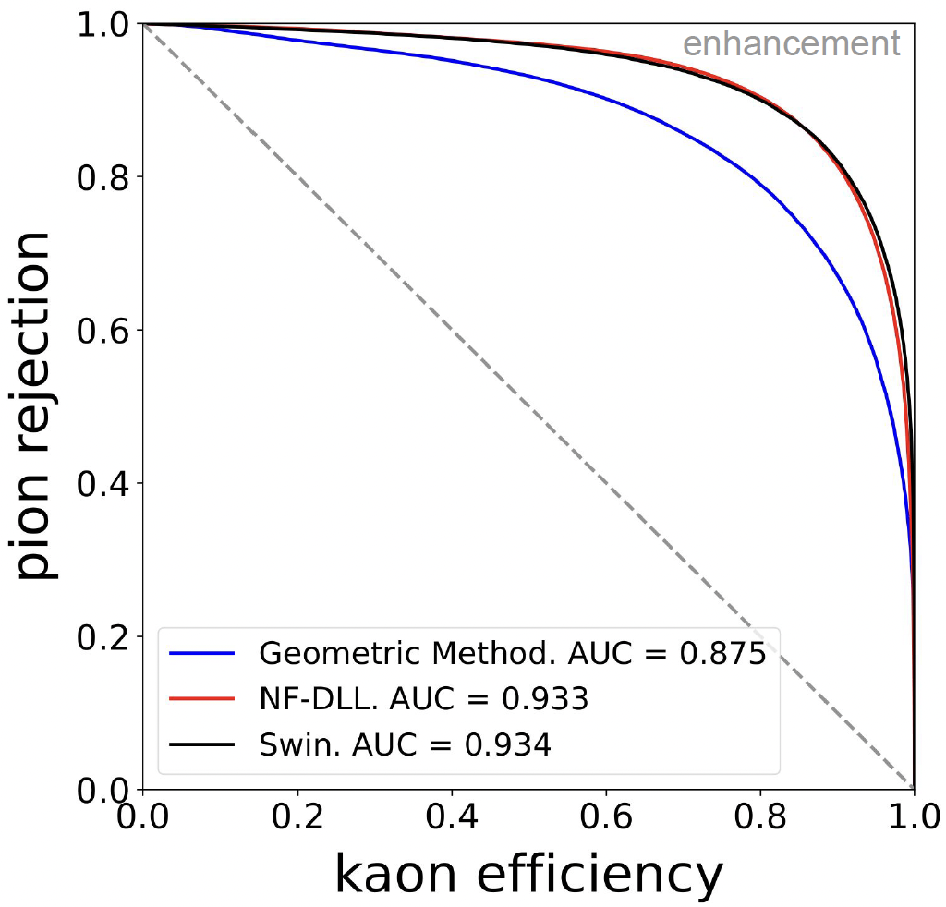
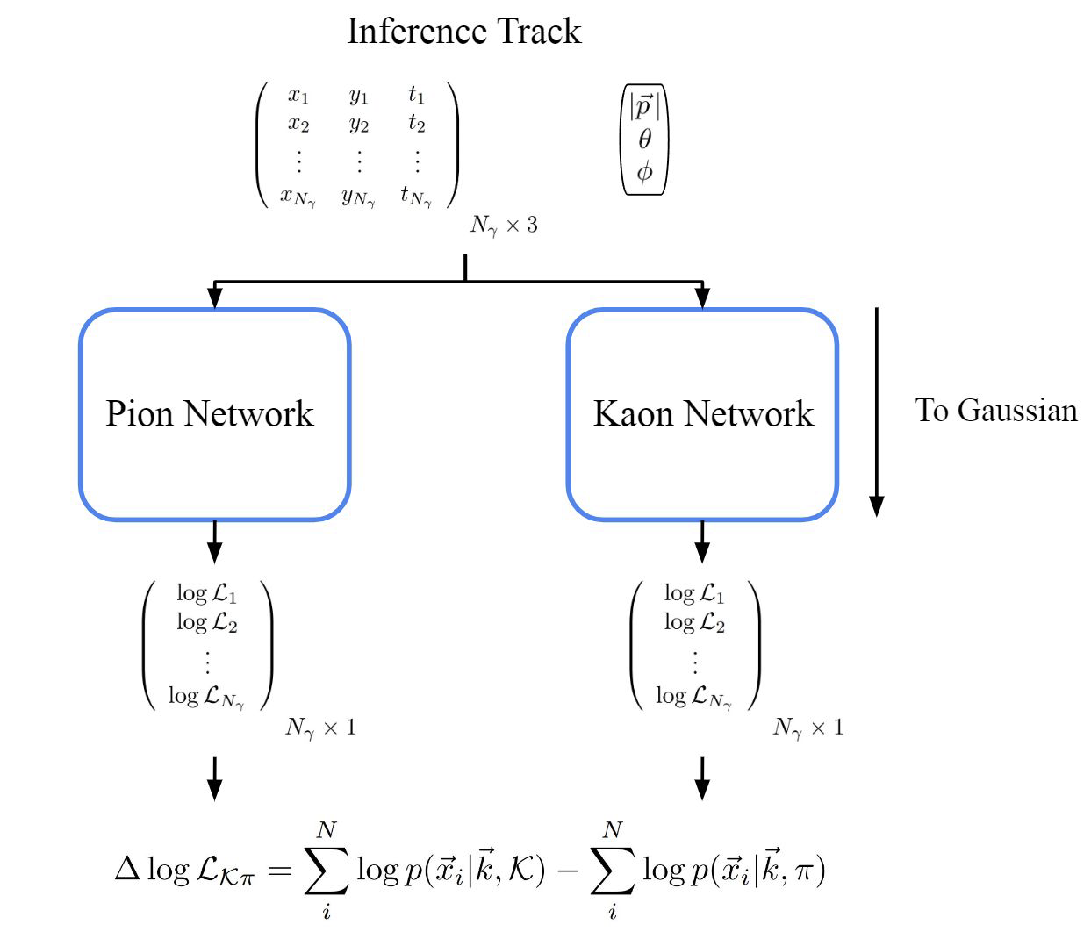
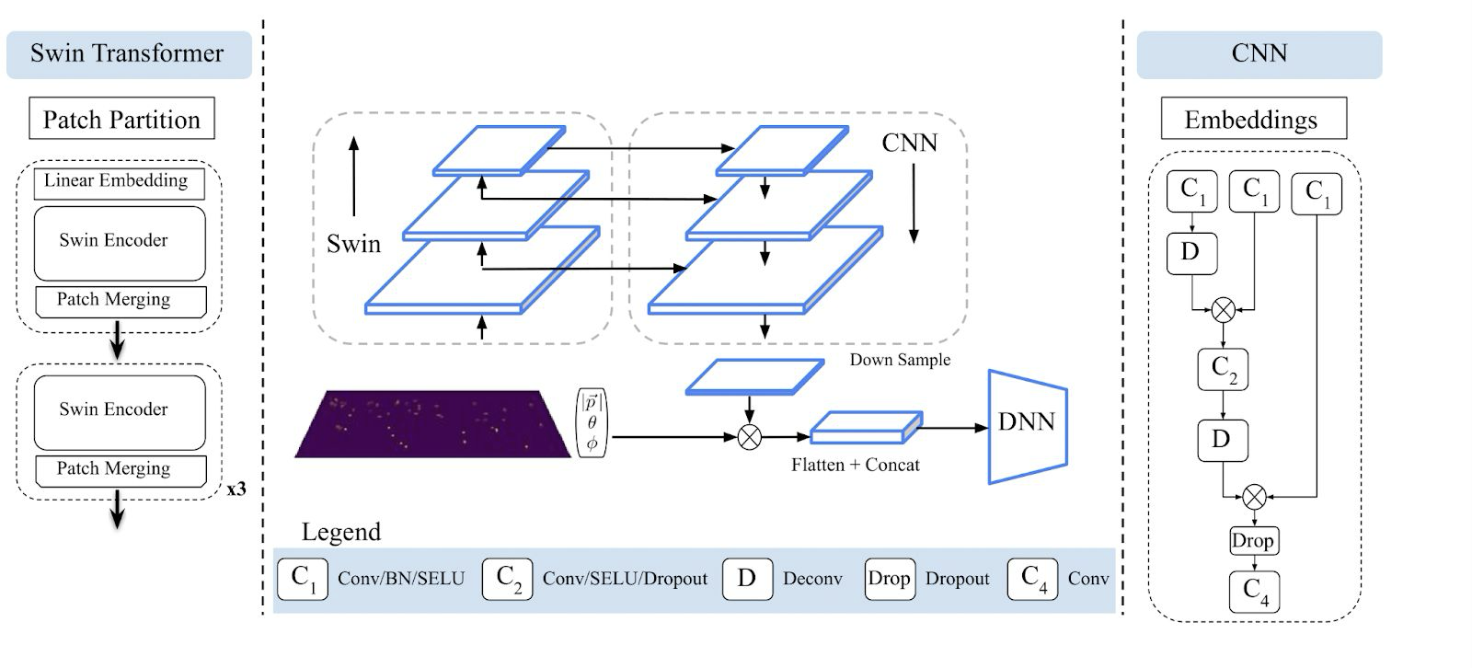
PID from fast sims- C. Fanelli
Fast simulations can be used to train for PID by measuring log-likelihood for differed hypothesis
Mach. Learn.: Sci. Technol. 6 015028

Slide 9
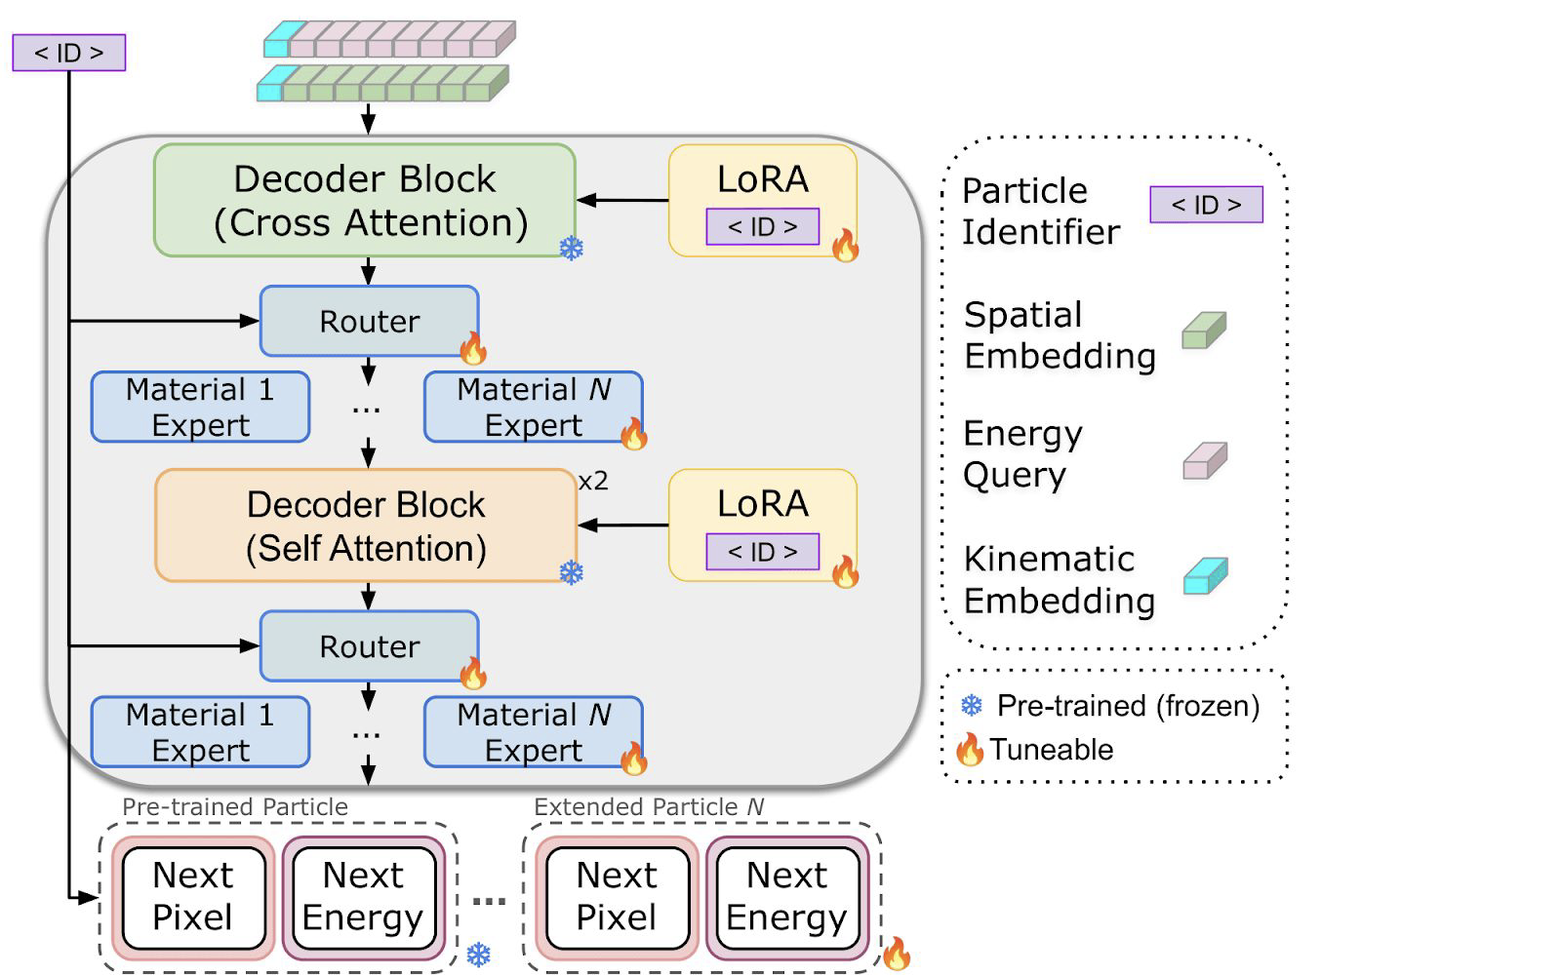
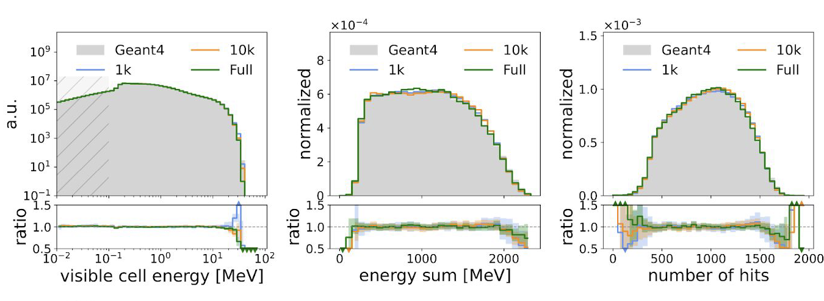
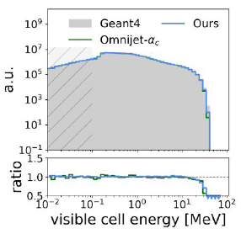
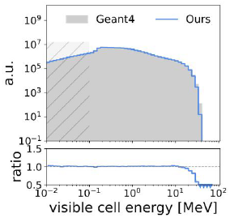



Foundation models - C. Fanelli
Foundation Models are “self-supervised” models trained on large datasets
They can work on multiple tasks (instead of single tasks such as background rejection)
Aim is to apply them to different input data sources (different detectors, accelerators etc)
Altering simulated designs often requires millions of simulated events to study response
Generalizable FM for calorimeter simulations can converge in ~10k generations
$γ$ in Lead
$γ$ in Tungsten
$γ$ in Tantalum
 | arXiv:2603.28804

Slide 10
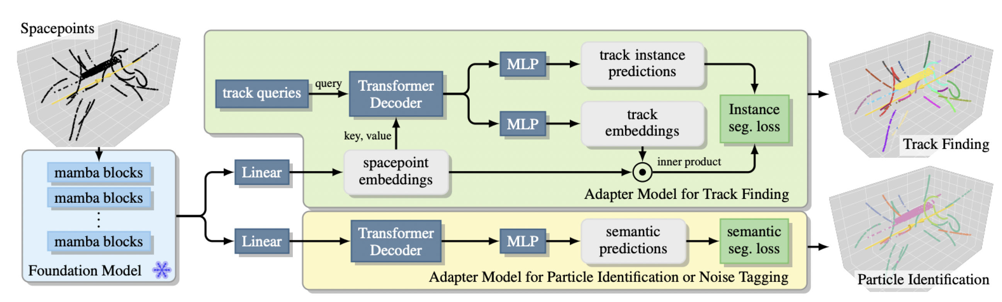
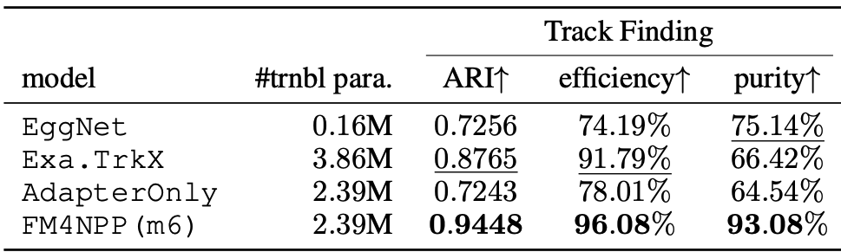
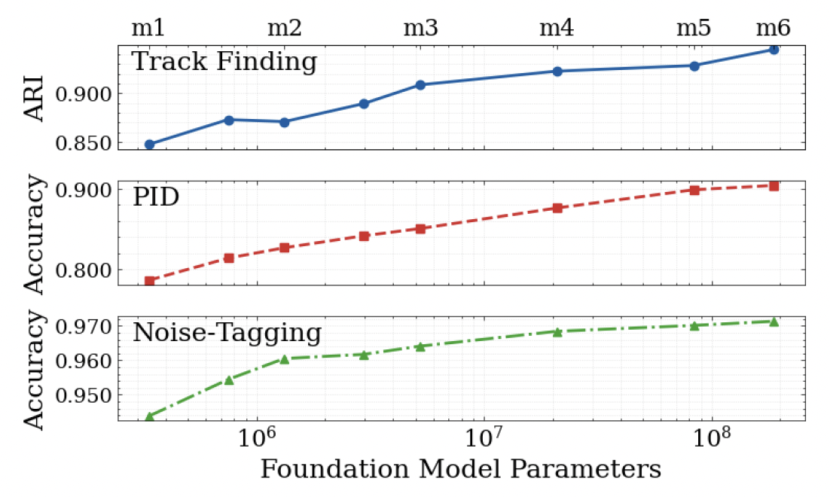
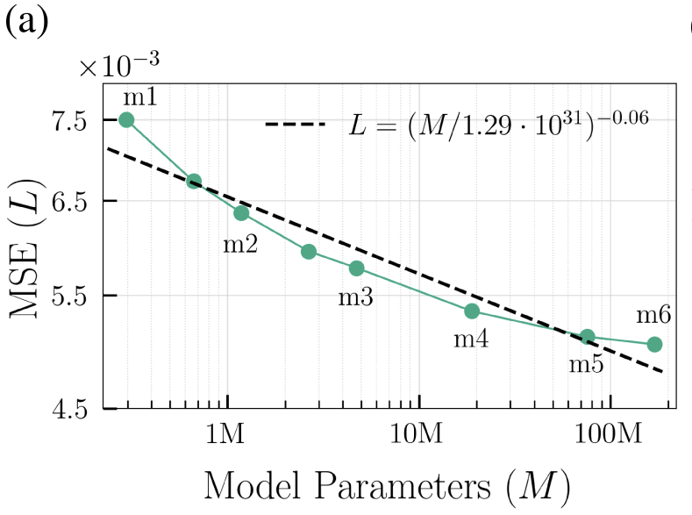
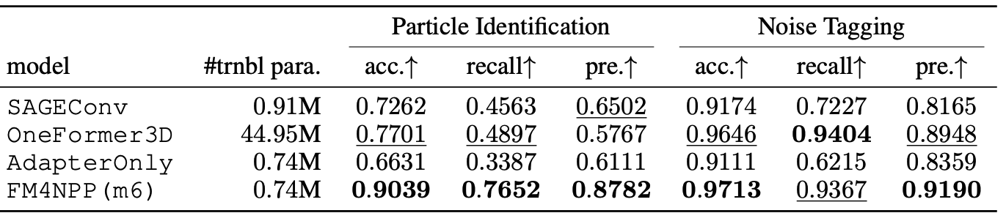
Foundation models for TPC data – D. Park
Tasks
Track finding
Particle Identification
Noise Finding
Extensions
Additional subsystems
Different experiments
arXiv:2508.14087, IJMP A (2025) 10.21239

Slide 11
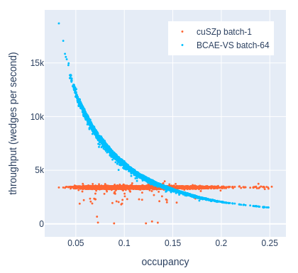
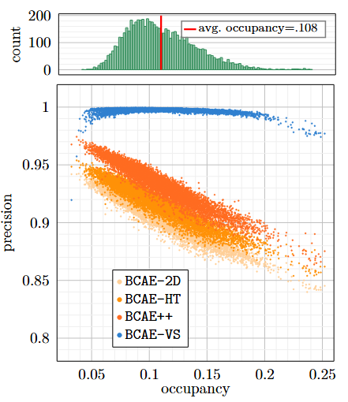
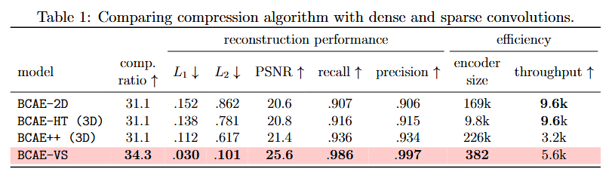
Compression for TPC data – Y. Huang
TPC data contributed the most to the sPHENIX raw data (~90%)
Efficient compression has direct impact on storage, buffer requirements and more
Clusters can be saved based on weight (importance)
Weight based on Mean Squared Error and nearest-neighbors
Cut on threshold weight
Work performed on pp and AuAu data (plots from AuAu)
BCAE-VS is an autoencoder with variable ratio compression for sparse input
Patterns (2026) 7.3.101452

Slide 12
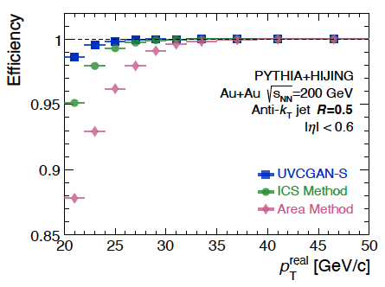
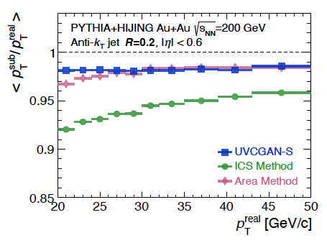
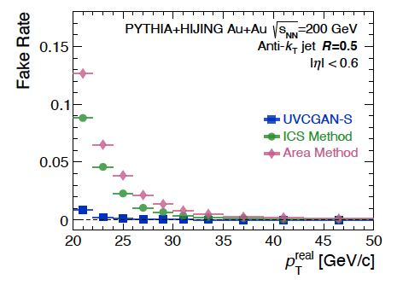
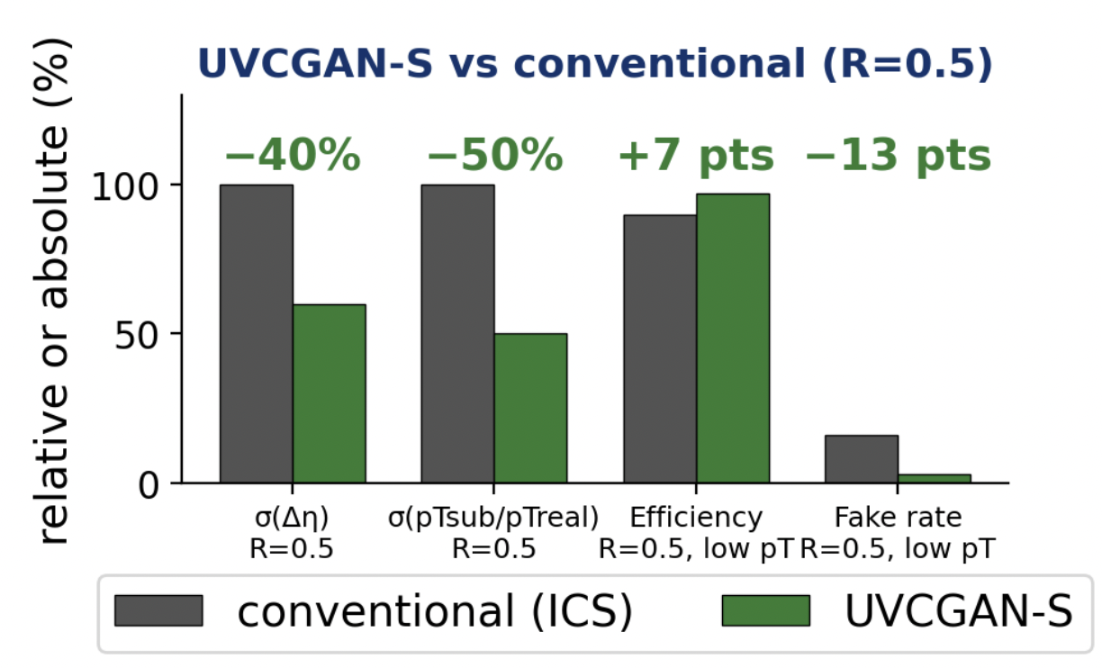
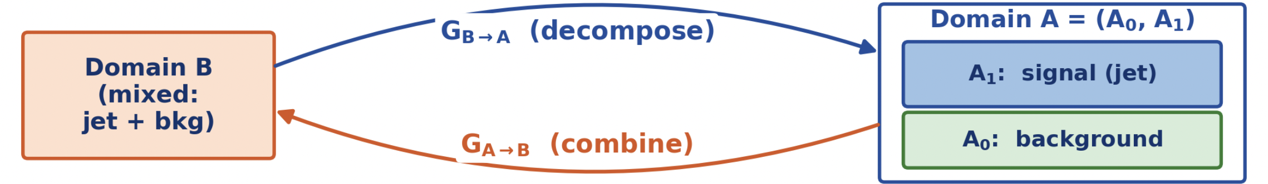
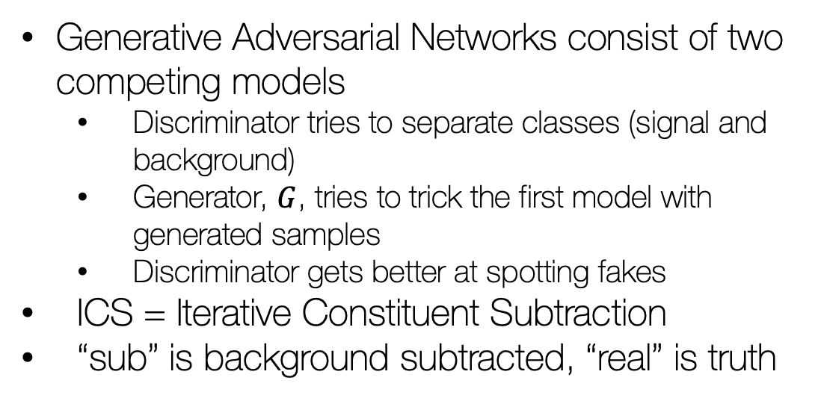
Background subtraction in jets – S. Li
Generative Adversarial Networks consist of two competing models
Discriminator tries to separate classes (signal and background)
Generator, $G$, tries to trick the first model with generated samples
Discriminator gets better at spotting fakes
ICS = Iterative Constituent Subtraction
“sub” is background subtracted, “real” is truth
 | arXiv:2510.23717

Slide 13
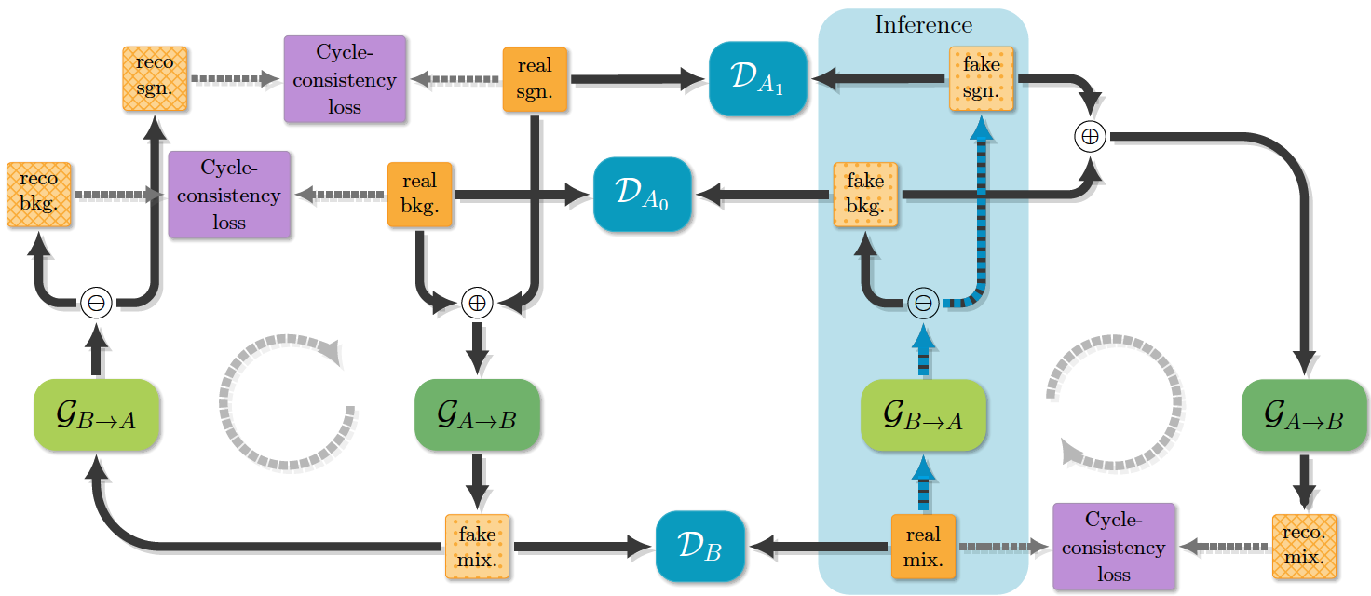

Background subtraction in jets – S. Li
 | arXiv:2510.23717

Slide 14
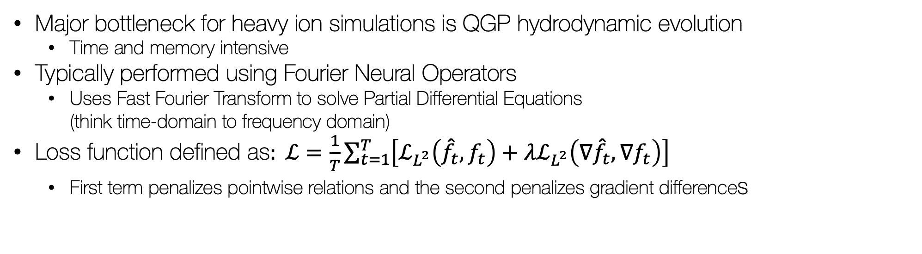
Fast simulations of QGP – S. Lee
Major bottleneck for heavy ion simulations is QGP hydrodynamic evolution
Time and memory intensive
Typically performed using Fourier Neural Operators
Uses Fast Fourier Transform to solve Partial Differential Equations (think time-domain to frequency domain)
Loss function defined as$: ℒ=\frac{1}{T}\sum_{t=1}^{T}{\left[ℒ_{L^{2}}\left({\hat{f}}_{t},f_{t}\right)+λℒ_{L^{2}}\left(∇{\hat{f}}_{t},∇f_{t}\right)\right]}$
First term penalizes pointwise relations and the second penalizes gradient differences

Slide 15
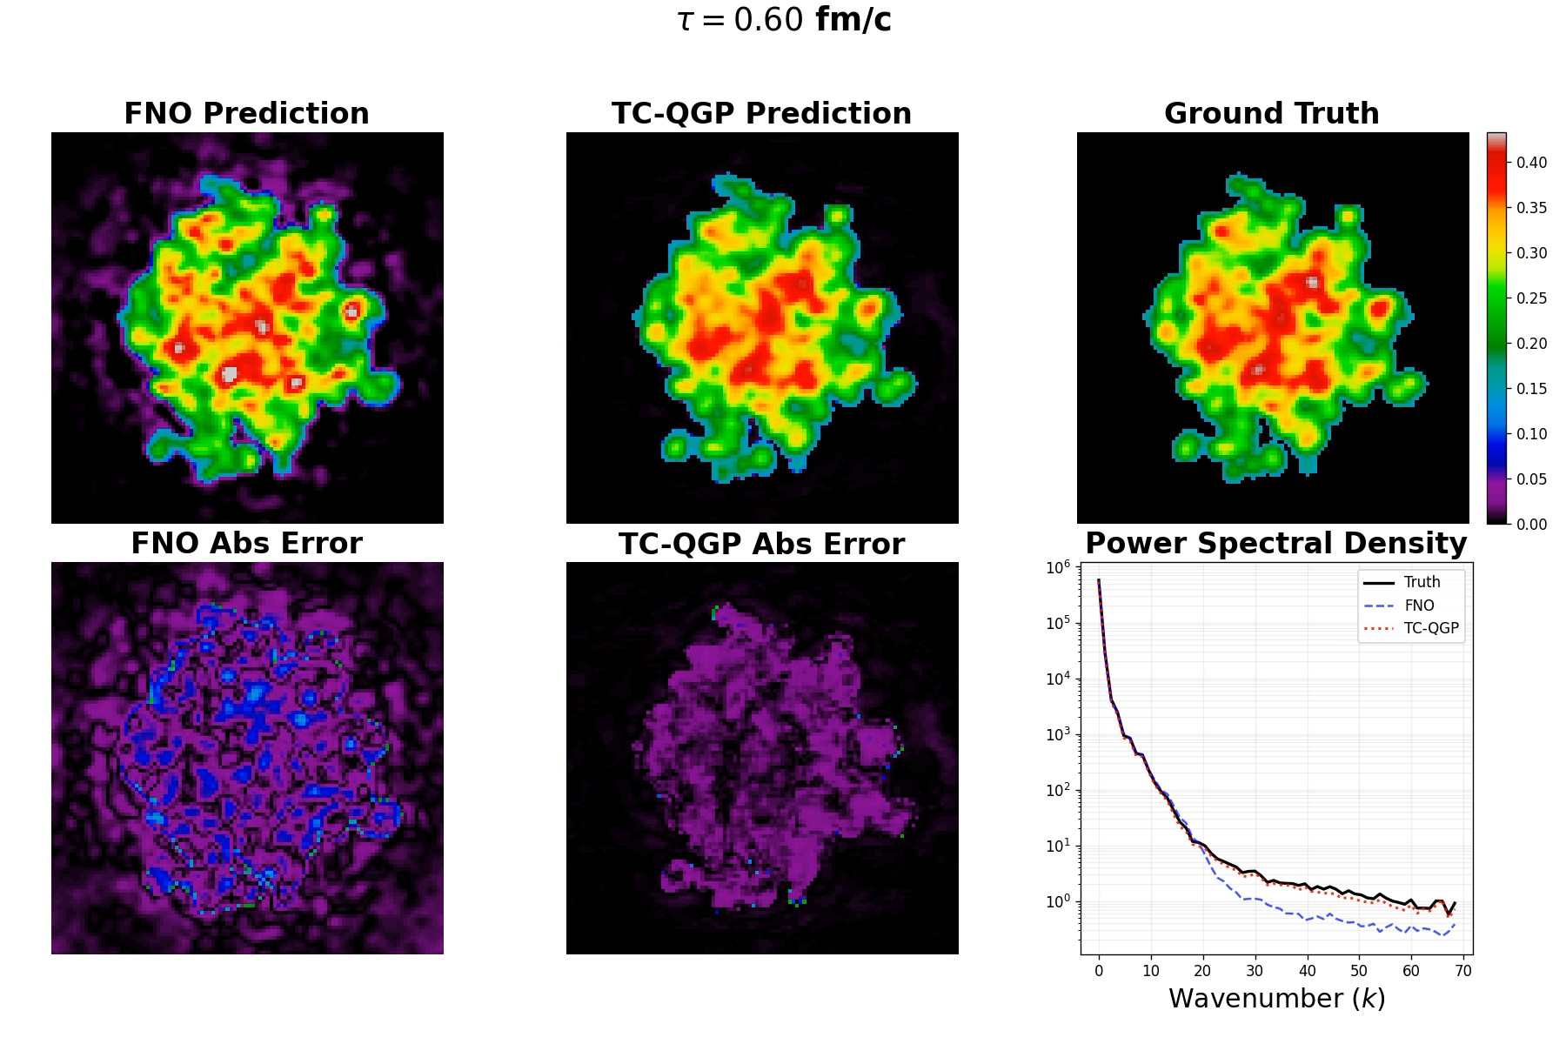

Fast simulations of QGP – S. Lee
Accuracy – Mean Relative Error (%)
Cost (single A100, batch 1)
 | FNO | TC-QGP | ↓
ε | 17.44 | 4.08 | 4.3×
T | 13.89 | 1.66 | 8.4×
P | 20.32 | 4.54 | 4.5×
u_{x} | 28.10 | 8.52 | 3.3×
u_{y} | 27.73 | 7.80 | 3.6×
u_{z} | 31.44 | 5.44 | 5.8×
All | 23.15 | 5.34 | 4.3×
 | FNO | TC-QGP
Parameters | 382.4 M | 356.6 M
GPU Memory | 16,585 MB | 4,459 MB
Inference Time | 108.8 ms | 230.4 ms
Temperature
vs MUSIC: ~20 hours per event $→$ TC-QGP: ~0.2 s per event

Slide 16
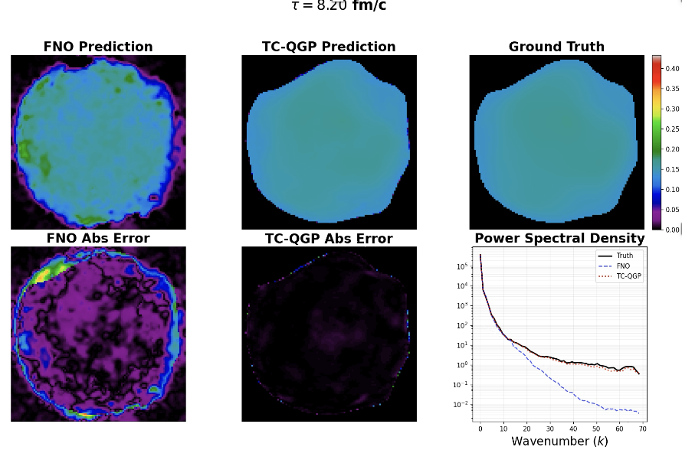
Fast simulations of QGP – S. Lee
Accuracy – Mean Relative Error (%)
Cost (single A100, batch 1)
 | FNO | TC-QGP | ↓
ε | 17.44 | 4.08 | 4.3×
T | 13.89 | 1.66 | 8.4×
P | 20.32 | 4.54 | 4.5×
u_{x} | 28.10 | 8.52 | 3.3×
u_{y} | 27.73 | 7.80 | 3.6×
u_{z} | 31.44 | 5.44 | 5.8×
All | 23.15 | 5.34 | 4.3×
 | FNO | TC-QGP
Parameters | 382.4 M | 356.6 M
GPU Memory | 16,585 MB | 4,459 MB
Inference Time | 108.8 ms | 230.4 ms
Temperature
vs MUSIC: ~20 hours per event $→$ TC-QGP: ~0.2 s per event

Slide 17
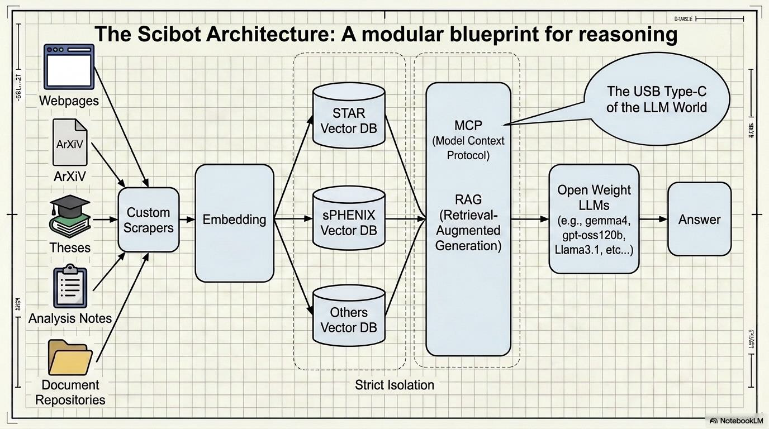
Chat bots for BNL data – A. Kanuganti
Chat bots are becoming increasingly popular (think ChatGPT)
How can scientists take advantage?
Some data is restricted to collaborators
Lots of research time can be spent in literature review
What if chat bots can parse theses, analysis notes, presentations and news releases

Slide 18
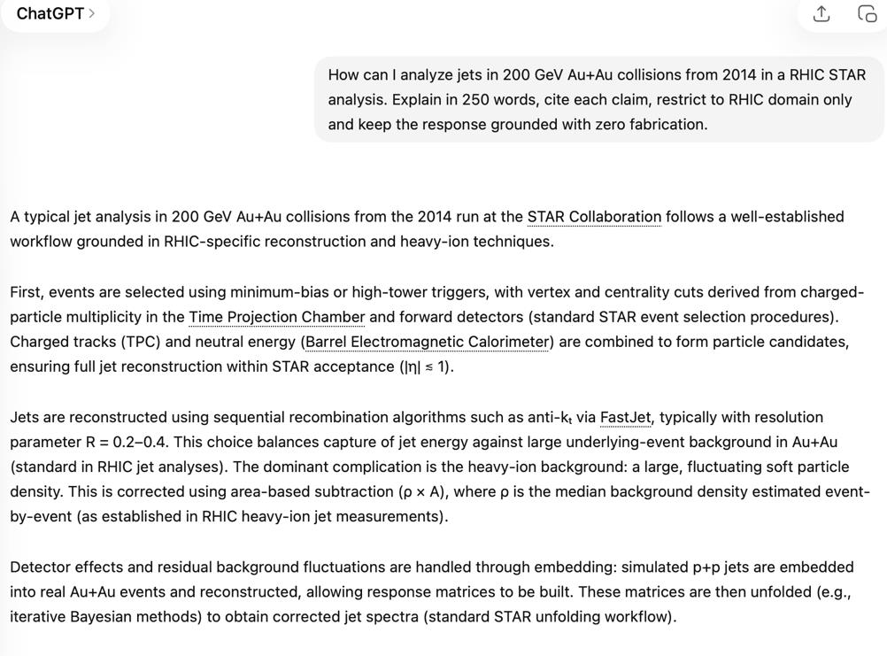
Chat bots for BNL data – A. Kanuganti

Slide 19
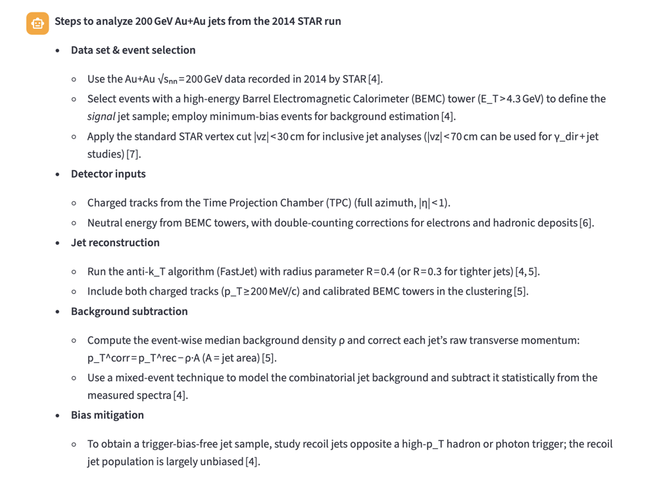
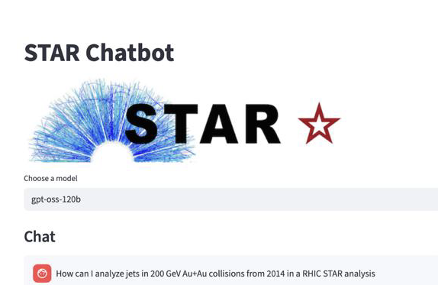
Chat bots for BNL data – A. Kanuganti

Slide 20

Conclusion
Variety of presentations
Demonstrates ML is being used in multiple aspects of nuclear physics; from experimental designs, data analysis and knowledge preservation
A clear trend
Lab and university personnel are leading innovation and overcoming restrictions from commercial products
A common point
Hardware availability can be a limiting factor
Deployment of operational algorithms at EIC will require dedicated computing power
Algorithm development is not limited by scientist ingenuity but by available compute
Try the SciBot!!!
scibot.csi.bnl.gov
Thank you for your attention

Slide 21
Backup

Slide 22
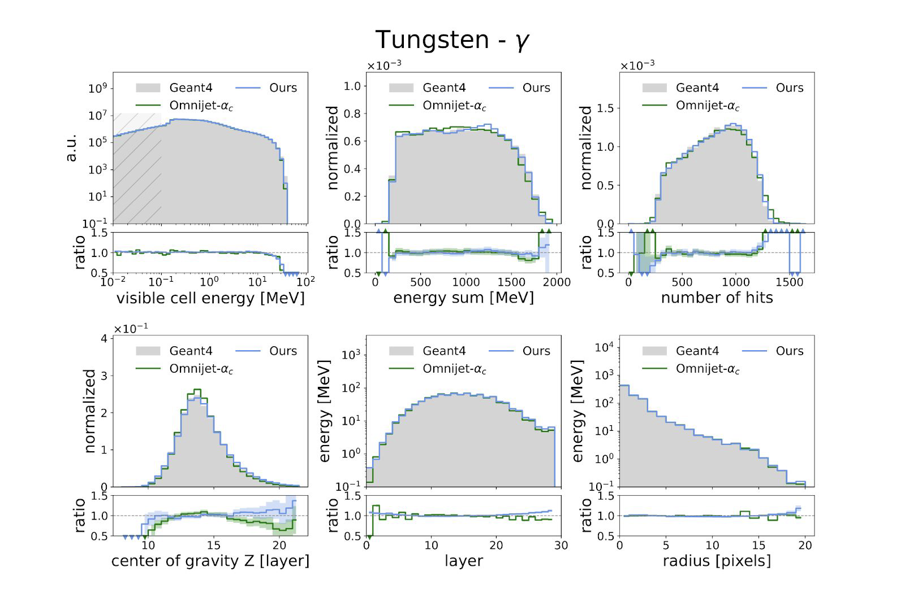
Foundation models for calorimetery
Baseline model, photons in tungsten
Clockwise from top left
Visible cell energy
Total energy sum per shower
Hit multiplicity
Radial energy profile relative to the shower centroid
Average energy deposition per calorimeter layer
Longitudinal center of gravity

Slide 23
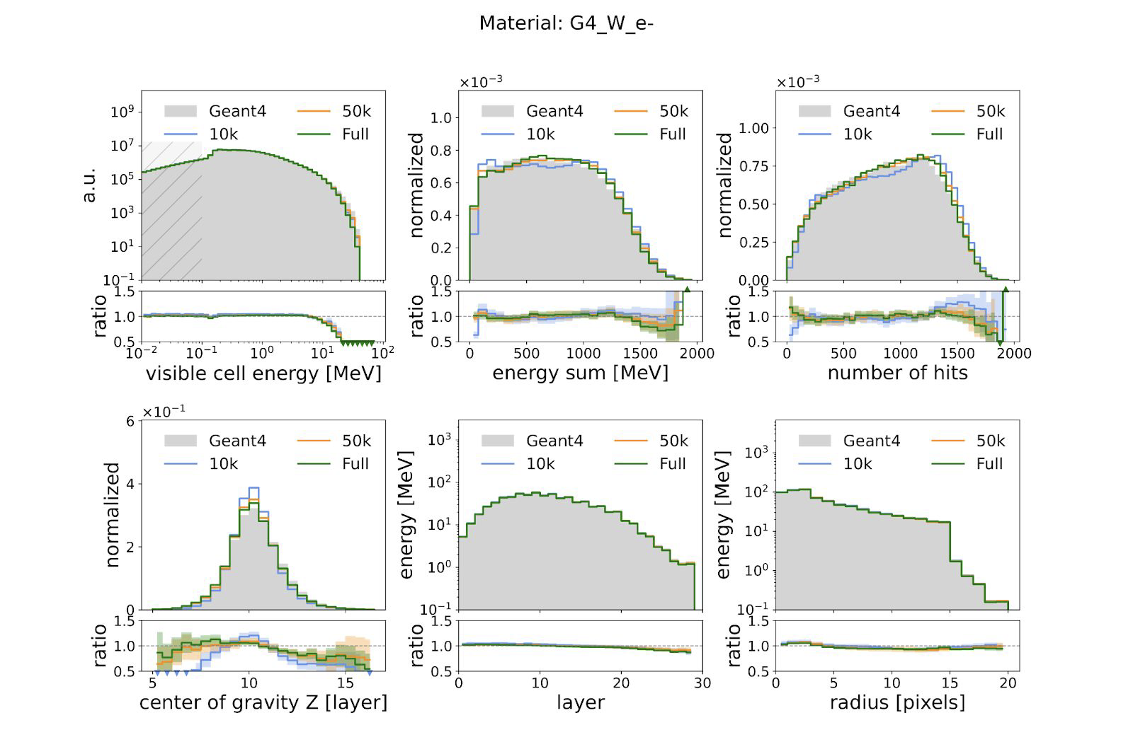
Foundation models for calorimetery
New model, electrons in tungsten
Clockwise from top left
Visible cell energy
Total energy sum per shower
Hit multiplicity
Radial energy profile relative to the shower centroid
Average energy deposition per calorimeter layer
Longitudinal center of gravity

Slide 24
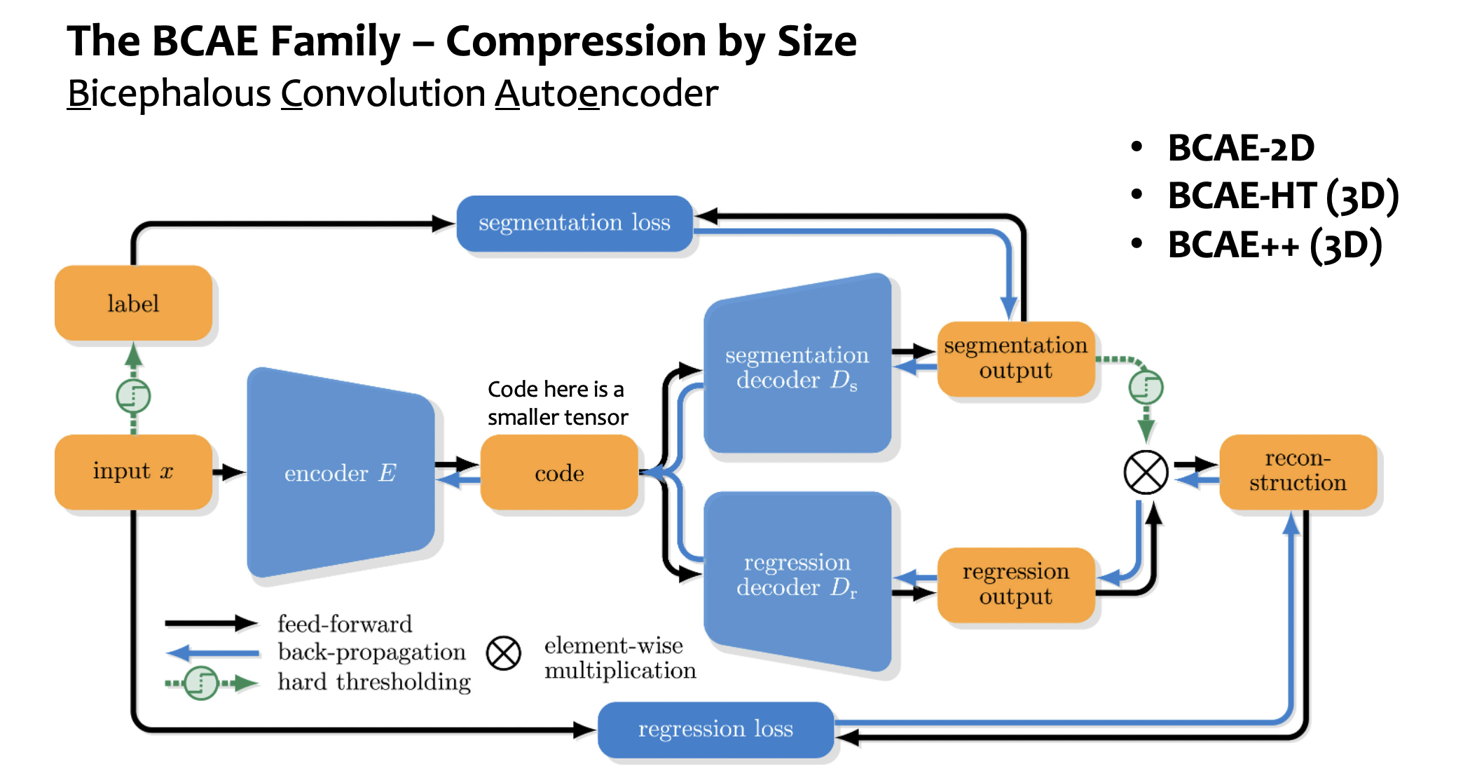
Compression - Autoencoders

Slide 25
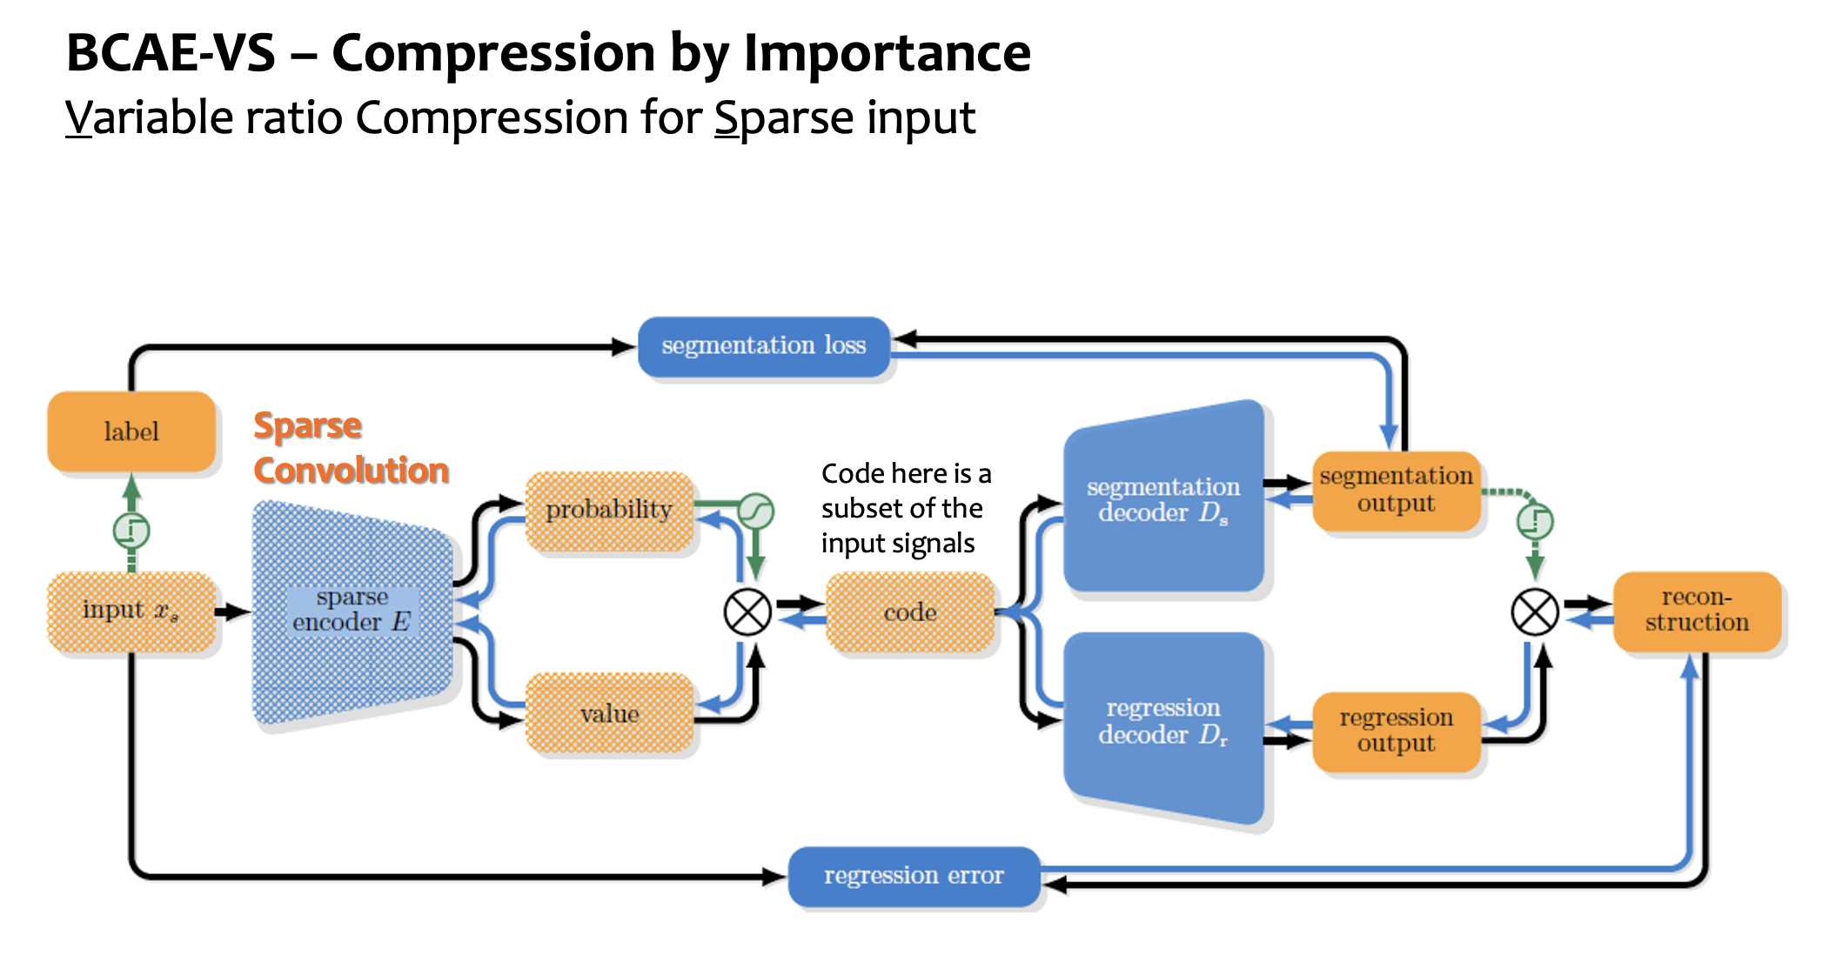
Compression - Autoencoders

