Slide 1
NASA Space Radiation Laboratory
Workshop Summary
Trevor Olsen
Jessica Gasparik
12 May 2026
2026 RHIC/AGS Annual Users' Meeting & RHIC Science Symposium

Slide 2
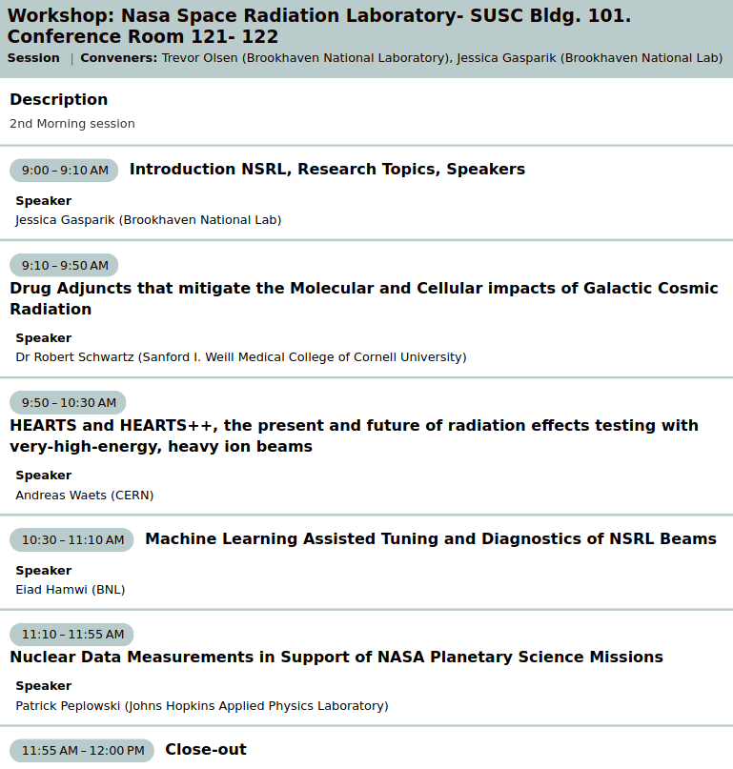
NSRL's first participation in RHIC/AGS Users' Meeting
Showcasing four speakers from across the facility's multi-disciplinary user community
Radiobiology – Robert Schwartz, M.D.
Electronics Testing – Andreas Waets
ML & Accelerator Physics – Eiad Hamwi
Nuclear Data Measurements – Patrick Peplowski

Slide 3

Introduction to NSRL

Slide 4
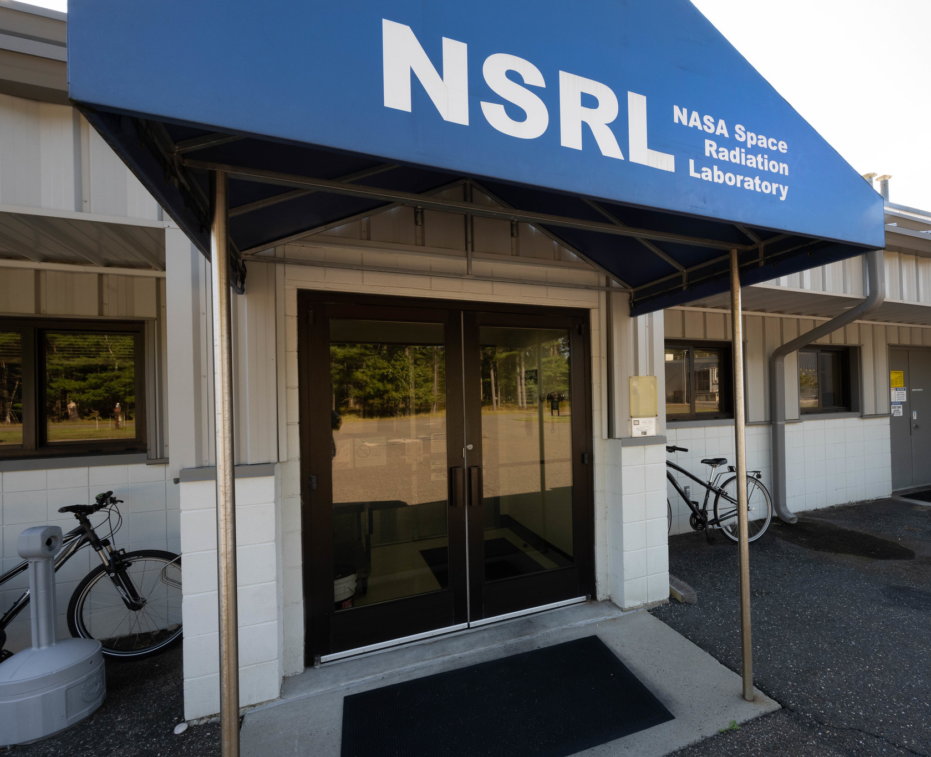
NASA’s Terrestrial Analog for Space Radiation Studies
As NASA sets its eyes towards Mars, understanding the risks and uncertainties from the space radiation environment is crucial:
“In space, astronauts are exposed to ionizing radiation that is quantitatively and qualitatively different from terrestrial radiation. This environment includes protons and high-Z, high-energy ions together with secondary radiation, including neutrons and recoil nuclei that are produced by nuclear reactions in spacecraft materials or tissue.”
- Risk of Radiation Carcinogenesis (2016)
NASA HRP Space Radiation Element

Slide 5
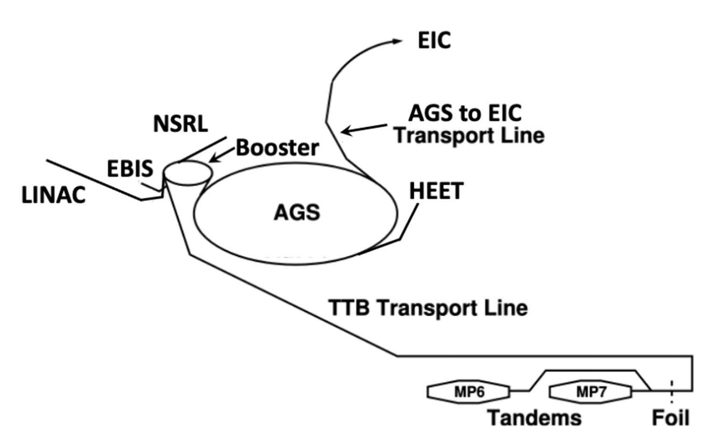
High Energy Beam Lines
NSRL & HEET (proposed)
Low Energy Beam Lines
Tandem VDG
Source Machines
Linac, EBIS & Tandem Van de Graaff

Slide 6
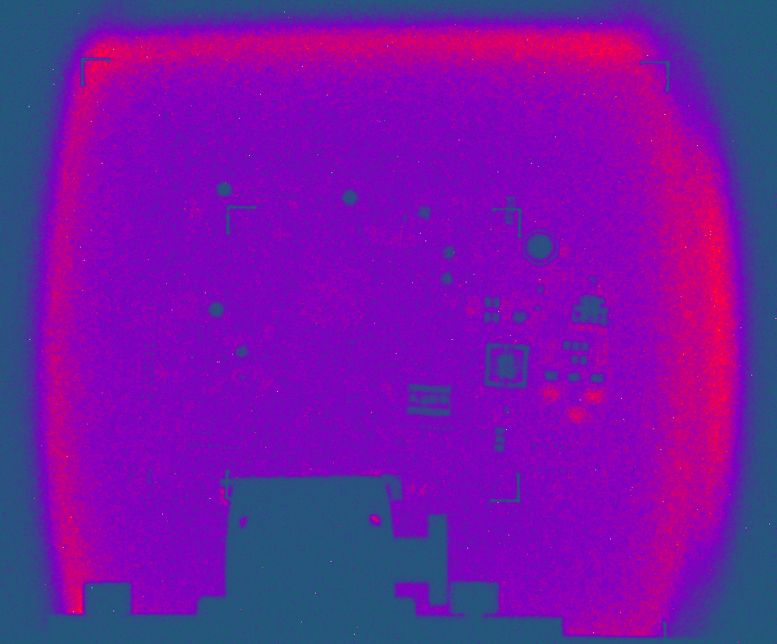
NSRL Beam Capabilities
Projectiles Options
  Protons, Deuterons, H₂
  18 heavy ions between 2 ≤ Z ≤ 83
  Uncharacterized neutron beam possible through deuteron breakup
Beam Energy
  50 – 2500 MeV for protons
  50 – 1500 MeV/n for heavy ions Z ≤ 26 (Iron)
  Reduced peak energy for Z > Fe… 380 MeV/n for Bi
  Stopping beams, 10 MeV and below possible using polyethylene degrader
Flux (spills ~ 400 ms)
  1000 to 2x10¹¹ protons per spill
  10 to 2x10⁹ Fe ions per spill
Bismuth @ 360 MeV/u
20 cm
Adapted from M. Sivertz
“Snowmass Workshop on Calibration and Test Beams”

Slide 7
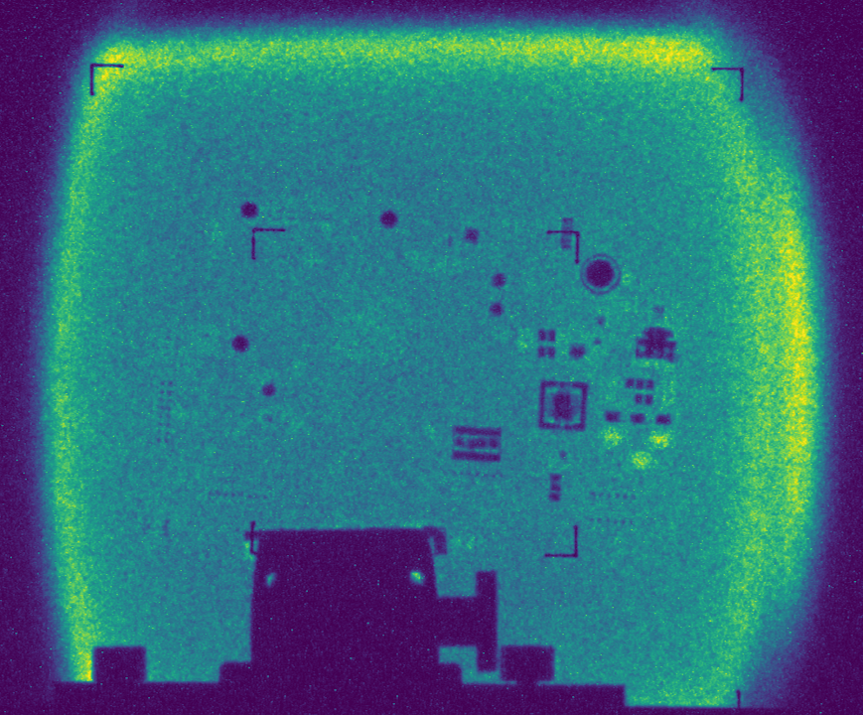

Slide 8
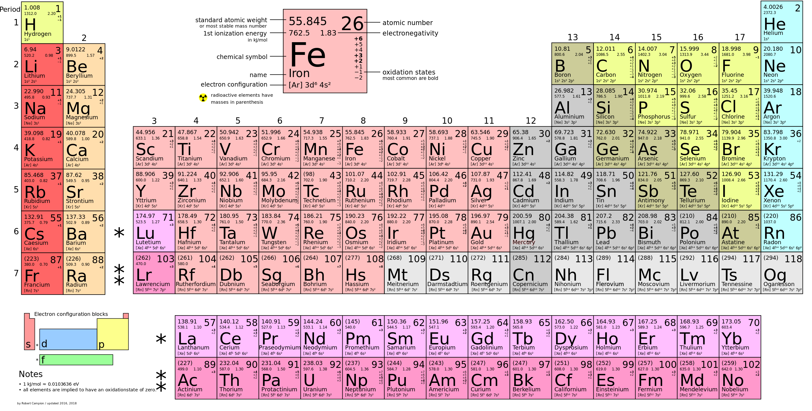
+ ²H
Ions Delivered to NSRL
past & present

Slide 9
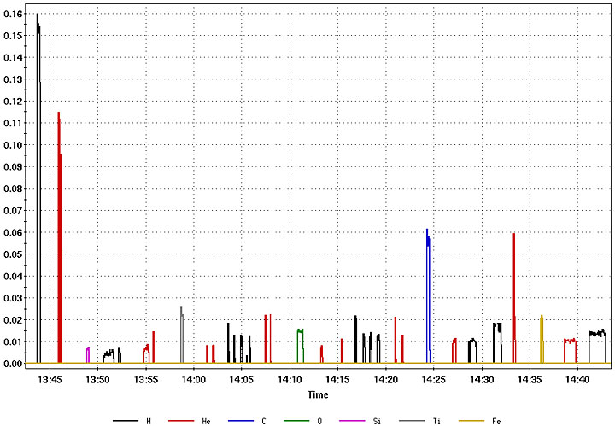
Rapid Beam Switching via Laser Ion Source + EBIS
Pulse-to-Pulse Modulation
for pre-injector systems allows for fast ion switches & simultaneous use of RHIC/EIC and NSRL
NASAs “GCR Sim”: 7 different ions in 33 beams within 1h
6 sec

Slide 10
NSRL Target Room
~6 Meter
Beam Line Length
Polyethylene Degrader
60x60 cm Test Area
~100 Meter
Transfer Beam Line
Upstream Test Table
Downstream Test Table
End of
Vacuum Pipe
Beam Current Detector
Digital Beam Imager
Tungsten Collimator

Slide 11
Session Highlights

Slide 12
Robert Schwartz, M.D. (Weill Medical College of Cornell), Radiobiology
Unfortunately, no slides available
Here is my attempt to summarize
Experimental evaluation of simulated microgravity and space radiation exposure
in mice with countermeasure drug (Kaempferol, flavonoid compound found in foods)
Does countermeasure provide medically observable protection for astronauts?
Yes, it was reported that organ function and oxidative stress was
improved in countermeasure-treated group compared to control group
While study is performed in mice, some up-regulated and down-regulated expressed genes are shared in human genetics with slight differences
Further investigation at NSRL is planned

Slide 13
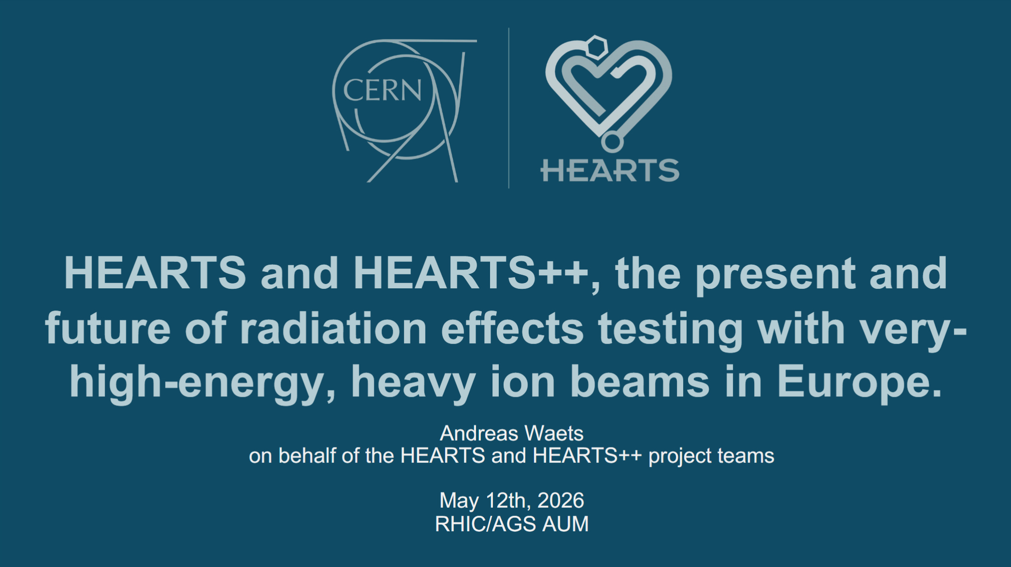
Andreas Waets (CERN), Microelectronics Testing

Slide 14
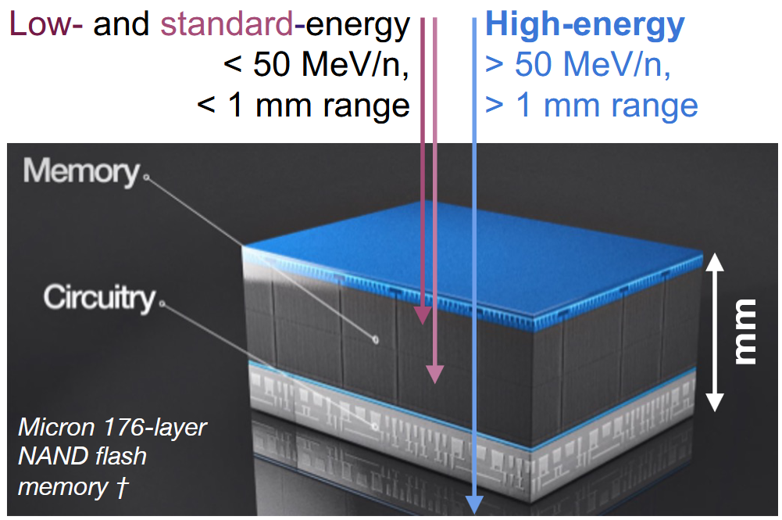
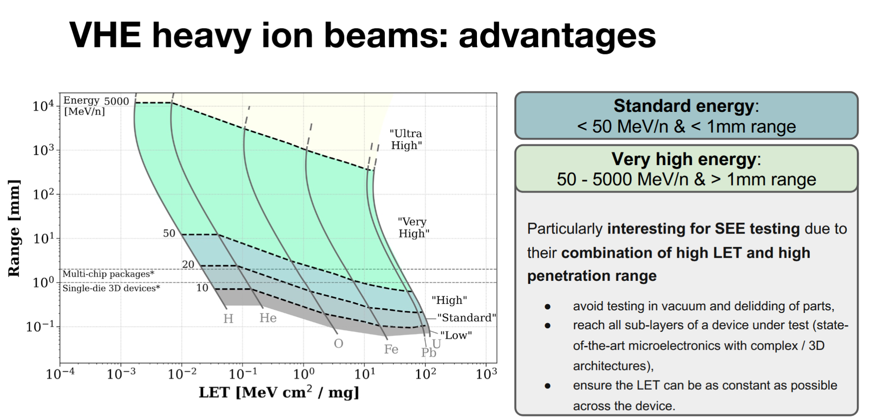
Andreas Waets (CERN), Microelectronics Testing

Slide 15
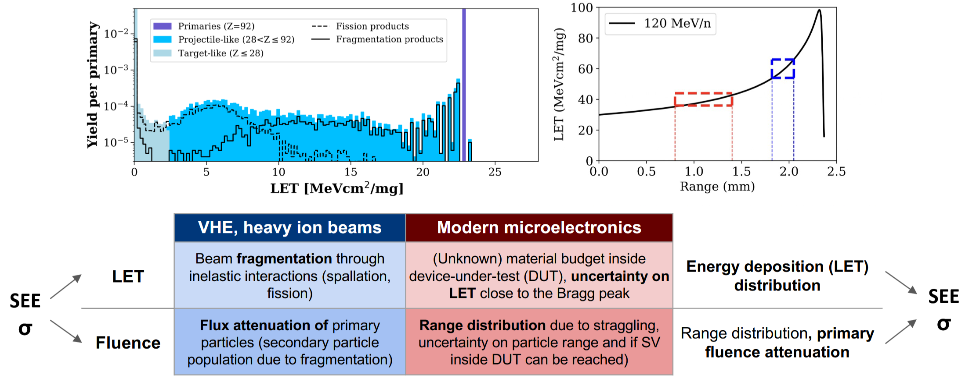
Andreas Waets (CERN), Microelectronics Testing

Slide 16
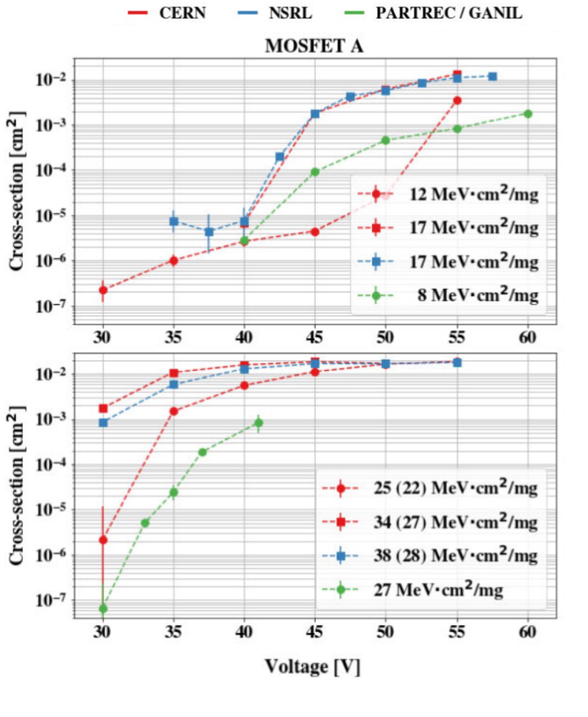
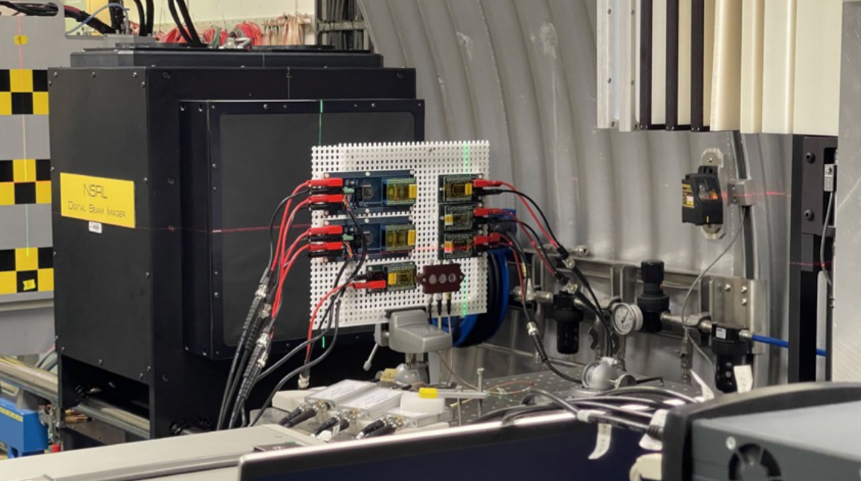
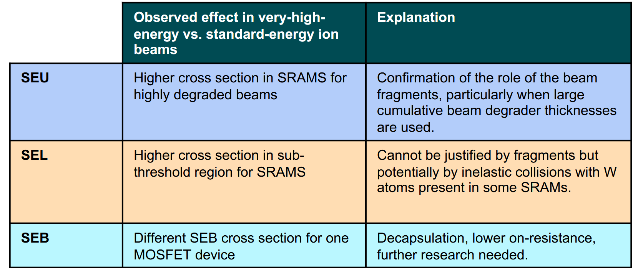
Andreas Waets (CERN), Microelectronics Testing

Slide 17
Machine Learning Assisted Tuning and Diagnostics of NSRL Beams
Eiad Hamwi (BNL), ML/AI Accl. Phys
E. Hamwi, K. Brown, L. Hajdu, G. Hoffstaetter, W. Lin, M. McCarthy, T. Olsen
EIC–BeamAI collaboration

Slide 18
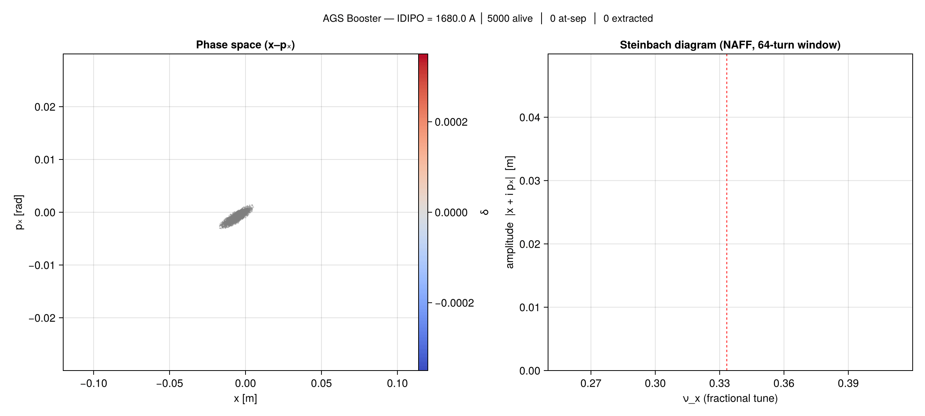
Eiad Hamwi (BNL), ML/AI Accl. Phys
SciBmad slow extraction sim. from the AGS booster

Slide 19
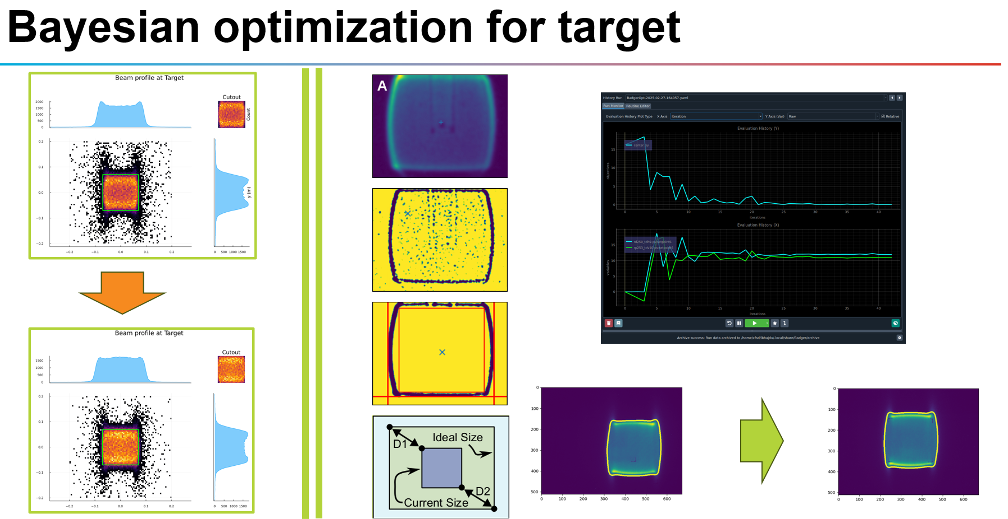
Eiad Hamwi (BNL), ML/AI Accl. Phys

Slide 20
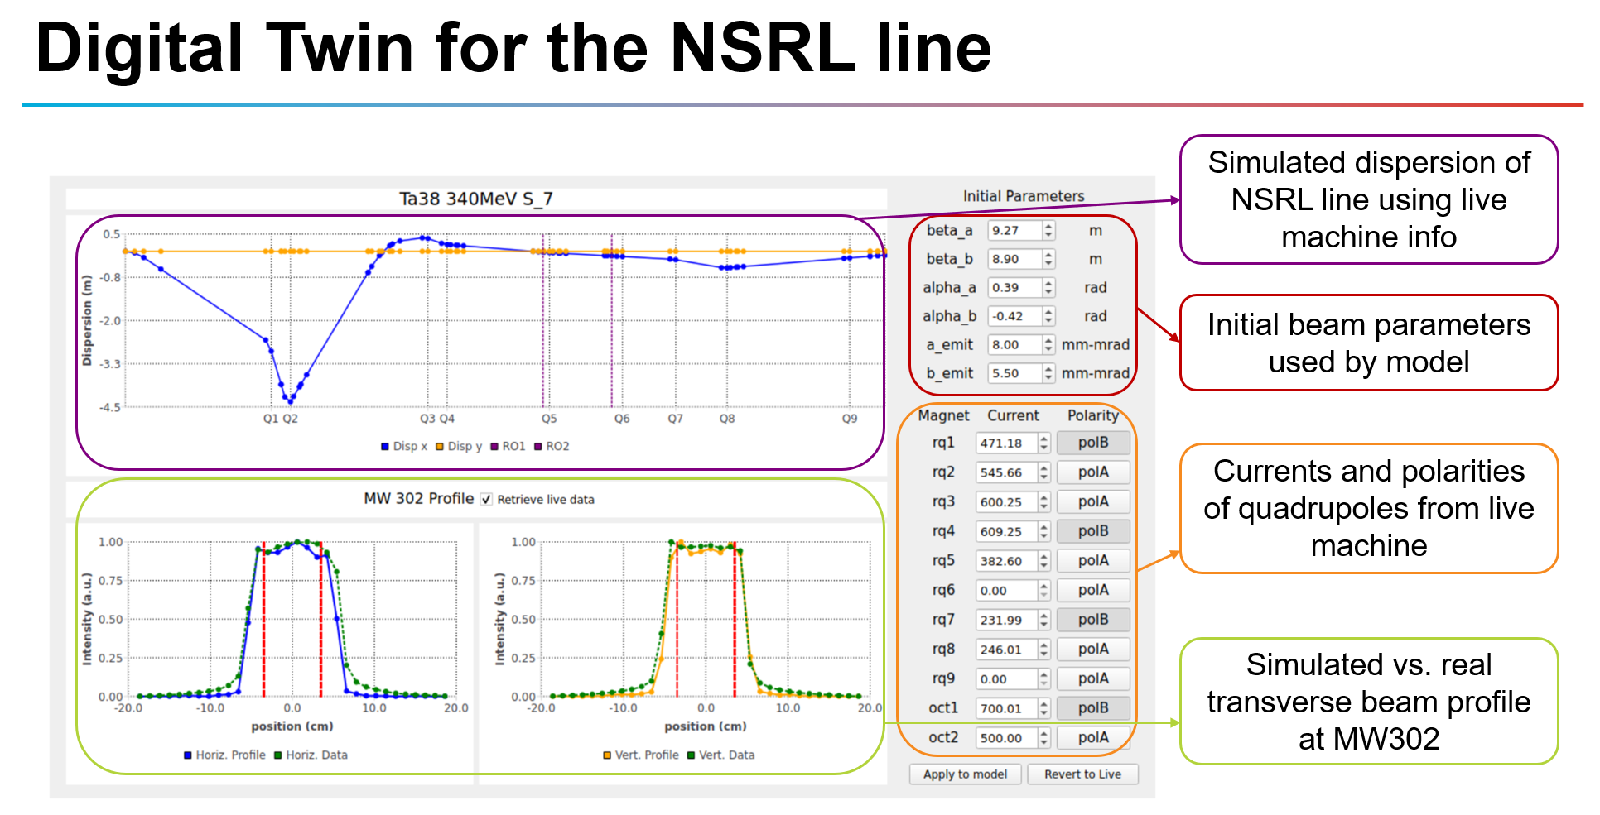
Eiad Hamwi (BNL), ML/AI Accl. Phys

Slide 21
Patrick Peplowski, Nuclear Data

Slide 22
Patrick Peplowski, Nuclear Data

Slide 23
Patrick Peplowski, Nuclear Data

Slide 24
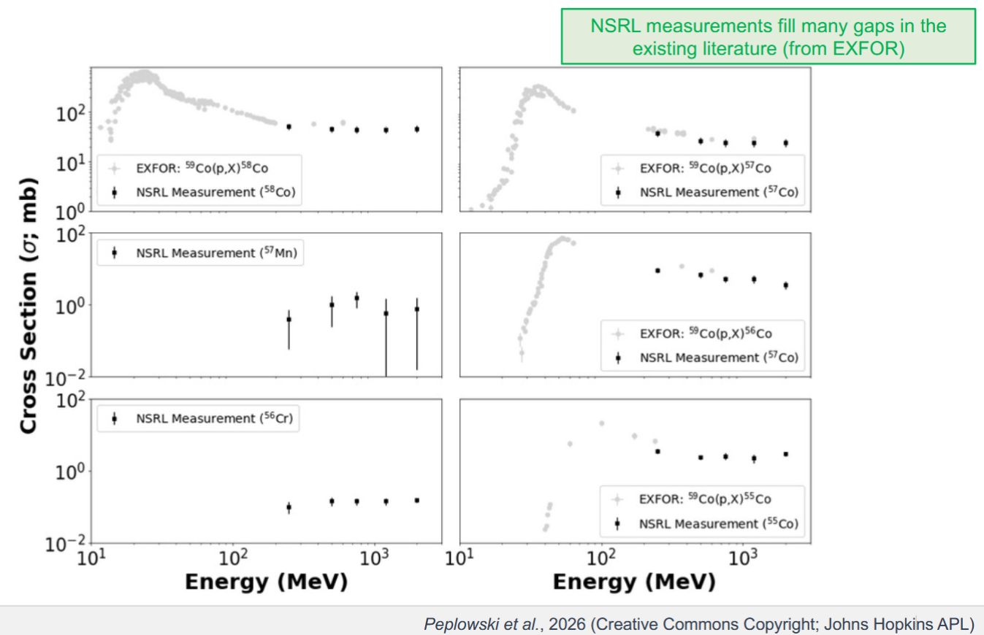
Patrick Peplowski, Nuclear Data

Slide 25
NSRL is a multi-disciplinary, fixed target beam line hosting user experiments at the RHIC/EIC complex
We will operate for the foreseeable future as demand for high energy heavy ion beam continues to grow

