Slide 1



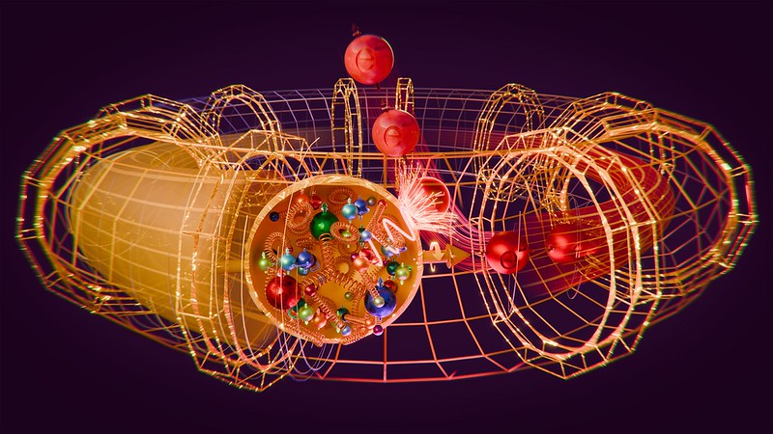
EIC,
and the Future Physics
Salvatore Fazio
Università della Calabria & INFN Cosenza
RHIC/AGS Annual Users’ Meeting
BNL
May 11-15, 2026

Slide 2
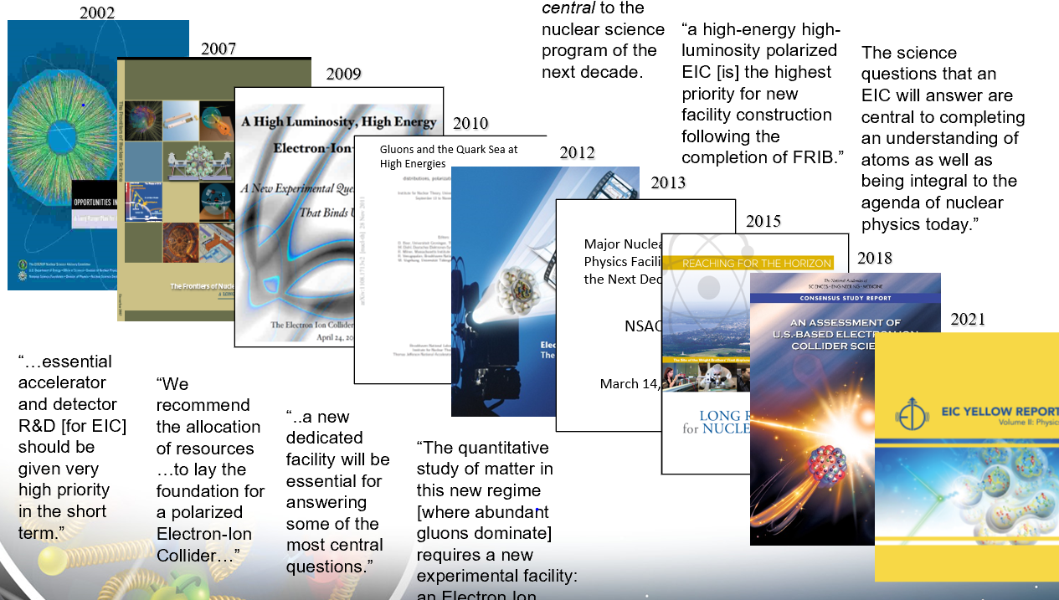

> 20 years long pathway!
NSAC LRP 2023:
We recommend the expeditious completion of the EIC as the highest priority for facility construction
2023

Slide 3


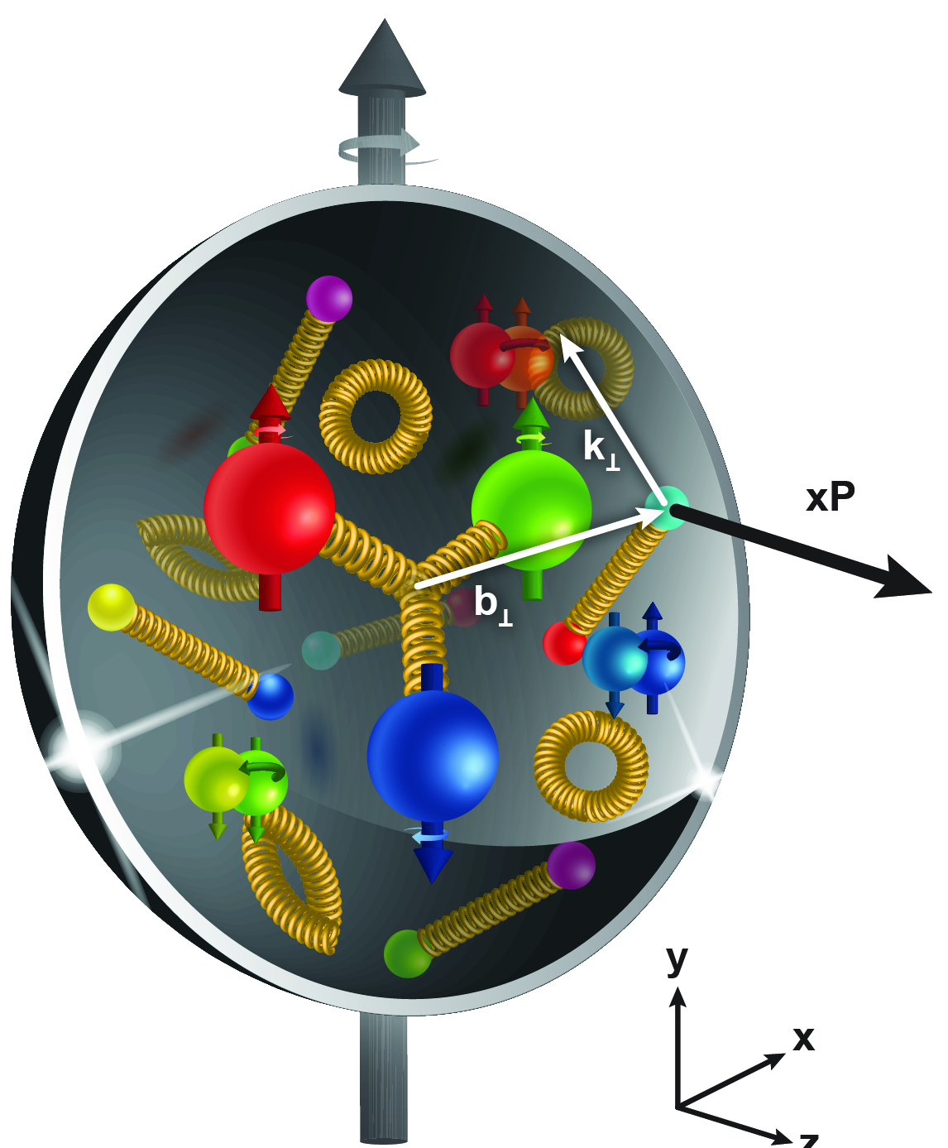
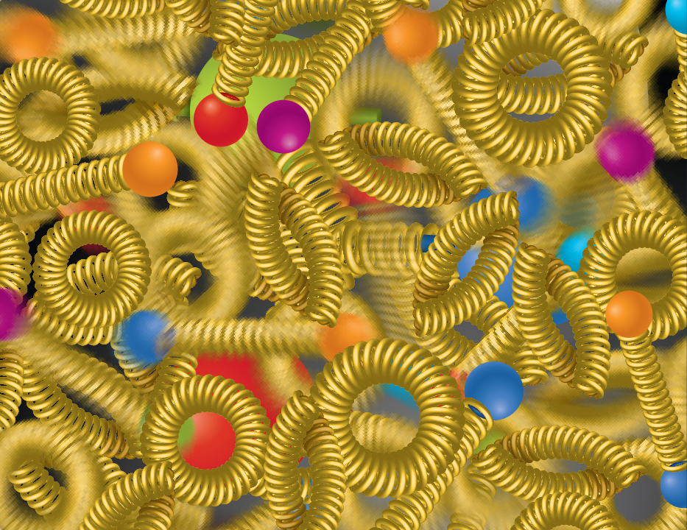
EIC science pillars
The EIC will unravel the different contribution from the quarks, gluons and orbital angular momentum
SPIN is one of the fundamental properties of matter.
All elementary particles, but the Higgs carry spin.
Spin cannot be explained by a static picture of the proton.
It is the interplay between the intrinsic properties and interactions of quarks and gluons
Does the mass of visible matter emerge from quark-gluon interactions?
Atom: Binding/Mass =
0.00000001
Nucleus: Binding/Mass =
0.01
Proton: Binding/Mass =
100
For the proton the EIC will determine an important term contributing to the proton mass, the so-called “QCD trace anomaly
How can we understand their dynamical origin in QCD?
What is the relation to Confinement
How are the quarks and gluon distributed in space and momentum inside the nucleon & nuclei?
How do the nucleon properties emerge from them and their interactions?
How do the confined hadronic states emerge from quarks and gluons?
Is the structure of a free and bound nucleon the same?
How do quarks and gluons, interact with a nuclear medium?
How do the quark-gluon interactions create nuclear binding?
What happens to the gluon density in nuclei? Does it saturate at high energy?
How many gluons can fit in a proton?
How does a dense nuclear environment affect the quarks and gluons, their correlations, and their interactions?
?
gluon
splitting
=
gluon
recombination

Slide 4
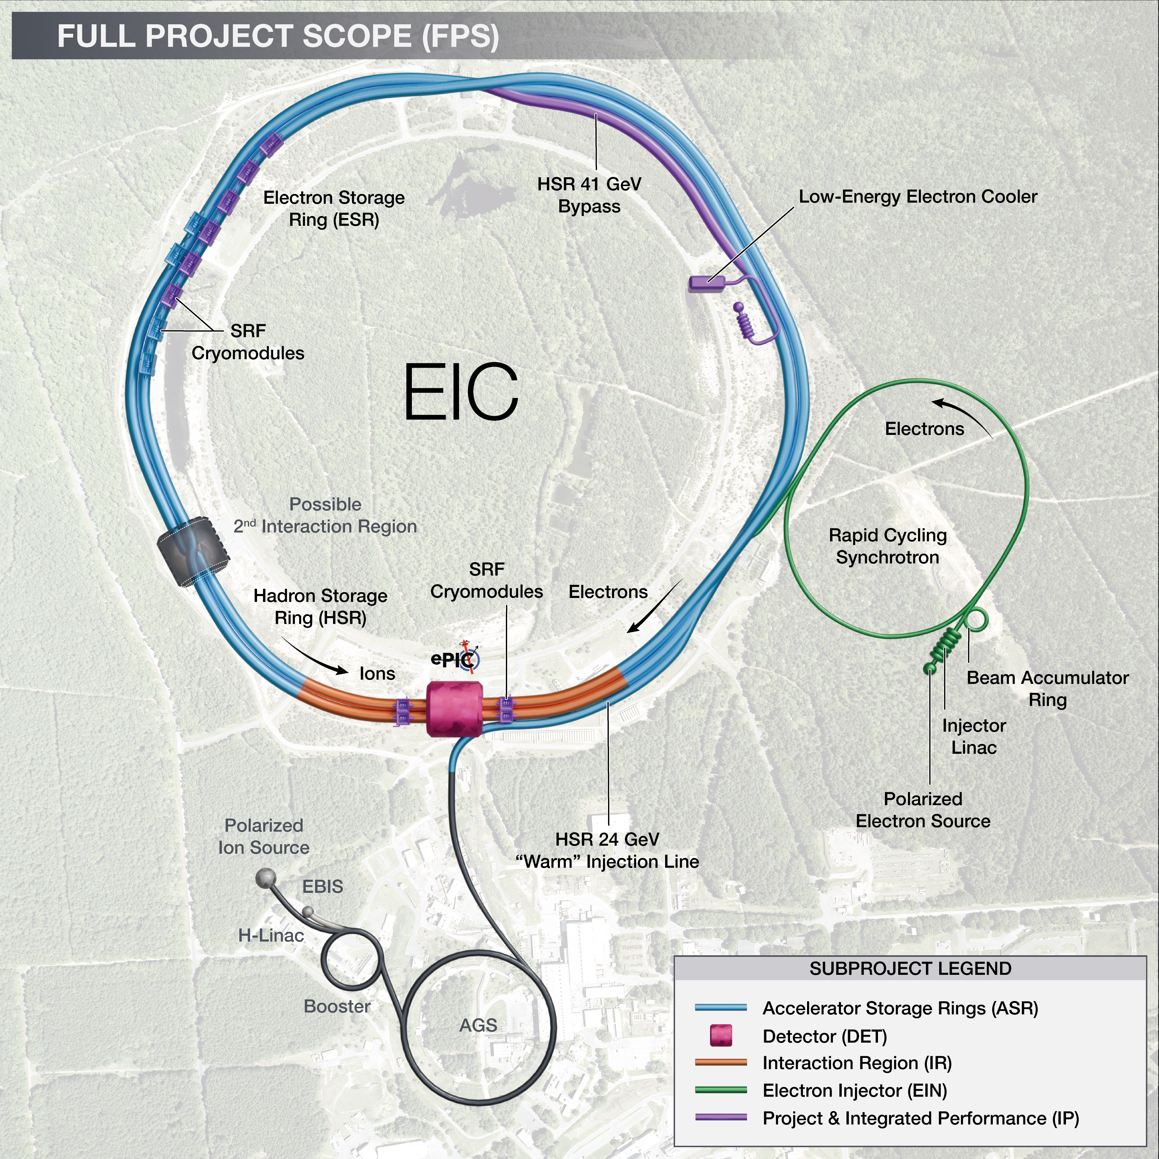
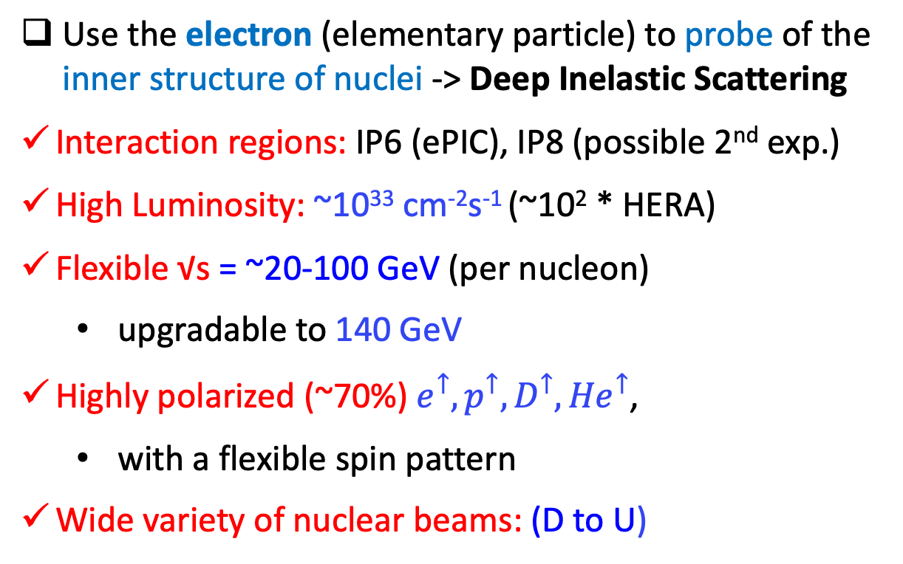
The Electron-Ion Collider
Use the electron (elementary particle) to probe of the inner structure of nuclei -> Deep Inelastic Scattering
Interaction regions: IP6 (ePIC), IP8 (possible 2nd exp.)
High Luminosity: ~10³³ cm⁻²s⁻¹ (~10² * HERA)
Flexible √s = ~20-100 GeV (per nucleon)
  upgradable to 140 GeV
Highly polarized (~70%) $e^{↑},p^{↑},D^{↑},{He}^{↑}$,
  with a flexible spin pattern
Wide variety of nuclear beams: (D to U)
World’s first Polarized electron-proton/light ion
and electron-Nucleus collider
EIC will be the only operating collider in the USA
The only new large collider in the coming ~20-30 years

Slide 5
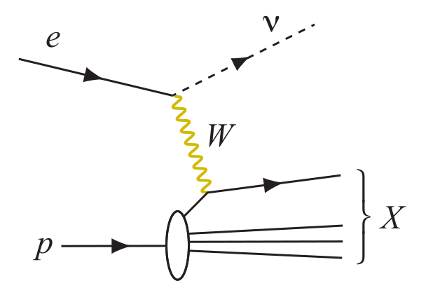
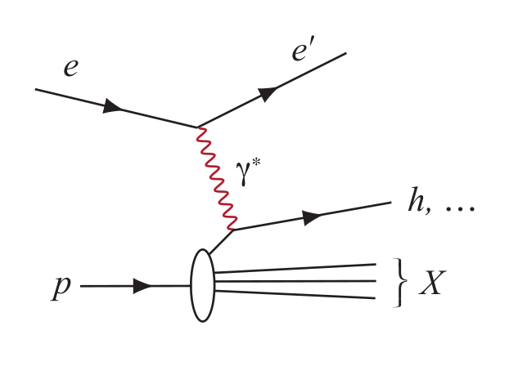
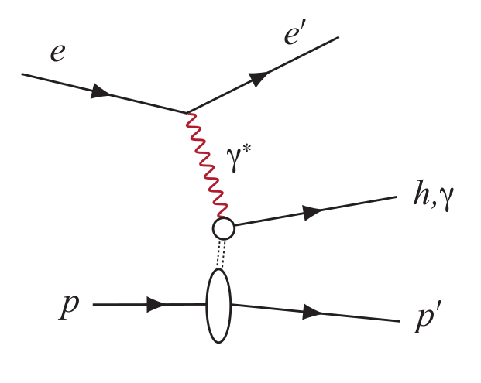
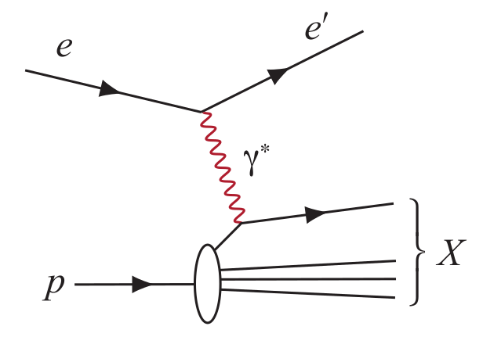
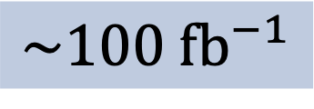
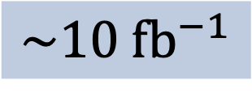
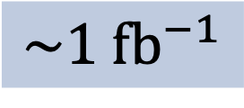
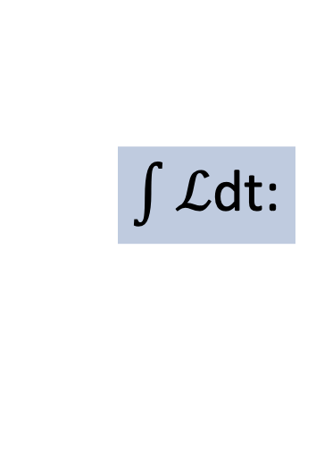
What process must be measured?
DIS event kinematics - scattered electron or final state particles (CC DIS, low y)
Neutral Current DIS
Detection of scattered electron with high precision - event kinematics
Charged Current DIS
Event kinematics from the final state particles (Jacquet-Blondel method)
Semi-Inclusive DIS
Precise detection of scattered electron in coincidence with at least 1 hadron
Exclusive Processes
Detection of all particles in event
Parton Distributions in nucleons and nuclei
QCD at Extreme Parton Densities - Saturation
Spin and
Flavor structure of nucleons and nuclei
Tomography Transverse Momentum Dist.
QCD at Extreme Parton Densities - Saturation
Tomography
Spatial Imaging
$\int{ℒ}$dt:
$$\sim 1 \text{f}{\text{b}}^{−1}$$
$$\sim 10 \text{f}{\text{b}}^{−1}$$
$$\sim 100 \text{f}{\text{b}}^{−1}$$

Slide 6
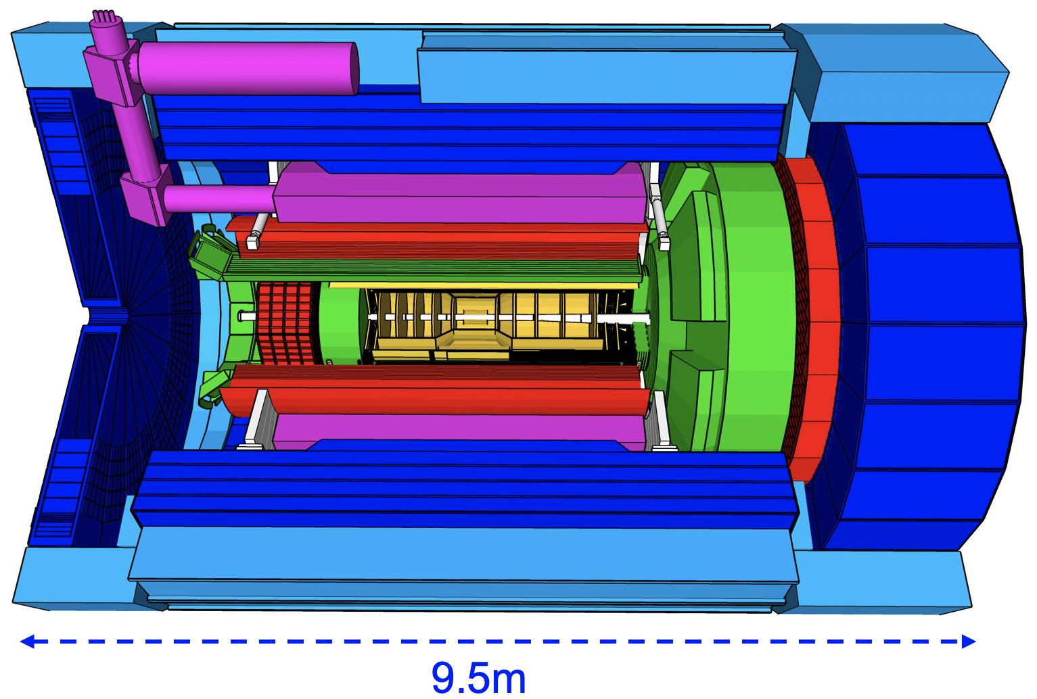
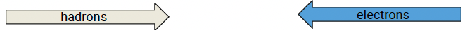
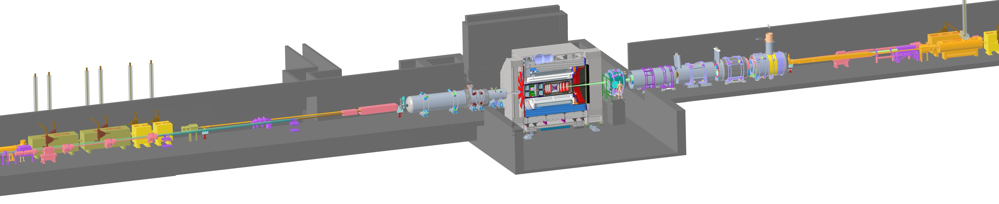
The detector
See also J. Lajoie’s talk
Tracking
  New 1.7 T solenoid
  Si MAPS (vertex, barrel, forward, backward disks)
  MPGDs (µRWELL/µMegas) (barrel, forward, backward disks)
5.3m
Particle identification
  High performance DIRC (barrel)
  Dual radiator (aerogel+gas) RICH (forward)
  Proximity focusing RICH (aerogel) (backward)
  TOF (~30ps): AC-LGAD (barrel and forward)
E.M. Calorimetry
  Imaging EMCAL (barrel)
  W-powder/ScFi (forward)
  PbWO₄ crystals (backward)
B0 Magnet
Spectrometer
Zero Degree Calorimeter
Low-Q2 Taggers
Hadronic Calorimetry
  Fe/Scint reuse from sPHENIX (barrel)
  Steel/Scint - W/Scint (backwards/forward)
Roman Pots (RPs) and
Off-Momentum Detectors (OMDs)
Luminosity
System
DAQ: streaming/triggerless with AI

Slide 7
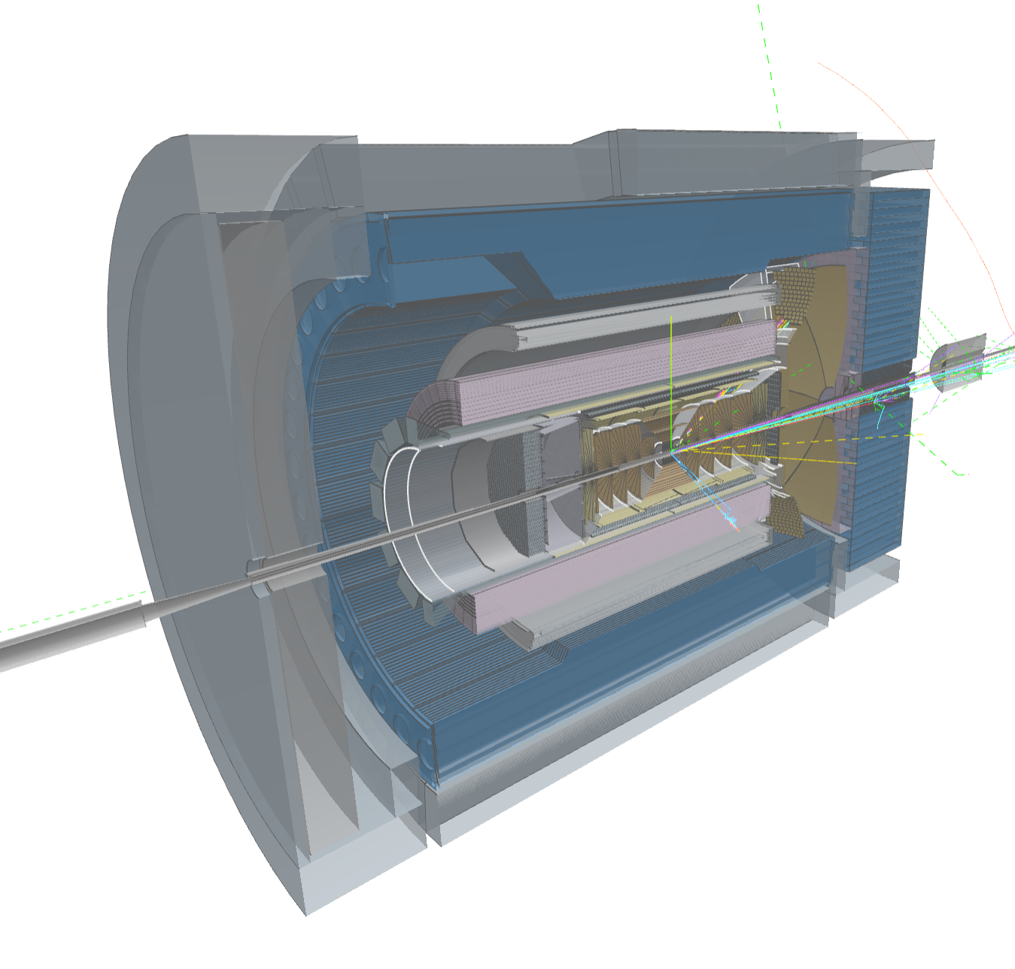
Computing-Detector Integration
Streaming Readout and DAQ:
High-speed data flow: The front-end electronics are designed to support a total bandwidth of up to 50 Tbps, with over 3,000 fiber streams feeding data from the detector to the computing system.
Zero dead time: By avoiding a traditional hardware trigger, the system eliminates dead time and allows for unbiased data collection.
AI and ML in the Data Pipeline:
Intelligent data filtering: AI/ML algorithms can select the most relevant collision events to study.
Real-time feedback: AI can enable rapid detector diagnostics and optimization, with systems capable of automatically calibrating detectors and validating data.
Streaming Computing Model:
Continuous calibration and alignment: Enables rapid delivery of scientific results.
Echelon Model: Organizes resources across the computing hierarchy and enables international contributions.
ePIC event display by Dmitry Romanov

Slide 8
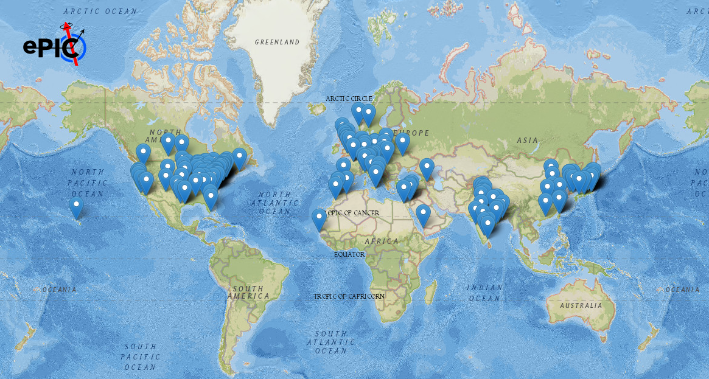
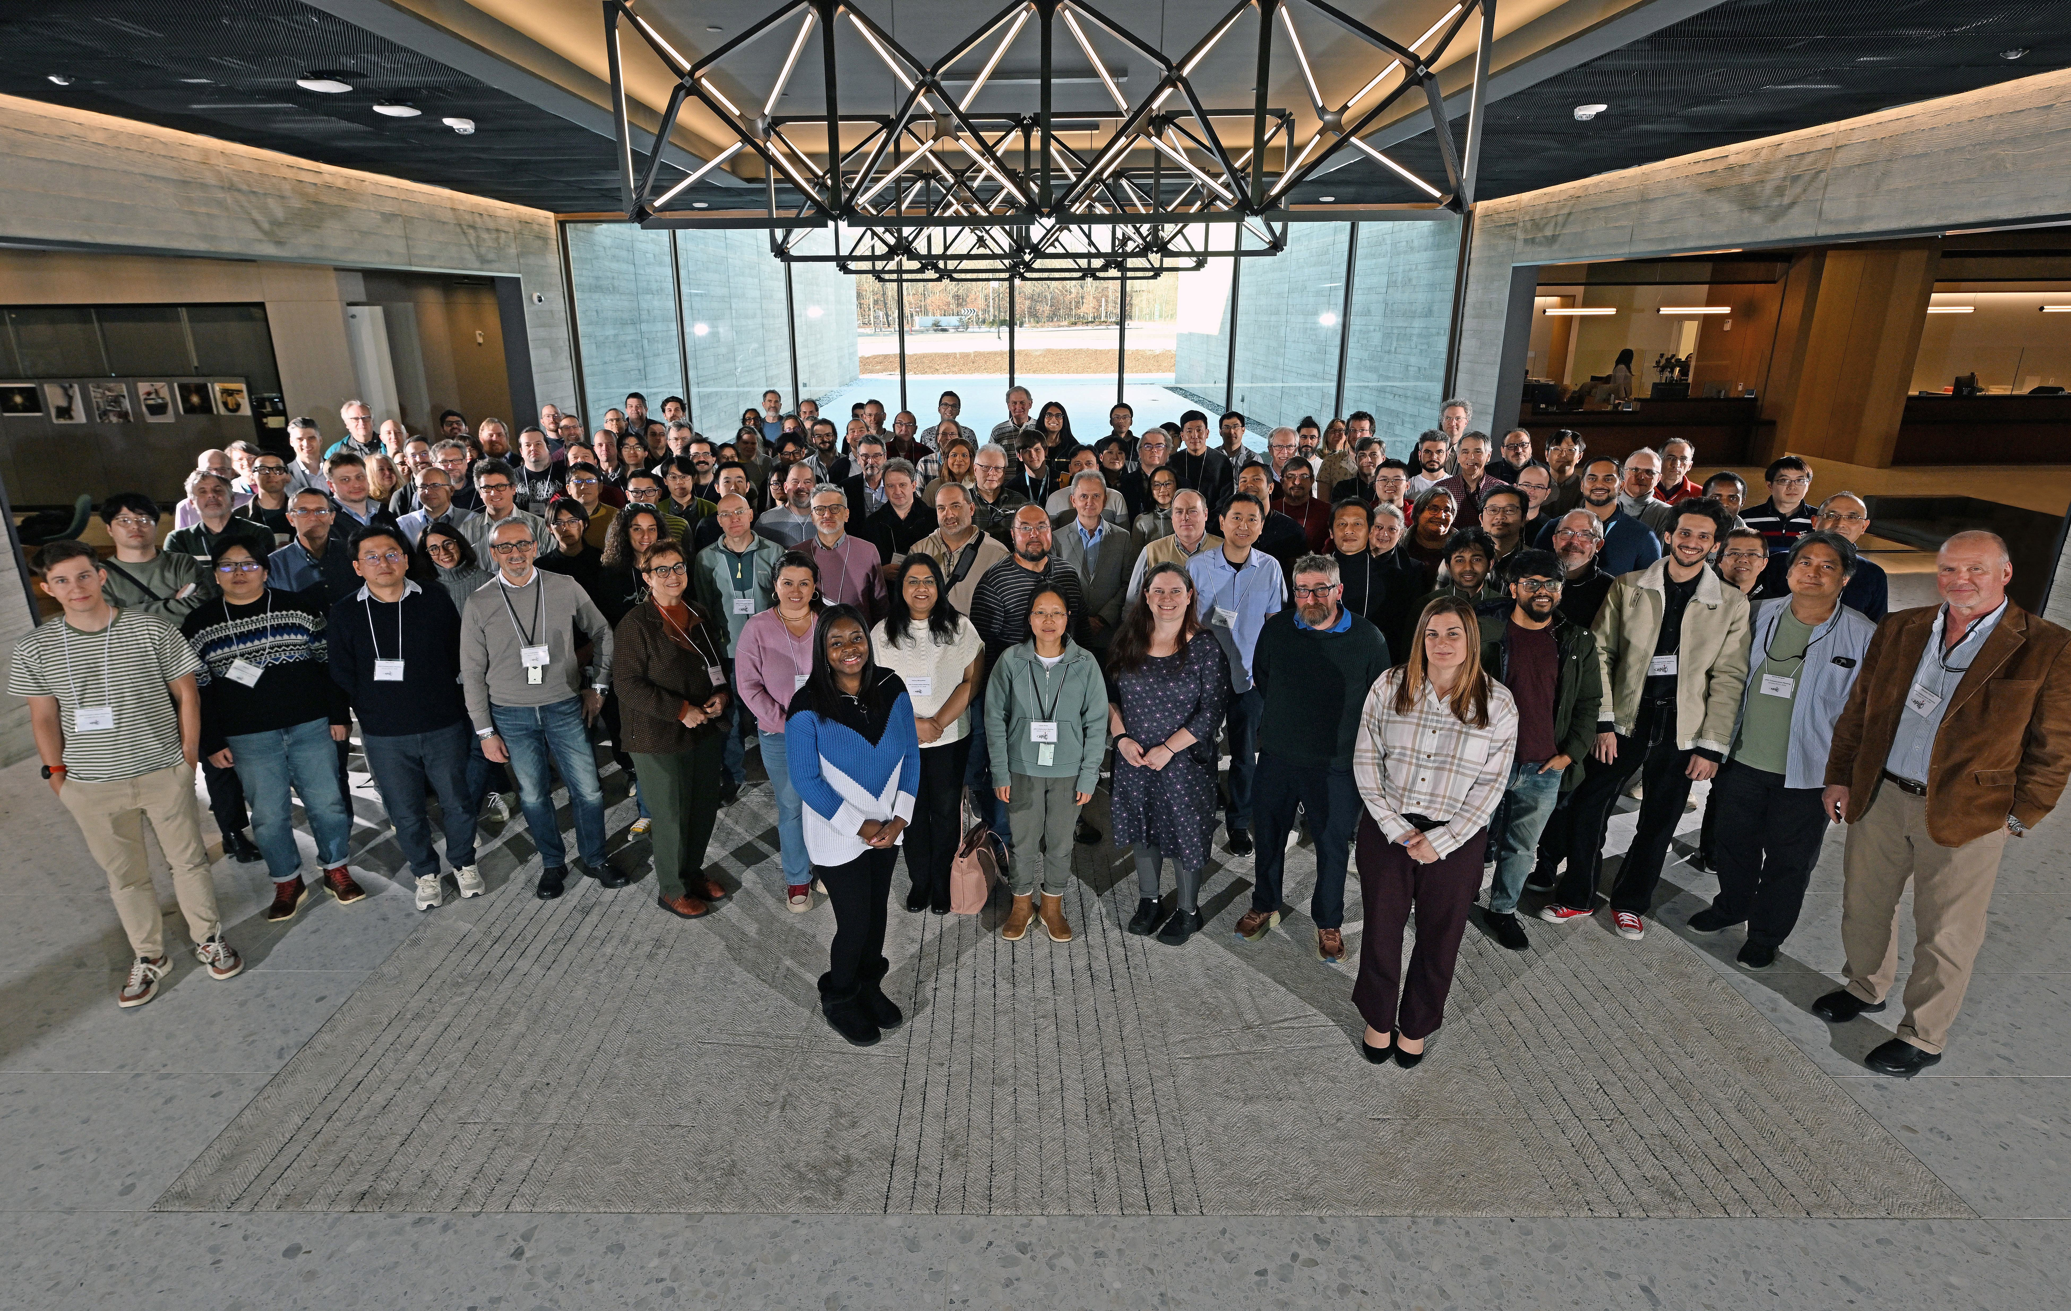
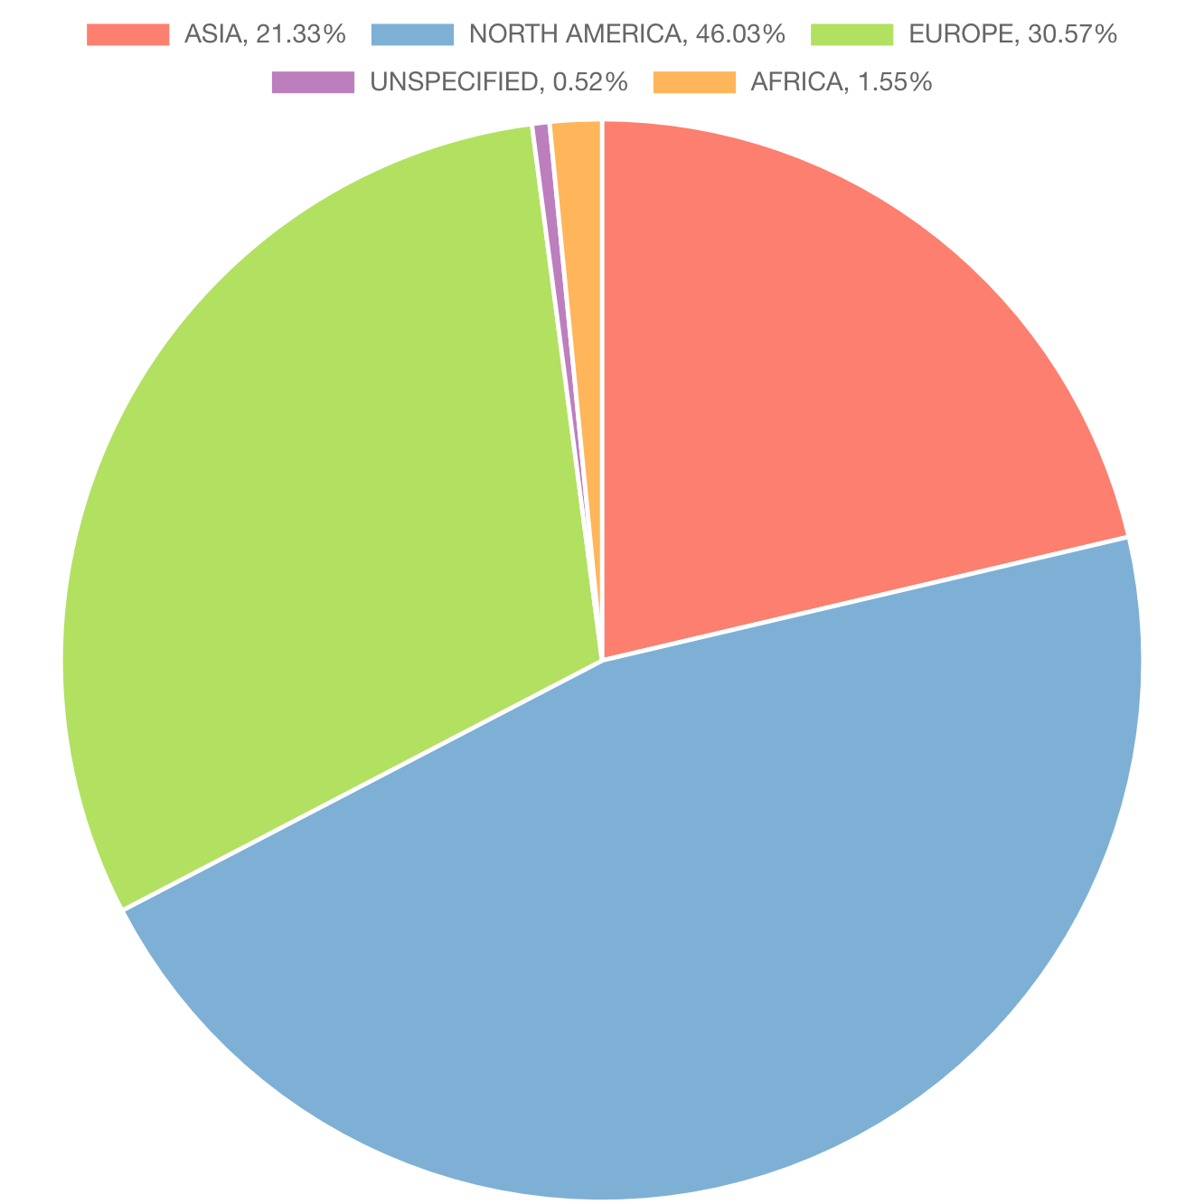
The Collaboration
A truly global pursuit for a new experiment at the EIC
26 Countries
183 Institutions and counting!
1160 scientists and counting!
Institutions
2%
Africa
21%
Asia
31%
Europe
46%
North America
BNL – January 2026

Slide 9
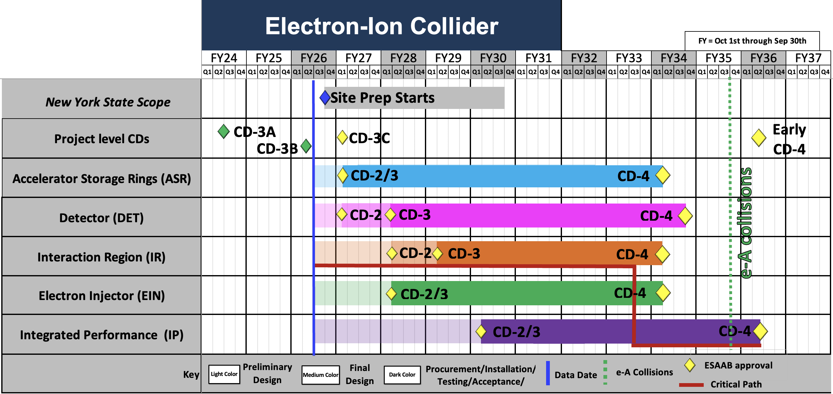
Current Project Schedule
High-level technically driven schedule – to be adjusted when funding profile is known
ePIC timeline:
Baseline ~ early 2027
Construction begins ~ early 2028
First collisions ~ late 2035
Goal:
Developing a fully integrated project plan that meets DOE requirements:
  ~$3B project cost
  First science within ten years
  Implementation plan that meets CD-0 Mission Need

Slide 10
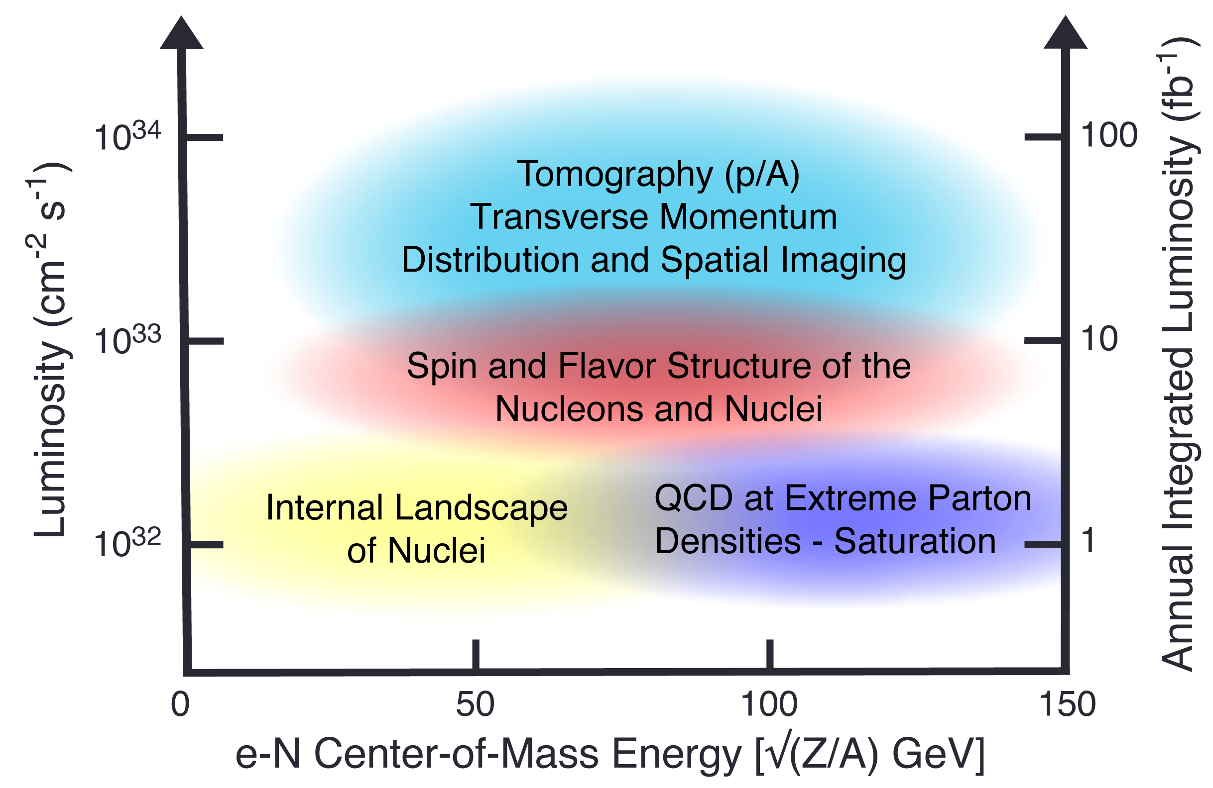
Projected Luminosity Rump Up
The luminosity will ramp up as additional equipment is installed and commissioned
+
EIC Full Capability
SRF for 28nC/bunch
140 GeV (upgrade)
+
+
EIC
SRF for 7nC/bunch @10 GeV
no 41 GeV bypass
+
+
+
Average Luminosity (cm⁻² s⁻¹)
+
+
+
EIC
SRF for 7nC/bunch @ 10 GeV
no 394 MHz crab cavities
no 41 GeV bypass
+
+
+
+
+
+
(30 weeks @ 80% uptime)
+
EIC
SRF for 7nC/bunch @ 10 GeV
no 394 MHz crab cavities
no low energy cooling
no 41 GeV bypass
+
e-p Center-of-Mass Energy [GeV]

Slide 11
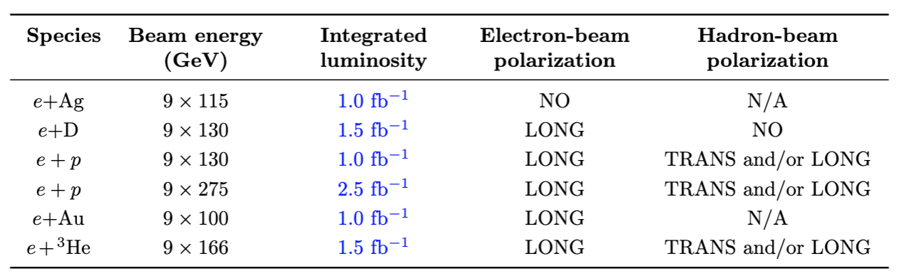
Anticipated Luminosities in the Early Running
. The e+A luminosity is per nucleon
For comparison: HERA delivered 0.5fb⁻¹ each to H1 and ZEUS in its lifetime
The EIC Early Science program will bring important new capabilities
  The Collaboration is compiling an Early Science Report in response to a charge by the ALDs of the host labs

Slide 12


Slide 13
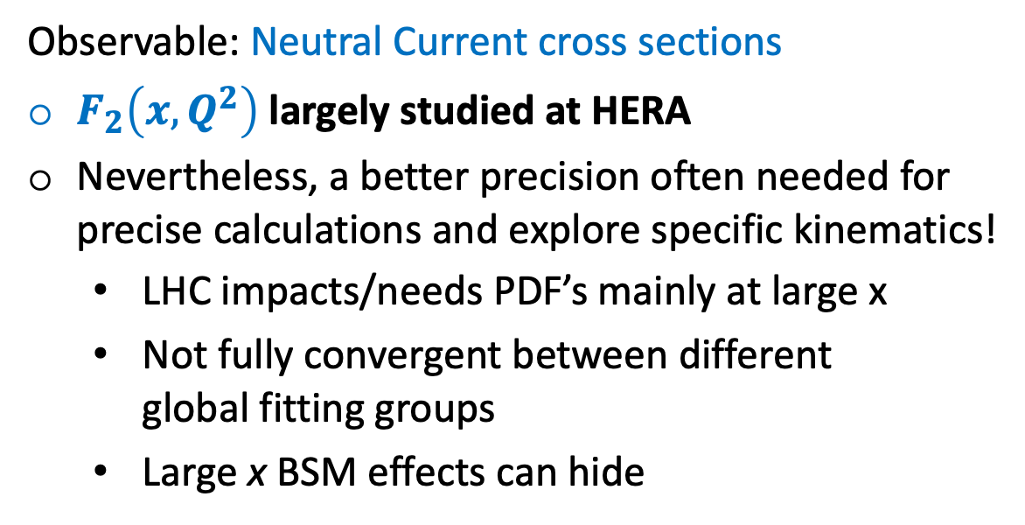
Scientific goals: proton PDFs
Observable: Neutral Current cross sections
$F_{2}\left(x,Q^{2}\right)$ largely studied at HERA
Nevertheless, a better precision often needed for precise calculations and explore specific kinematics!
  LHC impacts/needs PDF’s mainly at large x
  Not fully convergent between different
  global fitting groups
  Large x BSM effects can hide
Novel impact studies [arXiv:2602.00860] based on ePIC pseudodata and the conditions of the EIC early running combined with the HERA data
Key detector performance:
Electron ID
Fine y resolution over large phase space

Slide 14
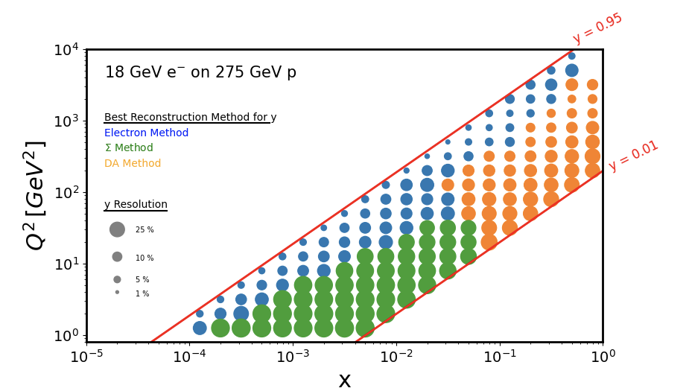
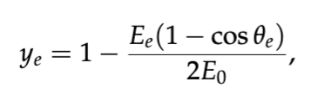
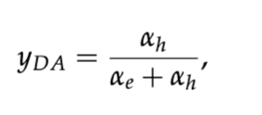
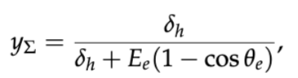
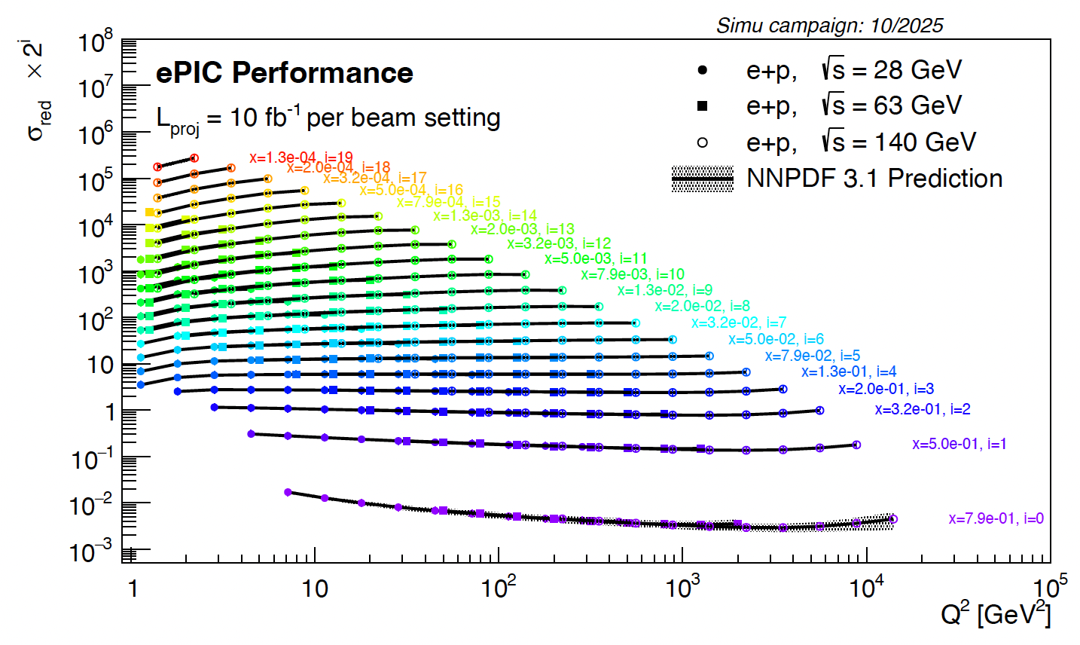
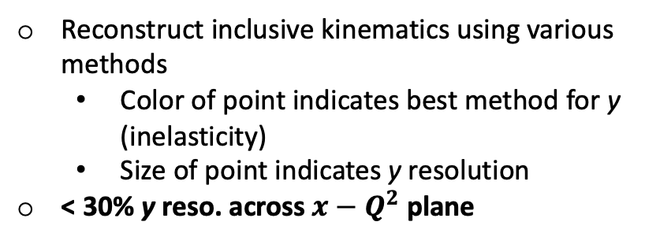
ePIC performance: proton PDFs
Kinematic Resolutions
Reconstruct inclusive kinematics using various methods
  Color of point indicates best method for y (inelasticity)
  Size of point indicates y resolution
< 30% y reso. across $x−Q^{2}$ plane
Neutral Current cross sections
→ parton distributions
arXiv:2602.00860

Slide 15
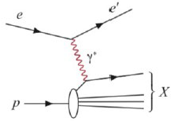
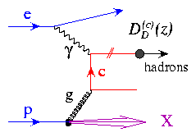
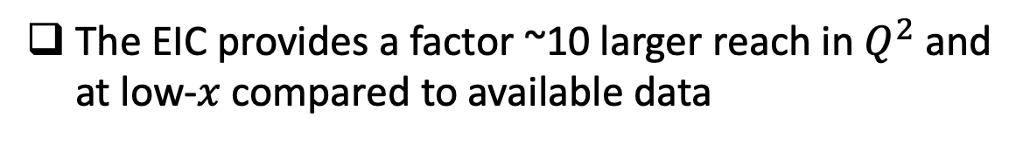
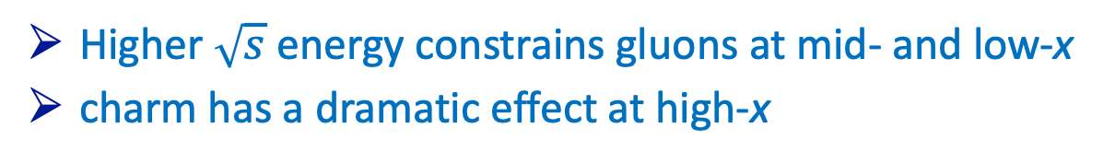

Scientific goals: nuclear PDFs
Inclusive DIS in e+A
  tag the scattered electron
Charm production:
Direct access to gluons at medium to high x by tagging photon-gluon fusion
$$A$$
The EIC provides a factor ~10 larger reach in $Q^{2}$ and at low-$x$ compared to available data
  Higher $\sqrt{s}$ energy constrains gluons at mid- and low-x
  charm has a dramatic effect at high-x
nPDFs studies in progress at ePIC
Key detector performance:
Vertexing (for charm tagging)
Electron ID
Fine resolution in y over a large phase space
E.C. Aschenauer, S. F., M.A.C. Lamont, H. Paukkunen, P. Zurita
[Phys. Rev. D 96, 114005 (2017)]

Slide 16
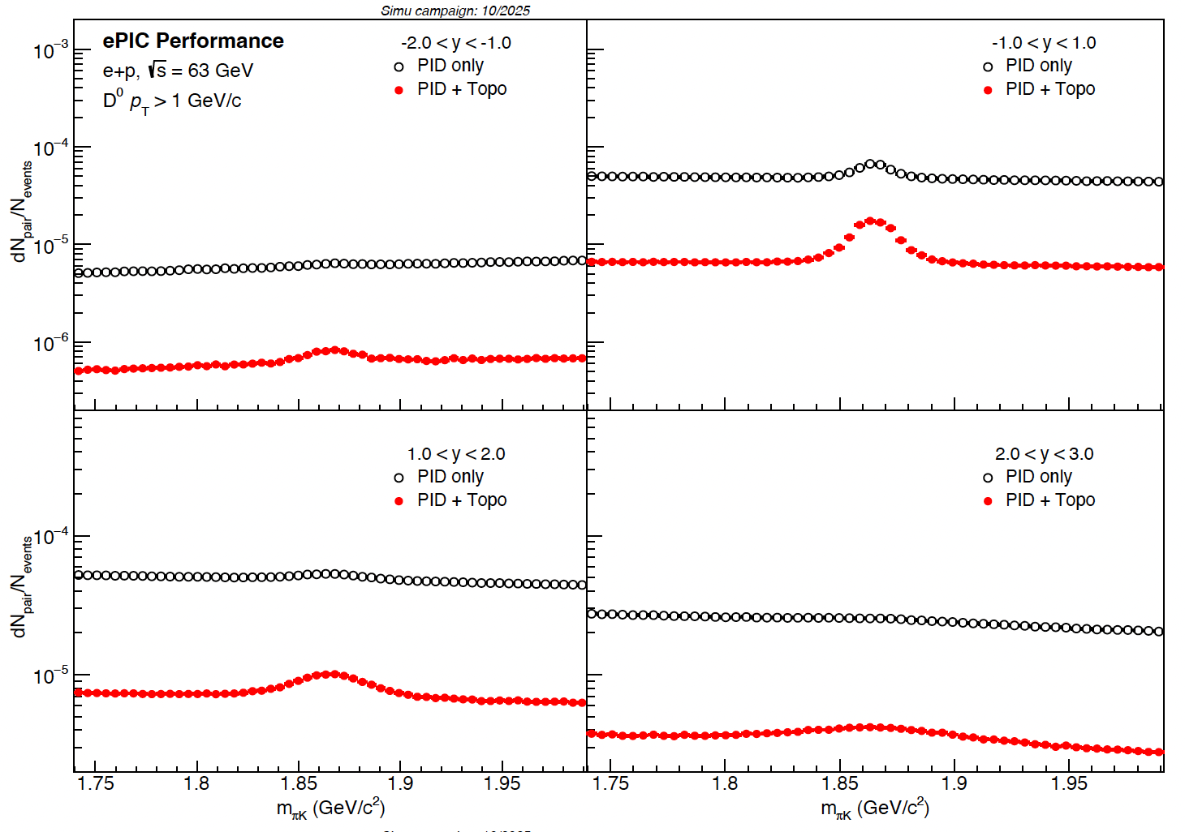
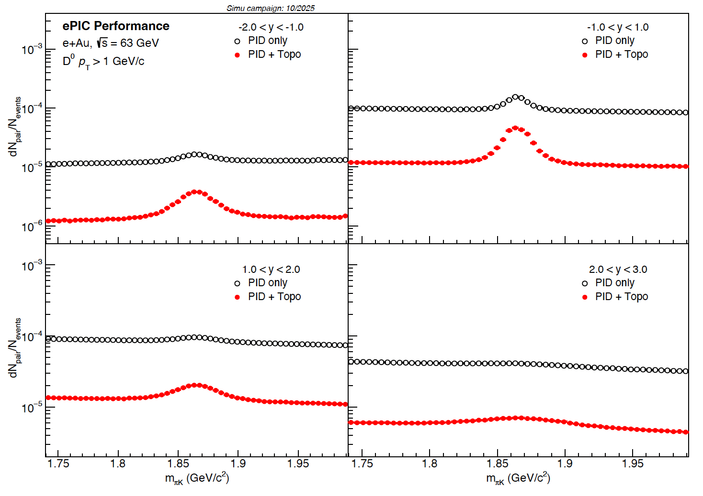
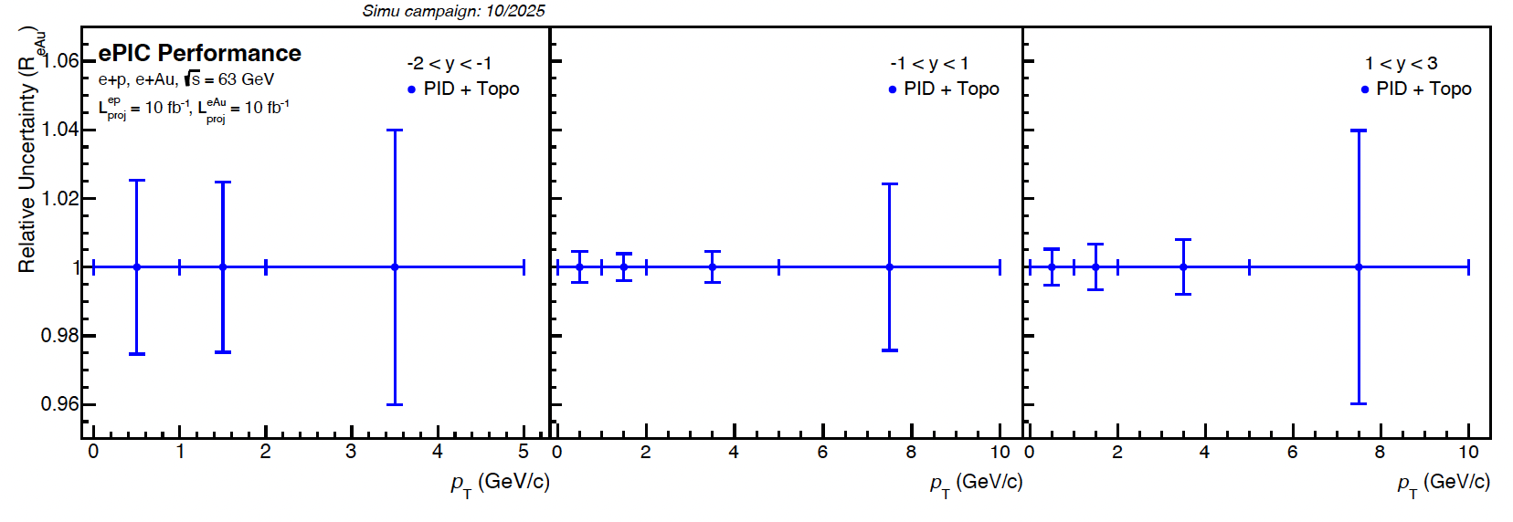
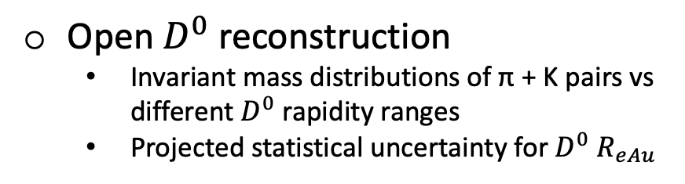
ePIC performance: Open D⁰ reconstruction
e+p, Q² > 1 GeV²
e+Au, Q² > 1 GeV²
Open $D^{0}$ reconstruction
    Invariant mass distributions of π + K pairs vs different $D^{0}$ rapidity ranges
    Projected statistical uncertainty for $D^{0}$ $R_{eAu}$
Projection for D⁰ R_{eAu}
[Physics Letters B 816 (2021) 136261]

Slide 17
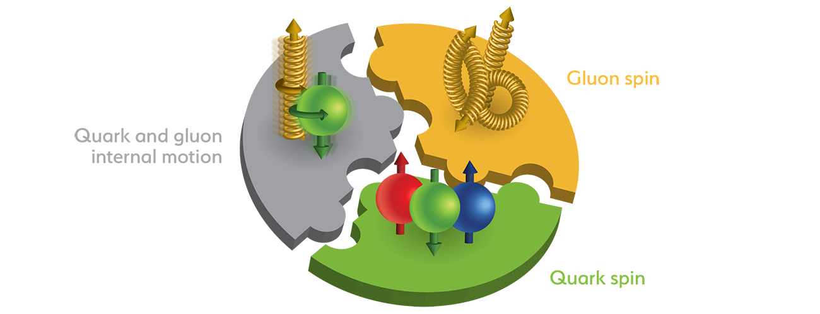

Scientific goals: source of the proton’s spin
Jaffe and Manohar “sum rule” [Nucl. Phys. B337, 509 (1990)]
gluon spin
total u+d+s
quark spin
angular
momentum
Observable: double spin asymmetries
DIS scaling violations determine gluons at small x
1/2 -
Quarks
-
Gluons
=
orb. angular momentum
From EIC Yellow Report

Slide 18
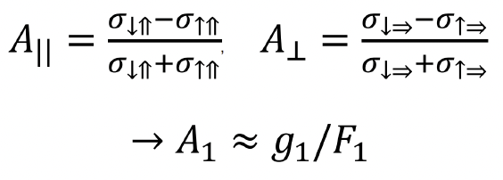
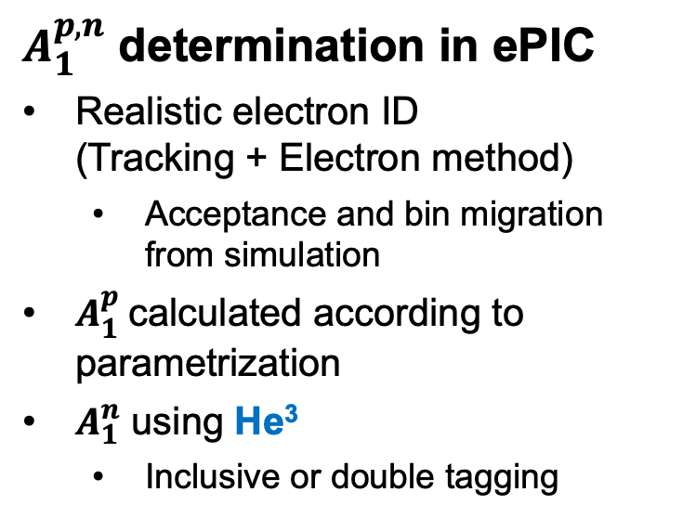
ePIC performance: Double Spin Asymmetries - $A_{1}^{p,n}$
$A_{1}^{p,n}$ determination in ePIC
Realistic electron ID
(Tracking + Electron method)
  Acceptance and bin migration from simulation
$A_{1}^{p}$calculated according to parametrization
$A_{1}^{n}$ using He³
  Inclusive or double tagging

Slide 19
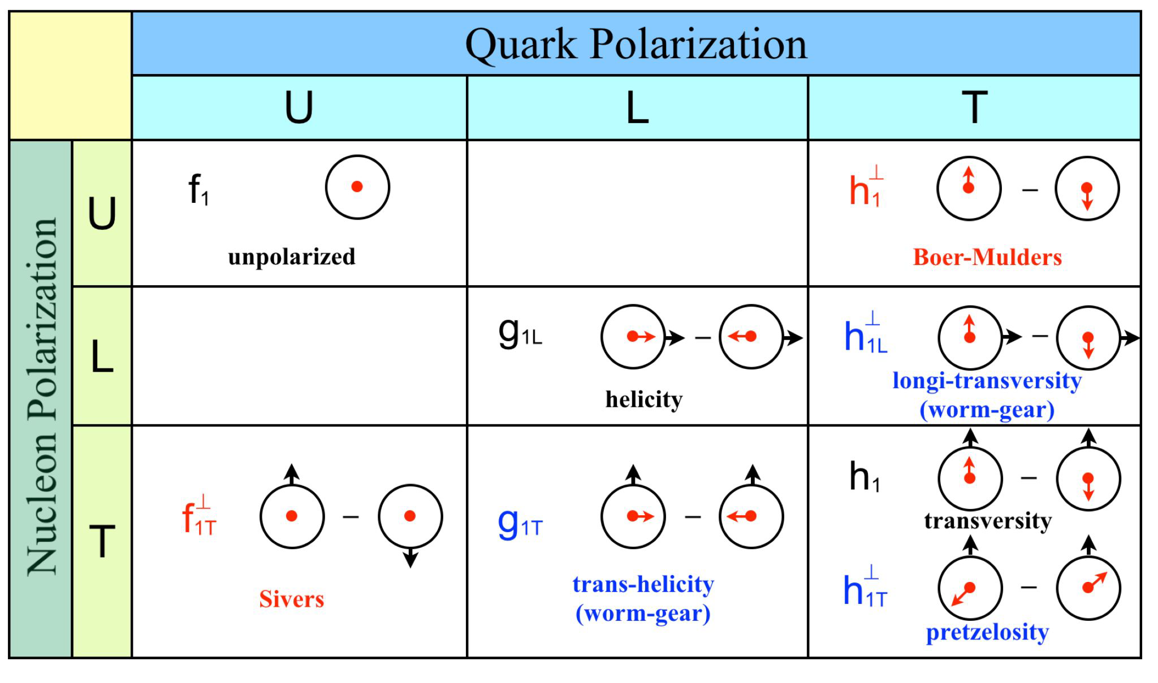
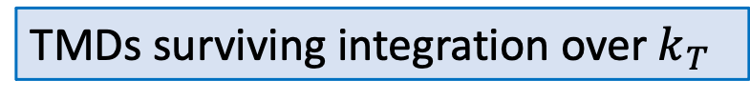
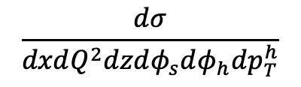
Scientific goals: TMDs
TMDs surviving integration over $k_{T}$
Time-reversal odd TMDs describing strength of spin-orbit correlations
Chiral odd TMDs
Note: off-diagonal part vanishes without parton’s transverse motion
Key detector performance:
PID
Acceptance
Vertexing (heavy flavor)
Quality of tracking
HCal (for jets)
Non-zero strength of spin-orbit correlations → indication of parton OAM
Sivers: correl. of transverse-spin direction and the parton transverse momentum
Boer-Mulders: correl. of parton transverse spin and parton transverse momentum
Collins: fragmentation of a transversely polarized parton into a final-state hadron
6-fold differential cross sections in SIDIS
Azimuthal asymmetries and their modulations
What we want to measure:
$$\frac{dσ}{dxdQ^{2}dzdφ_{s}dφ_{h}dp_{T}^{h}}$$

Slide 20
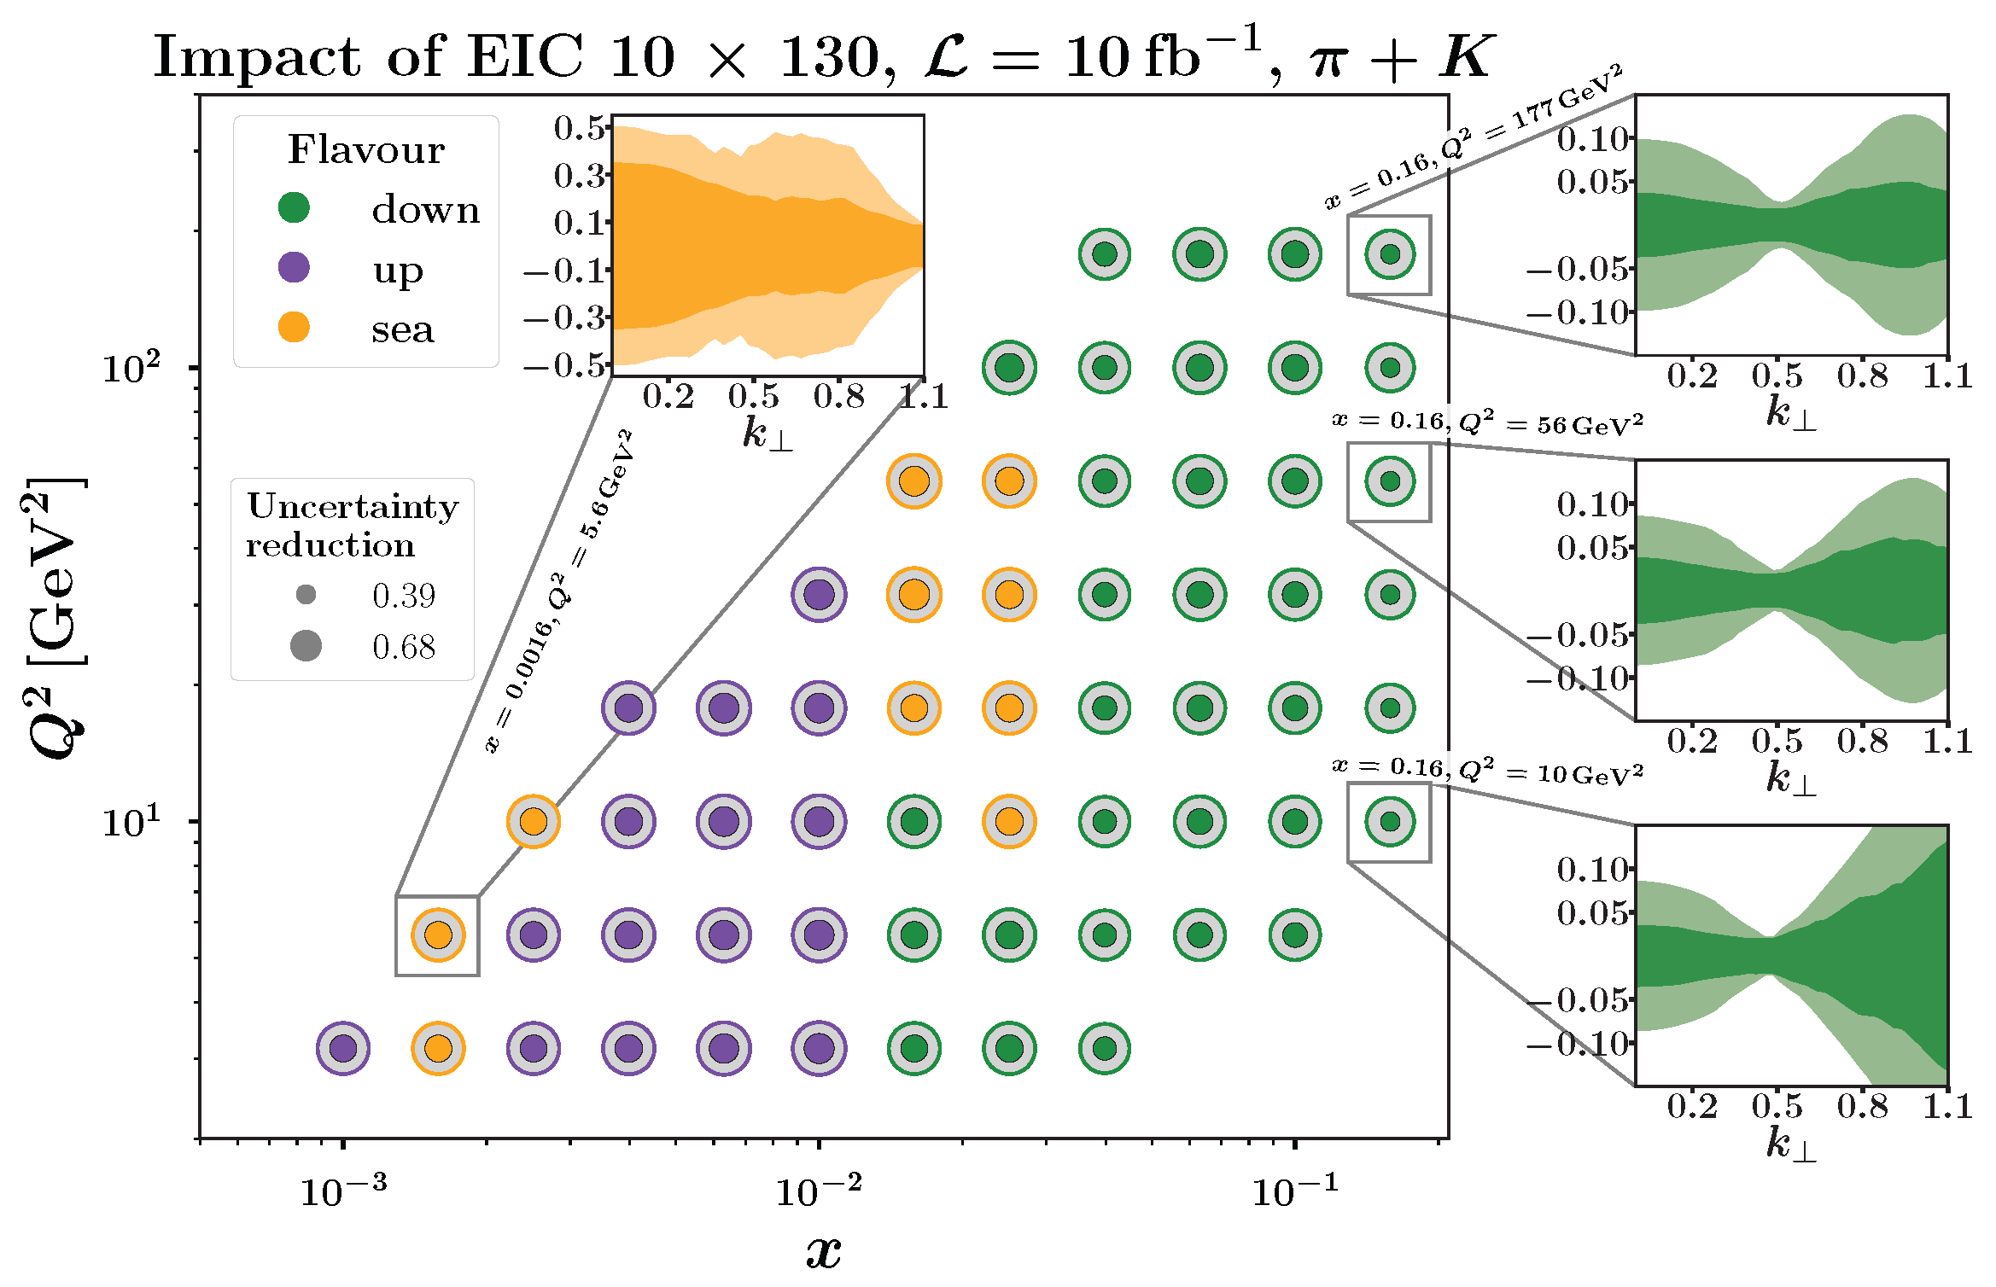

ePIC performance: Unpolarized TMDs
Expected statistical/total uncert. of un-polarized TMD PDFs
Inner (outer) circles: max uncertainty with (without) EIC data
Work in Progress
Uncertainties based on the MAP24 global TMD fit
Lighter shades: based on existing data
Darker shades: after including ePIC data

Slide 21
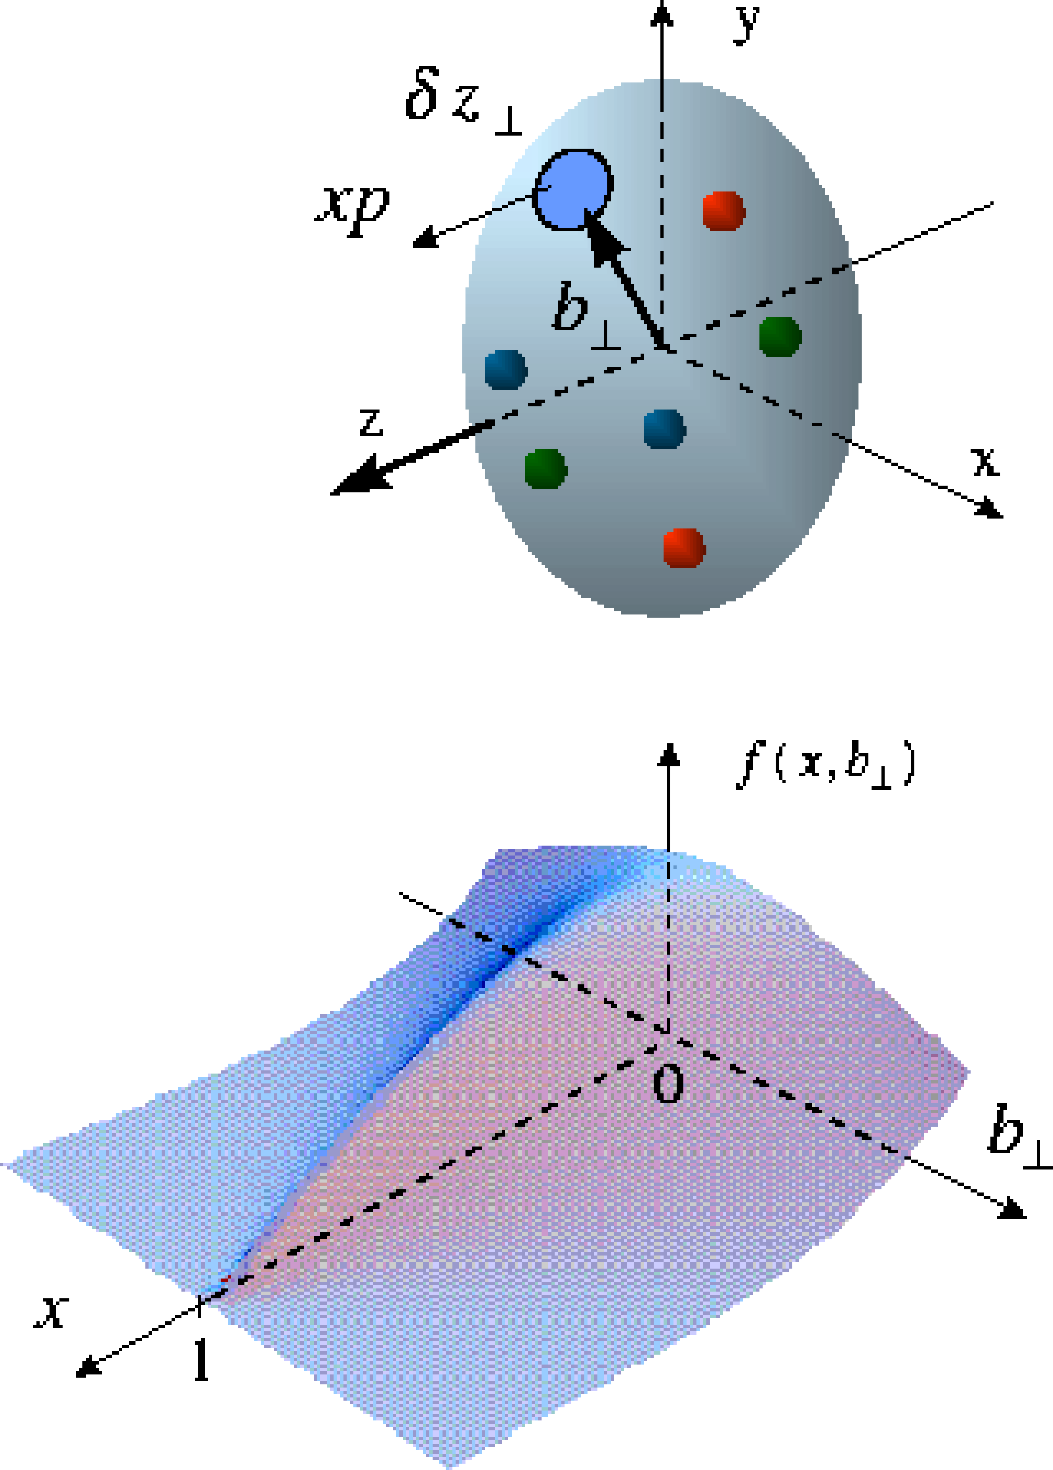
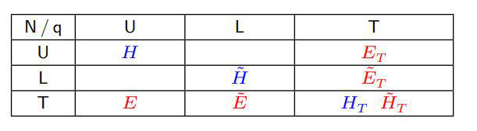
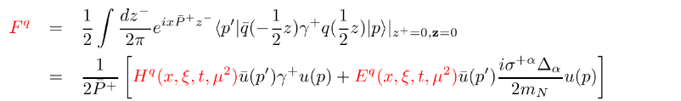
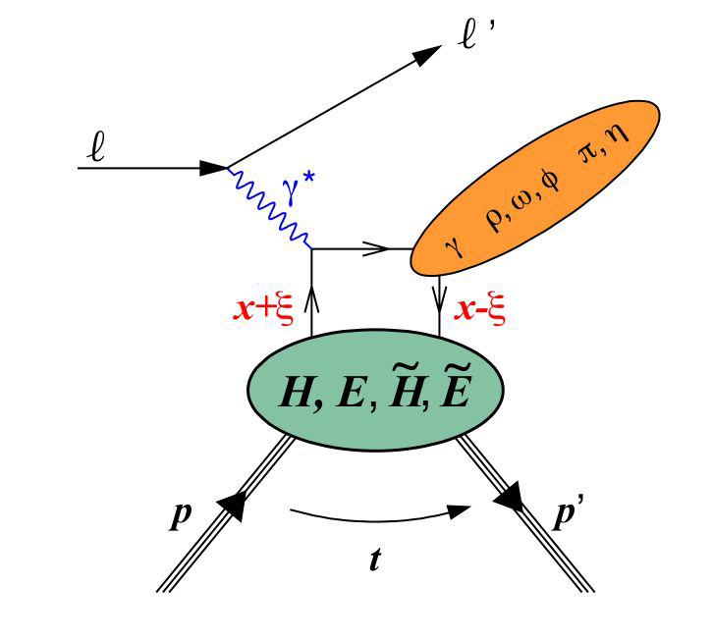




Scientific goals: GPDs
Spin-½ hadron: 4 chiral-even ($H$, $E$ and their polarized-hadron versions $\tilde{H}$, $\tilde{E})$ and 4 chiral-odd ($H_{T}\text{, }E_{T},{\tilde{H}}_{T}$, ${\tilde{E}}_{T}$) quark and gluon GPDs at leading twist
$$H\left(x,ξ,t\right)$$
GPDs
Like usual PDFs, GPDs are non-perturbative functions defined via the matrix elements of parton operators:
Experimental access to GPDs via Compton Form Factors (CFFs)
$$ℋ\left(ξ,t\right)=\sum_{q}{e_{q}^{2}\int_{−1}^{1}{dx H^{q}\left(x,ξ,t\right)\left(\frac{1}{ξ−x−iε}−\frac{1}{ξ+x−iε}\right)}}$$
Measure t-differential cross sections and asymmetries in exclusive processes [DVCS + VMs needed to constrain the whole set and separate flavors]
Mandelstam variable:
$$t=−{\left(p^{′}−p\right)}^{2}$$

Slide 22



ePIC performance: proton momentum via far-fwd spectrometers
$t=−{\left(p^{′}−p\right)}^{2},$ in exclusive and diffractive processes is directedly measured via far forward trackers, roman pots (RPs) and B0
Reconstructed minus generated track polar angle
for all reconstructed DVCS photons (left)
vs the generated photon θ (right)
Generated and reconstructed t-distributions for fully-exclusive DVCS events

Slide 23


ePIC performance: DVMP in e-A
Diffraction
High sensitivity to gluon density in linear regime σ~[g(x,Q²)]²
gluon
emission
gluon recombination
Enhancement of saturation scale
?=?
Gold: 197 times smaller effective x !
Work ongoing to use electron spin flip to further separate coherent and incoherent components statistically.
2-dimensional Fourier-Bessel transform. of the |t| distribution can be interpreted as the spatial distribution of gluons
Fourier
transformation

Slide 24
Summary
The EIC provides an unprecedented opportunity for the ultimate understanding of QCD
  Over two decades, the nuclear physics community has developed the scientific and technical case for the Electron-Ion Collider
“The science questions that an EIC will answer are central to completing an understanding of atoms as well as being integral to the agenda of nuclear physics today.” (National Academy of Sciences, 2018)
The ePIC Collaboration was formed in Spring ‘22 with a successful merging of several proposal efforts
New excitement ahead
Event reconstruction at the ePIC experiment being finalized & novel analysis tools being developed
  New, more realistic, impact studies
  TDR has a chapter on physics studies
  An Early Science plan is being developed
  NIM A special issue
Exploring synergies with LHC and JLAB on science is very important for us!

Slide 25


Slide 26





Tracking
MAPS Tracker:
  Small pixels (20 μm), low power consumption (<20 mW/cm²) and low material budget (0.05% to 0.55% X/X₀) per layer
  Based on ALICE ITS3 development
  Vertex layers optimized for beam pipe bake-out and ITS-3 sensor size
  Forward and backward disks
MPGD Layers:
  Provide timing and pattern recognition
  Cylindrical μMEGAs
  Planar μRWell’s before hpDIRC - Impact point and direction for ring seeding
AC-LGAD TOF and AstroPix (BECAL):
  Additional space point for pattern recognition / redundancy
  Fast hit point / Low p PID
MAPS Barrel + Disks
MPGD Barrels + Disks
AC-LGAD based ToF

Slide 27








Calorimetry
Forward EMCal
High granularity W/SciFi
a unique technology allowing to achieve e/h ~1 (response to hadrons)
Backwards HCal
Steel/Sc Sandwich
tail catcher
Backwards EMCal
PbW04 crystals, SiPM photosensors
Forward Hcal
SiPMs on tile
Barrel HCAL
Fe/Sc sandwich, ~3.5$λ$
(sPHENIX re-use)
Barrel EMCAL
4 (6) layers of imaging calorimetry
by Astropix MAPS,
and sampling calorimetry by Pb/SciFi

Slide 28









Particle ID
Proximity Focused (pfRICH)
Aerogel with Long proximity gap (~40 cm)
Sensor: HRPPDs
$3σ$ π/K sep. up to 9 GeV/c
Dual-Radiator RICH (dRICH)
C₂F₆ Gas Volume and Aerogel
Single photon sensors (SiPMs)
π/K 3σ sep. at 50 GeV/c
High-Performance DIRC
Quartz bar radiator (BaBAR bars) light detection with MCP-PMTs
$3σ$ π/K sep. at 6 GeV/c
AC-LGAD TOF (~30ps)
Accurate space point for tracking / Low p PID
Forward disk and central barrel

Slide 29



Scientific goals: origin of the mass of visible matter
Gluons have no mass and quarks are very light, but nucleons and nuclei are heavy, making up for most of the visible mass in the Universe
Visible matter only made of constituents of light mass: masses emerge from quark-gluon dynamics
Proton (valence quarks: uud) $→m_{p}=940$ MeV
The mass is dominated by the energy of highly relativistic gluonic field
EIC can determine an important contribution term to the proton mass, the so-called “QCD trace anomaly” ⟼ accessible in exclusive reactions (e.g. Y photoproduction near threshold)
Key detector performance:
Acceptance and low material for VM decay leptons
Resolution of lepton pair inv. mass
Muon id

Slide 30




ePIC performance: $Υ$ production
ϒ(1S), ϒ(2S), ϒ(3S) $→e^{+}e^{−}$
Sensitivity to gluon distributions
Challenges: tracking resolution is crucial
First studies at low $Q^{2}$
Ratio yields 1 : 0.45 : 0.33 from STARlight paper
Fitted with the Double-Sided Crystal Ball function
$m_{ΥnS}=m_{Υ1S}\frac{\text{PDGmas}{\text{s}}_{nS}}{\text{PDGmas}{\text{s}}_{1S}}$
left -> right: Different rapidity intervals

Slide 31


ePIC performance: α_{s}
HERA data alone (HERAPDF2.0) shows only limited sensitivity when fitting inclusive data only.
Adding EIC (precision high x) data to HERA can lead to a precision a factor ~2 better than current world experimental average, and than lattice QCD average
  Scale uncertainties remain to be understood (ongoing work)
2 EIC Energies (1fb⁻¹ ea.):
$$α_{S}\left(M_{Z}^{2}\right)=0.1162 ±0.0008$$
3 EIC Energies (1fb⁻¹ ea.):
$$α_{S}\left(M_{Z}^{2}\right)=0.1158 ±0.0006$$
EPJC (2023) 83: 1011
arXiv:2602.00860
Full EIC program

Slide 32








Accessing GPDs in exclusive processes
Real photon (DVCS):
Very clean experimental signature
No VM wave-function uncertainty
Hard scale provided by $Q^{2}$
Access to the whole set of GPDs
Sensitive to both quarks and gluons [via Q² dependence of xsec (scaling violation)]
Only possible at EIC:
from valence quark region, deep into the sea!
$$H^{q }$$
$$E^{q }$$
ρ⁰ | 2u+d, 9g/4
ω | 2u−d, 3g/4
φ | s, g
ρ⁺ | u−d
J/ψ, Y | g
$$\tilde{H^{q}}$$
$$\tilde{E^{q}}$$
π⁰ | 2Δu+Δd
η | 2Δu−Δd
Hard Exclusive Meson Production (HEMP):
Uncertainty of wave function
Hard scale provided by $Q^{2}+M^{2}$
J/Psi, Y → direct access to gluons, $c\overline{c},\text{or} b\overline{b}$ pairs
    produced via $q\left(g\right)−g$ fusion
Light VMs → quark-flavor separation
Psedoscalars → helicity-flip GPDs
Key detector performance:
$γ/{π^{0}}$ separ. in ECAL for DVCS
Acceptance and low material for VM decay leptons
Resol. of lepton pair invariant mass
Scattered electrons over full kinematics
$t$- lever arm in FF spectrometers

Slide 33




Scientific goals: jets as a versatile probe
Jets are extremely powerful probes!
  Dynamically generated, sensitive to many scales
  Good proxy for parton kinematics
  Like SIDIS (multiple particles in FS), but also encode correlations between particles
    Via both jet clustering & substructure
Can provide input on all areas of EIC physics program
  (n)PDFs,
    e.g. PRD 102, 074015 (2020)
  Spin/flavor structure of nuclei,
    e.g. PRD 103, 074023 (2021)
  Saturation/extreme parton density,
    e.g. PRL 116, 202301 (2016)
  TMDs/GPDs,
    e.g. PRL 116, 202301 (2016)
  Cold nuclear matter effects,
    e.g. arXiv:2308.08143; arXiv:2506.17454
PRD 103, 074023 (2021)
arXiv:2308.08143
PRD 102, 074015 (2020)
PRL 116, 202301 (2016)
Key detector performance:
Azimuthal acceptance
Quality of tracking
HCal (for jets)

Slide 34


ePIC performance: jets Energy Scale – Resolution
Above: JES (left) & JER (right) for charged jets
  Reco jets from tracks, truth jets from stable final particles
  Jets matched via $ΔR=Δφ⊕Δη<0.1$
Only charged particles used due to lack of adequate PF algorithm, and to assess tracking performance
  Note: baseline particle flow algorithm a development priority for 2026

Slide 35

ePIC performance: jet efficiency – fake rate
Jet finding efficiency (left) and fake jet rate (right) in percentage as a function of jet energy for charged jets in e+p and e+Au collisions at $\sqrt{s}=63$ GeV

