Slide 1
Making RHIC Possible: Reflections on the Machine
Thomas Roser
RHIC Science Symposium
May 14, 2026

Slide 2
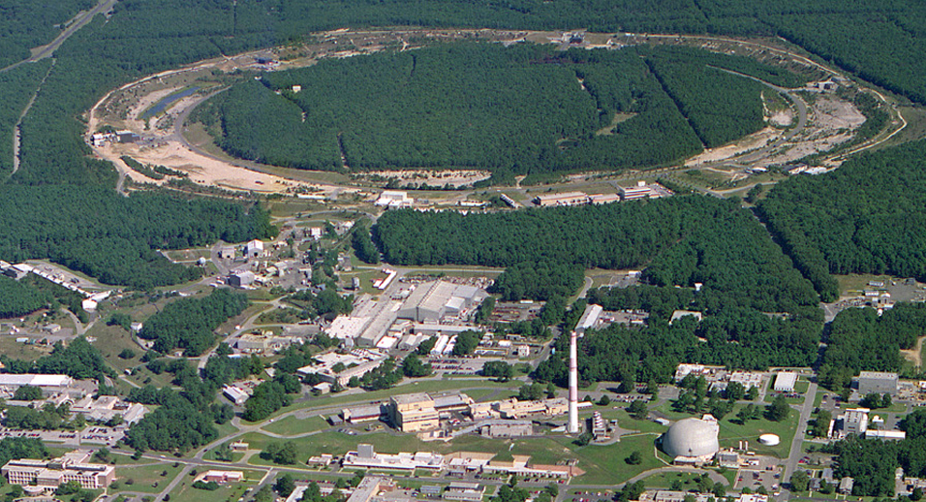



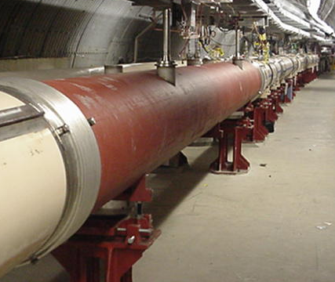


RHIC – a uniquely flexible collider
Collider with two independently powered 3.8 km superconducting rings that allows gold-gold, proton-gold, and proton-proton collisions at equal energies up to 100 GeV.
High luminosity polarized proton-proton collisions up to 250 GeV.
Six independently powered interaction regions, initially instrumented with four detectors: STAR, PHENIX, PHOBOS, BRAHMS.
Polarized Jet Target
Electron lenses
(PHOBOS)
RHIC
(Electron cooling)
(BRAHMS)
(s)PHENIX
RF
STAR
LINAC
EBIS
Booster
BLIP
AGS
Tandems

Slide 3
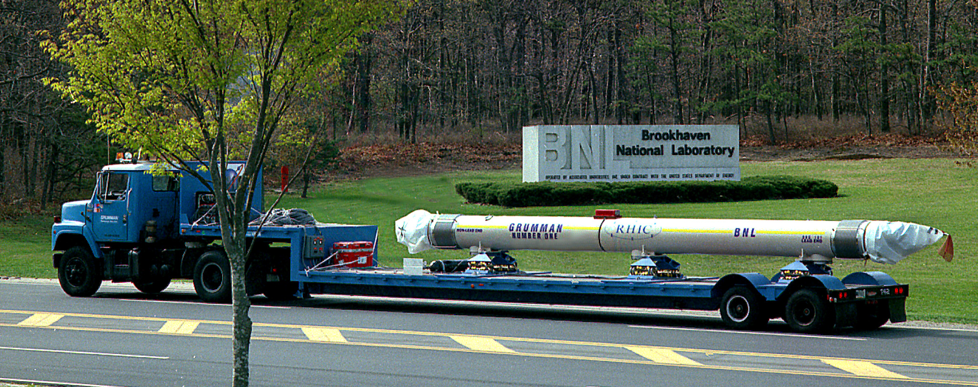
The superconducting magnets – the centerpiece of RHIC
Conservative design developed at BNL
Manufactured at Grumman based on prints from BNL
Large quench margin and excellent quench performance
The two RHIC rings are independent and can operate at a current ratio of 2.5:1
No RHIC dipole magnet failed over the 26-year operating time.

Slide 4
A brief timeline of RHIC
The 1983 NSAC Nuclear Physics Long Range Plan included a relativistic heavy ion collider as the highest priority new facility
It would use the tunnel and a 25-kW helium refrigerator from the ISABELLE/CBA project (it’s good to have a tunnel!)
First idea of a polarized proton collider was discussed at the 1990 Polarized Collider Workshop at Penn State
RHIC construction started in 1991
First beam in RHIC tunnel (sextant test) in 1997
RHIC commissioning started in 1999
First gold-gold collisions on June 12, 2000
Reached RHIC gold-gold design luminosity in 2001
First polarized proton collisions in RHIC in 2001

Slide 5
Known unknowns: Risks at start of RHIC construction
When RHIC construction started 1991 some critical performance parameters had not been demonstrated:
Probably the most important issue was the production of the very high bunch intensity of 10⁹ gold ions.
The lifetime of colliding high energy gold beams was unknown. Electron-positron pairs produced in the collisions followed by electron capture could lead to fast beam loss. This turned out not to be a problem.

Slide 6
The quest for high gold intensity
9 GeV/u
Q = +77 -> +79
Q = +32 -> +77
BOOSTER
AGS
Negative gold ion source injected into Tandem, stripped in terminal to Au32+ and accelerated to 1 Mev/u.
700 micro sec long pulse with very low emittance injected into Booster over about 100 turns painting both in horizontal and vertical directions.
Stripped to Au77+ on the way to AGS.
Accelerated in AGS to 9 GeV/u and stripped to Au79+ on the way to RHIC.
TANDEMS
1 MeV/u
Q = +32

Slide 7
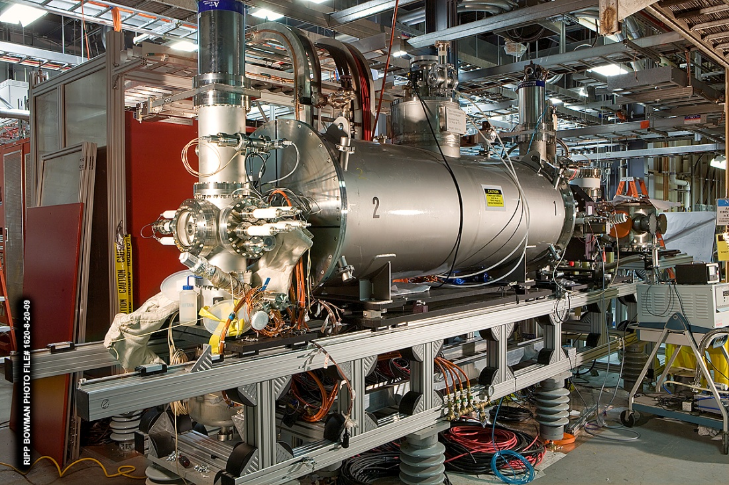
The race for high heavy ion bunch intensity
C-AD developed a high intensity Electron Beam Ion Source (EBIS), where an intense electron beam provides space charge compensation to accumulate high intensity Au32+ at low energy.
EBIS was developed in friendly competition with CERN, where a laser ion source was developed for the LHC. At the end, BNL successfully developed both the EBIS and a Laser ion Source (LION).

Slide 8
RHIC Sextant test, January 26, 1997

Slide 9
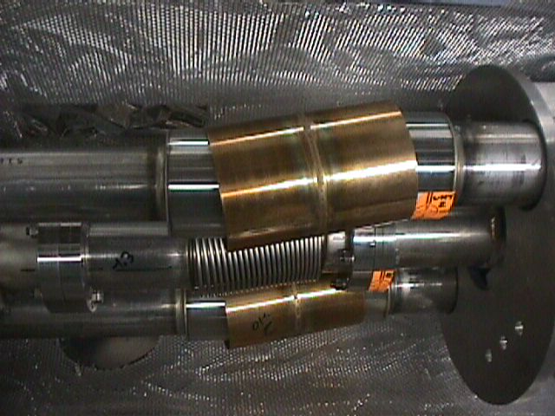
First circulating beam, summer 1999
Beam circulated in blue (45 minutes) and yellow (few thousand turns) despite major obstacles
Beam pipe bellows distorted at all dummies! They were twisted during a pressure test.192 bellows needed to be replaced over a 6 months period.
Newsday, January 9, 2000

Slide 10
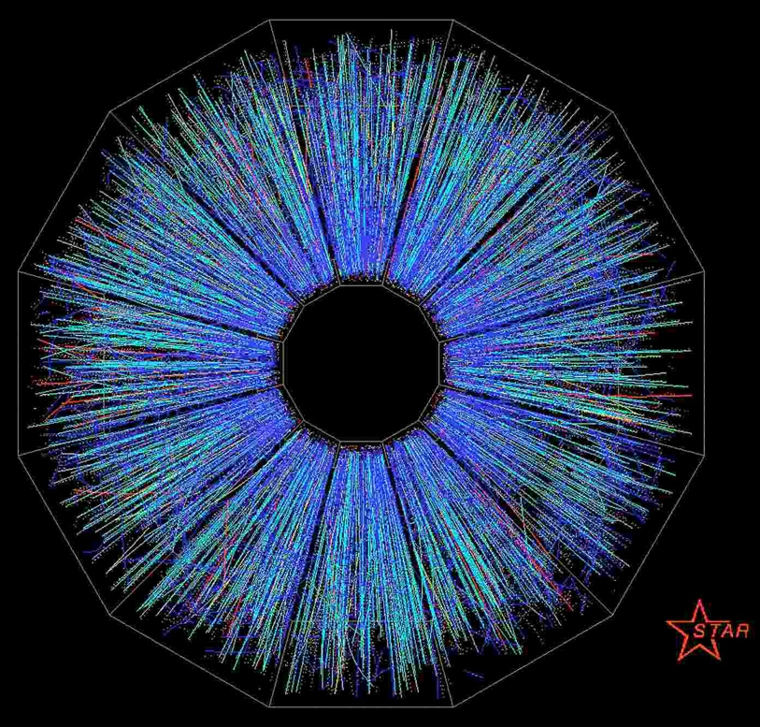
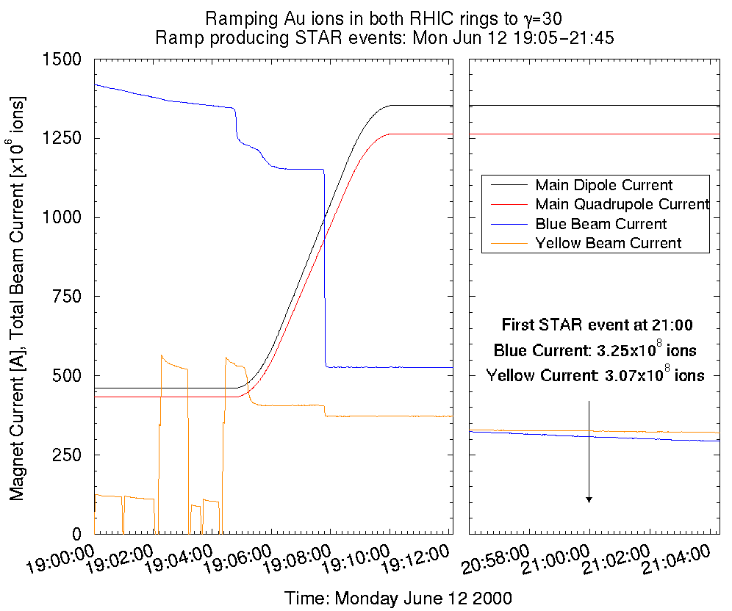
Ramp to First Collisions in RHIC, June 12, 2000
Newsday, June 14, 2000

Slide 11
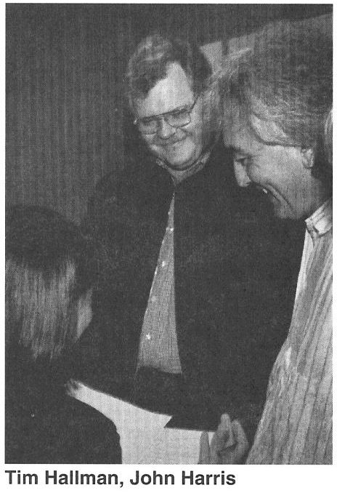
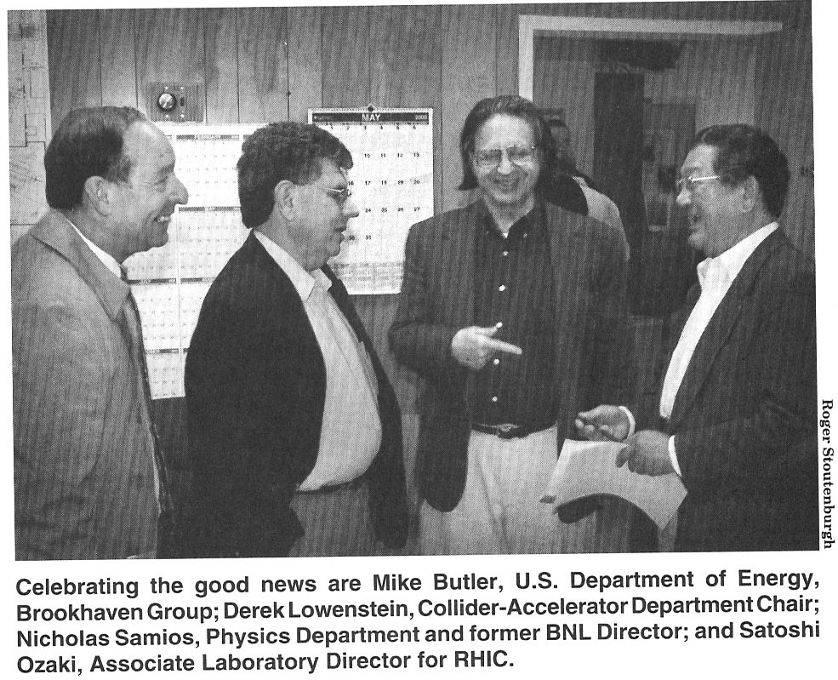
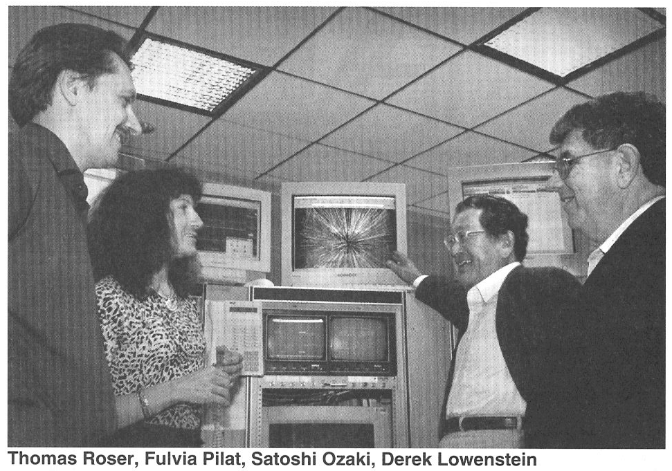
And then there was rejoicing…

Slide 12
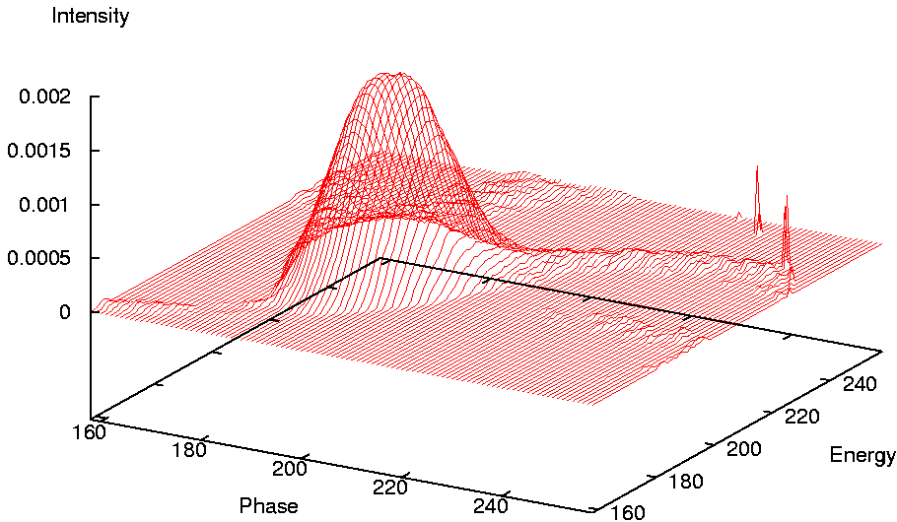
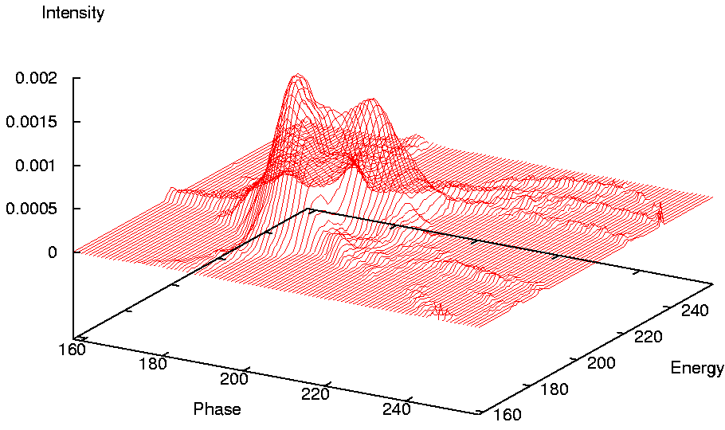
Unknown unknowns: Electron Clouds in RHIC
Before instability
RHIC beam intensity was limited by rapid dynamic pressure rise in warm beam pipes.
Also identified an ultra-fast transverse instability.
Both issues were caused by electron clouds in the room temperature sections of RHIC, an emerging realization at many accelerators at the time.
NEG coating and scrubbing resolved this issue over the next ~ 5 years.
After instability (10 ms growth time

Slide 13
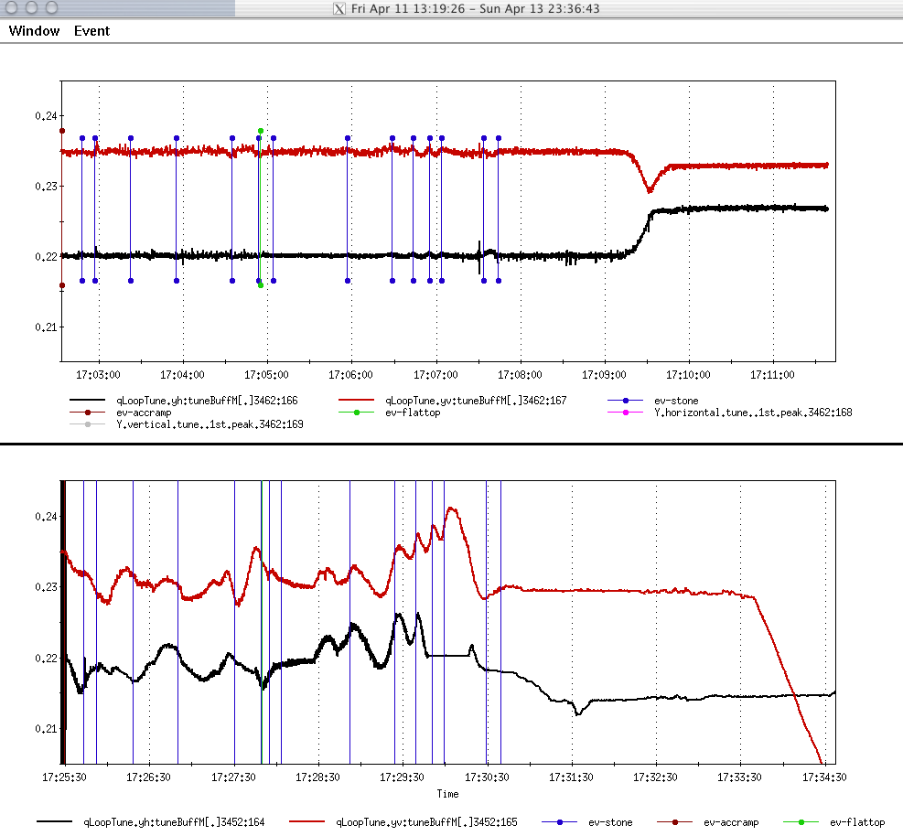
Development at RHIC: Beam-based tune and coupling feedback
Instantaneous and continuous tune measurements through phase lock to the beam and fast feedback
High precision control of tune and coupling. Particularly important for polarized proton acceleration.
Stable operation in the presence of persistent current variations
.24
.23
.22
With feed-back
.21
Dots are kicked tune measurement
.24
Without feed-back
.23
.22
.21
Peter Cameron, “Closed-loop technology speeds up beam control” CERN Courier, May 2006

Slide 14
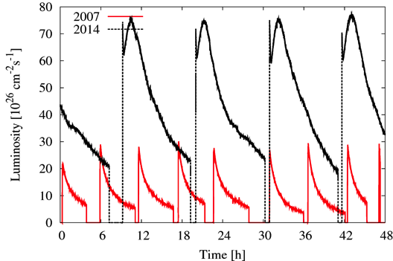
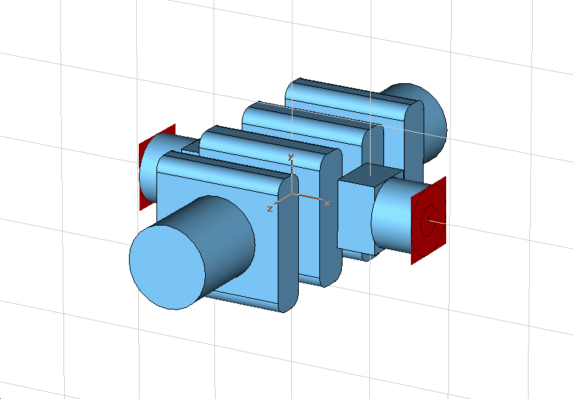
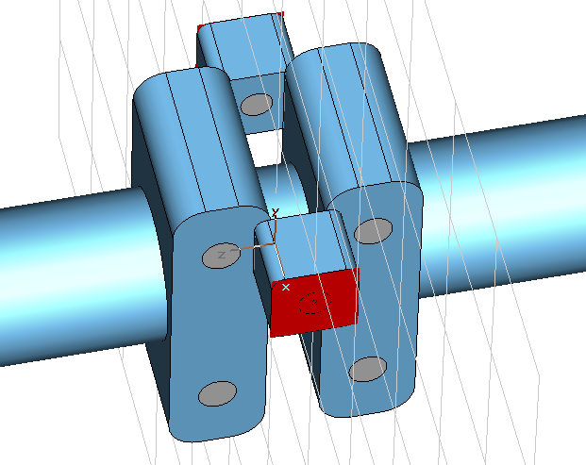
Development at RHIC: 3-D Stochastic Cooling in RHIC
High charge of Gold ions blows up bunches and causes rapid luminosity loss.
First high energy, bunched beam longitudinal and transverse stochastic cooling (3-D) in both rings to counteract Intra-Beam scattering.
Bunch structure of RHIC beams allowed for powerful high-Q cavity kickers
Longitudinal kickers
Transverse kickers
Notes:
14

Slide 15
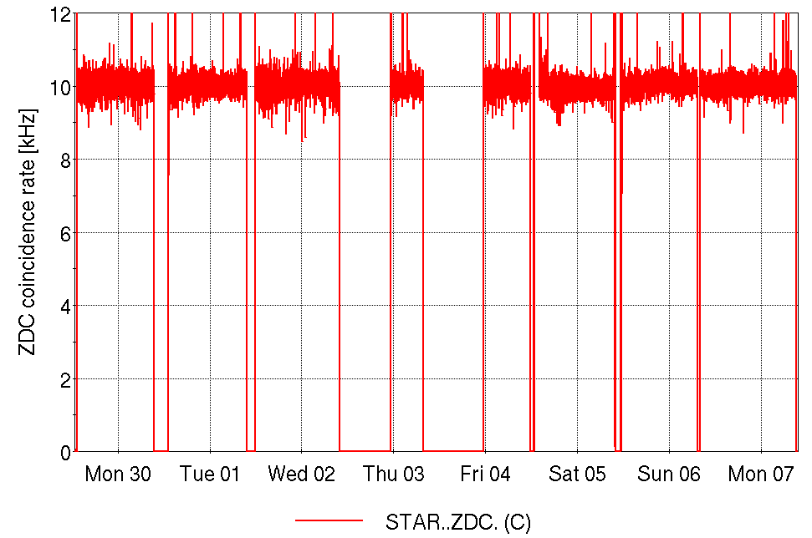
Development at RHIC: Fast alternating of species
For an accurate comparison of Ru-Ru and Zr-Zr collisions fast and automatic configuration switching was developed.
Store-by-store species change
With stochastic cooling: flat luminosity and 20-hour nominal store length
Zr-Zr
Ru-Ru
Zr-Zr
Ru-Ru
Ru-Ru
Zr-Zr
Ru-Ru
Zr-Zr
Notes:
15

Slide 16
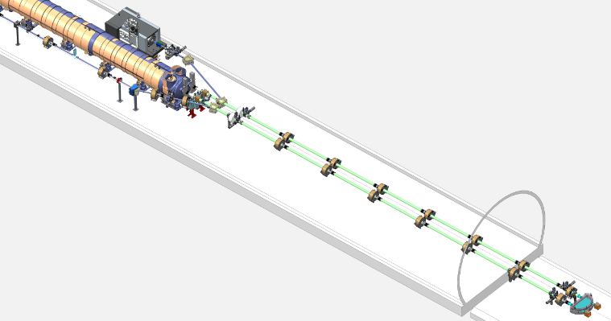
Development at RHIC: Low Energy RHIC electron Cooling
Yellow bunch length
First non-magnetized electron cooling with bunched electron beam.
Successfully cooled 4.6 GeV gold beams in both rings simultaneously
Longitudinal and transverse cooling demonstrated
Blue bunch length
Inj/Ext.
Dipoles
Cooling sections
Yellow/blue beam size
180º return
Dipole

Slide 17
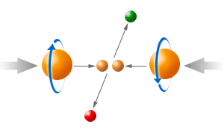
Development at RHIC: Polarized proton acceleration and collisions
Although not part of the initial design, polarized proton collisions became an essential part of RHIC’s success. Many aspects of a polarized collider were never demonstrated and RHIC became both the demonstrator as well as the first operational polarized collider. Much of the spin hardware was funded by Riken, Japan.
High intensity polarized Hminus source
Polarized proton acceleration in AGS without a full Siberian snake
Polarized proton acceleration in RHIC with two full Siberian snakes
Lifetime of beam polarization with high luminosity collisions

Slide 18
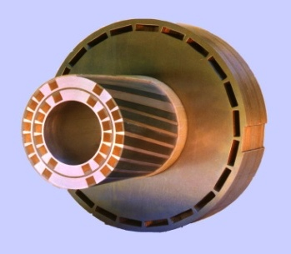
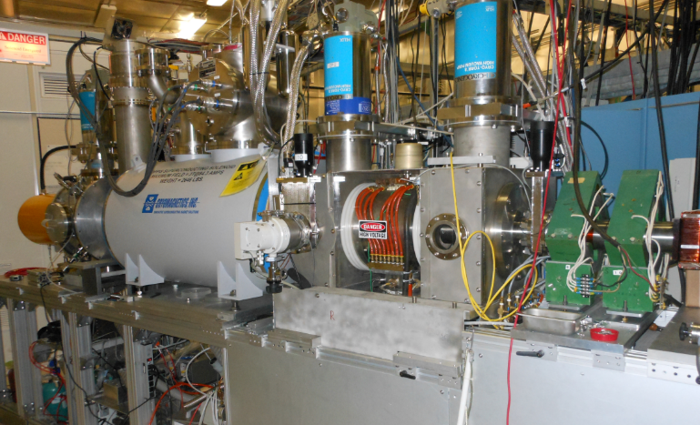
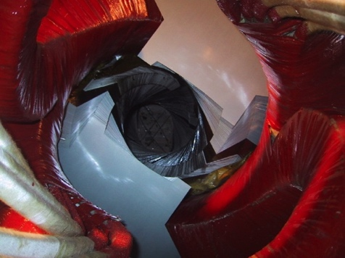
RHIC – First Polarized Hadron Collider
Two full Siberian snakes per ring preserve proton polarization to 255 GeV
Spin direction control at detectors with spin rotators
Minimally invasive polarimeters; also measure polarization profiles
Absolute polarimeter using world’s most intense polarized H jet
Absolute Polarimeter (H↑ jet)
pC Polarimeters
Spin flipper
Siberian Snakes
Siberian Snakes
(s)PHENIX
STAR
Spin Rotators
(longitudinal polarization)
Spin Rotators (long. pol.)
LINAC
5.9% Helical Partial
Siberian Snake
BOOSTER
Pol. H⁻ Source
AGS
200 MeV Polarimeter
pC Polarimeter
10-25% Helical Partial Siberian Snake

Slide 19
High intensity polarized H- source
Developed as BNL, TRIUMF, KEK, INR collaboration
1.0 mA in 300 μs (1.8 x 10¹² protons per pulse); 83% polarization
One source pulse is captured and accelerated for one bunch in RHIC
With inefficiencies and scraping to lower emittance and higher polarization bunch intensity in RHIC is 2.5 x 10¹¹ polarized protons

Slide 20
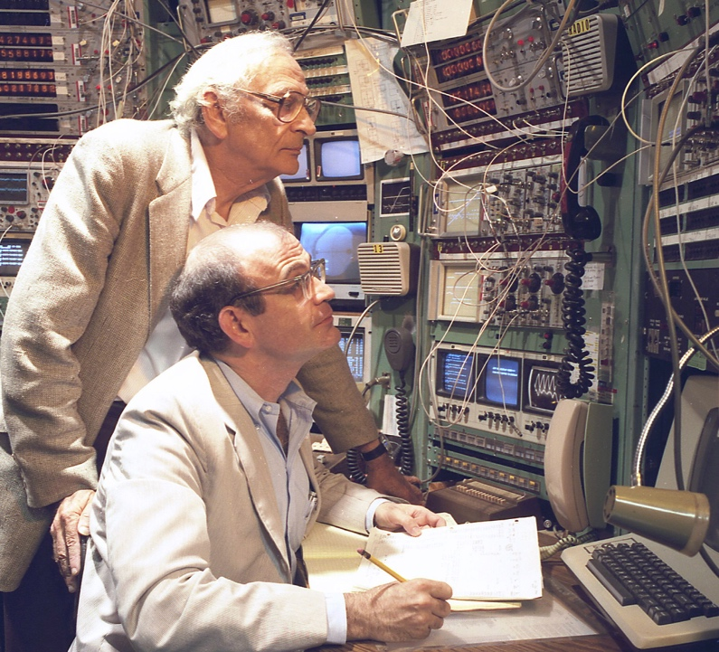
First Effort to Accelerate Polarized Protons in AGS
In the 1980s, Alan Krisch and Larry Ratner led the first effort to polarize the AGS by correcting the approximately 50 imperfection and intrinsic depolarizing resonances. This was a truly heroic effort!
1/95 correction dipole; 1/10 pulsed quadrupole; main field

Slide 21
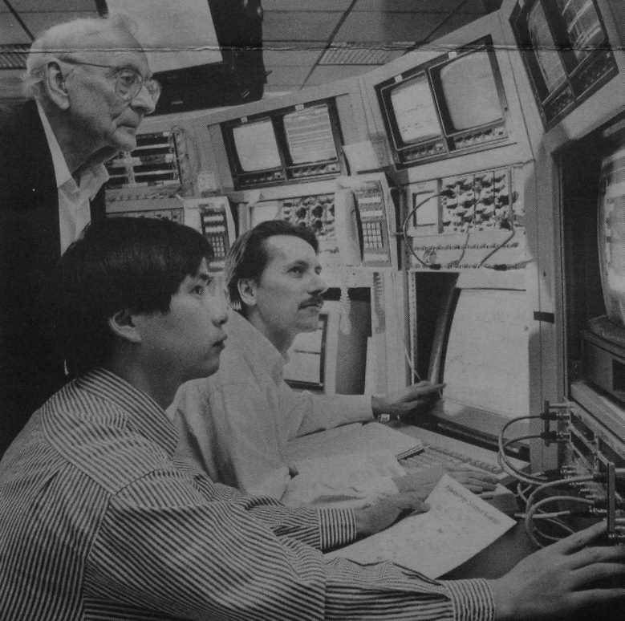
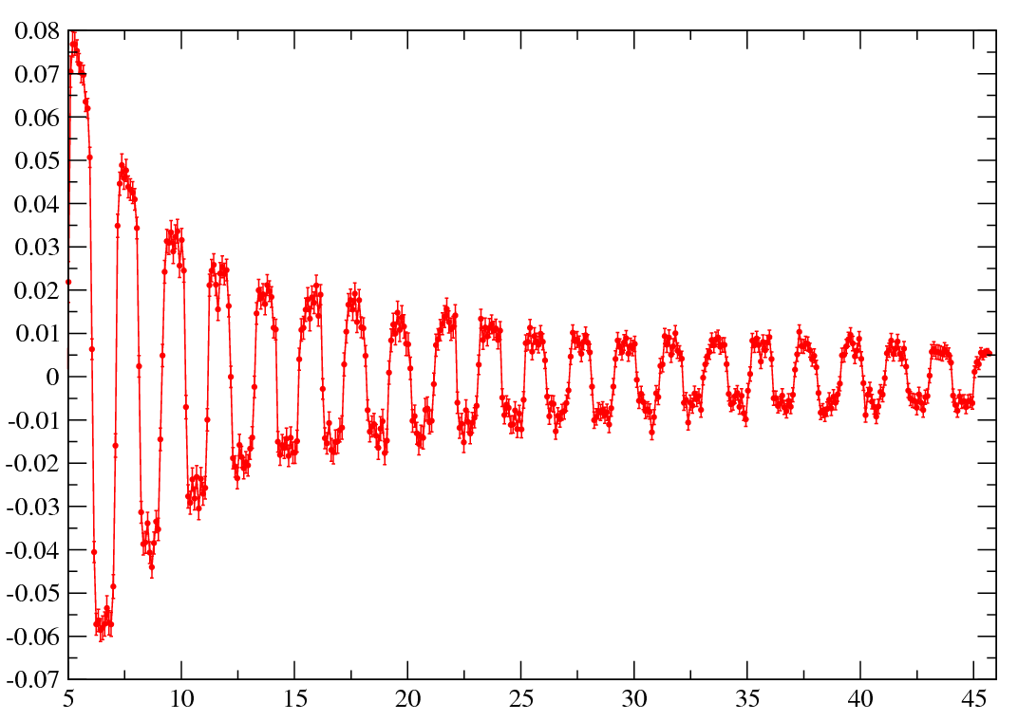
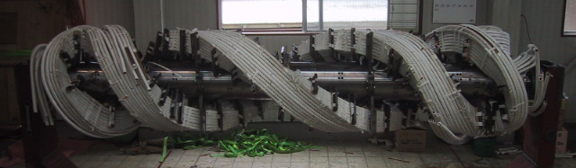
Polarized Protons in the AGS
Two strong partial Siberian snakes using variable-pitch helical dipoles
Vertical betatron tune at 8.98!
Pulsed quadrupoles to jump across the many weak horizontal spin resonances driven by the partial snakes.
Larry Ratner, Haixin Huang and TR in AGS MCR.
Polarimeter asymmetry
2.6 m
Gγ

Slide 22
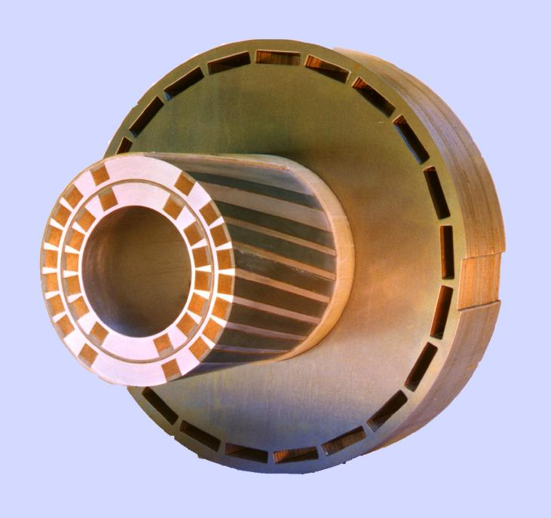
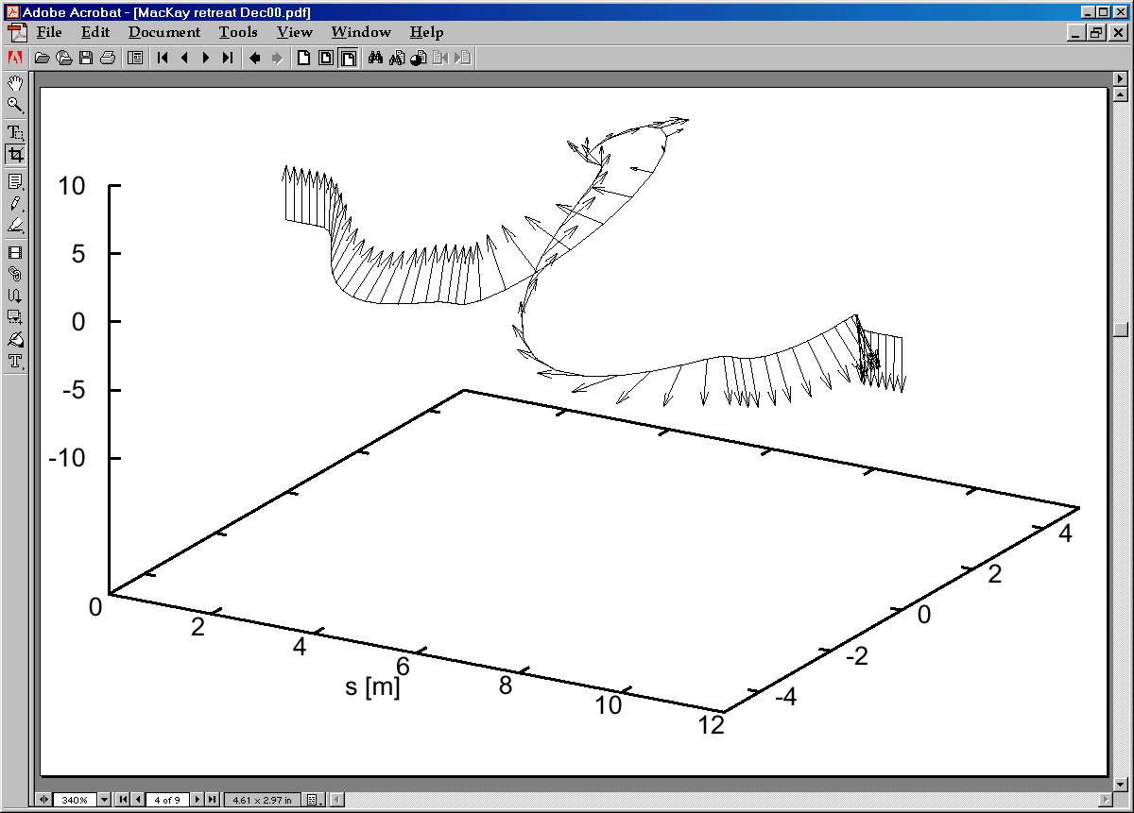
Polarized protons in RHIC
2+2 RHIC Siberian Snakes: four 4 Tesla superconducting helical dipoles, each 2.4 m long and with full 360-degree twist
4+4 RHIC spin rotators: four 4 Tesla superconducting helical dipoles, two right- and two left-handed, each 2.4 m long and with full 360-degree twist

Slide 23
Polarized Proton Collisions at 255 GeV Beam Energy
Reached ~ 57% average polarization in 14 best stores
Little polarization loss on ramp and during store
Peak luminosity: 2.5 × 10³² cm⁻² s⁻¹
Requires excellent control of orbit, tune and coupling

Slide 24
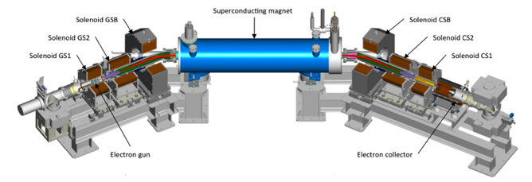
Development at RHIC: Beam-beam compensation with electron lenses
Proton-proton collisions in RHIC are limited by beam-beam tune spread.
First successful head-on beam-beam compensation by colliding with a low energy electron beam.

Slide 25
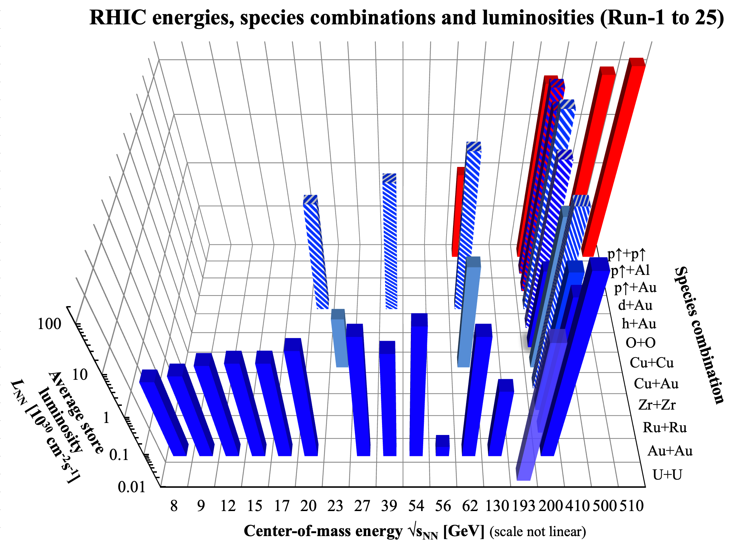
RHIC energies, species, and luminosities

Slide 26
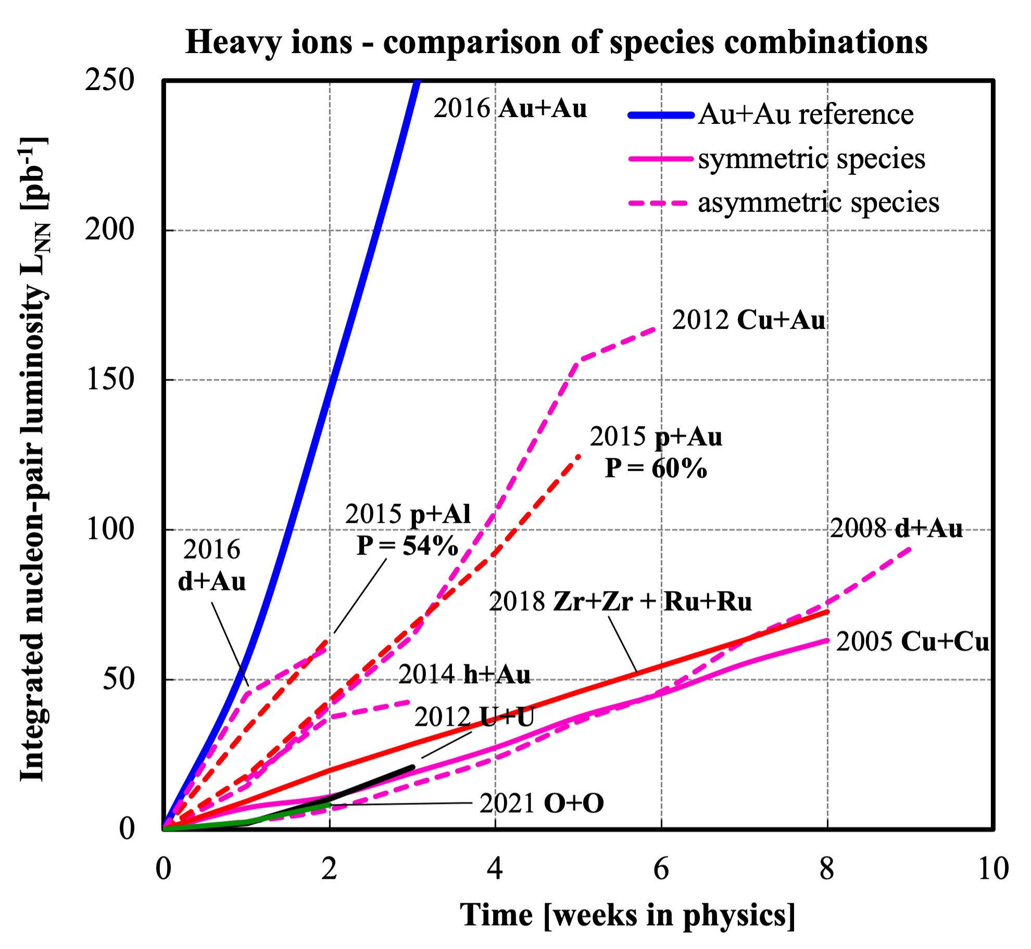
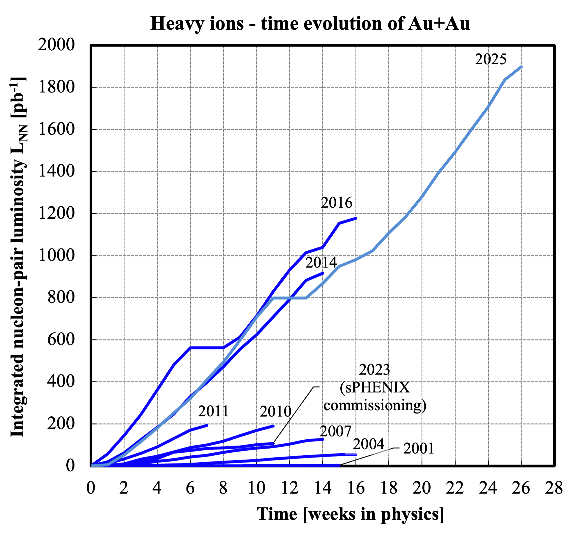
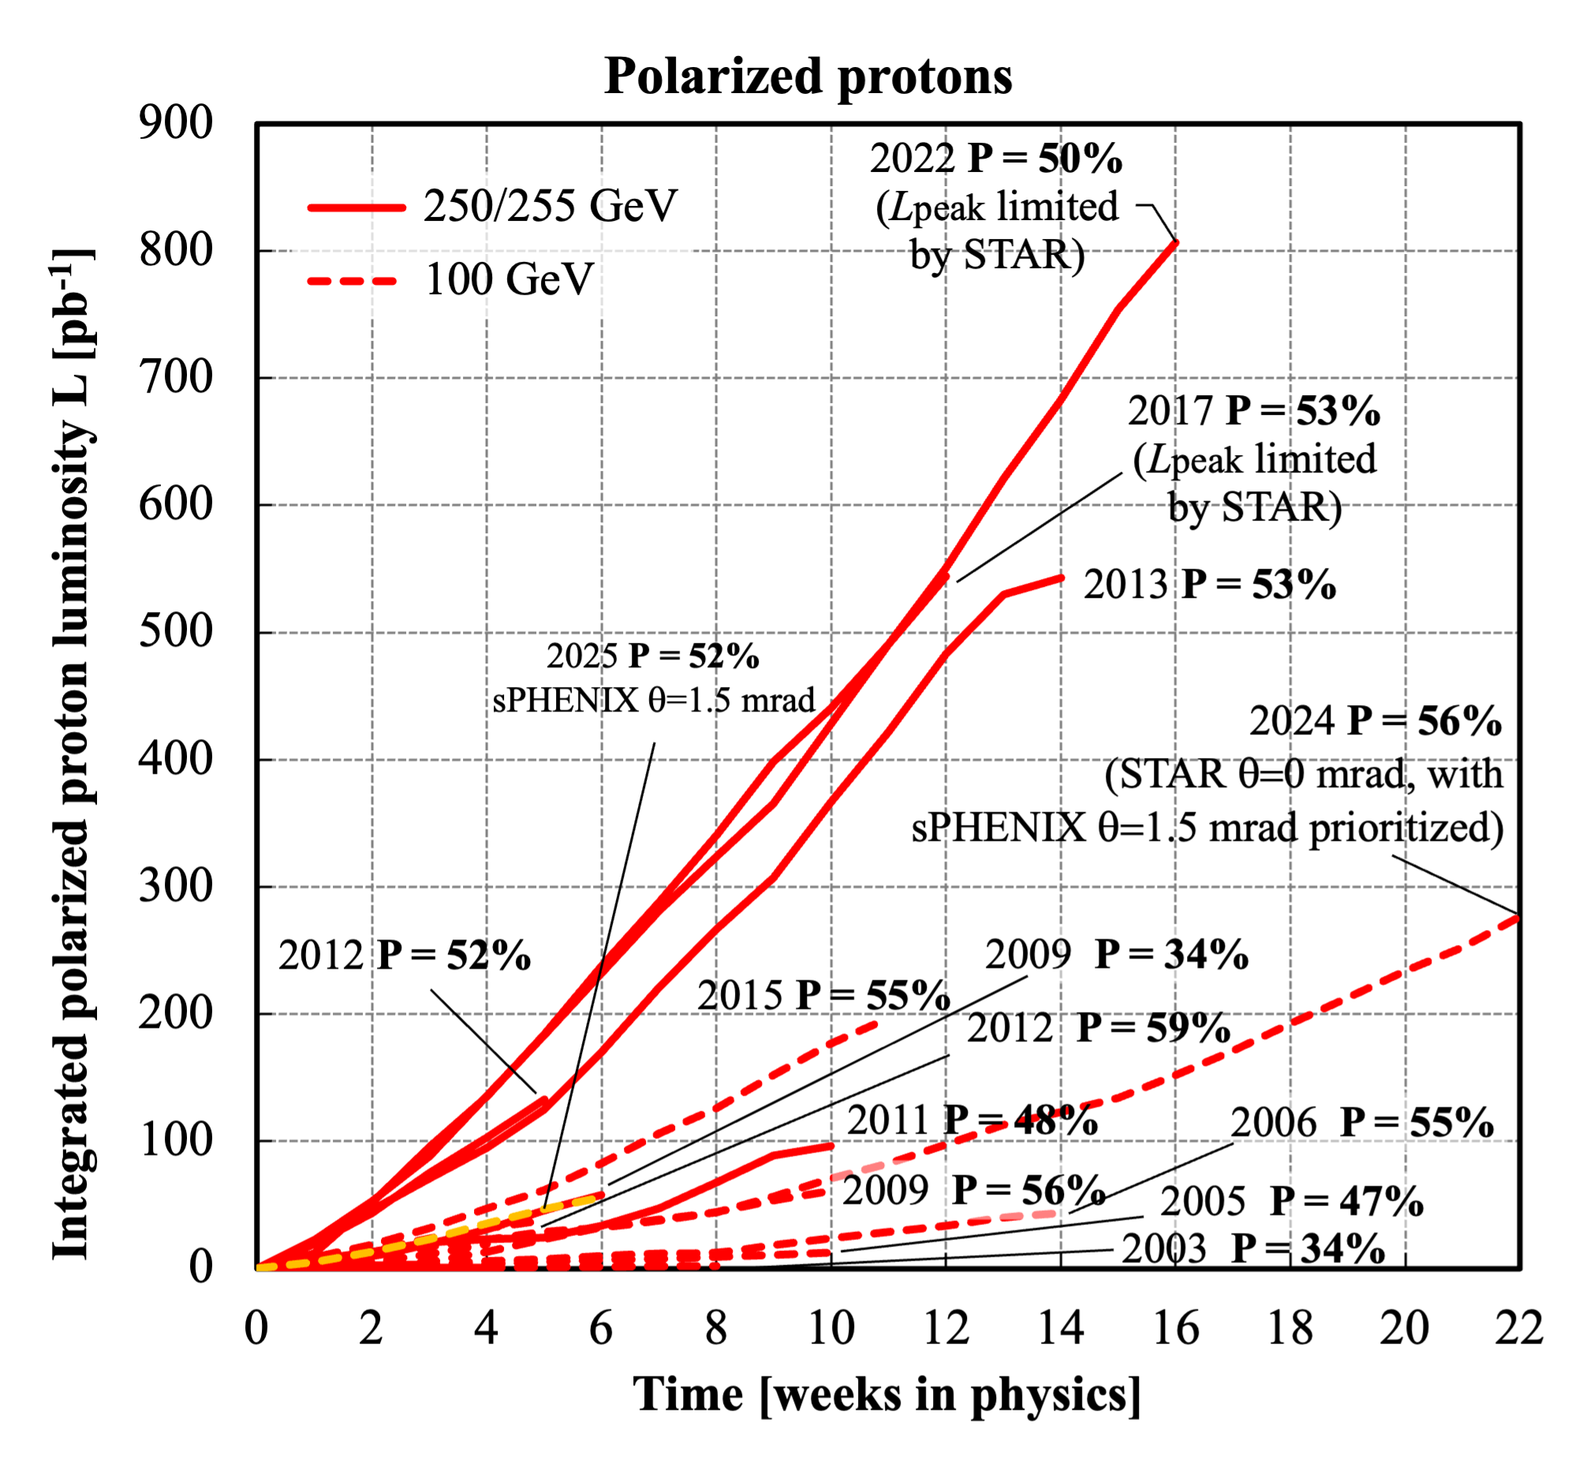
RHIC evolution

Slide 27
Summary
RHIC is the first heavy collider and reached record luminosities over a wide energy range with advanced beam cooling techniques
RHIC is also the first polarized proton collider establishing the feasibility of accelerating polarized proton beams to high energy using Siberian snakes and demonstrating head-on beam-beam compensation
Over the last 26 years RHIC has operated with unparalleled flexibility of collision energy from 7 to 510 GeV and ion species from protons to Uranium.
The fantastic achievements of RHIC form the basis for the polarized Electron Ion Collider.

