Slide 1
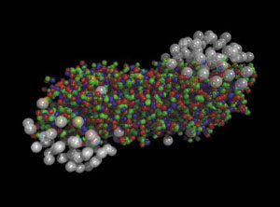
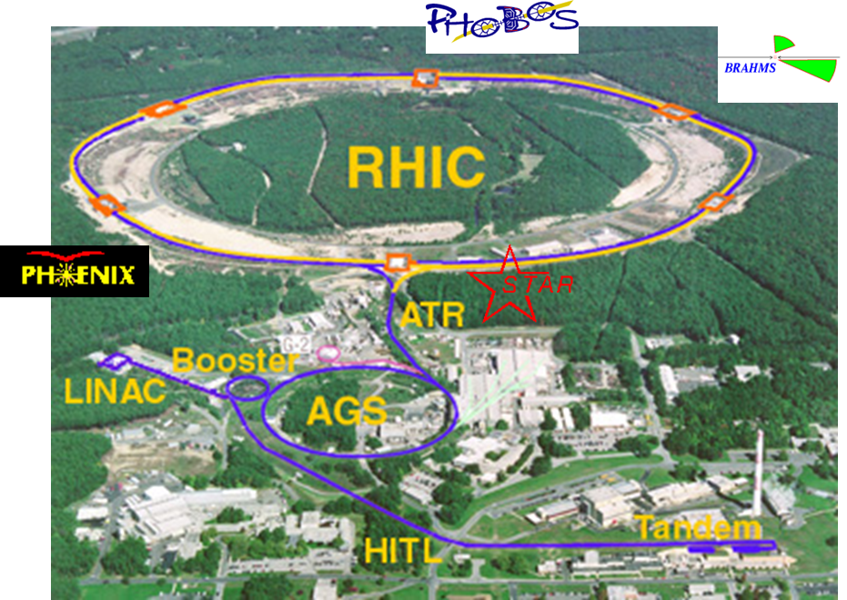
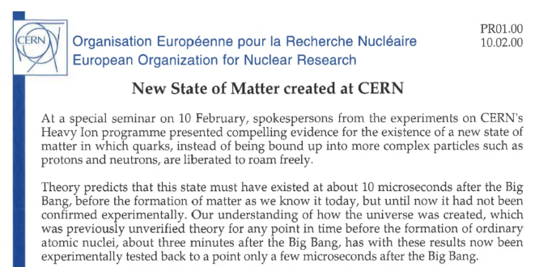
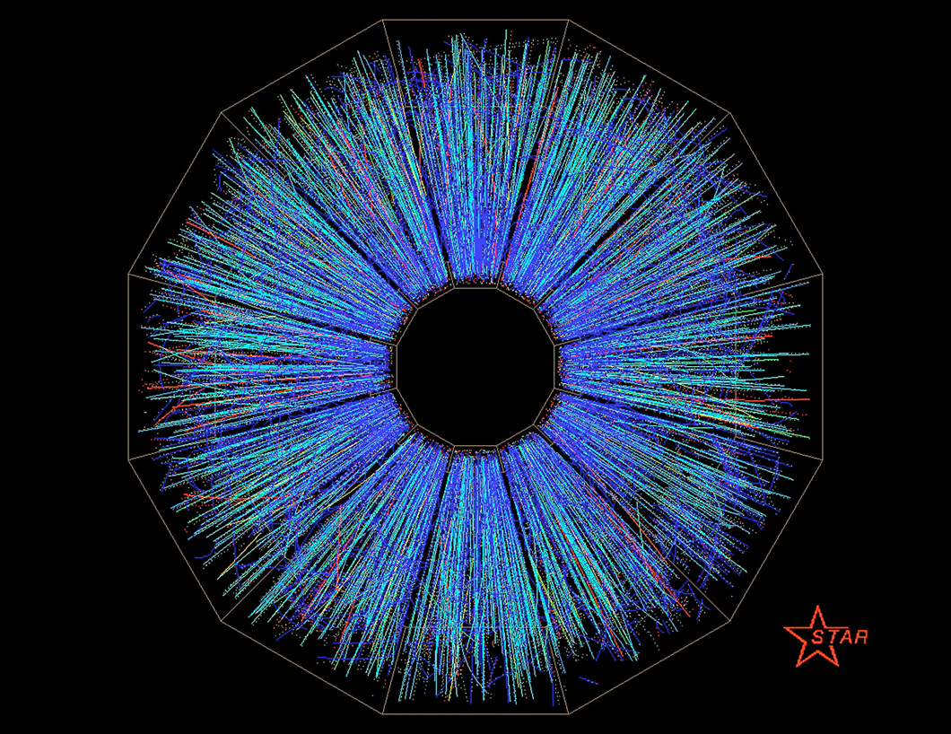
At the Dawn of the RHIC Heavy Ion Physics Era
Flash Back to 2000
RHIC Science Symposium, Axel Drees et al., BNL, May 2026
CERN press office 2/10/2000
From QCD to QGP
  Deconfined quarks
Quest to create QGP
  Heavy Ion Collisions
The AGS and SPS program
New State of Matter
  Chemical & thermal equilibrium
  Hubble expansion
  Interacting and radiating
  Evolves from partonic state
First RHIC Results
  QM 2001
New State of Matter created at CERN
6/12/2000 AuAu at 130 GeV

Slide 2
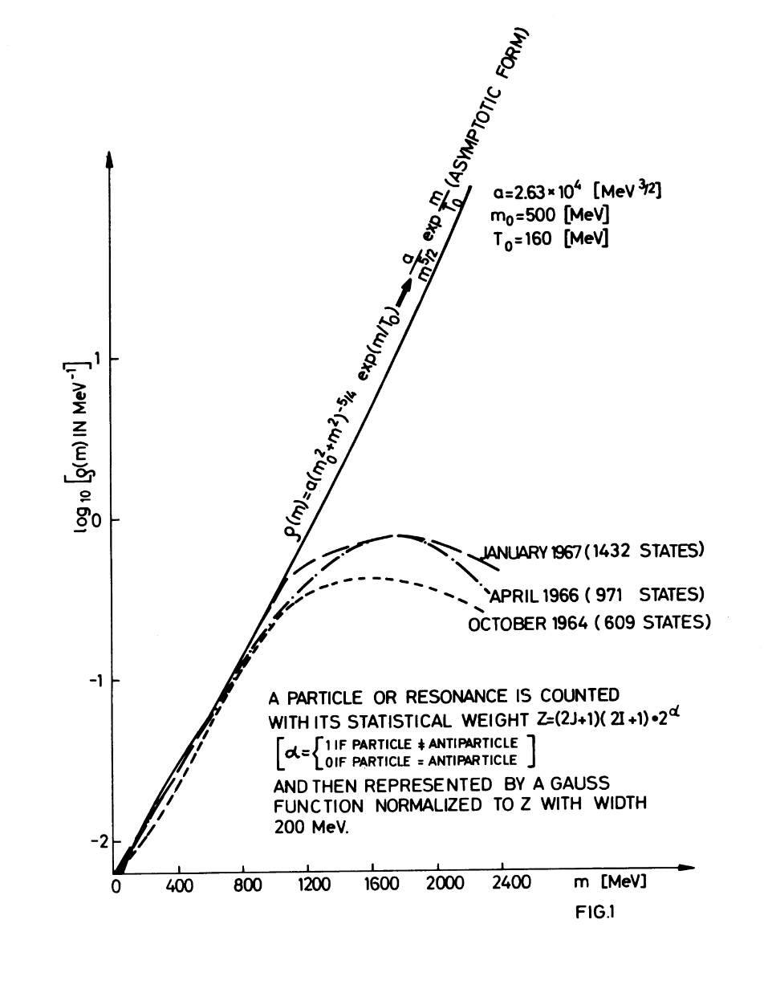
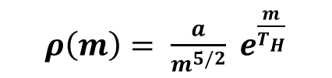
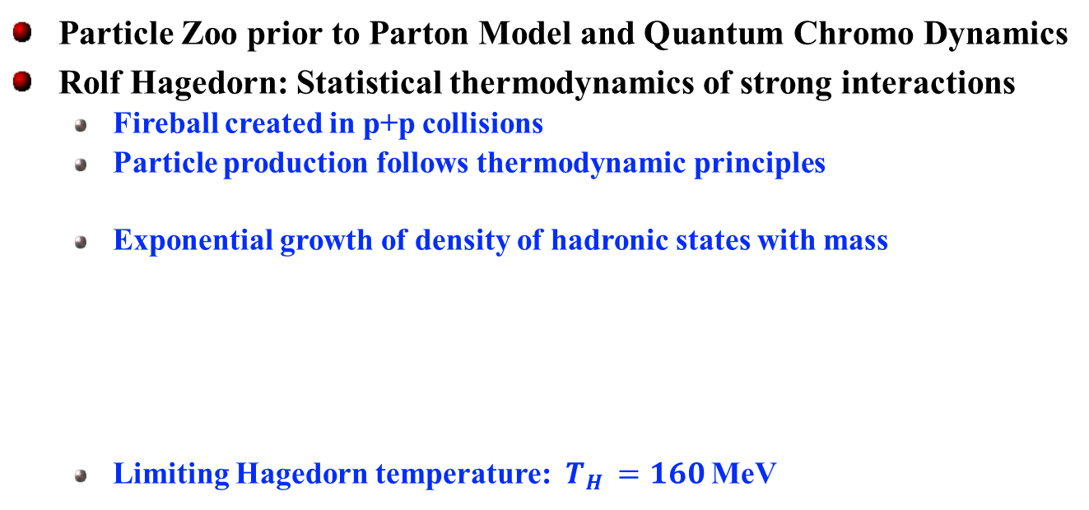
A New State of Matter
p+p Collisions at $\sqrt{s}$ of 6-8 GeV at BNL AGS and CERN PS in the 1960’s
Particle Zoo prior to Parton Model and Quantum Chromo Dynamics
Rolf Hagedorn: Statistical thermodynamics of strong interactions
  Fireball created in p+p collisions
  Particle production follows thermodynamic principles
  Exponential growth of density of hadronic states with mass
  Limiting Hagedorn temperature: $T_{H }=160$MeV
$ρ\left(m\right)= \frac{a}{m^{5/2}} e^{\frac{m}{T_{H}}}$
New state of matter at higher temperature
New degrees of freedom
R. Hagedorn & J. Ranft: Nuovo Cimento, Suppl. 6 (1968) 169

Slide 3
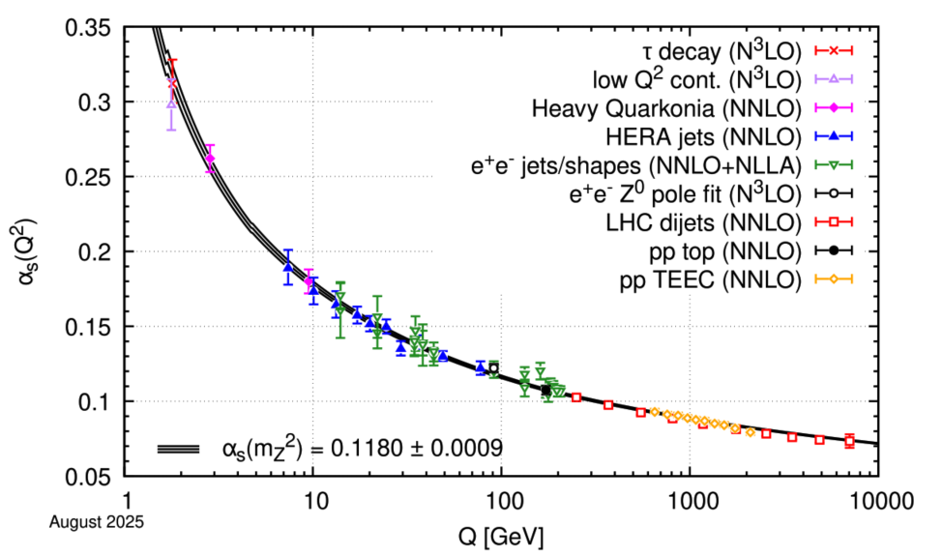

From Quantum Chromo Dynamics to Quark Gluon Plasma
Deep inelastic scattering (SLAC) late 1960 early 70’s
  Discovery of point like partons
  Quarks model established as key part of Standard Model
QCD confinement and asymptotic freedom 1973
  Energy dependence of coupling
  Quarks are confined within hadrons at low energy
  Quarks interact weakly at high energies
Foundational papers leading to QGP concept
  Exponential Hadronic Spectrum and Quark Liberation
  Superdense Matter: Neutrons Or Asymptotically Free Quarks?
  Quark-Gluon Plasma and Hadronic Production of Leptons, Photons and Psions
PDG: Phys. Rev. D 110 (2024) 030001
Friedman, Kendall, Taylor 1990
Gross, Politer, Wilcek 2004
Cabibbo & Parisi: Phys. Lett. B 59 (1975) 67
Quark Gluon Plasma
at high temperature or density
Collins & Perry: Phys. Rev. Lett. 34 (1975) 1353.
  Shuryak: Phys. Lett. B 78 (1978) 150

Slide 4
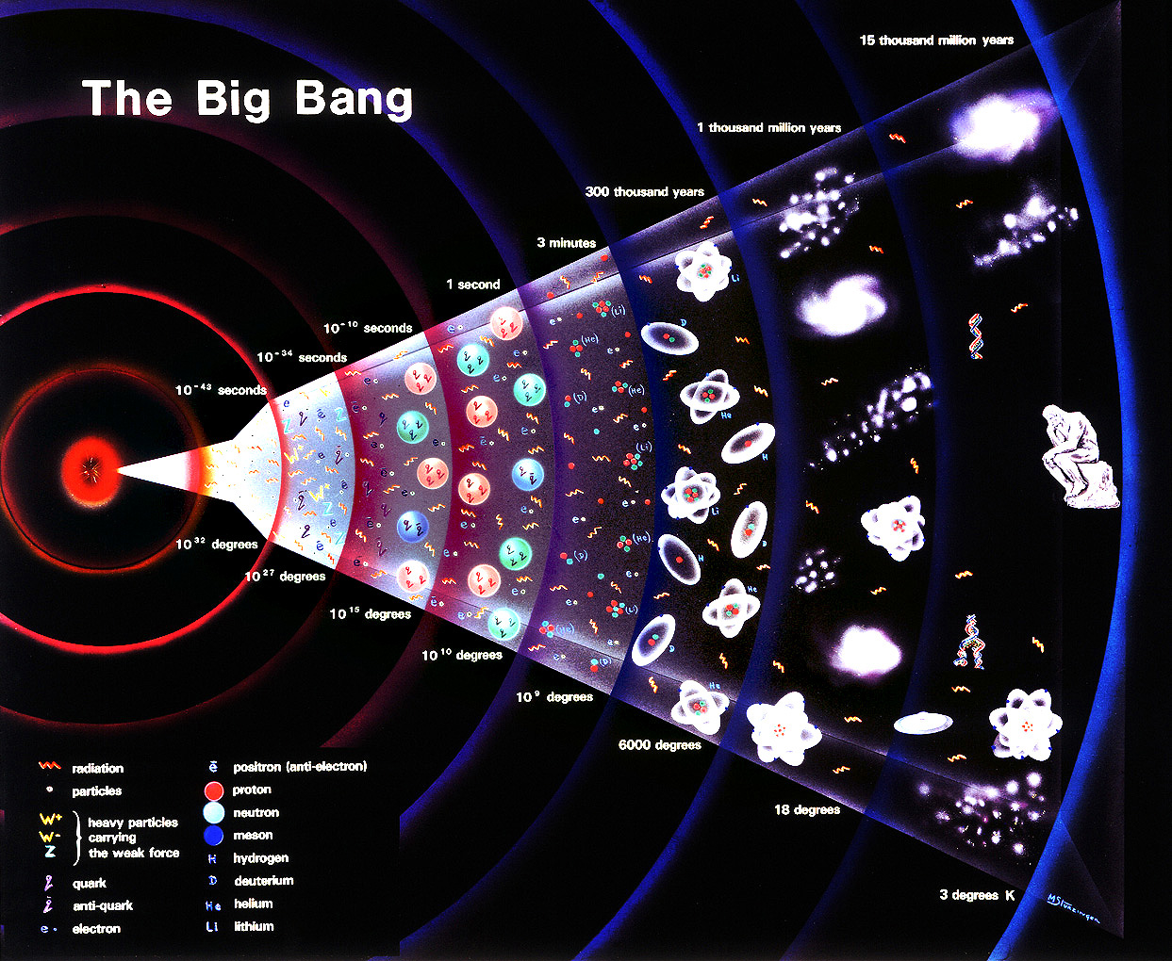
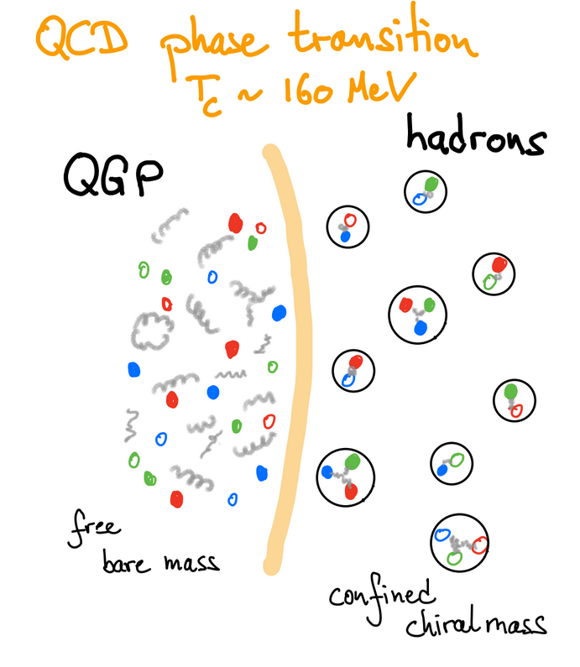

Quark Gluon Plasma in the Early Universe
10⁻⁵ seconds
2 10¹² Kelvin
QCD phase
transition
Create quark gluon plasma Heavy Ion collisions?

Slide 5
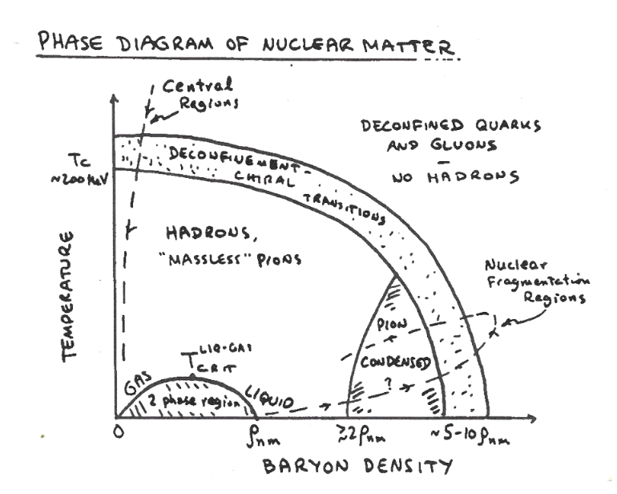
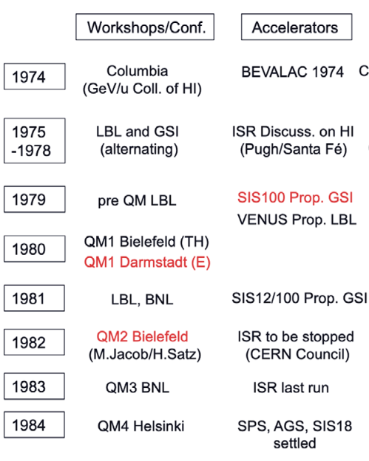
Quest to Create Quark Gluon Plasma in the Laboratory
Baym: 1983 NSSAC Long Range Plan
From H.J. Specht, Springer Biographies
Program development through constructive interplay between nuclear and particle physics communities
RHIC
NSAC: Highest priority
for new facilities
AGS and SPS
Heavy Ion programs
under construction by 1984
NSAC: reaffirms
community endorsement
1989
1991
DOE approval

Slide 6
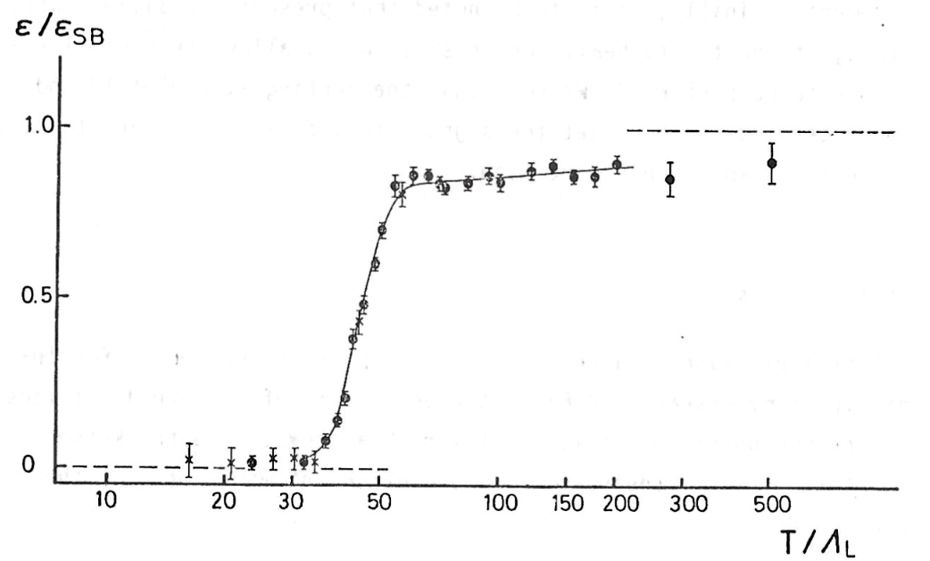
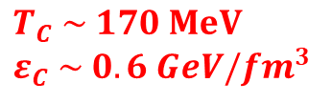
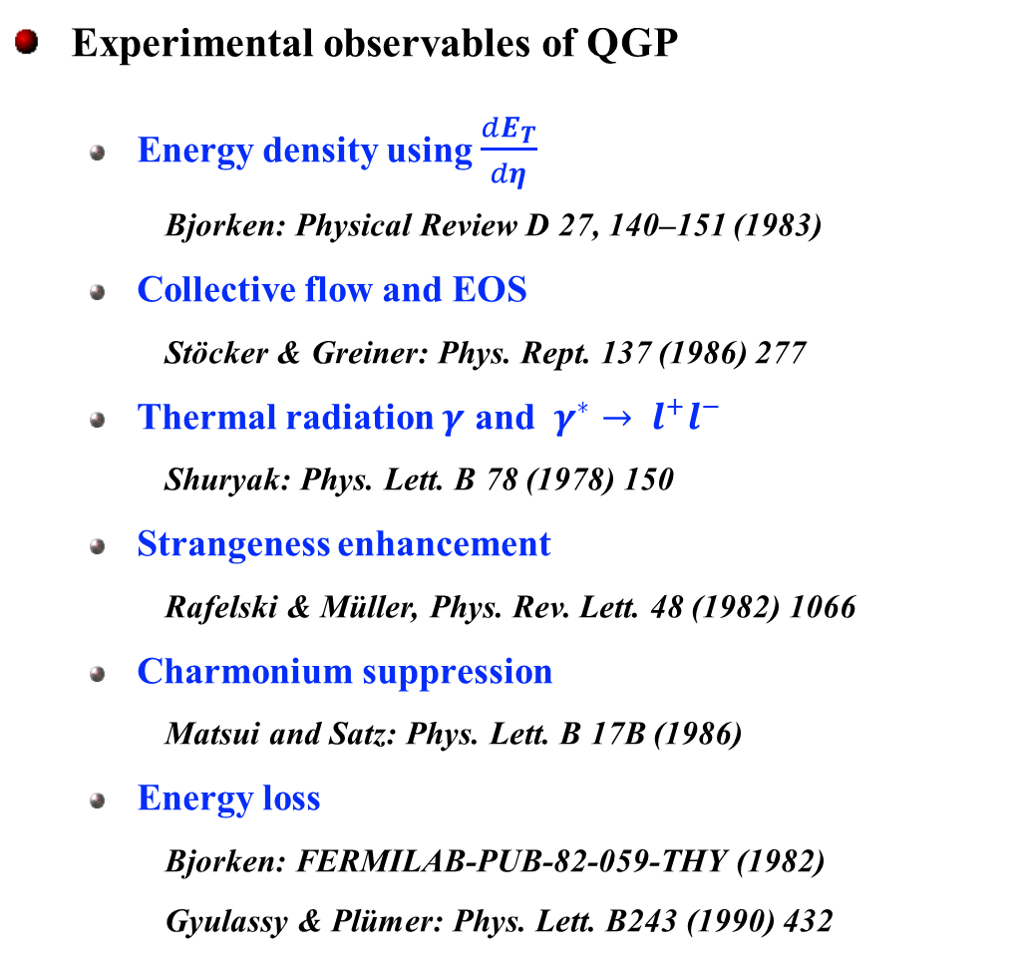
Quest to Create Quark Gluon Plasma in the Laboratory
Lattice QCD foundation
  confinement & chiral transition established
Experimental observables of QGP
  Energy density using $\frac{dE_{T}}{dη}$
    Bjorken: Physical Review D 27, 140–151 (1983)
  Collective flow and EOS
    Stöcker & Greiner: Phys. Rept. 137 (1986) 277
  Thermal radiation $γ$ and $γ^{∗}→ l^{+}l^{−}$
    Shuryak: Phys. Lett. B 78 (1978) 150
  Strangeness enhancement
    Rafelski & Müller, Phys. Rev. Lett. 48 (1982) 1066
  Charmonium suppression
    Matsui and Satz: Phys. Lett. B 17B (1986)
  Energy loss
    Bjorken: FERMILAB-PUB-82-059-THY (1982)
    Gyulassy & Plümer: Phys. Lett. B243 (1990) 432
Engels et al.: Nucl. Phys. B205 (1982) 545
$$T_{C} \sim 170 MeV$$
$$ε_{C} \sim 0.6 GeV/{fm}^{3}$$
QGP production in Lab
theoretically established
&
experimentally verifiable

Slide 7


Experimental Program at BNL AGS from 1986 to 1998
$\sqrt{s_{NN}} \sim$4.7 GeV
hadron production:
spectra
strangeness
flow
E802
E859
E866
E917
E810
global observables Nch, E_{T}
elliptic flow
E814
E877
$\sqrt{s_{NN}} \sim$5.6 GeV
coalescence
strangelet searches
E864
Create dense collectively expanding nuclear matter near thermal equilibrium
event-by-event flow
EOS
E895
1986 1987 1988 1989 1990 1991 1992 1993 1994 1995 1996 1997 1998 1999 2000
O-beam Si-beam Au-beam

Slide 8


Experimental Program at CERN SPS starting 1986 …
HELIOS/NA34
HELIOS-3
μμ - pairs
$\sqrt{s_{NN}} \sim$17.4 GeV
NA44
hadrons
$\sqrt{s_{NN}} \sim$19.5 GeV
CERES/NA45
ee - pairs
NA35
NA49
hadrons
WA80
WA93
WA98
photons
WA85
WA94
WA97
NA57
strange baryons
NA38
NA50
charmonium μμ - pairs
1986 1987 1988 1989 1990 1991 1992 1993 1994 1995 1996 1997 1998 1999 2000
O-beam S-beam Pb-beam

Slide 9
Experimental Program at CERN SPS starting 1986 …
HELIOS/NA34
HELIOS-3
μμ - pairs
$\sqrt{s_{NN}} \sim$17.4 GeV
NA44
hadrons
$\sqrt{s_{NN}} \sim$19.5 GeV
CERES/NA45
ee - pairs
NA35
NA49
hadrons
WA80
WA93
WA98
photons
WA85
WA94
WA97
NA57
strange baryons
By 2000 compelling, multi-observable evidence:
quark matter created near phase boundary
NA38
NA50
charmonium μμ - pairs
1986 1987 1988 1989 1990 1991 1992 1993 1994 1995 1996 1997 1998 1999 2000
O-beam S-beam Pb-beam

Slide 10
Quark Matter Formation at SPS Energies
system evolution
Original concept: H.J. Specht 1990s
hadronization
at phase boundary in chemical equilibrium
collision
chiral transition
at or close to phase boundary
QGP formation
collective expansion
of fireball under pressure
thermal freeze-out
end of strong interaction
conditions
T_{i} ~ 220 MeV; ε ∼ 3 GeV/fm³
J/ψ suppression
strangeness enhancement
thermal photon/dileptons
memory effect in hadron spectra
T_{f} ~ 110 MeV; t ~ 10 fm
Single and two particle spectra
T_{C} ~ 170 MeV; μ_{b} ~ 0.27 GeV
thermal analysis of hadron yields
excess in low mass dileptons
memory effect in hadron spectra
experimental evidence

Slide 11
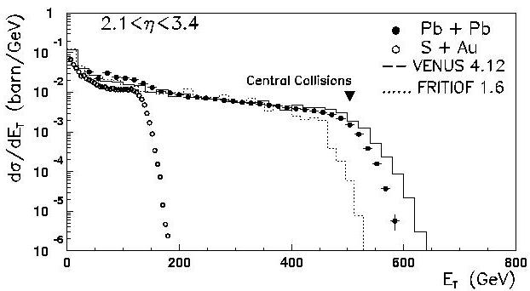

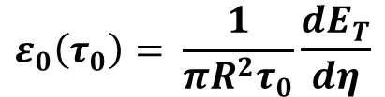
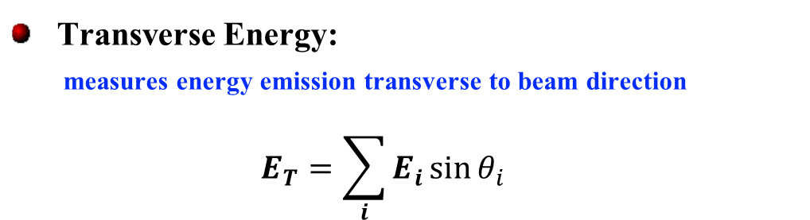
Primordial Energy Density
Transverse Energy:
measures energy emission transverse to beam direction
$$E_{T}=\sum_{i}{E_{i}\sin{θ_{i}}}$$
NA49: Phys. Rev. Lett. 75 (1995) 3814
NA49
“Bjorken estimate”
relates E_{T} to energy density:
$$ε_{0}\left(τ_{0}\right)= \frac{1}{πR^{2}τ_{0}}\frac{dE_{T}}{dη}$$
520 GeV
Initial energy density (formation time t₀=1 fm):
SPS Pb-Pb ε _{initial} ~ 3.2 GeV/fm³
AGS Au-Au ε _{initial} ~ 1.4 GeV/fm³
~ 60% of maximum available E_{T}
$ε_{0}$above critical energy density

Slide 12
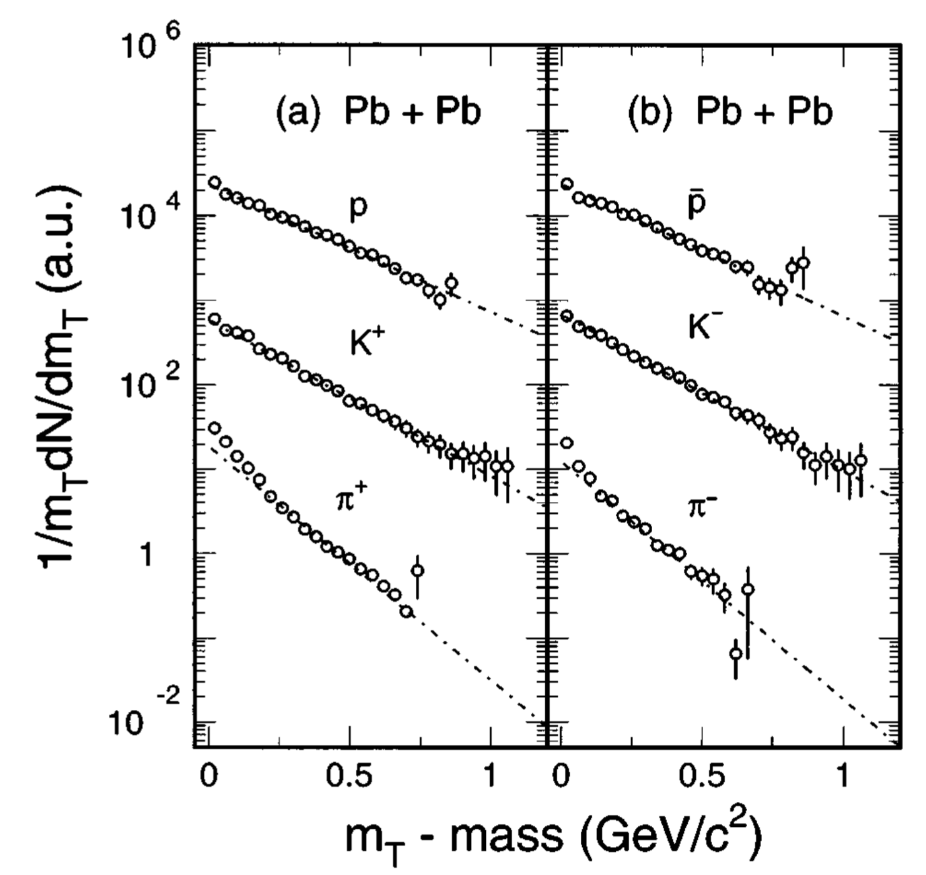



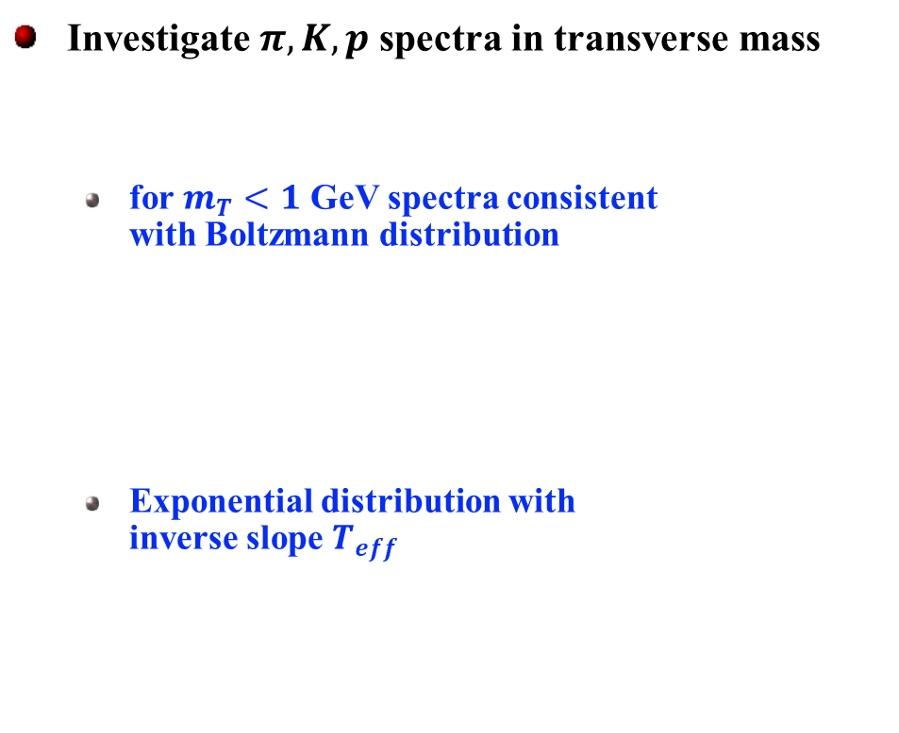
Exponential Transverse Momentum Spectra
large amount of data available
NA44 central collisions
Investigate $π, K, p$spectra in transverse mass
  for $m_{T}<1$ GeV spectra consistent with Boltzmann distribution
  Exponential distribution with inverse slope $T_{eff}$
NA44: Phys. Rev. Lett. 78 (1997) 2080
$$m_{T}= \sqrt{m^{2}+{p_{T}}^{2}}$$
289(7) MeV
278(9) MeV
$$\frac{d^{2}N}{dm_{T}^{2}} ∝ m_{T}e^{−\frac{m_{T}}{T_{eff}}}$$
234(6) MeV
235(7) MeV
156(6) MeV
154(8) MeV
$T_{eff}$increases with particle mass

Slide 13
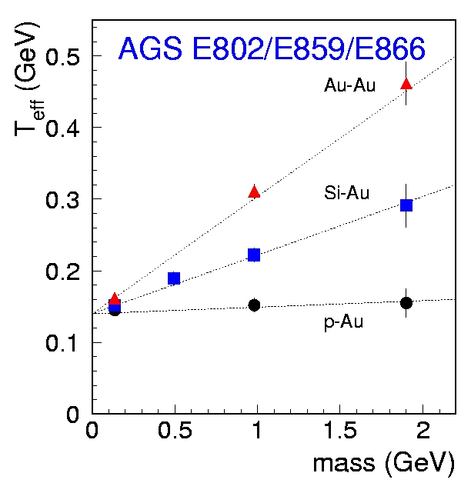
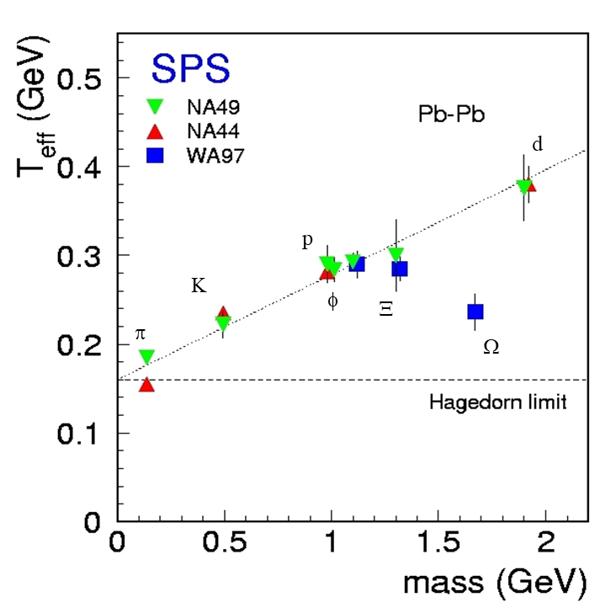
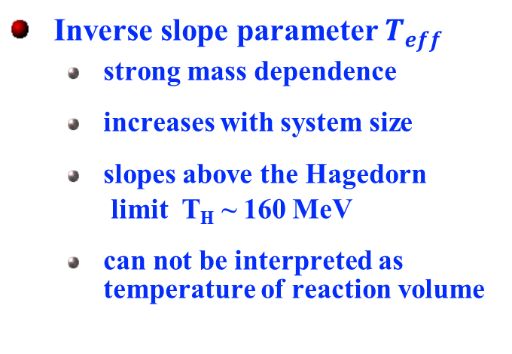

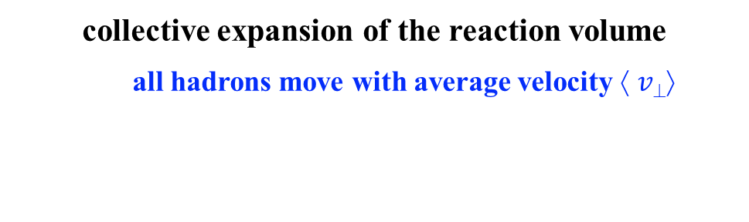
Collective Transverse Expansion
Inverse slope parameter $T_{eff}$
  strong mass dependence
  increases with system size
  slopes above the Hagedorn
  limit T_{H} ~ 160 MeV
  can not be interpreted as temperature of reaction volume
d
p
Κ
π
collective expansion of the reaction volume
  all hadrons move with average velocity $↑ v$
Hubble expansion of fireball
$$T_{eff}=T_{f}+ m \left\langle v⊥\right\rangle 2$$
Lee, Heinz, Schnedermann, Z.Phys.C 48 (1990) 525

Slide 14
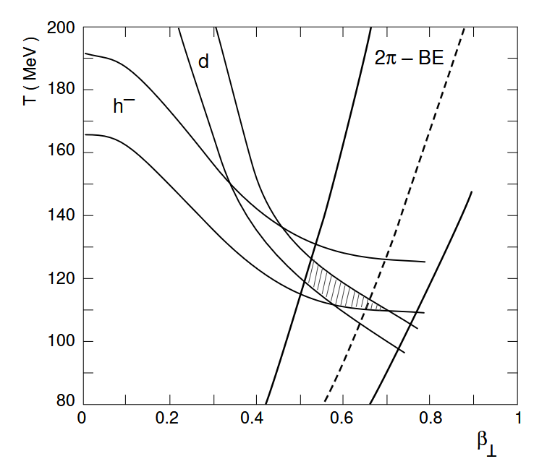
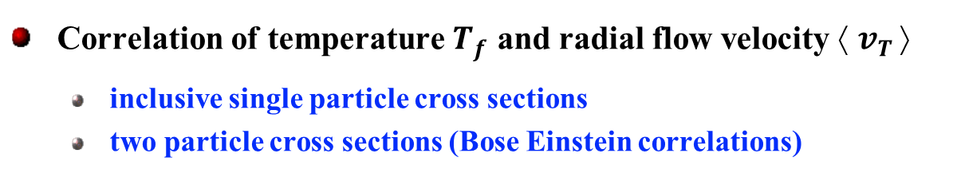
Thermal Freezeout of the Fireball
Heinz, Jacak: Annu.Rev.Nucl.Part.Sci. 49 (1999) 529
Correlation of temperature $T_{f}$ and radial flow velocity $↑ v_{T} $
  inclusive single particle cross sections
  two particle cross sections (Bose Einstein correlations)
NA49: EPJC 2 (1998) 661
SPS: T_{f} ~ 100 -120 MeV ⟨ v⊥ ⟩/c ~ 0.45-0.65
AGS: T_{f} ~ 90 -100 MeV ⟨ v⊥ ⟩/c ~ 0.3-0.5
T_{f}
NA49 Pb-Pb
Explosive expansion
of fireball
“Little Big Bang”
⟨ v⊥ ⟩/c

Slide 15
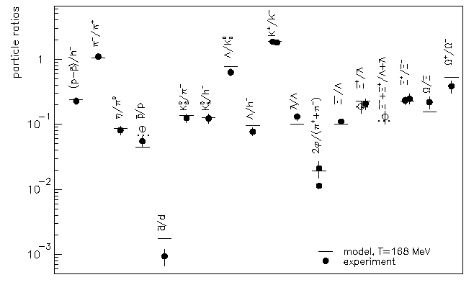
Chemical Equilibration at Hadronization
P. Braun-Munzinger et al. PLB (1999) 15
Thermal model for hadron production 2-3 parameters:
  temperature T
  baryon chemical potential μ_{b}
  strangeness equilibration γ_{s}
good description of hadron ratios in heavy ion collisions from SIS - AGS - SPS energies
  chemical freeze-out at
  SPS ~ 170-190 MeV AGS ~ 120-140 MeV
  strangeness equilibration or close to
  SPS γ_{s} ~ 1
  AGS γ_{s} < 1
Pb+Pb 158 AGeV
System born into chemical equilibrium
at hadronization

Slide 16
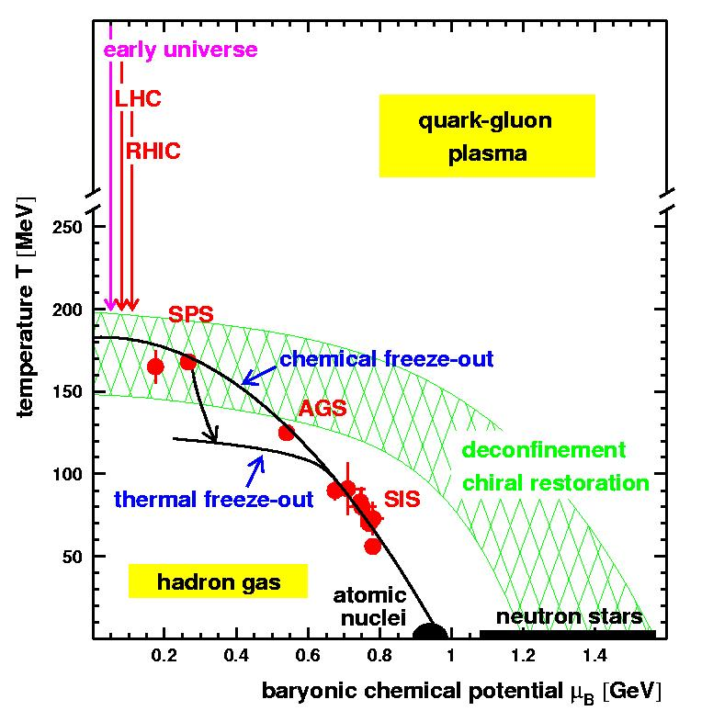
Space-Time Evolution of Hadronic System
R.Averbeck ‘2000
AGS SPS
hadronization and chemical freeze-out
close to at phase boundary
120-140 MeV 170-190 MeV
Fireball lifetime 8 - 10 fm
final flow velocity ~ 0.5 c
freezeout 90 - 100 MeV 100 - 120 MeV
LEP
Dense collectively expanding nuclear matter near thermal equilibrium

Slide 17
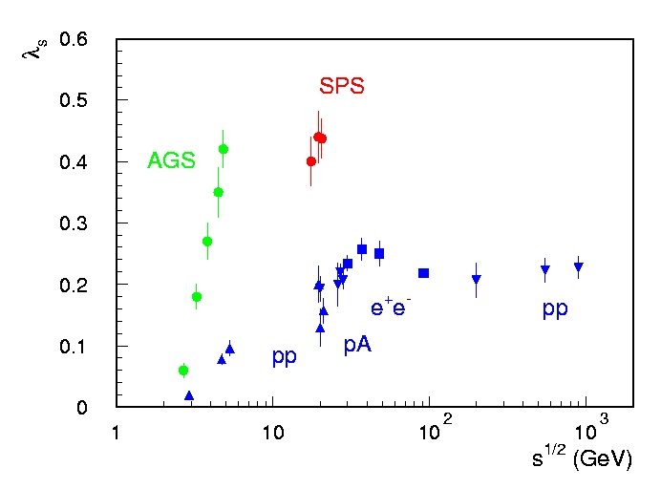
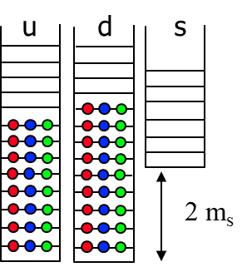

Strangeness Enhancement
Key Prediction: Strangness Euqilibration in QGP
J.Rafelski and B.Müller, Phys.Rev.Lett. 48 (1982) 1066
Wroblewski factor: $λ_{s}=\frac{2\left\langle s\overline{s}\right\rangle }{\left\langle u\overline{u}\right\rangle +\left\langle d\overline{d}\right\rangle }$
“shell model type picture” for partonic degrees of freedom
elementary p-p collision:
u,d quark levels empty
s quark levels large energy gap
⇒ strangeness production suppressed
nucleus-nucleus collisions (QGP):
u,d quark levels occupied
s quark levels large energy gap
⇒ strangeness production enhanced
equilibrium
Production enhanced
by factor ~2
SPS: strange particle production in chemical equilibrium

Slide 18
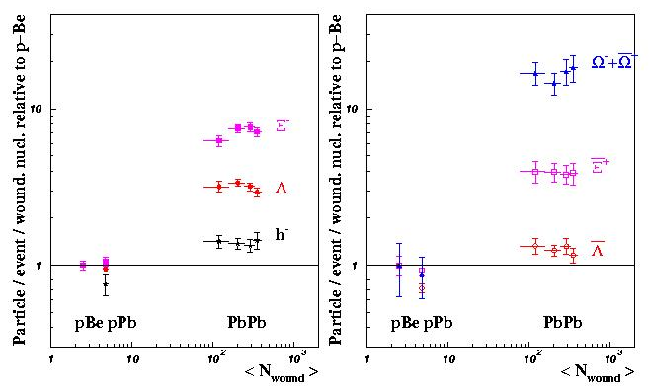
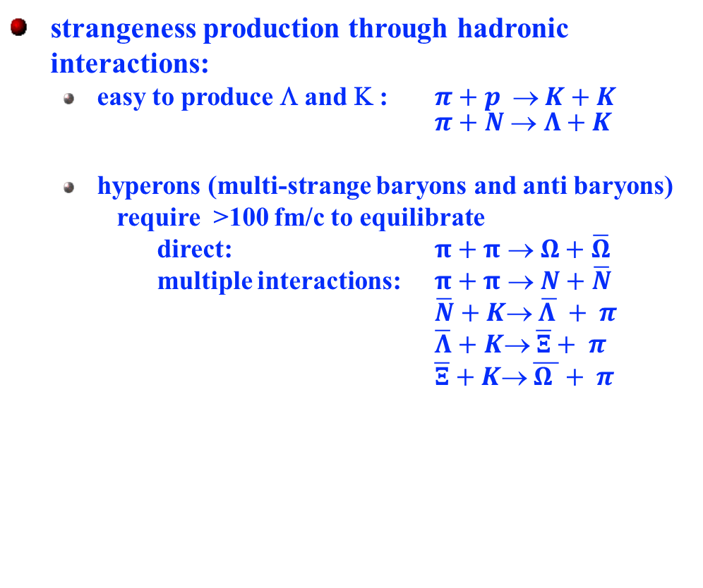
Strangeness Equilibration
Significant hyperon enhanced:
strangeness production through hadronic interactions:
  easy to produce Λ and Κ : $π+p  K+K$ $π+N  Λ+K$
  hyperons (multi-strange baryons and anti baryons)
  require >100 fm/c to equilibrate
  direct: $π+π → Ω+\overline{Ω}$
  multiple interactions: $π+π → N+\overline{N}$
  $\overline{N}+K→ \overline{Λ }+ π$
  $\overline{Λ}+K→ \overline{Ξ}+ π$
  $\overline{Ξ}+K→ \overline{Ω }+ π$
WA97: Phys.Lett B 433 (1998) 209
compared to p-Be:
WA97
Ω factor 20
Ξ factor 4
lifetime of hadronic system only ~ 10 fm/c
Hyperon enhancement set before hadronic phase

Slide 19
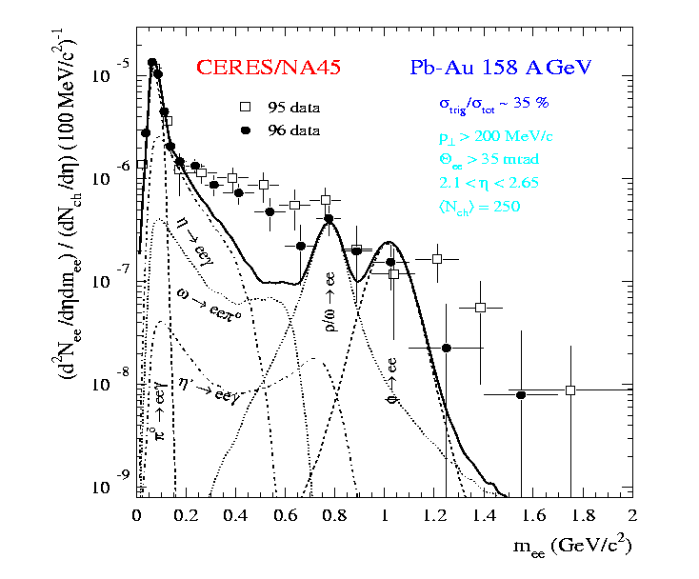
Thermal Radiation
Key Prediction: Direct Radiation
Shuryak Phys.Lett. 78B (1978)
thermal real or virtual photons (lepton pairs)
hadron gas:
photons low mass lepton pairs
QGP:
photons medium mass
CERES: e⁺e⁻ pairs at low mass (m < 1 GeV)
  low mass lepton pair excess
  threshold near 2m_{π}
  different spectral shape
  no ρ resonance structure
e⁻
e⁺
e⁻
CERES: Nucl.Phys. A661 (99) 23c
π
π
π
ρ∗
γ*
γ
ρ
γ
γ∗
π
e⁺
γ
g
q
q
e⁻
q
γ
‾q
e⁺
Thermal radiation from hadronic phase
requires modified ρ meson
dropping masses or melting resonances
meson decay contribution
after freeze-out

Slide 20
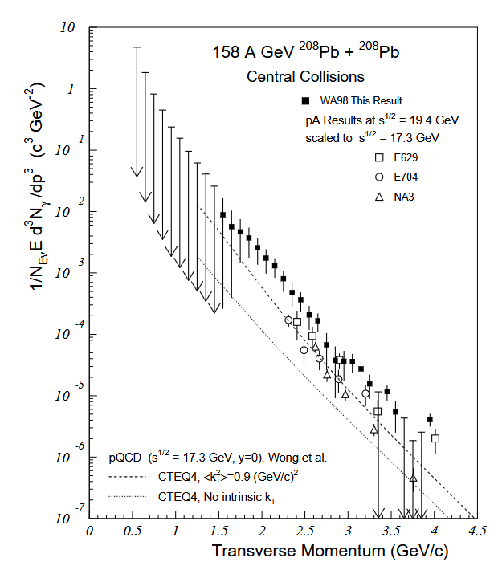
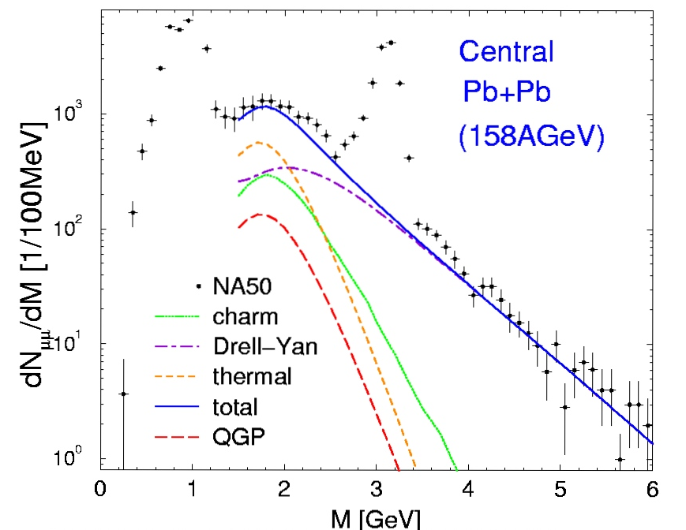
Thermal Radiation
NA50: μμ-pairs for 1 < m < 3 GeV
WA98: photon excess
WA98: Phys.Rev.Lett. 85 (2000) 3595
NA50 Nucl.Phys A661 (99) 538c
Rapp & Shuryak, Phys.Lett B473 (2000) 13
thermal radiation
(T_{i} ~220 MeV)
direct photon excess
over expected sources
Data consistent with thermal radiation
from quark matter near phase transition

Slide 21
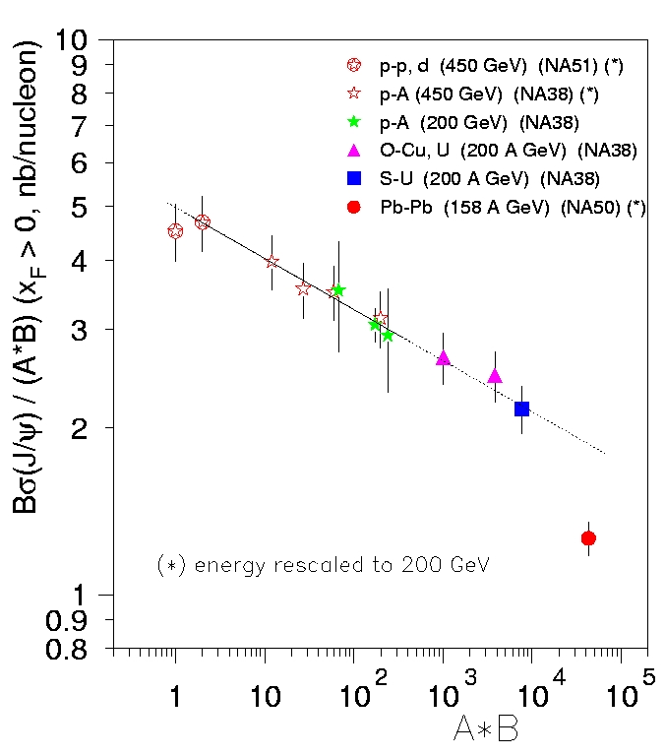
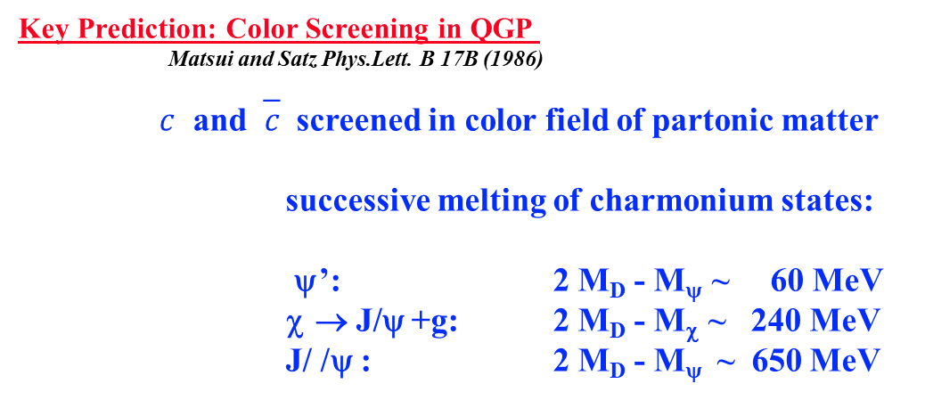
Color Screening of Charmonium
Key Prediction: Color Screening in QGP
Matsui and Satz Phys.Lett. B 17B (1986)
$c$ and‾$c$ screened in color field of partonic matter
successive melting of charmonium states:
ψ’: 2 M_{D} - M_{ψ} ~ 60 MeV
χ → J/ψ +g: 2 M_{D} - M_{χ} ~ 240 MeV
J/ /ψ : 2 M_{D} - M_{ψ} ~ 650 MeV
NA50: J/ψ → μ⁺μ⁻ production
  p-A, O-A, and S-A: “nuclear” absorption
  Pb-Pb: anomalous J/ψ suppression
Anomalous suppression of J/ψ

Slide 22
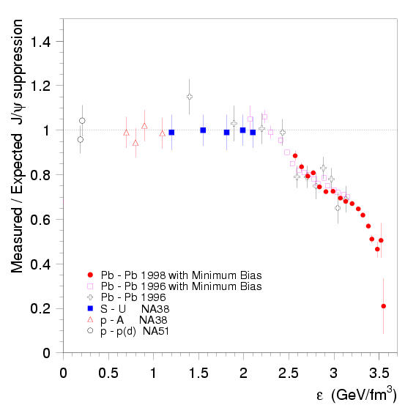
Sequential Melting of Charmonium States
< 2.4 GeV/fm³
  absorption of ‾cc pre-resonance state in hadronic matter
at ~ 2.4 GeV/fm³
  pre χ states dissolved in partonic phase
above ~ 3.2 GeV/fm³
  energy density of partonic phase sufficient to dissolve pre J/ψ states
Data consistent with
consecutive melting of
charmonium in QGP

Slide 23

A New State of Matter: Quark Matter
AGS: dense collectively expanding nuclear matter
  Sensitivity to EOS: collective flow
  Approach chemical equilibration of strangeness
SPS: compelling evidence for deconfined Quark Matter
  Initial energy density well above transition
  Collective expansion in chemical equilibrium
  Strange baryon enhancement
  Thermal radiation
  Charmonium suppression consistent with deconfinement
SPS
QGP
RHIC
LHC
energy density $ε/T4$
AGS
hadron gas
T_{C} ~ 170 MeV
temperature
AGS √s_{NN} = 5 GeV
SPS √s_{NN} = 17 GeV
T_{i} ~ 170 MeV
ε_{i} ~ 1.4 GeV/fm³
τ ~ 8 fm
dN_{ch}/dy ~ 250
T_{i} ~ 220 MeV
ε_{i} ~ 3.2 GeV/fm³
τ ~ 10 fm
dN_{ch}/dy ~ 450

Slide 24
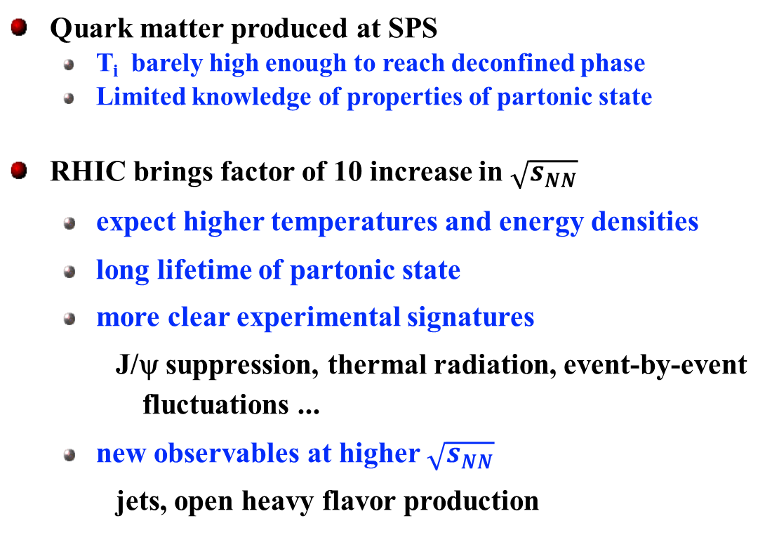
Expectations at the Start of the RHIC Program
Quark matter produced at SPS
  T_{i} barely high enough to reach deconfined phase
  Limited knowledge of properties of partonic state
RHIC brings factor of 10 increase in $\sqrt{s_{NN}}$
  expect higher temperatures and energy densities
  long lifetime of partonic state
  more clear experimental signatures
    J/ψ suppression, thermal radiation, event-by-event fluctuations ...
  new observables at higher $\sqrt{s_{NN}}$
    jets, open heavy flavor production
QGP
SPS
RHIC
LHC
energy density $ε/T4$
AGS
hadron gas
T_{C} ~ 170 MeV
temperature
RHIC √s_{NN} = 200 GeV
T_{i} ~ 250 - 500 MeV
ε_{i} ~ 5 - 50 GeV/fm³
τ ~ 10 - 30 fm
dN_{ch}/dy ~ 500 - 1500

Slide 25
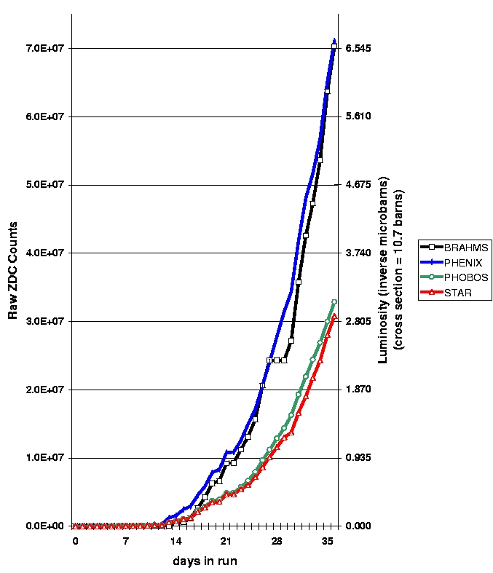
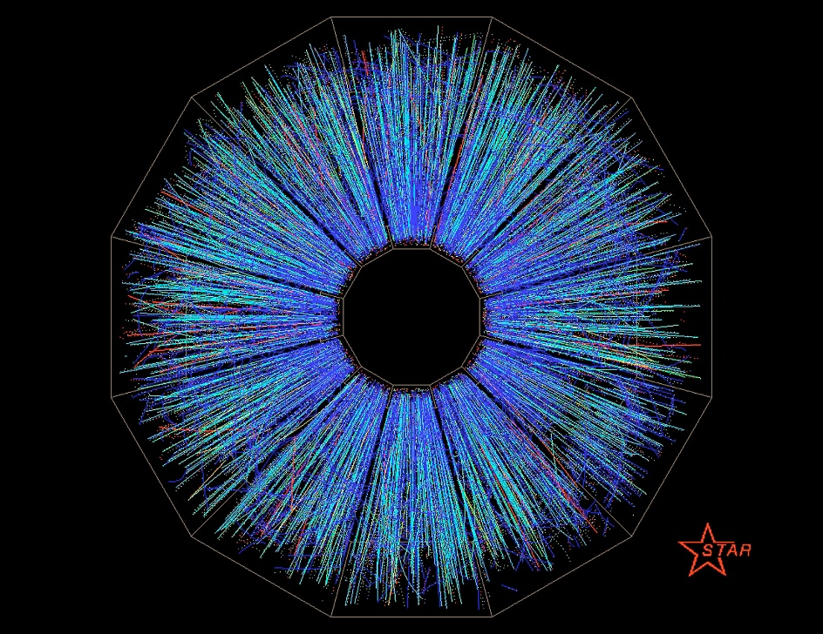
First Physics Run at RHIC 2000 with Au-Au at √s_{nn} = 130 GeV
7.0
6.0
5.0
4.0
3.0
2.0
1.0
first Au-Au collisions at STAR June 12
PHENIX
BRAHMS
PHOBOS
STAR
Integrate Luminosity (mb⁻¹)
( cross section = 10.7 b)
First RHIC data
1-10x10⁶ recorded events/experiment
July
August
September

Slide 26
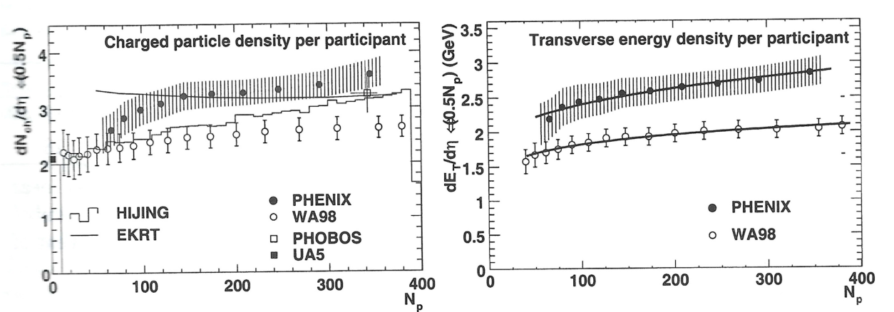
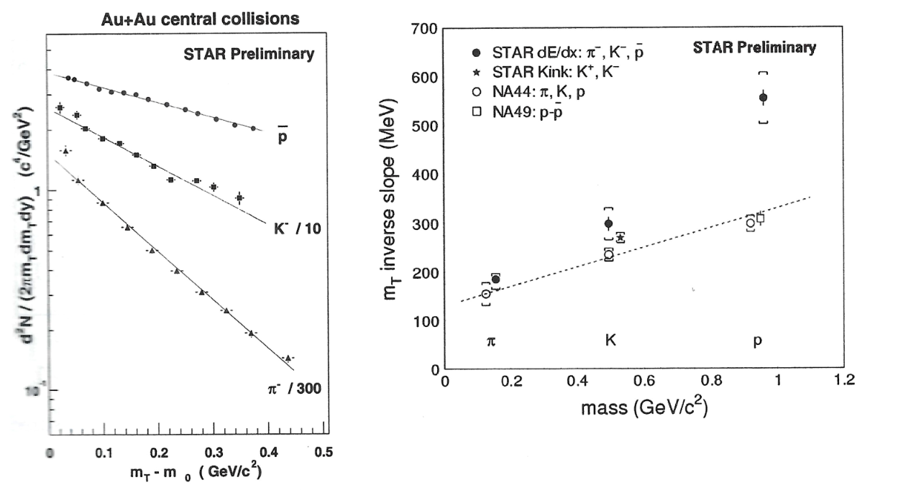
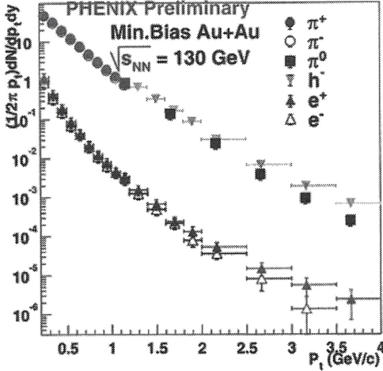
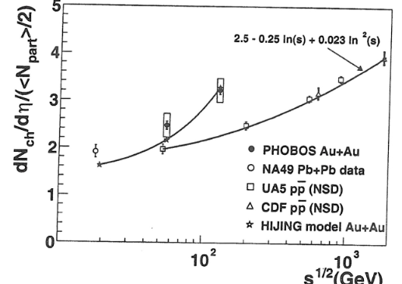
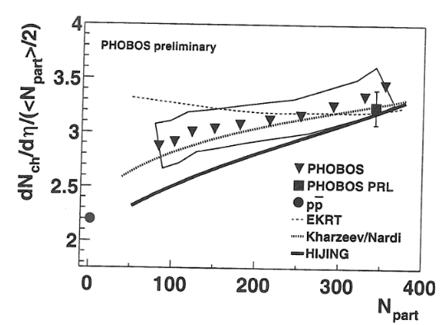
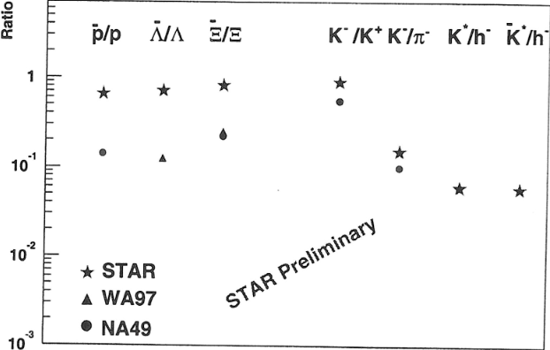
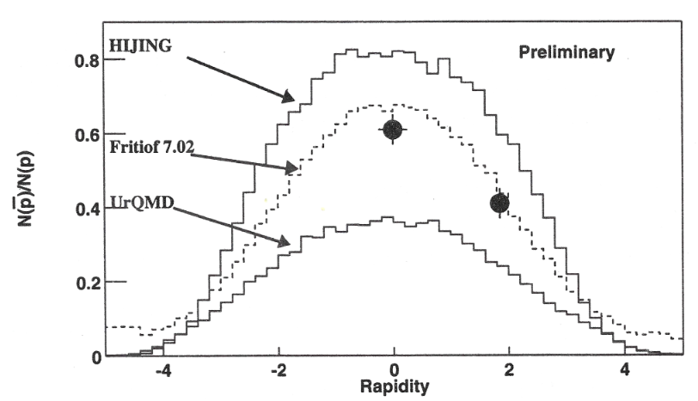
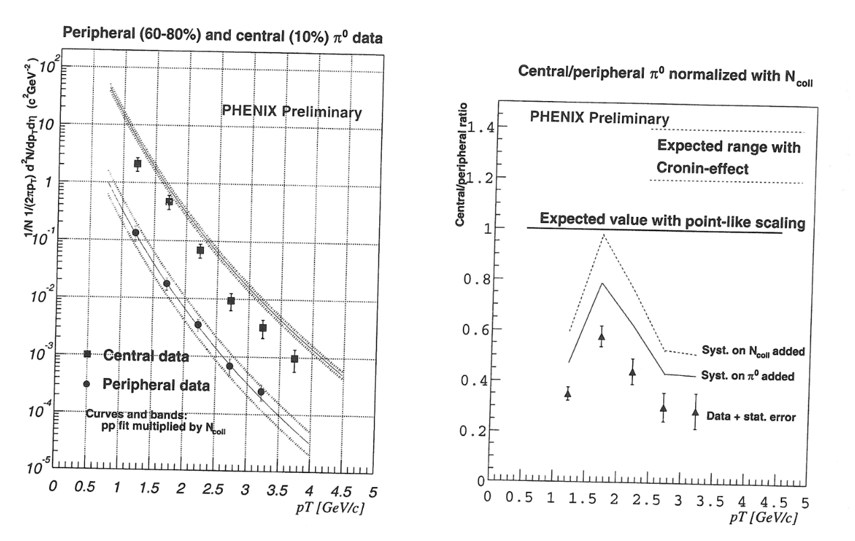




A Grand Firework of New Results at QM 2001
4 Months after first data:
Observables measured at SPS:
  Energy density 4.6 GeV/fm³
  Multiplicity > 550
  Baryon stopping $\frac{\overline{p}}{p}$ = 0.6
  π, $K$, p spectra
  Large radial and elliptic flow
  HBT correlations
  Hyperon enhancement
  ….
Qualitative new observables:
  High $pT$ hadron suppression
  Heavy flavor electrons
BRAHMS,PHENIX,PHOBOS,STAR:
QM2001 proceedings
Conference Highlight
First hints for Jet Quenching
H.J. Specht QM2001 summary talk: I congratulate all of you, management, the machine crew and the large number of enthusiastic young researchers who have made this miracle possible.

Slide 27
Final Remark
The AGS and SPS programs laid the scientific foundation for RHIC.
They established a vibrant international collaborations including university groups and national laboratories.
Most importantly, they trained a generation of scientists that went on to build and lead the RHIC program.
RHIC would not have succeeded without this young enthusiastic workforce.

