Slide 1
Completing PHENIX Scientific mission
Y. Akiba
RHIC symposium
May 15, 2026

Slide 2
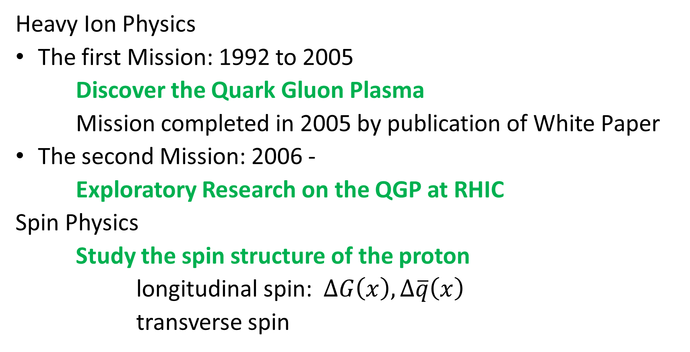
What are the Scientific Misson of PHENIX
Heavy Ion Physics
The first Mission: 1992 to 2005
Discover the Quark Gluon Plasma
Mission completed in 2005 by publication of White Paper
The second Mission: 2006 -
Exploratory Research on the QGP at RHIC
Spin Physics
Study the spin structure of the proton
longitudinal spin: $ΔG\left(x\right), Δ\overline{q}\left(x\right)$
transverse spin

Slide 3
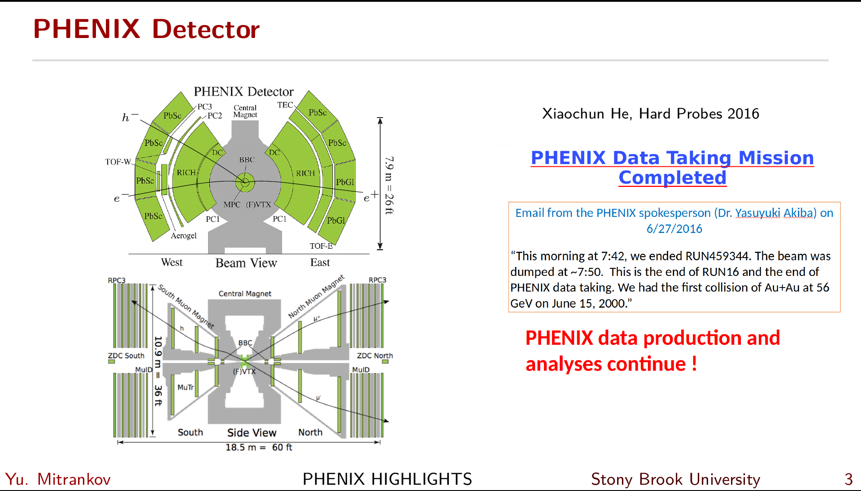
From Yuri Mitrankov's talk in AUM Wednesday

Slide 4
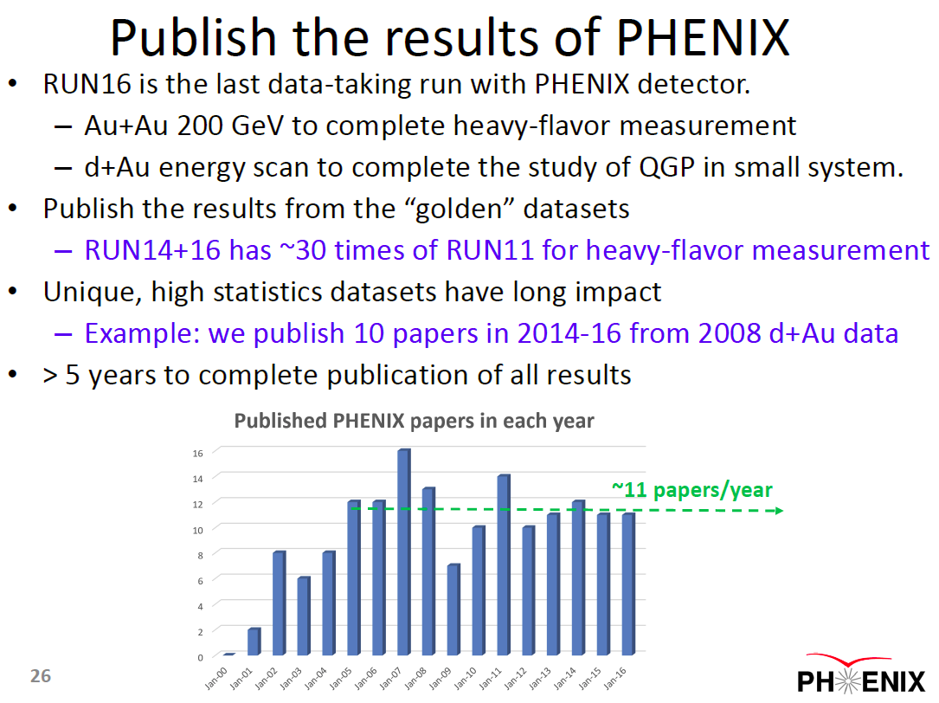
From my talk in RHIC S&T review on 2016/08/23
The main purpose of an experiment is to publish physics papers
The completion of data taking is NOT end of experiment.
After completion of data taking, its focus is to publish papers.

Slide 5
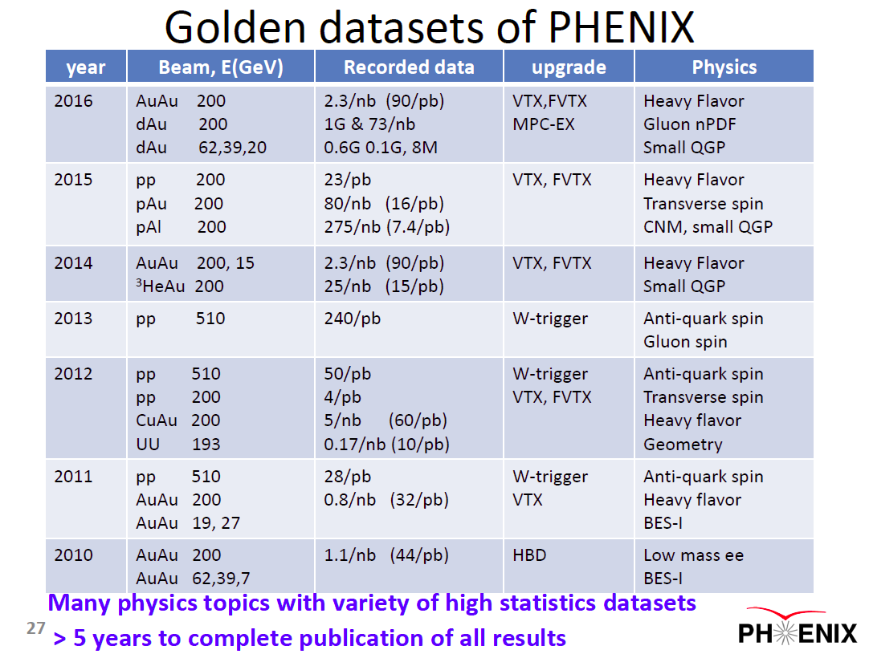
From my talk in RHIC S&T review on 2016/08/23
After completing data collection in 2016, PHENIX’s mission was to analyze its unique dataset and publish the results.
We anticipated that it would take more than 5 years

Slide 6
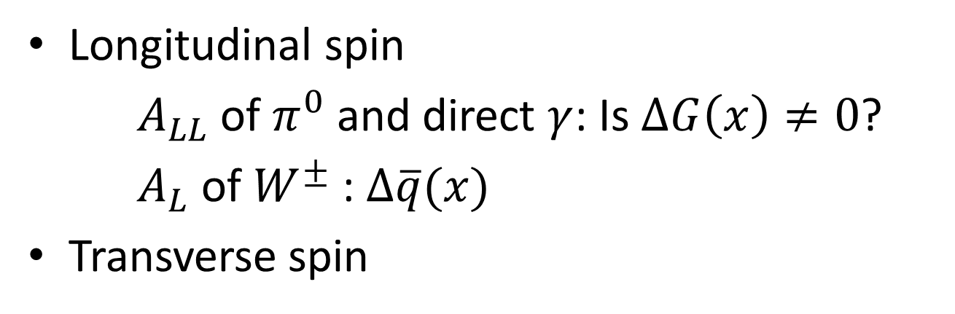
Completing Spin Physics Mission
Longitudinal spin
$A_{LL}$ of $π^{0}$ and direct $γ$: Is $ΔG\left(x\right)≠0$?
$A_{L}$ of $W^{±}$ : $Δ\overline{q}(x)$
Transverse spin

Slide 7
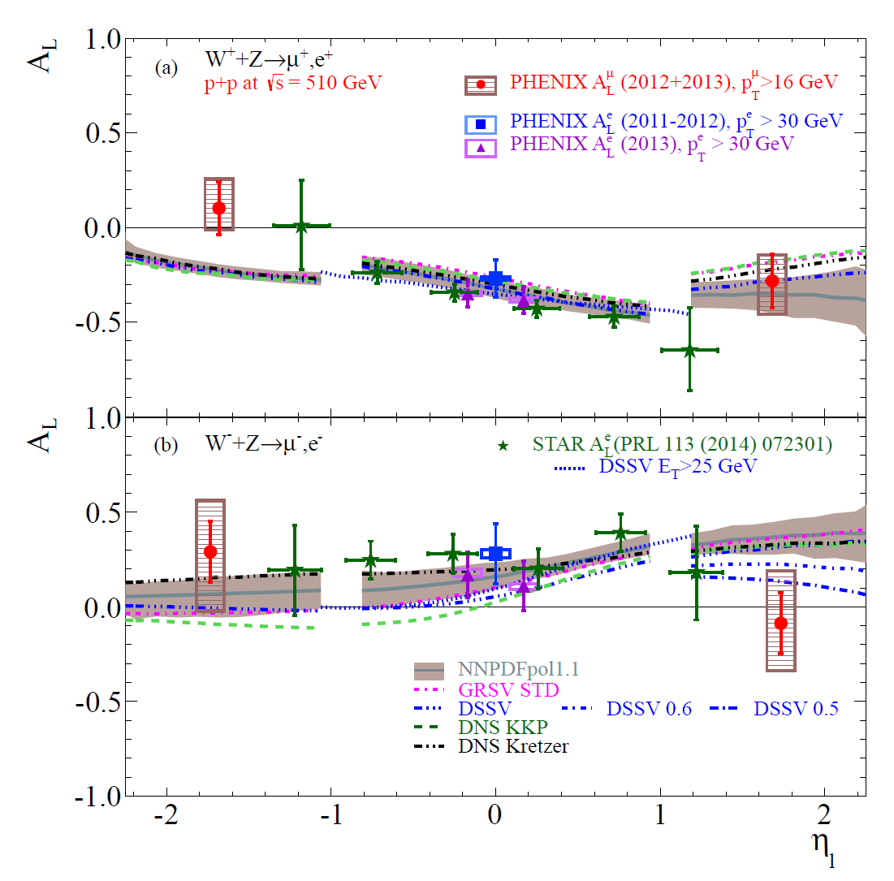
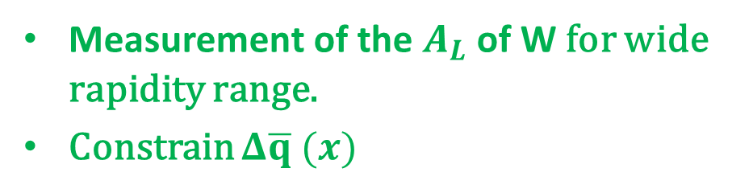
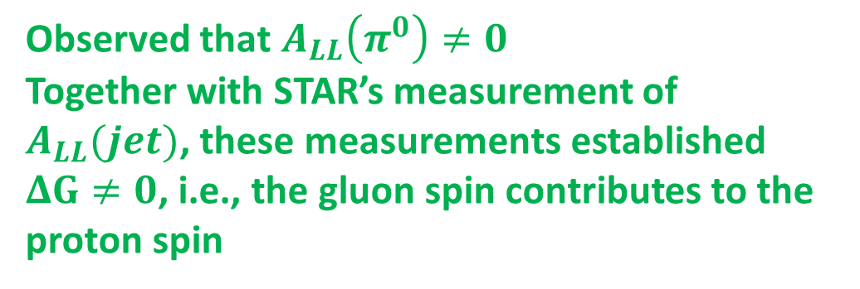
$ΔG≠0$ from $π^{0} A_{LL}$ and $Δ\overline{q}$ from $W→e,μ$
PRD93 051103 (2016)
PRD93 011501 (2016)
PRD98 032007 (2018)
Observed that $A_{LL}\left(π^{0}\right)≠0$
Together with STAR’s measurement of $A_{LL}(jet)$, these measurements established $ΔG≠0$, i.e., the gluon spin contributes to the proton spin
Measurement of the $A_{L}$ of W for wide rapidity range.
Constrain $Δ\overline{q} (x)$

Slide 8
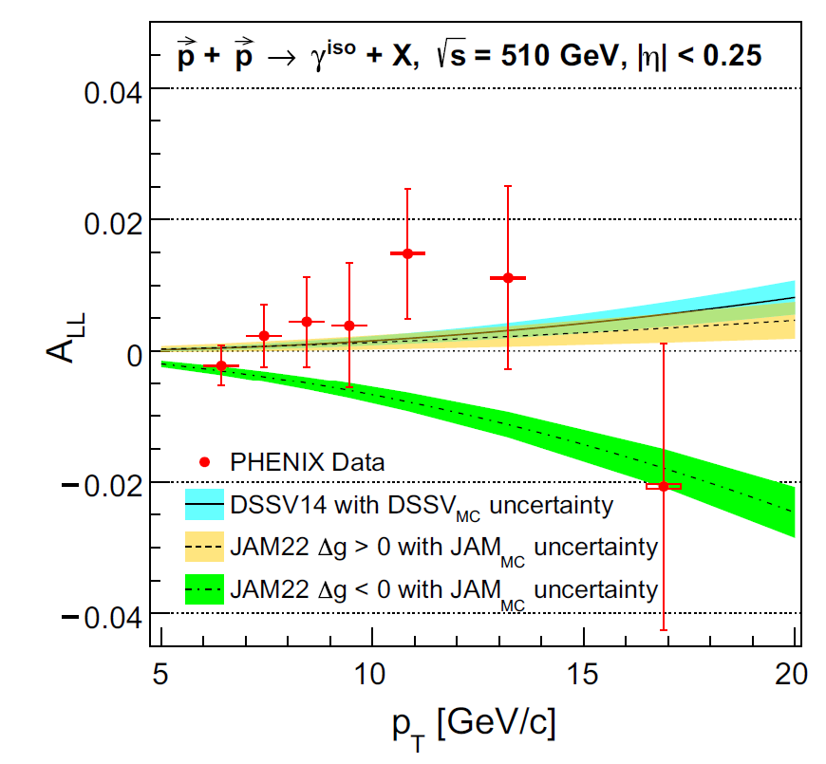
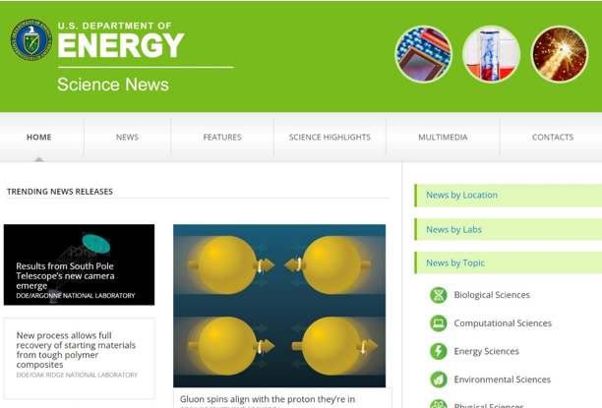

Direct photon $A_{LL}$
The results showed that the spin of gluons aligned in the same direction of the proton spin
This measurement is one of main goals of RHIC spin program

Slide 9
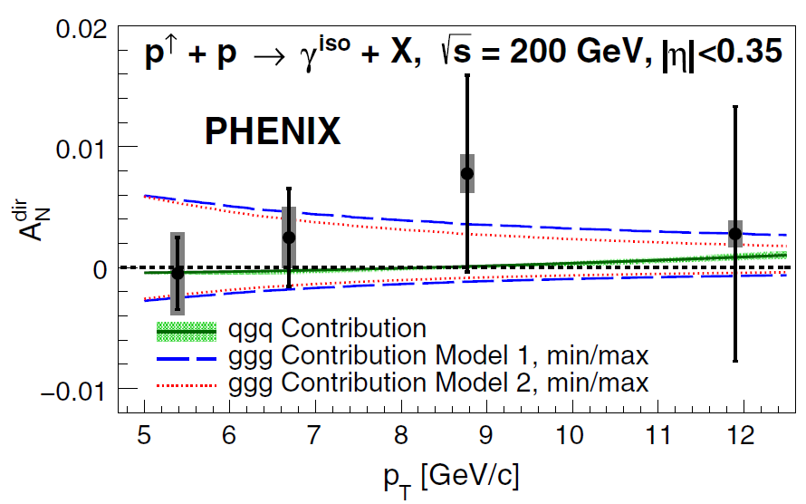
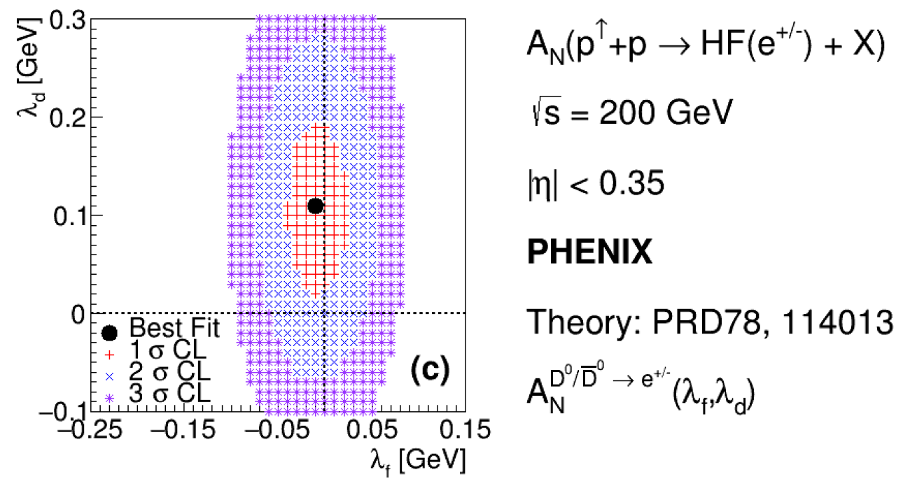

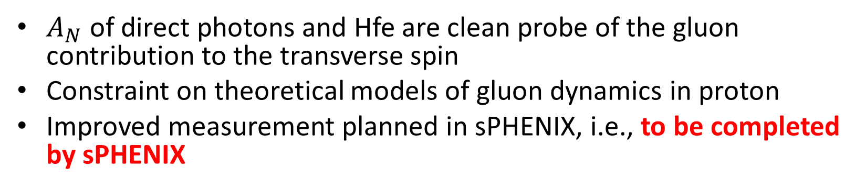
$A_{N}$ of direct photons and heavy flavor electrons
PRL127, 162001 (2021)
PRD107,052012 (2023)
$A_{N}$ of direct photons and Hfe are clean probe of the gluon contribution to the transverse spin
Constraint on theoretical models of gluon dynamics in proton
Improved measurement planned in sPHENIX, i.e., to be completed by sPHENIX
9

Slide 10
Completing Heavy Ion Physics Mission

Slide 11
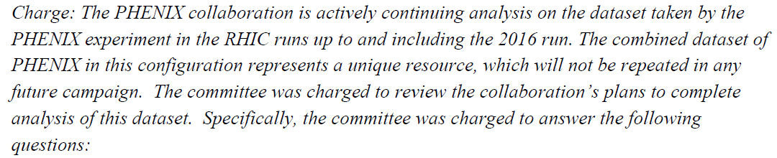
2019 PHENIX analysis review (internal)
Q3,Q4,Q5 are about workforce and resource to carry out
Q6 is about plan of Analysis and Data Preservation

Slide 12
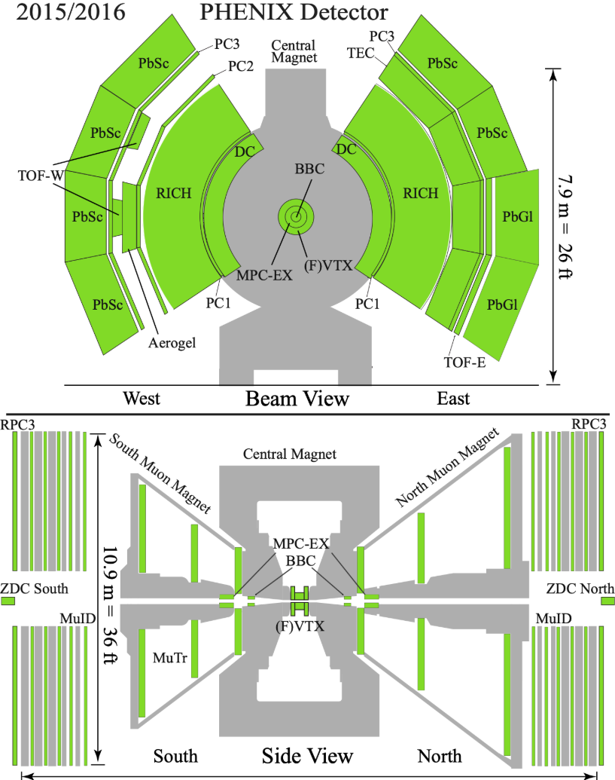
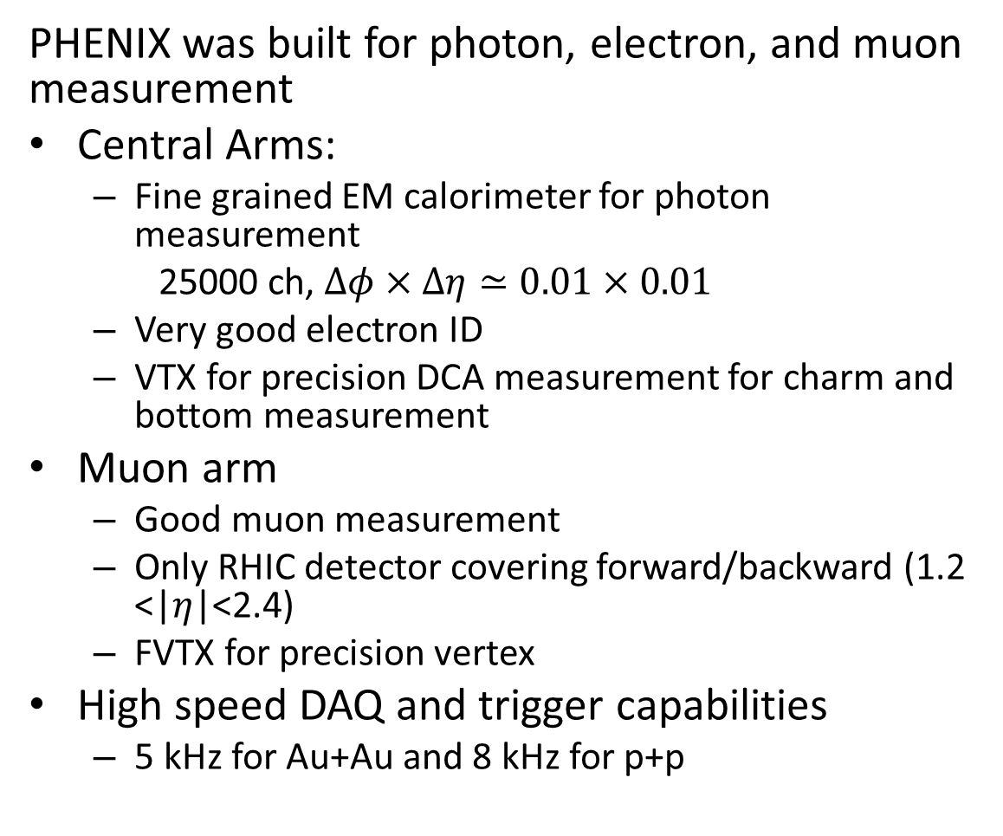
PHENIX’s unique capabilities
PHENIX was built for photon, electron, and muon measurement
Central Arms:
  Fine grained EM calorimeter for photon measurement
  25000 ch, $Δφ×Δη≃0.01×0.01$
  Very good electron ID
  VTX for precision DCA measurement for charm and bottom measurement
Muon arm
  Good muon measurement
  Only RHIC detector covering forward/backward (1.2 <|$η$|<2.4)
  FVTX for precision vertex
High speed DAQ and trigger capabilities
  5 kHz for Au+Au and 8 kHz for p+p

Slide 13
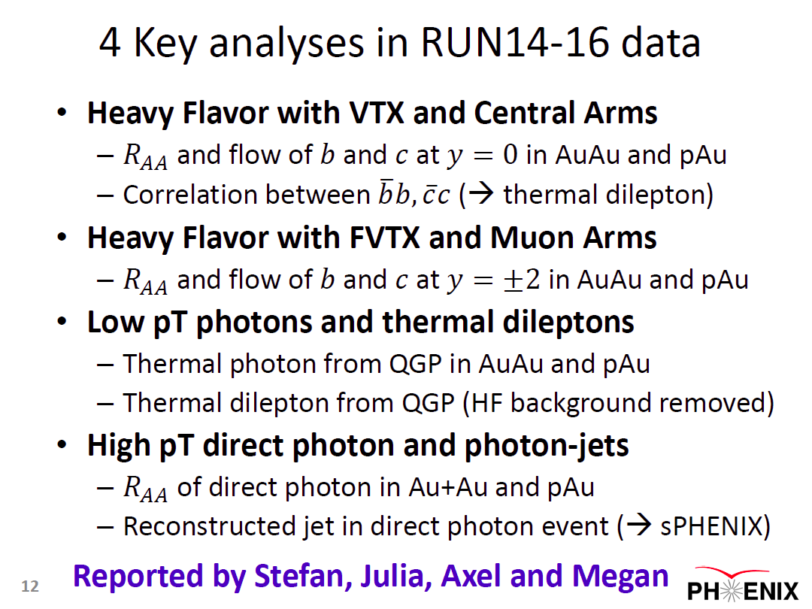
2019 PHENIX Analysis Review
From my overview talk of PHENIX analysis review on 2019/12/12
PHENIX presented 4 key analyses in the review, (and asked for the resource to carry out these analysis)
The review panel endorsed first 3 key analysis topics

Slide 14
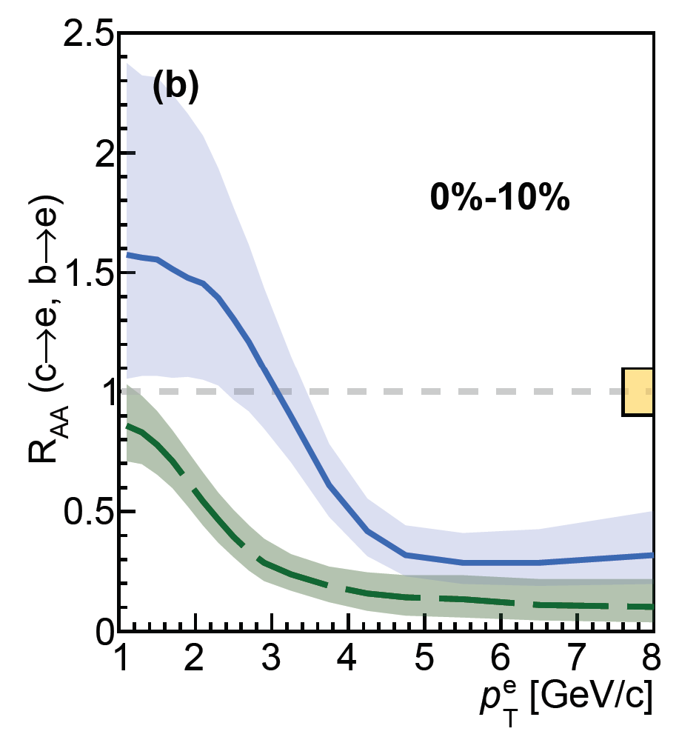
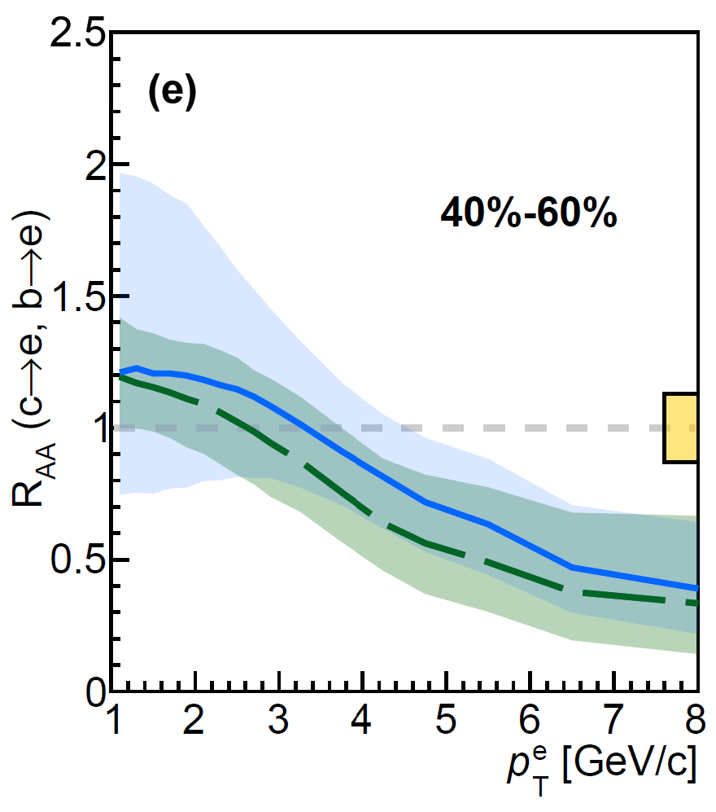
Heavy flavor measurement with VTX Si tracker
PRC109,044907(2024)
Using Si-vertex tracker VTX (2011-2016), b->e and c->e are separated
Mass dependence of heavy quark energy loss is observed

Slide 15
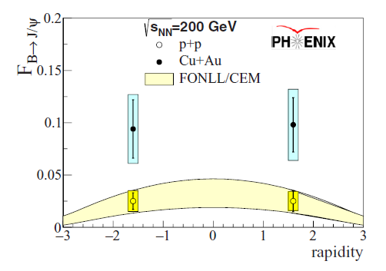
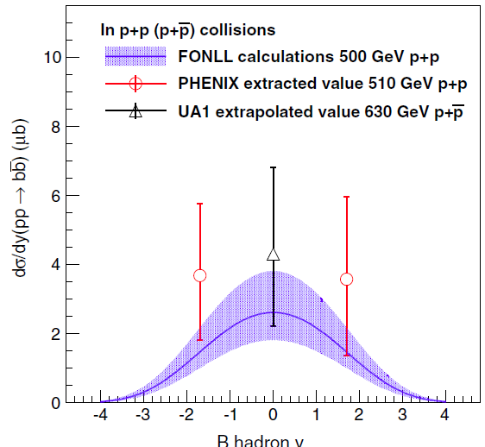
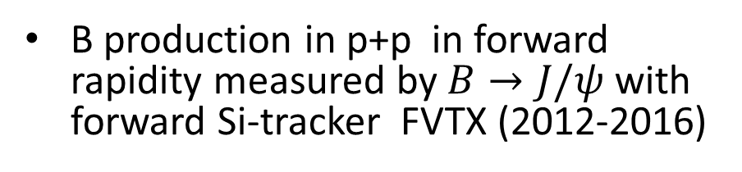

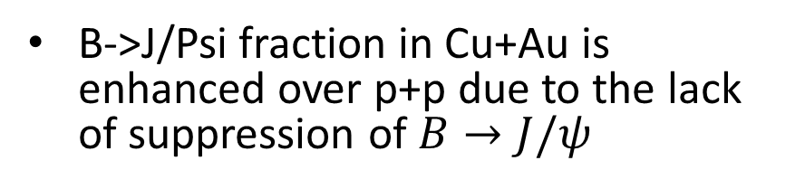
FVTX results ($B→J/ψ$)
PRD95,092002(2017)
PRC96,064901(2017)
B->J/Psi fraction in Cu+Au is enhanced over p+p due to the lack of suppression of $B→J/ψ$
B production in p+p in forward rapidity measured by $B→J/ψ$ with forward Si-tracker FVTX (2012-2016)

Slide 16
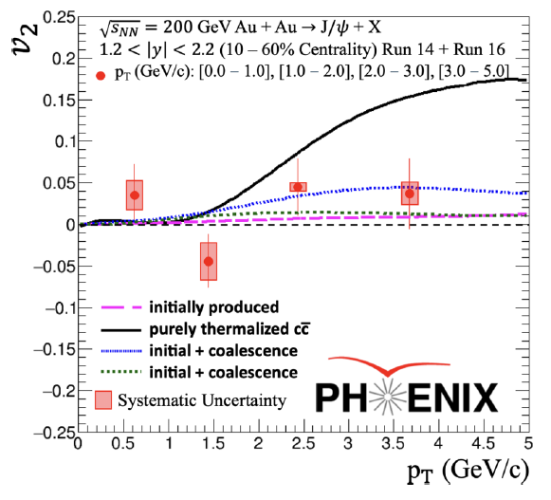
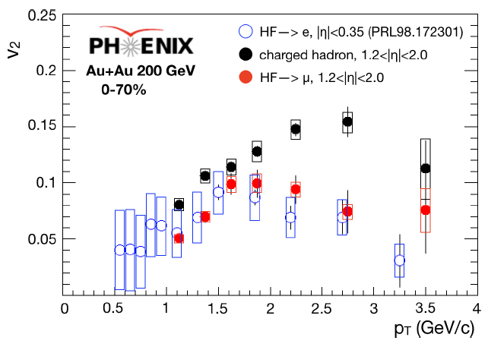
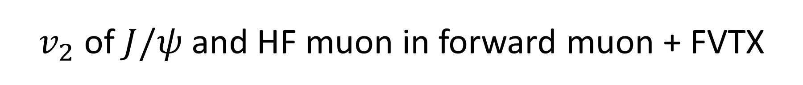
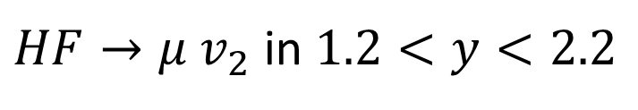
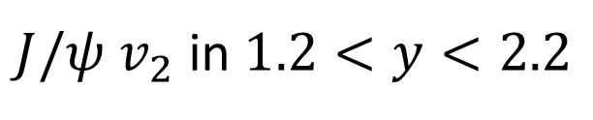
$v_{2}$ of $J/ψ$ and HF muon in forward muon + FVTX
PRC112,014904 (2025)
PRC112,034902 (2025)
$J/ψ$ $v_{2}$ in $1.2<y<2.2$
$HF→μ$ $v_{2}$ in $1.2<y<2.2$

Slide 17
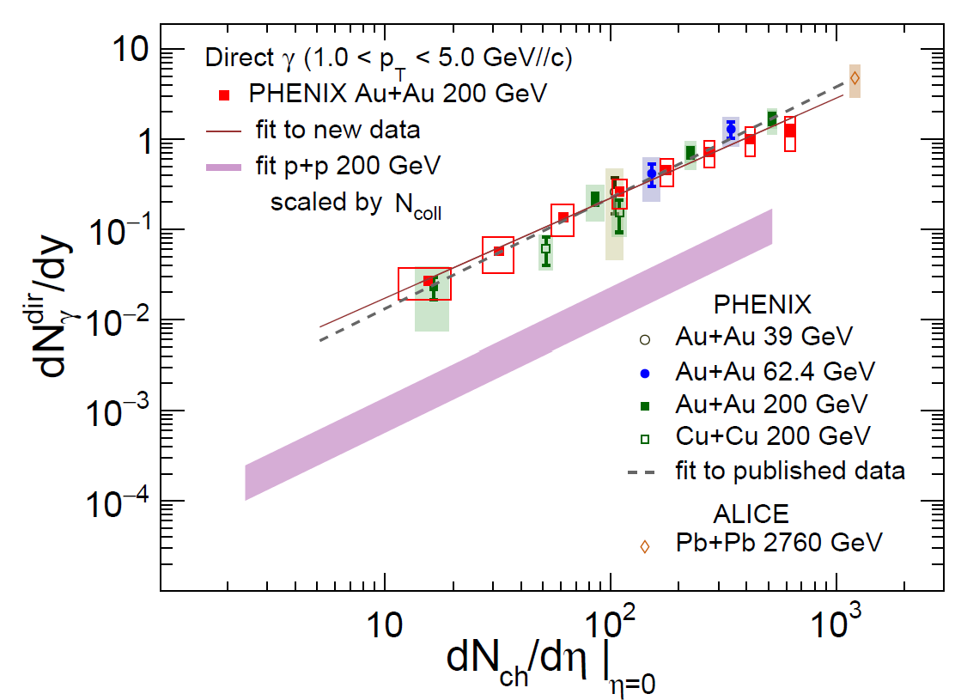
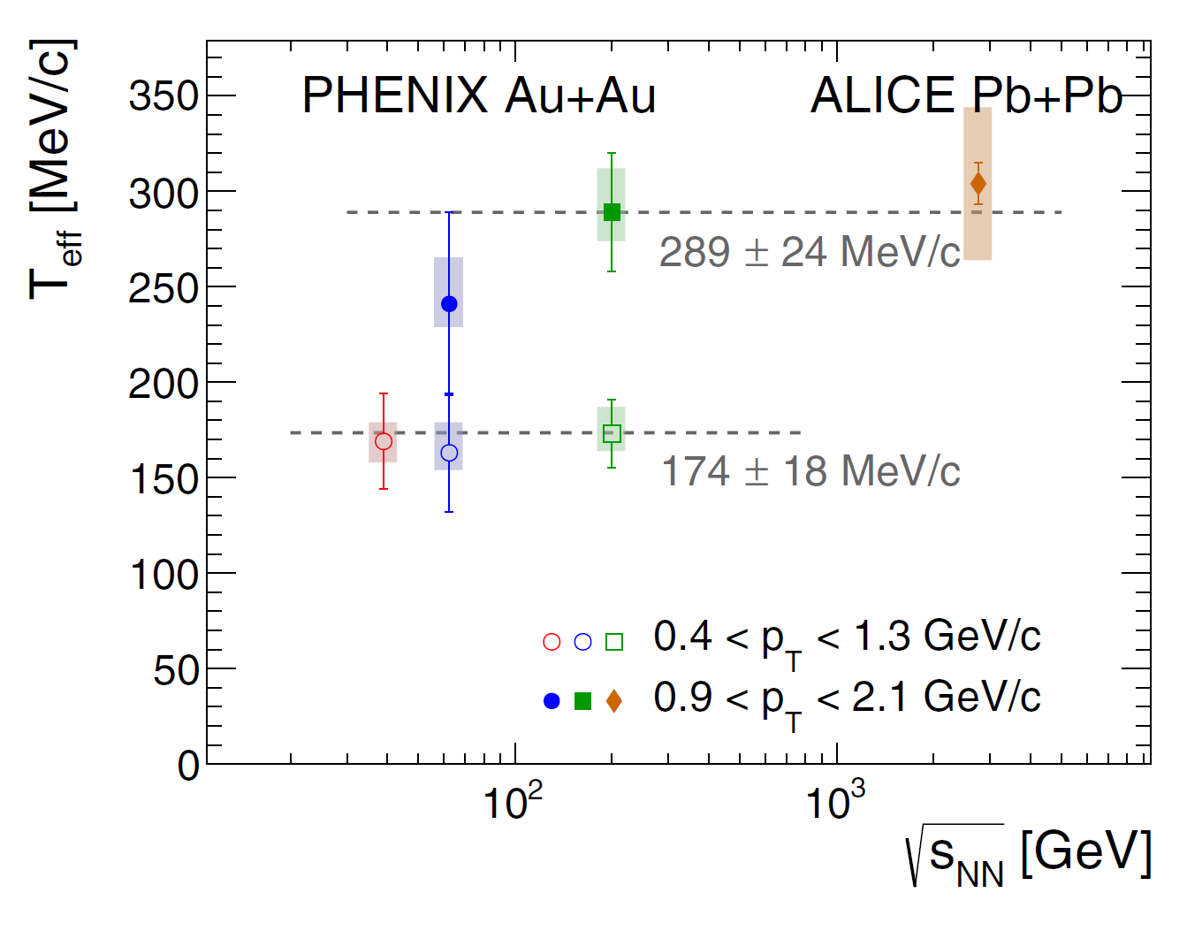

Low $p_{T}$ direct photons
(（260 cites) establish low pT direct photon measurement by photon conversion
PRCC91,064904 (2015)
PRC109,044912 (2024)
60 cites
PRC107,024914 (2023)
31 cites
Systematic measurement of direct photons in various systems in wide pT range:

Slide 18
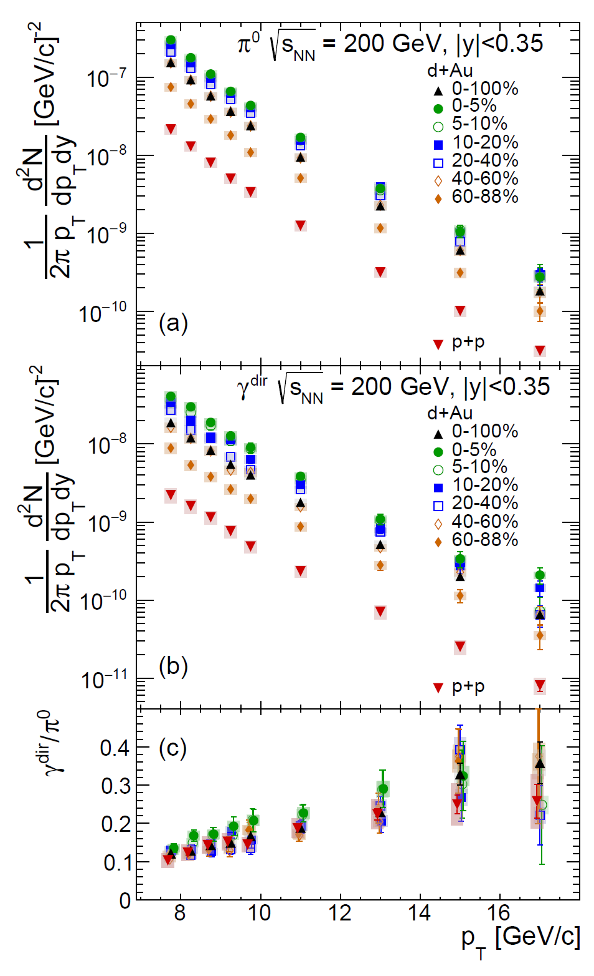
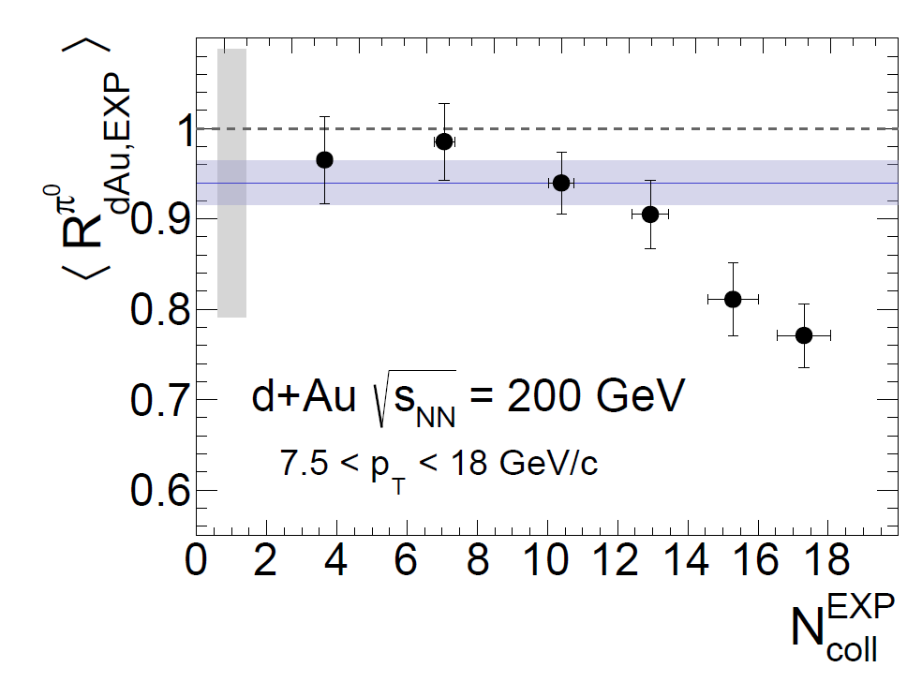

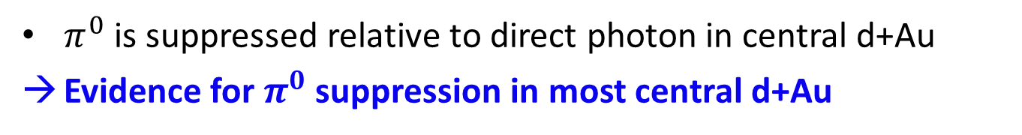
High $p_{T}$ direct $γ$: $π^{0}$suppression in d+Au
PRL134,022302(2025)
$π^{0}$ is suppressed relative to direct photon in central d+Au
Evidence for $π^{0}$ suppression in most central d+Au

Slide 19
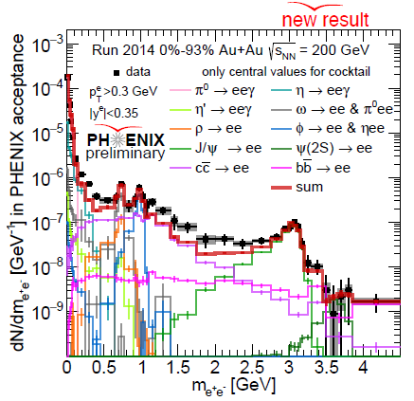
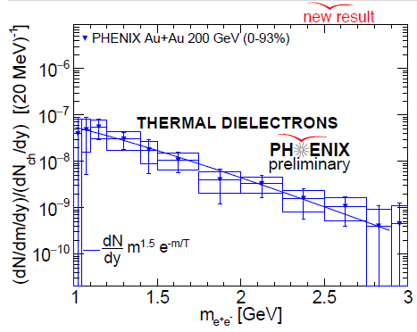
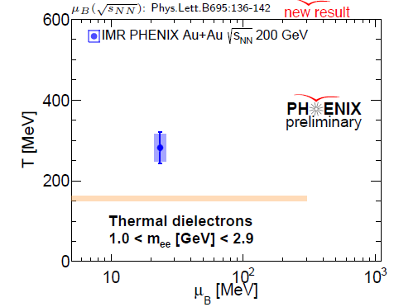
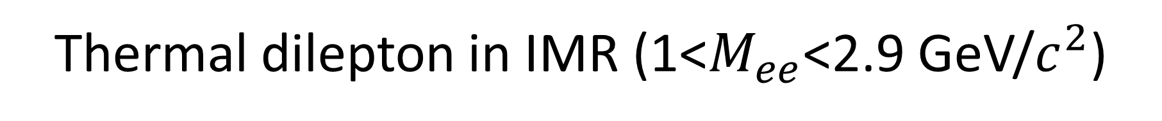
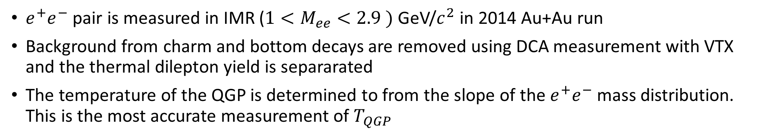
Thermal dilepton in IMR (1<$M_{ee}$<2.9 GeV/$c^{2}$)
$e^{+}e^{−}$ pair is measured in IMR ($1<M_{ee}<2.9 )$GeV/$c^{2}$ in 2014 Au+Au run
Background from charm and bottom decays are removed using DCA measurement with VTX and the thermal dilepton yield is separarated
The temperature of the QGP is determined to from the slope of the $e^{+}e^{−}$ mass distribution. This is the most accurate measurement of $T_{QGP}$

Slide 20
2019 PHENIX Analysis Review
From my overview talk of PHENIX analysis review on 2019/12/12
PHENIX presented 4 key analyses in the review
The review panel endorsed the first 3 key analysis topics
PHENIX is about to complete these 3 key analysis topics

Slide 21
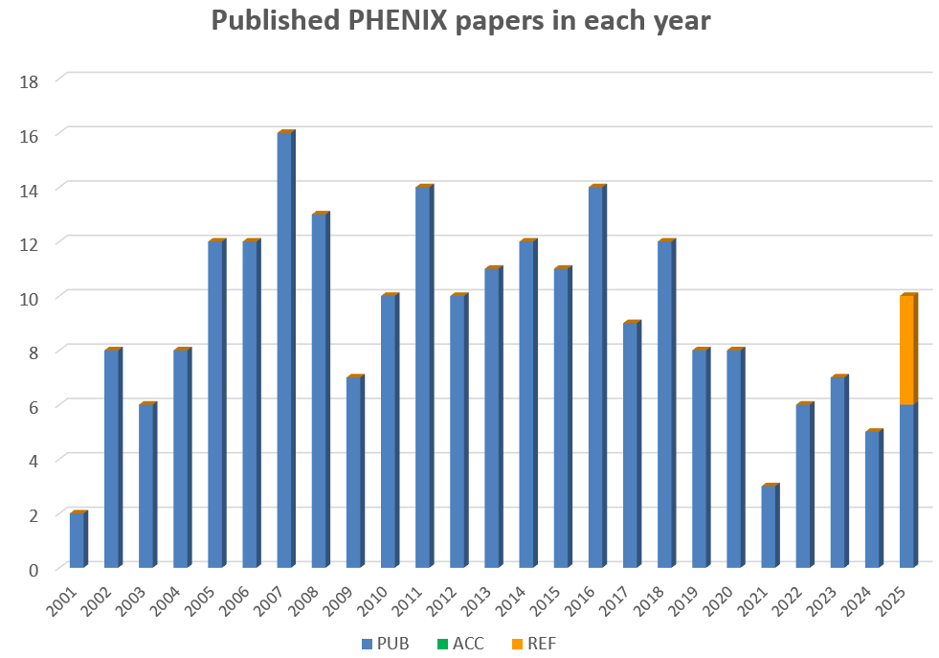
PHENIX publications
230 physics papers published
  Phys. Rev. Lett. 77
  Phys. Rev. C 98
  Phys. Rev. D 49
  Nature Physics 1
  Phys. Letter B 4
  Nucl. Phys. A 1
Total citation: ~38000
Topcite 1000+ 3
  500-1000 7
  250-500 25
  100-250 68
  50-100 43
PHENIX White Paper: 4013 cites
Jet quenching discovery: 1284 cites
PID hadron in AuAu: 1064 cites
Nature P paper: 397 citations
146 physics papers in topcite 50+
(165 if proceedings and detector papers are included)
PHENIX Data Taking 2000-2016
Journal review
published
COVID

Slide 22
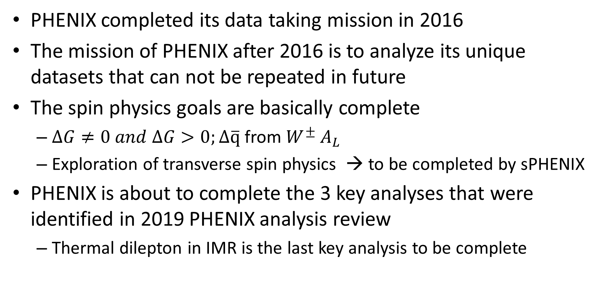
Summary
PHENIX completed its data taking mission in 2016
The mission of PHENIX after 2016 is to analyze its unique datasets that can not be repeated in future
The spin physics goals are basically complete
  $ΔG≠0 and ΔG>0;Δ\overline{q}$ from $W^{±}$ $A_{L}$
  Exploration of transverse spin physics → to be completed by sPHENIX
PHENIX is about to complete the 3 key analyses that were identified in 2019 PHENIX analysis review
  Thermal dilepton in IMR is the last key analysis to be complete

Slide 23
Final Remark
PHENIX is about to complete its Scientific Mission
This is only possible with the strong collaboration, in particular, the students and postdocs
It took 10 years for PHENIX to complete its Scientific Mission after the completion of data taking.
  It will take a similar time scale for sPHENIX and STAR to complete its Scientific Mission.
RHIC dataset is a unique resource, which cannot be repeated in any future.
Analysis and Data and Analysis preservation (DAP) requires resource. Nothing can be done without resource
What is the mission of RHIC experiments?
  My personal opinion: Quantitative understanding of the properties of the QGP at RHIC

