Slide 1


Scientific Origins of the Electron Ion Collider
My personal story with apologies for omissions and incompleteness
Origins of EIC
Timeline of Evolution of the Science Case
Outlook

Slide 2

Source of the Amazon the World’s Largest River
Subject of speculation for
centuries
Current understanding:
headwaters of three different
Peruvian rivers
- the Marańón
- the Apurímac
- the Mantaro
that rise high (~ 17,000 ft) in the
Andes.
Downstream tributaries that
join are essential.

Slide 3
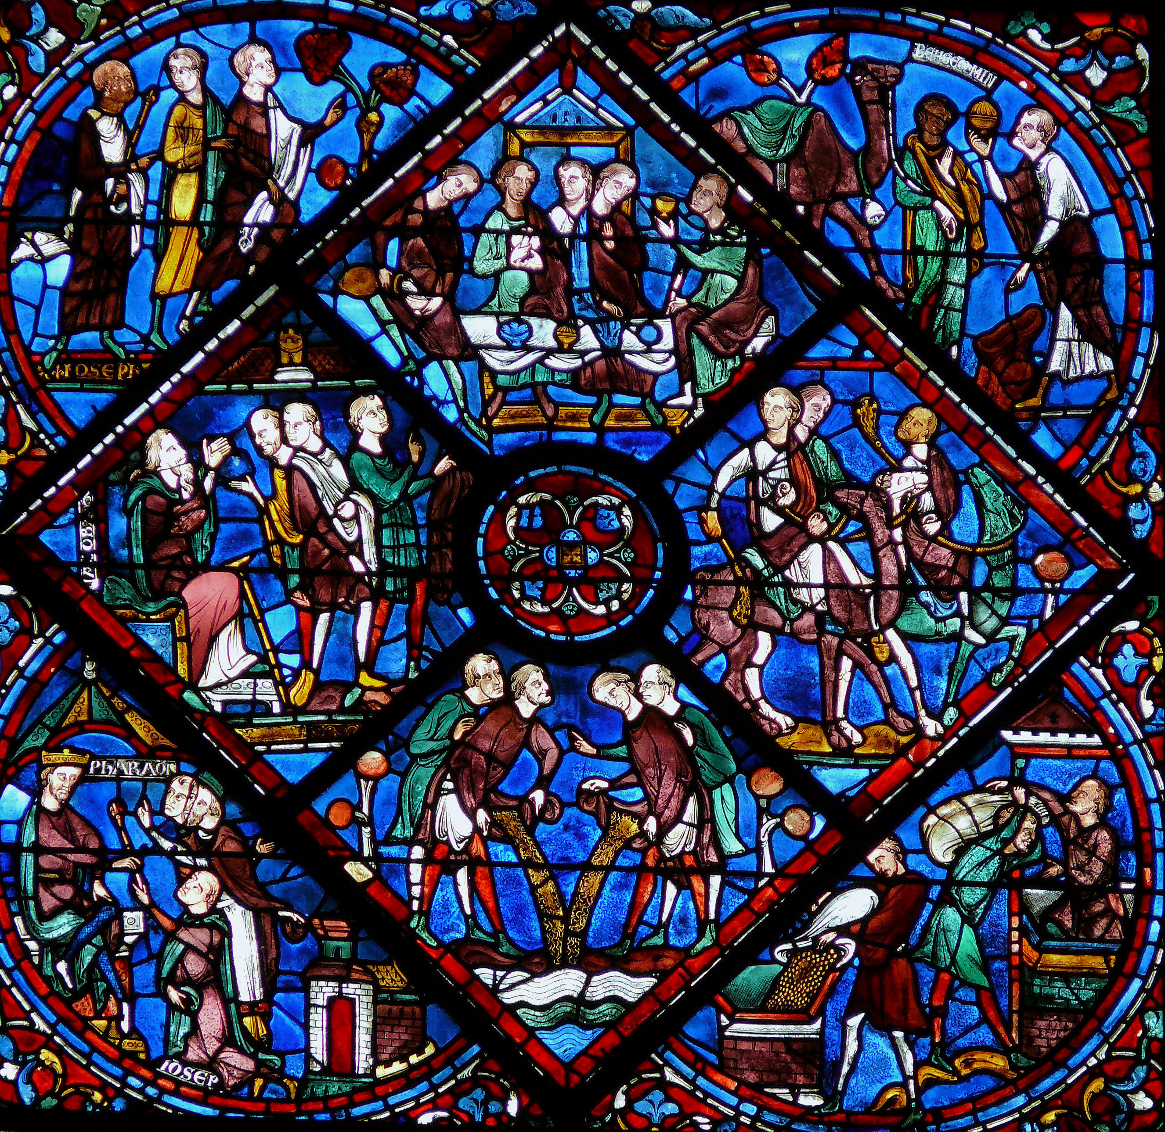
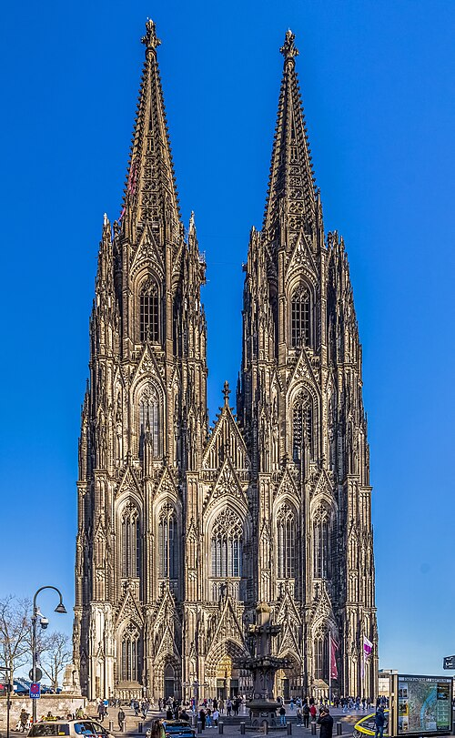
Large Human Endeavors
Building Gothic
Cathedrals
Chartres
Constructed in N. Europe in 11th to 13th
centuries from stone, wood, iron and
stained glass.
Tallest buildings in Europe since Roman times.
$ 1 billion class projects.
Took decades to centuries, e.g. Cologne
cathedral took 600 years (1248-1560, 1814-1880).
Required highly skilled workforce: masons, carvers, carpenters, glass workers, laborers,…
Kölner Dom

Slide 4
Quantum Chromodynamics
1961
Particle zoo organized in terms of the eightfold way by Gell-Mann and Ne’eman
1963
Quarks proposed by Gell-Mann and Zweig
1968
Pointlike quarks discovered experimentally at SLAC by Friedman, Kendall and Taylor
1973
- color as source of the strong field developed into QCD by Frisch, Leutwyler and Gell-Mann
- asymptotic freedom discovered by Gross, Politzer and Wilczek
1974 November Revolution

Slide 5
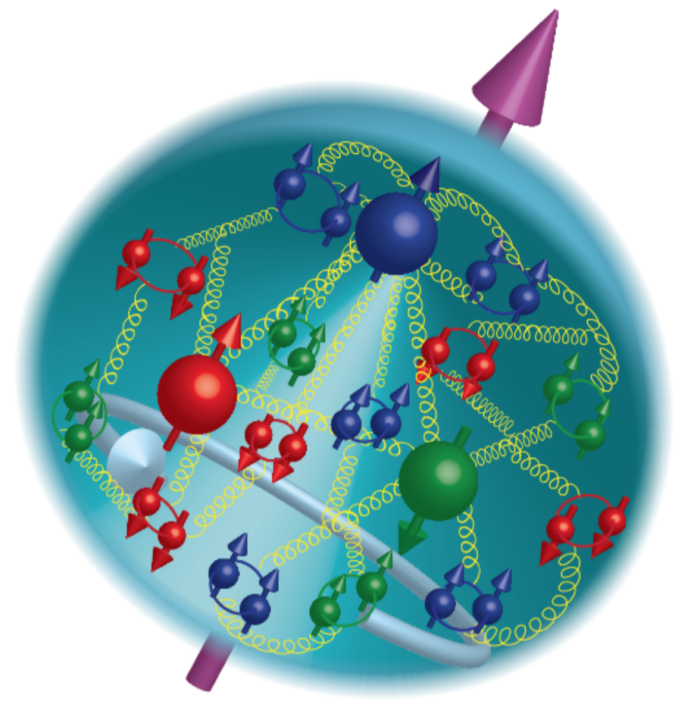
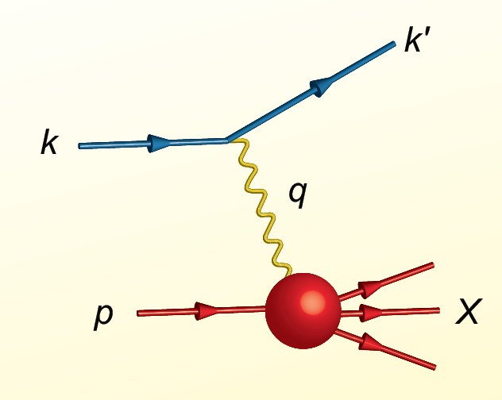
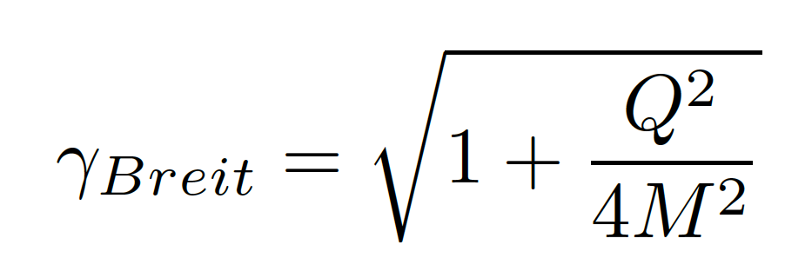
Proton Viewed in High Energy Electron Scattering: Longitudinal Dimension
Viewed from boosted frame,
length contracted by
Internal motion of the proton’s constituents is slowed down by time dilation – the instantaneous charge distribution of the proton is seen.
In boosted frame x is understood as the longitudinal momentum fraction
valence quarks: 0.1 < x < 1
sea quarks: x < 0.1
Lorentz Invariants
E²_{CM} = (p+k)²
Q² = -(k-k’)²
x = Q²/(2p•q)
J. Bjorken, SLAC-PUB-0571
March 1969

Slide 6
The structure of the proton ~ 1985
Structure and dynamics understood in terms of quarks: gluons assumed to carry half of the proton’s momentum but essentially `invisible’
Theoretical QCD inspired models based on quarks and confinement, e.g. the MIT bag model
EMC Effect => quark momentum modified in the nucleus
Violation of Gottfried Sum Rule => flavor asymmetry of the sea established
Lattice QCD in its infancy

Slide 7
Polarized lepton beams
In ~ 1987 available beams included
- low intensity, highly polarized muon beams
- high intensity, low polarization electron beams
Interest in studying the spin structure of the nucleon drove the polarized electron beam technology in a major way
At SLAC, ~ 80% polarized electron beams were developed for E122 – direct evidence for Z⁰ in parity violating electron scattering.
At DESY, HERMES drove the development of ~65% polarized electron/positron beams using the Sokolov-Ternov effect
Precision beam polarimetry was developed

Slide 8
HERMES originated in 1987 from a number of sources
EMC spin results => quarks carry only a fraction of the proton’s spin
Significant development in polarized internal gas target technology
HERA had the potential for longitudinally polarized electron/positron beams
Common interests of scientists in Europe and North America
Seek to understand proton structure in terms of the quarks (and gluons) of QCD
Desire to be technically innovative
Initial focus was on inclusive electron detection but quickly added hadron particle id.

Slide 9
Importance of HERA Collider
While proposed as a discovery machine, it ended up being a QCD machine of enormous consequence
Rise of F₂(x,Q²) with Q² at low x
Observation of high fraction (~15%) of diffraction events in DIS
Search for gluon saturation
Limitations: no polarized proton beams, low luminosity

Slide 10
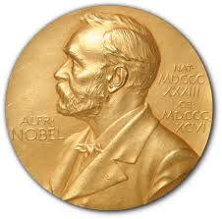
Quark Structure of Proton from High-Energy Lepton Scattering
2004
e-p cross section ≈ σ_{Mott} •F₂(x,Q²)
Snap shots of the charged structure of the proton taken in the boosted frame
1/Q spatial resolution
1/x shutter speed
QCD prescribes evolution with Q² which
connects quarks and gluons
1990

Slide 11
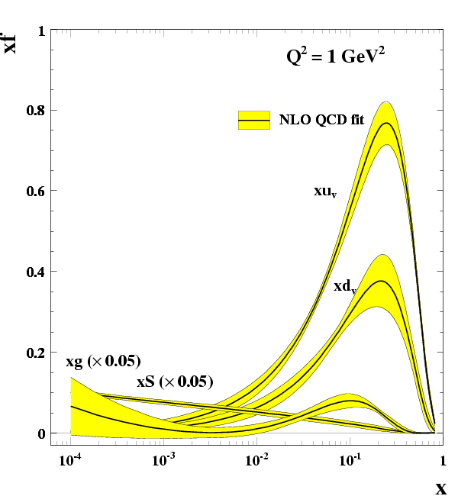
Low x rise of the gluons!
R. Yoshida
C. Gwenlan

Slide 12
Theory 1990-2010
Realization that one could access transverse structure in high energy lepton scattering
Generalized Parton Distributions and Transverse Momentum Distributions
Experimentally, one needs a high energy scattering event where the target was left intact.
Deeply Virtual Compton Scattering
X. Ji, PRL 78, 610 (1997)
Gluon saturation at low x: development of the chiral glass condensate
L. McLerran and R. Venugopalan, Phys. Rev. D 50, 2225 (1994)

Slide 13
Proton Viewed in High Energy Electron Scattering: 1 Longitudinal Dimension

Slide 14

Proton Tomography: 2 New Dimensions Transverse to Longitudinal Momentum
Structure mapped in terms of
b_{T} = transverse position
k_{T} = transverse momentum
Nuclei!
Goal:
Unprecedented
21st Century Imaging
of Hadronic Matter
Direction of longitudinal
momentum normal to
plane of slide
Valence Quarks: JLab 12 GeV
Sea Quarks and Gluons: EIC

Slide 15
21st Century View of the
Fundamental Structure of the Proton
Elastic electron scattering determines charge and magnetism of nucleon
Approx. sphere with <r> ≈ 0.85 Fermi
The proton contains quarks,
as well as dynamically
generated
quark-antiquark pairs
and gluons.
The proton spin
and mass have large
contributions from
the quark-gluon
dynamics.
1961

Slide 16
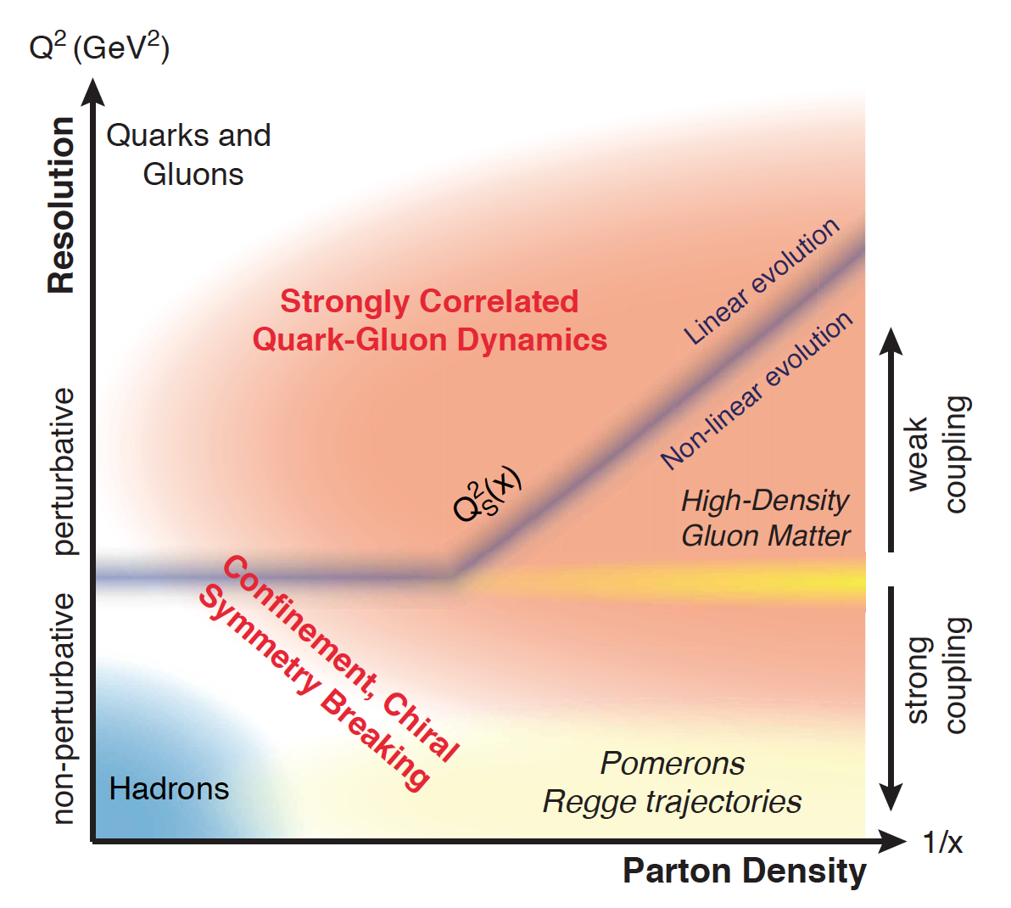
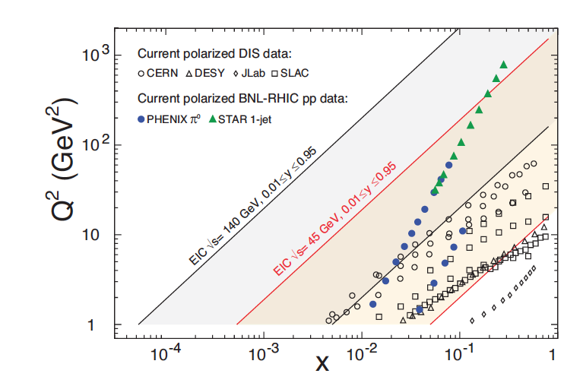
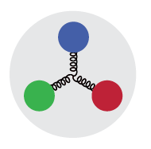
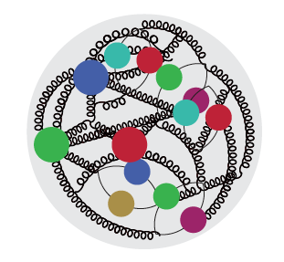
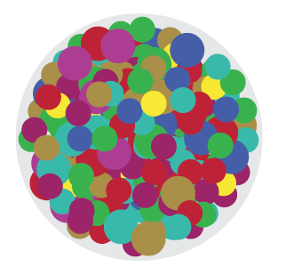
QCD Exploration
Desire to explore the QCD
landscape over a wide range in x
and Q².
Study high-density gluon matter
Different coupling regimes
Nuclei are terra incognita
Study modifications of gluons in
nuclear environment complementing
heavy ion programs at RHIC and LHC

Slide 17
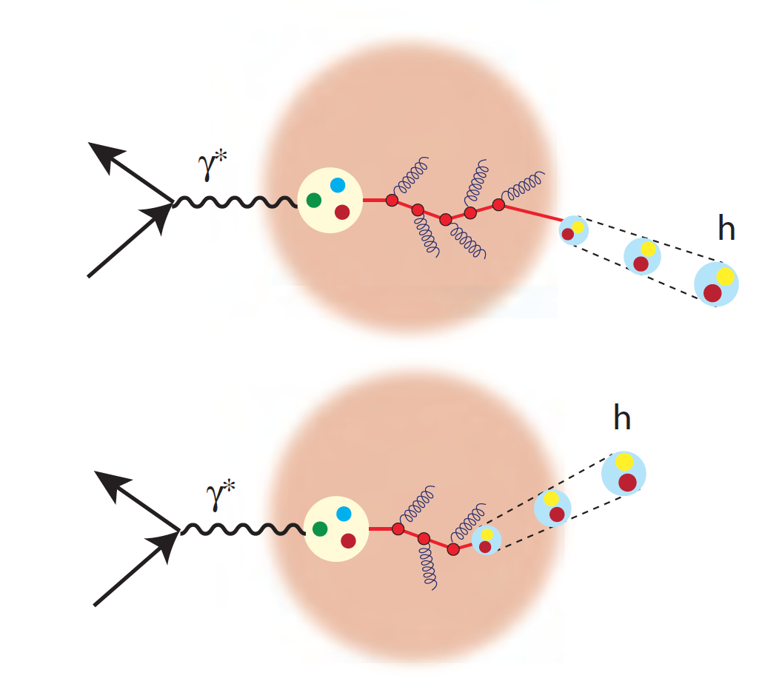
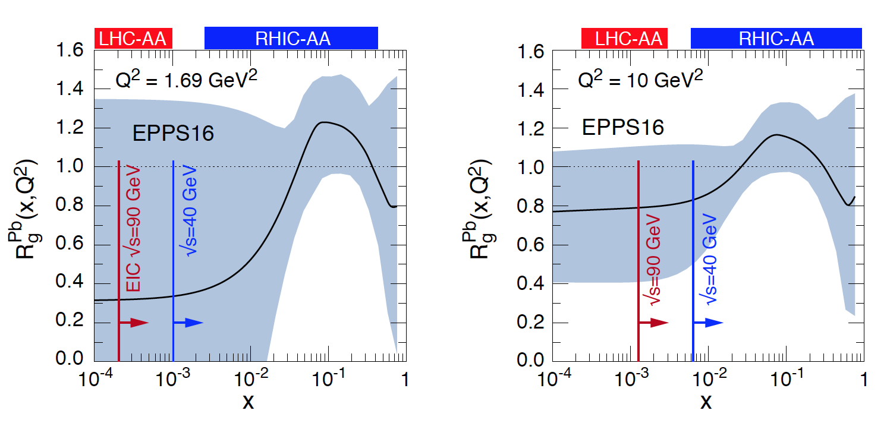
QCD Dynamics in Nuclei
Hadronization: the process that
connects QCD with experiment
Nuclear PDFs
Color neutralization and propagation
Diffraction: no net color exchange
1/x
Hadronization

Slide 18
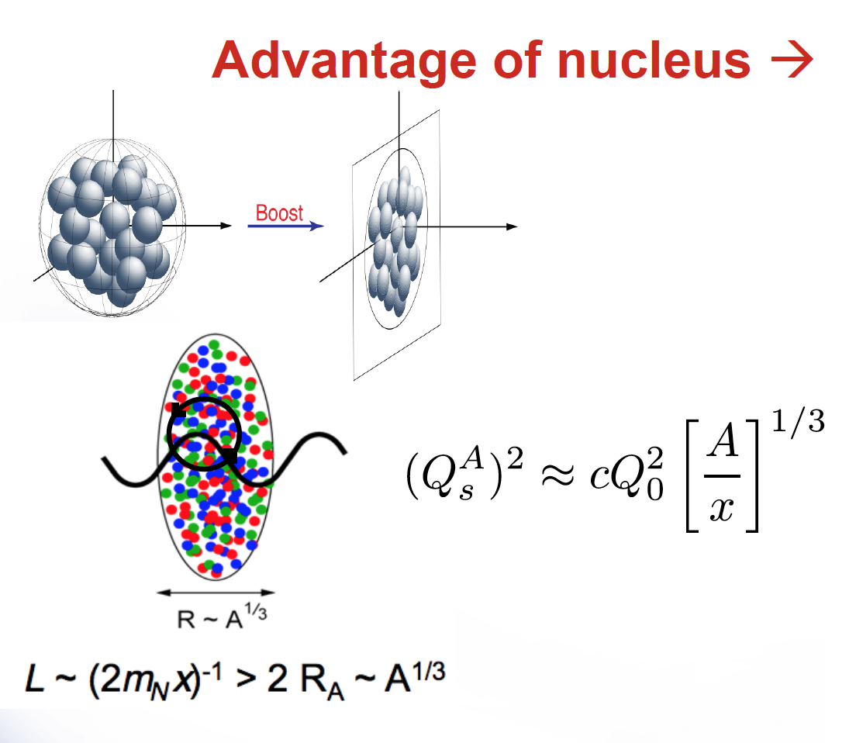
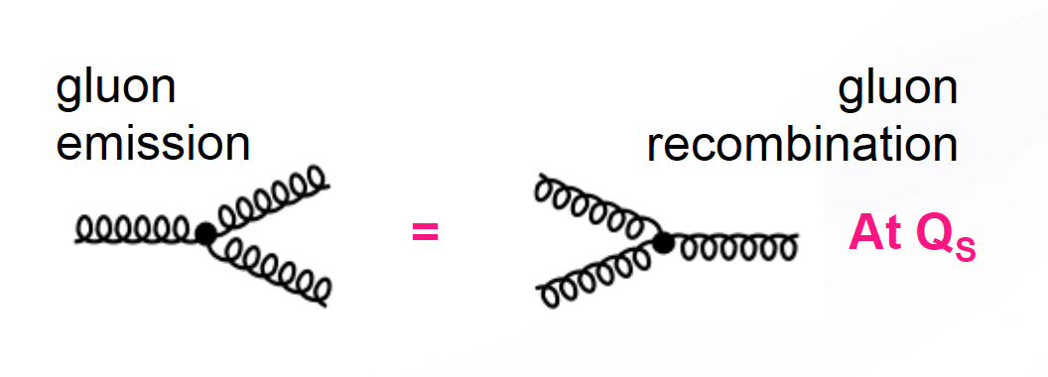
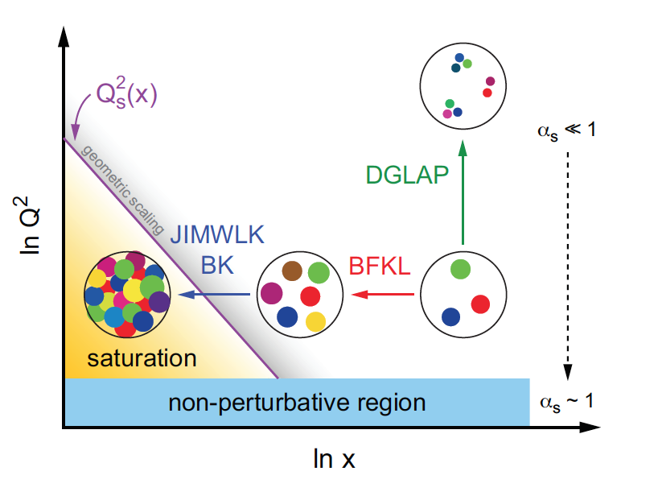
What tames the low-x rise of the gluons?
New evolution equations at low x and moderate Q²
Saturation scale Q_{s}(x) where gluon emission and recombination become comparable
First observation of gluon recombination effects in nuclei
Is this a universal property?
What is the new effective theory in this regime?

Slide 19
Mid-1990’s
1995
- ZEUS and H1 taking data
- HERMES and CEBAF begin taking data
- SMC taking data at CERN
March 1997
DESY/GSI NuPECC meeting at Seeheim, Germany
- electron-nucleus collisions at HERA
- new electron-nucleus collider; E_{cm} ~20-30 GeV
- 20 GeV linac ELFE

Slide 20
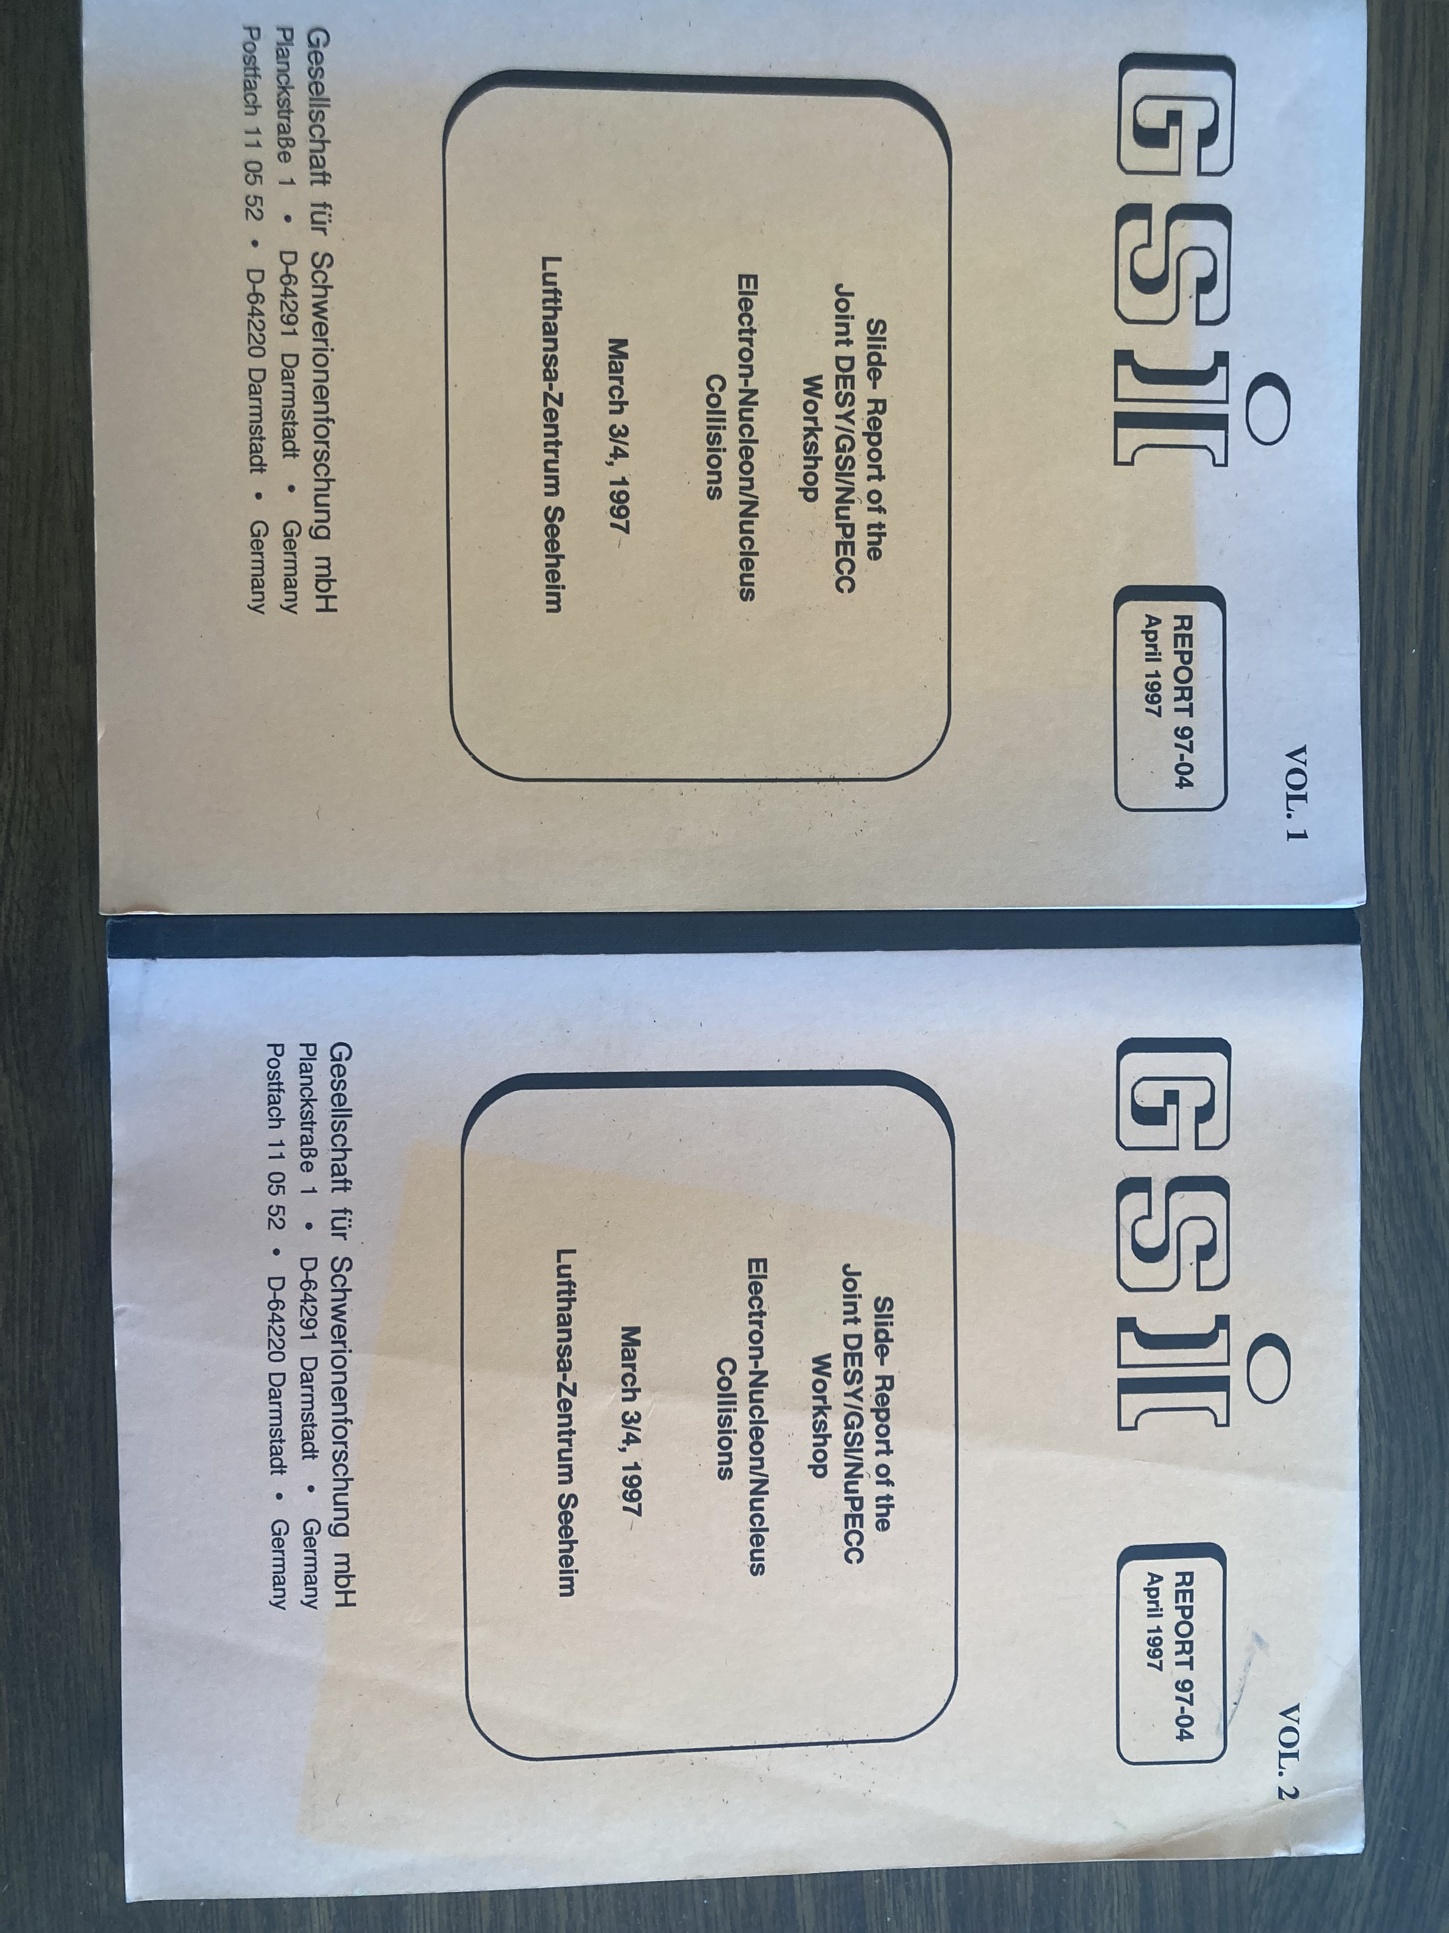
Earliest Headstream for EIC?

Slide 21
Low energy facilities at universities in the US were being phased out
Indiana University Cyclotron Facility
John Cameron, Tim Londergan and colleagues developed a concept for a low high electron-proton collider: (EPIC) workshop in April 1999.
MIT-Bates Linear Accelerator Center
Manouchehr Farkhondeh, Chris Tschalaer and RM became interested in EPIC and hosted a workshop at MIT in September 2000.

Slide 22
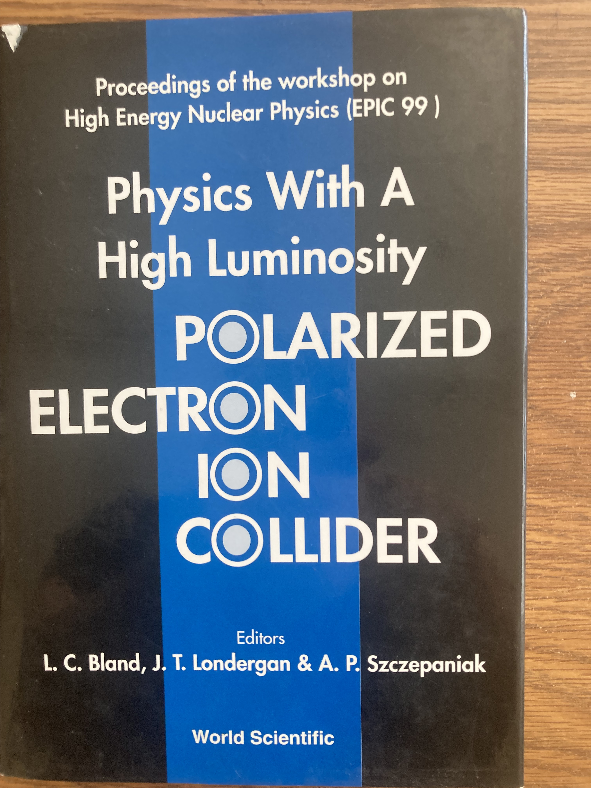
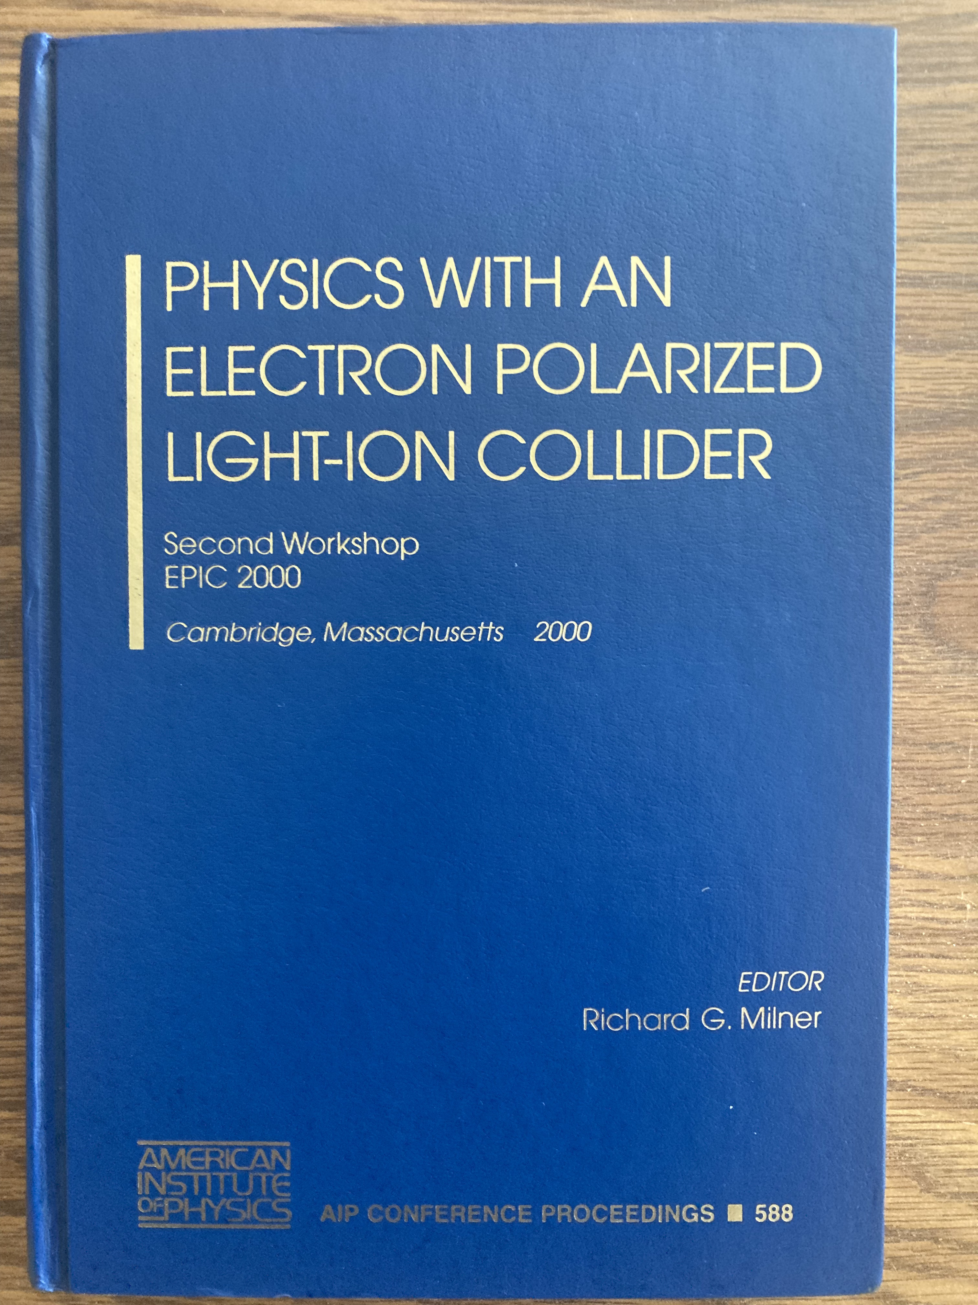
Headstreams for EIC
IUCF, Indiana April 1999
MIT, August 2000

Slide 23
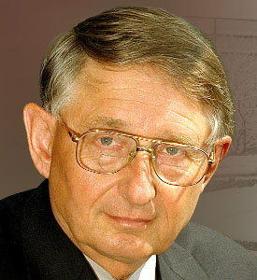
Brookhaven National Laboratory
Headstream for EIC
December 1999 BNL
Abhay Deshpande, Gerry Garvey, Vernon Hughes, Larry McLerran, Peter Paul, Raju Venugopalan held a workshop at BNL on eRHIC.
April 2000 Yale University
Second eRHIC workshop at Yale.
March 2001 Santa Fe, NM
EPIC and eRHIC united to make a case for eRHIC at the 2002 US Nuclear Physics Long Range Planning Exercise.

Slide 24
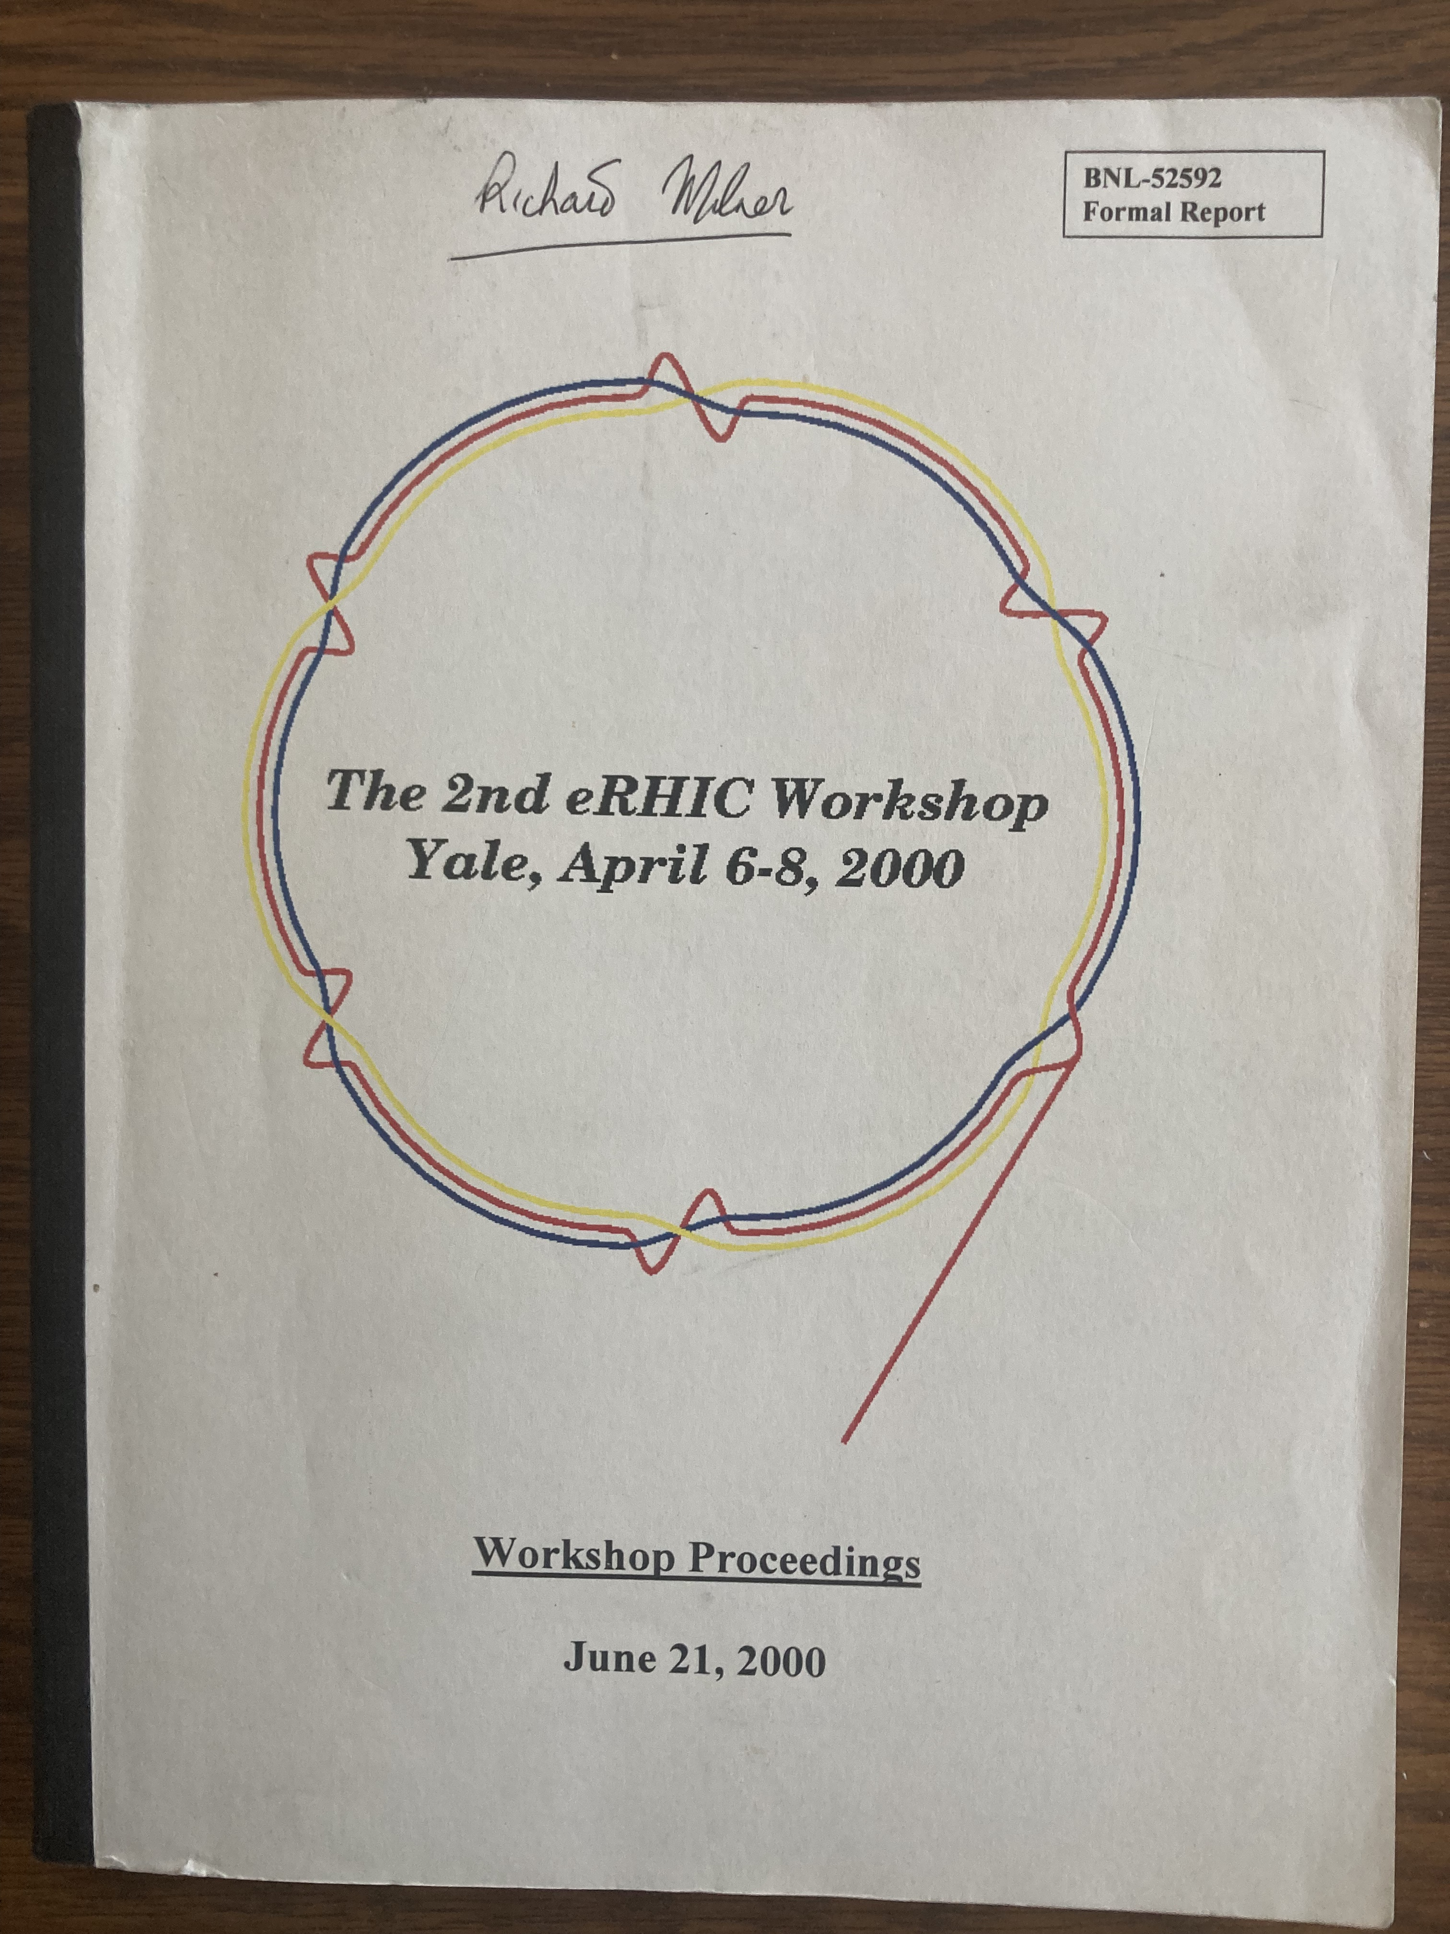
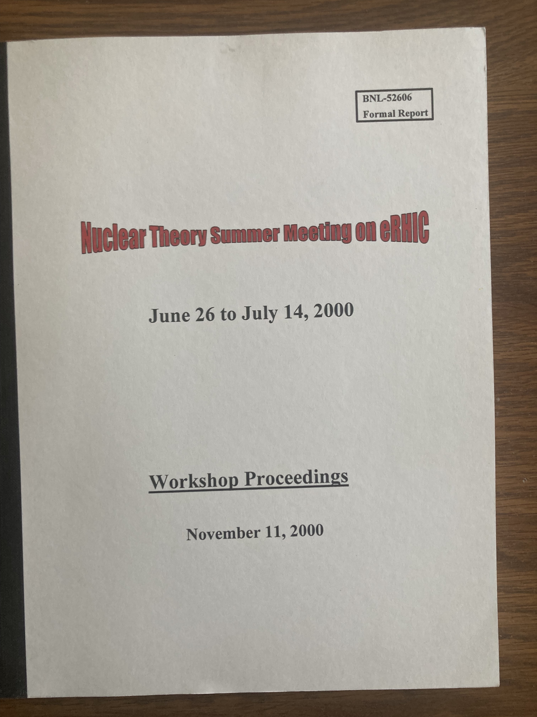
The current builds

Slide 25
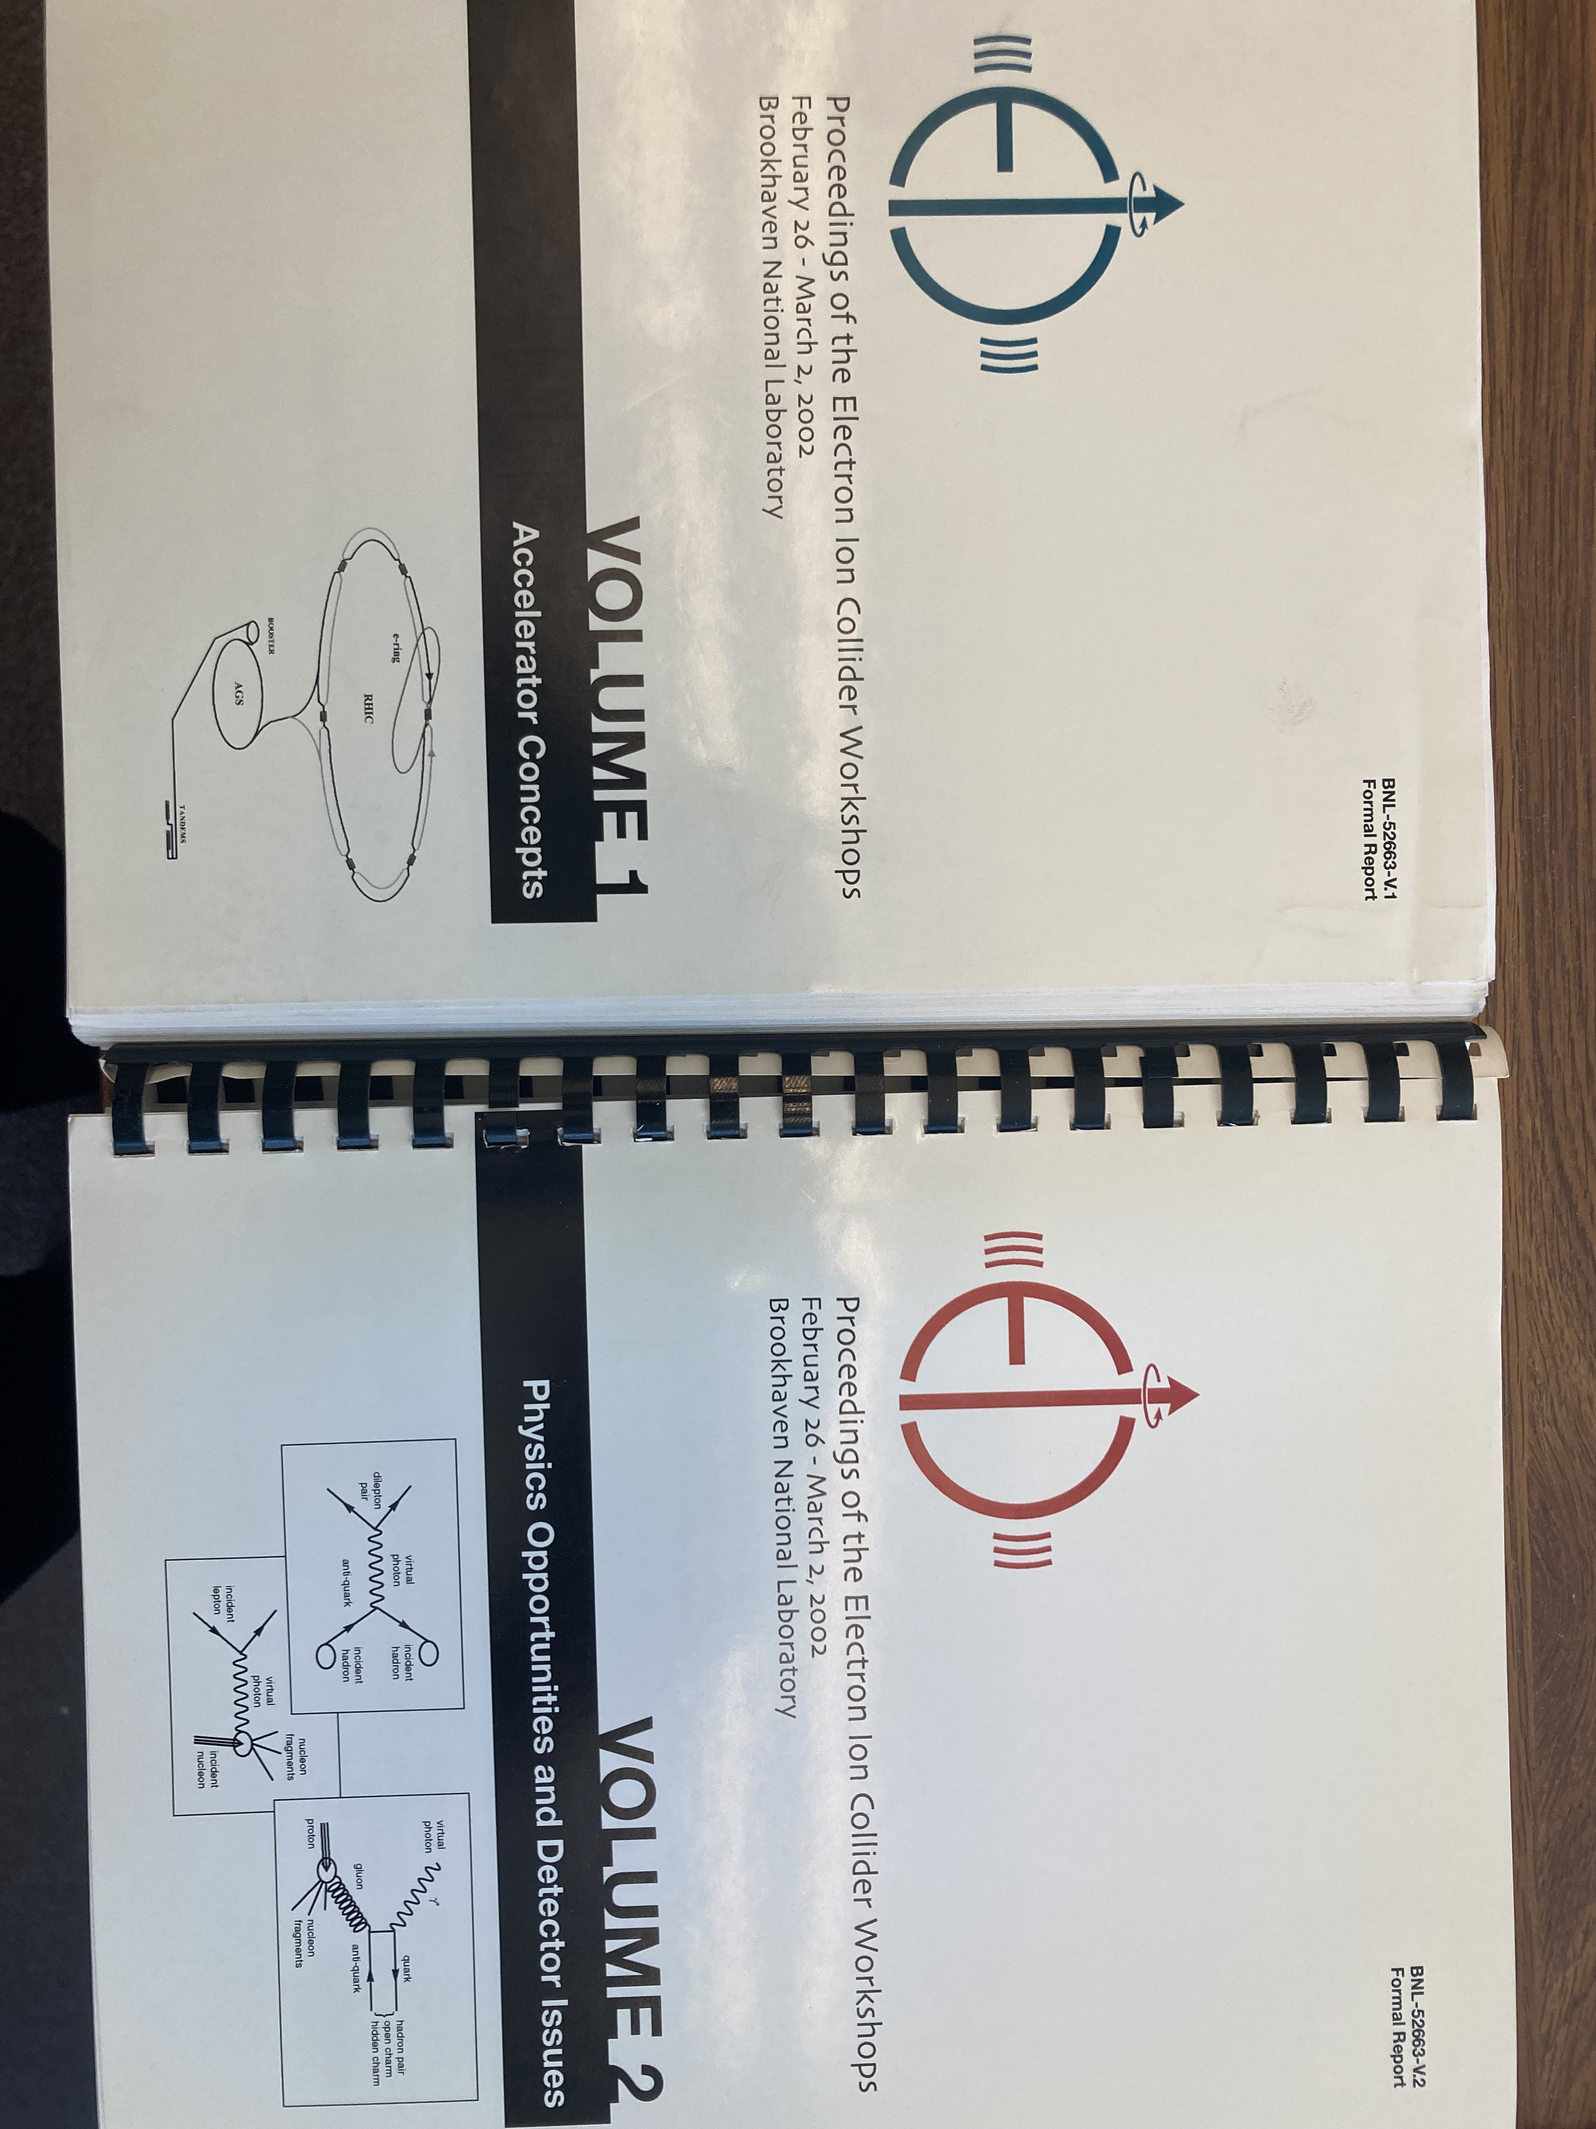
Electron-Ion Collider is Born!
BNL Feb 26 – March 2, 2002
ELIC Layout

Slide 26
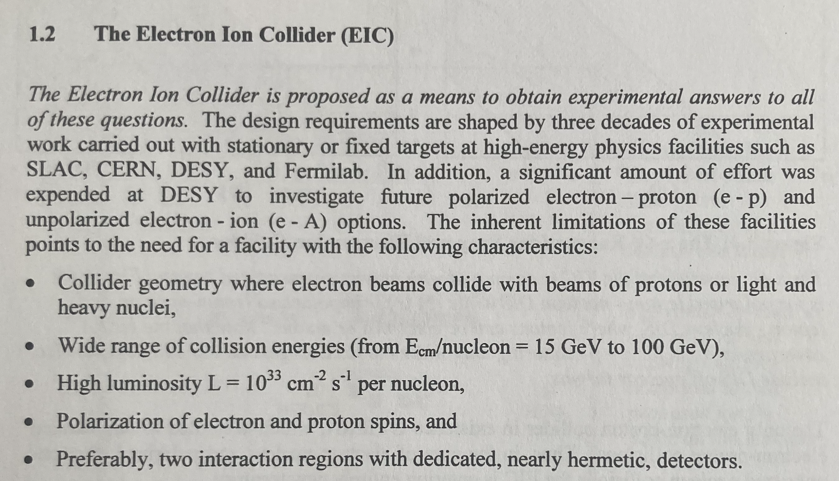
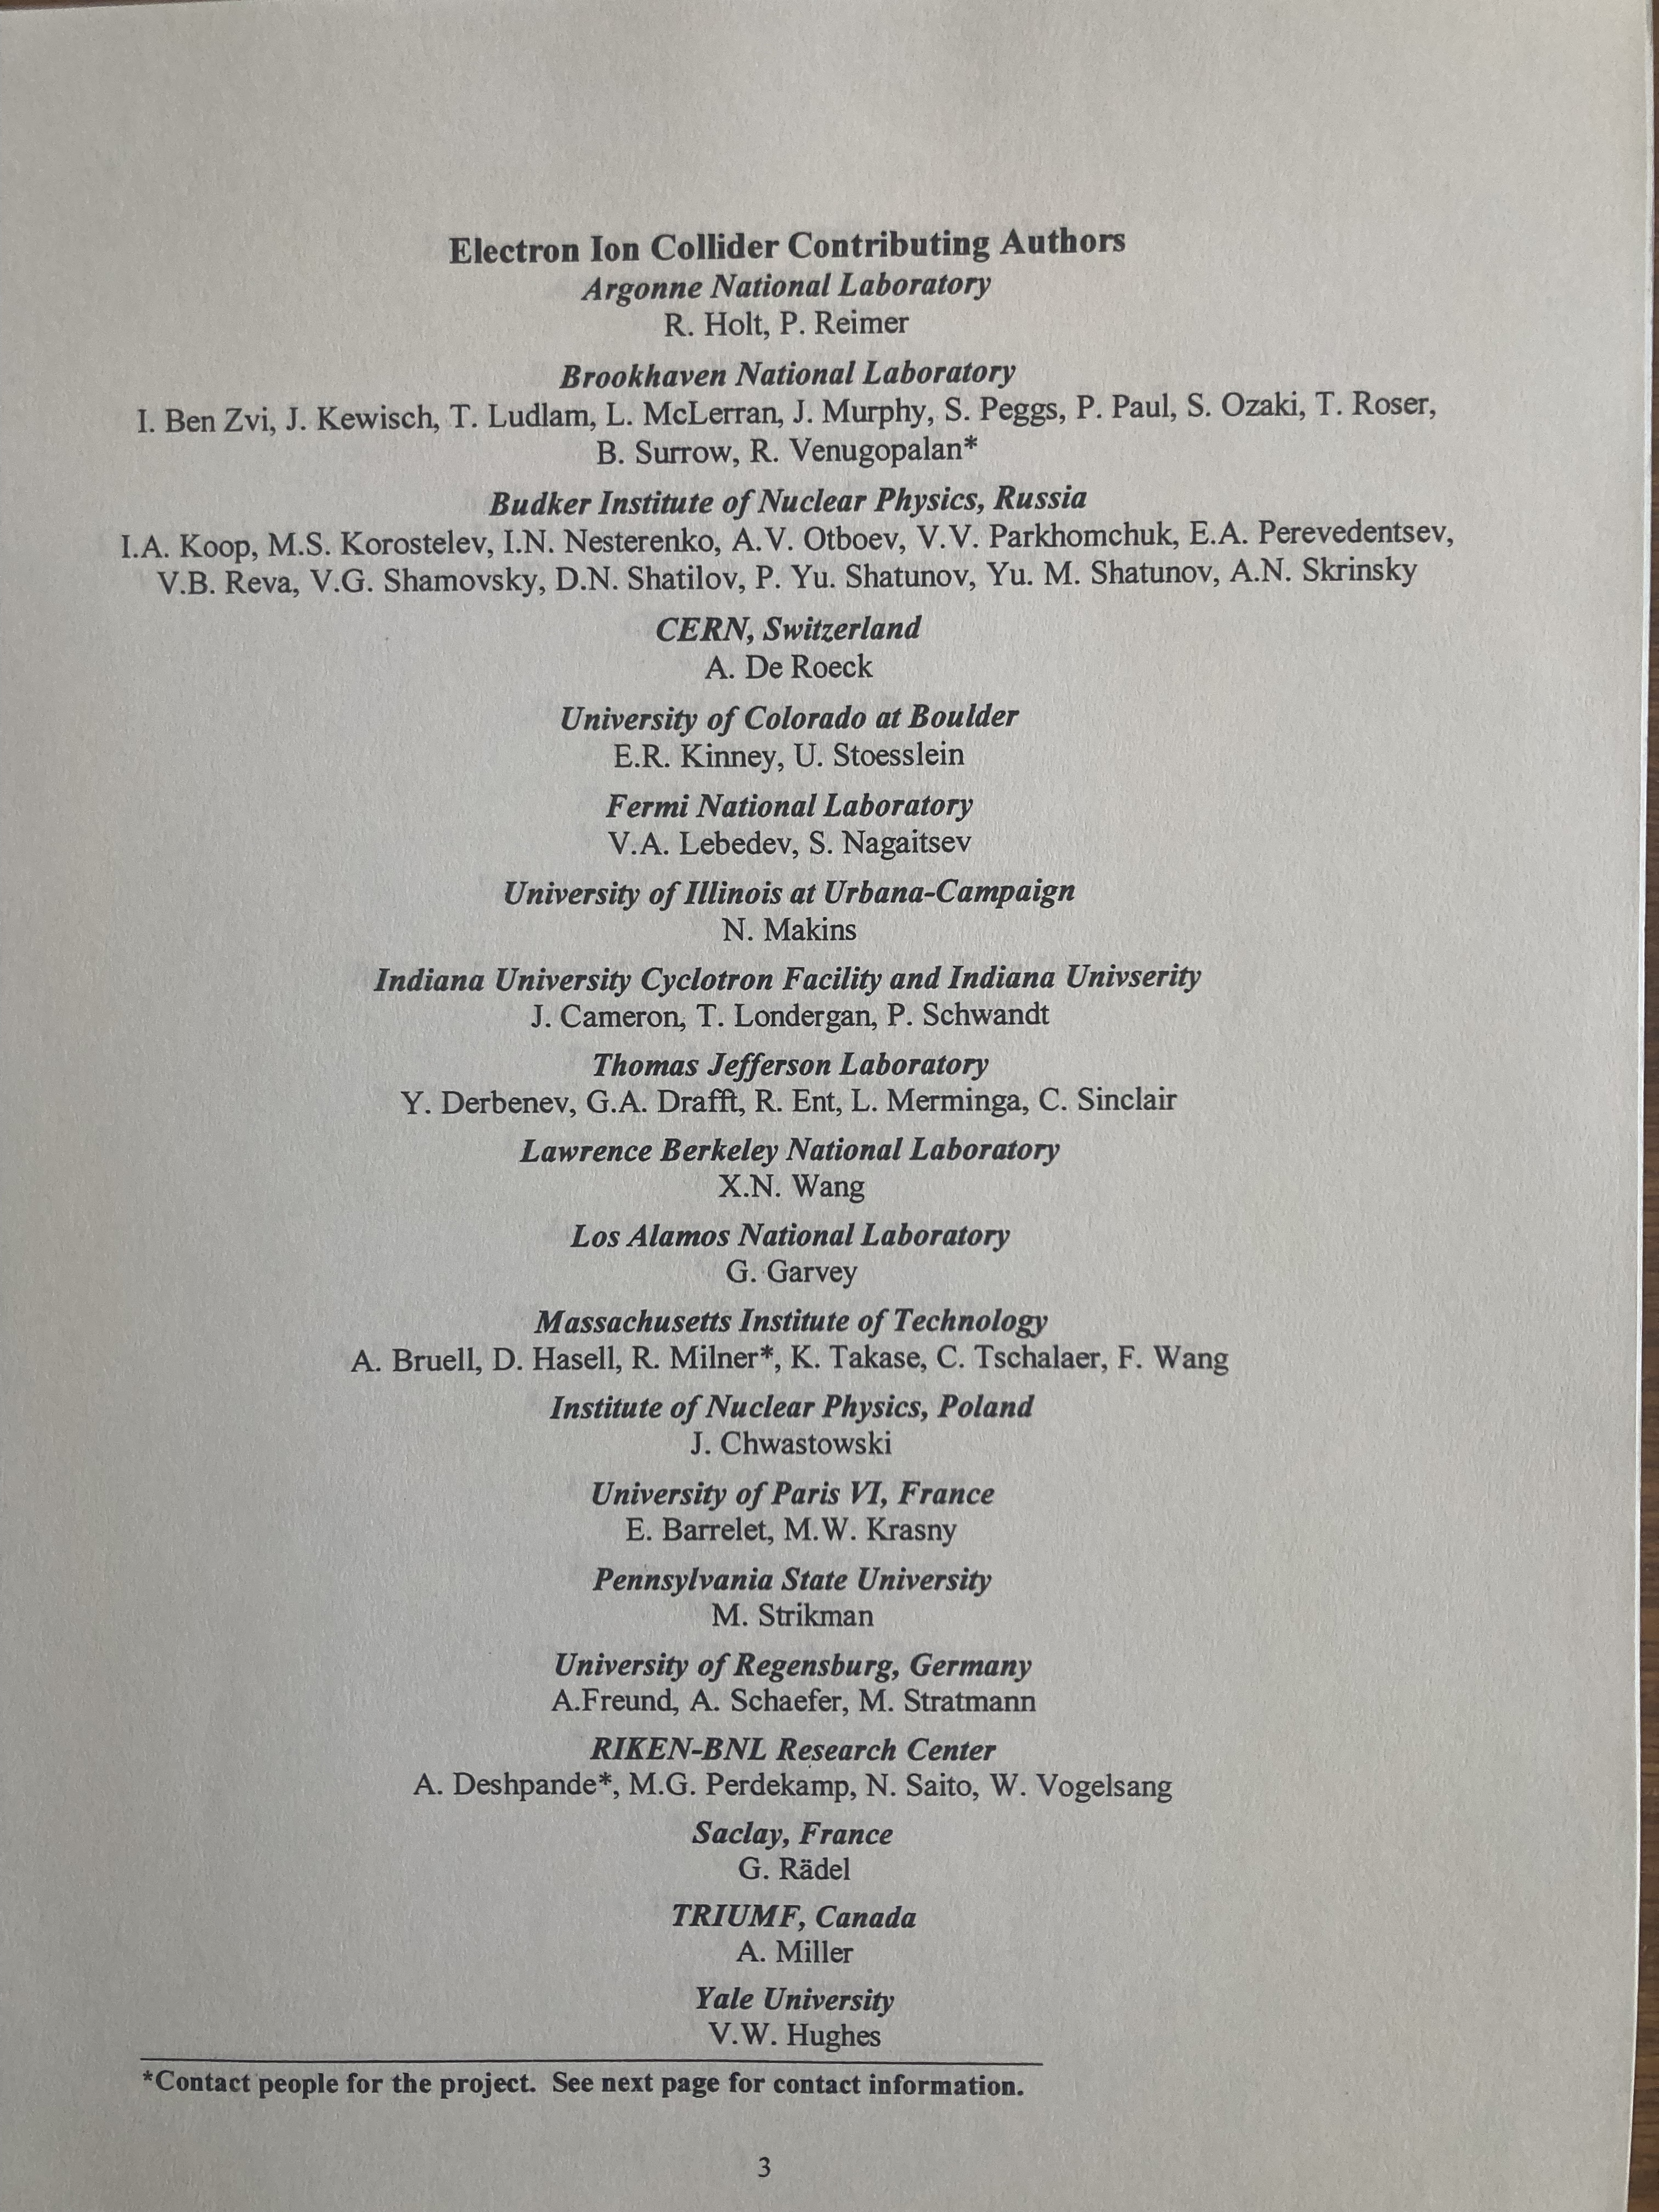
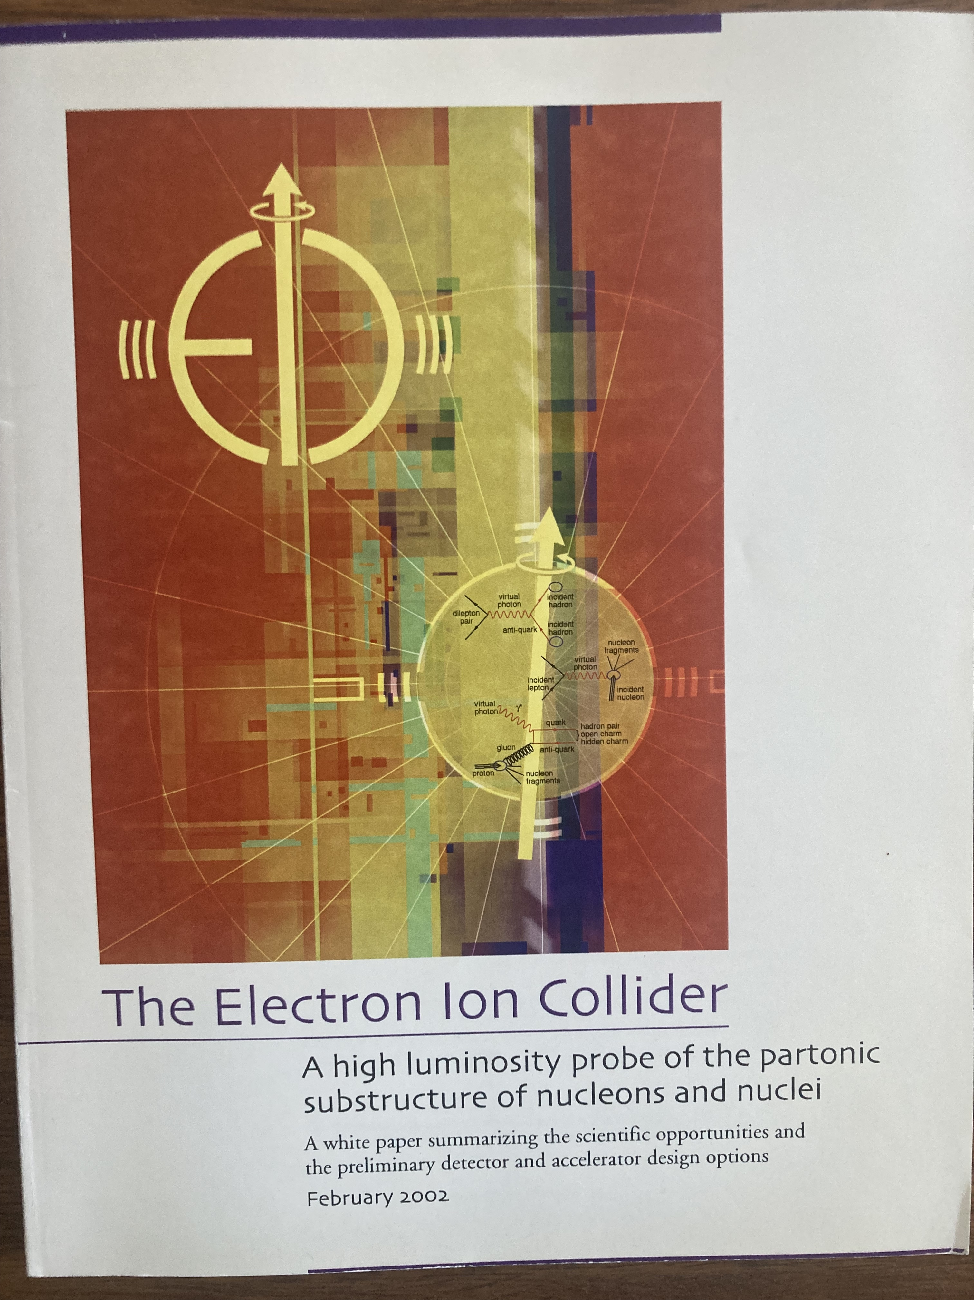
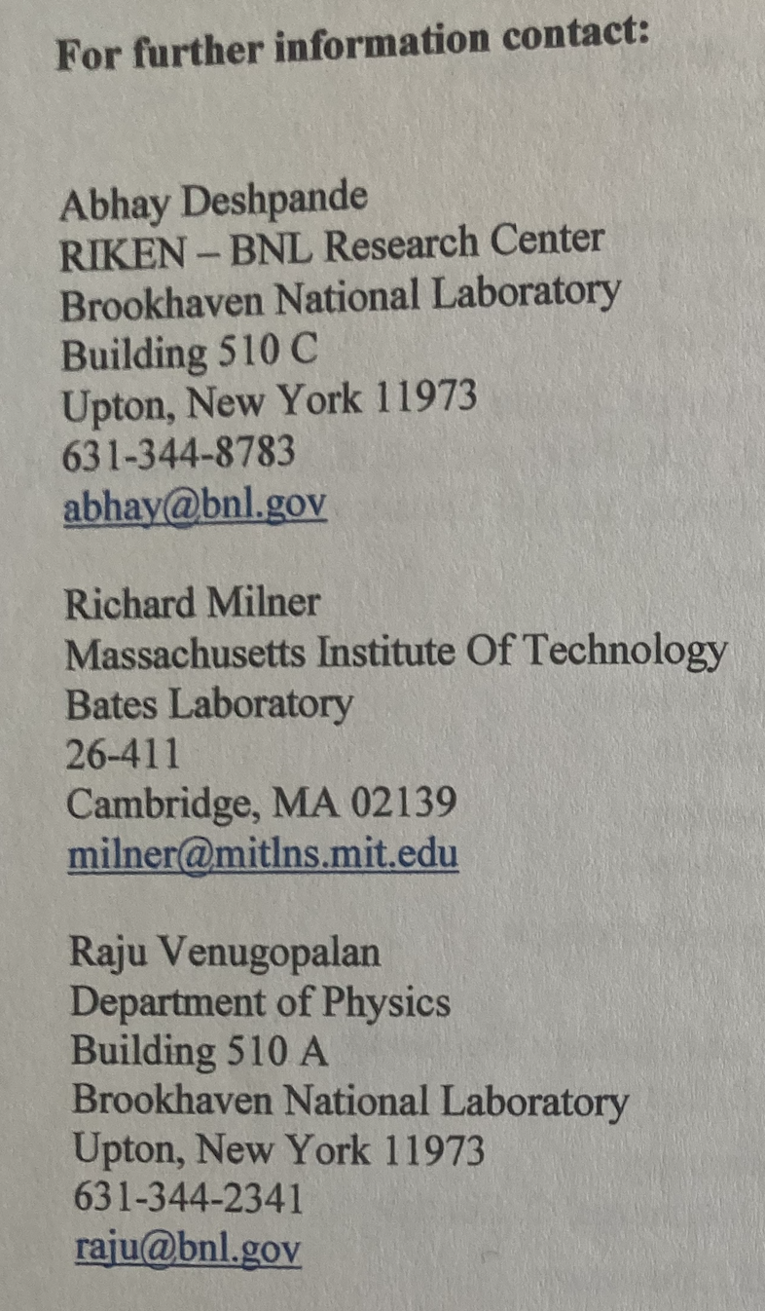
First Formal Proposal February 2002

Slide 27
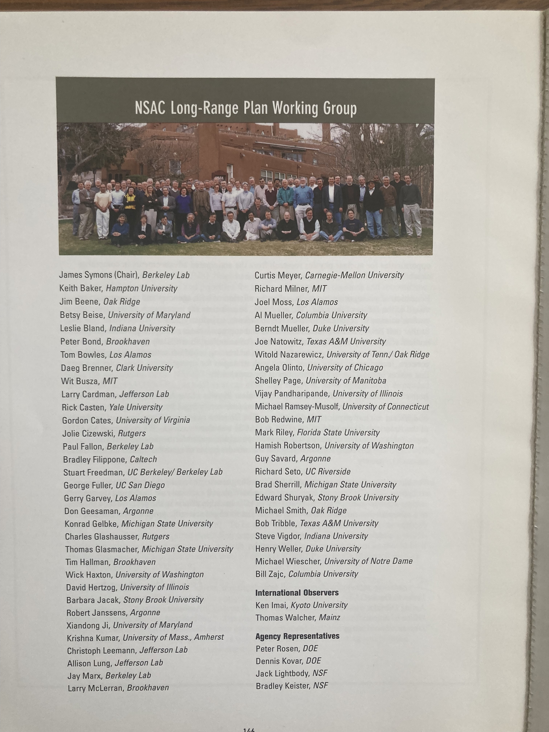
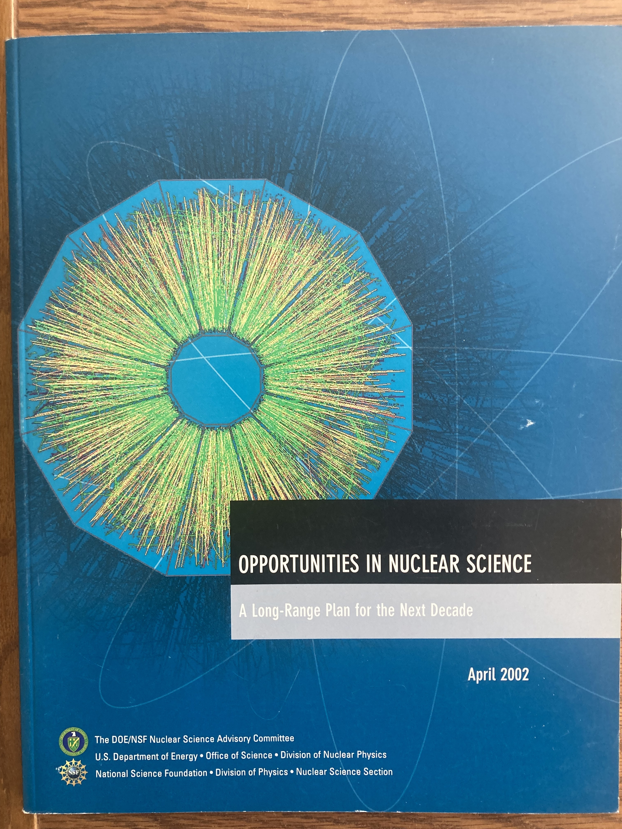
NSAC 2002 Long Range Plan
Met in Santa Fe in March 2001
Secret science ballot ranked eRHIC science highly
Community sense was positive

Slide 28
NSAC 2002 Long Range Plan
Met in Santa Fe in March 2001
Secret science ballot ranked eRHIC science highly
Community sense was positive
“…essential accelerator and detector R&D [for EIC] should be given very high priority
in the short term.”

Slide 29
HERA III Not Realized
Meanwhile, back at DESY, then the world center of high-energy electron-proton scattering, there was a concerted eﬀort to make the case for a post-2007 HERA-III era, where nuclear beams would be accelerated and collided with the 27 GeV electron beam and the interactions studied in the existing H1 and ZEUS detectors. Ferdinand Willeke led the accelerator eﬀort to collide nuclei up to calcium and the estimated cost was DM 50 million. However, the German high energy physics community had little interest in HERA III and rather chose to focus on the LHC at CERN. Thus, HERA running came to an end in 2007. Subsequently, several of the leaders of the HERA-III project, including Max Klein, originated LHeC, the high-energy electron-ion collider project at CERN.
When one door closes, another door opens.

Slide 30
Jefferson Lab enters the picture!
At the Santa Fe meeting, there were presentations on eRHIC and on CEBAF energy upgrades. The idea to use the CEBAF linac as an injector into an injector for a future collider came up.
After the 2002 LRP Exercise, there was a strong push from BNL Management and their PAC to engage the broader electromagnetic physics community.
If this is so important for QCD why isn’t Jefferson Lab interested?”
Rolf Ent played a leadership role in the science case from the beginning.
The strong accelerator group at CEBAF developed a novel and compelling figure-eight ring-ring design.
This was introduced at the Second EIC Workshop which took place at Jefferson Lab in March 2004.

Slide 31
EIC Accelerator Design
In 2004, the ﬁrst EIC accelerator conceptual design was developed by a Bates-BNL collaboration, the so-called Zeroth order Ring-Ring eRHIC Design, coordinated by Manouchehr Farkhondeh and Vadim Ptitsyn. The maximum luminosity in this design was 10³² cm⁻²s⁻¹.
After the development of the initial eRHIC ring-ring concept in 2004, the BNL eRHIC machine design group focused for about a decade on an electron linac colliding with the RHIC ion beam. While this concept had the possibility of attaining higher collision luminosity than the ring-ring concept, it demanded enormously high currents of polarized electrons as well as very ambitious hadron cooling mechanisms. This drove ambitious R&D for over a decade at BNL.
Jefferson Lab developed a design ELIC which used CEBAF as an injector into a figure eight storage ring. This design was very stable over more than a decade.

Slide 32
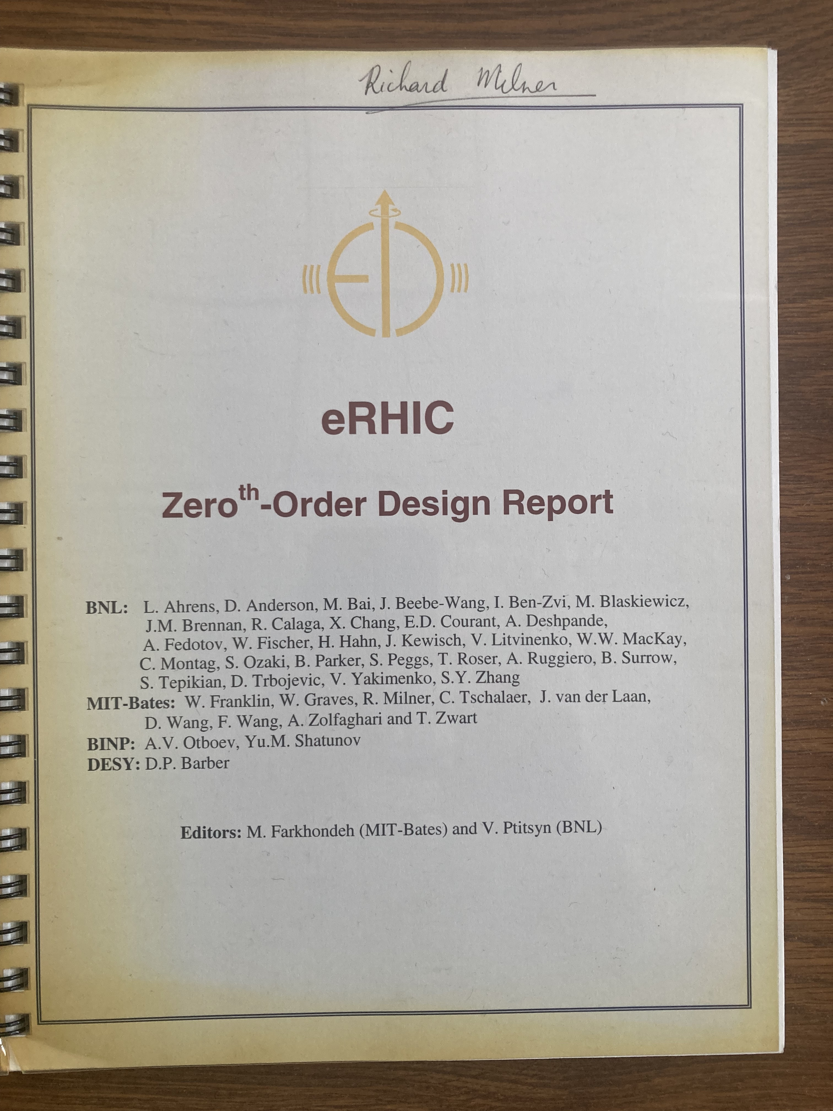
BNL EIC Accelerator Design
In 2004, the ﬁrst EIC accelerator conceptual design was developed by a Bates-BNL collaboration, the so-called Zeroth order Ring-Ring eRHIC Design, coordinated by Manouchehr Farkhondeh and Vadim Ptitsyn. The maximum luminosity in this design was 10³² cm⁻²s⁻¹.
After the development of the initial eRHIC ring-ring concept in 2004, the BNL eRHIC machine design group focused for about a decade on an electron linac colliding with the RHIC ion beam. While this concept had the possibility of attaining higher collision luminosity than the ring-ring concept, it demanded enormously high currents of polarized electrons as well as very ambitious hadron cooling mechanisms. This drove ambitious R&D for over a decade at BNL.

Slide 33
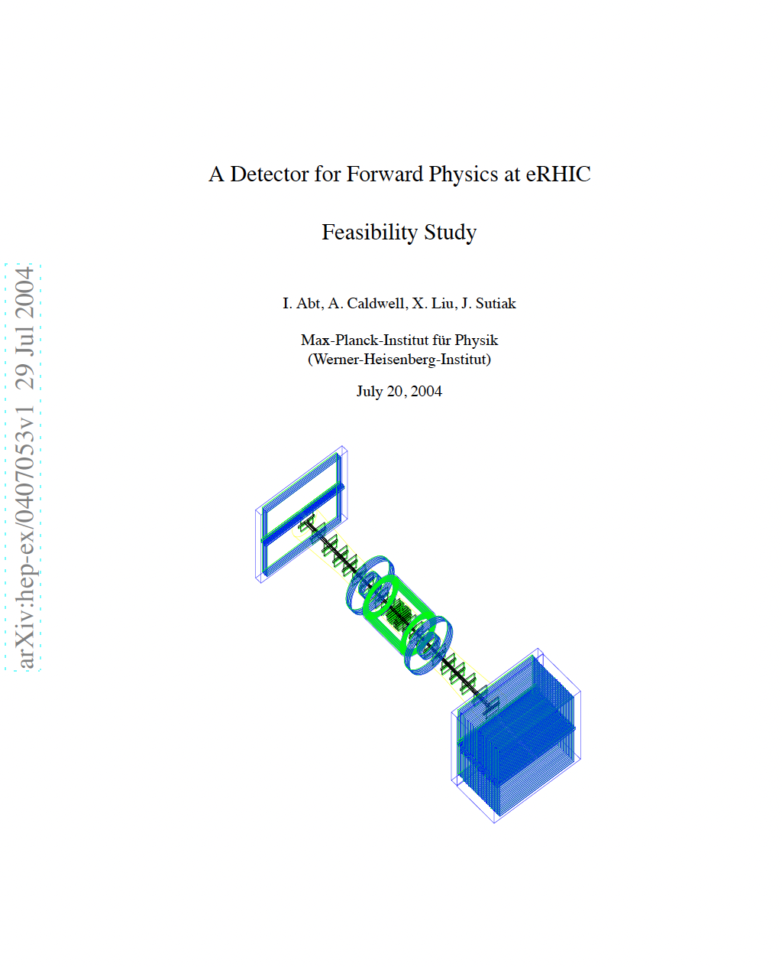
Learning from HERA

Slide 34
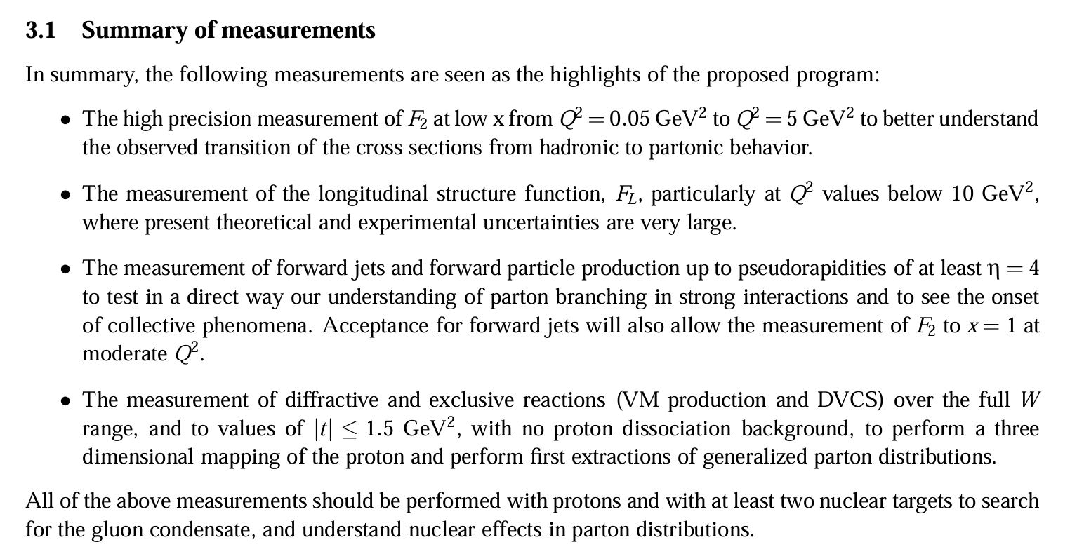
Learning from HERA

Slide 35
EIC Collaboration (EICC)
In April 2007 in an EIC meeting at MIT, the EIC Collaboration (EICC) was formed with three goals:
(1) to develop the most compelling science case for a high luminosity, high energy electron-ion collider (EIC) independent of where it may be sited;
(2) to work with accelerator physicists, especially at BNL and JLab, to develop the optimal EIC accelerator design;
(3) to design and realize through a R&D program the most optimal suite of detectors for the EIC.
The following EICC Steering Committee was established:
Allen Caldwell (MPI Munich), Abhay Deshpande (Stony Brook) (Co-Chair),
Rolf Ent (JLab), Gerry Garvey (LANL), Emlyn Hughes (Caltech), Ken’ichi Imai (Kyoto U.), Peter Jacobs (LBNL), Lia Merminga (JLab), Richard Milner (MIT) (Co-Chair),
Peter Paul (BNL), Jen-Chieh Peng (U. Illinois), and Thomas Roser (BNL).
EICC was active through the 2010 Long Range Planning Exercise and held meetings at BNL, JLab, U Maryland, MIT, Washington DC, Stony Brook U, Hampton U, GSI, LBNL,

Slide 36
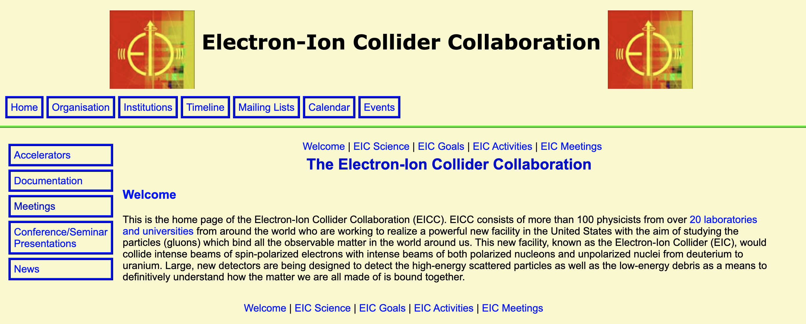
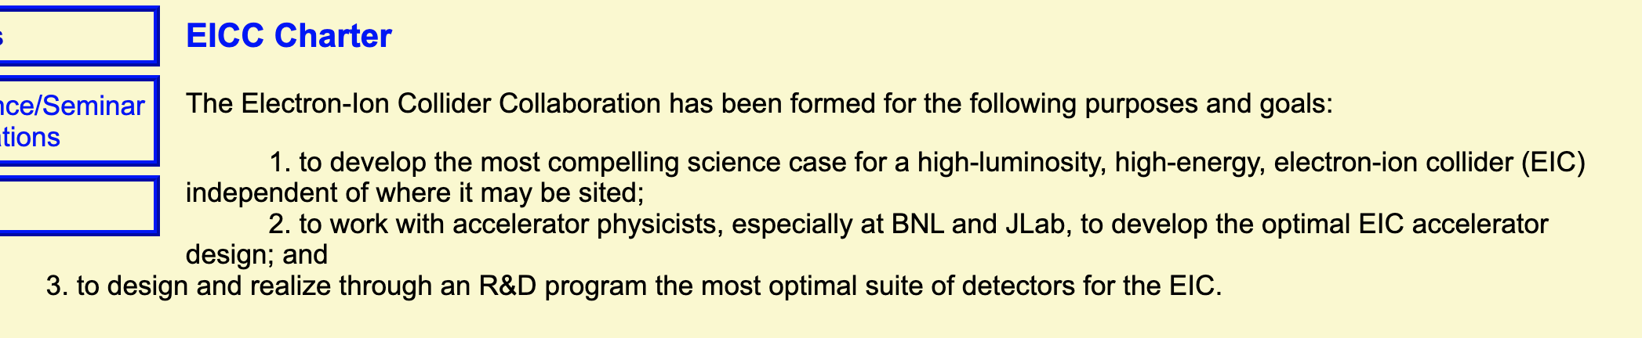
https://web.mit.edu/eicc/

Slide 37
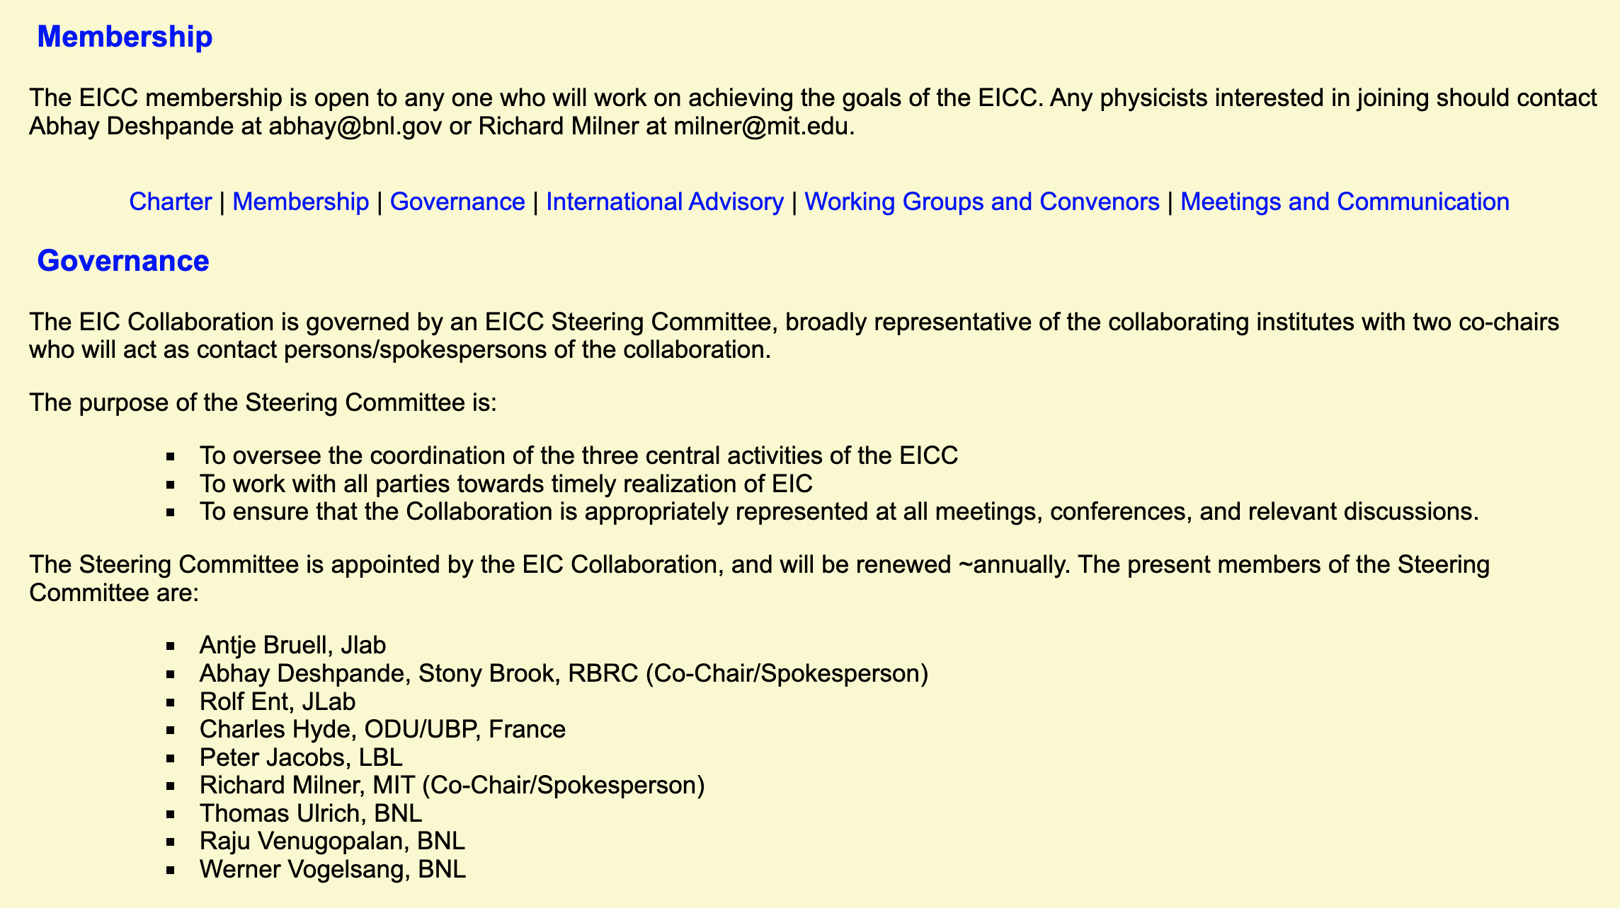
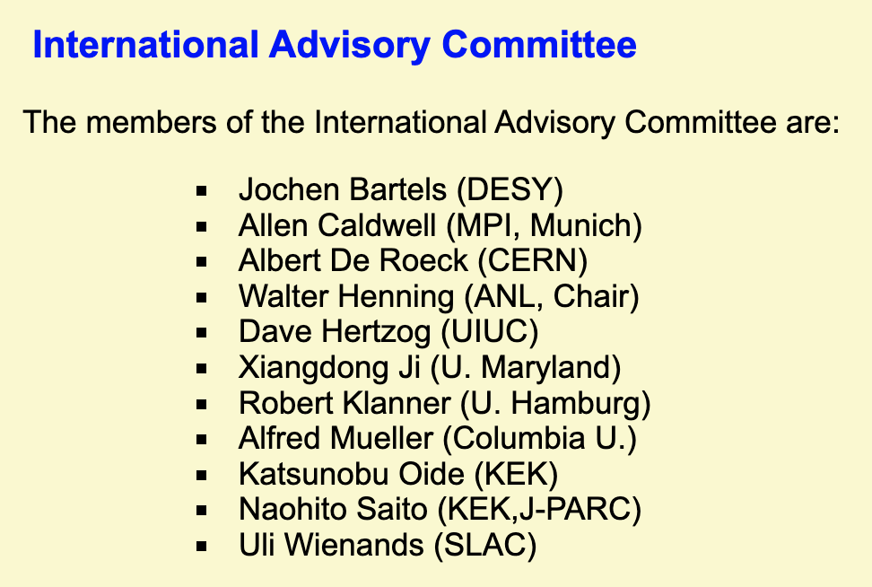

Slide 38
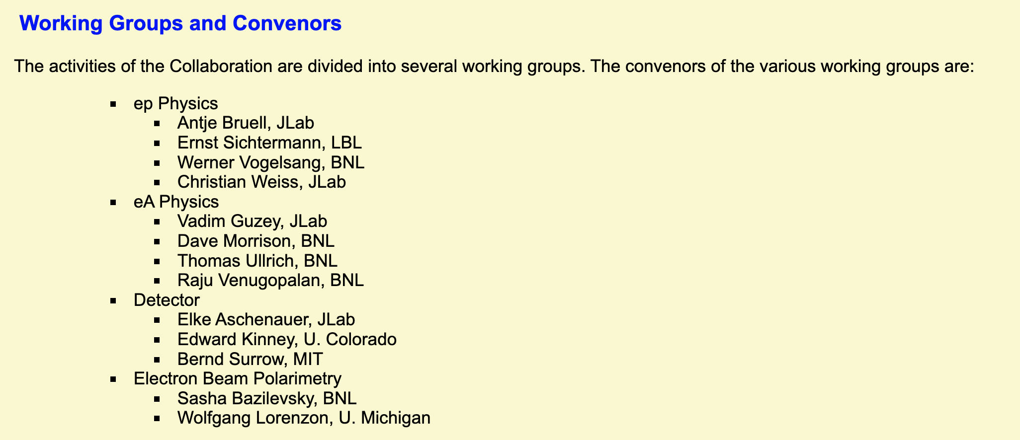

Slide 39
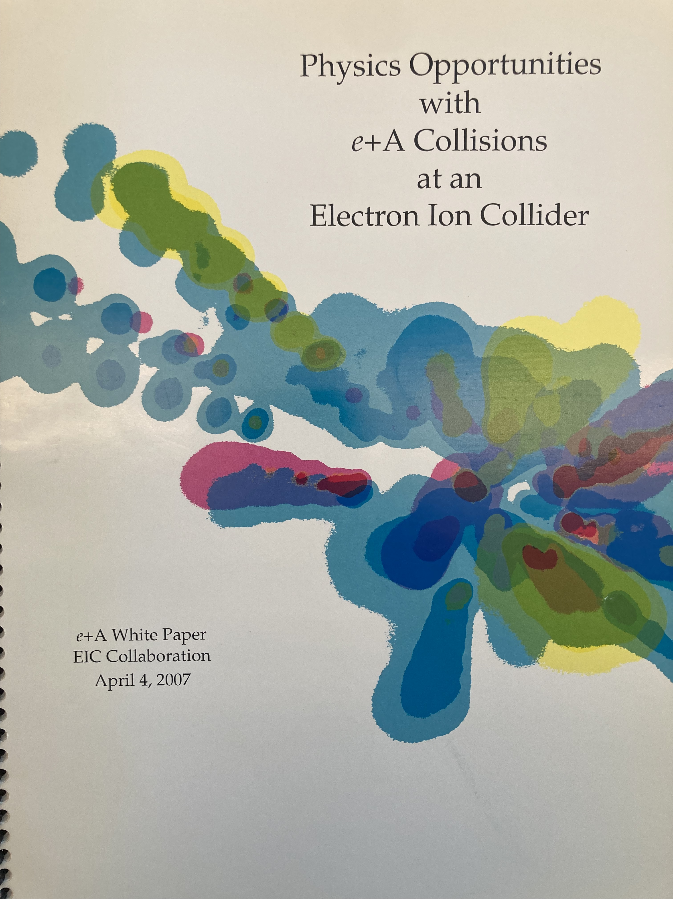

Slide 40
2007 Long Range Plan
In April 2007, the resolution meeting of the U.S. Long Range Plan took place in Galveston, Texas and discussions were led by Robert Tribble. This was preceded by Town Meetings in the diﬀerent sub-ﬁelds. The principal EIC proponents at the Galveston meeting were Abhay Deshpande, Rolf Ent, Richard Milner and Thomas Ullrich. A strong recommendation to pursue EIC R&D together with a dedicated chapter on the science in the report meant that the forward momentum for the EIC project continued. Steven Vigdor played a signiﬁcant role in writing the most eﬀective case for EIC in the 2007 long range plan document.

Slide 41
2007 Long Range Plan
2007
In April 2007, the resolution meeting of the U.S. Long Range Plan took place in Galveston, Texas and discussions were led by Robert Tribble. This was preceded by Town Meetings in the diﬀerent sub-ﬁelds. The principal EIC proponents at the Galveston meeting were Abhay Deshpande, Rolf Ent, Richard Milner and Thomas Ullrich. A strong recommendation to pursue EIC R&D together with a dedicated chapter on the science in the report meant that the forward momentum for the EIC project continued. Steven Vigdor played a signiﬁcant role in writing the most eﬀective case for EIC in the 2007 long range plan document.

Slide 42
INT Workshop Fall 2010
Following the 2007 U.S. Long Range planning exercise, an intensive ten-week workshop took place in fall 2010 at the Institute for Nuclear Theory at the University of Washington Seattle. The purpose was to bring together the world’s experts in QCD to make a comprehensive and broad study of the EIC science case with the aim of then writing a succinct and compelling summary paper for the subsequent U.S. long range planning exercise. Thus, a 538 page proceedings from the INT workshop was published in August 2011.

Slide 43
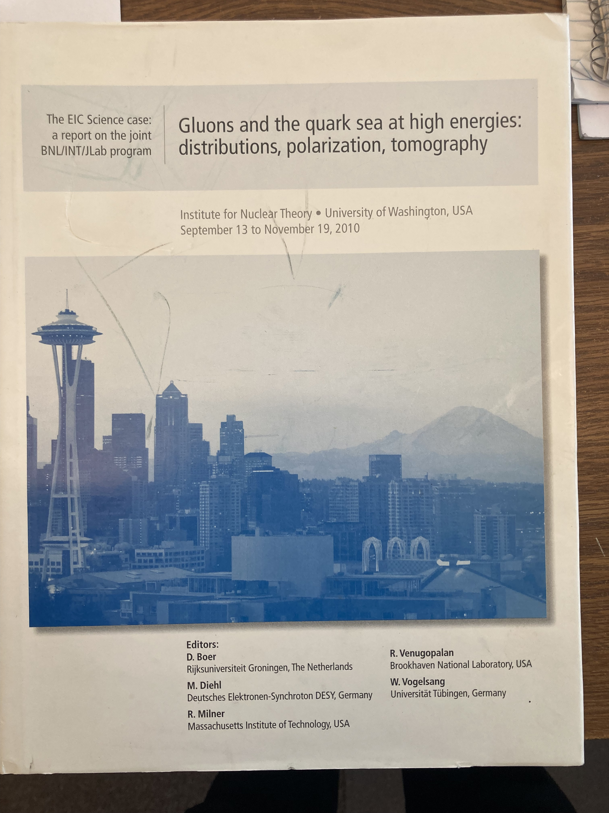
INT Workshop Fall 2010
Following the 2007 U.S. Long Range planning exercise, an intensive ten-week workshop took place in fall 2010 at the Institute for Nuclear Theory at the University of Washington Seattle. The purpose was to bring together the world’s experts in QCD to make a comprehensive and broad study of the EIC science case with the aim of then writing a succinct and compelling summary paper for the subsequent U.S. long range planning exercise. Thus, a 538 page proceedings from the INT workshop was published in August 2011.

Slide 44
EIC White Paper and
2015 Long Range Plan
Subsequently, Brookhaven National Laboratory and Jeﬀerson Laboratory, with Steven Vigdor (and later Berndt Mueller) and Bob McKeown together playing an important leadership role, led the writing of the EIC White Paper, which was ﬁrst published in 2012, and revised in 2014. Abhay Deshpande, Jian-Wei Qiu and Zein-Eddine Meziani were the lead editors of the EIC White Paper. This EIC White Paper presented the science case which was reviewed in the 2015 U.S. Long Range planning exercise.
In September 2014, a town meeting of the entire U.S. QCD community took place at Temple University in Philadelphia. The EIC was endorsed unanimously as the highest priority for new construction, after existing commitments were fulﬁlled. In April 2015, the Long Range Planning resolution meeting took place at Kitty Hawk, North Carolina led by Donald Geesaman. It unanimously endorsed the Electron-Ion Collider as the next facility to study QCD, after completion of existing commitments. Thus, an initiative which began in the mid-1990s by those intent on understanding the fundamental quark and gluon structure of matter using lepton scattering, had ﬁnally become the top priority for future construction for the U.S. nuclear physics community.

Slide 45

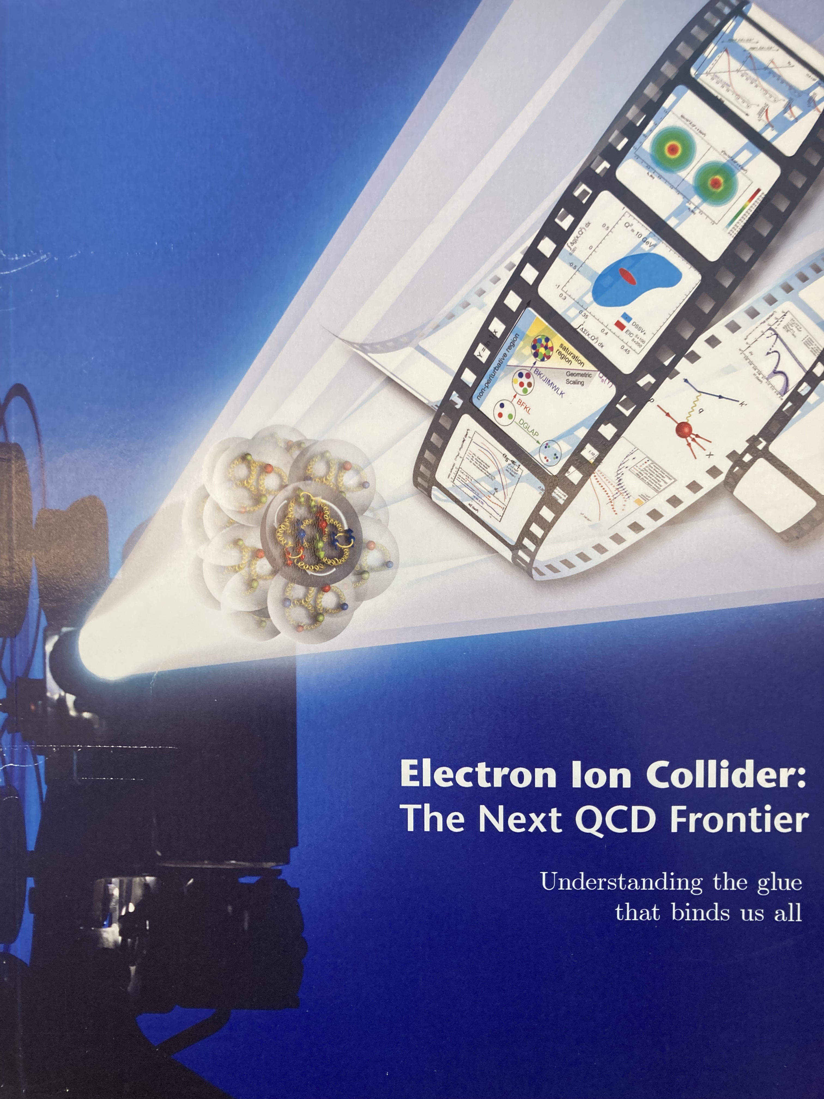
EIC White Paper
Subsequently, Brookhaven National Laboratory and Jeﬀerson Laboratory, with Steven Vigdor (and later Berndt Mueller) and Bob McKeown together playing an important leadership role, led the writing of the EIC White Paper, which was ﬁrst published in 2012, and revised in 2014. Abhay Deshpande, Jian-Wei Qiu and Zein-Eddine Meziani were the lead editors of the EIC White Paper. This EIC White Paper presented the science case which was reviewed in the 2015 U.S. Long Range planning exercise.
In September 2014, a town meeting of the entire U.S. QCD community took place at Temple University in Philadelphia. The EIC was endorsed unanimously as the highest priority for new construction, after existing commitments were fulﬁlled. In April 2015, the Long Range Planning res-olution meeting took place at Kitty Hawk, North Carolina led by Donald Geesaman. It unanimously endorsed the Electron-Ion Collider as the next facility to study QCD, after completion of existing commitments. Thus, an initiative which began in the mid-1990s by those intent on understanding the fundamental quark and gluon structure of matter using lepton scatter-ing, had ﬁnally become the top priority for future construction for the U.S. nuclear physics community.

Slide 46
National Academy of Sciences Evaluation of EIC Science Case
In 2017 and 2018, a committee appointed by the U.S. National Academy of Sciences and Engineering evaluated the science case for EIC. The committee, chaired by Ani Aprahamian and Gordon Baym, released a report in July 2018 that favorably endorsed the science case for EIC and emphasized the strategic importance for the U.S. of the accelerator science technology associated with EIC realization.
The U.S. National Academy of Sciences judged the physics case to be
“compelling, fundamental and timely.”

Slide 47
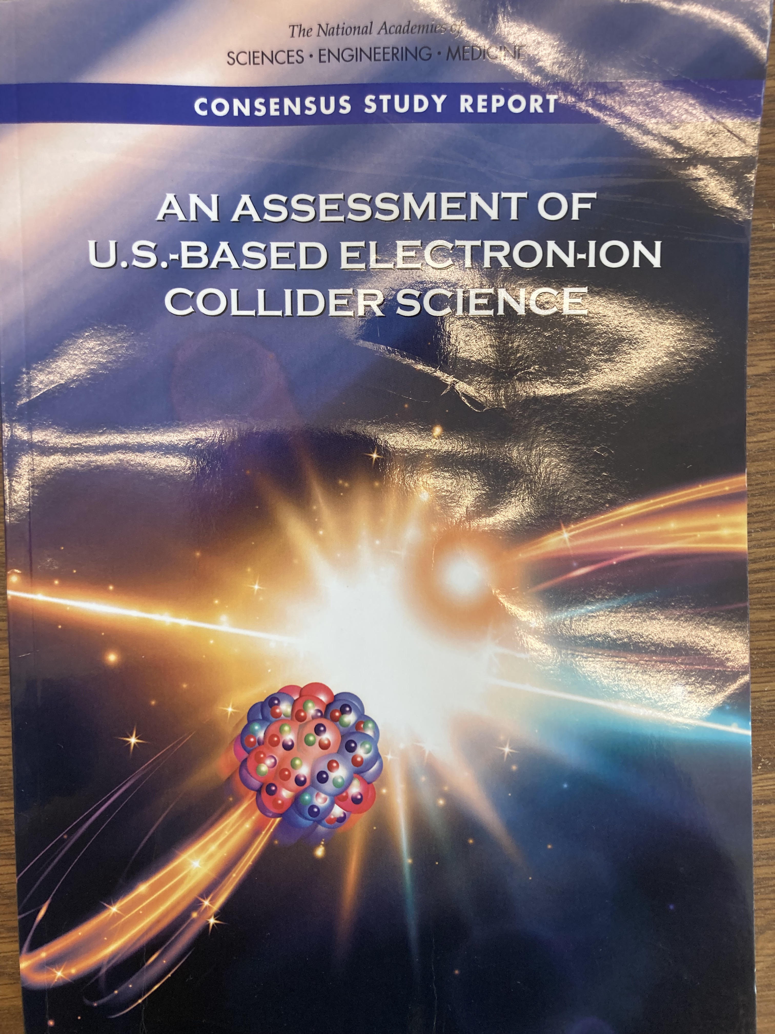
National Academy of Sciences Evaluation of EIC Science Case
In 2017 and 2018, a committee appointed by the U.S. National Academy of Sciences and Engineering evaluated the science case for EIC. The committee, chaired by Ani Aprahamian and Gordon Baym, released a report in July 2018 that favorably endorsed the science case for EIC and emphasized the strategic importance for the U.S. of the accelerator science technology associated with EIC realization.
The U.S. National Academy of Sciences judged the physics case to be
“compelling, fundamental and timely.”

Slide 48
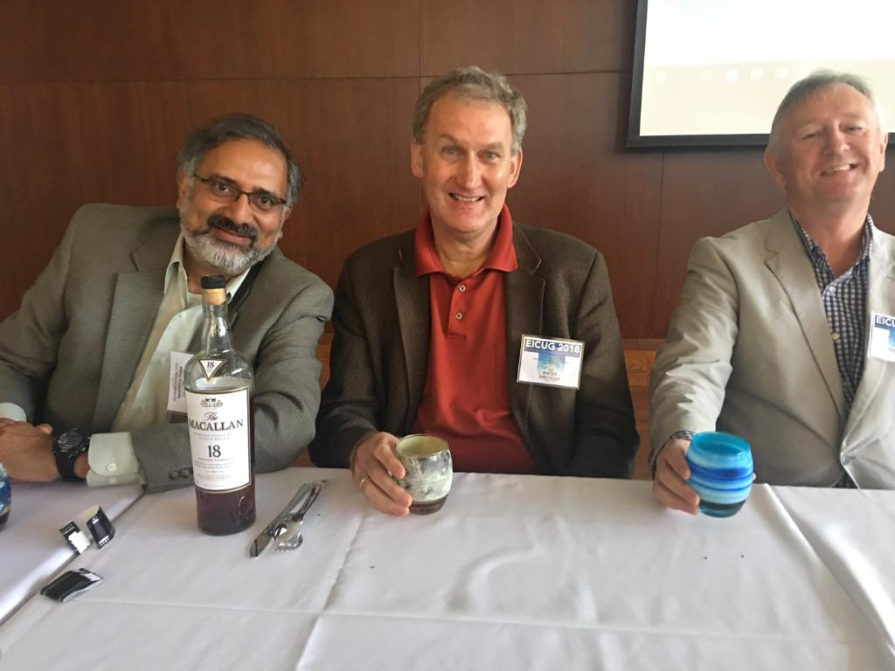
National Academy of Sciences Evaluation of EIC Science Case
In 2017 and 2018, a committee appointed by the U.S. National Academy of Sciences and Engineering evaluated the science case for EIC. The committee, chaired by Ani Aprahamian and Gordon Baym, released a report in July 2018 that favorably endorsed the science case for EIC and emphasized the strategic importance for the U.S. of the accelerator science technology associated with EIC realization.
The U.S. National Academy of Sciences judged the physics case to be
“compelling, fundamental and timely.”
EICUG Annual Meeting 2018

Slide 49
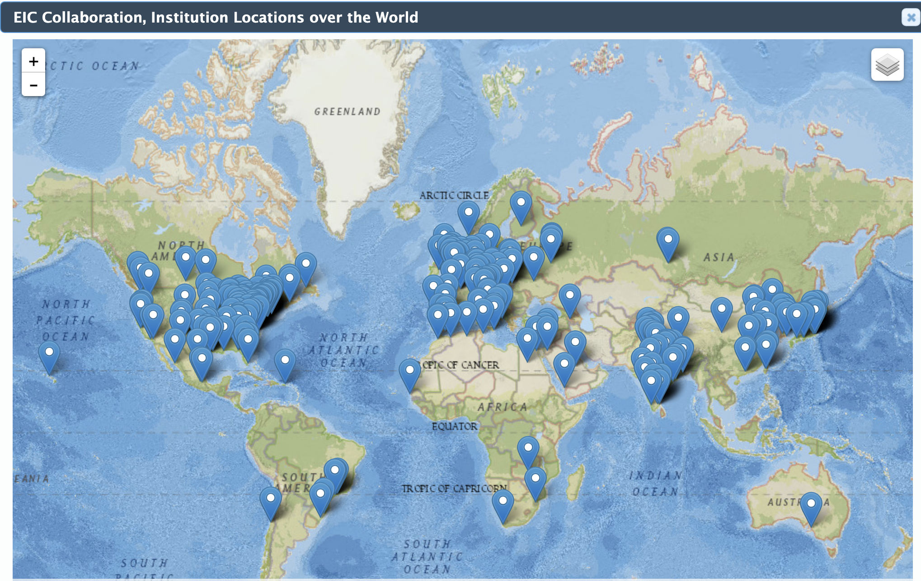
EIC Users Group Founded
In 2016 the EIC User Group was founded with the aim of promoting the science and technical case for EIC, independent of the siting.
By 2026, this has
over 1558
members from
more than 310
institutions in
41 countries
across the globe.

Slide 50
U.S. Governments Commits to
EIC Construction
December 2019: U.S. Department of Energy grants Critical Decision Zero: “mission need” for EIC
January 2020: U.S. Department of Energy launched EIC construction
EIC would be realized around the existing RHIC complex at BNL
Jefferson Lab a major partner with BNL in EIC
January 2021: U.S. Department of Energy grants Critical Decision One

Slide 51
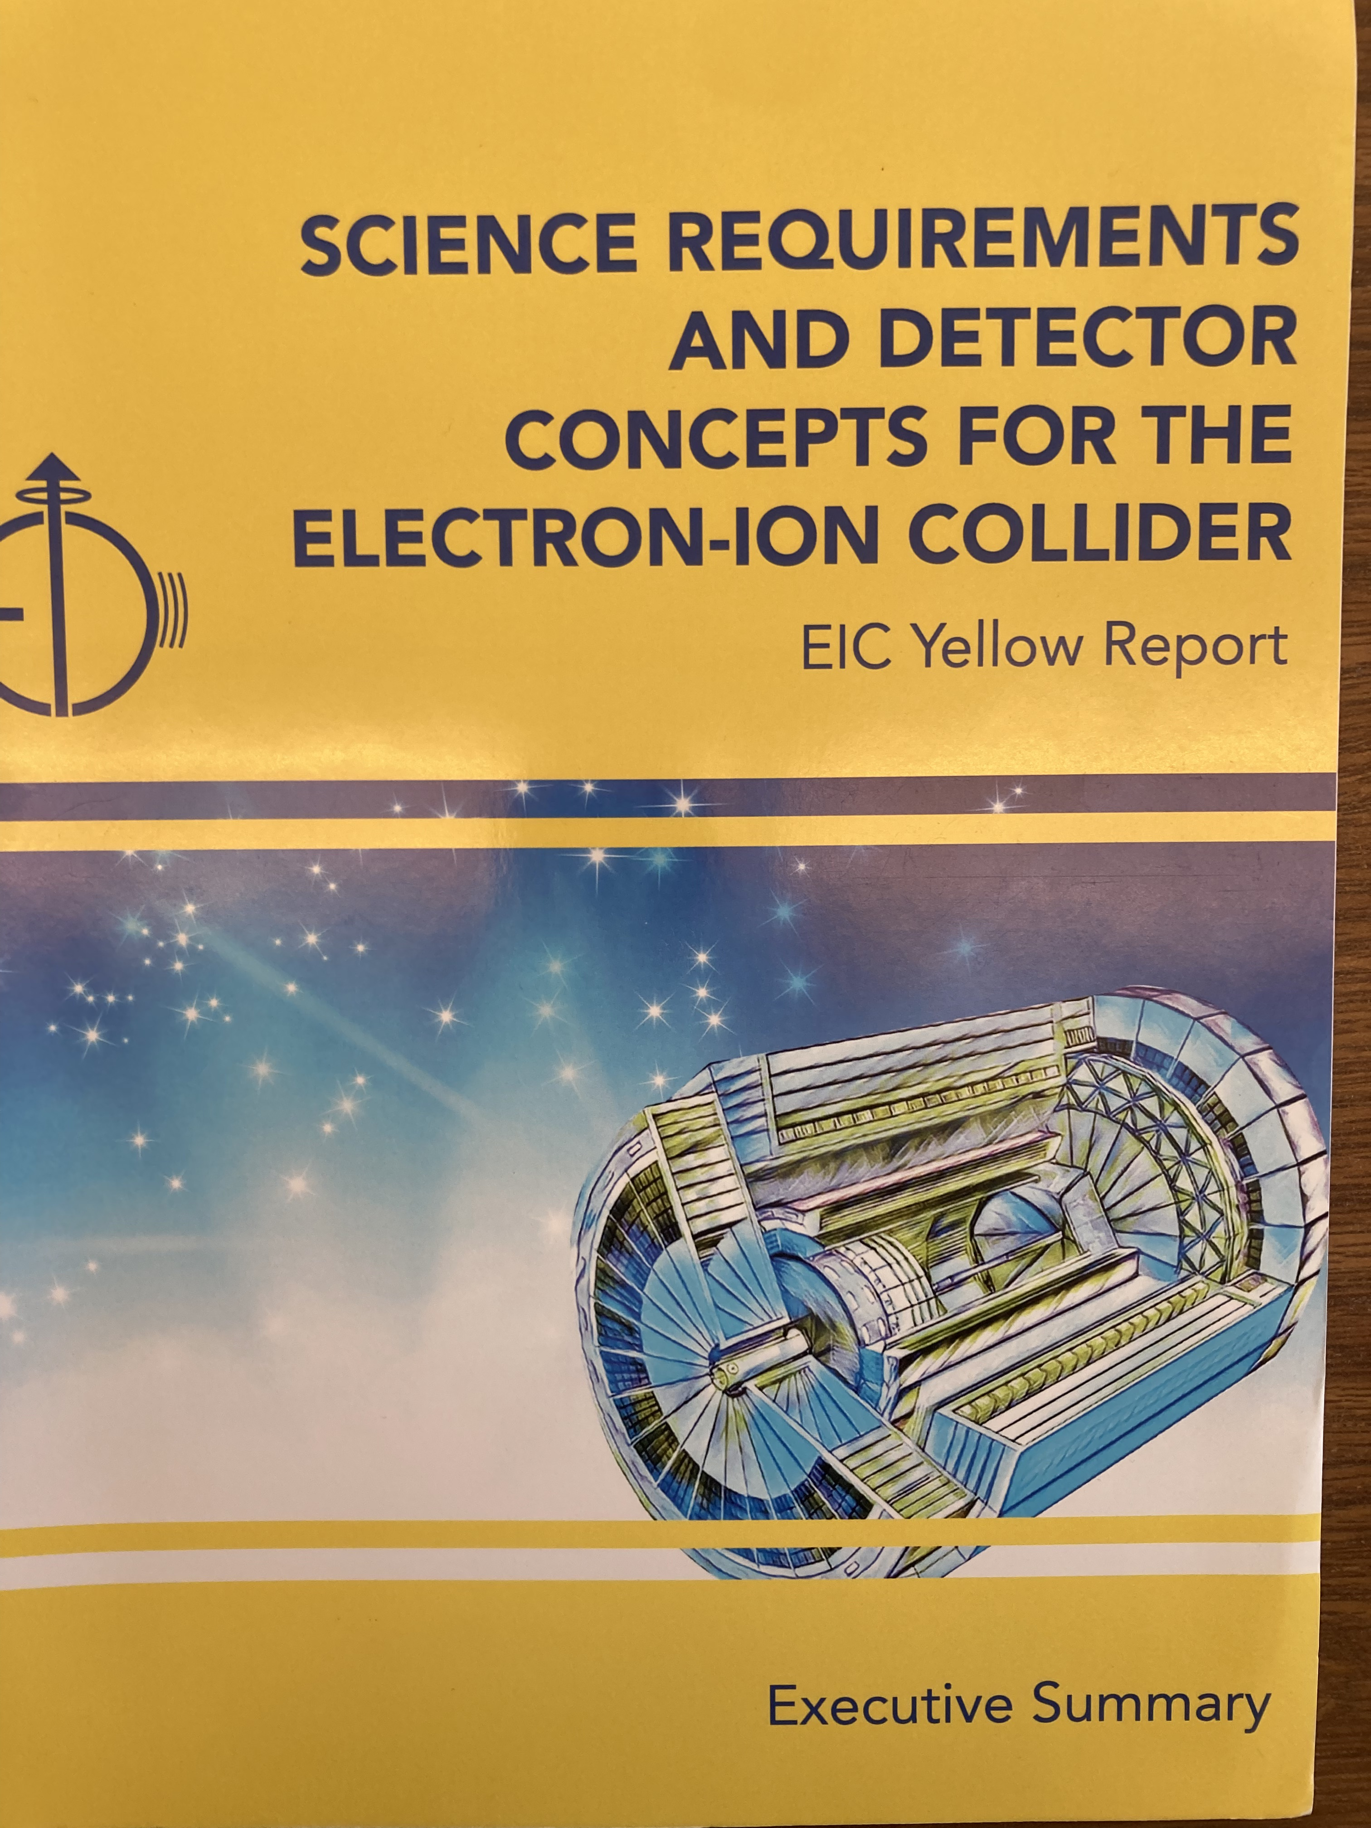
EIC Yellow Report
December 2019 – March 2021
Organizational in-person meeting
at MIT, December 2019.
Subsequently developed in a series
of remote meetings organized
around the world at the height of
the pandemic.

Slide 52
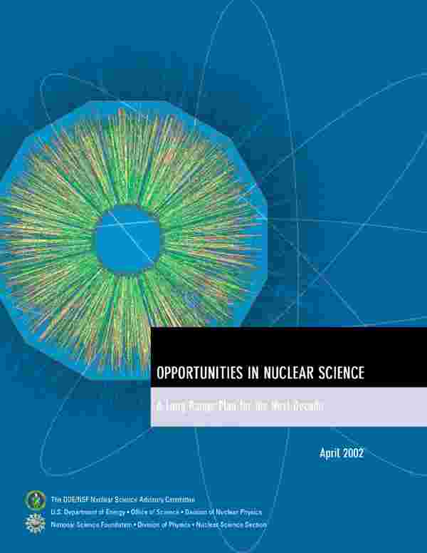
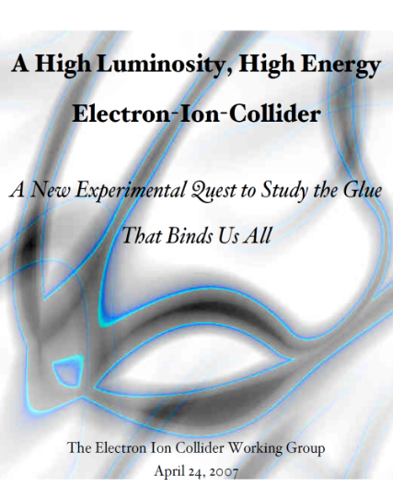
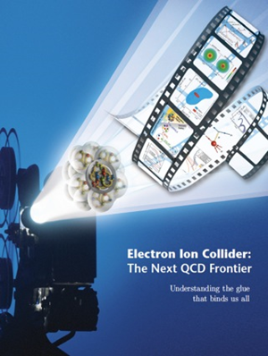
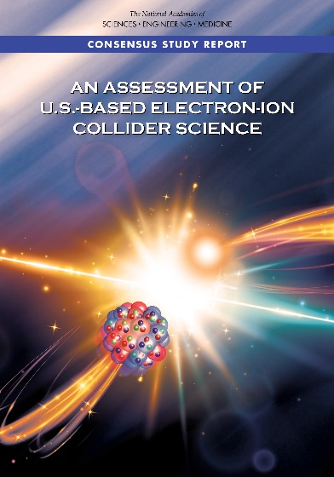

The Scientific Foundation for the EIC was Built Over Two Decades
2002
“a high-energy high-luminosity polarized EIC [is] the highest priority for new facility construction following the completion of FRIB.”
2007
The science questions that an EIC will answer are central to completing an understanding of atoms as well as being integral to the agenda of nuclear physics today.”
2009
2010
Gluons and the Quark Sea at High Energies
2012
2013
2015
Science Requirements and Detector Concepts for the EIC – Drives the requirements of EIC detectors
  High Level Requirements to Accelerator stable since the 2010 INT Program
Major Nuclear Physics Facilities for the Next Decade
2018
NSAC
2021
“…essential accelerator and detector R&D [for EIC] should be given very high priority
in the short term.”
2023
We recommend the expeditious completion of the EIC as the highest priority for facility construction.
“We recommend the allocation of resources …to lay the foundation for a polarized Electron-Ion Collider…”
March 14, 2013
“..a new dedicated facility will be essential for answering some of the most central questions.”
“The quantitative study of matter in this new regime [where abundant gluons dominate] requires a new experimental facility: an Electron Ion Collider..”
Electron-Ion Collider..absolutely central to the nuclear science program of the next decade.
arXiv:2103.05419

Slide 53
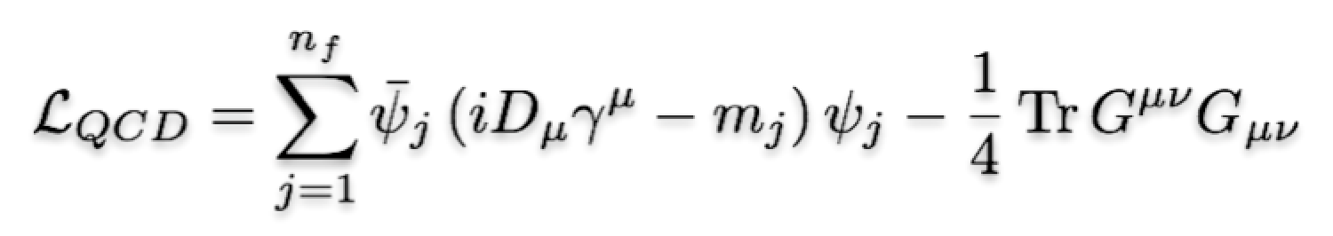
EIC: 21st Century QCD Laboratory
To explore the fundamental structure and dynamics of the matter in the visible world
Interactions arise through fundamental symmetry principles
Properties of the visible universe emerge through complex structure of the QCD vacuum
The proton is a highly relativistic system described by QCD, a fully relativistic quantum field theory.
Lattice QCD is an increasingly powerful means to carry out ab initio QCD calculations of hadron structure in the rest frame.
The goal of the EIC is to provide us with an understanding of the internal structure of the proton and more complex atomic nuclei that is comparable to our knowledge of the electronic structure of atoms themselves, which lies at the heart of modern technologies.

Slide 54

Large Reach of EIC in x and Q² with greatly increased luminosity inclusive, semi-inclusive, exclusive

Slide 55

EIC is NOT a high energy frontier machine

Slide 56
EIC is NOT a high energy frontier machine
EIC
LHC ~2 x 10⁻⁵ fm

Slide 57


Collider Specifications from Science
First drafted by Abhay, Rolf and RM at EICC meeting in Darmstadt in 2009.

Slide 58




Understanding
The Nucleus
Reality: experiments deal with hadrons
How do we relate the successful hadronic
description of the nucleus to the fundamental
quarks and gluons?
How does the nucleon with its structure and
properties emerge from quarks and gluons of
QCD?
What role does QCD play in the structure and
properties of nuclei?

Slide 59
In closing
EIC is the unique accelerator required to advance the frontiers of our understanding of the fundamental structure of matter in the twenty first century:
- first double-polarized e-p collider
- first e-A collider.
It is the first machine designed to probe the complex quantum world of the quarks and gluons of QCD.
It originated ~ 2000 from within the U.S. nuclear physics research community motivated by the desire to make a substantial advance in the study of the fundamental structure of matter.
Theoretical developments were essential to developing the convincing science case for a billion dollar class machine.
The 2010 INT program was pivotal in creating the EIC White Paper that led to the 2015 Long Range Plan recommendation, the successful NAS evaluation and decision by DOE to begin construction in 2020.
Going forward to realization, a healthy U.S. nuclear physics research community is essential to harvest the considerable investments in the Electron-Ion Collider, the ePIC detector and other scientific instrumentation. There will be surprises!

Slide 60

In closing
EIC is the unique accelerator required to advance the frontiers of our understanding of the fundamental structure of matter in the twenty first century:
- first double-polarized e-p collider
- first e-A collider.
It is the first machine designed to probe the complex quantum world of the quarks and gluons of QCD.
It originated ~ 2000 from within the U.S. nuclear physics research community motivated by the desire to make a substantial advance in the study of the fundamental structure of matter.
Theoretical developments were essential to developing the convincing science case for a billion dollar class machine.
The 2010 INT program was pivotal in creating the EIC White Paper that led to the 2015 Long Range Plan recommendation, the successful NAS evaluation and decision by DOE to begin construction in 2020.
Going forward to realization, a healthy U.S. nuclear physics research community is essential to harvest the considerable investments in the Electron-Ion Collider, the ePIC detector and other scientific instrumentation. There will be surprises!

