Slide 1
Making the EIC possible: machine perspectives
Sergei Nagaitsev
EIC Technical Director
May 15, 2026

Slide 2
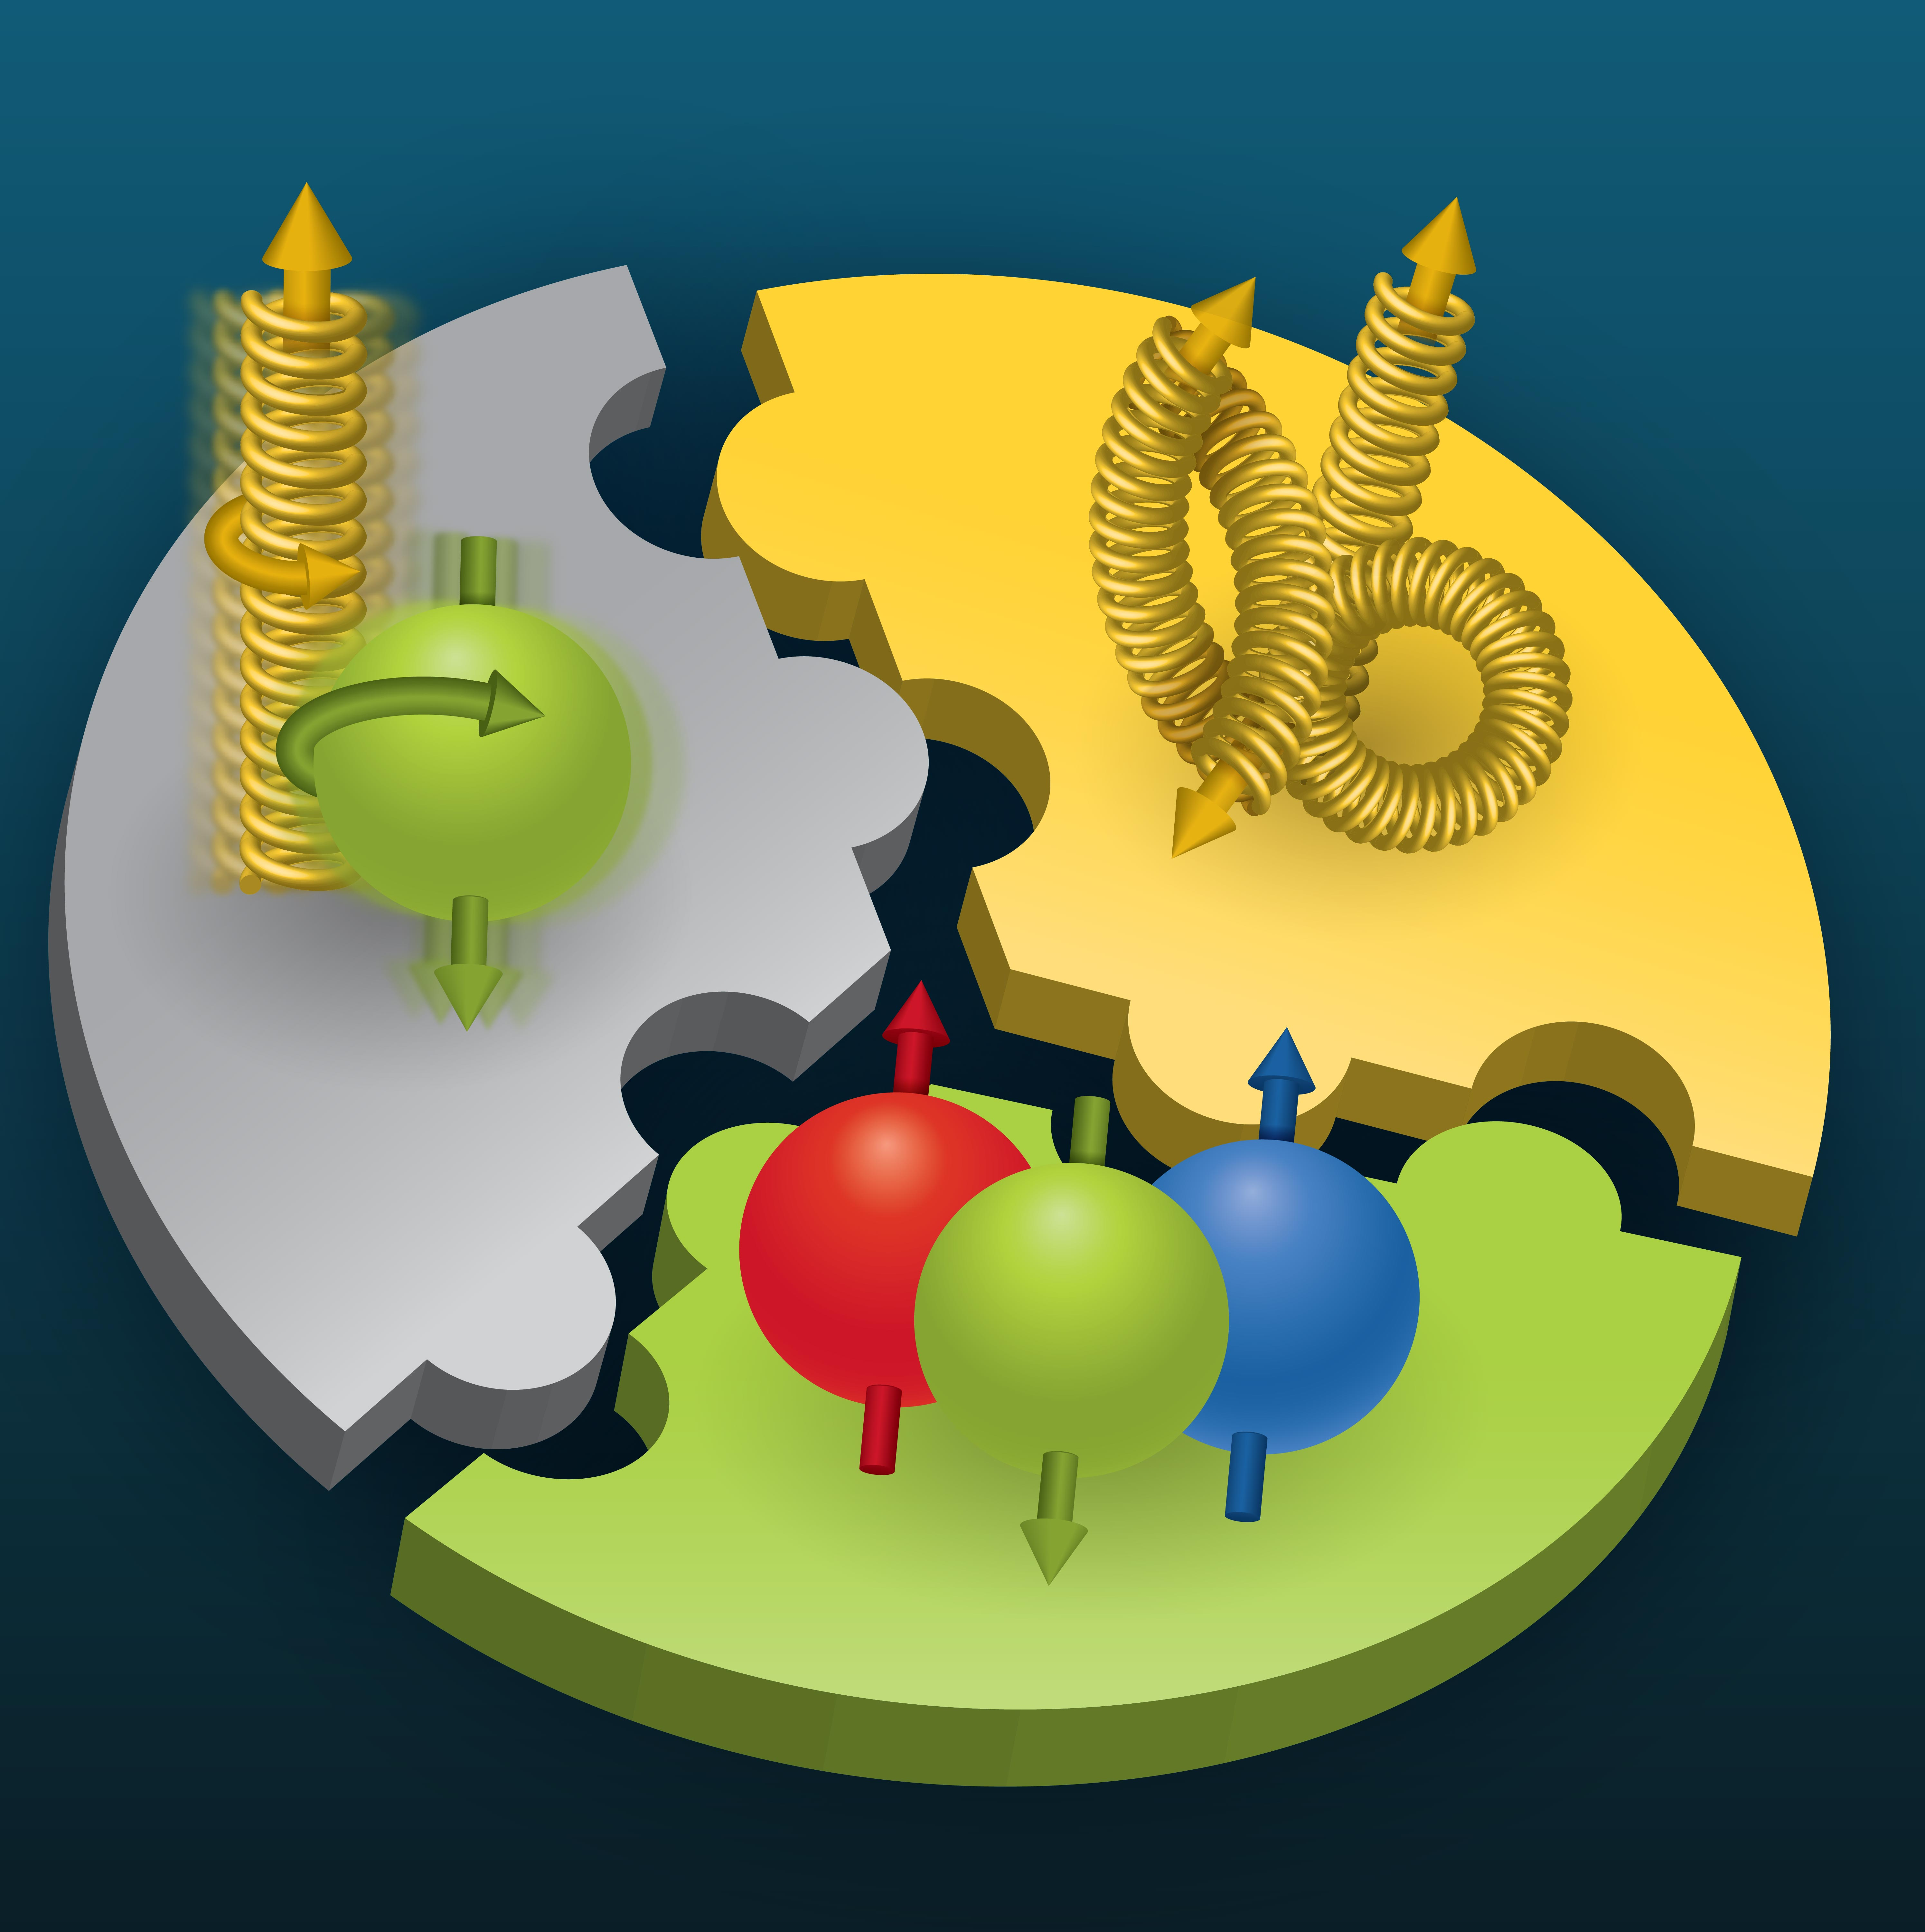

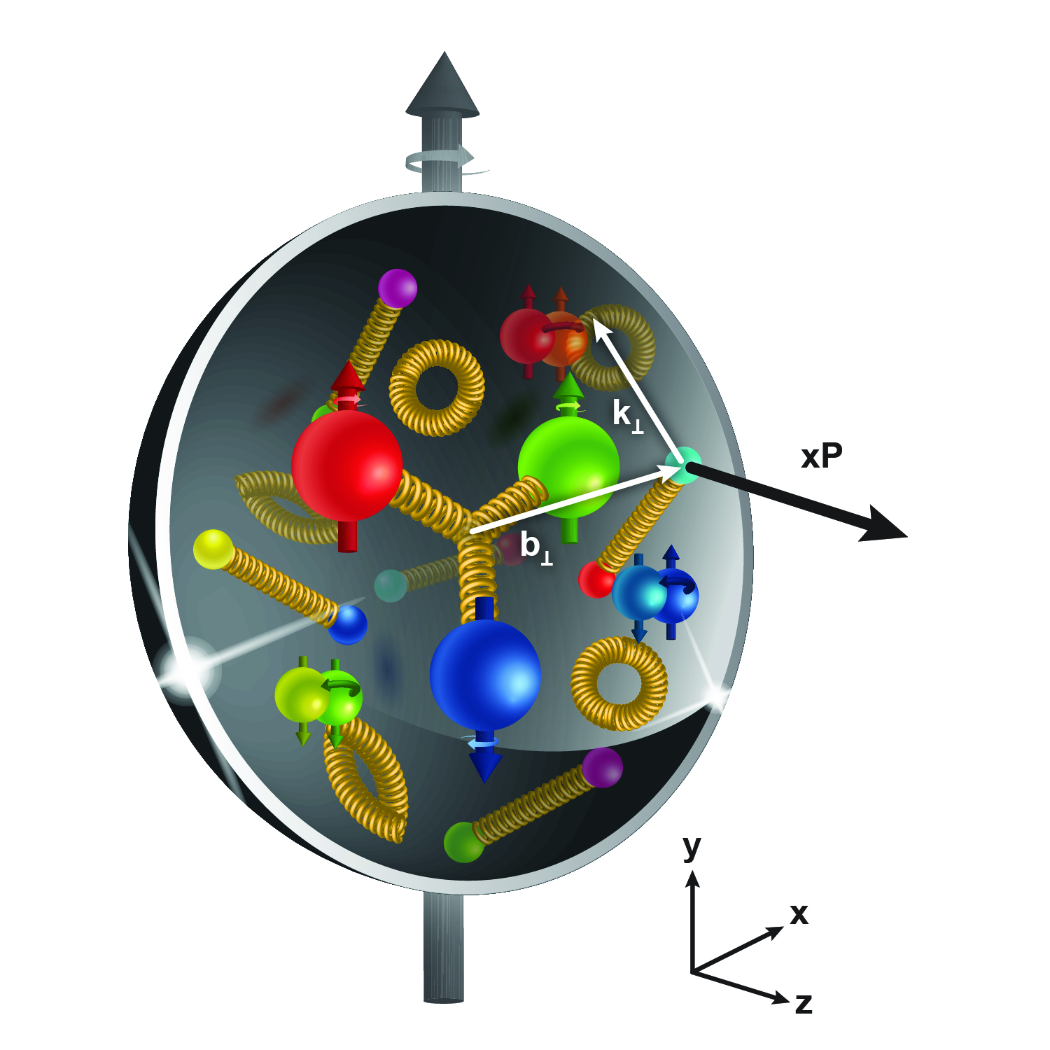
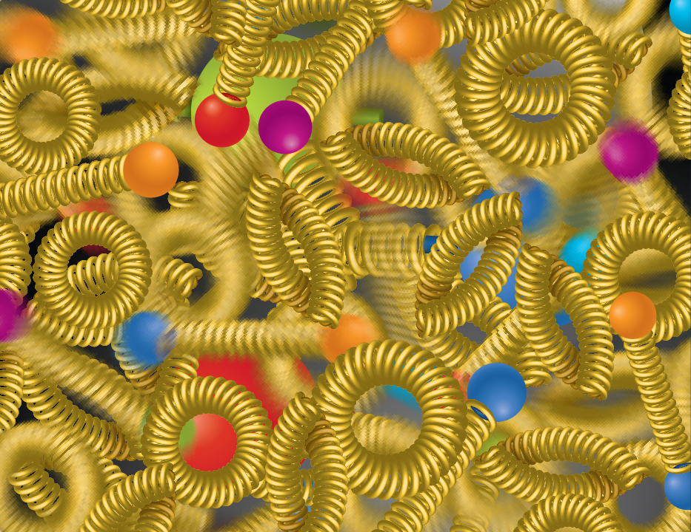
Compelling EIC Science Case
How do quarks, gluons, and orbital angular momentum contribute to proton spin?
Spin is a fundamental property of matter.
All elementary particles,
but the Higgs, carry spin.
Spin cannot be explained by a static picture, rather the interplay between the properties and interactions of quarks and gluons inside
the proton.
Does the mass of visible matter emerge from quark-gluon interactions?
Atom: Binding/Mass = 0.00000001
Nucleus: Binding/Mass = 0.01
Proton: Binding/Mass = 100
The EIC will determine an important term contributing to the proton mass, the so-called quantum chromodynamics (QCD) trace anomaly.
How can we understand QCD dynamics and the relation to confinement?
EIC will image quarks and gluons in 3D in space and momentum inside the nucleon and nuclei and uncover how the nucleon properties emerge from quarks and gluons and their interactions.
How do quark-gluon interactions create nuclear binding?
Is the structure of a free and bound nucleon the same?
How do quarks and gluons, interact with a nuclear medium?
How do the confined hadronic states emerge from these quarks and gluons?
Does gluon density in nuclei saturate at high energy?
How many gluons can fit in a proton?
How does a dense nuclear environment affect the quarks and gluons, their correlations and interactions?
=
gluon
splitting
?
gluon
recombination
National Academies of Sciences, Medicine, and Engineering, 2018 Consensus Study Report)

Slide 3
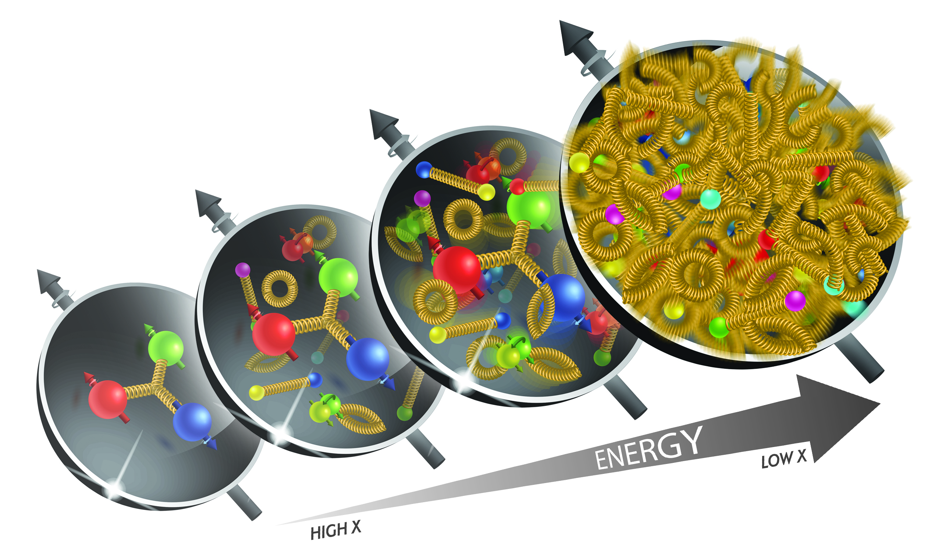
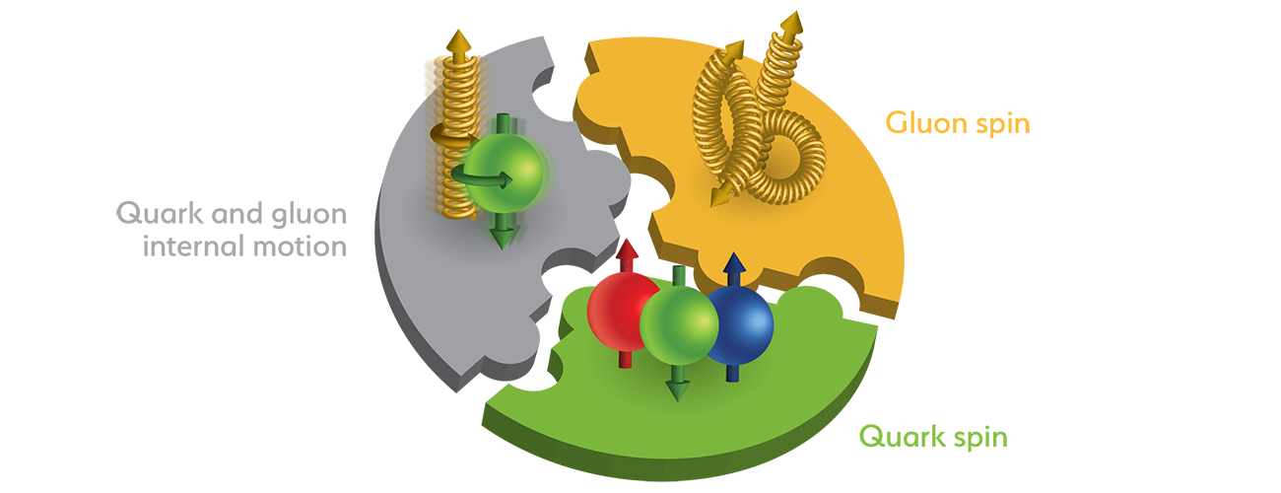
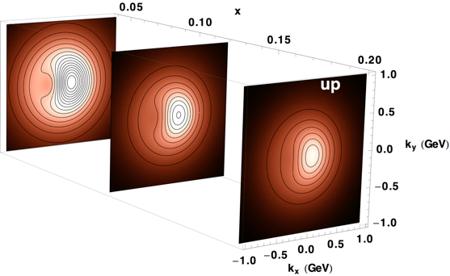
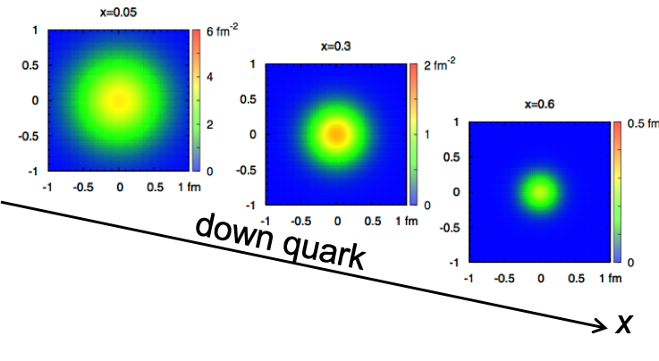
EIC Accelerator Performance
wide center-of-mass energy √s: 20 – 140 GeV :
map the out nucleon and nuclei structure from high to low x
polarized electron and hadron (p, He-3) beams:
access to spin structure of nucleons and nuclei
Spin vehicle to access the spatial and momentum structure of the nucleon in 3d
Full specification of initial and final states to probe q-g structure of NN and NNN interaction in light nuclei
nuclear beams: p to Uranium
accessing the highest gluon densities → saturation
quark and gluon interact with a nuclear medium
high luminosity 10³³-10³⁴ cm⁻²s⁻¹ :
mapping the spatial and momentum structure of nucleons and nuclei in 3d
access to rare probes, i.e. Ws
large acceptance (0.2 – 1.3 GeV) through forward focusing IR magnets
spatial imaging of nucleons and nuclei
gluon emission
gluon recombination
?
=

Slide 4
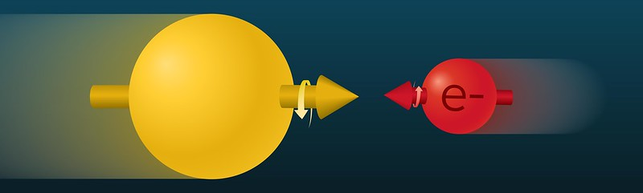
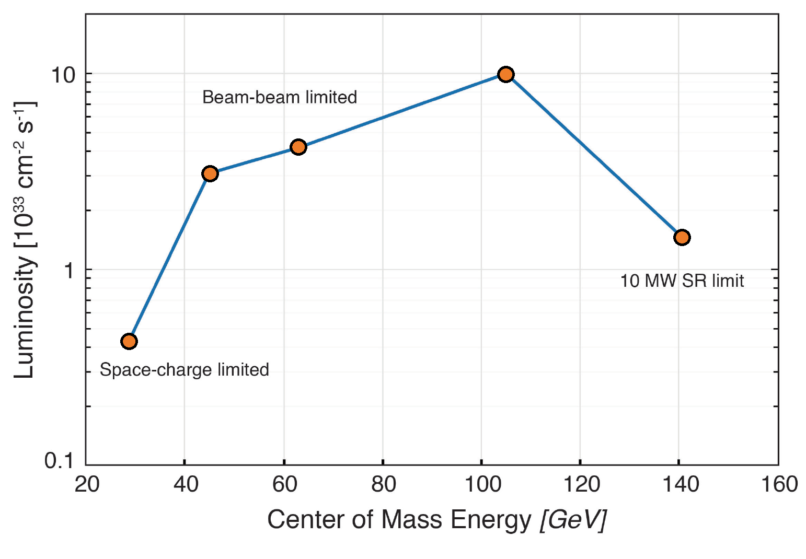
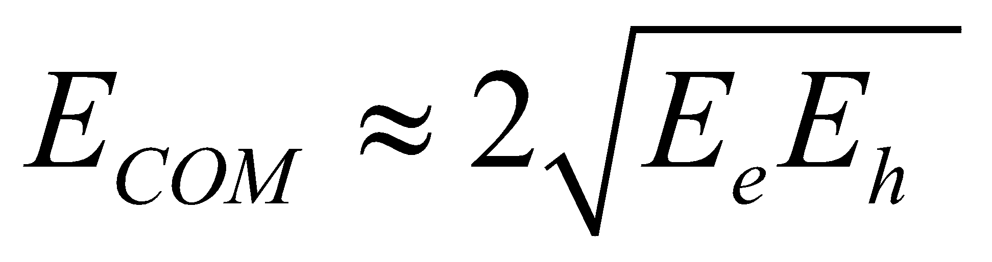
EIC Accelerator Performance Requirements
Center-of-mass energies: E_{cm} = ~20 – 100 GeV (upgradeable to 140 GeV)
High degree of beam polarization: ~70%
Availability of ion beams: from proton to Uranium
Luminosity: 10³³ – 10³⁴ cm⁻²sec⁻¹
Possibly more than one IR
Figure of merit: to
10x275
Based on the 2015 US NSAC Long-Range Plan
5x100
Bunch charges: 28 nC (10 GeV, e) and 11 nC (275 GeV, p)
10x100
18x275
5x41
EIC peak luminosities (CDR)

Slide 5
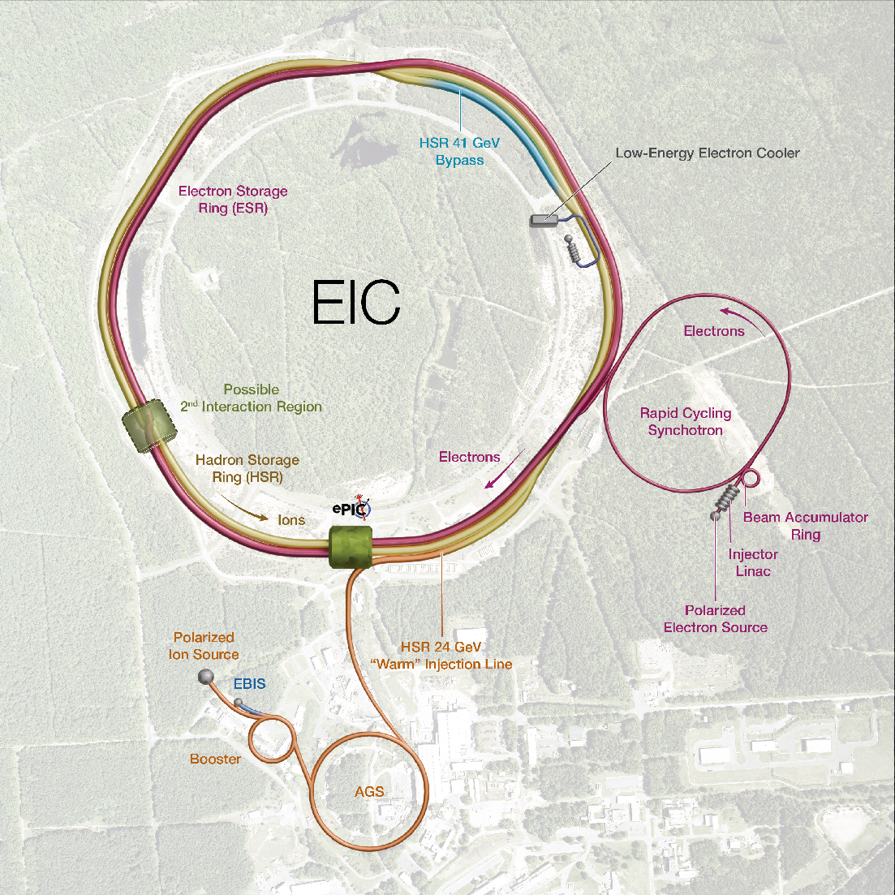
EIC concept

Slide 6
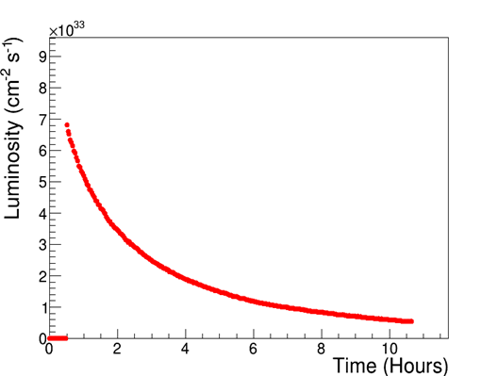
Luminosity performance
“Flat” proton bunches allow for high initial luminosity
CoM Energy (GeV) | Average Lumi (x10³³ cm⁻²s⁻¹) (per 4-hour store)
105 | 3
63 | 1.2
45 | 1
140 | 0.44
29 | 0.13
10x275
Optimal store duration
~4 hours
Average
Lumi
10x275
Upgrade
5x100
10x100
18x275
ESR fill
Detector Off
5x41
EIC peak luminosities (CDR)

Slide 7
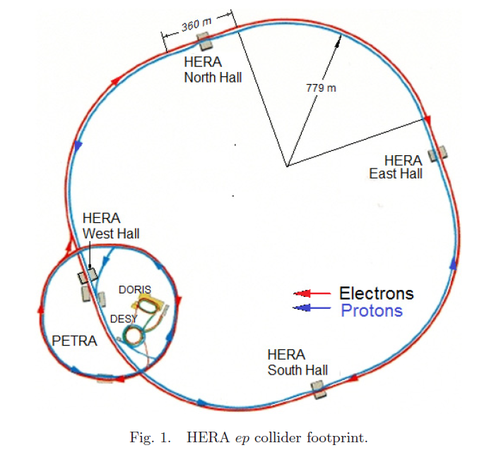
HERA (1992 – 2007)
920 GeV protons (unpolarized)
27.5 GeV electrons (self-polarized by the Sokolov-Ternov effect)
HERA peak luminosity: ~5x10³¹ cm⁻²s⁻¹
at E_{COM} = 318 GeV
The EIC is an electron – ION collider (HERA was an e-p collider)
Variable CoM energy
EIC beams are polarized, starting from the source
New modern particle detector
EIC luminosity is a factor of ~200 higher

Slide 8
HERA vs EIC: key parameters
HERA EIC FACTOR
Circumference (km) 6.3 3.8 1.7
Number of bunches 174 1160 6.7
Proton bunch charge (nC) 11.7 11 1
Electron bunch charge (nC) 5.3 28 5.3
Bunch length (cm), p/e 16/0.9 6/0.7
Beta at IP (cm), proton H/V (cm) 245/18 80/7.2
Beta at IP (cm), electron H/V (cm) 62/26 45/5.6
Proton emittance, (nm, rms) 4/4 11/1
Electron emittance, (nm, rms) 20/3 20/1.3
Energy (COM), GeV 320 105
Luminosity, x10³¹ cm⁻²s⁻¹ 5.3 1000 190
60
~3

Slide 9

Key EIC accelerator concepts
Ribbon-like (flat) hadron beam (11:1 transverse emittance/size ratio)
Large crossing angle (25 mrad)
Operating at beam-beam limits for both beams (0.1 e/ 0.01 p)
Spin preservation from source to collisions (protons and electrons)
Very high bunch intensities and circulating beam currents (1 A (p), 2.5 A (e))
Upgrade path: high-energy hadron cooling at collisions, 2nd detector
These are the key concepts that allow to attain luminosity of ~10³⁴ cm⁻²s⁻¹ and maintain high polarization at collisions over a broad range of CoM energies

Slide 10
Key EIC Accelerator Technology Areas
Hadron Beam Cooling
Spin-transparent optics
  High polarization for both beams from source to collisions
  Swap-out injection for electron bunches (at 1 Hz) to maintain high polarization in the ESR
SRF (Crab and elliptical) cavities
  Large-size, complex geometries;
  High-power; HOMs
  Very tight phase and amplitude noise requirements
IR magnets (large aperture, one-of-a-kind SC magnets)
Instability and impedance control;
  Maintain low impedance budget for vacuum chambers, beam screens, kickers, SRF cavities

Slide 11
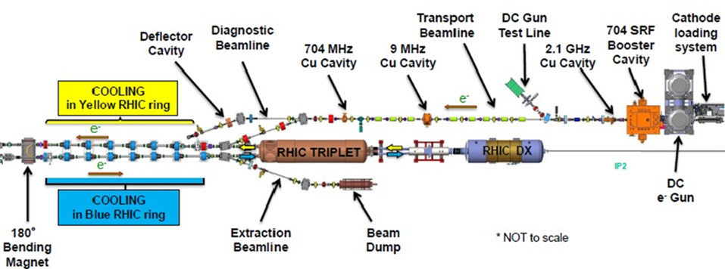
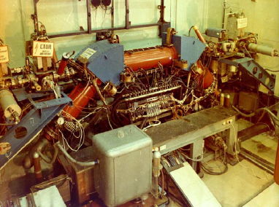
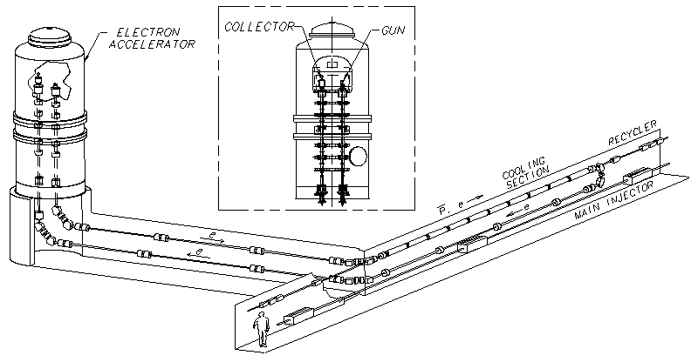
Hadron beam cooling
LEReC was designed to operate at electron energies up to 2.6 MeV
(using single-cell SRF accelerating cavity).
S. Nagaitsev, et al. “Experimental Demonstration of Relativistic Electron Cooling”, Phys. Rev. Lett. 96, 044801 (2006)
Experimental
demonstration of electron cooling
at NAP-M
(Novosibirsk, 1974).

Slide 12
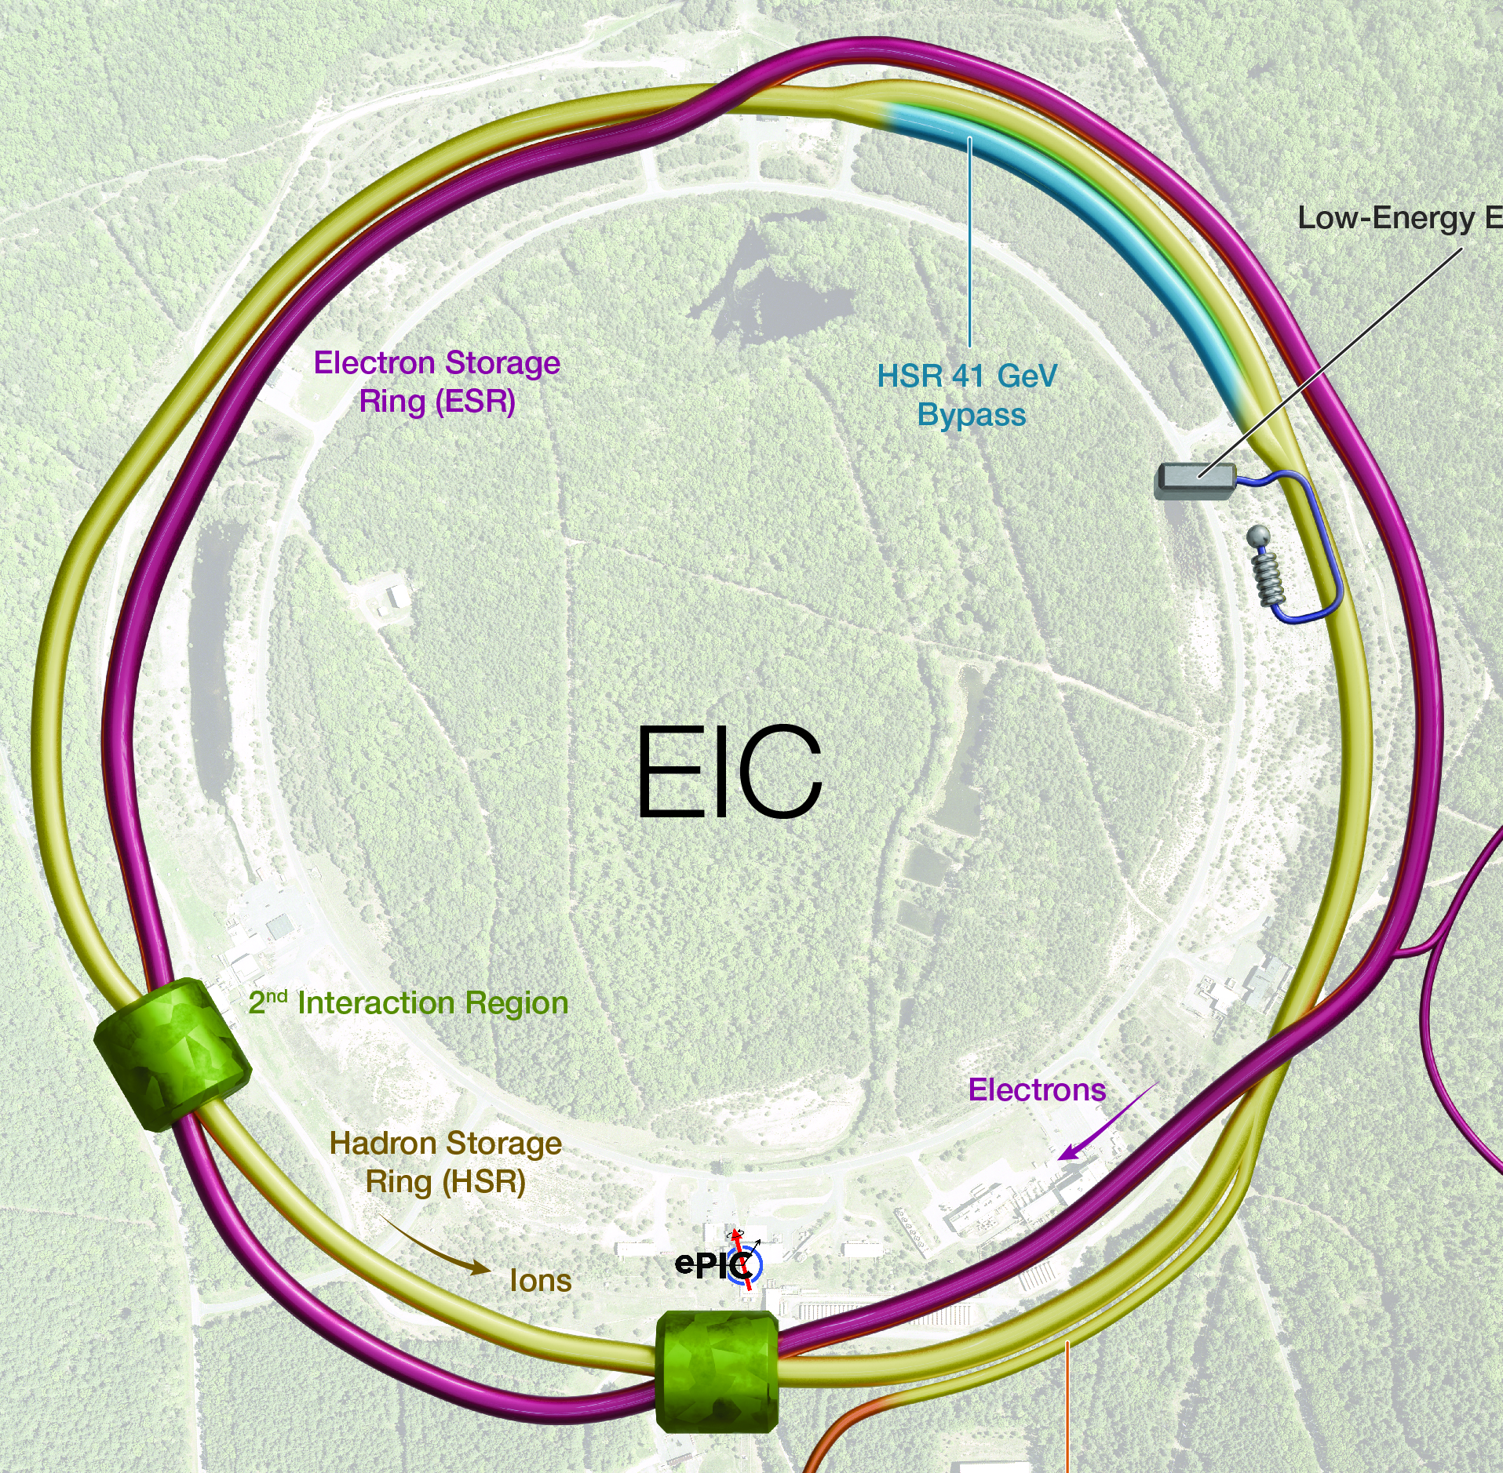
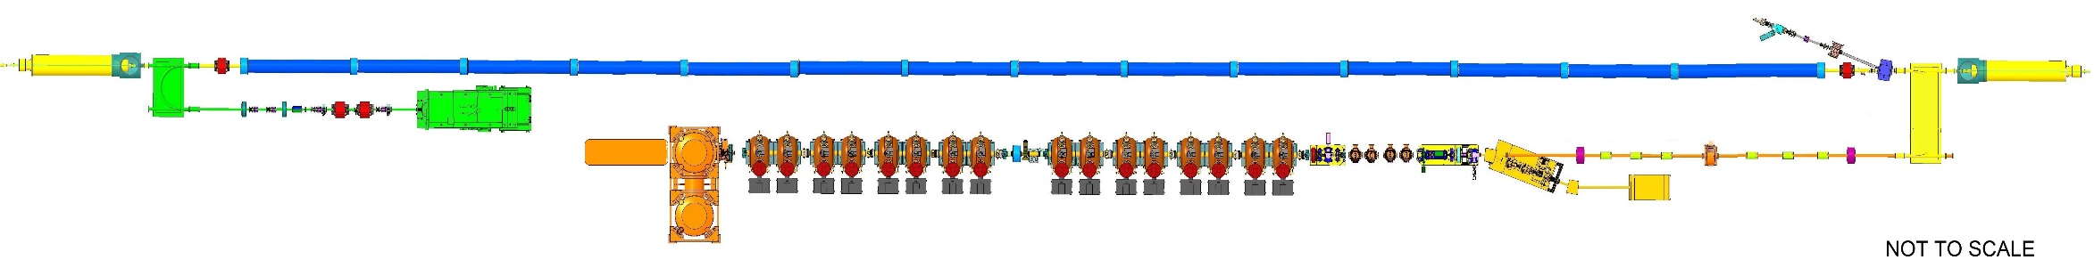
Low-energy Cooler Concept
24 GeV protons
12.5 MeV electrons
RF diagnostics line with Deflecting cavity
180°Dipole
(U-turn)
LEReC
Cooling Solenoids
180° Dipole
Spectrometer
Not to scale
Mu-metal shielding
Quad
150 m cooling section
cooling
RF diagnostic
hadron
hadron
hadron
e⁻
HSR
e⁻
HSR
e⁻
extraction
transport
IR2 layout
(all within the
existing RHIC
Tunnel)
Injector test
injection
SC Quad
PM
Cathode transport
PM
PM
Solenoids
Laser
197 MHz
130 kW Beam Dump
Extraction line
900 kW Beam Dump
4x 591 MHz
NCRF correction Cavities
DC Gun
400kV
Injector/linac
Test line
24MHz
RF cavity
16x 197 MHz
NCRF LINAC
Compatible with future beam cooling upgrades at the collision energies

Slide 13
EIC Low Energy Cooler Parameters
LEReC (2019-2025) key
parameters for reference
 | electrons | protons
gamma | 25.4 | 25.4
RHIC RF frequency, MHz | 197 | 24.6
Cooling section length, m | 168 | 168
Cooling sections beta function, m | 150 | 100-200
Hadrons Dy, Dy’, m, rad |  | <1, <0.02
Total charge per proton bunch, nC | 3 | 45
Electrons kinetic energy, MeV | 12.46
Electron average current, mA | 74
Normalized emittance, rms, um | <1.5 | 2
rms bunch length, cm | 4 | 100
rms dp/p | <5e-4 | 6e-4
Angles in cooling section, urad | 20-30 | 20
electrons
4-5
704 MHz (9 MHz)
20 m
30 m
3 nC
1.6-2 MeV
30 (60 mA in tests)
<2 um
5 cm
<5e-4
<150 urad
A. V. Fedotov et al., Phys. Rev. Lett. 124, 084801 (2020)

Slide 14
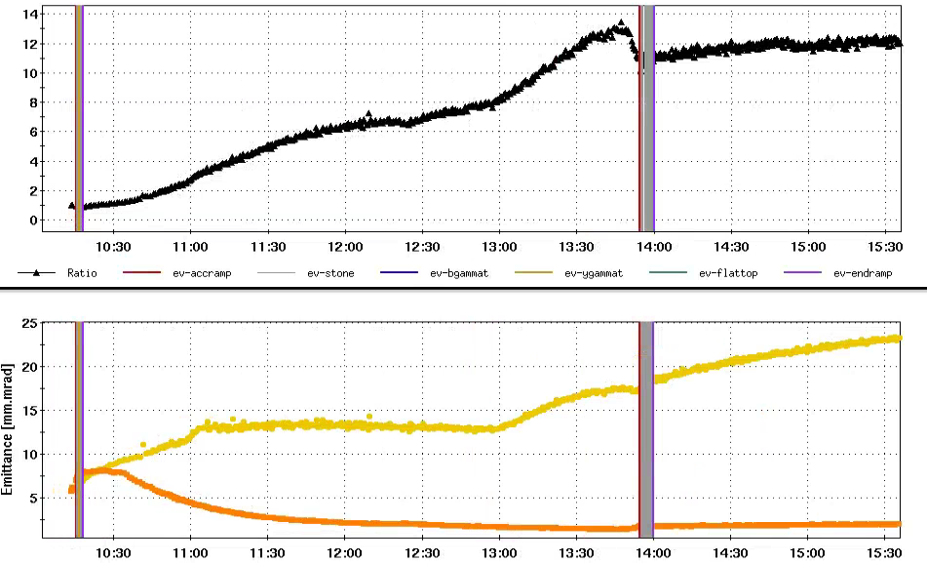
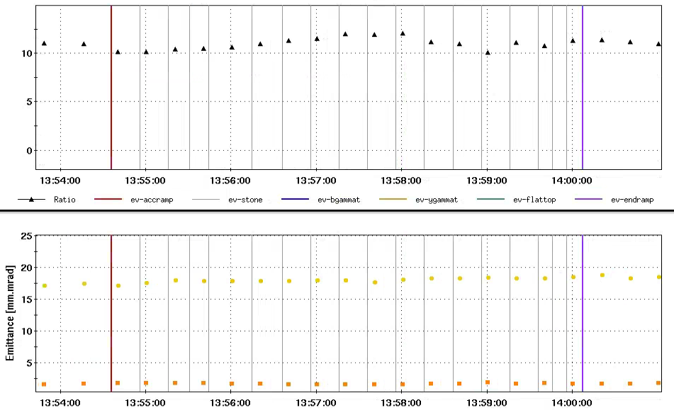
Flat Beam Acceleration Experiment in RHIC
July 23, 2025
Maximum transverse beam emittance ratio 13:1 was obtained with stochastic cooling at 31 GeV/nucleon
Transverse emittance ratio 11:1 was well maintained during acceleration from 31 GeV/nucleon to 100 GeV/nucleon
Flat beam was stored at 100 GeV/u with EIC/HSR tunes for ~2 hours, 11:1 emittance ratio was well maintained too
Entire store duration
31 GeV
During Acceleration
100GeV
Emittance Ratio
Emittance Ratio
Emittance ratio
100GeV
31 GeV
Emittance ratio
Horizontal Emittance
Horizontal Emittance
IBS growth
Acceleration
Vertical Emittance
Vertical Emittance

Slide 15
Electron beam polarization

Slide 16
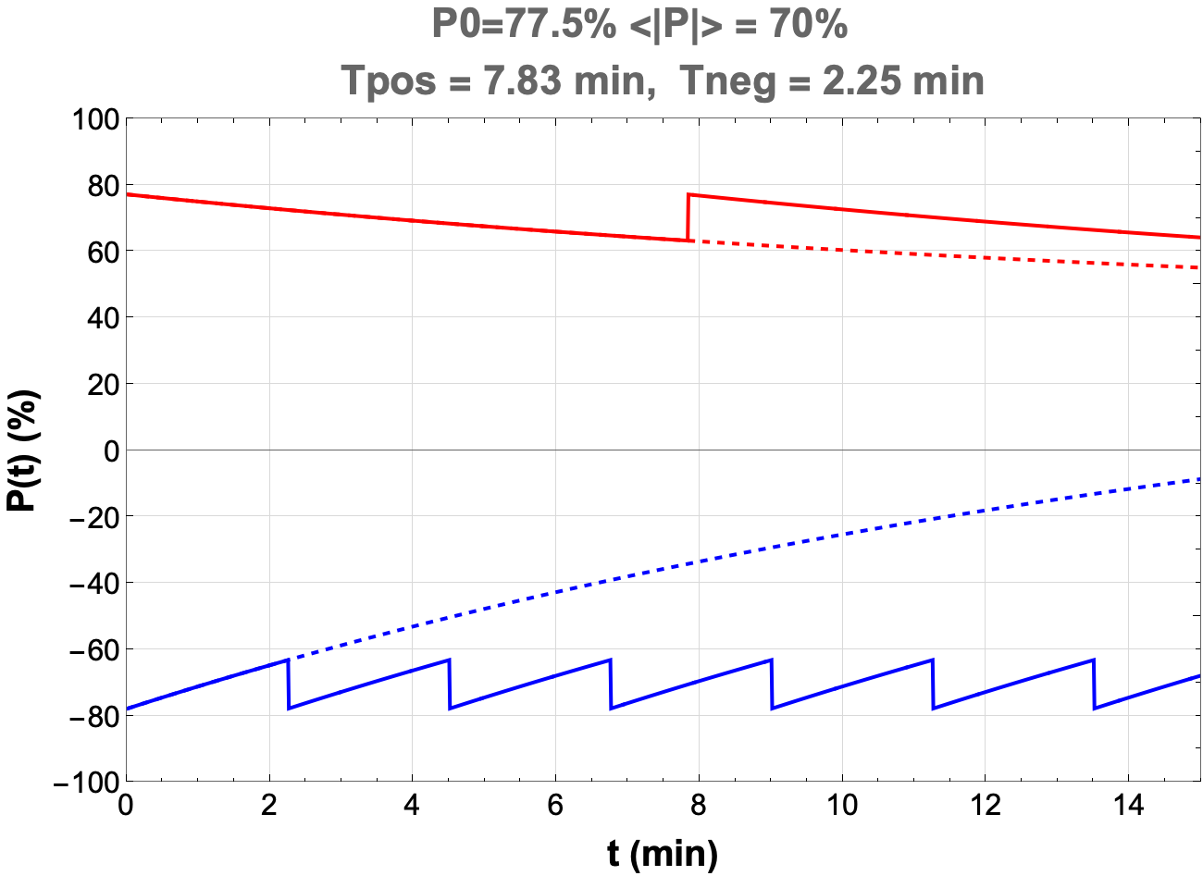
Electron polarization loss in the ESR
Frequent swap-out injection of bunches with high initial polarization of 85%
  Bunch spacing is ~10 ns
Initial polarization decays towards P∞
At 18 GeV, every bunch is replaced (on average) after 2.2 min with RCS cycling rate of 1Hz
The HSR will also have polarized
protons and light ions; RHIC experience
will be key to polarization performance.
Polarization Pav = 70%

Slide 17
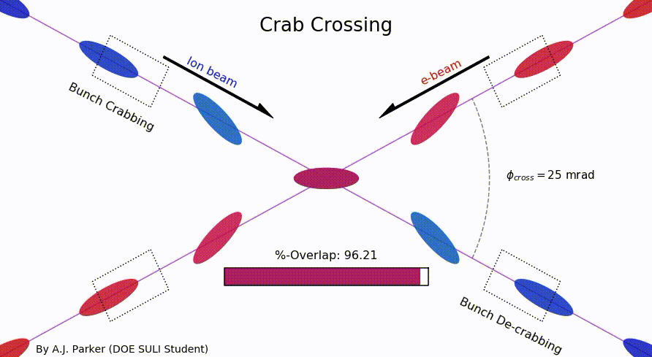
SRF cavities
Hadron bunch length (rms): 6 cm
Electron bunch length (rms): 6 mm

Slide 18
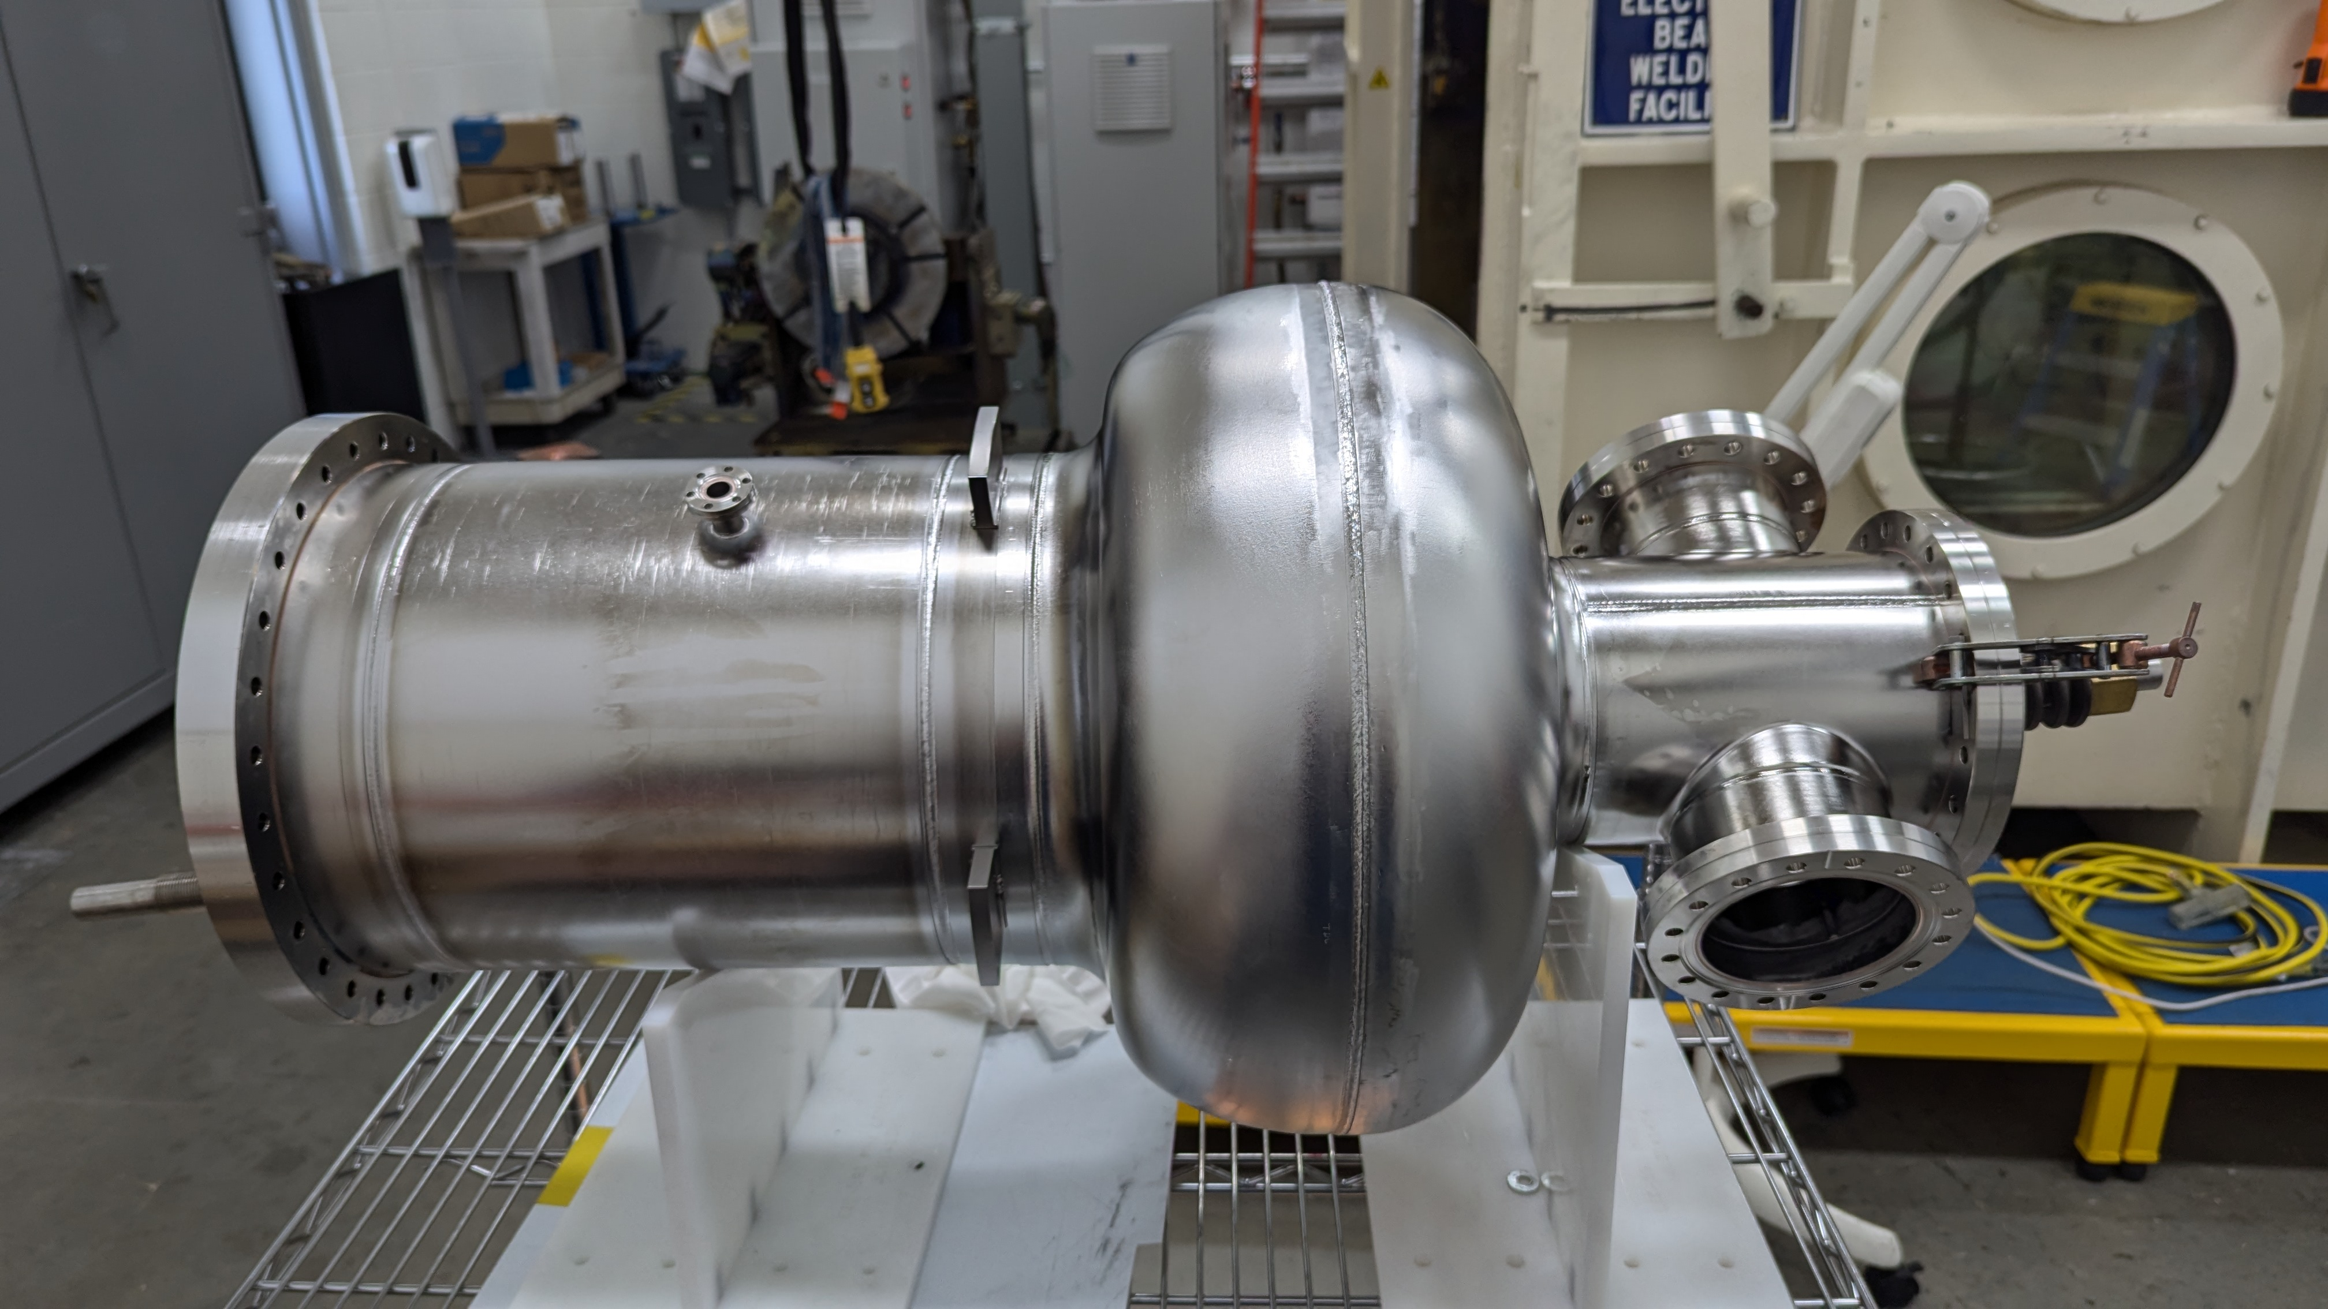
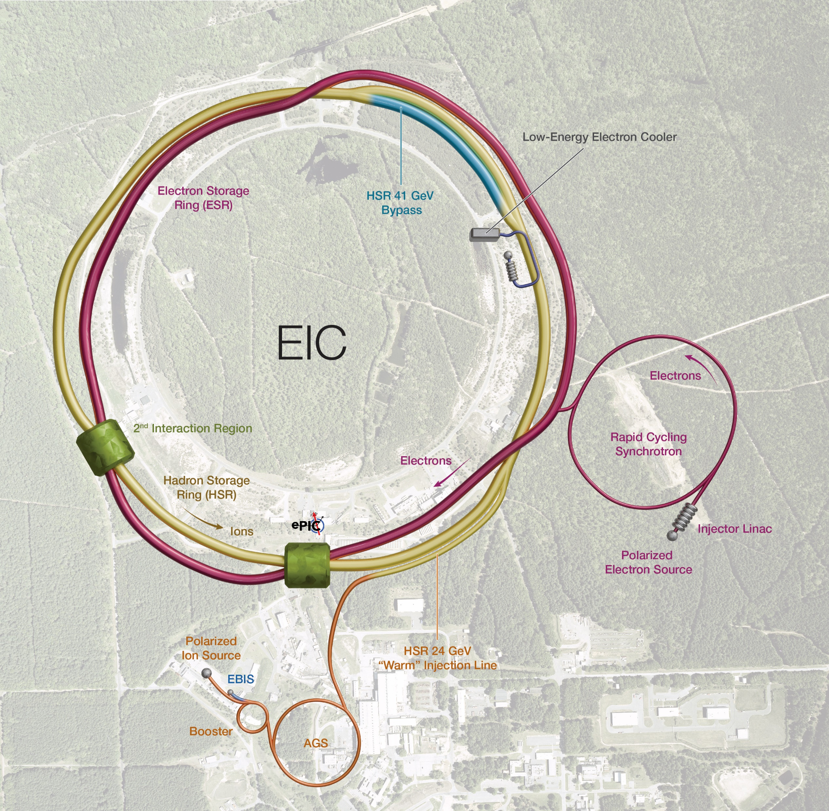

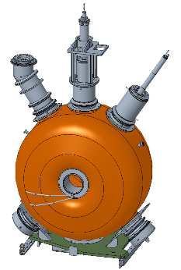
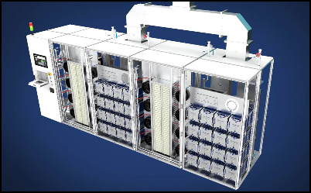
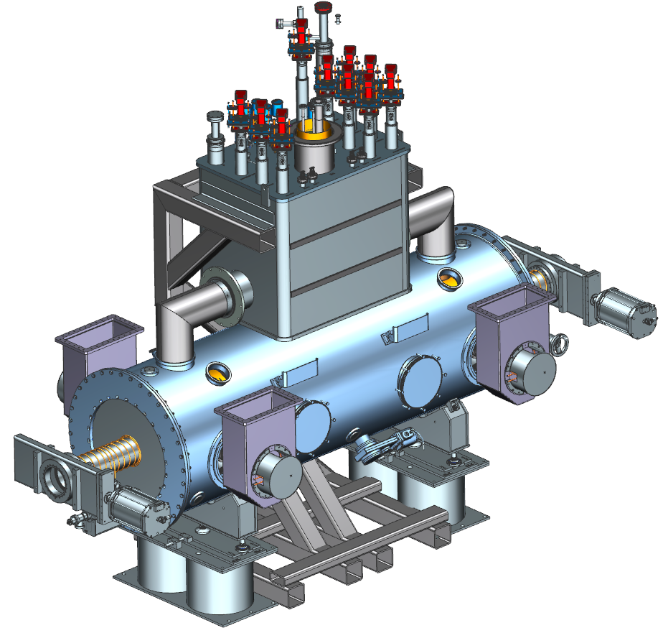
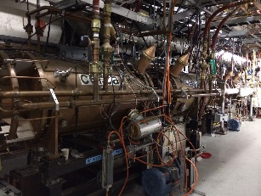
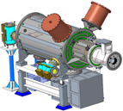
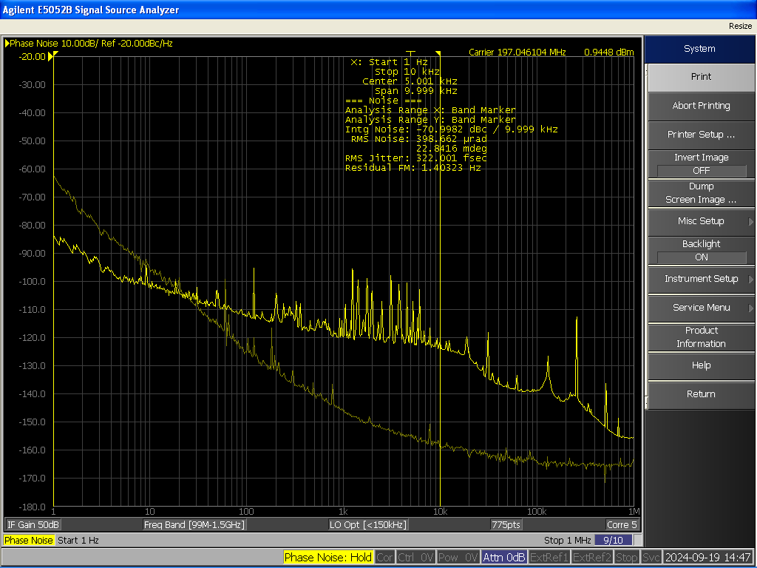
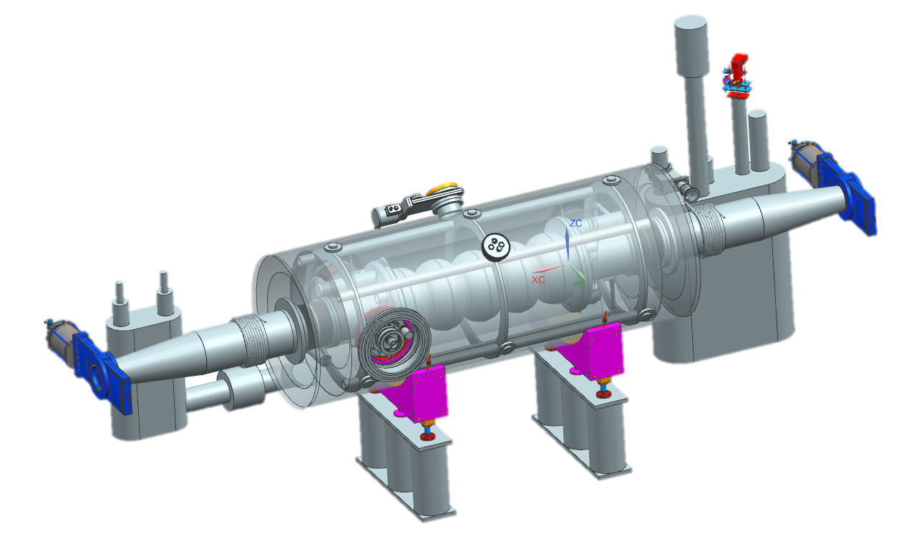
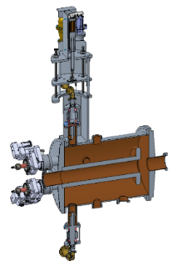
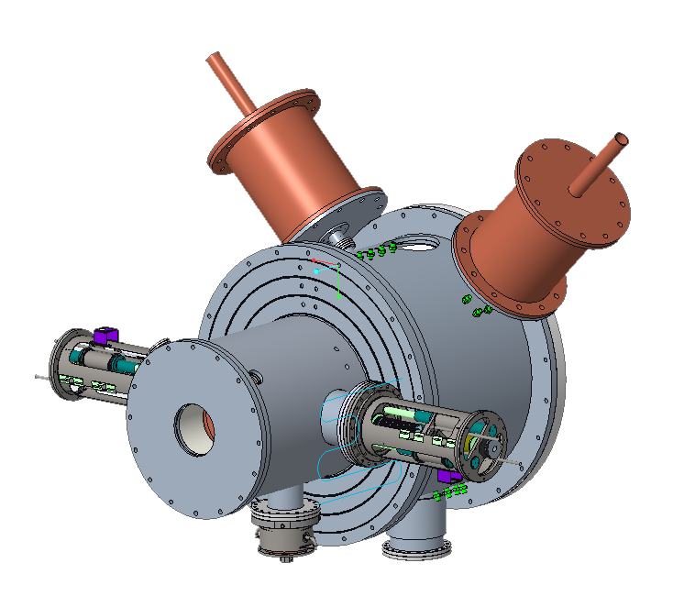
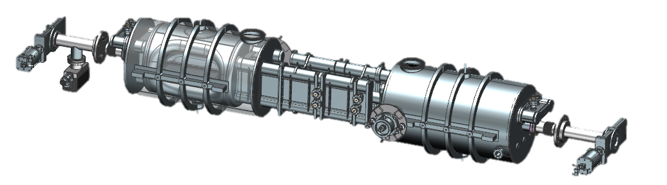
EIC - RF Systems
The Project is pre-CD2 and in the design phase.
Many systems are still developing.
Low-Energy Cooler, IR02 -
16 197 QWR NCRF,
4 591 NCRF,
1 24 MHz NCRF,
And 1 591 MHz Deflecting Cavity
Electron Storage Ring & Hadron Storage Ring – IR10
591 MHz 800 kW 2 K
1-Cell Cavity Cryomodules
ESR = 8 CMs, 16 Cav
HSR = 2 CMs, 4 Cav
400 kW Solid State Amplifier
HSR NCRF – IR04
EIC LLRF DAC Clock for Crab Cavities
IR06
RHIC – 28 MHz acceleration cavity
4 24.6 MHz Capture & Accel Cavity, IR04
Crab Cavities (per IR) | HSR (Cavities/CMs) | ESR (Cavities/CMs)
197 MHz | 8/4 | –
394 MHz | 4/4 | 2/2
RCS
591 MHz 5-Cell Cavity Cryomodules
2 CMs
Bunch Splitting
3 49.2 MHz NCRF
4 98.5 MHz NCRF Capture & Accel
8 197 MHz NCRF

Slide 19
IR6 (Crab Cavities)
RF Controls
Facilities
Crab Cavity Cryomodules
Crabbing System | Quantity
197 MHz HSR | 4 & 4
394 MHz HSR | 2 & 2
394 MHz ESR | 1 & 1
HPRF Amplifiers and Distribution
c/o: Karim Hamdi
Notes:
Add extra verbiage on issues

Slide 20
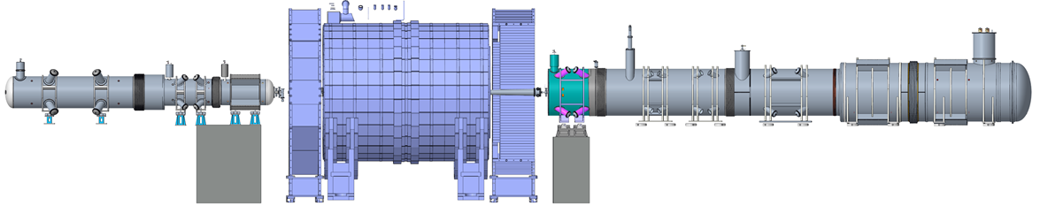
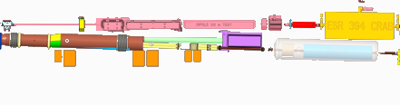
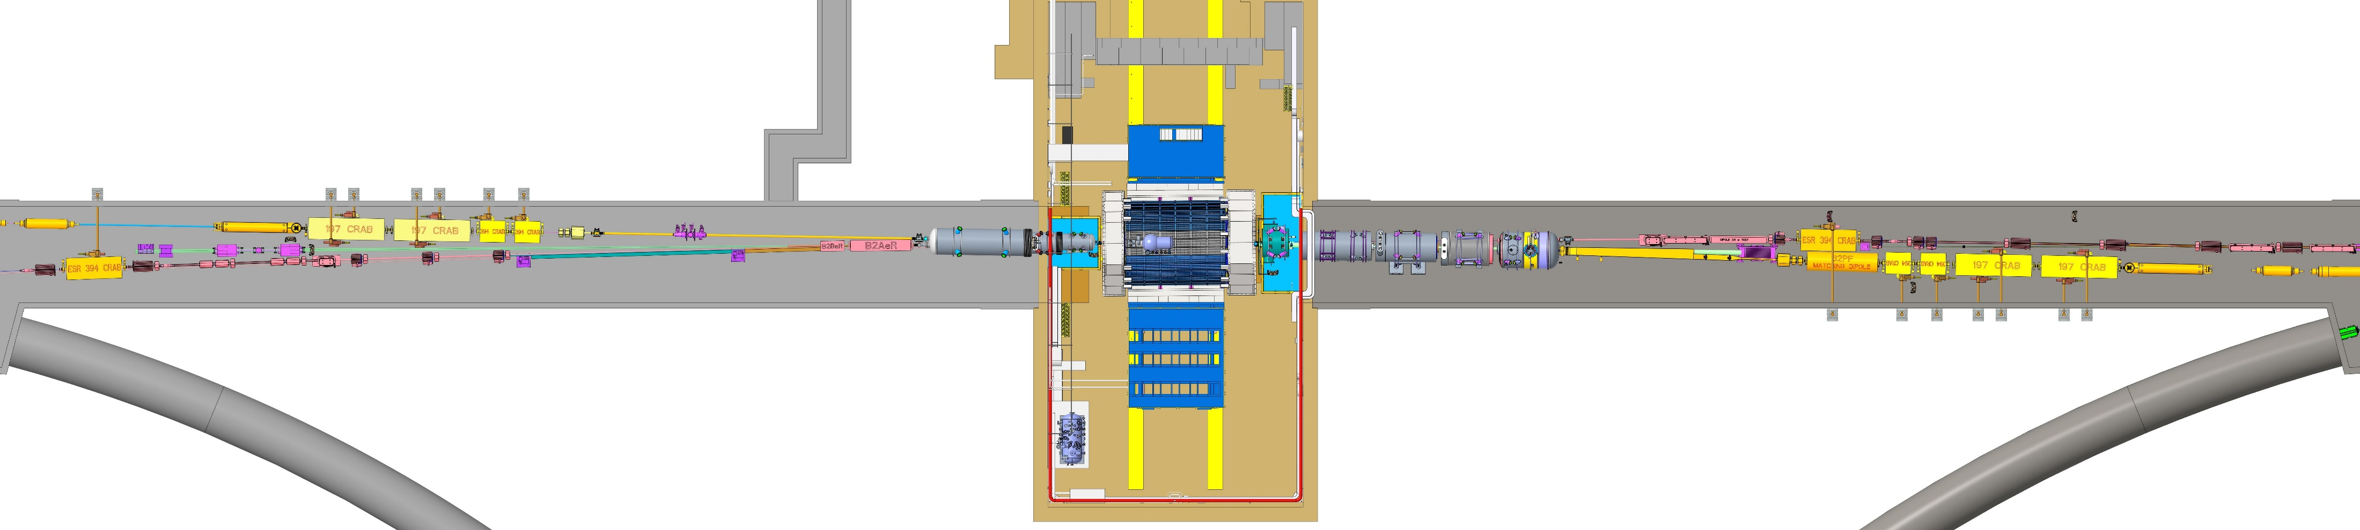
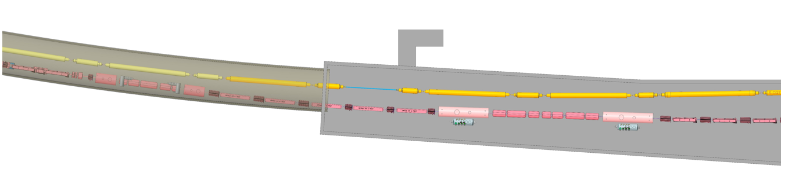
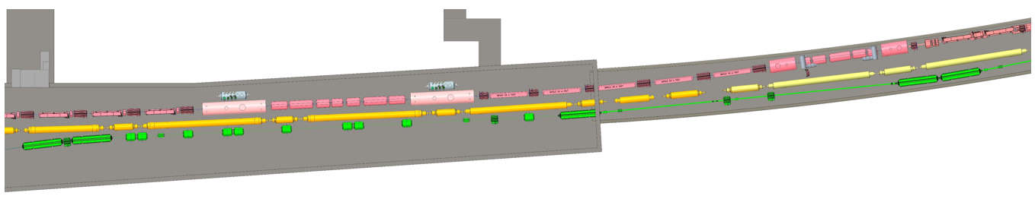
EIC IR layout
9 cryostats housing 11 cold masses (2 K)
  15 magnets (dipole, quadrupole, and combined-function)
    6 “cos-theta” magnets with Rutherford cables, 9 magnets fabricated with Direct Wind technique (DW)
Interaction Region – Rear
Interaction Region - Forward
RC-3
RC-2
RC-1
B0pF
FC-1
FC-2
FC-3
FC-4
B2pF
8 cryostats (4 per side) which contain the spin rotators (solenoids 8.5 T, 2K)
  2 long and 2 short per side
Interaction Region – Rear
Interaction Region - Forward

Slide 21
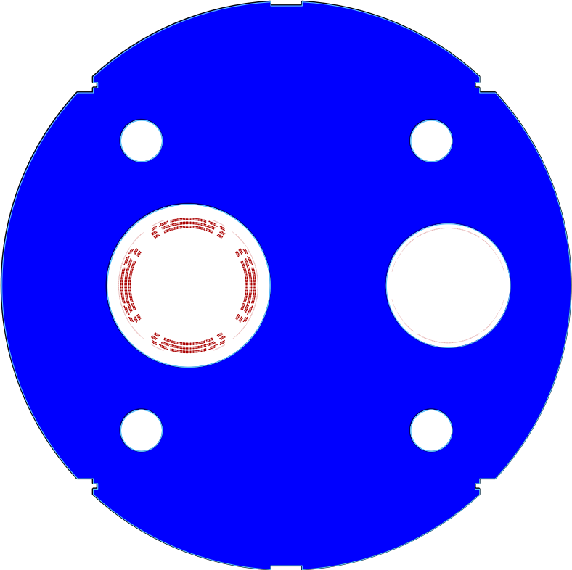
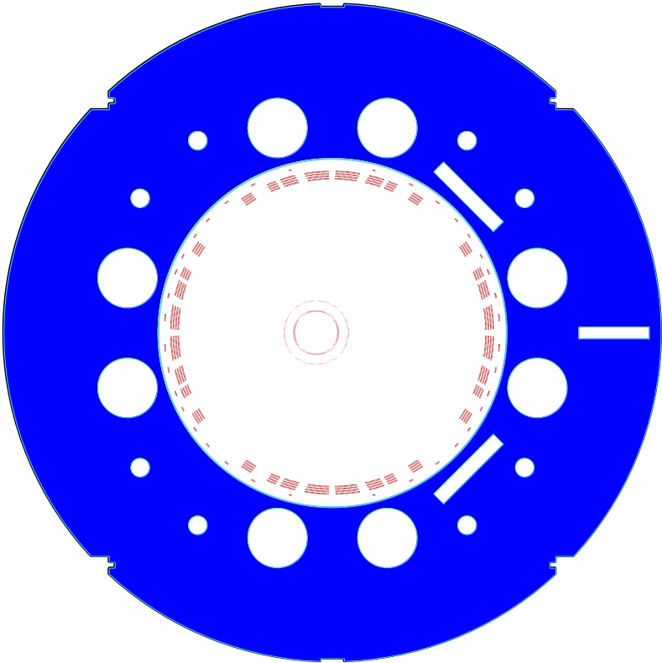
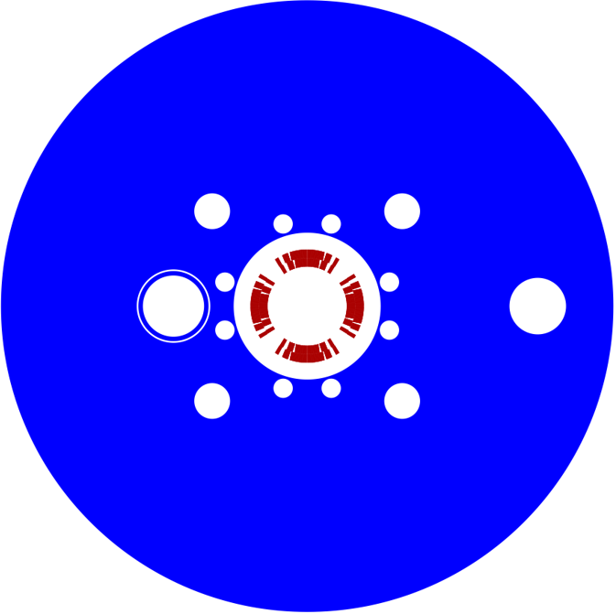
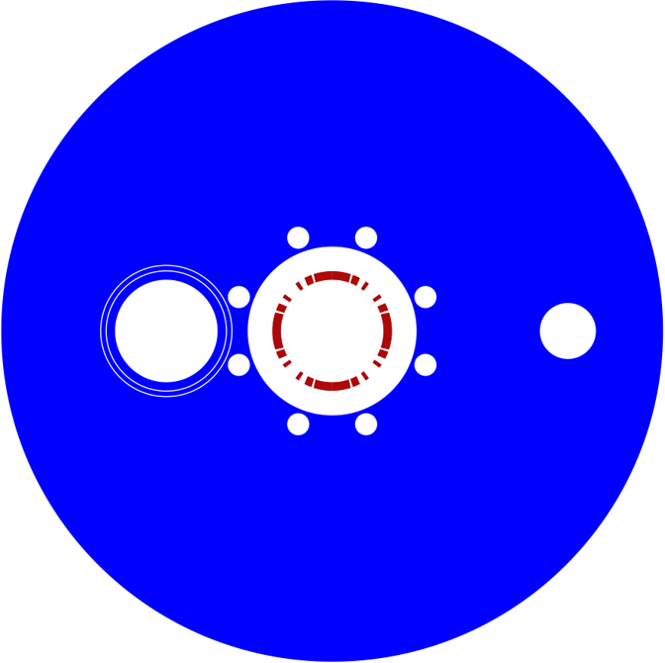
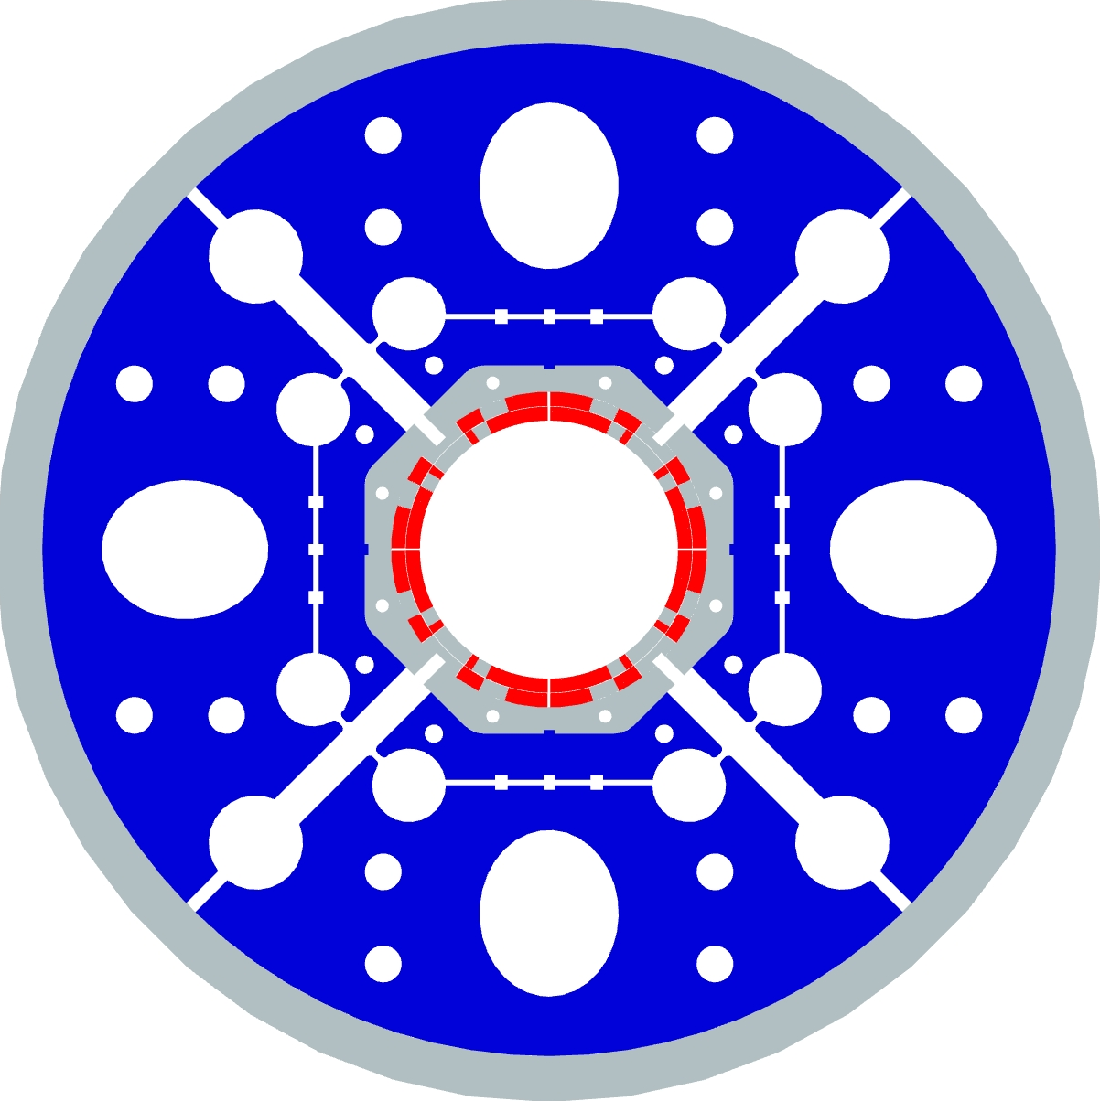
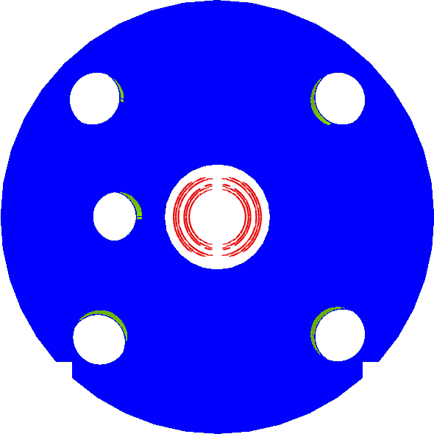
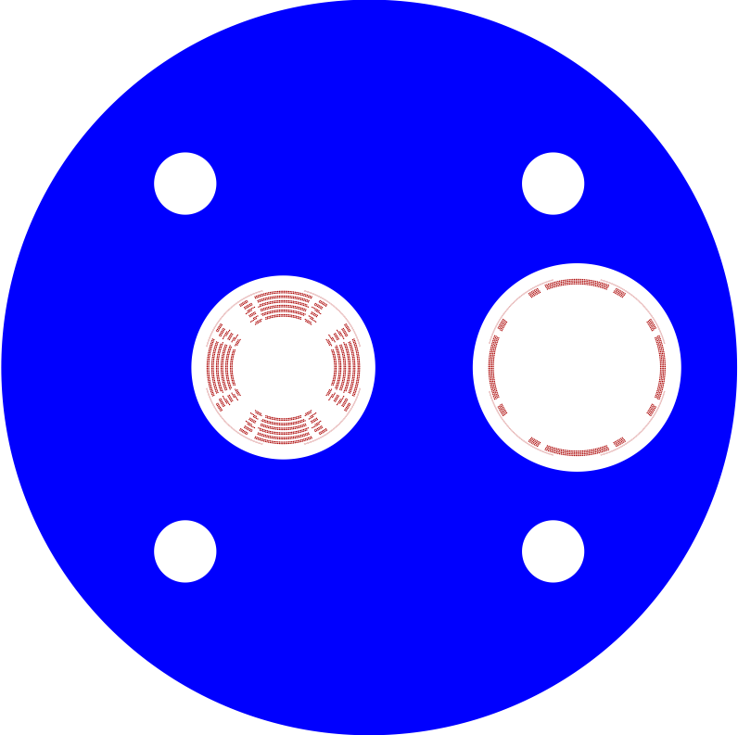
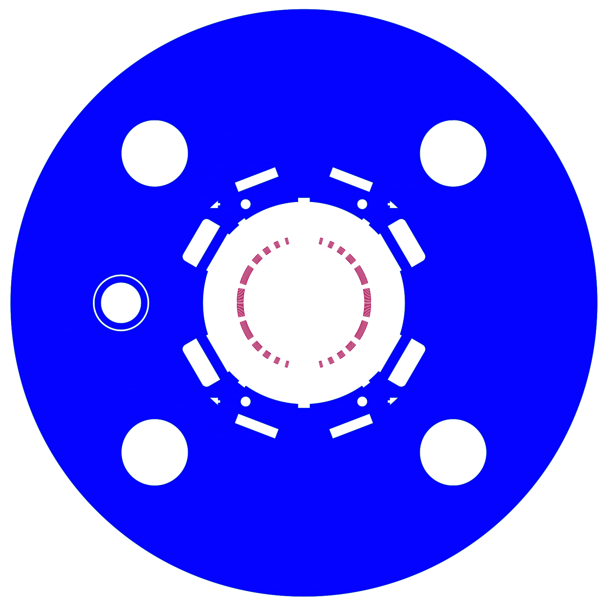
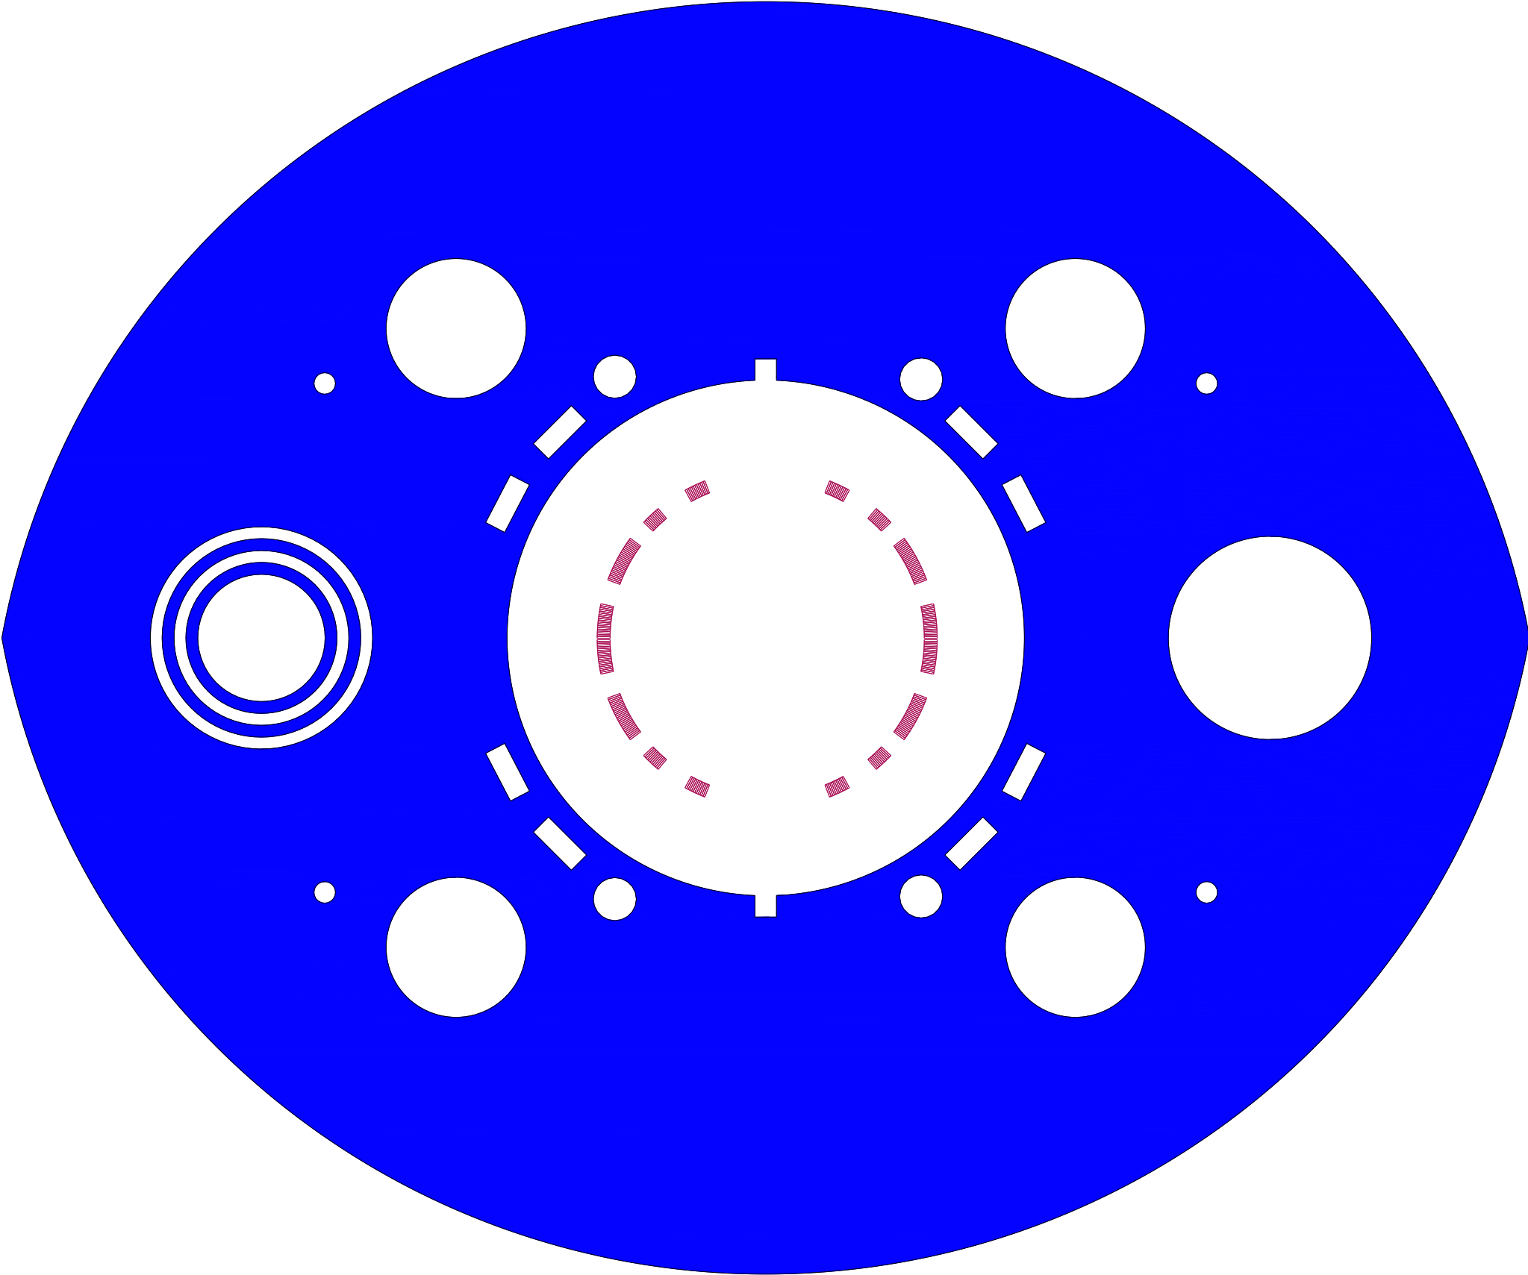
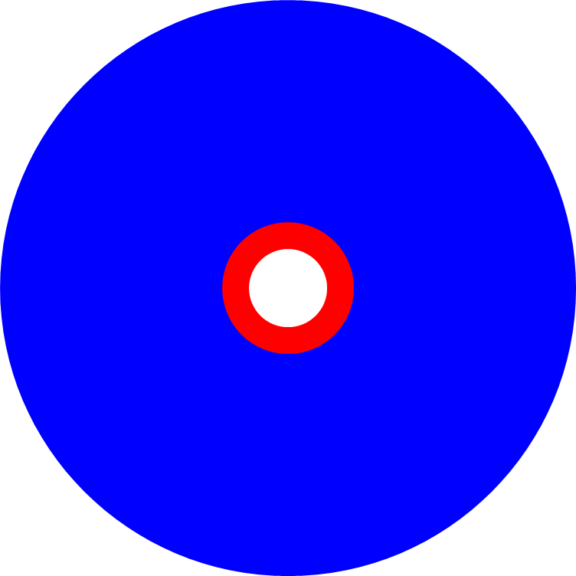
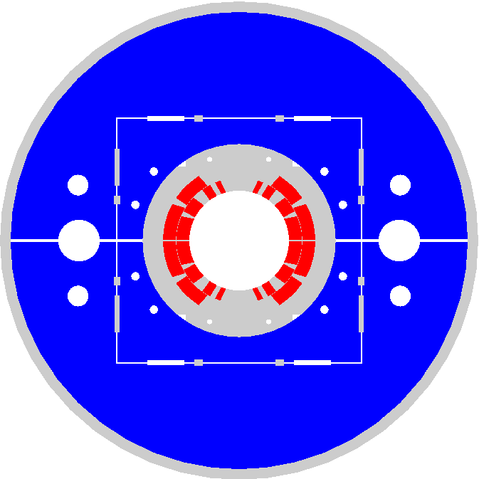

EIC IR Superconducting Magnets
View from the IP
Q2pR-eDrift
B0ApF-eDrift
Q1ApF-eDrift
Q1BpF-Q1eF
Q2pF-eDrift
B0pF-Q0eF
Q1BpR-Q2eR
B2pF
Q1ApR-Q1eR
1 m
Spin rotator
B1pF-eDrif
B1ApF-eDrift
All magnets to the same scale

Slide 22


From RHIC to EIC
RHIC
RHIC
Ion species:
proton – Uranium
60% p polarization
EIC
Protons: ~40 – 275 GeV
Electrons: 5 – 18 GeV

Slide 23


From RHIC (yellow ring) to EIC HSR
Tripled beam current, shorter bunch length, shorter bunch distance, ‘flat’ beams with small vertical emittance
EIC HSR to be composed of existing arcs of the Yellow RHIC ring (remove unused magnets)
Insert sleeves coated with copper and amorphous carbon into superconducting magnet beam pipes to improve conductivity and reduce secondary electron yield (-> electron cloud)
Add new RF cavities
Add hadron cooling to create flat beam
Add crab cavities, new IR SC magnets
Add a collimation system
Add extra ‘snakes’
Actively Cooled Beam
Screen Material procurement

Slide 24


Beam Energy and Average Orbit Radius in the HSR
20 mm
130 GeV
100 GeV
store
275 GeV
70 mm $∅$ beam pipe
Since the electron revolution frequency is fixed, the hadron orbit must be adjusted with energy to keep the collisions in sync.

Slide 25


The 41-GeV ‘bypass’
This bypass provides access to the lowest EIC CoM energy, 29 GeV
Sector 1 without and with the 41-GeV bypass line

Slide 26


EIC Electron Storage Ring
Electron Storage Ring (ESR) consists of six FODO-cell arcs, and six straight sections (IRs)
High-intensity (28 nC), short (7 mm) bunches
add many interesting accelerator challenges
Circulating beam current ~2.5 A and the synchrotron
radiation power of ~10MW
BPM mount
Pump port
36mm
80mm
Heater wire groove
EIC needs nearly constant (20 to 24 nm) emittance from
5 to 18 GeV for optimum luminosity, but equilibrium
emittance in an electron storage ring depends on beam energy.
We will use ‘super bends’ (reverse bends) for emittance
control below 10 GeV

Slide 27

ESR Beam Intensity Parameters
 | 5 GeV | 10 GeV
Num. of electrons per bunch, $N$ | 1.72x10¹¹
Bunch Charge, $Ne$ | 28 nC
Number of Bunches, $M$ | 1160
Single Bunch Current, $I_{0}=\frac{Ne}{T_{0}}$ | 2.2 mA
Bunch Length, $σ_{τ}$ | 22.7 ps | 25.4 ps
Peak Bunch Current, $I_{p}=\frac{Ne}{\sqrt{2π}σ_{τ}}$ | 484 A | 433 A
Average Current, $I_{av}$ | 2.5 A | 2.5 A

Slide 28

EIC IR Layout
High Luminosity:
  25 mrad crossing angle
  Small β* for high luminosity
  with limited IR chromaticity contributions
  Large final focus quadrupole aperture
  Machine Detector Interface
  Large detector acceptance
  Forward spectrometer
  No magnets within - 4.5 / +5 m from IP
  Space for luminosity detector, neutron detector, “Roman Pots”

Slide 29


Electron Injector

Slide 30






Electron Injector
Concept modeled after the ANL APS-U injector
Function: Deliver electron bunches of up to 28 nC at a 1 Hz repetition rate for injection into the ESR at various energies of 5 – 10 GeV (upgradeable to 18 GeV).
RCS magnet assembly
Vacuum chamber: stainless steel, copper coated (50 um)
RCS SRF Cavity, 591 MHz
RCS
750 MeV – 18 GeV
28 nC, 1 Hz
85% polarization
1.4 km
Beam Accumulator Ring
750 MeV, 40 m
Polarized Electron Gun
1-nC, 30 Hz
S-band linac, 750 MeV, 30 Hz, 1 nC single bunch

Slide 31


Present EIC Concept (2026)
Ultimate EIC Performance Parameters:
High Luminosity: L= 10³³ – 10³⁴cm⁻²sec⁻¹
Highly Polarized Beams: 70%
Large Center of Mass Energy Range: Ecm = 28 – 140 GeV
Large Ion Species Range: protons – Uranium
Large Detector Forward Acceptance and Low-Background Conditions
Possibility to Implement a Second Interaction Region (IR)
Accelerator Status at a glance:
Polarized ion/proton source
Ion injection and initial acceleration systems – Linac (200 MeV), Booster (1.5 GeV), AGS (25 GeV)
Hadron Storage Ring (40-275 GeV) – HSR
Electron Pre-Injector (750 MeV linac)
Beam Accumulation Ring (750 MeV) – BAR
Electron Rapid Cycling Synchrotron (0.75 GeV – top energy) – RCS
Electron Storage Ring (5 GeV – 10 GeV) – ESR
Interaction Region(s) – IR
Hadron Cooling System
Protons: ~40 – 275 GeV
Electrons: 5 – 10 GeV

Slide 32

EIC Project: Critical Decisions and Plans
2019
2021
CD-2 and CD-3 in Preparation
CD-4 EF = 2034
CD-3A, Long-Lead Procurement, approved March 2024. Excellent use of IRA funding.
CD-3B, Long-Lead Procurement, approval planned for 2025.

Slide 33
Summary
EIC is a unique, high-energy, high-luminosity, polarized beam collider that will be one of the most challenging and exciting accelerator complexes ever built – the only new collider in the next decades.
EIC design has converged. The EIC scope is stable and supports the Global Requirements and the DOE Mission Need Statement.
Some project scope is well developed, designs are mature, and is being executed as Long-lead procurements (DOE CD3A and CD3B)
We understand what we need to build to deliver the EIC!

