Slide 1
The EIC-BeamAI Collaboration: Preparing Machine Learning for the Electron-Ion Collider
Georg Hoffstaetter de Torquat
For the EIC-BeamAI collaboration
Georg.Hoffstaetter@Cornell.edu 05/11/2026

Slide 2
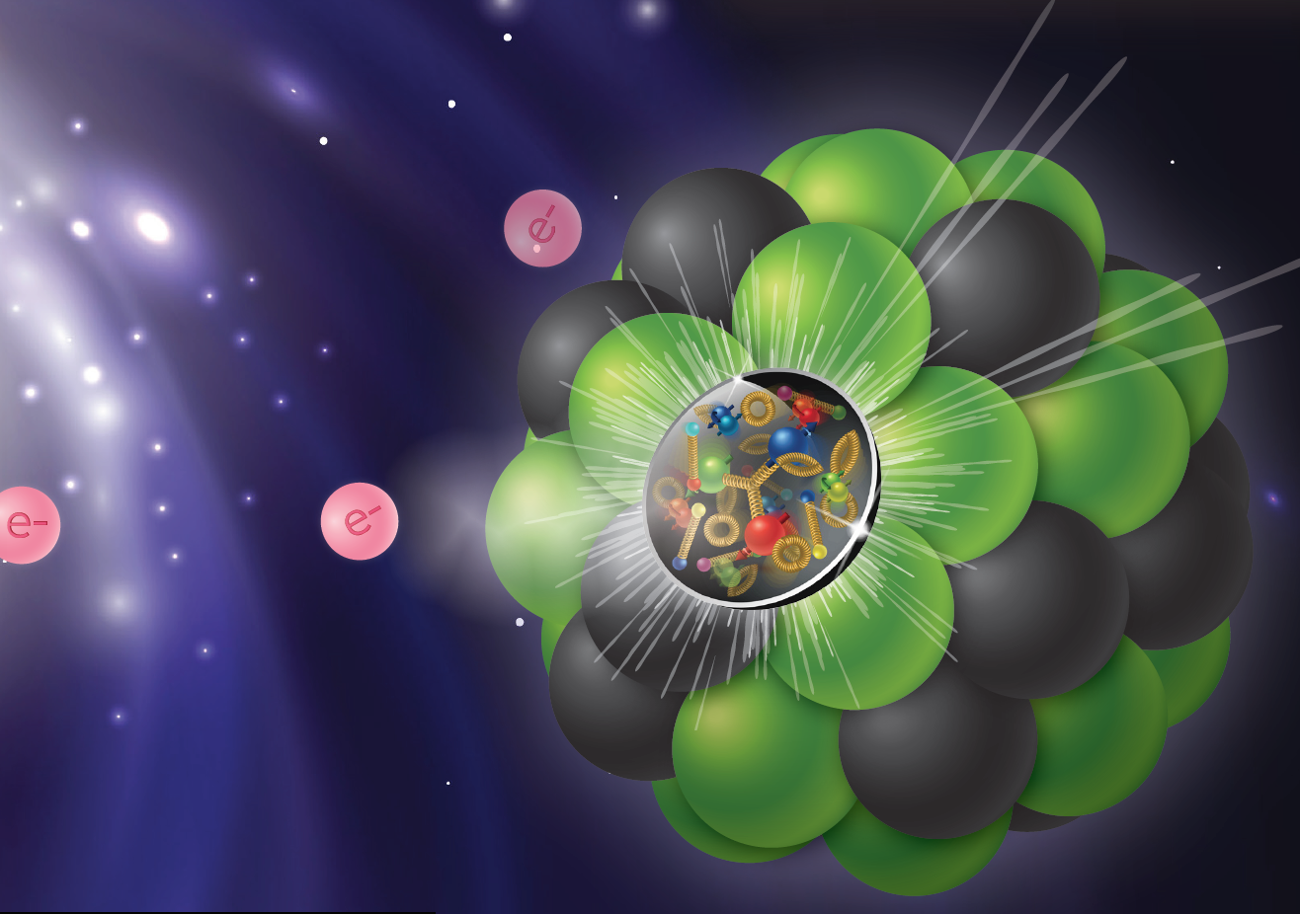




Goal of the EIC-BeamAI collaboration
Improve EIC accelerator performance by ML/AI
Probably the most complex accelerator ever built:
Polarized protons and electrons.
Beam cooling (Rf, e, and photon based)
Superconducting RF acceleration
Superconducting magnets
Too complex to be operated with traditional operator control
Notes:
If you ask those here who have been around for a decade or more, they will nod in agreement when you say, HERA should have been turned into an EIC.
Carl Sagan: If you want to build an apple pie from scratch, you first have to invent the universe.

Slide 3

AI/ML funded projects for the EIC
3
AI / ML is not part of the EIC construction project
(partly because AI for accelerator operations is so now.)
Subsequent (off-project) funding:
Higher RHIC polarization by Physics-informed Bayesian Learning
BNL, Cornell, JLAB, SLAC, RPI (DOE-NP funding 2023 – 2025)
Toward higher brightness and polarization of hadron beams: Digital-Twin-based autonomous control of BNL’s hadron accelerator chain
BNL, Cornell, JLAB, SLAC, FNAL, RPI (DOE-NP funding 2025 – 2027)
Developing AI-Ready Data Framework for DOE NP Particle Accelerators
Now called NARAD = NP AI-Ready Accelerator Data
JLAB (lead), BNL, Cornell, LBNL, PNNL (ASCR/NP funding 2025-2027)
National collaboration: Multi Organization Accelerator Team (MOAT)
To prepare for AI/ML in accelerators funding through the US Genesis mission.

Slide 4
What is the EIC-BeamAI collaboration
4
Grown out of the DOE-NP funded AI/ML projects for the EIC, we have …
Worked on the funded projects
Contributed to workforce development for AI/ML in the EIC.
Connected to related work from other collaborations
AI/ML optimization of electron gun commissioning
Osprey for LLM aided accelerator operations
Topics of the Multi Office Accelerator Team (MOAT) – US collaboration for AI in accelerators
Zoom meetings are open to all (Tuesdays 11am, Friday 3pm EST)
We are requested to expand to the International EIC accelerator collaboration

Slide 5
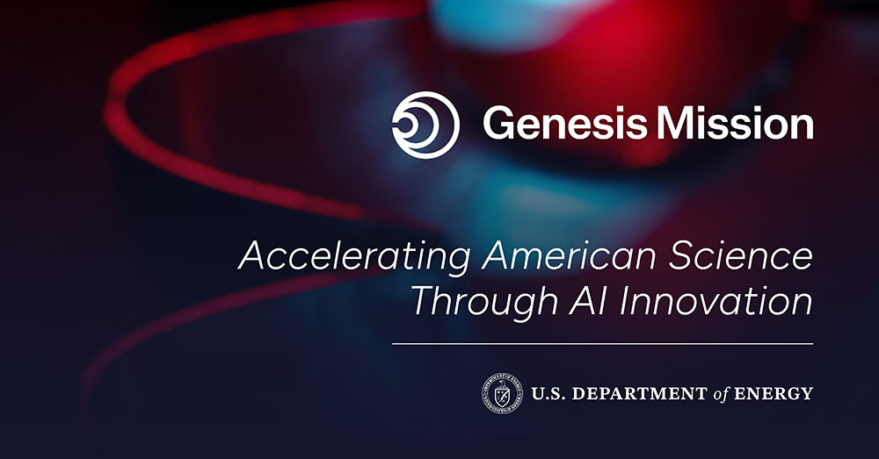
The US Genesis mission
5
Genesis Mission is a national initiative to build the world's most powerful scientific platform to accelerate discovery science, strengthen national security, and drive energy innovation.
MOAT (9 DOE labs and universities) prepares the particle accelerator community for the Genesis Mission. It aims to build national accelerator physics knowledge into a national AI infrastructure that can be used across all platforms to inform on accelerator design and operation.
Several of the MAOT-related proposals are applicable to or focused on the EIC, e.g.,
AI-Driven, Self-Learning Digital Twins for Robust Operation of Particle Accelerators (focused on EIC pre-accelerators)
AI-reform of legacy codes in Accelerator modeling and operations (focused on Bmad and SciBmad that models EIC)
AI-driven Accelerator Operations Prototyping with Cornell’s Electron Test Beams (with implementation at EIC pre-accel.)
Robust Diagnostic Comprehension for Facilitation of Large Scale Digital Twins (with examples form BNL, e.g., IPMs)
Robust and Safe Deep Agent for Optimization and Control of Particle Accelerators (Collaboration with BNL)
And more …
The EIC-BeamAI collaborations aim as part of the Genesis Mission is to build infrastructure that will benefit EIC.
The EIC will be one of the first large-scale collider-based programs in which AI/ML is integrated from the start.

Slide 6
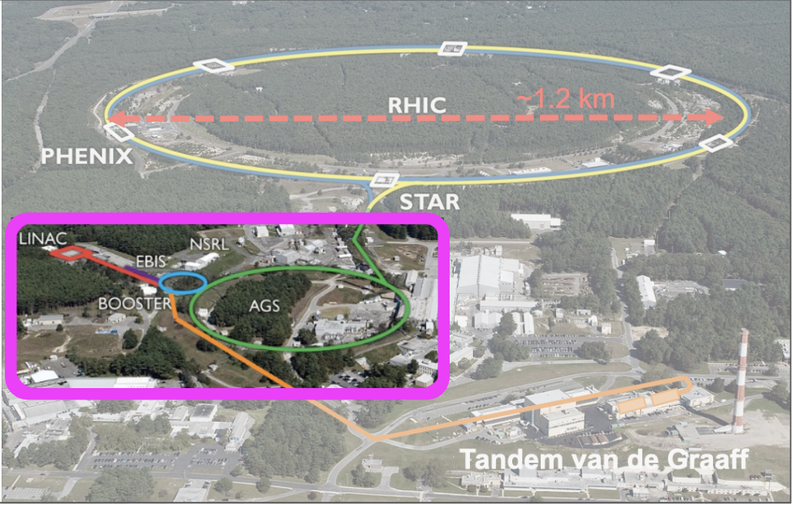
Development at existing EIC systems
6
Accelerator Rings
 | Circumference [m]
Booster | 201
AGS | 807
RHIC | 3833
RH.IC / EIC
Typical Top Energies [Total, GeV/N]
 | Au | Pol. Protons
Linac (H⁻) | -- | 1.1
Booster | 1 | 2.3
AGS | 10 | 23.8
RHIC | 100 | 255

Slide 7
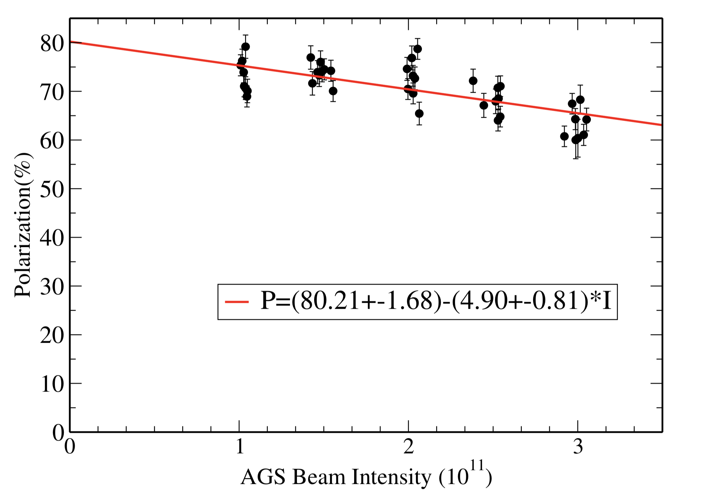
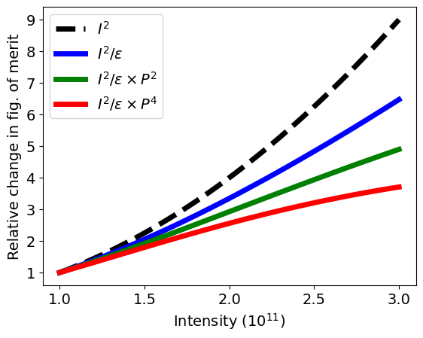
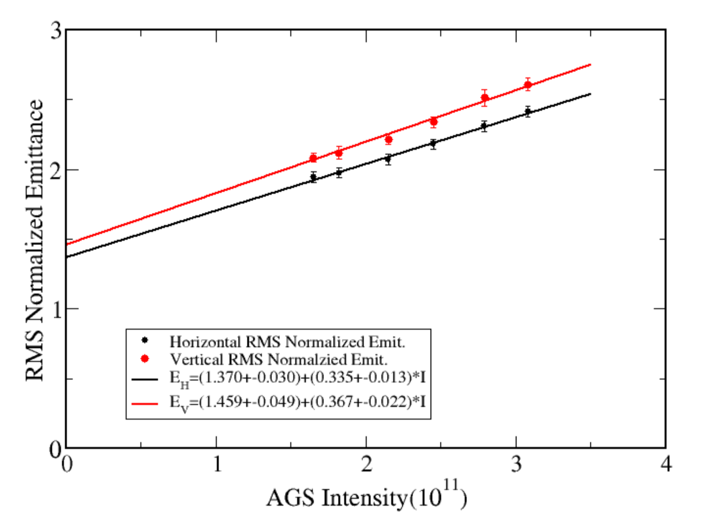

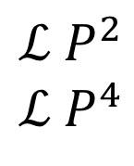
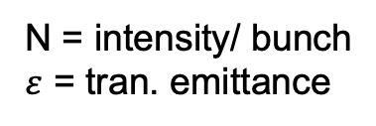
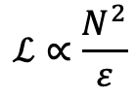
Improving polarized collider performance
7
Collider luminosity, $ℒ$
AGS extraction
Pol vs Intensity
$$ℒ∝\frac{N^{2}}{ε}$$
N = intensity/ bunch
$ε$ = tran. emittance
Polarized beam collider FOM
Polarized collider figure of merit (for polarization P):
$$ℒ P^{2}$$
$$ℒ P^{4}$$
transverse spin
FoM =
longitudinal spin
Emittance vs Intensity
Since both emittance and polarization degrade with intensity figure of merit decreases rapidly
FoM dependence on intensity closer to linear in N than quadratic.
Impact of intensity increase on FoM given emittance and polarization dependence at AGS extraction

Slide 8
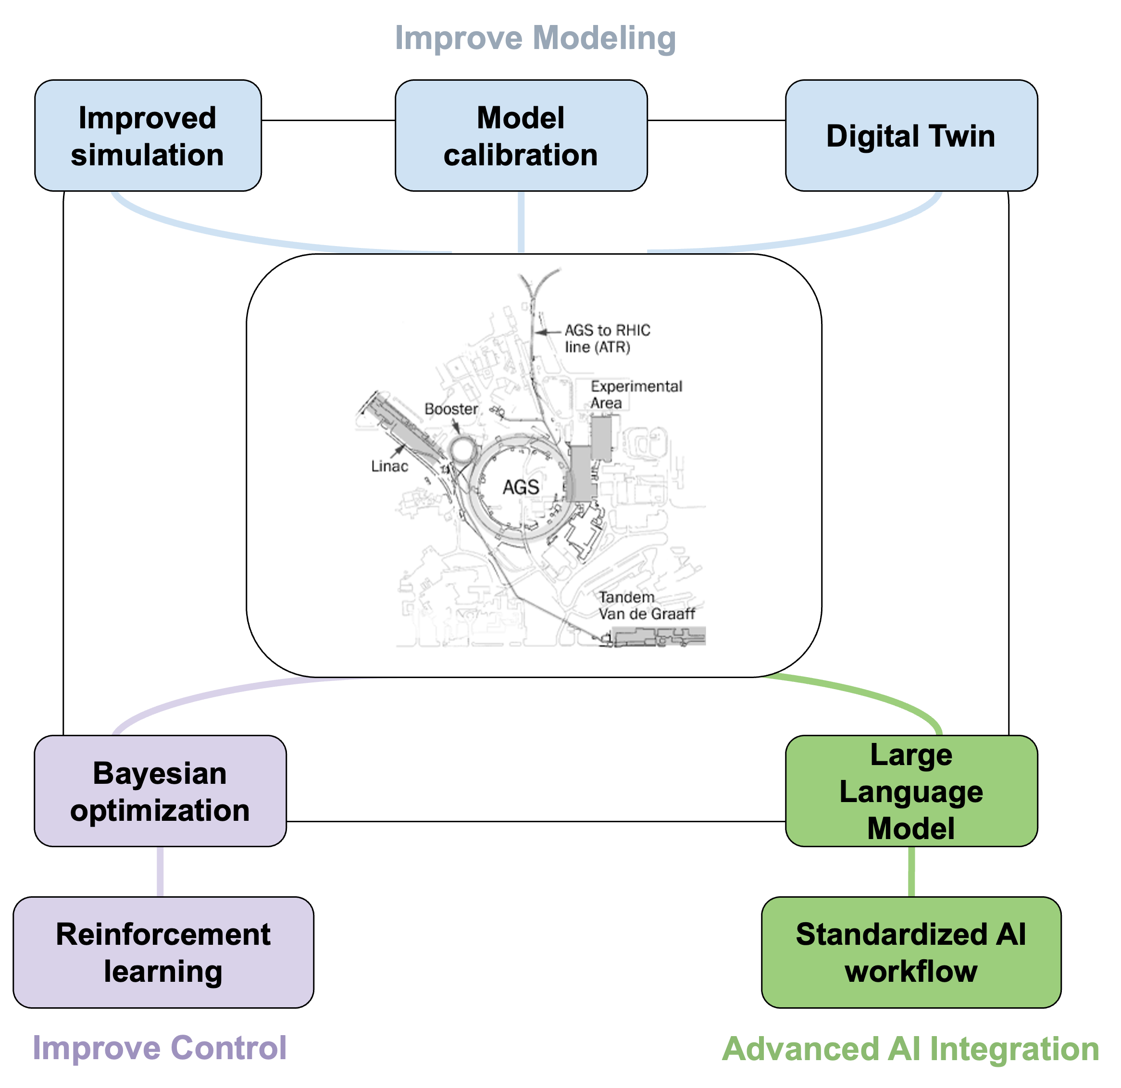
Preparation of AI for the EIC
8
Goal: Improve beam quality (brightness and polarization ) and operational efficiency for the EIC.
Focus areas
Automated beam tuning
Operational Digital Twins
Data-driven model calibration
Fast adaptive control
Case studies: BNL hadron injector complex

Slide 9
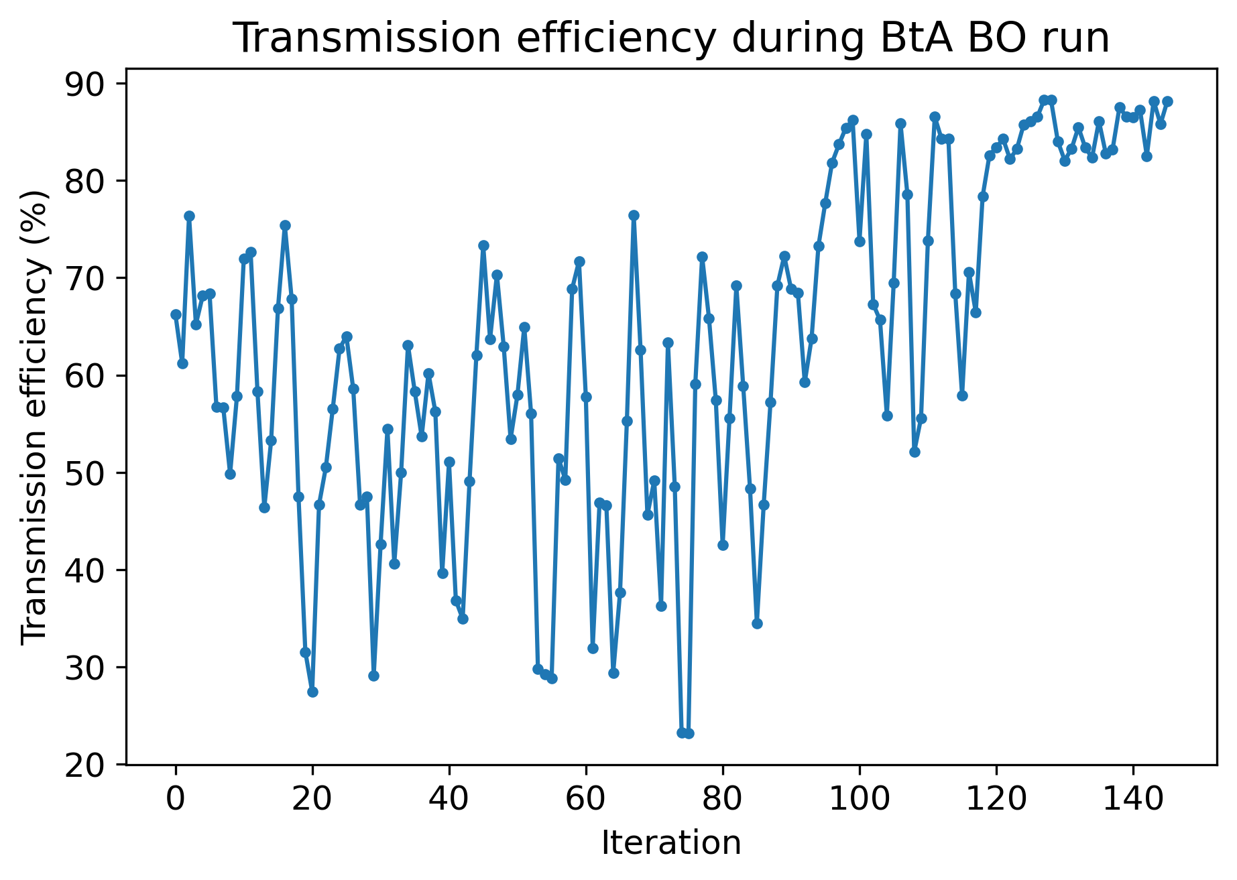
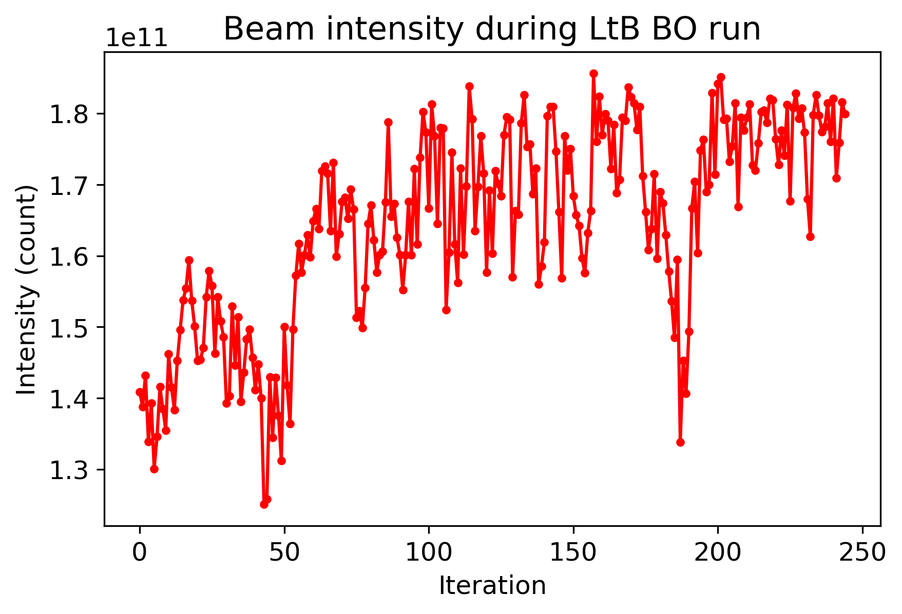
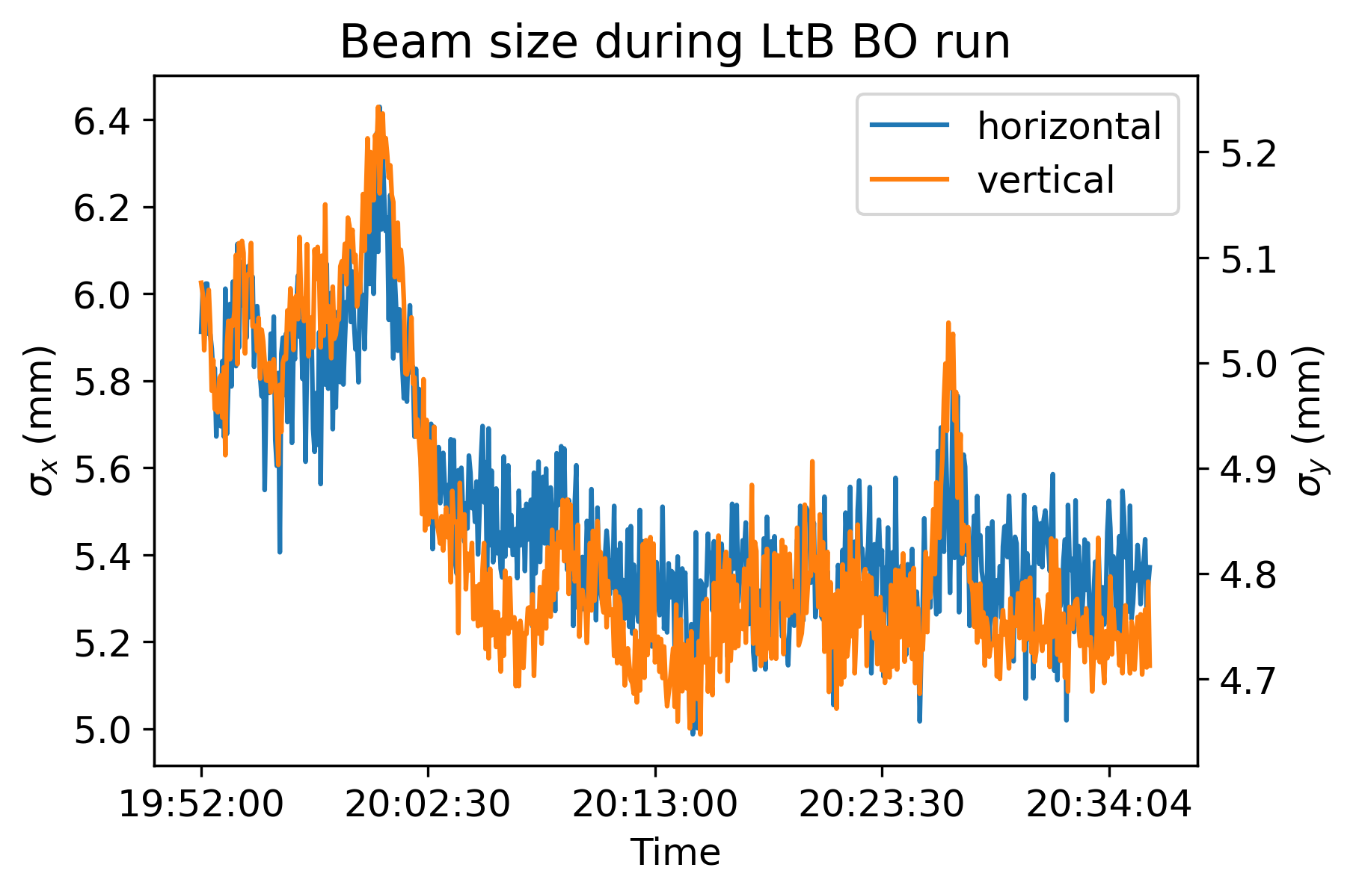

Booster injection optimization with BO
9
LtB Injection Optimization
BO maximizes Booster beam intensity using LtB optics.
Beam size decrease in both planes during LtB optimization.
BtA Injection Optimization
BO maximizes beam transmission efficiency using using BtA optics.
20% improvement from operational settings.

Slide 10
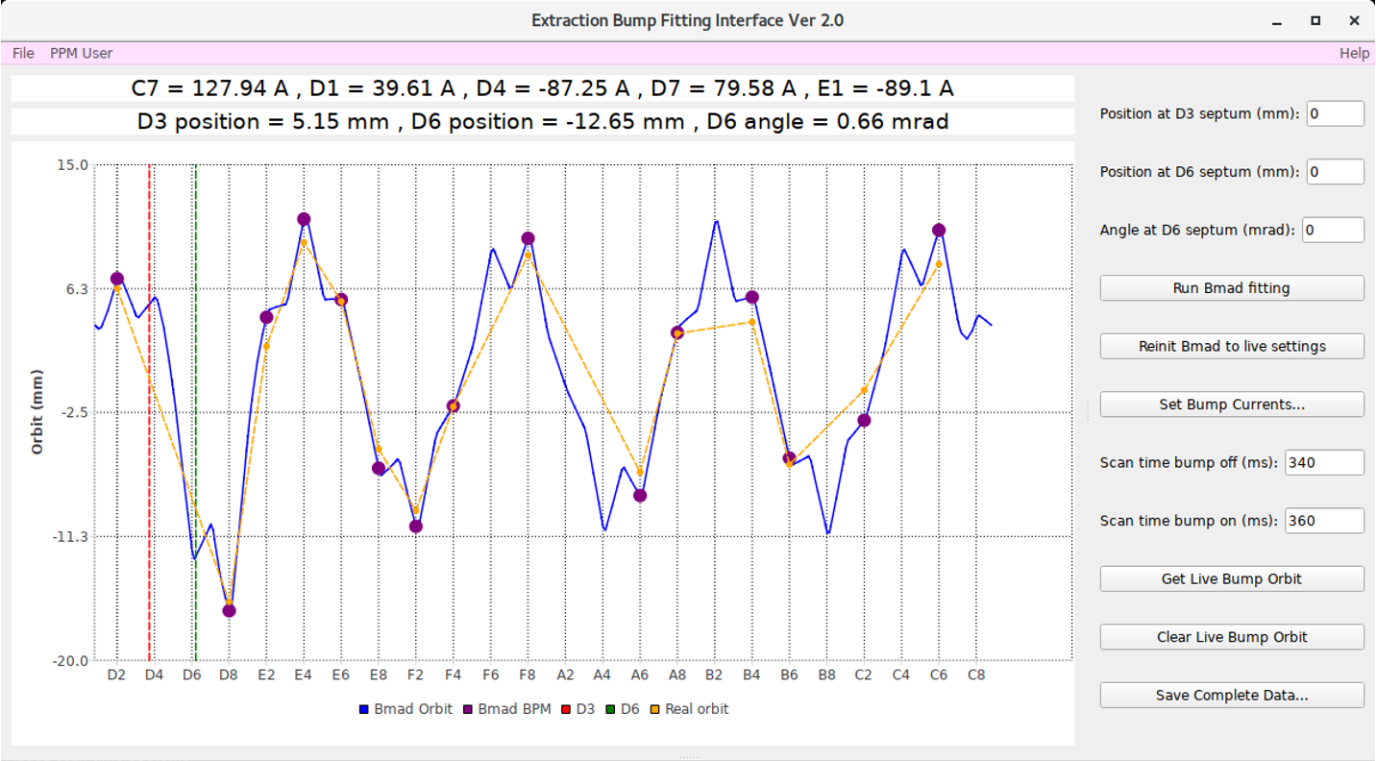
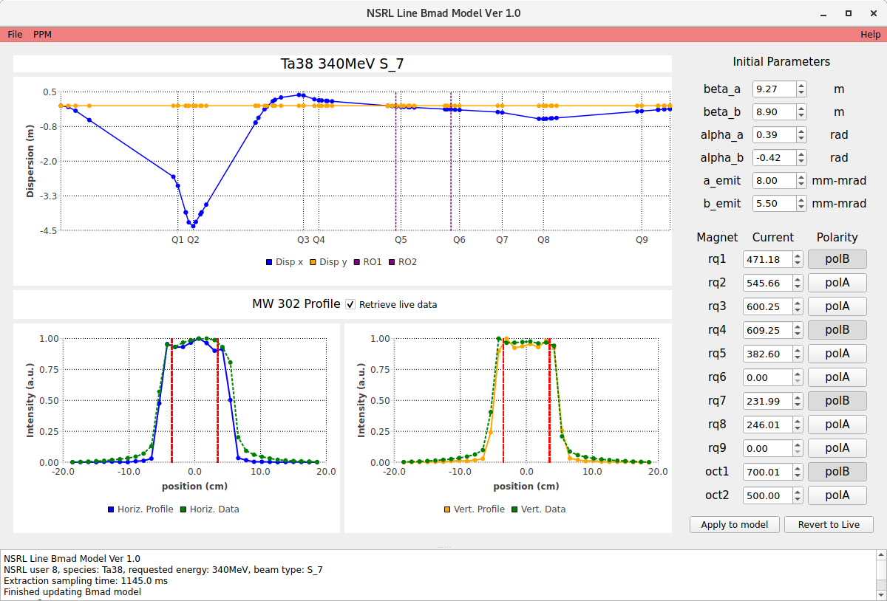
Digital Twin for NSRL
10
Goal: Operational digital twin framework with bidirectional interaction between the physical and virtual machines.
Outcome: Enable non-interruptive, model-based routine tuning for NSRL operations.

Slide 11

Digital Twin for NSRL
11
Goal: Operational digital twin framework with bidirectional interaction between the physical and virtual machines.
Outcome: Enable non-interruptive, model-based routine tuning for NSRL operations.
Weijian (Lucy) Lin
BNL postdoc

Slide 12
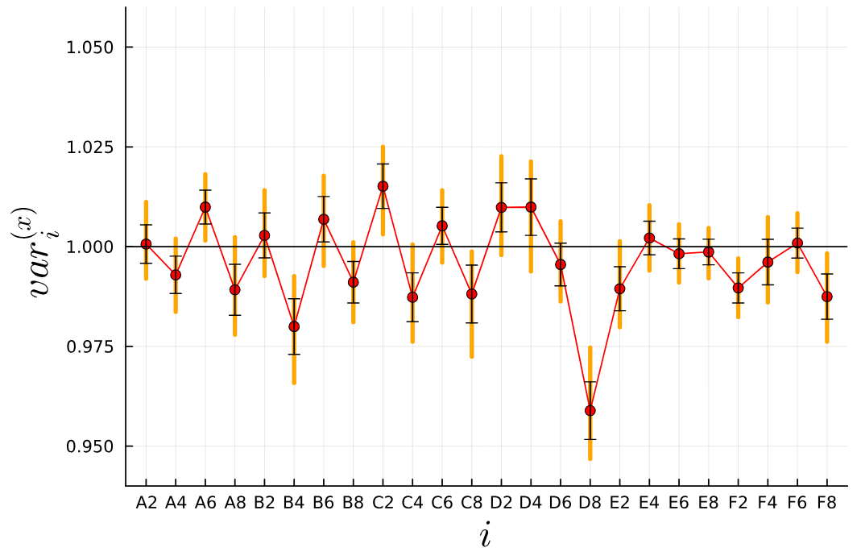
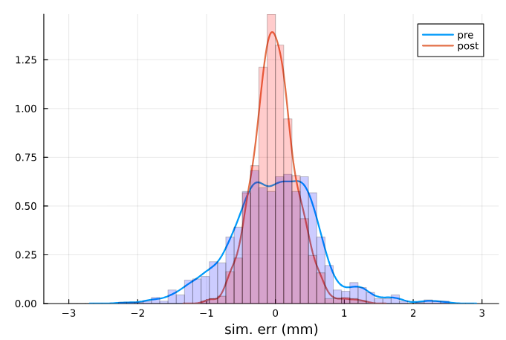
UQ to improve the Booster Model
12
Goal: Use Bayesian Uncertainty Quantification (UQ) to characterize and reduce model-data mismatches, assisting Digital Twin development.
Approach
Bayesian UQ analyzes orbit response discrepancies.
Neural network surrogate model accelerates UQ process.
Outcome
UQ analysis investigates quadrupole field errors as possible sources of errors.
Incorporating UQ results improves agreement between simulation and measurement.

Slide 13
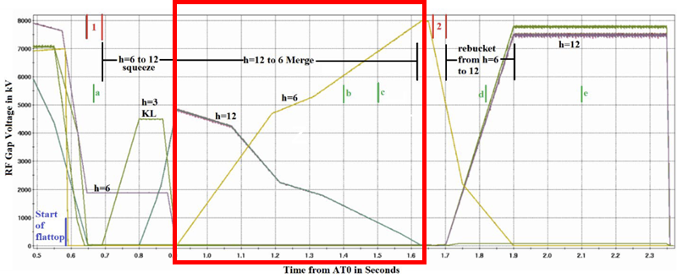
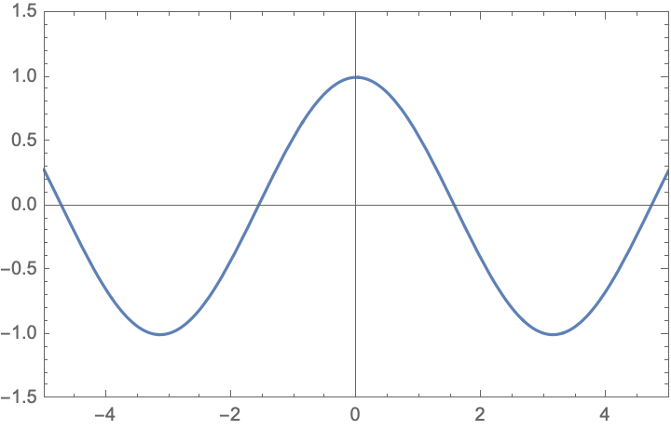
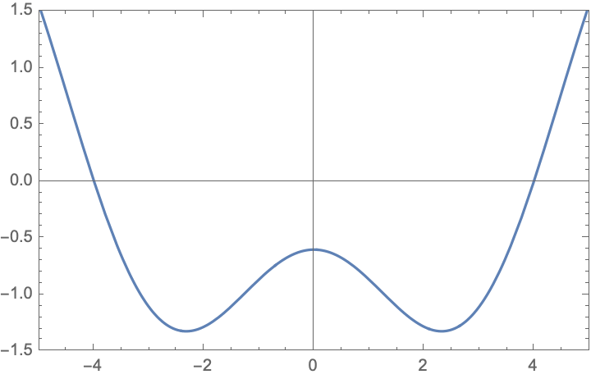
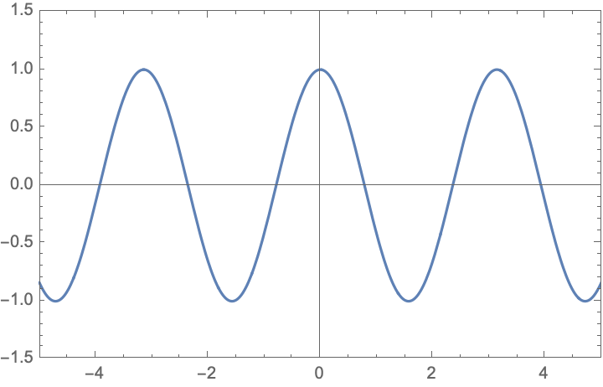
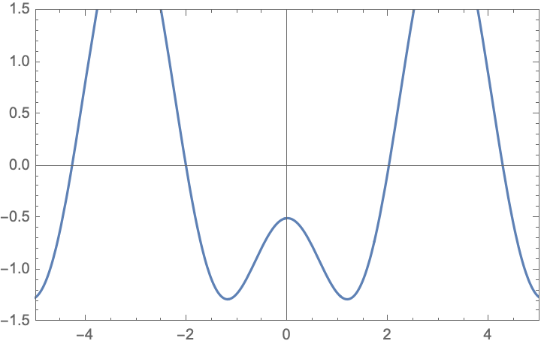
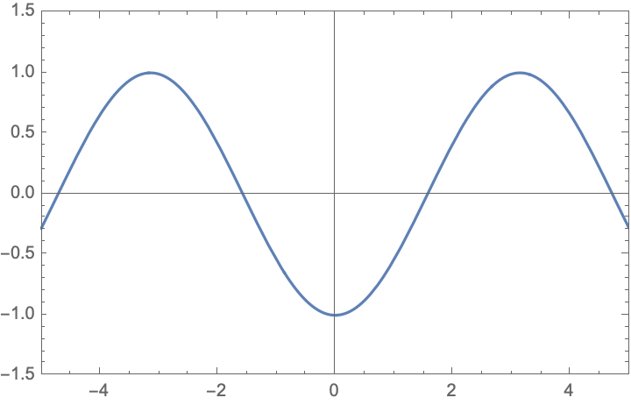
Bunch splitting and merging at BNL
13
Splitting in the Booster and merging after AGS accelerator reduces space charge and emittance growth ➔ more polarization
Three RF amplitudes (h=3, 6, 12) in the AGS during bucket manipulation and merging.
➔ We have set up Reinforcement Learning for the merging section.
Accelerating RF h=6
Attracting RF h=3
Close bucketing h=12
Combining h=6
Final bucketing h=6

Slide 14
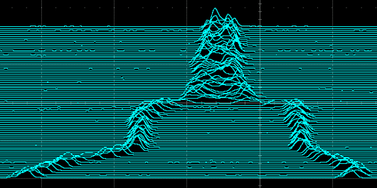
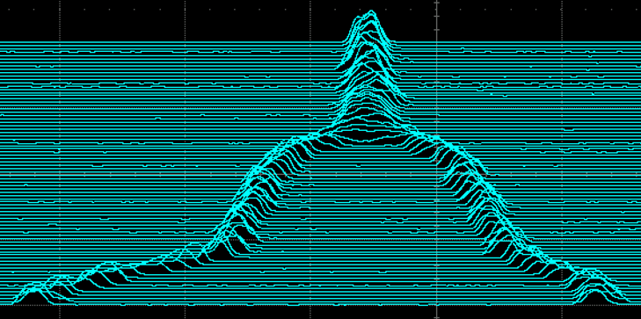
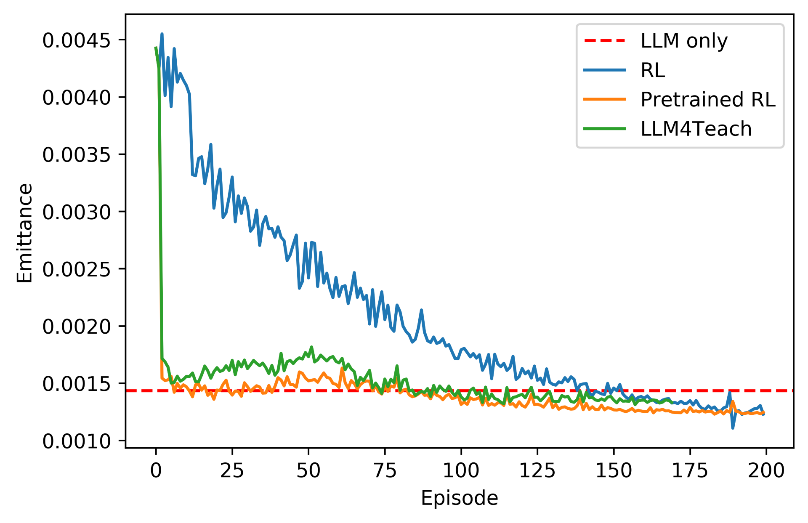
LLM optimized RL for Bunch Merging
14
Initial bad merge
Goal: Obtain a good merged bunch profile – low emittance growth, no loss, centered and stable.
RL Optimization
RL agent trained to minimize emittance growth.
Begins from poor merge conditions; finds good RF settings after one step.
Comparable performance to operational settings.
LLM-based policy teacher for RL agent in development, leads to faster convergence and better performance.
RL optimized merge

Slide 15
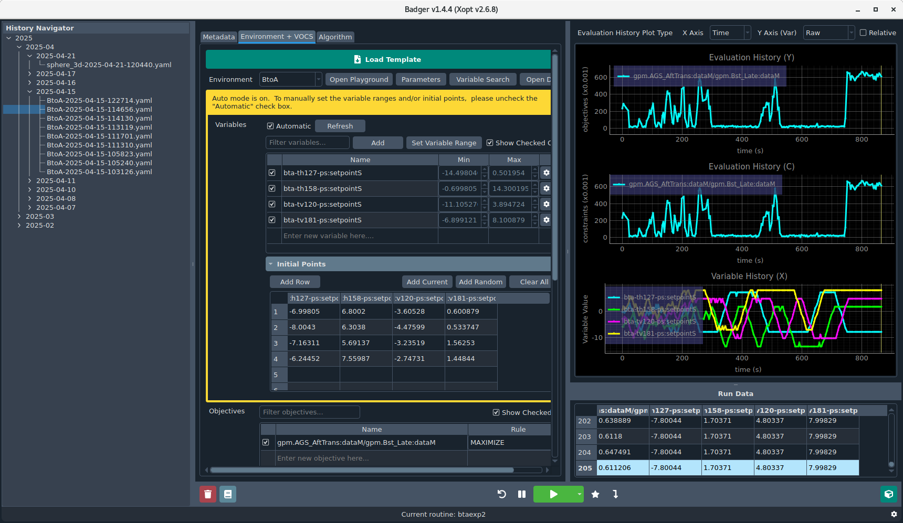

Badger: GUI for BO in the control room
15

Slide 16
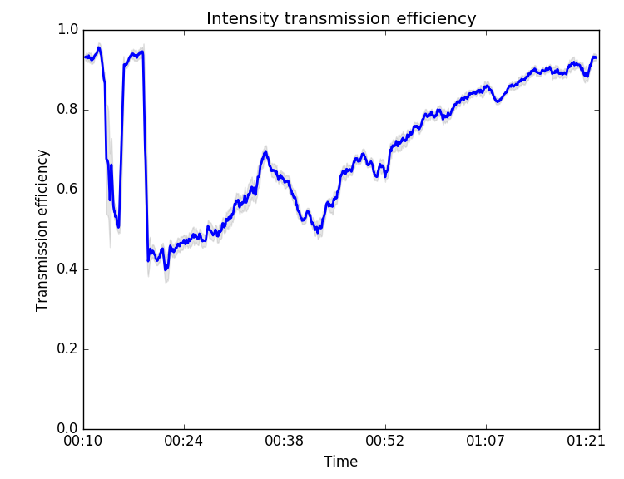
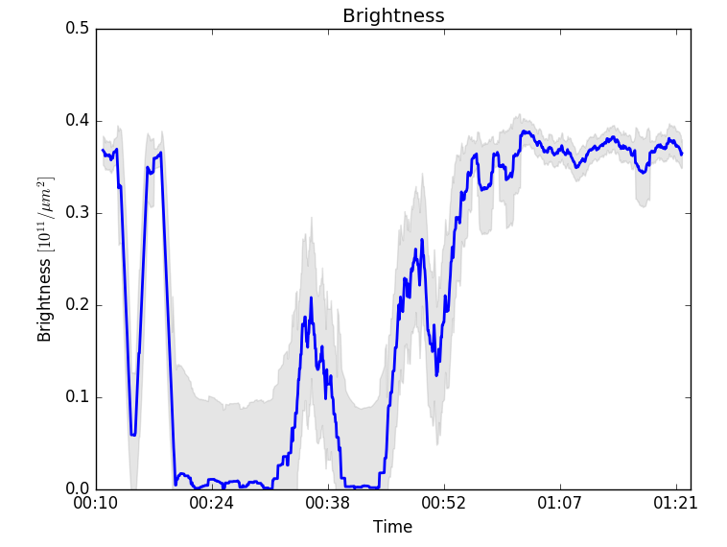
Automated AGS injection by BO
16
Algorithm efficiently found settings that were different, but at least as good as the previously optimized ones, automatically maintain the AGS injection at optimal performance without human intervention.
➔ Optimization of current while observing the brightness.

Slide 17

Automated AGS injection by BO
17
Algorithm efficiently found settings that were different, but at least as good as the previously optimized ones, automatically maintain the AGS injection at optimal performance without human intervention.
➔ Optimization of current while observing the brightness.
Eiad Hamwi, BNL postdoc

Slide 18
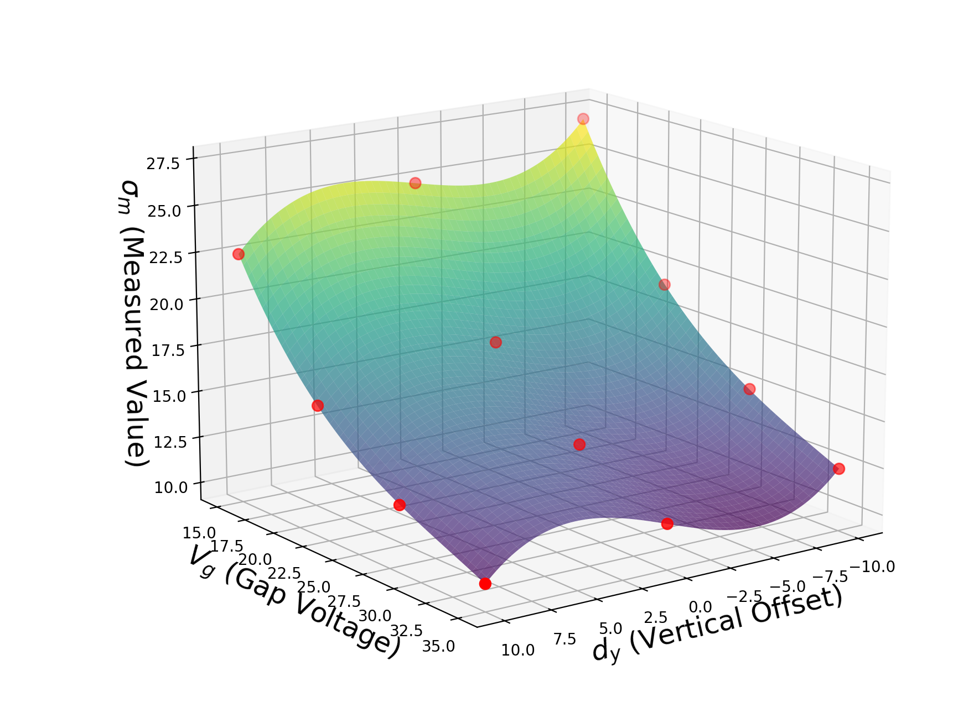
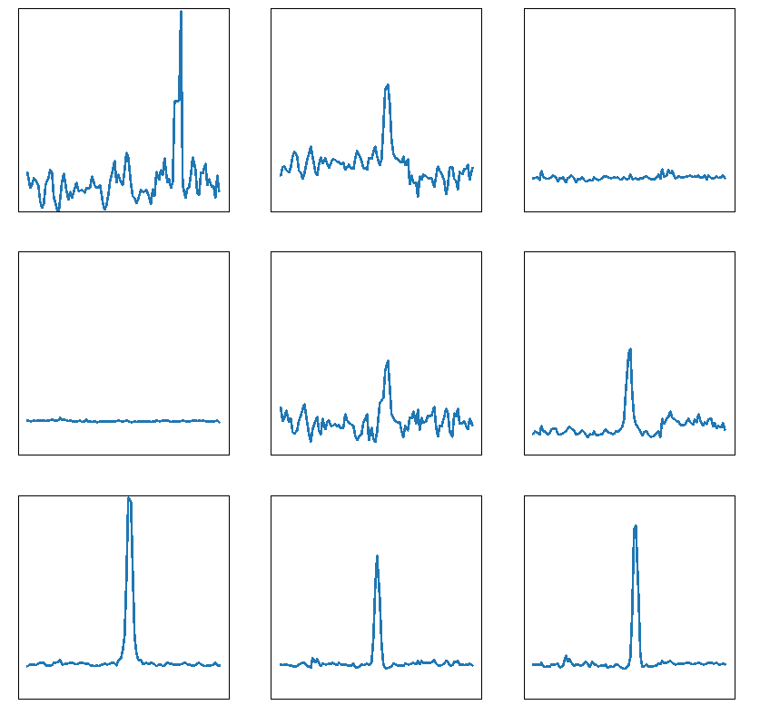
ML-improved AGS IPM
18
Simulated scan with surface fitting
Goal: Improve emittance reconstruction accuracy and robustness of AGS Ion Profile Monitor.
Approach
Gaussian process based surrogate model for fast IPM profile inference.
Unsupervised anomaly classifier to detect atypical IPM profiles.
Outcome
Improved accuracy in reconstructed bunch size and automated detection of anomalous IPM signals.
Classifier predictions on archive data
Anomalous
Normal

Slide 19
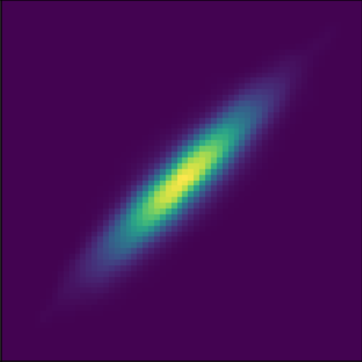

Fast Beam Propagation in Latent Space
19
Compress beam distributions into a learned latent space, then predict dynamics there.
Encoder
(VAE)
Decoder
(VAE)
Input
Beam
Dynamics Model
Predicted
beam
z₀
z₁
z₂
…
zₙ
e₁
e₂
e₃
eₙ
low-dimensional latent space
Fast: dynamics in low-dimensional latent space, not full beam.
Application: collective effect (space charge, etc.) dominated regimes where tracking is computationally expensive.

Slide 20

Fast Beam Propagation in Latent Space
20
Compress beam distributions into a learned latent space, then predict dynamics there.
Encoder
(VAE)
Decoder
(VAE)
Input
Beam
Dynamics Model
Predicted
beam
z₀
z₁
z₂
…
zₙ
e₁
e₂
e₃
eₙ
low-dimensional latent space
Fast: dynamics in low-dimensional latent space, not full beam.
Application: collective effect (space charge, etc.) dominated regimes where tracking is computationally expensive.
Grad Ningdong Wang

Slide 21

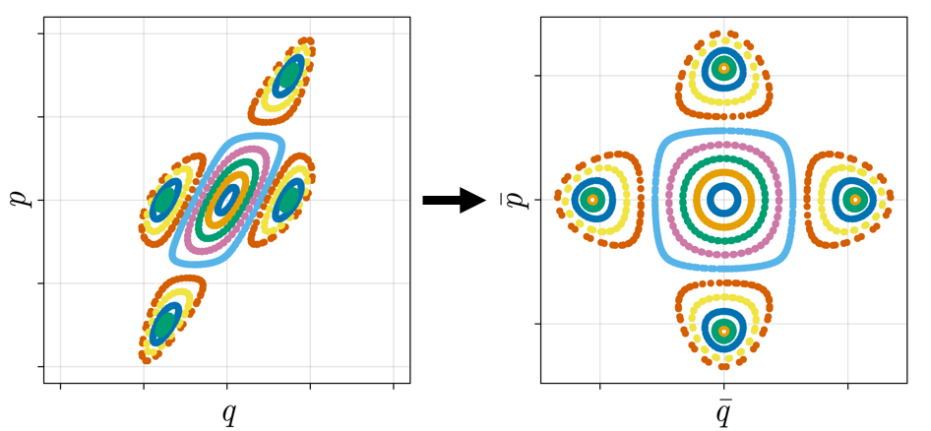
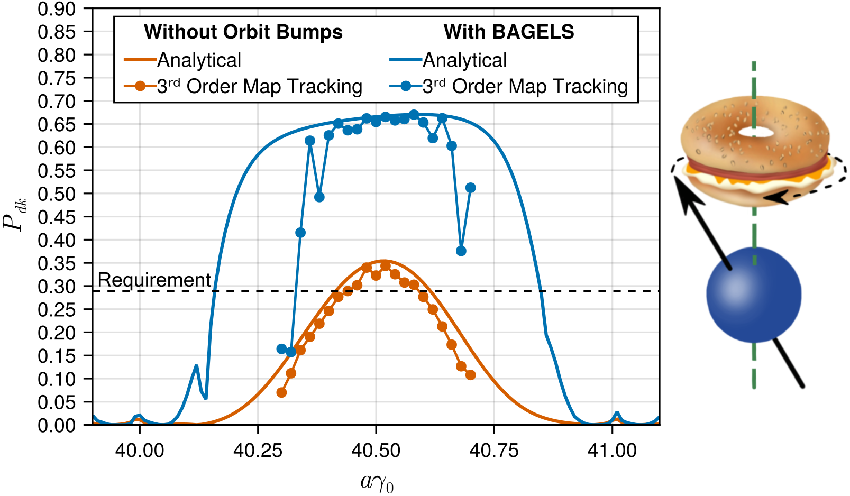
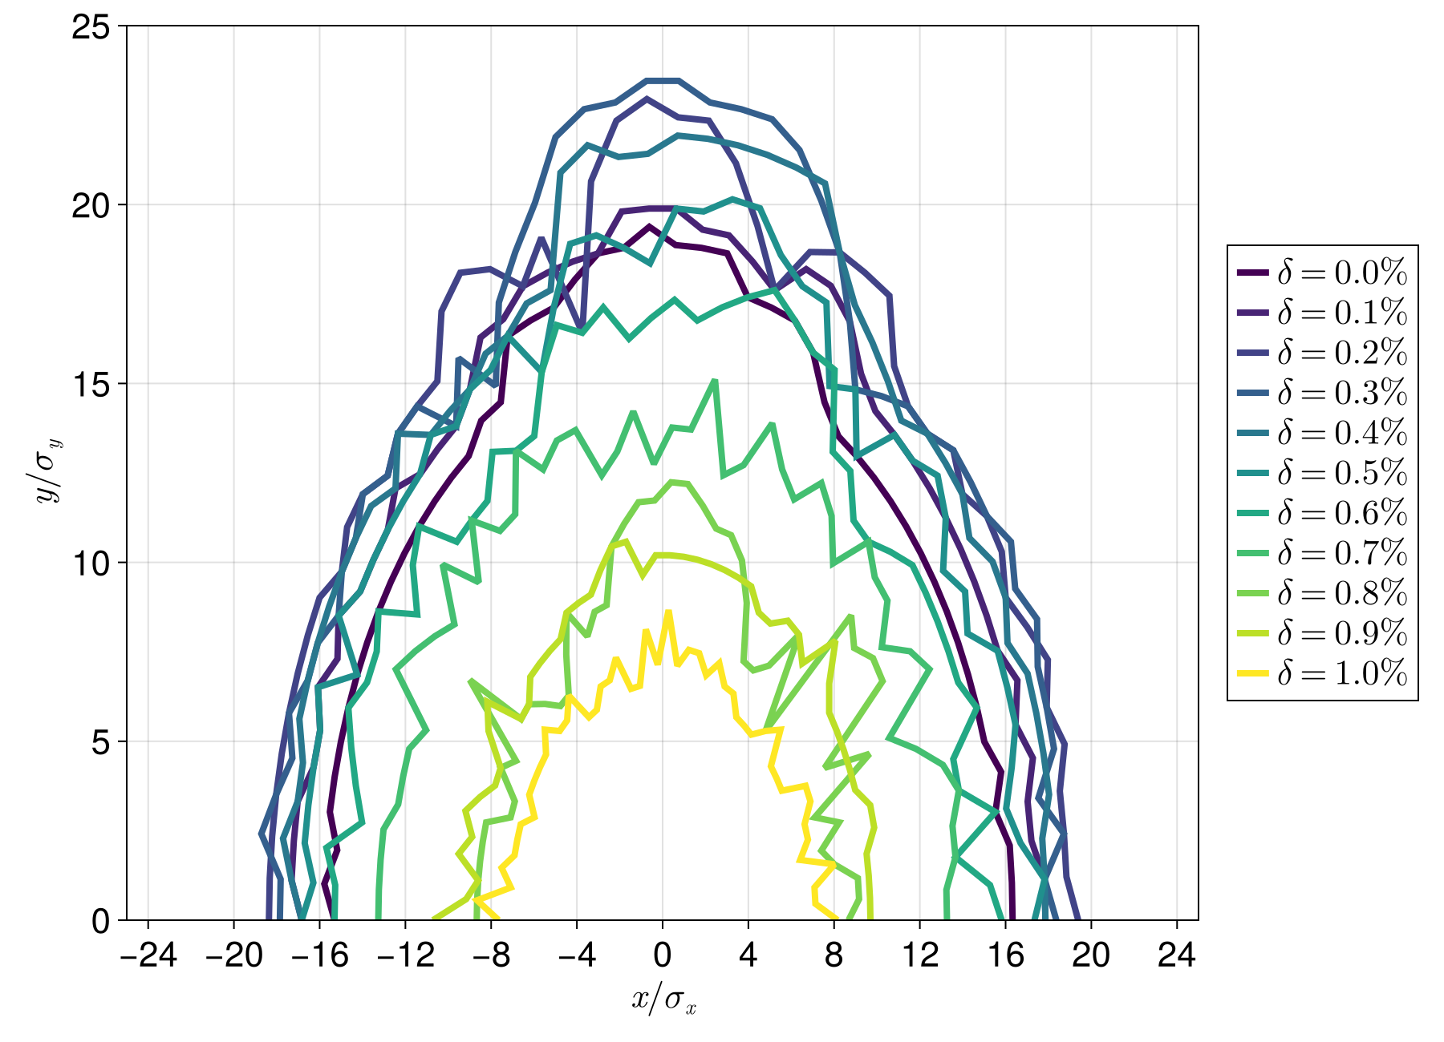
SciBmad – ML oriented beam modeling
21
New accelerator modeling library SciBmad
for nonlinear dynamics simulation, analysis + optimization:
Fully forward, backward, and Taylor differentiable.
Fully GPU and CPU parallelized.
Spin dynamics optimized “BAGELS”
“Single resonance normal form”
Optimization by
GPU lattice
parallelization
Phys. Rev. Accel. Beams 28, 031002, Editor’s Suggestion
Dynamic aperture for the EIC

Slide 22

SciBmad – ML oriented beam modeling
22
New accelerator modeling library SciBmad
for nonlinear dynamics simulation, analysis + optimization:
Fully forward, backward, and Taylor differentiable.
Fully GPU and CPU parallelized.
Spin dynamics optimized “BAGELS”
“Single resonance normal form”
Optimization by
GPU lattice
parallelization
Phys. Rev. Accel. Beams 28, 031002, Editor’s Suggestion
Matt Signorelli
EIC Postdoc
Dynamic aperture for the EIC

Slide 23
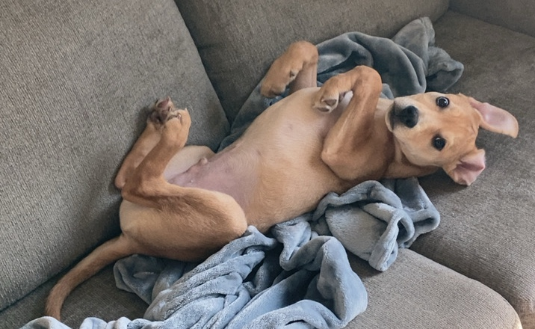
SciBmad – ML oriented beam modeling
23
New accelerator modeling library SciBmad
for nonlinear dynamics simulation, analysis + optimization:
Fully forward, backward, and Taylor differentiable.
Fully GPU and CPU parallelized.
Spin dynamics optimized “BAGELS”
“Single resonance normal form”
Optimization by
GPU lattice
parallelization
Phys. Rev. Accel. Beams 28, 031002, Editor’s Suggestion
Matt Signorelli
EIC Postdoc
Arrow,
Matt’s puppy
Dynamic aperture for the EIC

Slide 24
AI integration in EIC operations
24

Slide 25
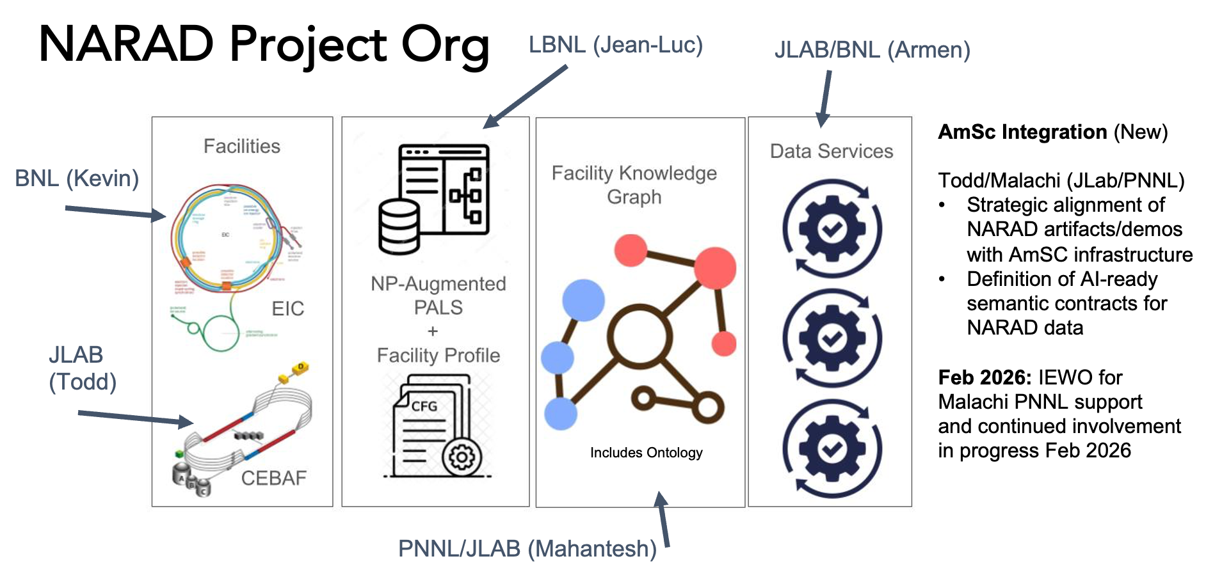
NP AI-ready Accelerator Dada (NARAD)
25
NP-focused, but facility independent
Cornell
American Science Cloud (AmSC) integration
NP facilities
JLab/PNNL
PNNL/JLAE

Slide 26







Participants
26
Kevin Brown, Yuan Gao, Eiad Hamwi, Levente Hajdu, Christopher Kelly, Trevor Olsen, Vincent Schoefer, Nathan Urban
Georg Hoffstaetter de Torquat, David Sagan
Tia Miceli
Armen Kasparian, Kishansingh Rajput, Todd Satogata
Christopher Hall
Yinan Wang, Yue Zhao
+ Unfunded collaborators
Auralee Edelen, Ryan Roussel
Work supported by Brookhaven Science Associates, LLC under Contract No. DE-SC0012704 and No. DE-SC0024287 with the U.S. Department of Energy and by NASA (Contract No. T570X).

Slide 27
Publications
27
[1] Y. Gao et al., “Applying Bayesian Optimization to Achieve Optimum Cooling at the Low Energy RHIC Electron Cooling System”, Physical Review Accelerators and Beams 25, 014601 (2022).
[2] W. Lin et al., “Simulation Studies and Machine Learning Applications at the Coherent electron Cooling experiment at RHIC”, in Proc. IPAC'22, Bangkok, Thailand, Jun. 2022, pp. 2387-2390.
[3] W. Lin et al., “Machine learning applications for orbit and optics correction at the Alternating Gradient Synchrotron”, in Proc. IPAC'23, Venice, Italy, May 2023, pp. 4460-4463.
[4] W. Lin et al., “AGS Booster model calibration and digital-twin development”, in Proc. IPAC’24, Nashville, TN, May 2024, pp. 3449-3452.
[5] R. Roussel et al., “Bayesian Optimization Algorithms for Accelerator Physics”, Physical Review Accelerators and Beams 27, 084801 (2024).
[6] T. Balasooriya et al., “Reinforcement Learning for Charged Particle Beam Control to Minimize Injection Mismatch in Particle Accelerators”, ICASSP 2025 - 2025 IEEE International Conference on Acoustics, Speech and Signal Processing (ICASSP), Hyderabad, India, 2025, pp. 1-5.
[7] W. Lin, “Maintaining optimal beam brightness and luminosity using machine learning”, in Proc. HIAT2025, East Lansing, MI, Jun. 2025, pp. 79-84.
[8] W. Lin et al., “Improve beam brightness with Bayesian optimization at the AGS Booster injection at BNL”, in Proc. NAPAC’25, Sacramento, CA, Aug. 2025, pp. 157-159.
[9] E. Hamwi et al., “Application of Bayesian optimization to BtA injection at BNL”, in Proc. NAPAC’25, Sacramento, CA, Aug. 2025, pp. 58-60.
[10] W. Lin et al., “Machine learning assisted Bayesian calibration of accelerator digital twin from orbit response data”, in Proc. NAPAC’25, Sacramento, CA, Aug. 2025, pp. 177-180.
[11] Y. Gao et al., “Exploring Reinforcement Learning for Optimal Bunch Merge in the AGS”, in New York Scientific Data Summit 2025, pp. 13-16 (2025).
[12] T. Miceli et al., “Twinac: initiation of a community-driven accelerator digital twin framework”, in Proc. ICALEPCS’25, Chicago, IL, USA, Sep. 2025, pp. 72-79.
[13] L. Hajdu et al., “Image processing with ML for automated tuning of the NASA Space Radiation Laboratory beam line”, in Proc. ICALEPCS2025, Chicago, Sep. 2025, pp. 1008-1011.
[14] W. Lin et al., “Digital twin development for the NASA space radiation laboratory”, submitted to Physical Review Accelerators and Beams, Nov. 2025.

Slide 28
Summary
28
The EIC-BeamAI collaboration has the goal to utilize AI/ML for EIC design and operation.
The collaboration was formed around DOE-NP funded proposals
Bayesian Optimization for increased proton polarization from the AGS
Using ML for brighter & more polarized beams in the EIC’s hadron injectors.
NARAD to develop cross-facility AI-ready workflow
Utilize MOAT goal by connecting to US-wide AI/ML accelerator work
Key Outcomes
Automated beam-tuning routines
Operational bidirectional Digital Twins with differentiable accelerator models
Streamlined and automated model calibration
Robust anomaly detection and diagnostics
Workforce development

