Slide 1
AI Surrogate Modeling for Fast Simulation of the Hydrodynamic Evolution of the Quark-Gluon Plasma
Computing and Data Sciences, BNL
Seungjun Lee
In collaboration with Y. Go, B. Schenke, C. Shen, Y. Ren, J. Huang, M. Chamizo-Llatas
This work is funded under BNL LDRD 26-46
RHIC/AGS Annual User’s Meeting · AI/ML Workshop
05/11/2026
Notes:
Good morning.
Thank you to the organizers for inviting me to this workshop.
I'm Seungjun Lee, from the AI department at BNL Computing and Data Sciences.
Today I'll share our work — AI surrogate modeling for QGP hydrodynamics.
This work is supported under a BNL LDRD project, with collaborators at BNL, listed here.

Slide 2
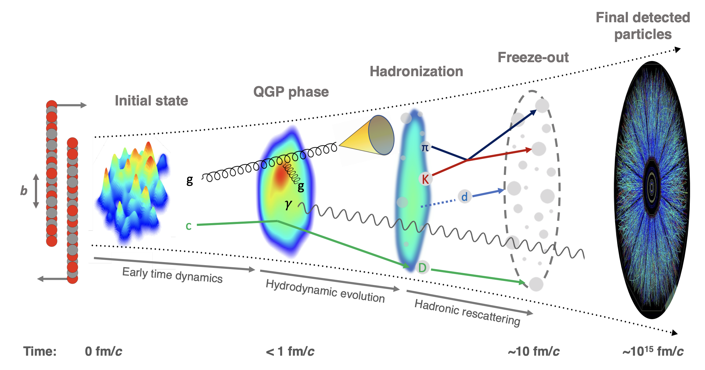

Heavy Ion Collision Simulations
M. Arslandok, et. al., Hot QCD White Paper, arxiv:2303.17254, 2023.
Traditional Solver (IP-Glasma+MUSIC)
 | 2+1D | 3+1D
Time/event | ~10 mins | ~20 hours
Many simulated events are required for parameter inference and uncertainty quantification.
The hydrodynamic evolution of the QGP is a computational bottleneck, motivating fast and accurate AI surrogate models that can replace or accelerate the hydrodynamic stage.
Notes:
Let me start with the standard heavy-ion collision simulation pipeline.
Since most of you are familiar with this pipeline, I will skip the physics details. The key point for this talk is the red-boxed stage: the QGP hydrodynamic evolution.
For parameter inference and uncertainty quantification from final-state observables, we need a large number of event-by-event simulations.
However, solving the hydrodynamic evolution is the computational bottleneck — about 10 minutes per event in 2+1D, and 20 hours in 3+1D on a single CPU.
So, our goal is to build a fast and accurate AI surrogate model that can emulate this hydrodynamic stage.

Slide 3
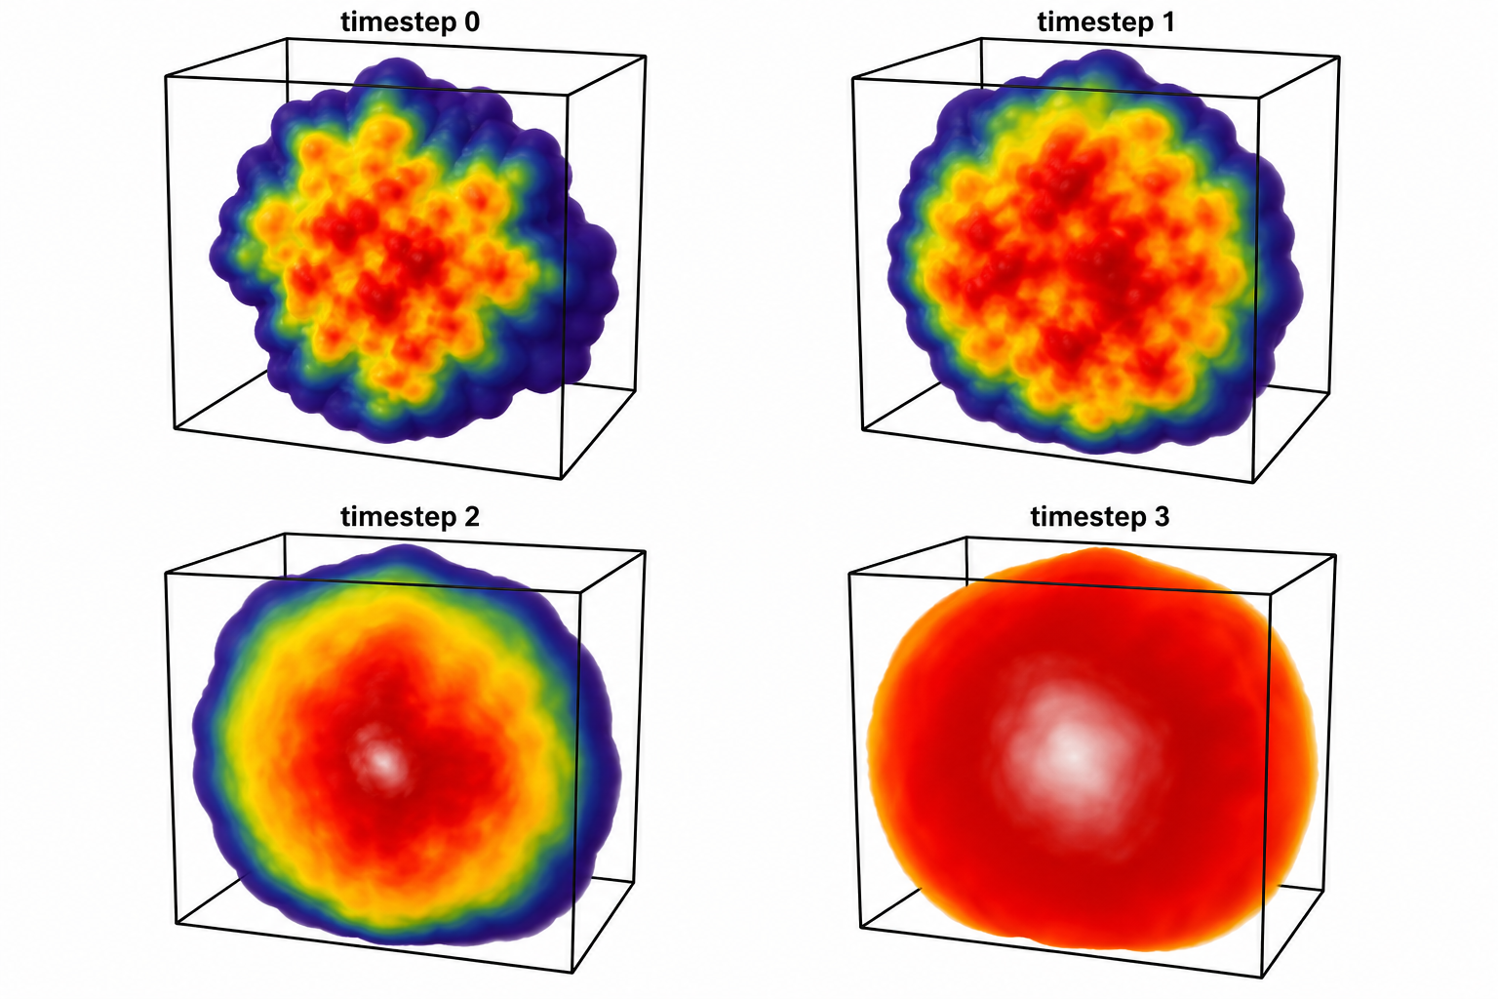
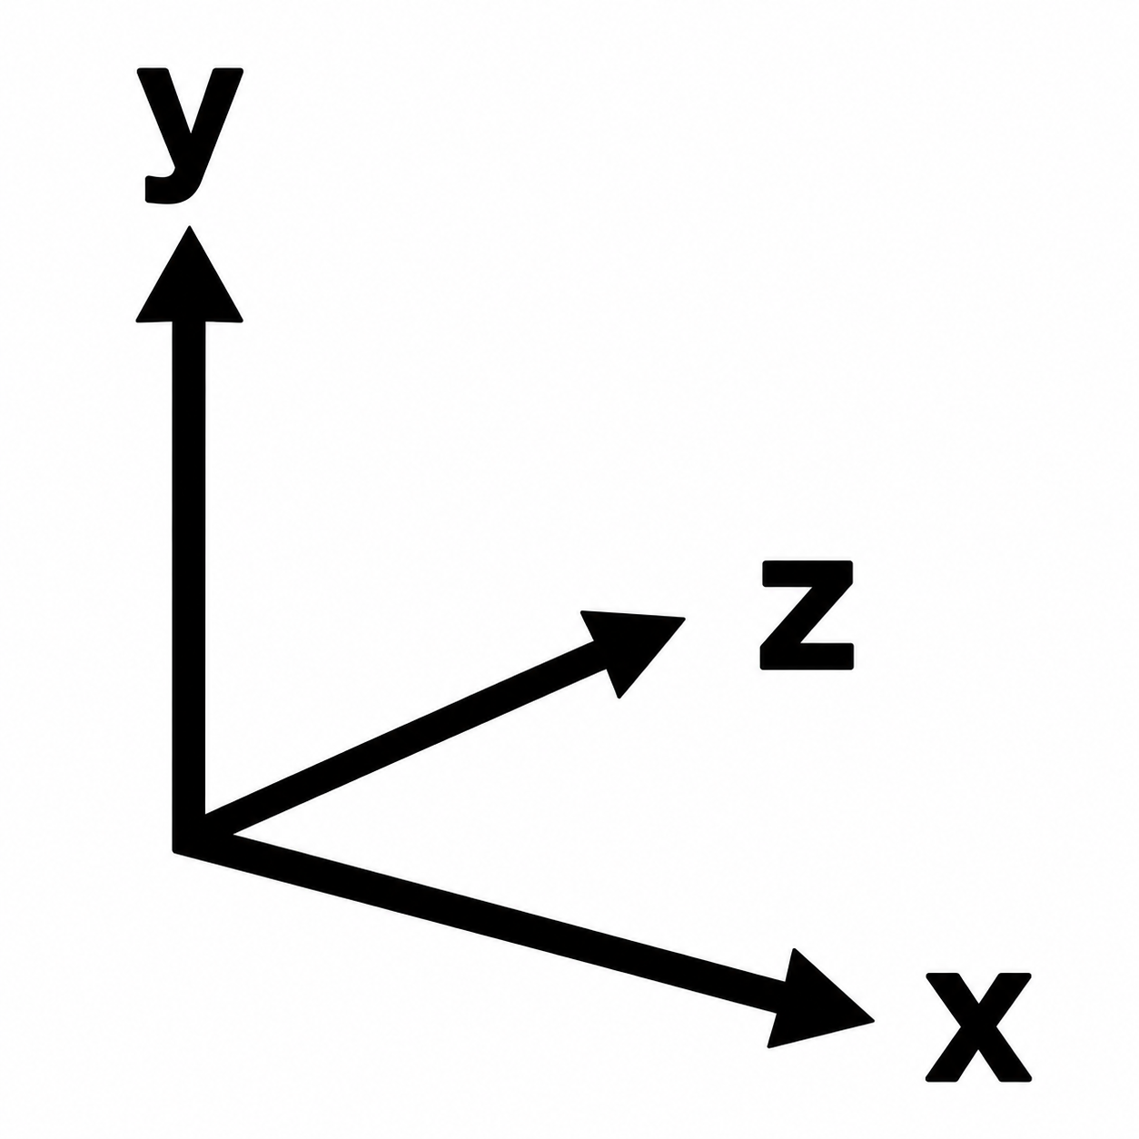

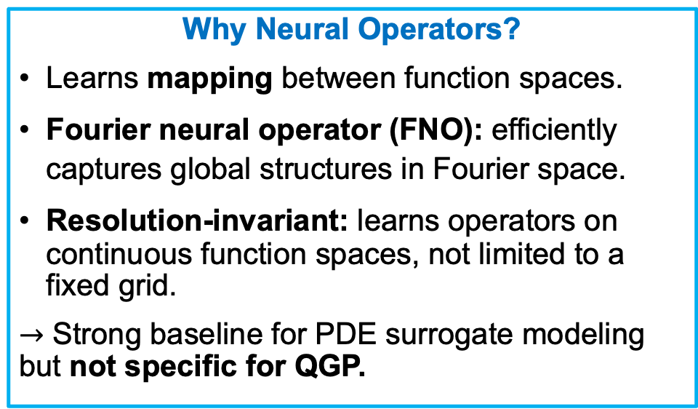


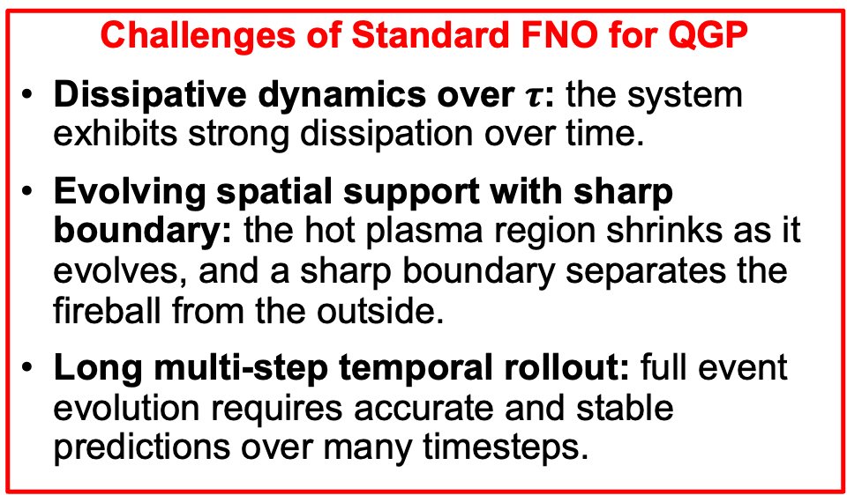

Neural Operators for QGP: Promise and Limits
$$τ=τ_{0}$$
$$τ_{1}$$
$$τ_{t}$$
$$τ_{T}$$
…
…
Input: Initial state
Output: hydrodynamic evolutions
Why Neural Operators?
Learns mapping between function spaces.
Fourier neural operator (FNO): efficiently captures global structures in Fourier space.
Resolution-invariant: learns operators on continuous function spaces, not limited to a fixed grid.
$→$ Strong baseline for PDE surrogate modeling but not specific for QGP.
Challenges of Standard FNO for QGP
Dissipative dynamics over $τ$: the system exhibits strong dissipation over time.
Evolving spatial support with sharp boundary: the hot plasma region shrinks as it evolves, and a sharp boundary separates the fireball from the outside.
Long multi-step temporal rollout: full event evolution requires accurate and stable predictions over many timesteps.
Notes:
As the QGP surrogate problem can be formulated as learning a mapping from an initial state to hydrodynamic evolution over proper time, we use neural operators, which are well suited for PDE-governed dynamics.
In particular, Fourier neural operators, or FNOs, which is standard neural operator, efficiently capture global structures in Fourier space.
They learn operators on continuous function spaces rather than on a fixed grid which make them resolution-invariant.
So, FNO provides a strong baseline for common PDE surrogate modeling, but it is not specifically designed for QGP.
By the way, QGP evolution involves dissipative dynamics over proper time, evolving spatial support with sharp moving boundaries, and long temporal rollouts. And in practice, scaling these models to 3+1D evolution introduces significant memory and computational challenges.
These challenges motivate our model, a modification of FNO designed for QGP.

Slide 4
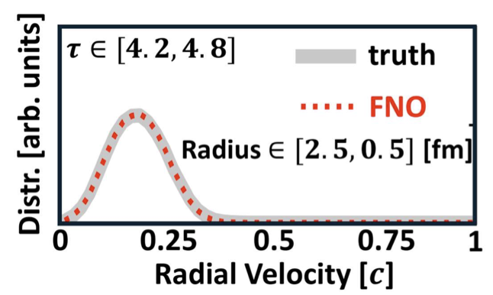
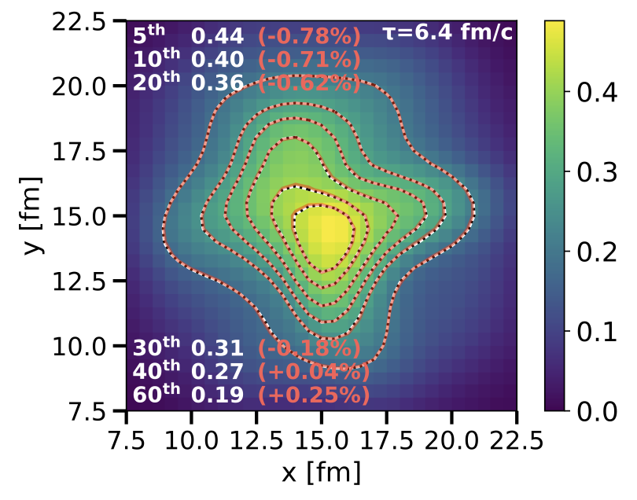
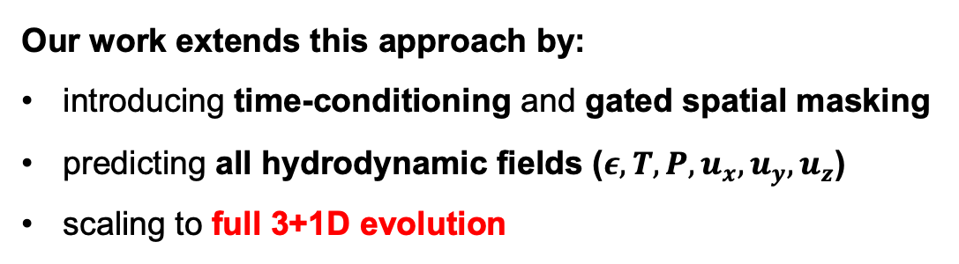
Previous Works
Earlier ML surrogate work: stacked U-Net acceleration for 2+1D hydrodynamics (PRR 2021).
H. Huang, et. al., Physical Reivew Research 3, 023256, 2021.
Stewart & Putschke (PRC 2026) demonstrated FNOs for fast prediction of 2+1D QGP evolution.
Predicted energy density and velocity fields, as well as flow and jet-quenching observables.
D. Stewart, and J. Putschke, Physical Review C 113, 014904, 2026.
Energy Density
Our work extends this approach by:
introducing time-conditioning and gated spatial masking
predicting all hydrodynamic fields ($ε, T, P, u_{x}, u_{y}, u_{z}$)
scaling to full 3+1D evolution
Notes:
Before introducing our model, I would like to briefly mention related work in this area.
Earlier work explored ML surrogates for 2+1D hydrodynamics using stacked U-Nets.
More recently, Stewart and Putschke demonstrated that standard FNOs can effectively predict 2+1D QGP evolution.
Our work extends this approach by introducing time-conditioning and gated spatial masking modules to address the challenges that I discussed earlier.
We also predict all hydrodynamic fields, including temperature and pressure, and velocity fields, while scaling the framework to full 3+1D evolution.

Slide 5
Methods - Overview
Notes:
Let me walk through the method.
This figure is overview of our pipeline.
We encode the initial state once with Factorized FNO, then decode all timesteps through a time-conditioned decoder. And masking modules are applied after the decoder.
Let me explain each part in the next few slides.

Slide 6
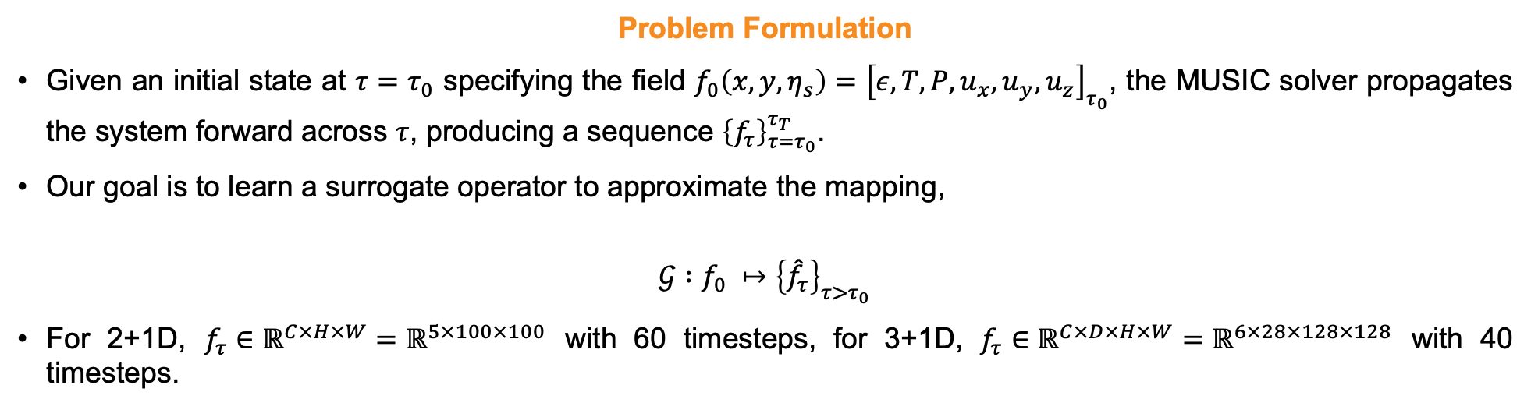
Methods – Problem Formulation
Problem Formulation
Given an initial state at $τ=τ_{0}$ specifying the field $f_{0}\left(x,y,η_{s}\right)={\left[ε,T, P, u_{x}, u_{y},u_{z}\right]}_{τ_{0}}$, the MUSIC solver propagates the system forward across $τ$, producing a sequence ${\left\{f_{τ}\right\}}_{τ=τ_{0}}^{τ_{T}}$.
Our goal is to learn a surrogate operator to approximate the mapping,
$$𝒢 :f_{0} ↦{\left\{{\hat{f}}_{τ}\right\}}_{τ>τ_{0}}$$
For 2+1D, $f_{τ}∈ℝ^{C×H×W}=ℝ^{5×100×100}$ with 60 timesteps, for 3+1D, $f_{τ}∈ℝ^{C×D×H×W}=ℝ^{6×28×128×128}$ with 40 timesteps.
Notes:
For the problem formulation.
Given an initial state at tau0, the solver propagates the system forward to produce a sequence up to tau_T.
We learn a surrogate model G that approximates the mapping from tau0 to tau1totaumax.
For 2+1D and 3+1D fields have the following shapes.

Slide 7
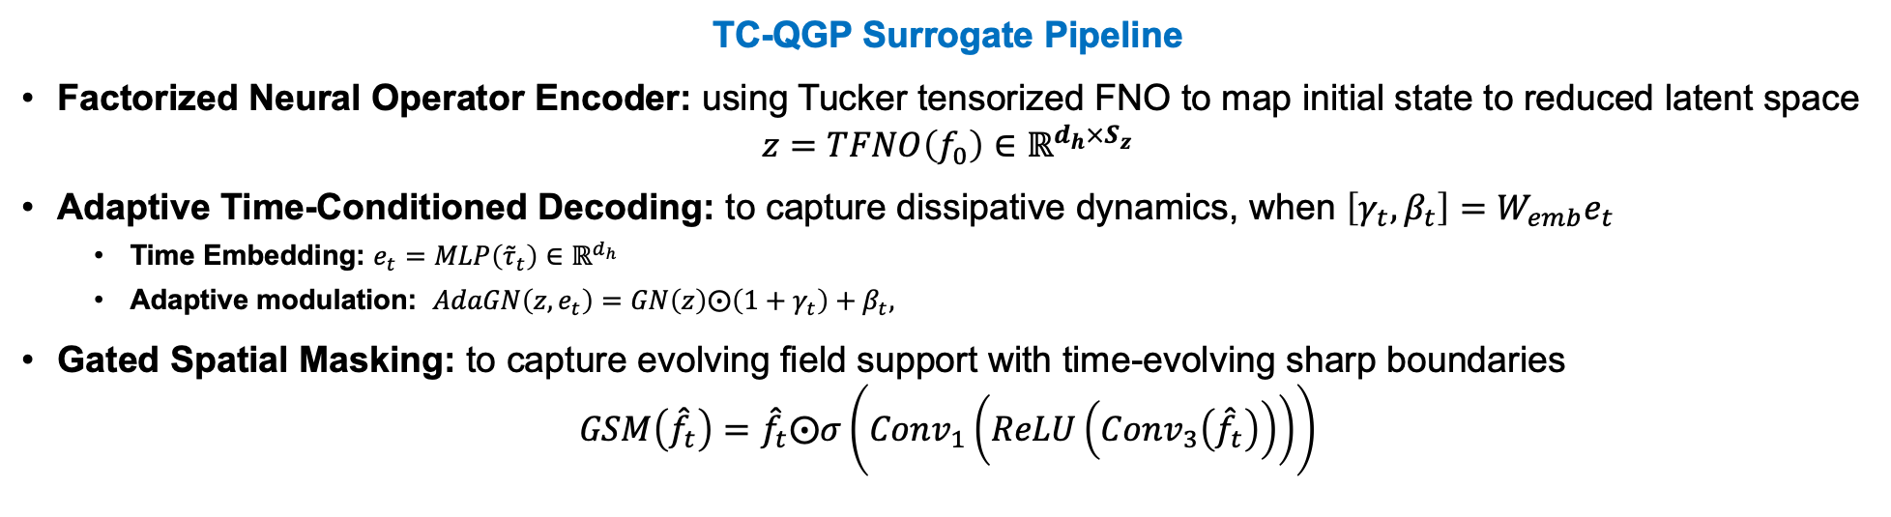
Methods – Surrogate Pipeline
TC-QGP Surrogate Pipeline
Factorized Neural Operator Encoder: using Tucker tensorized FNO to map initial state to reduced latent space
$$z=TFNO\left(f_{0}\right)∈ℝ^{d_{h}×S_{z}}$$
Adaptive Time-Conditioned Decoding: to capture dissipative dynamics, when $\left[γ_{t},β_{t}\right]=W_{emb}e_{t}$
Time Embedding: $e_{t}=MLP\left({\tilde{τ}}_{t}\right)∈ℝ^{d_{h}}$
Adaptive modulation: $AdaGN\left(z,e_{t}\right)=GN\left(z\right)⨀\left(1+γ_{t}\right)+β_{t},$
Gated Spatial Masking: to capture evolving field support with time-evolving sharp boundaries
$$GSM\left({\hat{f}}_{t}\right)={\hat{f}}_{t}⨀σ\left(Conv_{1}\left(ReLU\left(Conv_{3}\left({\hat{f}}_{t}\right)\right)\right)\right)$$
Notes:
Our architecture has three modules.
First, a Factorized Neural operator encoder: a tucker-tensorized FNO that maps the initial state to a reduced latent space. The factorization separates the spectral computation across spatial dimensions enables scaling to 3+1D.
Second, an Adaptive time-conditioned decoder. We embed each proper time and use it to modulate the latent features through Adaptive modulation - channel-wise scale and shift driven by tau. This captures the dissipative dynamics.
Third, a Gated spatial masking module. We apply a parameterized soft spatial gate at each timestep – approximately zero outside, one inside the fireball – to capture the evolving sharp boundary.
The encoder runs once per event; the decoder runs T times in a single forward pass.

Slide 8
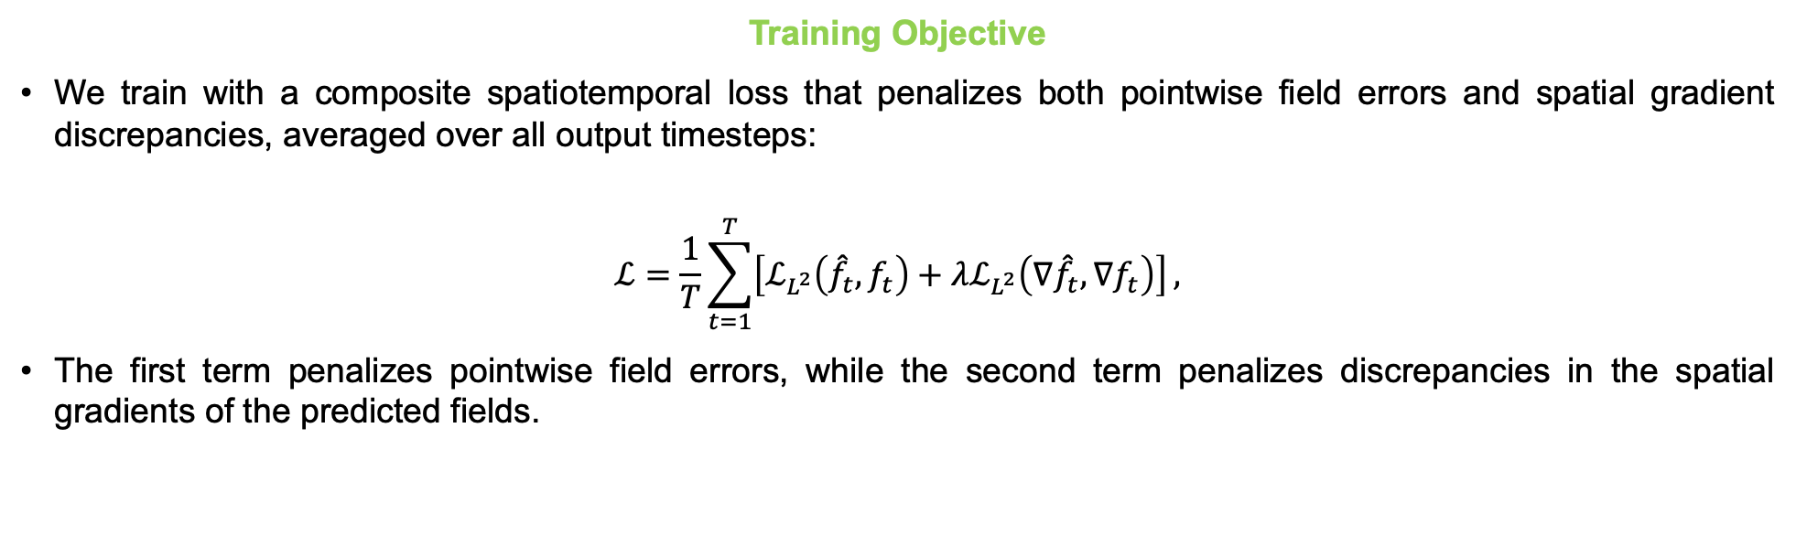
Methods – Training Objective
Training Objective
We train with a composite spatiotemporal loss that penalizes both pointwise field errors and spatial gradient discrepancies, averaged over all output timesteps:
$$ℒ=\frac{1}{T}\sum_{t=1}^{T}{\left[ℒ_{L^{2}}\left({\hat{f}}_{t},f_{t}\right)+λℒ_{L^{2}}\left(∇{\hat{f}}_{t},∇f_{t}\right)\right]},$$
The first term penalizes pointwise field errors, while the second term penalizes discrepancies in the spatial gradients of the predicted fields.
Notes:
The training objective.
We train the model with a spatiotemporal loss which consists of relative L2 loss on the fields and relative L2 loss on their spatial gradients, averaged over all timesteps.
The gradient term help sharpen the fireball boundary.
Lambda is set to one-half.

Slide 9
Methods – Key Advantages
Notes:
The key advantages tie with specific architectural choices.
First – encoding with factorized FNO to separate the computation at each dimension enables it to scale to 3+1D.
Second – decoding with time-conditioned adaptive modulation to capture dissipative dynamics and predict all timesteps in a single forward pass.
Third – applying the gated spatial masking module to learn the evolving support and moving sharp boundaries.
Next, I’ll show the results to present that our proposed model significantly improves standard FNO in the accuracy and cost.

Slide 10
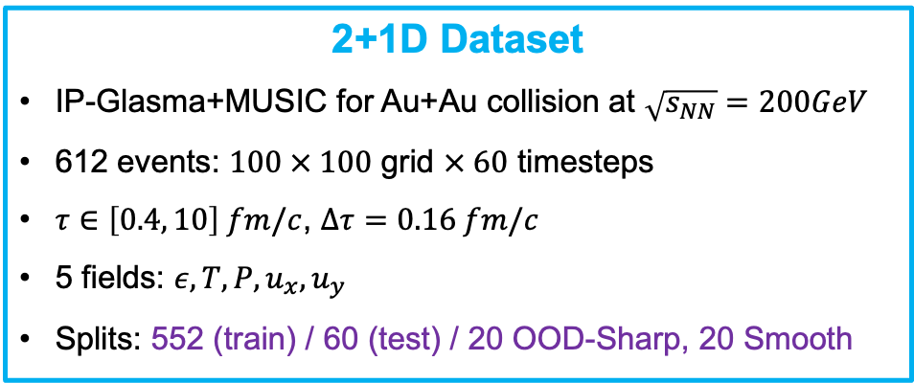
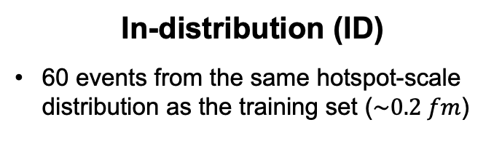
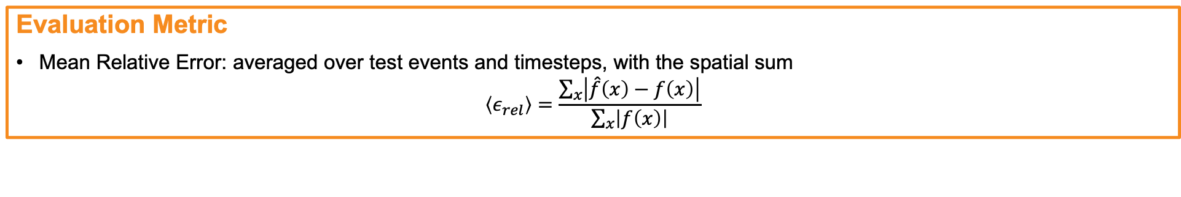
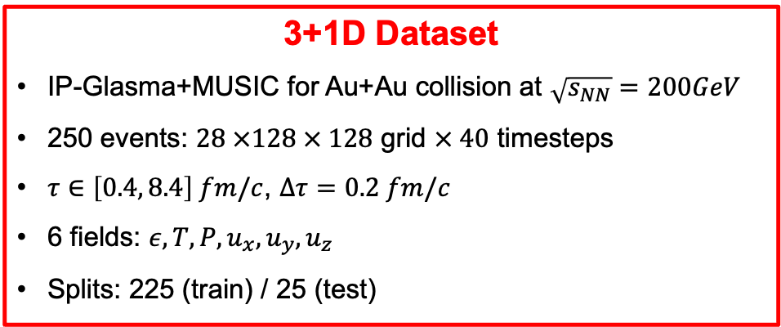
Experimental Setups
2+1D Dataset
IP-Glasma+MUSIC for Au+Au collision at $\sqrt{s_{NN}}=200GeV$
612 events: $100 × 100$ grid $× 60$ timesteps
$τ∈\left[0.4, 10\right] fm/c$, $Δτ=0.16 fm/c$
5 fields: $ε,T, P, u_{x}, u_{y}$
Splits: 552 (train) / 60 (test) / 20 OOD-Sharp, 20 Smooth
3+1D Dataset
IP-Glasma+MUSIC for Au+Au collision at $\sqrt{s_{NN}}=200GeV$
250 events: $28 ×128 × 128$ grid $× 40$ timesteps
$τ∈\left[0.4, 8.4\right] fm/c$, $Δτ=0.2 fm/c$
6 fields: $ε,T, P, u_{x}, u_{y},u_{z}$
Splits: 225 (train) / 25 (test)
Out-of-distribution (OOD) Evaluation (2+1D)
In-distribution (ID)
60 events from the same hotspot-scale distribution as the training set ($\sim 0.2 fm$)
OOD-Sharp
20 events with a finer hotspot scale, yielding initial conditions with sharper than the training distribution
OOD-Smooth
20 events with a coarser hotspot scale, yielding initial conditions with smoother than the training distribution
Evaluation Metric
Mean Relative Error: averaged over test events and timesteps, with the spatial sum
$$\left\langle ε_{rel}\right\rangle =\frac{\sum_{x}{\left|\hat{f}\left(x\right)−f\left(x\right)\right|}}{\sum_{x}{\left|f\left(x\right)\right|}}$$
Notes:
The experimental setup.
Both datasets use IP-Glasma for initial state and MUSIC for propagation for Au-Au collisions.
The 2+1D dataset has 100 by 100, 60 timesteps, 3+1D is 28 has 128 by 128, 40 timesteps.
For 2+1D, we additionally test on out-of-distribution testsets – OOD sharp include more spiky initial states than the training, and OOD-Smooth use less spiky initial states than the training.
We’ll report mean relative error for main evaluation metrics.

Slide 11
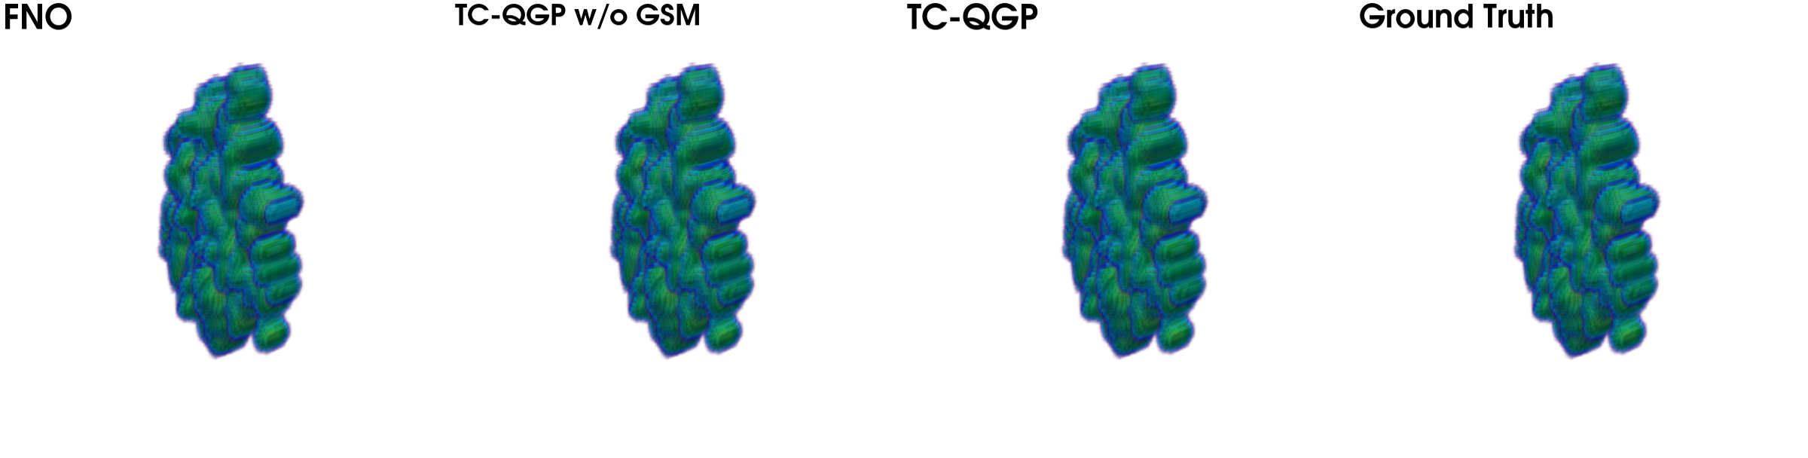
Results – 3+1D Full Evolution (including ablation)
Temperature Field
Notes:
Here is the full 3+1D temperature evolution.
Standard FNO shows some boundary artifacts over time.
TC-QGP without GSM only using time-conditioning, partially improves the result, but the boundary remains blurry.
Full TC-QGP preserves the compact fireball and closely matches the ground truth while successfully preserving the sharp evolving boundary throughout the evolution.

Slide 12
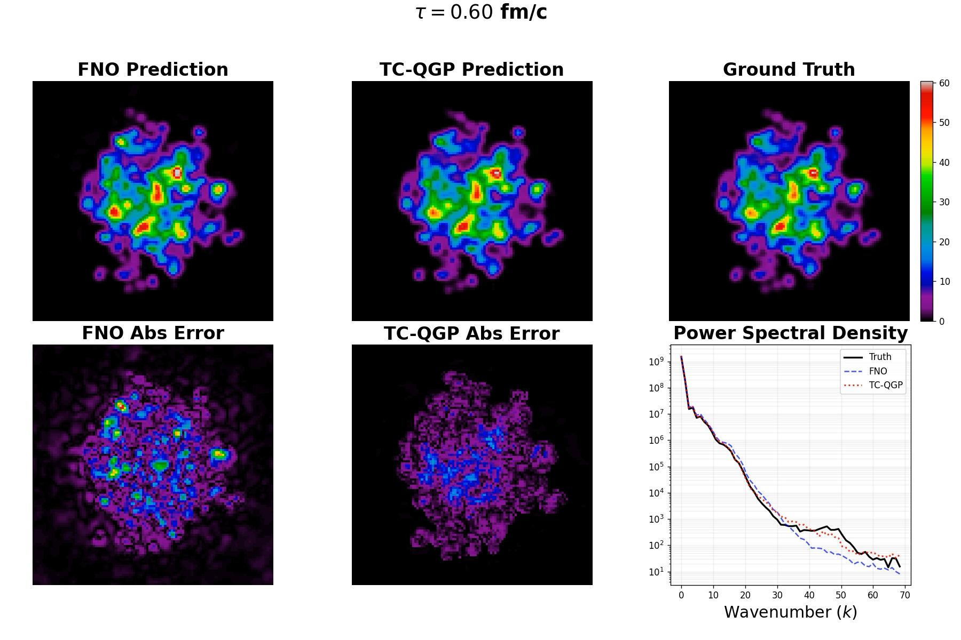
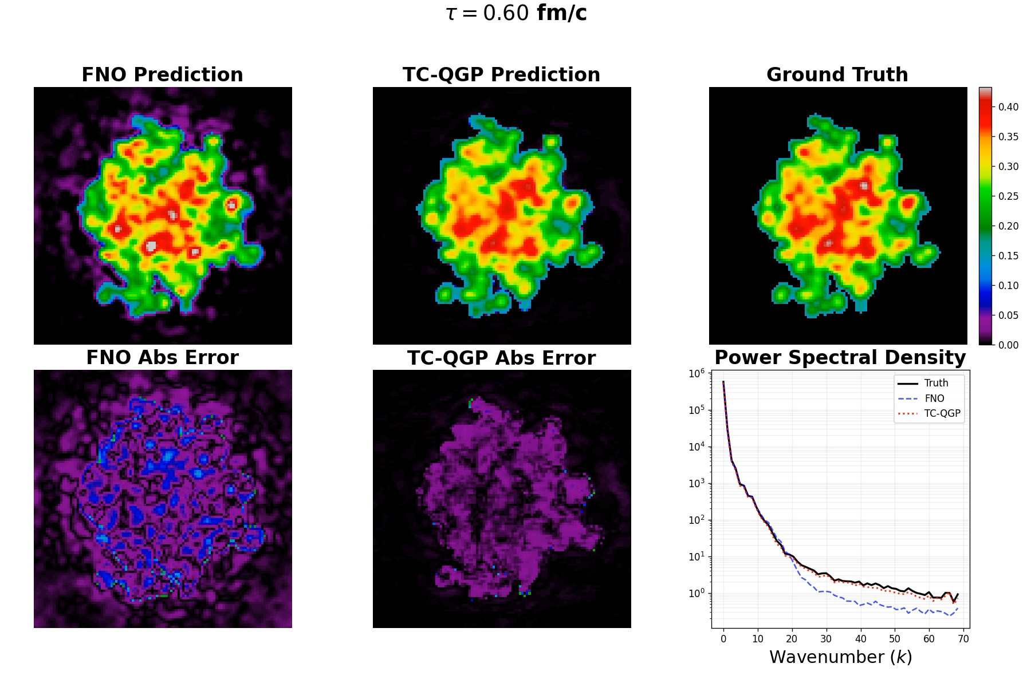
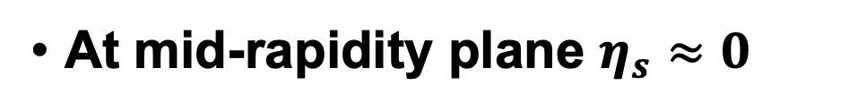
Results – 3+1D Energy Density, Temperature
At mid-rapidity plane $η_{s}≈0$
Energy Density
Temperature
Notes:
Here I show mid-rapidity slices for 3+1D – energy density on the left and temperature on the right.
TC-QGP preserves large-scale structure and the fine-details much better than the standard FNO baseline.
The power spectral density plots at the bottom-right quantify how well the spatial structures are preserved across different frequency scales. (which is a common evaluation metric in the PDE community.)
Low k corresponds to large-scale structures, while high k represents fine-grained structures.
We can see that TC-QGP maintains the high-frequency spectrum much more accurately throughout the evolution.

Slide 13
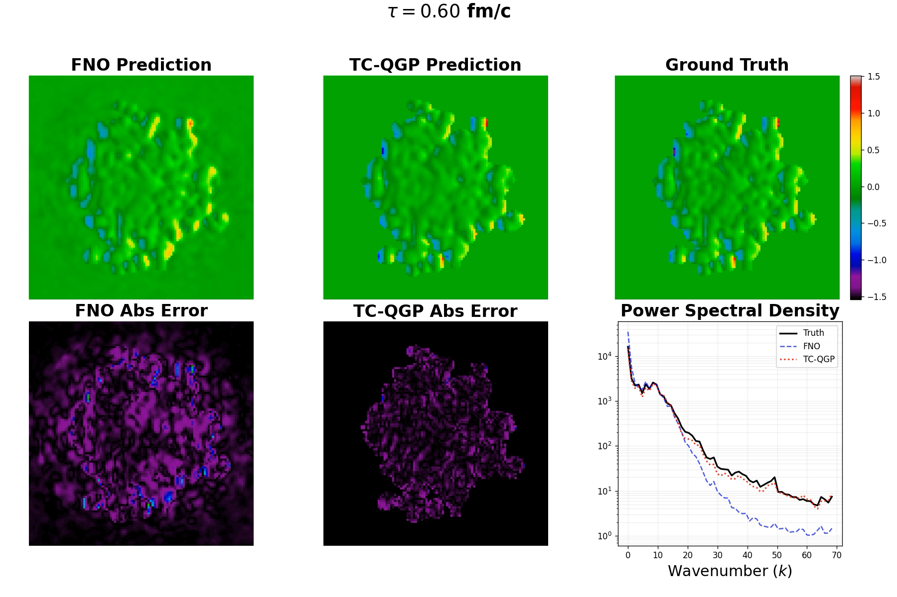
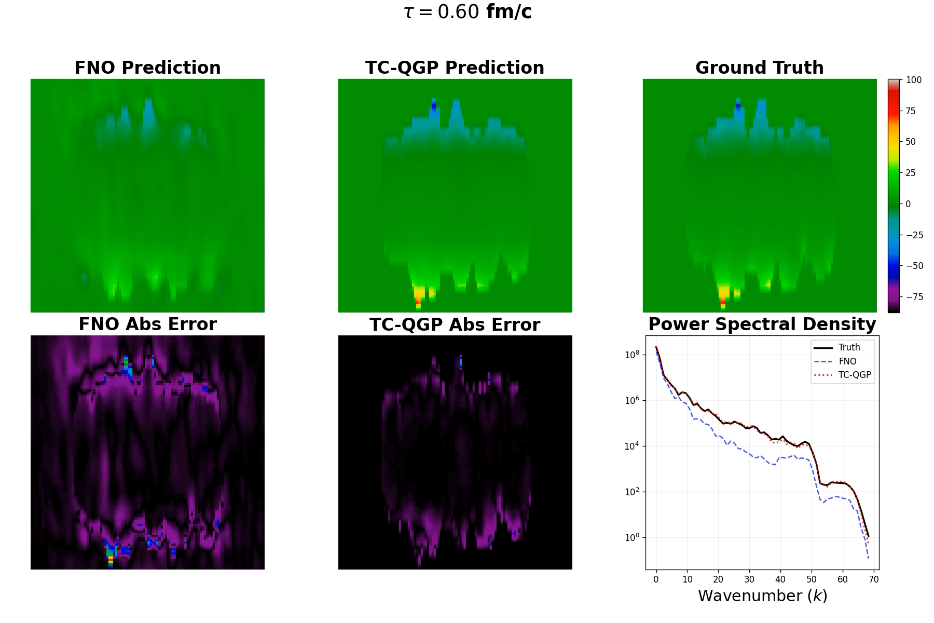


Results – 3+1D Velocity Fields $u_{x}$, $u_{z}$
Velocity Fields
$u_{x}$ on the $x−y$ plane at mid-rapidity $η_{s}≈0$
$u_{z}$ on the $x−η_{s}$ plane at mid-$y$
Notes:
These are the transverse and longitudinal velocity fields. The longitudinal component $u_{z}$only exists in full 3+1D evolution and is more challenging to model, because it contains rapidity-dependent structure. TC-QGP captures both the rapidity-dependent structure and the spectral behavior much more accurately than standard FNO.

Slide 14
Results – 2+1D Generalization: (0.8, 9.6 fm/c)
In-distribution (ID)
OOD-Sharp
OOD-Smooth
Notes:
Now to the 2+1D results, for temperature field.
Three columns — in-distribution on the left, OOD-Sharp in the middle, OOD-Smooth on the right. The top row is early evolution at τ ≈ 0.8 fm/c, the bottom row is late evolution at τ ≈ 9.6 fm/c.
For in-distribution, both FNO and TC-QGP reconstruct the ground truth well.
For both OOD settings, FNO loses fine detail and accumulates error over time, while TC-QGP stays much closer to the ground truth.
At the late times under distribution shift, TC-QGP is clearly better than FNO, but it's not perfect either.
Distribution shift is a fundamentally hard problem in machine learning, and improving generalization further would be one of our future works.

Slide 15
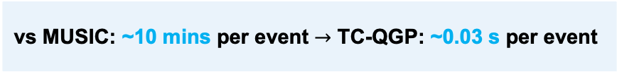
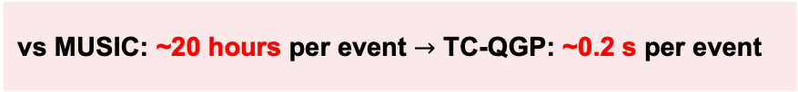
Results – Quantitative Results
2+1D Dataset
Accuracy – Mean Relative Error (%)
Cost (single A100, batch 1)
3+1D Dataset
Accuracy – Mean Relative Error (%)
Cost (single A100, batch 1)
 | FNO | TC-QGP
ID | 1.10 | 0.86
OOD-Sharp | 9.55 | 9.23
OOD-Smooth | 8.20 | 8.01
 | FNO | TC-QGP | ↓
ε | 17.44 | 4.08 | 4.3×
T | 13.89 | 1.66 | 8.4×
P | 20.32 | 4.54 | 4.5×
u_{x} | 28.10 | 8.52 | 3.3×
u_{y} | 27.73 | 7.80 | 3.6×
u_{z} | 31.44 | 5.44 | 5.8×
All | 23.15 | 5.34 | 4.3×
→ Outperforms FNO across ID and OOD settings
 | FNO | TC-QGP
Parameters | 151 M | 21.4 M
GPU Memory | 1,193 MB | 127 MB
Inference Time | 34.4 ms | 29.7 ms
 | FNO | TC-QGP
Parameters | 382.4 M | 356.6 M
GPU Memory | 16,585 MB | 4,459 MB
Inference Time | 108.8 ms | 230.4 ms
→ ~7× fewer parameters, ~9× less memory with comparable wall time
vs MUSIC: ~10 mins per event $→$ TC-QGP: ~0.03 s per event
vs MUSIC: ~20 hours per event $→$ TC-QGP: ~0.2 s per event
Notes:
Now the numbers.
TC-QGP consistently outperforms the standard FNO baseline in both 2+1D and 3+1D settings.
In 2+1D, our model is more accurate while using lower computational cost.
In 3+1D, the overall error is reduced from about 23 percent to 5 percent.
And compared to the traditional solver, inference is extremely fast while remaining accurate. This can open the door to million-event Monte Carlo studies.

Slide 16
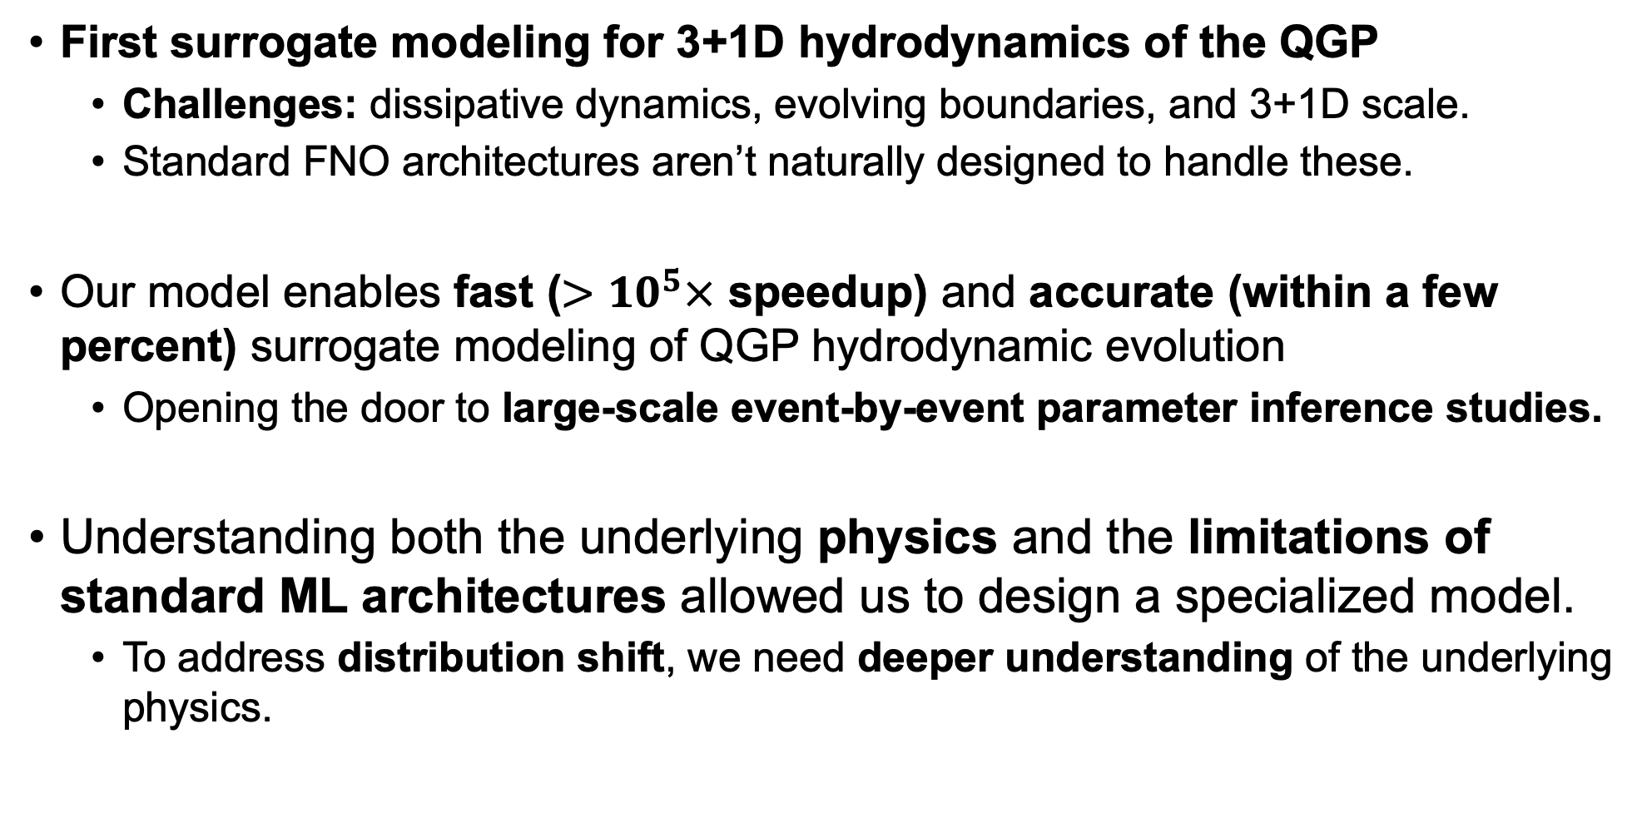
Conclusion
First surrogate modeling for 3+1D hydrodynamics of the QGP
Challenges: dissipative dynamics, evolving boundaries, and 3+1D scale.
Standard FNO architectures aren’t naturally designed to handle these.
Our model enables fast ($>{10}^{5}×$ speedup) and accurate (within a few percent) surrogate modeling of QGP hydrodynamic evolution
Opening the door to large-scale event-by-event parameter inference studies.
Understanding both the underlying physics and the limitations of standard ML architectures allowed us to design a specialized model.
To address distribution shift, we need deeper understanding of the underlying physics.
Notes:
To wrap up.
We proposed the first surrogate modeling for 3+1D QGP hydrodynamics
-challenges: dissipative dynamics, evolving sharp boundaries, and the scale to 3+1D.
-where standard FNO architectures aren't naturally designed to handle these challenges.
Our model enables fast and accurate surrogate modeling of QGP hydrodynamic evolution — opening the door to large-scale event-by-event parameter inference studies.
key point is that by understanding both the underlying physics of the problem and the limitations of standard ML architectures, we were able to design a model specifically tailored to the underlying physics.
Deeper physical insights from this community would be helpful not just for QGP, but for many other problems where ML and physics can be co-designed. I would be very glad to collaborate with you on these directions.
Thank you.

