Slide 1
Variable Rate Neural Compression for TPC Data
RHIC annual user meeting workshop
05-11-2026

Slide 2
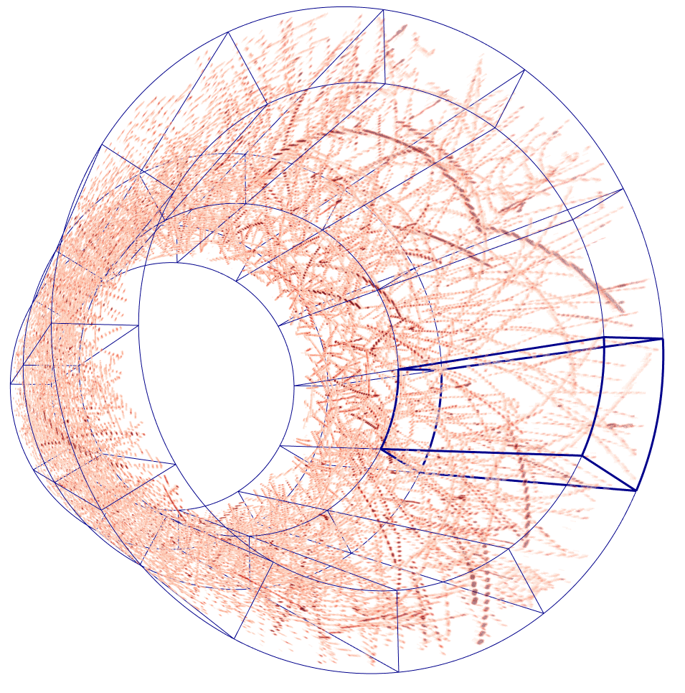
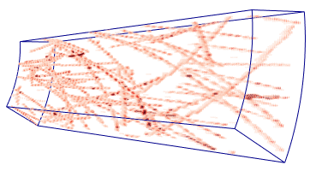

The outer layer group of TPC
249 timesteps on each side along beam direction
16 layers along the radial direction
2304 channels along the azimuthal direction (192 per sub module)
Data from $\sqrt{sNN}=200$ GeV Au+Au collisions with 170 kHz pileup collisions.
Input to a compression algorithm

Slide 3
Compression by Size
The vector for one location in the compressed data can be considered as a semantic summary of the receptive field of the location in the input data.
Input (a spatially big but flatten tensor)
Compression
Algorithm
(The encoder part of an Autoencoder model)
Compressed data
(a spatially small tensor with more channels.)
Spatial dimensions
Channel dimensions
(1 for TPC since it has only one value)
Spatial dimensions

Slide 4
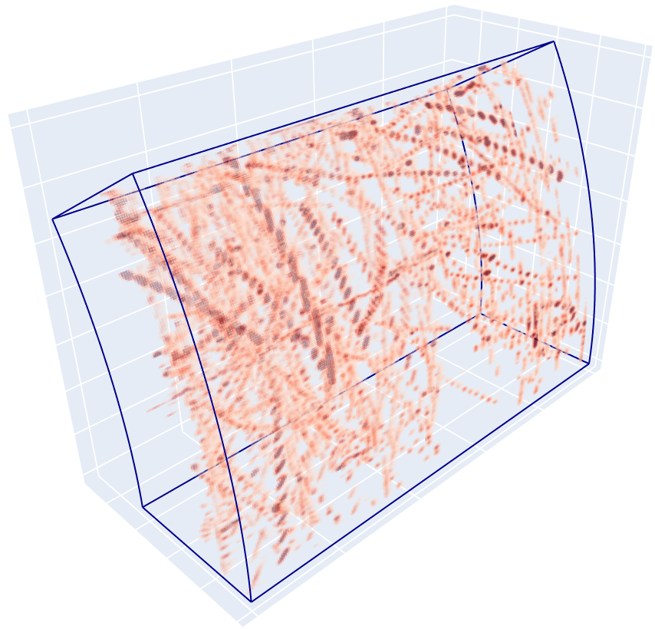

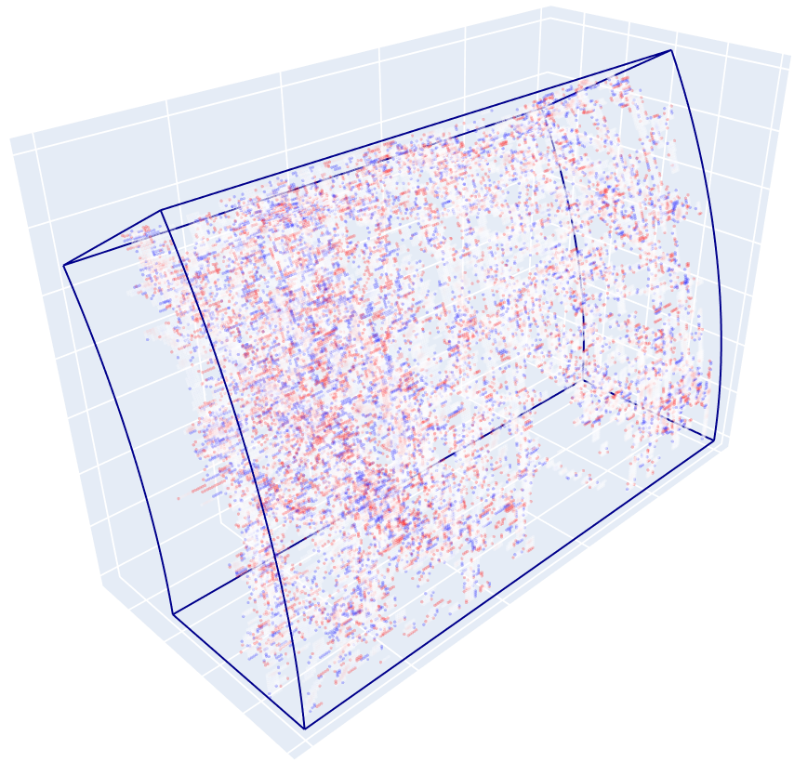
Bruised Reconstruction of the Compression-by-Size approach
input
Reconstruction by the compression-by-size approach
Difference
Red: reconstruction > ground truth
Blue: reconstruction < ground truth

Slide 5

Problems of the Compression-by-Size Approach
Inaccurate reconstruction
Fixed size output, even if there is no signals in the input
Fixed time compression, even if there is no signals in the input

Slide 6
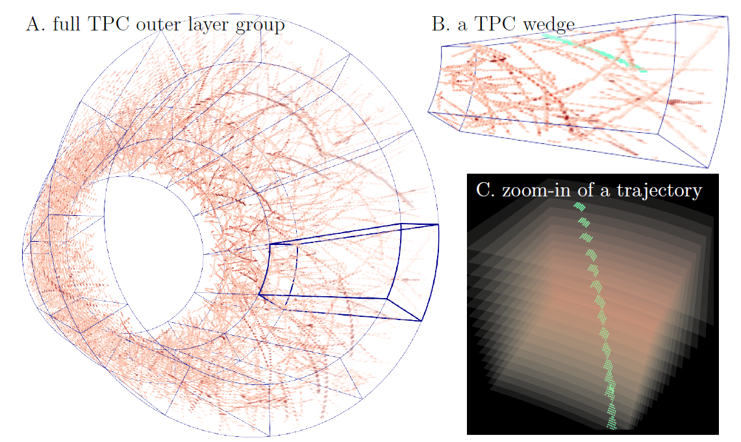

Slide 8
Then, I determined to be lazy
I let the encoder do nothing but to drop signals randomly…
And train the decoder to reconstruct the input with remaining signals
Mean squared error of the reconstruction
220
220
19
90
With 50% randomly selected signals
With 25% randomly selected signals
Best performance of the compression-by-size approach.
What if the encoder can choose which voxels to keep?

Slide 9
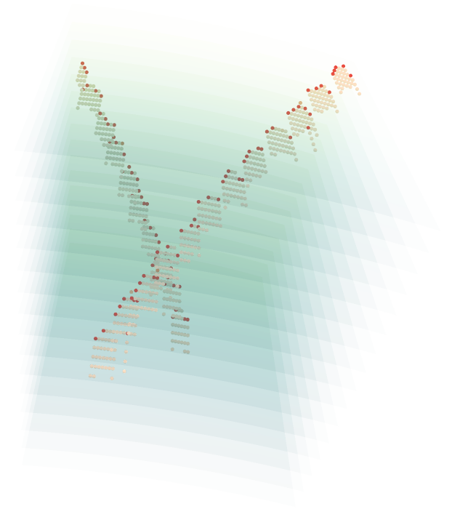
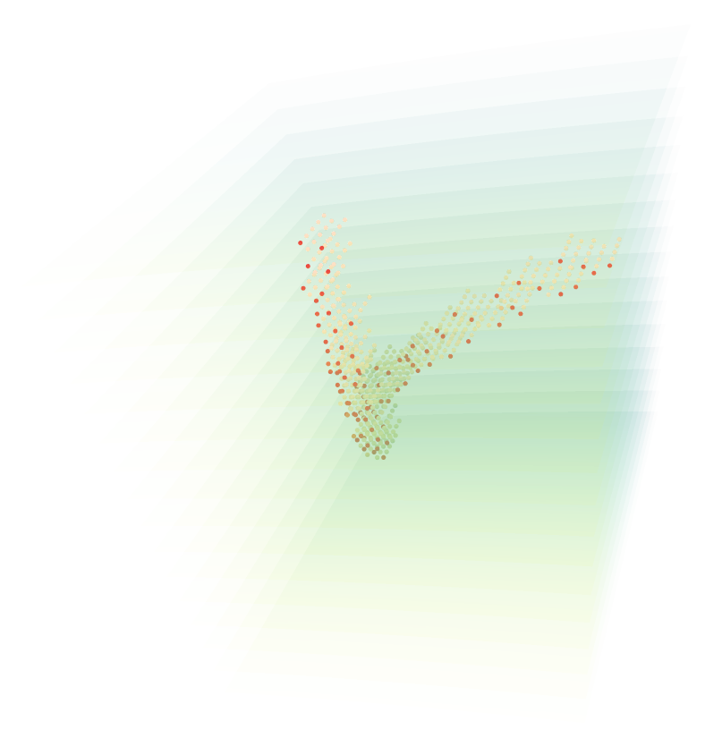
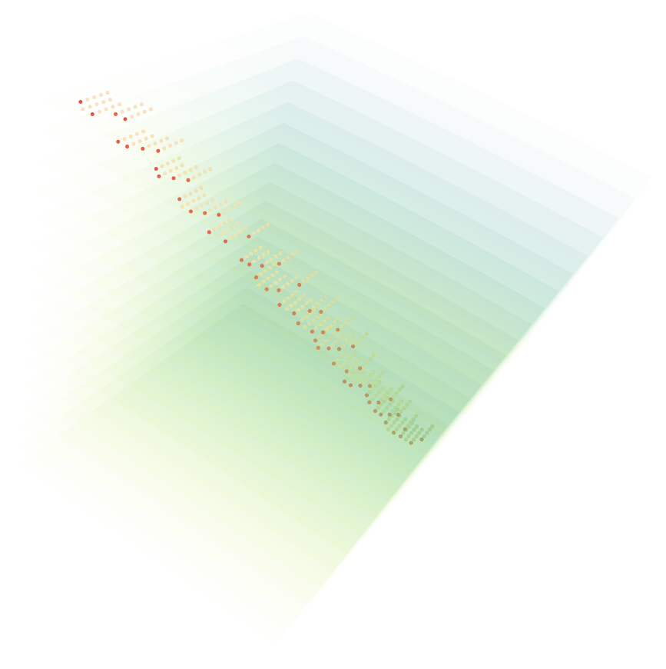
Locate the most important signals

Slide 10
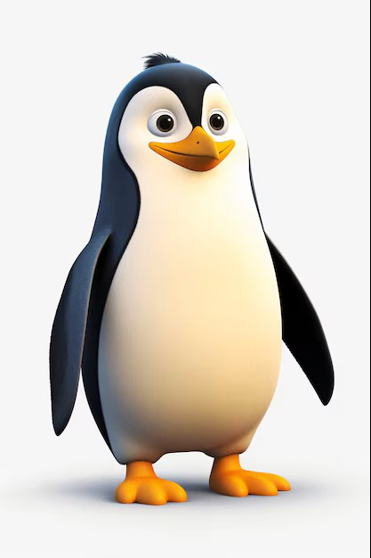
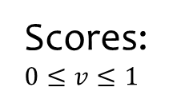
Compression by Importance
Voxels:
1
2
3
4
5
6
7
8
9
10
Encoder (importance score assigner)
Scores:$0≤v≤1$
.42
.35
.93
.01
.57
.88
.71
.89
.95
.99
Now, we need to determine voxels to keep, but how?
By choosing a threshold, of course!
Threshold = 0.815484548538

Slide 11
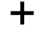
Compression by Importance
1
1
Scores
Voxels
2
2
Decoder
.93
3
3
3
.42
.35
.93
.01
4
4
.88
6
5
5
.57
.88
.71
.89
.89
8
reconstruction
Ground truth
6
6
.95
9
.95
.99
7
7
.99
10
8
8
Minimize total importance score to achieve compression
9
9
10
10
Back propagation
Threshold = 0.815484548538
Reconstruction accuracy

Slide 12
Compression by Importance
Threshold = 0.815484548538

Slide 13
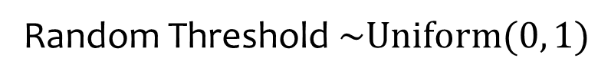
Random Threshold $\sim \text{Uniform}(0, 1)$
1
Density
1
7
10
.42
.71
.99
1
Threshold
Random Thresholding
Kept:

Slide 14
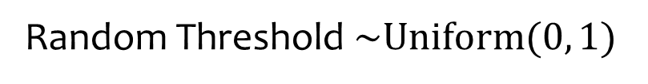
Random Threshold $\sim \text{Uniform}(0, 1)$
1
Now, we get rid of absolutely arbitrary nonsense! But will it work?
Density
Random thresholding can push very important voxels, and very important voxels only, to high scores.
viv
.71
1.0
1
Threshold
Random Thresholding

Slide 15
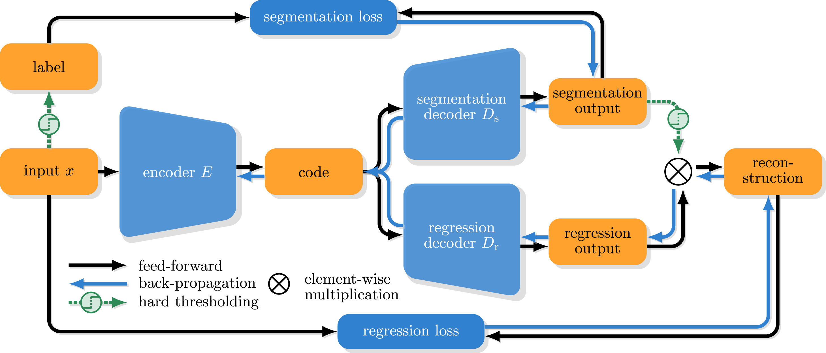
The BCAE Family – Compression by Size
Bicephalous Convolution Autoencoder
BCAE-2D
BCAE-HT (3D)
BCAE++ (3D)
Code here is a smaller tensor

Slide 16
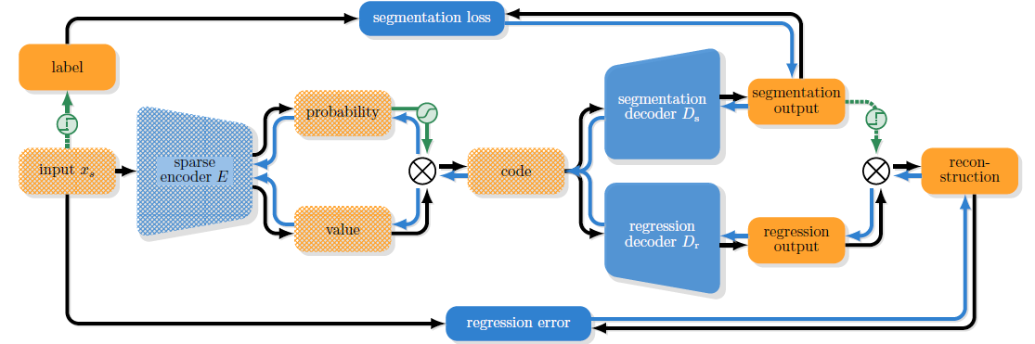
BCAE-VS – Compression by Importance
Variable ratio Compression for Sparse input
Sparse
Convolution
Code here is a subset of the input signals

Slide 17
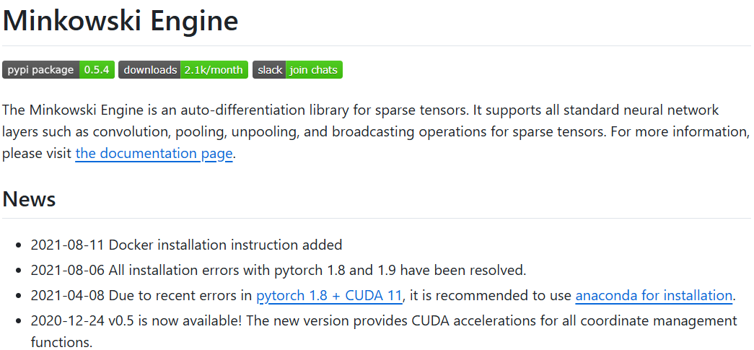
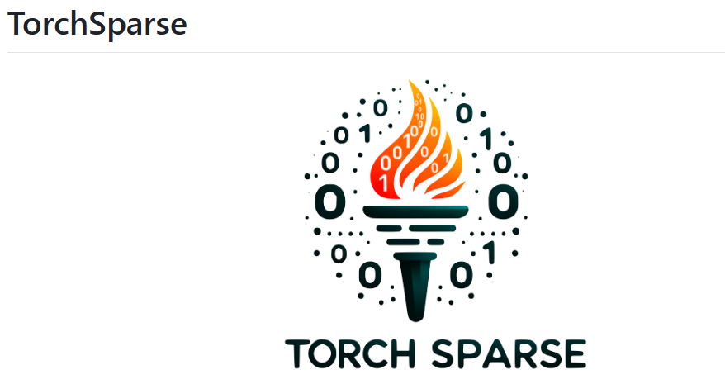
Sparse Convolution Engines

Slide 18
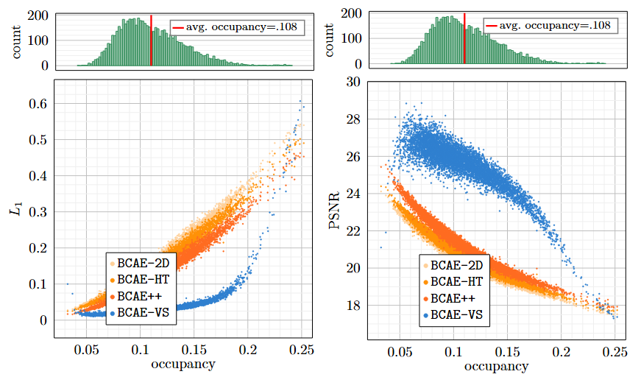
Reconstruction Accuracy—regression

Slide 19
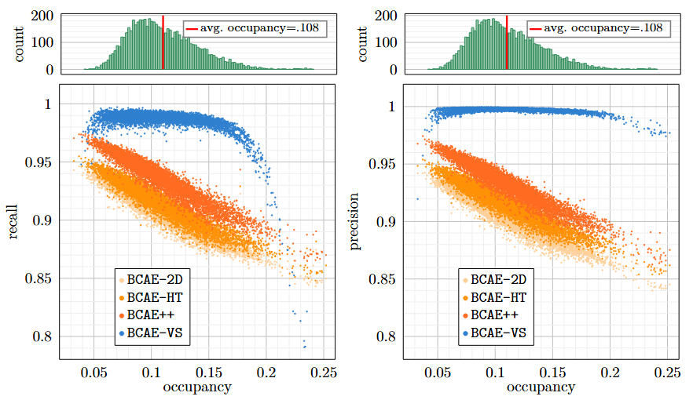
Reconstruction Accuracy—classification

Slide 20
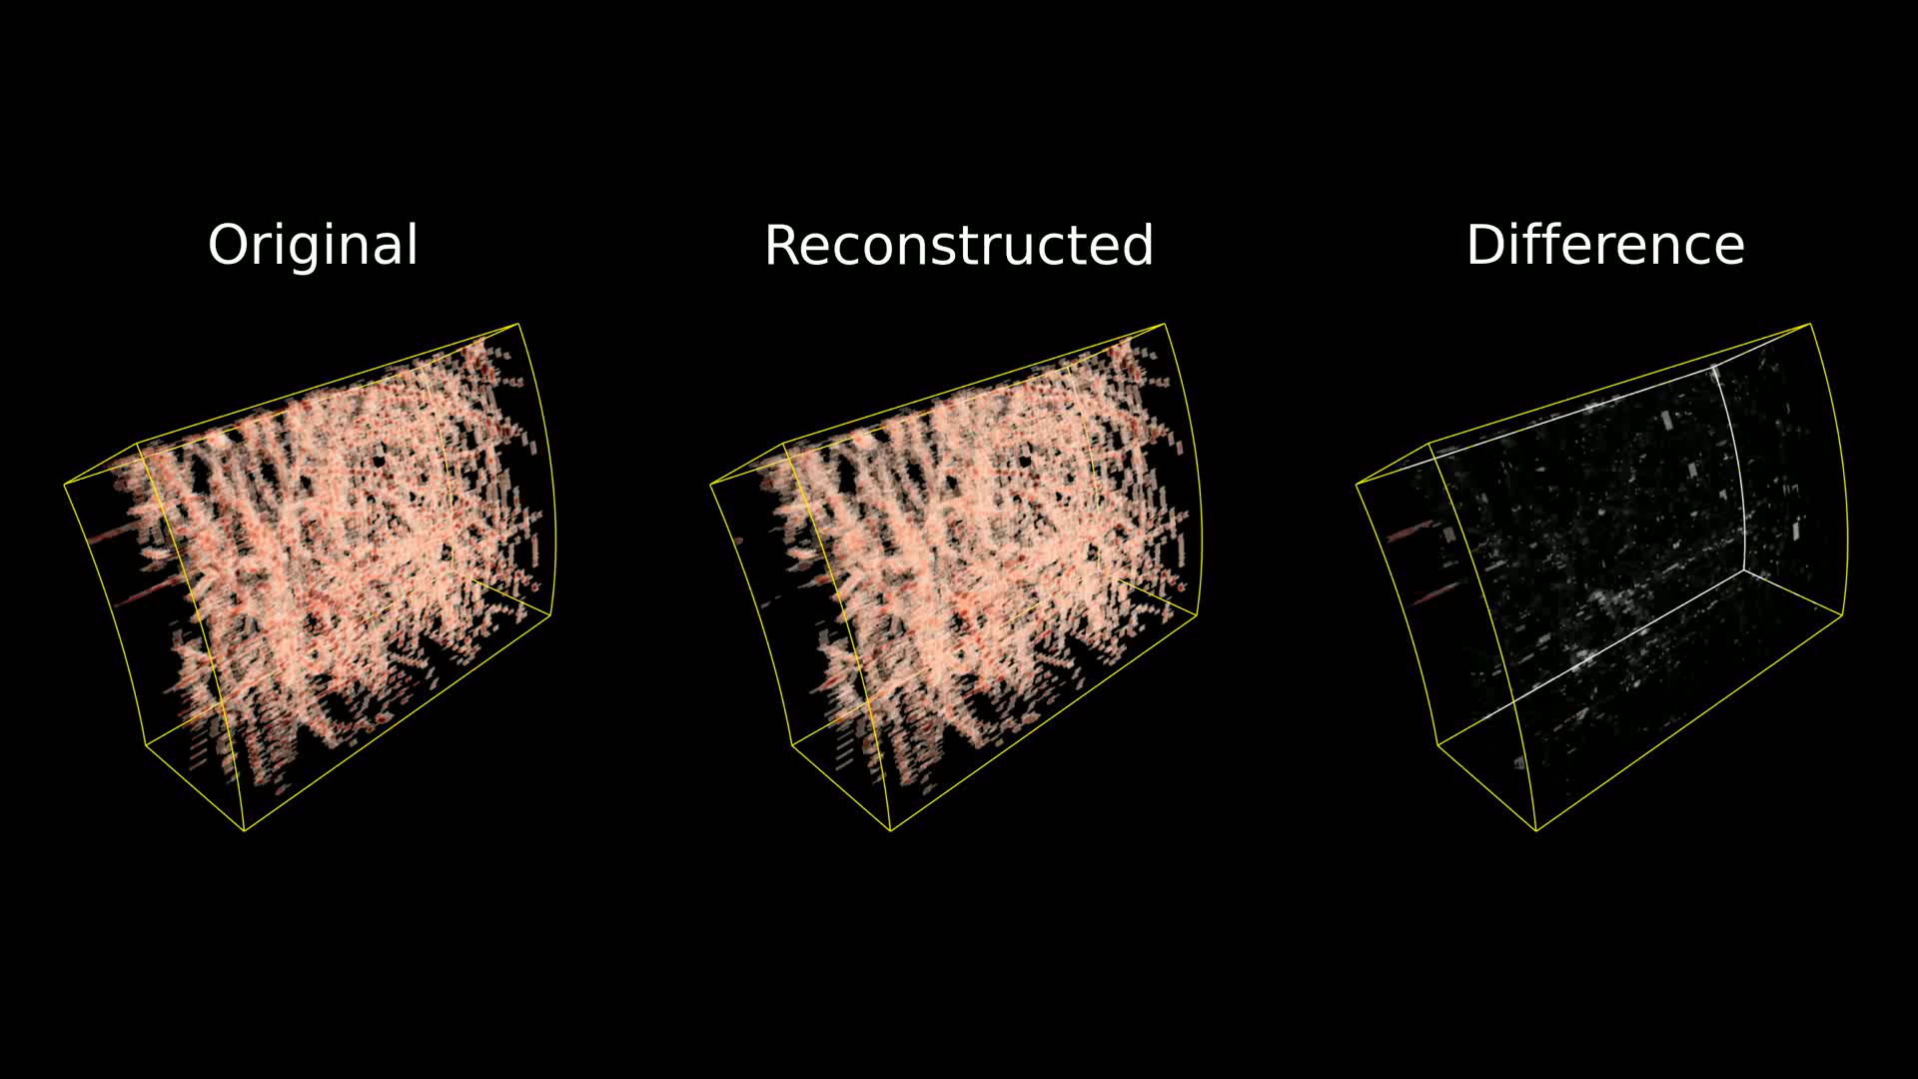
BCAE-VS Reconstruction Performance
Performance Comparison

Slide 21
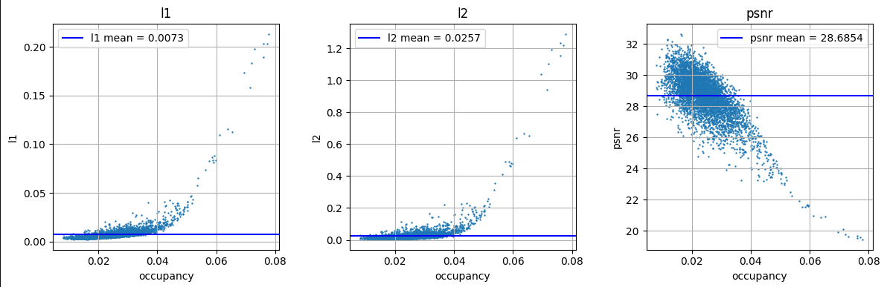
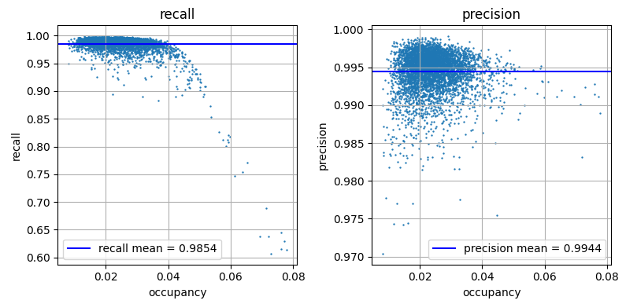
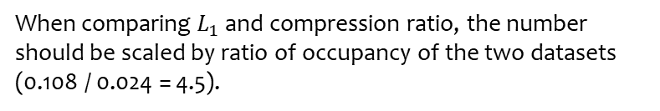
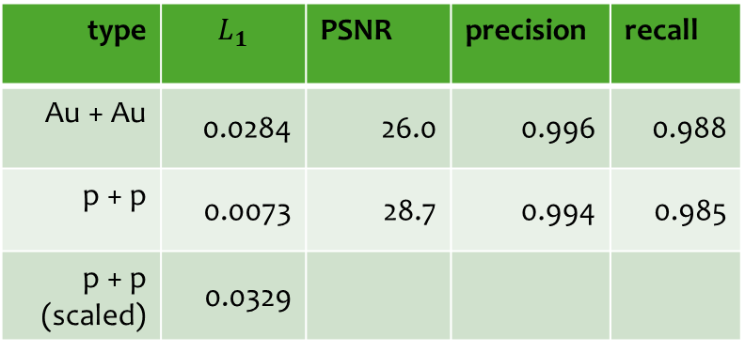
Newest Result of BCAE-VS on proton-proton Collision
type | $$L_{1}$$ | PSNR | precision | recall
Au + Au | 0.0284 | 26.0 | 0.996 | 0.988
p + p | 0.0073 | 28.7 | 0.994 | 0.985
p + p (scaled) | 0.0329
type | Retention ratio | occupancy | CR
Au + Au | 0.133 | 0.108 | 34
p + p | 0.109 | 0.024 | 185
p + p (scaled) |  |  | 41
When comparing $L_{1}$ and compression ratio, the number should be scaled by ratio of occupancy of the two datasets (0.108 / 0.024 = 4.5).

Slide 22
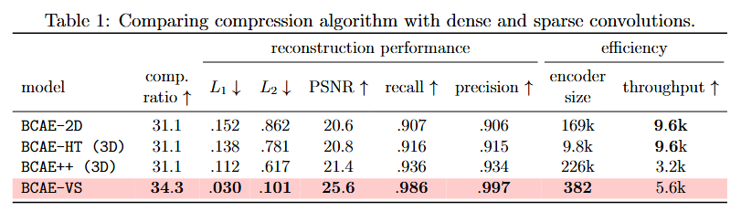

Performance Comparison
When we attack the problem from the correct angle, we may not need large model.

Slide 23
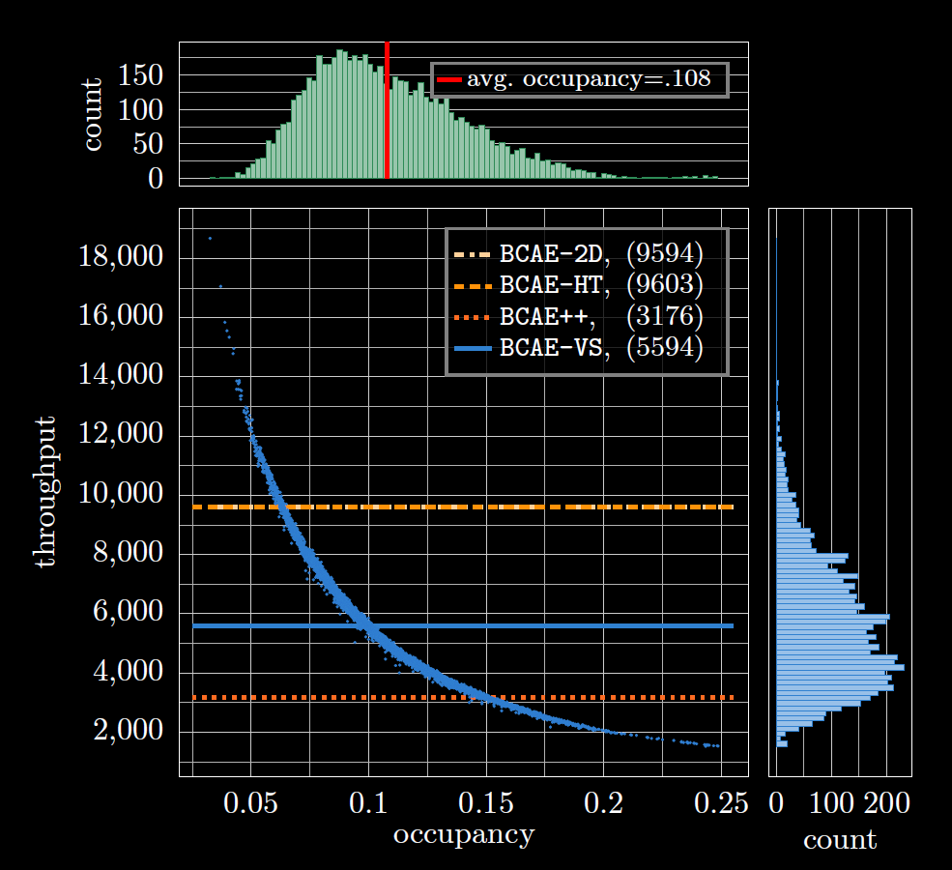
The average throughput of BCAE-VS is smaller than that of the fastest BCAE variant. However, BCAE-VS’s throughput is a function of occupancy. For low occupancy (< 5%), the throughput of BCAE-VS outperforms even the fastest BCAE.
The sparse convolution engine we used for BCAE-VS is not optimized for the state-of-the-art hardware. We can hope for a significant speed-up when there is more hardware support for the sparse convolution engine.

Slide 24
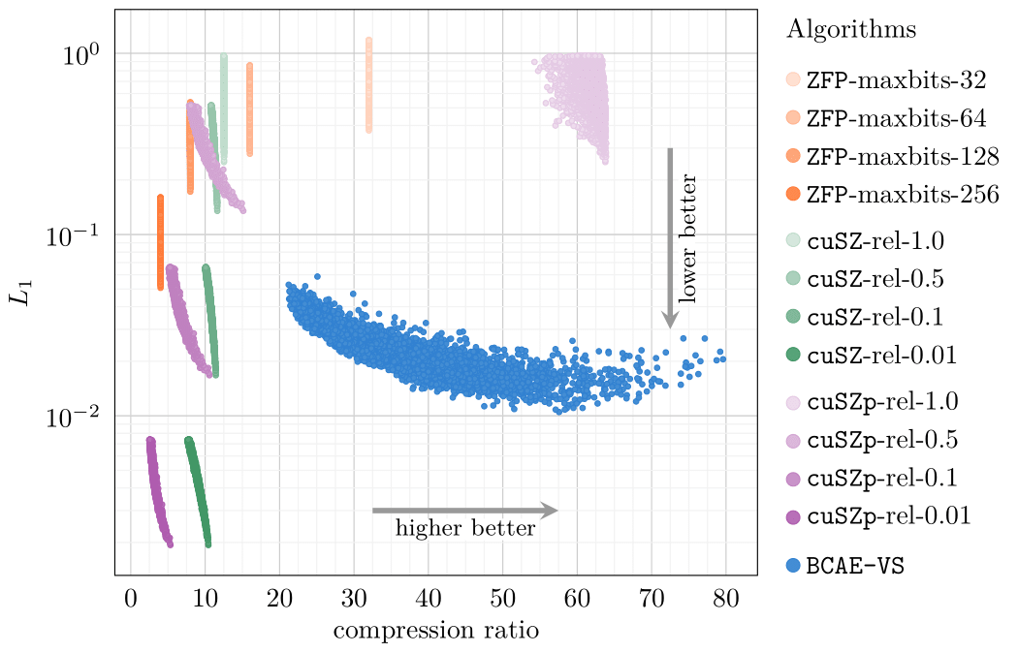
Compare to Cuda-Enabled Learning-Free Algorithms
ZFP is a lossy compressor designed for floating-point scientific data. It compresses small independent blocks, making it ideal for simulation data storage with random-access capability.
cuSZ is the first error-bounded lossy compressor on GPUs for scientific data, significantly improving SZ's throughput in GPU-based heterogeneous HPC systems.
cuSZp is an ultra-fast error-bounded GPU lossy compressor that fuses massive computation into one kernel via hierarchical parallelism, drastically improving end-to-end throughput.
Cuda-Enabled Learning-Free
Notes:
The power of adaptability comparing to smart crafting.

Slide 25
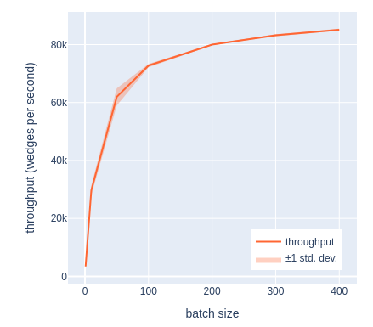
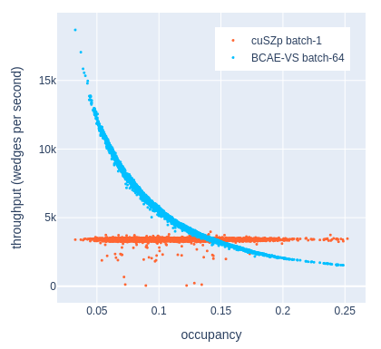
Compare to Cuda-Enabled Learning-Free Algorithms
cuSZp throughput vs batch size
cuSZp throughput at batch size 1
Have to concatenate a lot of TPC wedges before compression to achieve optimal speed. The compressed data cannot be separated by individual wedge.
72 TPC submodules
Current BCAE-VS implementation needs help with throughput to compete with learning-free compressions

Slide 26
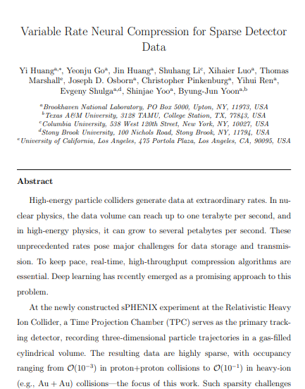
Summary
For sparse data, we can compress by importance for
More accurate reconstruction
A variable compression ratio
A higher throughput with proper software support
The current hardware support is still lacking
Dataset: https://zenodo.org/records/14064045
GitHub repo: https://github.com/BNL-DAQ-LDRD/NeuralCompression_v3

