Slide 1


Physics and Detector Opportunities for a Fixed-target Program in EIC Cesar Luiz da Silva Los Alamos National Lab RHIC & AGS Users Group Meeting 2026

Slide 2
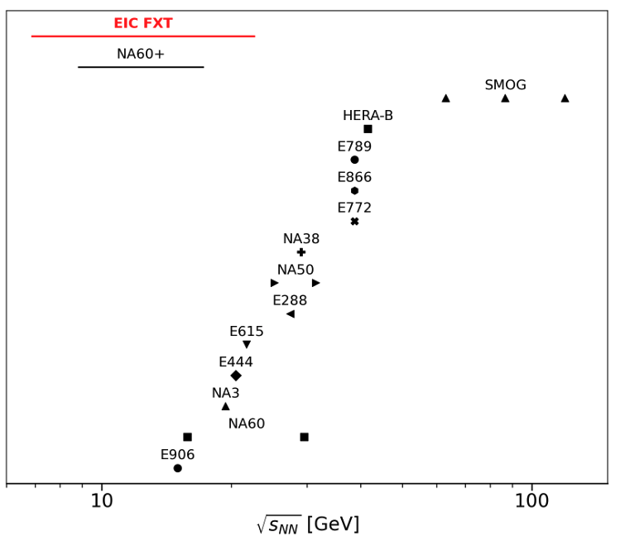
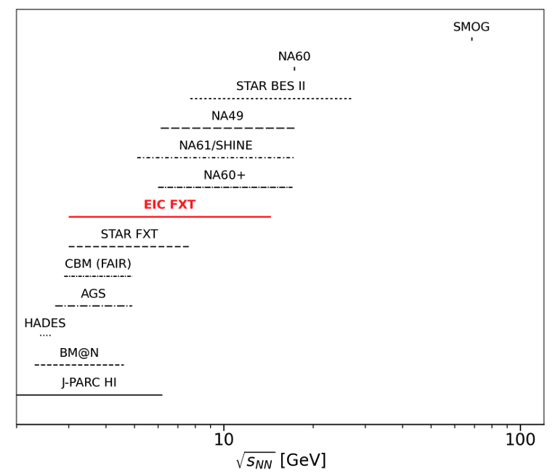
Collision Energy Range.
Physics Opportunities with a Fixed-Target Program at the EIC. arXiv:2603.00265
p+A
A+A

Slide 3
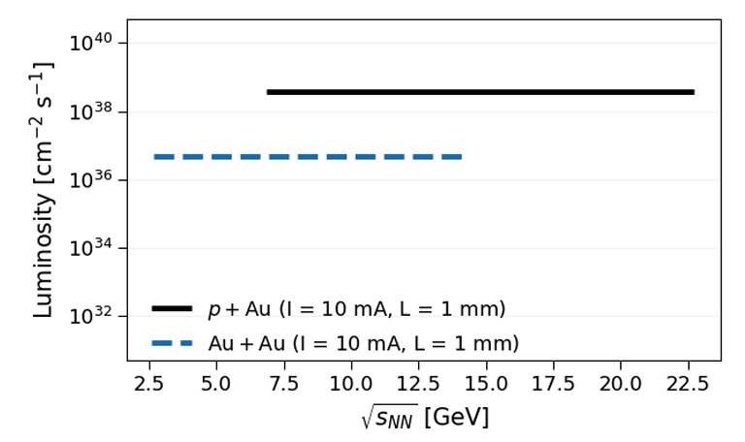
Expected Luminosity
Physics Opportunities with a Fixed-Target Program at the EIC. arXiv:2603.00265

Slide 4
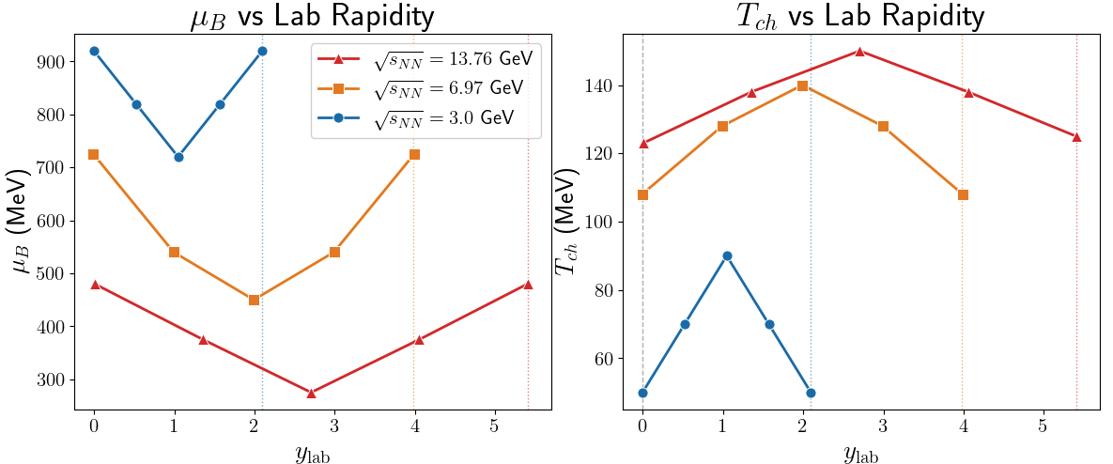
QCD phase space exploration.
Based on parametrizations describing SPS and RHIC data :
J. Manninen & F. Becattini: arXiv:0806.4100 (2008),
F. Becattini, J. Manninen & M. Gazdzicki: PRC 73, 034905 (2006),
Cleymans & Worku: hep-ph/0701029.

Slide 5
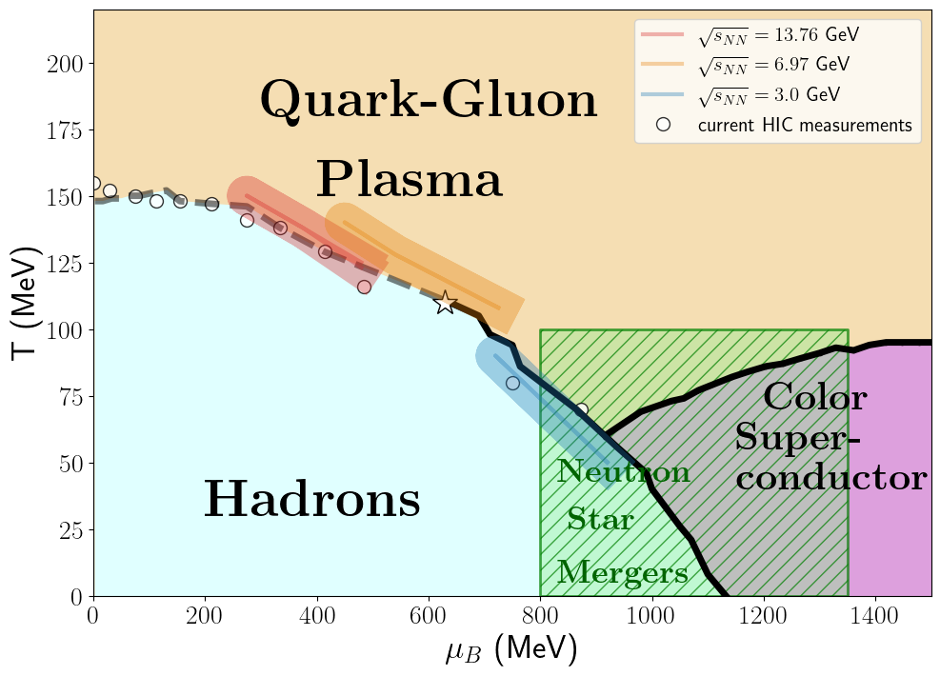
QCD phase space exploration.
Measurements based on identified particle ratios at freeze-out
Rapidity dependent measurements cover a broader QCD phase space range than mid-rapidity measurements, better chance to find the QCD critical point
Low-energy fixed target starts to overlap with QCD phase space of neutron star merger conditions
a field expected to grow fast with the new gravitational wave experiments
crossover
1st order
transition
conjectured
Critical Point
More on QCD phase space in Mikhail Stephanov and Lipei Du presentations in the afternoon.

Slide 6
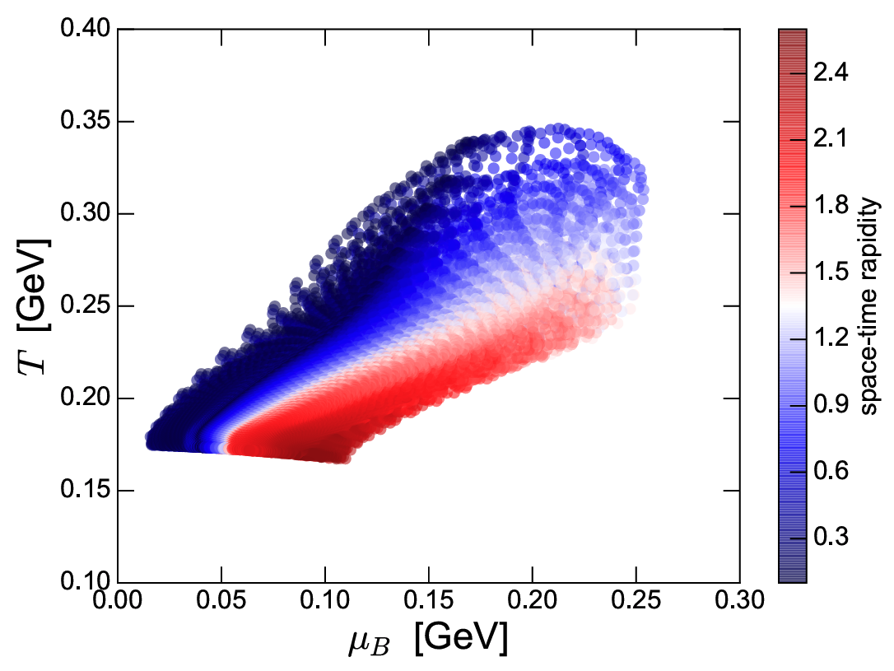

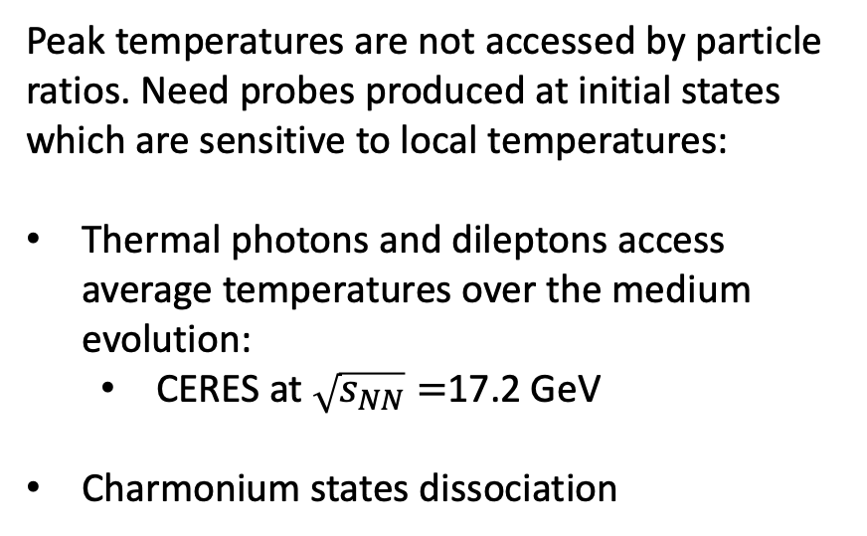
What is the peak temperature in these collisions?
Do they form QGP?
T at τ₀ = 0.64 fm/c
Acta Phys. Polon. B50 (2019), 141-148
Pb+Pb @ $\sqrt{s_{NN}}$=72 GeV
vHLLE+UrQMD
Peak temperatures are not accessed by particle ratios. Need probes produced at initial states which are sensitive to local temperatures:
Thermal photons and dileptons access average temperatures over the medium evolution:
CERES at $\sqrt{s_{NN}}=$17.2 GeV
Charmonium states dissociation
Freeze-out

Slide 7
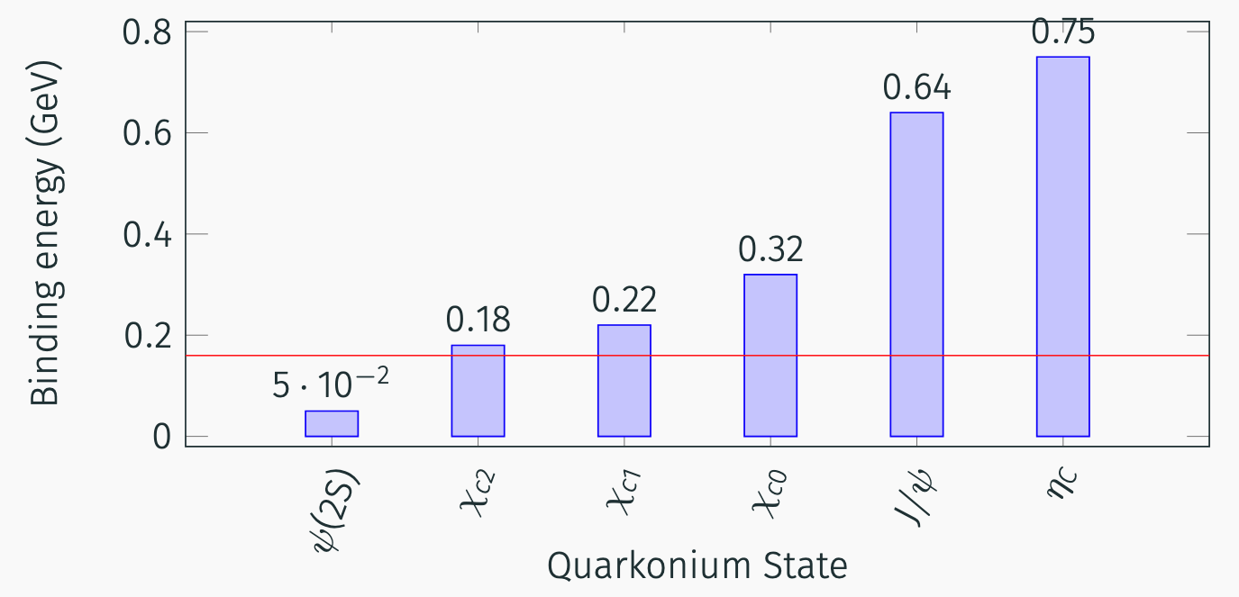
What is the peak temperature in these collisions?
Do they form QGP?
Quarkonia states work as fuses which blowup if the local peak temperature is larger than its binding energy.
freeze-out temperature

Slide 8
What is the peak temperature in these collisions?
Do they form QGP?
Quarkonia states work as fuses which blowup if the local peak temperature is larger than its binding energy.
freeze-out temperature
QGP formation is not a requirement to dissociate $ψ(2S)$ states.

Slide 9
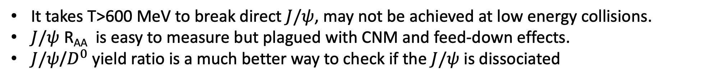
What is the peak temperature in these collisions?
Do they form QGP?
Quarkonia states work as fuses which blowup if the local peak temperature is larger than its binding energy.
freeze-out temperature
It takes T>600 MeV to break direct $J/ψ$, may not be achieved at low energy collisions.
$J/ψ$ R_{AA} is easy to measure but plagued with CNM and feed-down effects.
$J/ψ$/$D^{0}$ yield ratio is a much better way to check if the $J/ψ$ is dissociated

Slide 10
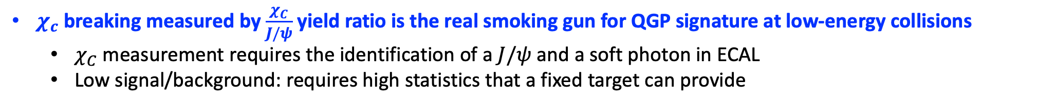
What is the peak temperature in these collisions?
Do they form QGP?
Quarkonia states work as fuses which blowup if the local peak temperature is larger than its binding energy.
freeze-out temperature
$χ_{c}$ breaking measured by $\frac{χ_{C}}{J/ψ}$ yield ratio is the real smoking gun for QGP signature at low-energy collisions
$χ_{C}$ measurement requires the identification of a $J/ψ$ and a soft photon in ECAL
Low signal/background: requires high statistics that a fixed target can provide

Slide 11
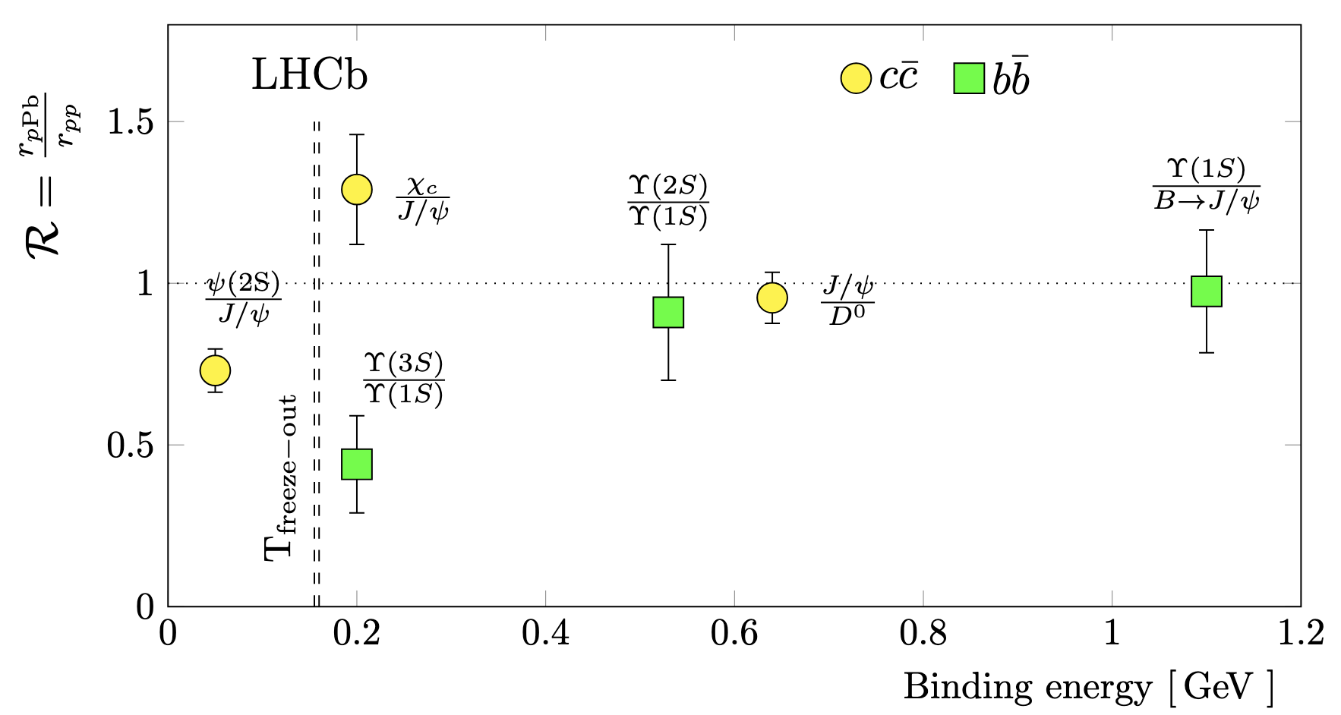
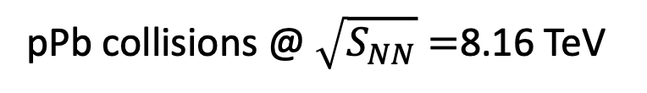
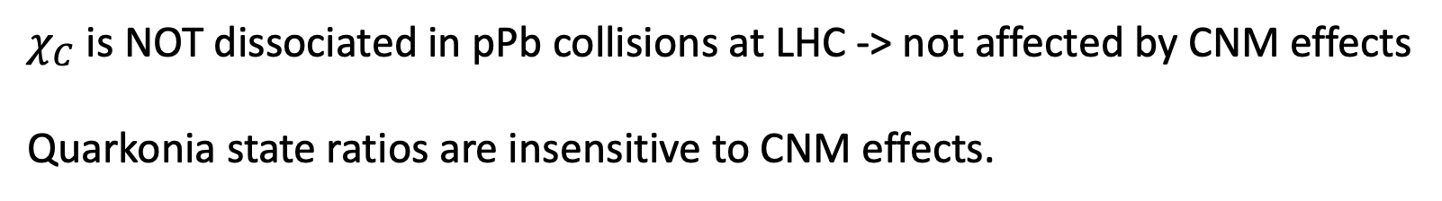
$χ_{C}$ measurements in heavy ions
pPb collisions @ $\sqrt{S_{NN}}=$8.16 TeV
$χ_{C}$ is NOT dissociated in pPb collisions at LHC -> not affected by CNM effects
Quarkonia state ratios are insensitive to CNM effects.

Slide 12

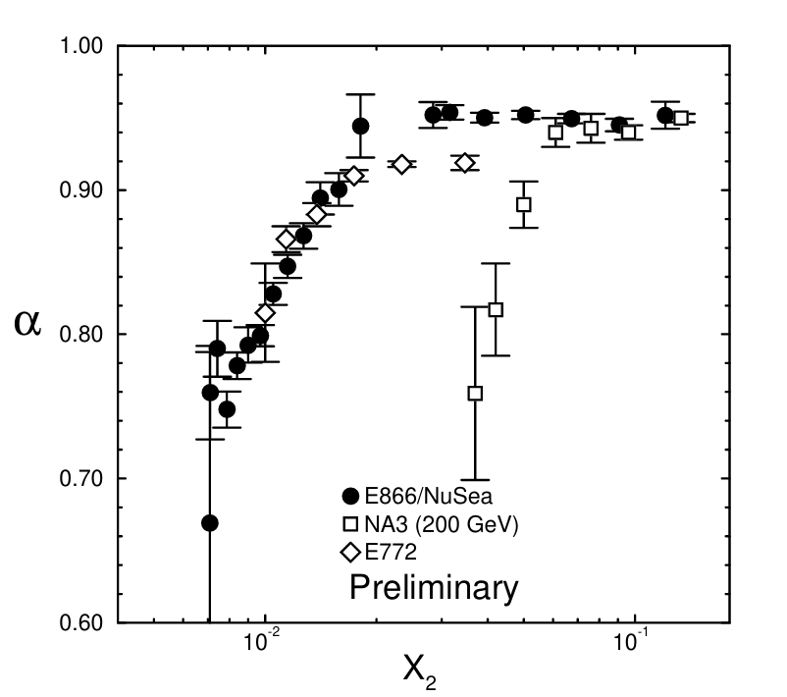
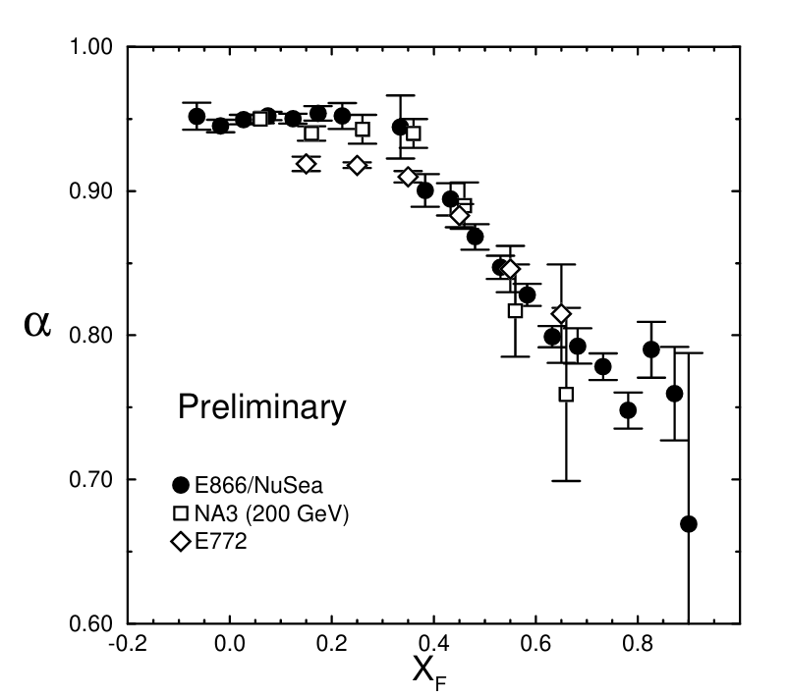






Probing nPDFs
$\sqrt{s_{NN}}=38.8$ GeV
$\sqrt{s_{NN}}=38.8$ GeV
$\sqrt{s_{NN}}=19.4$ GeV
$\sqrt{s_{NN}}=19.4$ GeV
$\sqrt{s_{NN}}=19.4$ GeV
$\sqrt{s_{NN}}=19.4$ GeV
$J/ψ$ measurements indicates a complex pattern of CNM effects along different x-regions
High-statistics heavy flavor, Drell-Yan, direct photon measurements are essential to disentangle initial-state effects.
More on CNM effects in the next talk by Ramona

Slide 13
EXPERIMENTAL APPROACHES

Slide 14
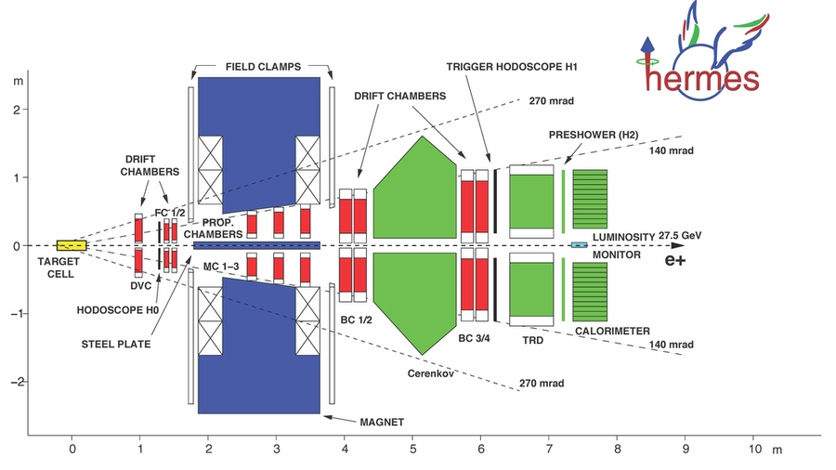
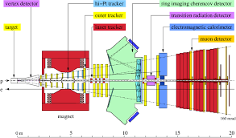
Fixed Target Experiments at HERA
HERA-B
Polarized gas target cell
Dedicated to spin physics
Wire target at the proton beam halo
Dedicated to flavor physics

Slide 15
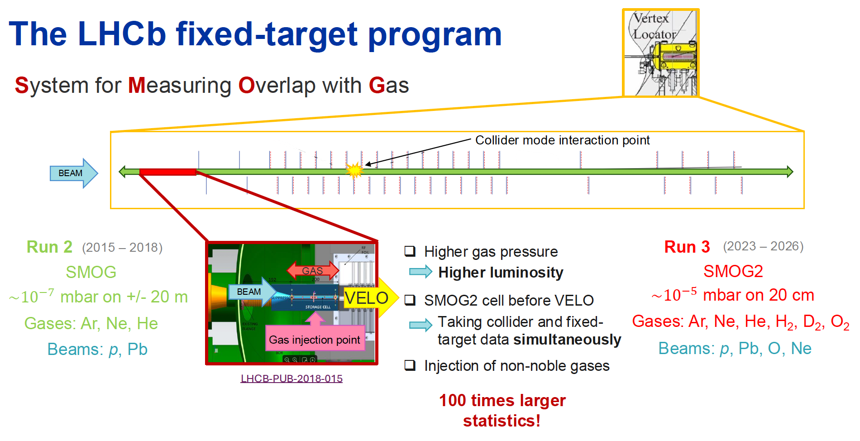
2
Phys. Rev. Accel. Beams 27, 111001

Slide 16
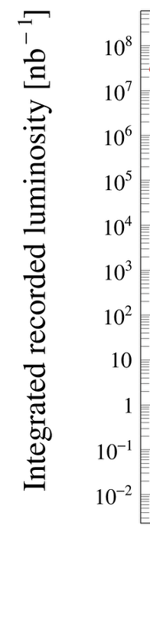
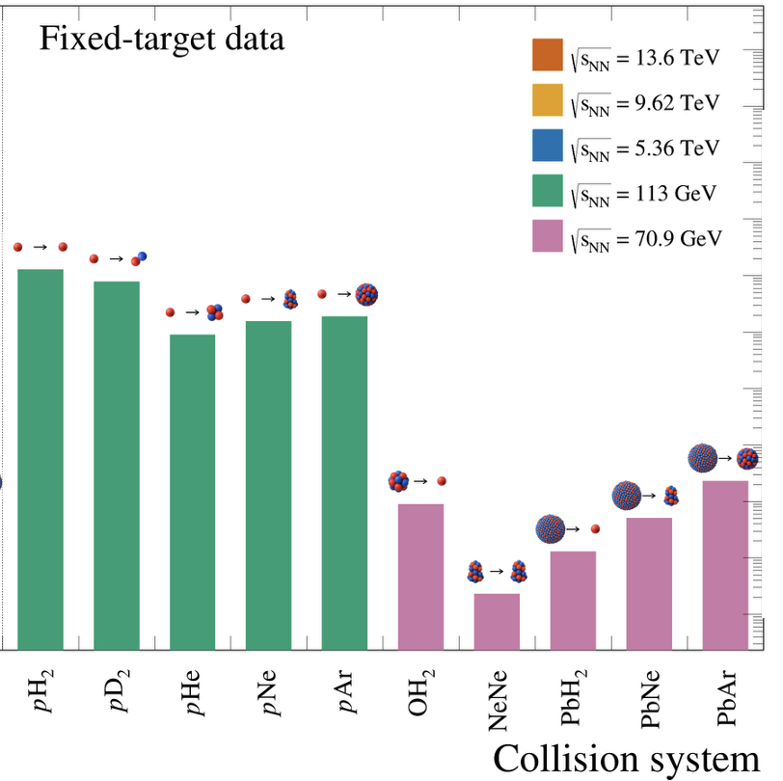
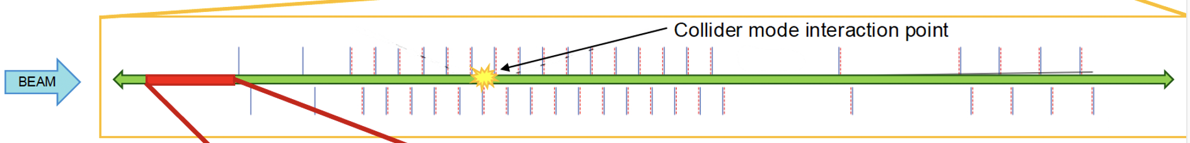

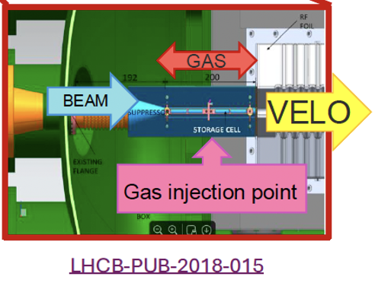
The LHCb fixed target program

Slide 17
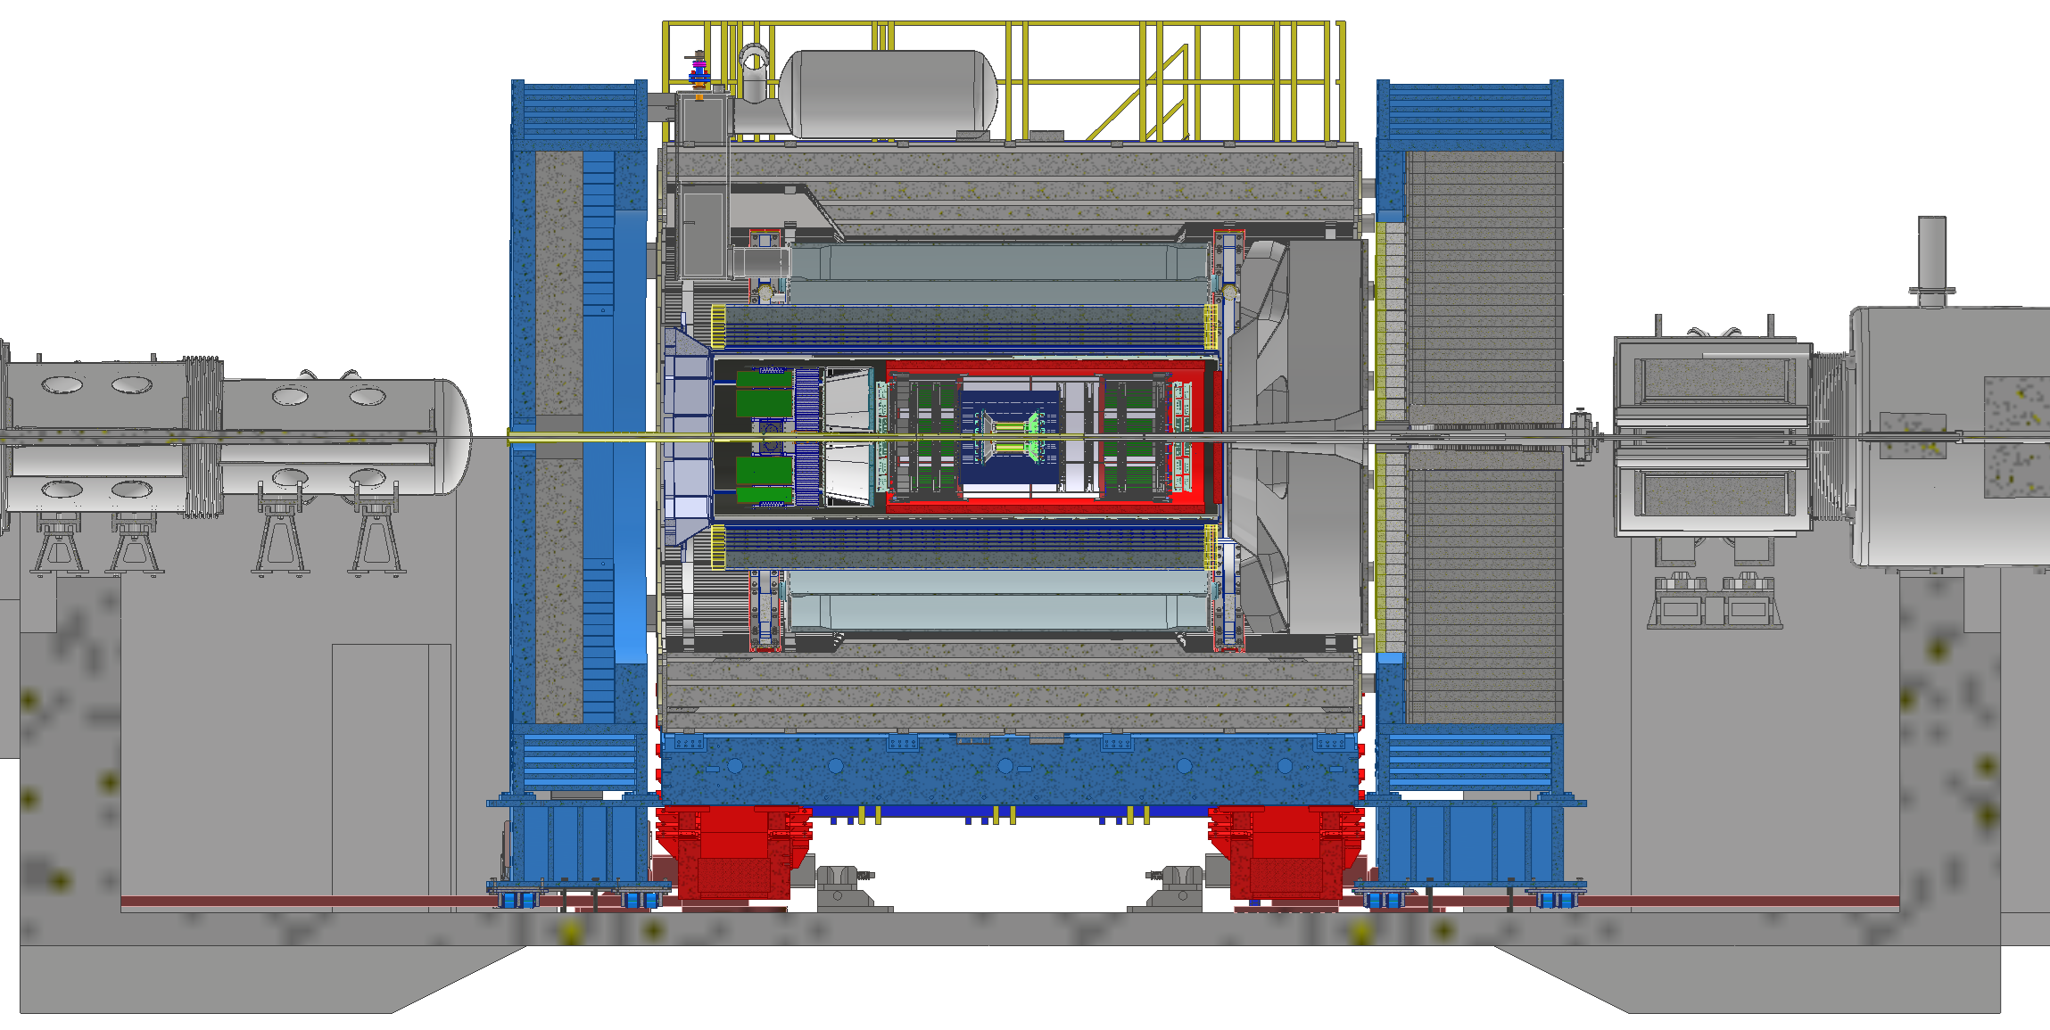
How to integrate a fixed Target into ePIC
E.C. Aschenauer
Exploring a fixed Target Program at the EIC
September 30th – 31st, 2025
electron beam
p/A beam
50 cm
50 cm
9.5 m
Fixed targets can be integrated at flanges at indicated locations
there is space to integrate foils and maybe a HERMES like storage cell for a gas target, but there is no space for a polarized target.
Electrons: E_{B}: 3 to 18 GeV with being polarized 5 to 18 GeV
Hadron beams like RHIC → E_{B}: 26 GeV to 275 GeV for polarized protons
→ E_{B}: 10 GeV to 110 GeV for Au and scaled respectively with ~A/Z,
can also run the beam energies below injection as for STAR beam energy scan-II
Tracking far from FXT points (Cesar)

Slide 18
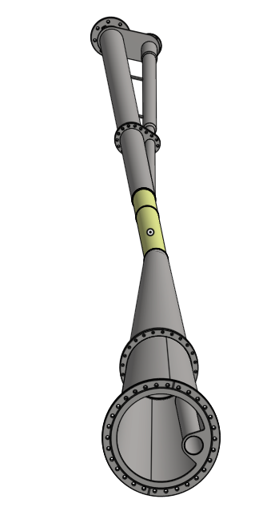
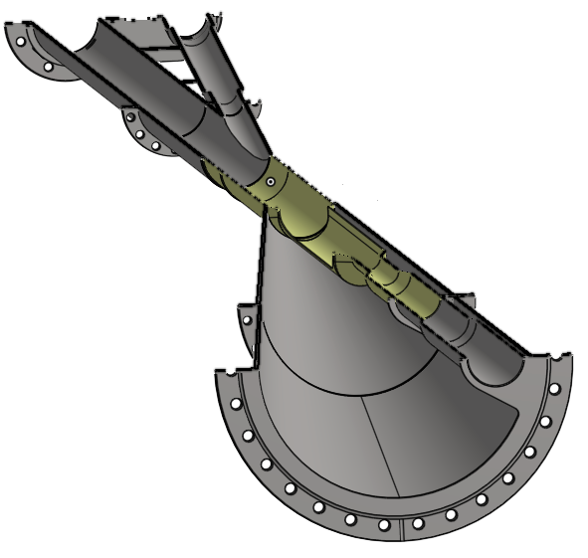
What you need to consider for a EIC FXT program
EIC is running with a crossing angle IP-6: 25 mrad
future IP-8: 35 mrad
→ impacts kinematic: see here for details
ePIC is aligned with the electron beam - axis
Beam pipe is complex
p/A beam
E.C. Aschenauer
Exploring a fixed Target Program at the EIC
September 30th – 31st, 2025
electron beam

Slide 19
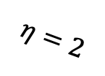
Detector 2 Concept
2.0< $|η|<4.5$ (limited by beam pipe magnetic shielding)
$$η=2$$
25mrad
25mrad
p/A beam
electron beam
TOF
TOF
1.24m
gas (polarized?)
injector
Mag shielding
Machine
quadrupole
Magnet
RICH
Mid-rapidity
activity det.
RICH
ECAL
< 1T.m dipole magnet
< 1T.m dipole magnet
Machine
quadrupole
Magnet
ECAL
Hadron absorber
Inner detector 1-5cm radius from beam
Hadron absorber
small-x e+p/A
large-x FXT
large-x e+p/A
small-x FXT
Muon Det.
4.5m
Muon Det.
Compact detector to complement EPIC physics capabilities, some overlap with EPIC acceptance for measurement cross-checks
Operation in collider and fixed target mode like in LHCb/SMOG
TDC resolution< 5ns in all detectors for synchrotron radiation suppression and real time 4D GNN tracking
~ $80M, 3% of the total EIC cost (machine + detector), potential foreign funding

Slide 20
Detector 2 Concept
2.0< $|η|<4.5$ (limited by beam pipe magnetic shielding)
$$η=2$$
25mrad
25mrad
p/A beam
electron beam
TOF
TOF
1.24m
gas (polarized?)
injector
Mag shielding
Machine
quadrupole
Magnet
RICH
Mid-rapidity
activity det.
RICH
ECAL
< 1T.m dipole magnet
< 1T.m dipole magnet
Machine
quadrupole
Magnet
ECAL
Hadron absorber
Inner detector 1-5cm radius from beam
Hadron absorber
small-x e+p/A
large-x FXT
large-x e+p/A
small-x FXT
Muon Det.
4.5m
Muon Det.
Back to envelope estimation for the magnetic shielding
Piggybacking from the septum plate magnet used in HERMES detector
7mm soft iron + 1mm gap w/ saddle coils (5A) + 2mm mu-metal liner
< 0.5 mT residual field on beam

Slide 21
Detector 2 Concept
2.0< $|η|<4.5$ (limited by beam pipe magnetic shielding)
$$η=2$$
25mrad
25mrad
p/A beam
electron beam
TOF
TOF
1.24m
gas (polarized?)
injector
Mag shielding
Machine
quadrupole
Magnet
RICH
Mid-rapidity
activity det.
RICH
ECAL
< 1T.m dipole magnet
< 1T.m dipole magnet
Machine
quadrupole
Magnet
ECAL
Hadron absorber
Inner detector 1-5cm radius from beam
Hadron absorber
small-x e+p/A
large-x FXT
large-x e+p/A
small-x FXT
Muon Det.
4.5m
Muon Det.
LHCb-SMOG like gas injector:
Luminosity measurement < 1%
Fixed target covering 1.5<y_{lab}<4.5, depending on the position of the hadron+gas colision
Space to polarize the gas, like in HERMES
a new spin program at EIC: transverse spin asymmetry, DY
See FXT logistics talk by Daniel Cebra in the afternoon.

Slide 22
Reflections
DIS experiments have permeated particle physics for almost 60 years, and still requires decades of experimental/theoretical work ahead
HI physics is still in its infancy. RHIC and LHC have left many questions and guidance for the next steps in the formulation of a standard model of multi-particle and hot QCD
A fixed target in EIC could provide a broader QCD phase space coverage exploring broad rapidity ranges. High potential for critical point searches and reproduce astrophysical conditions such as neutron star mergers.
High luminosity of fixed target mode enables the use of hard probes at low energies
A forward/backward detector 2 configuration would be the ideal configuration to explore fixed target in EIC and opens the possibility to extend the spin physics with a polarized target

Slide 23
BACKUP SLIDES

Slide 24
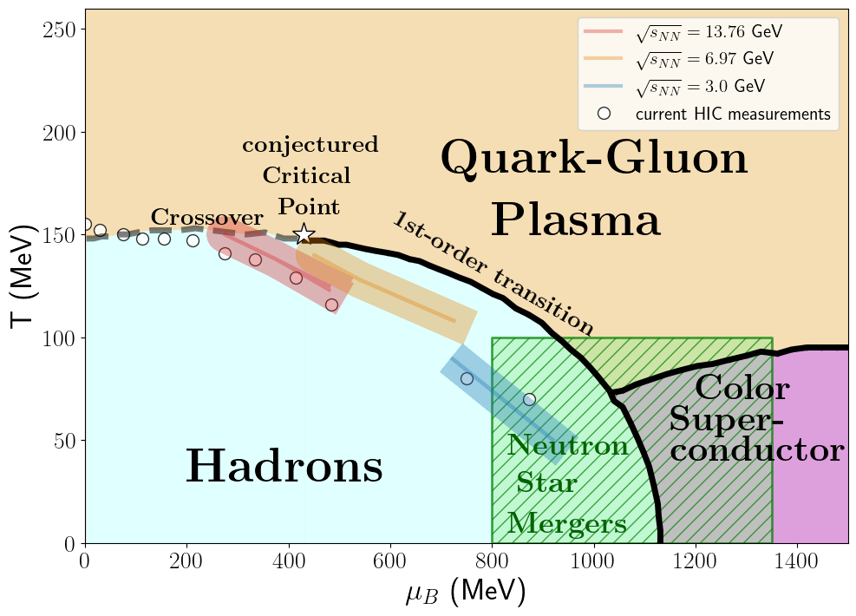
QCD phase space exploration.
Measurements based on identified particle ratios at freeze-out
Rapidity dependent measurements cover a broader QCD phase space range than mid-rapidity measurements, better chance to find the QCD critical point
Low-energy fixed target starts to overlap with QCD phase space of neutron star merger conditions
a field expected to grow fast with the new gravitational wave experiments
More on QCD phase space in Mikhail Stephanov and Lipei Du presentations in the afternoon.

