Slide 1
Machine Learning Assisted Tuning and Diagnostics of NSRL Beams
E. Hamwi, K. Brown, L. Hajdu, G. Hoffstaetter, W. Lin, M. McCarthy, T. Olsen
EIC–BeamAI collaboration

Slide 2
NSRL injector complex
AGS Booster synchrotron:
Accelerate beam to KE between 50 and 2500 MeV/n
Target
NSRL
Booster
Source machines:
Linac (proton)
EBIS (ion)
Tandem Van de Graaffs (ion)
LtB
Linac
TtB
EtB
Tandem
Ebis
RHIC/AGS Users Meeting 2026
Eiad Hamwi

Slide 3
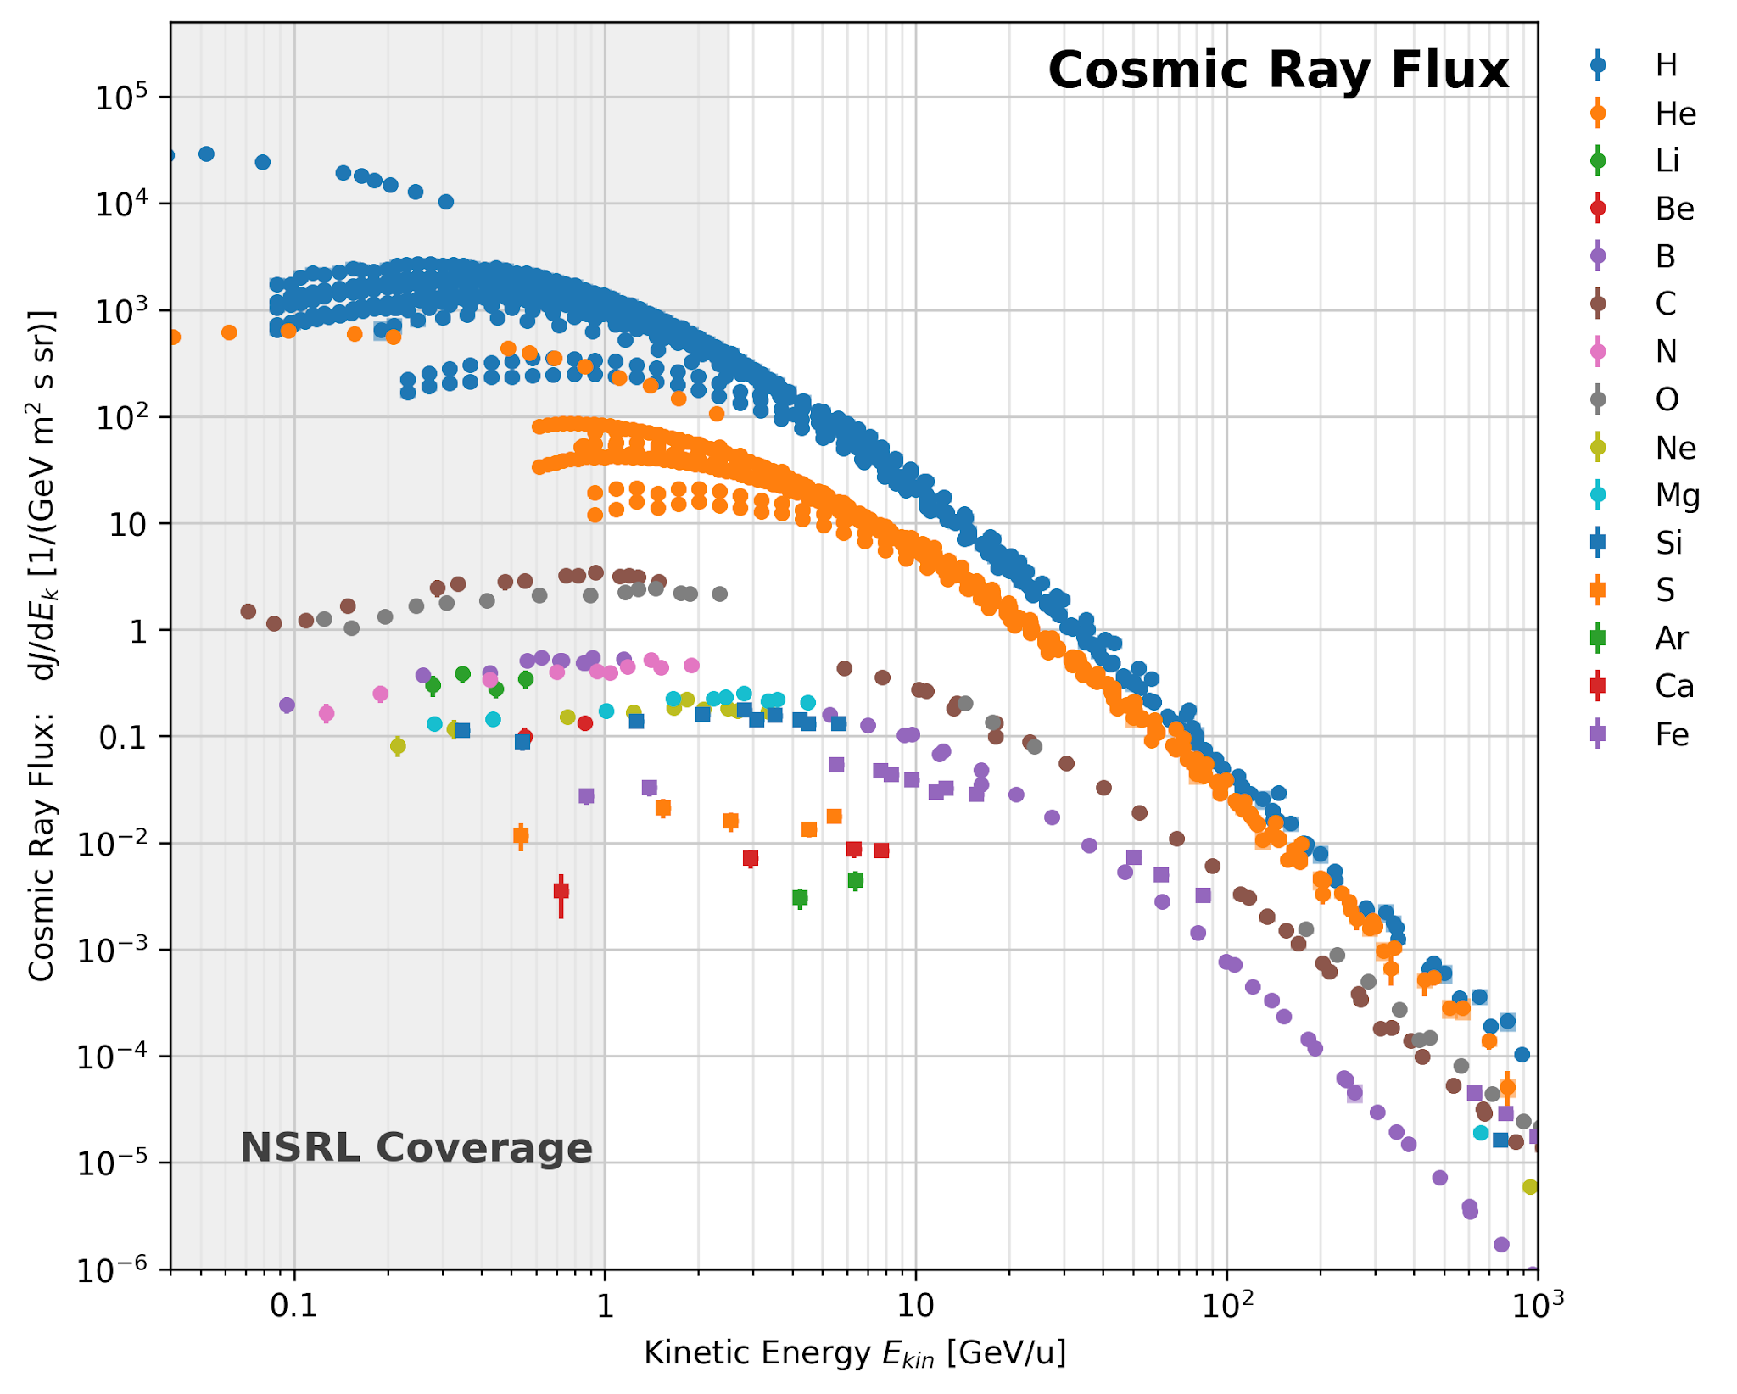
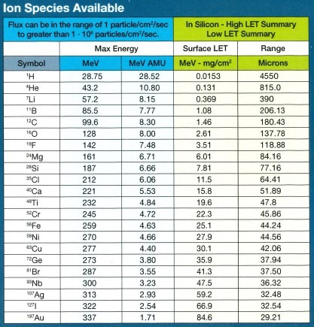
Science capabilities
Wide range in intensity (1 – 10¹⁰ p/s)
Wide range in energy (2+ GeV/p)
Large variety of ion species
Extremely fast species swap
Long, stable spills (1s +)
RHIC/AGS Users Meeting 2026
Eiad Hamwi

Slide 4
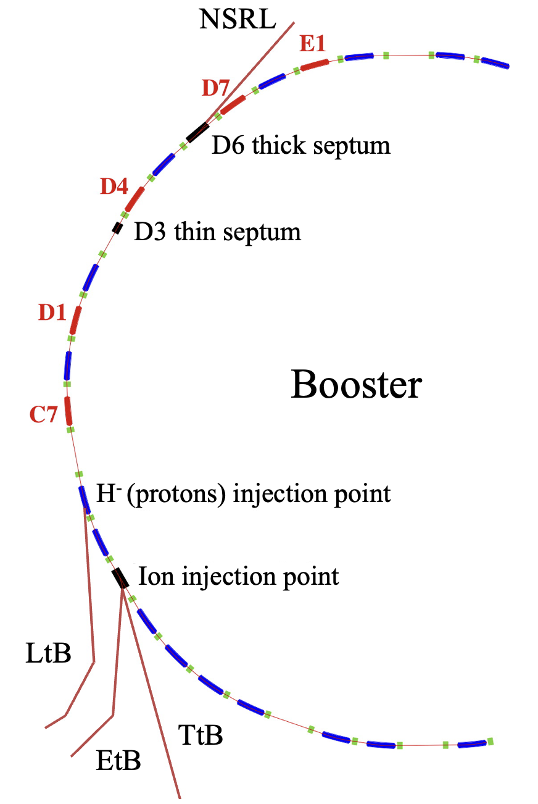
Subsystems
Sources
AGS Booster synchrotron
NSRL transfer line
Target room
RHIC/AGS Users Meeting 2026
Eiad Hamwi

Slide 5
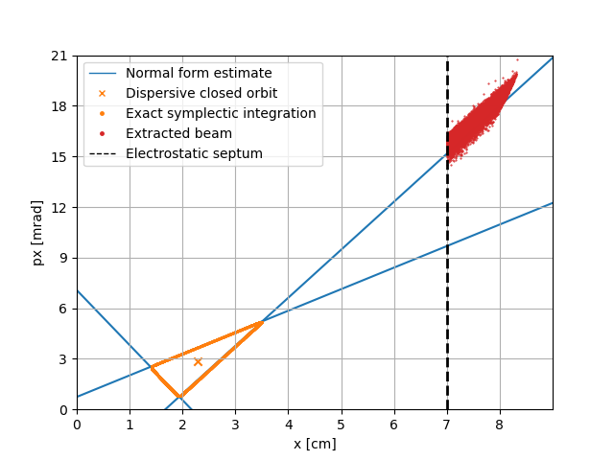
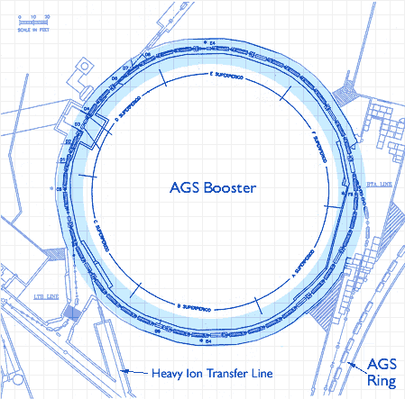



AGS Booster synchrotron
Circumference $\sim 200m \sim 1μs$
…
Slow extraction!
Slow resonant extraction
was developed in the early
proton synchrotron era to provide
quasi-continuous beams for fixed-target experiments.
These methods have been in operation at BNL since the AGS era from the 60s!
RHIC/AGS Users Meeting 2026
Eiad Hamwi

Slide 6
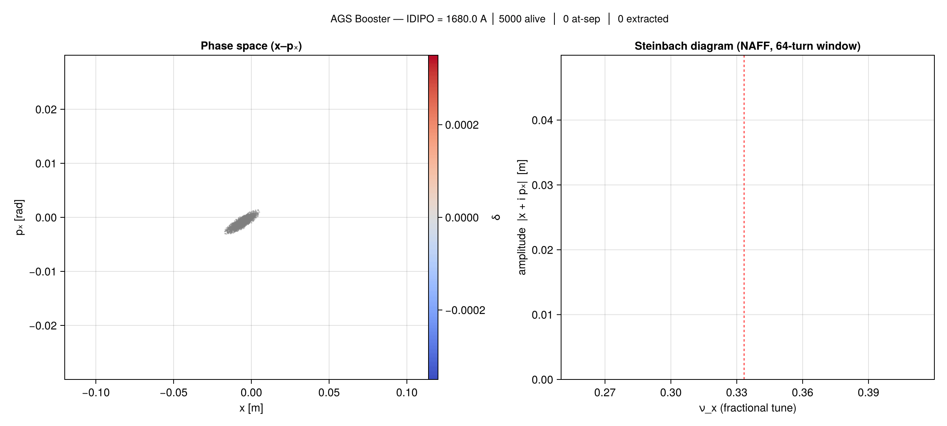
Slow extraction from the AGS booster
RHIC/AGS Users Meeting 2026
Eiad Hamwi

Slide 7
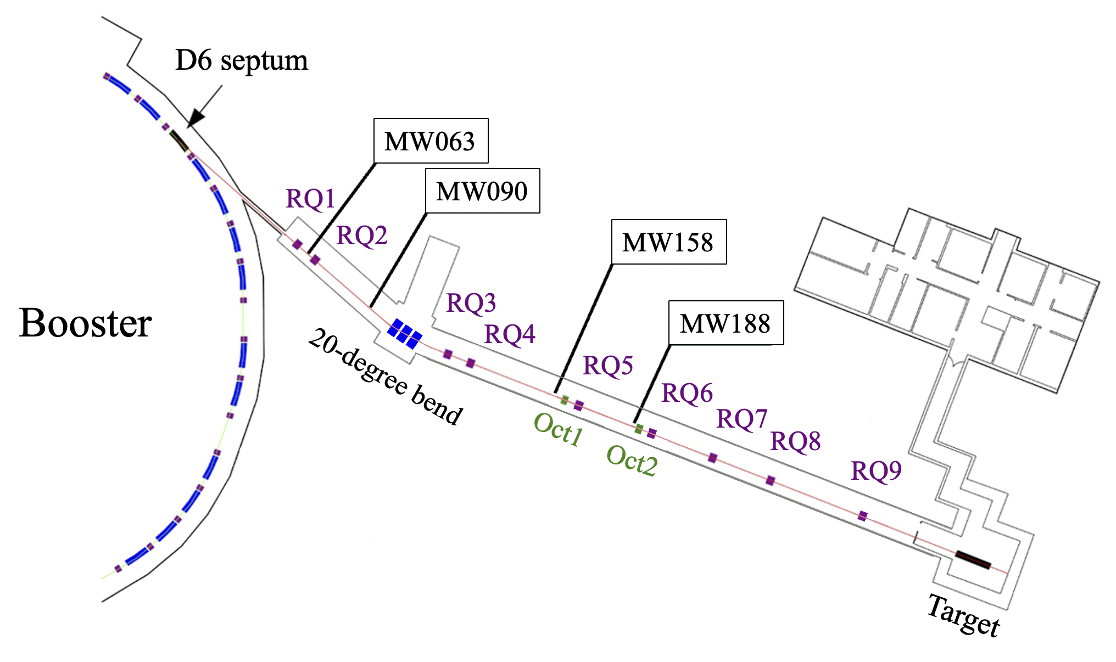
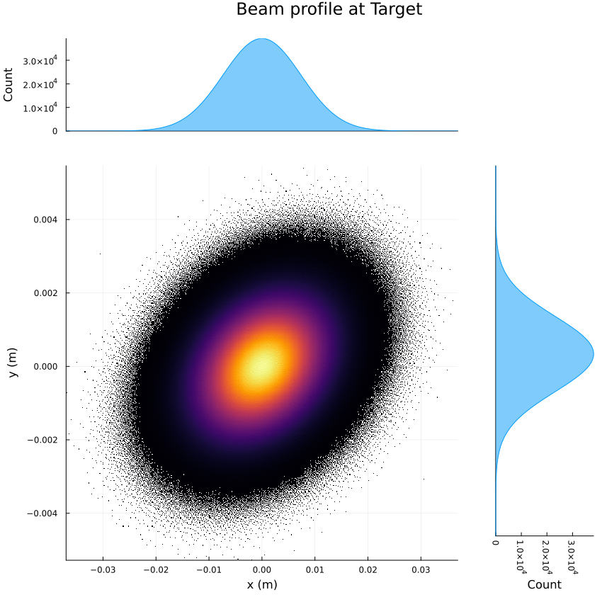
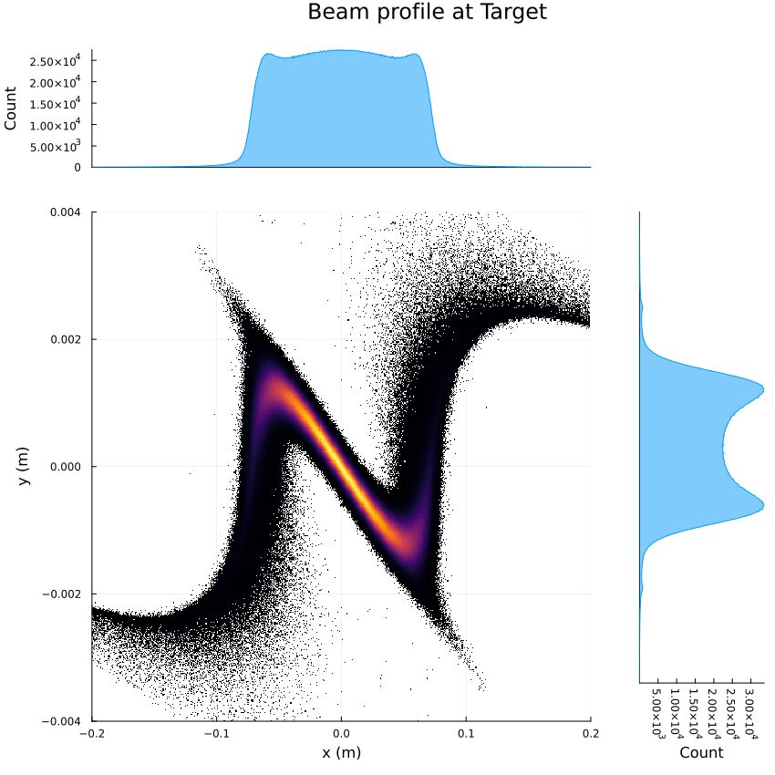
NSRL transfer line
High-efficiency transport line
Uses:
Specialized magnetic septa
Stripping foils for high Q
Octupole magnets for beam flattening
RHIC/AGS Users Meeting 2026
Eiad Hamwi

Slide 8
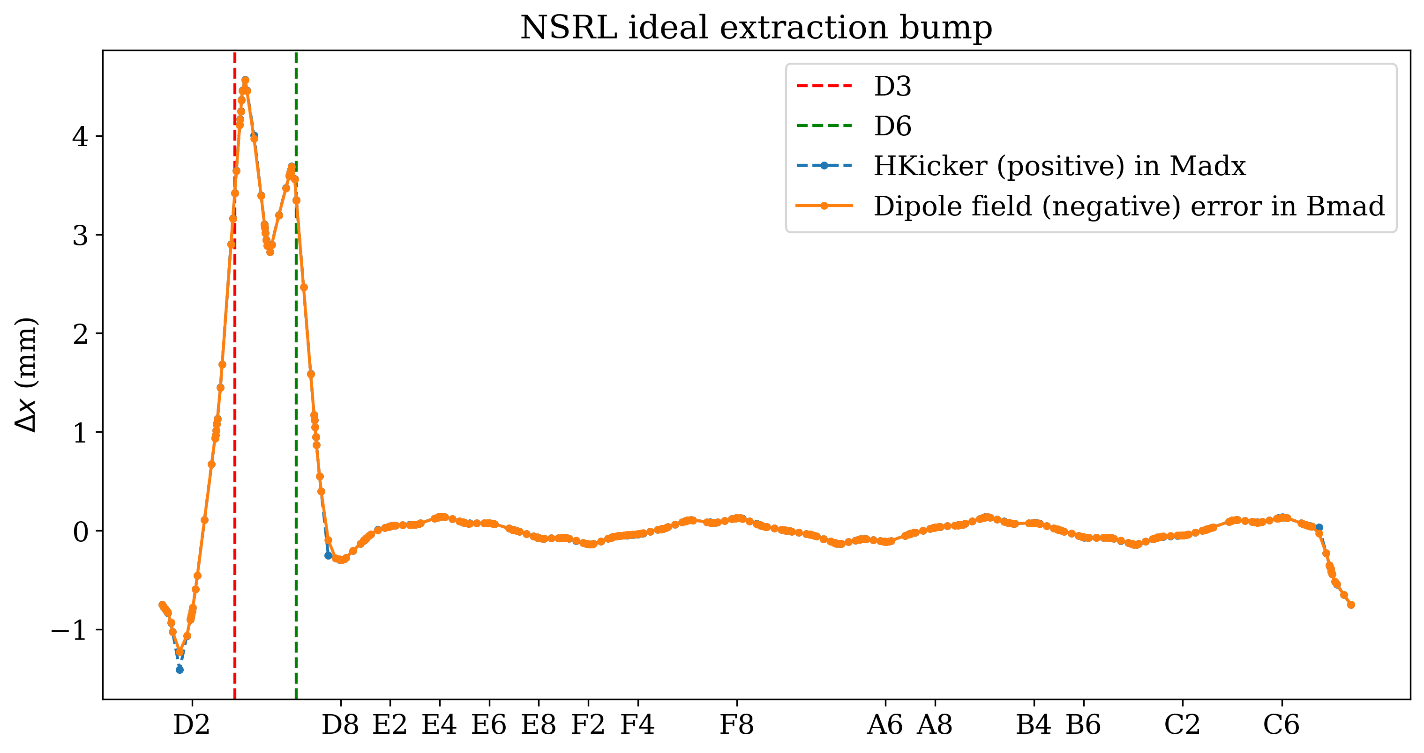
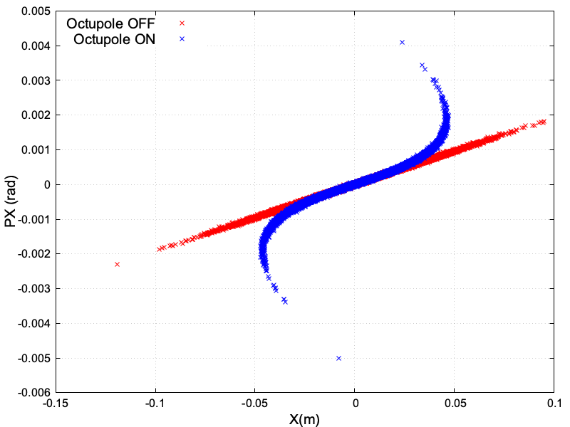
Traditional methods
Booster slow extraction efficiency
  Orbit control
    Closed orbit correction
    Extraction bump optimization
    Optimal septum positioning
  Resonance crossing
    Precise magnetic setpoints (dipoles, quadrupoles)
    Spill rate (servo)
NSRL line beam diagnostics and shaping
  Closed orbit correction
  Beam phase space reconstruction
  Octupole-driven beam shaping
RHIC/AGS Users Meeting 2026
Eiad Hamwi

Slide 9
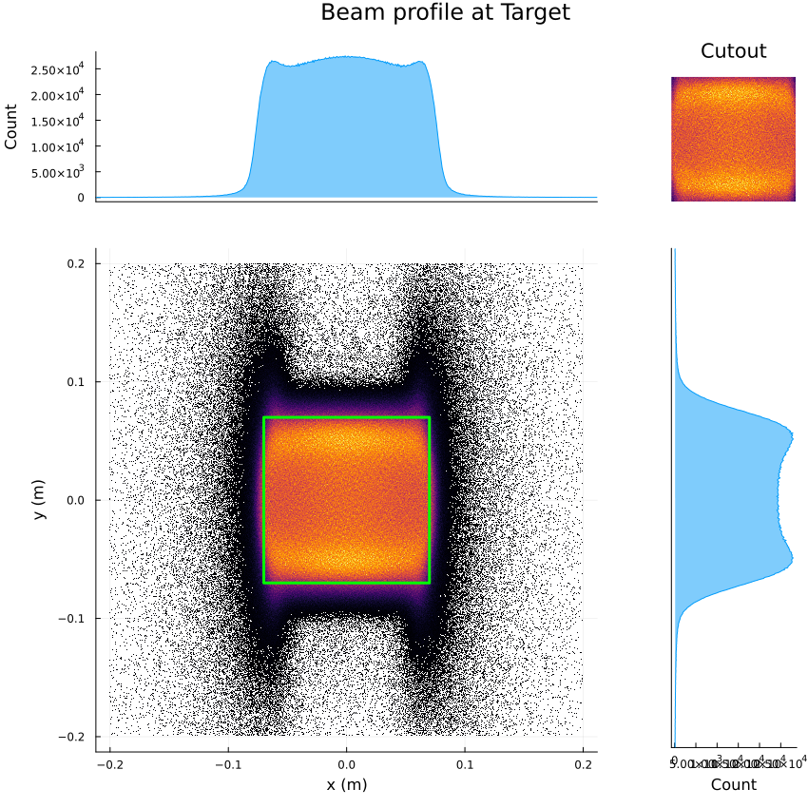
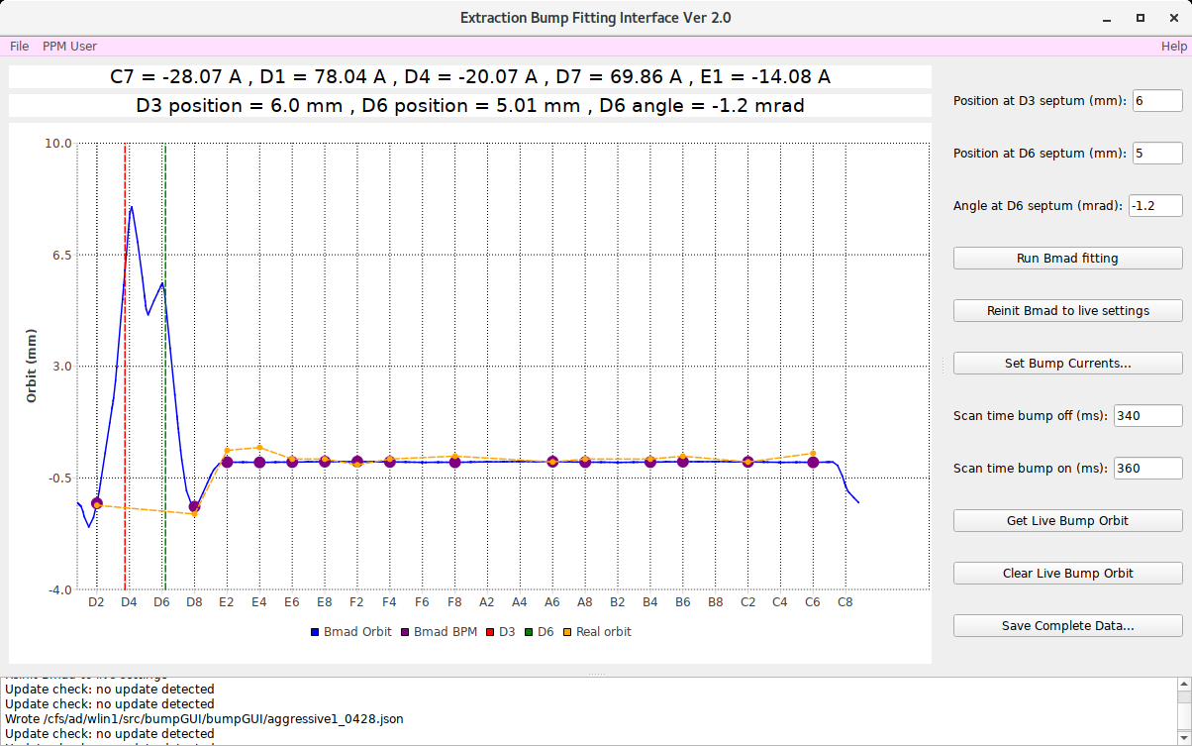
Avenues for automation
Large system – many DoF
Routine measurements amenable to automation
  Emittance measurement (beam covariance matrix)
  Orbit response measurement (magnet strengths)
Routine optimizations amenable to automation
  Extraction bump
  Beam flattening
RHIC/AGS Users Meeting 2026
Eiad Hamwi

Slide 10
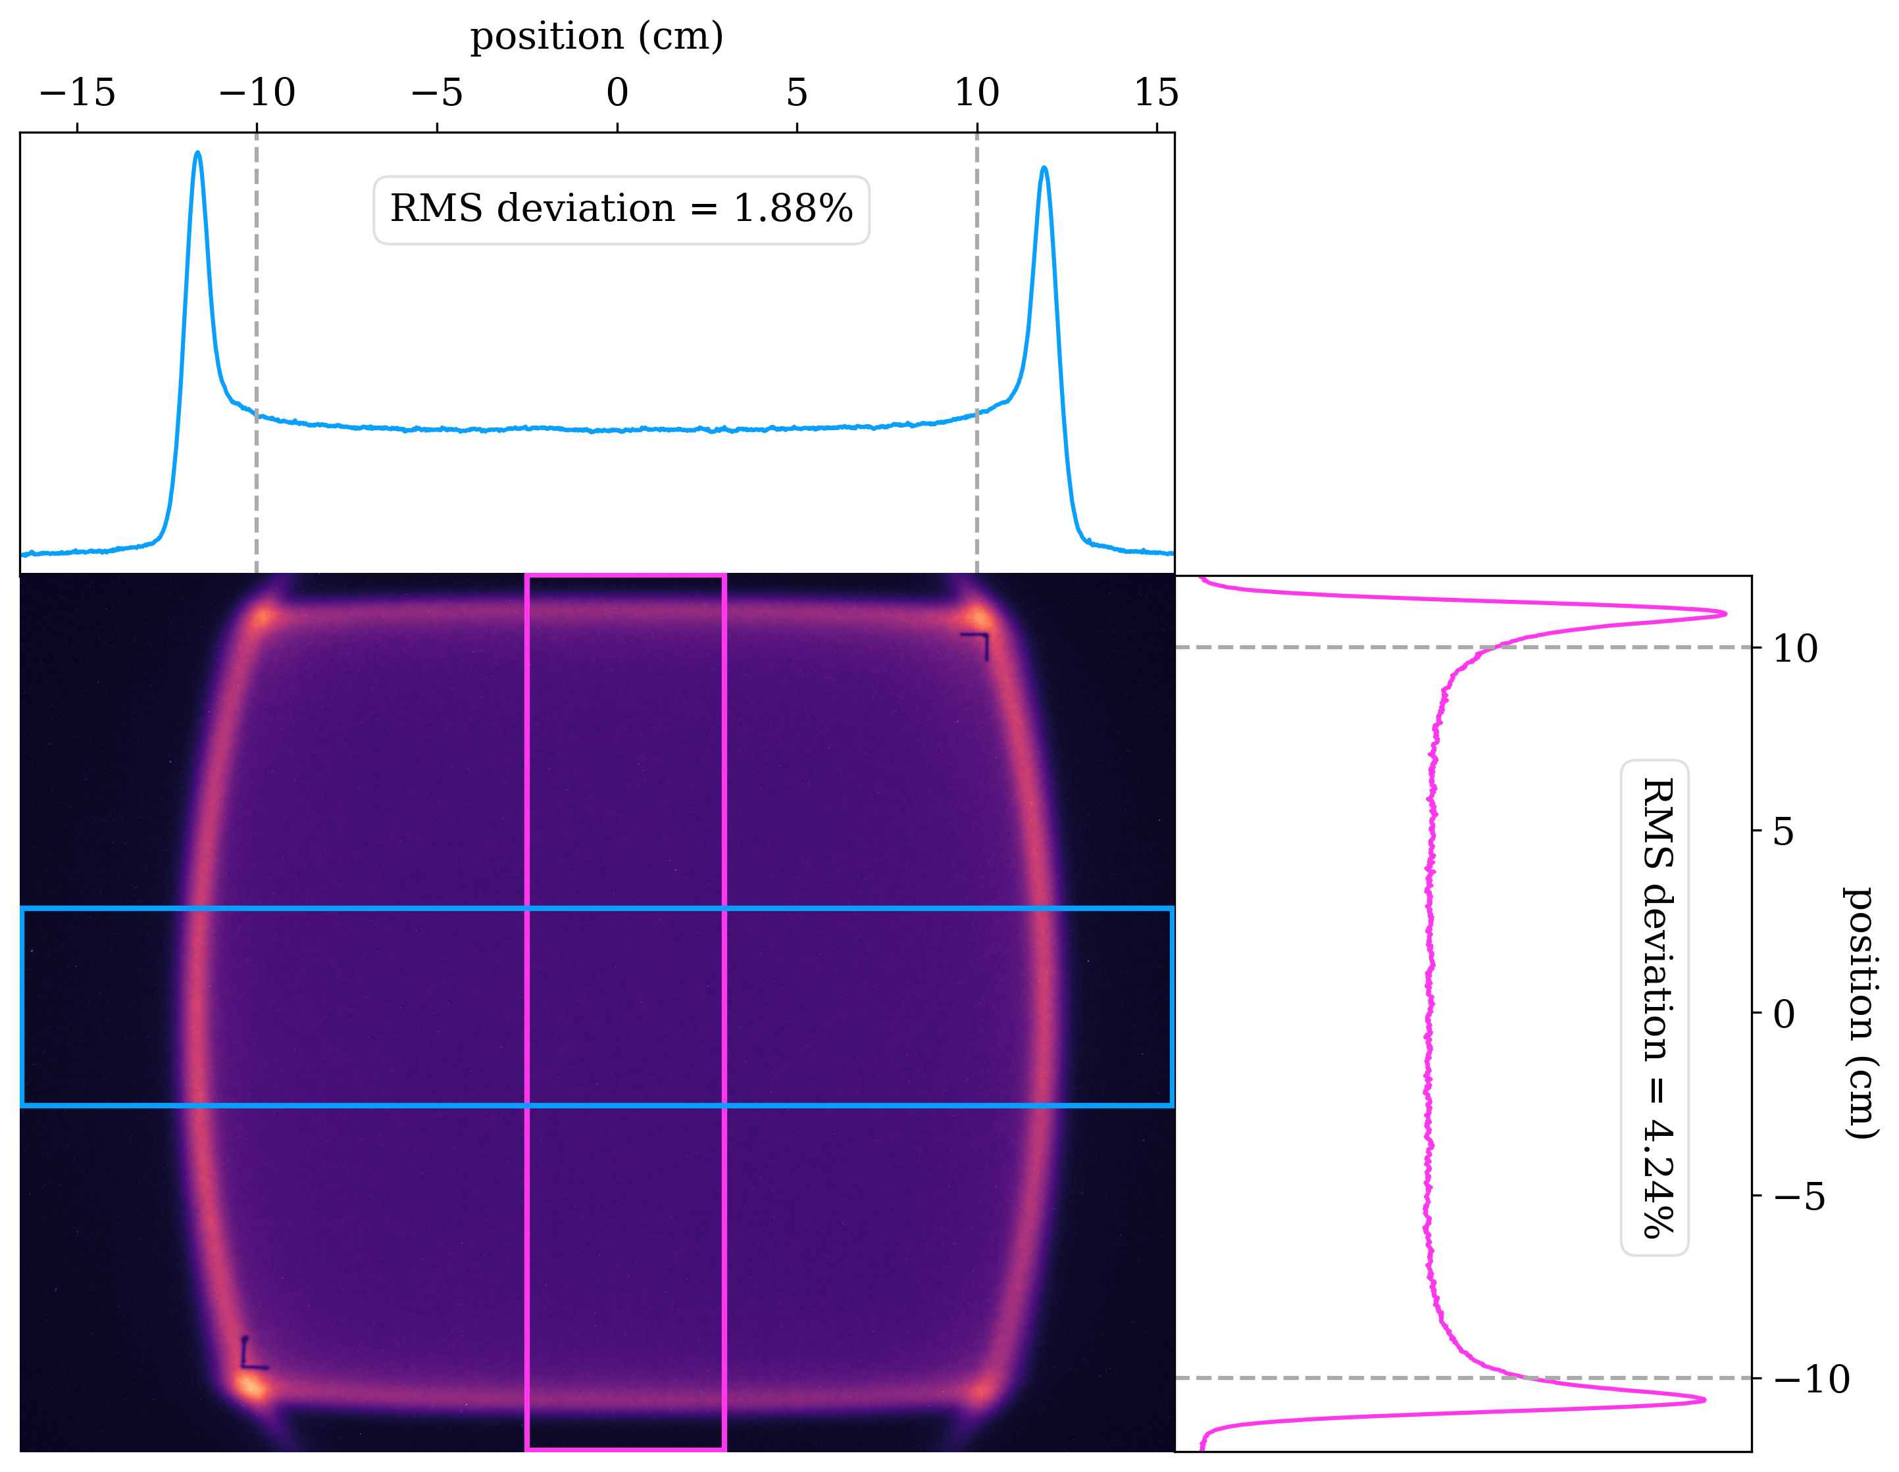
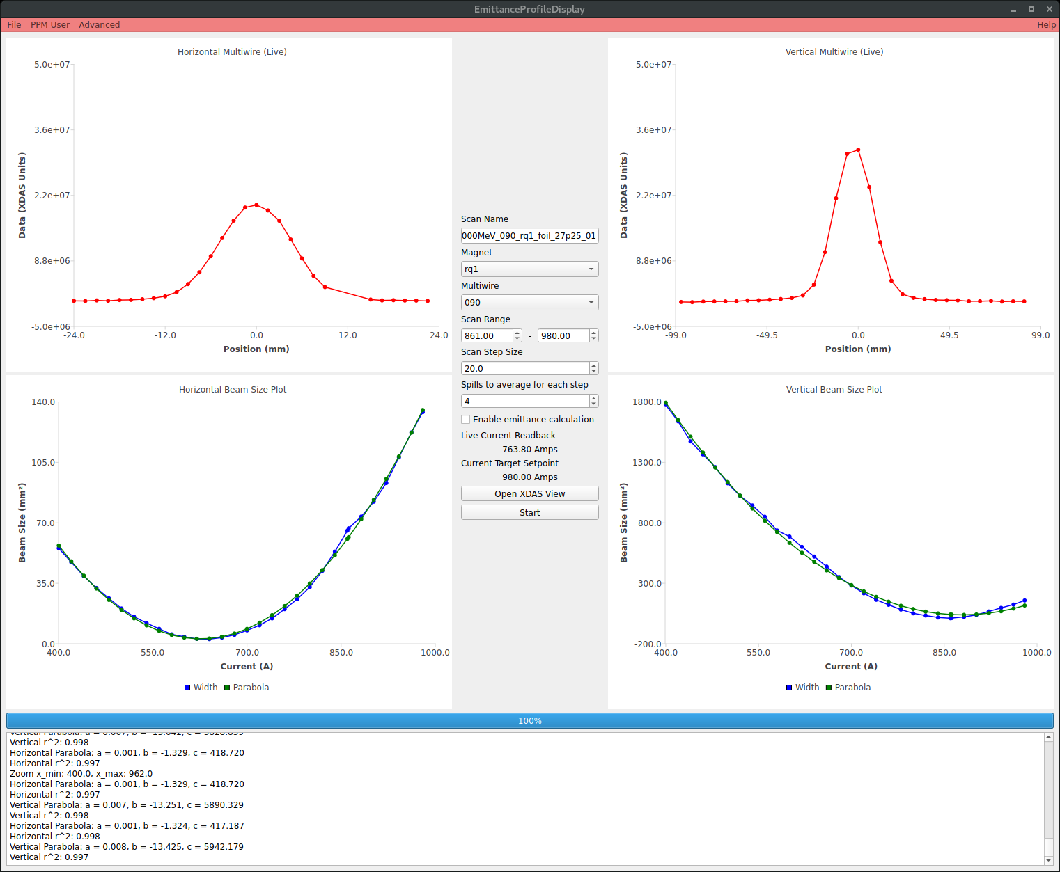
Routine measurements
Quadrupole scan Downstream profile
RHIC/AGS Users Meeting 2026
Eiad Hamwi

Slide 11
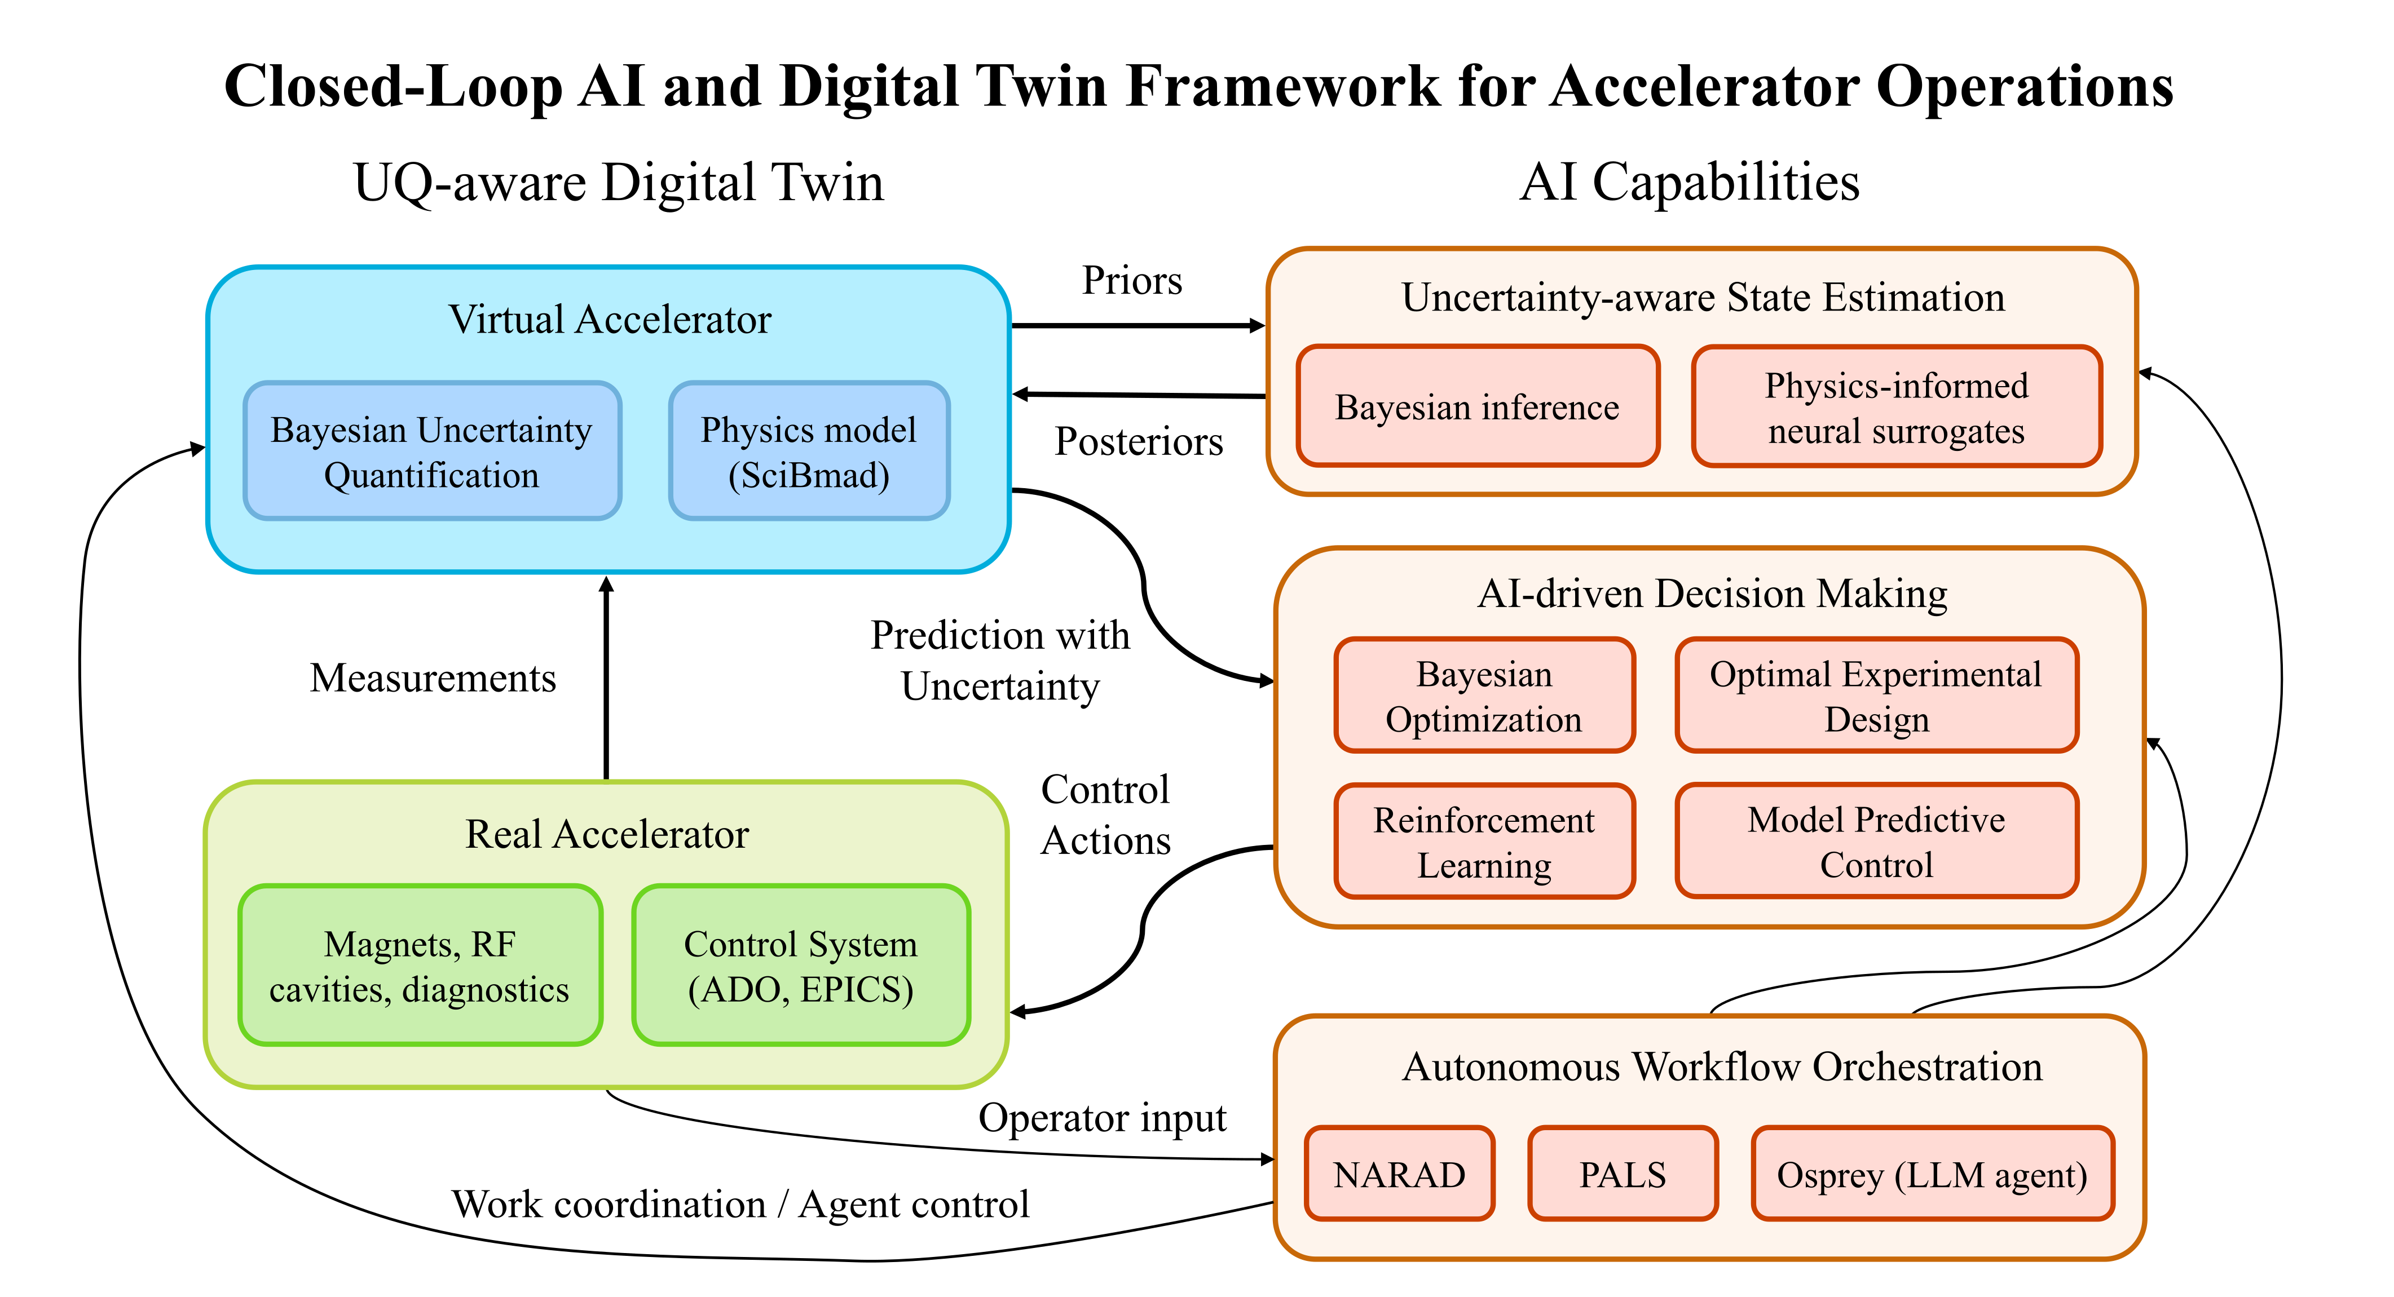
Digital Twins
RHIC/AGS Users Meeting 2026
Eiad Hamwi

Slide 12
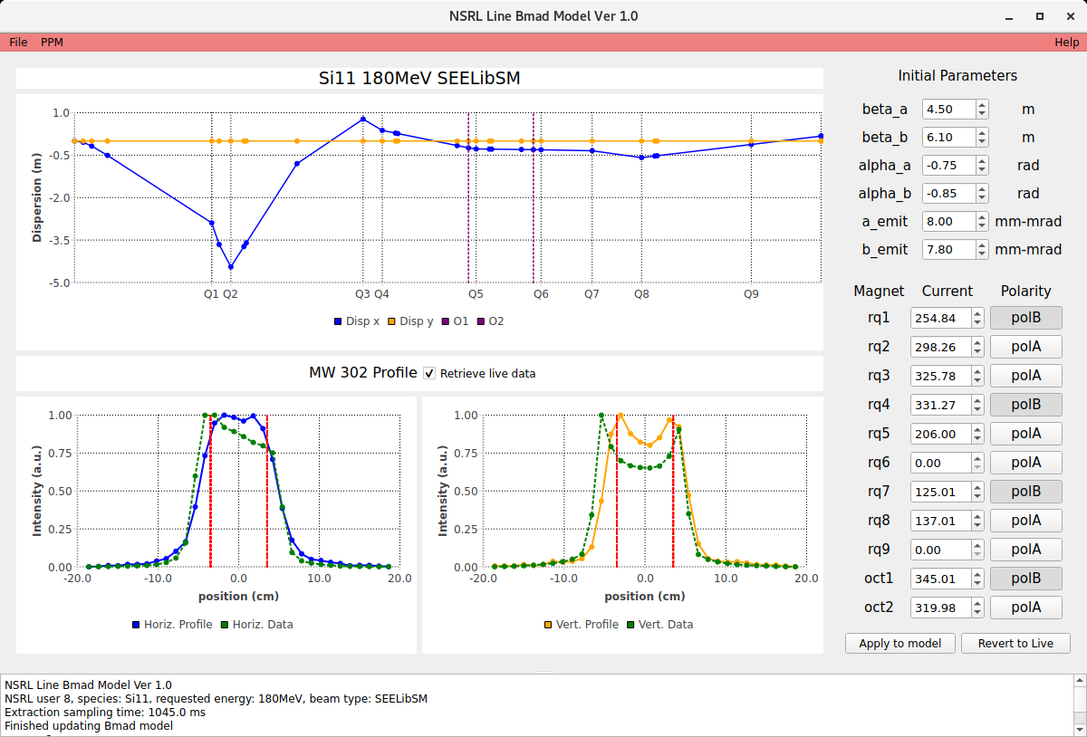
Digital Twin for the NSRL line
180 MeV/n Silicon
Initial beam parameters used by model
Currents and polarities of quadrupoles from live machine
Simulated dispersion of NSRL line using live machine info
Simulated vs. real transverse beam profile at MW302
RHIC/AGS Users Meeting 2026
Eiad Hamwi

Slide 13
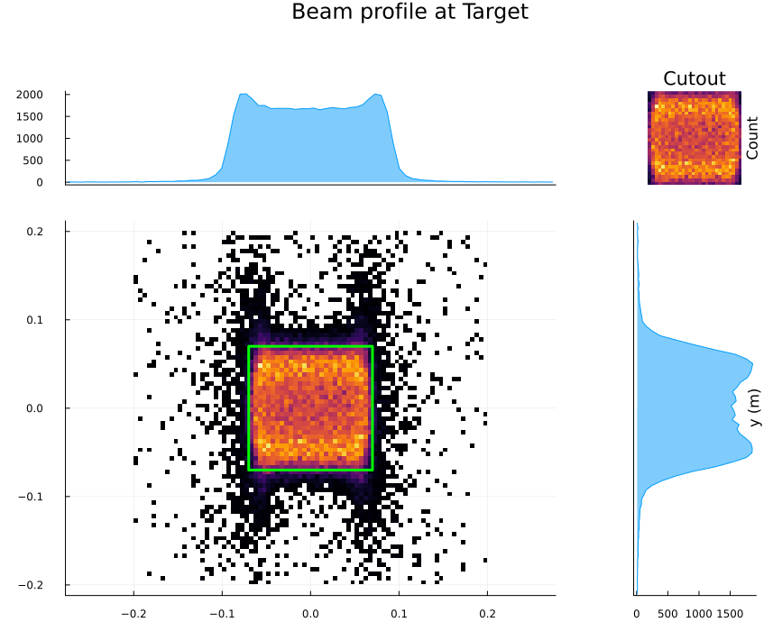
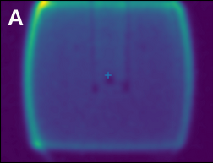
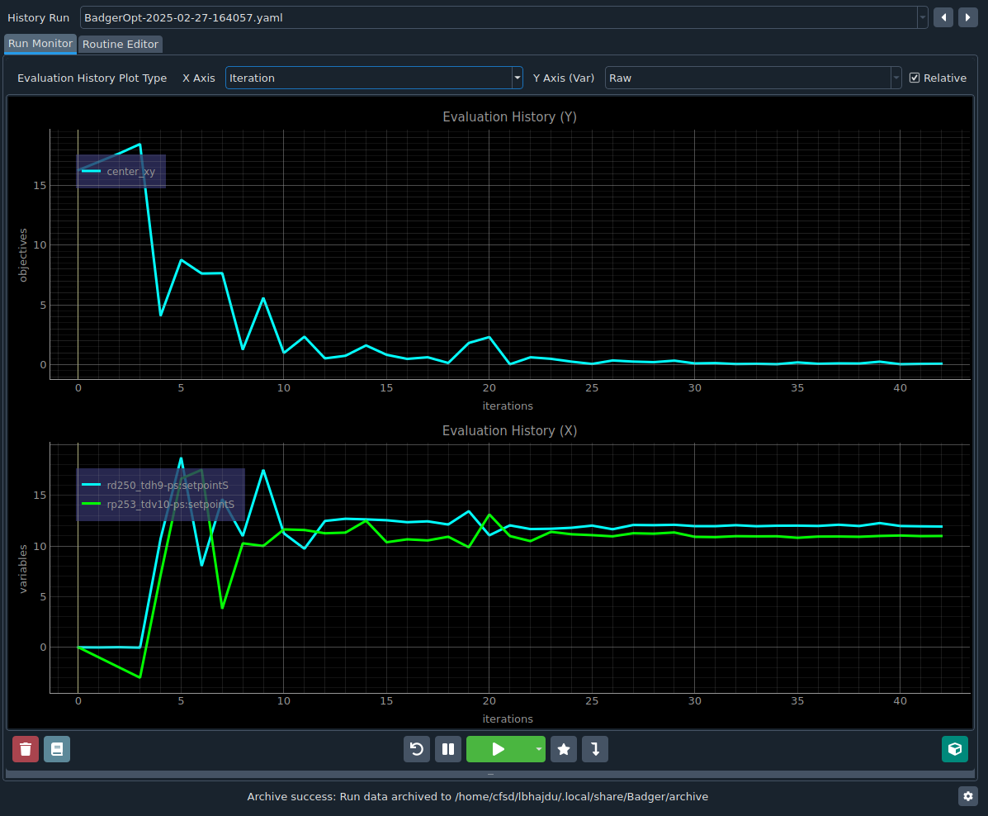
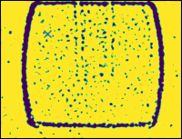
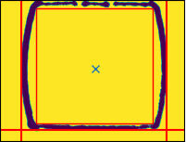
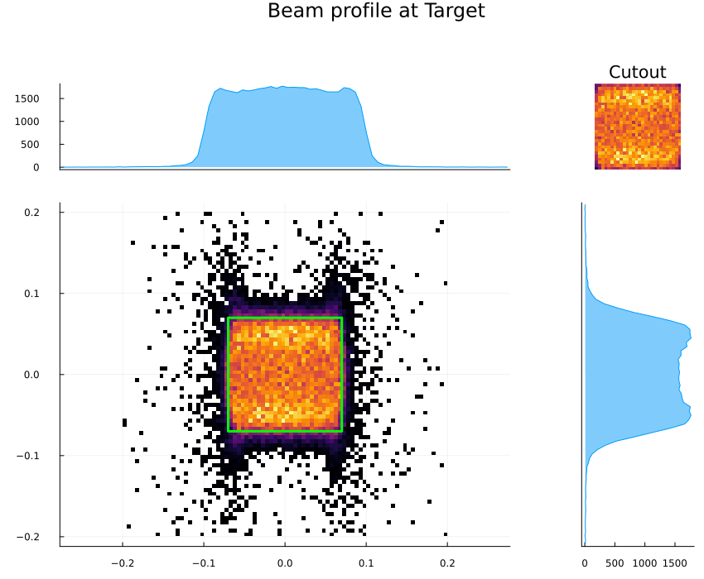
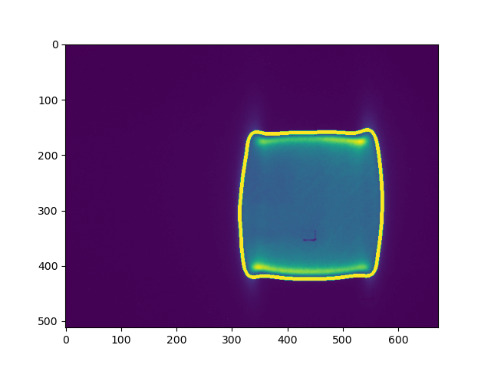
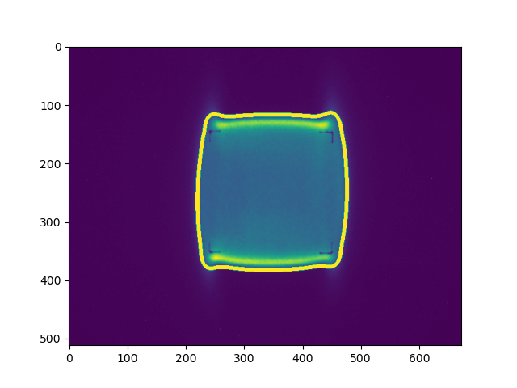
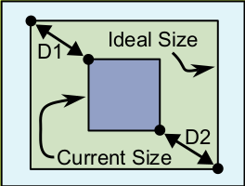
Bayesian optimization for target
RHIC/AGS Users Meeting 2026
Eiad Hamwi

Slide 14
ML assistance
Again: large system – many DoF!
Optimal experimental design for Bayesian parameter inference
  Magnet strengths
  Magnet misalignments
  Non-gaussian beam distributions
High-performance NN surrogates for slow-extraction
RL-driven feedforward ripple controls
RHIC/AGS Users Meeting 2026
Eiad Hamwi

Slide 15
Summary
NSRL provides highly flexible continuous-beam irradiation capabilities for radiobiology, materials science, and space electronics testing.
Slow resonant extraction remains a powerful but operationally complex system with many coupled control parameters.
Routine measurements and tuning procedures are increasingly amenable to automation through digital twins and online optimization.
Reinforcement learning and Bayesian inference methods offer promising paths toward adaptive accelerator control at NSRL.
ML-assisted accelerator operations can improve spill quality, transport efficiency, reliability, and experimental throughput for the NSRL and future user facilities.
RHIC/AGS Users Meeting 2026
Eiad Hamwi

Slide 16
Thank you!
RHIC/AGS Users Meeting 2026
Eiad Hamwi

