Slide 1
Spin Physics at RHIC An Early History and Early Data
Yousef I. Makdisi
Brookhaven National Laboratory
(Retired)

Slide 2
Outline
A brief history
The RHIC Spin Collaboration
Approval and preparations
The Polarimeters and Polarized Jet Target
Early Spin Physics

Slide 3
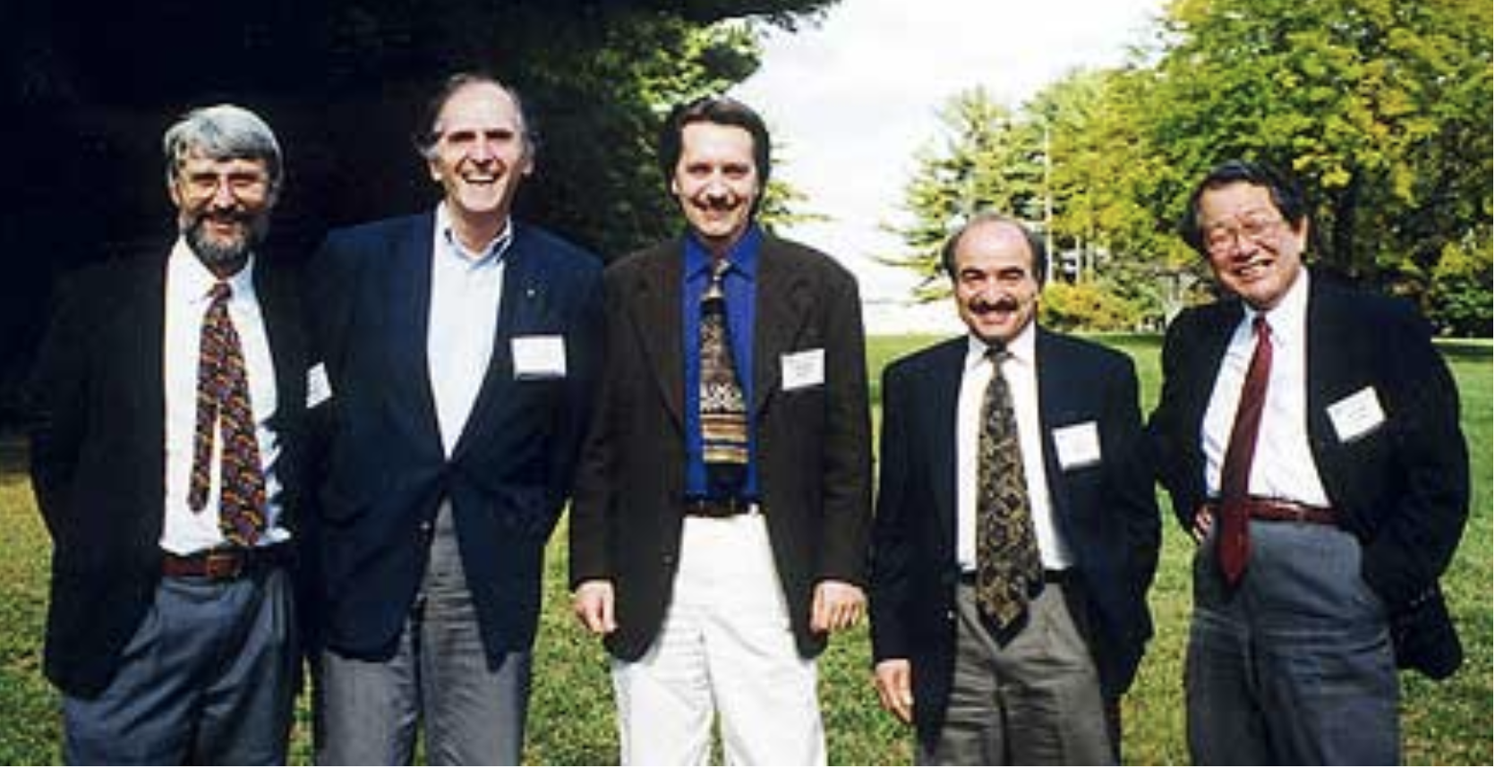
The Culprits and Proposal
At the Spin symposium 2002
Bunce, Roser, Tannenbaum, and Makdisi started the process early 1990
The Polarized Collider Workshop held at Penn State University, November 15–17, 1990
A first PAC presentation in 1991
The proposal approved 1993 and published 1996
1995 Agreement for RBRC & help funding the RHIC Snakes, Spin rotators, PHENIX Muon arm.
Ozaki, Yokosawa, Nagamiya, Samios, Lee, Ishihara

Slide 4
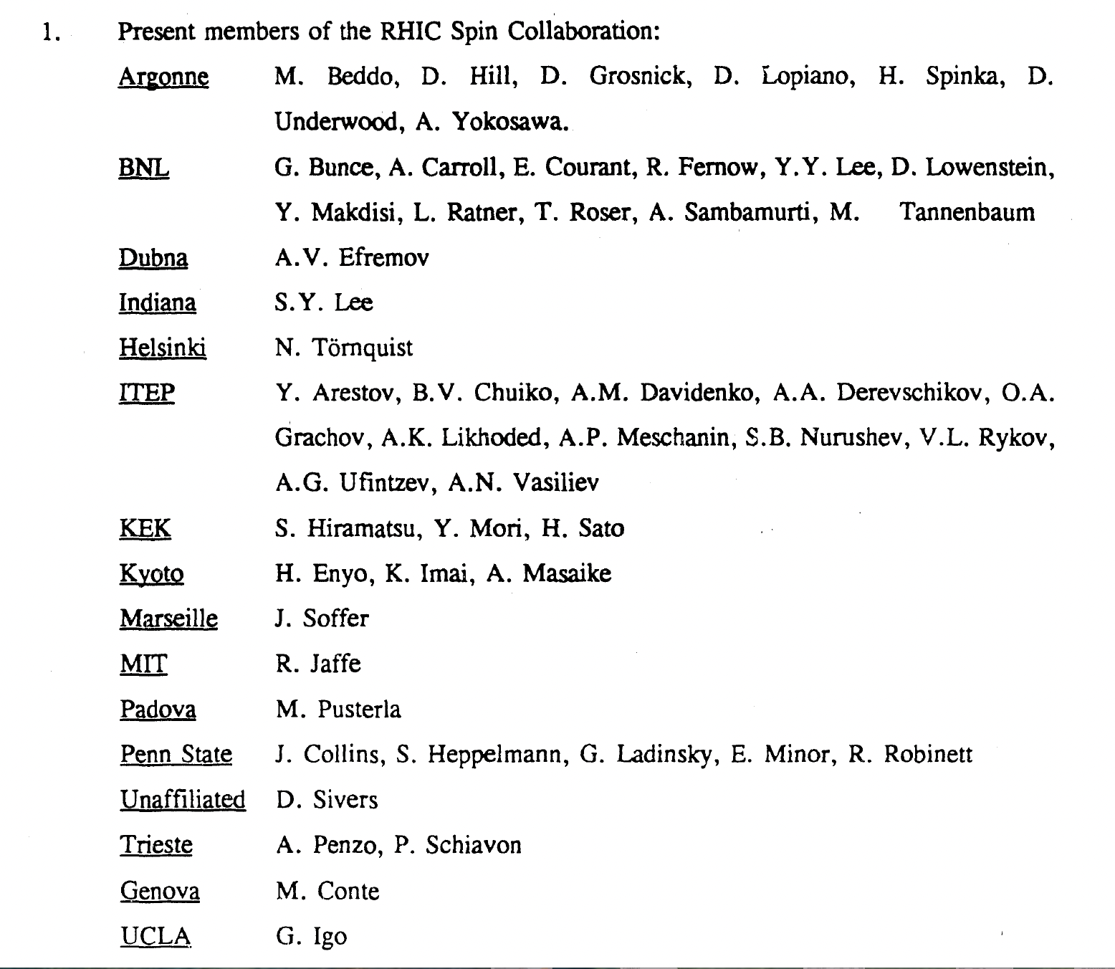
The RHIC Spin Collaboration 1991

Slide 5
The RHIC Polarized Collider
Absolute Polarimeter (H↑ jet)
RHIC pC Polarimeters
PHOBOS
BRAHMS / PP2PP
Siberian Snakes
Siberian Snakes
PHENIX
STAR
Spin Rotators
(longitudinal polarization)
Spin Rotators
(longitudinal polarization)
Pol. H⁻ Source
LINAC
EBIS
BOOSTER
Helical Partial Siberian Snake
200 MeV Polarimeter
AGS
AGS pC Polarimeter
Strong AGS Snake

Slide 6
RHIC Spin Physics and Polarimetry Requirements
The Program is quite versatile:
Various CMS energies 48-500 GeV
Spin rotators: the freedom to chose a preferred spin alignment
Measure the contribution to the proton spin: quarks, gluons and antiquarks. For gluons “direct photon production”.
The polarimeters operate at a wide energy range 24-250 GeV
The physics program required precision polarimetry < 5%
Absolute polarimeter calibration (Polarized H-Jet target)
Allowed beam polarization profile(s)
Polarization lifetime or decay during a store

Slide 7
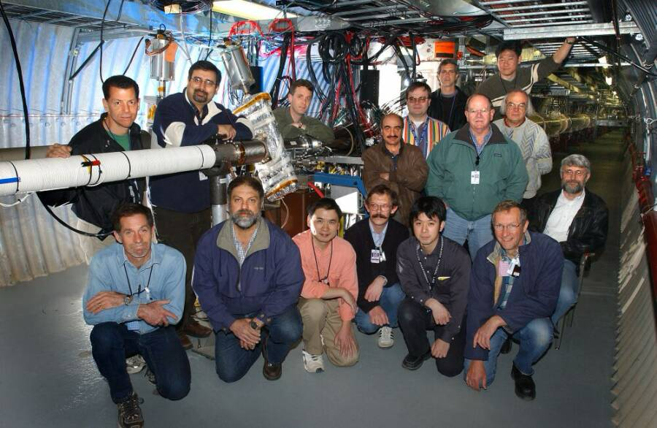
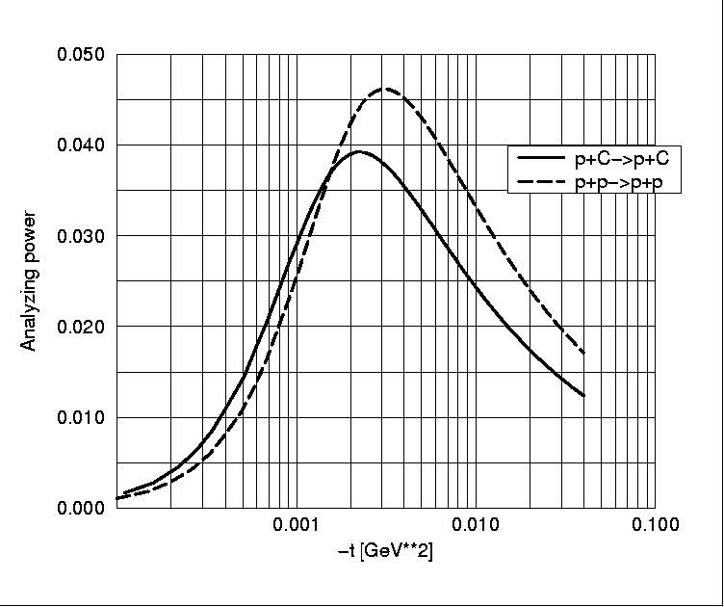
Polarimeters
For RHIC initially p-C inclusive pion
production. High analyzing power.
Theoretical help N. Buttimore, E. Leader,
B. Kopeliovich, J. Soffer, L. Trueman
Suggested CNI Polarimetry in both the AGS
and RHIC. Lower analyzing power high stats
Tested the concept with p-Carbon at IUCF
Early AGS installation used Yale equipment.
H. Huang, A. Bravar, H. Spinka, I. Alekseev
D. Underwood, D. Svirida, K. Yip, O. Eyser
W. Schmidke, A. Deshpande
Installed in the AGS first and then RHIC

Slide 8
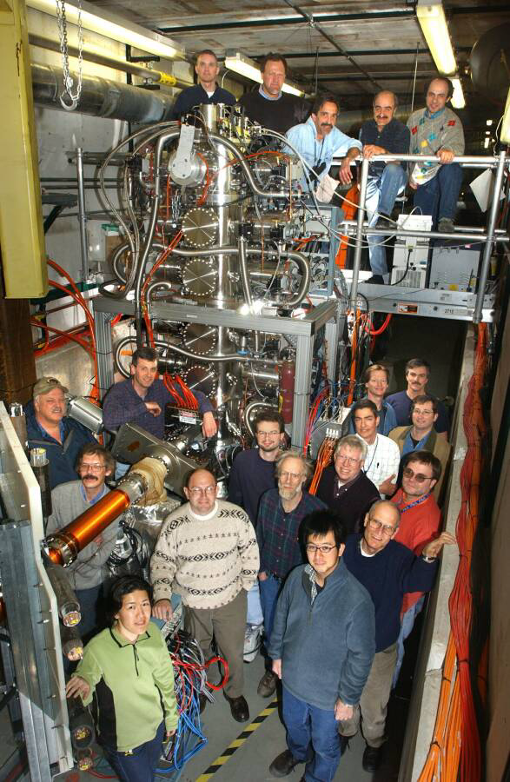
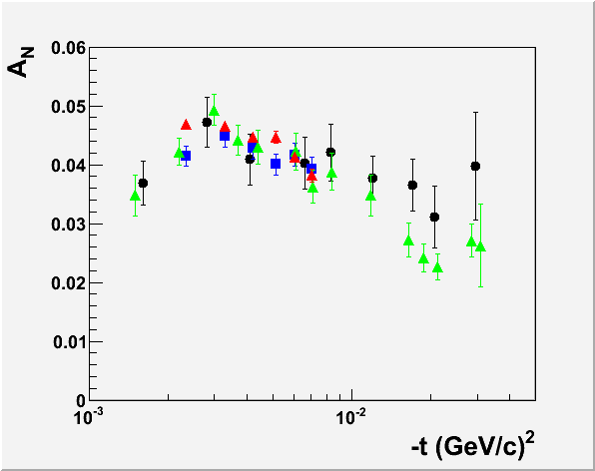
Polarized Proton Jet Target
Construction BNL & U Wisconsin
Zelenski, Wise, Nass, Haeberli, Makdisi
Installed 2006
H. Okada, N. Saito, A. Bravar, O. Eyser
Statistical and systematics <5%
Improved to 2% by A. Poblaguev

Slide 9
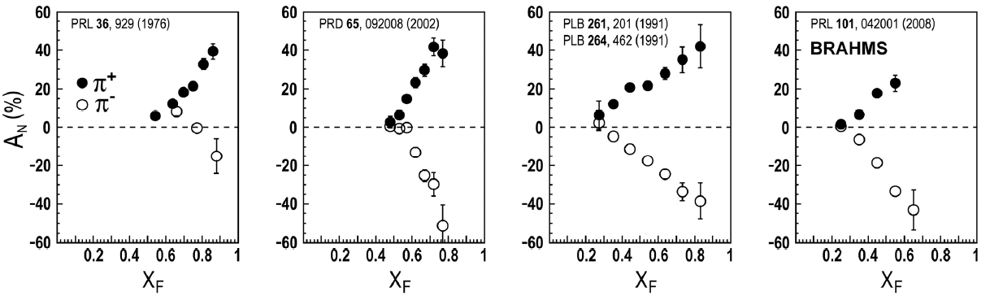
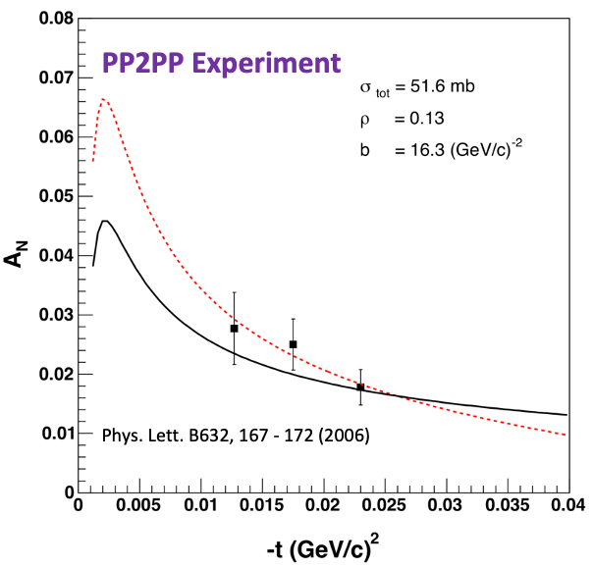
p+p → h± SSA and CNI
left
right
ANL
√s=4.9 GeV
BNL
√s=6.6 GeV
FNAL
√s=19.4 GeV
RHIC
√s=62.4 GeV
pp2pp@STAR
Large asymmetries seen over large range in √s, including RHIC energies BRAHMS
Early PP2PP data in the CNI region

Slide 10
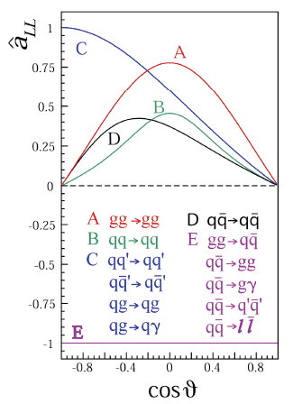
Accessing the gluon polarization ΔG
Polarized Gluon Distribution Measurements :
Use a variety of probes with variety of kinematics
Access to different gluon momentum fraction x
Different systematics
Use different beam energies
Access to different gluon momentum fraction x
Double longitudinal spin asymmetry A_{LL} is
sensitive to ΔG

Slide 11
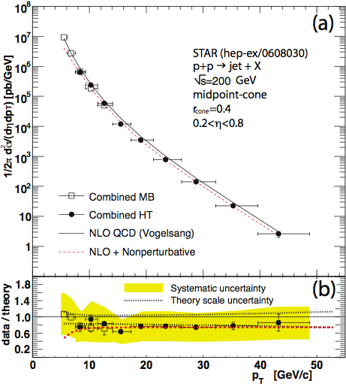
Cross Section and PQCD √s=200 GeV
PHENIX pp→ π⁰ X
PRD76, 051106
STAR: pp→jet X
PRL 97, 252001
PHENIX pp→γ X
PRL 98, 012002
|η|<0.35
|η|<0.35
Good agreement between NLO pQCD calculations and data ⇒ pQCD can be used to extract spin dependent pdf’s from RHIC data.

Slide 12
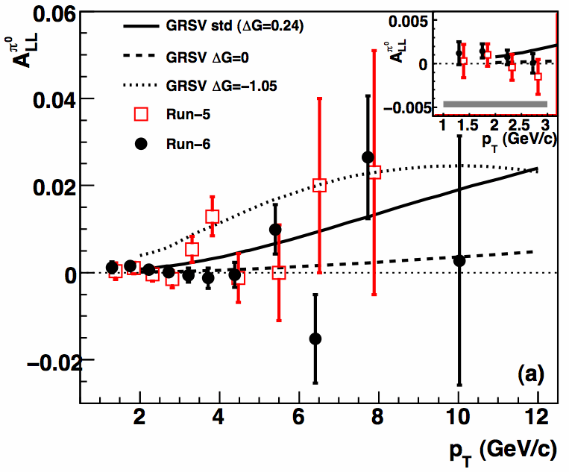
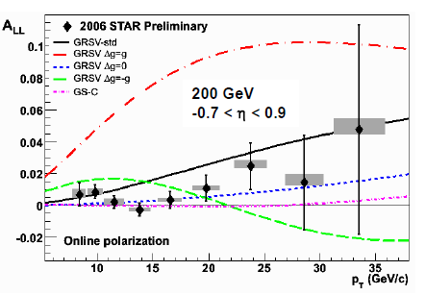
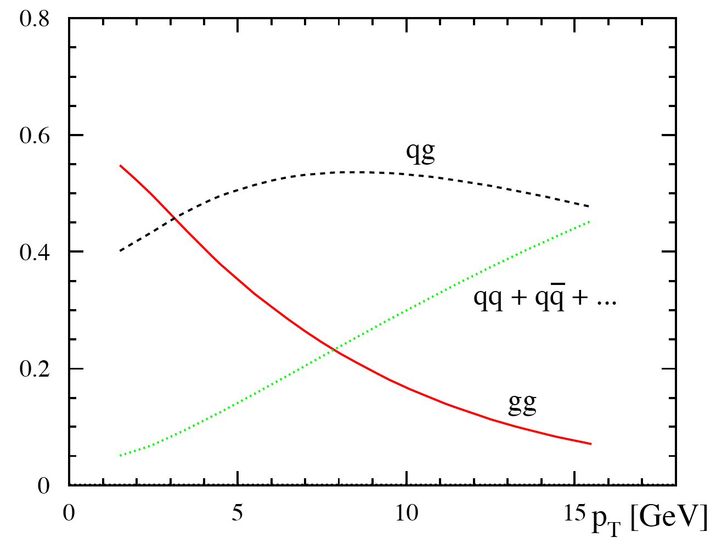
A_{LL}: π⁰ : PHENIX & Jets from STAR
pC: Polarization Profile
PHENIX Run5+6: PRL103, 012003
STAR Preliminary Run6 (√s=200 GeV)
Good discriminative power between calculations with different assumption for ΔG

Slide 13
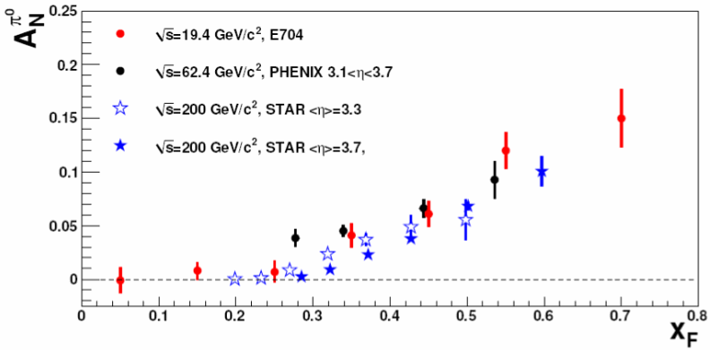
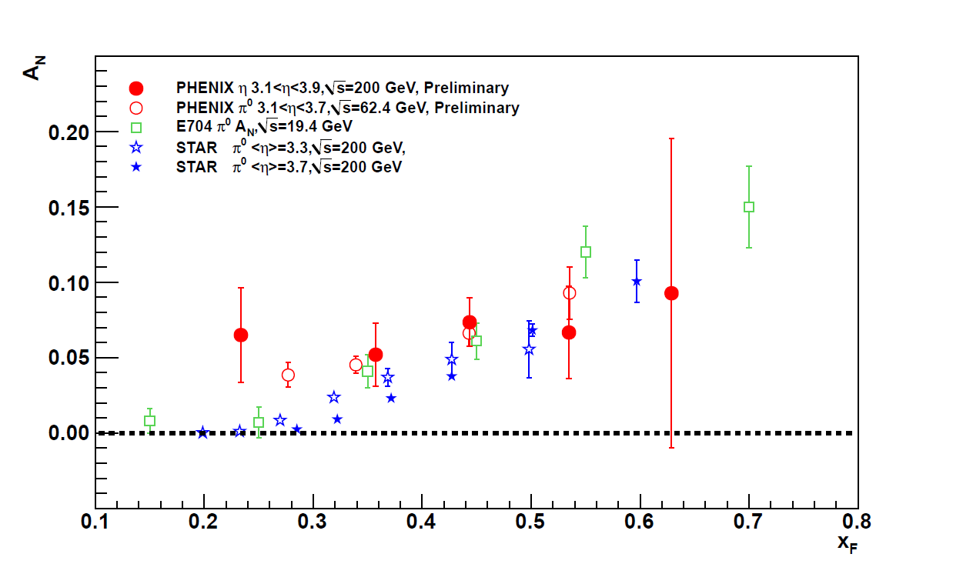
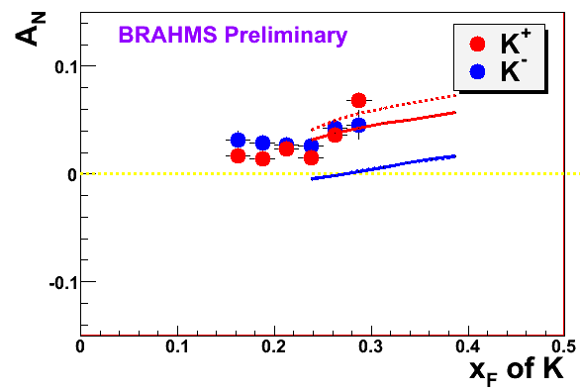
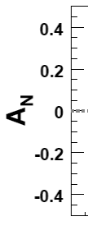
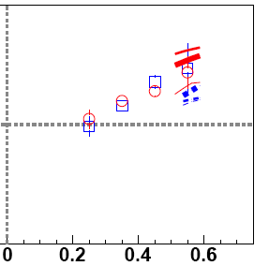

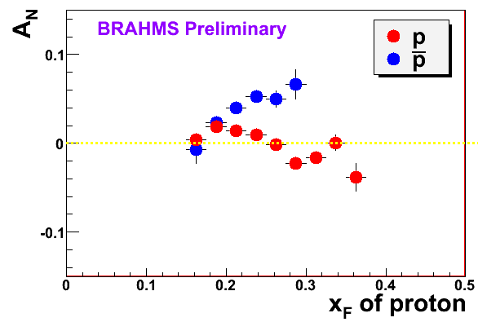
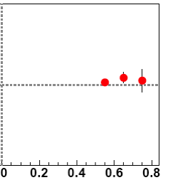
Asymmetry in Forward Production
left
right
At RHIC, we have measured forward SSA for many hadrons
π⁰, π±, K, p, η
200 GeV
62.4 GeV
η,π⁰
K
p

Slide 14
Summary
It has been quite a trip
A significant effort on behalf of several entities: The RSC
The RBRC, The AGS, The Magnet Division and RHIC
Provided a unique and first Polarized Proton collider
Longitudinal polarization to probe the gloun contribution to the proton spin through several venues
The antiquark polarization measurement
Large transverse polarization observed similar to lower energy results

