Slide 1
EIC Project News
E.C. Aschenauer (BNL), R. Ent (JLab)
Co-Associate Directors for the EIC Experimental Program
ePIC Bi-Weekly General Meeting
January 9th, 2026

Slide 2
Outline
Overall Project and Detector Update
Important Developments in December and over the Holidays

Slide 3
Update on Reviews (December and Beyond)
Preliminary Design Reviews (60% design maturity equivalent, called PDR, PDR2 or PDR3, pending the subsystem)
Peer Review: AC-LGAD-based Particle Identification Detectors (focus on sensors) – December 3rd 2025
PDR: Integration, Infrastructure and Installation (6.10.10) – everything inside & outside GST, includes cradle, HCAL, etc. – Dec. 8-9, 2025
PDR: MPGD Tracking Detectors (6.10.03.02) – Dec. 15, 2025
PDR2: Silicon Tracking Detectors (6.10.03.01) – Jan. 27-28, 2026
PDR2: Polarimetry (6.10.14) – February 18, 2026
PDR: DAQ-Slow Controls (6.10.09.02) – Spring 2026 – Separated from electronics/DAQ to ensure integration in the collider common platform
PDR3: IR Integration and Auxiliary Detectors (6.10.11) – March/April 2026 – includes 6.10.14 lumi detector
PDR2: AC-LGAD-based Particle Identification Detectors (6.10.04; BTOF, FTOF, common systems) – April 2026
Final Design Reviews (FDR):
FDR: Final Design Review of the BABAR DIRC Bar Refurbishment for the High Performance DIRC Particle Identification Detector – April 1, 2025
FDR: Backward EM Calorimetry – Mid February 2026
Project Reviews:
Detector Baseline Readiness Review Feb 3 – 5, 2026
BNL Director’s Review – Comprehensive, Mar. 9-12, 2026
DOE Status Review April 28-May 1, 2026
CD2 IPR & ICR Late Summer - Fall 2026?

Slide 4
Recent Updates – AC-LGAD/TOF Peer Review
On December 3 we had a peer review for the AC-LGAD/TOF detectors with three reviewers. See https://indico.bnl.gov/event/30519/ (Passwd: ToF122025).
Review Committee: Koji Nakamura (KEK), Stefania Bufalino (Torino) and Giovanni Pinaroli (BNL)
The main questions and discussions related to the overall time-of-flight requirements and what this entails for the sensor timing requirements, the need for electrical tests of the assembled modules to validate sensor yield, and the power budget estimation and cooling design strategy.
The closeout was a week later on December 10. The reviewers concluded that the status of the different activities presented shows a sufficient level of maturity for the current phase of the project. They had four recommendations for further project planning towards a 60% Preliminary Design Review in a few months, related to:
further work on PCB design for transmission lines and to define the technical performance;
clearer power budget estimation and cooling design strategy;
labor estimates as available and for the future phases of the project; and
need for an interface document with details about the interfaces of the single parts of the project (for instance the geometry envelope). This recommendation has been addressed with that ICD now posted.

Slide 5
Recent Updates – PDR of the ePIC Outer and Inner Support Structures
The 60% preliminary design review of the Support Structures in the Central Detector (under the Integration, Infrastructure and Installation scope) was held on December 8 and 9.
Review Committee: Michael Gaffney (BNL), Jim Mills (BNL), Timothy Whitlatch (JLab), Kyle Zeug (UW-Madison Physical Sciences Laboratory)
The review committee answered yes to four charge questions and mostly yes to the other three. The mostly yes relates to their three recommendations:
The status of the Cradle, Moving Mechanism and Barrel Access Platforms subsystem is still in a very preliminary state. It is important that the project address this issue by providing additional staff to the engineering lead.
Assign additional help to complete the design and analysis of the cradle system
Moving the detector assembly from the IR to the assembly hall after initial magnet testing will have a time critical element to keep the MARCO magnet cool. Consider adding redundancy in the air castor system.
Mock up a portion of the services runs to ensure there is enough space to install all services as soon as reasonably possible.
Expedite the analysis and modifications to the floor structure. Ensure a POC is identified to coordinate and lead this deliverable.
The report is posted on https://indico.bnl.gov/event/30101/ (Passwd: I3PDR2025).

Slide 6
Recent Updates – PDR of the MPGD Trackers
The preliminary (60%) design review for the gaseous-based tracking detectors was on December 15.
Review Committee: Maxim Titov (CEA), Florian Brunbauer (CERN), Marco Cortesi (FRIB/MSU)
The reviewers answered yes or partially yes to the six charge questions, with the partial yes correlated with four recommendations related to completion of tracking simulations with backgrounds included, improved documentation, and completion of the final gas mixture choice and the powering scheme.
The ongoing performance analyses and activities related to the selected gas mixtures, readout geometries, drift gaps, and mechanical support structures would benefit from being completed and more fully documented to provide a clear and well-justified technical basis for baselining. Clear demonstration of consistency between the design choices and the required detector performance would further support the maturity and readiness of the baseline design.
Comprehensive simulations, including realistic background conditions and beam-energy dependence, are needed prior to baselining to validate the technical approach. Completing this work at an early stage reflects systems-engineering practice and effective risk management, as it helps reduce the likelihood of post-baseline design changes that could introduce complications across mechanical, electrical, and integration interfaces.
It is recommended that the plan for full testing of the first articles for the various tracker systems be completed and clearly documented prior to baselining. Well-defined fabrication, testing, and qualification procedures, informed by the first-article experience, would help identify and address unforeseen technical issues and thereby further mitigate technical, cost, and schedule risks before proceeding to full-scale production. Develop a fabrication and assembly plan for the MPGD’s with emphasis on institutional commitments.
Possible optimization of the sectorization and powering scheme of the GEM in the muRWELL- ECT should be considered in view of the expected currents on each sector and the expected current per sector should be quantified. A different orientation of the sectors (radially) may result in a better distribution of background current rate. The powering scheme should account for possible resistive voltage drops due to expected background currents.
The review committee congratulates the ePIC MPGD’s tracking system teams on its significant progress since the previous review in 2024. The technologies for each component of the tracker are being advanced and development paths are now better defined from final prototypes to preproduction and final production.
The report has been posted. See https://indico.bnl.gov/event/30521/ (Passwd: MPGD122025PDR).

Slide 7
More Recent Updates - Miscellaneous
The procurement for the scintillation fibers for the Barrel Electromagnetic Calorimeter (CD-3A scope) was awarded to Kuraray.
A Record of Decision was signed by both ePIC and EIC detector project leadership to constrain the number of readout channels of the CALOROC ASIC (Application Specific Integrated Circuit) for readout of calorimeters with Silicon Photomultiplier sensors to 36 channels and evade an extra engineering run.
The individual quality control plan for the data acquisition/computing subsystem was posted, see https://eic.jlab.org/Detector.
The inspection and test plan for the wafer probing of the Silicon Vertex Tracker was posted.
The inspection and test plan for the scintillating fibers of the barrel imaging electromagnetic calorimeter was posted.
Interfaces were updated. The Interface Control Documents related to Hadron Polarimetry and to the Detector Envelope governing the various allotted sub-detector spaces were completed and posted (see https://eic.jlab.org/Detector).
Work is ongoing to document the detector pre-ops phase, one era with cosmics and a later era with beam.

Slide 8
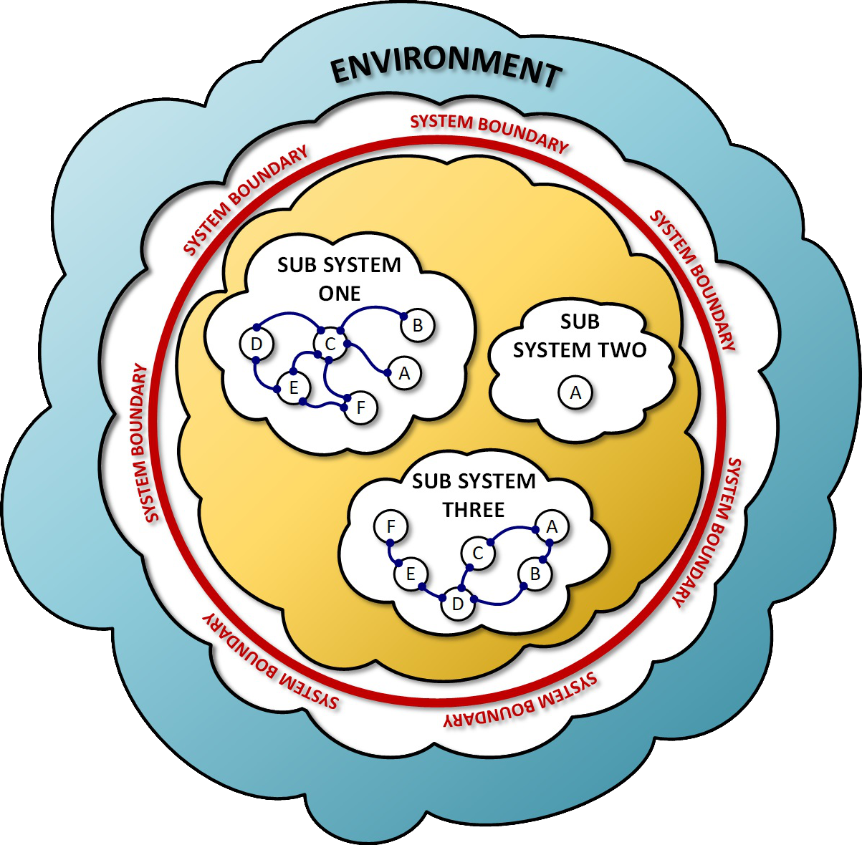
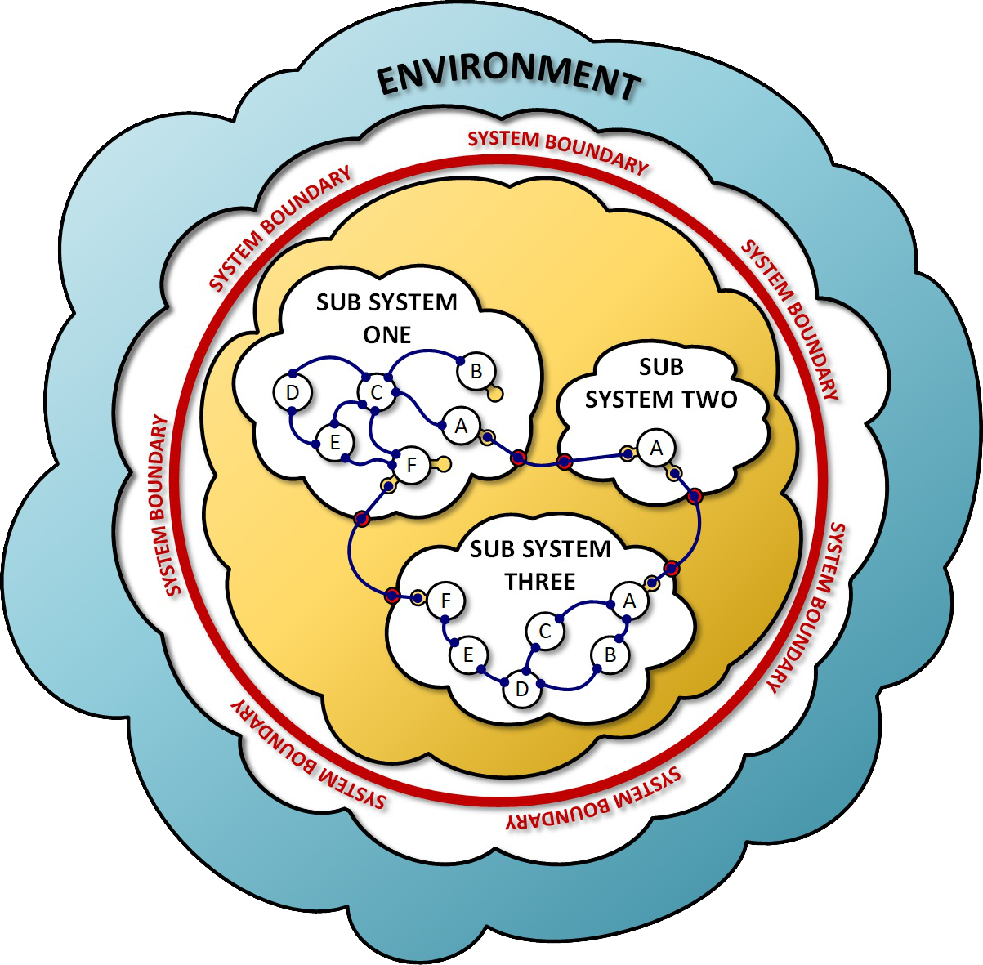
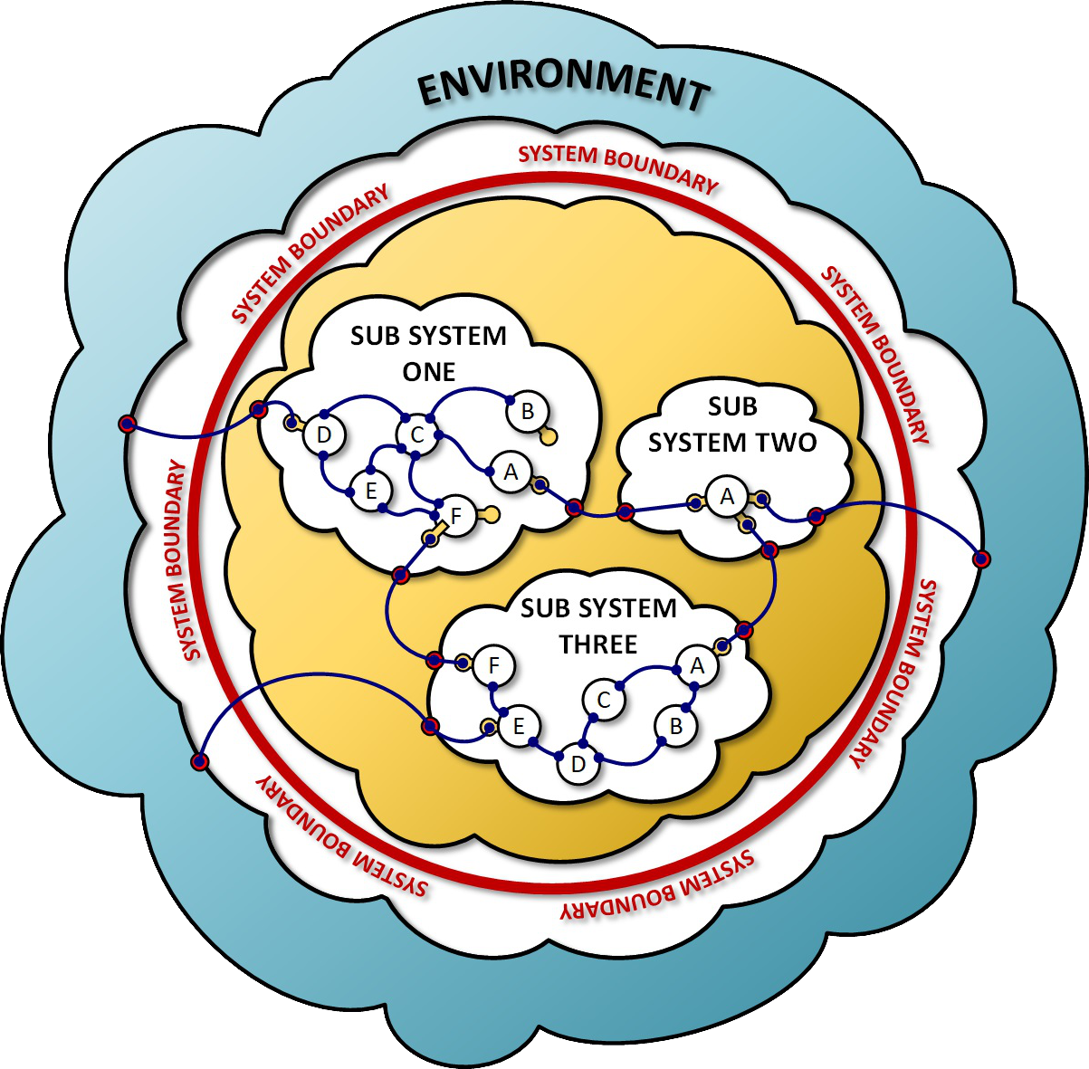
Remember: Hierarchy of Interfaces
Interface Development
Since this question came up at the recent SVT working meeting:
Interfaces fall into three distinct categories.
Inward Facing Interfaces
These are the connections that exist entirely within a sub-system and are used to exchange material, energy, information or support internally. They are private to the sub-system.
Outward Facing Interfaces
These are the connections that are used to join sub-systems within the larger system. Because they cross sub-system boundaries, they must be well-defined and coordinated. (we call these “internal” on https://eic.jlab.org/Detector)
External Interfaces
These are connections that join the system or sub-systems to resources and services outside of the system. They must be developed in coordination with resource providers and accommodate changing conditions within the system AND in the external environment.
8

Slide 9
Preparation for
Detector Baseline Readiness Assessment

Slide 10
Detector Baseline Readiness Assessment – Prep in good shape
To be ready: Must have:
Draft Preliminary Design Report == Draft Pre-TDR Version as is
WBS dictionary updates with scope descriptions and deliverables – done
P6 updates done (as applicable) - great progress made in various detector systems. Often just reshuffles without cost additions. Have now approved cost additions for electronics, a second engineering test article run for HRPPDs, an air bearing system for detector installation driven by (accelerator) alignment needs, rigging labor, and a more complex global support tube allowing for detector serviceability. Tracking (MPGD + SVT) updates should be complete in P6 this week.
Basis Of Estimates in good order such that they are traceable – ongoing, thanks for providing input to CAMs!
Remaining review (PDR, FDR) dates finalized – have almost all weeks defined, exact dates pend on reviewers
Some Interface Control Documents – Interfaces cleaned up and made consistent with Subprojects, many draft ICDs updated, final ICDs of Magnet, Hadron Polarimeter and Infrastructure/detector envelope. See https://eic.jlab.org/Detector
Some Subsystem Individual Quality Control Plans – Have Magnet and DAQ, and can complete EEEMCAL
Some Inspection and Test Plans (component and unit tests, transportation) – see below
Multi-Party ICRADAs started and Draft (In-Kind) Project Planning Document – ICRADA for magnet went to INFN for their read and is back, BNL & JLab working on synchronized submission to DOE.
Should have:
Many Inspection and Test Plans – posted on eic.jlab.org/Detector (see also backup slide), more in progress – THANKS!!!
(In-Kind) Project Planning Documents – postpone, started work on the first one for the detector solenoid
Updated Budget Estimate Quotes (many in, need them early 2026)

Slide 11
Detector is Ready to be Baselined
Subsystem | PDR Completed | PDR Scheduled | FDR Completed
Tracking | 40% Si, 40% & 60% MPGD | 60% Si PDR: January 27-28, 2026
PID | 40% & 60% hpDIRC, pfRICH, dRICH ToF 40%, TOF Peer review | 60% TOF PDR: aim for April 2026 | DIRC Bar refurbishment
ECals | 60% bECal, BECal, fECal |  | SiPM & SciFi fECal, BEcal SiPM & PbW04 bECal
HCals | 40% & 60% BHCal & fHCal 40% & 50% bHCal |  | SiPM bHcal & fHcal Lead blocks fHCal
Solenoid | 60% PDR Cryogenics |  | Magnet, Conductor and Power Supply
Electronics | 40%, 50% & 60% |  | VTRX+ & lpGBT
DAQ | 40%, 50% & 60%
Integration- Installation - infrastructure | 60% Inner and outer Barrel support-structures |  | electron and hadron endcap support structures
Auxiliary Detectors | 30% & 40% RP, B0, ZDC, Low Q2-Tagger, Lumi. | 60% RP, B0, ZDC, Low Q2-Tagger, Lumi: aim for late March/early April 2026
Polarimetry | 40% RCS & ESR Compton Polarimeter & HSR Polarimeters | 60% RCS & ESR Compton Polarimeter & HSR Polarimeters PDR: February 18, 2026.
June 11-13, 2025: Comprehensive Design Review by DAC
Feb 3-5, 2026: Baseline Readiness Assessment review scheduled

Slide 12
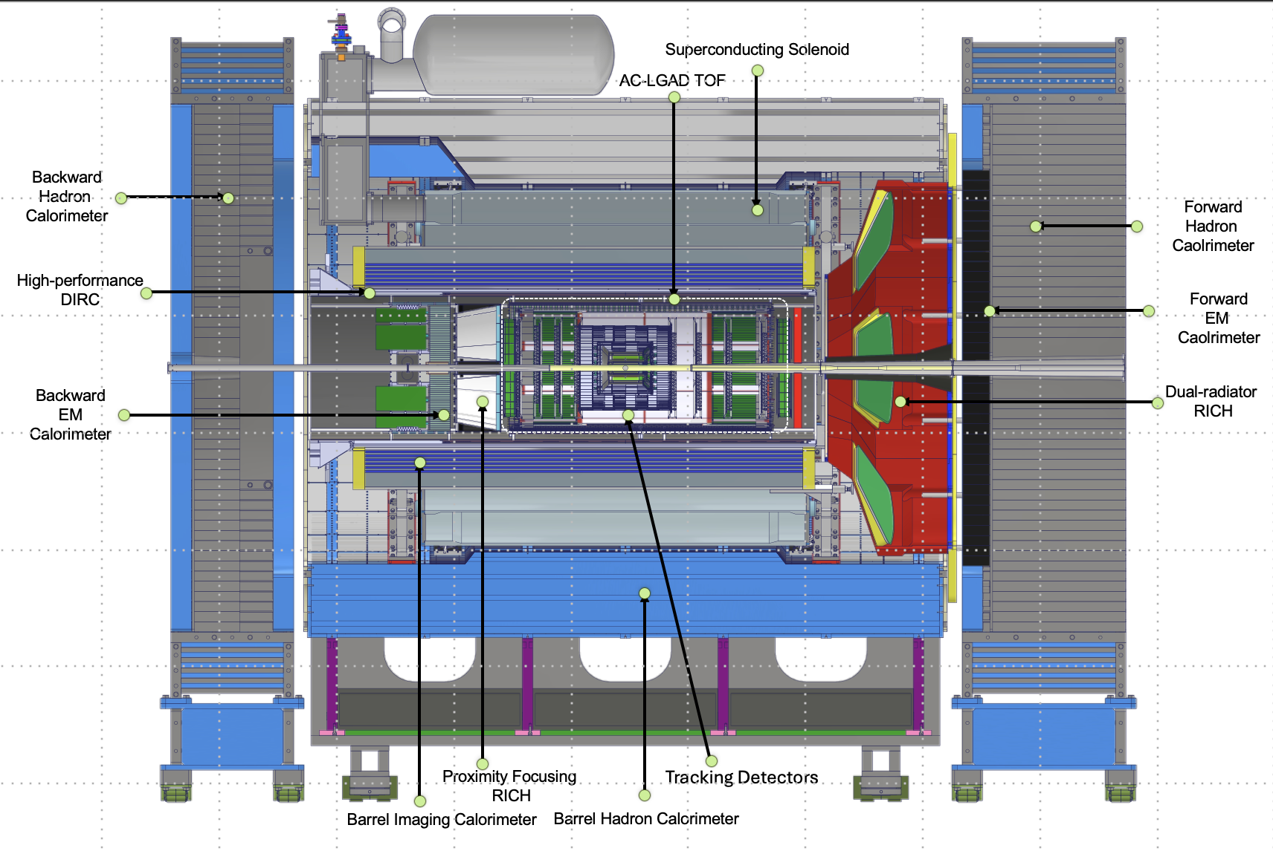








In-Kind Contributions – Status as shown at last RRB on November 4
Luminosity
Monitor
pC Hadron
Polarimeter
Zero Degree
Calorimeter
B0 Detectors
Hadron Storage Ring
Electron Storage Ring
Low Q²
Taggers
Off Momentum
Detectors
Roman
Pots
In-kind contribution goal: 30% of Detector TPC → ~100M
Reused equipment is not listed (~$22.5M); R&D and PED in-kind is not listed (~$10M)
Up-To Cost are DOE construction costs; they will differ greatly from the country proposals that include engineering and design and research activities
 | Up-To Cost | Tracking | ECal | HCal | PID | Solenoid | Auxiliary Det. | Luminosity | Electronics
Canada | $1 M |  | Barrel ECal Readout
France IN2P3 | $7.7 M |  | Rear Ecal: Cooling, Readout, Mechanics |  |  |  | RP & Off-momentum Det.: Cooling, Readout |  | CaloRoc & EICROC ASICs
France IRFU | $6 M | Barrel MicroMegas |  |  |  | Construction Oversight |  |  | Salsa ASIC
Italy | $24.5 M | MAPS L0-L2 μRWell Disks |  |  | dRICH (but not mirrors) | Construction |  |  | Alcor ASIC
Israel | $1.9 M |  |  |  |  |  | B0 Tracker & ECal
Japan | $14.6 M |  |  |  | Barrel Tof |  | ZDC - HCal
Korea | $7.6 M | Barrel μRWell | Half of Barrel ECal |  | Barrel & Forward ToF |  | Contribution to ZDC
Taiwan | $4.5 M |  |  |  | Barrel & Forward ToF |  | ZDC - ECal
UK | $16 M | MAPS L3 - L4 |  |  |  |  | Construction of Low-Q² Tagger | Construction of Lumi-Detector

Slide 13
EIC Project Developments

Slide 14
EIC Planning Dates - I
Milestone |  | Milestone
DOE Independent Project Review (IPR) | Jan. 7-9, 2025 | Assessments of Baseline Readiness for SPs | Nov’ 25 – Apr’ 26
Start Developing Scope of Subprojects | January 10, 2025 | Interaction Region | Nov. 18-20, 2025
IR SC Magnet Steering Group Meetings - Monthly | January 17, 2025 | Accelerator Storage Rings | Jan. 14-16, 2026
Project Advisory Committee Meeting | February 11, 2025 | Detector (Rescheduled from November 12-14) | Feb. 3-5, 2026
Detector Advisory Committee Meeting | June 11-13, 2025 | Global, Energy and Luminosity Ramp-Up (Full Project) | Feb. 9-13, 2026
EIC Advisory Board Meeting | June 17, 2025 | Electron Injector (follow-up to Apr ‘25 Review) | April 2026
DOE CD-3B ESAAB Approval | Pending | EIC Project Advisory Committee (2-3 hrs, virtual) | Dec. 2, 2025
DOE IPR Focused Status Review | August 5-7, 2025 | EIC Project Strategy Workshop - Stakeholders | Dec. 4, 2025
DOE RHIC R&R/Injector Operations Review | Sept. 8-10, 2025 | EIC Management Team Retreat – Action Plans | Dec. 5, 2025
Machine Advisory Committee Meeting | Sept. 16-18, 2025 | RHIC Operations Concludes and R&R Starts | January 2026
Infrastructure Construction Advisory Committee | October 1-2, 2025 | BNL Director’s Review – Comprehensive | Mar. 9-13, 2026
EIC Advisory Board Meeting | October 10, 2025 | DOE IPR Comprehensive Review | Apr. 28-May 1, 2026
Resource Review Board Meeting (BNL) | Nov. 4-5, 2025 | DOE CD-2/3 Approval for Accelerator Rings | ~End 2026
 |  | DOE CD-2 Approval for Detector | ~End 2026

Slide 15
DOE IPR Charge for April 28-May 1, 2026
IPR = Independent Project Review
Charge items 1-3, out of 6:
Is the project team effectively executing the work, including long-lead procurements? Is the project positioned to complete long-lead procurements within the established schedule and cost baseline? Are technical issues across all subprojects appropriately and proactively addressed?
Is the project team on track to present performance baselines for the first two subprojects it has proposed, the Accelerator Storage Rings and Detector subprojects, by the end of 2026? Is the team making adequate progress developing the performance baseline for the other subprojects it has proposed? Is each subproject scope well and logically defined? Are the subprojects ordered and phased optimally? Are the schedules and cost estimates credible for the current stage of each subproject? Do plans include adequate scope, schedule, and cost contingency?
Are the key performance parameters and scope for each subproject well documented, traceable, reasonable, and justifiable? Does the roll-up of subproject scope unambiguously and progressively elaborate a complete and responsive Electron-Ion Collider facility in an asset-oriented hierarchy? Are subproject interfaces understood and clearly delineated at this stage of design? Would attainment of the key performance parameters of all subprojects indicate delivery of the mission need?

Slide 16
EIC Status at A Glance
EIC facility scope provides the capability to achieve the performance required by the Mission Need.
CD-0 – December 2019
CD-1 – June 2021
CD-3A – March 2024
CD-3B – Successful Review January 2025 -- pending, ESAAB approval expected soon
EIC cost is $3B, continuing to absorb cost of delays
To date (through FY25) $0.5B funded by DOE, including $138M IRA funds
FY26 budget still process, good news Water and Energy Bill has $158M for EIC → needs to be signed in law
$100M of additional NYS funding is in the bank.
A single integrated line-item construction project executed as subprojects with well-defined deliverables, interfaces, and Key Performance Parameters.
Accelerator Storage Rings (ASR)
Detector (DET)
Interaction Region (IR)
Electron Injector (EIN)
Project and Integrated Performance (IP) (includes Energy & Luminosity Ramp-up (ELR))
EIC is ready to start construction after RHIC concludes late January 2026.
Anticipate CD-2/3 for ASR and CD-2 for DET in 2026.
EIC initial science begins in 2035

Slide 17
EIC Planning Dates - II
Milestone |  | Milestone
DOE Independent Project Review (IPR) | Jan. 7-9, 2025 | Assessments of Baseline Readiness for SPs | Nov’ 25 – Apr’ 26
Start Developing Scope of Subprojects | January 10, 2025 | Interaction Region | Nov. 18-20, 2025
IR SC Magnet Steering Group Meetings - Monthly | January 17, 2025 | Accelerator Storage Rings | Jan. 14-16, 2026
Project Advisory Committee Meeting | February 11, 2025 | Detector (Rescheduled from November 12-14) | Feb. 3-5, 2026
Detector Advisory Committee Meeting | June 11-13, 2025 | Global, Energy and Luminosity Ramp-Up (Full Project) | Feb. 9-13, 2026
EIC Advisory Board Meeting | June 17, 2025 | Electron Injector (follow-up to Apr ‘25 Review) | April 2026
DOE CD-3B ESAAB Approval | Pending | EIC Project Advisory Committee (2-3 hrs, virtual) | Dec. 2, 2025
DOE IPR Focused Status Review | August 5-7, 2025 | EIC Project Strategy Workshop - Stakeholders | Dec. 4, 2025
DOE RHIC R&R/Injector Operations Review | Sept. 8-10, 2025 | EIC Management Team Retreat – Action Plans | Dec. 5, 2025
Machine Advisory Committee Meeting | Sept. 16-18, 2025 | RHIC Operations Concludes and R&R Starts | January 2026
Infrastructure Construction Advisory Committee | October 1-2, 2025 | BNL Director’s Review – Comprehensive | Mar. 9-13, 2026
EIC Advisory Board Meeting | October 10, 2025 | DOE IPR Comprehensive Review | Apr. 28-May 1, 2026
Resource Review Board Meeting (BNL) | Nov. 4-5, 2025 | DOE CD-2/3 Approval for Accelerator Rings | ~End 2026
 |  | DOE CD-2 Approval for Detector | ~End 2026

Slide 18
EIC Key Challenge
The lab directors (BNL, JLab) and the EIC Project are working with DOE to find a path forward that provides the funding needed for the EIC project
→ Deliver scope necessary for Mission Need for a Total Project Cost (TPC) and
at a funding profile that is realistic.
Funding plans consider both the EIC line-item project and the portfolio of scope outside of the project that is essential for the EIC facility.
Guidance given to us (EIC project) by lab directors: Remain at a TPC below 3B$
→ Project Strategy Workshop December 2025
Participants included EIC primary points of contact and DOE observers
Chairs of Advisory Committees, Steering Group, and EIC Governance Boards
EIC Users Group and ePIC Collaboration Leadership
Members of the EIC Project Advisory Committee
Engaged stakeholders in the development of plans for delivering the EIC facility and efforts to align with DOE funding guidance and the mission need.
Assessed progress on revising plans based on new funding guidance
Discussed plans and results of the Assessments of Baseline Readiness
Discussed plans for establishing subproject baselines and starting construction in 2026

Slide 19
A very busy Pre-Christmas Time
December 2025
Project Update
Dec. 9th
Project Update
Dec. 23rd
Project Update
Dec. 23rd
“…long-term success depends on aligning scope, cost, and schedule with a reasonable funding profile while meeting performance expectations. We can achieve this by working in close partnership with DOE, the EIC user community, and all our stakeholders.
Across all three activities, we made substantial progress toward defining an EIC project that will meet DOE’s approved mission need within an affordable Total Project Cost (TPC). We plan to continue along this path, while continuing the dialogue with our partners. Important work remains, particularly in aligning with anticipated annual funding profiles, but the direction is positive and the engagement from the team has been excellent.”
Full detail slide 28 in backup
“…
DOE guidance is to target a $2.8B Total Project Cost for the preliminary baseline, corresponding to the upper bound of the approved CD-1 range. This note reflects that guidance and signals our intent to take it seriously.
The baseline is preliminary by design. Further refinement of subproject scope, design maturity, and cost estimates is expected prior to CD-2. Any future cost growth would be addressed through approved preliminary baseline changes.
The purpose of this note is to clarify our current position and to outline how we are organizing the path toward CD-2/CD-3.”
Full detail slide 29 in backup
From the note, Preliminary Cost Baseline:
“…
DOE Critical Decision 1 (CD-1), approval of the preliminary cost range, was granted in 2021. Since that time, the EIC Total Project Cost (TPC) point estimate has increased and now approaches the upper bound of the approved CD-1 range ($2.8B). There are many reasons for the increase in the cost estimate including funding delays, inflation, and the scope changes. DOE guidance is to target the $2.8B for the preliminary cost baseline, recognizing that further refinement of subproject baselines prior to CD-2 may result in additional cost growth that would need to be addressed as the project moves fully into construction.
The table below summarizes the current preliminary cost baseline, expressed in millions of year-of-expenditure dollars. The estimates reflect differing levels of design maturity and risk across the subprojects and incorporate explicit contingency at the total project level.
Full detail slide 30 in backup

Slide 20
Detector Cost Status
Detector | Total Cost | Cost to DOE | Cost in LLP | In-Kind | Re-Use
Si Tracker | $ 44.7M | $ 26.1M* |  | $ 18.6M
MPGD Tracker | $ 12.5M | $ 5.5M* |  | $ 7.0M
dRICH | $ 10.7M | $ 3.5M |  | $ 7.6M
DIRC | $ 14.4M | $ 7.3M | $ 0.8M |  | $ 6.3 M
pfRICH | $ 7.9M | $ 7.9M
Barrel ToF | $ 17.8M | $ 4.3M |  | $ 13.5 M
Forward ToF | $ 5.4M | $ 3.2M |  | $ 2.2M
forward ECal | $ 10.2M | $ 9.1M | $ 1.1M
Barrel ECal | $ 24.1 M | $ 12.3M | $ 3.4M | $ 8.4 M
backward ECal | $ 11.0M | $ 3.5M | $ 5.7M | $ 1.8M
forward HCal | $ 19.0M | $ 12.1M | $ 6.9M
Barrel HCal | $11.9M | $ 1.2M |  |  | $10.7M
Backward HCal | $ 7.3M | $ 7.3M
Magnet | $ 23.3M | $ 5.2M | $ 6.0M | $ 11.8M
Electronics | $ 47.7M | $ 30.1M | $ 1.8M | $ 15.8M
DAQ | $ 13.4M | $ 13.4M
Installation & …. | $ 42.6 M | $ 33.3M | $ 3.5M | $ 0.3M | $ 5.5M
Auxiliary Det. | $ 12.7M | $2.2 M |  | $ 10.5M
Cost Summary:
Re-Use: $ 22 M
In-Kind: $ 96 M
Actuals thru Oct 2025: $ 41 M
LLP (CD-3A/CD-3B): $ 29 M
Cost to DOE to go: $ 214.4 M
* Includes an assumed CCB-lite for tracking
Includes Polarimetry, PreOps, Management (not listed in the table)
Cost-to-go Target given to us:
$212M … but a recent wrinkle for In-Kind assumptions ☹

Slide 21
December 19th
Santa brought ePIC bad news

Slide 22
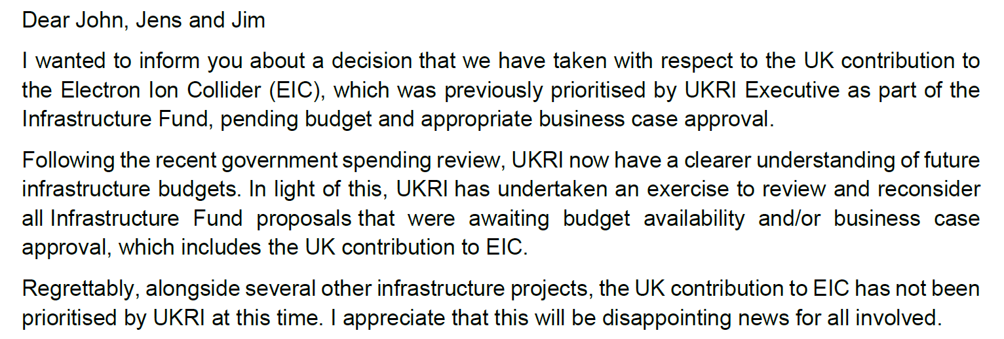
Letter of UKRI to Lab Directors of December 19, 2025

Slide 23
UKRI E-Mail of 12/19/25 – Impact Assumptions
UK contribution to EIC science development and the ePIC detector & collaboration has been and is important → It is crucial to allow UK scientists to be able to maintain their roles and leadership positions within EIC/ePIC… but situation is not clear.
UK Assumed In-Kind:
Lumi detector ~0.5M$
Is required for any EIC science → Absorb as DOE Cost
Low-Q2 Detector ~3.5M$
Almost no DOE Cost as this was assumed as UK in-kind → Delay
SVT L3/L4 ~ 12-15M$?
Critical towards LAS and L3/L4 of SVT barrel (and disks)
→ Keep moving as we can…
Requires UK critical specialized labor !!!

Slide 24
Further Campaign following up on the UKRI news
Several letters were sent to UKRI this week to point to the impact of their decision on UK scientists and their long-standing legacy and impact on EIC science and detector, to the impact on the DOE/EIC project, and on the long-term engagement in international scientific collaboration
A letter from DOE to UKRI
A letter from the Lab Directors (BNL & JLab) and the EIC Project Director
A letter from the ePIC spokespersons
A letter from the EIC-UK Collaboration

Slide 25
Guiding Principles for Scope Delay
Remember:
The ePIC Detector is designed to fulfill the EIC mission need science → NAS Science Report
Detector DOE scope is < 10% of the Project TPC augmented by large in-kind contributions
Guiding Principles:
Detector components can not directly impact start of the community-vetted NSAC/NAS science
Detectors with large in-kind contributions represent crucial engagement by the international community and must be maintained
Hadron, electron polarimetry and luminosity monitor cannot be touched as they are needed for collider commissioning
Detectors crucial to detect the scattered electron (or DIS kinematics) cannot be touched as they are needed for the entire science program
Detector elements that function as magnet flux return cannot be touched
We exclude options that substantially increase risk or have large coupling to CD-3A & CD-3B scope
Changes need to be recoverable on reasonable time scale without requiring a year+ shutdown

Slide 26
Mitigations After New Guidance and UKRI Info
Given the TPC, accelerator scope will also be limited → we will not have 18 GeV electrons at the start
We have to assume the detector DOE costs-to-go are $212M at best (for a technically driven schedule and without contingency)
It is not clear if this will not change, the EIC project as a whole is not yet at the <3B$ goal with sufficient contingency
We do benefit from a) $38M actuals costs to date, b) $29M in LLP scope, and c) large projected in-kind contributions
We were at a projected ~$215M costs-to-go (with lean labor assumptions and with an optimistic budget profile)
The UKRI letter implies a potential large increase of the DOE cost-to-go
We need to pick up the essential Lumi Detector as DOE scope, with an estimated cost-to-go of $0.5M
We need to keep the critical ITS3/LAS efforts moving → This would increase DOE costs-to-go by $12-15M
Note that this DOES rely on being able to keep the UK critical skill labor; since some of those are at UK national labs this may also be an issue…
We consider it critical that all ePIC Detector Sub-Systems can continue beyond PDR-level (almost there) to full E&D completion (90% design-maturity FDR-level) to allow the UK situation to evolve and seek further in-kind.
Mitigation to ensure we can baseline the detector given while keep working on ITS3/LAS:
Delay forward TOF construction
Delay backward HCal construction
Delay Low-Q2 Detector
Delay Astropix layers construction (DOE scope only)
Delay electronics (HV, LV, FEB) that accompanies these systems
The goal of the above is to reduce by >$15M. We are working with the CAMs to update P6 to check the $15M goal can be reached.

Slide 27


Slide 28
Project Update December 9 2025
Dear EIC Project Team,
I would like to provide a brief update following last week’s key engagements: the EIC Project Advisory Committee (PAC) meeting on Tuesday, the Project Strategy Workshop on Thursday, and the Executive Management Team retreat on Friday, December 5. Each of these project focused deliberations reinforced an essential truth for complex projects like ours: long-term success depends on aligning scope, cost, and schedule with a reasonable funding profile while meeting performance expectations. We can achieve this by working in close partnership with DOE, the EIC user community, and all our stakeholders.
Across all three activities, we made substantial progress toward defining an EIC project that will meet DOE’s approved mission need within an affordable Total Project Cost (TPC). We plan to continue along this path, while continuing the dialogue with our partners. Important work remains, particularly in aligning with anticipated annual funding profiles, but the direction is positive and the engagement from the team has been excellent.
A second update concerns the DOE Independent Project Review (IPR). We are proposing to shift the IPR dates from early March to April 27–30, 2026. This adjustment reflects the reality that too many essential reviews were previously concentrated in early 2026. The updated sequence of major reviews would be:
Interaction Region (IR) Assessment of Baseline Readiness (complete) November 18-20
Accelerator Storage Rings (ASR) Assessment of Baseline Readiness January 14-16
Detector (DET) Assessment of Baseline Readiness February 3-5
Director’s Review of the EIC Project March 9-12
DOE IPR April 27-30
All reviews will be conducted in person, except for the DOE IPR which will be fully remote if federal travel restrictions remain in place. Preparing for these reviews—while simultaneously advancing our technical deliverables within available funding—places a significant demand on the project team. I continue to appreciate your professionalism and perseverance.
Finally, I want to return to our shared responsibility to reduce total project cost. Each of us plays a role in challenging assumptions, refining requirements, clarifying essential project scope, and aligning schedules with available resources to ensure we pursue the most cost-effective path forward. As you evaluate your areas, please continue asking the difficult but essential questions: Is there a better or simpler approach? Could a partner or vendor perform this work at lower cost? Can we reduce technical risk without compromising performance? Is the scope more appropriately addressed in operations? These conversations are already yielding positive results, and your continued diligence is critical. We will capture the results in detailed guidance to the subproject leads.
Thank you for your sustained effort and dedication. I will provide another update in two weeks.
Sincerely,
Jim Yeck
EIC Project Director
→ April 28-May 1

Slide 29
Project Update December 23, 2025
Dear EIC Project Team,
Attached is a revised note summarizing the current preliminary cost baseline for the EIC line-item project. This document is intended primarily to support internal alignment as we prepare for upcoming subproject readiness assessments and continue our engagement with DOE.
A few points of context as you review the note:
DOE guidance is to target a $2.8B Total Project Cost for the preliminary baseline, corresponding to the upper bound of the approved CD-1 range. This note reflects that guidance and signals our intent to take it seriously.
The baseline is preliminary by design. Further refinement of subproject scope, design maturity, and cost estimates is expected prior to CD-2. Any future cost growth would be addressed through approved preliminary baseline changes.
The purpose of this note is to clarify our current position and to outline how we are organizing the path toward CD-2/CD-3.
The next steps will be to:
Establish a timeline leading up to CD-2;
Identify areas requiring further consideration of scope, value engineering, and cost and requirements scrubbing;
Update the preliminary baseline monthly; and,
Establish a funding profile that supports the preliminary baseline and evaluate the implications of current guidance.
Please treat this as a working document intended to support internal coordination and disciplined planning. Feedback is welcome, particularly where additional clarity would be helpful as we move toward upcoming assessments.
Thank you.
Jim

Slide 30
Project Update December 23, 2025 – excerpts from note
Subject: EIC Line-Item Project – Preliminary Cost Baseline
The Electron–Ion Collider (EIC) mission need was approved by the Department of Energy (DOE) in December 2019. The project will deliver a high-energy, high-luminosity, polarized Electron–Ion Collider that will serve as the world’s most powerful microscope for studying the fundamental structure of nuclear matter. The scientific discoveries enabled by the EIC are expected to define the field for decades and to become core material in future textbooks.
Delivering this capability requires sustained effort over an extended period and substantial capital investment. As with all large, complex DOE Office of Science projects, success depends on disciplined planning, credible cost and schedule baselines, and predictable funding profiles.
DOE Critical Decision 1 (CD-1), approval of the preliminary cost range, was granted in 2021. Since that time, the EIC Total Project Cost (TPC) point estimate has increased and now approaches the upper bound of the approved CD-1 range ($2.8B). There are many reasons for the increase in the cost estimate including funding delays, inflation, and the scope changes. DOE guidance is to target the $2.8B for the preliminary cost baseline, recognizing that further refinement of subproject baselines prior to CD-2 may result in additional cost growth that would need to be addressed as the project moves fully into construction.
The most effective path to completing EIC construction is to establish a credible and disciplined preliminary cost baseline that is aligned with CD-1 expectations and with DOE guidance on annual funding profiles, thereby enabling construction to begin on a predictable schedule. Achieving this alignment positions the project to seek CD-2 (Performance Baseline: scope, cost, and schedule) and CD-3 (Authorization to Start Construction) approvals.
The EIC project is structured into five distinct subprojects, each of which will require CD-2 and CD-3 approval. These approvals will be sequenced deliberately within an integrated project governance framework, with the first CD approvals planned for the end of 2026.
The table below summarizes the current preliminary cost baseline, expressed in millions of year-of-expenditure dollars. The estimates reflect differing levels of design maturity and risk across the subprojects and incorporate explicit contingency at the total project level.

Slide 31
EIC Detector Subsystems versus Science Pillars
 | Spin | Mass | 3D-Imaging | QCD in Nuclei | Dense Gluon Systems
Tracking (SVT + MPGD) | X X | X X | X X | X X | X X
forward ECal |  | X | X
Barrel ECal | X | X X | X X | X | X
Backward ECal | X | X X | X X | X | X
Forward HCal | X | X | X | X | X
Barrel HCal (also required as flux return)
Backward HCal (becomes important at s ~140 GeV → low x)
dRICH | X | X | X | X | X
DIRC | X |  | X | X | X
pfRICH | X |  | X | X | X
Magnet + Flux Return (incl. BHcal & fHCal) | X X | X X | X X | X X | X X
ToF (required SIDIS PID for low z hadrons)
B0 & RP & OMD |  | X | X | X
ZDC |  | X |  | X | X
Map of science pillars to main mission need detector components
for starting NAS science
X indicate needed subsystems to measure scattered electron
and DIS kinematics
X,X,X,X,X indicate needed subsystems to measure the hadronic final state, for Spin, Mass, 3D-Imaging, QCD in Nuclei, and Dense Gluon Systems, respectively.

Slide 32
In-Kind Contributions – December 19 letter from UKRI
Luminosity
Monitor
pC Hadron
Polarimeter
Zero Degree
Calorimeter
B0 Detectors
Hadron Storage Ring
Electron Storage Ring
Low Q²
Taggers
Off Momentum
Detectors
Roman
Pots
In-kind contribution goal: 30% of Detector TPC → ~100M
Reused equipment is not listed (~$22.5M); R&D and PED in-kind is not listed (~$10M)
Up-To Cost are DOE construction costs; they will differ greatly from the country proposals that include engineering and design and research activities
 | Up-To Cost | Tracking | ECal | HCal | PID | Solenoid | Auxiliary Det. | Luminosity | Electronics
Canada | $1 M |  | Barrel ECal Readout
France IN2P3 | $7.7 M |  | Rear Ecal: Cooling, Readout, Mechanics |  |  |  | RP & Off-momentum Det.: Cooling, Readout |  | CaloRoc & EICROC ASICs
France IRFU | $6 M | Barrel MicroMegas |  |  |  | Construction Oversight |  |  | Salsa ASIC
Italy | $24.5 M | MAPS L0-L2 μRWell Disks |  |  | dRICH (but not mirrors) | Construction |  |  | Alcor ASIC
Israel | $1.9 M |  |  |  |  |  | B0 Tracker & ECal
Japan | $14.6 M |  |  |  | Barrel Tof |  | ZDC - HCal
Korea | $7.6 M | Barrel μRWell | Half of Barrel ECal |  | Barrel & Forward ToF |  | Contribution to ZDC
Taiwan | $4.5 M |  |  |  | Barrel & Forward ToF |  | ZDC - ECal
UK | $16 M | MAPS L3 - L4 |  |  |  |  | Construction of Low-Q² Tagger | Construction of Lumi-Detector
~12-15M$
~3,5M$
~0,5M$

Slide 33
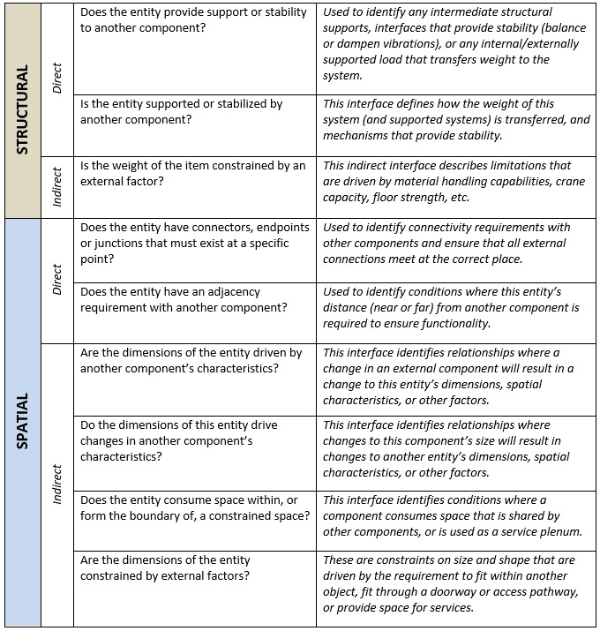
Deriving Interfaces
Interface Development
Interfaces have been derived using an interrogative process that examines the stated requirements and identified dependencies. It is a three-part process that includes:
Interrogating Requirements
Identify relationships or dependencies that are represented by each requirement. For each relationship, identify and document the type of interface that will be required to accommodate it.
Interrogating Known Interfaces
Using a list of expected system interfaces (provided by an SME), confirm that each one is represented by an interface identified in the prior step. If it is missing, then the reviewer should determine if the requirements need to be revised.
Inter-System Interrogation
For each interface that extends outside of the local system, ensure that there is a corresponding interface on the external system.
The current Interface Requirements Document is available from: https://eic.jlab.org/Documents/DET/Interfaces/DET-Interfaces-Current.pdf
Current and draft Interface Control Documents are available from: https://eic.jlab.org/Detector/#INTSet (recently added comprehensive ICDs for hadron polarimetry and related to the infrastructure/detector envelope)
Visit https://eic.jlab.org/Documents/InterfaceInterrogation.pdf
for more details.
33

Slide 34
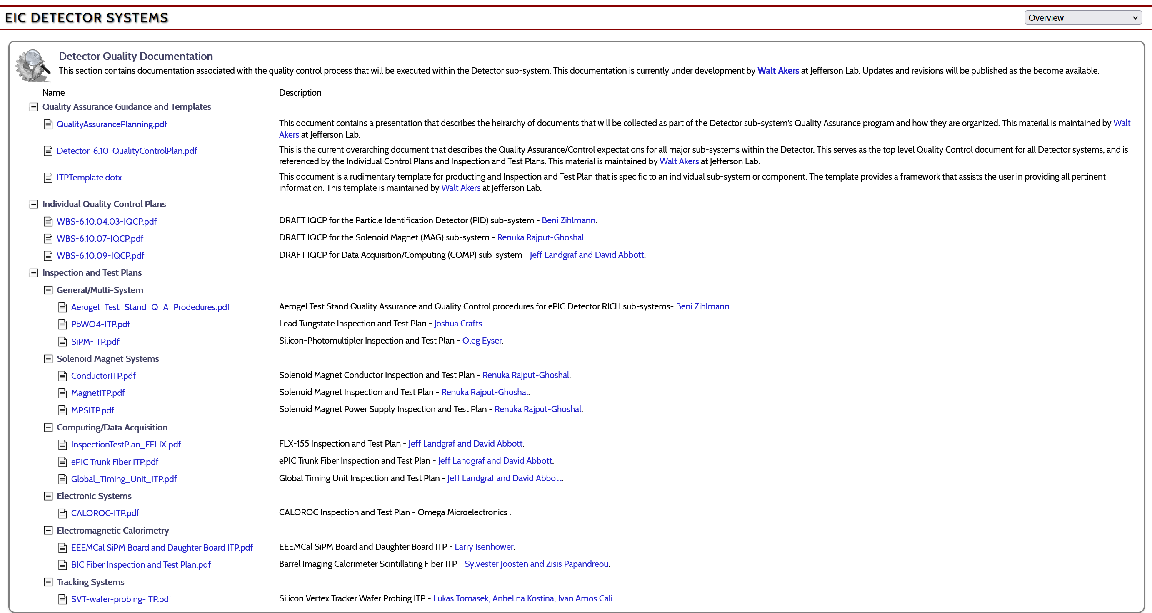
Documenting the Information
Requirements, Interfaces, Quality Assurance
34

