Slide 1

ePIC Collaboration News
J. Lajoie, S. Dalla Torre
January 9th, 2026

Slide 2
Hey John, start the recording….

Slide 3

Happy New Year 2026!

Slide 4
What’s Ahead in 2026
Slide from 12/5/2025 GM
It is imperative that the EIC project transition to a construction project in 2026.
  Must develop a project plan that fits budgetary, and mission need constraints
  Continue to make technical progress that justifies the CD-2/3 milestones
This transition will not be easy.
The collaboration has been successful by continuing to push on the technical readiness of the ePIC design and developing the Early Science physics program.
  This puts us in the best position to advocate for EIC science!

Slide 5
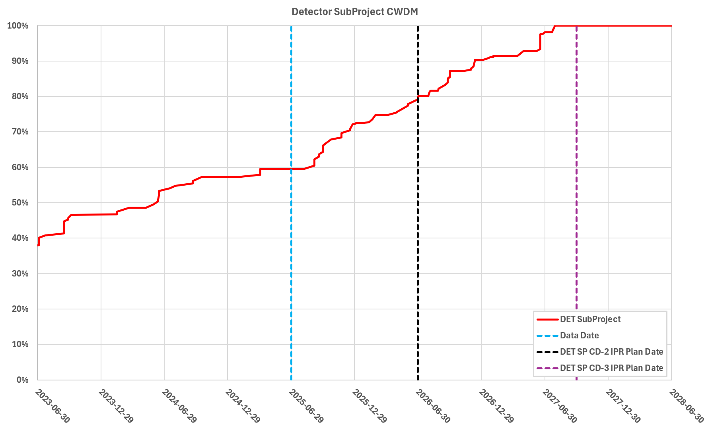
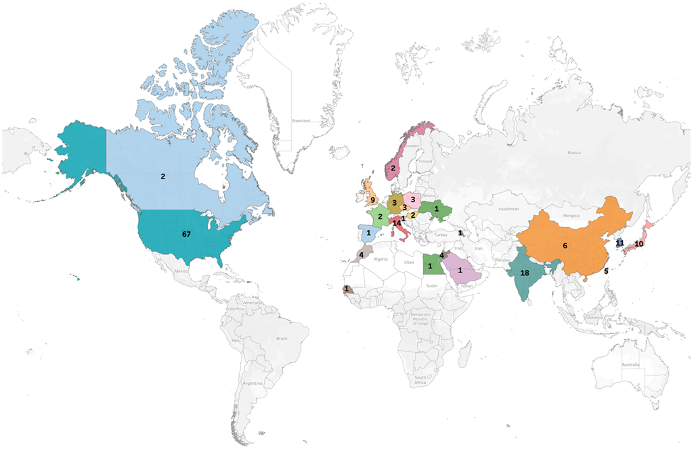
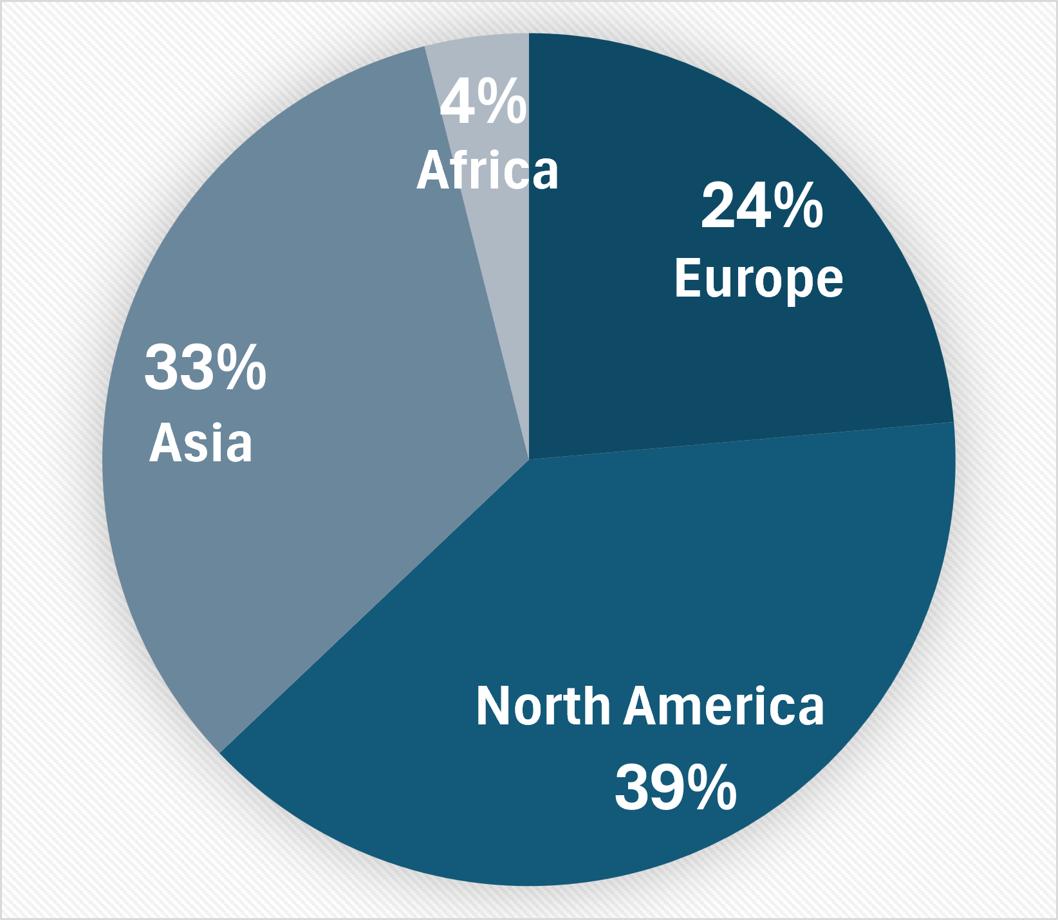
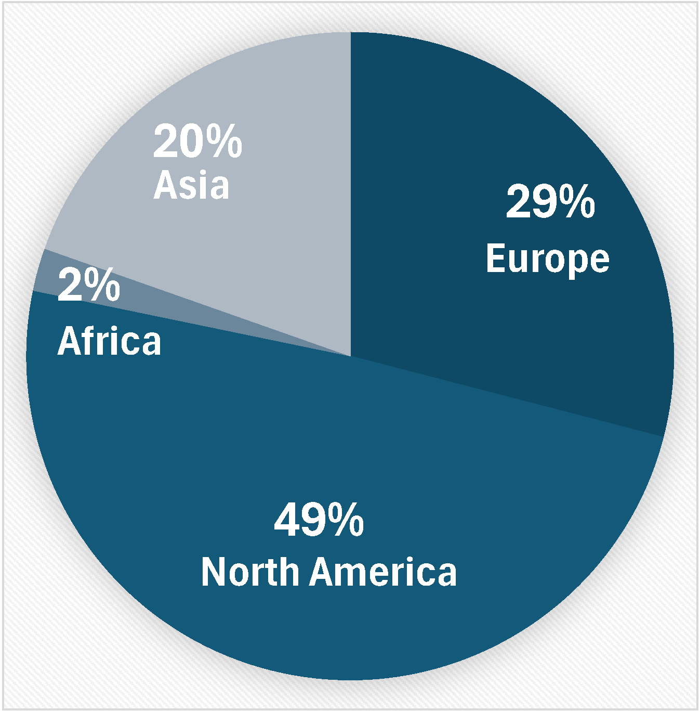
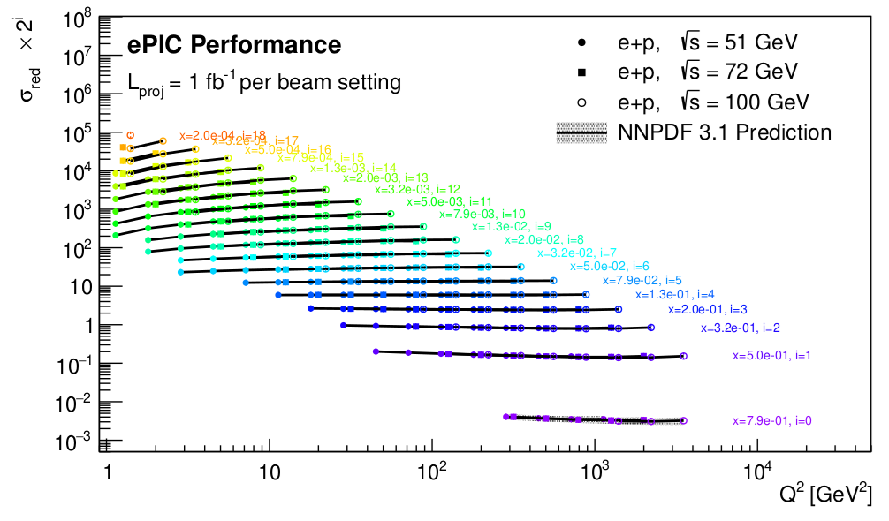
Elements of our Success
Cost Weighted
Design Maturity
>1100 collaborators
181 institutions, 25 countries
ePIC is a CERN recognized experiment
Long list of completed FDR/PDR’s
Achieved design maturity required for CD-2
$29.1M in CD-3A/3B Long-Lead Procurements
First ePIC Physics Forum –
Dec. 16, 2025:
Institutions:
Collaborators:

Slide 6
Why this General Meeting?
Things have been moving very rapidly with respect to the EIC/ePIC, and there have been a number of important developments over the holidays.
This meeting is the first part of a process – to bring these developments to the collaboration in a transparent fashion.
  I will give an overview and context. Elke and Rolf will discuss the impact to the DET subproject.
The intention is to give the collaboration time to consider and discuss prior to the collaboration meeting.
We will have some time for discussion at this meeting
The next step will be opportunities for extended discussions at the collaboration meeting.

Slide 7
Project Strategy Workshop (Dec 4, 2025)
Goal: Engage stakeholders in the development of plans for delivering the EIC facility and efforts to align with DOE funding guidance and the mission need.
Assess progress on revising plans based on new funding guidance
Discuss plans and results of the Assessments of Baseline Readiness
Discuss plans for establishing subproject baselines and starting construction in 2026
Participants: EIC primary points of contact and DOE observers
Chairs of Advisory Committees, Steering Group, and EIC Governance Boards
EIC Users Group and ePIC Collaboration Leadership
EIC Project Advisory Committee Chair and/or members
Format: Similar to Aug 2024 Project Strategy Workshop (Focused on Subprojects)
August 2024 Indico Site: https://indico.bnl.gov/e/PSW

Slide 8
EIC Project Strategy Workshop
The EIC project must:
  Address the EIC CD-0 Mission Need Statement
  Start early science within 10 years
  Cost less that ~$3B
The current point estimate for the EIC project is higher than $3B, the EIC project need to find cost reductions between $0.5-1B.
  Some of this can come from cost scrubbing and optimizing labor costs
  The rest will need to come from reducing scope from the project
    Scope can potentially be recovered from upgrades and EIC operations funds
The strategy workshop discussed potential scope reductions.
  NO DECISIONS were made, but the project committed to providing cost targets for the subprojects.

Slide 9
EIC Planning Dates
From Jim Yeck’s Dec 4th Slides
Preparing for a Successful DOE Review |  | Aligning w/ TPC and Funding Profile Expectations
DOE Independent Project Review (IPR) | Jan. 7-9, 2025 | Launch Cost Scrubbing Plan D.C. | Nov. 20, 2025
DOE IPR Focused Status Review | August 5-7, 2025 | EIC Project Advisory Committee (2-3 hrs, virtual) | Dec. 2, 2025
DOE RHIC R&R/Injector Operations Review | Sept. 8-10, 2025 | EIC Project Strategy Workshop - Stakeholders | Dec. 4, 2025
Assessments of Baseline Readiness for SPs |  | EMT Management Retreat / Execution Plan | Dec. 5, 2025
Interaction Region | Nov. 18-20, 2025 | Project Director Establishes EIC Cost Targets | Dec. 8, 2025
Accelerator Storage Rings | Jan. 14-16, 2026 | NPP ALD Establishes Ops Cost Targets | Dec. 8, 2025
Detector | Feb. 3-5, 2026 | Reconsideration of EIC vs Ops | End Dec. 2025
Electron Injector (follow-up to Apr ‘25 Review) | TBC - May 2026 | Preliminary KPP Proposal | End Dec. 2025
 |  | Project Manager Preliminary Baseline (not P6) | Jan. 12, 2026
 |  | Preliminary Baseline Static (P6) | Feb. 9, 2025
BNL Director’s Review – Comprehensive | Mar. 9-13, 2026 | BNL Director’s Review – Comprehensive | Mar. 9-13, 2026
DOE IPR Comprehensive Review | April 27-30, 2026
DOE CD-2/3 Approval for Accelerator Rings | ~End 2026
DOE CD-2 Approval for Detector | ~End 2026

Slide 10
Request to the EIC Project
The outcome of the project baselining exercise can affect the EIC science program in multiple ways:
  Changes the scope of the DET subproject
  Changes to the ASR, EIN and ISR subprojects (EIC performance)
The collaboration must have an opportunity to respond to changes to the baseline that affect EIC science
We have discussed with Jim Yeck, David Dean, and Abhay a process by which the collaboration is charged to provide a formal, written response on the impact to EIC science once the preliminary baseline is established
  The timescale for this will be VERY short!
We hope to have a better understanding of the baselining implications for the EIC collider at the collaboration meeting.
  Today the focus is on the detector.

Slide 11
STFC UKRI Letter (19 December)
Other UKRI Projects Cut:
LHCb 2030++, £50M for the upgrade project.
RUEDI, Relativistic and Ultrafast Electron Diffraction and Imaging National Facility (£124M)
C-MASS UK (£50M) for mass spectrometry in healthcare.
DISSCo UK (£155M) — digitisation and research exploitation of natural science collections (museums / private & university collections).
The situation is still developing, but the primary concern of the collaboration is the ability of our UK collaborators to continue to participate in ePIC. This is a loss of in-kind contributions to ePIC that must be factored into the total cost/scope of the detector.
A letter in support for our UK colleagues has been sent to the UKRI on behalf of the collaboration.

Slide 12
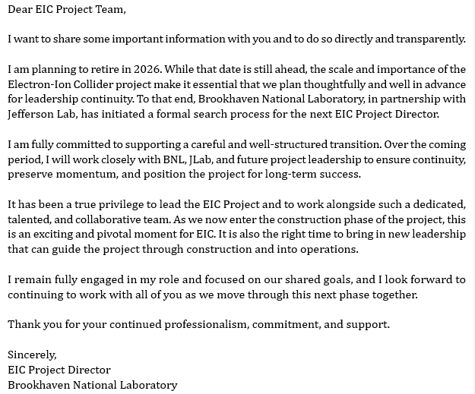
Jim Yeck’s Retirement Announcement
Email from Jim Yeck to the EIC project Dec. 29th, 2025

Slide 13
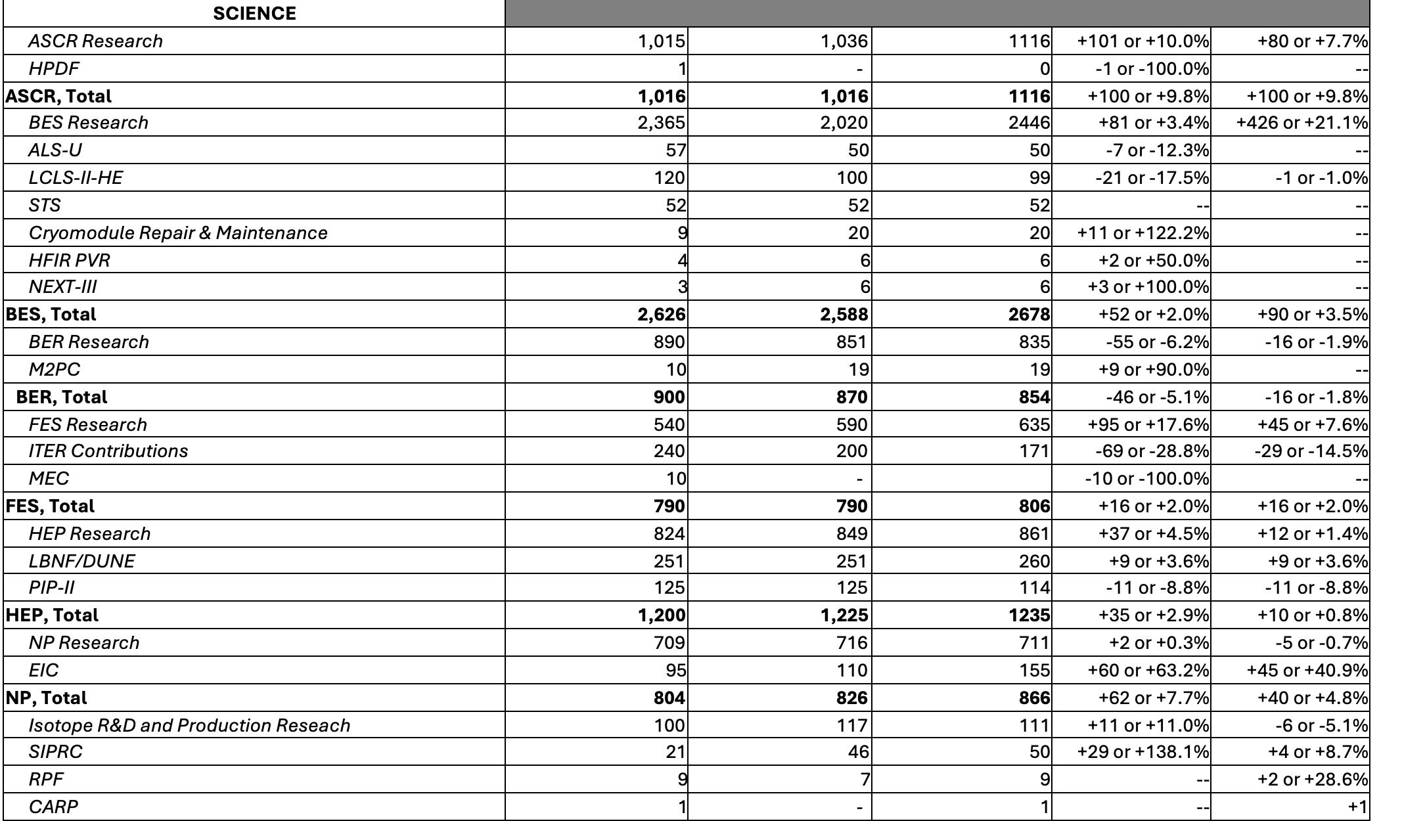
Minibus Congressional Budget - Good News!
Conference committee markup as of 1/5/26:
EIC @ $155M
NP Research +2%
Optimism that the E&W bill will pass the House this week, Senate the next.
ALSO: CD-3B approval expected in few weeks

Slide 14

January 2026 Collaboration Meeting
Jan 20-23rd, 2026 at Brookhaven National Laboratory
  In new Science and User Support Center (SUSC)
Registration is OPEN!
https://www.bnl.gov/epic-meeting/
Due Jan 7th!
Guest registration for non-US citizens:
https://www.bnl.gov/guv/gis.php
Early-career travel support available
https://www.epic-eic.org/collaboration/travel_support.html
Registration for online participation required
(no fee)
Registration Extended to Jan 12th!
A huge thanks to Thomas and the BNL LOC for organizing the meeting on short notice.

Slide 15
Plenary Agenda
Tuesday, Jan 20th : Sergei Nagaitsev will talk to us about the status of the baselining process for the EIC collider (ASR/EIN/INT).
Thursday, Jan 22nd (afternoon session):
  Jim Yeck will attend in-person to tell us about the status of the overall baselining process and answer questions
  Following this we will schedule ample time for discussion and an “open mic” session with contributions from the collaboration.
Despite the fact that things are changing rapidly, we hope that this General Meeting and the plenary sessions at the collaboration meeting will allow ample time for collaborators to think through the challenges prior to the discussion session.

Slide 16
Personal Comments
This is not being done to us. We are a part of the process.
The most challenging part of any project is the transition from design to construction. The EIC project is no different.
It is critically important that we work as a collaboration with the EIC project to establish the project baseline.
  A well advanced pTDR is an essential part of this effort!
We have to stay the course on what has been a successful path and continue to work united to maximize EIC science. This will take time, patience, and fortitude.

Slide 17
What’s Ahead in 2026
Slide from 12/5/2025 GM
It is imperative that the EIC project transition to a construction project in 2026.
  Must develop a project plan that fits budgetary, and mission need constraints
  Continue to make technical progress that justifies the CD-2/3 milestones
This transition will not be easy.
The collaboration has been successful by continuing to push on the technical readiness of the ePIC design and developing the Early Science physics program.
  This puts us in the best position to advocate for EIC science!

Slide 18

Looking forward to seeing everyone at BNL!

Slide 19


Slide 20
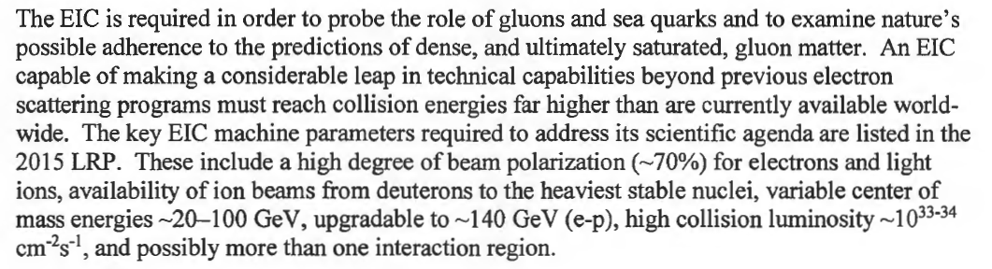

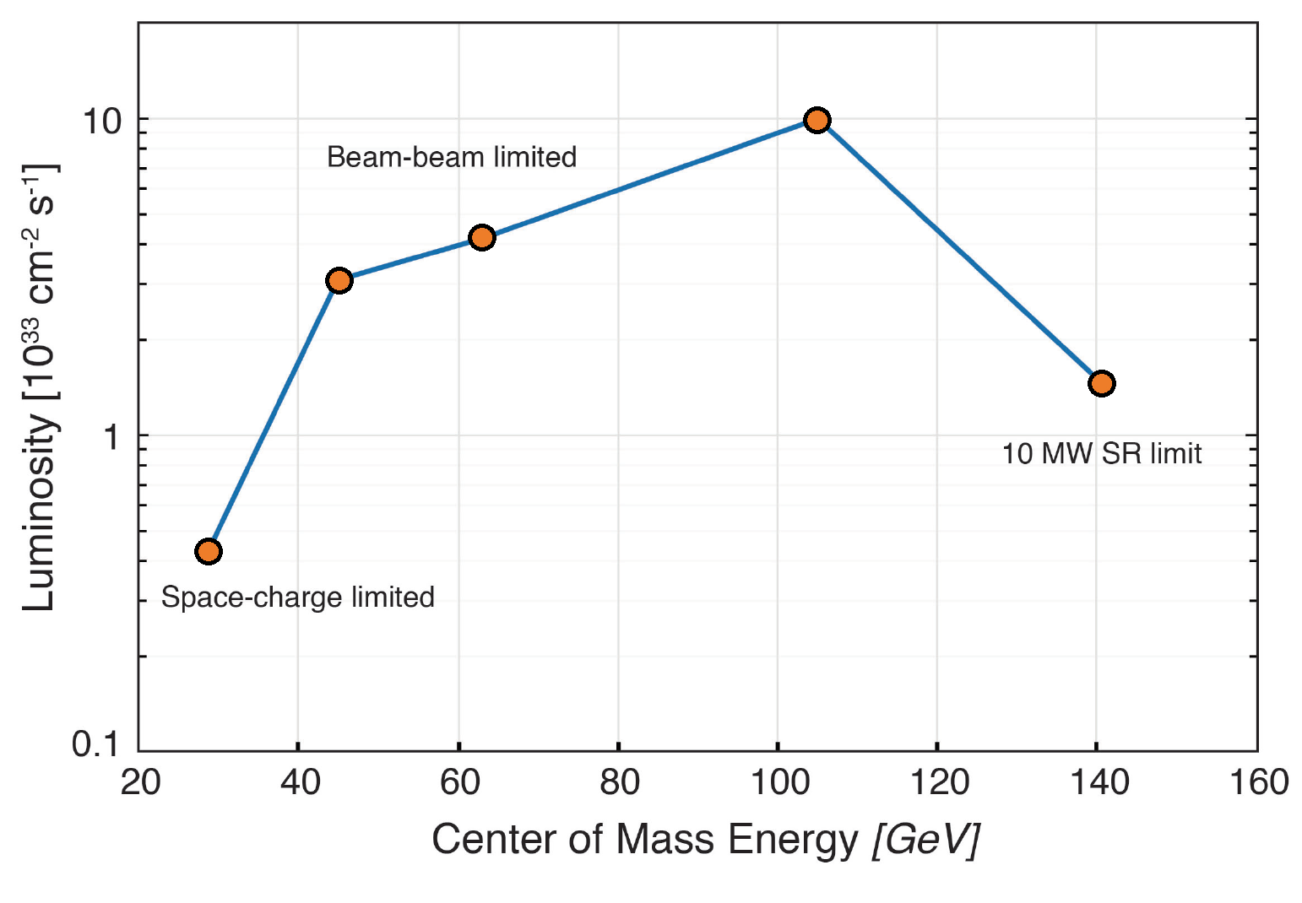
The DOE CD-0 Mission-Need Statement (MNS) 2019
10x275
Bunch charges: 28 nC (10 GeV, e) and 11 nC (275 GeV, p)
5x100
10x100
18x275
5x41
The EIC CDR design parameters are all traceable to the MNS and the
EIC Global Requirements Document.
EIC peak luminosities (CDR)

Slide 21
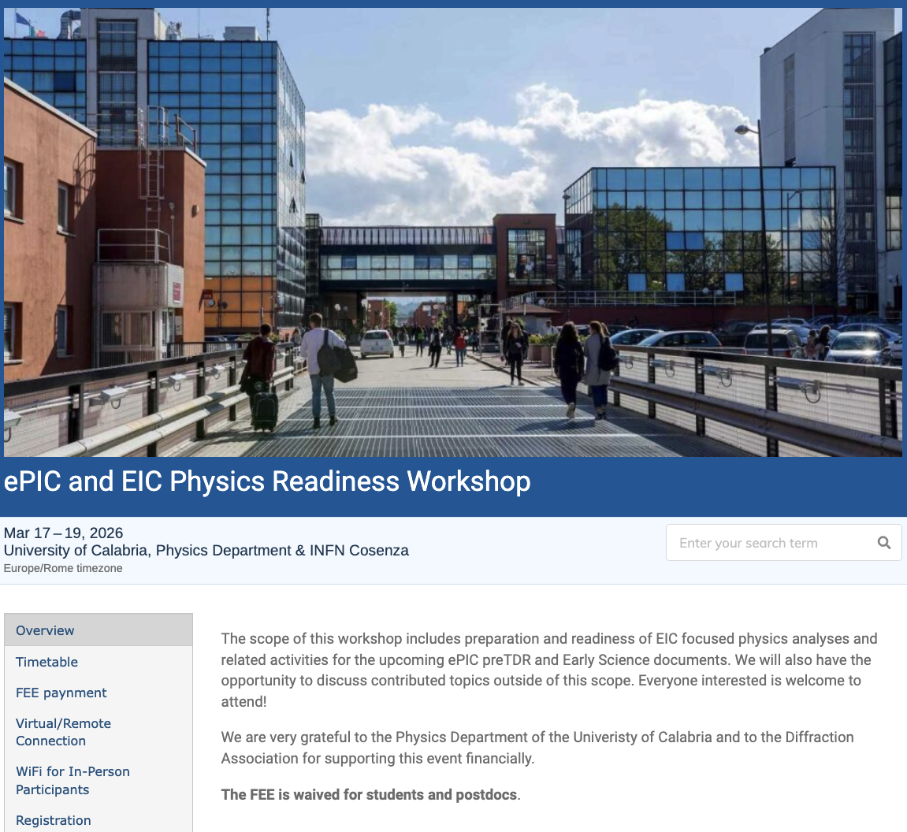
The discussion on performance continues!
Next Physics Readiness Workshop scheduled for March 17-19
  Hosted by the University of Calabria & INFN Cosenza
  Indico: https://indico.bnl.gov/event/30283/
  Hybrid format - Please register even if attending online (select proper option)
  €150 FEE waived for students/postdocs
  Possibility (limited) for ECRs support
The workshop will focus on the finalization of studies and text for the TDR and early science documents

Slide 22

ePIC Resources
Public Website - https://www.bnl.gov/eic/epic.php
Mailing Lists – https://lists.bnl.gov/mailman/listinfo
Indico Agenda - https://indico.bnl.gov/category/402/
  ePIC Software and Computing: https://indico.bnl.gov/category/435/
Wiki - https://wiki.bnl.gov/EPIC
ePIC Software Training:
  Landing Page: https://eic.github.io/documentation/landingpage.html
  Tutorials: https://eic.github.io/documentation/tutorials.html
Mattermost: https://chat.epic-eic.org
ePIC Zenodo Community: https://zenodo.org/communities/epic

Slide 23


EICUG Membership
The EICUG is a vital organization to promote the interests of the EIC community!
  Without the EICUG we would never have gotten far enough to form ePIC!
Please register your institution!
Check with your EICUG IB representative to get registered as a member
https://www.eicug.org/content/join.html

Slide 24
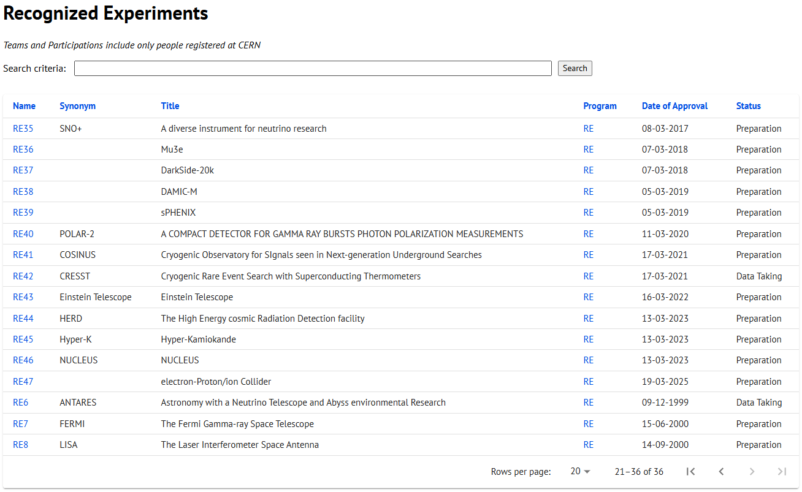
CERN Recognized Experiment Status: RE47
ePIC now appears in the CERN Grey Book database as RE47:
https://greybook.cern.ch/experiment/recognized
Two steps to get ePIC Collaborators registered at CERN:
CC Representative needs to register as team leader with
CERN Users Office:
  https://usersoffice.web.cern.ch/
  https://usersoffice.web.cern.ch/team-leaders-corner
  Users.Office@cern.ch
CC member can then certify registrations of team members
Contact us if you run into problems!

