Slide 1
EIC Roman Pots

Slide 2
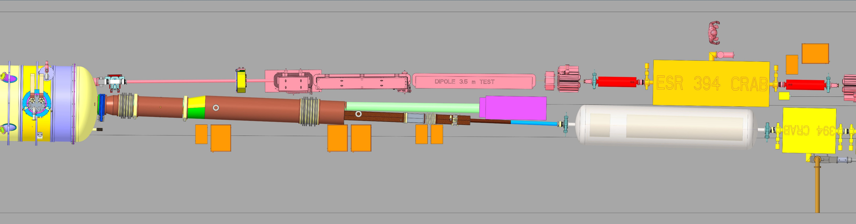
SKEW QUAD
NEUTRON BEAM
ZDC
Off-momentum detectors
Roman Pots
Q3-B2PF

Slide 3
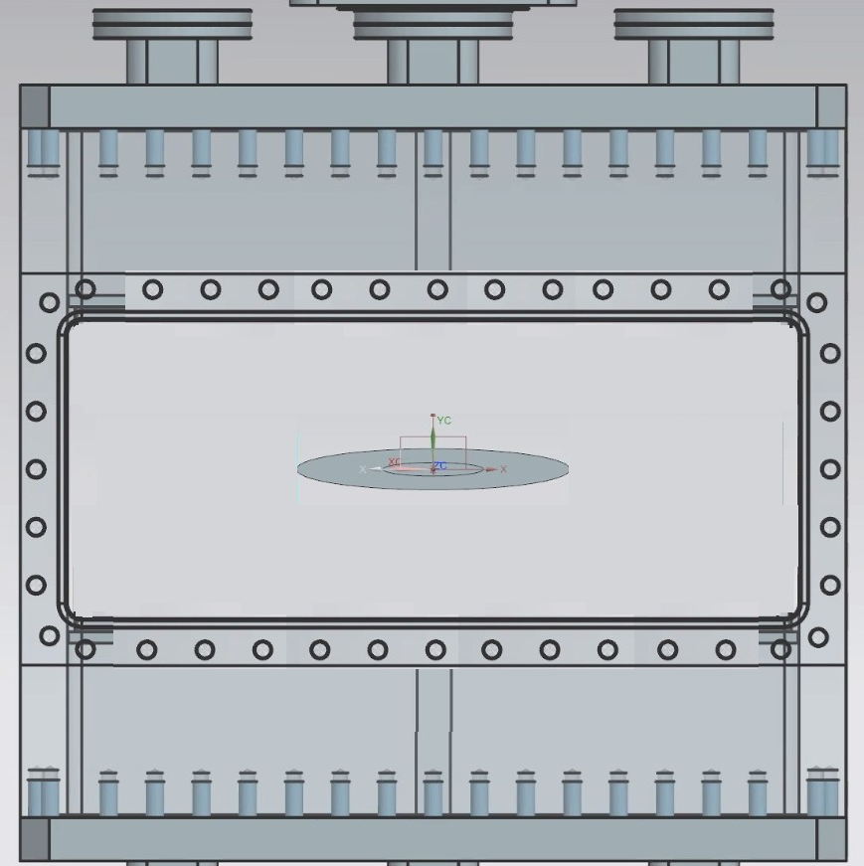
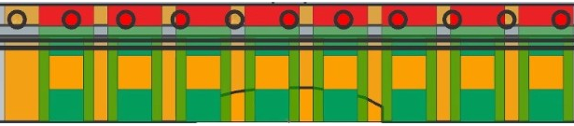

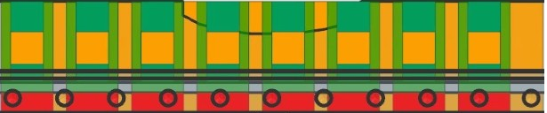
OPTION #1
3 Independent actuators
1
Add more sensors?
1
3
3
2
INSERTED
@ ENERGY 1
PARKED
2

Slide 4
OPTION #1
3 Independent actuators
1
No coverage
3
2
INSERTED
@ ENERGY 2

Slide 5
OPTION #2
4 Independent actuators
3
1
3
3
INSERTED
@ ENERGY 1
4
INSERTED
@ ENERGY 2
4
PARKED
2
4

Slide 6
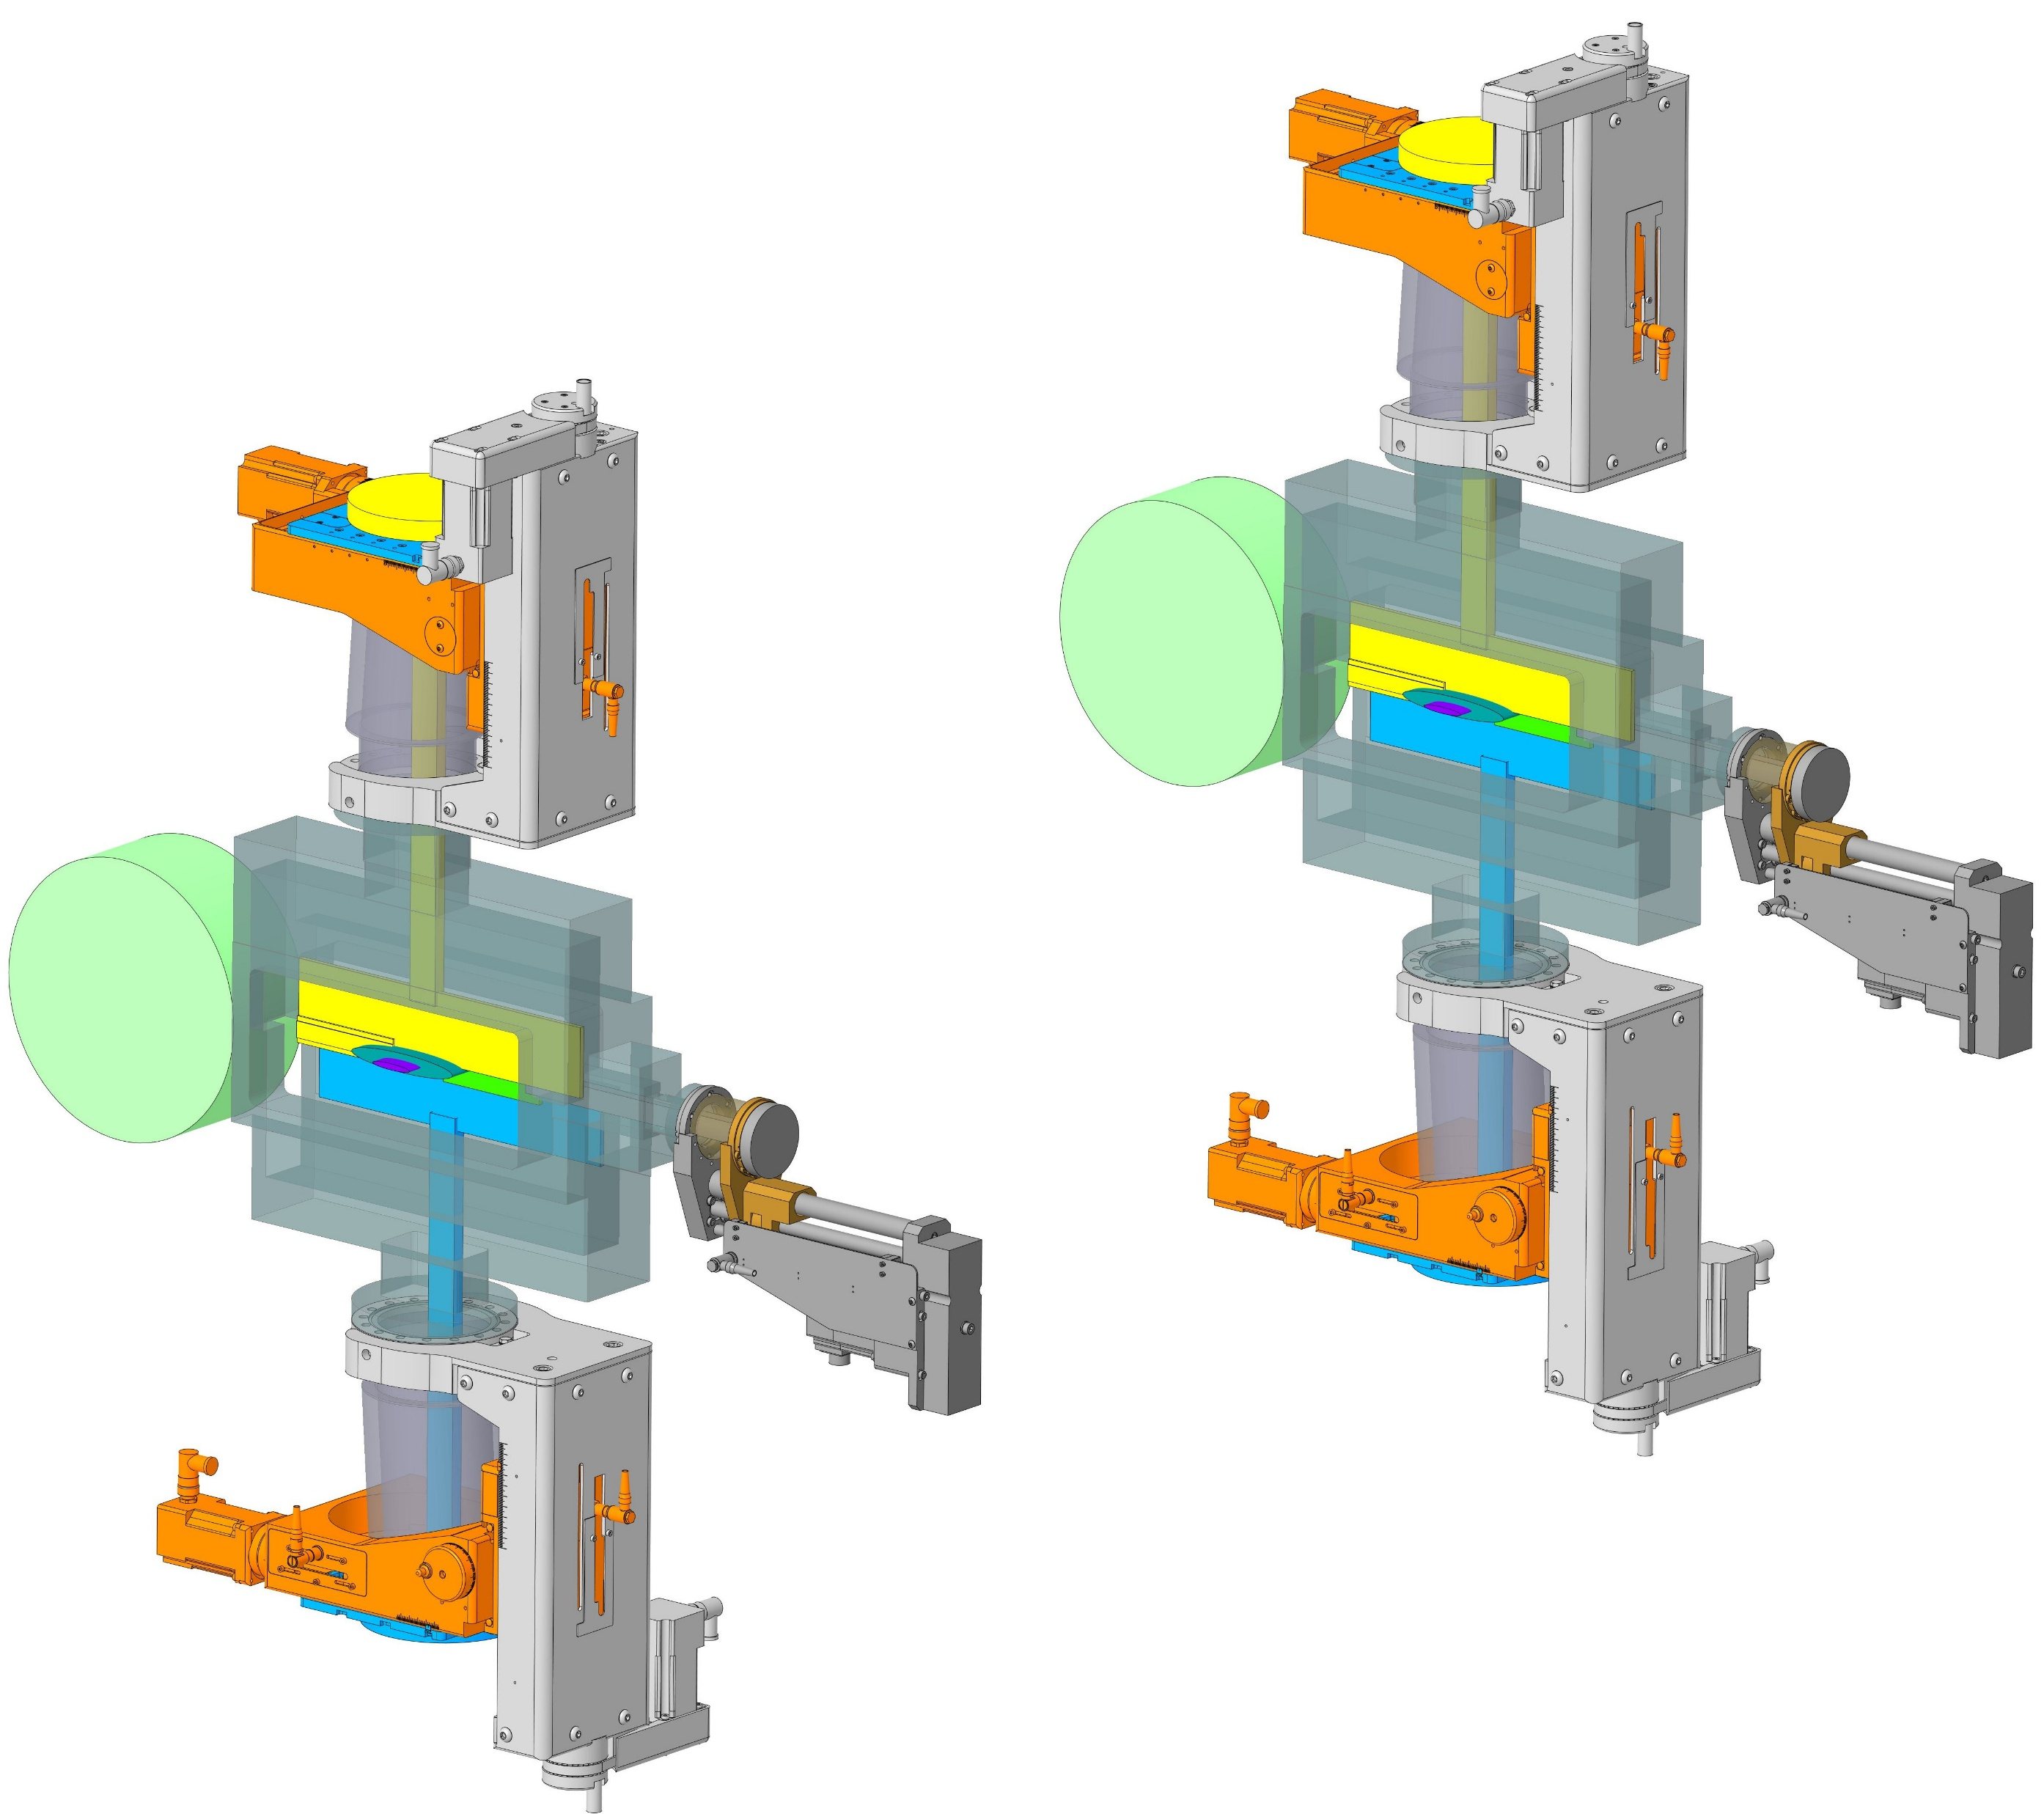
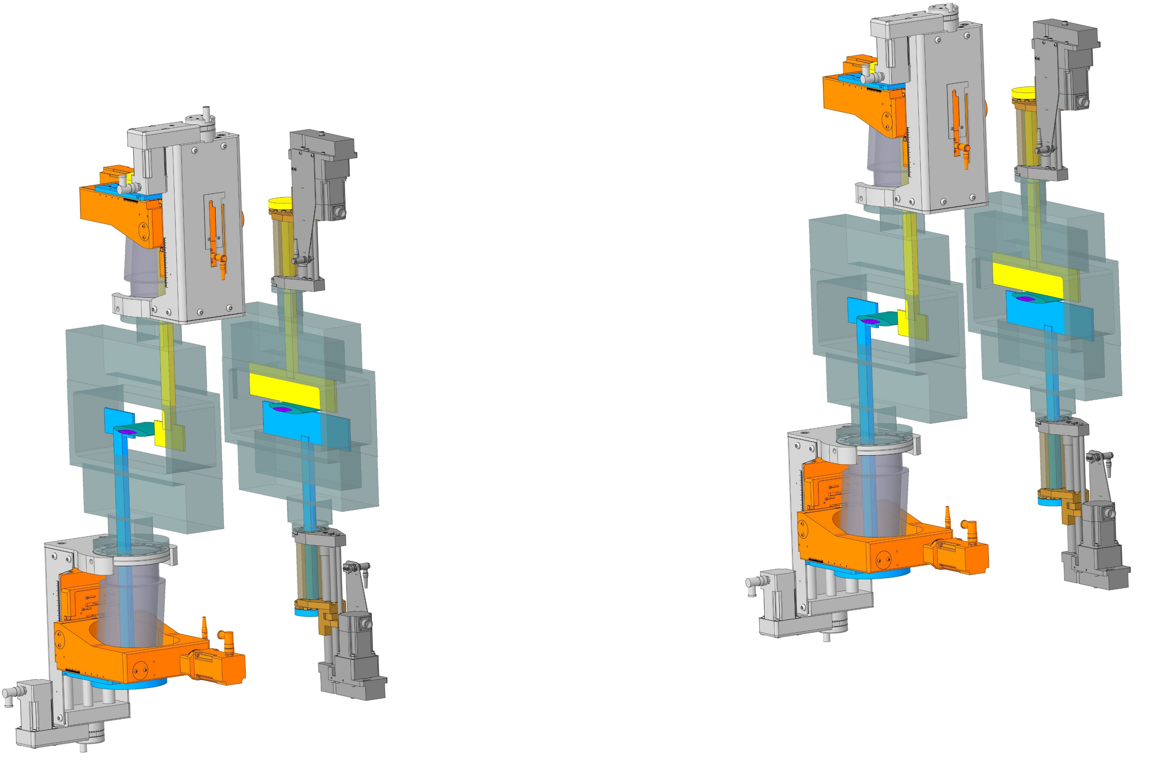
Option 1
Option 2

Slide 7
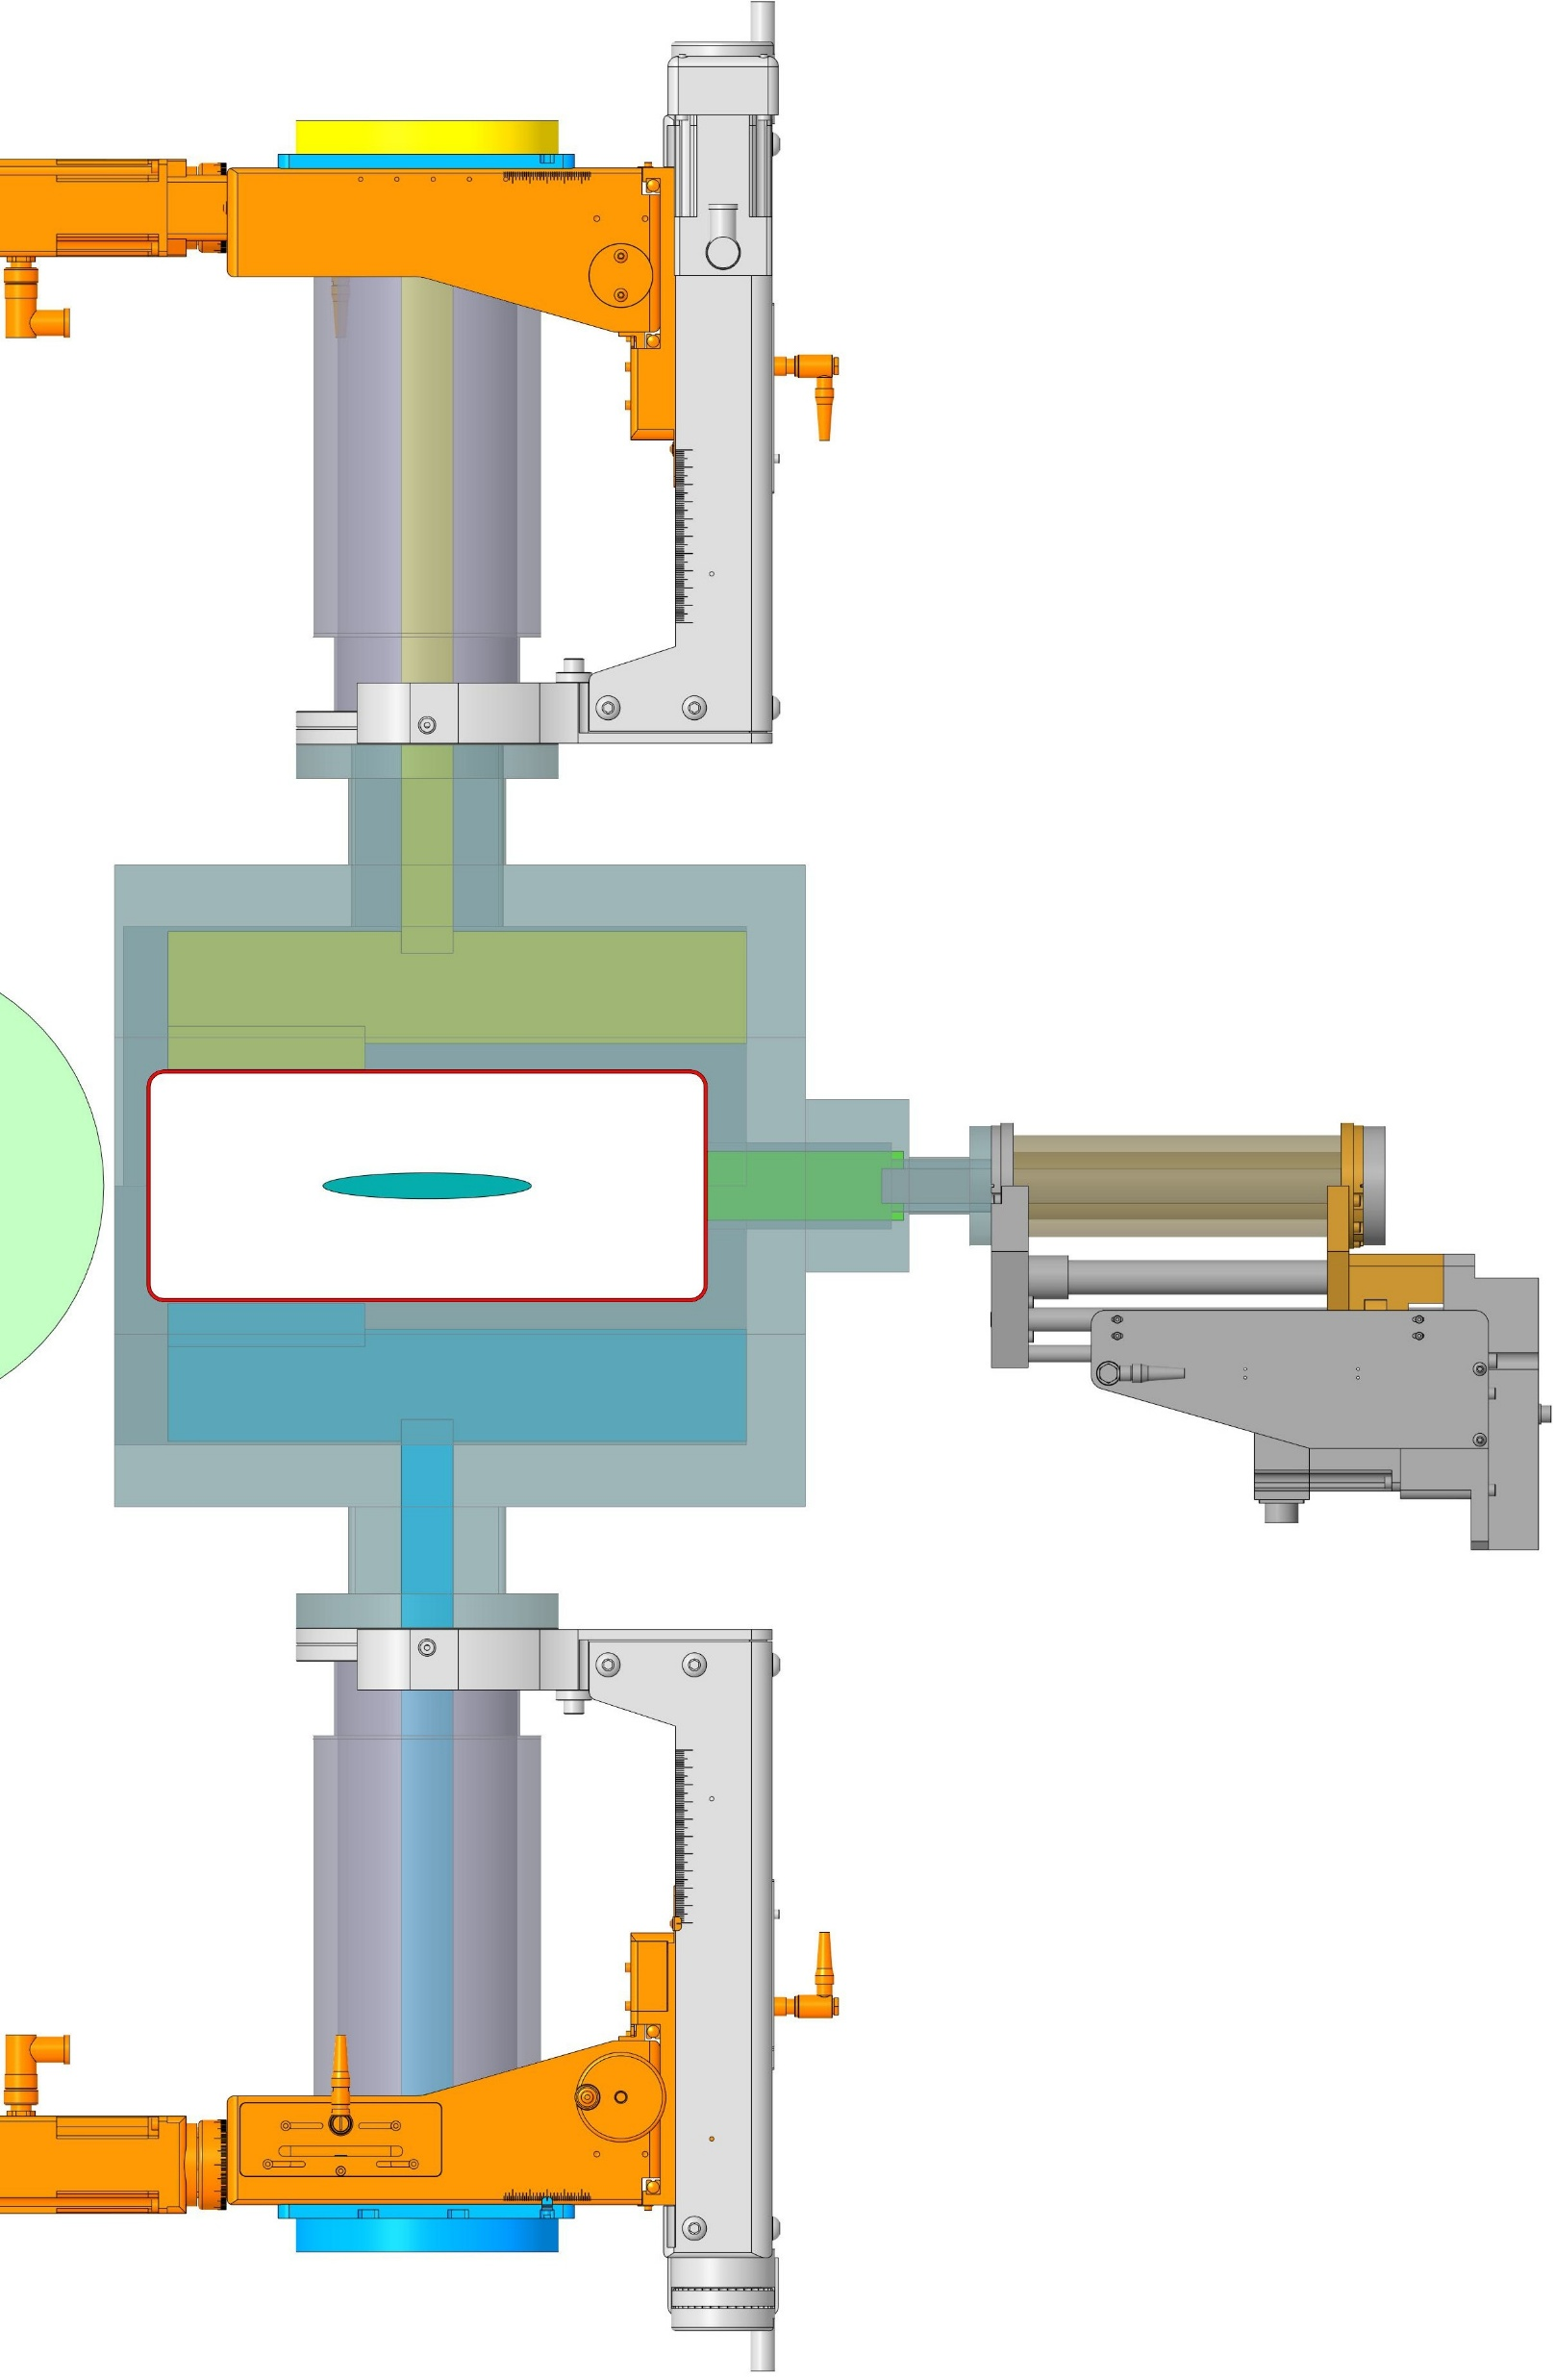
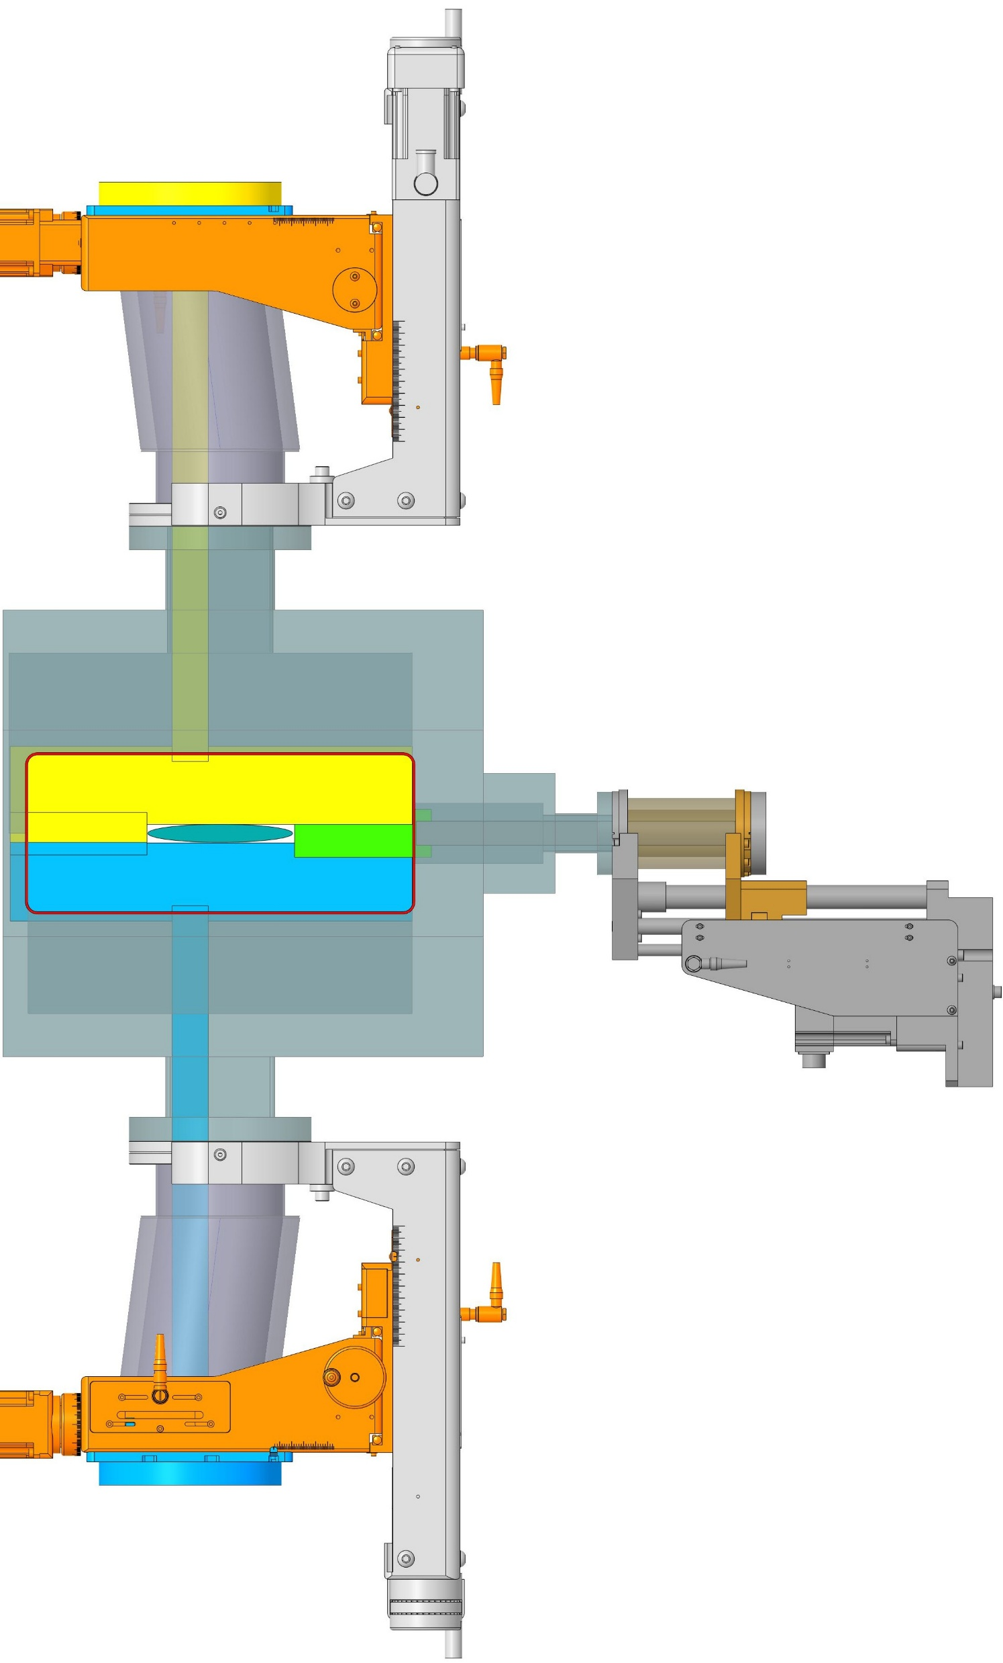
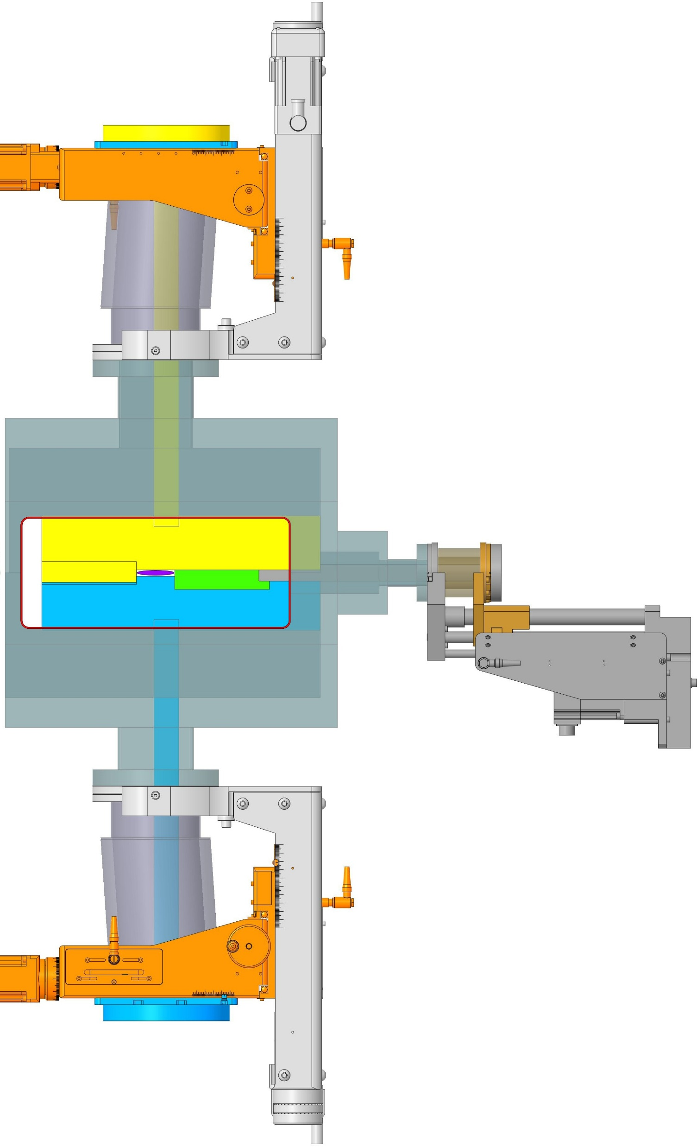
Option 1
+25 mm
-13 mm
UHV Design
TTX100-100-100-YZS
2 Stepper Motors
Axial Stroke 100 mm
Radial Stroke ±25 mm
75 mm
79 mm
320.6 mm
Coverage requirement?
100 mm
139 mm
130.4 mm
4 mrad
Neutron
cone
Hadron beam
UHV Design
CLSM38-150-SS-UP
1 Stepper Motor
Stroke 150 mm
INSERTED
@ ENERGY 1
INSERTED
@ ENERGY 2
PARKED
Notes:
130.429

Slide 8
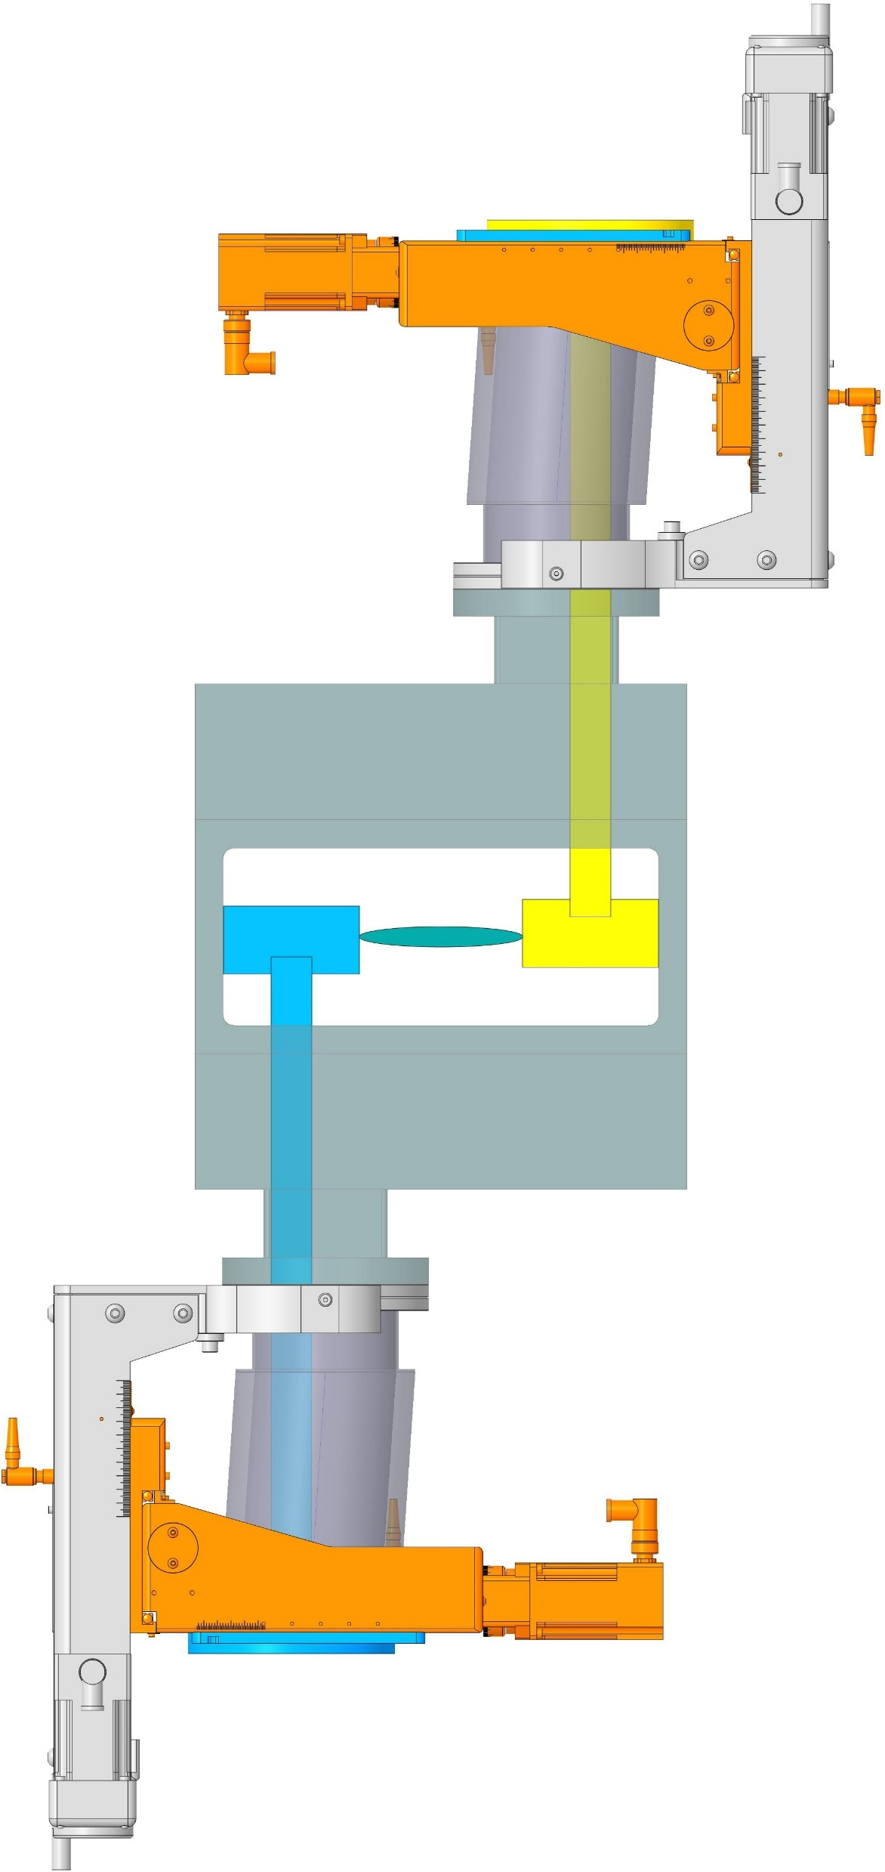
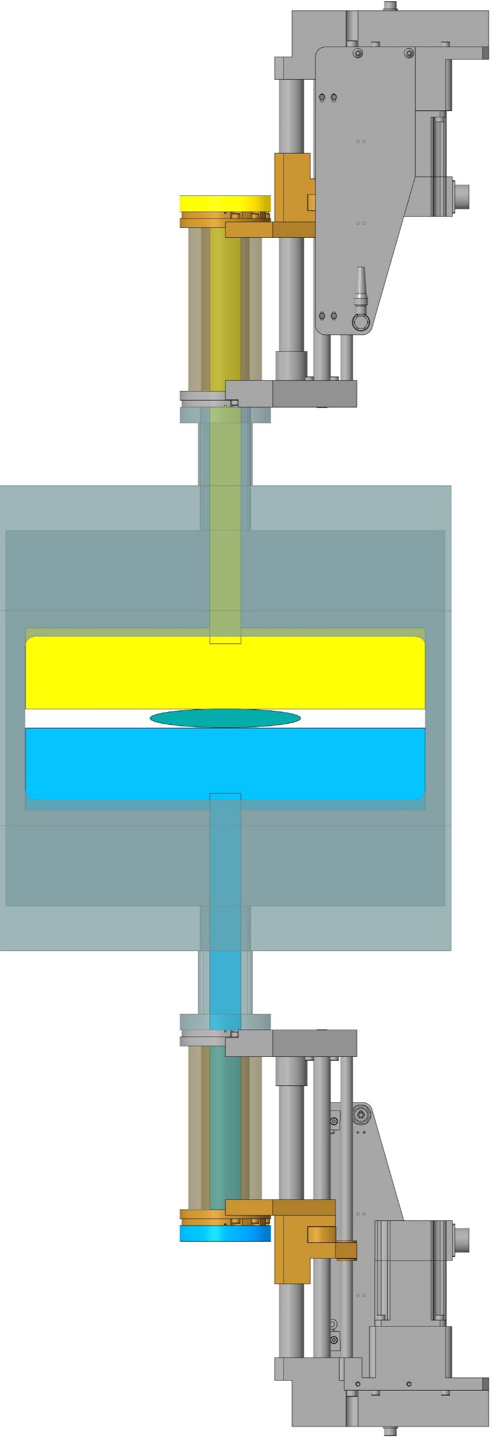
Option 2

Slide 9
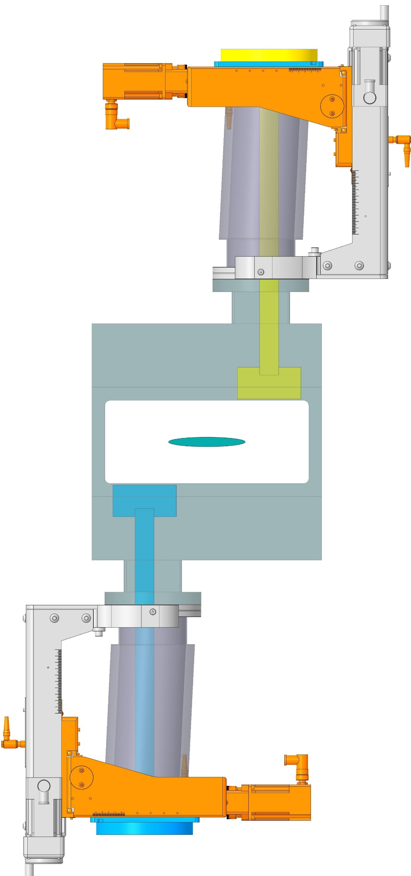
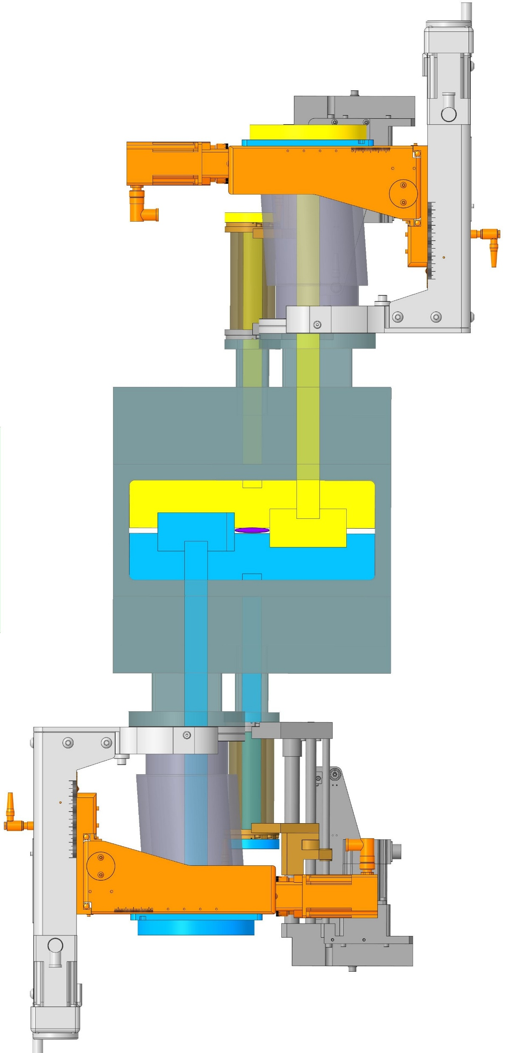
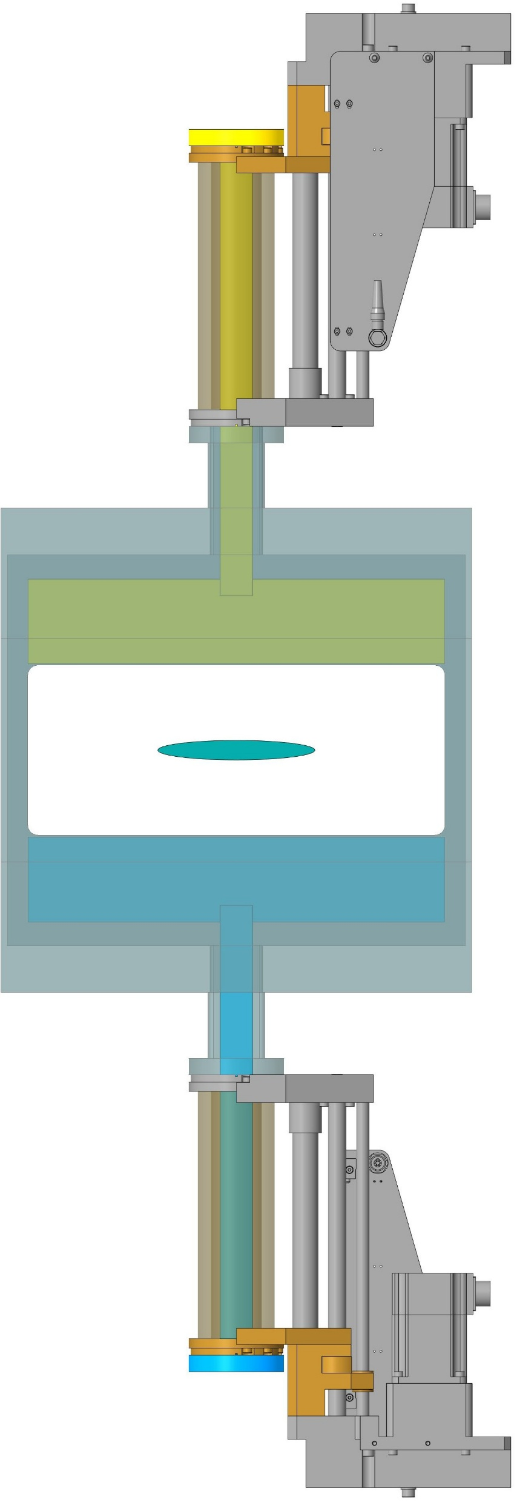
test

Slide 10
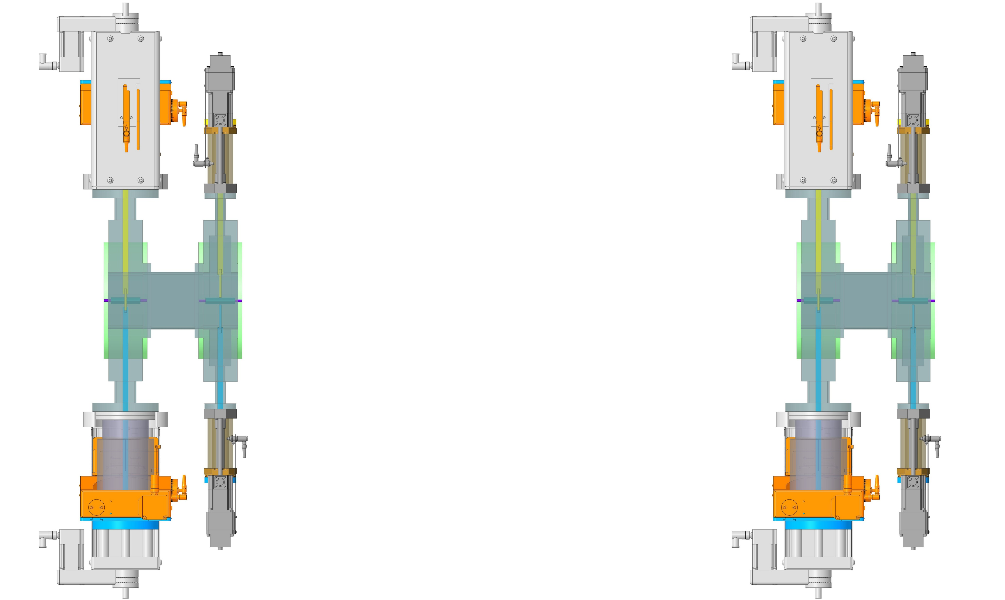
SEPARATE CHAMBERS
1.5 m
BEAM
1.5 m

Slide 11
Specifications
Coverage Area =320 x 130 mm ?
Beam envelopes @ 100 GeV and 275 GeV
Horizontal Travel = 38 mm + x (beam misalignment?)
Vertical travel = 80 mm
Cooling
Impedance
Sensors types
Numbers of layers
Signal cable
Actuator speed
Position accuracy
Parked position requirement

Slide 12
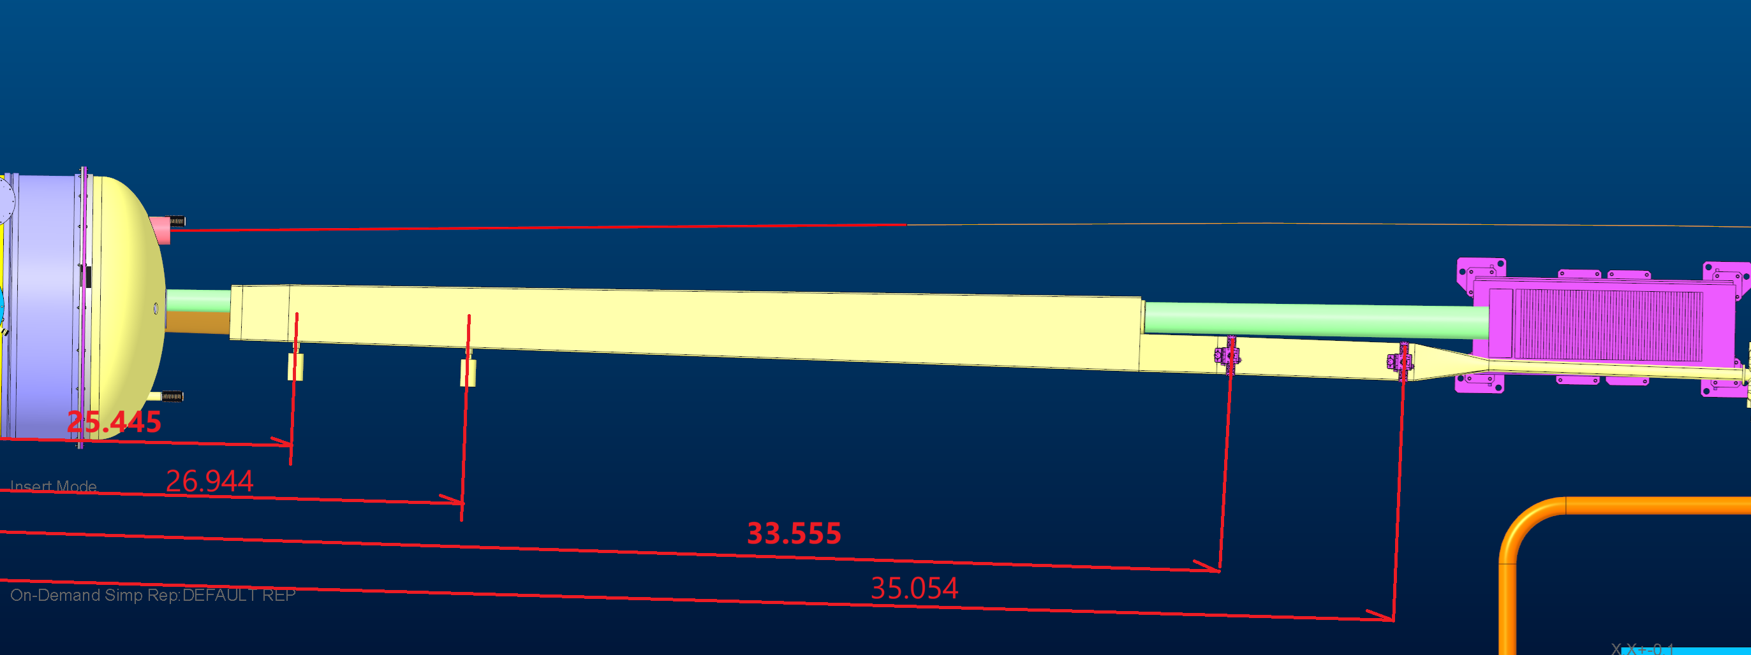
RP’s and OMD locations as of 12/2/25 – Not final
Using the ESR as Z axis, the locations
Off momentum #1; z= 25.445
Off momentum #2 ; z= 26.944
Roman Pot #1 ; z= 33.555
Roman Pot #2 ; z= 35.054

Slide 13
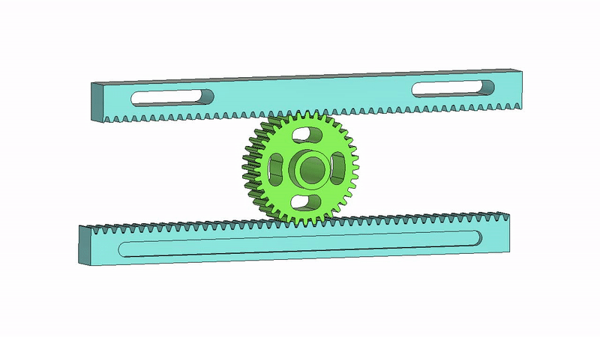
Backup

Slide 14
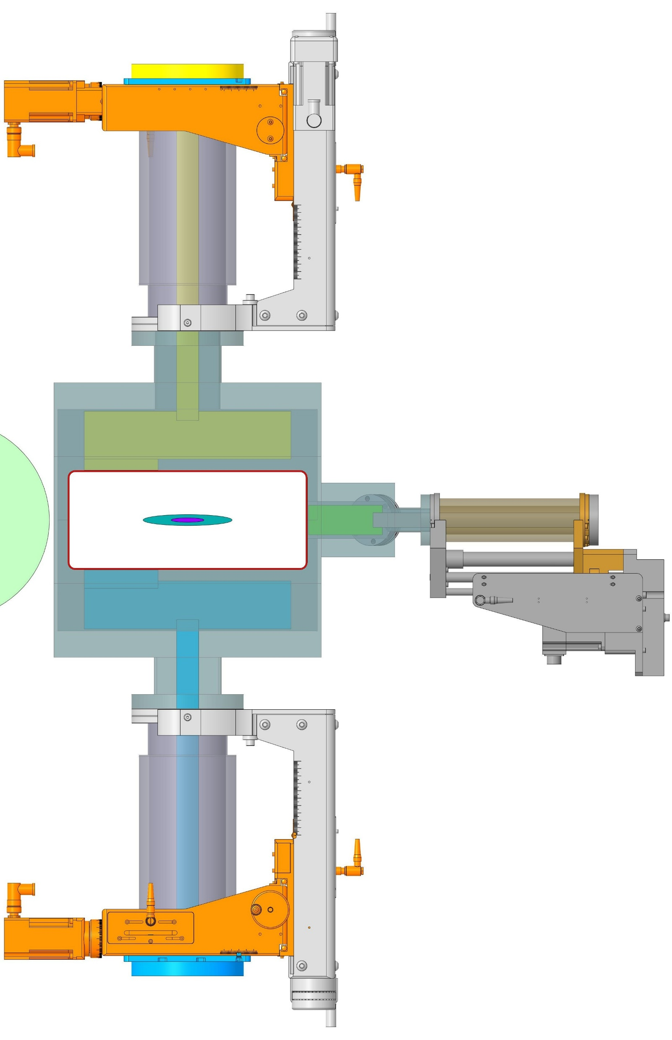
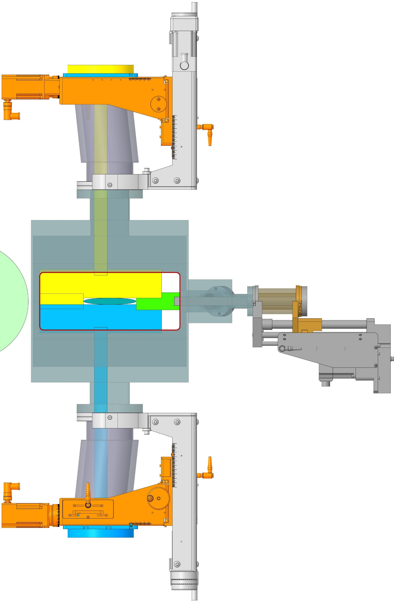
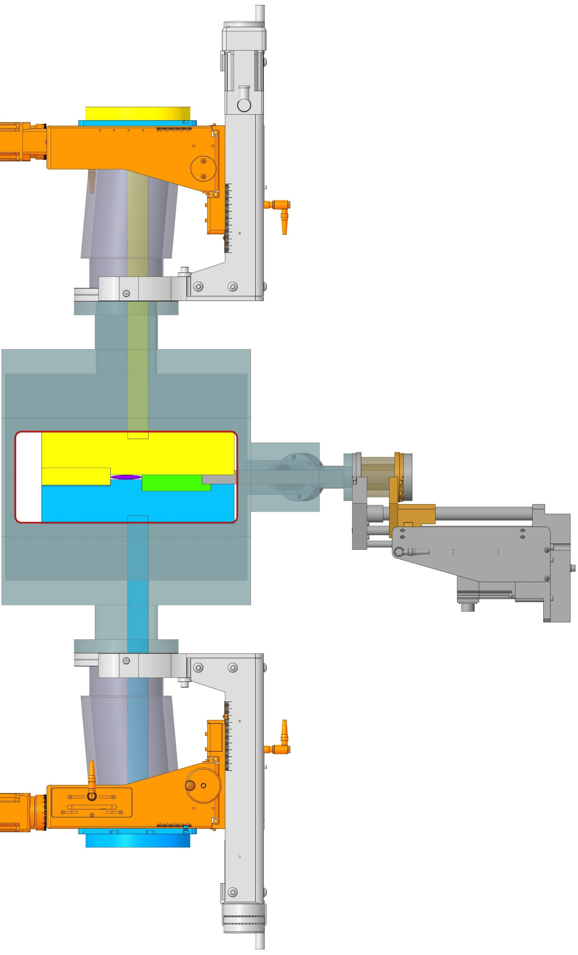
+21 mm
-17 mm
UHV Design
TTX100-100-100-YZS
2 Stepper Motors
Axial Stroke 100 mm
Radial Stroke ±25 mm
75 mm
79 mm
320.6 mm
100 mm
141 mm
130.4 mm
4 mrad
Neutron
cone
Hadron beam
UHV Design
CLSM38-150-SS-UP
1 Stepper Motor
Stroke 150 mm
INSERTED
@ ENERGY 1
INSERTED
@ ENERGY 2
PARKED
Notes:
130.429

