Slide 1
Steeling Rubin LSST Weak Lensing Source Galaxy Samples against Systematics using Wide Field Spectroscopy
FY27 NPP LDRD Type B Pre-Proposal
PI — Joe DeRose
1/9/26

Slide 2
FY27 NPP LDRD Type B Pre-Proposal
Proposal title: Steeling Rubin LSST Weak Lensing Source Galaxy Samples against Systematics using Wide Field Spectroscopy
Primary Investigator: Joseph DeRose
Other Investigators:
Indicate if this is a cross-directorate proposal: No
If yes, identify other directorates/organizations:
Proposal Term: From: 10/26 To: 10/28

Slide 3
FY27 NPP LDRD Type B Pre-Proposal
Proposal title: Steeling Rubin LSST Weak Lensing Source Galaxy Samples against Systematics using Wide Field Spectroscopy
Abstract: Rubin Observatory weak lensing analyses will be limited by a number of important systematics as soon as the survey begins. Redshift distribution uncertainties in particular have the potential to significantly bias cosmological inference from weak lensing. This program will develop a redshift calibration strategy, called the Steel sample, that takes advantage of the strengths of the Dark Energy Spectroscopic Instrument (DESI) to fully mitigate this systematic. This program already has seen significant investment by DESI ($100k equivalent). It will pave the way for an EC proposal in FY27 that will enable mitigation of additional lensing systematics in coordination with DESI2 and LSST, making this Steel sample the workhorse lensing sample for stage IV surveys.

Slide 4

FY27 NPP LDRD Type B Pre-Proposal
Program: HEP
Return on Investment:
Significantly increased chance of obtaining early career grant based on extensions of this work.
Calibration of a weak lensing source galaxy catalog that will be optimal for LSST analyses.
Significant involvement in DESI-2 planning/operations.
Broader impact on the activities at the laboratory:
Significant synergies with ongoing work in cosmology group on galaxy shape measurement for LSST.
Potential for impact as training data for cosmology for Cosmological foundation model work currently funded in BNL cosmology group.
Additional involvement in extremely successful DESI/DESI-2 surveys.
Total planned funding per year in FY27 and FY28: $250k / year
Postdoctoral researcher (0.5 FTE)
Staff (0.5 FTE)

Slide 5
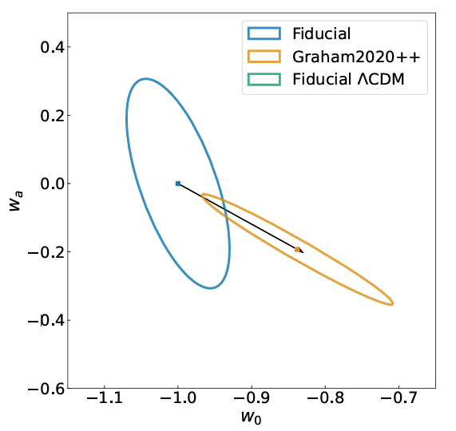
Systematics in Rubin Observatory Analyses
Redshift distribution of galaxies used for weak lensing studies must be known precisely for accurate cosmological interpretation. <1% level biases in estimation of these distributions will severely bias dark energy constraints from Rubin Observatory.

Slide 6
Lensing sample selection
Gold Sample:
Steel Sample:
Select ~all galaxies
Cherry pick galaxies that can easily be redshifted by DESI
Failures are not random!!!
Fewer galaxies, but equal constraining power and more robust physics
Try to take redshifts of a representative sample
Succeed in taking redshifts of a representative sample (by design)
Extremely hard to characterize all uncertainties
Build approximate n(z), deal with systematics by adding nuisance parameters
Get exact n(z) with measured systematics from spectroscopy
Cosmology

Slide 7
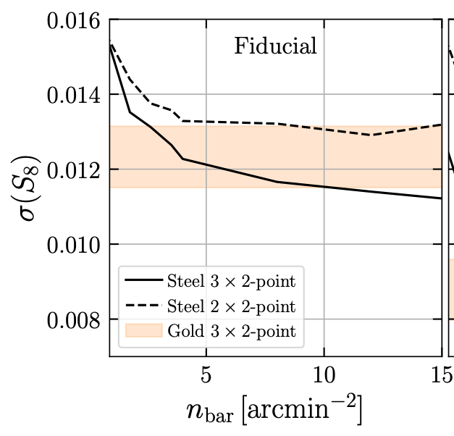
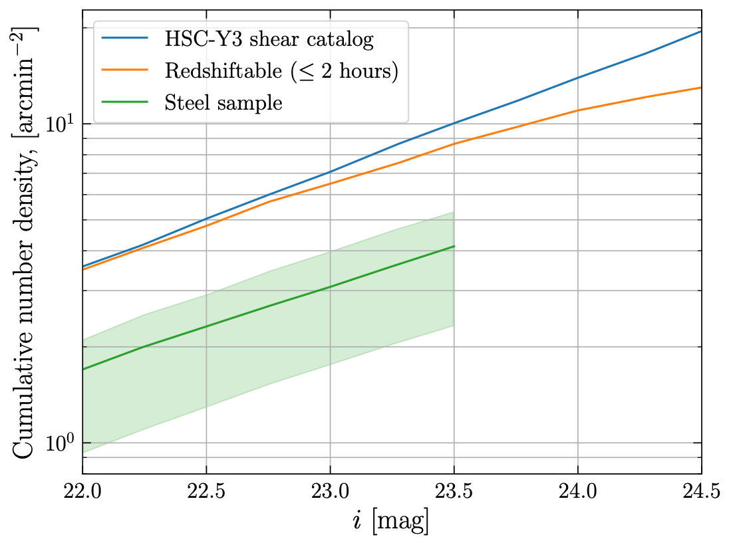
Constraining power vs number density
We were awarded time (~$100k value) in a competitive DESI time allocation committee proposal process to characterize the Steel sample. Exact density that can be selected needs to be determined, and optimizing this selection will be the key component of this LDRD program. Goal is to achieve a density of 5 arcmin^{-2,} at which density the cosmological constraining power will be better than the Gold sample.
Observation of this sample is also being included in the CDR for DESI-2.
Wide area coverage allowed by DESI-2 will allow calibration of galaxy intrinsic alignments, another important weak lensing systematic.
Will give BNL another point of contact with this survey along with instrumentation projects currently under investigation.
This will become the primary source galaxy sample for LSST analyses, beginning in the next year. Highly synergistic project across cosmology group at BNL. Optimal characterization will require use of AI/ML techniques.
Further development of this sample will be the topic of a DOE EC proposal that has a high likelihood of being funded.

Slide 8
Summary
Redshift distribution uncertainties will be the dominant systematic for LSST weak lensing science.
Current LSST plans for redshift calibration (Gold sample) are not tailored to the strengths of existing spectroscopic resources. Our proposed Steel sample explicitly accounts for these strengths, while delivering improved constraining power over Gold assuming realistic levels of systematic uncertainty.
This work:
will enable the use of the Steel sample as the primary weak lensing sampling in LSST.
is highly synergistic with BNL LSST shape measurement efforts, as well as BNL work on an AI Foundation model for cosmology.
give BNL a scientific point of leadership within DESI-2 to go with potential instrumentation involvement.
provide additional proof of concept required for a successful early career proposal in FY27.

