Slide 1
Improving LArTPC Clustering through AI-Based Scientific Reasoning and Fine-grained Domain-specific Tools toward Enhanced Discovery Capability in DUNE and SBND
FY27 NPP LDRD Type B Pre-Proposal
Haiwang Yu (PI, PO, Presenter) , Yi Huang (co-PI, CDS)
Yousen Zhang (PO), Xin Qian (PO), Brett Viren (PO), Yihui Ren (CDS)
Jan 9 2026

Slide 2
FY27 NPP LDRD Type B Pre-Proposal
Proposal title: Improving LArTPC Clustering through AI-Based Scientific Reasoning and Fine-grained Domain-specific Tools toward Enhanced Discovery Capability in DUNE and SBND
Primary Investigator: Haiwang Yu (PI, PO) , Yi Huang (co-PI, CDS)
Other Investigators: Yousen Zhang (PO), Xin Qian (PO), Brett Viren (PO), Yihui Ren (CDS)
Indicate if this is a cross-directorate proposal: Yes
If yes, identify other directorates/organizations: CDS
Proposal Term: From: 2026/10 To: 2028/9

Slide 3
FY27 NPP LDRD Type B Pre-Proposal
Proposal title and brief abstract:
Improving LArTPC Clustering through AI-Based Scientific Reasoning and Fine-grained Domain-specific Tools toward Enhanced Discovery Capability in DUNE and SBND
LArTPC technology is central to the DUNE and SBN programs, which target the next generation of neutrino physics discoveries. Recent MicroBooNE results exclude the single light sterile neutrino explanation of the LSND and MiniBooNE anomalies, highlighting both the strengths of LArTPC detector technology and the limitations of current reconstruction methods, particularly for complex topologies such as photon-related channels. We propose to explore a novel approach that integrates fine-grained domain-specific tools from the Wire-Cell Toolkit with AI-based scientific reasoning to orchestrate reconstruction workflows, with LArTPC clustering as a concrete and representative use case. This approach aims to improve physics performance while establishing LArTPC reconstruction as a high-impact testbed for AI-driven scientific reasoning in experimental physics.

Slide 4
FY27 NPP LDRD Type B Pre-Proposal
Program: HEP
Return on Investment
The proposed study aligns well with recent U.S. initiatives (e.g., AmSC and Genesis Mission) emphasizing AI-empowered science.
The application of agentic AI to the HEP reconstruction chain, particularly fine-grained tool orchestration, remains novel and exploratory, strengthening the combined capabilities of BNL HEP and CDS.
Positions BNL to compete more effectively for future DOE AI-focused funding opportunities.
Broader Laboratory Impact
Expands and deepens expertise in advanced AI methodologies for HEP reconstruction
Establishes a pathway for broader AI integration, from coarse- to fine-grained levels, across other scientific domains at BNL
Total planned funding per year in FY27 and FY28: $250k/year
Postdoctoral researcher (PO): 0.5 FTE
Scientific staff (PO + CDS): 0.5 FTE
Computing resources

Slide 5
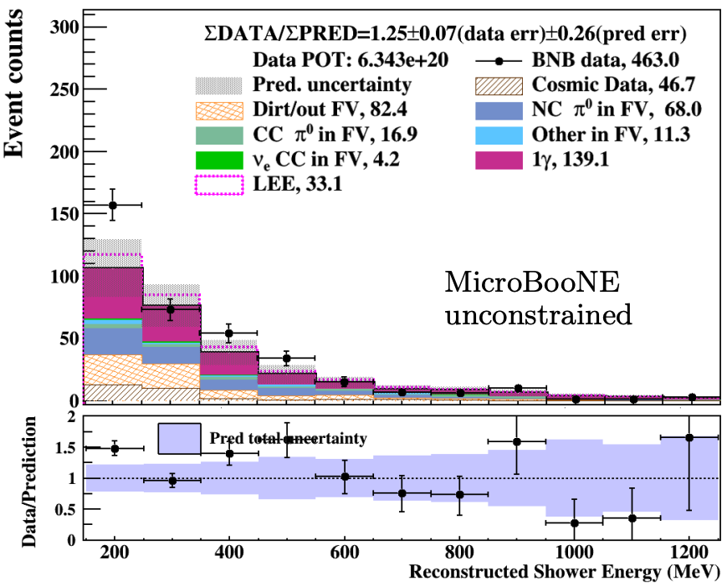
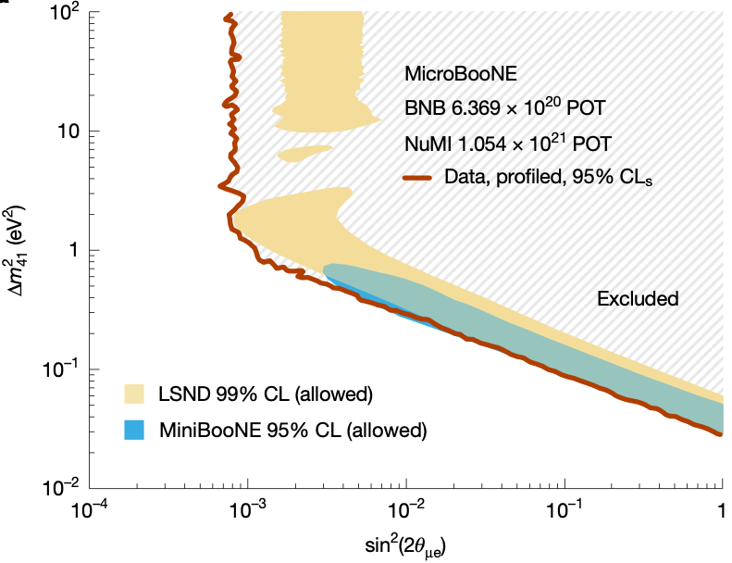
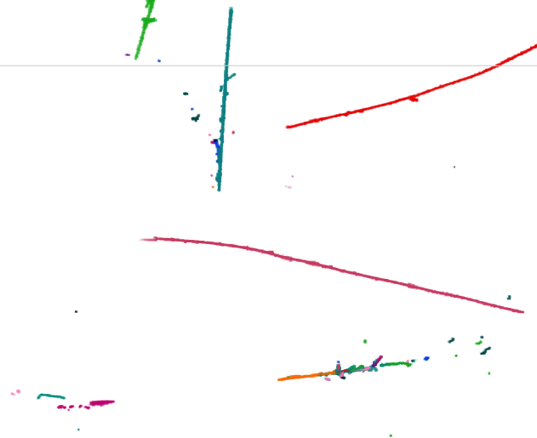


Motivation: Improve LArTPC reconstruction for complex topologies, such as photon-related channels, which are expected to carry rich and potentially new physics messages
The single light sterile neutrino interpretation has been ruled out
The first MicroBooNE search for the MiniBooNE LEE in an inclusive photon channel observed a 2.2σ local significance relative to GENIE predictions
Current LArTPC clustering performance remains limited for complex topologies such as photon-rich final states
Experience from Wire-Cell development shows that human reasoning in selecting and sequencing tools plays a key role in achieving optimized performance.
Human reasoning -> AI reasoning?
arxiv:2502.06064
B
Nature volume 648, pages64–69 (2025)
C
A
BEE link
Notes:
SBND is expected to have ~10x data than uboone
Detector is also expected to be better and so is systematics

Slide 6
Approach: Combine established Wire-Cell tools with agentic AI methodologies
Current Limitation: Existing clustering algorithms are applied in a fixed sequence across all topologies, leading to inefficiencies and suboptimal performance for complex or topology-specific events
Proposed Solution
Package existing clustering algorithms (granularity is at C++ function/algorithm level) as MCP tools
Develop an event descriptor to summarize key event features in text/JSON
Implement an MCP server in C++
Build a Python fine-tuning framework leveraging the MCP server and open-weight LLMs
Initialize with supervised fine-tuning guided by traditional workflows
Apply truth-based reinforcement learning fine-tuning (RLFT)

Slide 7
Deliverables
A validated workflow to enhance LArTPC reconstruction, with photon-related topologies as a representative use case
An extensible MCP-based framework integrated into Wire-Cell that is capable of algorithm-level tool orchestration
A reusable platform for testing and advancing AI methodologies in HEP reconstruction
(Optional extension) Photon-related analyses in SBND using the proposed workflow conducted through collaboration with Universities
Personnel
Haiwang Yu (PO): C++ implementation and system integration
Yi Huang (CDS): Python framework and fine-tuning pipeline
Postdoc (PO): Model training, validation, and performance studies
Additional team members: Advisory and domain-expert support

Slide 8
Summary 1
Proposal Overview
We propose to improve LArTPC clustering through AI-based scientific reasoning and fine-grained, domain-specific tools.
Long-Term Physics Impact: The final goal is to enhance the discovery capabilities of LArTPC in DUNE and SBND. This study serves as a technology demonstration, delivering infrastructure that can be reused in the future.
AI Impact: The proposed work focuses on the fine granularity of agentic AI in science, complementing and extending emerging agentic AI applications in scientific research.
Near-Term Physics Impact: The direct outcomes of the proposed work can be utilized by collaborators in physics analyses (out side scope of this LDRD) with the potential for high impact.
Note: Compared to traditional and machine-learning–based reconstruction optimization methods, the proposed agentic AI approach is exploratory in nature and is not included in the baseline R&D scope.
Effort and Resources (2 years)
Postdoctoral researcher (PO): 0.5 FTE
Scientific staff (PO + CDS): 0.5 FTE
Computing resources

Slide 9
Summary 2
Return on Investment
The proposed study aligns well with recent U.S. initiatives (e.g., AmSC and Genesis Mission) emphasizing AI-empowered science.
The application of agentic AI to the HEP reconstruction chain, particularly fine-grained tool orchestration, remains novel and exploratory, strengthening the combined capabilities of BNL HEP and CDS.
Positions BNL to compete more effectively for future DOE AI-focused funding opportunities.
Broader Laboratory Impact
Expands and deepens expertise in advanced AI methodologies for HEP reconstruction
Establishes a pathway for broader AI integration, from coarse- to fine-grained levels, across other scientific domains at BNL

