Slide 1
Technology Transfer-Pre Conceptual Design of the FLASH proton therapy facility for Academic Medical Institution
Principal Investigators - Dejan Trbojevic and Stephen Brooks
January 6, 2026

Slide 2
FY2026 NPP LDRD Type B Proposal
Proposal title: Technology Transfer-Pre Conceptual Design of the FLASH proton therapy facility for Academic Medical Institution
Primary Investigators: Dejan Trbojevic and Stephen Brooks
Other Investigators: Samuel Ruy, Xin Qian, George Mahler, Robert Michnoff, Alex Zalsman
Indicate if this is a cross-directorate proposal. YES
Proposal Term: From: Oct 2026 To: Oct 2028

Slide 3
FY2026 NPP LDRD Type B Proposal
Program: NPP, HEP spin-off for Medical Applications Technology Transfer-Pre Conceptual Design
of the FLASH Proton Therapy Facility
The LDRD proposal Technology Transfer – Pre-Conceptual Design of the FLASH proton Therapy Facility for a possible use at Stony Brook University Hospital, represents a continuation of the previously funded LDRD24-010 AD/NPP for building a “Section of the Fast-Cycling FFA Synchrotron”. We successfully confirmed by experimental results in July and September 2025 a proof of principle for the fast-cycling synchrotron a goal of the funded LDRD 26823.
A collaboration with the Radiation Oncology Department of the Stony Brook University Hospital Cancer Center started in 2014 and fully continued from 2022 with monthly collaboration meetings. This collaboration also resulted in a Seed Grant with a title “Proton FLASH Therapy for Targeting Deep Seated Tumors”, funded in June 2023 by the Stony Brook University and BNL. The PIs of the projects are the chairman professor Ruy Samuel and Dejan Trbojevic from BNL. The present LDRD proposal is a part of a mission of NPP and BNL to allow transfer of technology from the scientific results made at the BNL. The permanent magnet technology was developed in CAD-BNL during the project CBETA where 230 combined function magnets were designed, built, characterized, installed and fully commissioned with the beam as well as by the previous LDRD by building a part of the arc for the fast-cycling permanent magnet synchrotron. It is already proven technology.
Total Effort (FTE)
- Scientific: Few physicists' efforts are needed for specific Chapters of the Pre-Conceptual Design,
- Post Doc: possible
- Engineers: necessary for the review of the specific devices.
Total funding :
FY26 - $100k
FY27 - $90k

Slide 4
Description of the LDRD Proposal
This is unique proton FLASH therapy proposal which removes limitations of the present proton therapy facilities. In the recent decades there have been new investigations in cancer radiation therapy with FLASH effect where a very large radiation dose is delivered in a very short time, 40 Grays per second (40 Gy/s). It was found that the FLASH radiation significantly improves healthy tissue recovery. The FLASH therapy requirements of 40 Gy/s are to be compared to the dose of 0.01 Gy/s used in conventional radio therapy.
This LDRD proposal is to prepare a Pre Conceptual Design Report (PCDR) for the permanent magnet FLASH for proton therapy facility. Successful results from LDRD-24-010 included transmitting the beam though an arc of full-scale, full-field permanent magnets of up to 1.85 Tesla bending field, over the whole momentum range (using both NSRL and Tandem). With this technology proved feasible, the PCDR will integrate simulations of the full ring and address any remaining parameter inconsistencies. The BNL team collaborated with Stony Brook Hospital Radiation Oncology throughout the development, including a successful seed grant application for FLASH therapy studies at the Tandem. Professor Samuel Ryu MD and Qian Xin will prepare for technology transfer from BNL to academic institutions and industrial partners as necessary, as well as providing the clinical specifications for FLASH therapy, drawing from their multiple decades of experience treating cancer patients. They have also suggested designing a scaled-down machine for treating tumors in animals, which could be a lower-cost, self-funding facility as a step toward human trials, so this option will be included in the PCDR. Contact with Cornell College of Veterinary Medicine has also been suggested for this topic. Other parts of the PCDR can be based on existing work, such as commercial cyclotron injectors, conference papers documenting the accelerator and Dejan Trbojevic’s patents on the treatment gantry. C-AD expertise will be used in defining the diagnostics, vacuum and supporting systems, as well as injection and extraction power supplies. RF specifications will be based on existing designs at BNL and other labs (RAL, J-PARC).

Slide 5
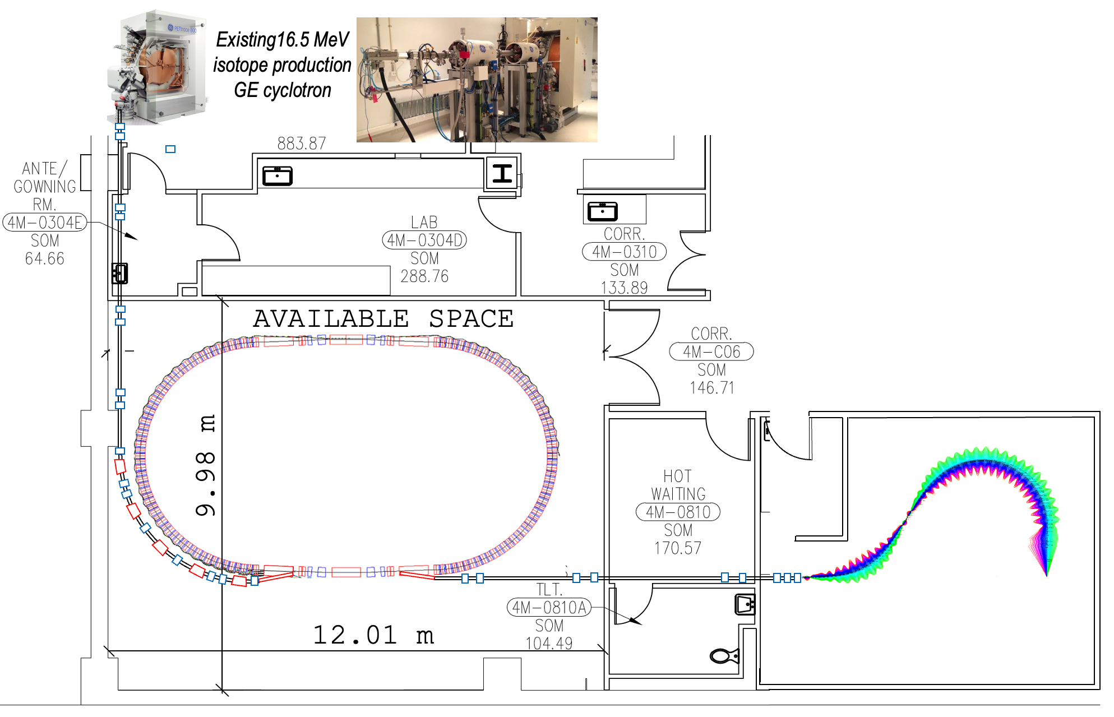
Pre-Conceptual Design of the Permanent Magnet FLASH Proton Therapy Facility
Isotope production 16.5 MeV
GE cyclotron
Advantages of our concept:
In proton acceleration within the non-relativistic energy range the main problem is the limitation the speed of magnetic field response to the change of energy. This limitation is now eliminated by using the permanent magnets for the same energy range.
Cost reduction: the cost proposed FLASH radiation therapy facility is estimated to be ~$40M to be compared to ~$200M (Varian Facility in New York city in Harlem)
Simplified operation as there is not a need to change the magnet settings for different proton energies.
REDUCTION OF:
The power consumption as the permanent magnets do not require electrical power.
The radiation shielding as the beam losses in synchrotron if any are controlled.
magnet sizes and weights ( The gantry weight is significantly reduced).

Slide 6
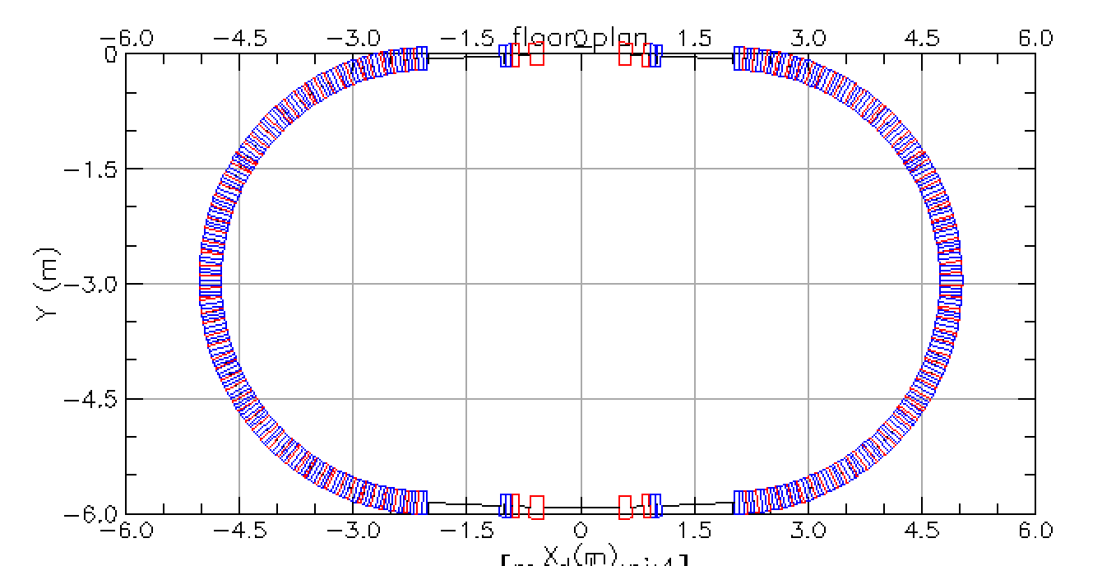
Fast Cycling FFA Synchrotron 10-250 MeV
Racetrack layout
Extraction Injection straight section
Section of the FFA arc
RF straight section

Slide 7
Comparison of our proposal to the existing facilities
Accelerator Type | Isochronous Cyclotron |  | Synchrocyclotron |  | Synchrotron | Linear | FFA facility
Vendor | IBA | Varian | IBA | Mevion | Hitachi | AVO | BNL
System | C230 | ProBeam | S2C2 | S250 | ProBeam | LIGHT | FFA
Maximum Energy (MeV) | 230 | 250 | 250 | 250 | 250 | 250 | 250
Minimum Energy (MeV) | 70 | 70 | 70 | 70 | 70 | 37.5 | 10 - 30
Peak Current | 0.3μA | 0.8μA | ~18μA | ~7μA | 4.8 mA | ~40μA | 1.2 mA
Max Ave. Current (nA) | 300 | 800 | ~130 | ~32 | 4.8 | 32 | 530 - 897
Accel. Frequency (MHz) | 106.1 | 72.8 | 87.6-63.2 | 133-90 | 1.3-10 | 3,000 | 378 MHz
Repetition Rate | CW | CW | 1 kHz | 500-750 Hz | CW | 200 Hz | 540-809 Hz
Treatment Pulse Length | >400μs | >400μs | 7μs | 6μs | 0.5 - 5s | 4μs | 725μs
Bunch Length | ~2ns | ~2 ns | ~2 ns | ~2 ns | 25-200 ns | 0.5 ns | ~10–405 ns
Max Part. Per Bunch/Pulse | 100,000 | 70,000 | 8 x 10⁸ | 4 x 10⁸ | 1.5 x 10¹¹ | 10¹⁰ | 1.8 x 10¹¹
Electric Central Field | 1.7 T | 2.4 T | 5.75 T | 9 T | 1.7 T | 25 MV/m | Max 1.8 T
[1] S. Jolly, H. Owen, M. Schippers, C. Welsch, “Technical challenges for FLASH proton therapy.” Phys. Med. 2020, 78, 71–82. https://pubmed.ncbi.nlm.nih.gov/32947086/

Slide 8
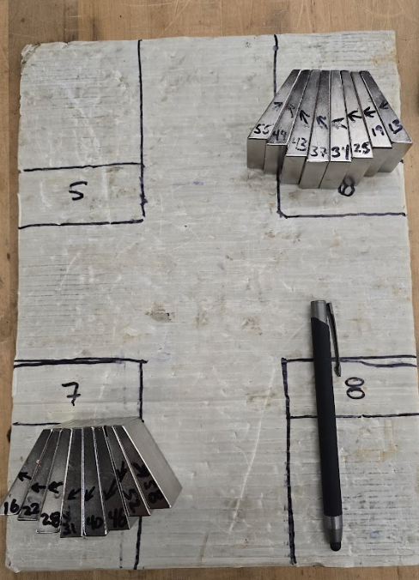
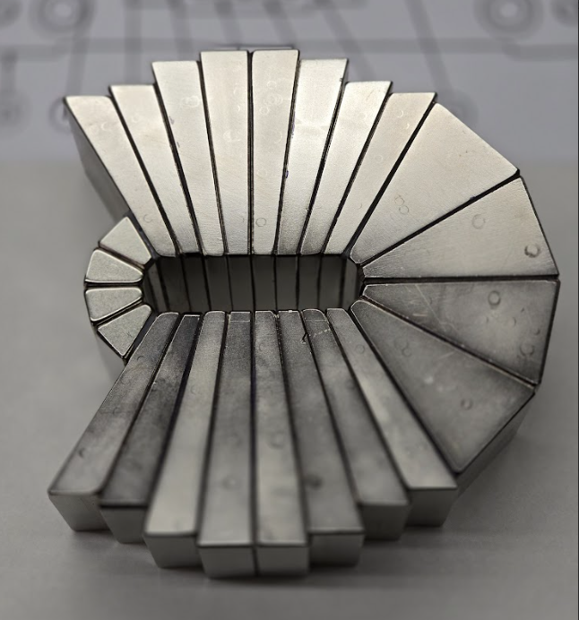
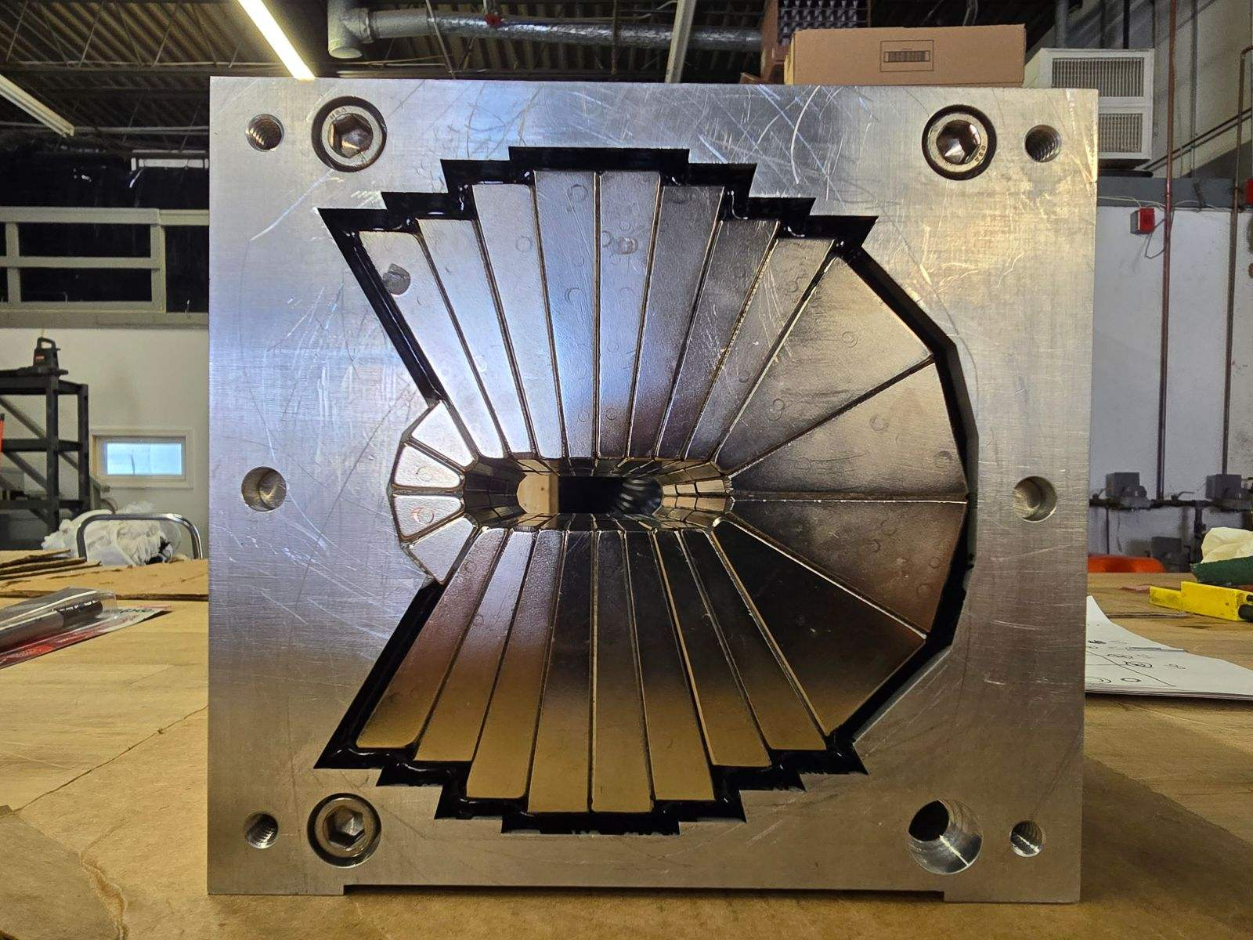
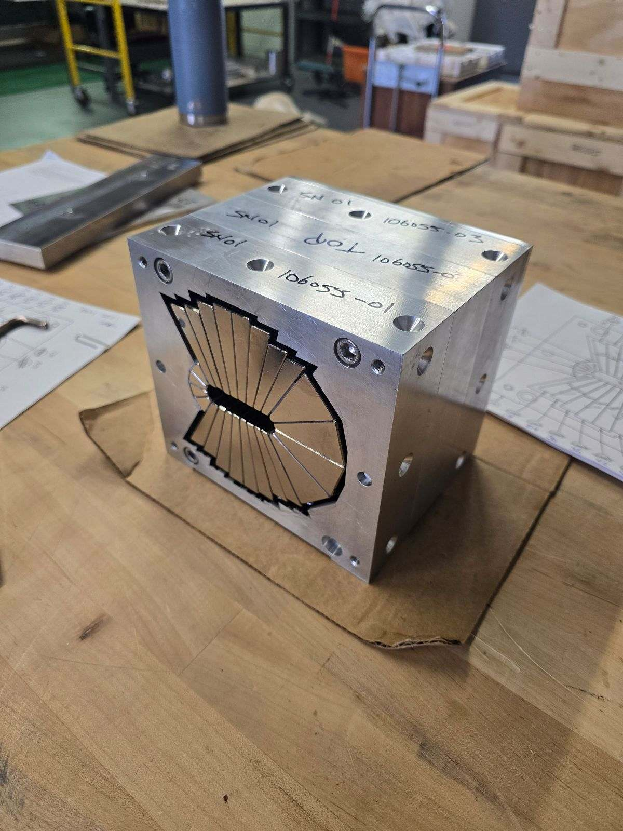
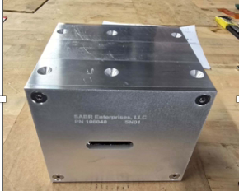
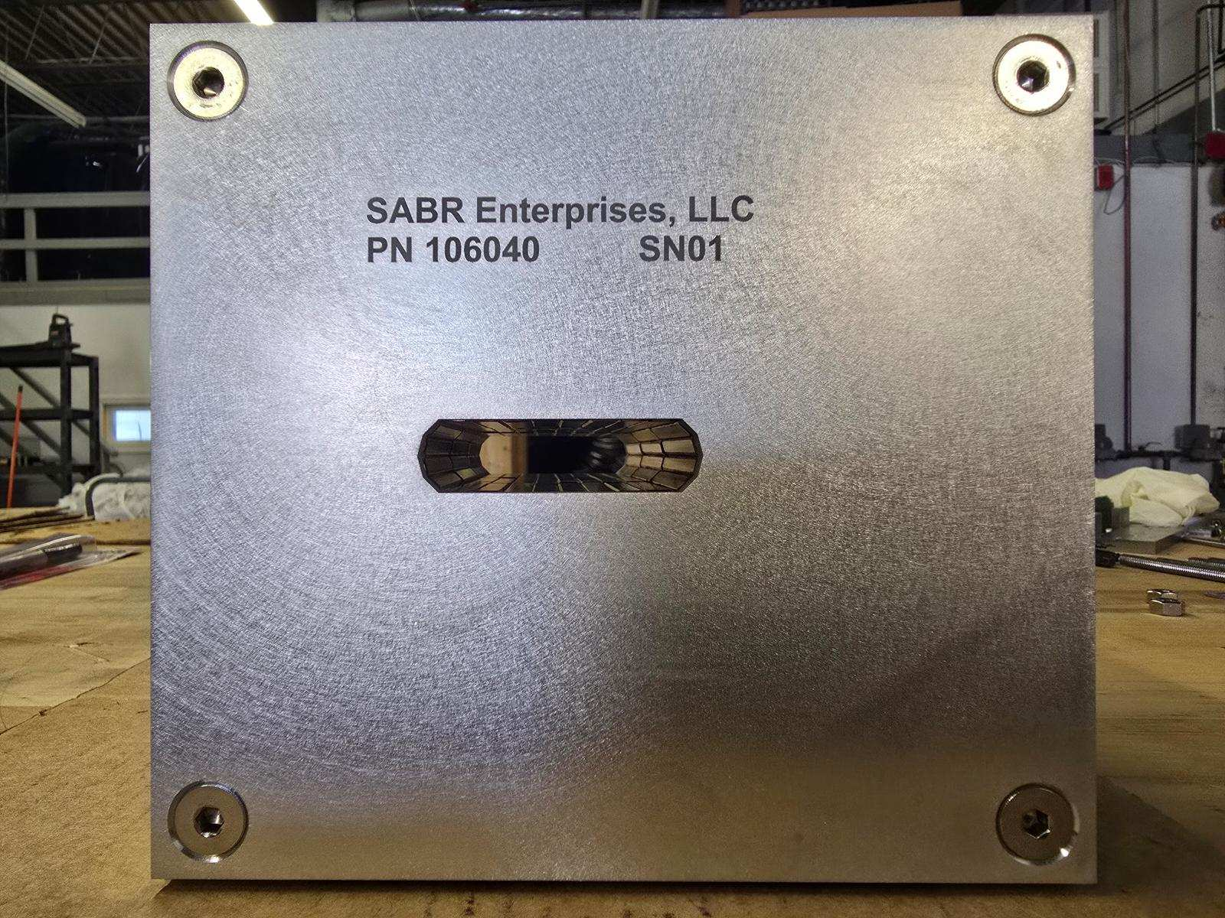
Permanent Magnet Production by ‘SABR’ Enterprises, LLC company (Massachusetts)

Slide 9
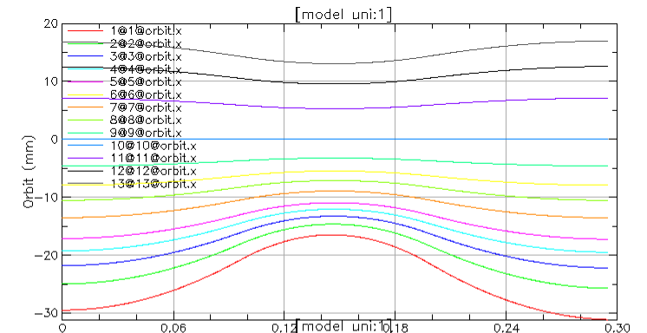
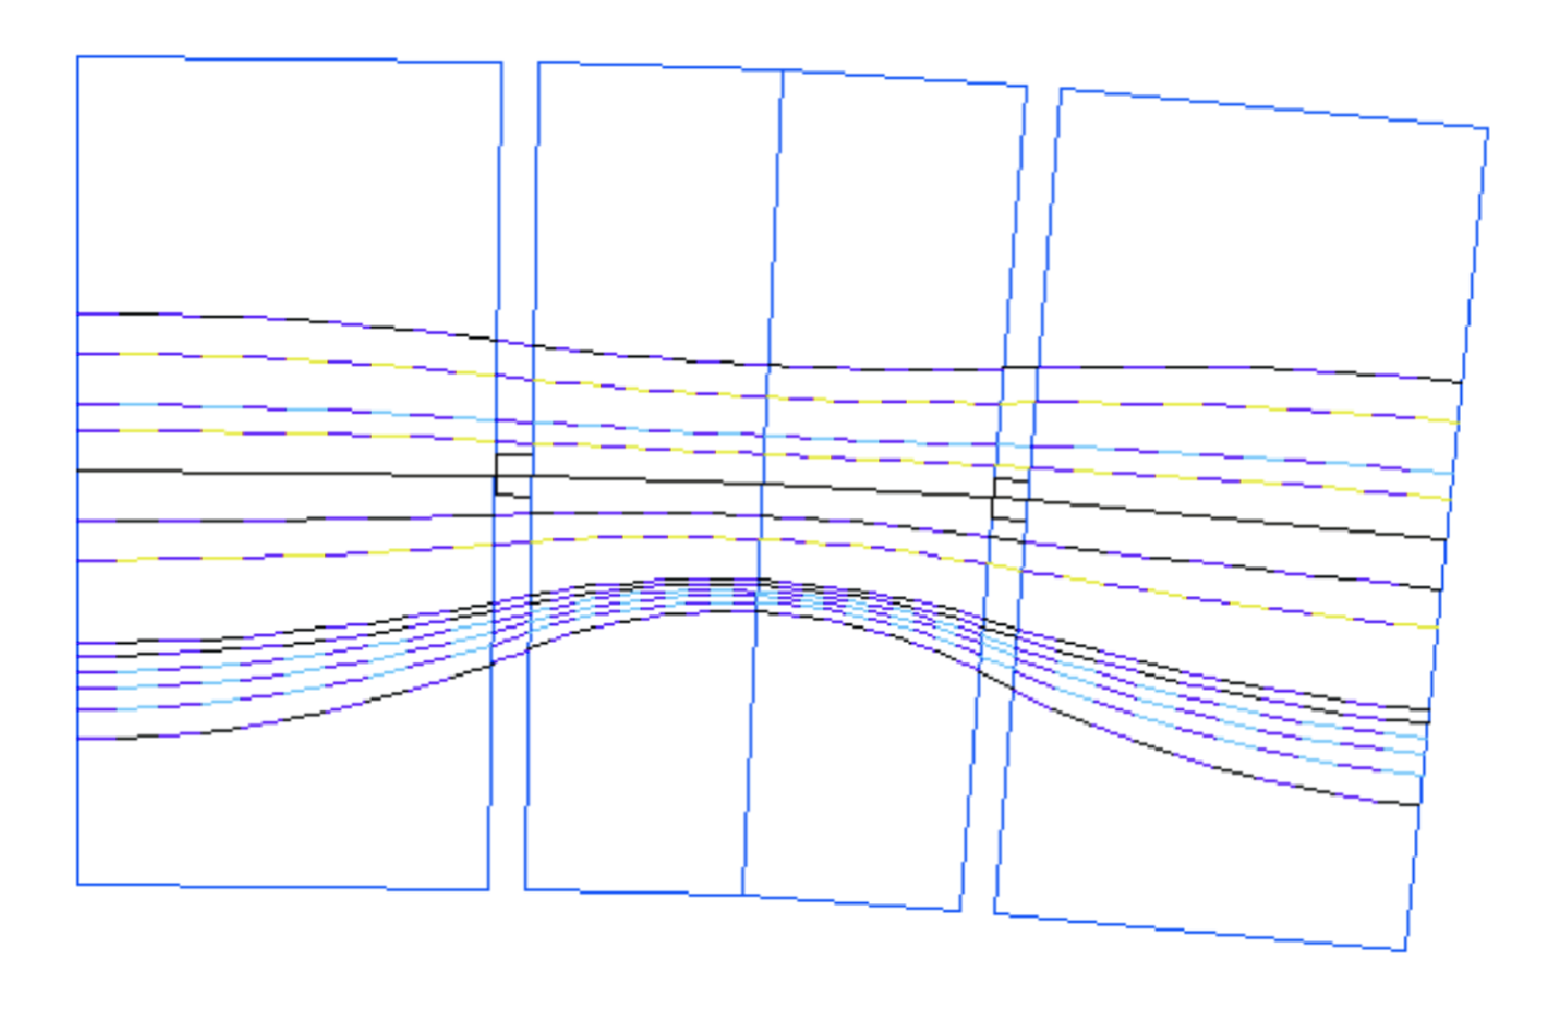
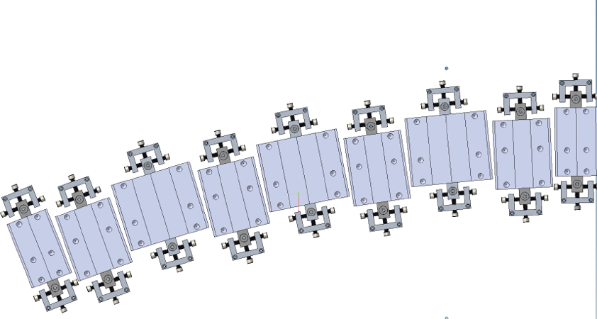
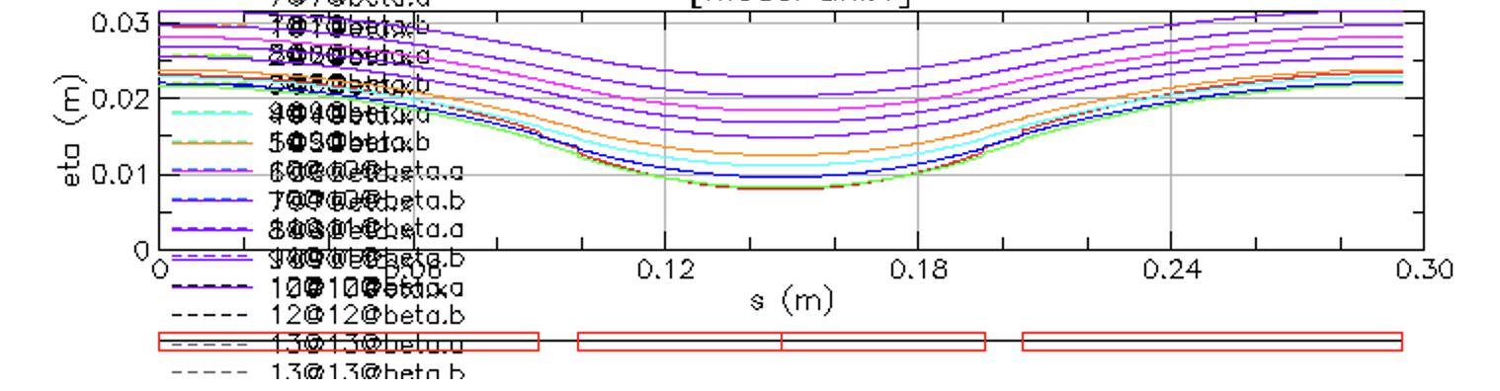
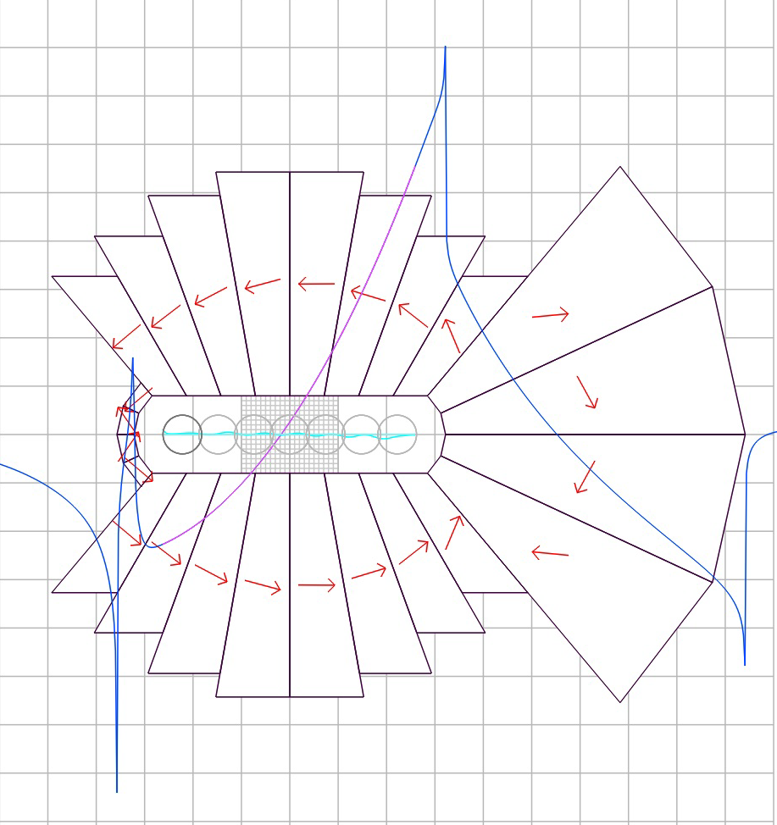
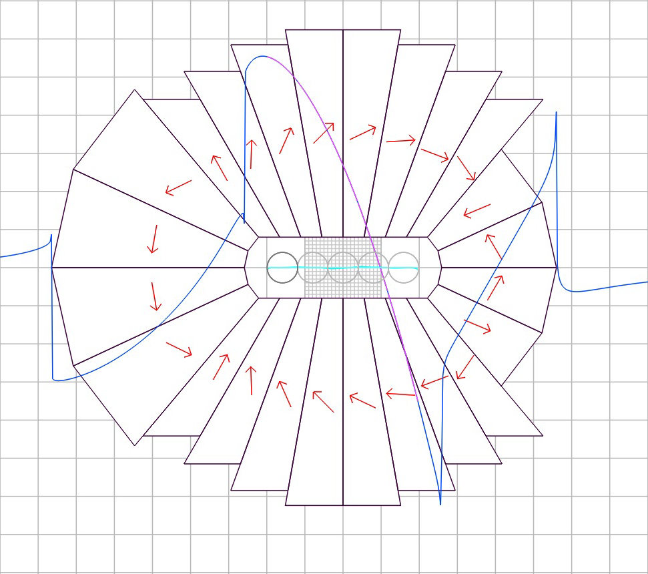
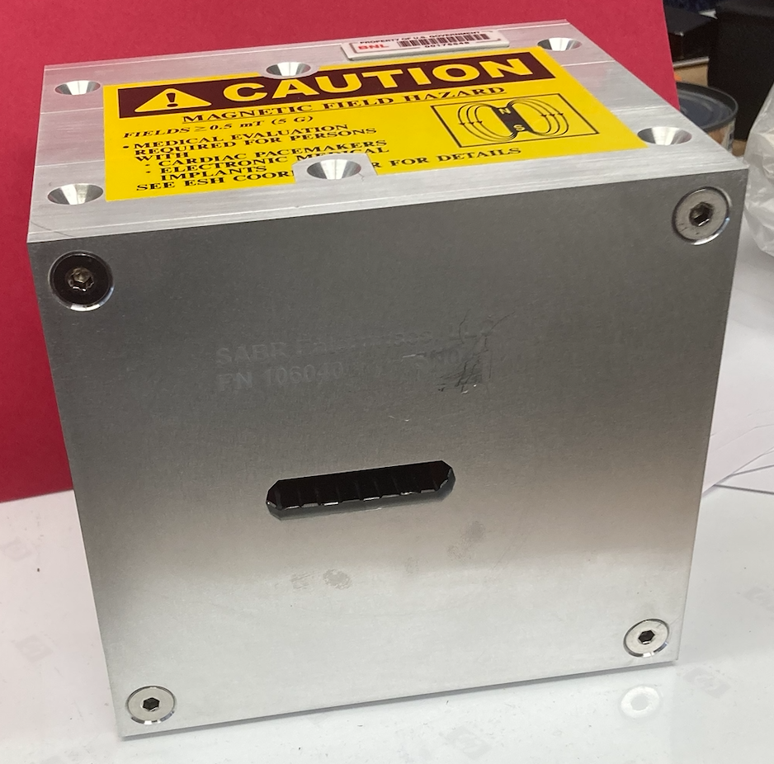
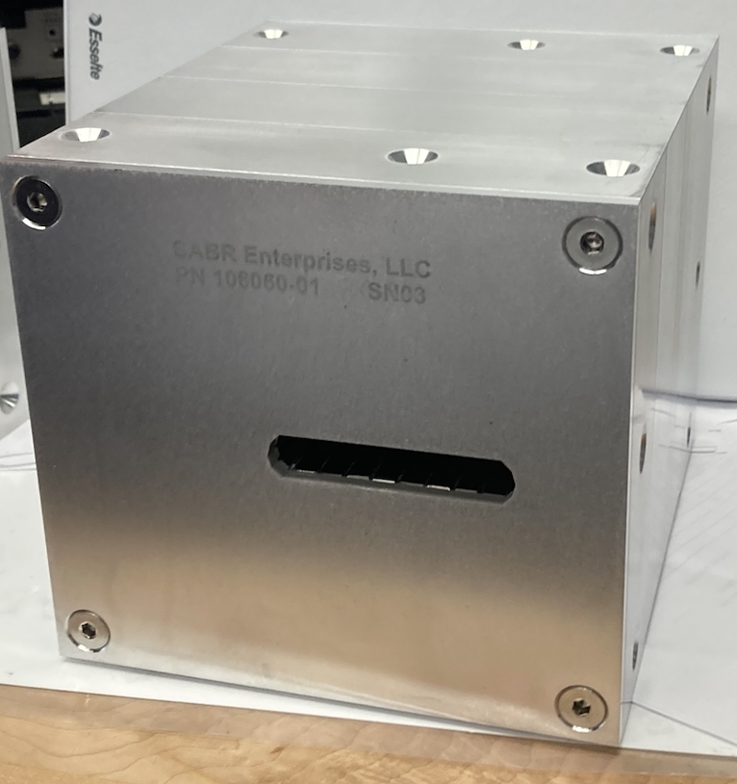
Orbits to Enter and Exit 9 magnets
20 mm
250 MeV
129 MeV
250 MeV
19.6 mm
202 MeV
150 MeV
129 MeV
70 MeV
50 MeV
-30 mm
10 MeV
25 MeV
10 MeV
-33.2 mm
DISPERSION
FUNCTION
F magnet length 18 cm
D magnet Length 9.652 cm
~12.5 cm
~11 cm
~13 cm
~14 cm

Slide 10
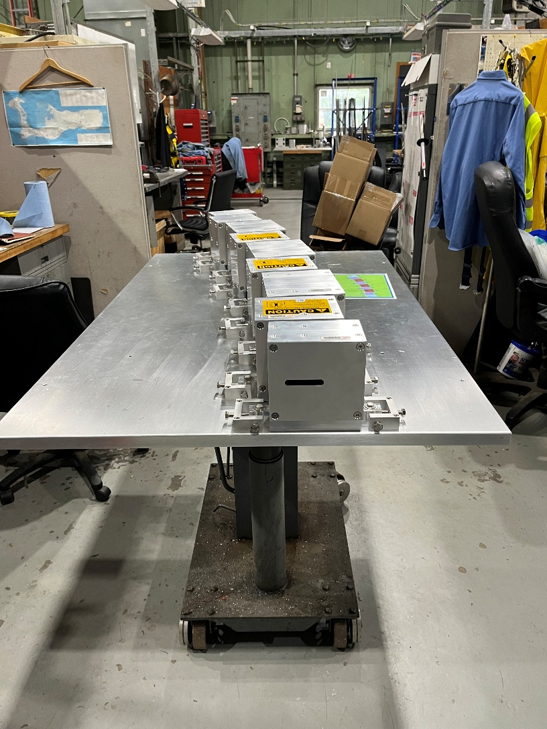
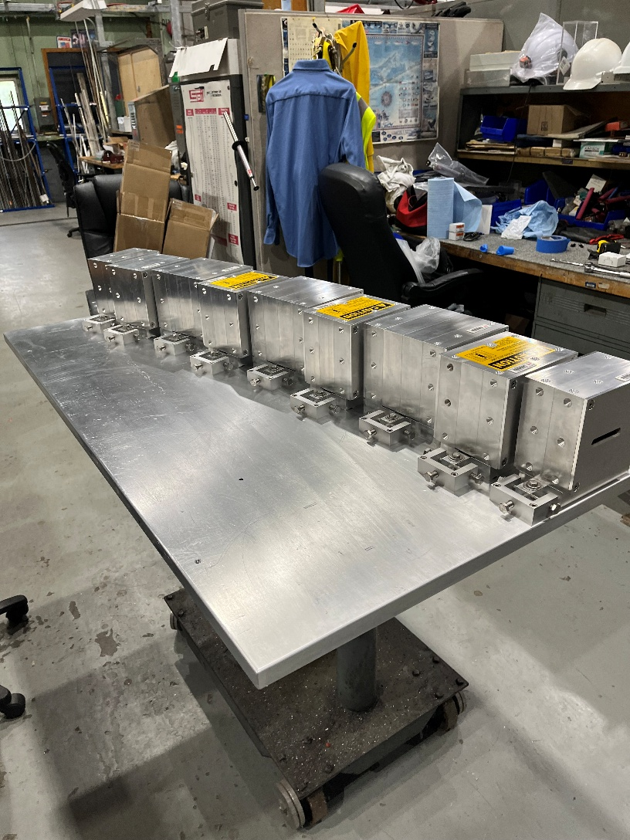
Beamline Assembly

Slide 11
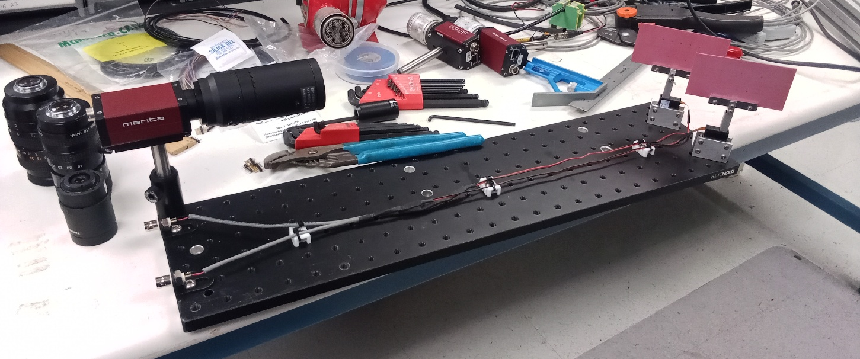
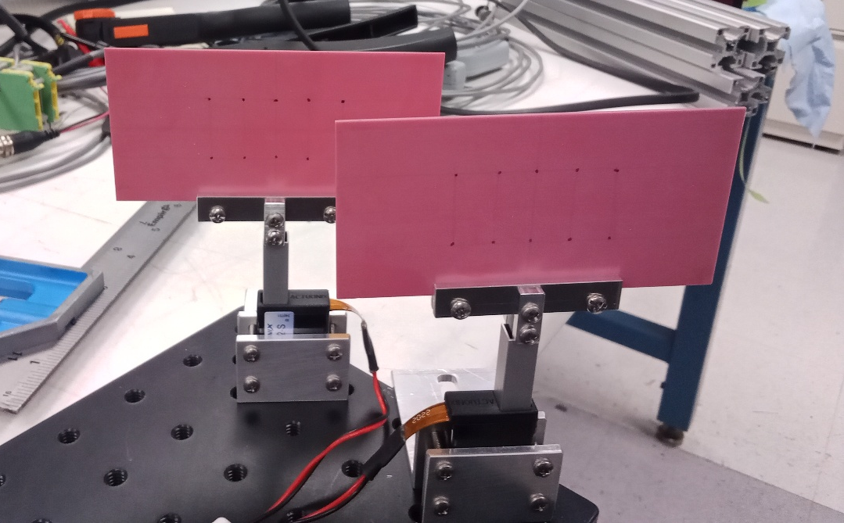
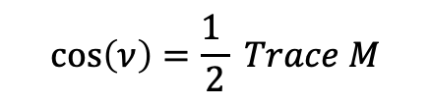


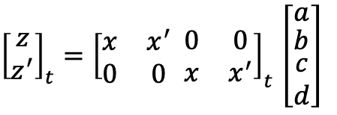




Beam Instrumentation to find the Transfer Matrix
M₄
M₃
M
M₂
M₁
[4]
[3]
[2]
[1]
Beam
l₄
l₃
l₂
l₁
$${x_{4},x}_{4}^{′}$$
$${x_{3},x}_{3}^{′}$$
$${x_{1},x}_{1}^{′}$$
$${x_{0},x}_{0}^{′}$$
$${\overset{⃑}{z}}_{t}=M\overset{⃑}{x}$$
$$M=\left[\begin{matrix}a & b \\ c & d\end{matrix}\right]$$
${\left[\begin{matrix}z \\ z^{′}\end{matrix}\right]}_{t}={\left[\begin{matrix}x & x^{′} \\ 0 & 0\end{matrix} \begin{matrix}0 & 0 \\ x & x^{′}\end{matrix}\right]}_{t}$ $\left[\begin{matrix}a \\ \begin{matrix}b \\ \begin{matrix}c \\ d\end{matrix}\end{matrix}\end{matrix}\right]$
Tune determination:
$$\cos\left(ν\right)=\frac{1 }{2} Trace M$$
There were three beam runs: the first one at NSRL without the assembly checking the beam-air interaction and the second one with the assembly. The last run in October-25 was at Tandem. The more different beam input positions the better accuracy of the betatron function measurements would be. System of Linear equations.

Slide 12
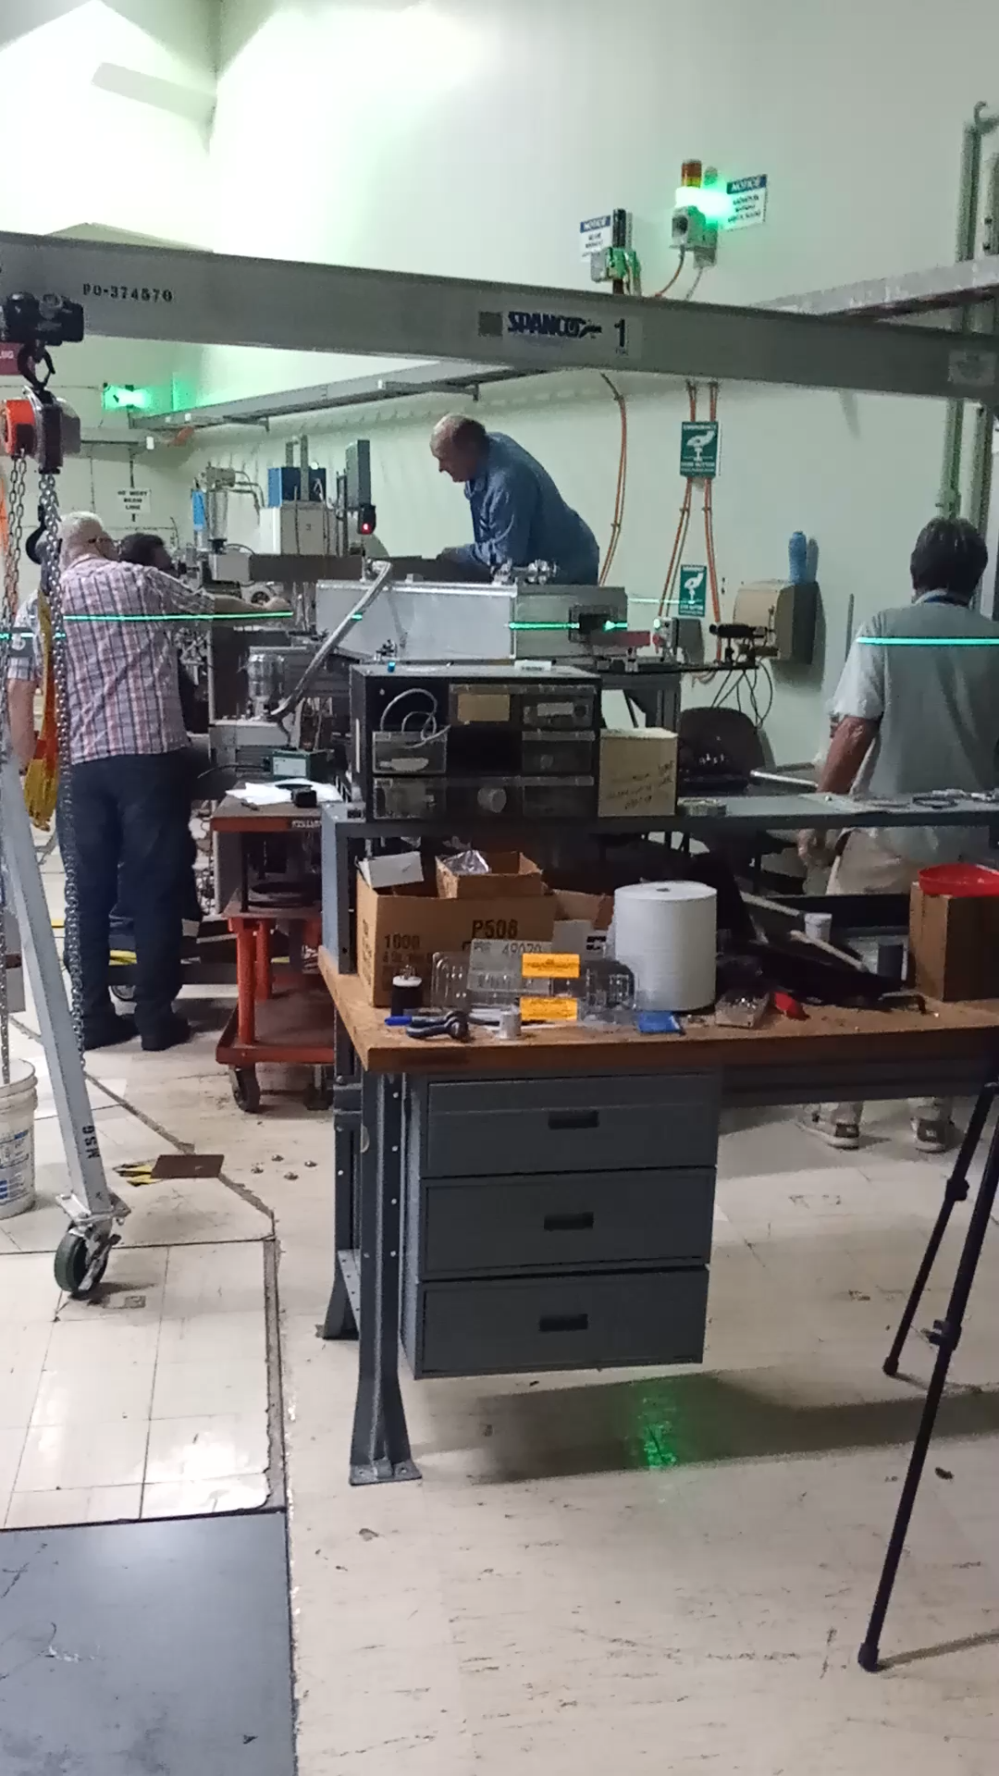
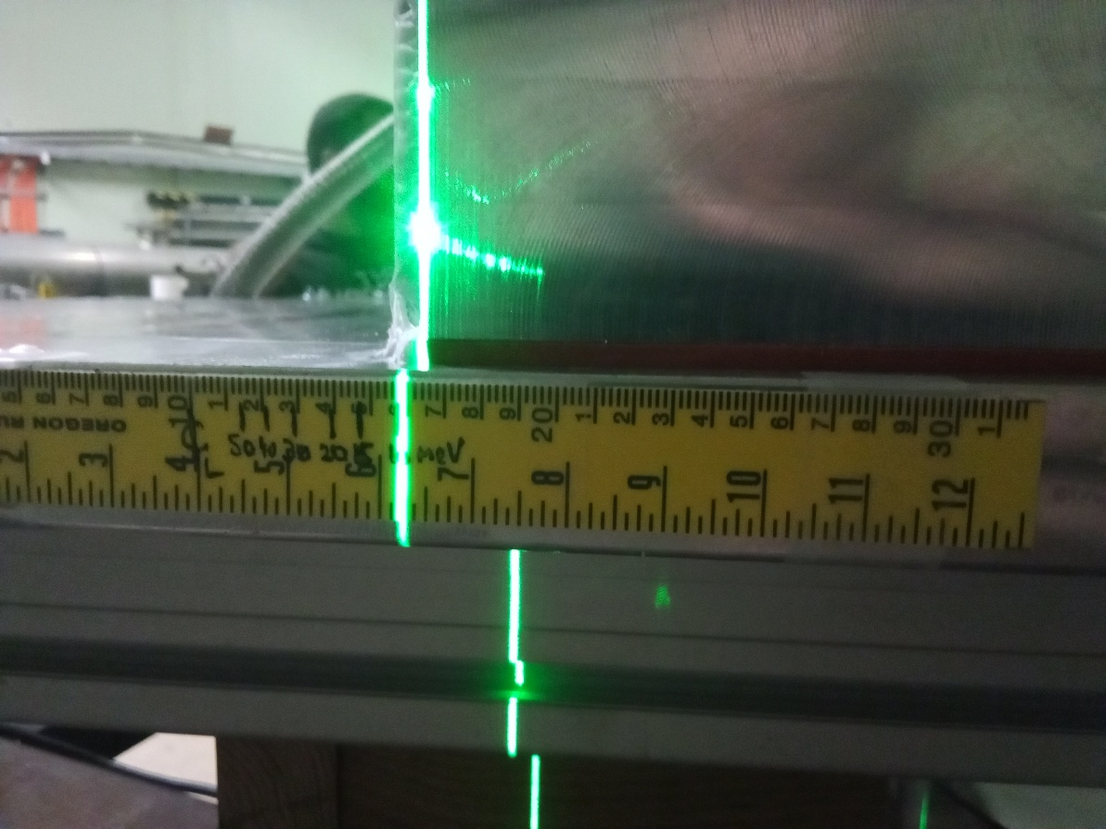
Installation @Tandem
Different beam energies marked on a ruler for alignment.

Slide 13
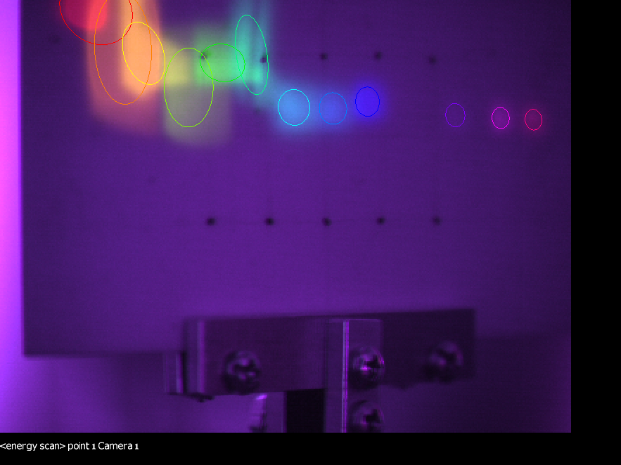
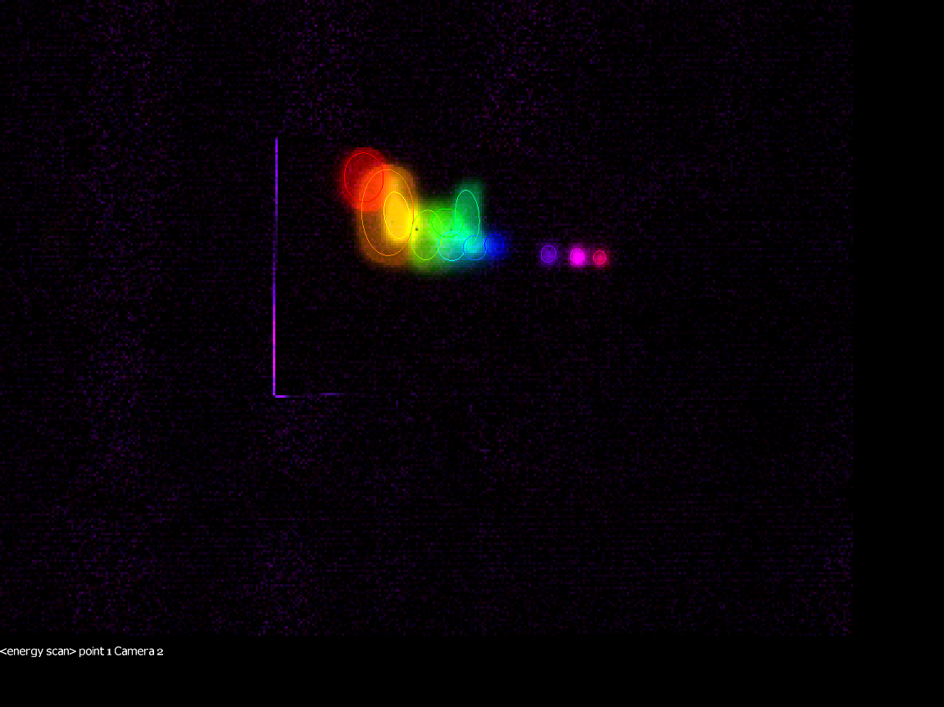
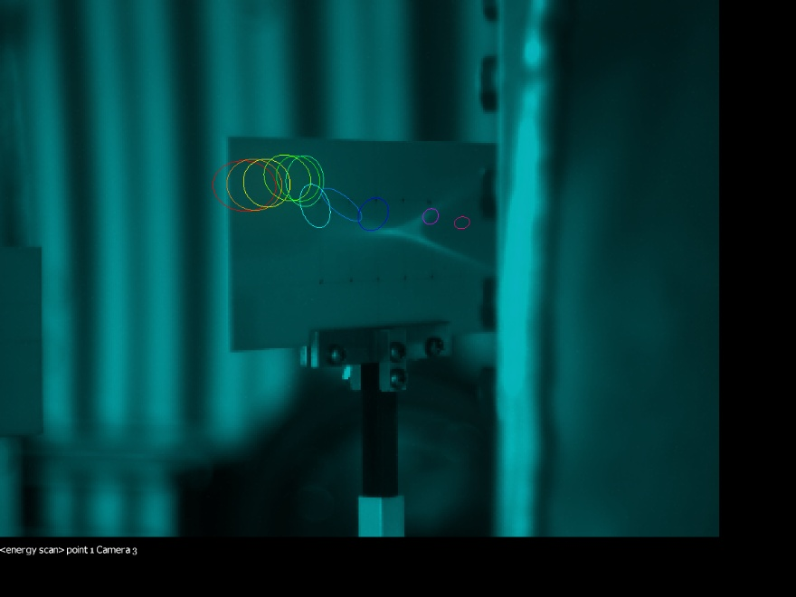
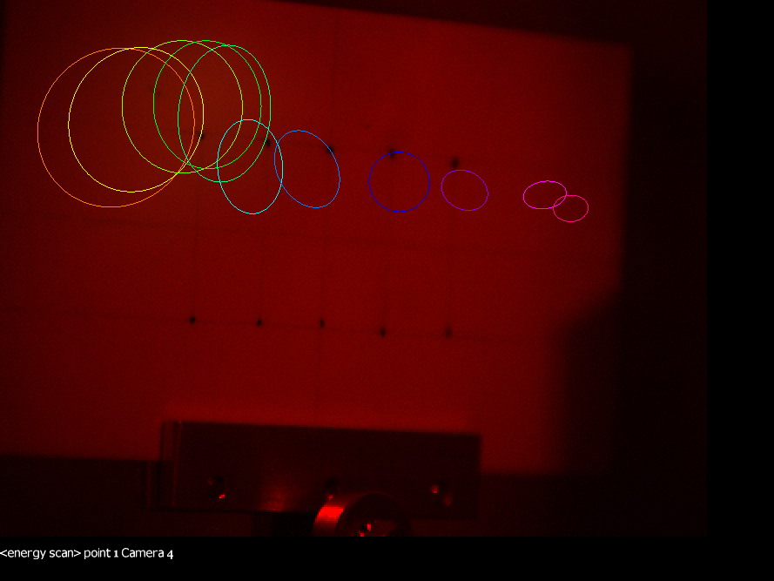
Results from NSRL and Tandem Experiments
All 12 Ellipses
Beam in
Beam out
[1] S. Jolly, H. Owen, M. Schippers, C. Welsch, “Technical challenges for FLASH proton therapy.” Phys. Med. 2020, 78, 71–82. https://pubmed.ncbi.nlm.nih.gov/32947086/

Slide 14
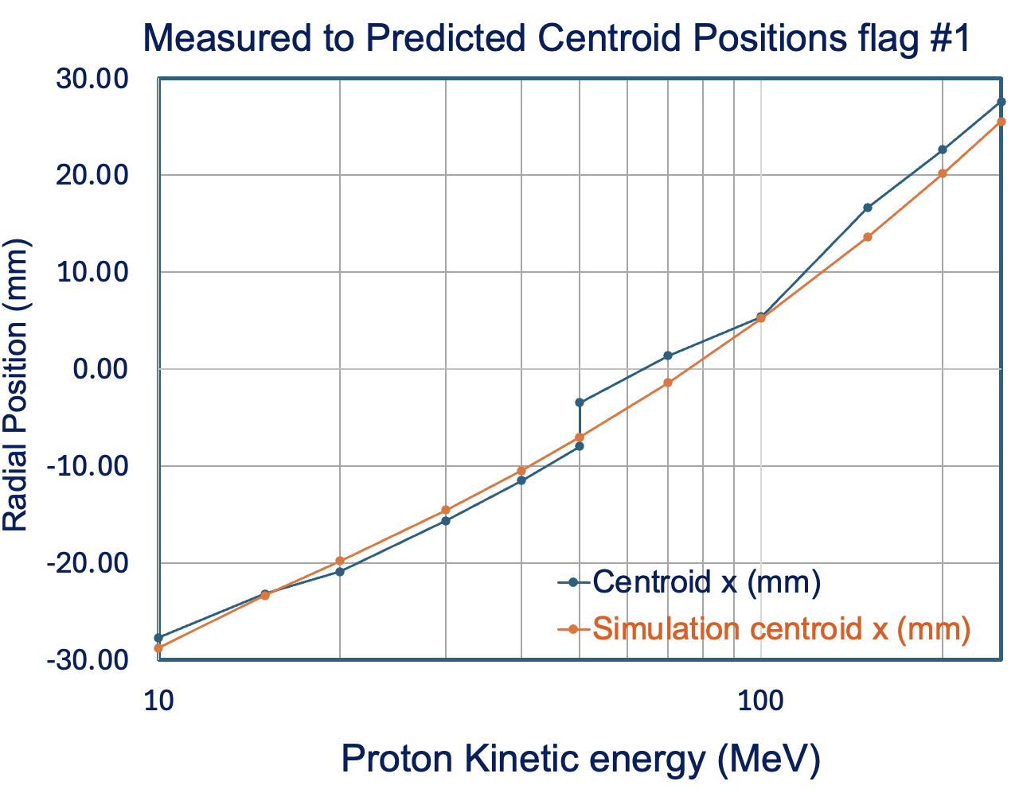
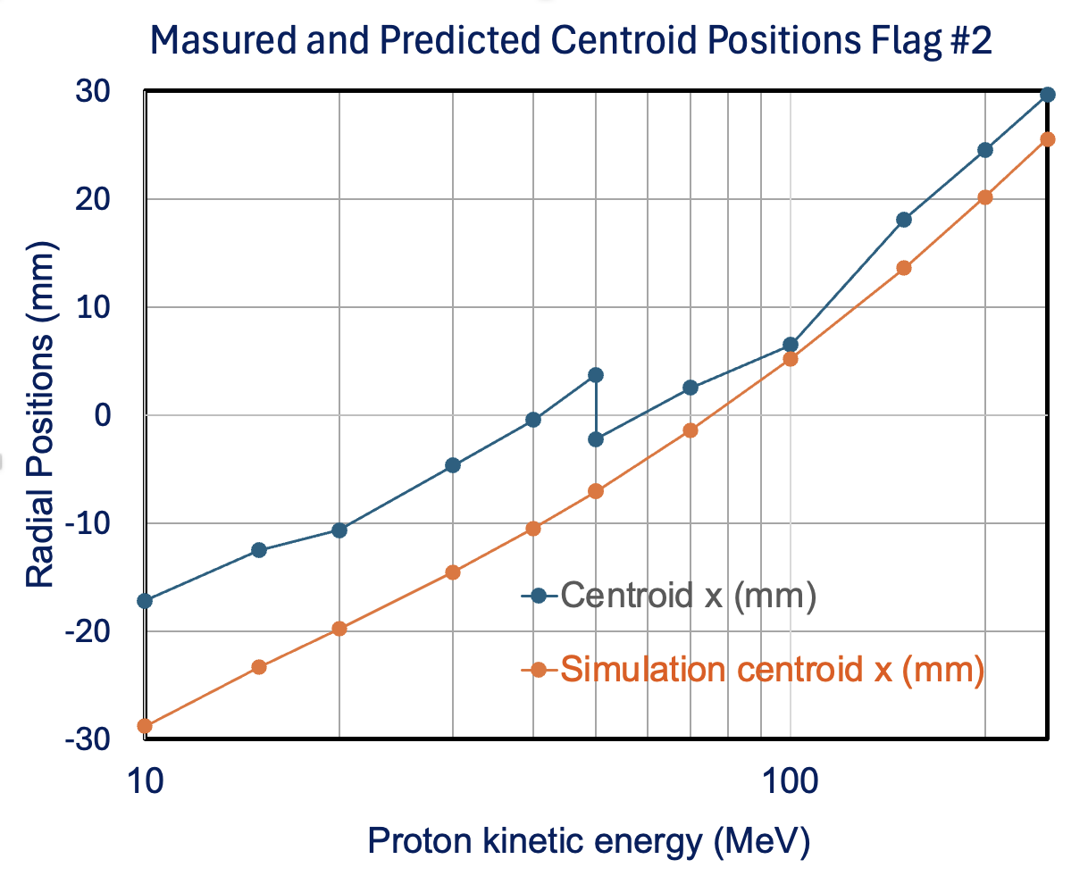
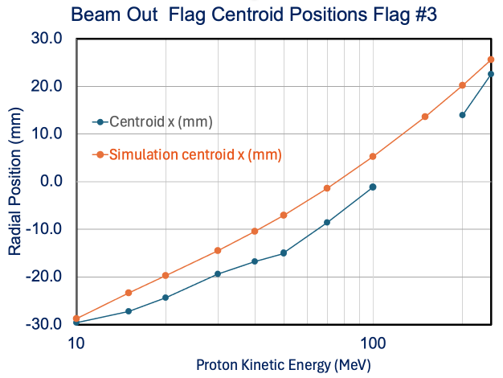
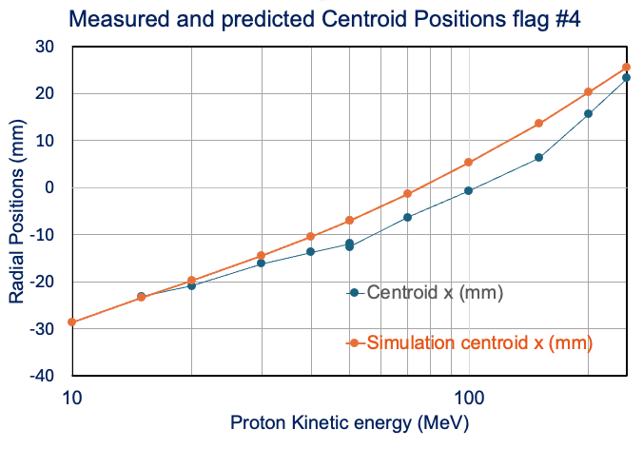
Measurements of the Centroid x Positions
Beam in
15
20
30
40
50
60
80
150
200
250
15
20
30
40
50
60
80
150
200
250
Beam out
15
20
30
40
50
60
80
150
200
250
15
20
30
40
50
60
80
150
200
250

Slide 15
Plan Execution
Our previous successful work on the “Ion Rapid Cycling Medical Synchrotron - iRCMS Pre-Conceptual Design Report (2012), the CBETA Design Report (2016), and of the CBETA Project report to NYSERDA (2020) are of great significance in this proposed LDRD project. These previous publications will provide a clear directions in producing high quality Pre-Conceptual Report for the Permanent Magnet FLASH therapy facility. The iRCMS report was a result of a total of 36 physicist and engineers fully contributing to each chapter. Here are the proposed chapters to be presented in this proposal:
  Executive Summary – this will be a collaborative work between BNL and SBU
  Clinical Specifications – We expect this chapter to be provided by our team from Radiation Oncology from Stony Brook University Hospital leading with the Chairman professor Samuel Ryu.
  Facility Specifications – There will be additional FLASH therapy requests added to the standard proton therapy requirements
  Permanent Magnet Synchrotron – this part of the project is well defined and the results from the previous magnet design and experimental measurements will be used. There are additional details to be added required for the RF and injection and extraction straight section.
  Permanent Magnet transfer beam lines – This important part for the FLASH application has already been developed.
  Permanent Magnet Proton Gantry – The design has been already patented and presented in multiple occasions during the last decade.
  Injector – There are already multiple choices available on the
  Radio Frequency System – We will be using the results from the UK –RAL, J-PARC.
  Power Supplies – we will repeat use correction power supplies used in the CBETA project
  Instrumentation – This part is the repeat from the CBETA project
  Vacuum System – Experience from the CBETA project will be applied here (Rob Michnoff).
  Injection-Extraction – this subject was extensively studied at the previous iRCMS report.
  Executive Summary

Slide 16
LDRD Project Plan and Execution
TASK | Persons | Period
Executive Summary | S. Ryu, D. Trbojevic, S. Brooks | Oct 2026 – Dec 2026
Clinical Specifications | S. Ryu and X. Qian | Oct 2026
Facility Specifications | D. Trbojevic, S. Ryu, S. Brooks | Oct 2026 – Oct 2028
Permanent Magnet Synchrotron | D. Trbojevic and S. Brooks | Oct 2026 – May 2027
Permanent Magnet transfer beam lines | D. Trbojevic and S. Brooks | Oct 2026 – Jan 2027
Permanent Magnet Proton Gantry | D. Trbojevic and S. Brooks | Oct 2026 – May 2027
Injector | D. Trbojevic, R. Deepak, S. Brooks | June 2023 – Dec 2023
Radio Frequency System | A. Zaltsman | Oct 2026 – May 2028
Power Supplies | R. Michnoff, Y. Marneris | Oct 2026 - May 2027
Instrumentation | R. Michnoff | Oct 2026 - Oct 2027
Vacuum System | D. Weiss | Oct 2026 – Oct 2027
Injection-Extraction | N. Tsoupas, Y. Marneris | Oct 2026 – Oct 2027
Executive Summary | D. Trbojevic, S. Ryu, S. Brooks | Aug 2028-Oct 2028

Slide 17
Summary
This LDRD will allow us to prepare the Pre-Conceptual Design Report for the Permanent Magnet Proton FLASH Therapy Facility a necessary step before financial support is obtained.
Well established team at the CAD who already created very well written iRCMS Pre-Conceptual Design Report will be able to produce even better report.
We a planning to make a summary publication in the Phys. Rev. Special Topics Journal
This report is essential for the further steps in obtaining the full financial support and transfer of BNL accelerator technology to the medical applications.
This LDRD will present a final step in multi year collaboration between SBU and BNL.
The RHIC Advisory Committee in the December 2025 review wrote about the results from the previous LDRD 24-010:
‘The committee congratulates the team on their experimental confirmation that the available momentum range is very large for a non-scaling FFA, particularly for one with a flattened tune. A factor of 5.3 in momentum could be reached. A beam energy of 250 MeV is the highest ever reached energy in any NS-FFA line.’

