Slide 1
A Beam Test Facility at the Booster R-line Complemented with Tracking Stations
FY27 NPP LDRD Type B Pre-Proposal
serving DOE Nuclear Physics and High Energy Physics detector test needs
( i.e. ePIC detector of EIC and HL-LHC detectors etc).
PI: Xiaodong Jiang (C-AD)
1/9/2026

Slide 2
FY27 NPP LDRD Type B Pre-Proposal
Proposal title: A Beam Test Facility at the Booster R-line (NSRL) Complemented with Tracking Stations
Primary Investigator: Xiaodong Jiang
Other Investigators (None). + 1 BNL dedicated postdoc (after approval).
Collaborators: SBU ATLAS group and other University groups. Other BNL groups.
Indicate if this is a cross-directorate proposal: Yes ___ No__x_
If yes, identify other directorates/organizations:
Proposal Term: From: 10/1/2026 To: 9/30/2028

Slide 3
FY27 NPP LDRD Type B Pre-Proposal
Title: A Beam Test Facility at the Booster R-line Complemented with Tracking Stations.
Abstract: to add four particle tracking stations with DAQ to the Booster R-line (NSRL) to provide event-by-event tracking capability for detector tests, to fulfill detector beam test needs for DOE Nuclear Physics and High Energy Physics communities (i.e. EIC, HL-LHC).
Program: DOE Office of Science, Nuclear Physics and High Energy Physics.
Return on Investment: a DOE funded detector beam test facility at BNL.
Broader impact to BNL: expect significant follow-up investments and support from DOE Office of Science, both HEP and NP program, to serve US detector development community. The readily available beam test facility will enhance BNL’s position as the world leader in new detector technology.
Total planned funding:
FY27 ($250k): 1 FTE postdoc, 1/4 scientist, equipment and engineer design.
FY28 ($250k): 1 FTE postdoc, 1/4 scientist, equipment, design, test beam time etc.

Slide 4
Urgently Need: Test Beam for Detectors at BNL
Accelerator-based beam facilities are critical for testing components and validating detector technologies, for EIC, HL-LHC etc.
Many test-beam facilities will experience multi-year downtimes over next decade: FNAL, LANL, CERN, DESY.
new detector designs and prototypes urgently need to be tested to feedback on long term critical decisions in DOE projects, such as the ePIC detectors at EIC, and the HL-LHC detectors. The ePIC collaboration: “a beam test facility at BNL would be a significant reduction of risk for ePIC”.
BNL’s Booster R-line (NSRL) will continue to operate during EIC construction (2026-2035).
NSRL available now: a beam line, with protons up to 2,5 GeV (~1E11 /sec),
many empty slots in beam time user schedule.
Not available: event-by-event tracking capability.
NSRL can do now: radiation hardness/damage studies
NSRL can not do: tracking quality verification, i.e. position resolution studies

Slide 5
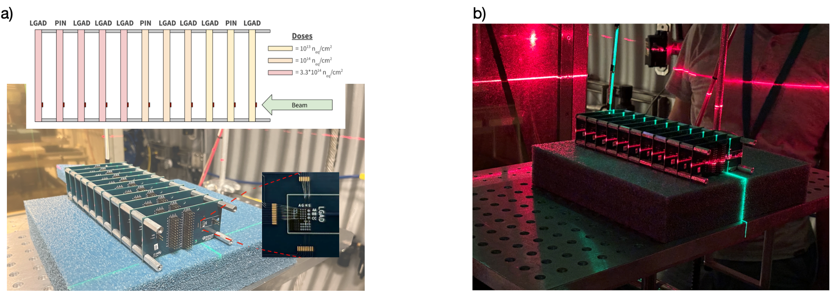
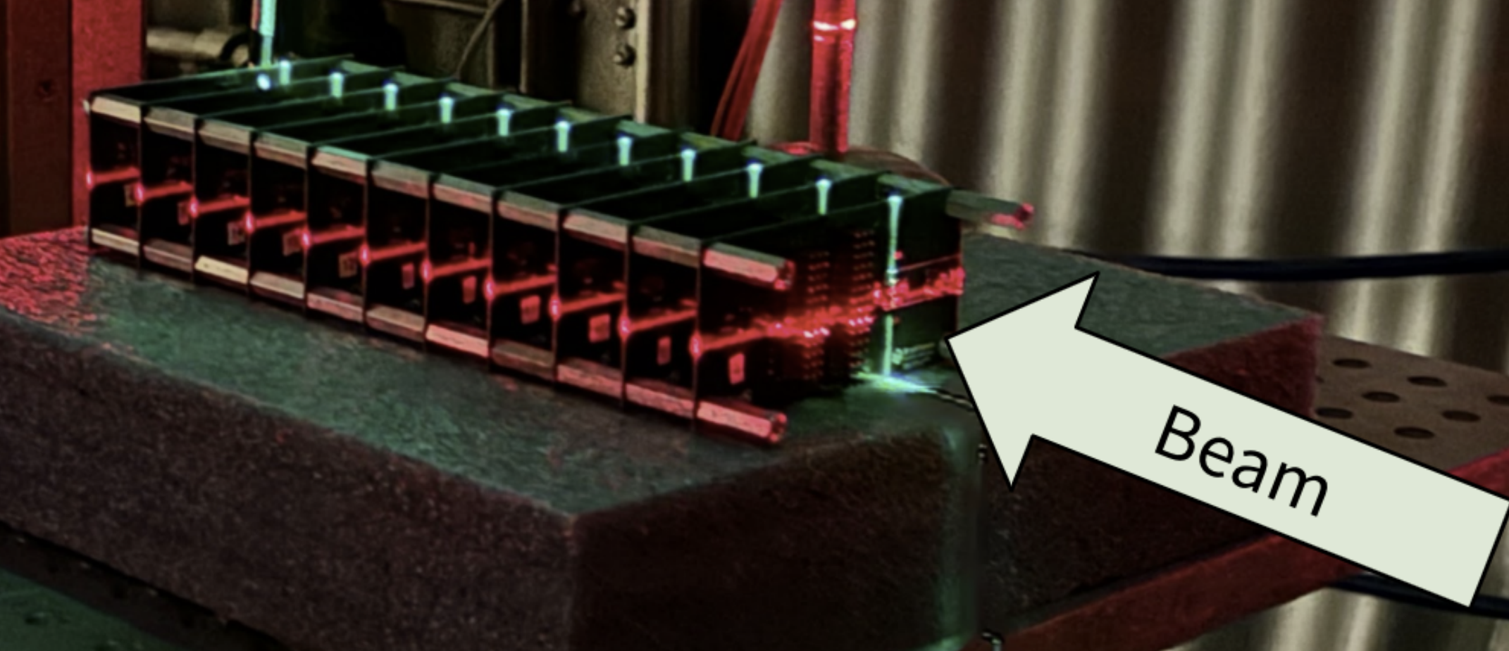
Serving HEP/NP community, NSRL beam is best suited for tests of charge particle tracking detectors, radiation hardening of detectors and front-end electronics, etc.
For example, BNL group completed a SiC tracking detectors radiation damage test.
August,2024, radiation tests at NSRL(12 hrs, supported by BNL-LDRD, Physics Dept.).
SiC operate at room temperature eliminate cooling systems, reducing material budgets and improving performance
A stack of 4H-SiC low gain avalanche detectors and complementary PiN diodes were irradiated with 2.5 GeV protons at fluences up to 3.33×10¹⁴ p/cm² (arXiv:2507.23062 BNL, LBNL, North Carolina State).
However, NSRL beamline currently has no tracking capability.
Not able to perform tracking quality studies, quantify position resolution as a function of radiation exposure, corresponding to 5yr, 10yr HL-LHC operation.

Slide 6
Proposed work: to reproduce Fermilab test beamline’s reference tracking capability at BNL.
detectors under test
tracking station #1
#4
#3
#2
x
x
x
x
x
beam
x₄, y₄
x₃, y₃
σ_{x ,}σ_{y}: 50μm
x₂, y₂
x₁, y₁
Add four silicon tracking stations (with a DAQ sys), 50 μm pitch in (x,y), over 1 m distance, 50 cm space in between for “detectors under test”.
NSRL detector beam test facility (high flux proton up to 2.5 GeV ) is best suited:
verify tracking detector design and performance (efficiencies, resolutions).
optimize detector and read-out electronics operation under extreme conditions.
assess radiation degrading/damage for detectors and electronics, etc.
Deliverables:
FY27: a prototype tracking telescope, covers ~cm², with DAQ capacity 10 kHz.
FY28: four tracking stations, cover 10cm x10cm, with DAQ capacity up to1 MHz.
(use off-the-shelf commercial components and/or decommissioned BNL equipment)

Slide 7
Summary
There’s an urgent need of test beam for detectors at BNL
Booster R-line (NSRL) will operate during EIC construction (2026-2035).
Adding tracking capability, NSRL beamline can serve DOE Nuclear Physics and High Energy Physics detector test needs (i.e. ePIC and HL-LHC etc).
Return of Investment: a DOE funded detector beam test facility at BNL.
Best use of BNL resources, fill empty NSRL beam time slots.
Availability of a beam test facility for detectors at BNL would be a tremendous boon to particle physics and would provide a testbed for innovative ideas in instrumentation
Enhance BNL’s capacity as a world leader in:
new detector technology developments.
training of next generation particle detector experts.
In the full proposal:
initial design specifications, technical expertise, procurements and budget estimates for different detector and DAQ options: 1. ATLAS prototype tracker (SBU group), 2. commercial trackers (TimePix3), 3. other decommissioned trackers (BNL).

Slide 8
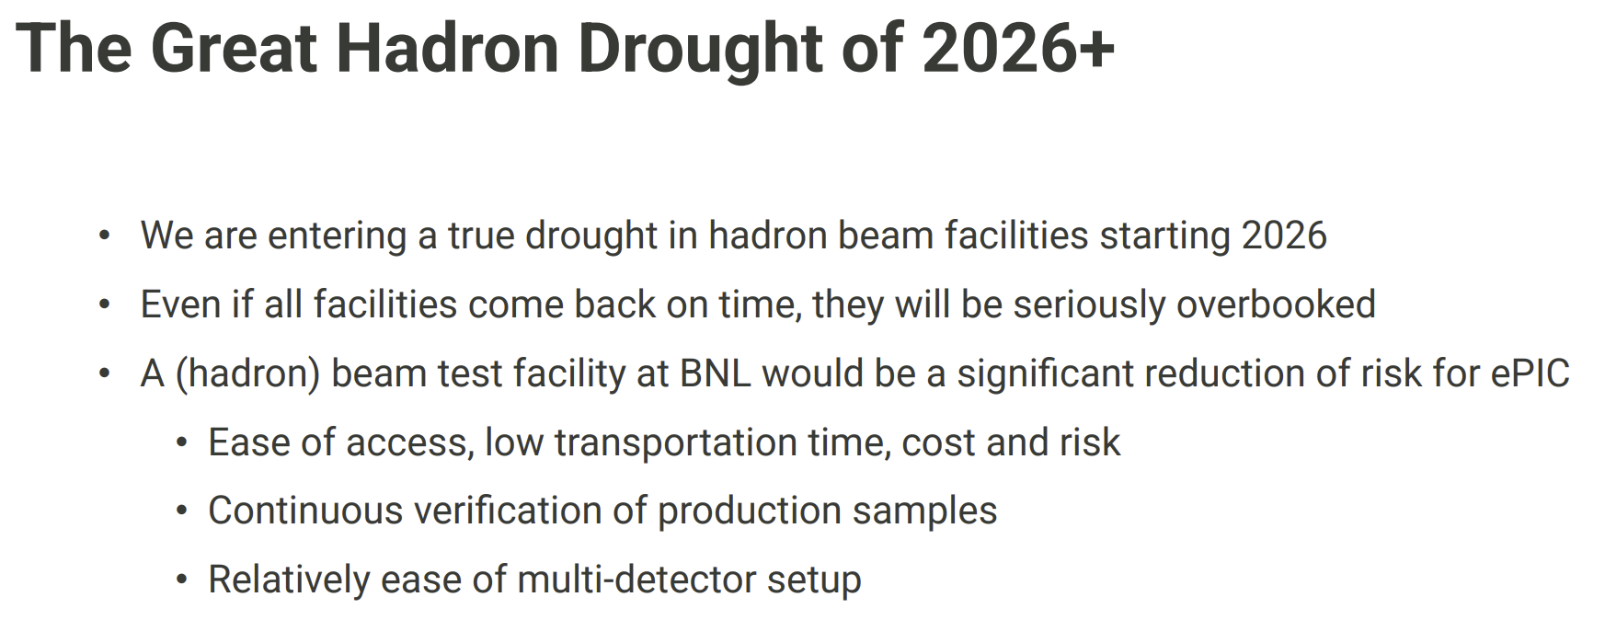
Backup Slide:
from ePIC collaboration meeting, 2025.

