Slide 1

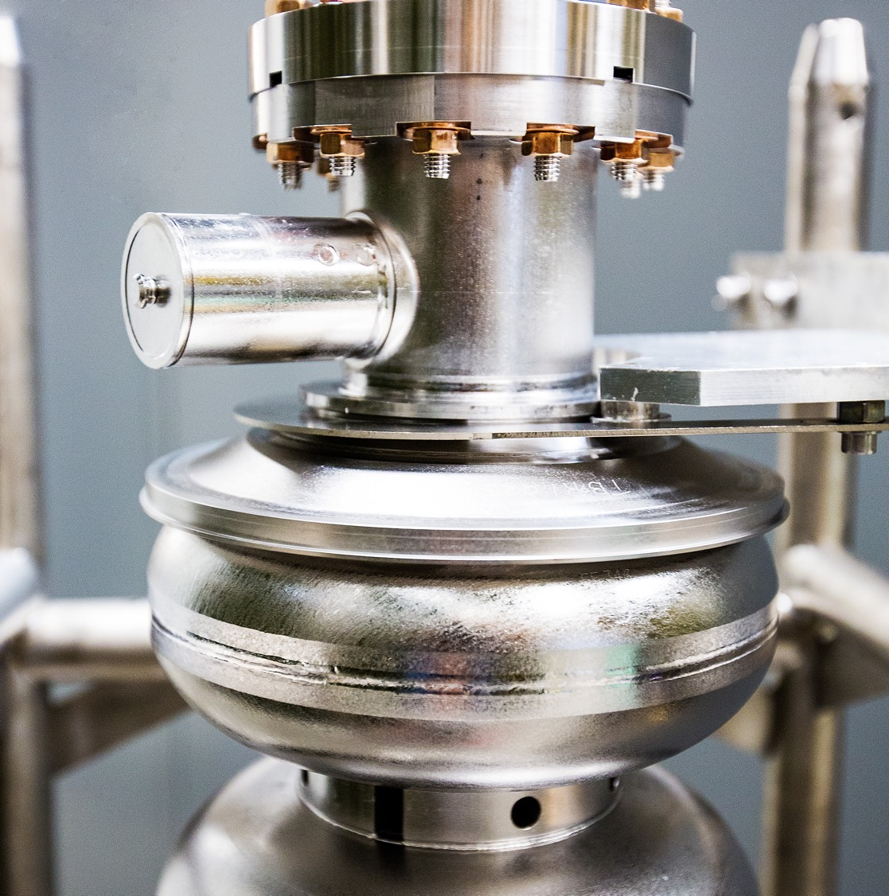
HRPPD Meeting #3 Update
2025-12-23
Raymond Dawson
Notes:
Tip: Keep titles under 60 characters for readability
To change the photo: Right-click on photo and select change photo

Slide 2
Current Status
HRPPD Tasks: Due by 01/12/2026
Simulations
  Complete - stitching vias, air side interposer pad reduction, GND planes
  Complete 12/16 - Vacuum side pad size selection
  Complete 12/23 – air side pad size, interposer ground pour
High Voltage (HV) Design
  Complete - preliminary pogo pins selected, HV spacing determined
  TBD
    Location of ground and power connections to MCPs
Mechanical Changes
  TBD
    Interposer positional tolerance
    Pogo pin placement on HRPPD and backplane
    Match outline to mechanical changes
Other
  Complete - Break in ground ring placed
  TBD
    Update HRPPD with final design changes
Awaiting input:
  Interposer downselection - # of grounds TBD, footprint will fit by2 and by4 arrangement
  Optimization of number of vias – may not be needed depending on HV change to sidewall
  Test file import with Kyocera – files sent 12/18, Theo out of office until 1/12
Non-HRPPD Tasks: Due after
Backplane Changes
  Cables
  Safety resistors
  Bypass capacitors + ringing resistors
  Plastic connectors for HV connections
FCFD Test Board
  Board design complete
  Final quote received, ETA 20 days ARO
  12/23 – all signatures, buyer assigned, waiting for PO to issue
Notes:
Add due date

Slide 3
Air Pad Size Simulations
Tested 3 air pad dimensions with 2.75 and 2.85 mm vacuum pad size (6 total)
  0.8mm – this has been the default, derived from the recommended Samtec interposer
  0.87mm – this is the maximum pad size given Kyocera design limits
    Pads are 1mm pitch, Kyocera requires 0.127mm between copper features
  0.65mm – this is the recommended pad size from Neoconix
Tested ground pour between pads
  2.75 mm vacuum pad size and 0.8 mm air pad size tested only
  Tested 2 copper clearances – 4 mil and 12 mil

Slide 4
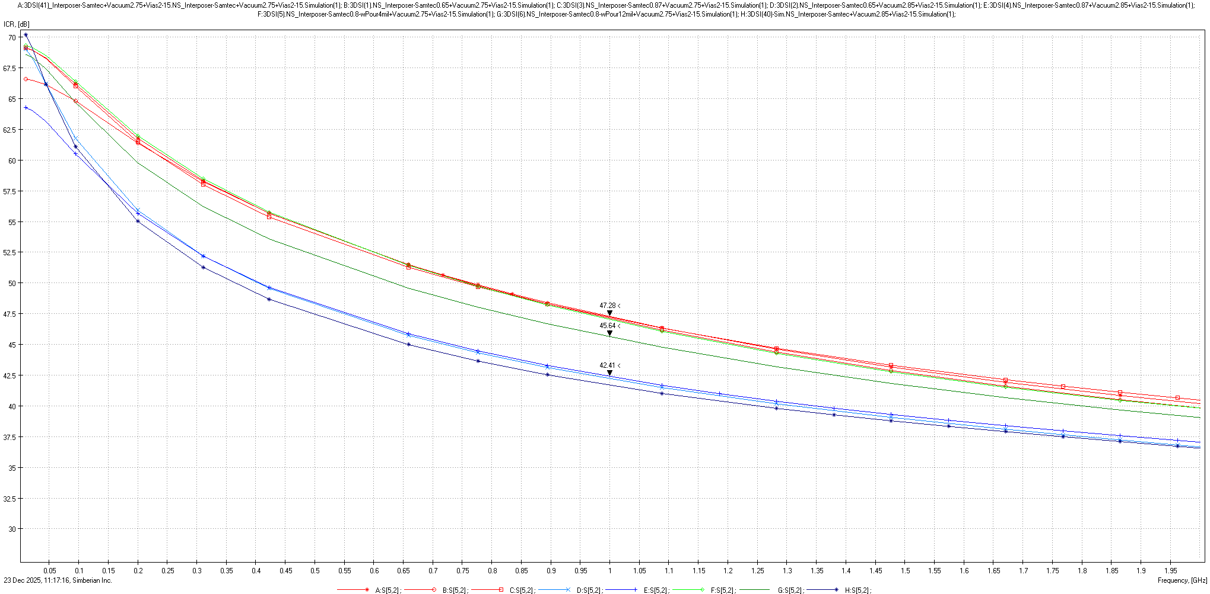
Air Pad Size Comparison - ICR
Higher is better
Target >40dB (<1% voltage xtalk)
Red lines = Vacuum pad size 2.75 mm
Blue lines = Vacuum pad size 2.85 mm
Green lines = Air side pour, Vacuum pad 2.75mm, Air pad 0.8 mm
Takeaways
Air pad size has negligible impact since majority of crosstalk is found elsewhere
Air pad size has slightly more effect where there’s greater crosstalk
Ground pour without close spacing seems to have unintended effect
Marked red line = 0.43%
- 0.01% difference in red lines + green
- Clustered green line is 4 mil pour clearance
Marked green line = 0.52%
- 12 mil pour clearance
Marked blue line = 0.77%
- 0.04% difference in blue lines

Slide 5
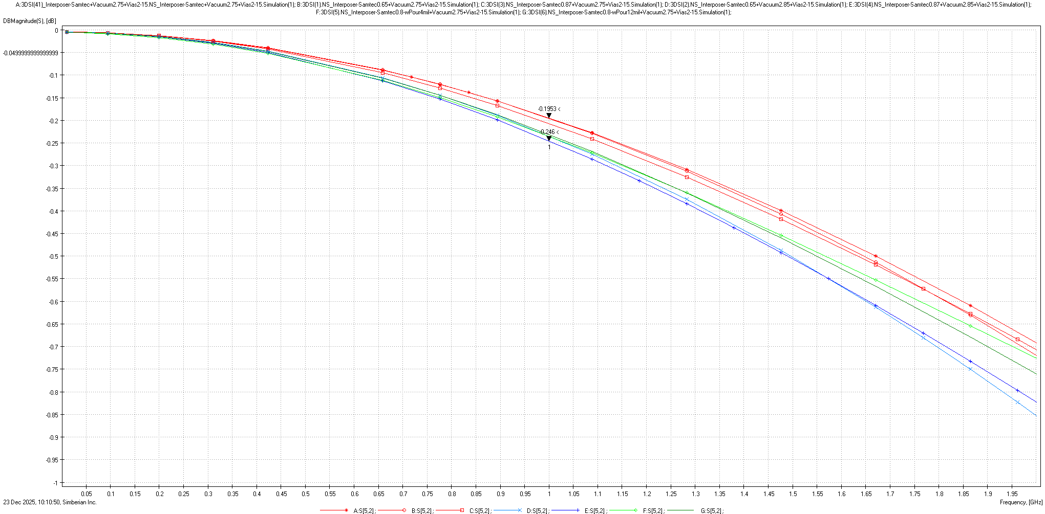
Air Pad Size Comparison - IL
Higher is better
Target >-1dB (10% voltage loss)
Takeaways:
Difference in IL is negligible (~0.5%)

Slide 6
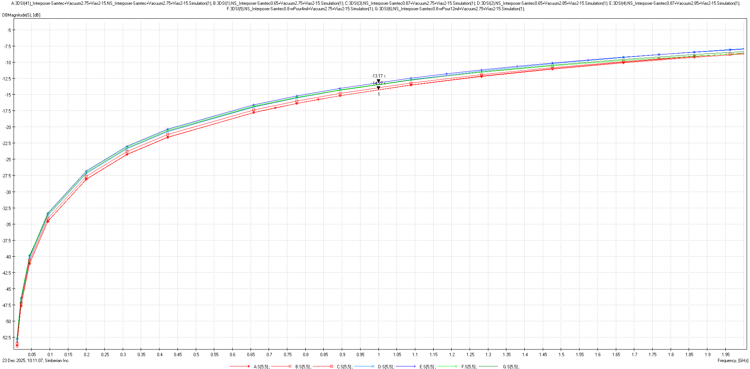
Air Pad Size Comparison - RL
Lower is better
Target <-13dB (5% power reflected)
Takeaways:
Difference in RL is negligible (1.1%)

Slide 7
Summary
Air pad size
  Has no significant impact on SI performance
  Recommendation: use pad size that matches mechanical requirement
Air pad ground pour
  Potential negative performance if not implement correctly
    Difference in performance is not huge (<0.1%)
  Recommendation: do not add pour since ground pour has no significant improvement
  May investigate pour further if time available

Slide 8
Discussion
Vacuum side pad size / gap
  2.75 mm pad size = 500 micron gap
    Best results
  2.85 mm pad size = 400 micron gap
Example anodes:
  Hamamatsu R10754 MCP gap = 300 microns
  PLANACON-XP85112 = 600 microns

