Slide 1
HRPPD B-field Campaign –
Partial Results
Jihee Kim (jkim11@bnl.gov)
Brookhaven National Laboratory
2025/12/24
HRPPD B-field Measurements at BNL Meeting

Slide 2
Overview
Looked into a subset of available data. (thanks to Ping and Alexander)
Generated some figures to support interpretation of HRPPD performance
  Charge spectra for different magnet currents and inclination angles
  Mean charge as a function of magnet currents
    With different inclination angle
    With different bias voltage
To-do list
JIHEE KIM

Slide 3
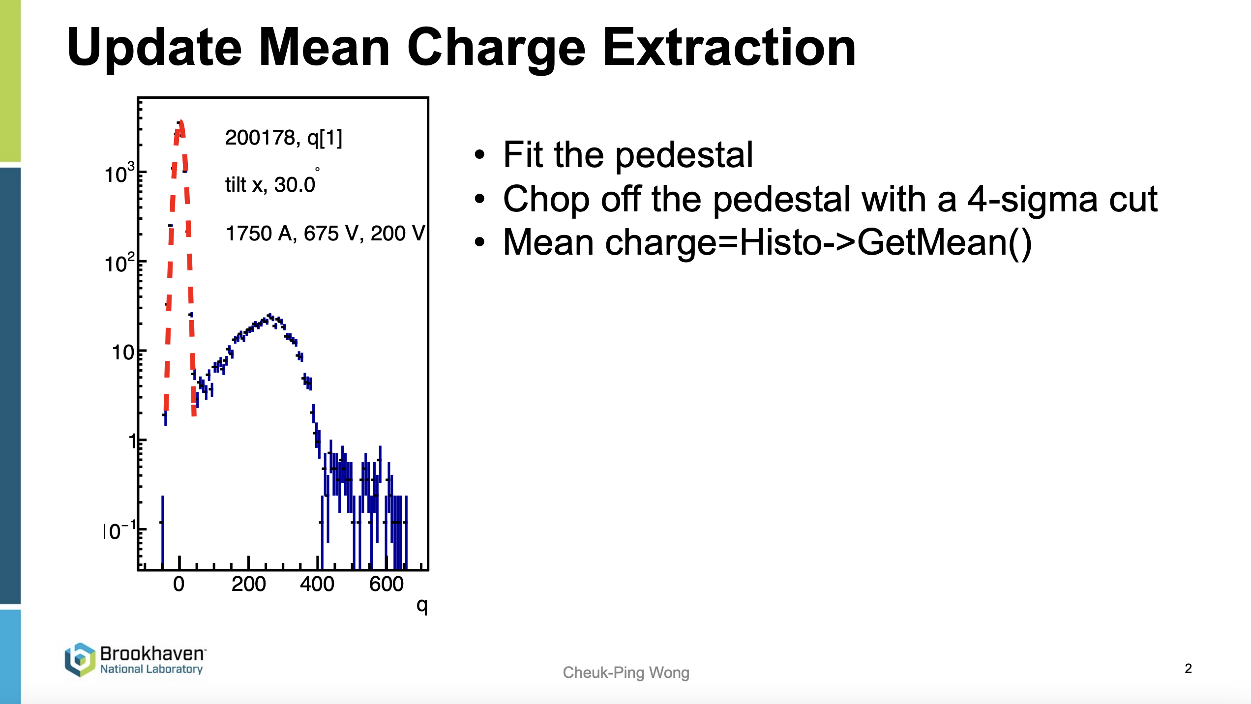
Charge Calculation
Thanks to Ping
JIHEE KIM

Slide 4

Charge Spectra VS Magnet Current
Measured charge spectra with different magnet current
Charge calculation:
  3$×$4 channel selection
  Channels: 10-13, 16-19, 22-25
Data used: 200197, 200198, 200199, 200200, 200201, 200202, 200203, 200204, and 200205
JIHEE KIM

Slide 5

Charge Spectra VS Magnet Current
With Reduced Samples
Measured charge spectra with different magnet current
Charge calculation:
  3$×$4 channel selection
  Channels: 10-13, 16-19, 22-25
Observation:
  Clear peak shift with increasing magnetic field
  Higher magnetic field $→$ narrower spectra
  Peak shifts toward lower charge values
Conclusion:
  Gain reduction with increasing magnetic field
Data used: 200197, 200198, 200199, 200200, 200201, 200202, 200203, 200204, and 200205
JIHEE KIM

Slide 6

Charge Spectra VS Magnet Current
Measured charge spectra with magnet current 0A
Charge calculation:
  3$×$4 channel selection
  Channels: 10-13, 16-19, 22-25
Observation:
  Charge distribution extends up to 14,000 fC
Data used: 200197, 200198, 200199, 200200, 200201, 200202, 200203, 200204, and 200205
JIHEE KIM

Slide 7

Charge Spectra VS Inclination Angle
Measured charge spectra with different inclination angle at $\vec{B}$ ~ 1.4 T
Charge calculation:
  Major signal channel selection by accumulated signals
Observation:
  At fixed magnetic field, charge shows weak angular dependence
  Two distinct trends observed for positive and negative angles
Conclusion:
  Overall angular dependence is weak
Data used: 200171, 200185, 200194, 200203, 200217, 200227, 200236, 200245, and 200254
JIHEE KIM

Slide 8

Charge Spectra VS Inclination Angle
Measured charge spectra with different inclination angle at $\vec{B}$ ~ 1.4 T
Charge calculation:
  Major signal channel selection by accumulated signals
Data note:
  Some runs lack laser repetition rate information
  Affects angles: $θ=±15°, ±25°, ±13°$
Observation:
  $13°$ and $15°$ exhibit trends different from other angles
Conclusion:
  Overall angular dependence is weak
Data used: 200171, 200185, 200194, 200203, 200217, 200227, 200236, 200245, 200254, 200267, 200280, 200289, 200298, 200307, and 200316
JIHEE KIM

Slide 9

Charge Spectra VS Inclination Angle
Measured charge spectra with different inclination angle at $\vec{B}$ ~ 1.4 T
Charge calculation:
  Major signal channel selection by accumulated signals
Data note:
  Some runs lack laser repetition rate information
  Affects angles: $θ=±15°, ±25°, ±13°$
Observation:
  $13°$ and $15°$ exhibit trends different from other angles
Conclusion:
  Overall angular dependence is weak
Data used: 200171, 200185, 200194, 200203, 200245, 200267, 200280, and 200316
JIHEE KIM

Slide 10

Charge Spectra VS Inclination Angle
Measured charge spectra with different inclination angle at $\vec{B}$ ~ 1.4 T
Charge calculation:
  Major signal channel selection by accumulated signals
Data note:
  Some runs lack laser repetition rate information
  Affects angles: $θ=±15°, ±25°, ±13°$
Observation:
  Overall consistent trend across angles
Conclusion:
  Overall angular dependence is weak
Data used: 200217, 200227, 200236, 200254, 200289, 200298, and 200307
JIHEE KIM

Slide 11
Sign Alignment
Facing HRPPD Window
MCP#1
pc
MCP#2
JIHEE KIM

Slide 12
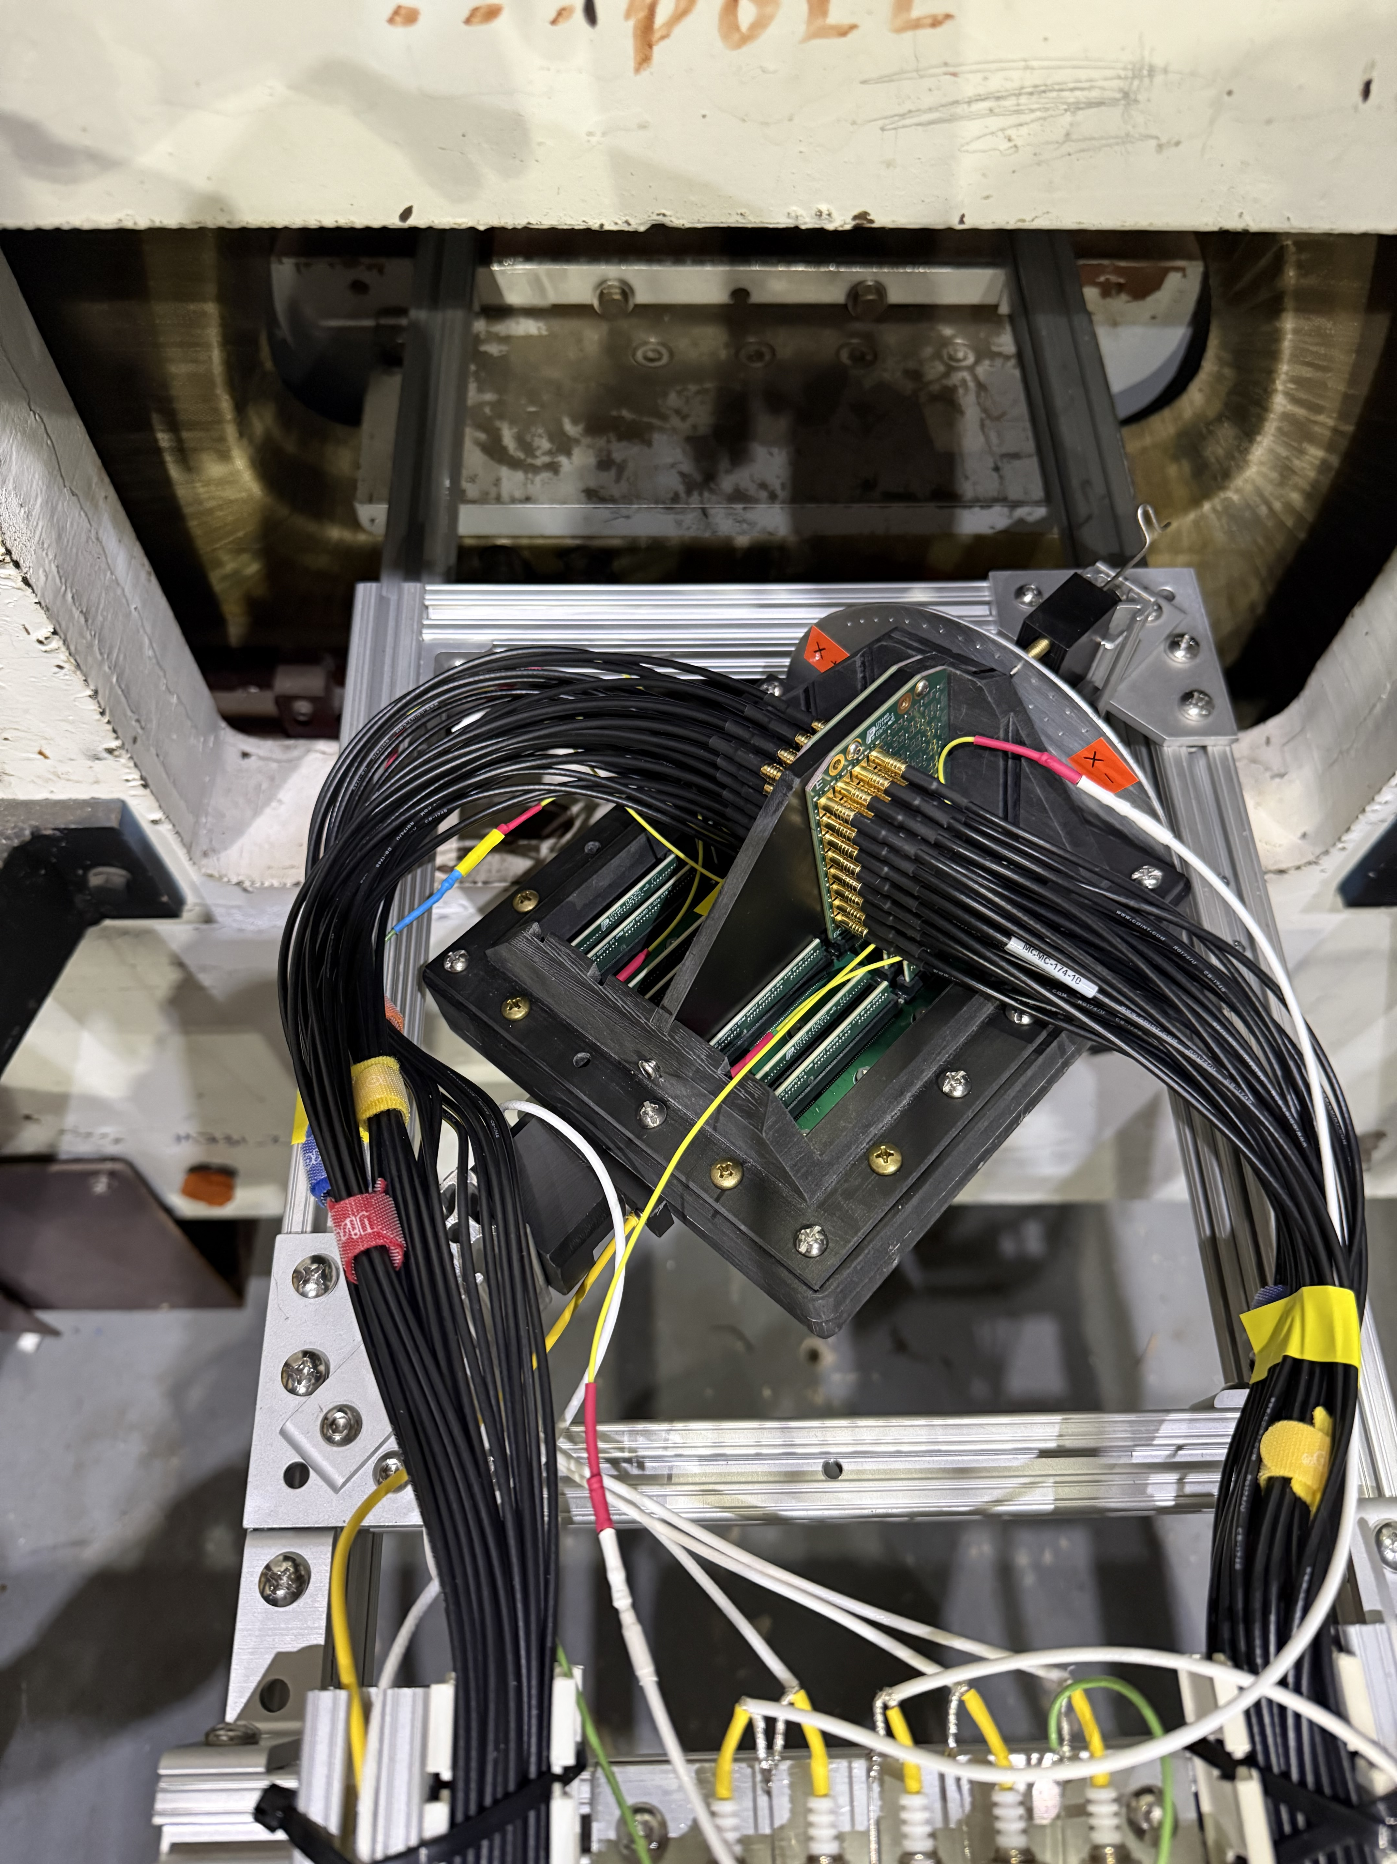

Sign Alignment
Rear of HRPPD Window
+X
angle
Up
pc
-Angle
Align with MCP#2
Facing HRPPD Window
$$\overset{⃑}{B}$$
MCP#1
MCP#1
+Angle
Align with MCP#1
pc
Down
MCP#2
MCP#2
-X
angle
JIHEE KIM

Slide 13
Charge VS Magnet Current
Measured mean charge with different inclination angle
Charge calculation:
  Major signal channel selection by accumulated signals
Observation:
  Overall follows exponential slope across angles
  Two distinct trends observed for positive and negative angles
Conclusion:
  Overall angular dependence is weak
JIHEE KIM

Slide 14
Charge VS Magnet Current
With Reduced Samples
Measured mean charge with different inclination angle
Charge calculation:
  Major signal channel selection by accumulated signals
Observation:
  Overall follows exponential slope across angles
  Two distinct trends observed for positive and negative angles
Conclusion:
  Overall angular dependence is weak
JIHEE KIM

Slide 15

Charge VS Magnet Current
Measured mean charge with different bias voltage
Charge calculation:
  Major signal channel selection by accumulated signals
Data note:
  Inclination angle at $0°$
Observation:
  Mean charge reduces as higher magnet current
  Mean charge increases as higher bias voltage
Conclusion:
  Gain partially recovered by increasing bias voltage
JIHEE KIM

Slide 16

Charge VS Magnet Current
Measured mean charge with different bias voltage
Charge calculation:
  Major signal channel selection by accumulated signals
Data note:
  Inclination angle at $+13°$
Observation:
  Mean charge reduces as higher magnet current
  Mean charge increases as higher bias voltage
Conclusion:
  Gain partially recovered by increasing bias voltage
JIHEE KIM

Slide 17

Charge VS Magnet Current
Measured mean charge with different bias voltage
Charge calculation:
  Major signal channel selection by accumulated signals
Data note:
  Inclination angle at $−12.5°$
Observation:
  Mean charge reduces as higher magnet current
  Mean charge increases as higher bias voltage
Conclusion:
  Gain partially recovered by increasing bias voltage
JIHEE KIM

Slide 18
Accumulated Waveforms at I_{B} = 400 A
+x title axis, $θ=−12.5°$, laser tune 40 %, laser rep rate 1.6 kHz
HV 200-650-200-650-200
HV 200-675-200-675-200
HV 200-700-200-700-200
Primary signal channel is 18 and an increase in MCP bias voltage leads to more pronounced afterpulses and higher signal amplitude
Data used: 200938, 200939, and 200940
JIHEE KIM

Slide 19
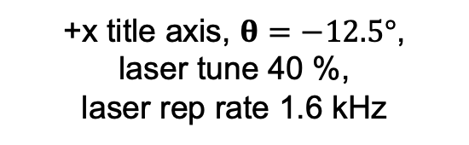
Accumulated Waveforms at I_{B} = 800 A
HV 200-650-200-650-200
HV 200-675-200-675-200
+x title axis, $θ=−12.5°$, laser tune 40 %,
laser rep rate 1.6 kHz
Primary signal channel is 18
and an increase in MCP bias voltage leads to more pronounced afterpulses and higher signal amplitude
HV 200-700-200-700-200
HV 200-725-200-725-200
Data used: 200941, 200942, 200943, and 200944
JIHEE KIM

Slide 20
Accumulated Waveforms at I_{B} = 1600 A
HV 200-650-200-650-200
HV 200-675-200-675-200
+x title axis, $θ=−12.5°$, laser tune 40 %,
laser rep rate 1.6 kHz
Primary signal channel is 18
and an increase in MCP bias voltage leads to more pronounced afterpulses and higher signal amplitude
Higher magnetic field strength results in fewer afterpulses
HV 200-700-200-700-200
HV 200-725-200-725-200
Data used: 200952, 200953, 200954, and 200955
JIHEE KIM

Slide 21
Accumulated Waveforms at I_{B} = 1900 A
HV 200-650-200-650-200
HV 200-675-200-675-200
+x title axis, $θ=−12.5°$, laser tune 40 %,
laser rep rate 1.6 kHz
Primary signal channel is 18
and an increase in MCP bias voltage leads to more pronounced afterpulses and higher signal amplitude
Higher magnetic field strength results in fewer afterpulses
HV 200-700-200-700-200
HV 200-725-200-725-200
Data used: 201451, 201452, 201453, and 201454
JIHEE KIM

Slide 22
Accumulated Waveforms at I_{B} = 2000 A
HV 200-650-200-650-200
HV 200-675-200-675-200
+x title axis, $θ=−12.5°$, laser tune 40 %,
laser rep rate 1.6 kHz
Primary signal channel is 18
and an increase in MCP bias voltage leads to more pronounced afterpulses and higher signal amplitude
Higher magnetic field strength results in fewer afterpulses
HV 200-700-200-700-200
HV 200-725-200-725-200
Data used: 200956, 200957, 200958, and 200959
JIHEE KIM

Slide 23
To-Do List
Convert mean charge to gain
  160 fC ~ Gain of 10⁶
Verify sign alignment with MCP #1 and #2
  Cross-check with MCP#1 (top) and MCP#2 (bottom) using recorded photos
Apply an exponential fit to mean charge (gain) versus magnet current
Find polya fit example
1st and 2nd day when laser warm up time short
Identify runs with significant dark current
  Compare behavior across different bias voltages
Review current mean charge extraction method
  Based on combined 1-photon and 2-photon contributions (first-order approximation acceptable)
  Develop a weighted mean charge method: Aim to isolate and extract 1-photon mode (no filed, gain remains same* with diff angles)
JIHEE KIM

Slide 24
Backup Slides
JIHEE KIM

Slide 25

Charge Spectra VS Inclination Angle
Measured charge spectra with different inclination angle
Charge calculation:
  3$×$4 channel selection
  Channels: 10-13, 16-19, 22-25
Observation:
  At fixed magnetic field, charge shows weak angular dependence
  Two distinct trends observed for positive and negative angles
Conclusion:
  Overall angular dependence is weak
Data used: 200171, 200185, 200194, 200203, 200217, 200227, 200236, 200245, and 200254
JIHEE KIM

Slide 26

Charge Spectra VS Inclination Angle
Measured charge spectra with different inclination angle
Charge calculation:
  3$×$4 channel selection
  Channels: 10-13, 16-19, 22-25
Data note:
  Some runs lack laser repetition rate information
  Affects angles: $θ=±15°, ±25°, ±13°$
Observation:
  $13°$ and $15°$ exhibit trends different from other angles
Conclusion:
  Overall angular dependence is weak
Data used: 200171, 200185, 200194, 200203, 200217, 200227, 200236, 200245, 200254, 200267, 200280, 200289, 200298, 200307, and 200316
JIHEE KIM

Slide 27
Charge Spectra VS Inclination Angle
Measured charge spectra with different inclination angle
Charge calculation:
  3$×$4 channel selection
  Channels: 10-13, 16-19, 22-25
Data note:
  Some runs lack laser repetition rate information
  Affects angles: $θ=±15°, ±25°, ±13°$
Observation:
  $13°$ and $15°$ exhibit trends different from other angles
Conclusion:
  Overall angular dependence is weak
Data used: 200171, 200185, 200194, 200203, 200245, 200267, 200280, and 200316
JIHEE KIM

Slide 28

Charge Spectra VS Inclination Angle
Measured charge spectra with different inclination angle
Charge calculation:
  3$×$4 channel selection
  Channels: 10-13, 16-19, 22-25
Data note:
  Some runs lack laser repetition rate information
  Affects angles: $θ=±15°, ±25°, ±13°$
Observation:
  Overall consistent trend across angles
Conclusion:
  Overall angular dependence is weak
Data used: 200217, 200227, 200236, 200254, 200289, 200298, and 200307
JIHEE KIM

