Slide 1
Calibrations. Discussion 03/12/2025 O.Tsai
Within Calo WG we did not yet touch calibrations.
There will be on-going discussion during next few months on this topic.
Goals:
Understand calibration requirements and procedures for each subsystem.
Fulfill request made by Computing/software WG in about two months time frame.
How we’ll do this?
Similar to discussion we had for SiPM degradations, i.e. folders for each sub-systems with common questions which has to be answered. (List of questions TBD – part of our discussion, let’s plan to define it during next calo meeting on Dec. 17’th)
As a start please look at TIC meeting 01/12/2025 “The ePIC Computing Model and Calibrations”
https://indico.bnl.gov/event/30589/contributions/116726/attachments/66484/114079/gunji_TIC_SRO_Calibration_20251201_v2.pdf
Here you will find what Computing group wants to hear from us.

Slide 2
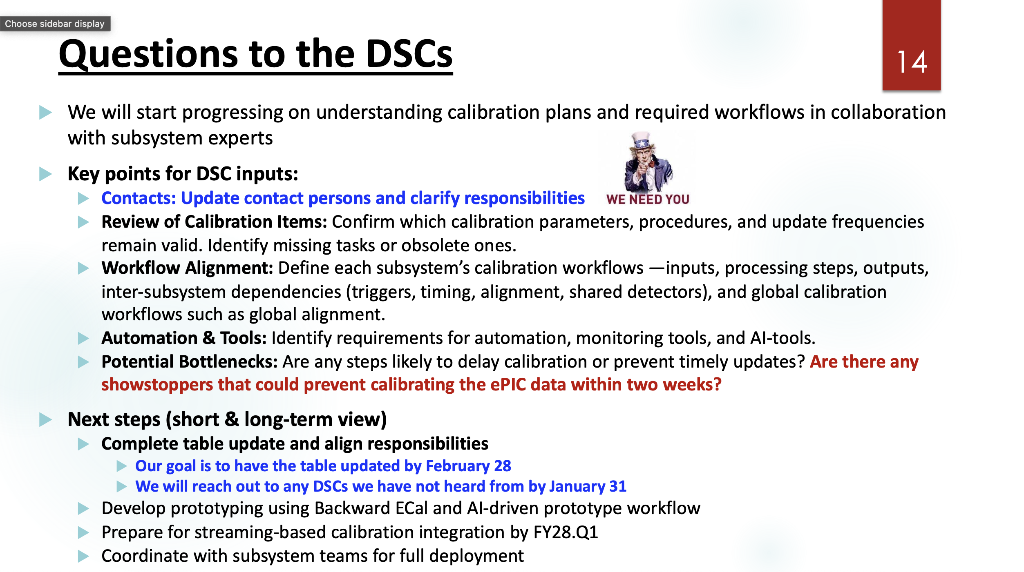

Slide 3
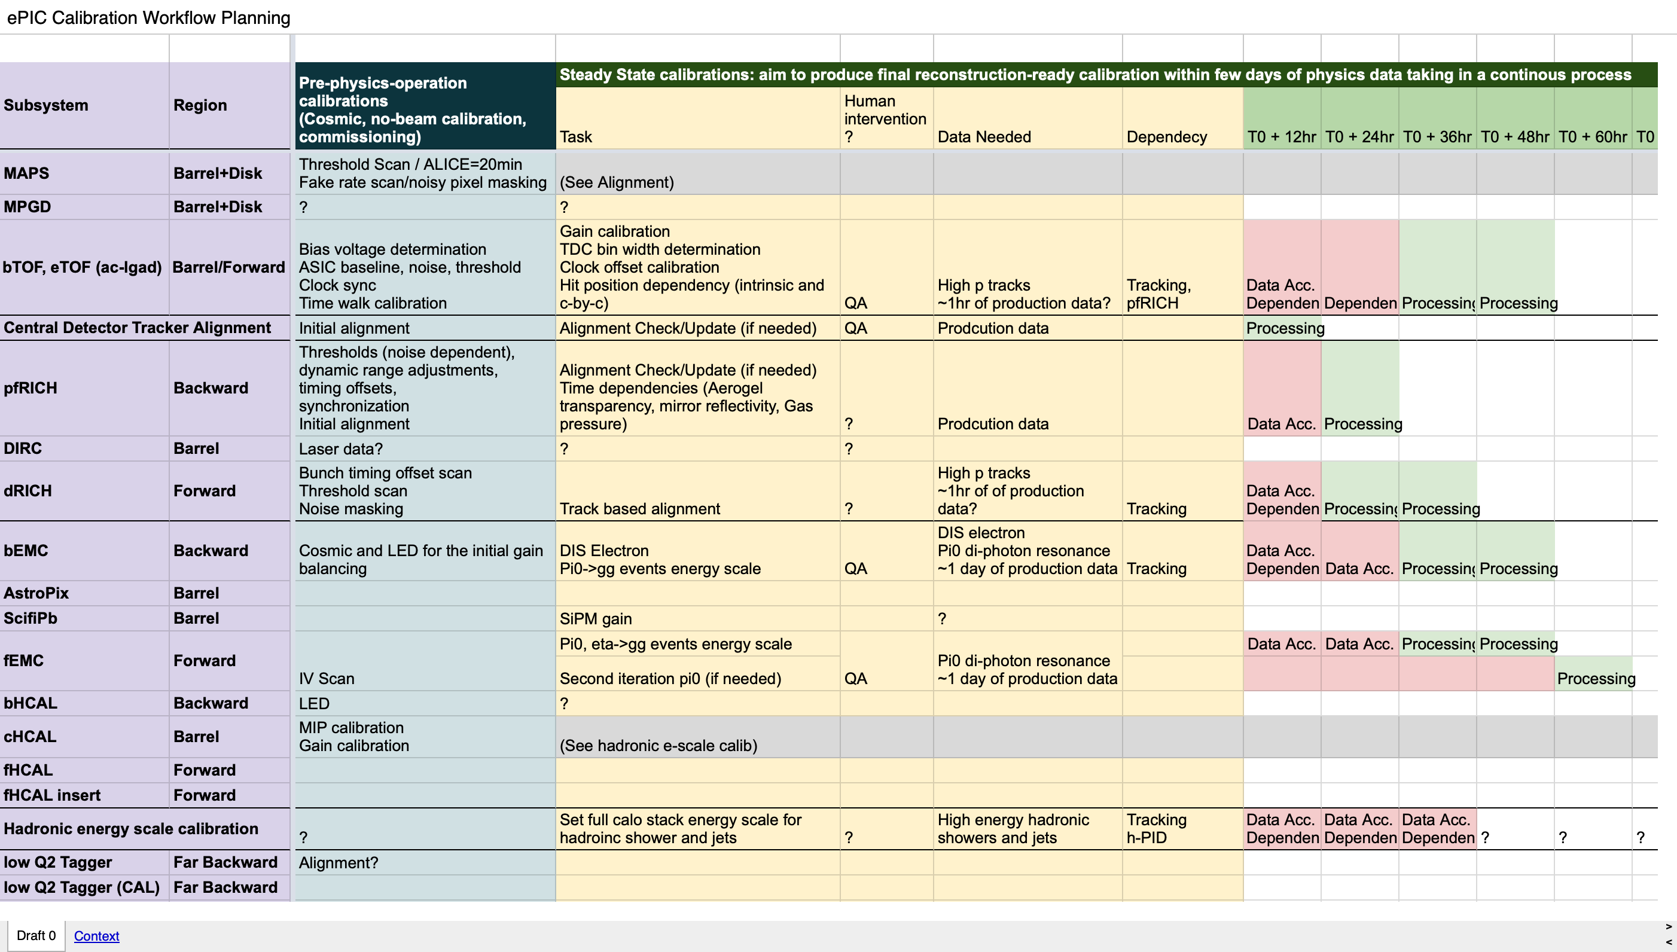

Slide 4
Open Discussion.

