Slide 1
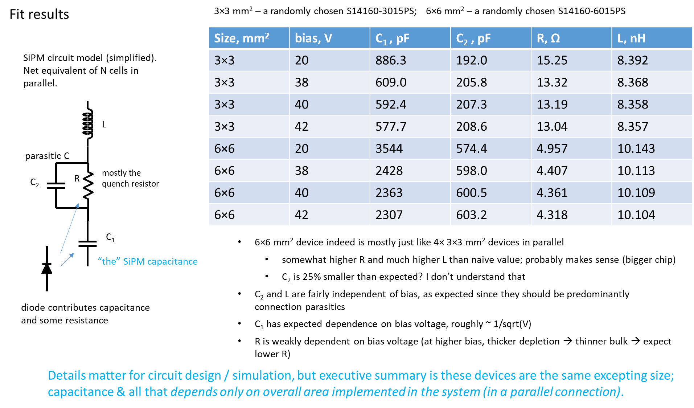
FEMC CALOROC requirements G. Visser 1/14/2026
[Norbert’s] request to the calorimeters: to collect some of your updates simulation and measurement studies which will be important for the readout point of view:
What is the capacitance of the detector per channel? (pF)
2. What is the lowest signal measurement required? (fC)
3. What is the highest signal measurement required? (fC)
4. Do you have a measurement with certain settings of MIP peak, other fixed signal? (With the H2GCROC and settings)
9.6 nF
It MIGHT be split over two readout channels, although this would make it harder (I believe) to meet low energy requirements, it is a possible scheme to consider.
GV 6/2024
FEMC light yield 1.6 pixels/MeV, FEMC OV = 2.0 V (low, to reduce self-heating after radiation damage)
FEMC minimum energy (taken in streaming readout i.e. threshold value), goal 15 MeV [higher close to beamline]
→ 690 fC
FEMC max energy (single tower) 80(?) GeV (cluster 100 GeV)
→ 3.7 nC
We have no measurement of FEMC w/ H2GCROC at this time.
Looking forward to a test with CALOROC’s.
Our SiPM boards are not designed for CALOROC input, some modifications necessary. An option to have external preamp with future CALOROC remains of interest! (I.e. a CALOROC functional mode as ADC’s+SRO only, voltage inputs.)

Slide 2
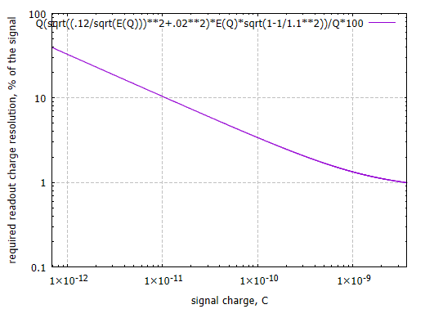
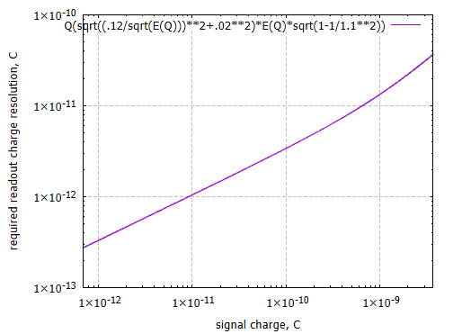
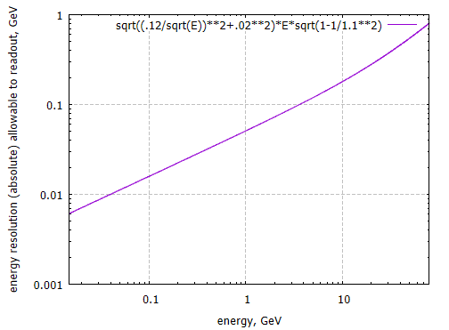
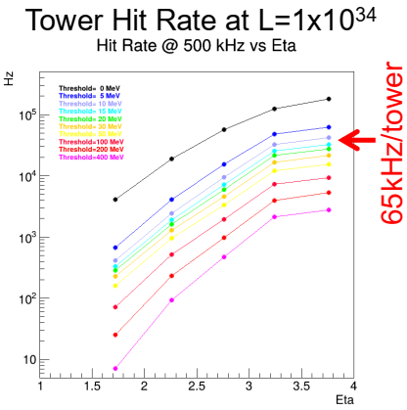
FEMC CALOROC requirements G. Visser 1/14/2026
[Norbert’s] request to the calorimeters: to collect some of your updates simulation and measurement studies which will be important for the readout point of view:
5. What is the charge resolution requirements? (Percentage as a function of charge, not in bits)
6. What is your timing requirements/measurements?
7. What is the expected occupancy per channel from simulation? (Including full background)
Somewhat arbitrarily, we require that readout makes the overall resolution <10% more than detector with perfect readout.
→ (same thing plotted three ways…)
Note: The above is inclusive of all effects of random pulse shape from the detector!
Resolve bunch crossings, e.g. resolution ~3 ns should suffice.
Smallest signals likely will have worse resolution than we wish, that must be recognized.
FEMC’s inherent time resolution probably ~0.5 – 1 ns (for >1 GeV).
At a threshold of 15 MeV, occupancy in DIS events is up to 6% (closest to beam). →
Occupancy per bunch crossing up to 0.03%.
These figures are for real hits only (excluding SiPM noise).
Also have to be multiplied by 1.1 to account for hadron beam-gas background.
Akio Ogawa, FEMC PDR

Slide 3
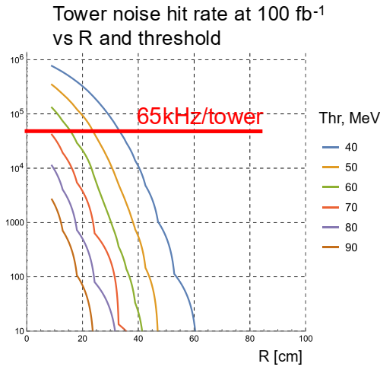
FEMC CALOROC requirements G. Visser 1/14/2026
[Norbert’s] request to the calorimeters: to collect some of your updates simulation and measurement studies which will be important for the readout point of view:
8. What is the maximum hit rate per channels needed if all channels are activated at the same time?
9. What is the expected dark noise rate?
10. What is the maximum hit rate required for a single channel? (If only one receives signal)
11. What is the double pulse separation needed? Overlap signals from two independent bunch crossings? (This affects small or large signals differently in your detector?)
The meaning of this question is not entirely clear IMHO.
But we can state that simulations show the average number of hits in DIS events in FEB’s closest to beamline is 3.0.
(Since often it is 0, in a typical event when an FEB has ≥1 hit it typically has fairly many hits. AO could provide further details.)
FEB = 32 channels for FEMC, in a fixed geometry, this will not change.
(for “discrete” readout’s pulse shape! may be worse for CALOROCx)
Dark count rate (pixels) is up to ~30 GHz (after 100 fb-1 radiation damage).
Dark count rate (hits) of course depends on thresholds.
15 MeV threshold will be too low to handle, on a large fraction of FEMC.
Thresholds will have to be raised; must be kept to minimum!
Acceptable thresholds require DC hit rate of order 50 – 100 kHz.
Baseline plan (“discrete”) should work to at leask 65 kHz (more w/ feature extraction.)
Summary: The requirement is “as high as possible, up to ~100 kHz.”
This is entirely dominated by dark count rate, see above.
No strong requirement, rates of real hits are low. WAG goal perhaps 200 ns?

Slide 4
FEMC CALOROC requirements G. Visser 1/14/2026
[Norbert’s] request to the calorimeters: to collect some of your updates simulation and measurement studies which will be important for the readout point of view:
12. How many number of samples you require as minimum (max is 7 now in CALOROC)?
13. What is the preference for A or B for CALOROC?
14. [GV] What is required for gain stability on fast to medium timescales (microseconds to days)? Inclusive of temperature effects, rate effects, etc.
15. [GV] What is required for linearity?
Whatever it takes to achieve the other requirements. There’s no other reason to care.
No reason to say other than performance. It may be reasonable to have confidence that B will perform better w.r.t. linearity, gain stability, and insensitivity to random pulse shape. But we’ll see about that later this year, hopefully.
Better than 1%.
FEMC overall gain stability should be 1%, but this also includes SiPM bias voltage stability (20 mV ←→ 1%).
[BTW if CALOROC controls in part the SiPM bias voltage then that plays a role in overall gain stability too.]
Perhaps 1% nonlinearity. More complex calibrations may allow for more nonlinearity in the readout. And we will anyway have SiPM nonlinearity to contend with.
But calibrations over the whole energy scale may be difficult.

