Slide 1
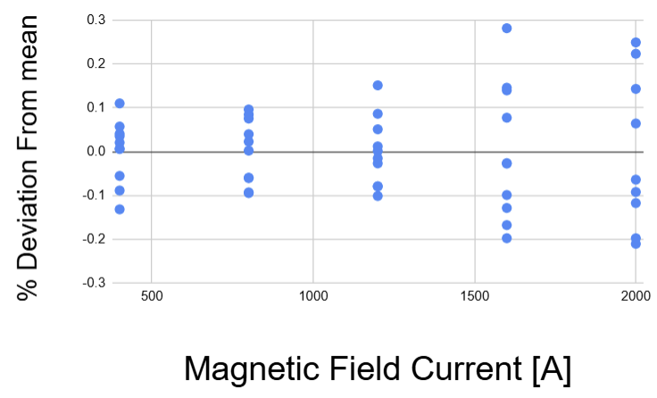
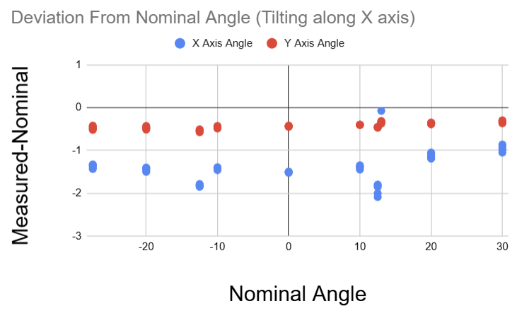
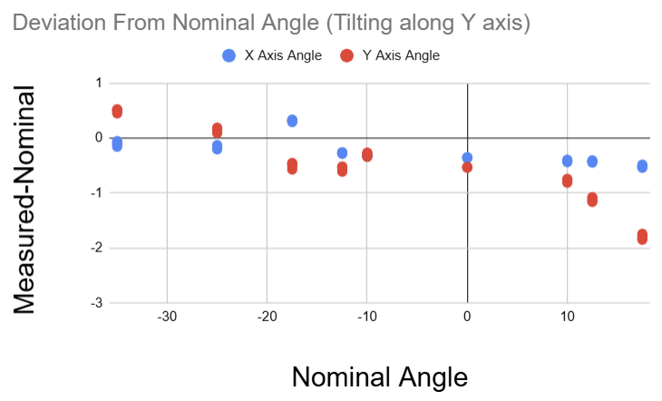
Hall Probe Measurement of Angle
Use mounted Hall probe to measure magnetic field (x,y,z)
Offsets from nominal tilt values can be corrected
Minimal spread (max 0.3 %) in field values
Tilting Along X axis
  X axis avg. offset: -1.41 degrees (Rotation mechanism error)
  Y axis avg. offset: -0.426 degrees (Hall probe misalignment)
Tilting Along Y axis
  Offset has small dependence on nominal angle due to slight misalignment

