Slide 1


Slide 2
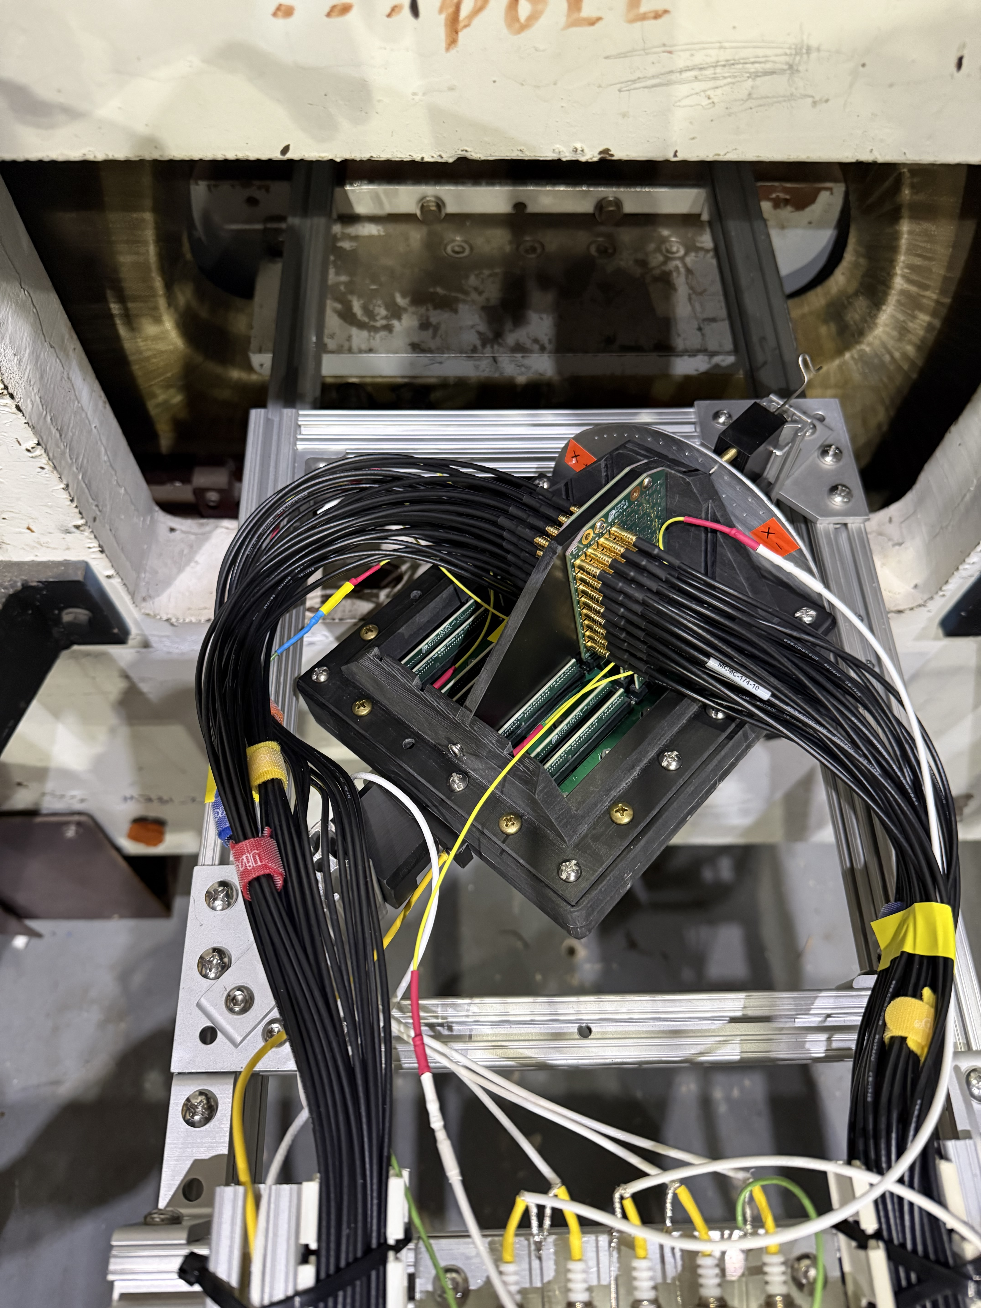

Sign Alignment
Magnetic field test setup with HRRPD facing down
$$\overset{⃑}{B}$$
y
x
z

Slide 3
Sign Alignment
Magnetic field test setup with HRRPD facing down
$$\overset{⃑}{B}$$
PC
y
x
z

Slide 4

Sign Alignment
Magnetic field test setup with HRRPD facing down
$$\overset{⃑}{B}$$
$$+θ$$
y
x
z

Slide 5



Sign Alignment
$$\overset{⃑}{B}$$
Magnetic field test setup with HRRPD facing down
Back: anode, readout, PCB
$$\overset{⃑}{B}$$
$$+θ$$
MCP 2
Capillary orientation
MCP 1
y
x
y
PC
Front: fused silica
$$+θ$$
x
z
PiLas
z

Slide 6
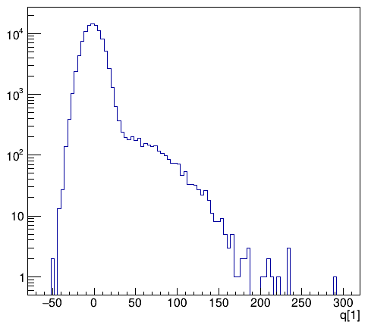
HRPPD Gain vs B Field (MCP1 Alignment, Inclination Angle around $±13^{∘}$)
The gain decreases with increasing magnetic field strength

Slide 7
HRPPD Gain vs B Field (MCP1 Alignment, Inclination Angle around $±13^{∘}$)
The gain decreases with increasing magnetic field strength
The gain recovers with higher MCP bias voltage
A gain of 10⁶ or higher is achieved at an inclination angle of approximately 13° at B = 1.5 T with an MCP bias voltage of ≥ 675 V.

Slide 8
HRPPD Gain vs Tilting Angle
A minimum in gain is observed at approximately +14°, with a second minimum around −14°
The second minimum at −14° is less pronounced than the one at +14°
The gain decreases at large negative tilting angles (around −30°)

Slide 9
HRPPD Gain vs Tilting Angle
*Angle correction not applied in the y-axis rotation results
A minimum in gain is observed at approximately +14°, with a second minimum around −14°
The second minimum at −14° is less pronounced than the one at +14°
The gain decreases at large negative tilting angles (around −30°)
A smaller angular dependence is observed when rotating along the y-axis

