Slide 1


Slide 2
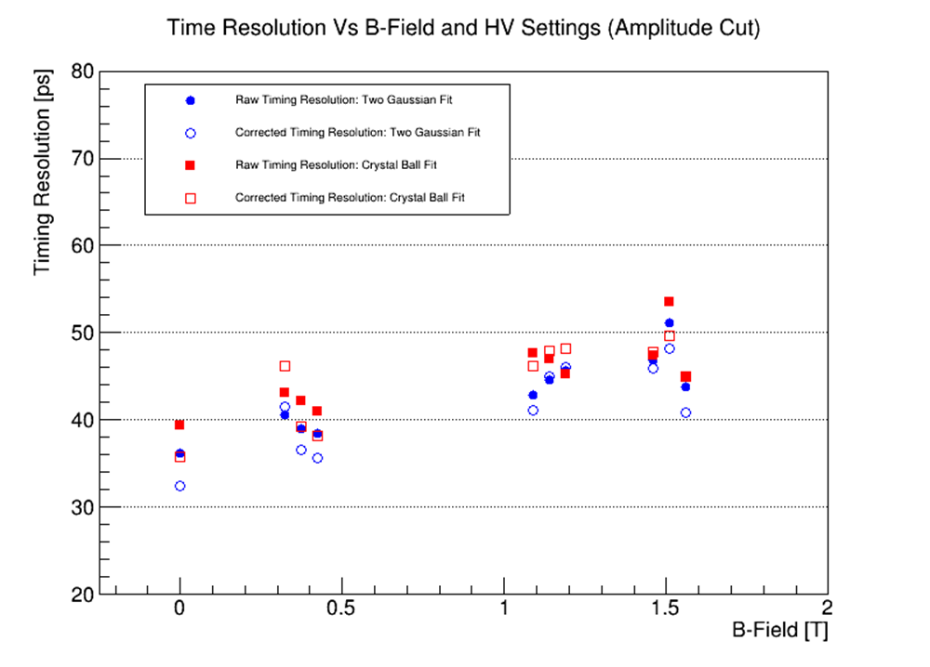
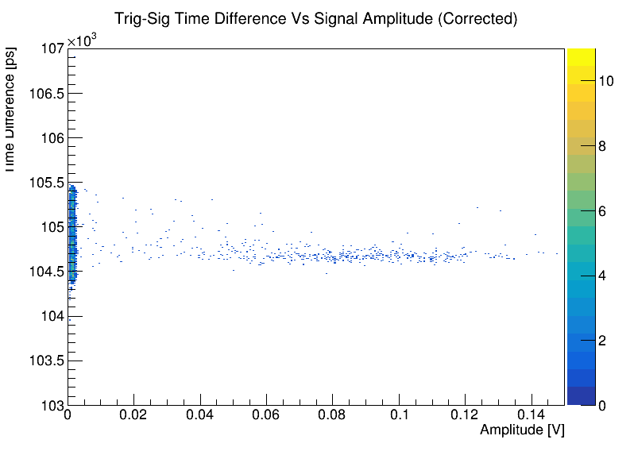
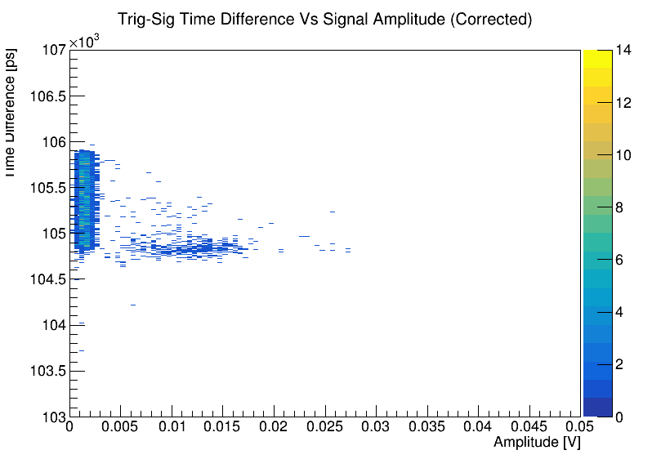
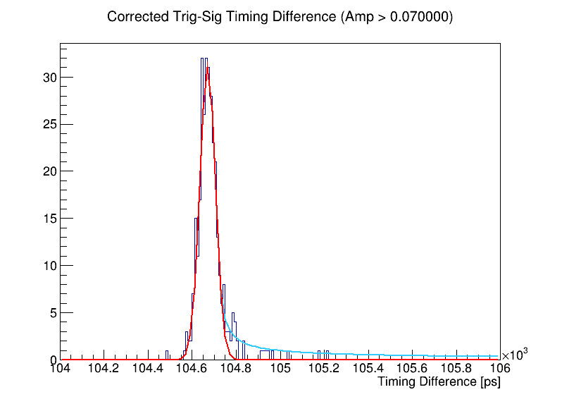
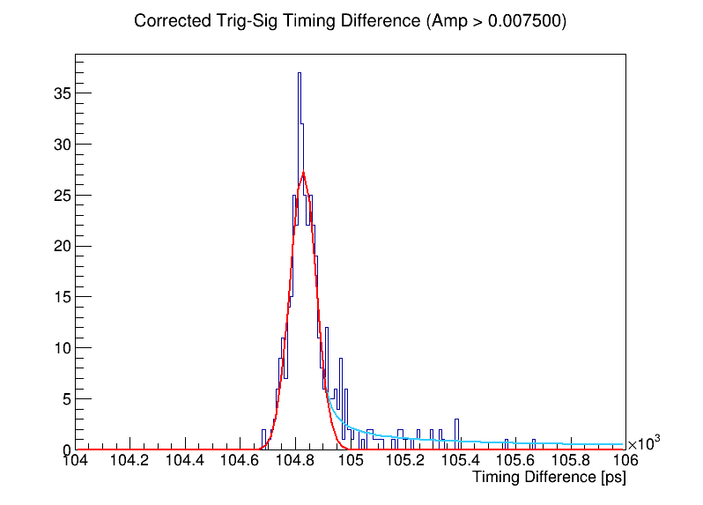
Timing resolution using a 50 GS/s scope
0.15
0.05
Zero Field
1.5 T (first point)
Crystal Ball
Gaus Core
Data taken at 0, 0.374, 1.138, and 1.509 T
Zero field HV: MCP = 650, PC = 200 V
Non-zero field HV (left to right):
MCP = 675, PC = 200
MCP = 675, PC = 400
MCP = 700, PC = 200

Slide 3
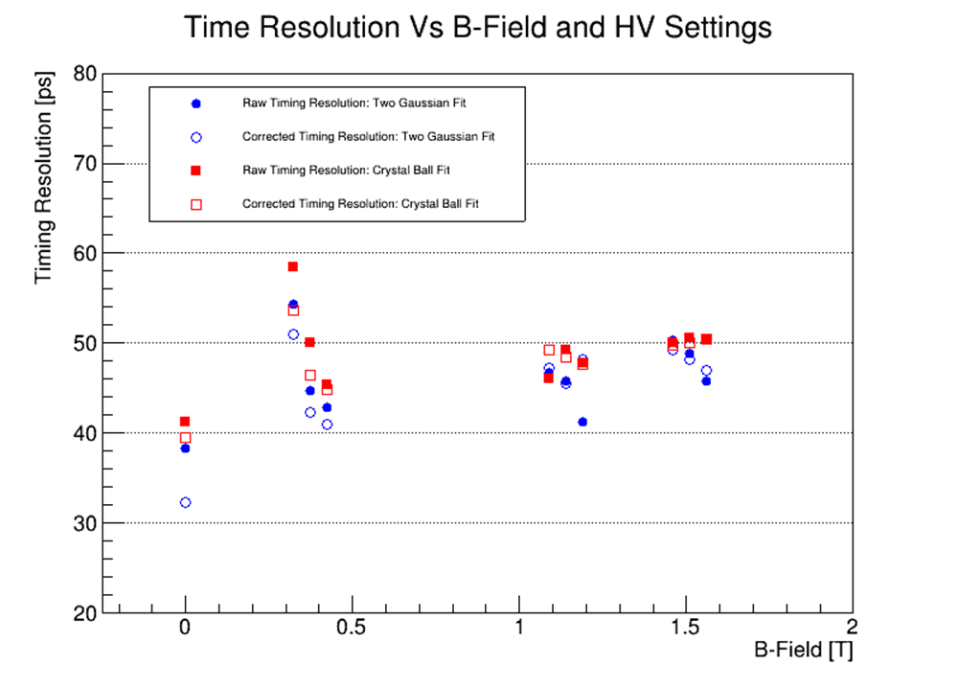
Scope Timing resolution: Pedestal Cut Only
BACKUP

Slide 4

Scope Timing resolution: Amplitude Correction
BACKUP

Slide 5
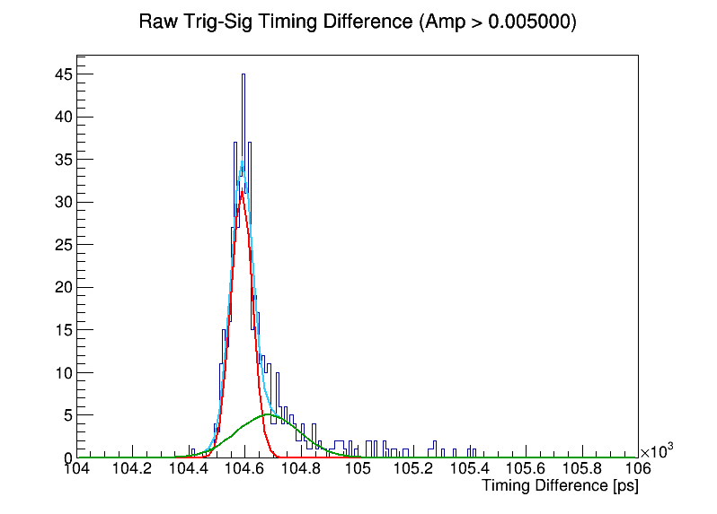
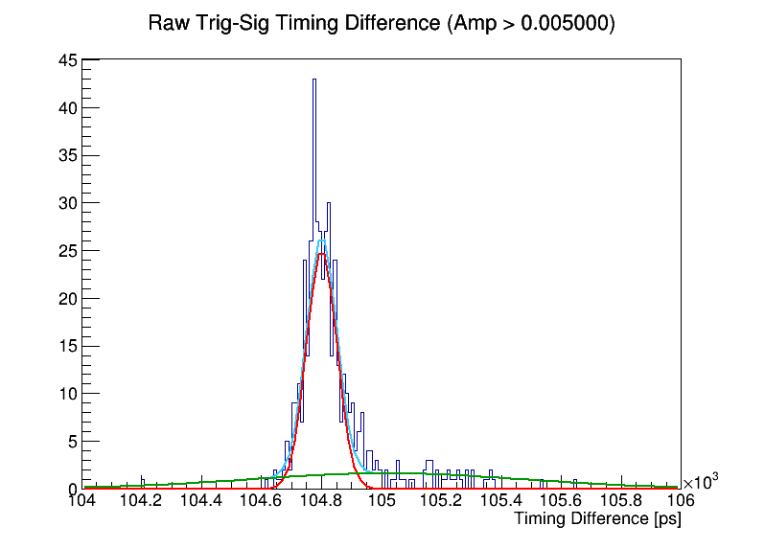
Scope Timing resolution: 2-Gaus Fit
Zero Field
1.5 T Field
MCP = 675 V
PC = 200 V
Full Fit
1st Gaus
2nd Gaus
BACKUP

Slide 6
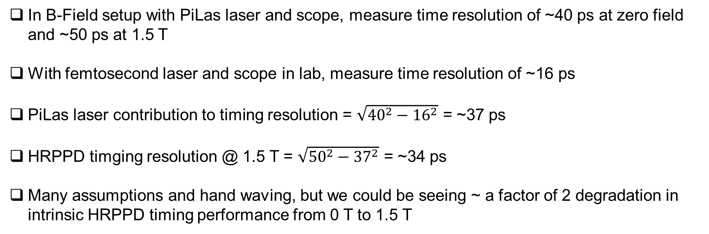
Scope Timing resolution: Laser Contribution
In B-Field setup with PiLas laser and scope, measure time resolution of ~40 ps at zero field and ~50 ps at 1.5 T
With femtosecond laser and scope in lab, measure time resolution of ~16 ps
PiLas laser contribution to timing resolution = $\sqrt{{40}^{2}−{16}^{2}}$ = ~37 ps
HRPPD timging resolution @ 1.5 T = $\sqrt{{50}^{2}−{37}^{2}}$ = ~34 ps
Many assumptions and hand waving, but we could be seeing ~ a factor of 2 degradation in intrinsic HRPPD timing performance from 0 T to 1.5 T
BACKUP

