Slide 1

Yifan Jin

Slide 2
Repetition rate dependency
Signal rate = laser repetition rate * fraction of signal events in a run.
Optical condition is introduced previously.
HRPPD have gain dropping with respect to signal rate, although the dropping is not significant.
Laser 1.6 kHz
Signal fraction ~5%

Slide 3
After-pulse
For different HV setting, after-pulse rate ranges from O(1)% - O(10)%.
With working HV (675-675), 1.3 T, 0º tilting angle, in next 70 ns, after-pulse rate ~1.3%
B field: 1.3 T
Set 1
B field: 1.3 T
Set 2

Slide 4
Dark count rate
Using 11 runs, each run has 100k events, 32 channels, first 500 bins in the waveform (laser shots around bin 600), with HV setting 200-675-200-675-200, 1.3 T magnetic field, 0º tilting angle: 10 dark count events are found.
Thus, dark count rate (1.3T) = 28.4 Hz/cm².
With HV setting 200-675-200-675-200, 0 T magnetic field, 5697 dark count events are found in one run.
Thus, dark count rate (0 T) = 168 kHz/cm².
Approach using oscilloscope also ready.
mV
LASER
Bin [0.2ns]

Slide 5
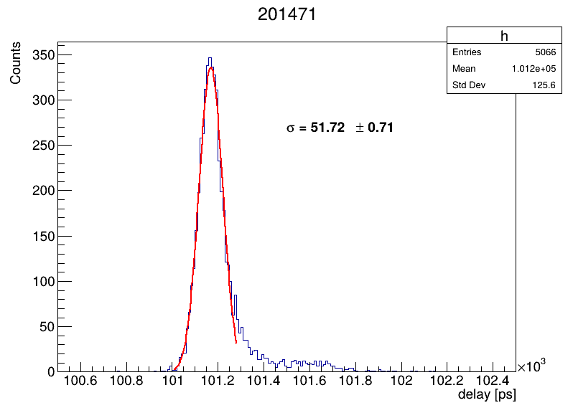
Timing resolution with DRS4 readout
In a 1.3 T magnetic field, HV setting 200-675-200-675-200, 0º tilting angle, achieves average 52 ps timing using PiLas and time calibrated DRS4. (see left)
Dependence of B-field is shown on the right.

Slide 6
Back up

Slide 7
Gain VS Magnetic Field (w/ θ)
Alexander’s
Yifan’s
Yifan uses peak searching, amplitude>2 mV, fit with Skewed Gaussian, (|peak - mean|) as error.
θ=+12.5°, has the lowest gain.
JIHEE KIM

Slide 8
Gain VS Magnetic Field (w/ HV)@ θ=-12.5°
Alexander’s
Yifan’s
Large difference was shown at 1900 A measurement especially at HV = 650 V and 725 V.
JIHEE KIM

Slide 9
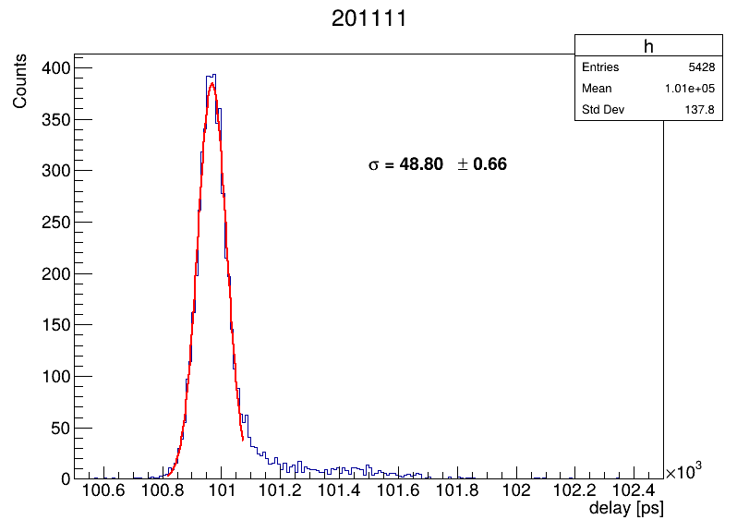
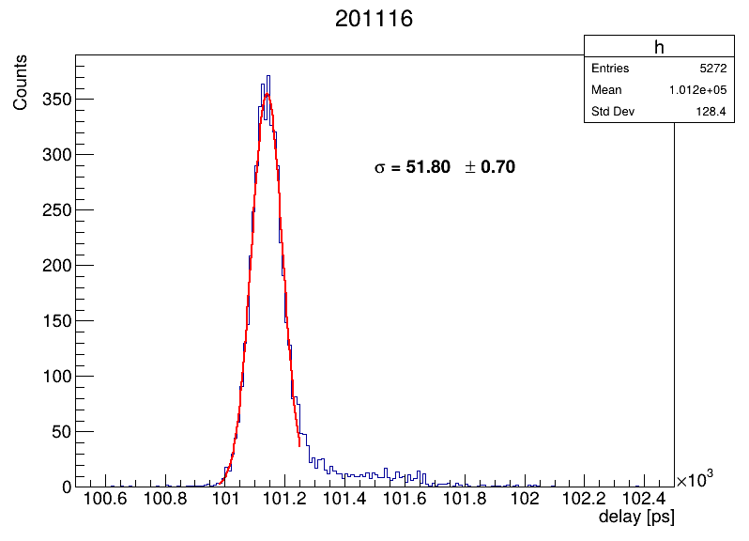
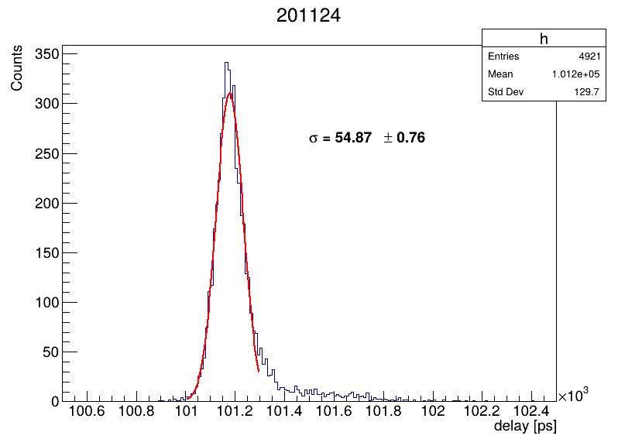
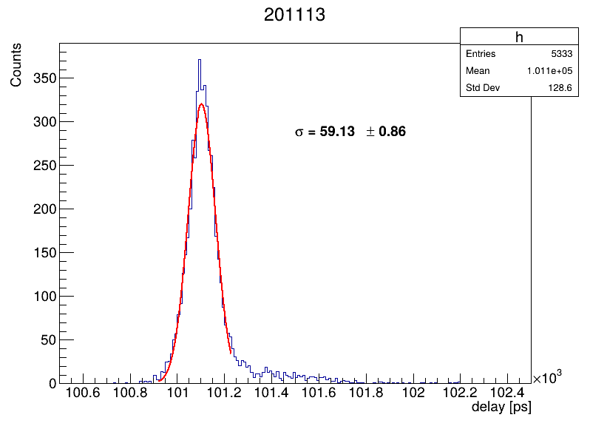
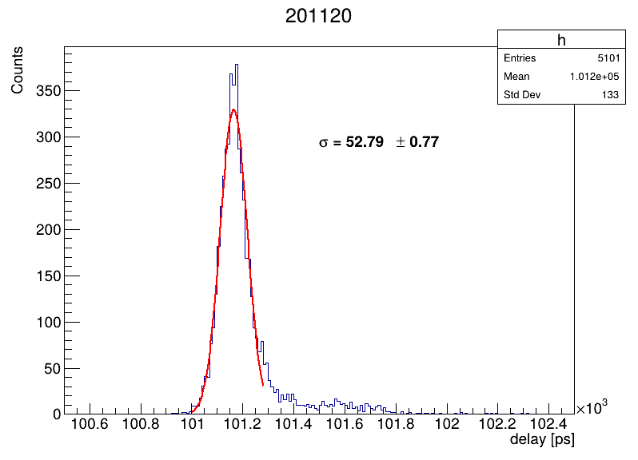
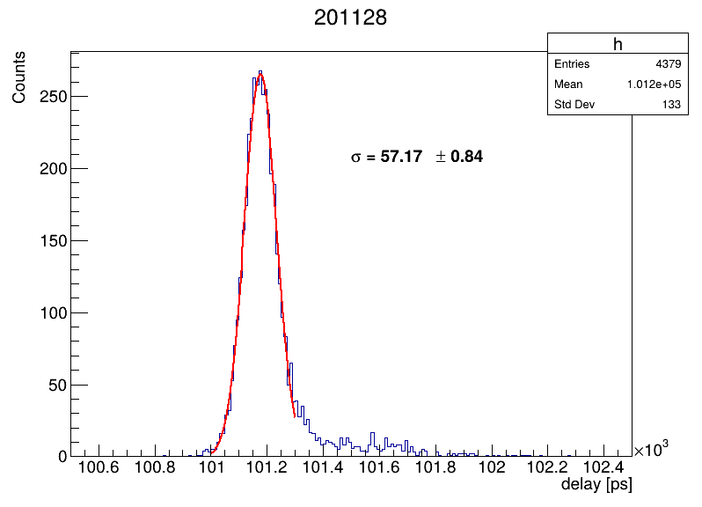
Delete this slide
Complimentary documents for timing VS B-Field.

