Slide 1
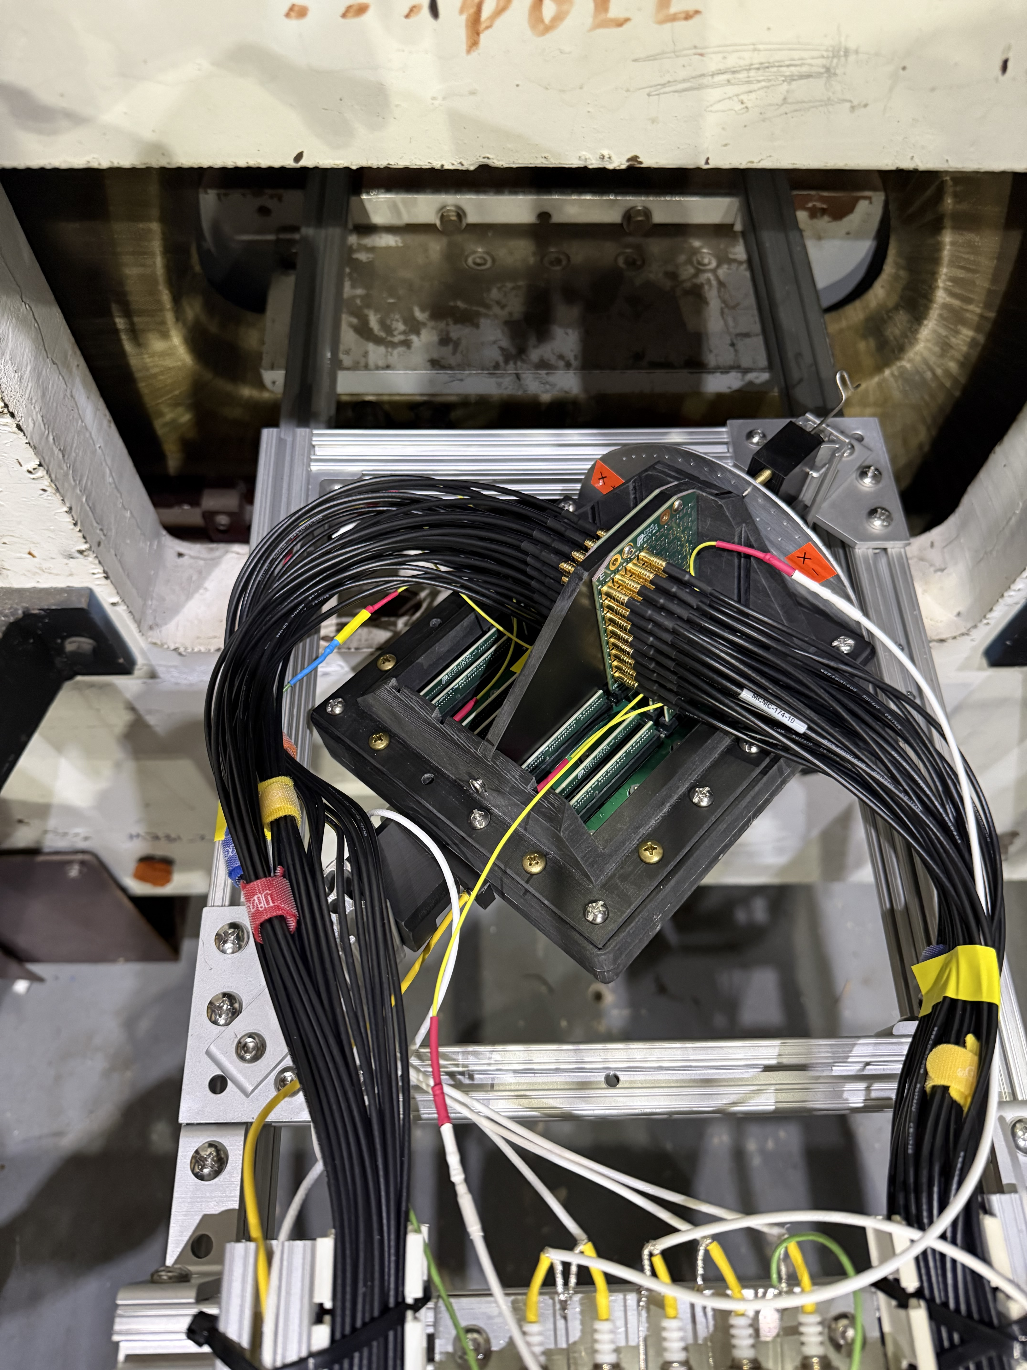







Sign Alignment
$$\overset{⃑}{B}$$
Magnetic field test setup with HRRPD facing down
Back: anode, readout, PCB
$$\overset{⃑}{B}$$
$$+θ$$
MCP 2
Capillary orientation
MCP 1
$$e^{−}$$
y
PC
x
y
Front: fused silica
$$γ$$
$$+θ$$
x
z
z
PiLas

