Slide 1
Initial Results from HRPPD B-field Campaign at BNL
Bob Azmoun, Yifan Jin, Jihee Kim, Alexander Kiselev, Brian Page, Martin Purschke, Cheuk-Ping Wong, Craig Woody (BNL)
Andrew Tamis (Yale), Mark Popecki (Incom)
2026/01/12
ePIC TIC Meeting – HRPPDs in magnetic field

Slide 2
Motivation
pfRICH: ePIC PID detector
in the electron-going endcap
Verify HRPPD operation in magnetic fields typical for the pfRICH sensor location in ePIC
  Magnetic field strength up to ~1.3 T
  Field-to-HRPPD window normal angles up to ~13°
Conduct a systematic study over (HV, magnetic field, inclination angle) parameter space
Goal: Produce publishable-quality results
Two measurement campaigns @ Superconducting Magnet Division at BNL
  Nov 17–26* (installation and dry runs included)
    *Nov 20–21 (CERN Director-General Visit SMD at BNL)
  Dec 11–12

Slide 3
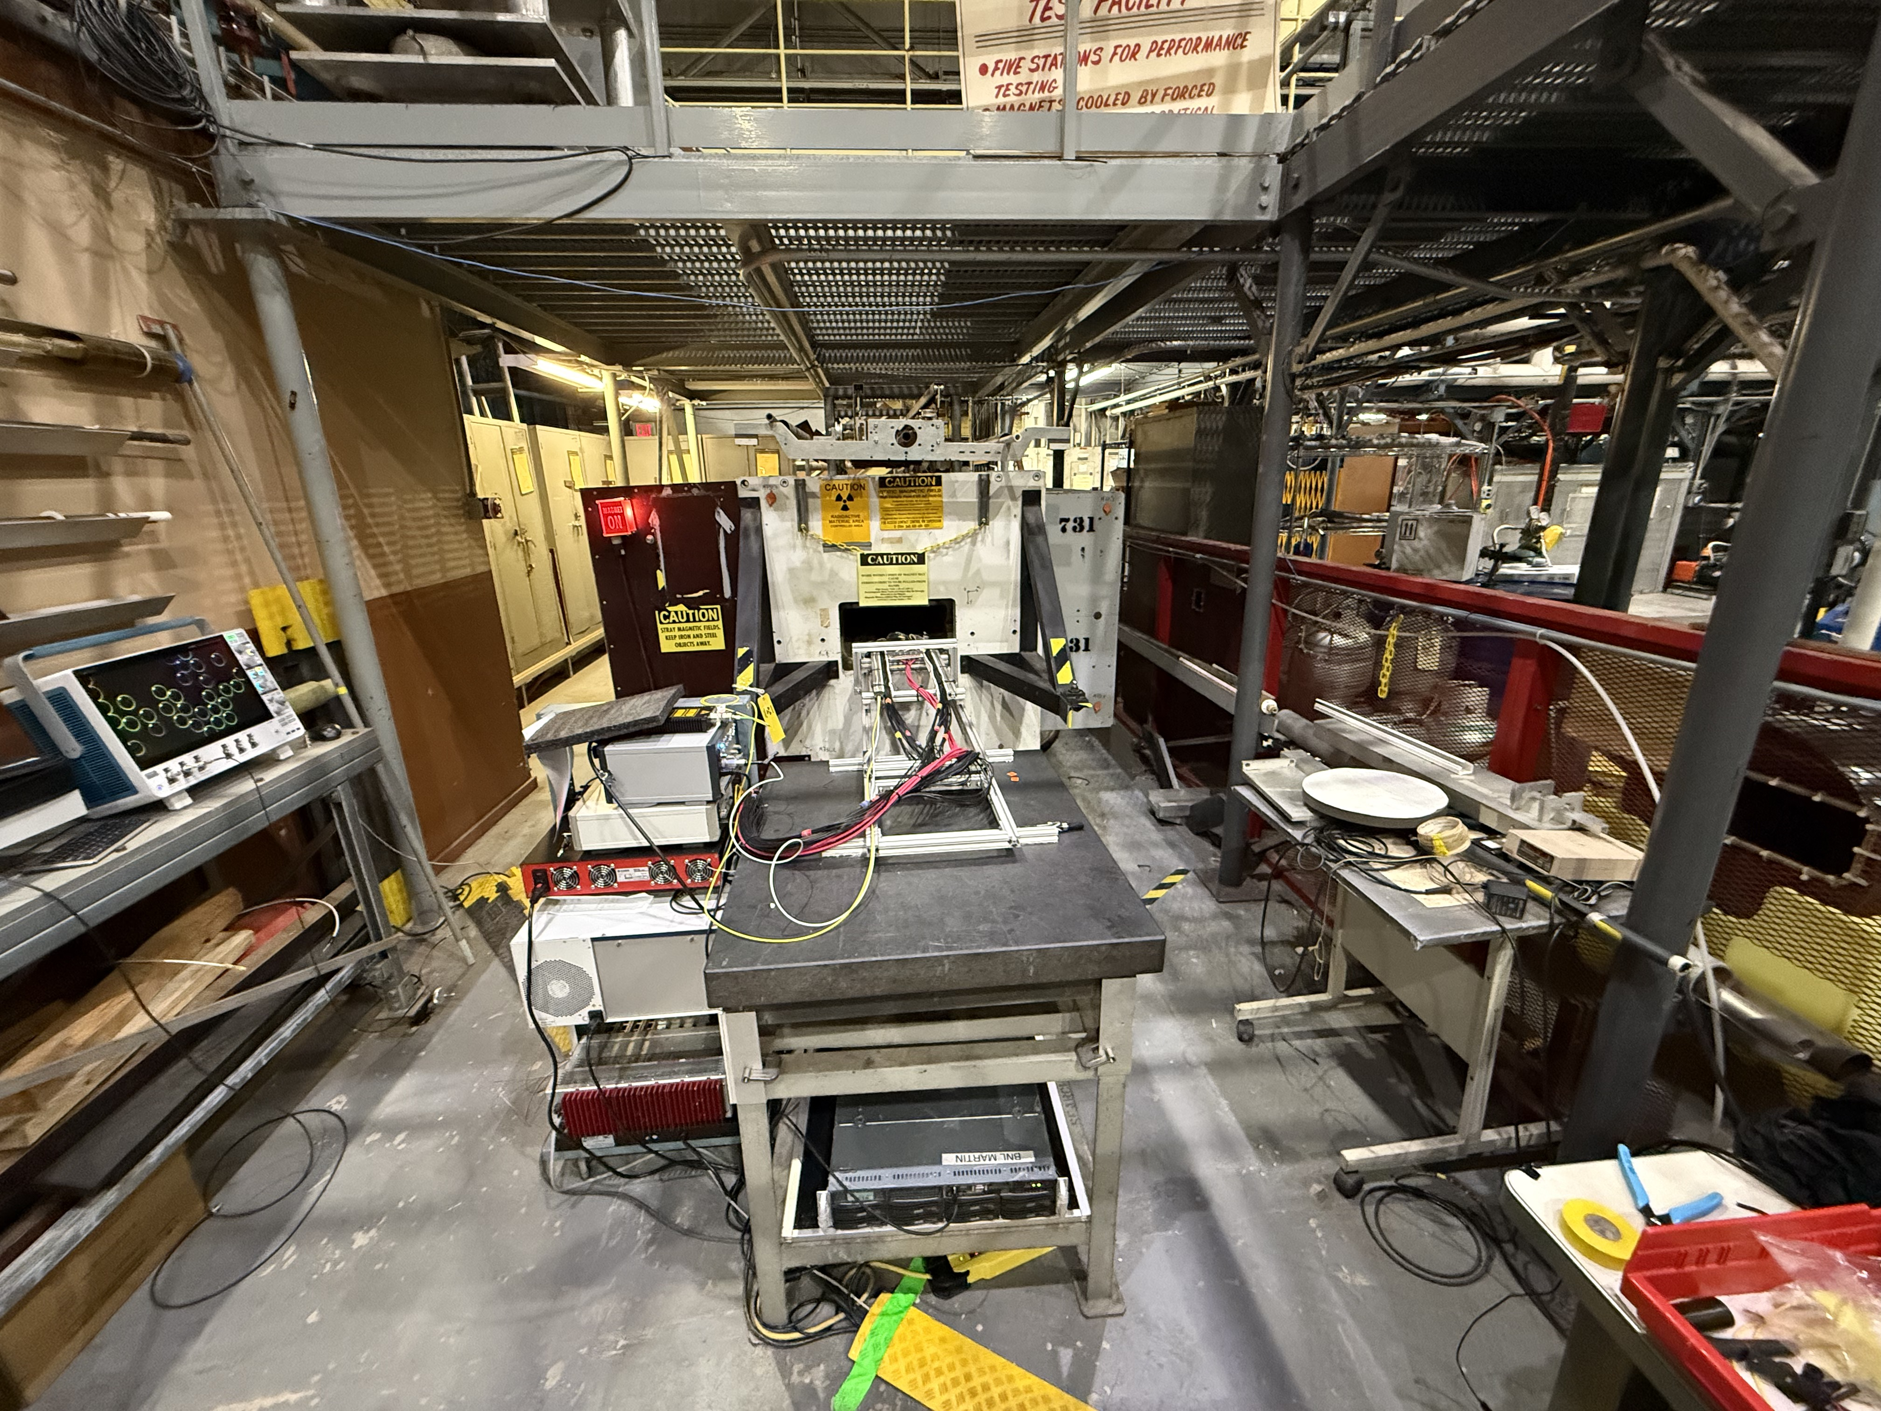
Facility and Experimental Area
Superconducting
Magnet Division (SMD)
at BNL
warm dipole
HRPPD enclosure mounted on a sled
PiLas laser; Hall probe controller
10’ long rails
rack with HV, digitizers, NIM logic
DAQ PC
Notes:
10′: 10 feet

Slide 4










Team
Alexander
Andrew (Yale)
Bob
Brian
Craig
Jihee
Mark (Incom)
Martin
Ping
Yifan
Participated remotely: Alexey Lyashenko (Incom), Yordanka Ilieva (South Carolina)
Local support @ SMD: Vikas Teotia, Chris Tamagro, Ray DeSalvo

Slide 5
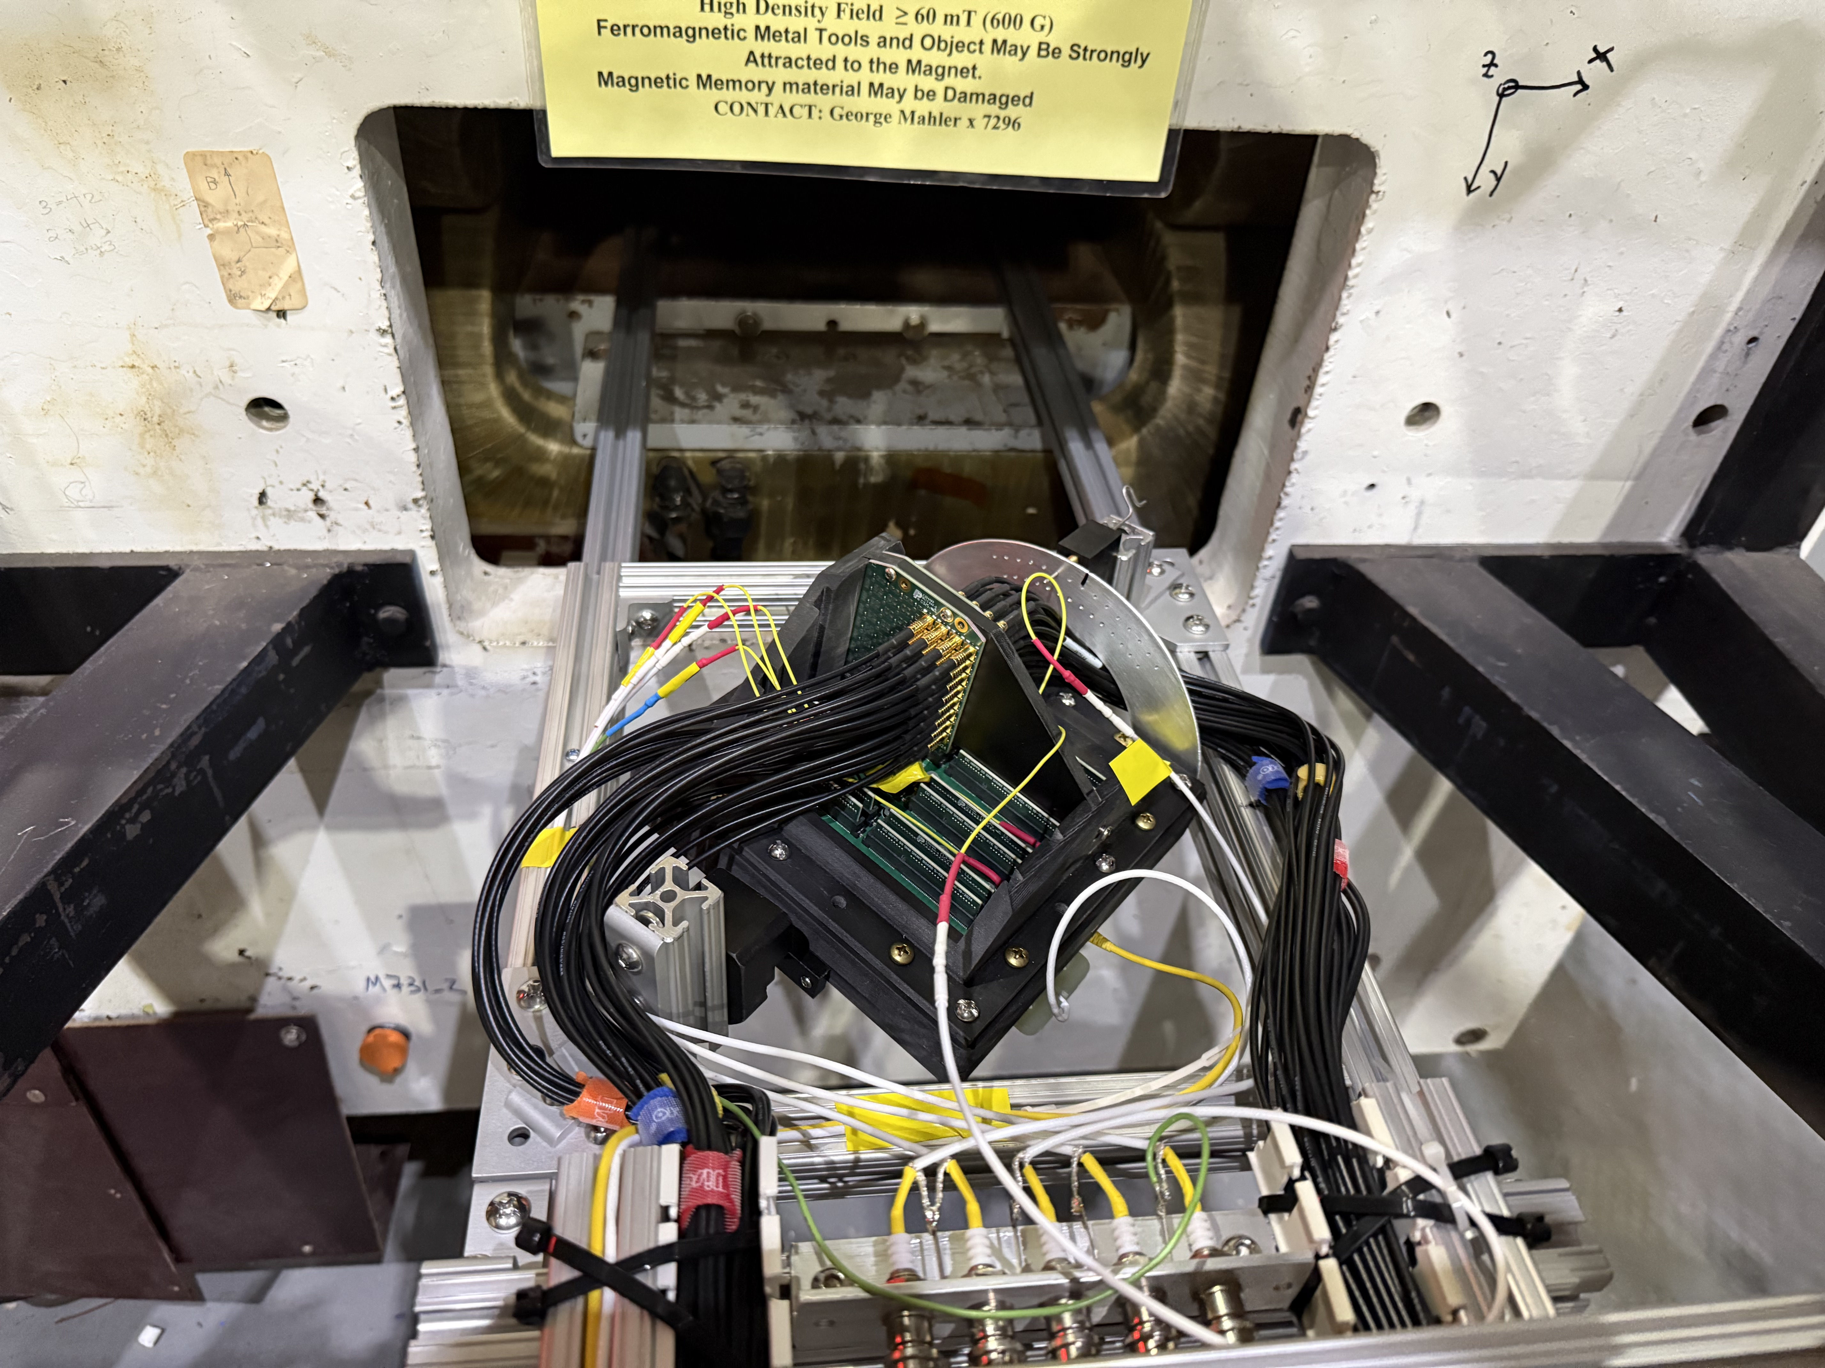
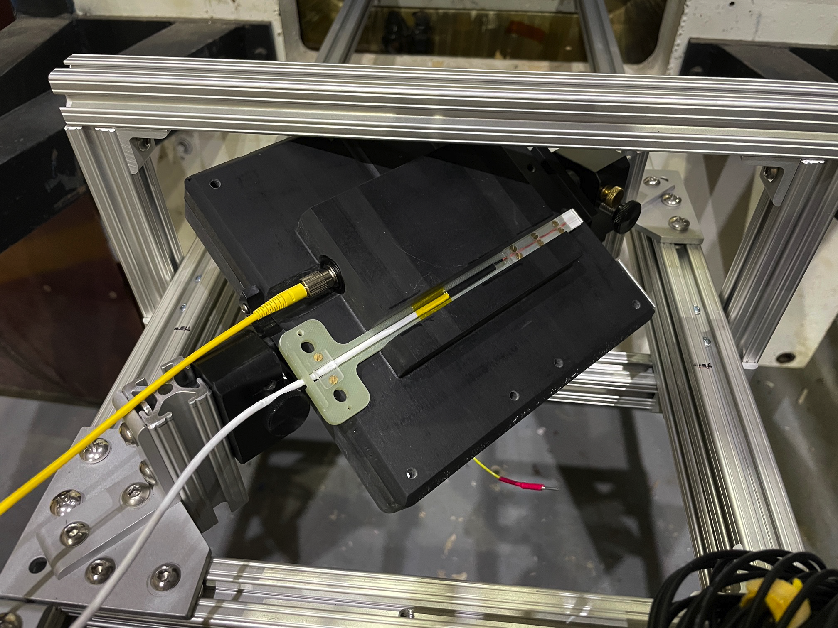
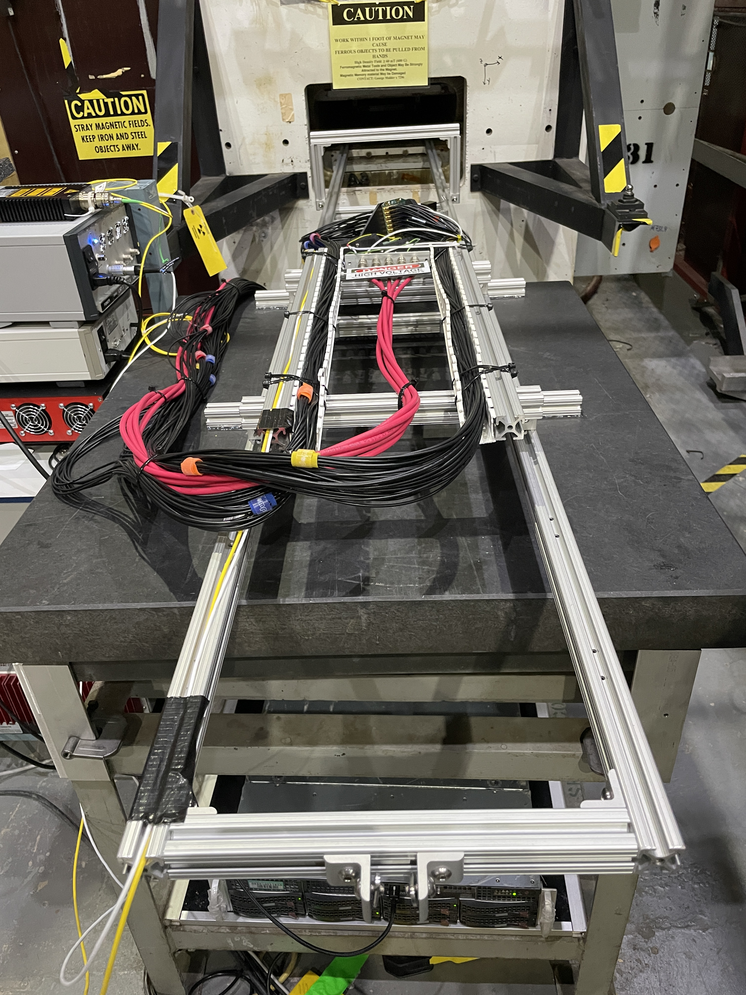
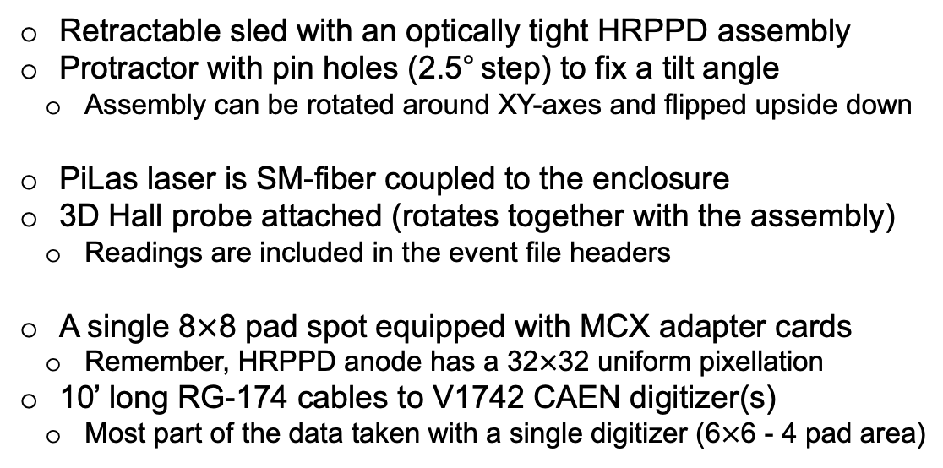
Experimental Setup details
HRPPD assembly
Hall probe and fiber port at the bottom
Retractable sled with an optically tight HRPPD assembly
Protractor with pin holes (2.5° step) to fix a tilt angle
Assembly can be rotated around XY-axes and flipped upside down
PiLas laser is SM-fiber coupled to the enclosure
3D Hall probe attached (rotates together with the assembly)
Readings are included in the event file headers
A single 8$×$8 pad spot equipped with MCX adapter cards
Remember, HRPPD anode has a 32$×$32 uniform pixellation
10’ long RG-174 cables to V1742 CAEN digitizer(s)
Most part of the data taken with a single digitizer (6$×$6 - 4 pad area)

Slide 6
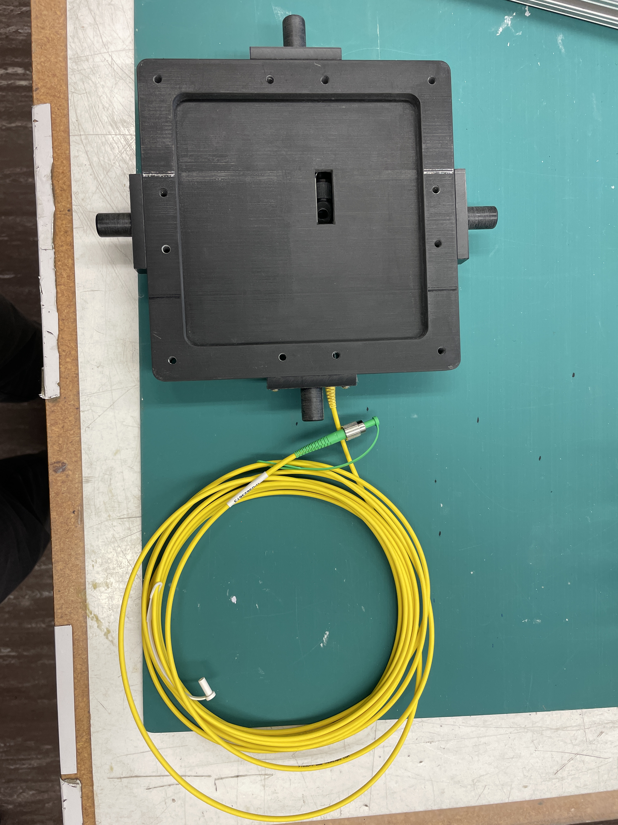
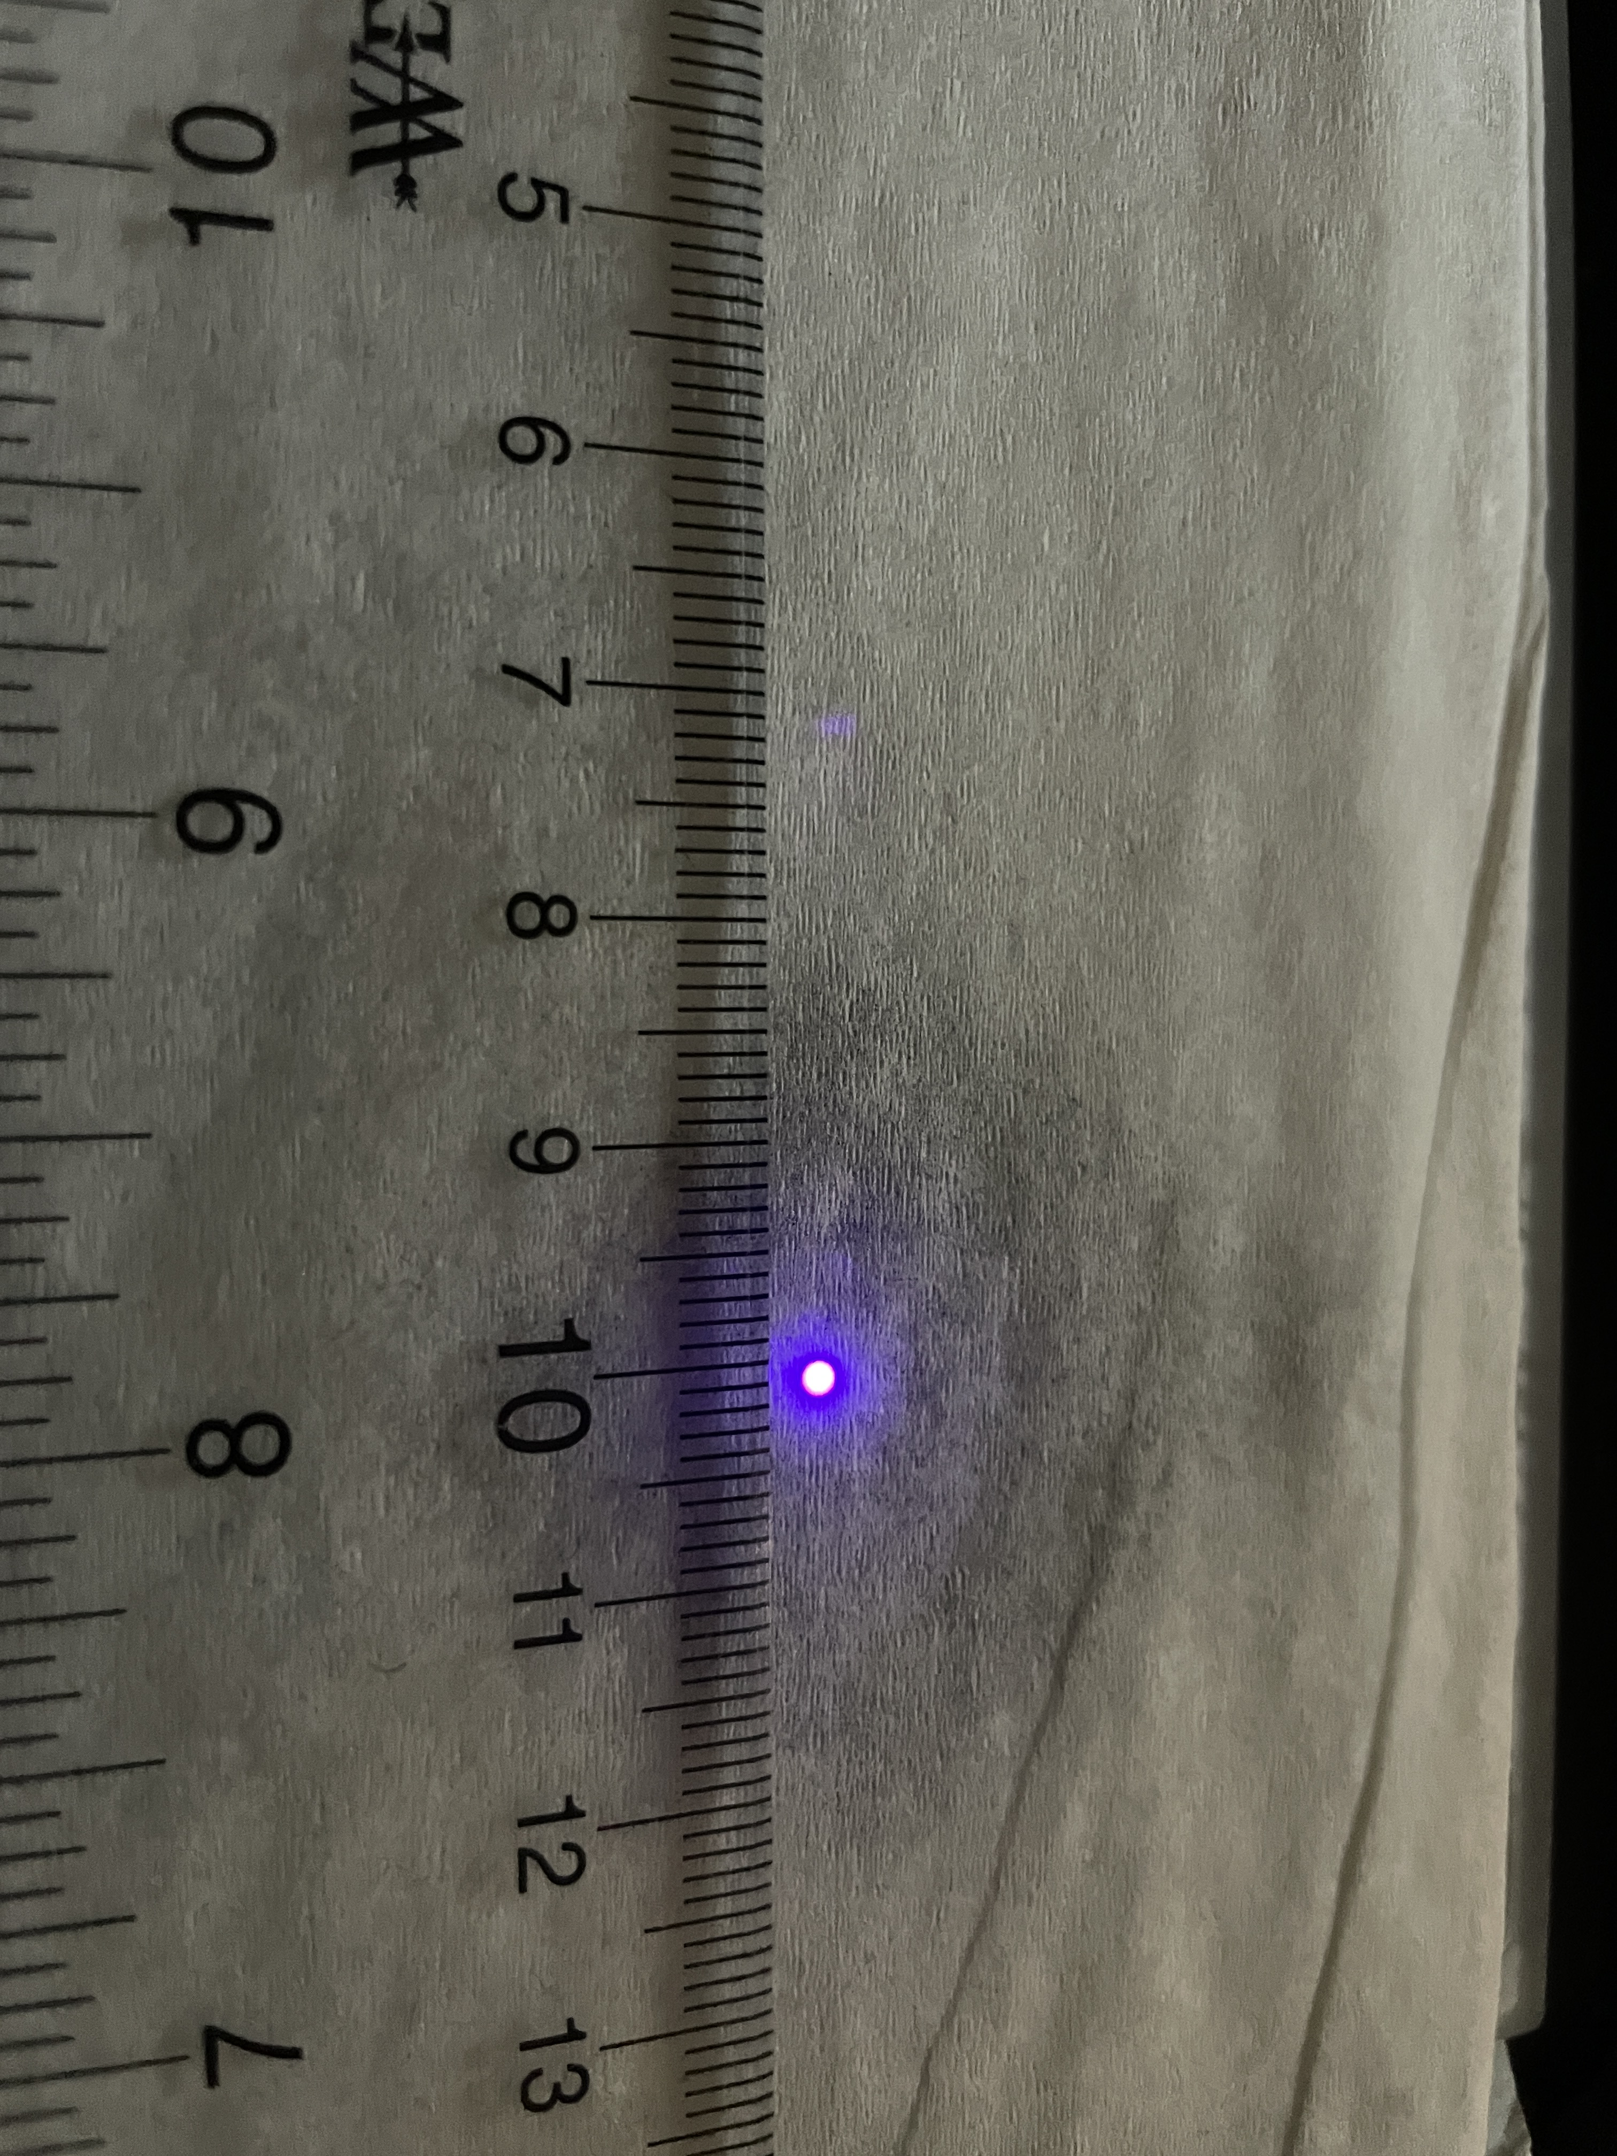
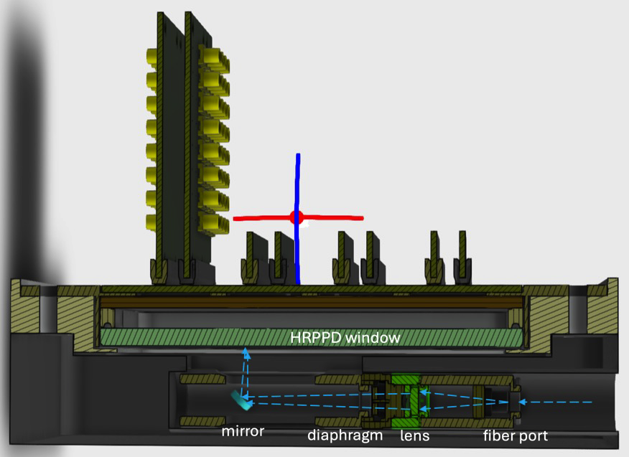
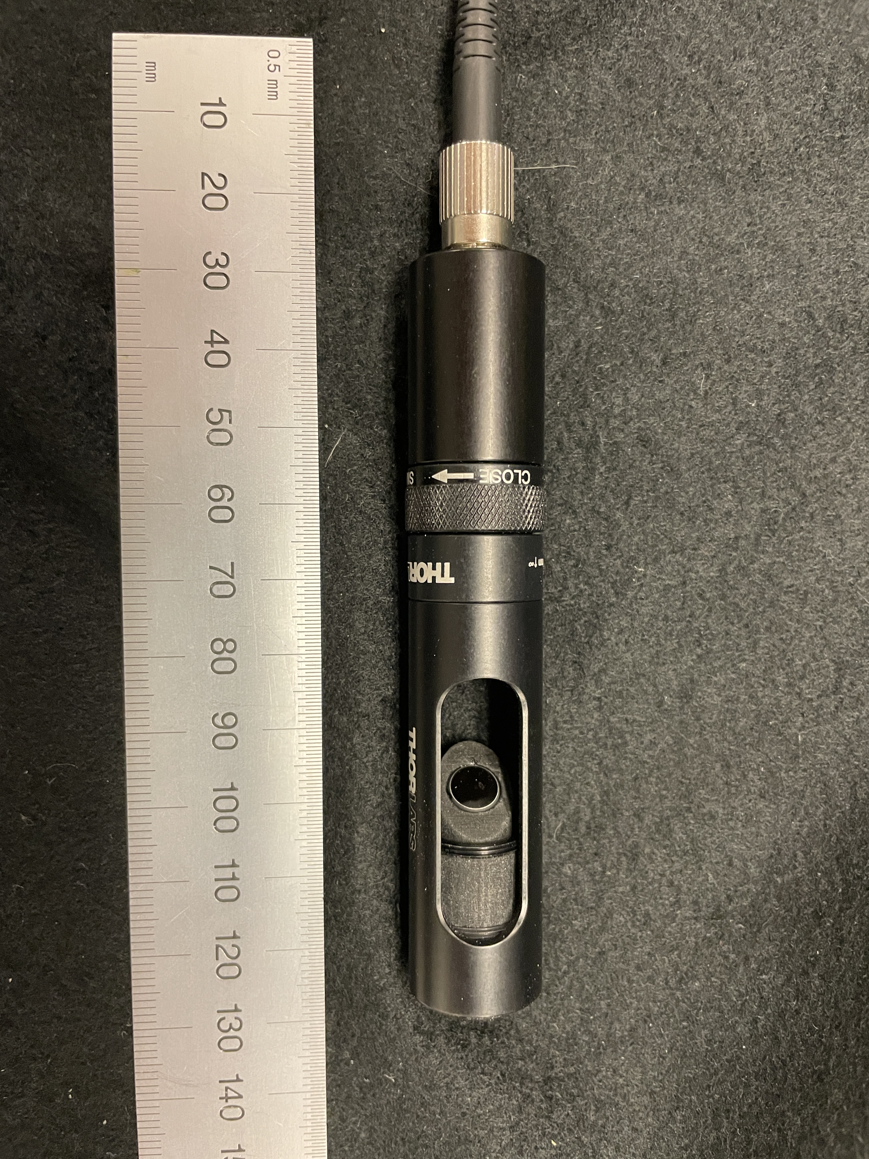
Optical configuration details
Bottom half of the HRPPD enclosurel
Use F=20mm plano-convex lens in a 2F-2F configuration
OD4 filter, diaphragm fully open
At a 40% laser tune get 5-7 % useful events
Beam spot size ~1.5mm diameter
See backup slides
lens
ND filter inside
CAD model
mirror
diaphragm
fiber adaptor

Slide 7
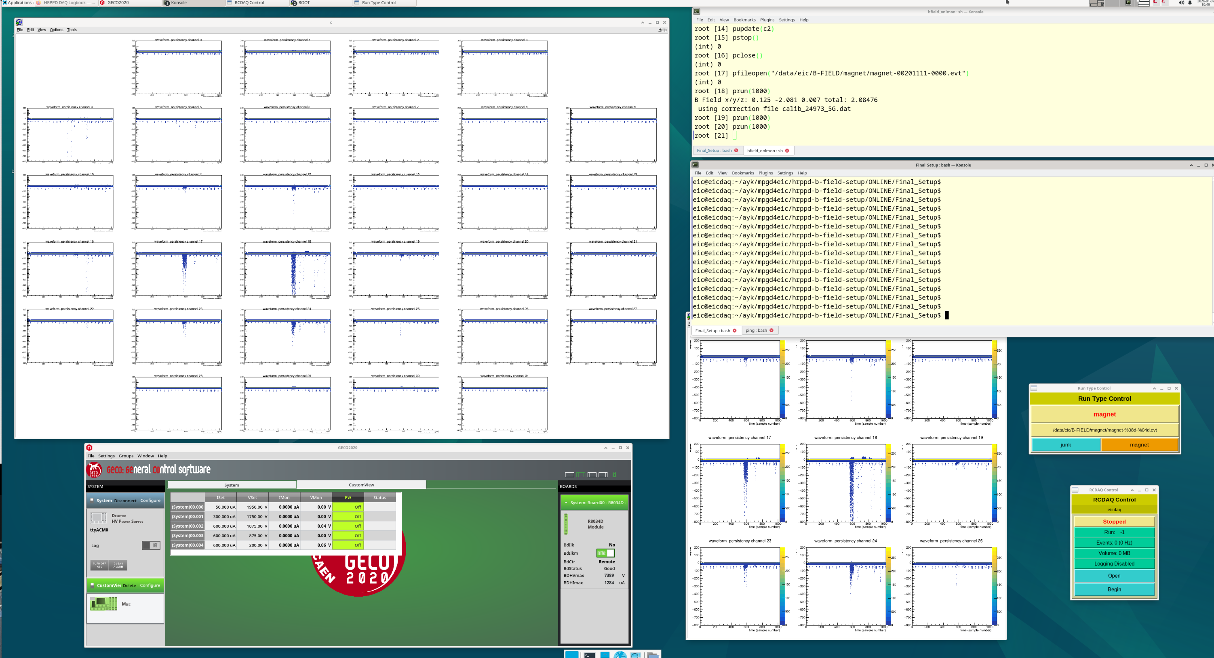
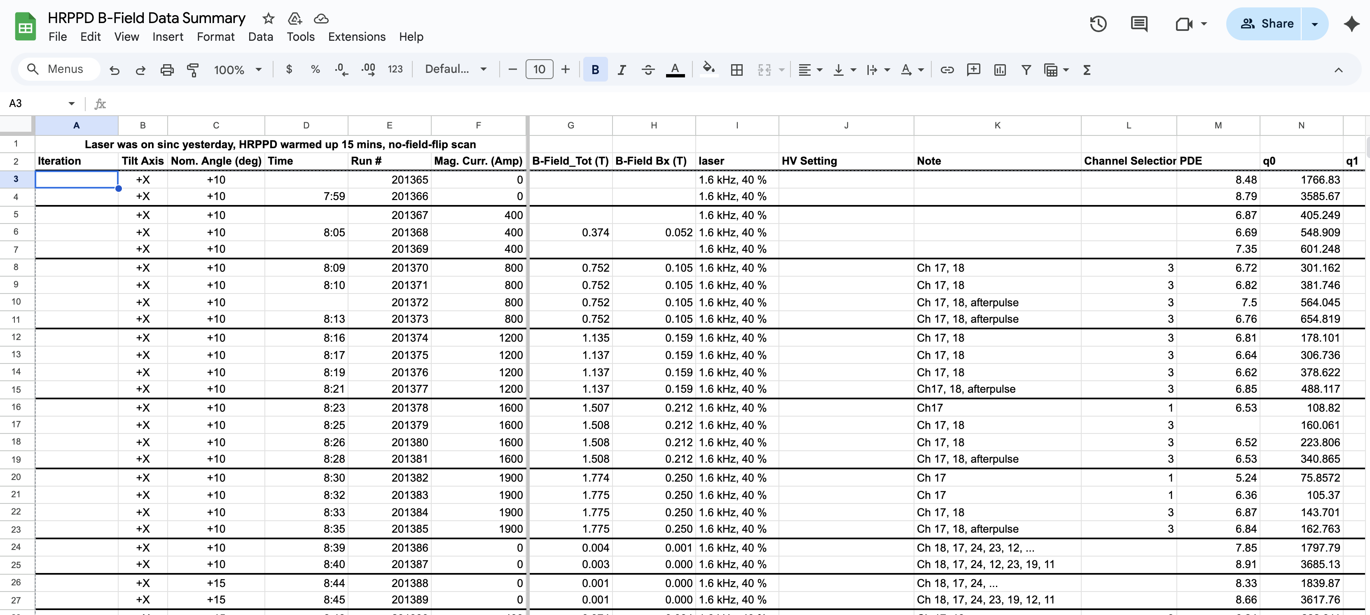
Data Taking and Online Monitoring
Online Monitoring VNC display
A 6x6-4 instrumented pad area
Data Summary Google sheet
RCDAQ-based data acquisition by Martin Purschke, VNC, elog, HV control, online display
Fully automated data taking in a batch mode (except for magnet ramp-up and ramp-down)
~1.5 kHz on tape, typically 100k events per setting, ~1500 runs, ~7.5TB of data
A typical “beam test” environment (and a very useful exercise before going to a pfRICH beam test @ CERN)
Near-online data analysis, with subsequent data productions on BNL SDCC

Slide 8
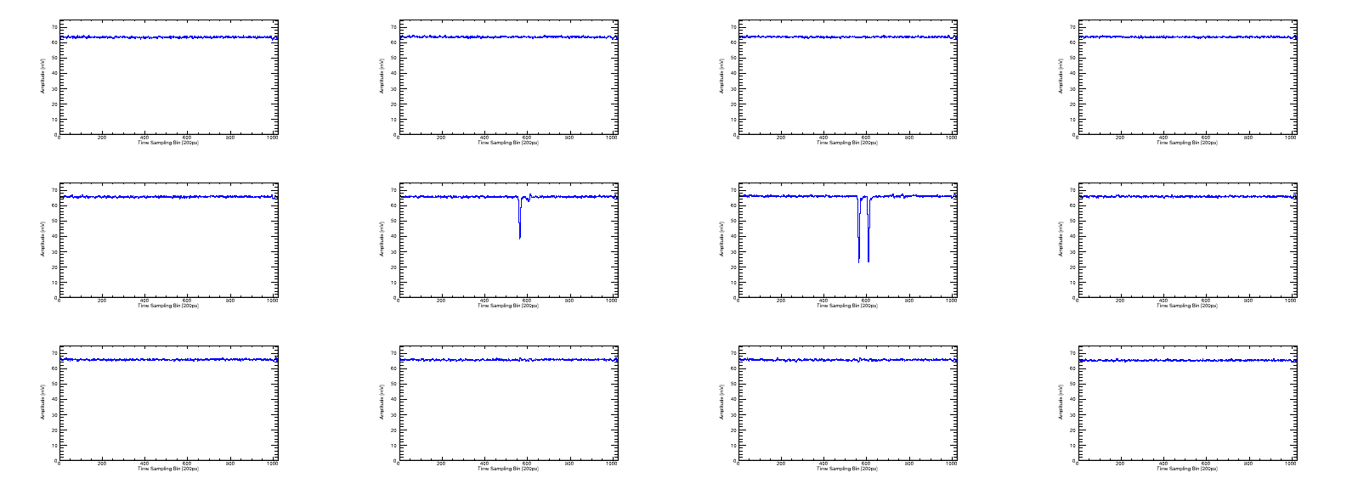
Typical Waveforms (Single Event)
Amplitude [mV]
Amplitude [mV]
Amplitude [mV]
Amplitude [mV]
ch10
ch11
ch12
ch13
Time Sampling Bin [200ps]
Time Sampling Bin [200ps]
Time Sampling Bin [200ps]
Time Sampling Bin [200ps]
Amplitude [mV]
Amplitude [mV]
Amplitude [mV]
Amplitude [mV]
ch16
ch17
ch18
ch19
Time Sampling Bin [200ps]
Time Sampling Bin [200ps]
Time Sampling Bin [200ps]
Time Sampling Bin [200ps]
Amplitude [mV]
Amplitude [mV]
Amplitude [mV]
Amplitude [mV]
ch22
ch23
ch24
ch25
Time Sampling Bin [200ps]
Time Sampling Bin [200ps]
Time Sampling Bin [200ps]
Time Sampling Bin [200ps]
~200 ns full range (1024 samples @ 5 GS/s); few dozens of mV signals (gain-dependent of course)
Charge sharing between channels 17 and 18, with an afterpulse observed in channel 18

Slide 9
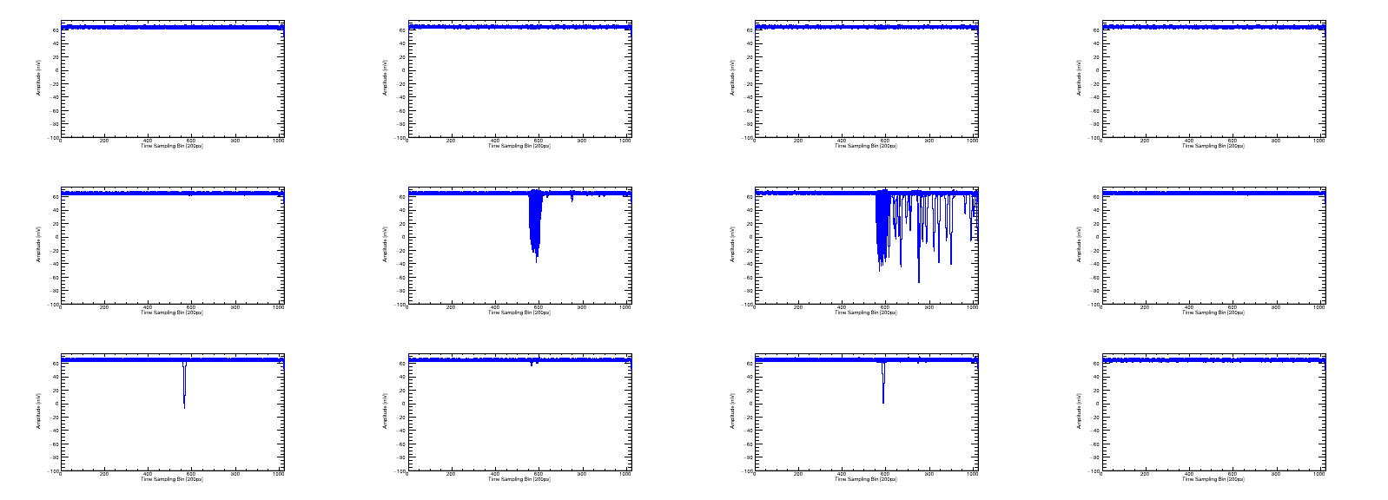
Typical Accumulated Waveforms
Amplitude [mV]
Amplitude [mV]
Amplitude [mV]
Amplitude [mV]
ch10
ch11
ch12
ch13
Time Sampling Bin [200ps]
Time Sampling Bin [200ps]
Time Sampling Bin [200ps]
Time Sampling Bin [200ps]
Amplitude [mV]
Amplitude [mV]
Amplitude [mV]
Amplitude [mV]
ch16
ch17
ch18
ch19
Time Sampling Bin [200ps]
Time Sampling Bin [200ps]
Time Sampling Bin [200ps]
Time Sampling Bin [200ps]
Amplitude [mV]
Amplitude [mV]
Amplitude [mV]
Amplitude [mV]
ch22
ch23
ch24
ch25
Time Sampling Bin [200ps]
Time Sampling Bin [200ps]
Time Sampling Bin [200ps]
Time Sampling Bin [200ps]
Charge sharing between channels 17 and 18, with afterpulsing observed in channel 18
Other channels also show some activity when several waveforms are accumulated (stray photons?)

Slide 10
Run Configuration Parameters
Tilt axis: +/-X, +/-Y, +/-X with assembly flip imitating B-field sign change
High voltage (HV): MCP symmetric, MCP asymmetric, PC HV variation
Magnetic field: 0–1.86 T (magnet current 0–2000 A)
Inclination angle (θ): -30° to +30° (actual range tilt axis dependent)
Only a fraction of results will be shown today; also see the backup
Laser repetition rate: 600 Hz, 1 kHz, 1.6 kHz (default), 2 kHz, 10 kHz
A NIM trigger pulse signal gets digitized by the V1742 along with the HRPPD pad signals
Laser tune: 30 %, 40 % (default)
Single photon mode: typically, ~5-7% of “useful” events out of 100k events / run
Notation: 200 – 675 – 200 – 675 – 200V
anode photocathode

Slide 11
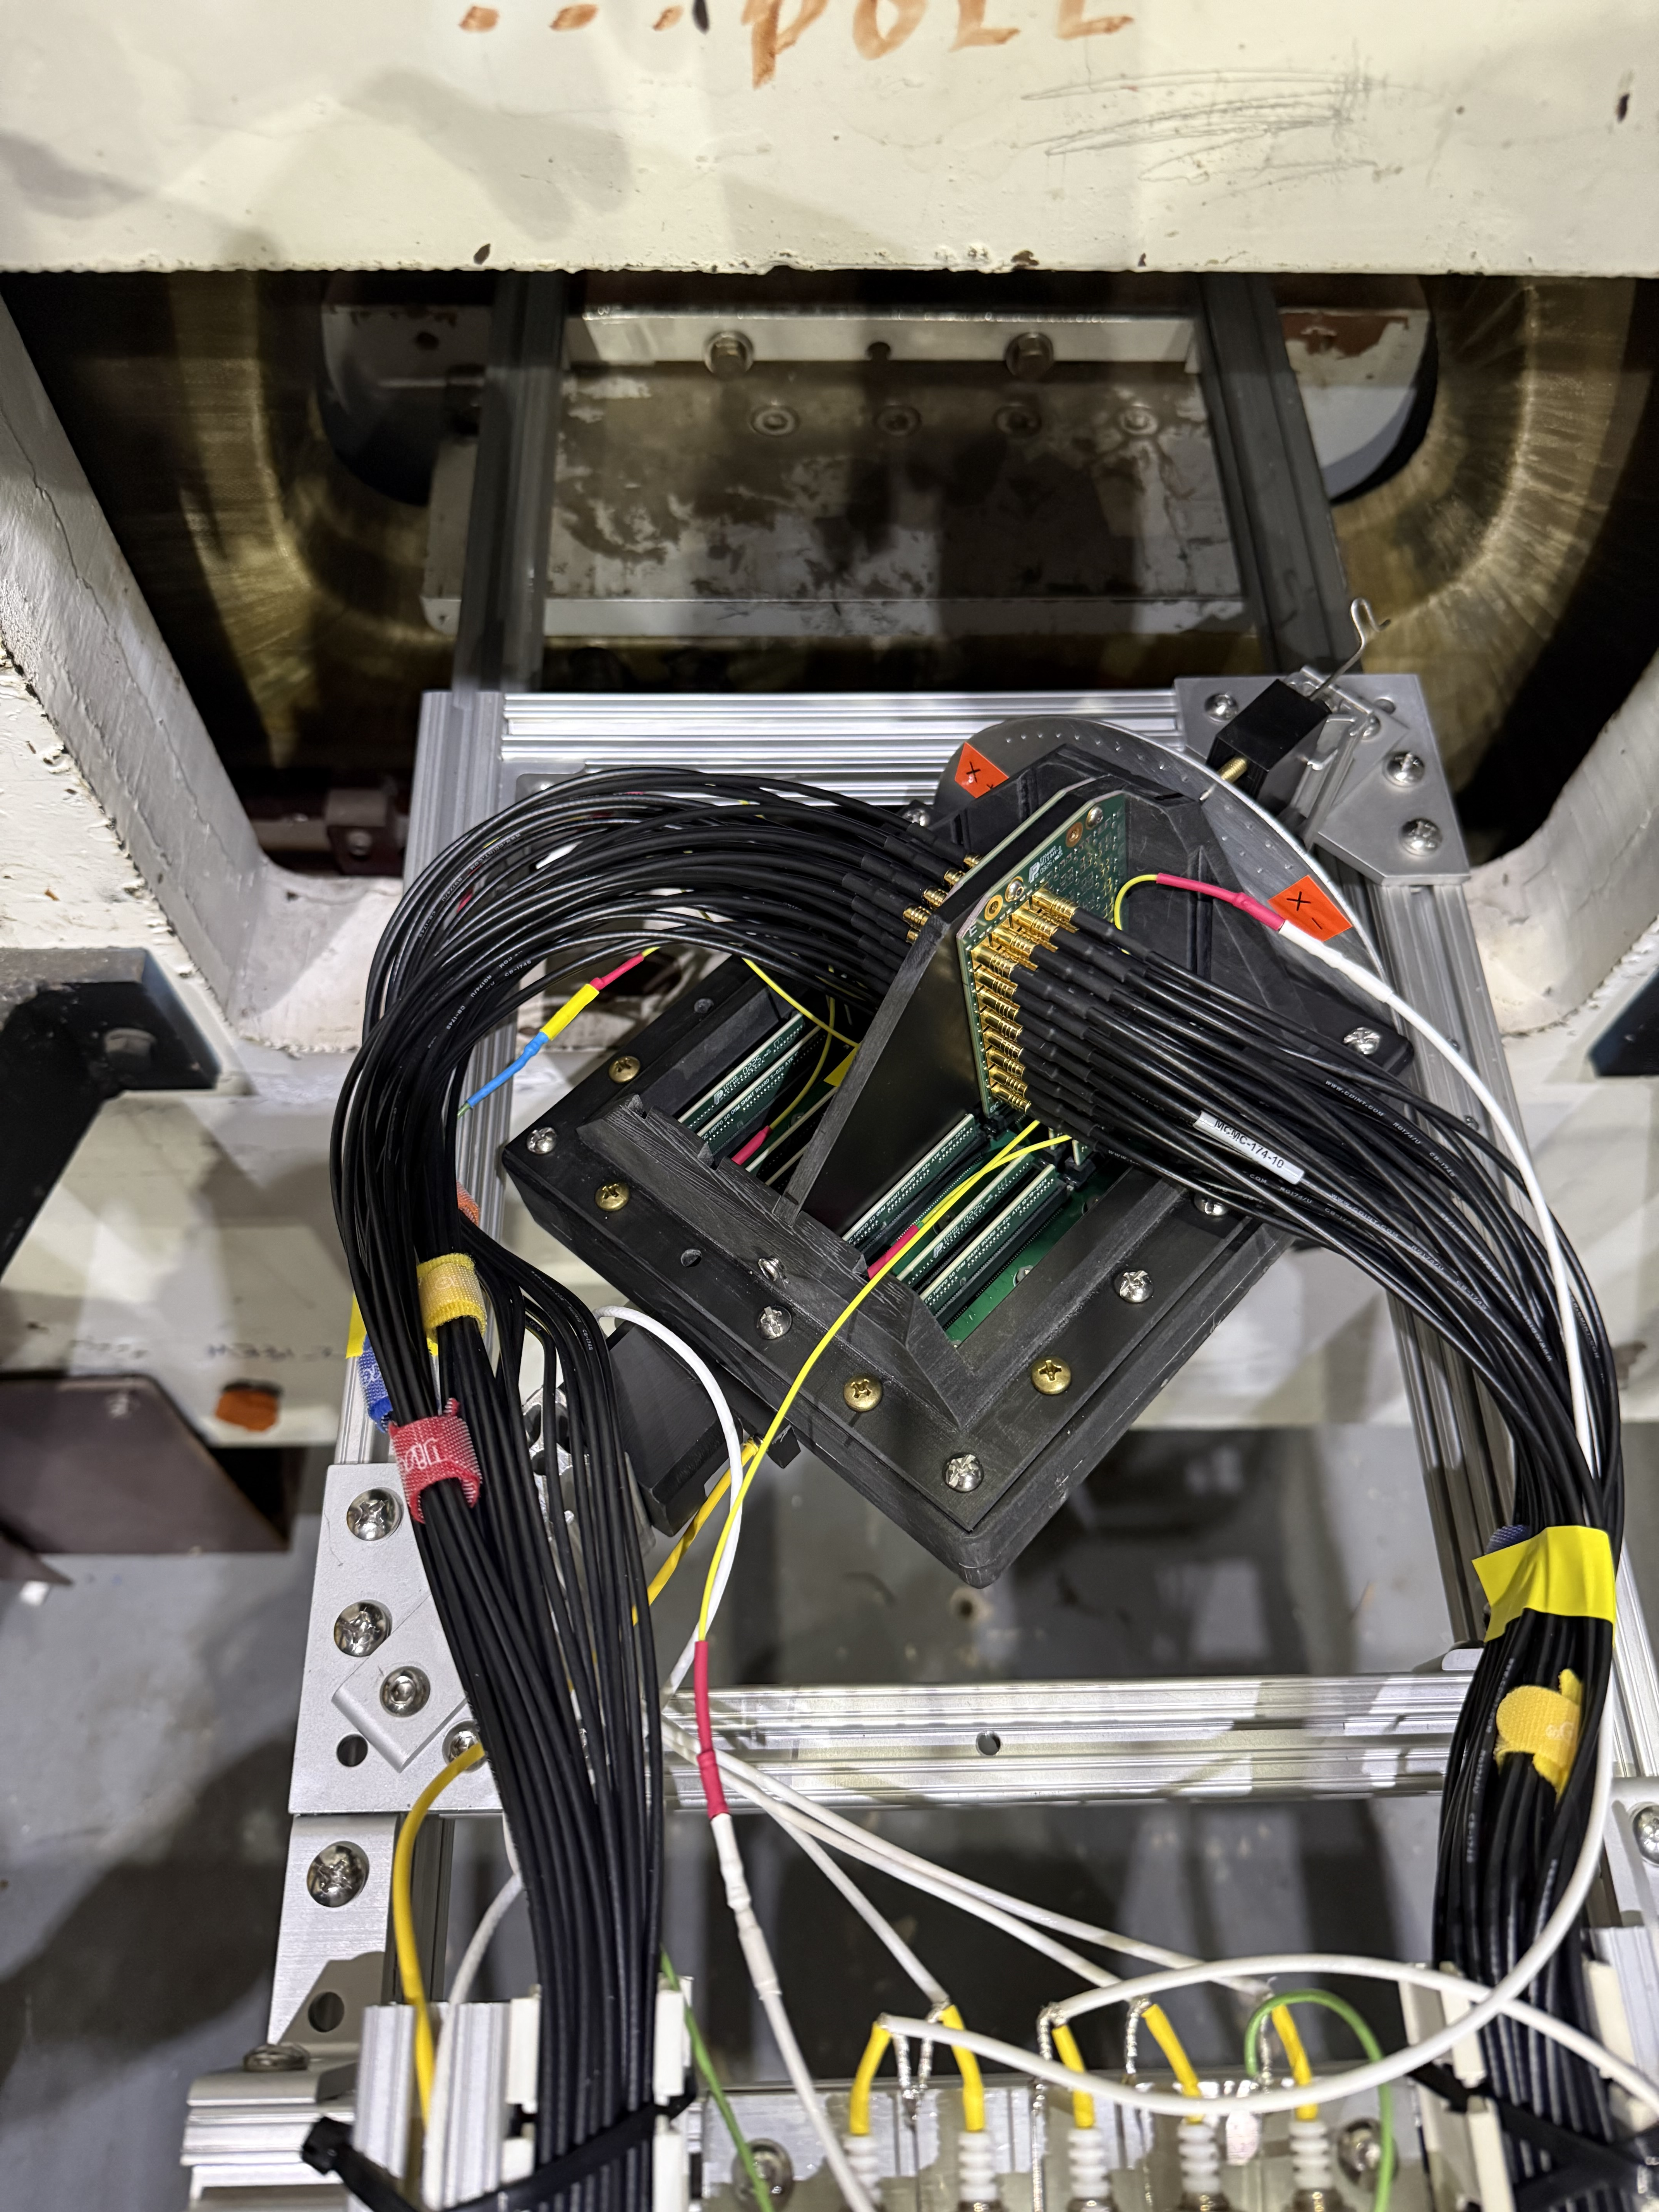

HRPPD assembly rotation axes
HRRPD facing down, +/-X rotation (“main” axis)
$$\overset{⃑}{B}$$
y
x
z

Slide 12
HRPPD assembly rotation axes
HRRPD facing down, +/-X rotation (“main” axis)
$$\overset{⃑}{B}$$
PC
y
x
z

Slide 13

HRPPD assembly rotation axes
HRRPD facing down, +/-X rotation (“main” axis)
$$\overset{⃑}{B}$$
$$+θ$$
y
x
z

Slide 14





HRPPD assembly rotation axes
$$\overset{⃑}{B}$$
HRRPD facing down, +/-X rotation (“main” axis)
Back: anode, readout, PCB
$$\overset{⃑}{B}$$
$$+θ$$
MCP #2
Capillary orientation
MCP #1
$$e^{−}$$
y
PC
x
y
Front: fused silica
$$γ$$
+12.5° rotation around X axis
is when MCP#1 pores
are aligned with the B-field (?)
$$+θ$$
x
z
z
PiLas
Yet MCP#1 & MCP#2 chevron capillary orientation needs to be clarified

Slide 15
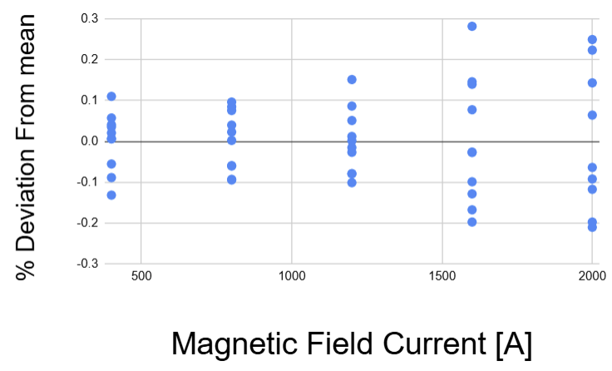
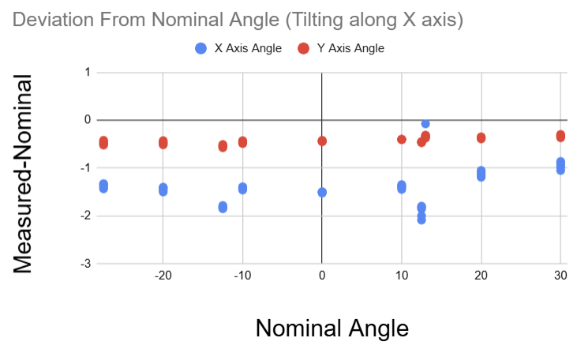
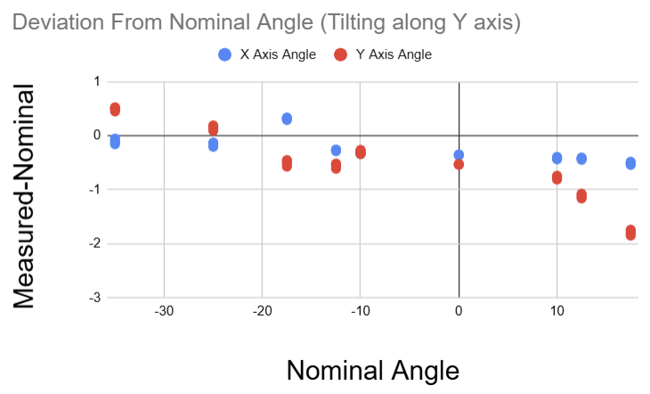
Hall probe orientation / misalignment
Use mounted Hall probe readings to measure magnetic field components on a run-by-run basis to correct the “nominal” angles
Absolute field values
are reproducible within ~0.3 % throughout the whole data taking period
Tilting Along X axis
  X axis avg. offset: -1.4° (Protractor error)
  Y axis avg. offset: -0.4° (Hall probe misalignment)
Tilting Along Y axis
  Offset has small dependence on nominal angle due to slight misalignment
ANDREW TAMIS

Slide 16
Example charge Spectra vs Magnetic Field
With a 0T Spectrum included
Zoomed in non-zero B-field data
Charge calculation: a sum of 3$×$4 neighboring pad signals in a 4ns wide window (20 time bins)
Gain reduction with increasing magnetic field (see backup: full magnetic field set)
Units: 1600 fC is equivalent to a gain of 10⁷
JIHEE KIM

Slide 17
Mean Charge Extraction (Gain)
Fit pedestal (Gaussian) alone
Apply a 4σ cut to remove the pedestal
Mean charge =
Histo→GetMean()
Mean charge error =
Histo→GetRMS()
1-photon
1-photon
2-photon
2-photon
Currently it is based on an average over 1-photon & 2-photon contributions
Eventually, will account for 0-photon, 1-photon & 2-photon Poisson statistics and also go down to a ~2σ cut
Polya fit does not work well anyway (see backup: gain saturation, no large amplitudes)
JIHEE KIM

Slide 18
Gain vs Magnetic Field at various tilt angles
Time Window Based Analysis
Threshold Based Analysis
Two independent analyses were conducted: time-window–based and threshold-based event selection
The mean charge values from both methods are consistent
JIHEE KIM, YIFAN JIN

Slide 19
HRPPD Gain in a “pfRICH tilt angle” range of interest
pfRICH sensor plane location in ePIC: up to ~1.3T field, tilt angles up to 13°
~1.3T
~1.3T
~1.3T
One can easily achieve >10⁶ gain of few times 10⁶ the whole tilt angle range of interest
Which may mean that all 68 HRPPDs can be oriented the same way
At these HV settings an HRPPD would not trip even at a zero field
We’ve taken this type of data in a range of a photocathode and transfer voltages, for a sake of completeness

Slide 20
HRPPD Gain vs Tilting Angle
X-axis: a minimum in gain is observed at approximately +15° nominal angle (B-fieldis roughly aligned with MCP#1 pores)
X-axis: there is also a small dip at −12.5° nominal angle (B-field is roughly aligned with MCP#2 pores)
Y-axis: a smaller angular dependence is observed
Gain slightly decreases at large negative tilting angles (around −30°)

Slide 21
Repetition rate dependency
200-675-200-675-200V
1.3 T, 0° tilt angle
Signal rate = laser repetition rate * fraction of signal events in a run.
Gain can be rate-dependent, especially in a high magnetic field, due to the electron avalanche focusing when only few of the MCP#2 pores are involved and can therefore saturate
One can indeed see a substantial rate dependency, however under the conditions we took data (1.6 kHz repetition rate, ~5-7% useful event fraction) a respective correction will be very small
Laser 1.6 kHz
Signal fraction ~5%
YIFAN JIN

Slide 22
After-pulsing example: accumulated waveforms
+X tilt axis, $\vec{B}$ = 0.37T, $θ=−13.9°$, laser tune 40 %, laser rep rate 1.6 kHz
HV 200-650-200-650-200
HV 200-675-200-675-200
HV 200-700-200-700-200
ch18
ch18
ch18
An increase in MCP bias voltage leads to more pronounced after-pulses
Which presumably means a faster photocathode aging
As a rule of thumb, the after-pulsing rate should be kept <1% or so

Slide 23
After-pulse rate
For different HV setting, after-pulse rate ranges from O(1)% - O(10)%
For “reference” pfRICH settings (200-675-200-675-200V @ 1.3 T and 0º tilting angle), after-pulse rate is ~1.3% in a 70ns window past the primary photoelectron pulse
B field: 1.3 T
Set 1
B field: 1.3 T
Set 2
After-pulse rate (for about the same gain)
strongly depends on MCP#1 voltage
YIFAN JIN
H⁺ ions

Slide 24
Dark count rate
pfRICH case
Using 11 runs, each run has 100k events, 32 channels, first 500 bins in the waveform (laser shots around bin 600), with HV setting 200-675-200-675-200, 1.3 T magnetic field, 0º tilting angle: 10 dark count events are found.
Thus, dark count rate (1.3T) = ~30 Hz/cm²
With HV setting 200-675-200-675-200, 0 T magnetic field, ~5700 dark count events are found in one run
Thus, dark count rate (0 T) = ~170 kHz/cm²
mV
LASER
Compare to a zero-field case:
Bin [0.2ns]
dark counts
after-pulses
primary
photo-electrons
YIFAN JIN

Slide 25
Detection efficiency
HV setting 200-675-200-675-200, 0º tilting angle
More studies needed (in a range of tilt angles and HV settings), but first impression is that there is no critical detection efficiency loss in a “typical pfRICH configuration”
~1.3T
YIFAN JIN

Slide 26
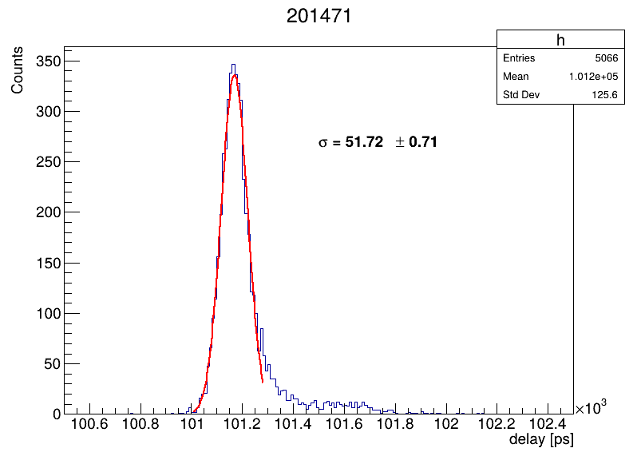
Timing resolution with a DRS4 readout
no idea why
don’t ask
In “typical” pfRICH conditions (1.3 T magnetic field, 0º tilting angle), with HV settings 200-675-200-675-200V (gain ~3*10⁶), we observe ~52 ps timing distribution core Gaussian width
PiLas laser contribution, effect of DRS4 timing calibration and NIM trigger jitter not unfolded
Weak dependence on a B-field is observed
YIFAN JIN

Slide 27
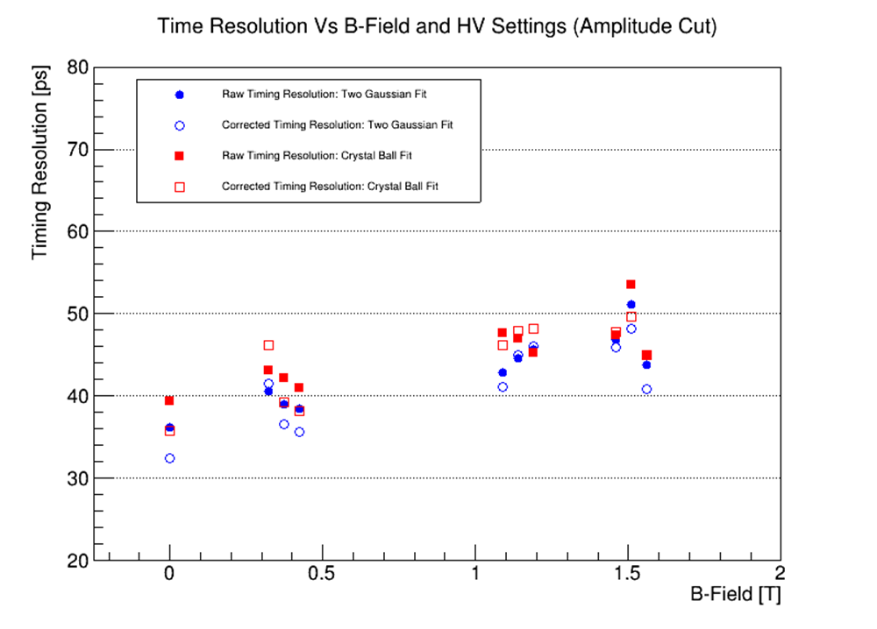
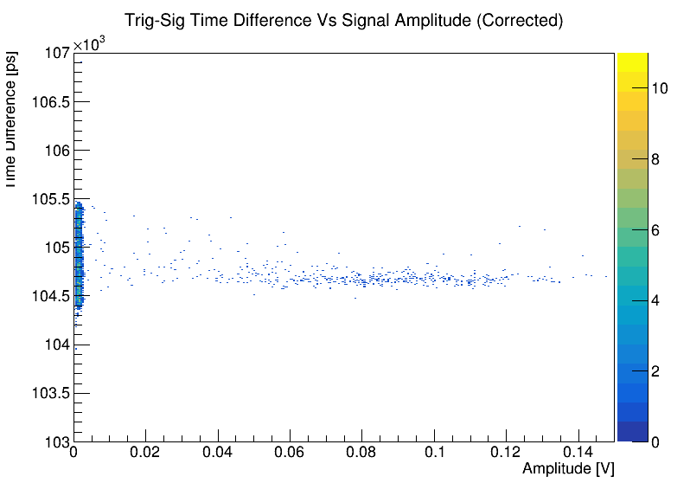
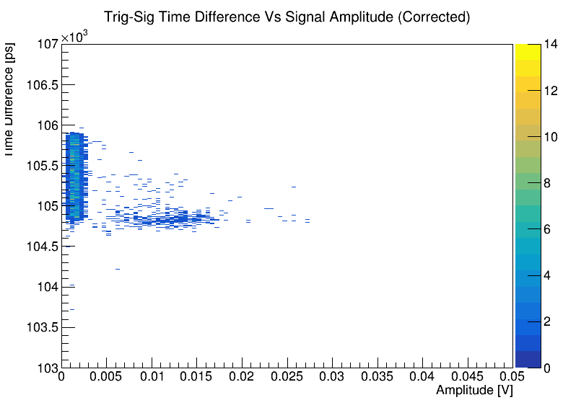
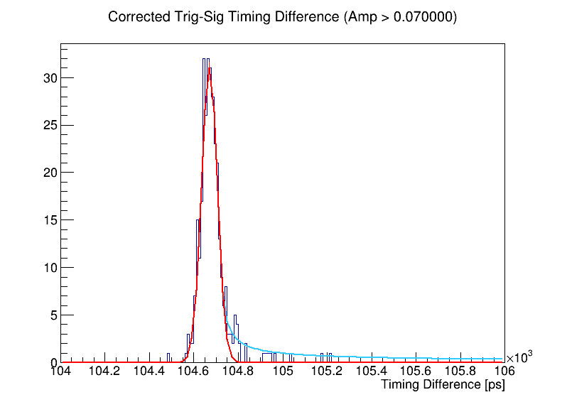
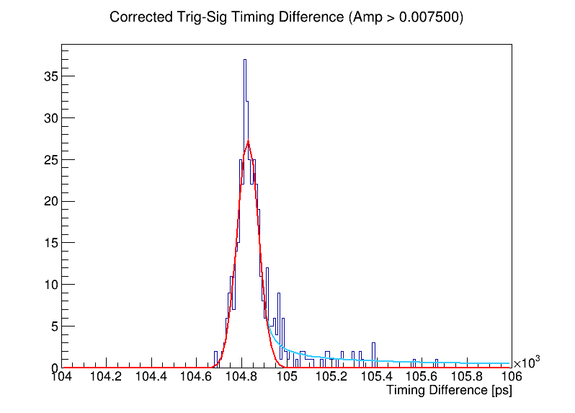
Timing resolution using a 50 GS/s scope
0.15
0.05
Zero Field
1.5 T (first point)
Data taken at 0, 0.374, 1.138, and 1.509 T
Zero field HV: MCP = 650, PC = 200 V
Non-zero field HV (left to right):
  MCP = 675, PC = 200
  MCP = 675, PC = 400
  MCP = 700, PC = 200
Crystal Ball
Gaus Core
BRIAN PAGE

Slide 28
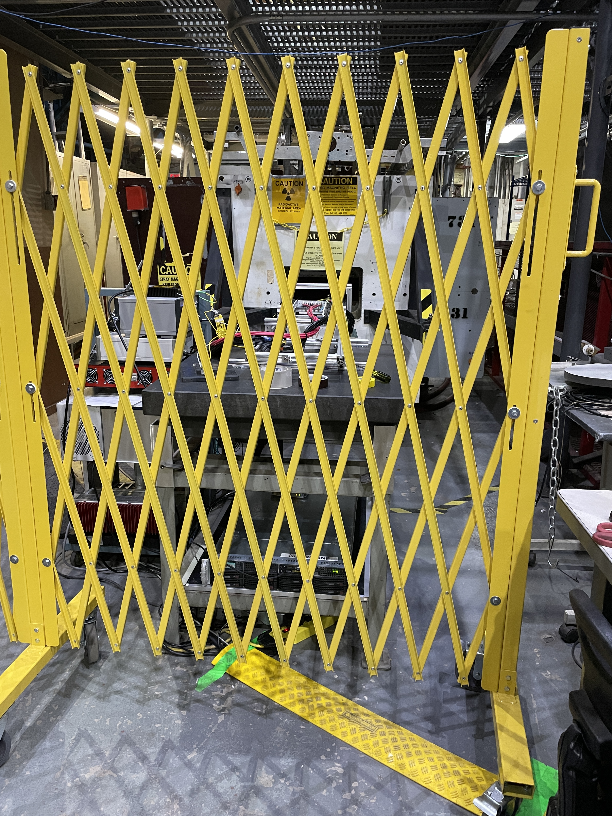
Outlook
Need to perform a gain uniformity scan and other calibration measurements
A thorough data analysis and paper drafting will take a couple of more months
  All materials are available under this Indico category
The setup has been left intact and turnkey ready
Would therefore like to come back and repeat the timing measurements using a femtosecond laser and a fast scope, some time in February
  Eliminate PiLas laser timing jitter, DRS4 calibration contribution and NIM trigger jitter
  Come up with a definitive statement about the expected HRPPD timing resolution in a pfRICH-like configuration
BNL SMD welcomes other ePIC groups to use the facility (but be aware about a 6” gap and <1.8 T field limitations)

Slide 29
Backup Slides

Slide 30
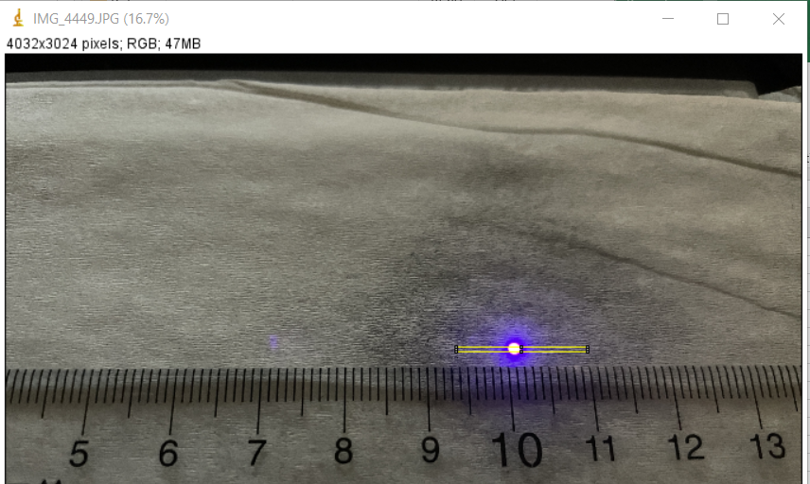
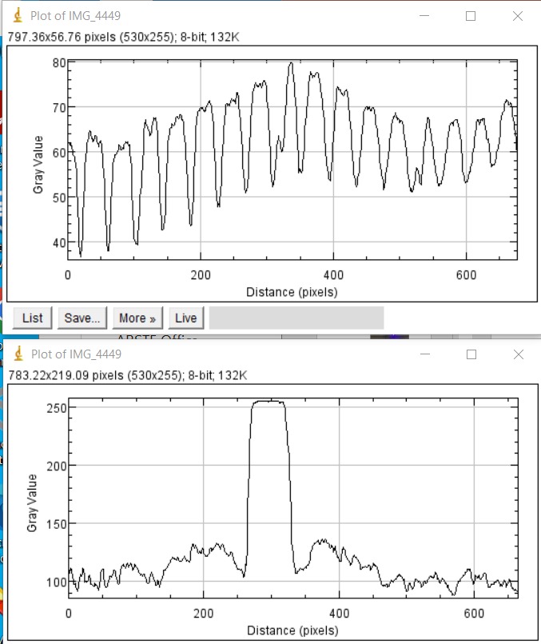
IMG-4449.jpg
Small spot, vacuum side of window
No. of mm width: 1.5
MARK POPECKI

Slide 31
Example – Mean Charge Extraction (Gain)
Apply a 4σ cut to remove the pedestal
Fit polya function
Fit pedestal (Gaussian) alone
Define pedestal using Gaussian fit and apply a 4σ cut to remove the pedestal
Remaining distribution using polya fit to estimate mean charge. Not always works (case-by-case)

Slide 32
Example – Mean Charge Extraction (Gain)
Apply a 4σ cut to remove the pedestal
Fit polya function
Fit pedestal (Gaussian) alone
Define pedestal using Gaussian fit and apply a 4σ cut to remove the pedestal
Remaining distribution using polya fit to estimate mean charge. Not always works (case-by-case)

Slide 33
Example – Mean Charge Extraction (Gain)
Fit pedestal (Gaussian) alone
Fit combined Gaussian + Polya
Define pedestal using Gaussian fit and signal using Polya fit.
Apply a combined fit (Gaussian + Polya)

Slide 34
Example – Mean Charge Extraction (Gain)
Fit pedestal (Exponential) alone
Fit combined Exponential + Polya
Define pedestal using Exponential fit and signal using Polya fit.
Apply a combined fit (Exponential + Polya)

Slide 35
Charge Spectra VS Magnetic Field
With 0T Spectrum
Without 0T Spectrum
Charge calculation: 3$×$4 neighboring pad selection.
Peak shifts toward lower charge values.
Gain reduction with increasing magnetic field.

Slide 36

Charge Spectra VS Inclination Angle
Measured charge spectra at different inclination angles with magnetic field $\vec{B}$ ~ 1.4 T
Charge calculation:
  Major signal channel selection by accumulated signals
Observations:
  Mean charge remains consistent across most angles
  $13°$ case shows behavior different from other angles
Takeaway:
  Overall angular dependence is weak

Slide 37

Charge Spectra VS Inclination Angle (+θ)
Measured charge spectra at different inclination angles with magnetic field $\vec{B}$ ~ 1.4 T
Charge calculation:
  Major signal channel selection by accumulated signals
Observations:
  Mean charge remains consistent across most angles
  $13°$ and $15°$ cases show behavior different from other angles
Takeaway:
  Overall angular dependence is weak

Slide 38

Charge Spectra VS Inclination Angle (-θ)
Measured charge spectra at different inclination angles with magnetic field $\vec{B}$ ~ 1.4 T
Charge calculation:
  Major signal channel selection by accumulated signals
Observations:
  Mean charge remains consistent across most angles
Takeaway:
  Overall angular dependence is weak

Slide 39
Charge Spectra VS Inclination Angle
Measured charge spectra at different inclination angles with magnetic field $\vec{B}$ ~ 1.4 T
Charge calculation:
  Major signal channel selection by accumulated signals
Observations:
  Mean charge remains consistent across most angles
  $13°$ and $15°$ cases show behavior different from other angles
Takeaway:
  Overall angular dependence is weak

Slide 40
Gain VS Magnetic Field (w/ HV)@ θ=-1.4°
Measured mean charge as a function of magnet current at different bias voltage
Charge calculation:
  Major signal channel selection by accumulated signals
Observations:
  Mean charge reduces as higher magnet current
  Mean charge increases as higher bias voltage
Takeaway:
  Gain partially recovered by increasing bias voltage

Slide 41
Gain VS Magnetic Field (w/ HV)@ θ=+11.6°
Measured mean charge as a function of magnet current at different bias voltage
Charge calculation:
  Major signal channel selection by accumulated signals
Observations:
  Mean charge reduces as higher magnet current
  Mean charge increases as higher bias voltage
Takeaway:
  Gain partially recovered by increasing bias voltage

Slide 42

Charge Spectra VS Magnet Current
Measured charge spectra with different magnet current
Charge calculation:
  3$×$4 channel selection
  Channels: 10–13, 16–19, 22–25
Observations:
  Clear peak shift with increasing magnetic field
  Peak shifts toward lower charge values
  Higher magnetic field $→$ narrower spectra
Takeaway:
  Gain reduction with increasing magnetic field
Data used: 200197, 200198, 200199, 200200, 200201, 200202, 200203, 200204, 200205 (11/19/2025)
JIHEE KIM

Slide 43

Charge Spectra VS Magnet Current
Measured charge spectra with different magnet current
Charge calculation:
  3$×$4 channel selection
  Channels: 10–13, 16–19, 22–25
Observations:
  Clear peak shift with increasing magnetic field
  Peak shifts toward lower charge values
  Higher magnetic field $→$ narrower spectra
Takeaway:
  Gain reduction with increasing magnetic field
Data used: 200197, 200198, 200199, 200200, 200201, 200202, 200203, 200204, 200205 (11/19/2025)
JIHEE KIM

Slide 44
Charge Spectra VS Inclination Angle
Measured charge spectra at different inclination angles with magnetic field $\vec{B}$ ~ 1.4 T
Charge calculation:
  Major signal channel selection by accumulated signals
Observations:
  Mean charge remains consistent across most angles
  $13°$ and $15°$ cases show behavior different from other angles
Takeaway:
  Overall angular dependence is weak
Data used: 200171, 200185, 200194, 200203, 200217, 200227, 200236, 200245, 200254 (11/19/2025), 200267, 200280, 200289, 200298, 200307, 200316 (11/24/2025)
JIHEE KIM

Slide 45

Gain VS Magnet Current (w/ θ)
Measured mean charge as a function of magnet current at different inclination angles
Charge calculation:
  Major signal channel selection by accumulated signals
Observations:
  At 0 A, gain remains the same regardless of angles
  Overall gain follows exponential slope across angles
Takeaway:
  Overall angular dependence is weak
  Gain dependence on magnet current can be parameterized as: $Gain\left(I_{\vec{B}}\right)=Gain(0)×e^{−0.0015 I_{\vec{B}}}$
See backup slides for results from measurements taken on different dates
Data used: 200332, 200336, 200338, 200341, 200351, 200356, 200390, 200395, 200398, 200402, 200409, 200413, 200450, 200455, 200458, 200462, 200469, 200473, 200540, 200545, 200548, 200552, 200559, 200563 (11/24/2025), 200934, 200939, 200942, 200946, 200953, 200957, 200969, 200974, 200977, 200981, 200988, 200992, 201049, 201068 (11/26/2025), 201452, 201457, 201525 (12/12/2025)
JIHEE KIM

Slide 46

Gain VS Magnet Current (w/ θ=0°, ±12.5°)
Measured mean charge as a function of magnet current at different inclination angles
Charge calculation:
  Major signal channel selection by accumulated signals
Observations:
  At 0 A, gain is nearly identical for all inclination angles
  Overall gain follows exponential slope across angles
  Measurements taken on different dates are consistent with each other
Takeaway:
  Overall angular dependence is weak
  Gain dependence on magnet current can be parameterized as: $Gain\left(I_{\vec{B}}\right)=Gain(0)×e^{−0.0015 I_{\vec{B}}}$
Data used: 200450, 200455, 200458, 200462, 200469, 200473 (11/24/2025), 200934, 200939, 200942, 200946, 200953, 200957, 200969, 200974, 200977, 200981, 200988, 200992, 201049, 201068, 201085, 201091, 201099 (11/26/2025), 201412, 201414, 201417, 201421, 201425, 201429, 201435, 201437, 201440, 201444, 201448, 201452, 201457 (12/12/2025)
JIHEE KIM

Slide 47

Gain VS Magnetic Field (w/ θ=0°, ±12.5°)
Measured mean charge as a function of magnet current at different inclination angles
Charge calculation:
  Major signal channel selection by accumulated signals
Observations:
  At 0 A, gain is nearly identical for all inclination angles
  Overall gain follows exponential slope across angles
  Measurements taken on different dates are consistent with each other
Takeaway:
  Overall angular dependence is weak
  Gain dependence on magnetic field can be parameterized as: $Gain\left(\vec{B}\right)=Gain(0)×e^{\frac{\vec{B}}{−0.61}}$
Data used: 200450, 200455, 200458, 200462, 200469, 200473 (11/24/2025), 200934, 200939, 200942, 200946, 200953, 200957, 200969, 200974, 200977, 200981, 200988, 200992, 201049, 201068, 201085, 201091, 201099 (11/26/2025), 201412, 201414, 201417, 201421, 201425, 201429, 201435, 201437, 201440, 201444, 201448, 201452, 201457 (12/12/2025)
JIHEE KIM

Slide 48

Gain VS Magnet Current (w/ θ=0°)
Measured mean charge as a function of magnet current at different inclination angles
Charge calculation:
  Major signal channel selection by accumulated signals
Observations:
  At 0 A, gain is nearly identical for all inclination angles
  Overall gain follows exponential slope across angles
  Measurements taken on different dates are consistent with each other
Takeaway:
  Overall angular dependence is weak
  Gain dependence on magnet current can be parameterized as: $Gain\left(I_{\vec{B}}\right)=Gain(0)×e^{−0.0015 I_{\vec{B}}}$
Data used: 200197, 200198, 200199, 200200, 200201, 200202, 200203, 200204, 200205 (11/19/2025), 200450, 200455, 200458, 200462, 200469, 200473 (11/24/2025), 201085, 201091, 201099 (11/26/2025), 201457 (12/12/2025)
JIHEE KIM

Slide 49

Gain VS Magnetic Field (w/ θ=0°)
Measured mean charge as a function of magnet current at different inclination angles
Charge calculation:
  Major signal channel selection by accumulated signals
Observations:
  At 0 A, gain is nearly identical for all inclination angles
  Overall gain follows exponential slope across angles
  Measurements taken on different dates are consistent with each other
Takeaway:
  Overall angular dependence is weak
  Gain dependence on magnetic field can be parameterized as: $Gain\left(\vec{B}\right)=Gain(0)×e^{\frac{\vec{B}}{−0.61}}$
Data used: 200197, 200198, 200199, 200200, 200201, 200202, 200203, 200204, 200205 (11/19/2025), 200450, 200455, 200458, 200462, 200469, 200473 (11/24/2025), 201085, 201091, 201099 (11/26/2025), 201457 (12/12/2025)
JIHEE KIM

Slide 50
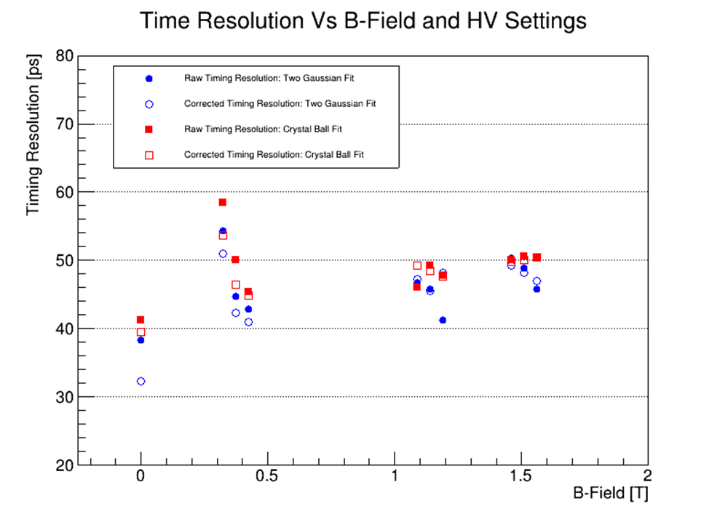
Scope Timing resolution: Pedestal Cut Only
BACKUP

Slide 51

Scope Timing resolution: Amplitude Correction
BACKUP

Slide 52
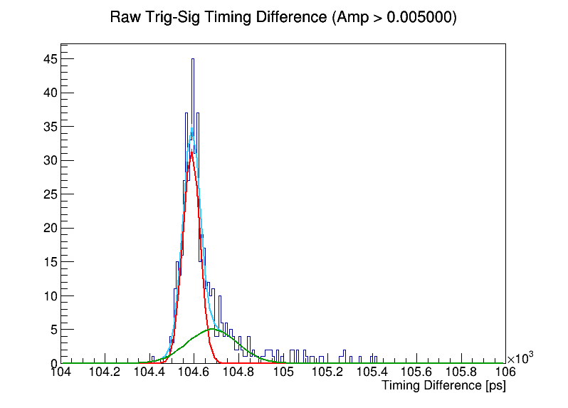
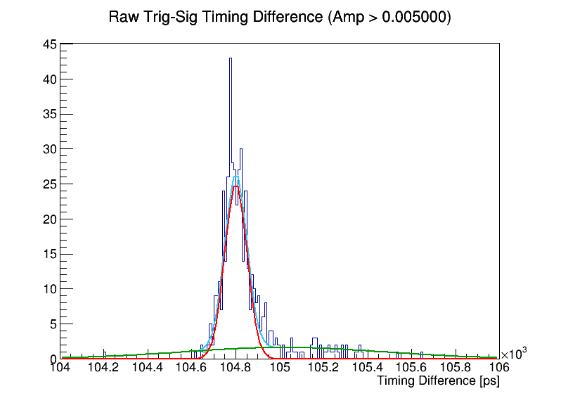
Scope Timing resolution: 2-Gaus Fit
Zero Field
1.5 T Field
MCP = 675 V
PC = 200 V
Full Fit
1st Gaus
2nd Gaus
BACKUP

Slide 53
Scope Timing resolution: Laser Contribution
In B-Field setup with PiLas laser and scope, measure time resolution of ~40 ps at zero field and ~50 ps at 1.5 T
With femtosecond laser and scope in lab, measure time resolution of ~16 ps
PiLas laser contribution to timing resolution = $\sqrt{{40}^{2}−{16}^{2}}$ = ~37 ps
HRPPD timging resolution @ 1.5 T = $\sqrt{{50}^{2}−{37}^{2}}$ = ~34 ps
Many assumptions and hand waving, but we could be seeing ~ a factor of 2 degradation in intrinsic HRPPD timing performance from 0 T to 1.5 T
BACKUP

Slide 54
Gain VS Magnetic Field (w/ HV)@ θ=-12.5°
Alexander’s
Yifan’s
Large difference was shown at 1900 A measurement especially at HV = 650 V and 725 V.
JIHEE KIM

Slide 55
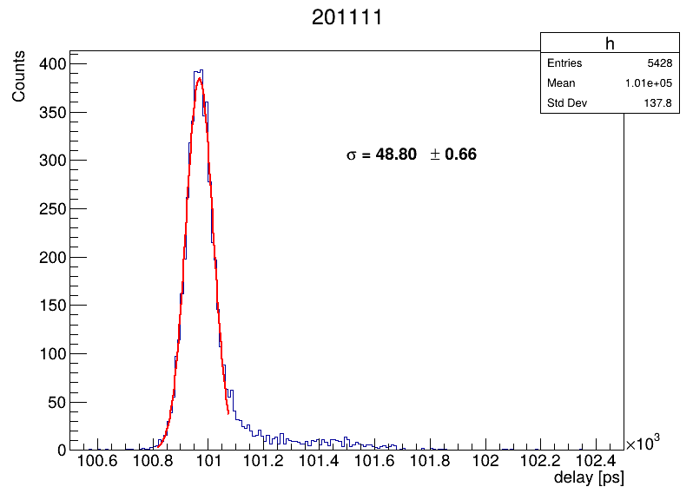
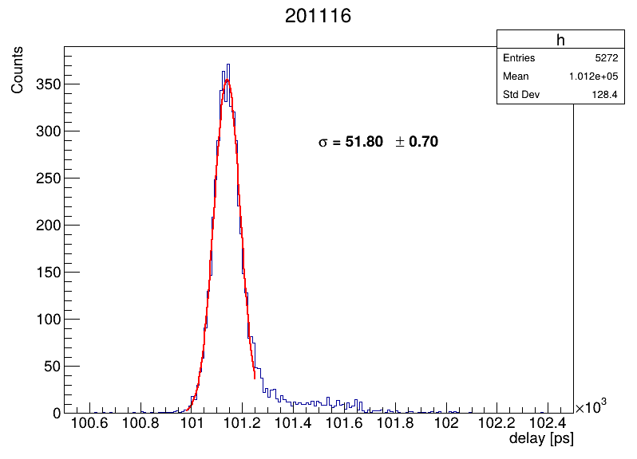
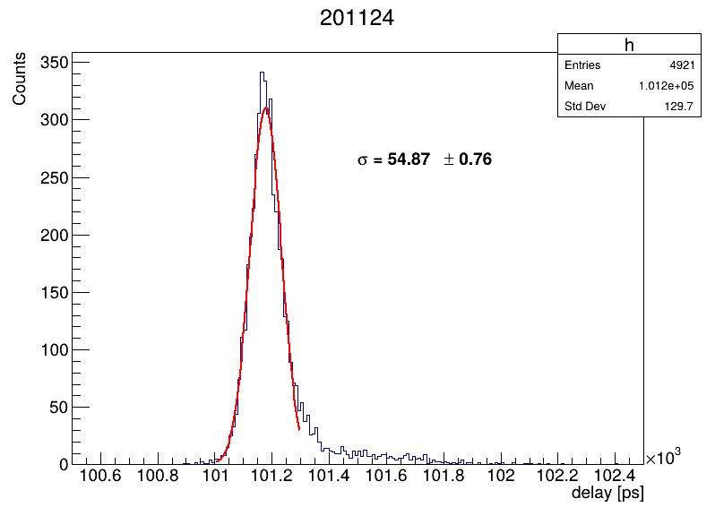
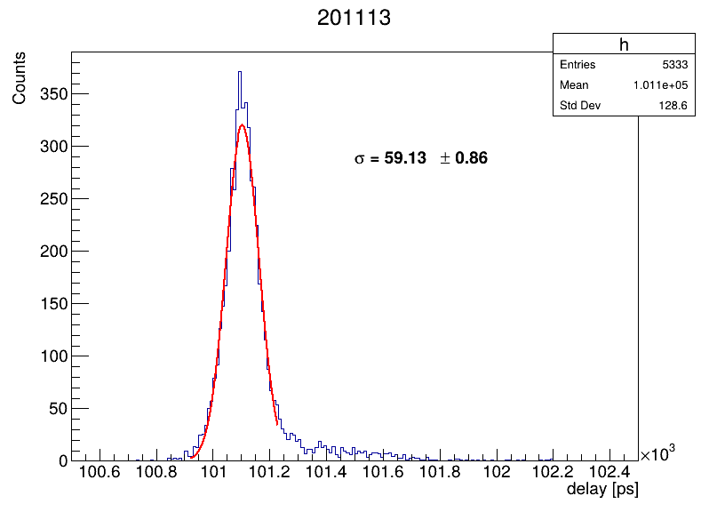
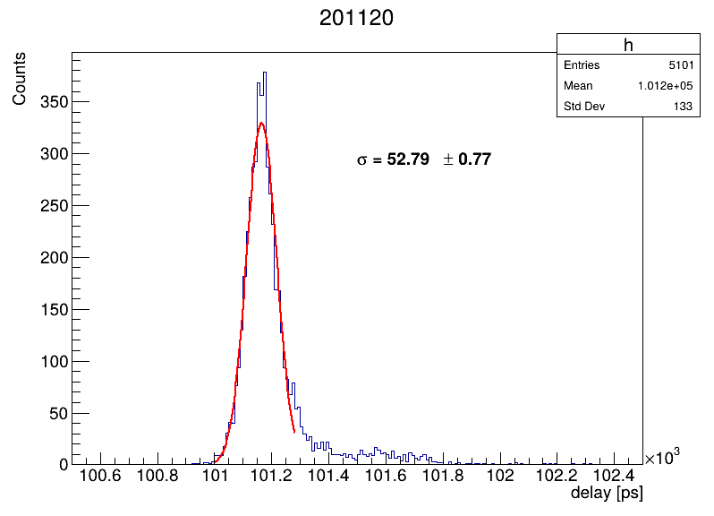
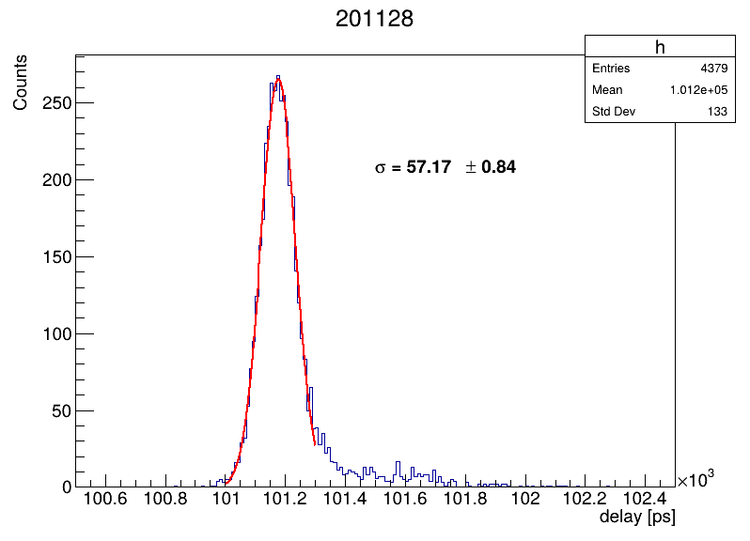
Complimentary documents for timing VS B-Field.

