Slide 1

Team Photo
JIHEE KIM

Slide 2
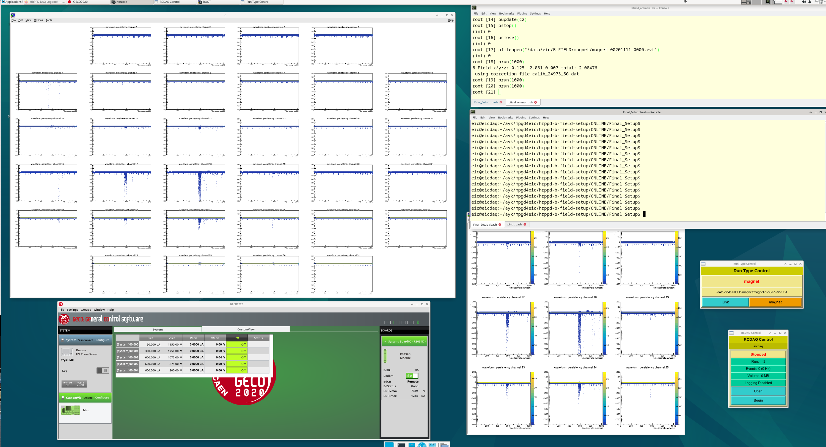
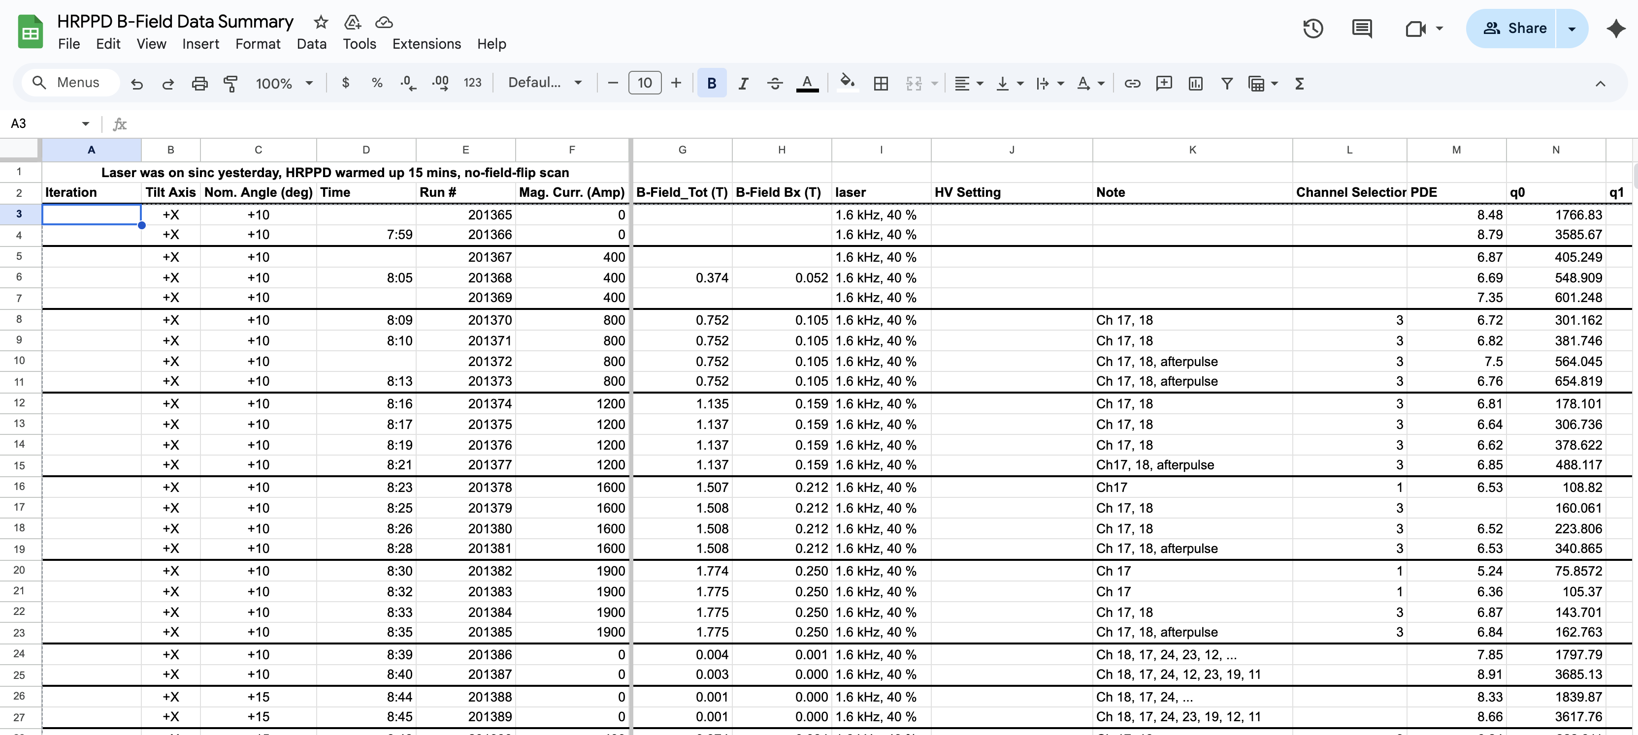
Data Taking and Online Monitoring
Online Monitoring DAQ PC
Data Summary Google Sheet
https://docs.google.com/spreadsheets/d/1YWhTMTupEhW2SHGdD-VX3CkcM7VUVixBggy1QHezrBc/edit?usp=sharing
RCDAQ-based data acquisition @ ~1.5 kHz on tape, VNC, elog
Fully automated data taking in a batch mode (except for magnet ramp-up and ramp-down)
Real-time tabulated data summaries generated during data taking
Express online data quality analysis
JIHEE KIM

Slide 3
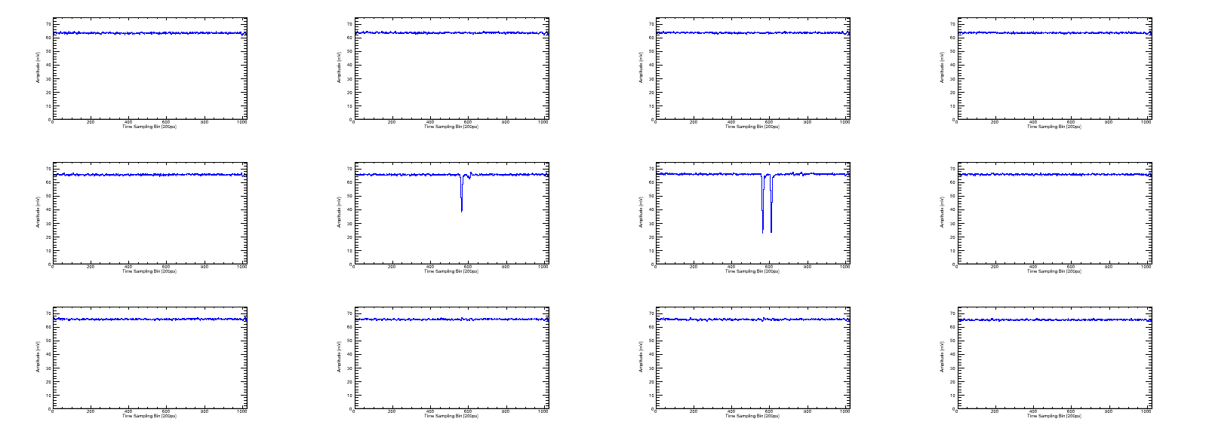
Typical Waveforms (Single Event)
Amplitude [mV]
Amplitude [mV]
Amplitude [mV]
Amplitude [mV]
ch10
ch11
ch12
ch13
Time Sampling Bin [200ps]
Time Sampling Bin [200ps]
Time Sampling Bin [200ps]
Time Sampling Bin [200ps]
Amplitude [mV]
Amplitude [mV]
Amplitude [mV]
Amplitude [mV]
ch16
ch17
ch18
ch19
Time Sampling Bin [200ps]
Time Sampling Bin [200ps]
Time Sampling Bin [200ps]
Time Sampling Bin [200ps]
Amplitude [mV]
Amplitude [mV]
Amplitude [mV]
Amplitude [mV]
ch22
ch23
ch24
ch25
Time Sampling Bin [200ps]
Time Sampling Bin [200ps]
Time Sampling Bin [200ps]
Time Sampling Bin [200ps]
Main charge sharing occurs between channels 17 and 18, with afterpulsing observed in channel 18.
JIHEE KIM

Slide 4
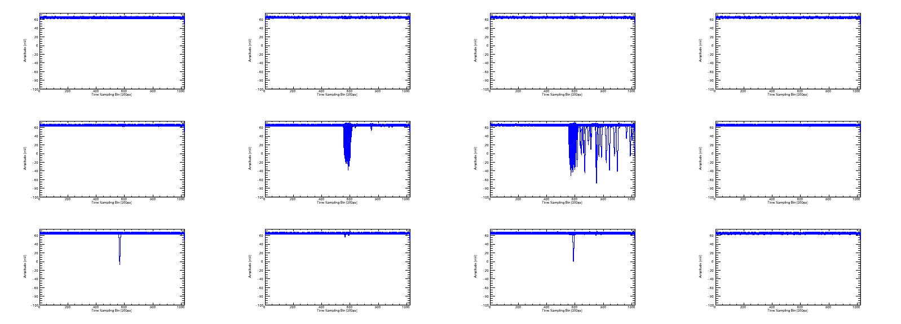
Typical Accumulated Waveforms
Amplitude [mV]
Amplitude [mV]
Amplitude [mV]
Amplitude [mV]
ch10
ch11
ch12
ch13
Time Sampling Bin [200ps]
Time Sampling Bin [200ps]
Time Sampling Bin [200ps]
Time Sampling Bin [200ps]
Amplitude [mV]
Amplitude [mV]
Amplitude [mV]
Amplitude [mV]
ch16
ch17
ch18
ch19
Time Sampling Bin [200ps]
Time Sampling Bin [200ps]
Time Sampling Bin [200ps]
Time Sampling Bin [200ps]
Amplitude [mV]
Amplitude [mV]
Amplitude [mV]
Amplitude [mV]
ch22
ch23
ch24
ch25
Time Sampling Bin [200ps]
Time Sampling Bin [200ps]
Time Sampling Bin [200ps]
Time Sampling Bin [200ps]
Main charge sharing occurs between channels 17 and 18, with afterpulsing observed in channel 18.
Additional channels also show signal activity when up to 10k waveforms are accumulated.
JIHEE KIM

Slide 5
Mean Charge Extraction (Gain)
Fit pedestal (Gaussian) alone
Apply a 4σ cut to remove the pedestal
Mean charge =
Histo→GetMean()
Mean charge error =
Histo→GetRMS()
1-photon
1-photon
2-photon
2-photon
Currently it is based on combined 1-photon & 2-photon contributions (first-order approximation)
Eventually, will be extracting 1-photon event charge
Polya fit does not work well (see backup: gain saturation, no large amplitudes)
JIHEE KIM

Slide 6
Charge Spectra VS Magnetic Field
With 0T Spectrum
Without 0T Spectrum
Charge calculation: 3$×$4 neighboring pad selection.
Peak shifts toward lower charge values.
Gain reduction with increasing magnetic field (see backup: full magnetic field set).
JIHEE KIM

Slide 7
Gain VS Magnetic Field (w/ θ)
Time Window Based Analysis
Threshold Based Analysis
Two independent analyses were conducted: time-window–based and threshold-based.
The mean charge values from both methods are consistent.
JIHEE KIM

Slide 8
Afterpulsing: Accumulated Waveforms
+X tilt axis, $\vec{B}$ = 0.37T, $θ=−12.5°$, laser tune 40 %, laser rep rate 1.6 kHz
HV 200-650-200-650-200
HV 200-675-200-675-200
HV 200-700-200-700-200
ch18
ch18
ch18
Primary signal channel is 18.
An increase in MCP bias voltage leads to more pronounced afterpulses and higher signal amplitude
JIHEE KIM

Slide 9
Backup Slides
JIHEE KIM

Slide 10
Example – Mean Charge Extraction (Gain)
Apply a 4σ cut to remove the pedestal
Fit polya function
Fit pedestal (Gaussian) alone
Define pedestal using Gaussian fit and apply a 4σ cut to remove the pedestal
Remaining distribution using polya fit to estimate mean charge. Not always works (case-by-case)
JIHEE KIM

Slide 11
Example – Mean Charge Extraction (Gain)
Apply a 4σ cut to remove the pedestal
Fit polya function
Fit pedestal (Gaussian) alone
Define pedestal using Gaussian fit and apply a 4σ cut to remove the pedestal
Remaining distribution using polya fit to estimate mean charge. Not always works (case-by-case)
JIHEE KIM

Slide 12
Example – Mean Charge Extraction (Gain)
Fit pedestal (Gaussian) alone
Fit combined Gaussian + Polya
Define pedestal using Gaussian fit and signal using Polya fit.
Apply a combined fit (Gaussian + Polya)
JIHEE KIM

Slide 13
Example – Mean Charge Extraction (Gain)
Fit pedestal (Exponential) alone
Fit combined Exponential + Polya
Define pedestal using Exponential fit and signal using Polya fit.
Apply a combined fit (Exponential + Polya)
JIHEE KIM

Slide 14
Charge Spectra VS Magnetic Field
With 0T Spectrum
Without 0T Spectrum
Charge calculation: 3$×$4 neighboring pad selection.
Peak shifts toward lower charge values.
Gain reduction with increasing magnetic field.
JIHEE KIM

Slide 15

Charge Spectra VS Inclination Angle
Measured charge spectra at different inclination angles with magnetic field $\vec{B}$ ~ 1.4 T
Charge calculation:
  Major signal channel selection by accumulated signals
Observations:
  Mean charge remains consistent across most angles
  $13°$ case shows behavior different from other angles
Takeaway:
  Overall angular dependence is weak
JIHEE KIM

Slide 16

Charge Spectra VS Inclination Angle (+θ)
Measured charge spectra at different inclination angles with magnetic field $\vec{B}$ ~ 1.4 T
Charge calculation:
  Major signal channel selection by accumulated signals
Observations:
  Mean charge remains consistent across most angles
  $13°$ and $15°$ cases show behavior different from other angles
Takeaway:
  Overall angular dependence is weak
JIHEE KIM

Slide 17

Charge Spectra VS Inclination Angle (-θ)
Measured charge spectra at different inclination angles with magnetic field $\vec{B}$ ~ 1.4 T
Charge calculation:
  Major signal channel selection by accumulated signals
Observations:
  Mean charge remains consistent across most angles
Takeaway:
  Overall angular dependence is weak
JIHEE KIM

Slide 18
Charge Spectra VS Inclination Angle
Measured charge spectra at different inclination angles with magnetic field $\vec{B}$ ~ 1.4 T
Charge calculation:
  Major signal channel selection by accumulated signals
Observations:
  Mean charge remains consistent across most angles
  $13°$ and $15°$ cases show behavior different from other angles
Takeaway:
  Overall angular dependence is weak
JIHEE KIM

Slide 19
Gain VS Magnetic Field (w/ HV)@ θ=0°
Measured mean charge as a function of magnet current at different bias voltage
Charge calculation:
  Major signal channel selection by accumulated signals
Observations:
  Mean charge reduces as higher magnet current
  Mean charge increases as higher bias voltage
Takeaway:
  Gain partially recovered by increasing bias voltage
JIHEE KIM

Slide 20
Gain VS Magnetic Field (w/ HV)@ θ=+13°
Measured mean charge as a function of magnet current at different bias voltage
Charge calculation:
  Major signal channel selection by accumulated signals
Observations:
  Mean charge reduces as higher magnet current
  Mean charge increases as higher bias voltage
Takeaway:
  Gain partially recovered by increasing bias voltage
JIHEE KIM

