Slide 1
Detector Cooling
Girish Gowda
Mechanical Engineer
I^3 Engineering Meeting
February 2nd, 2026

Slide 2
ePIC Detector – Heat Load
Air Cooling System
Special Cooling System
 |  | Units
Cooling media | Air
Barrel HCAL | 1,280 | W
Forward HCAL | 1,656 | W
SVT Inner | 211 | W
SVT Disks | 5,819 | W
SVT Outer | 3,218 | W
Barrel Emcal | 2,000 | W | Astropix sensors
Forward Emcal | 796 | W | SiPM boards
Total Heat Load | 14,980 | W
 |  | Units
Cooling media | Silicon Oil
dRICH | 19,968 | W
Glycol, Novec
Platform Electronics & Racks
 |  | Units
Cooling media | Water
Platform | 80,000 | W
DAQ Room | 250,000 | W
Total Heat Load | 330,000 | W

Slide 3
ePIC Detector – Heat Load
Liquid Cooling System Liquid Cooling System – Updated
 |  | Units
Cooling media | Water
Forward EMCAL | 3,428 | W
Barrel EMCAL | 3,101 | W
Cymbal | 1,944 | W
Outer MPGD | 2,856 | W
pfRICH | 294 | W
DIRC | 310 | W
EEMCAL | 1,010 | W
TOF | 30,000 | W
SVT Outer | 301 | W
SVT Disks | 655 | W
SVT Inner | 412 | W
MPGD Endcap Disks | 1,296 | W
Total Heat Load | 45,564 | W
 |  | Units
Cooling media | Water
Forward EMCAL | 2,633 | W
Barrel EMCAL | 2,300 | W
Cymbal | 2,300 | W
Outer MPGD | 5,380 | W
pfRICH | 294 | W
DIRC | 310 | W
EEMCAL | 1,010 | W
Barrel TOF | 11,500 | W
Forward TOF | 6,700 | W
SVT Outer | 301 | W
SVT Disks | 655 | W
SVT Inner | 385 | W
MPGD Endcap Disks | 1,280 | W
Total Heat Load | 35,048 | W
Barrel TOF and Forward TOF heat load needs update
December PDR data January ePIC Collaboration data

Slide 4
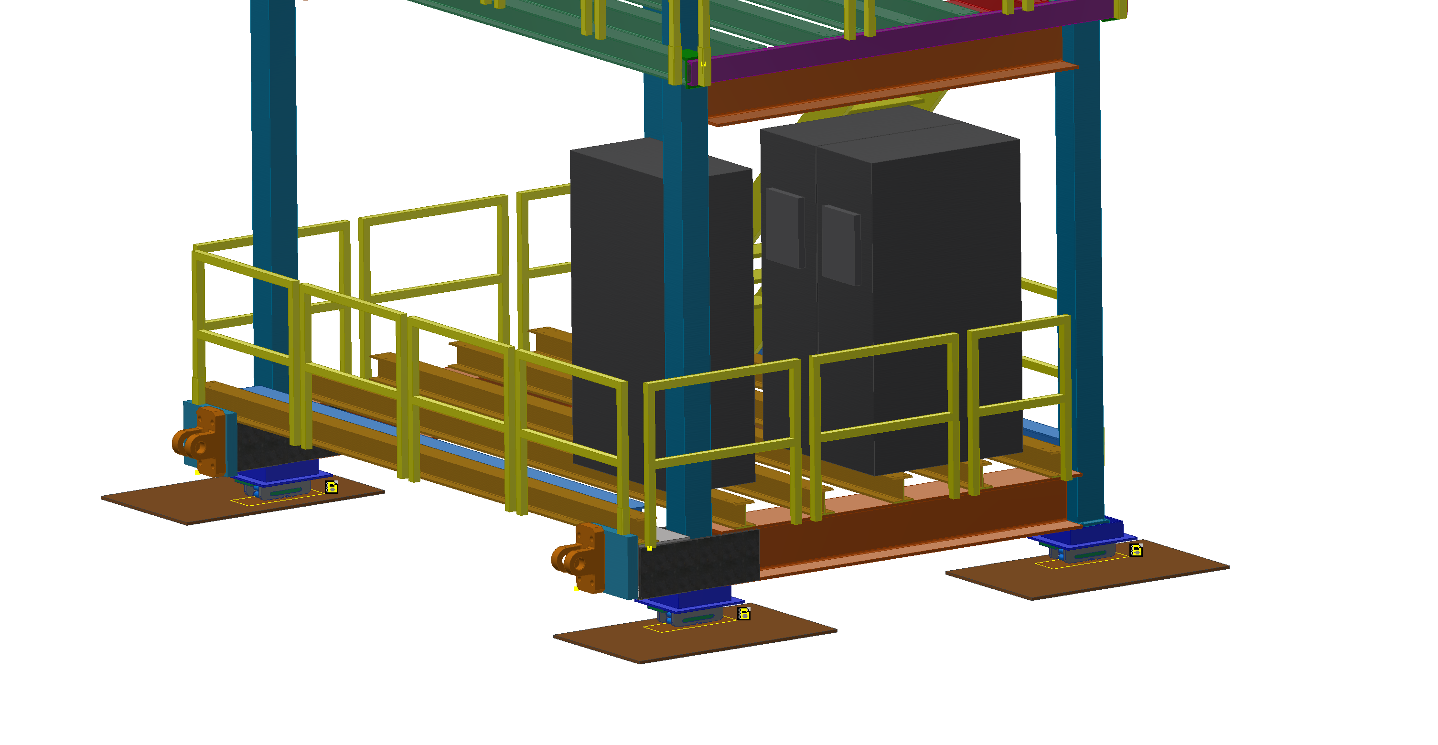
ePIC Detector – Cooling Distribution Unit – CDU – Old data
Chilldyne Option 1
 |  | Units
Cooling media | Water/Glycol
Total Heat Load of Electronics | 46 | kW
CDU Cooling Capacity | 40 | kW
Number of CDUs required | 1.15 | 2
Single CDU | 57.50 | %
Margin CDU | 3 | CDUs
density | 1000 | kg/m^3
Specific Heat | 4186 | J/kg C
Temperature rise, ΔT | 2 | C
Pressure available | 0.5 | bar
Pressure available | 50000 | Pa
Mass flow rate | 5.49 | kg/s
Volumetric flow rate | 0.00549 | m^3/s
Volumetric flow rate per unit | 0.00275 | m^3/s
Volumetric flow rate per unit | 164.84 | lpm
Volumetric flow rate per unit | 43.52 | gpm
CDUs
Cooling Distribution Units on Ring Inside
Each CDU will operate at 23 kW – 57.5 percent of it’s rated capacity
Active CDUs – 2, Standby CDU – 1 for backup
Dimensions (L*W*H) inches : 45’’ * 24’’ * 80’’
Decrease in temperature rise decreases CDU cooling capacity
Decrease in temperature rise increases flow rate at given pressure
Product Line: CF-CDU300
Cooling Capacity: Up to 300kW with 15 °C rise.
Flow Rate: Up to 300 LPM at 0.5 bar differential

Slide 5
ePIC Detector – Cooling Distribution Unit – CDU - Updated
Chilldyne – 2 Units
Chilldyne – 3 Units
 |  | Units
Cooling media | Water/Glycol
Total Heat Load of Electronics | 35 | kW
CDU Cooling Capacity | 40 | kW
Number of CDUs required | 0.88 | 1
Single CDU | 87.50 | %
Margin CDU | 2 | CDUs
density | 1000 | kg/m^3
Specific Heat | 4186 | J/kg C
Temperature rise, ΔT | 2 | C
Pressure available | 0.5 | bar
Pressure available | 50000 | Pa
Mass flow rate | 4.18 | kg/s
Volumetric flow rate | 0.00418 | m^3/s
Volumetric flow rate per unit | 250.84 | lpm
Volumetric flow rate per unit | 66.22 | gpm
 |  | Units
Cooling media | Water/Glycol
Total Heat Load of Electronics | 35 | kW
CDU Cooling Capacity | 40 | kW
Number of CDUs required | 0.88 | 2
Single CDU | 43.75 | %
Margin CDU | 3 | CDUs
density | 1000 | kg/m^3
Specific Heat | 4186 | J/kg C
Temperature rise, ΔT | 2 | C
Pressure available | 0.5 | bar
Pressure available | 50000 | Pa
Mass flow rate | 4.18 | kg/s
Volumetric flow rate | 0.00418 | m^3/s
Volumetric flow rate per unit | 0.00209 | m^3/s
Volumetric flow rate per unit | 125.42 | lpm
Volumetric flow rate per unit | 33.11 | gpm
Each CDU will operate at 35 kW – 88 percent of it’s rated capacity
Active CDUs – 1, Standby CDU – 1 for backup
Dimensions (L*W*H) inches : 45’’ * 24’’ * 80’’
Each CDU will operate at 18 kW – 44 percent of it’s rated capacity
Active CDUs – 2, Standby CDU – 1 for backup
Decrease in temperature rise decreases CDU cooling capacity
Decrease in temperature rise increases flow rate at given pressure
Product Line: CF-CDU300
Cooling Capacity: Up to 300kW with 15 °C rise.
Flow Rate: Up to 300 LPM at 0.5 bar differential

