Slide 1
Far-Forward / Far-Backward
Detector Integration
Jonathan Smith (JLAB), Ron Lassiter (JLAB),
India Krehbiel (JLab),
February 2, 2026

Slide 2
Primary Updates Outline
Roman Pots
Future Roman Pot Development Discussions
Options 1 and 2
Future work
Updated B0 Detector Railing Concept
Detector Update “Horseshoe” Design
Linear Rail + Guide Rail
External Updates
ZDC Updates

Slide 3
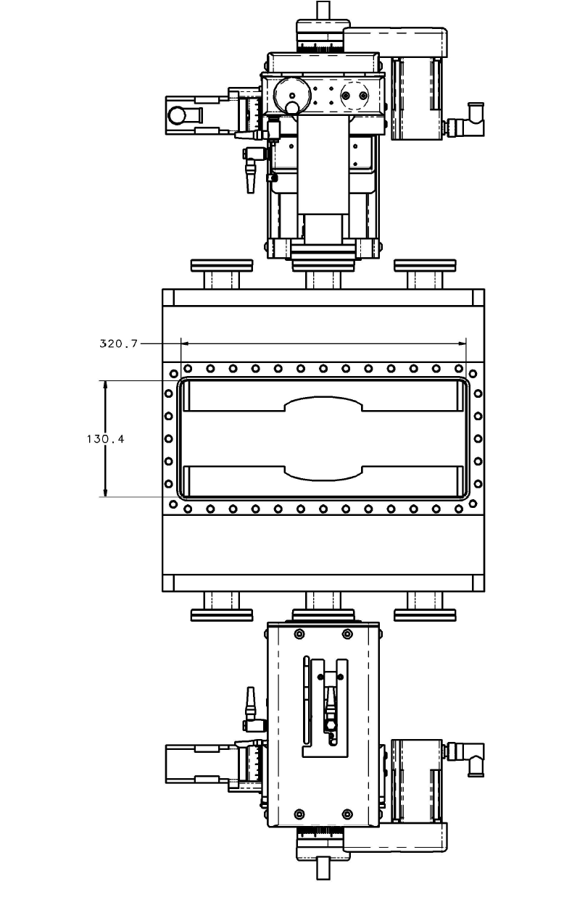
Primary Updates Outline
Current overall Scattering Chamber size opening is 320.7mm x 130.4mm
(4) ports used for outside services (cooling/electronics) – Circled
Moving Stage motors from UHV Designs (http://www.uhvdesign.com)
Currently utilizing the existing STAR Roman Pots stands as a ‘stand-in’ and anticipate modeling the final stand once Roman Pot design is complete.
Sensors used are the preliminary ACLGAD (EICROC) modules
Detector Coverage Arrangements for (2) Beam Energies: 100 GEV and 275 GEV
Anticipate running 100 GEV for the first three years of operation

Slide 4
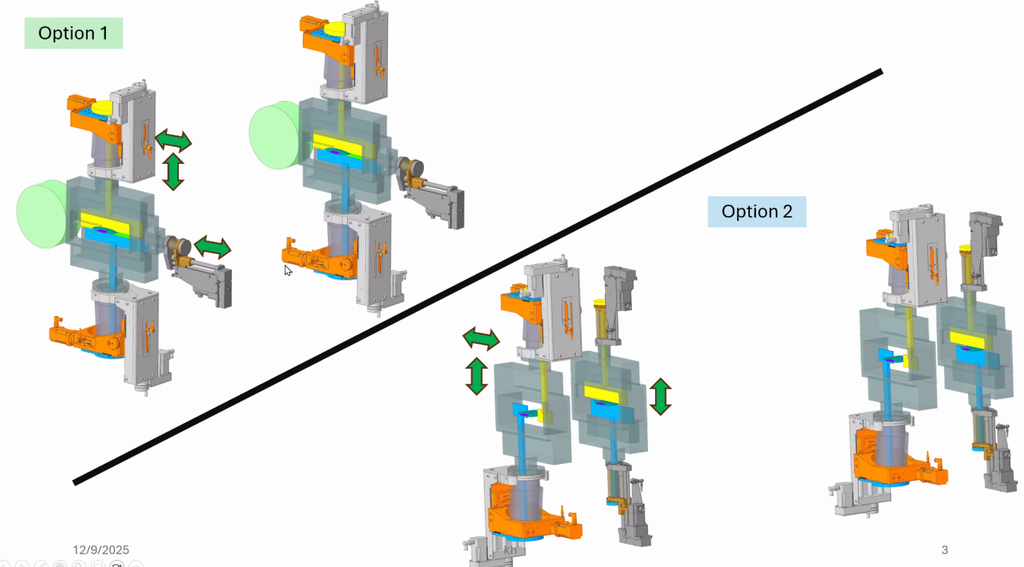
Future Roman Pot Development Discussions
Slide courtesy of Karim Hamdi and Alexander Jentsch

Slide 5
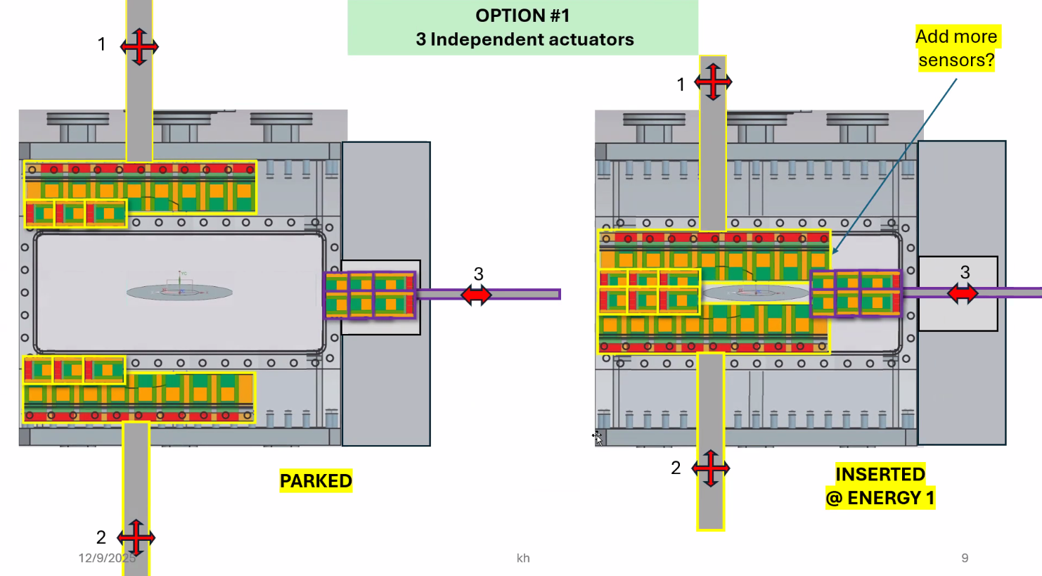
Roman Pots - Option 1
Adds a third independent
stage motor
Top and Bottom layers
include a row of horizontal staves.
May require different stave
configurations to
support various
beam energies
Neutron cone
Slide courtesy of Karim Hamdi and Alexander Jentsch

Slide 6
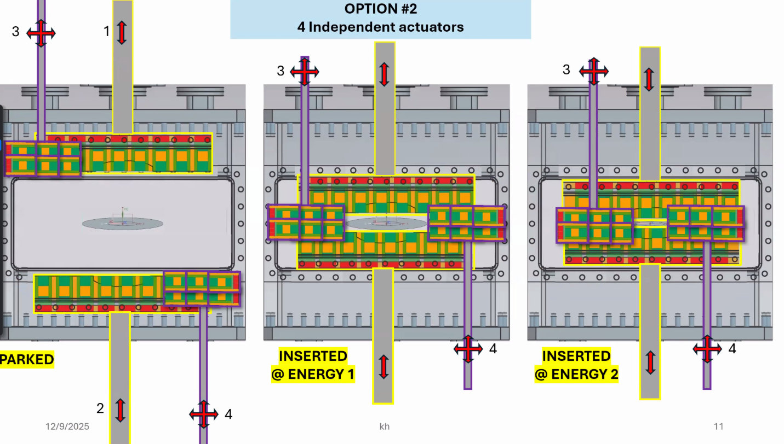
Roman Pots – Option 2
Adds (2) additional Roman
Pot stations for full coverage:
Two stations with vertical moving staves (# 1 & 2)
Two stations with horizontal moving staves (# 3 & 4)
This option adds
(2) Additional Roman
Pots stations, but
does not require multiple
removable detector planes
for different beam energies
Neutron cone
Slide courtesy of Karim Hamdi and Alexander Jentsch

Slide 7
Roman Pots – Future Work
Once complete, update the detector coverage to suit final ACLGAD/EICROC Module design
Update support frame (using existing STAR design) to suit latest Roman Pot (increasing scattering chamber, modifying service ports)

Slide 8
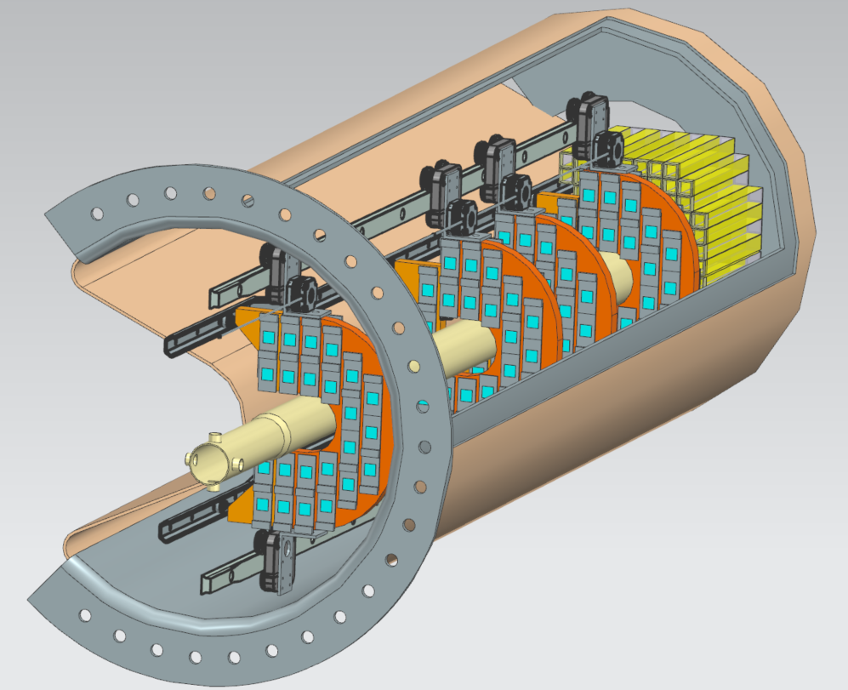
B0PF Detector Concept

Slide 9
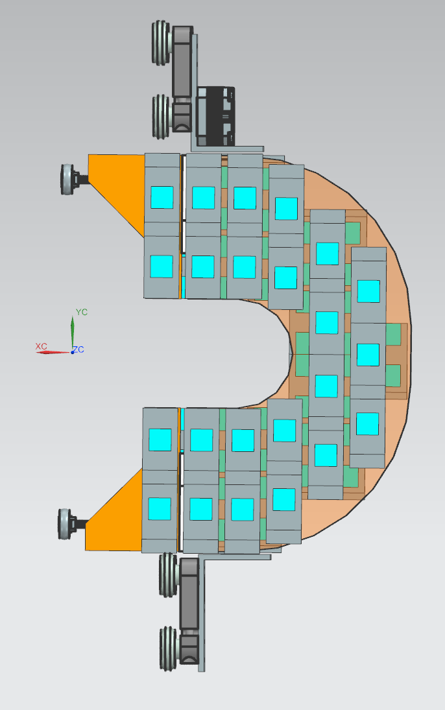
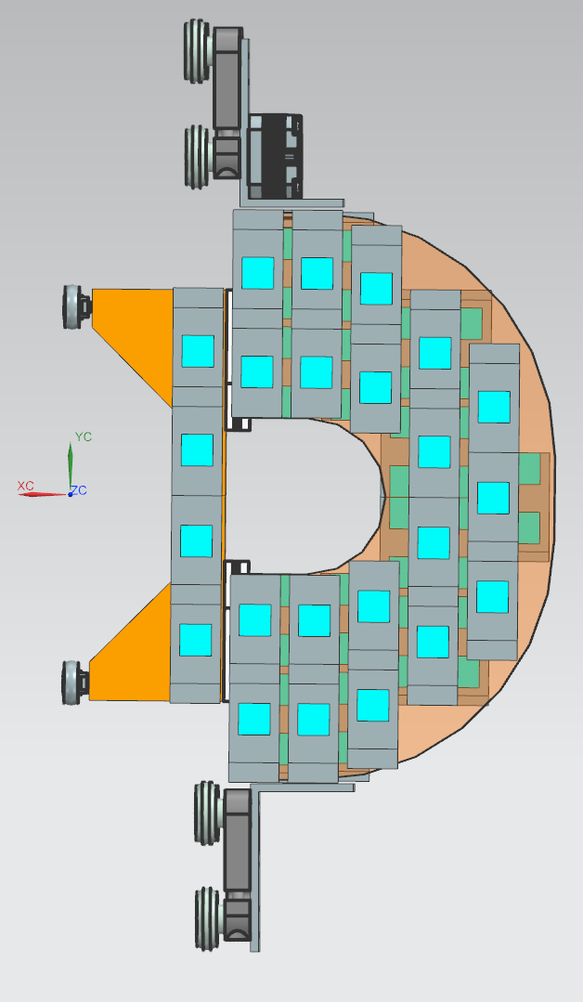
B0PF Detector Concept
Previous Detector plane design were split in two halves alone the X-axis and ‘attached’ once over beamline from outside the B0 Magnet.
Updated version uses a “Horseshoe” shape with moving inner-detector ‘slides’ to close around beampipe. This method is simpler in concept and eliminates much of the complexity of the original design.
OPEN
CLOSED

Slide 10
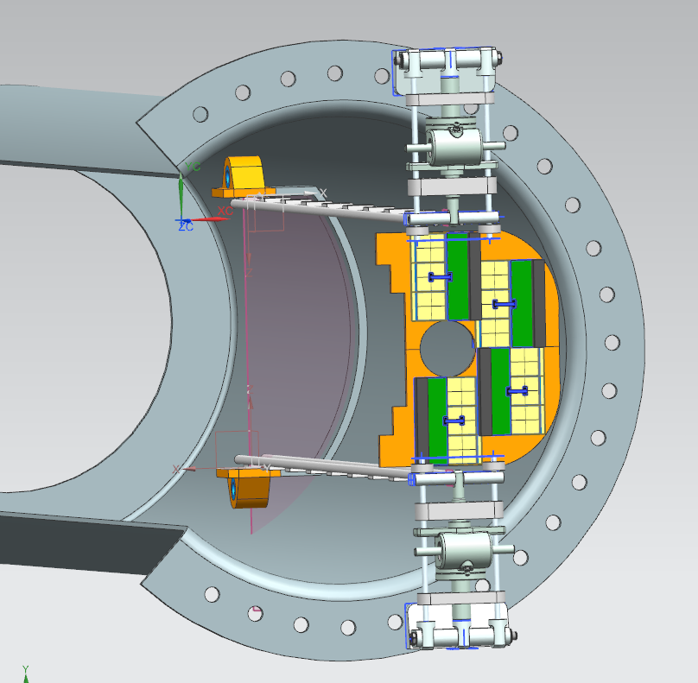
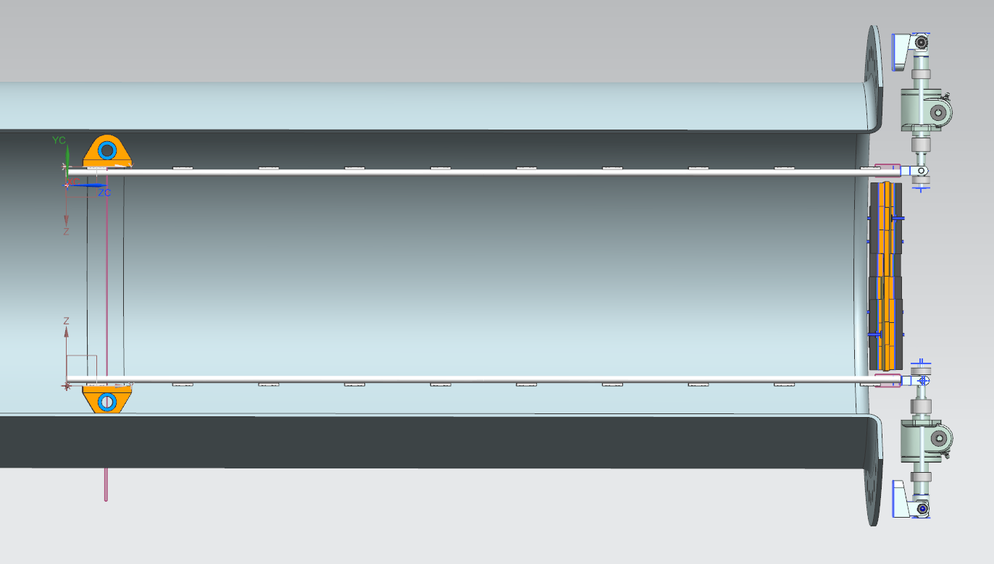
Previous B0 Concept

Slide 11
B0PF Detector Concept
Latest Concept utilizes a linear rail for each carriage and a guide rail for inner detector slide.
As the carriage goes into the barrel, the guide rail will close the inner detector staves around the beampipe to provide detector coverage
Each plane will be individually driven via the motors attached on the carriage.
This version eliminates the need for (2) jack lifts, and the vertical movement on the external frame.

Slide 12
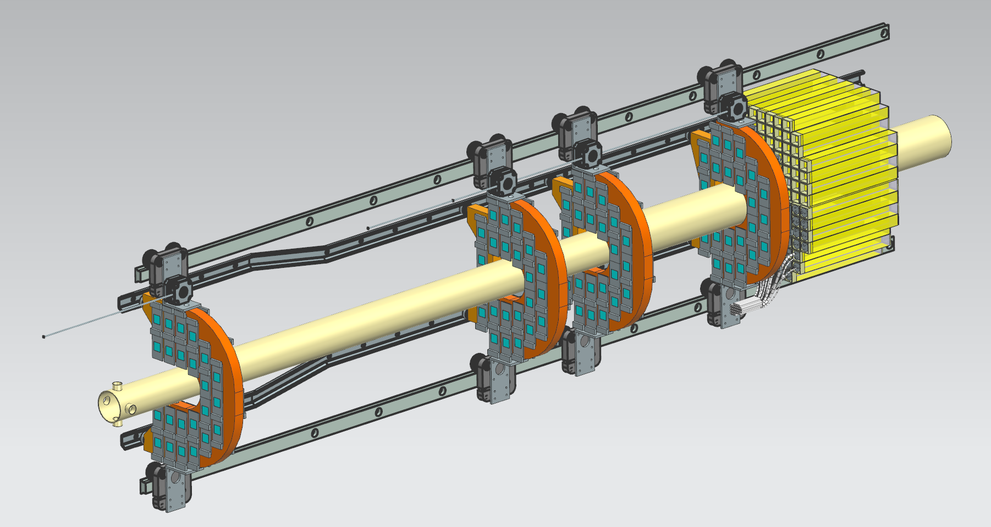
Latest Detector Concept
Linear Rail →
Guide Rail

Slide 13
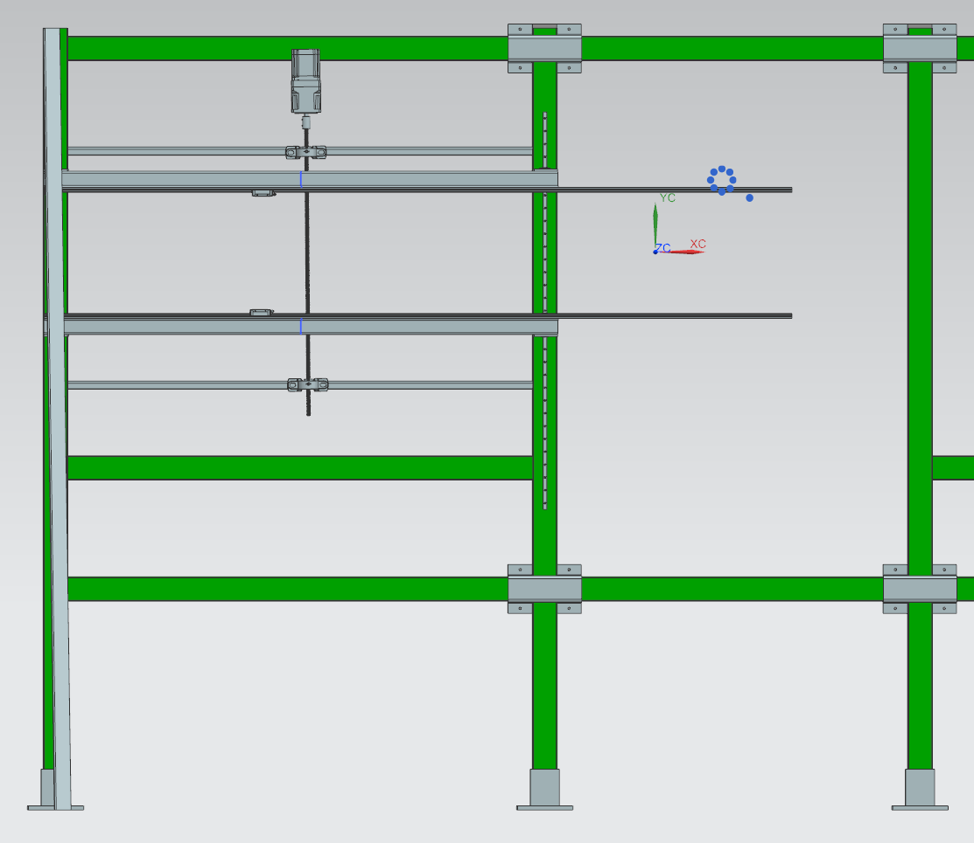
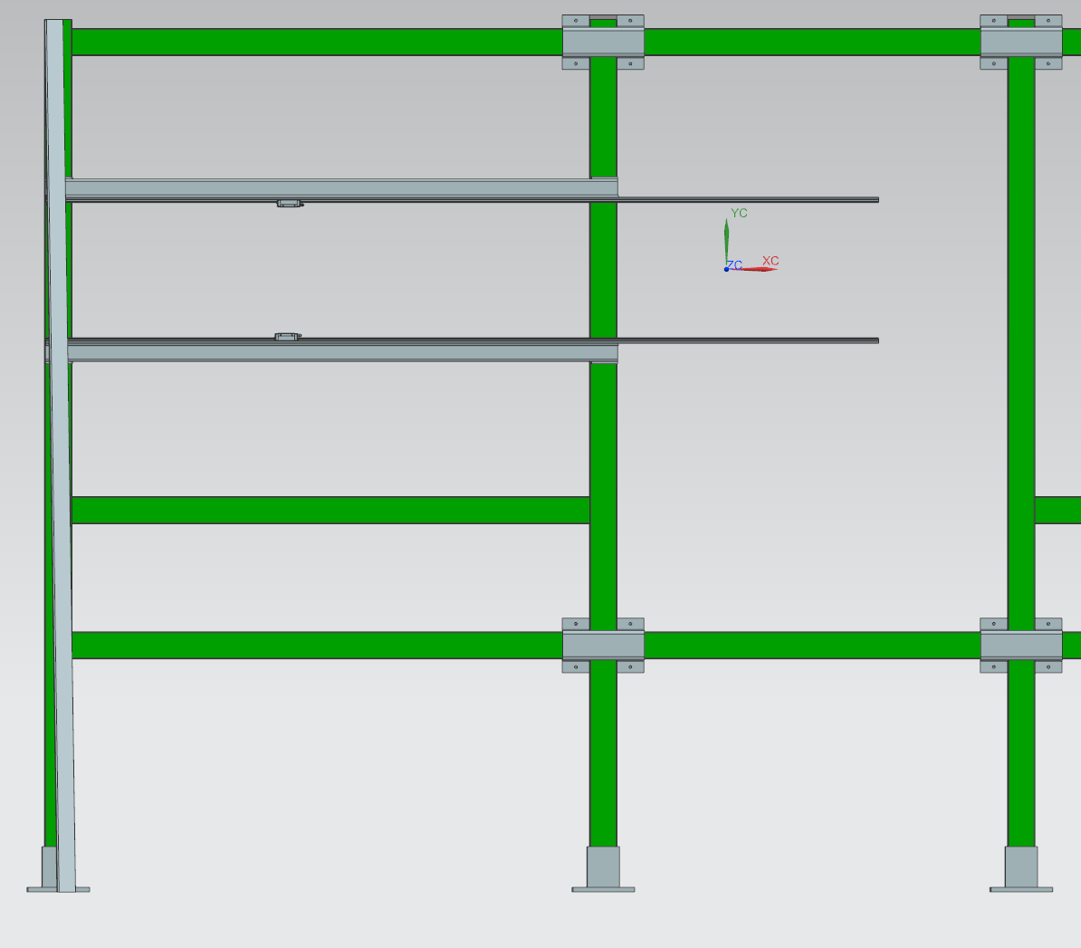
External B0 Outlook
Current Layout (+/- Y-Axis and X-Axis Motion)
Upcoming Concept (Simpler, Only X-Axis Motion)

Slide 14
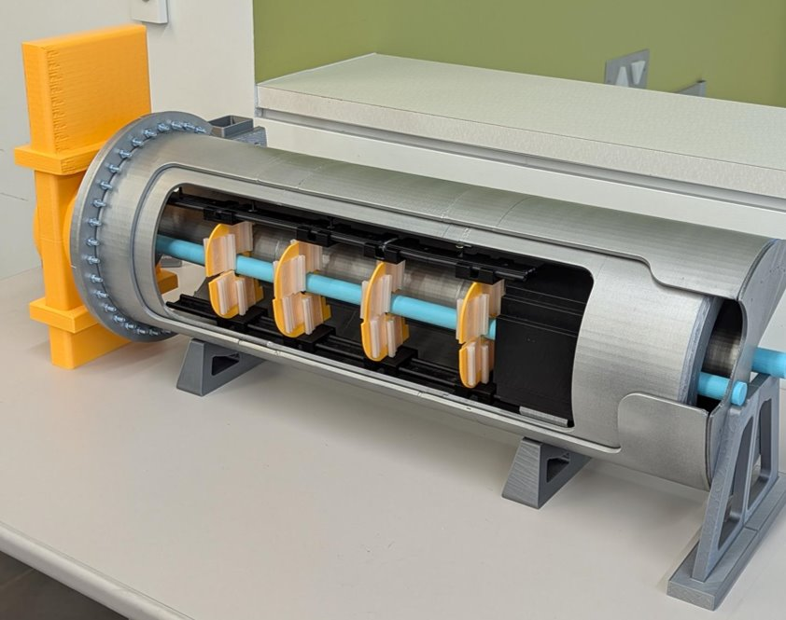
Update B0 3D Print Mockup
We will be updating our 3D print as an early mock-up for the latest detector railing system.

Slide 15
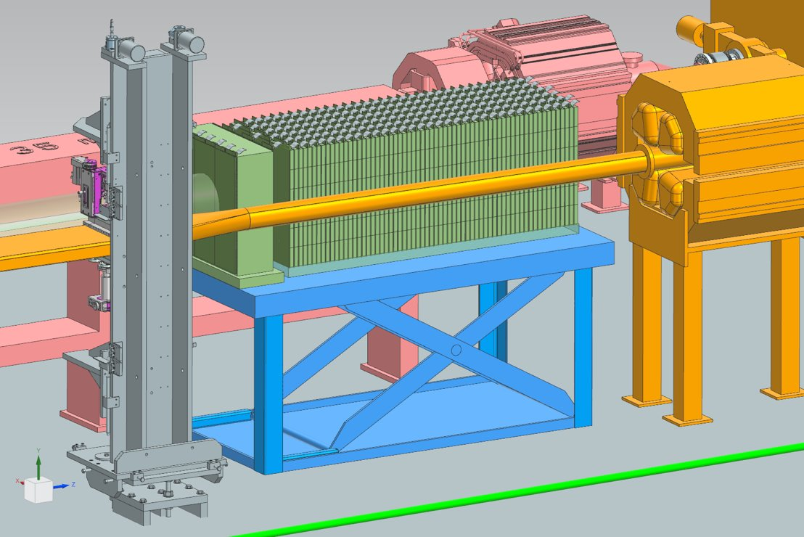
ZDC Updates - Cabling
Original design routed the cables from the side around the beampipe.
We can rotate the calorimeter around and route the cabling via the top

Slide 16
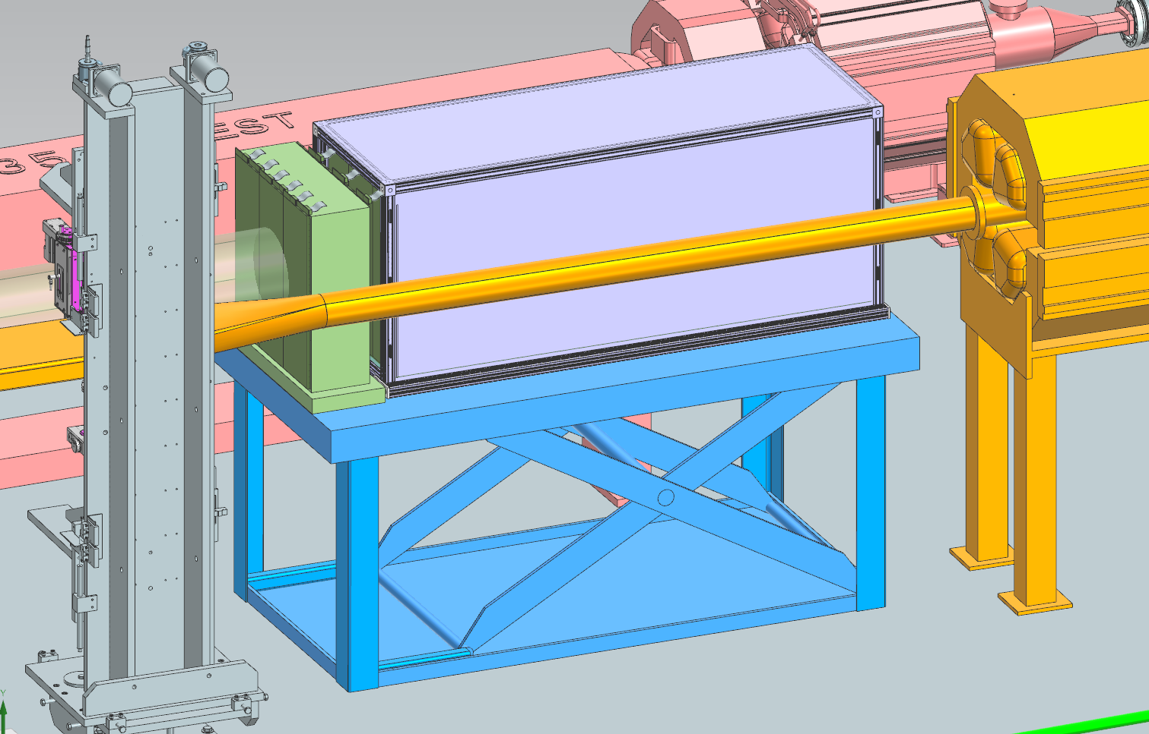
ZDC Updates – Dark Box
Dark box support frame
The box is constructed with 1.5” 80/20 and is shown here with sheets affixed to the outside, Though a black cloth will also work in this application.
The 80/20 frame also serves as additional support for the absorber block stacks.

Slide 17
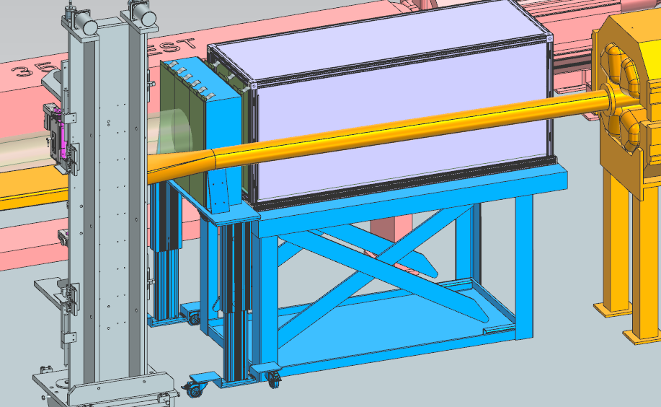
ZDC Updates – Current Discussions
Single Lift Table
Dual Lift Tables

