Slide 1
Cradle, Barrel HCAL & Moving Mechanism
EIC Experimental Equipment Mechanical Engineering Round Table 2/9/26
Nathaniel Speece-Moyer (BNL)

Slide 2
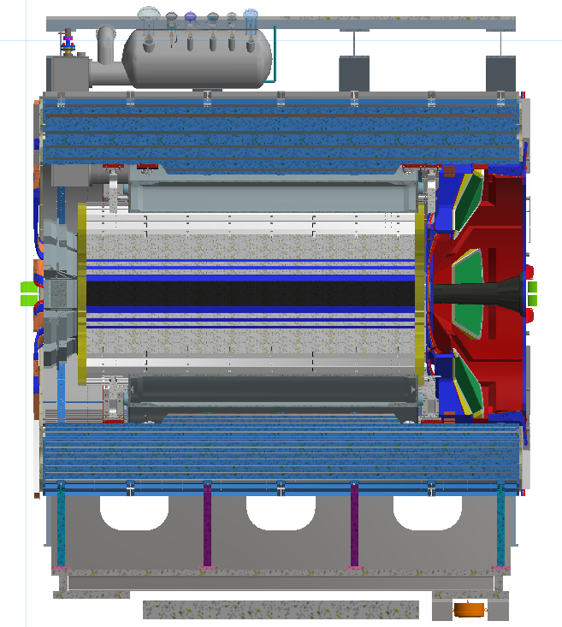
Cradle and Moving Mechanism Updates
  Updates
  A valve on the magnet phase separator interferes with the door between the experimental and assembly halls.
  Changes to the valve and cradle are underway to increase clearance.
  Requires lowering the valve on the phase separator and making adjustments to the cradle.
  Need to maintain a minimum of 1 in clearance to the doorway with all positional and assembly tolerances considered.
  The doorway in the CAD model needs to be updated to reflect actual survey data. Currently it is modeled too high.
  The tracks and floor in the CAD model also are at nominal values and do not reflect variation in the actual tracks in the STAR hall. This is mentioned for info only.
Valve with clearance issues

Slide 3
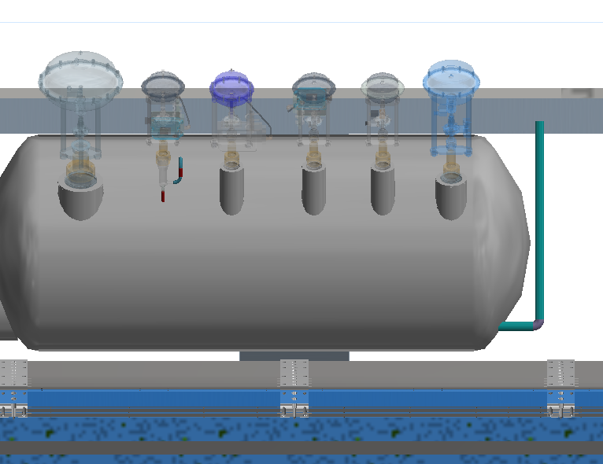
Cradle and Moving Mechanism Updates
  Info needed and next steps
  Need allowable positional and angular tolerance of the magnet within the HCAL. This directly affects how far the valve sticks up relative to the bottom of the HCAL, and therefore the bottom of the cradle.
  Discuss tolerances and clearances with the III group at BNL and Magnet Group at JLab to make sure everyone agrees how to proceed.
  Need to revisit the cradle height and lifting specs
  Current specs can’t be accommodated within current constraints and hydraulic cylinders. Mentioned here only for reference since they were included in the last update presentation.
    The height from the rail to beam center to use for the cradle design will be 169.75 in. (This an arbitrary value, not average height of rails from IP. Need to account for min and max levels of tracks in the design since we are cutting things very close with the valve and door opening.)
    The pistons must lift the assembly a nominal 1 in. (This will not currently be enough lift with current constraints and could position the detector too low).
    Pistons must lift the cradle by 1.5 in then lower down. (Current pistons are not capable of this much travel and require custom pistons).

Slide 4
Cradle and Moving Mechanism Updates
  Hilman Rollers
  Current direction is to re-use STAR rollers to save cost, but this increases risk.
    Current rollers are 30 years old.
    Accu-Roll guides gripped the tracks to keep the detector in line. Photos Accu-Roll guide plates are bent due to heavy side loading. Not sure what else we are going to run into when taking things apart.
    How to remove and replace 4 in top mounting plate so it works with the current design? This was pinned and bolted in place. Are they easily separable after 30 years?
    Adding a new top mounting plate requires cutting away material from the cradle, reducing strength of the design.
  Getting a budgetary quote for new rollers and Accu-Roll guides from Hilman.
    Carries less risk since they will be new.
    Easier to integrate: No need to remove top mounting plate and replace with new plate. Total height will be less, meaning less/no material cut out of the cradle assembly.
  More discussion is needed at BNL.

Slide 5
Cradle and Moving Mechanism Updates
  Pistons
  Changes to the cradle to clear the magnet phase separator valve mean that the cradle must be lowered more to get it through the door between experimental and assembly halls.
  This also means that pistons will be required to lift the cradle up more at the experimental position.
  Current pistons do not have enough stroke length do to this. Either we get a longer piston or have go through an elaborate shimming process to “walk” the detector up to the beam level.
  The needed piston is between commercial sizes and looks like it will require custom pistons. Enerpac and other vendors can should be able to make custom pistons that would meet requirements.
  Positioning Accuracy and Moving Challenges
  Accuracy decreases when relying on vertical pistons as an intermediate step for the final position, rather than just using air bearings to drop the cradle on fixed stops.
  Need to carefully think through how vertical pistons are deployed, the cradle is raised and lowered, and how vertical fixed stops are used to locate the cradle in the final position.

Slide 6
Cradle and Moving Mechanism Updates
  Next steps
  Need resolution on Magnet-Barrel HCAL positioning tolerance.
  Need to discuss layout and get agreement between BNL and JLAB on the solution.
  Decision on rollers
  Decision on pistons
  Additional design work and analysis
  Central platform design (Rick Porqueddu)
  Including magnet forces in the stress analysis in Ansys
  Guide rollers for the cradle when lifted on air bearings
  Connection between cradle and moving pistons
  Winch system to move air bearings in place under the detector
  Fixed stops
  Additional side pistons to seat the cradle against fixed stops
  Seismic anchors
  Linkages between the cradle and the platforms

Slide 7
Questions & Comments

