Slide 1





10 psTOF (mRPC) Update
Mickey Chiu

Slide 2
Updates since Jan 2017
New group (IHEP Protvino) working on DRS4-based ADC board layout, and possibly preamp design improvement
2nd NextGen mRPC R&D Collaboration Meeting with Chinese groups on Jan 13. Next meeting is after Hadron-China on July 28-29.
Study of self-t0 in PHENIX
sPHENIX/ePHENIX implementation of mRPC barrel TOF
Lab updates at BNL (done with spring SULI student)
Straw tube tracking system for cosmics being developed
SVX4-based Si Tracker efficiency ended up being too low, plus too much expertise required to make it run
New materials mRPC (G10)

Slide 3
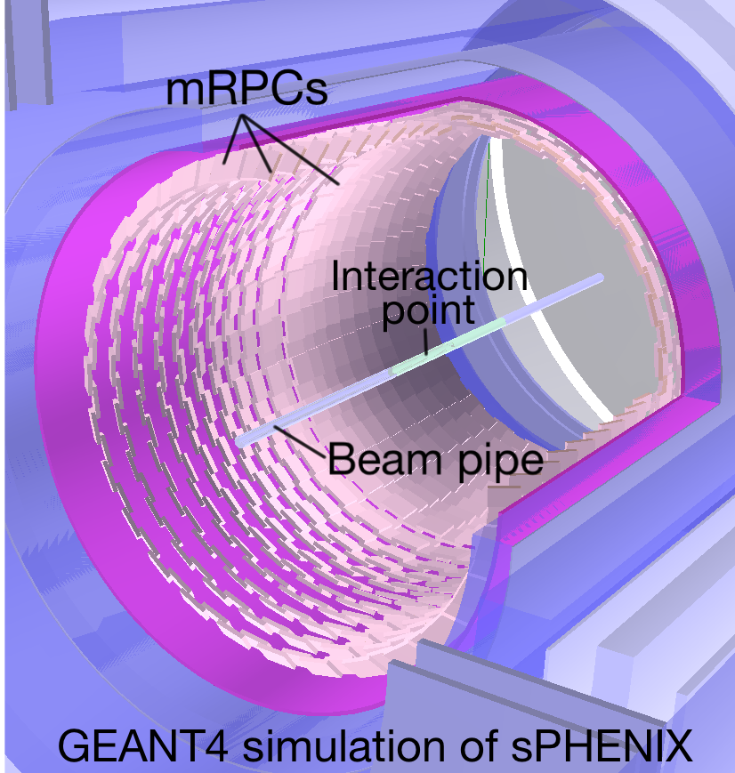
psTOF in sPHENIX/ePHENIX Simulation
Row A
Row B
TOF will be just 80 cm from IP and have 10 cm radial space!
Each module will be ~7x14 cm² and have four 1x10 cm² strips
Read out on both ends to get interpolation of ~1 mm RMS
Work on study to determine how well the t0 can be self-extracted

Slide 4
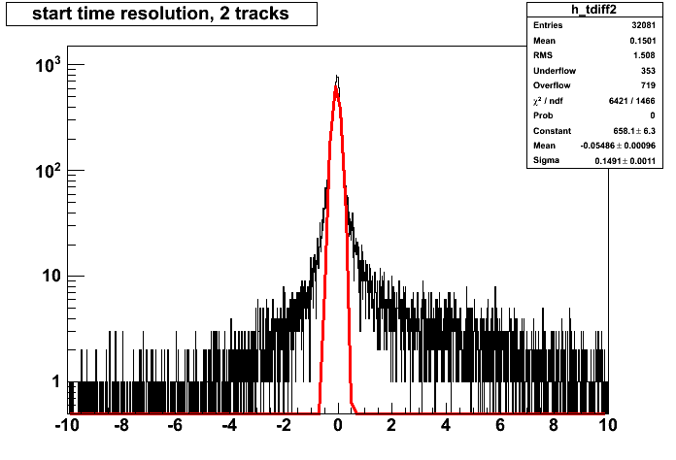
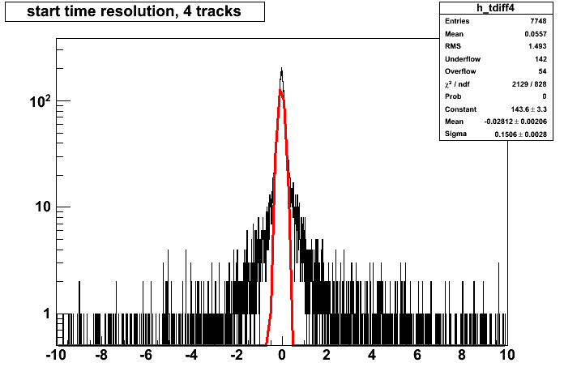
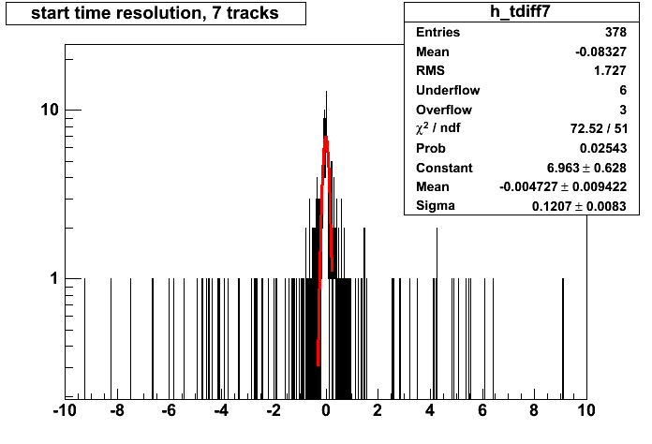
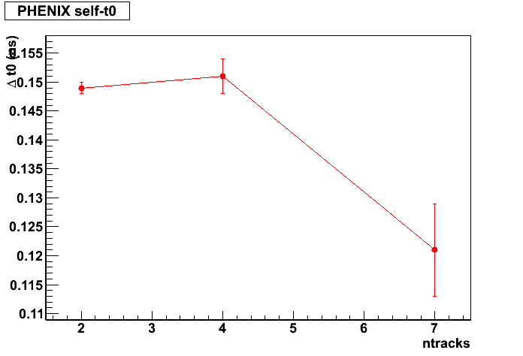
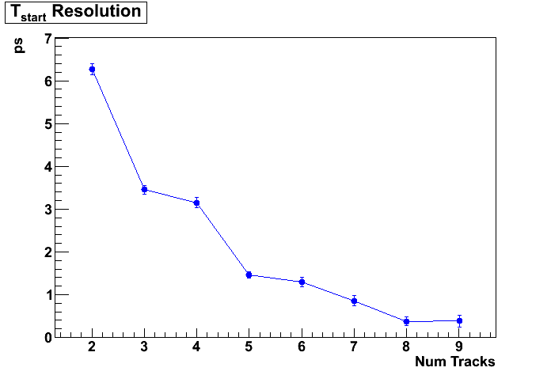
PHENIX Self-Extracted t0
PHENIX data
PYTHIA e+p
Self-extracted t0 from PHENIX TOF.E (150 ps) compared to BBC t0 (50 ps?)
t0 is taken from mean of all t0’s from each “good” TOF hit, after brute force determination of t0 by assuming each pi,K,p combination
PYTHIA study includes most resolution effects, but not nuisances (like fakes)
But I was missing time resolution as a function of momentum

Slide 5
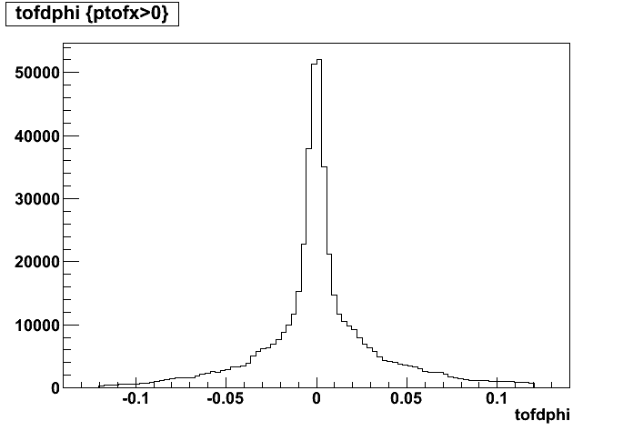
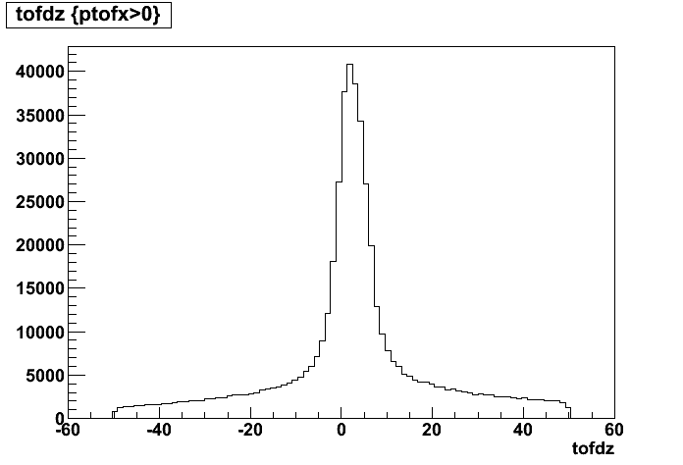
Fake tracks in PHENIX
Fake track background
Very high multiplicities (hundreds of particles) lead to a lot of fake tracks O(10-30%)
PHENIX has up to 12 hits/track, vs 28 in ePHENIX, and much lower multiplicities (expect fake rate to be few %) and this won’t be as much a problem at the EIC (or at least we learn what is necessary for this algorithm to work)
Some more optimization possible with PHENIX data (truncated mean to remove outliers from background tracks) or maybe a clustering algorithm

Slide 6
Start time at EIC for psTOF
At least 3 possible solutions. In order of my preference, they are
TOF everywhere. Then you just get t₀ from the electron.
Self-t₀ from TOF detector
4D inner tracker
LHC detectors require a working 4D tracker for the HL-LHC era, and so will (probably) have 10 ps resolution silicon tracking system. This could serve as the start time.

Slide 7
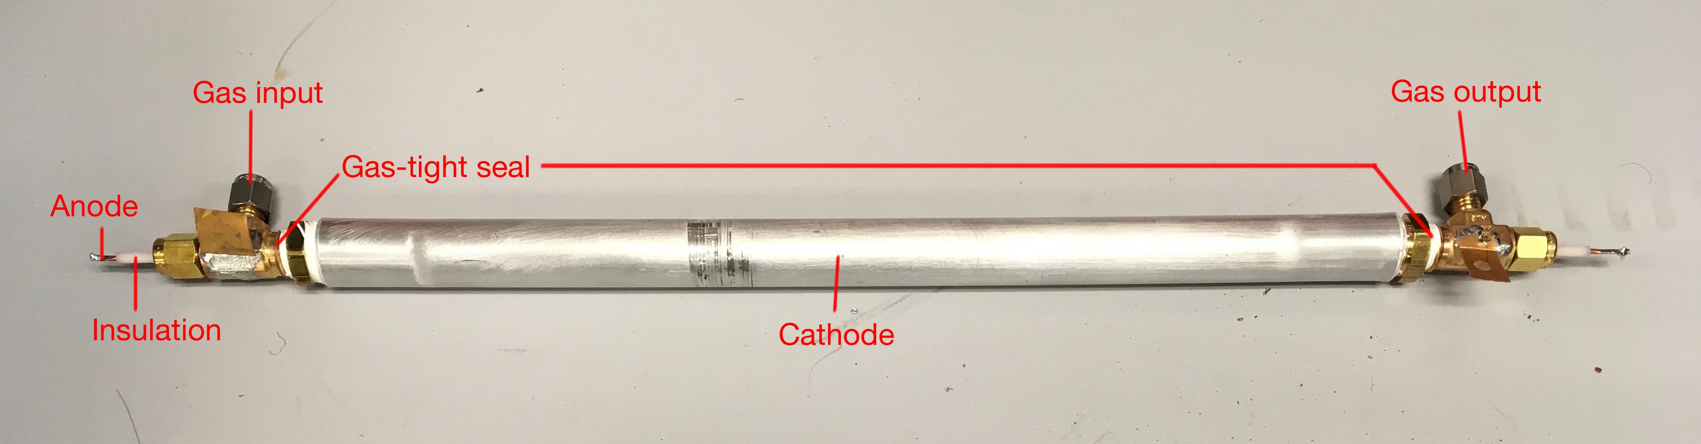
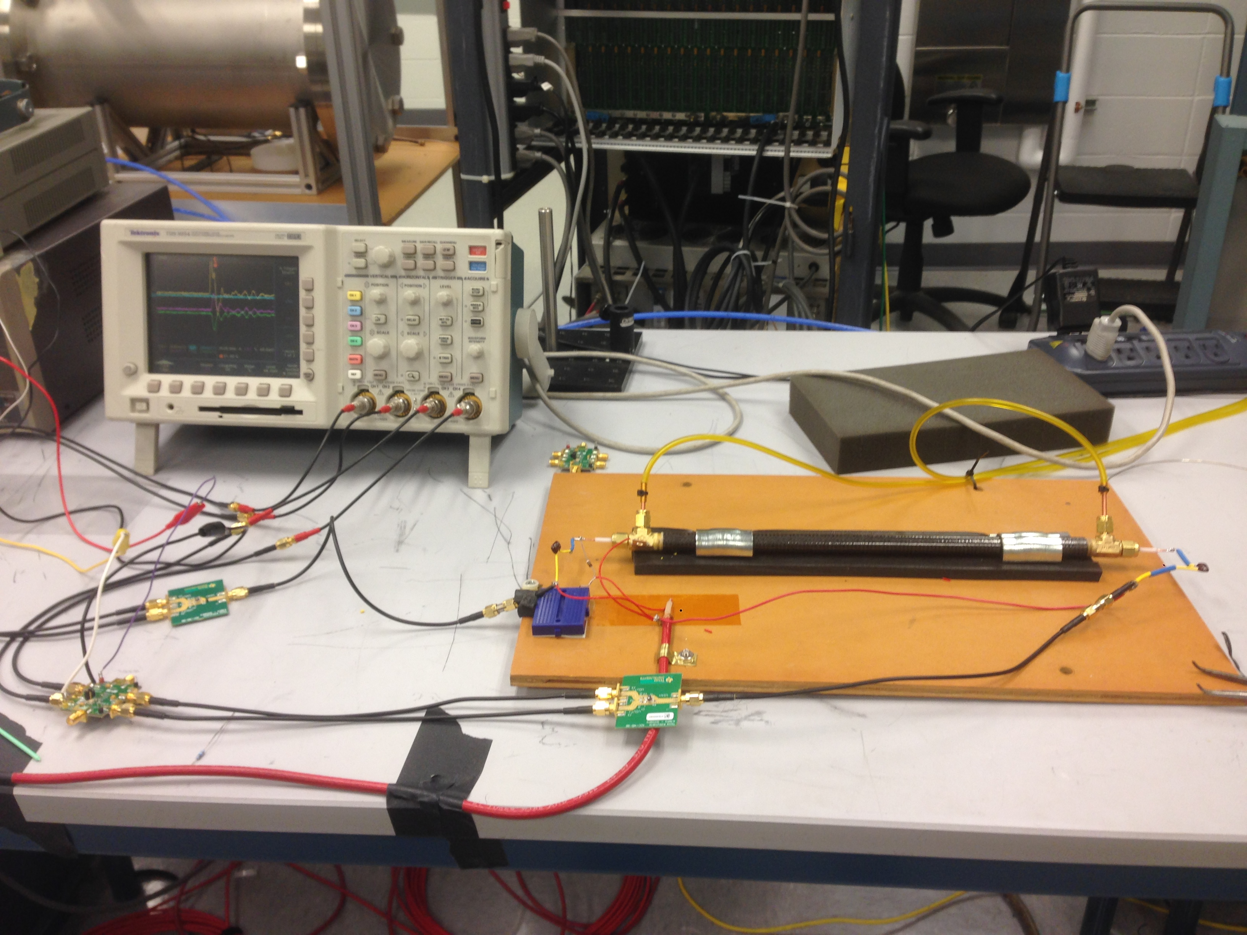
Straw tube tracking for lab studies
Develop a straw tube tracking system to track cosmic rays – plan to build out full system over summer
Allows for positional studies in the lab, so more studies can be done without test-beam
Using either standard preamps from BNL instrumentation or HBD preamps

Slide 8
G10 mRPC?
 | Glass mRPC (M.C.S. Williams et al) | Glass mRPC (UIUC & BNL) | G10 mRPC (BNL)
Gas Gap Width (um) | 160 | 105 | 152, 160
Number of Gas Gaps | 24 | 32 | 48
Gas Gap Spacing Material | Fishing line | Fishing line, mylar strips | Kapton dots or RTV dots
Dielectric Thickness (um) | 250 | 210 | 100
Preamp | Differential type, NINO chip | TI LMH6554 Preamp | TI Preamp
TDC and DAQ | Oscilloscope (10 GHz) | DRS4-V5 (5 GSa/s) + Raspberry Pi 2 | DRS4-V5 (5 GSa/s) + Raspberry Pi
Time Resolution (ps) | 16 | ~20 | TBD
Want to get more gas gaps in same space, to improve S/N (fundamental to improving timing resolution)
Trying G10 as an alternatives to mylar

Slide 9
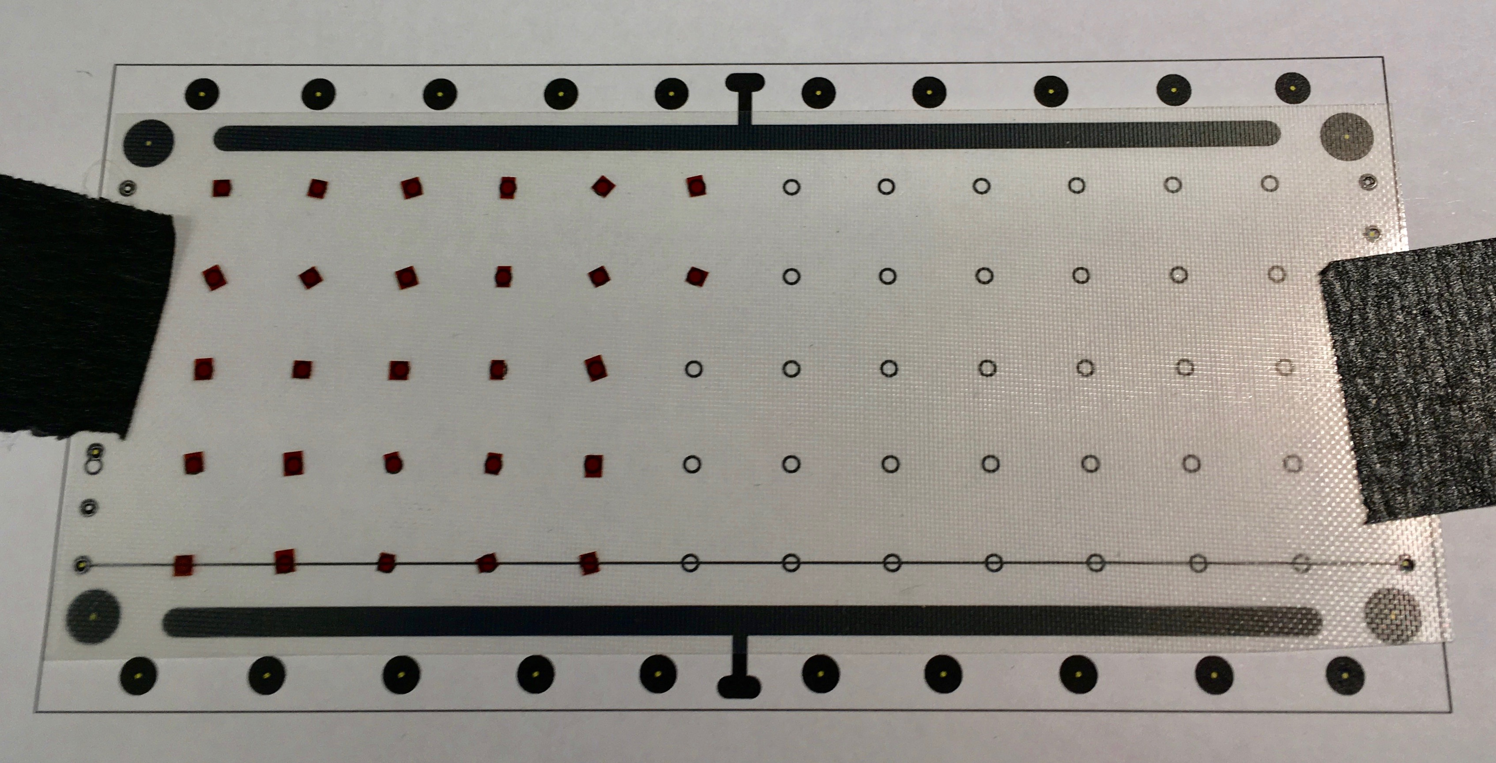
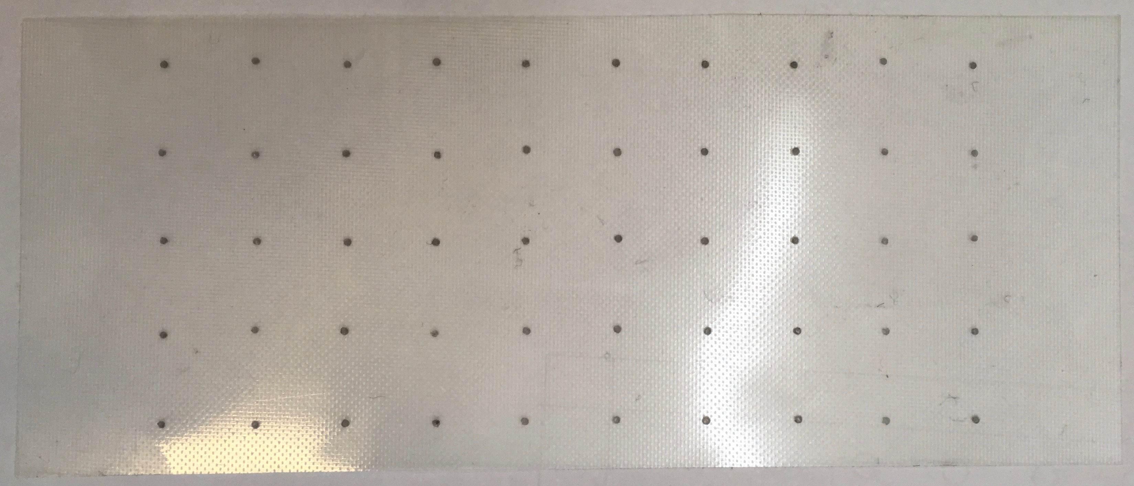
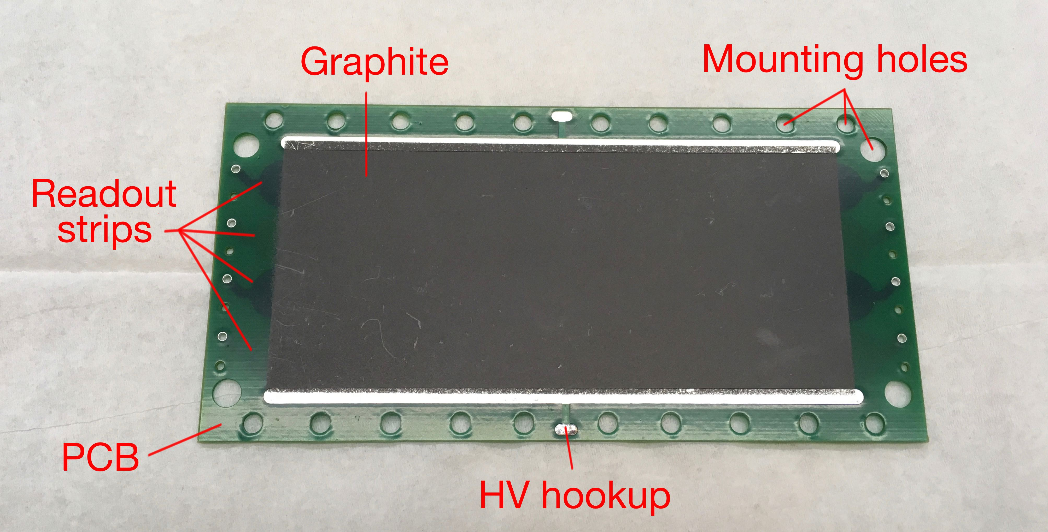
How to keep spacing for flexible materials
Kapton tape was cut into 1 mm² pieces and spaced in a 6x12 grid.
A 6.5mil shim with 1 mm diameter holes was used to screen print RTV dots onto the G10.
New cathode-strip board design,
only 7x14 cm²

Slide 10
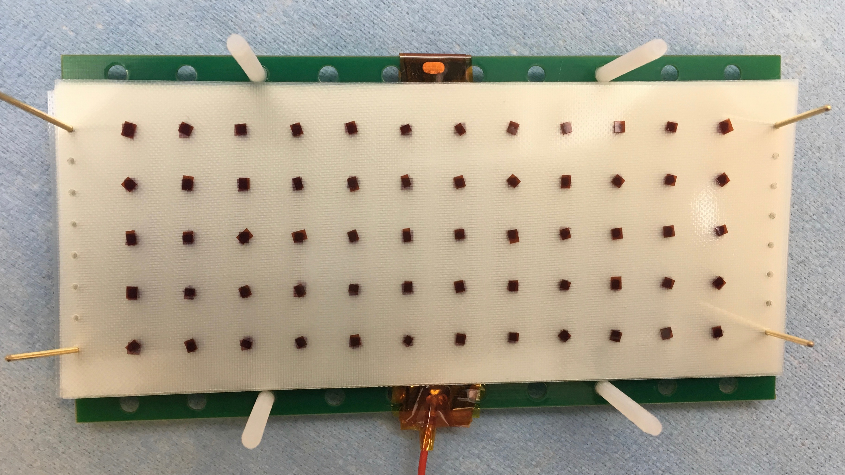
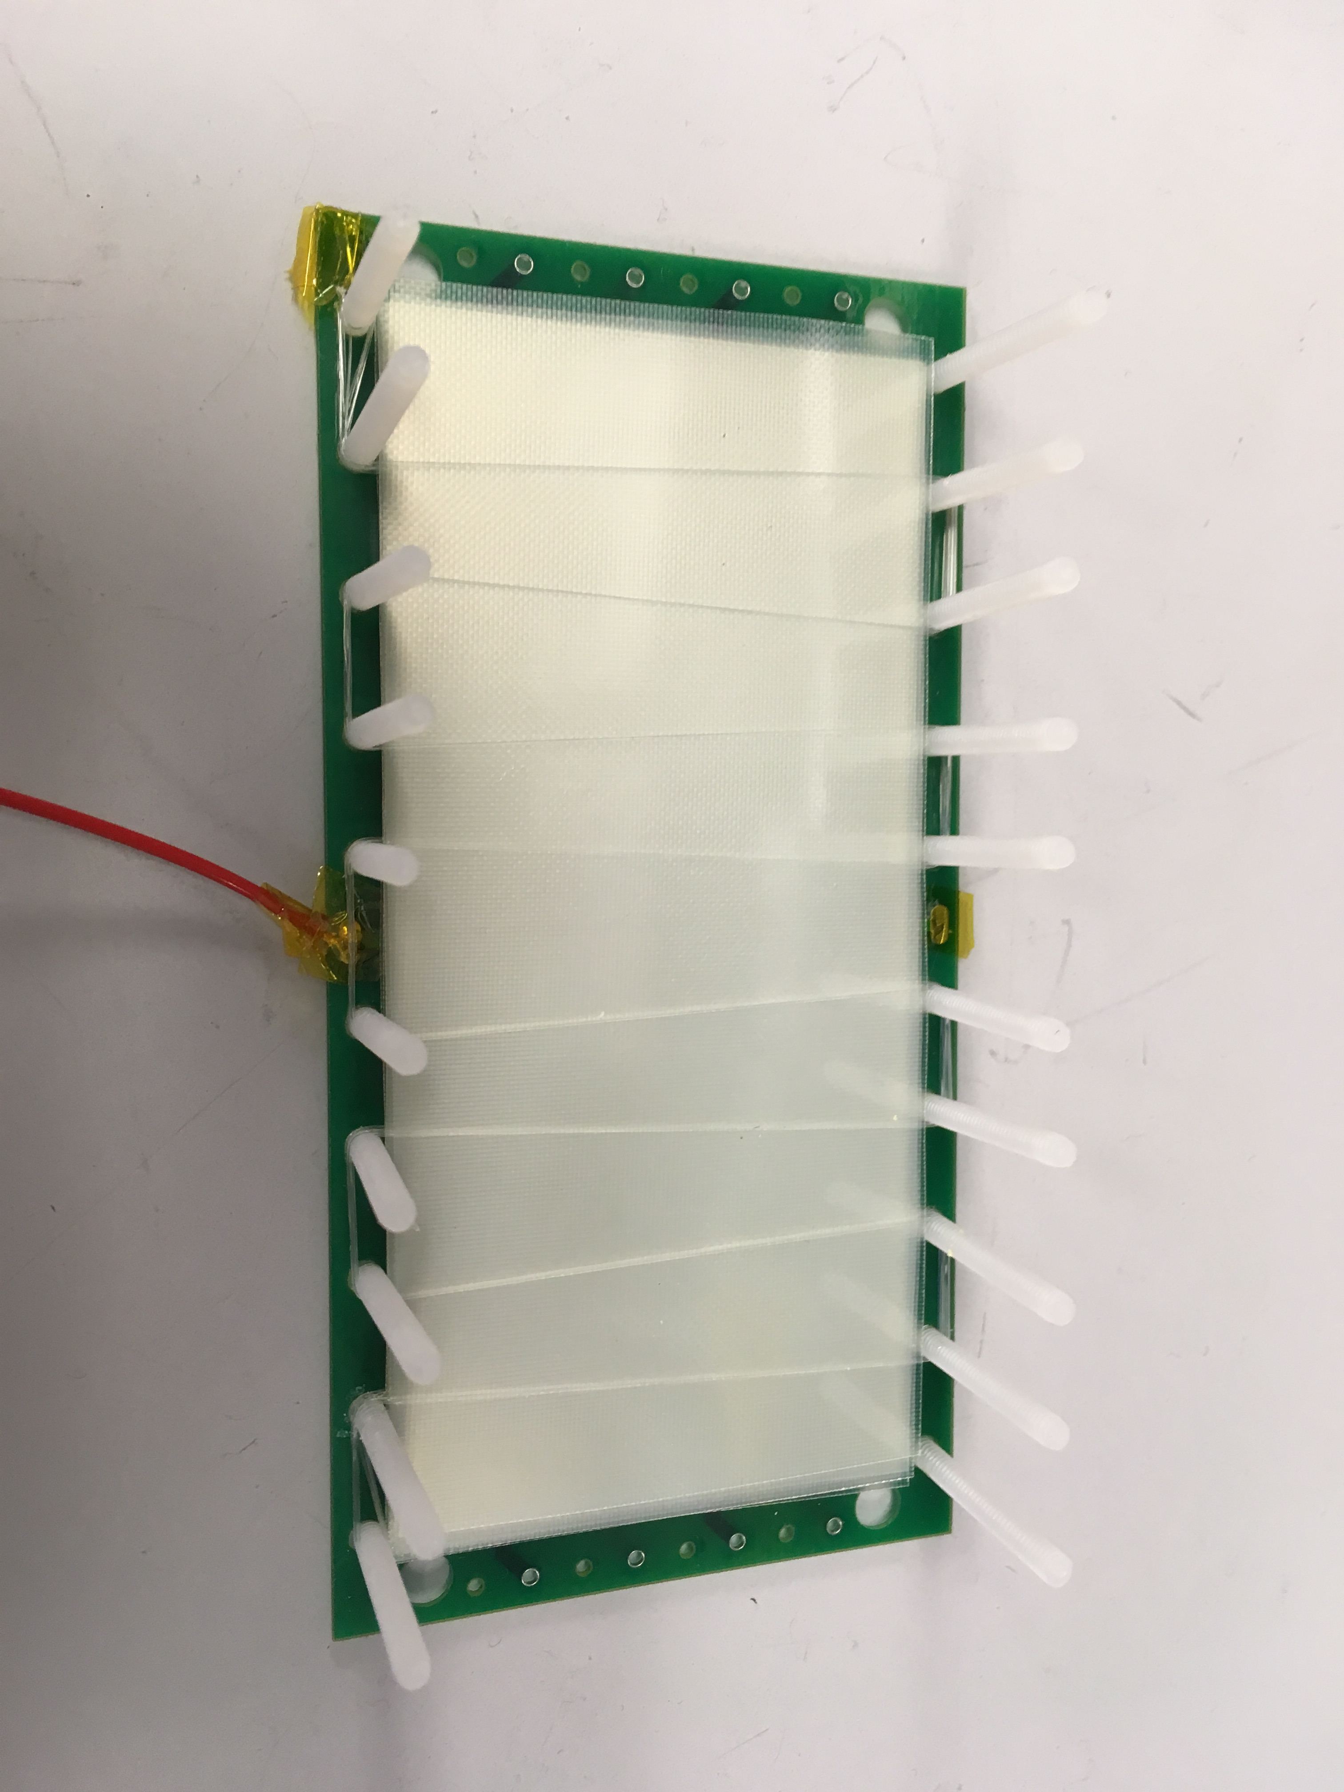
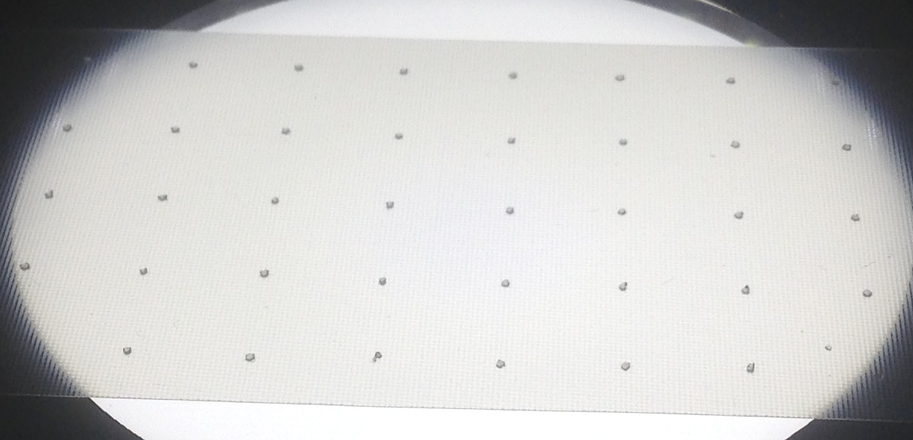
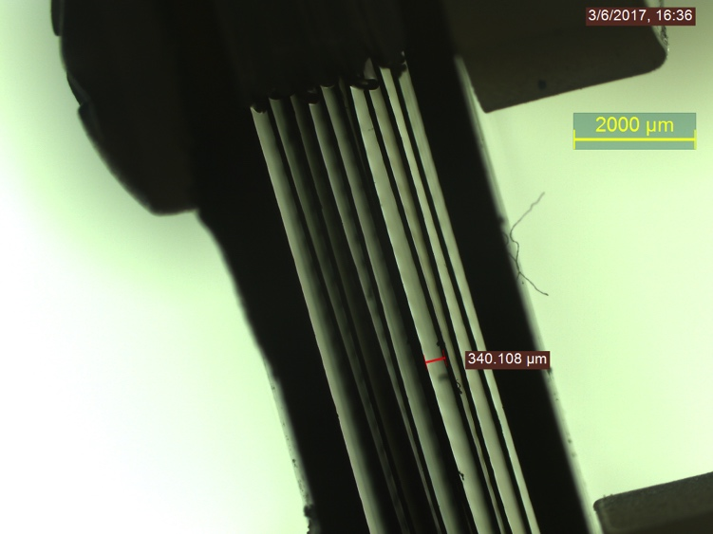
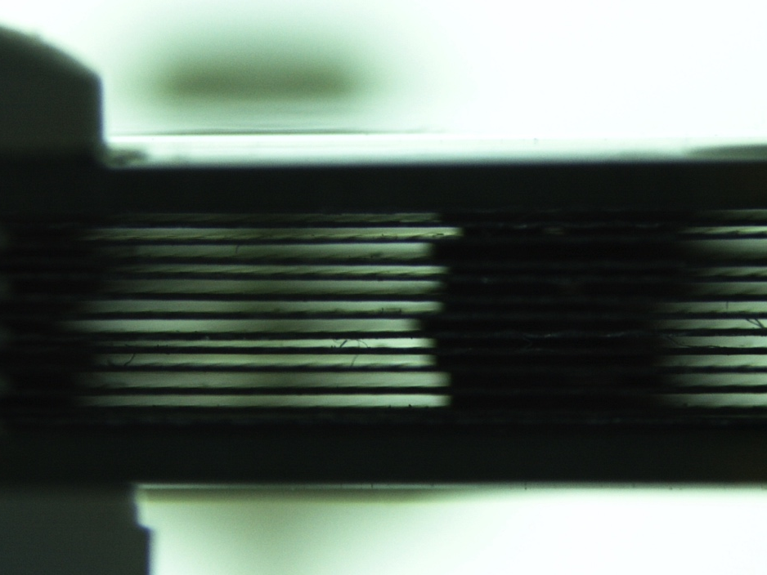
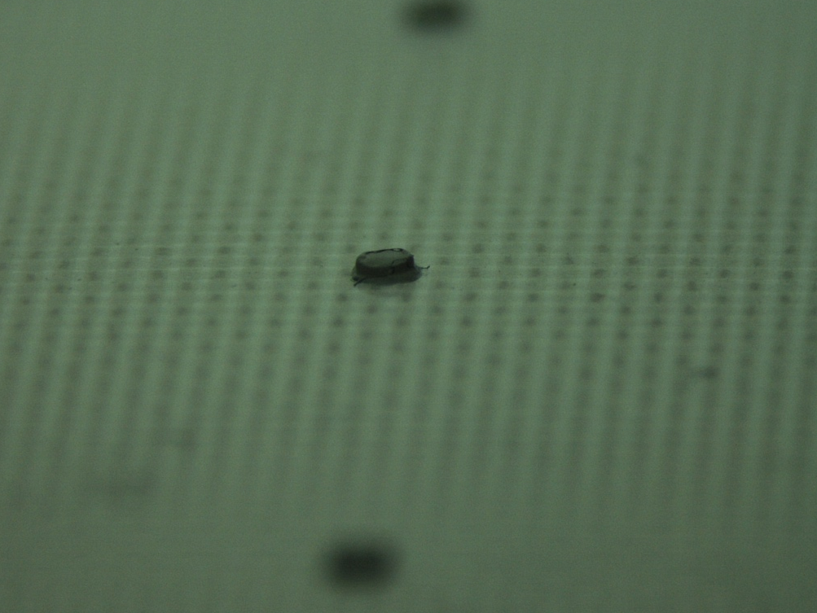

G10 mRPC Fabrication
Fishing Line | Kapton Tape | Screen Printing
160 um fishing line
152 um Kapton Tape
~1 mm² dots
160 um RTV dots
1 mm diameter dots
Non-uniform
spacing
RTV dots
Parallel gas gaps

Slide 11
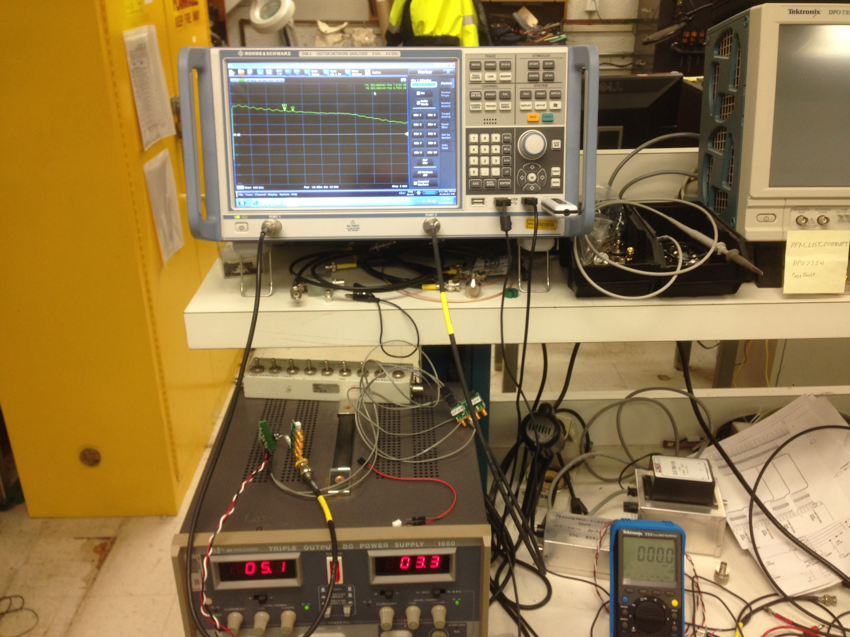
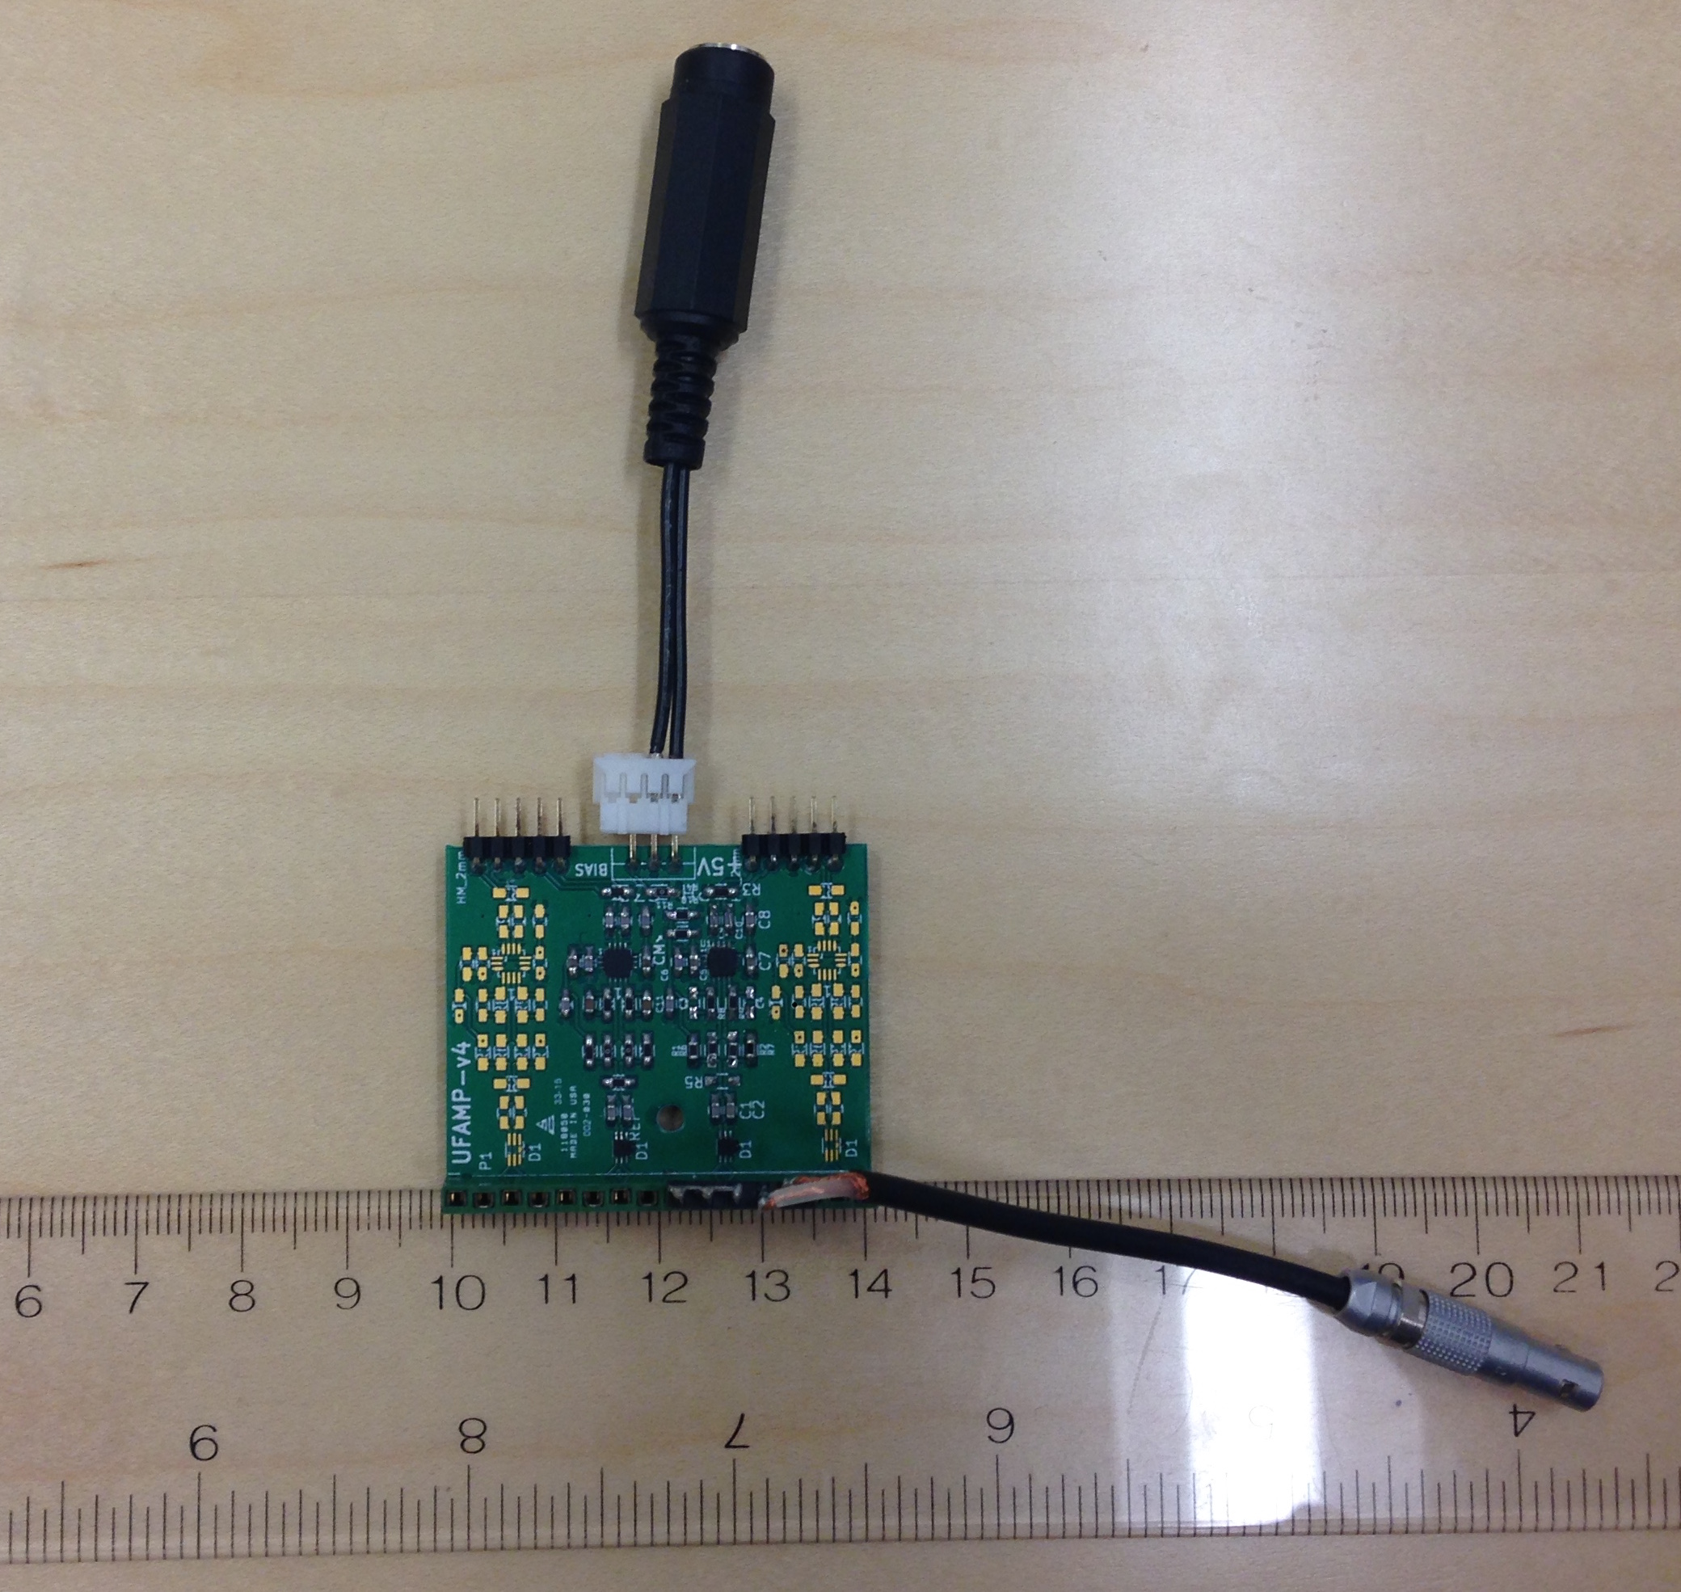
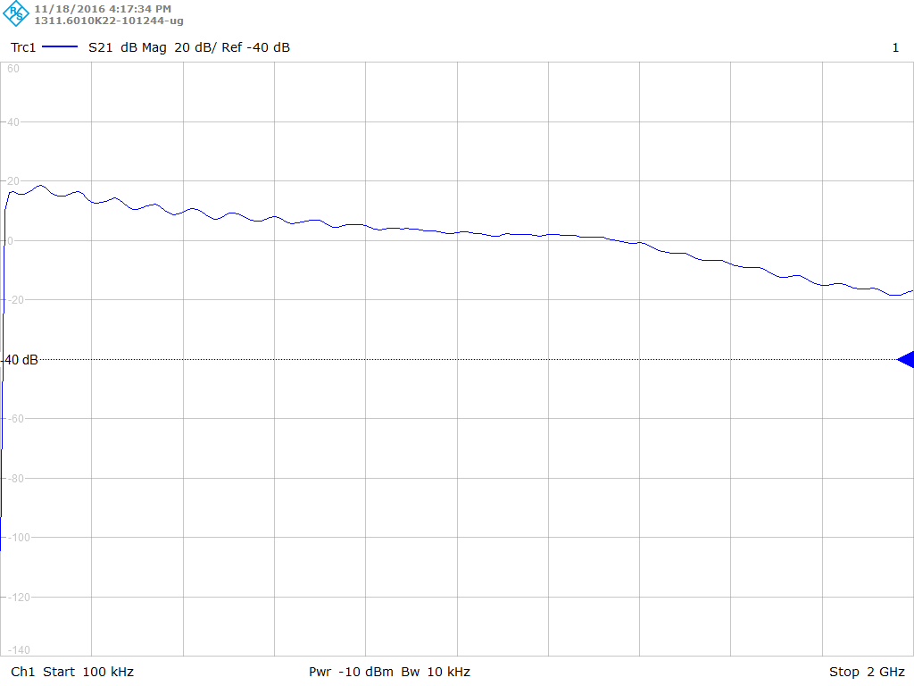
Preamp Study with Network Analyzer
4 ch preamp
+5V power
Detector input
Maybe lower analog bandwidth than expected
Should go to ~900 MHz and then drop to -3dB
Looking into this with IHEP and Andrey

Slide 12
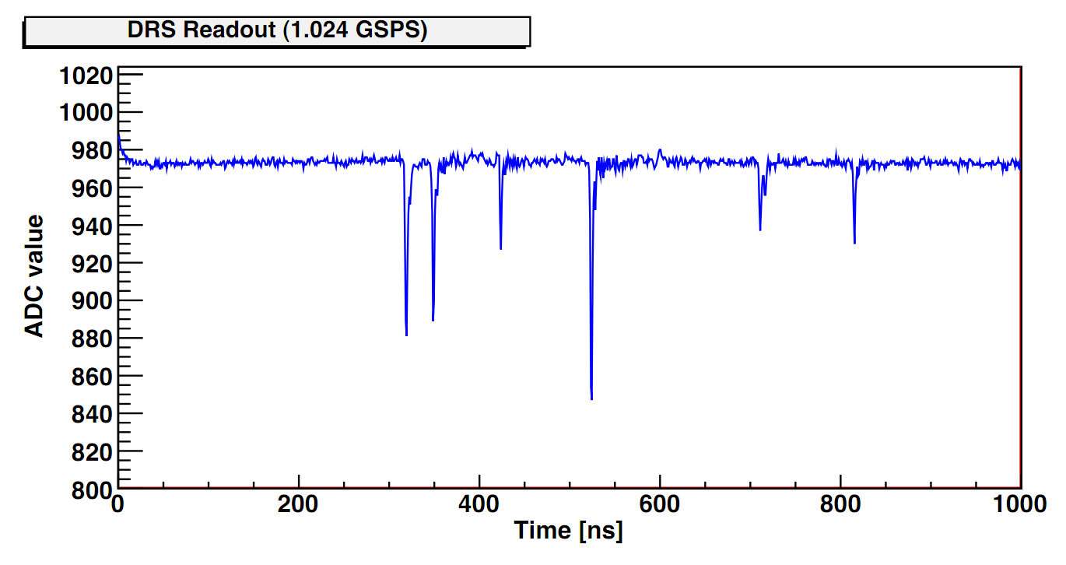
Region of Interest (Windowed) Readout
DRS4 running at 5 GSPS takes 200 ns to fill 1024 SCA buffer
Collider trigger signals require at least a few μs to be sent to FEM
PHENIX trigger latency is 4 μs >> 200 ns.
To solve this, we propose to use the ROI readout for the DRS4 – have a fast LOCAL threshold trigger on each channel, and digitize small window immediately
Need to generate accurate timestamp for ROI (my main worry right now)
Digitizing a 6 ns window with a 37.52 MHz ADC (4x RHIC clock), takes ~3 μs (1+2 overhead), where the DRS4 is dead
Q: What is deadtime effect? At 100 kHz Au+Au rate, we expect about 500 tracks on average per event, over 10K channels, or 5 kHz hit rate on one channel
Poisson prob P(N>=2; 5 kHz hits and 3 us deadtime) ~ 1.5% lost events

Slide 13
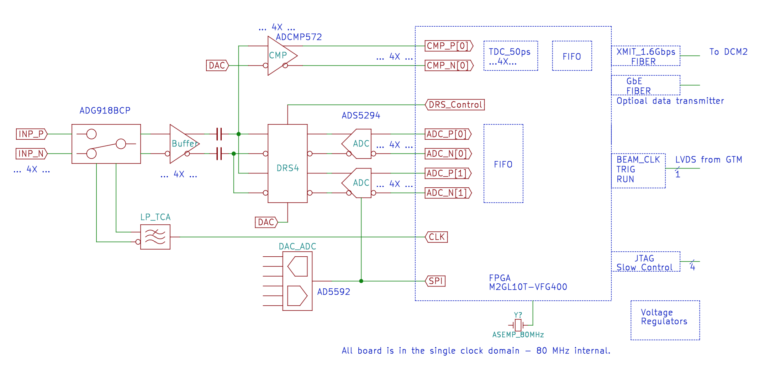
DRS4 ROI Electronics Block Diagram
sPHENIX psTOF DRS4 Board
PHENIX MPC-EX FEM Board
Preamp
Input
Block diagram for DRS4 prototype board using windowed readout for EIC
psTOF DRS4 Board layout hopefully done by end of July
China funding passed 1st review, but need another review. Money won’t come until early next year. Likely to consider asking EIC R&D committee for funding.

