Slide 1
Prelim B-Field Study Slides

Slide 2


Slide 3
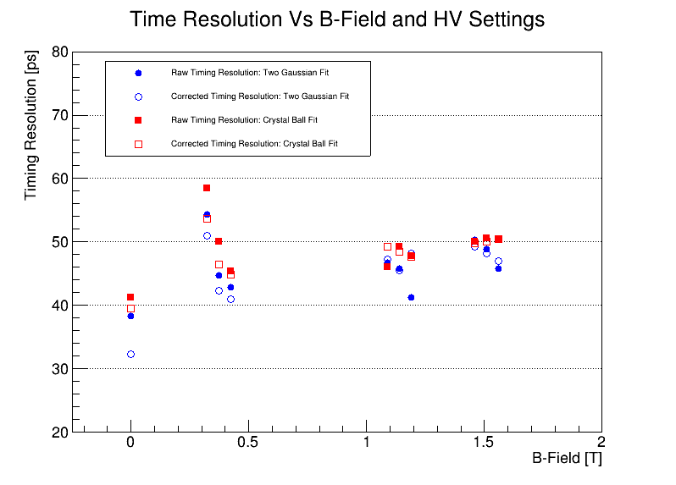
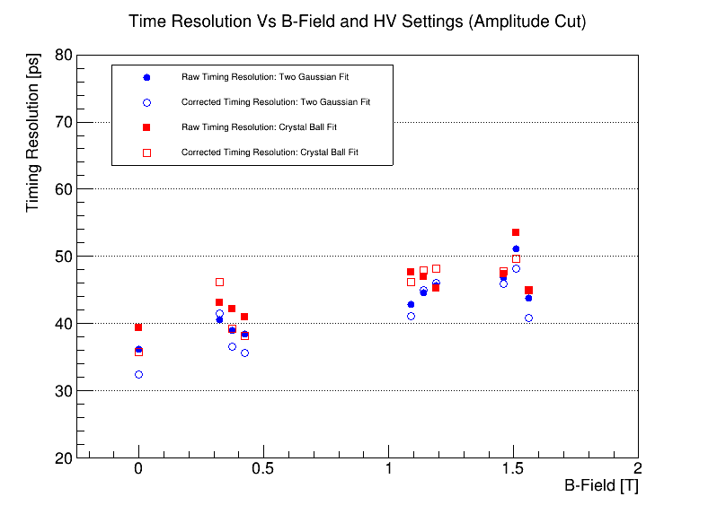
Data taken at 0, 0.374, 1.138, and 1.509 T
Zero field HV: MCP = 650, PC = 200 V
Non-zero field HV (left to right):
MCP = 675, PC = 200
MCP = 675, PC = 400
MCP = 700, PC = 200
Compare double Gaussian and Crystal Ball fits
Compare with and without slope correction
Compare with and without amplitude cut
See degradation in timing with increasing field
Changes in HV have inconsistent effects – dominated by fitting details?

Slide 4
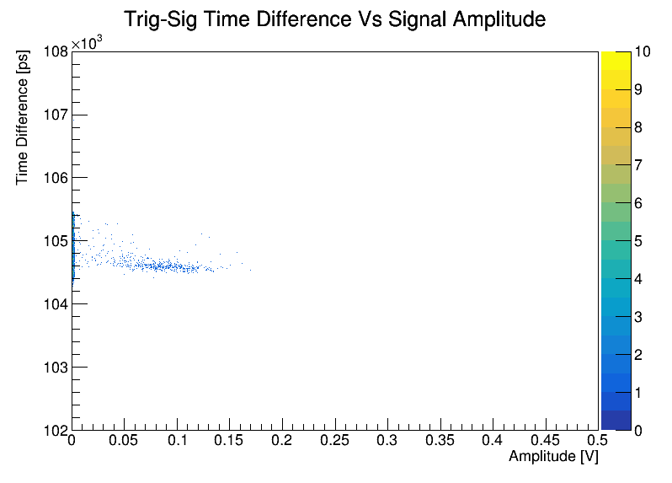
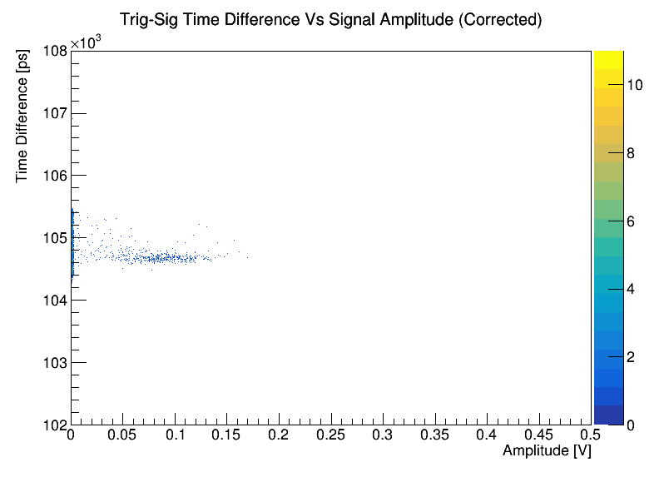
Time difference between trigger and signal can change with amplitude
Correct for this : cor time diff = raw time diff + m*amplitude
Place a cut on signal amplitude to isolate “core” of timing distribution
Always place a cut at Amp = 0.005 V to remove pedestal contribution

Slide 5
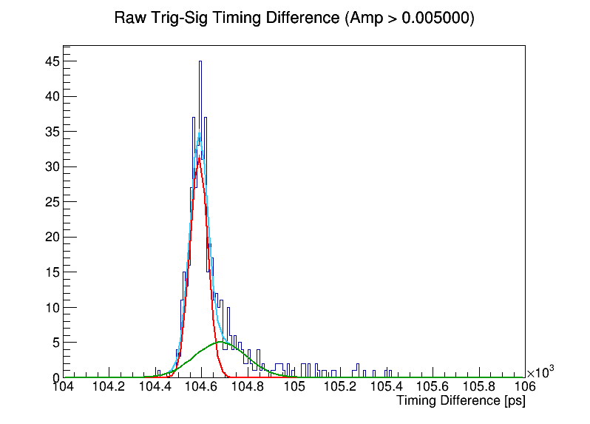
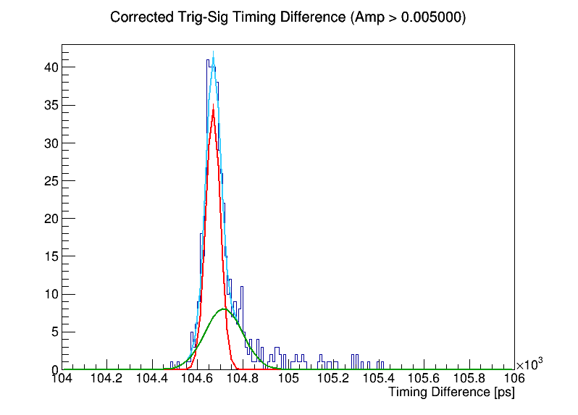
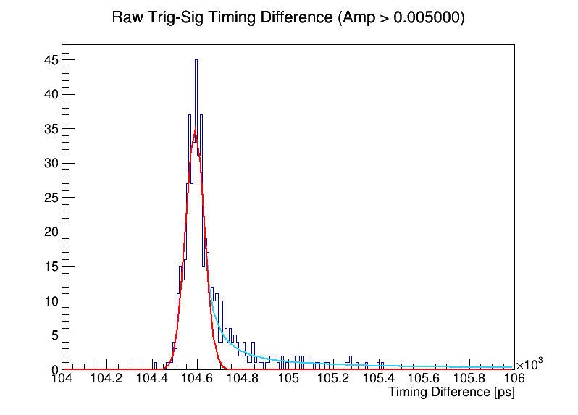

Slide 6
