Slide 1

Yifan Jin

Slide 2

After-pulse
For different HV setting, after-pulse rate ranges from O(1)% - O(10)%.
Working HV (675), after pulse rate is ~1.3%
6.4 ns $→$ H⁺ from the
bottom of first MCP
H⁺ from the face of first MCP
B field: 1.3 T

Slide 3
Dark count rate
Using 11 runs, with HV setting 200-675-200-675-200, 1.3 T magnetic field, each run has 100k events, first 500 bins in the waveform (laser shots around bin 600), and 32 channels, 10 dark count events are found.
Thus, dark count rate = 28.4 Hz/cm².
Approach using oscilloscope also ready.
(run 201457, 201469, 201470, 201471, 201472, 201473, 201474, 201475, 201476, 201477, 201586)

Slide 4
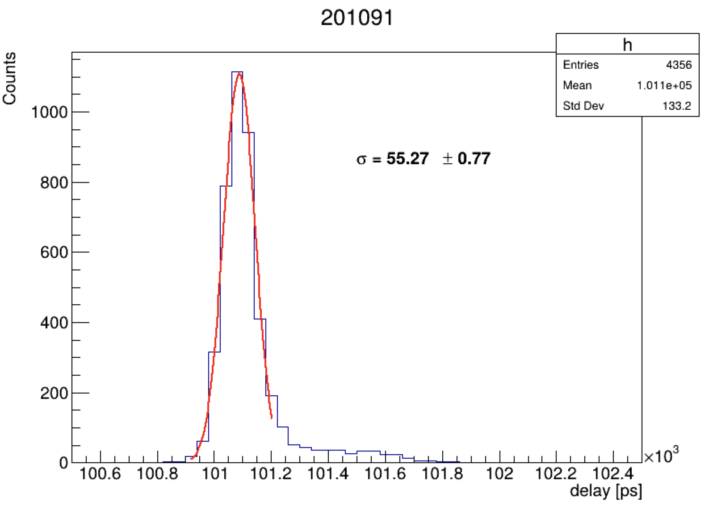
Timing resolution with DRS4 readout
In a 1.2 T magnetic field, HV setting 200-675-200-675-200, achieves average 54 ps timing (from a few runs) using PiLas, time calibrated DRS4.
One run is shown on left.
Dependence of B: timing increases from 50 ps to 60 ps for B field from 0 to 1.8 T.

Slide 5
Repetition rate dependency
Signal rate = laser repetition rate * fraction of signal events in a run.
Optical condition is introduced previously.
HRPPD have gain dropping with respect to signal rate, although the dropping is not significant.
Laser 1.6 kHz
Signal fraction ~5%

Slide 6
Back up

Slide 7
Gain VS Magnetic Field (w/ θ)
Alexander’s
Yifan’s
Yifan uses peak searching, amplitude>2 mV, fit with Skewed Gaussian, (|peak - mean|) as error.
θ=+12.5°, has the lowest gain.
JIHEE KIM

Slide 8
Gain VS Magnetic Field (w/ HV)@ θ=-12.5°
Alexander’s
Yifan’s
Large difference was shown at 1900 A measurement especially at HV = 650 V and 725 V.
JIHEE KIM

