Slide 1

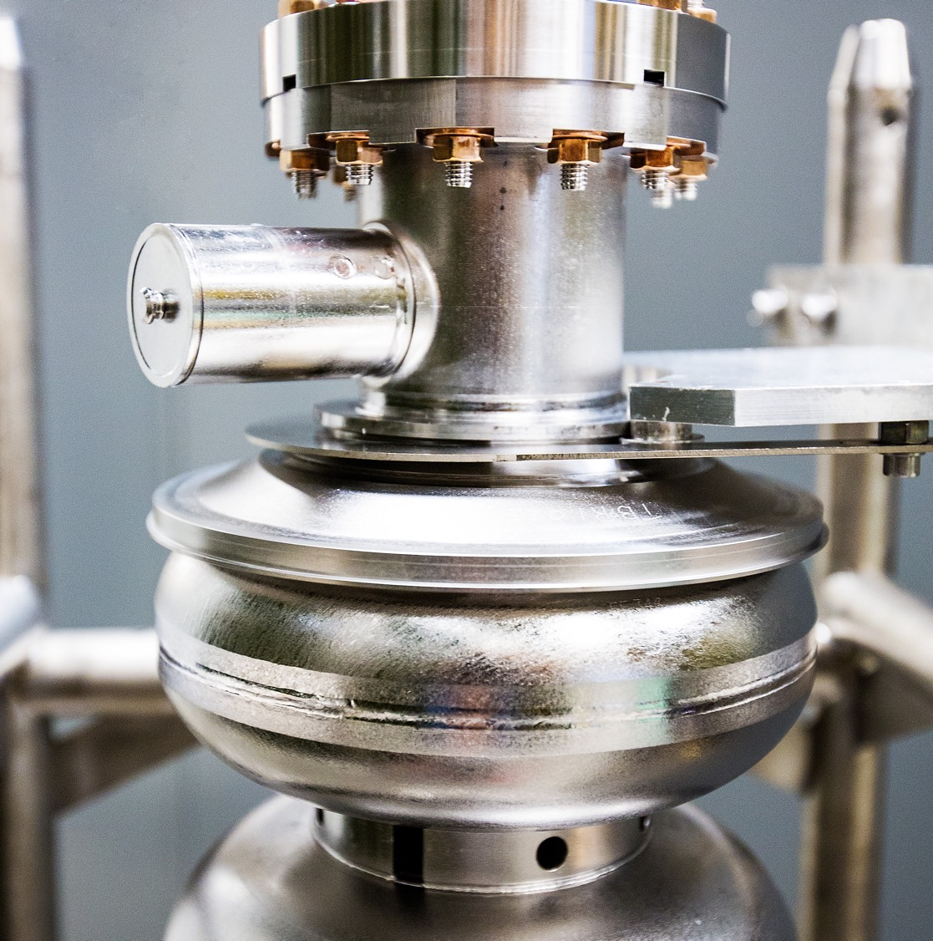
HRPPD Meeting #5 Update
2026-01-13
Raymond Dawson
Notes:
Tip: Keep titles under 60 characters for readability
To change the photo: Right-click on photo and select change photo

Slide 2
Current Status
Ceramic Tasks: Due by 01/12/2026
PED contract with Incom will be signed soon
Priority tasks:
Location of new HV tabs and placement of pads/vias on ceramic
Sidewall chamfer
Need to fit 8mm chamfer at minimum
Interposer tolerance stackup (air side)
Confirmed pad location tolerance with Kyocera
Design File
Update HRPPD with final design changes
Need to complete nets connections
Stitching vias mostly implemented in 1 interposer group, need to copy-paste
Pad size changes - <1 day
Estimated to complete: 1 week + TBD changes
Simulations
TBD – Hi-Z input simulations
Non-Ceramic Tasks: Due after
Interposer downselection - thickness + # grounds vs crosstalk
Update 1/13 – received 1mm models from Neoconix
Backplane Changes
Cables
Safety resistors
Bypass capacitors + ringing resistors
Plastic connectors for HV connections
Pogo pins vs interposer for HV connections
FCFD Test Board
Buyer out last week, sorting issues with vendor this week for order
Aiming for arrival mid-February
Notes:
Add due date

Slide 3
Archive

Slide 4
Record of Design Decisions
Amount of stitching vias will be increased
Vacuum pad size will be 2.75mm square
Interposer footprint will fit either “by2” or “by4” configuration
Preliminary
Air side pads will be 1.2mm round with ground pour with 8mil clearance
If needed, HV pads will fit both pogo pins and interposers so either can be used with the ceramic
1mm vs 3mm interposer will be independent of ceramic design

Slide 5
Completed Tasks
Simulations
Complete - stitching vias, air side interposer pad reduction, GND planes
Complete 12/16 - Vacuum side pad size selection
Complete 12/23 – air side pad size, interposer ground pour
Complete 1/6 – Max air pad size + ground pour
TBD – Hi-Z input simulations
High Voltage (HV) Design
Complete - preliminary pogo pins selected, HV spacing determined
Complete 1/6 – determined pad size for 2 pogos or 1 4x4 interposer, if needed
Other
Complete - Break in ground ring placed
Test file import with Kyocera
Update 12/23 Kyocera confirmed successful import of ODB++

