Slide 1

Sizing of the SVT air cooling system
ePIC SVT WP4 / WP6 meeting
2026-05-20
Joe Silber (LBNL)

Slide 2
Requirements

Slide 3
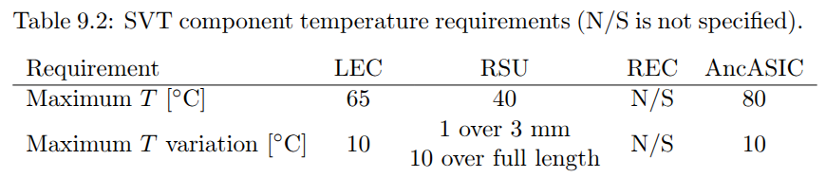
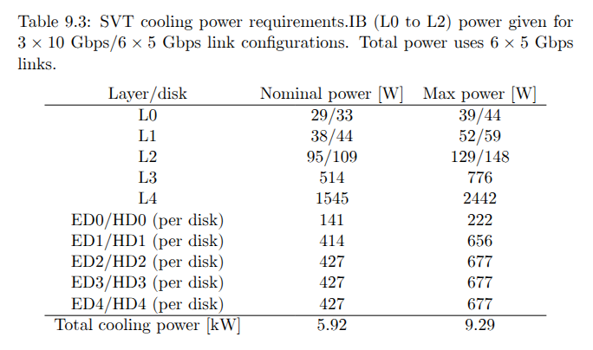
High level cooling requirements
…from current draft Preliminary Design Report (PDR)
Detector temperature
Power dissipation
Source: https://www.overleaf.com/project/67170d690d68308814b3ba47
Diff between max and nominal is large. I.e. we shouldn’t need to spec an air system with excessive “margin on margin”

Slide 4
Additions / modifications / clarifications to requirements that could be helpful
Is the ∇T = 10°C max gradient “over full length” within one EIC-LAS module?
if not, what is the max gradient within module?
for the “slow and cold” approach, could we accept a gradient of ∇T = ___ °C?
Specify the minimum allowable silicon temperature for each component (LEC, RSU, AncASIC)
for the “slow and cold” approach
informally, we believe this could be at least as low as T_{min} = -20°C
Could we increase RSU max temperature from T_{max} = 40°C to perhaps 45°C ?
for the “fast and warm” approach
Can the current pre-production sensor run (ER2) inform these?

Slide 5
Design overview

Slide 6
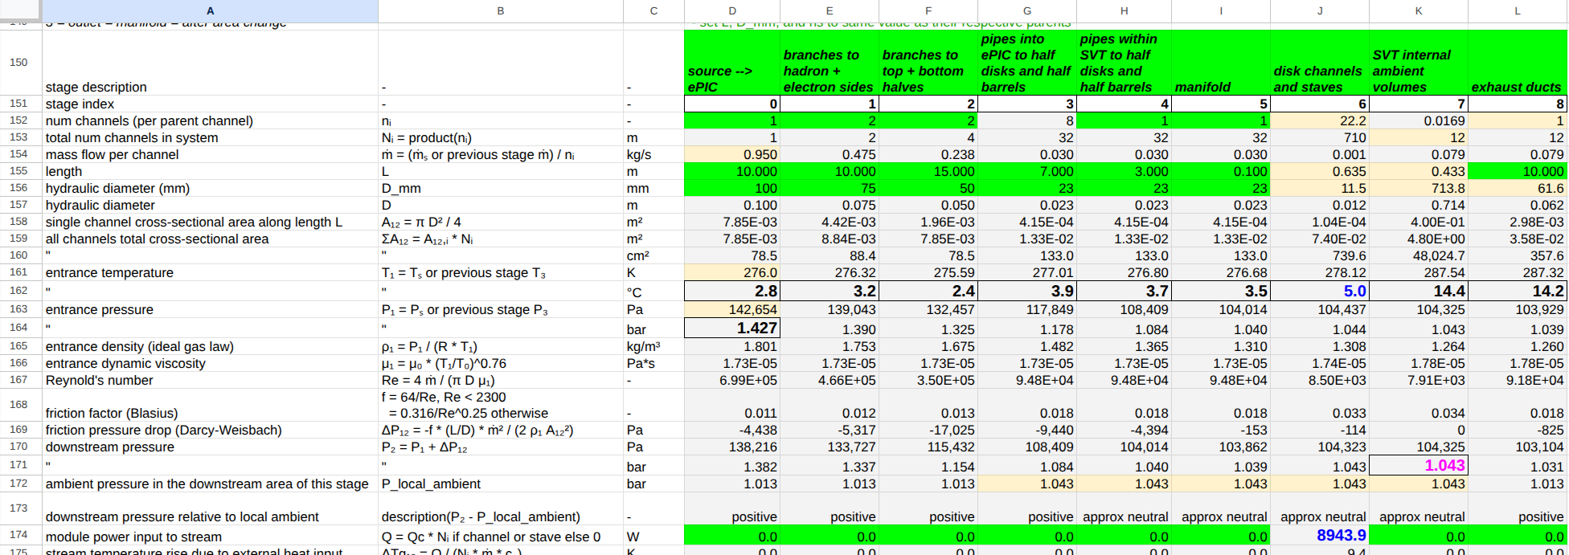
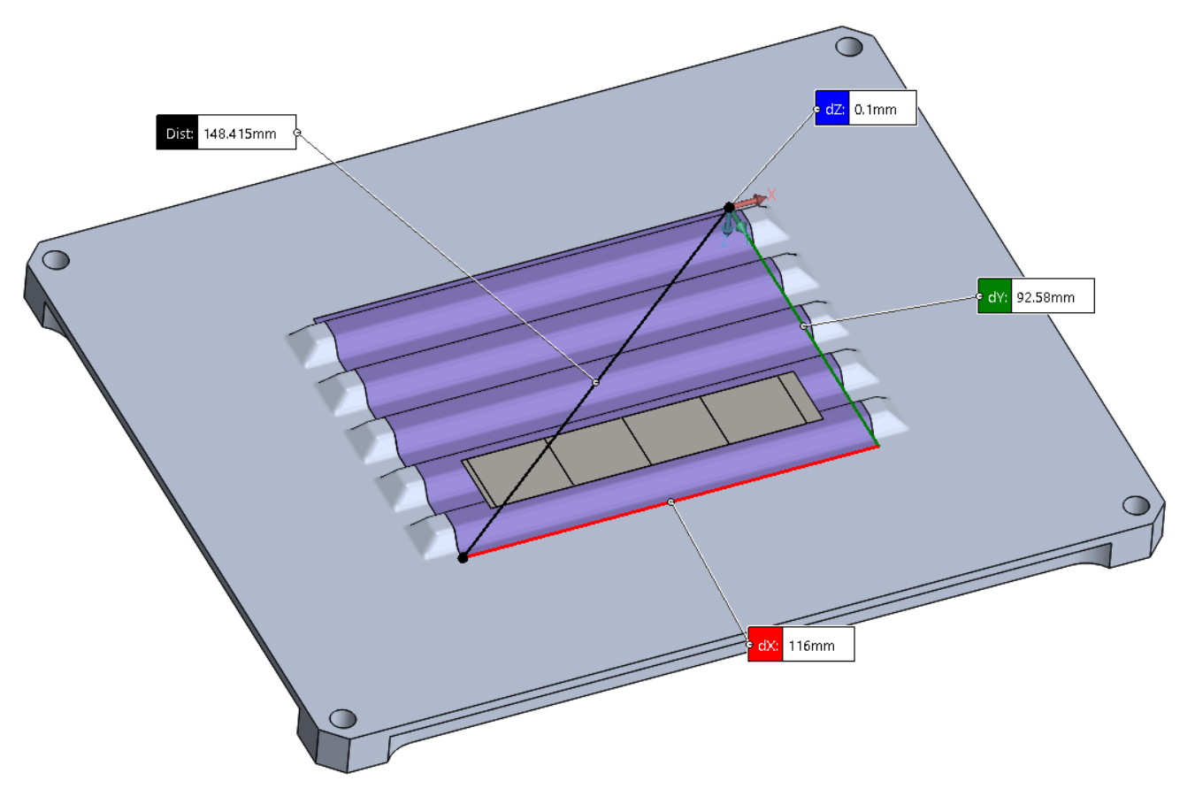
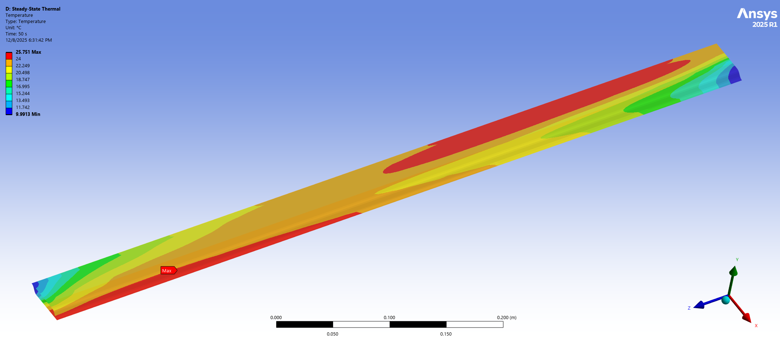
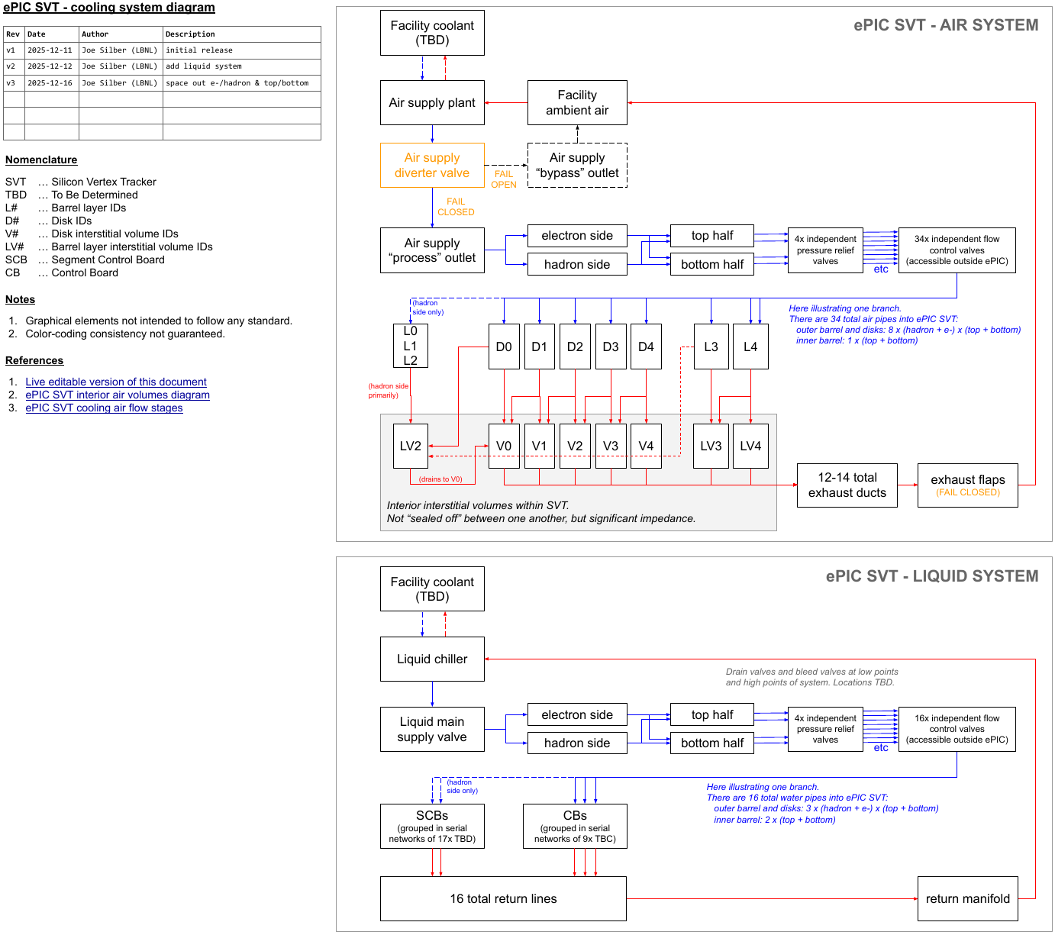
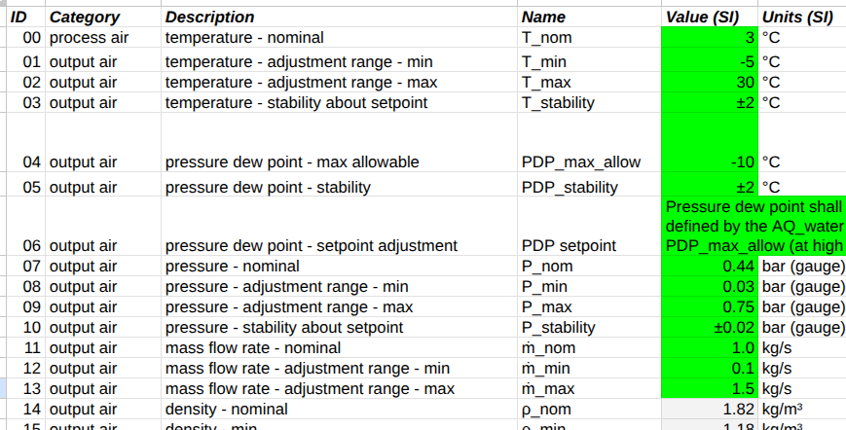
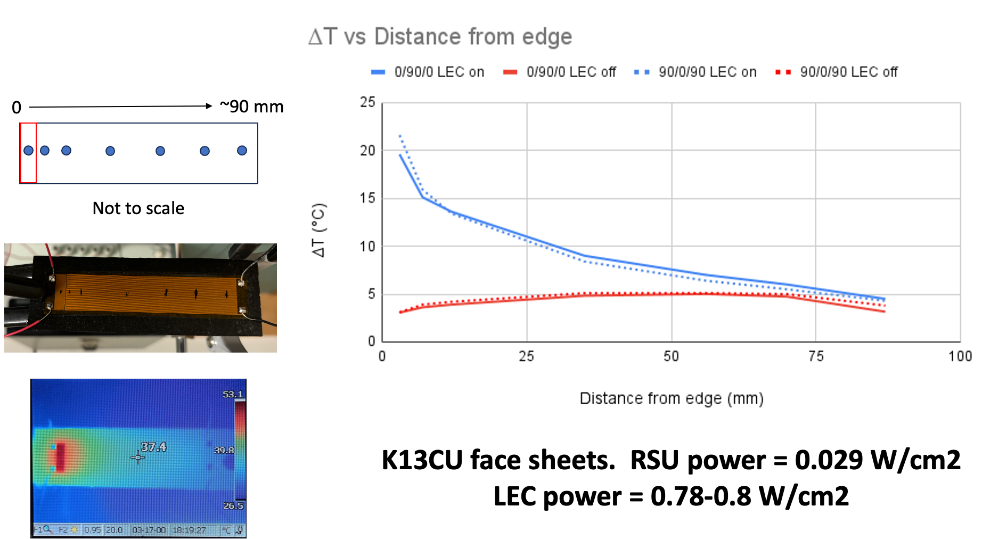
Design process from high level req’ts to detailed specs
High level requirements
End-to-end system performance calculation
Req’ts on silicon
T_{max}, ∇T
Constraints on ΔT_{cooling} = T_{Si}-T_{air}, ΔP, air speed
CAD design
Local supports heat transfer analysis
System architecture
Temperatures, pressures, flow rates
System layout
Detailed specs on cooling plant
Local supports physical test
Operational logic

Slide 7
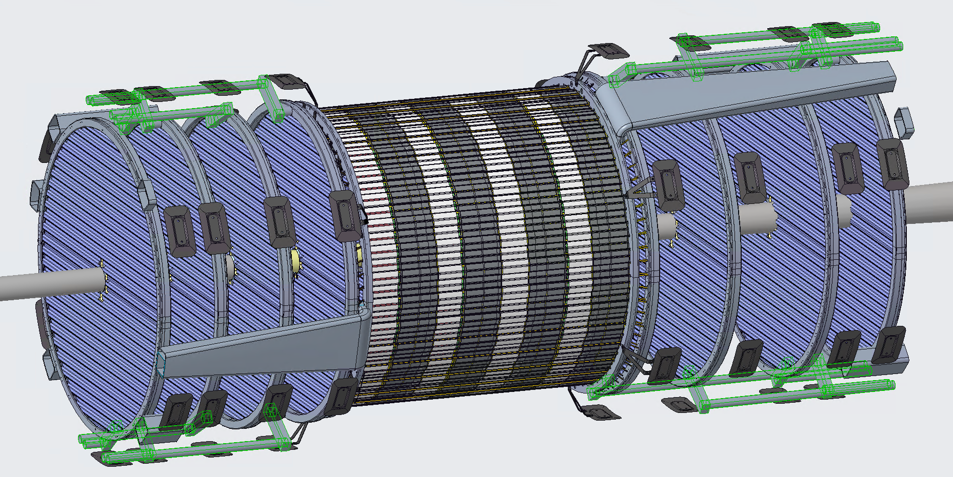
Air supply pipes

Slide 8
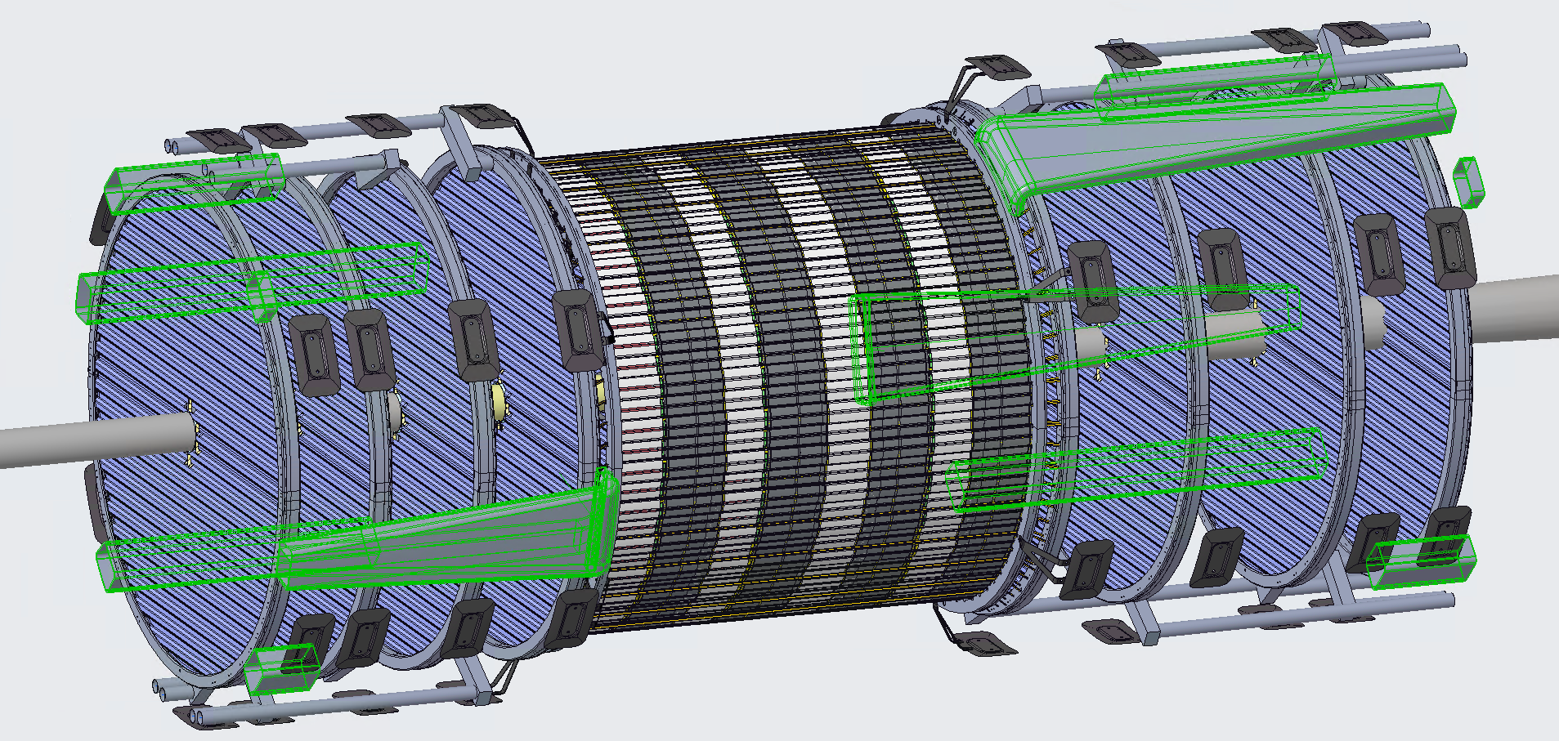
Air exhaust ducts

Slide 9
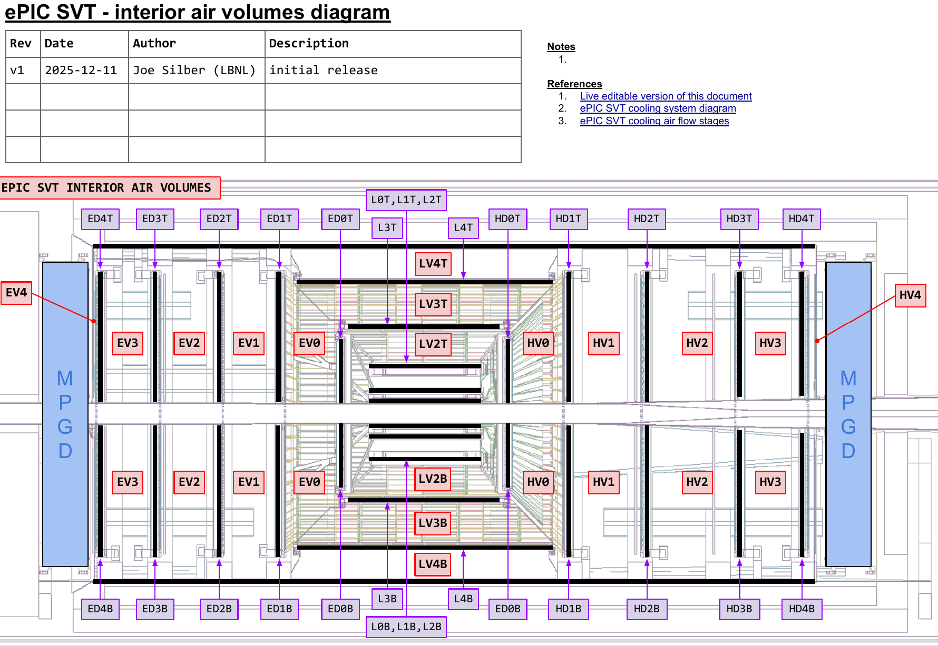
Air exhaust
Exhaust via 12-14 ducts
Duct hydraulic ⌀52 mm
I.e. much greater cross-section than input pipes (4 x ⌀50 mm)
Ducts draw from interior volumes (see diagram)
These volumes aren’t “sealed” from each other, but significant impedance
Suction could be done but probably not necessary
Flapper valves at outlets to prevent ingress when flow off
Link: ePIC SVT interior air volumes diagram - v1.pdf

Slide 10
Link:
ePIC SVT cooling system diagram - v3.pdf

Slide 11
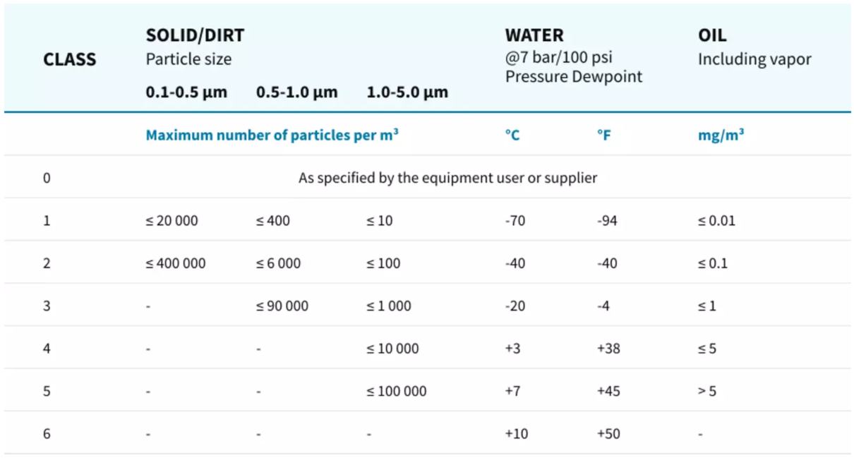
Air quality strategy
ISO 8573-1:2010 defines compressed air purity classes
Supply air quality
solid particulate: Class 1
total oil: Class 1
water: ≤ Class 3 (will come back to this later in talk)
Air supply diverter valve
vent supply air to bypass outlet for startup, air quality test, etc
Additional air filters at manifolds just outside ePIC
extra line of defense
Table source: Atlas Copco

Slide 12
Also see slides from December 2025 working meeting at Oxford
2025-12-18 - SVT Working Mtg - Cooling system and humidity - Silber - v1.pdf
More details on how the system calculator spreadsheet works
Boundary conditions (flow rates, inlet temperature)
Power load detail estimates
Liquid cooling for CBs and SCBs
Historical dewpoint data (STAR and sPHENIX halls)
Insulation sizing calculation method for cold pipes outside the dry volume of SVT
More details on humidity management strategy (interlocks, exhaust flapper valves, etc)
And see latest rev of cooling system performance spreadsheet:
ePIC SVT cooling air flow stages - v19.xlsx
(note this

Slide 13
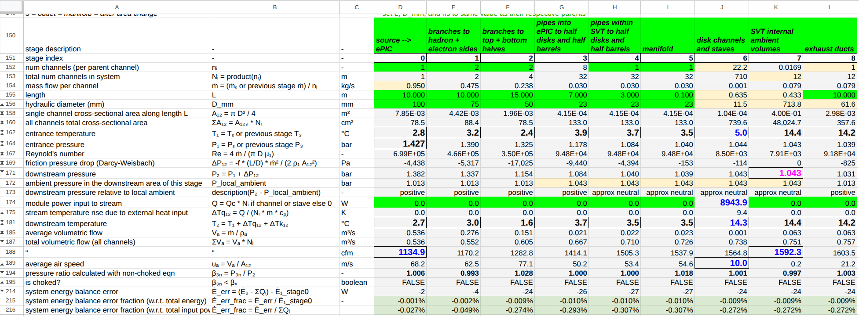
Cooling system performance baseline (Dec 2025, v15)
source temperature = 2.8°C
total mass flow = 0.95 kg/s
total volume flow = 1135 cfm @ source pressure, 1604 cfm @ exhaust
source pressure = 1.43 bar → 1.03 bar positive pressure @ exhaust
channel/stave entrance temperature = 5.0°C
channel/stave air speed = 10.0 m/s
total power extracted = 8.9 kW
SVT internal ambient temperature = 14.4°C

Slide 14
Air flow rates through channels at the detectors

Slide 15
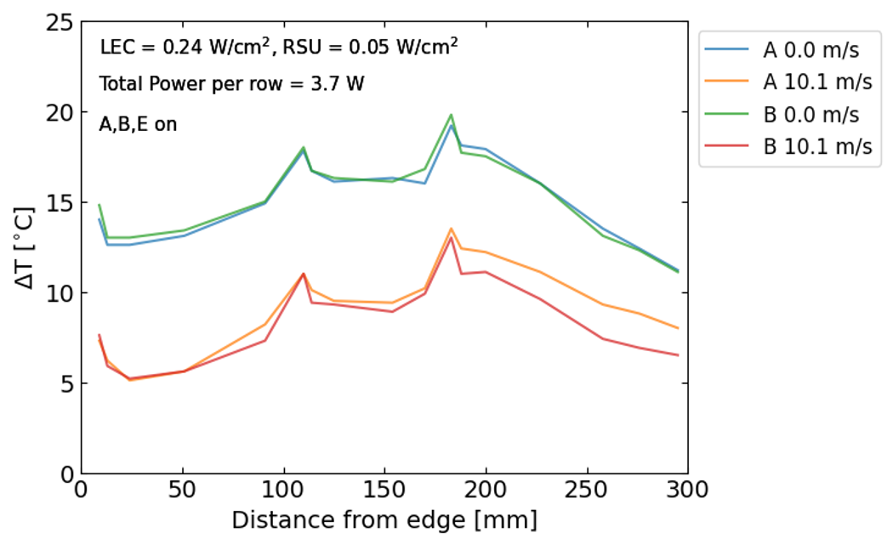


Lab tests on single corrugation with nominal vs max power with and without internal air flow
Extrapolated full- length max ΔT ≈ 28°C
~28
flow off
This test unit is 30% the length of an avg channel. Peak temps rise approximately linearly over the length.
flow on
Nikki Apadula (LBNL) Nov 2025
~680 mm

Slide 16
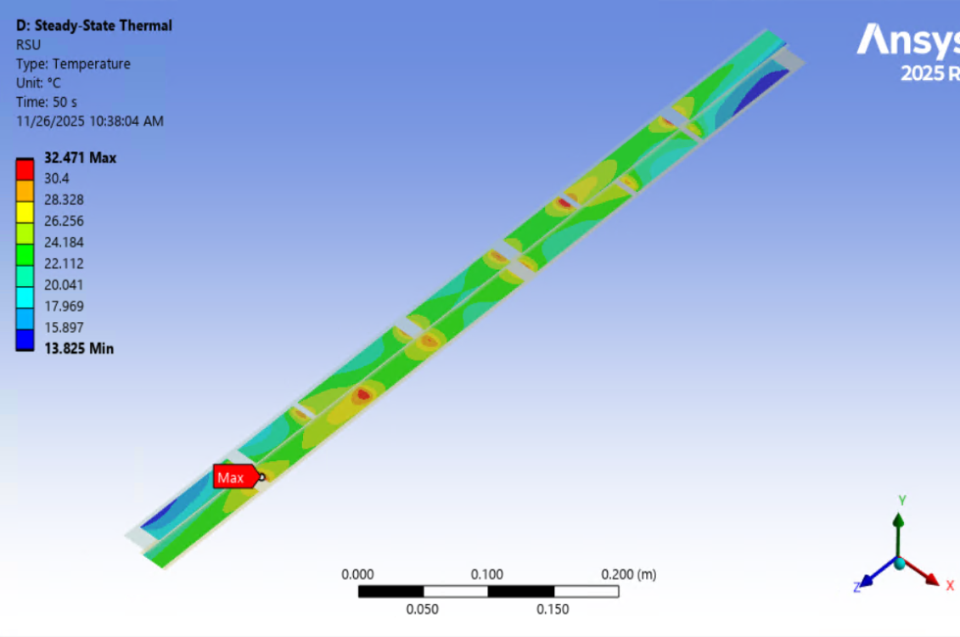
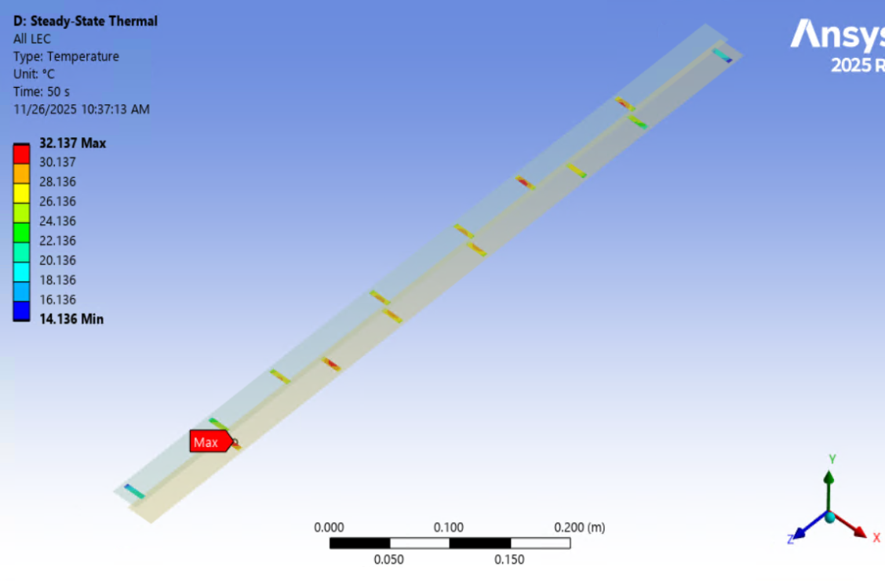
T_{max, RSU} = 40°C is key limit on silicon temp. LECs conduct directly into RSUs.
CFD heat transfer study by Jaime Cruz-Duran (LBNL), Dec 2025
RSUs
AncASICs

Slide 17
Inlet air conditions selected for baseline: 5°C @ 10 m/s
Air temp setpoint at inlet:
ΔT_{cooling} = T_{RSU} - T_{air} = 27.5°C @ 10 m/s
margin = T_{RSU, allowed} - ΔT_{cooling, max} - T_{air}
= 40 - 27.5 - 5 = +7.5°C ✓
Gradient within module:
∇T ≈ 32 - 22 = 10°C @ 10 m/s ⚠️ (Eyeballed from CFD plot. Right on edge of 10° req’t. Physical test on sub-length unit had ∇T ~ 6° within module, despite similar ΔT_{cooling}. Suggests higher real-world in-plane conductivity than was assumed in model.)
CFD heat transfer study by Jaime Cruz-Duran (LBNL), Dec 2025

Slide 18
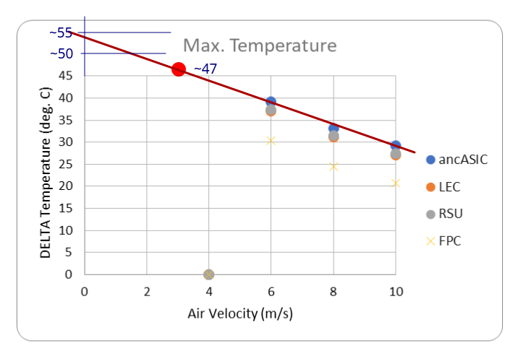
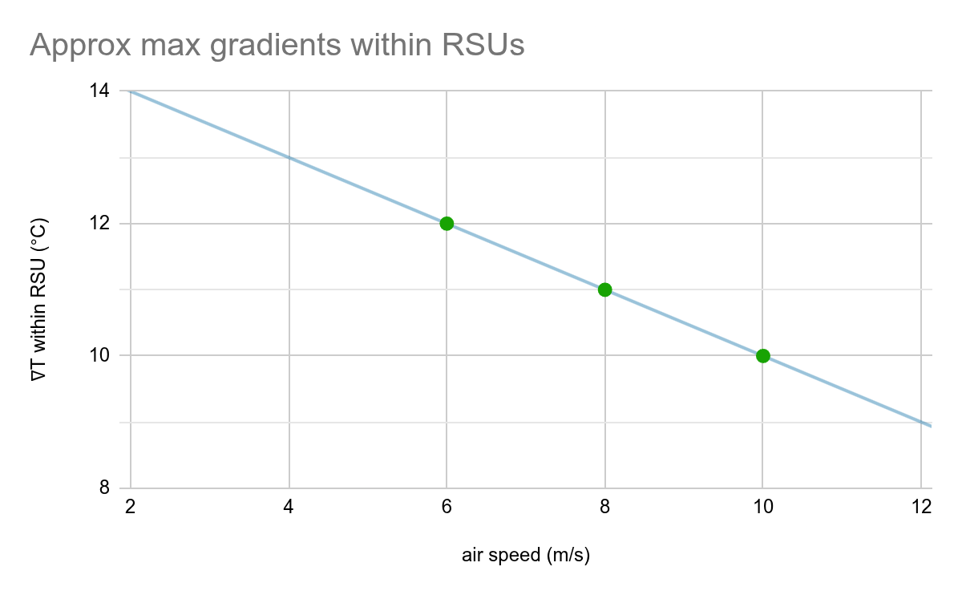
Rough extrapolations of Cruz-Duran’s Dec 2025 CFD study
Vertical axis is ΔT_{cooling, max} = T_{Si, max} - T_{air, inlet}
Max gradient values here were eyeballed off FEA graphical plots.

Slide 19
Can we slow down the baseline ~20% to fit better within 1500 SCFM limit of some typical compressor models?
Air temp setpoint at inlet:
ΔT_{cooling} = T_{RSU} - T_{air} ≈ 34°C @ 8 m/s
margin = T_{RSU, allowed} - ΔT_{cooling, max} - T_{air}
= 40 - 34 - 5 = +1.0°C ✓
Gradient within module:
∇T ≈ 11°C ⚠️ (Eyeballed from CFD plot.)
System could look like:
channel/stave entrance air temperature = 5.1°C
channel/stave air speed = 8.1 m/s
source air temperature = 3.5°C
total mass flow = 0.75 kg/s
total volume flow = 1300 SCFM (977 cfm @ source pressure)
source pressure = 4.3 psig (0.30 barg)
total power extracted = 8.9 kW
SVT internal ambient temperature = 17.0°C

Slide 20
Could we shift flow regime to “Slow and cold”?
Air temp setpoint at inlet:
ΔT_{cooling} = T_{RSU} - T_{air} ≈ 47°C @ 3 m/s
margin = T_{RSU, allowed} - ΔT_{cooling, max} - T_{air}
= 40 - 47 - (-10) = +3°C ✓
Gradient within module:
∇T ≈ 13°C ⚠️ (Eyeballed and scaled from CFD plot.)
System could look like:
channel/stave entrance air temperature = -10.1°C
channel/stave air speed = 3.0 m/s
reduced mechanical excitation is a side benefit
source air temperature = -12°C
extra insulation thickness required in non-dry service lanes
total mass flow = 0.29 kg/s
total volume flow = 502 SCFM (424 cfm @ source pressure)
compressor system is 3-4X smaller and lower power
source pressure = 1.1 psig (0.08 barg)
total power extracted = 8.9 kW
SVT internal ambient temperature = 19.0°C

Slide 21
Could we shift implementation from a compressor to a blower based system? (“Fast and warm”)
Air temp setpoint at inlet:
ΔT_{cooling} = T_{RSU} - T_{air} = 27.5°C @ 10 m/s
margin = T_{RSU, allowed} - ΔT_{cooling, max} - T_{air}
= 40 - 27.5 - 9.2 = +3.3°C ✓
Gradient within module:
∇T ≈ 10°C @ 10 m/s⚠️ (Eyeballed from CFD plot.)
System could look like:
channel/stave entrance air temperature = 9.2°C
channel/stave air speed = 10.0 m/s
source air temperature = 7.0°C
min temperature throughout system = 6.7°
this is comfortably above refrigeration dryer dewpoint @ 3°
total mass flow = 0.92 kg/s
total volume flow = 1594 SCFM (1130 cfm @ source pressure)
blower can be spec’d for lots of extra capacity and still be efficient at turned-down speeds
source pressure = 5.7 psig (0.40 barg)
total power extracted = 8.9 kW
SVT internal ambient temperature = 18.9°C

Slide 22
Air supply plant

Slide 23
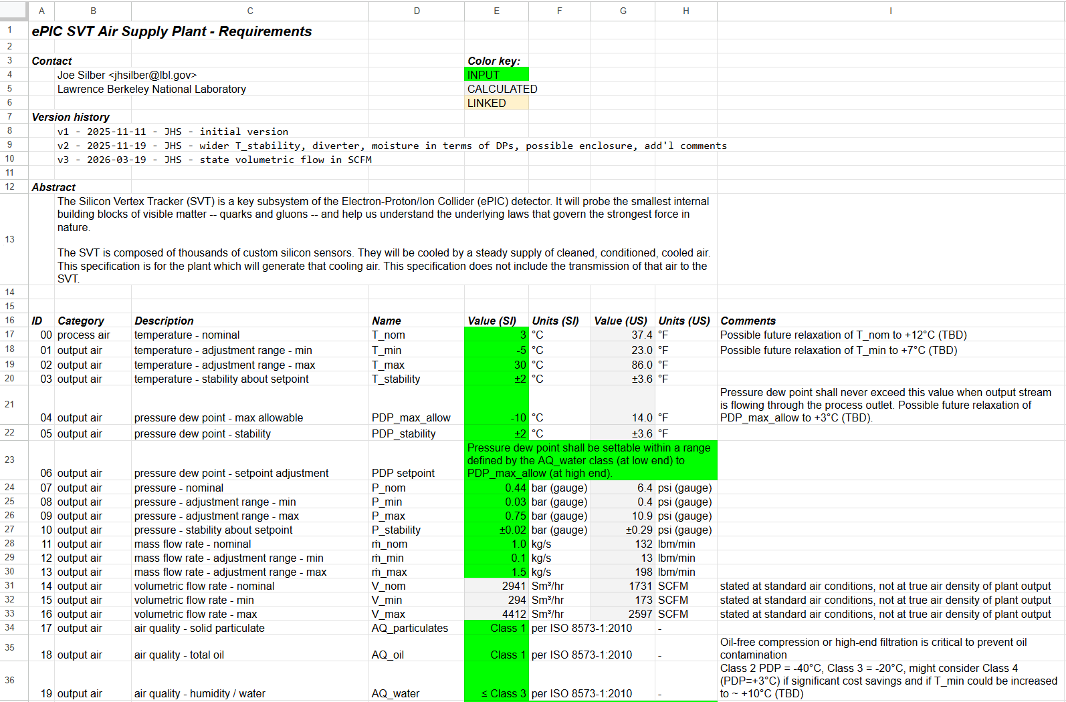
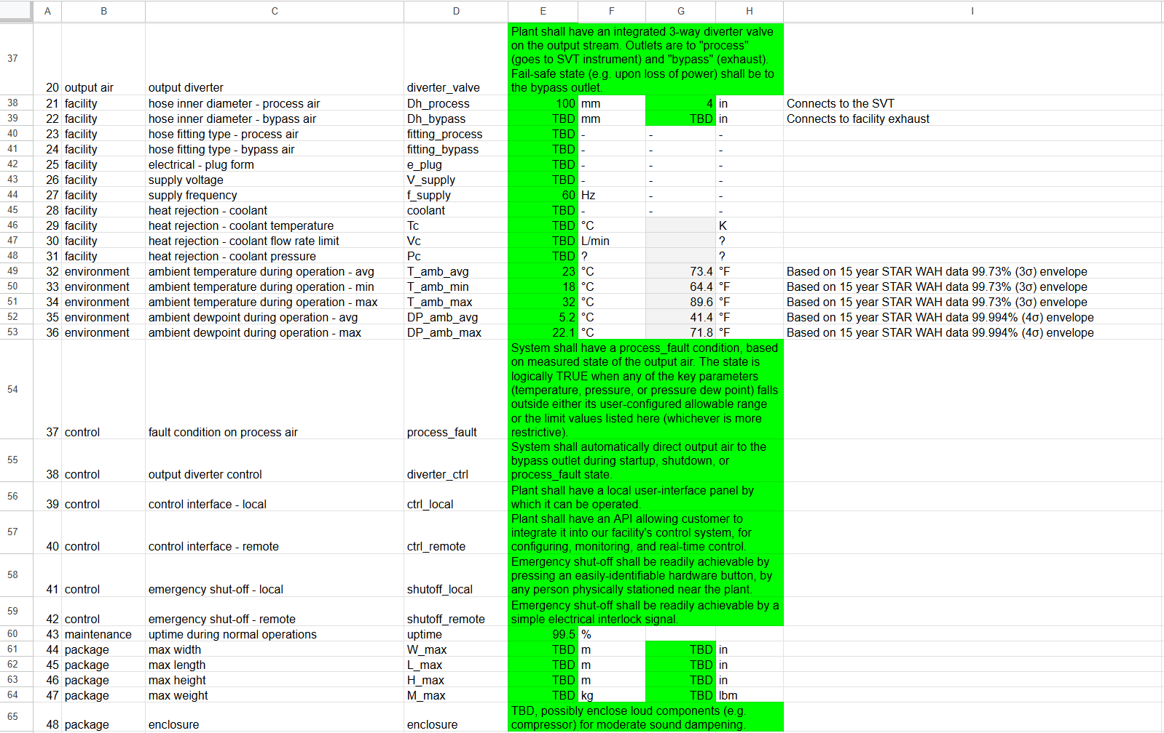
System calcs + humidity management + air quality + control considerations → detailed specs on air supply plant
Link: ePIC SVT air supply plant reqts - v3.xlsx

Slide 24
Compressors vs blowers
Key takeaways from numerous discussions with vendors during Dec 2025 - May 2026
Compressors
Blowers
Provide sufficient pressure to drive air through desiccant (adsorption) dryers that achieve -40°C dewpoint (Class 2)
Require large storage tank (~ 1 gallon storage per SCFM of system flow)
Large ones will provide ~ 1500 SCFM of flow, need more than one compressor in parallel to get more
Power consumption ~ 20 kW / 100 SCFM
i.e. 320 kW @ SVT’s nom 1600 SCFM
~100 psi gauge, which must be regulated down to SVT’s nominal 6 psi
Refrigerated drying only, will achieve +3°C dewpoint (Class 4)
More compact system
Very high flow rates available
Power consumption ~ 5 kW / 100 SCFM
i.e. 80 kW @ SVT’s nom 1600 SCFM
~10-20 psi gauge, depending on model
N.B. Either option requires an after cooler to bring the air to desired temperature.
The after cooler itself requires cooling, on the order of 30-40 kW, probably by facility water.

Slide 25
Rough dimensions for a 2000 SCFM compressor (~100 psig) system, such as for baseline design
Item | Example model | Length (m) | Width (m) | Height (m)
compressor (qty 2) | Atlas Copco ZR 160 | 5.6 | 1.6 | 2.0
receiver tank | 2000-Gallon Vertical Tank | 1.5 | 1.5 | 4.5
desiccant dryer | Atlas Copco BD 2600+ | 2.4 | 1.6 | 3.2
heat exchanger | API Heat Transfer Basco Type 500 | 1.8 | 0.5 | 0.5
chiller | MTA TAEevo Tech 302 | 2.3 | 0.9 | 1.6
filtration (pre & post) | Atlas Copco DD & PD 2600 | 1.0 | 0.5 | 1.2
Overall footprint ~ 96 m² (1056 ft²) |  | 14.6 m (48’) | 6.6 m (22’) | 4.5 m (15’)

Slide 26
Rough dimensions for a 1500 SCFM compressor (~100 psig) system, i.e. for ~80% less flow than baseline
Item | Example model | Length (m) | Width (m) | Height (m)
compressor | Atlas Copco ZR 250 | 3.4 | 1.6 | 2.0
receiver tank | 1500-Gallon Vertical Tank | 1.4 | 1.4 | 4.2
desiccant dryer | Atlas Copco BD 1800+ | 2.2 | 1.4 | 3.0
heat exchanger | API Heat Transfer Basco Type 500 | 1.5 | 0.4 | 0.4
chiller | MTA TAEevo Tech 251 | 2.0 | 0.8 | 1.5
filtration (pre & post) | Atlas Copco DD & PD 1750 | 0.8 | 0.4 | 1.0
Overall footprint ~ 68 m² (740 ft²) |  | 11.3 m (37’) | 6.0 m (20’) | 4.2 m (14’)

Slide 27
Rough dimensions for a 600-700 SCFM compressor (~100 psig) system, i.e. the “cold and slow” case
Item | Example model | Length (m) | Width (m) | Height (m)
compressor | Atlas Copco ZR 110 | 2.5 | 1.3 | 2.0
receiver tank | 600-Gallon Vertical Tank | 1.0 | 1.0 | 3.0
desiccant dryer | Atlas Copco BD 850+ | 1.6 | 1.1 | 2.4
heat exchanger | API Heat Transfer Basco Type 500 | 1.2 | 0.3 | 0.3
chiller | MTA TAEevo Tech 161 (Low Temp) | 1.5 | 0.7 | 1.4
filtration (pre & post) | Atlas Copco DD & PD 850 | 0.6 | 0.3 | 0.8
Overall footprint ~ 40 m² (420 ft²) |  | 8.4 m (28’) | 4.7 m (15’) | 3.0 m (10’)

Slide 28
Rough dimensions for a 1500 - 2500 SCFM blower (~10 psig) system, i.e. the “warm and fast” case
Item | Example model | Length (m) | Width (m) | Height (m)
blower | Robuschi Robox Screw 3.5 | 2.1 | 1.6 | 2.0
refrigeration dryer | Atlas Copco FD 4000 VSD | 2.9 | 1.2 | 2.0
heat exchanger | API Heat Transfer Basco Type 500 | 1.8 | 0.5 | 0.5
chiller | MTA TAEevo Tech 302 | 2.3 | 0.9 | 1.6
filter | Atlas Copco DDp 3200 | 0.6 | 0.6 | 1.3
Overall footprint ~ 47 m² (512 ft²) |  | 9.7 m (32’) | 4.8 m (16’) | 2.0 m (7’)

Slide 29
Summary: four basic implementation options for air supply
 |  | Dec 2025 baseline | “80% of baseline” | “Slow & cold” | “Fast & warm”
Design targets | air speed thru detector channel | 10 m/s | 8 m/s | 3 m/s | 10 m/s
 | air temp at channel inlet | +5°C | +5°C | -10°C | +9°C
Air supply nominals* | pressure | 6 psig | 4 psig | 1 psig | 6 psig
 | flow rate | 1600 SCFM | 1300 SCFM | 500 SCFM | 1600 SCFM
 | dewpoint | -40°C | -40°C | -40°C | +3°C
 | air temp at supply | +3°C | +3°C | -12°C | +7°C
Source |  | double large compressor | single large compressor | single small compressor | blower
Approx system power draw |  | 400 kW | 300 kW | 150 kW | 150-200 kW
Rough size estimate | footprint | 1056 ft² | 740 ft² | 420 ft² | 512 ft²
 | height | 15 ft | 14 ft | 10 ft | 7 ft
Comments |  | generous operating margins | tighter margins on ΔT & ∇T, low T available | higher ∇T, more insulation, less vibration | narrower T oper range (limited by dewpoint)
* Real supply plant will require margin on these nominal values.

Slide 30
Backup

Slide 31
Can the specific requirements on detector temperatures be memorialized into central location?
Is the JLab site (https://eic.jlab.org/Detector/) the right place?
Or is it perhaps preferable to treat these more as implementation specifications, which the SVT group should internally manage?

Slide 32
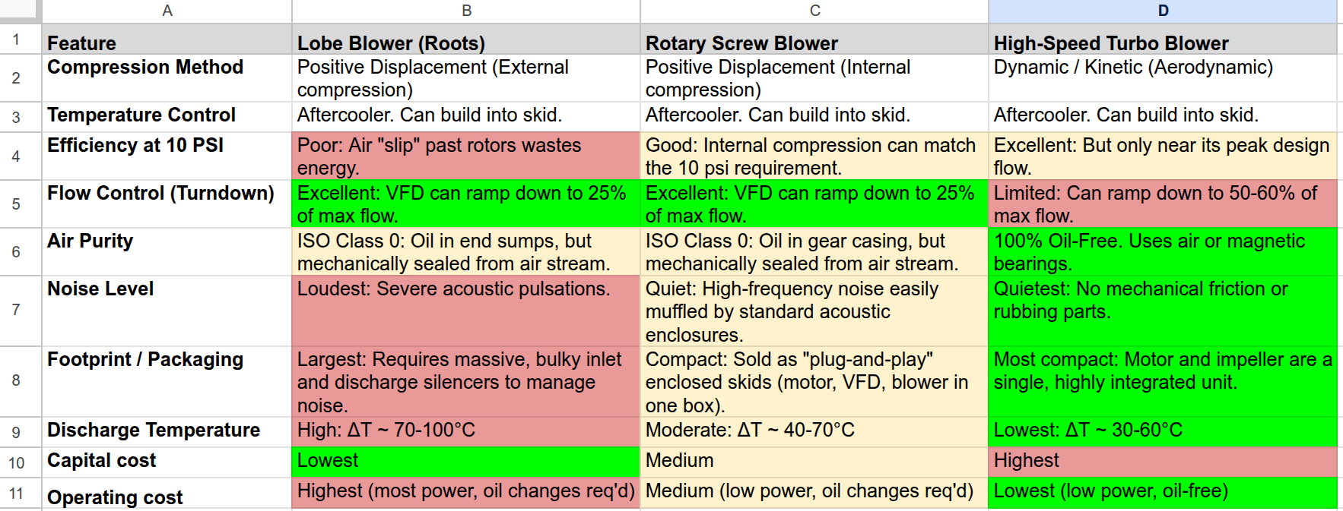
“Warm & fast” case → We would probably use a rotary screw blower
IMPORTANT!

