Slide 1
Global Support Structure (GST) and interfaces
Covers both GST and interface mechanics
Andreas Jung
Physicist
Purdue University

Slide 2
Charge Questions Addressed
Is the progress and design maturity for all detector systems, support structures, and moving mechanisms technically sound, feasible, and sufficiently mature to advance toward final design and aligned with being baselined in June 2026 (>60% maturity is required)?
Have the required building and facility modifications (floor loading, rails, crane capacity, utilities, service routing, etc.) been adequately analyzed, addressed, or planned?
Have ES&H and QA considerations been adequately incorporated into the designs at their present stage?
Do the designs and installation plans for the Outer Detectors (Barrel HCAL, Barrel EMCAL, Magnet), Inner Detectors within the GST (DIRC, MPGD, TOF, Silicon, EEEMCAL, pfRICH), and the Endcaps (Forward EMCAL/HCAL) meet support, alignment, movement, access, and integration requirements within building/rail constraints?
Are preliminary cooling schemes adequately developed and documented, do they meet thermal and reliability requirements, and are interfaces across subsystems and to facility cooling/HVAC clearly defined?
Is the project team ready to proceed to final design for the scope under review, and what recommendations should be addressed beforehand?
Have the recommendations from previous reviews been adequately addressed?

Slide 3
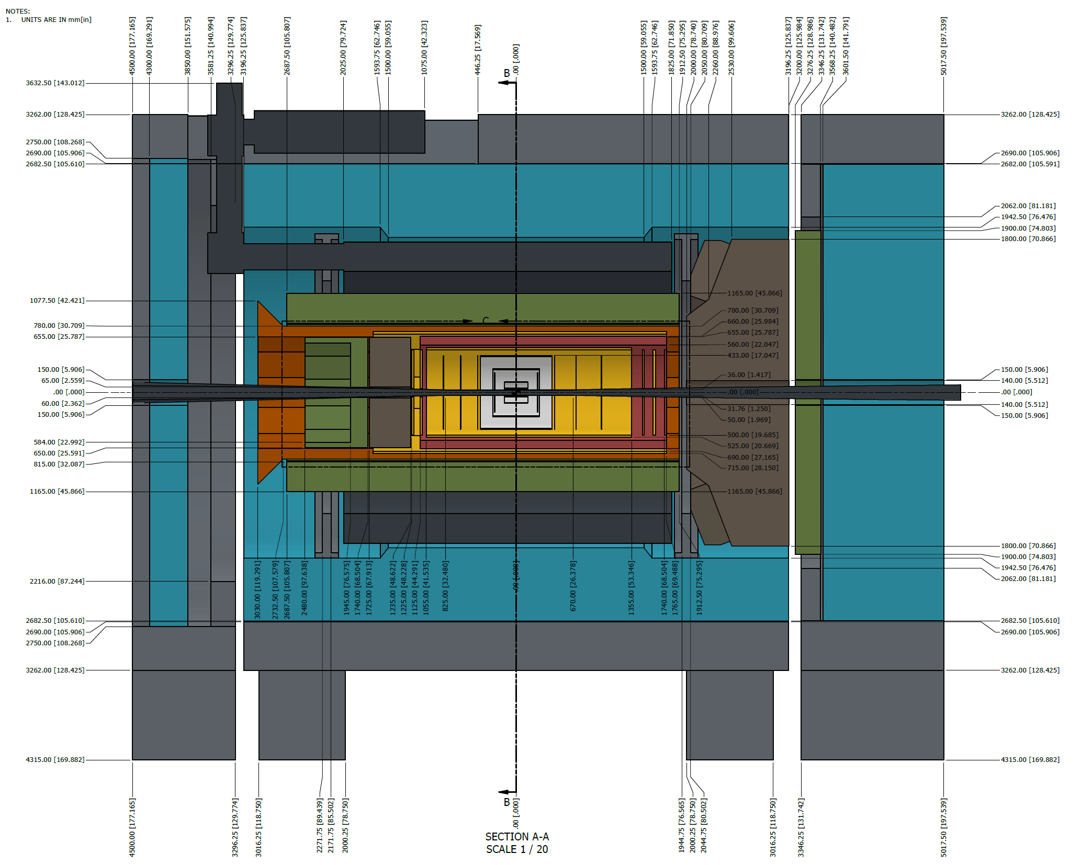
Outline
Charge 1, 4
Introduction
TOF-LGAD mechanics
LGAD-TOF Barrel and Discs
TOF tray Integration
Global Support Tube
Design
Envelopes & Loads
FEA simulations
Integration & Assembly
Inner Detectors + GST
For PST+SVT: see Ben’s talk
QA/QC, ES&H
Summary

Slide 4
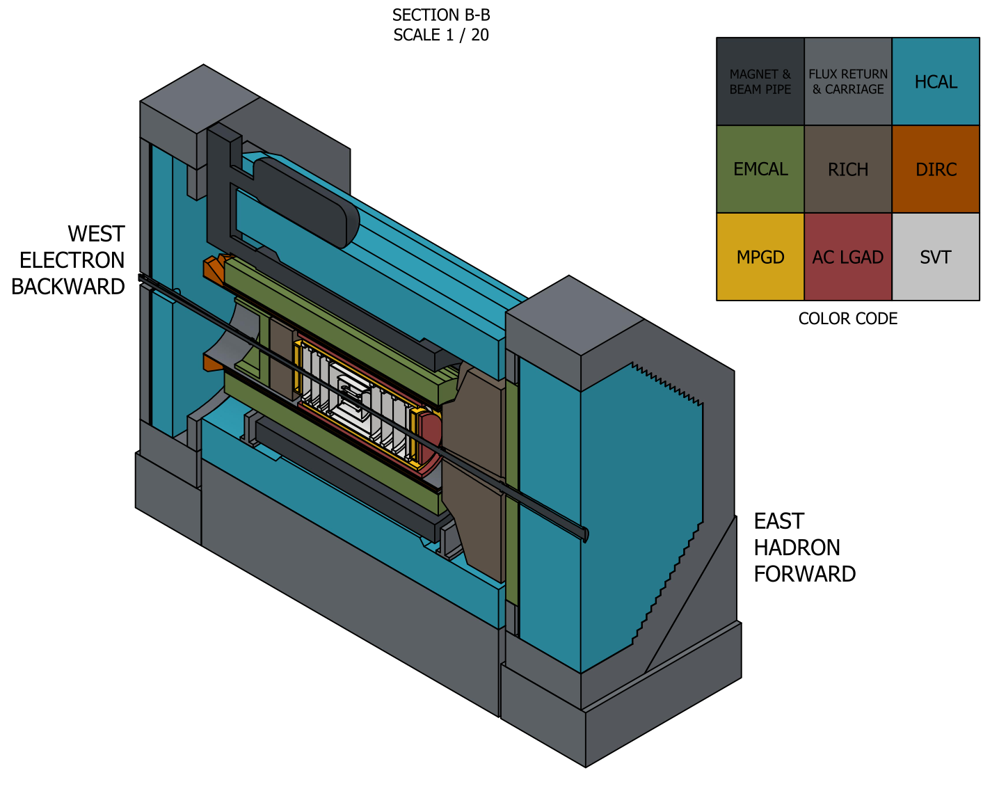
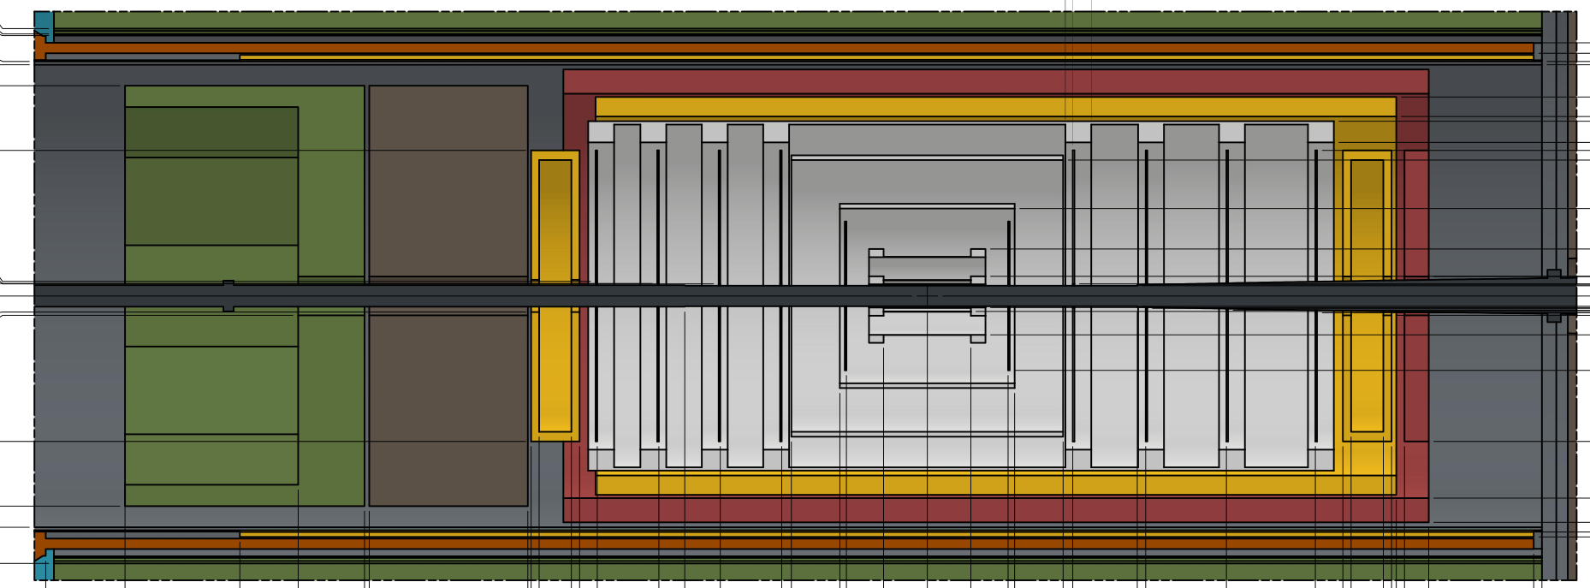
Introduction to Support Structure
Charge 1, 4
Global Support Tube (GST) supports all inner detectors: DIRC, MPGD, TOF, Silicon, EEEMCAL, pfRICH
Time-of-Flight (TOF) aka AC-LGAD
Detectors and services supported by Global Support Tube (GST)
9.5m
6.5m
Images from Roland Wimmer, BNL
GST
TOF

Slide 5
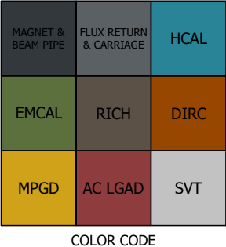
Inner Detector Support Hierarchy Y-Z View - Oct 2025
NOT TO SCALE
Charge 1, 4
All masses are on slide 20 of this talk, details on SVT mass are in B. Denos talk
Total Weight: 5675 kg
HP DIRC
OMPGD
GST
Services Support
E
E
E
M
C
A
L
p
f
R
I
C
H
LGAD - TOF
MPGD
MPGD
PST Feet to Rails
L4
L3 L2
L1, L0
M
P
G
D
M
P
G
D
M
P
G
D
M
P
G
D
TO
F
PST
Beam Pipe Break
e-
ED4 ED3 ED2 ED1 ED0
Y
HD0 HD1 HD2 HD3 HD4
p
Z
X o
Beam Pipe
Hadron Beam
(West, Backward, Z-, electron-going)
Electron Beam
(East, Forward, Z+, hadron-going)
PST Feet to Rails
Services Support
MPGD
MPGD
LGAD - TOF
GST
OMPGD
HP DIRC
Supports that act as load transfer paths
Sector Trays to GST
Outer MPGD on the outside of GST

Slide 6
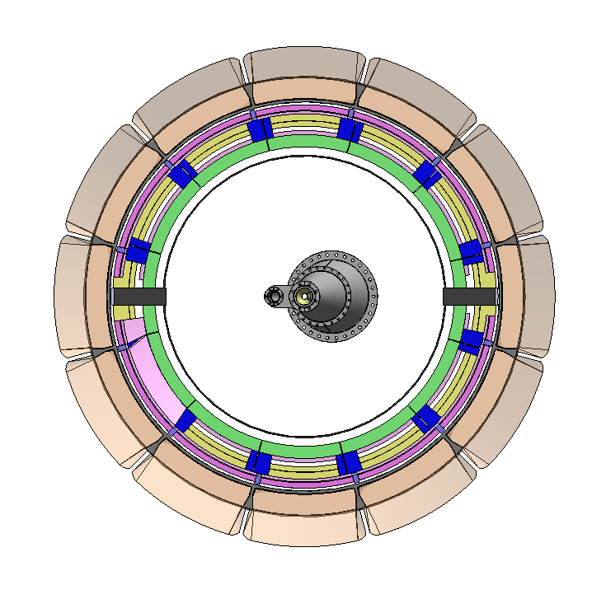
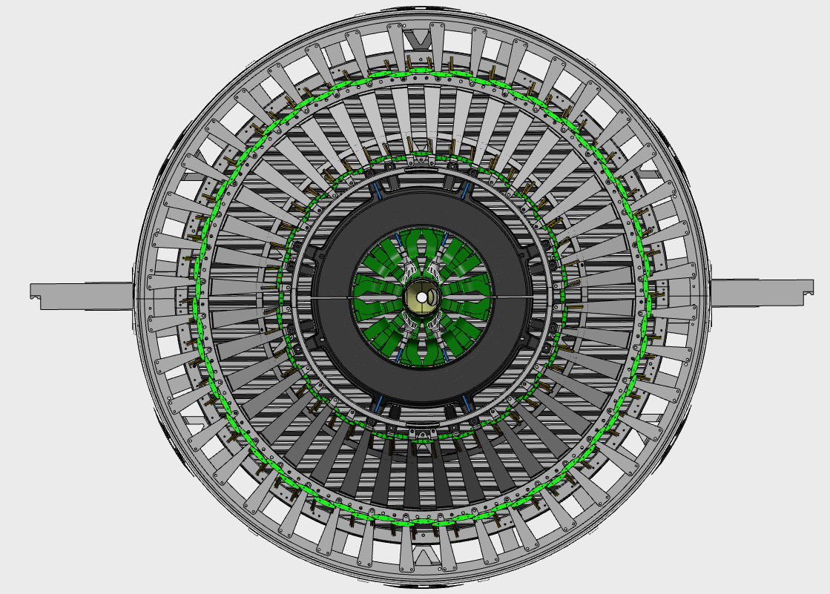
Inner Detector Support Hierarchy X-Y View - Oct 2025
NOT TO SCALE
Charge 1, 4
To ease maintenance and integration the inner detectors (TOF, i- and o-MPGD) follow a 30 degree segmentation!
Key:
hpDIRC Prism
hpDIRC & oMPGD
Services
Barrel TOF
iMPGD
Support tubes
- GST & PST
Detector View at Z=0
GST
Key:
Beam Pipe
SVT Inner
Outer Barrel
SVT Disks
Inner MPGD
TOF Barrel
Composite Support Tube/s
Support
Rail
PST
GST supports (provides adjustability)
Beampipe support plates via PST (Details in B. Denos’ talk)
Barrel connection radial “cone” attachments seen in gray
3 connections per SVT half-disk to PST

Slide 7
Presentation Section 1:
Brief Overview of Sub-detector Mechanics
(all supported by GST)

Slide 8
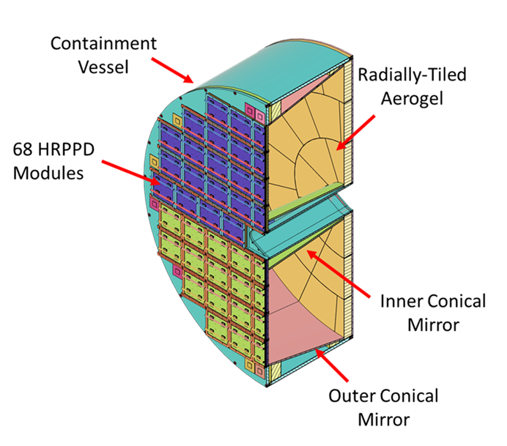
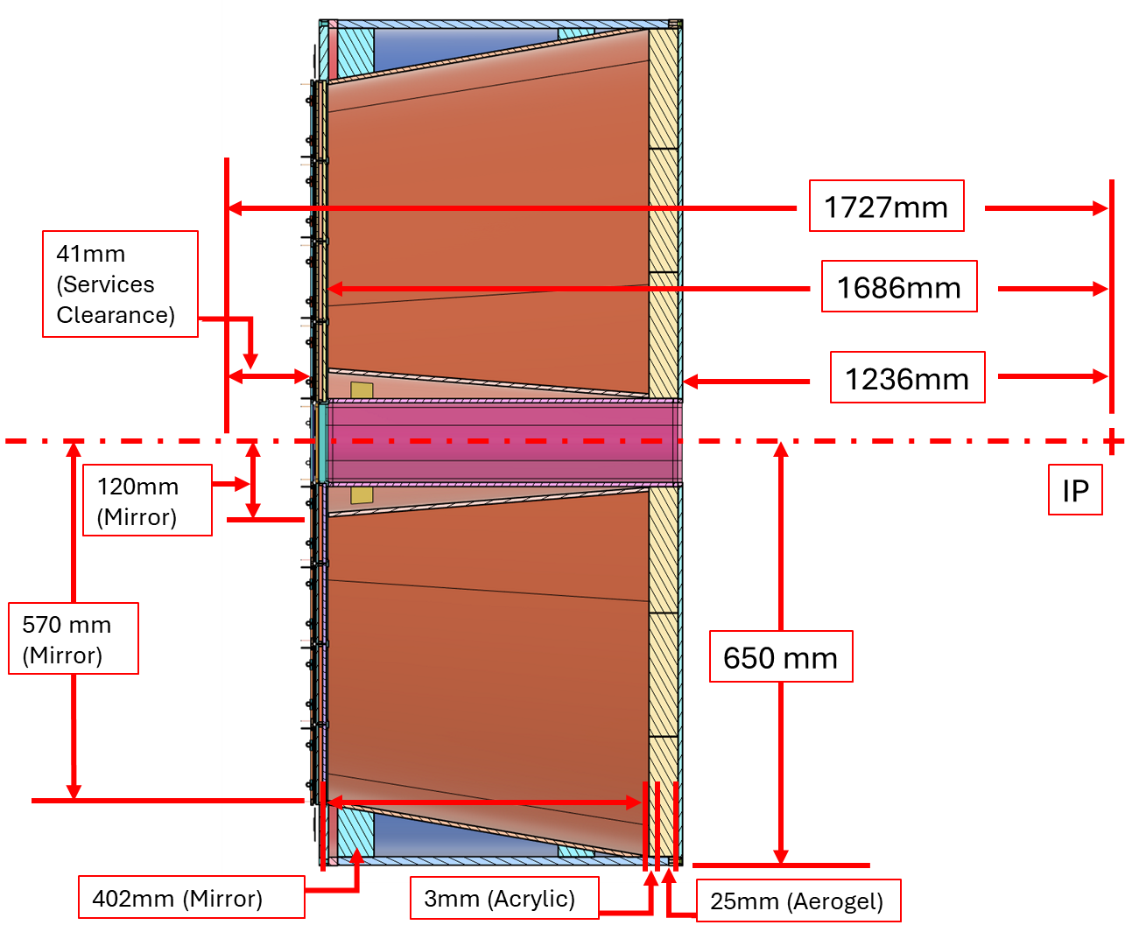
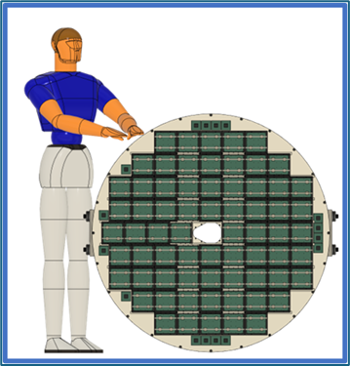
pfRICH Design
Chosen as a technology baseline for ePIC in April 2023
Major Components:
Shape: 1/2” thick cylinder (12.7 mm)
Outer Diameter: 1300 mm
Length: 491 mm
Precision: < 1 mm radius and length
Technology: Carbon-fiber composite material with nomex honeycomb core
Vessel
Sensor Plane
Mirrors
Aerogel Wall

Slide 9
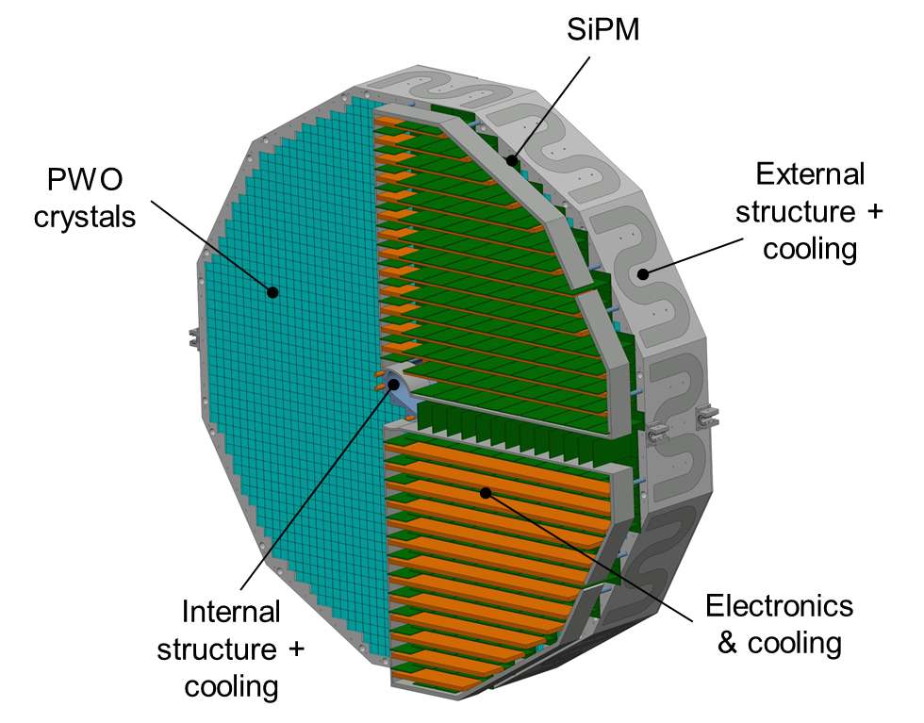
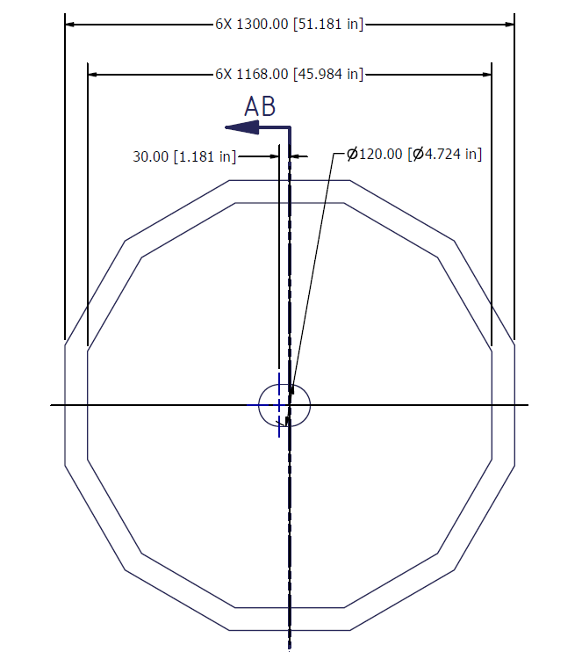
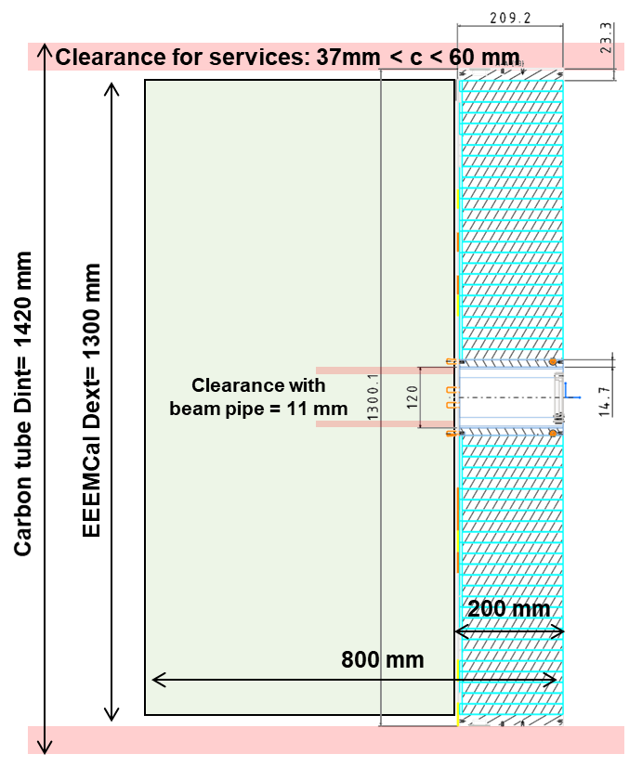
EEEMCAL Detector Design
Major components:
PWO crystals
External structure (Cooling, FSW coldplates)
Internal structure (Cooling, copper tubes)
Front copper plate (Passive cooling)
Electronics (SiPM + Front end)
Dimensions:
Outer diameter = 1346 mm (R673 mm)
Inner diameter = 120 mm
Length max (with electronics and cables) = 800 mm
Crystal ≈ 700g / Nb of crystals ≈ 2750 → 2 Tons
Total mass ≈ 2,5 Tons (with mechanics & electronics)

Slide 10
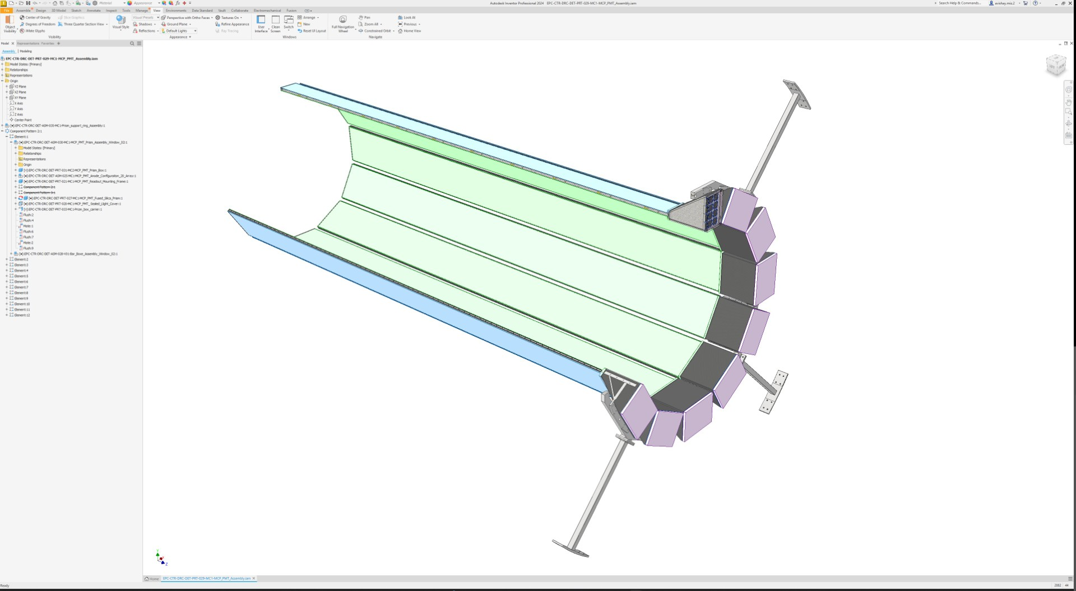
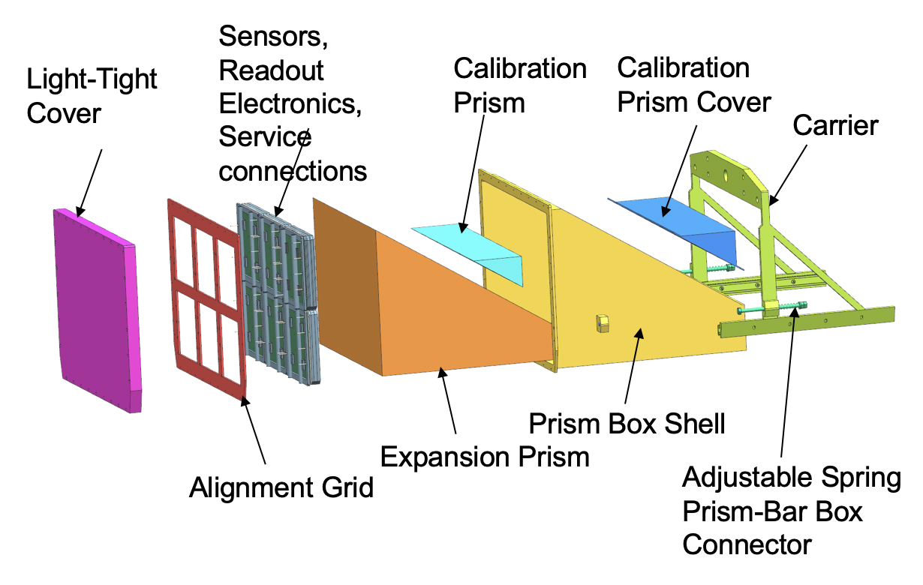
hpDIRC Detector Design
Bar Boxes:
CFRP Shell
Approximately 4.6m Long
Thickness: 1.5 mm – 3 mm (thicker at times)
Contains Quartz Radiator Bars, Mirrors, and Lenses
10 long bars each formed by 3 short bars and a Light Guide section
Bar Box
Support Ring
Prism Box
Forward
Backward
Readout Box
Box shell
Current Material: CFRP with thickness 5 mm
Contains expansion prism, calibration laser
Supports sensors, readout electronics, and associated services
Connection to ePIC Barrel

Slide 11
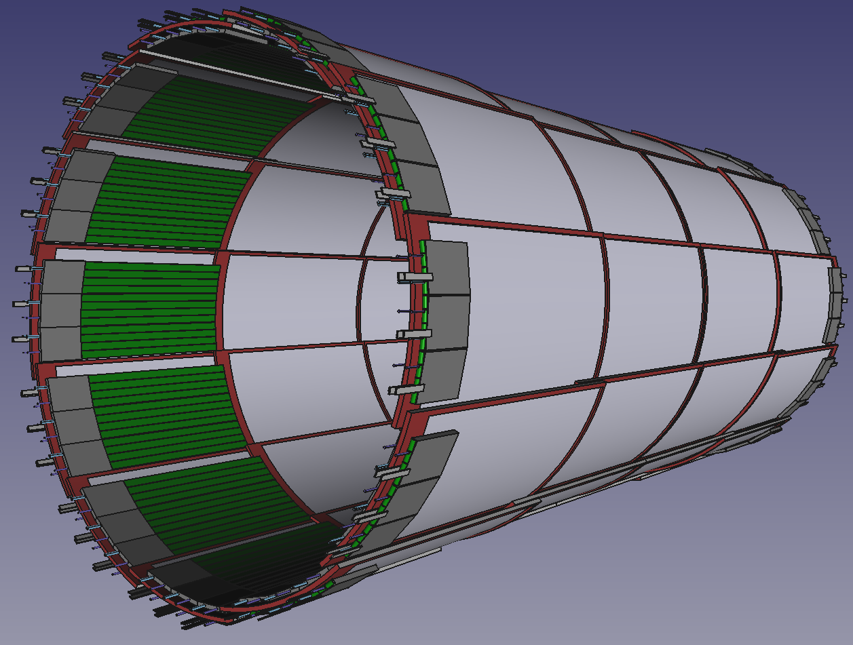
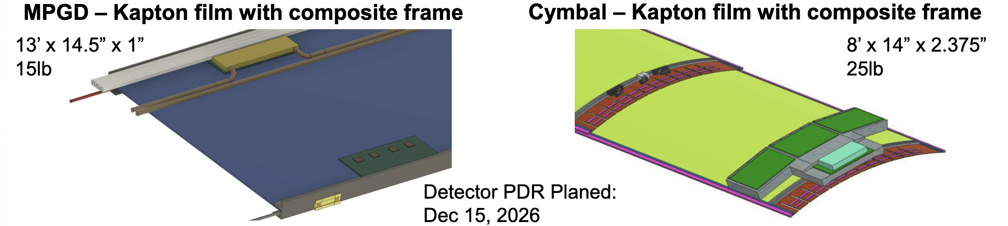
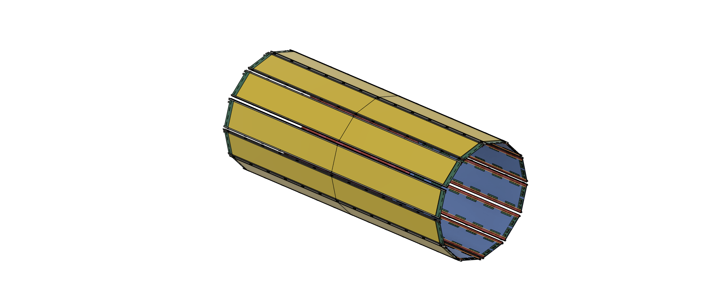
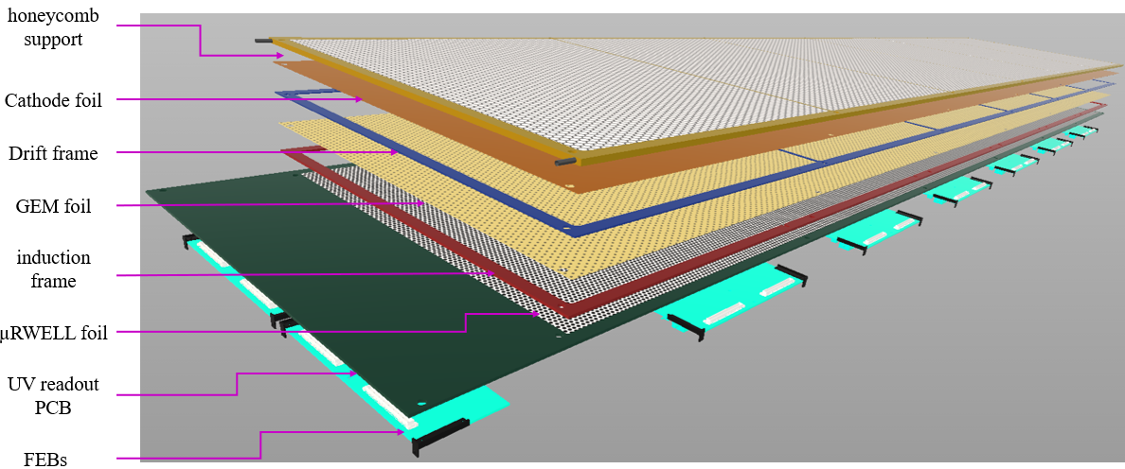
Outer MPGD (μRWELL-BOT) and Inner MPGD aka CyMBaL
New design for inner MPGD (CyMBal): 12 sectors with fish scale overlaps
New design with 12 sectors for better integration, installation and maintenance together with the barrel time of flight detector
48 tiles: 12 in ϕ × 4 in z
GST (and TOF trays) provides 4 mount points to inner MPGD (cymbal) per z-side
All services route within iMPGD envelope to outside, TOF is outermost radii and iMPGD is below that as far as services go
µRWELL-BOT layout
Module design
24 planar detector modules
12 sectors in r*φ × 2 modules in z ➔ No overlaps
R_{min} = 72.5 cm; R_{max} = 75 cm
Module
Module

Slide 12
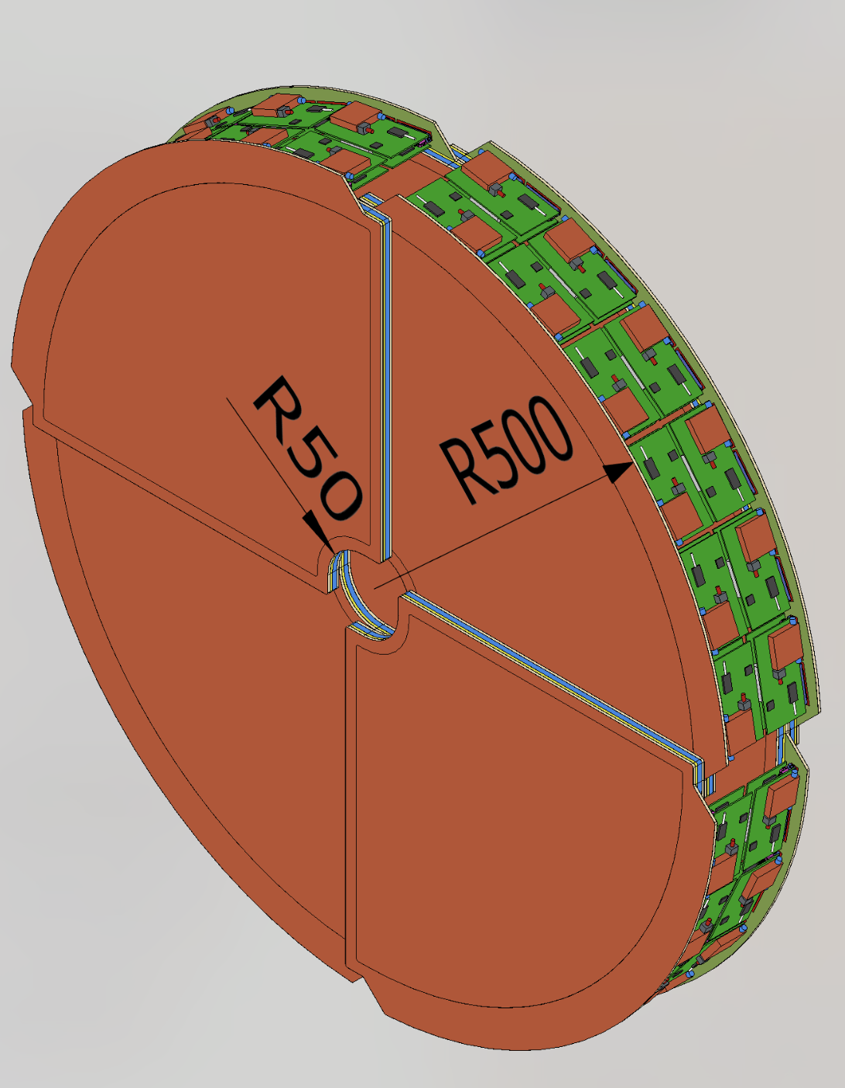
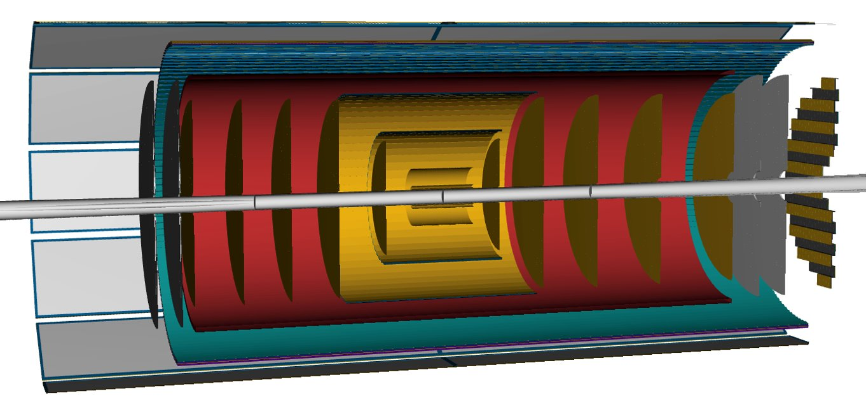
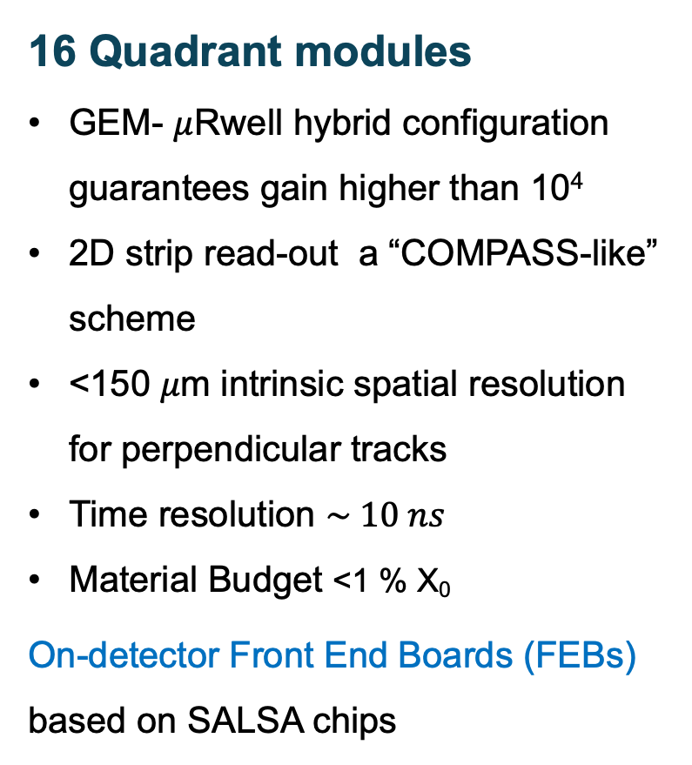
MPGD discs (μRWELL-ECT)
16 Quadrant modules
GEM- $μ$Rwell hybrid configuration guarantees gain higher than 10⁴
2D strip read-out a “COMPASS-like” scheme
<150 𝜇m intrinsic spatial resolution for perpendicular tracks
Time resolution $\sim 10 ns$
Material Budget <1 % X₀
On-detector Front End Boards (FEBs) based on SALSA chips
Lepton Endcap
Disks
Hadron Endcap
Disks
μRWELL-ECT
Two MPGD Endcap Tracking (ECT) disks both in the hadronic and in the leptonic regions increase the number of hits in the |η| > 2 region to improve pattern recognition.

Slide 13
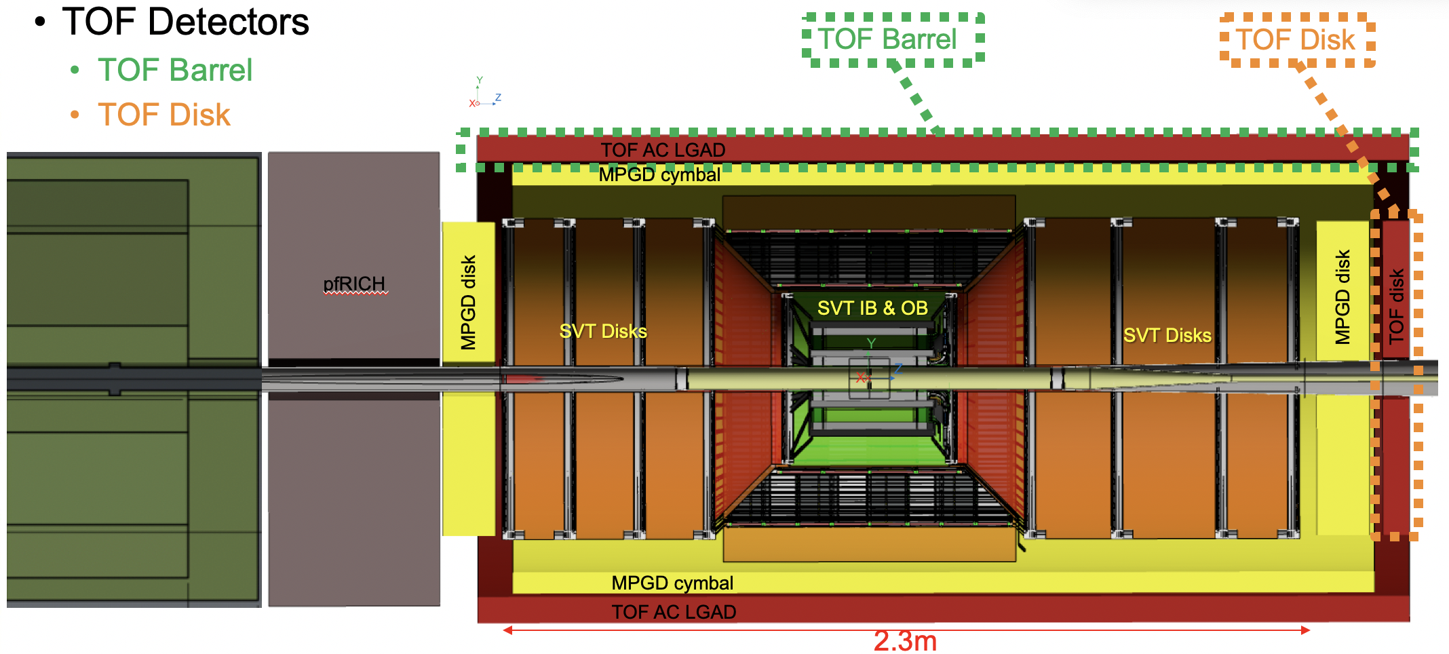
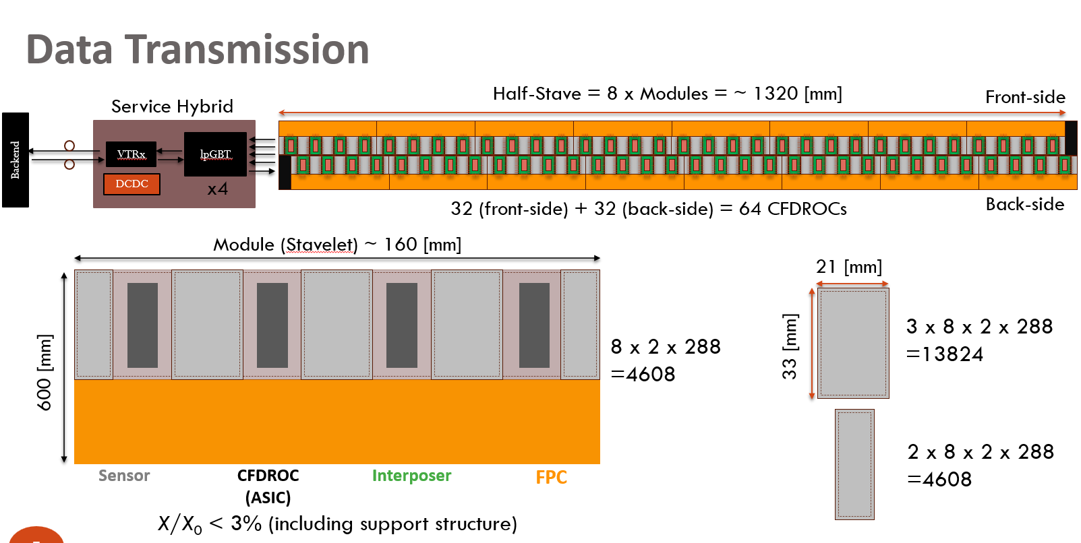
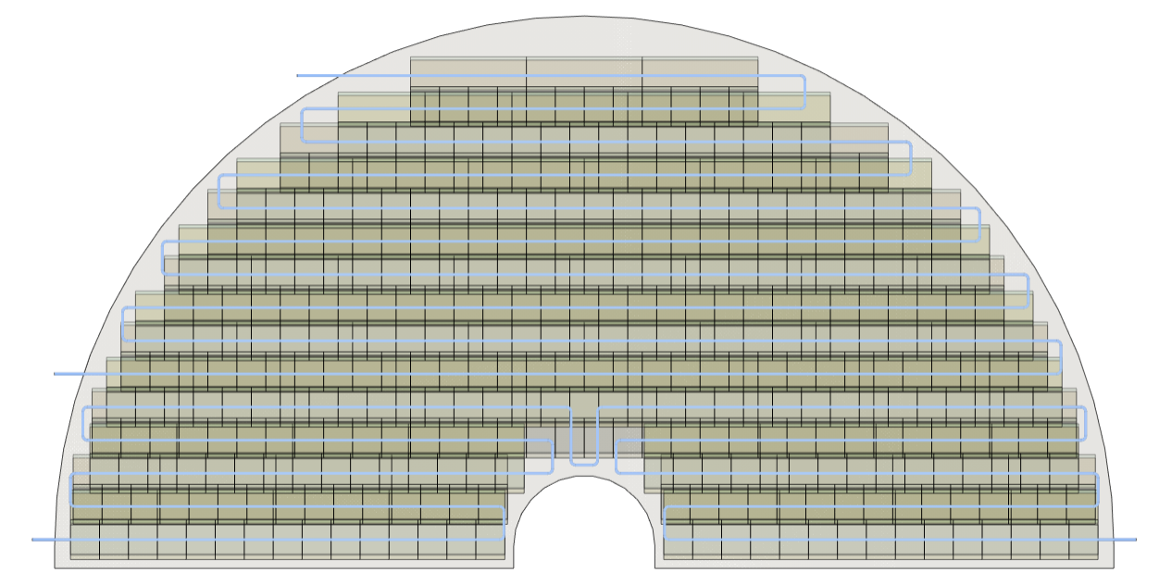
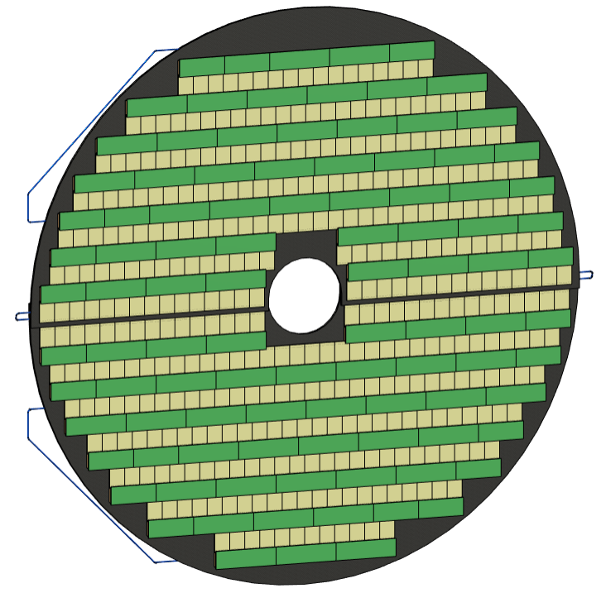
TOF Sub-Systems
To ease maintenance and integration the
inner detectors follow a 30 degree segmentation!
Charge 1, 4
TOF detector provides particle ID for EPIC
Consists of AC-LGAD’s
Barrel “stavelet” base unit
60mm wide, 160mm long
2 x 8 stavelets per half-stave of 1270mm (z+) and 1370 (z-) length
Includes space for portcards and patchpanel on z-
→ 288 half staves yields 4608 stavelets
Forward TOF (disc)
Sandwich structure with cooling pipes
Kinematic mount to PST - GST

Slide 14
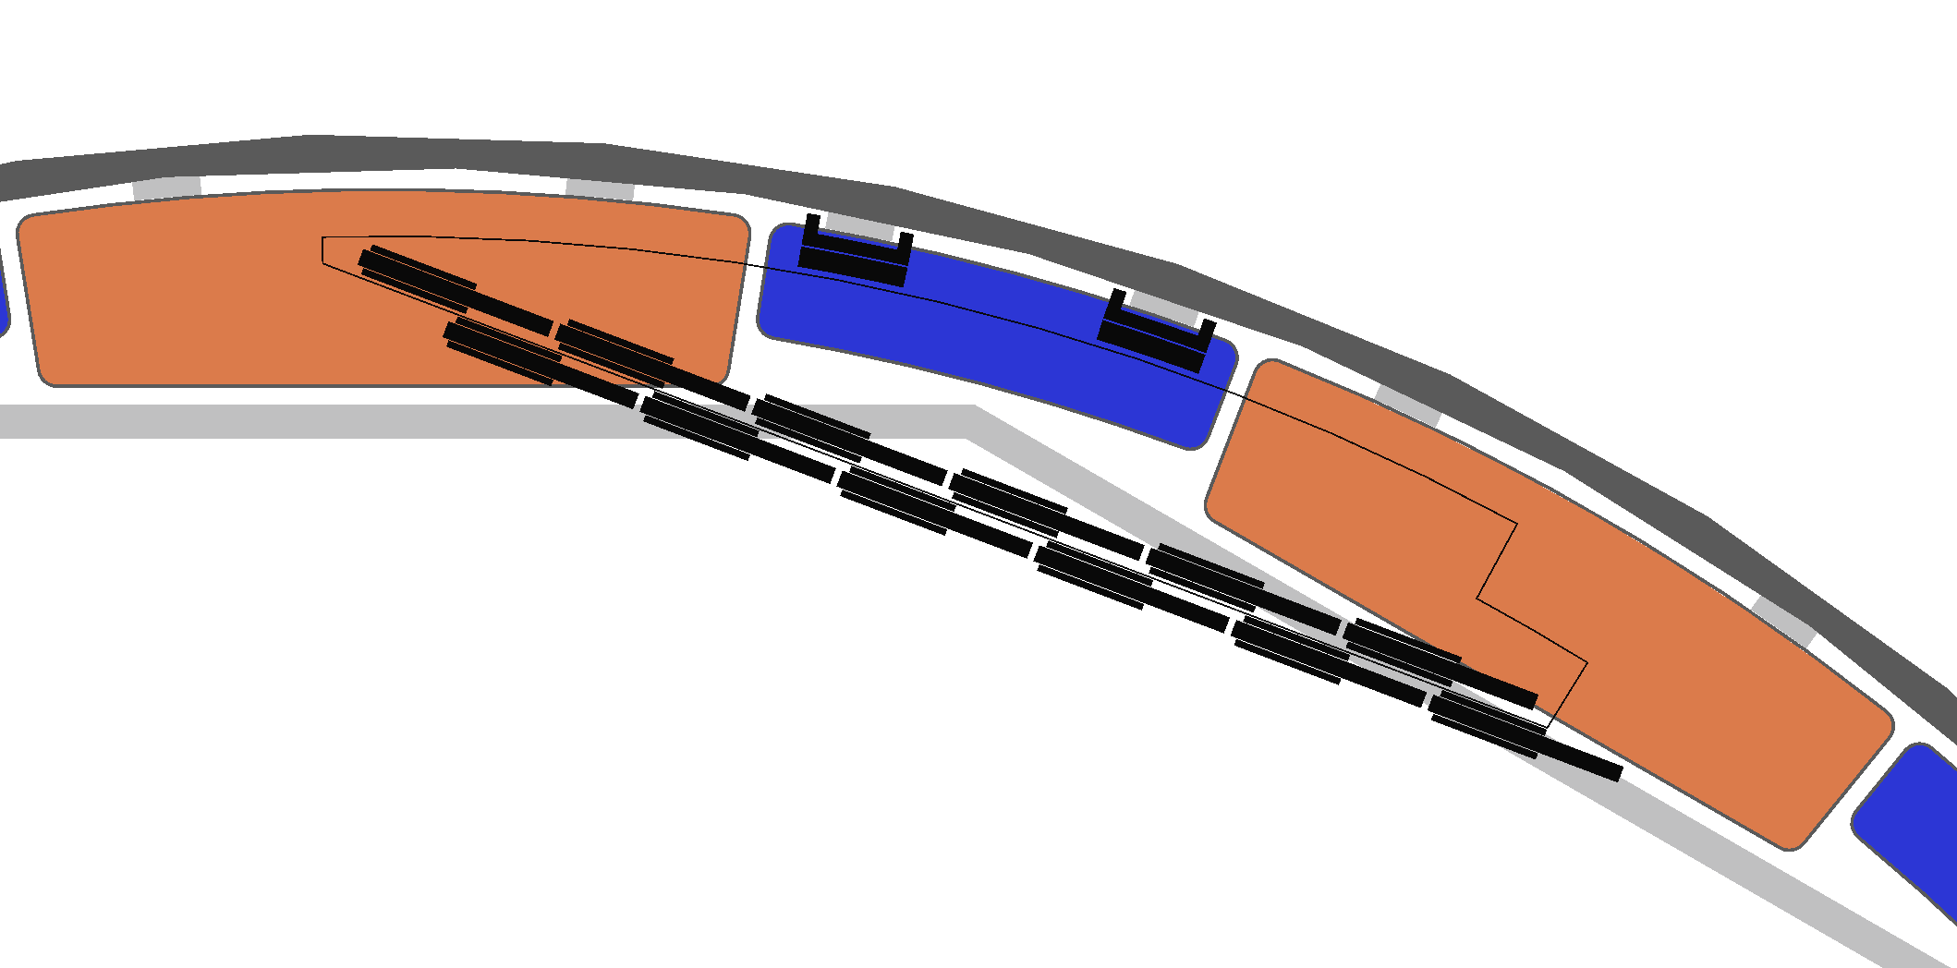
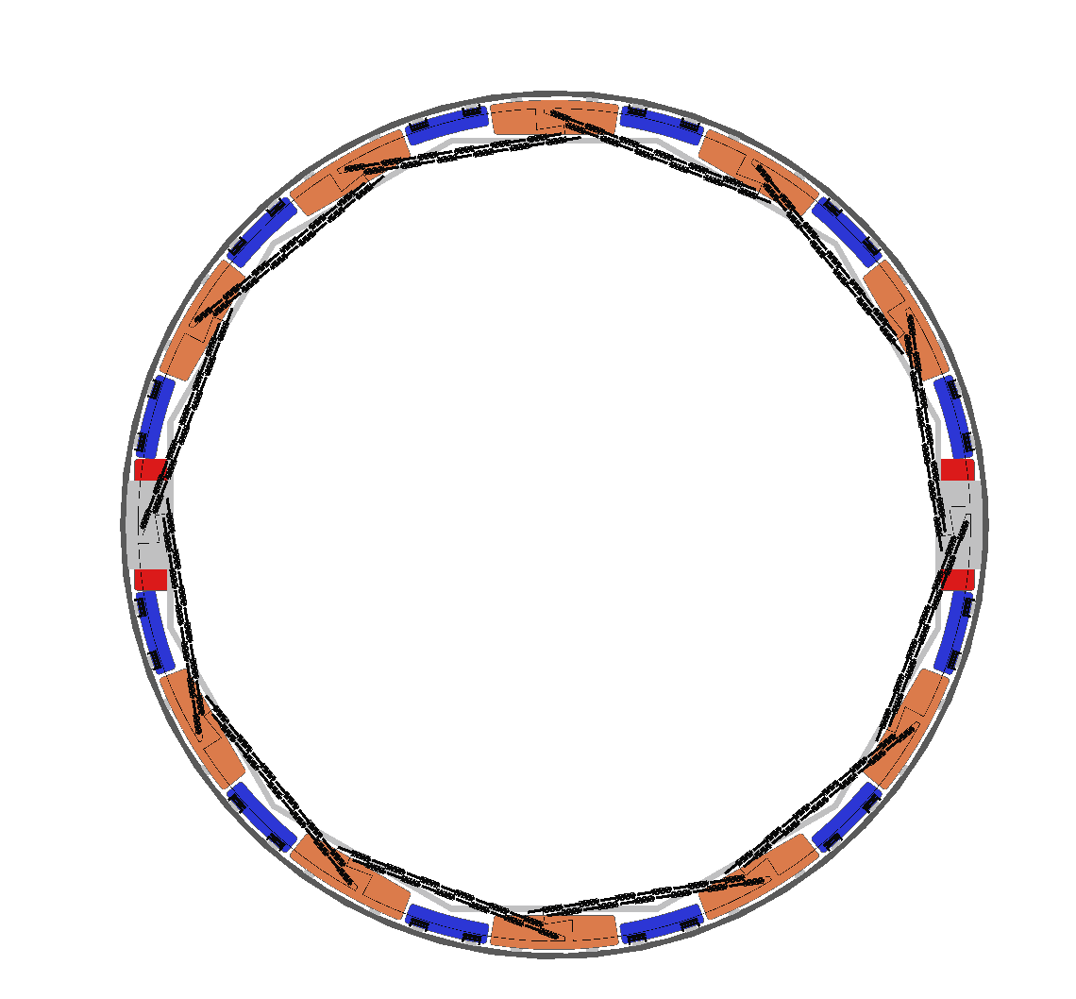
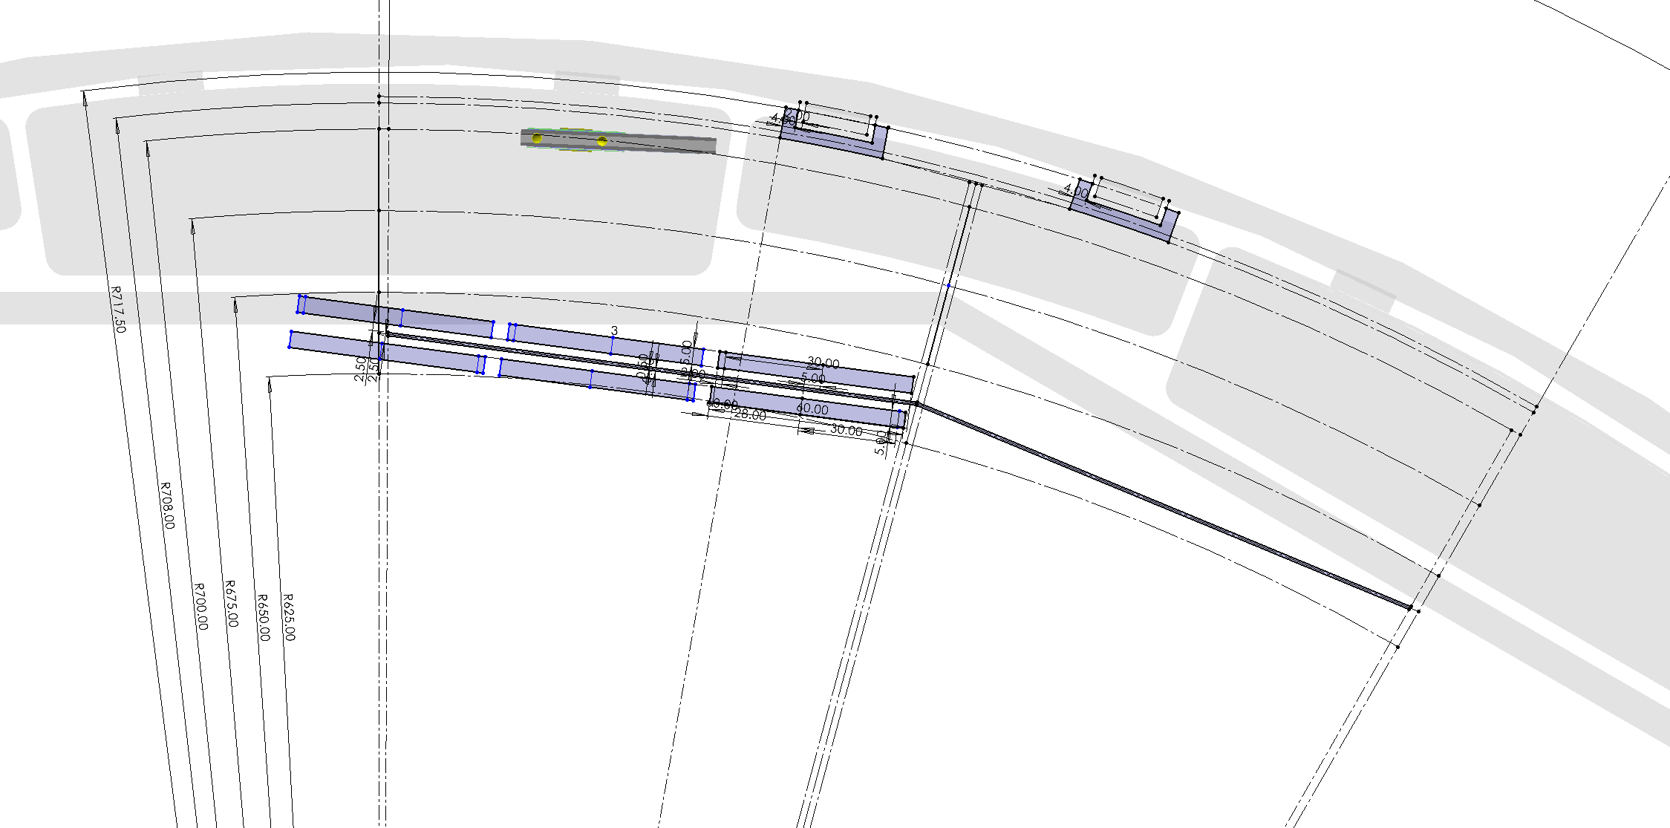
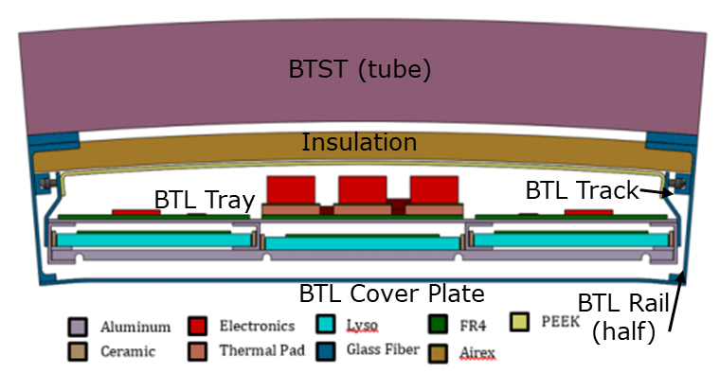
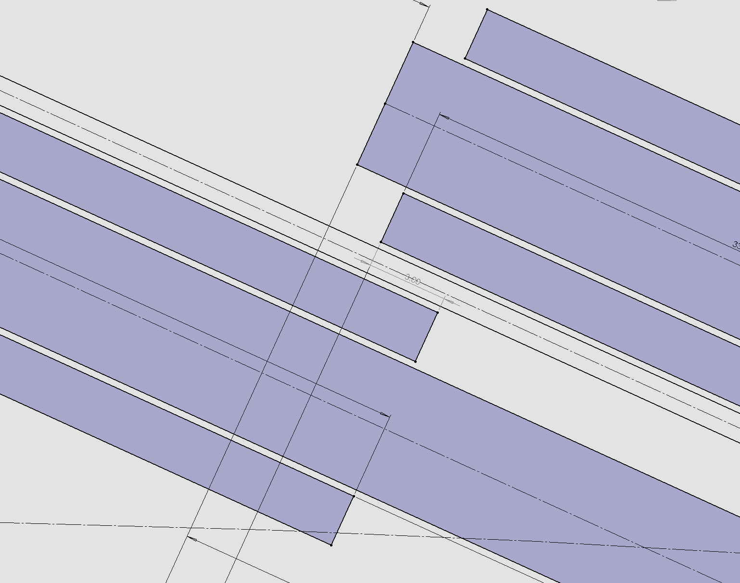
Barrel TOF & inner MPGD supports
Charge 1, 4, 6
Tray mounts via top rails to GST
Thin line “tracks” a TOF tray, open space inside is for services of TOF
Designed for 2mm overlap
Other solidly filled areas are “reserved” for service of SVT+oMPGD and TOF+iMPGD
GST and TOF trays provide 4 mount points to inner MPGD (cymbal) per z-side
All services route within iMPGD envelope to outside, TOF is outermost radii and iMPGD is below that as far as services go
Updated drawing for support of inner MPGD:
Example from CMS “trays”
2mm overlap

Slide 15
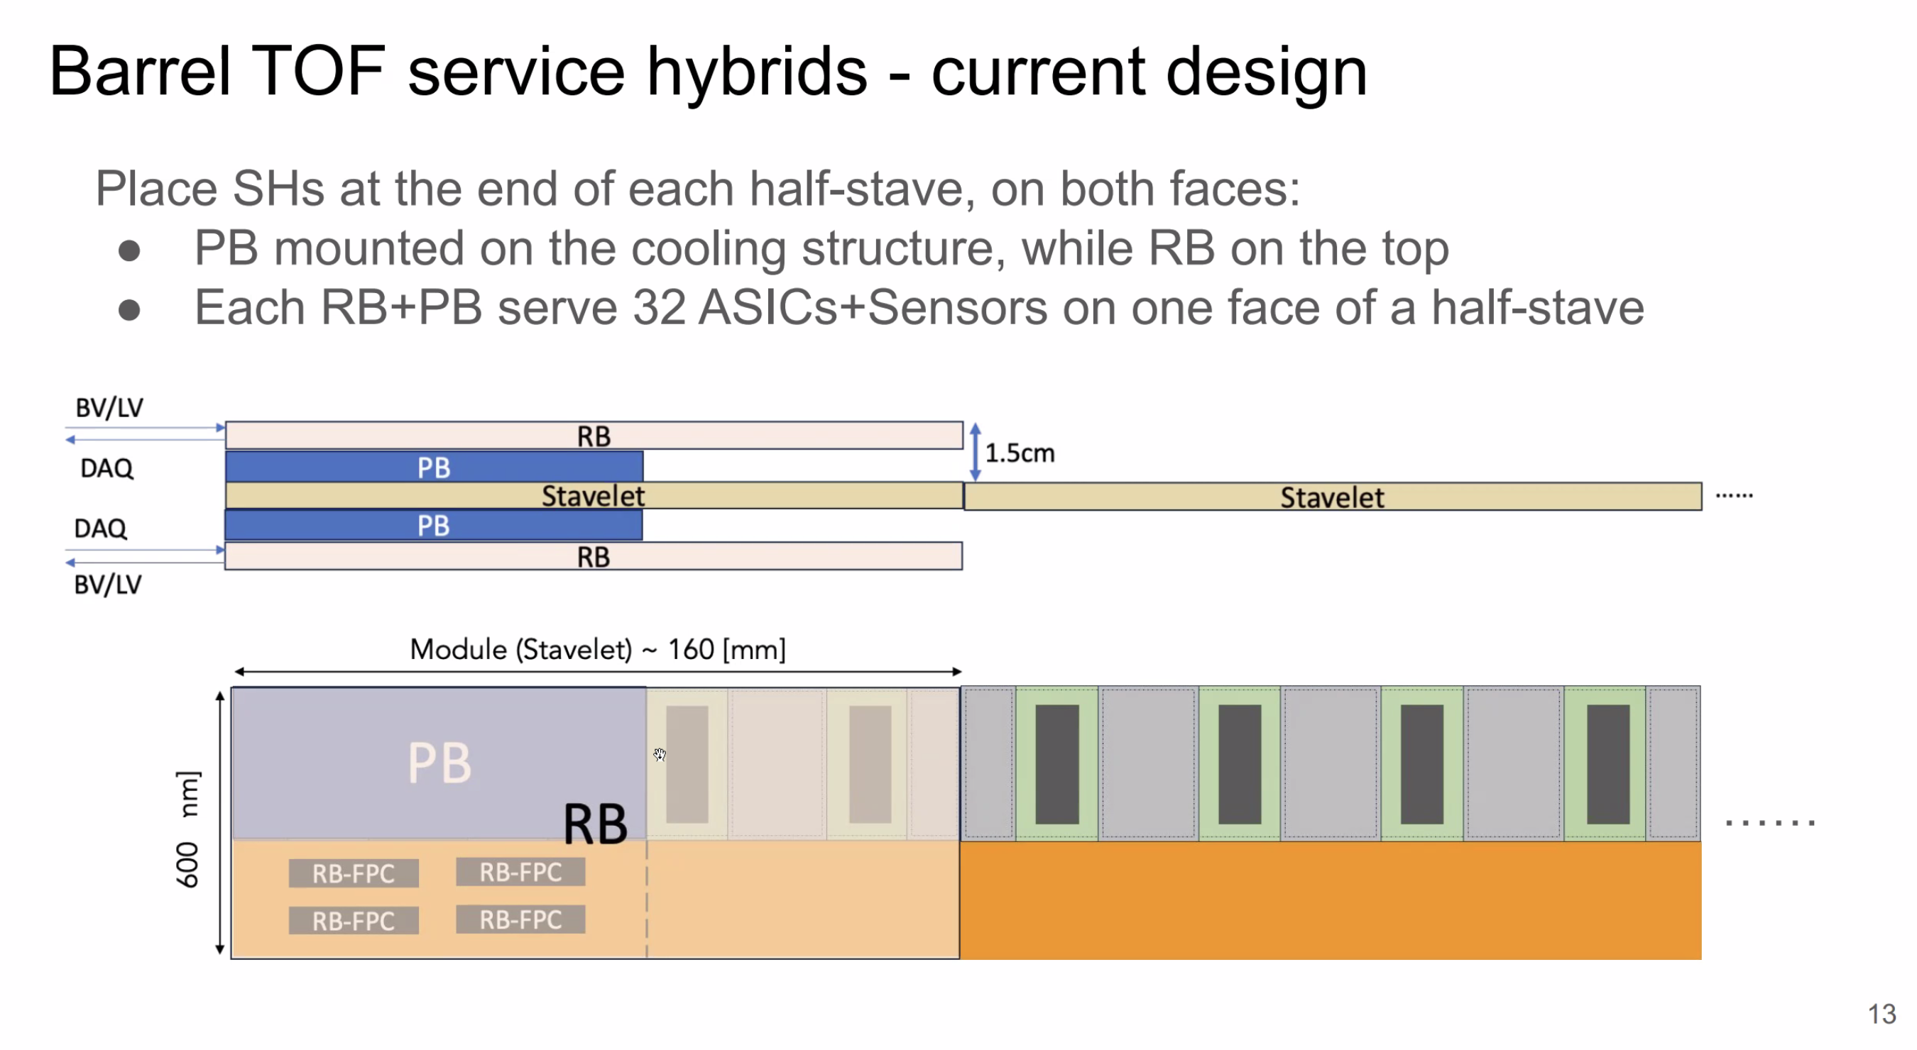

Slide 16
Presentation Section 2:
Global Support Tube (GST)

Slide 17
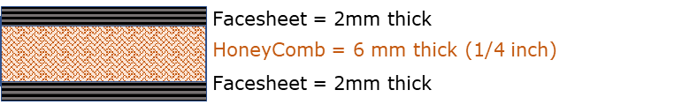
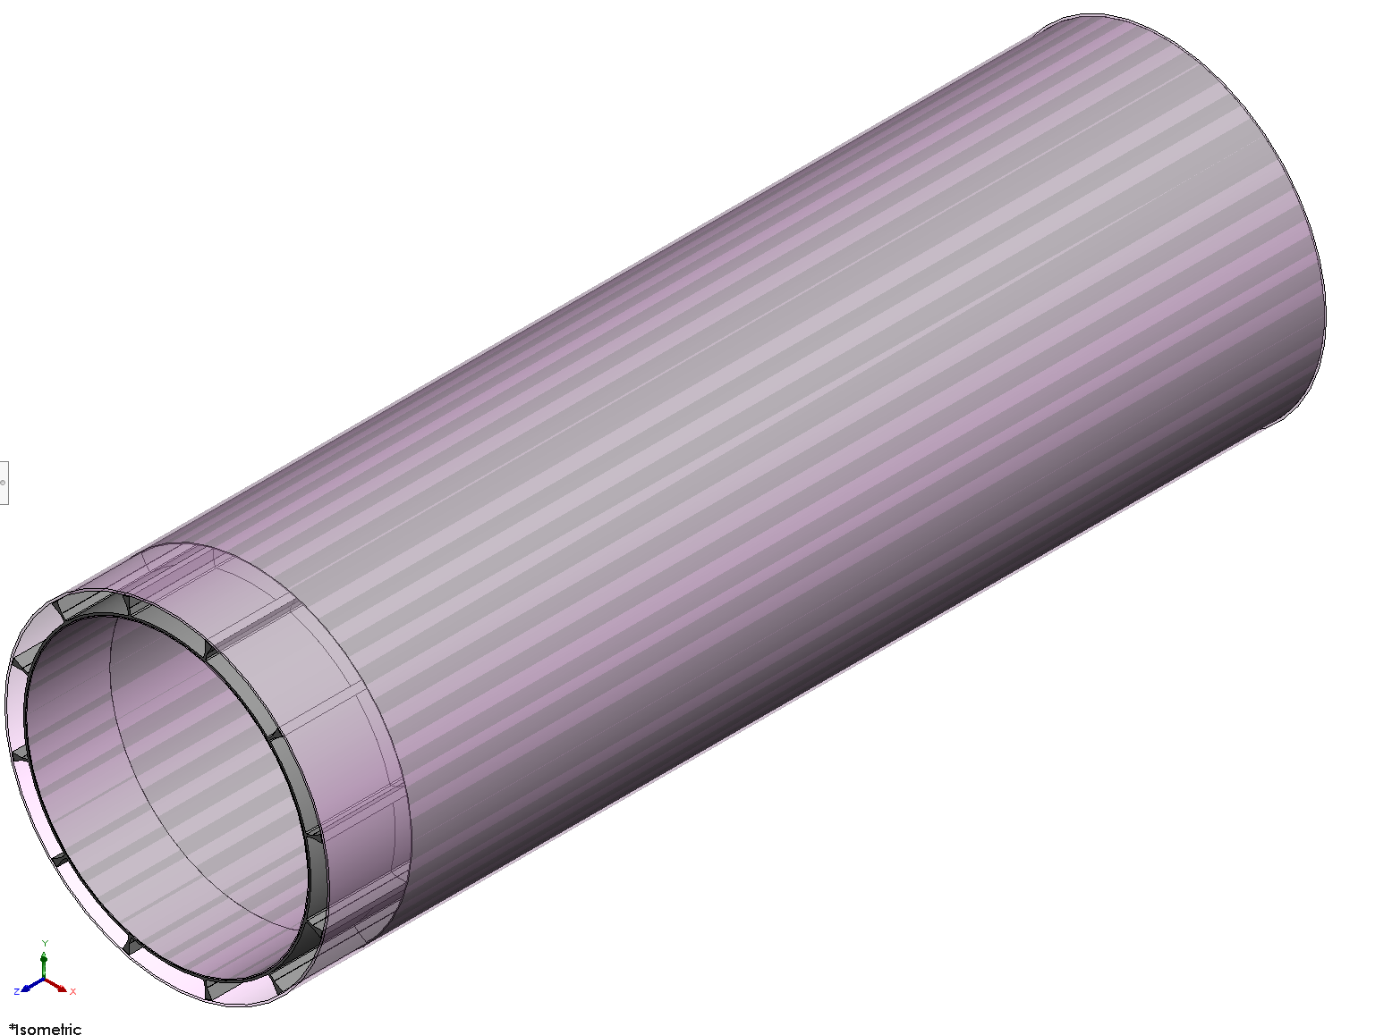
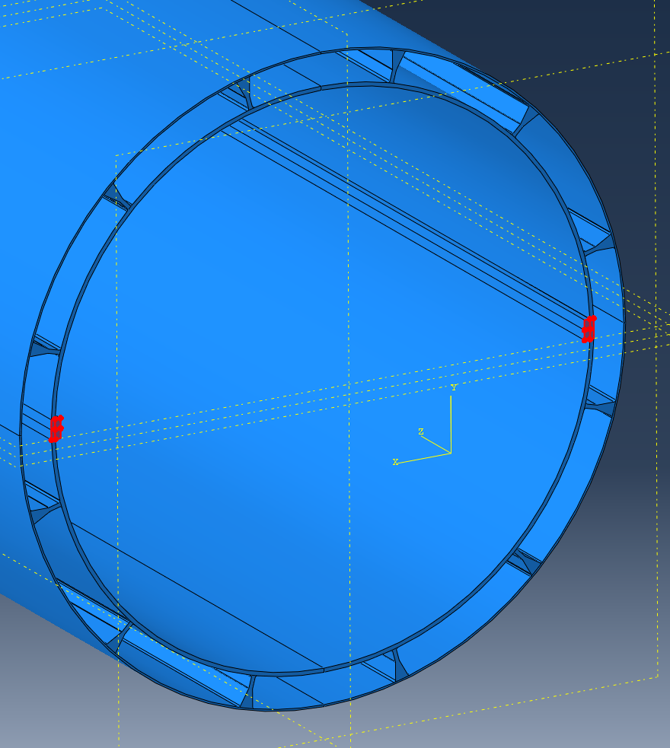
Global Support Structure (GST)
Charge 1, 4, 6
GST supports the 2 “outer” detector systems (hpDIRC & oMPGD) and all inner detectors, all supported by the Global Support Tube
Total weight GST + inner and outer detectors + services: ~ 5600kg
For comparison: CMS is similar!
“Double-decker” sandwich structure with internal beams and I-beam cells
Made from honeycomb core and two face sheets on either side bonded to it + 5mm skin further out
2mm face sheets +6mm core
~425kg self weight
Two Inner detector support rails:
5.3m long (or 2.65m x 2); ~14x20mm cross section
Support ~3100 kg inner detectors
Face sheets:
“Carbon Fiber Reinforced Polymer” or CFRP
Dimensions:
Structure is 5050 mm long; with the outer being shorter 4600 mm
Sandwich tube: 1430mm ID, 1450mm OD
Outer tube: 5mm skin between 1610mm and 1620mm

Slide 18
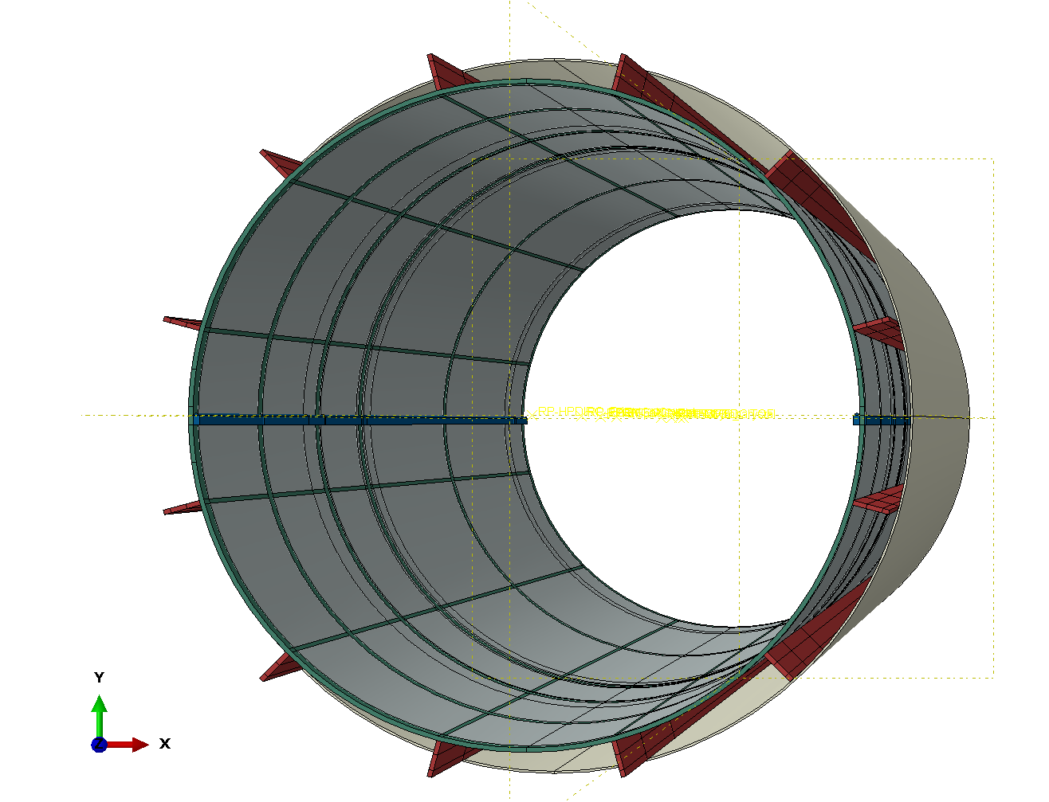
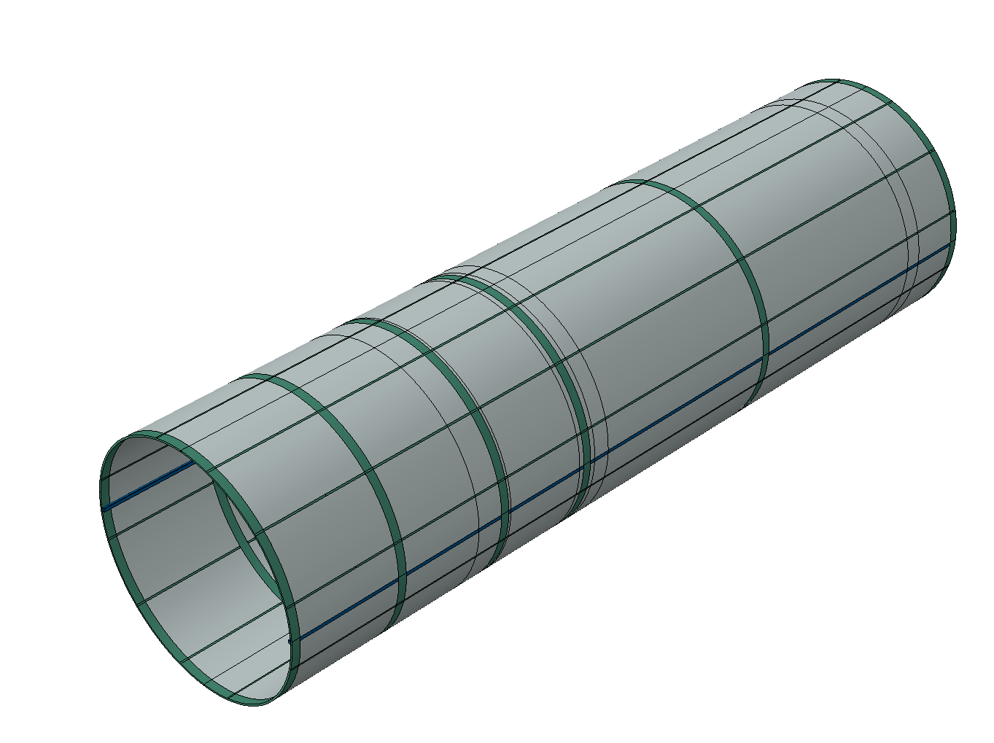
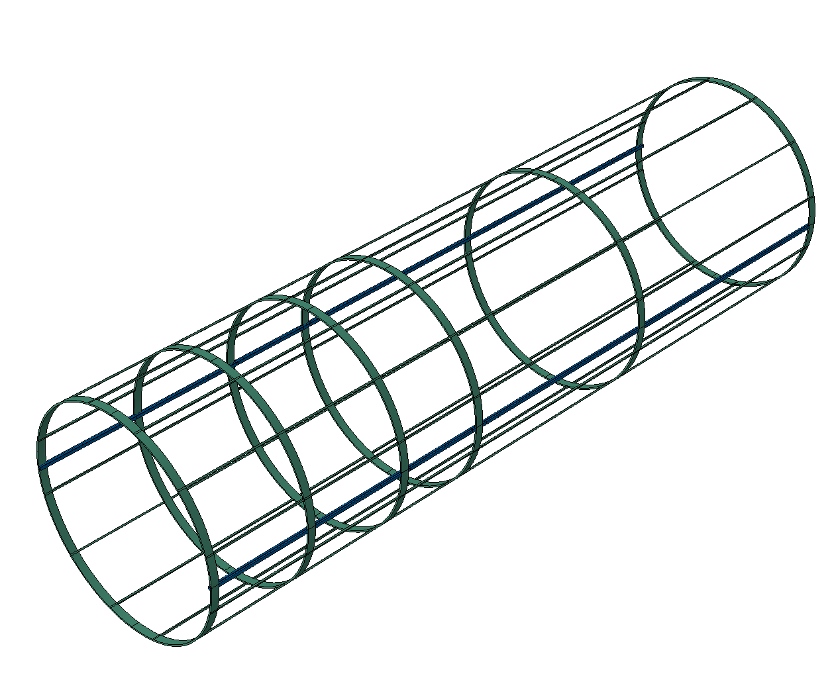
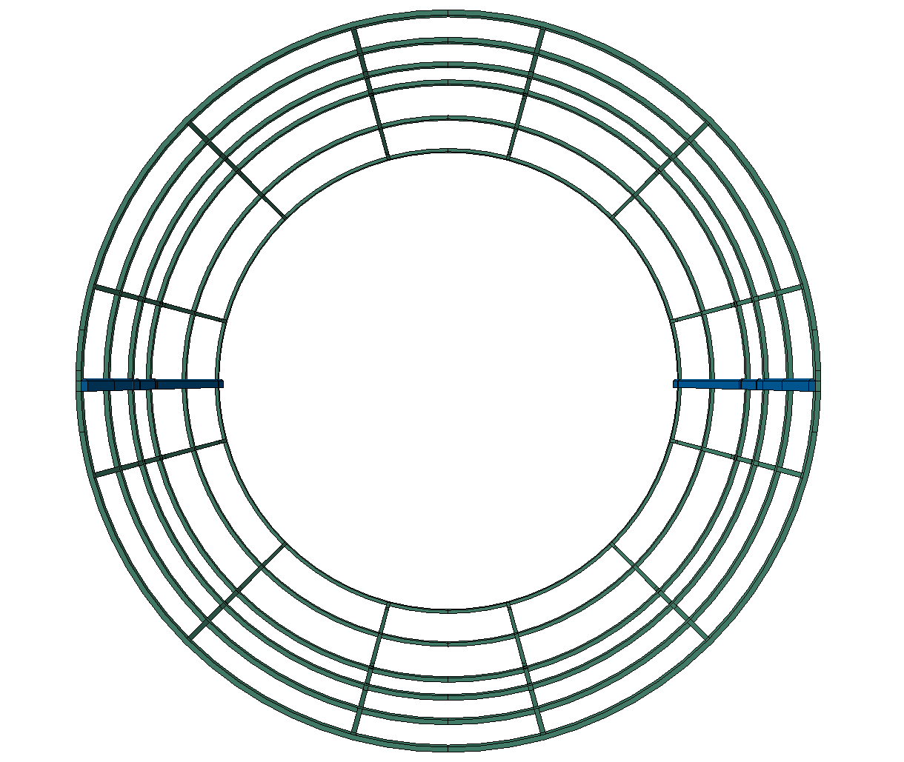
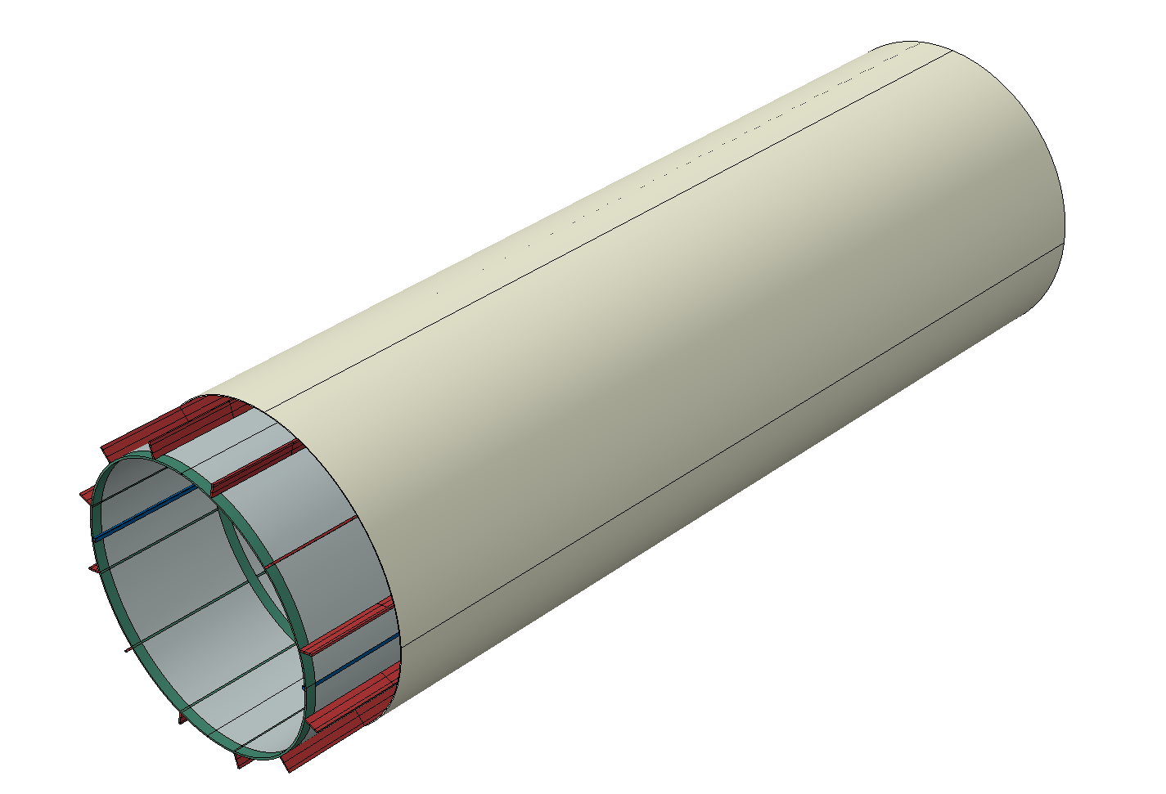
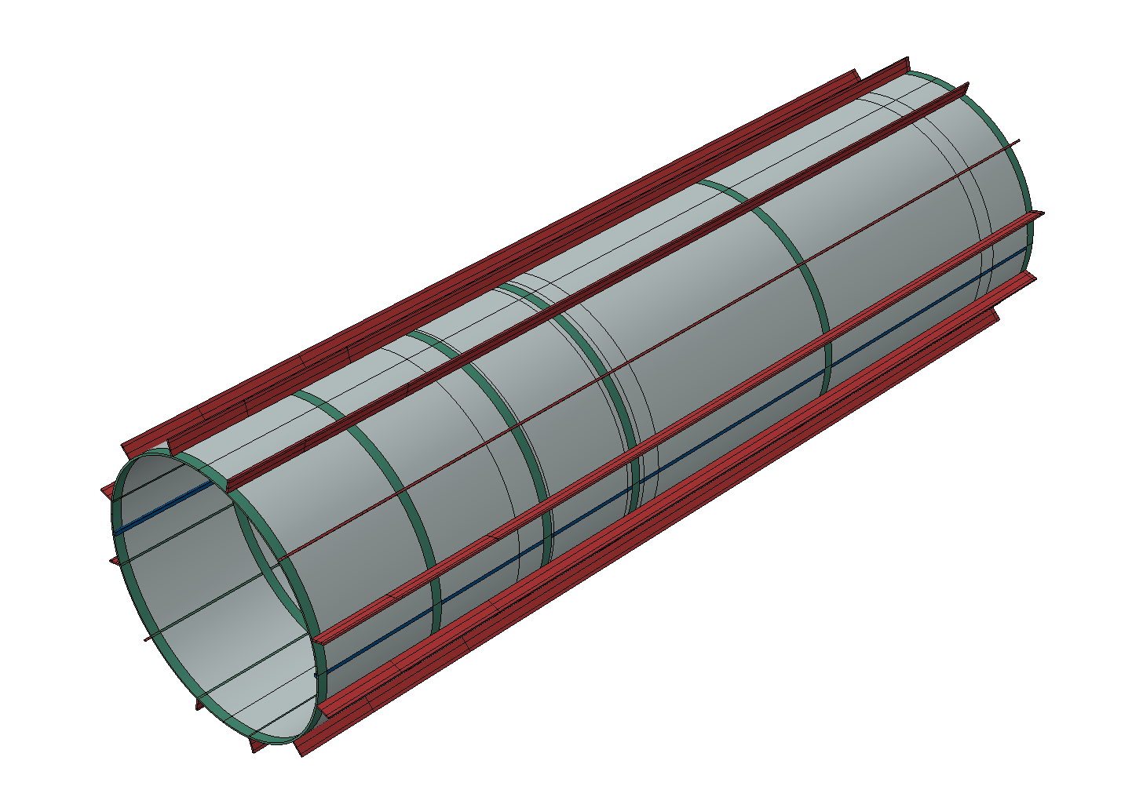
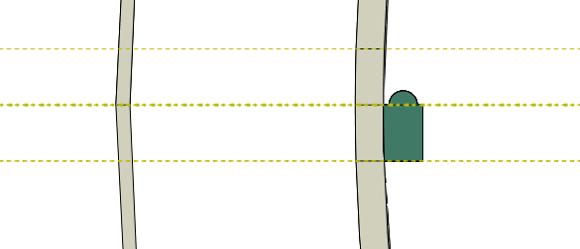
GST – internal rip structure
Charge 1, 4, 6
Internal rip structure to stiffen GST as needed to support >5t
End rings to provide support for GST bracket and to distribute load, more rings in EEEMCal area
GST support rails for PST feet
Electron direction
(EEEMCal direction)
Massive CFRP
20 x 14mm, full length

Slide 19
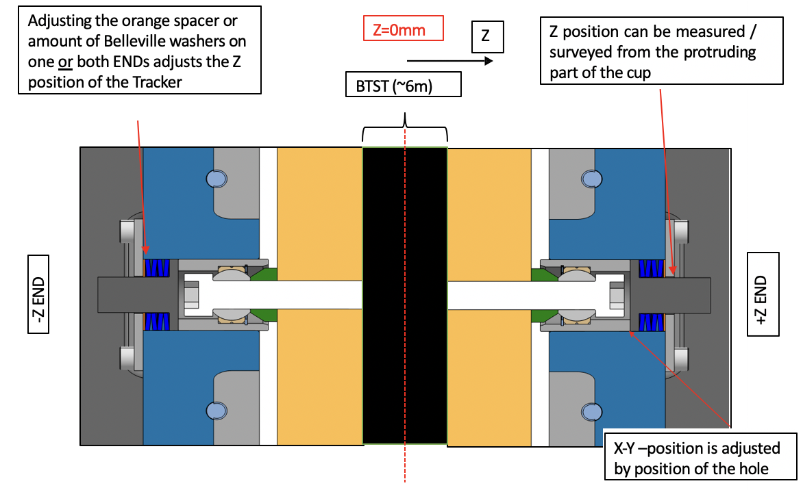
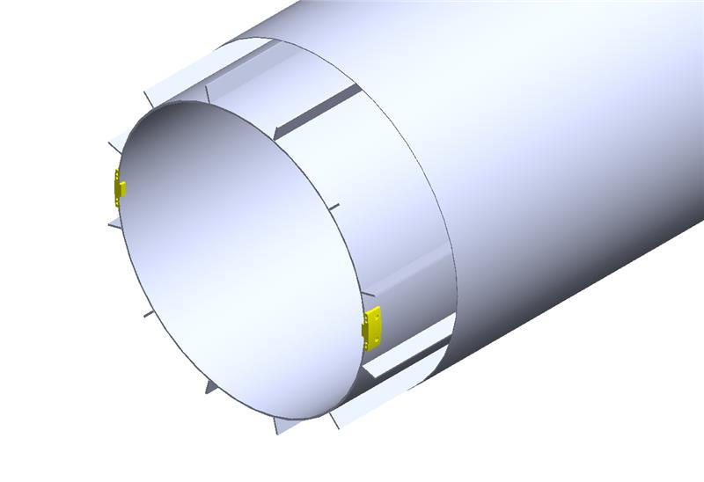
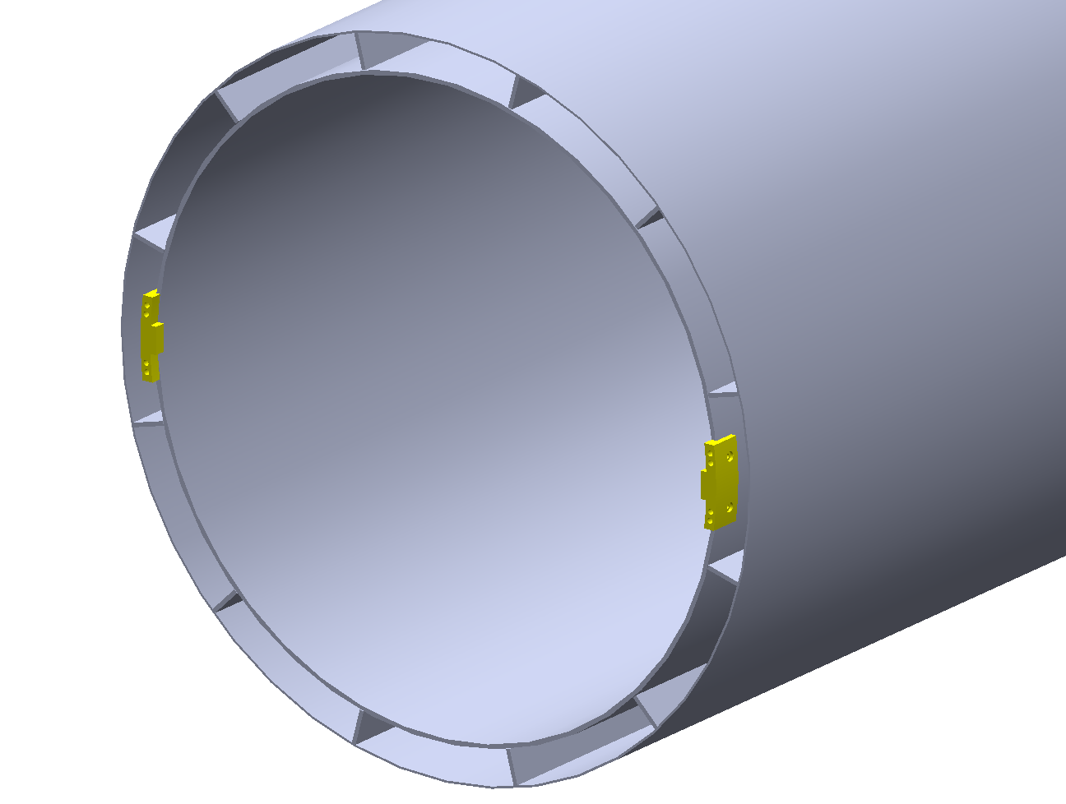
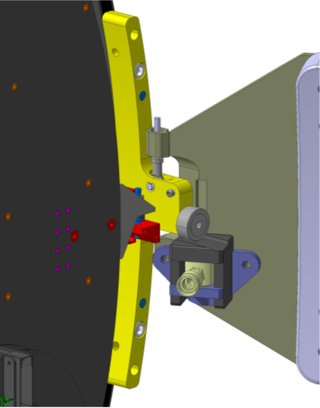
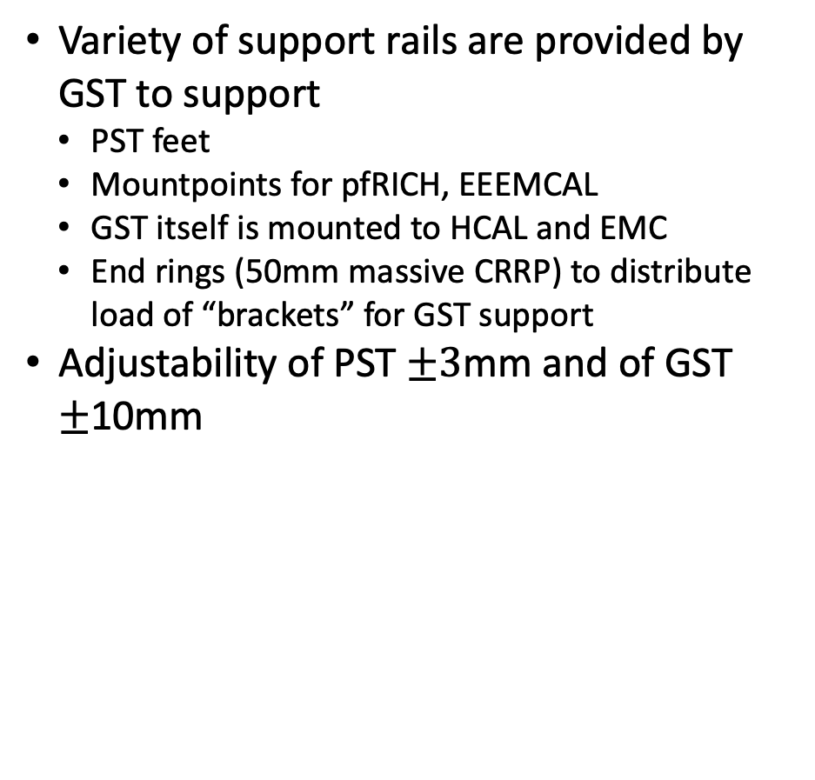
GST tolerances/constraints and mount points
Charge 1, 4, 6
Variety of support rails are provided by GST to support
PST feet
Mountpoints for pfRICH, EEEMCAL
GST itself is mounted to HCAL and EMC
End rings (50mm massive CRRP) to distribute load of “brackets” for GST support
Adjustability of PST $±3$mm and of GST $±$10mm
Envelope inner radius is 715 to 725mm
Inner installation clearance is 710 to 715 mm
Inner cylinder (sandwich) is z= -1900 mm to +3125mm
Envelope outer radius = 805 to 810 mm
Outer installation clearance = 810 to 820 mm (this is the clearance between GST and the barrel EMcal (BIC)
Outer Cylinder (CFRP) z= -1900 to +2700 mm

Slide 20
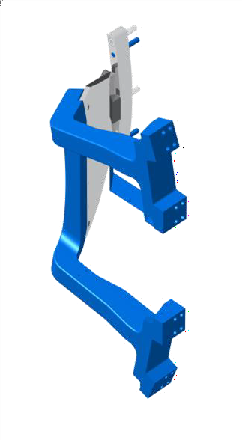
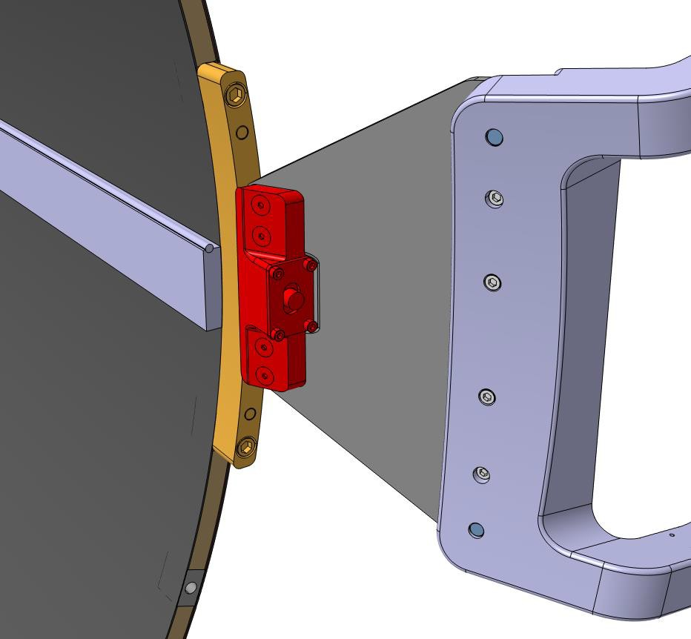
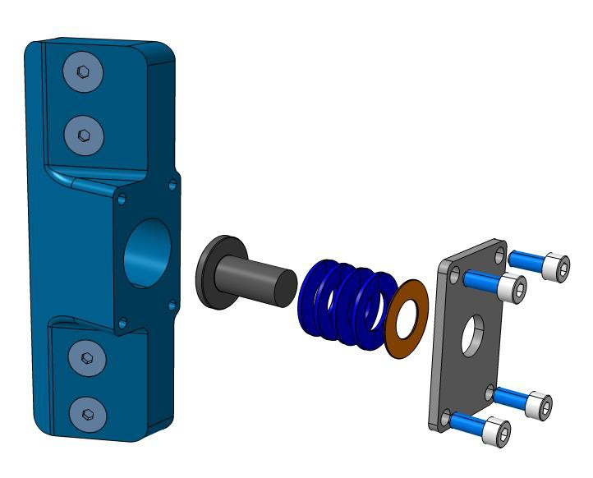
Periphery interface mapping
Best existing design via CMS, adopted for EPIC as needed
The four Tracker brackets support the GST in its final position inside EPIC
The spherical joint allows the tracker to ”settle” without overconstraining
Spherical joint assembly
M10
Connection Block
BTST
Cover
Coupler
Belleville Springs
Preload spacer
M8
BTST
Banana
TK Bracket
Connection Plate

Slide 21
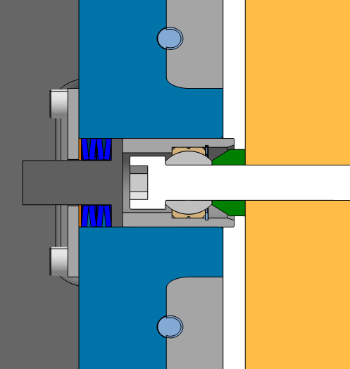

Periphery interface mapping
The four Tracker brackets support the GST in its final position inside EPIC
The spherical joint allows the tracker to ”settle” without overconstraining
The mechanism on the right allows “alignment” by set screws which then gets “mounted” in position with the below mechanism
Adjusting the orange spacer or amount of Belleville washers on one or both ENDs adjusts the Z position of the Tracker
Z=0mm
Z position can be measured / surveyed from the protruding part of the cup
Z
BTST (~6m)
-Z END
+Z END
X-Y –position is adjusted
by position of the hole

Slide 22




Detailed drawings on GST adjustment & support
GST Bracket Spherical Joint
GST Banana
Periphery interface mapping
Bracket Spherical Connection

Slide 23


Support of the Global Support Tube
Charge 1, 4, 6
Mechanism to support GST is in final design adjustments
Connector on GST end ring supported by “bracket”
Bracket allows for adjustability as presented on previous slides
Support bracket via C-channel of EMC

Slide 24


HPDIRC and oMPGD support by GST
2mm clearance on installation of the trays into the 12 sectors between the GST inner and outer skins
GST support “Cavities”
GST consists of supports for HP-DIRC and outer MPGD in between inner sandwich and outer skin
Provide a temporary mounting plate for interfacing to external rails for integration of hpDIRC and oMPGD
Inner beams for Insertion trays for barrel TOF and iMPGD (CyMBal)
See details on sl 14
Rails to support hpDIRC & oMPGD
Pin holes for interfacing temp rails

Slide 25
FEA: Loads of detector systems supported by GST
Total weight is 5,675 kg
Comparable to CMS timing layer + all of the tracker
Services are included in the respective detector subsystem
Additional service mass outside the respective detector volume is added in addition
GST properties:
weight is ~ 420 kg
CFRP rails are 5 kg
For comparison if made in stainless steel GST weight is 3082 kg (7x GST), and in Al it would 1040 kg (2x GST)
Load distribution
 |  | z-coordinate | Mass (kg)
1 | EEEMCal Crystals | 1842.5 | 2000
2 | EEEMCal Electronics | 2212.5 | 500
3 | HPDIRC Bars | 425 | 1400
4 | HPDIRC Prisms | 3060 | 400
5 | oMPGD | 125 | 100
6 | AC LGAD TOF | -212.5 | 150
7 | Cymbal | -212.5 | 150
8 | SVT | -100 | 285
9 | pfRICH | 1500 | 97
10 | pfRICH Services | 2437.5 | 13
11 | SVT Services Zp | 2187.5 | 50
12 | SVT Services Zm | -1725 | 15
13 | Cymbal TOF Services Zp | 2150 | 50
14 | Cymbal TOF Services Zm | -1725 | 15
15 | EEEMCal Services Zp | 2815 | 30
16 | GST self weight | xx | 420
 |  | TOTAL | 5675

Slide 26



Finite element analysis of GST
The current GST design of a composite “double-decker” Carbon Fiber tube can support all inner detector masses within 2.5mm deflection
Currently assumed: HM63 + EX1515 matrix (fairly stiff, other choices exist) – Material properties are in backup
Sufficient within the envelope!
To come: Alternative materials and alternative sandwich
BCs in z-

Slide 27


GST envelope and constraints
Expected deflections, tolerances, geometric tolerances:
Deflections in final operation setup: $±$2.5 vs $±$2.0 mm
Manufacturing: $±$1.5mm, Core: $±$0.5mm & Cylindricity of $2$mm
Face sheets: $±$0.1mm + Core yields $±$0.7mm max deviation
Geometric to fit within envelope in worst case: $±1.5$mm
Envelope is $±10$mm for insertion
Worst case: $±1.5$mm $±2.5$/2.0mm = $±4$/ $±3.5$mm
Can consider more local add. stiffening structures
Key:
hpDIRC Prism
hpDIRC & oMPGD
Services
Barrel TOF
iMPGD
Support tubes
- GST & PST
Adjustability of PST $±3$mm in x-y and $±5$mm in z
Tolerance is $±1$mm
Adjustability of GST $±$10mm in all directions
Tolerance is $±3$mm

Slide 28
Presentation Section 3:
Integration and Insertion/Assembly
See also talk by Dan Cacace

Slide 29
ePIC Detector Support Hierarchy Y-Z View
Charge 6
Details are on the next slide
Two large sub-assemblies independently integrated
PST-SVT sub-assembly staying in one physical location
GST with subdetectors installed in EPIC ready to receive SVT sub-assembly
Side remarks:
Substantial amount of temporary supports needed for beam-pipe, service, cooling, etc
Temporary structures needed to “slide” / integrate sub-assemblies together and also for final step into EPIC GST structure

Slide 30


Assembly sequence
Charge 3, 6
GST gets integrated with outer MPGD and hpDIRC
Moved inside assembly hall and mounted
pfRICH and EEEMCal installed without services to measure deflection
Remove pfRICH and EEEMCal
Install PST and SVT package with beam pipe and align
Install TOF and inner MPGD (cymbal)
Put PST front feet in the GST rails
Back of PST rests on external supports
See Dan Cacace for details
⁠Install pfRICH
⁠Install EEEMCal
⁠TOF disc
pfRICH
SVT
EMCAL
GST TOF
EEEMCal

Slide 31
Assembly sequence
Charge 3, 6
GST gets integrated with outer MPGD and hpDIRC
Moved inside assembly hall and mounted
pfRICH and EEEMCal installed without services to measure deflection
Remove pfRICH and EEEMCal
Install PST and SVT package with beam pipe and align
Install TOF and inner MPGD (cymbal)
Put PST front feet in the GST rails
Back of PST rests on external supports
See Dan Cacace for details
⁠Install pfRICH
⁠Install EEEMCal
⁠TOF disc
pfRICH
SVT
EMCAL
GST TOF
EEEMCal

Slide 32



2nd sub-assembly for Beampipe + SVT
Charge 6
SVT + inner MPGD disc assembly
Temporary supports for beam pipe and services
Sub-assembly slides into GST rails
4 support feet of PST in PST end ring region are supported by GST rails
Next integration steps:
Follow PST subassembly with pfRICH, than EEEMCAL
Needs temporary support for cables & beam pipe of PST subassembly, e.g. “antlers”
Needs installation jigs to slide pfRICH and EEEMCAL into GST
Install outer MPGD barrel and hpDIRC with GST in place
Needs rails & kinematic mounts to avoid stress on either one of them
See Talk by Ben Denos

Slide 33



QA/QC and installation metrology
Charge 3, 6
Metrology and loading case scenarios based on realistic EPIC parameters
Rely on existing experience with CMS HL-LHC projects: ITST, SC & BTST projects
Large area metrology system “Creaform MetraScan” (received!)
Best circular fit and deviations point-by-point from expected one
Metrology and deformation studies
Deformation only studies (safe loads)
Adjust FEA to match deformation only
Compare to FEA to reproduce data
Predict behavior of full structures in all aspects & measure all
Deformation only + FEA match
Loading scenarios + FEA match
Predict and extrapolate to CMS conditions

Slide 34










QA/QC procedures informed by CMS experience
Charge 3, 6
CMS IT tube end section cylindricity:
Following best practice and lessons learned from CMS upgrade projects
Iteration of FEA of manufacturing method, performance under load, metrology
QA/QC during and at end of the process → repeat!
Prototyping using non-final materials
Smaller prototypes with final material, FEA driven
Met tolerances – we typically achieve:
1 – 2mm cylindricity (~ 6m length & 2.4m diameter)
< 500$μm$ cylindricity (Solid skin tube)
50-100$μm$ parallelism (Rail/Track alignment)
Target Diameter | 606 mm
Measured dry assembled diameter | 605.47 mm
Curve A
Curve B
Tube transition
to mid section:
Curve D
Curve C
Pixel Service Cylinder cylindricity:
ITST track alignment:
Target: -0.35 Target: -0.85 Target: -0.25
Actual: -0.40 Actual: -0. 75 Actual: -0.30
Best fit cylinder = 340.13mm
Nominal radius = 339.6mm

Slide 35

ES&H
Charge 7
No specific ES&H risks in this area
Standard lab practices are being observed
Purdue Radiological and Environmental Management
Safety officer Purdue CMSC: Johnathan Goodsell
REM contact at Purdue University: Eric Butt
Recent walk-through and inspection by REM – went well
DOE site visit by Project Office & Fermilab ESH – went well
https://www.purdue.edu/ehps/rem/index.html

Slide 36
Next steps
Mature design for GST adjustment mechanism
Carry out FEA to study material choice vs deflection
Prototype & load test to confront FEA vs reality
Failure mode FEA
Finalize envelopes for GST and adjustment mechanisms
GST

Slide 37
Summary
The current designs for support structures are well developed for the current phase of the project
The designs are all integrated into the larger central detector model
The current procedure and approaches for the installation of the inner detectors and their support structures are well developed for the current phase of the project
Separation of inner detectors and outer detectors ease separations!
Adjustments and optimizations are quickly worked into the larger integrated model
Next steps:
FEA to determine material choice for GST
GST

Slide 38
Backup

Slide 39

GST Bracket Spherical Joint
Work in progress
Spherical joint assembly
GST Banana
Bracket Connection Plate

Slide 40


BTST Banana
Banana
M16 x 80mm
OD15mm x 100mm Shear Pin
Circlip
Z spacer
SS Spherical Bearing
Bearing sleeve
M16 x 120mm

Slide 41


Bracket Spherical Connection
Survey Reference
Connection Block
M10 x 40mm
Coupler
Belleville Springs
Cover
Preload spacer
M8 x 20mm

Slide 42




Slide 43



Envelope Overview / CAD
HM63-EX1515
and Nomex Honeycomb

Slide 44





GST – additional drawings
Detailed drawings

Slide 45



Beampipe support
Charge 3, 6
Example of the CMS permanent beam pipe support at z = 1.6m
For the arm we want to bond a curve-to-flat adapter with inserts 4x M3 inside the ITST.
At the moment, precise z-locations are yet to be determined, not critical
Arm with curve-to-flat adapter and M3-0.5 (x4)
Ribbon operating
mechanism
M3-0.5 (x4)
Vertical BP supports at 1.6m

Slide 48


Scope Definition
MPGD trackers use MicroMegas for the inner barrel and µRWELL technology for the outer barrel and endcaps
In the barrel, each tracker is segmented in 12 sectors in Phi
Micromegas (CyMBaL) has 4 modules in the z direction and total of 48 modules, whereas µRWELL has 2 modules in z direction with a total of 24 modules
µRWELL Disks have 2 layers in each direction of Z and 4 modules in Phi, adding to 16 modules
Each MPGD detector readout with SALSA frontend electronics and equipped with all services, including cooling and gas system
Outer Barrel MPGD Tracker
Endcap MPGD Tracker
MicroMegas
μRWELL
μRWELL

Slide 49

Support of the barrel TOF staves: 12 trays
10mm clearance is closest distance
Doable, still add cover plate for any sensitive parts such as wire bonds
Orange = mostly SVT + inner MPGD discs
Blue = TOF + inner MPGD barrel ("Cymbal")
EEEMC = gray outline indicates the constraints for services further out
Tray mounts via top rails to GST
Thin line “tracks” a TOF tray, open space inside is for services of TOF
Designed for 2mm overlap
Other solidly filled areas are “reserved” for service of SVT+oMPGD and TOF+iMPGD

Slide 50


TOF – Design considerations
Detector modules need to overlap to guarantee coverage in r-phi
Designed for 2mm overlap
Integration/Assembly
10mm clearance is closest distance
Doable, still add cover plate for any sensitive parts such as wire bonds
2mm overlap

Slide 51

GST CAD Drawings

Slide 52

Closest clearance is 10mm

Slide 53

Detector Integration Layout
Charge 3, 6

