Slide 1
AC-LGAD TOF Mechanics and cooling simulations updates
Yuvraj Chauhan, Andreas Jung, Sushrut Karmarkar, Pau Simpson 14 Jan 2026

Slide 2

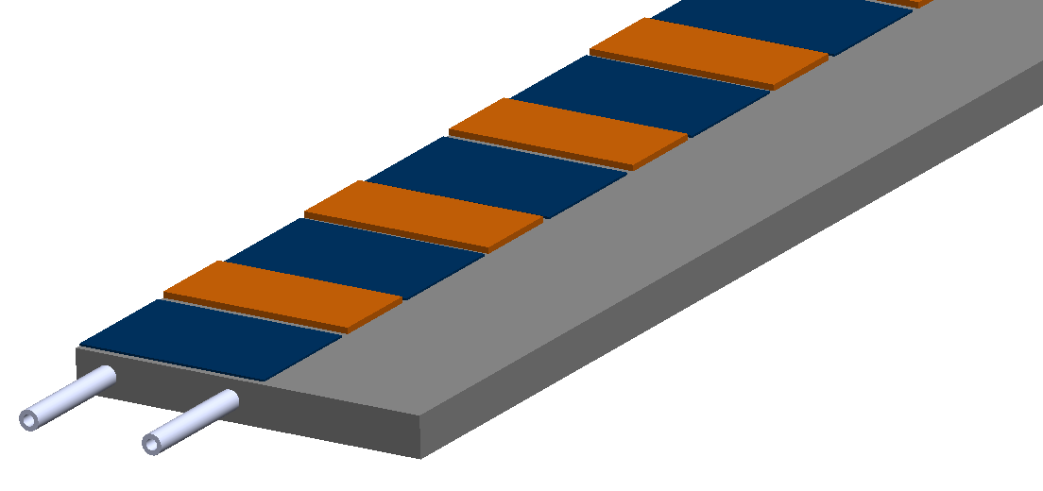

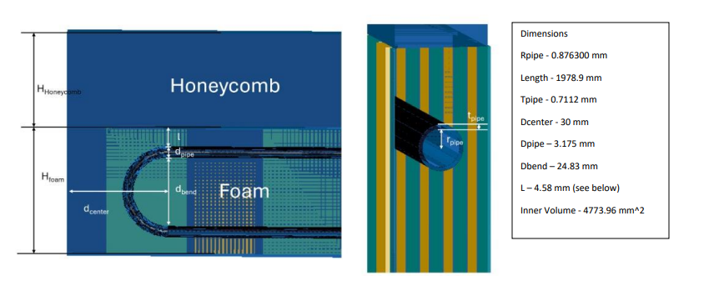
Updated double sided TOF geometry
TOF geometry is proposed to have sensors and ASICs on both sides of the stave
Geometry details for location of sensor and ASIC in Simone’s presentation
https://agenda.infn.it/event/43344/contributions/253261/

Slide 3

Material properties for TOF cooling simulation
We can move to a Ti pipe in final design if needed for $X_{0}$
This is the first baseline design from which optimization will be done for structural mass of the stave, once the loading and boundary conditions are known
Part Name | Thermal Conductivity (W/mK) | Thickness (µm)
ROC and ASIC (Kapton properties) | 0.97 | 400 and 300
Silicon Module | 148 | 200
Carbon Face Sheet | Kxx - 180 Kyy - 150 Kzz – 0.70-2.01(Shown in graph) | 200
Carbon Foam | 25 | 6420
Loctite Epoxy | 1.28 | 120
Stainless Steel Pipe | 16 | 716

Slide 4
Boundary Condition Updates
Heat Flux
1.024 W/Module converted to heat flux on top surface
ROC Modules - 1.09 W
ASIC Modules- 3.14 W
Pipe Cooling
Nusselt Number = 4.36
Fully developed flow with constant heat flux (Heat transfer to or from a fluid flowing through a tube)
Glycol
-5 C -> h = 895.58 W/m^2K
+5 C -> h = 915.48 W/m^2K
Ambient Air Cooling - h = 5 W/m^2 at T = 22 C

Slide 5
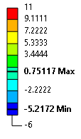
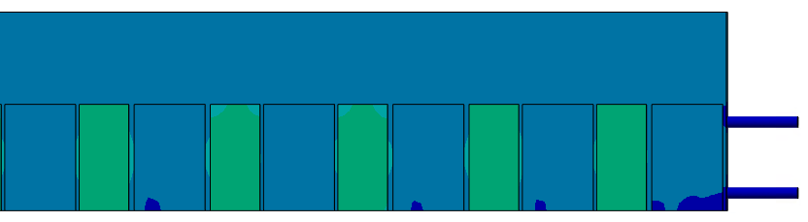
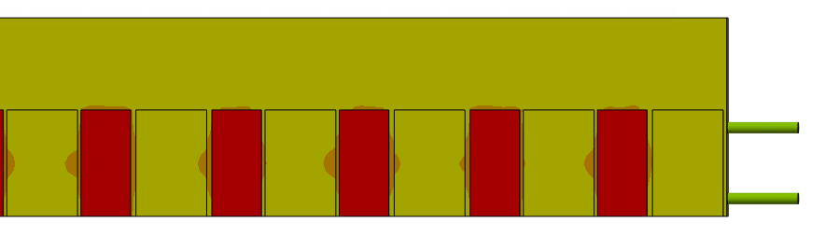
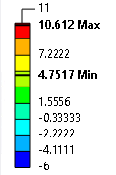
Results -5 C Glycol
°C
Results +5 C Glycol
°C

Slide 6

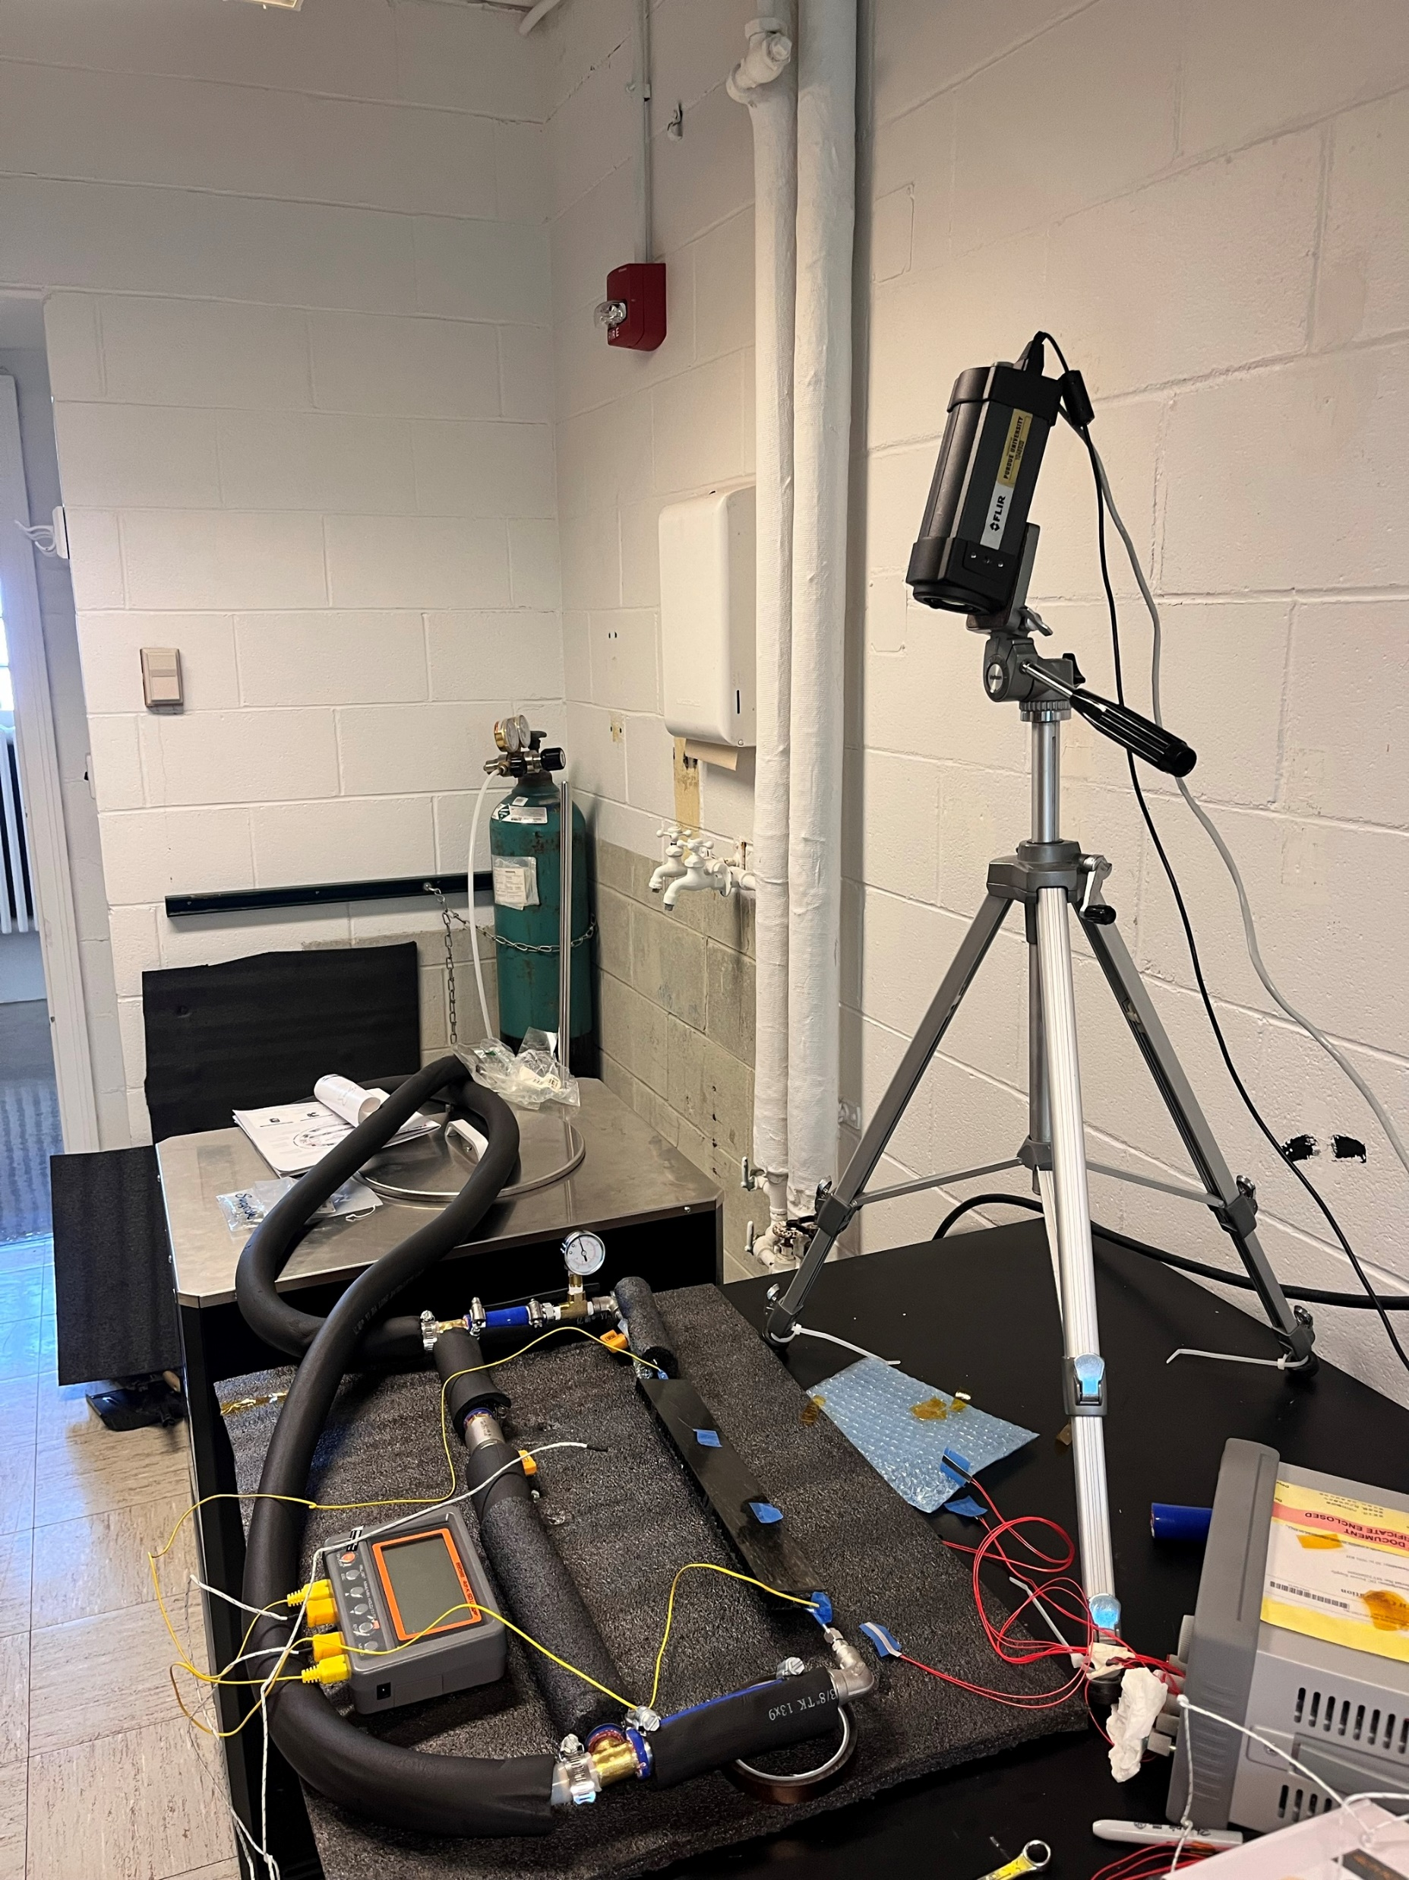
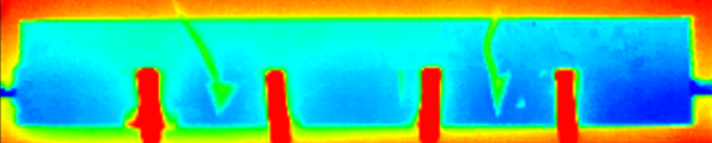
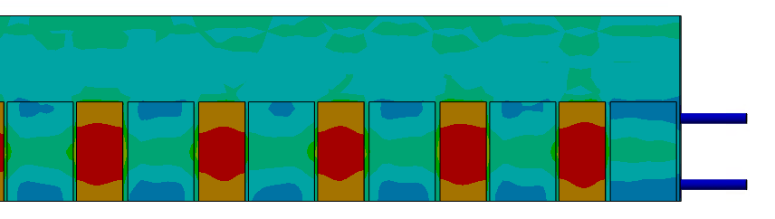
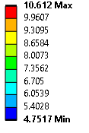

Results +5 C Glycol
°C
Experimental validation testing for cooling simulation using glycol and silicone heaters – test run 1
°C
End Middle Front

Slide 7
Module Average Temperature Results
Working Fluid | ASIC End | ASIC Middle | ASIC Front | Silicon End | Silicon Middle | Silicon Front
-5 C Glycol | -0.001 | -0.018 | 0.101 | -3.297 | -3.464 | -3.500
+5 C Glycol | 9.919 | 9.904 | 10.020 | 6.576 | 6.462 | 6.426
Average temperature for each sensor/ASIC along the length of half stave in °C
End Middle Front

Slide 8
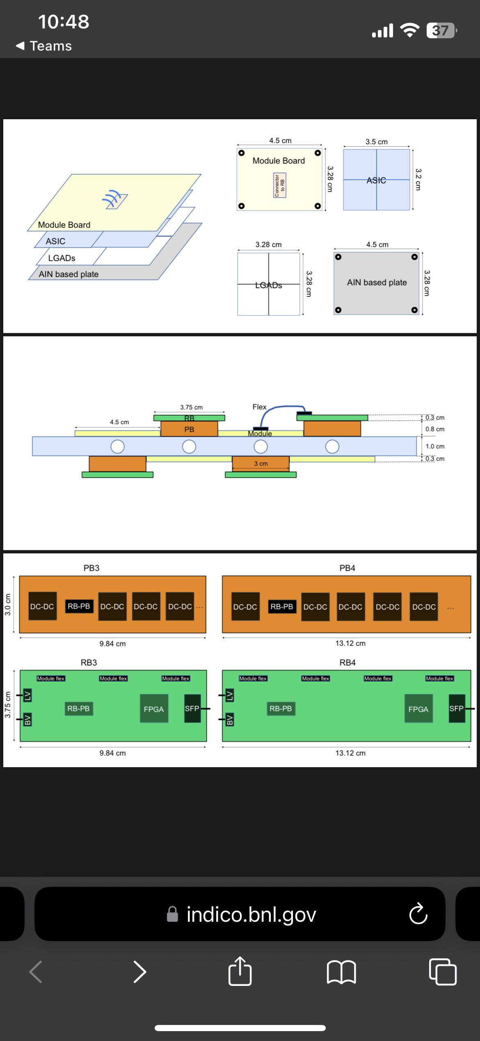
Dimensions and Boundary Conditions
1.4 W/cm^2 on ASIC surface
5 C pipe cooling – water glycol 70/30
22 C ambient air with 5 W/m^2 Film Coefficient
30 C impinging air from R500-R600 with 10 W/m^2 Film Coefficient

Slide 9
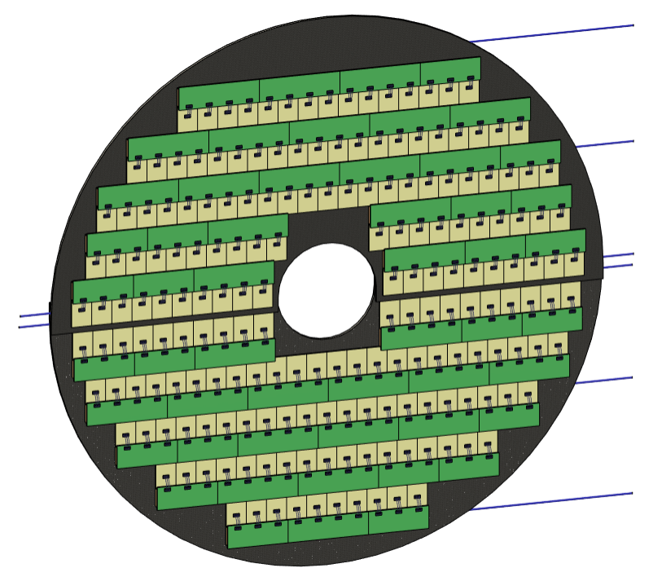
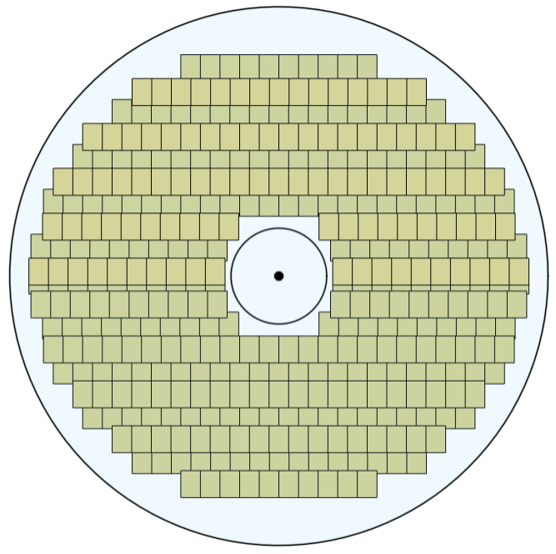
Sensor Tiling CAD

Slide 10
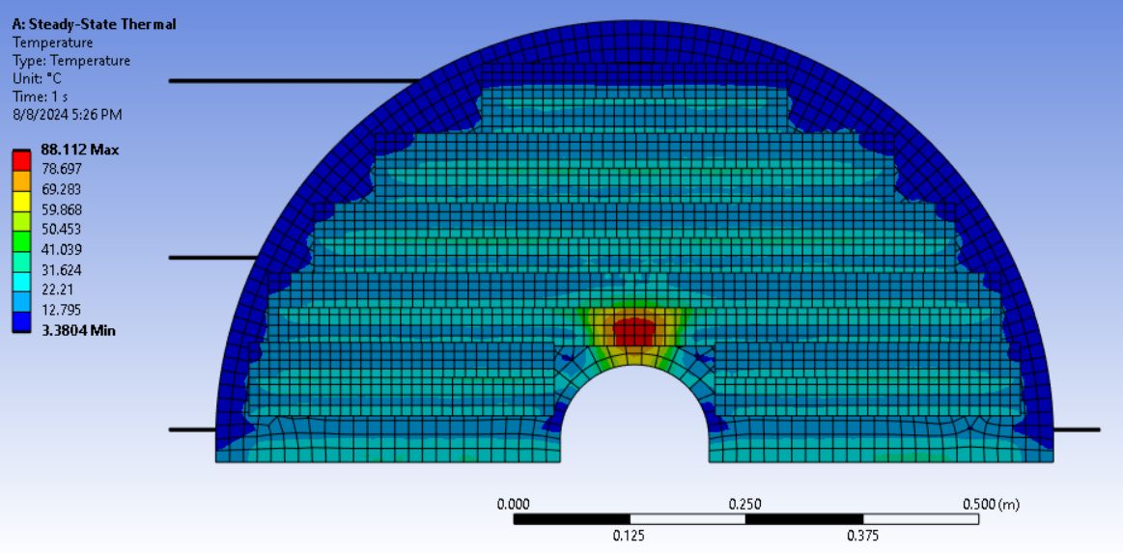
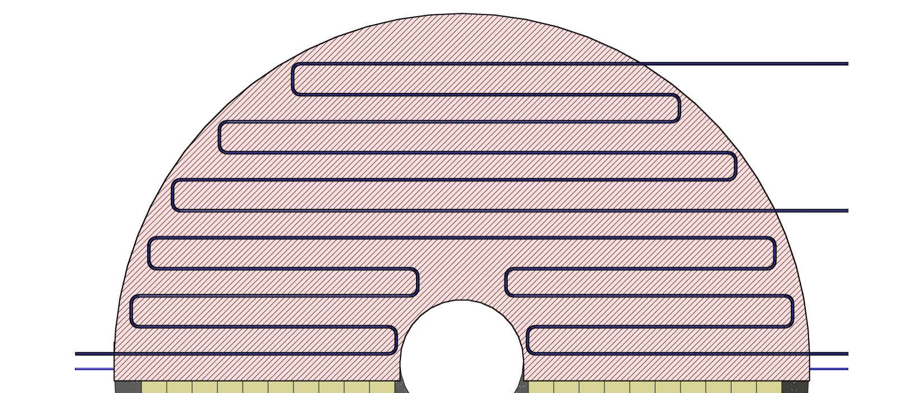
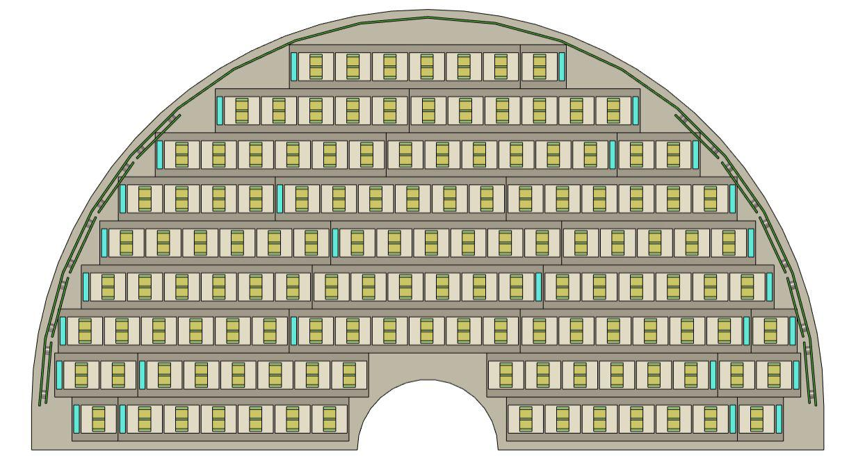
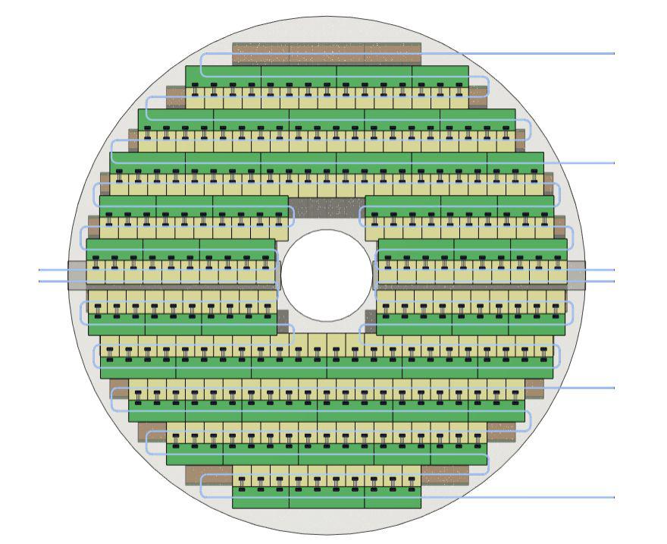
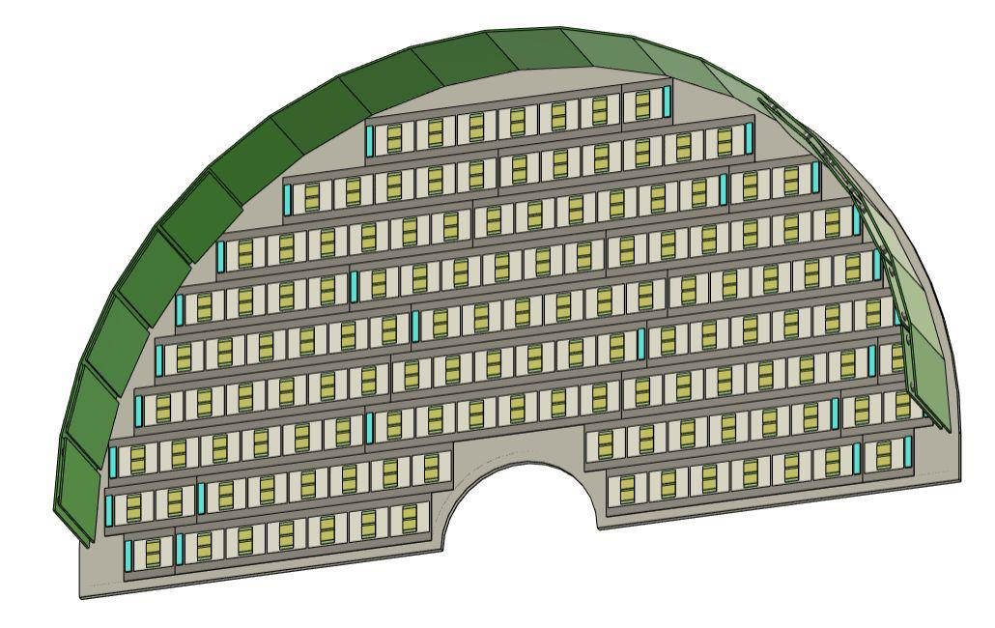
First iteration of piping layout and heat transfer FEA
PRELIMINARY

Slide 11
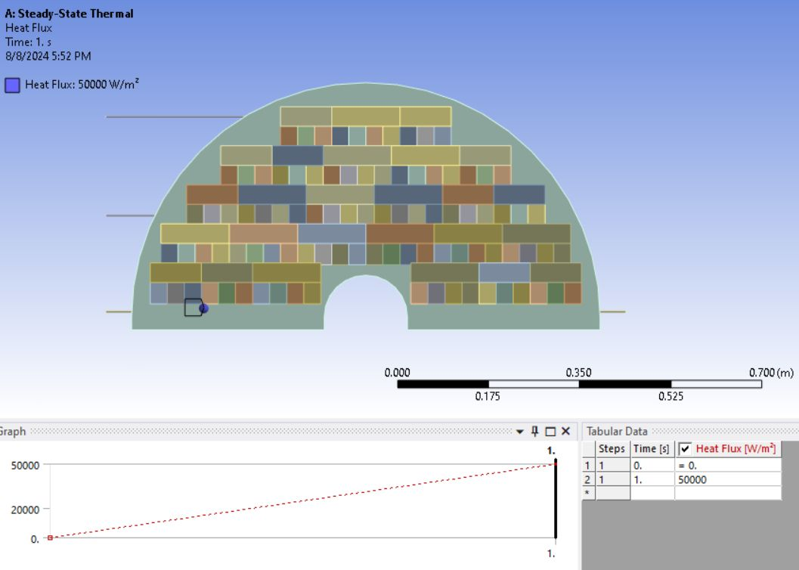
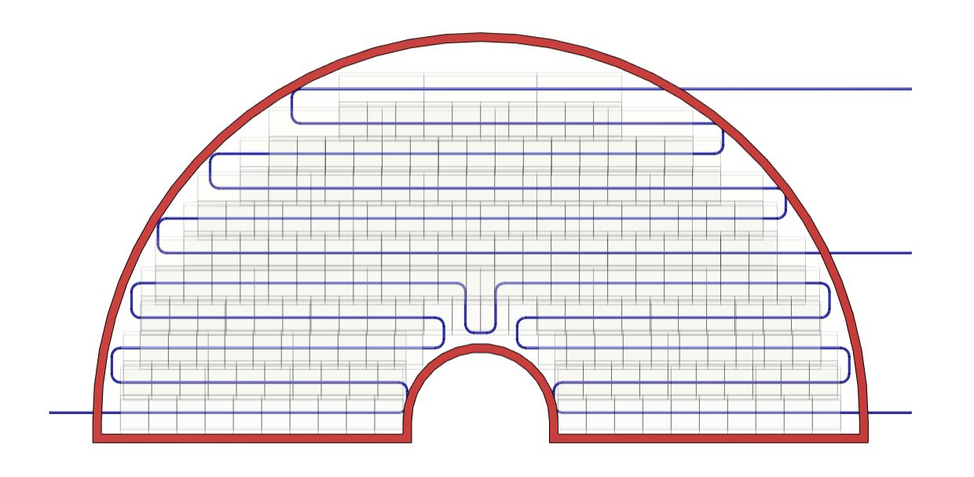
Pipe – rerouting and repeat on FEA

Slide 12
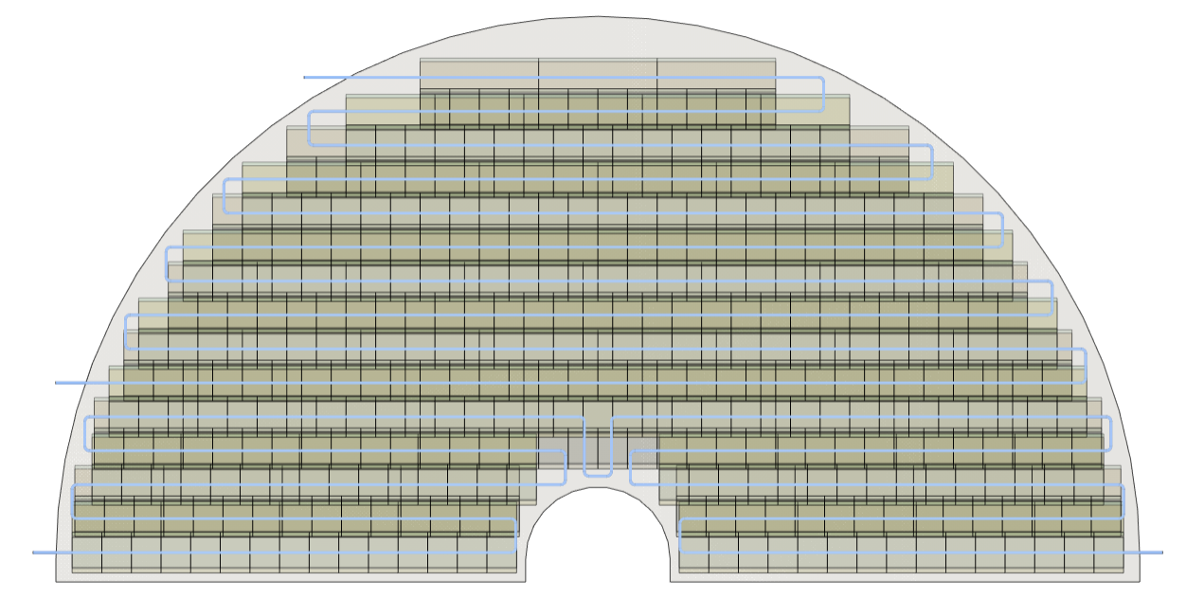
Updated Pipe Routing – 9/20/2024

